Slide 1
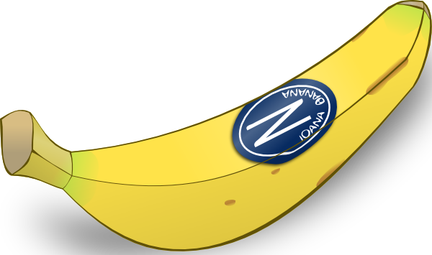
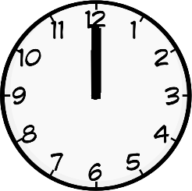
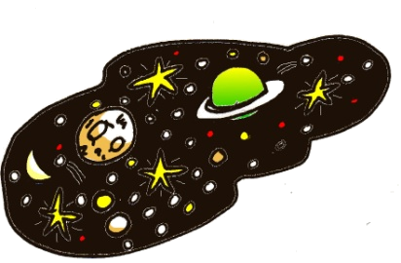
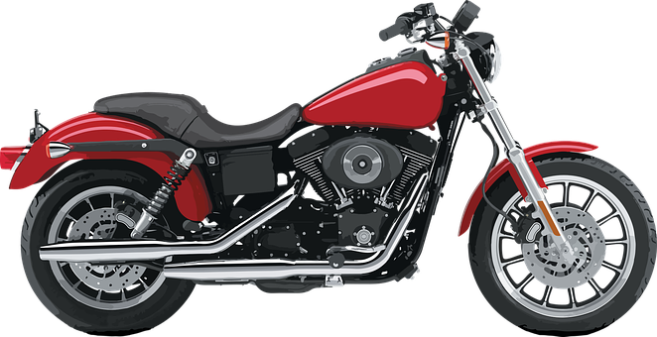
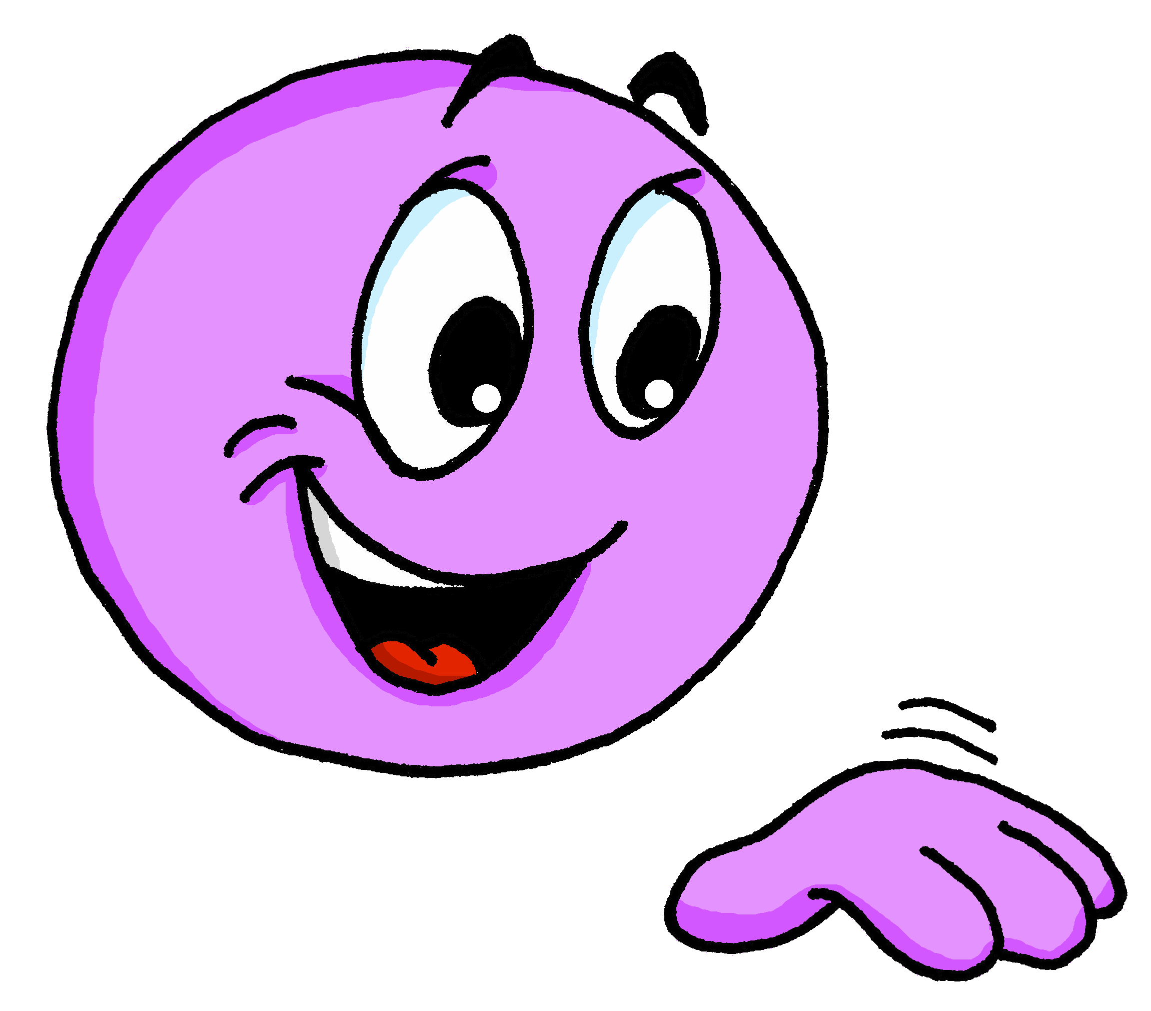
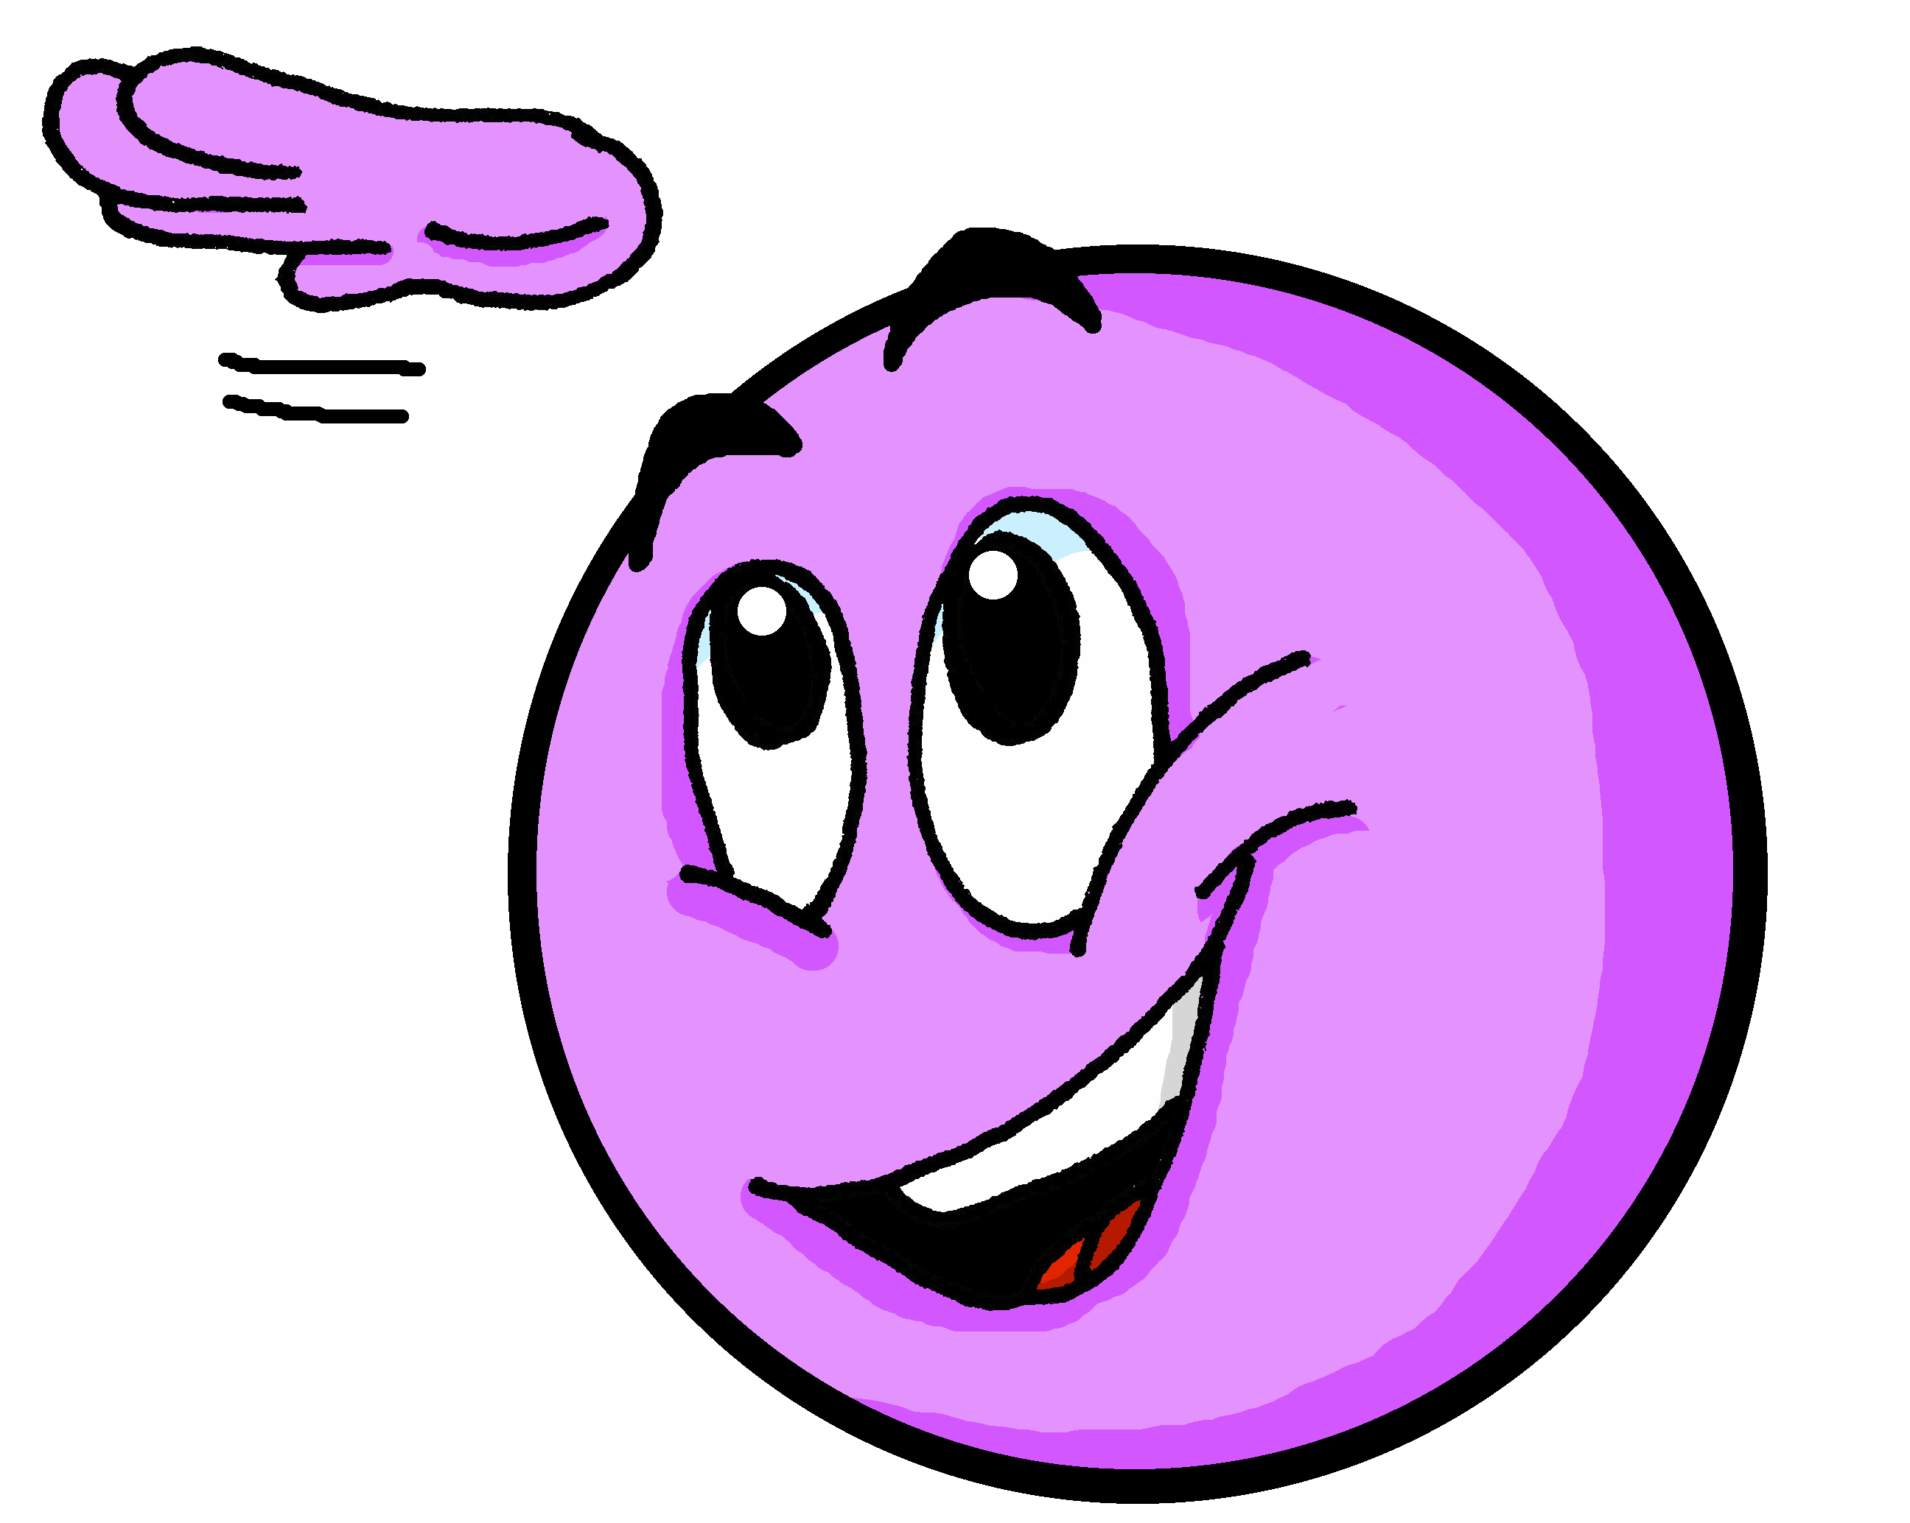
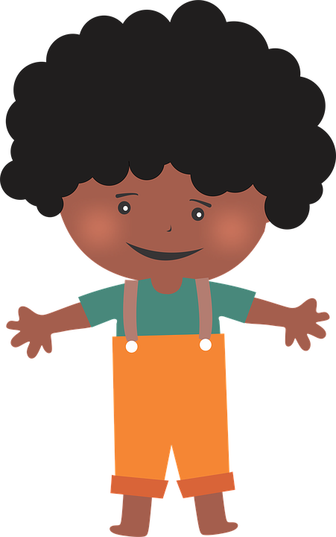
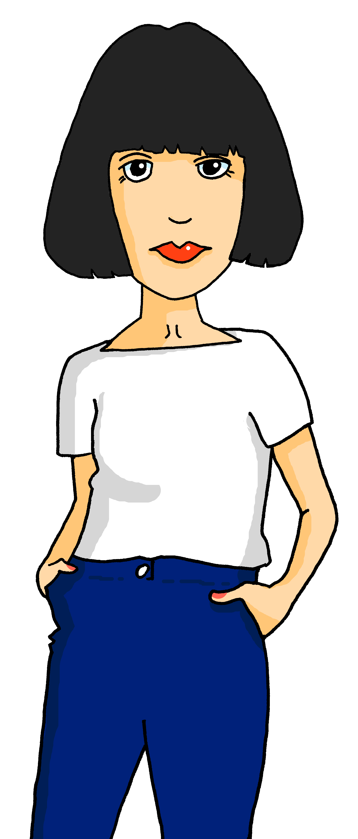
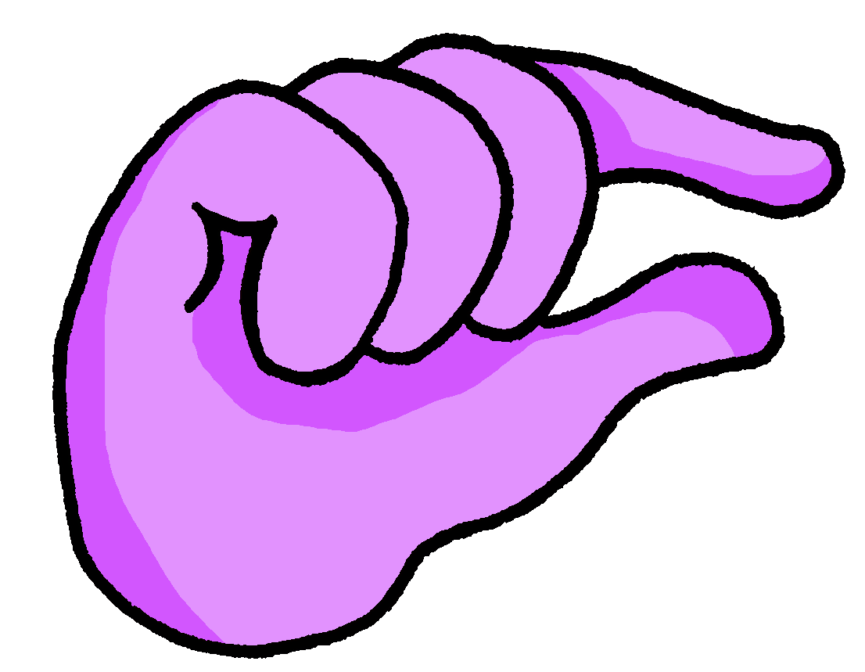
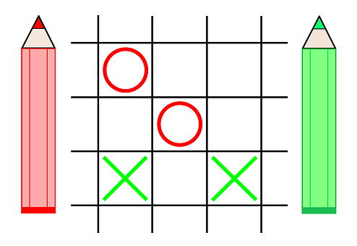
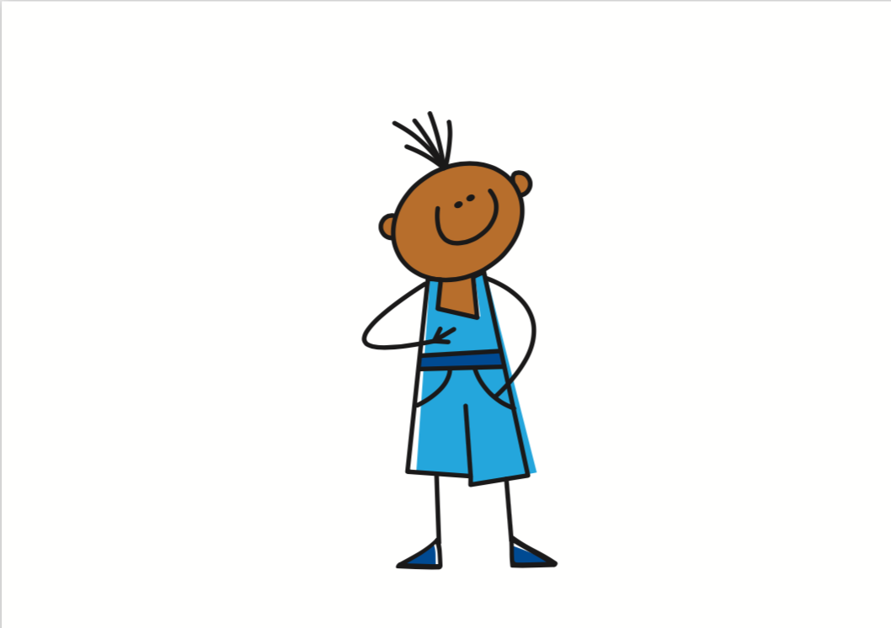
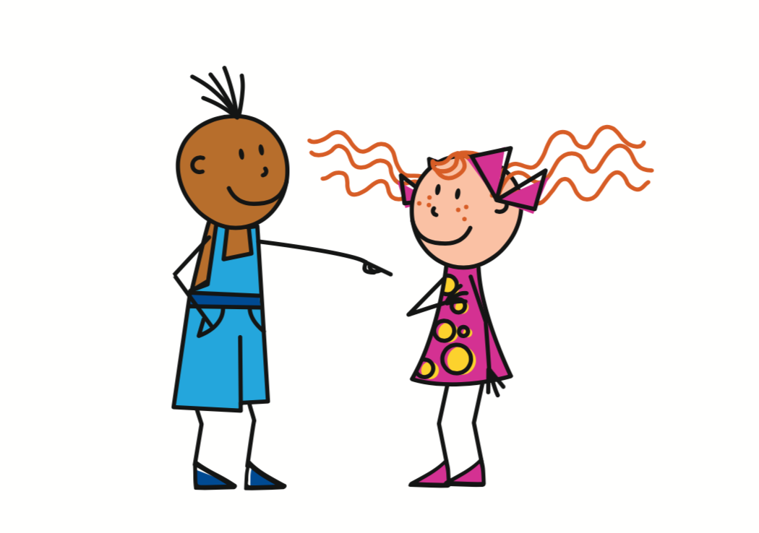
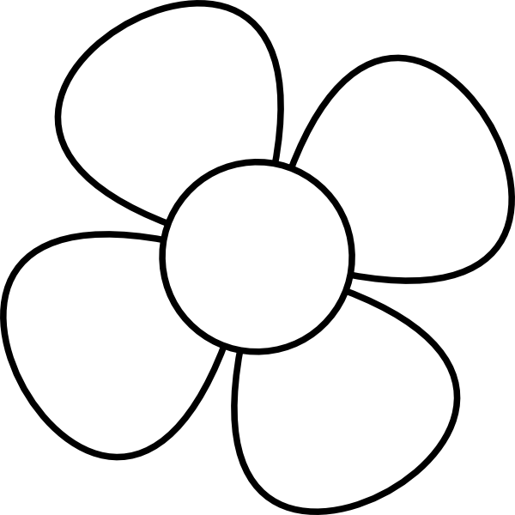
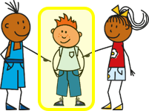
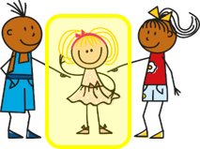
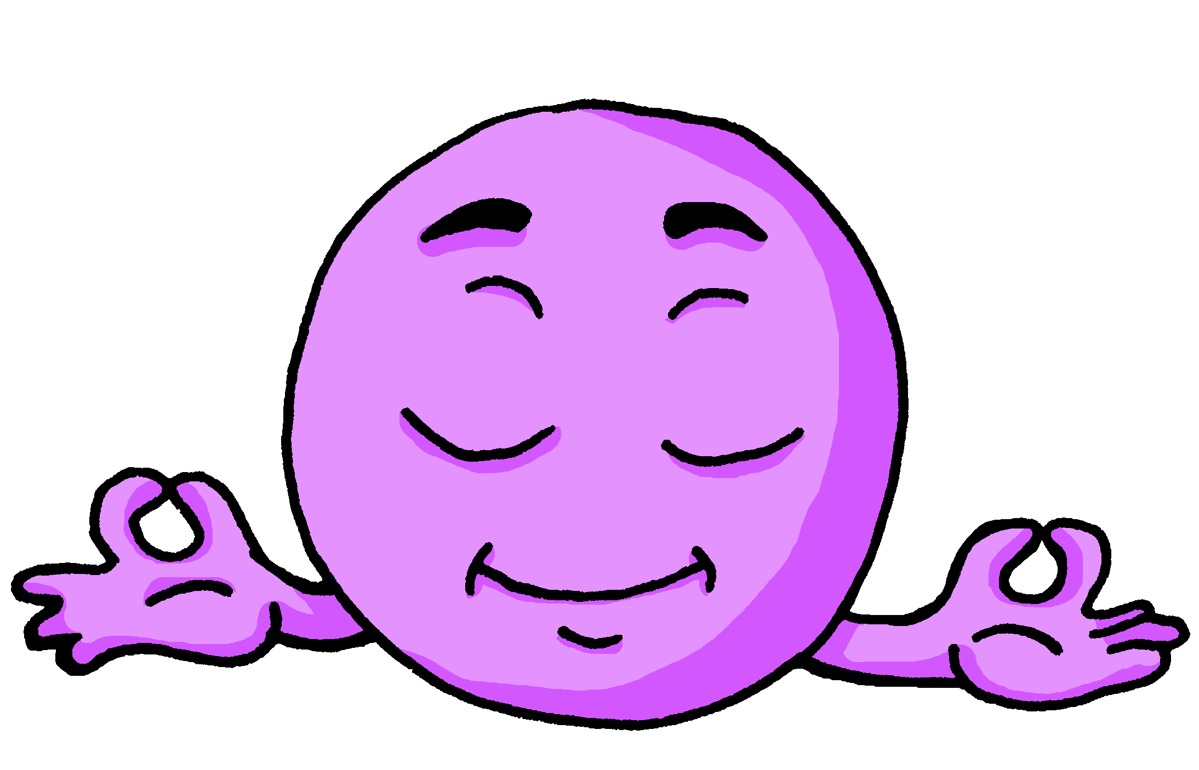
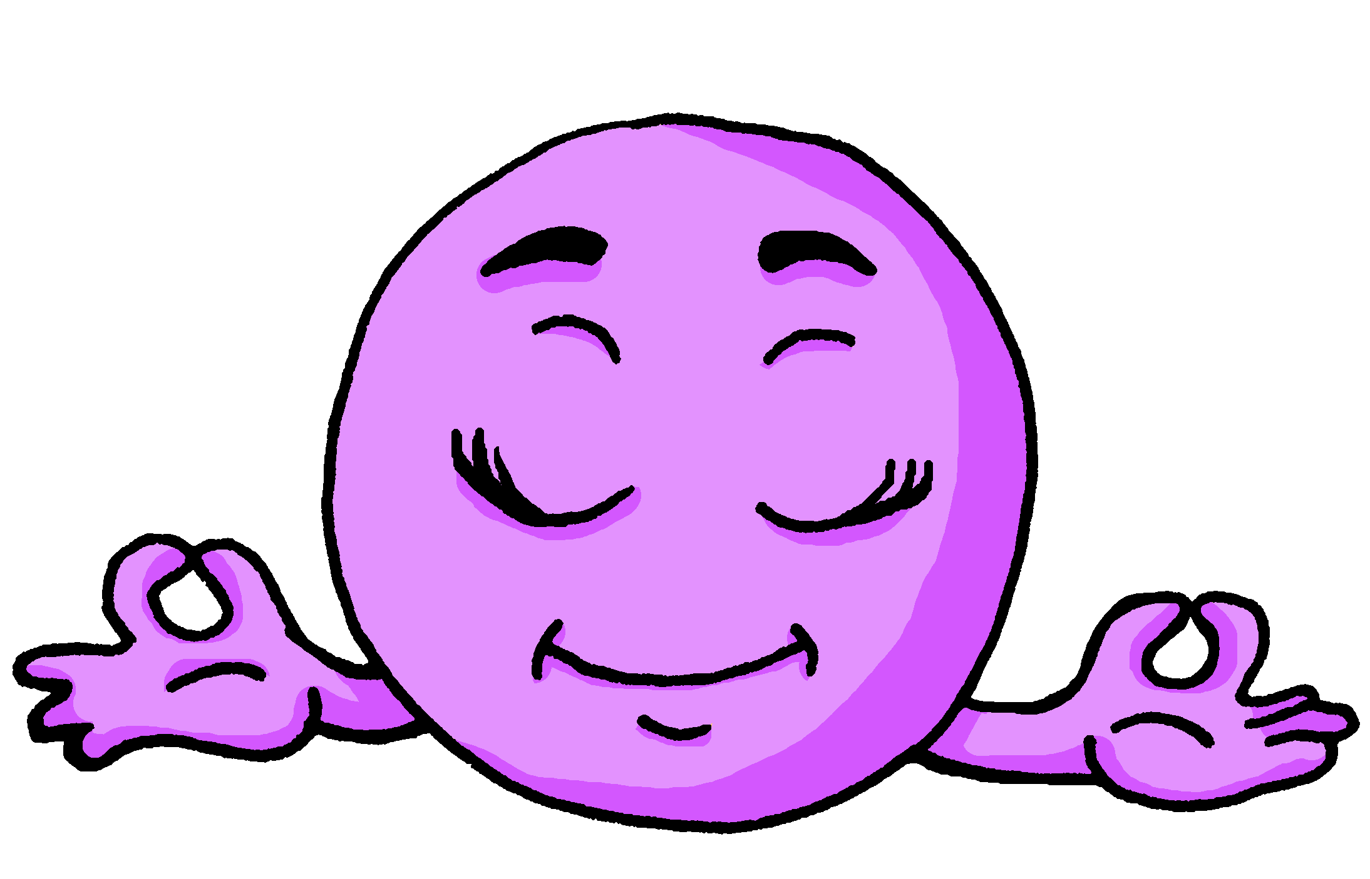
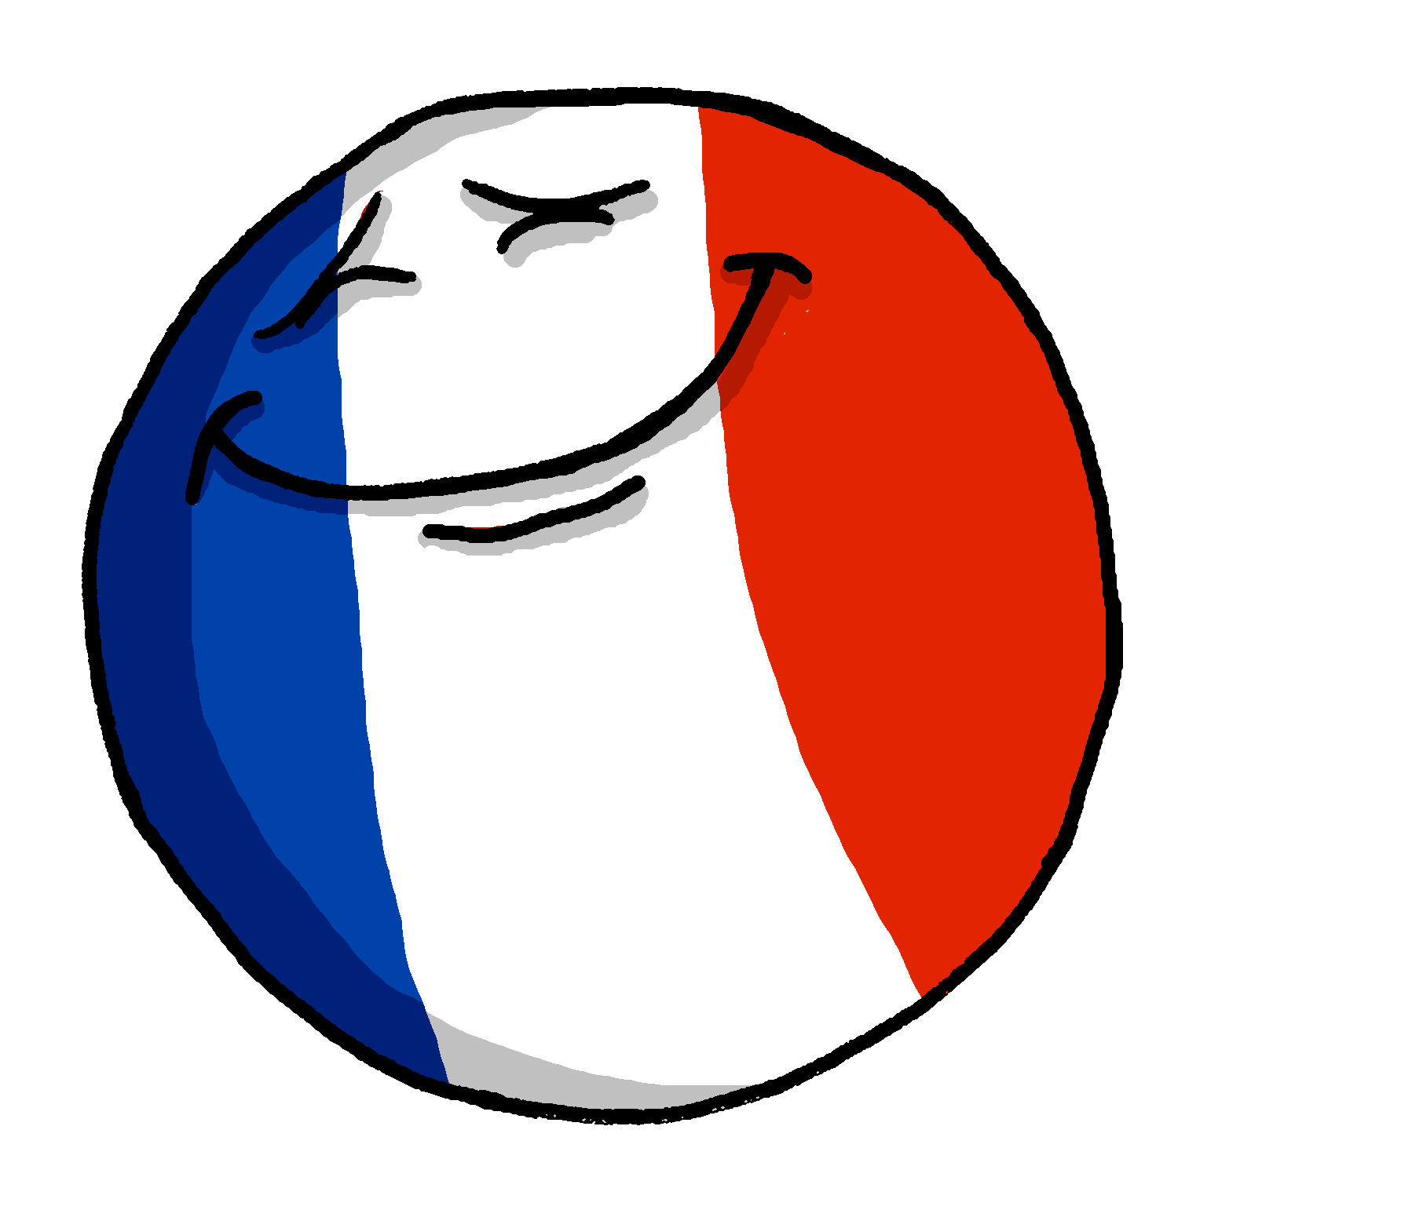
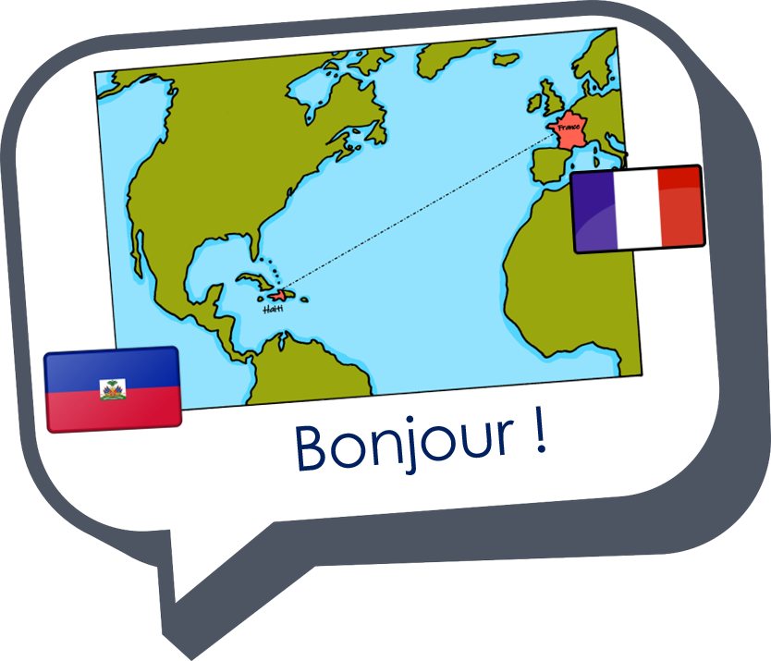
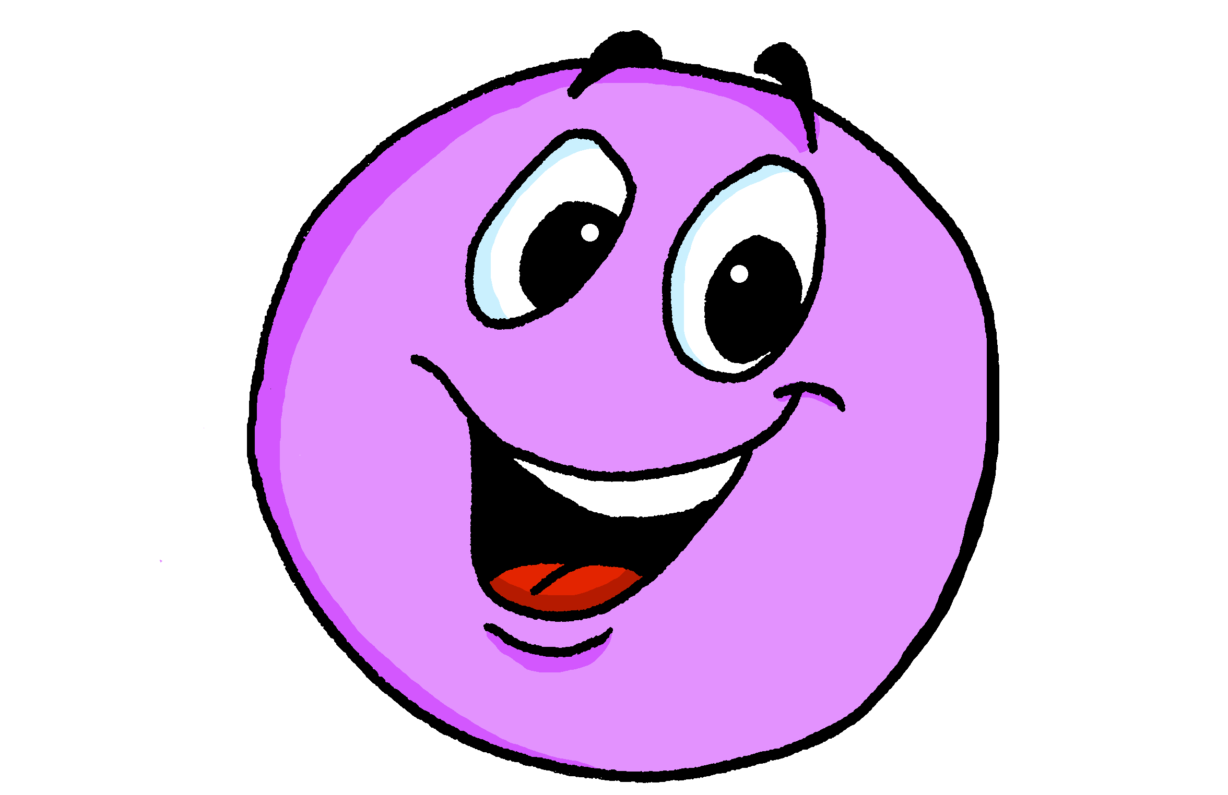
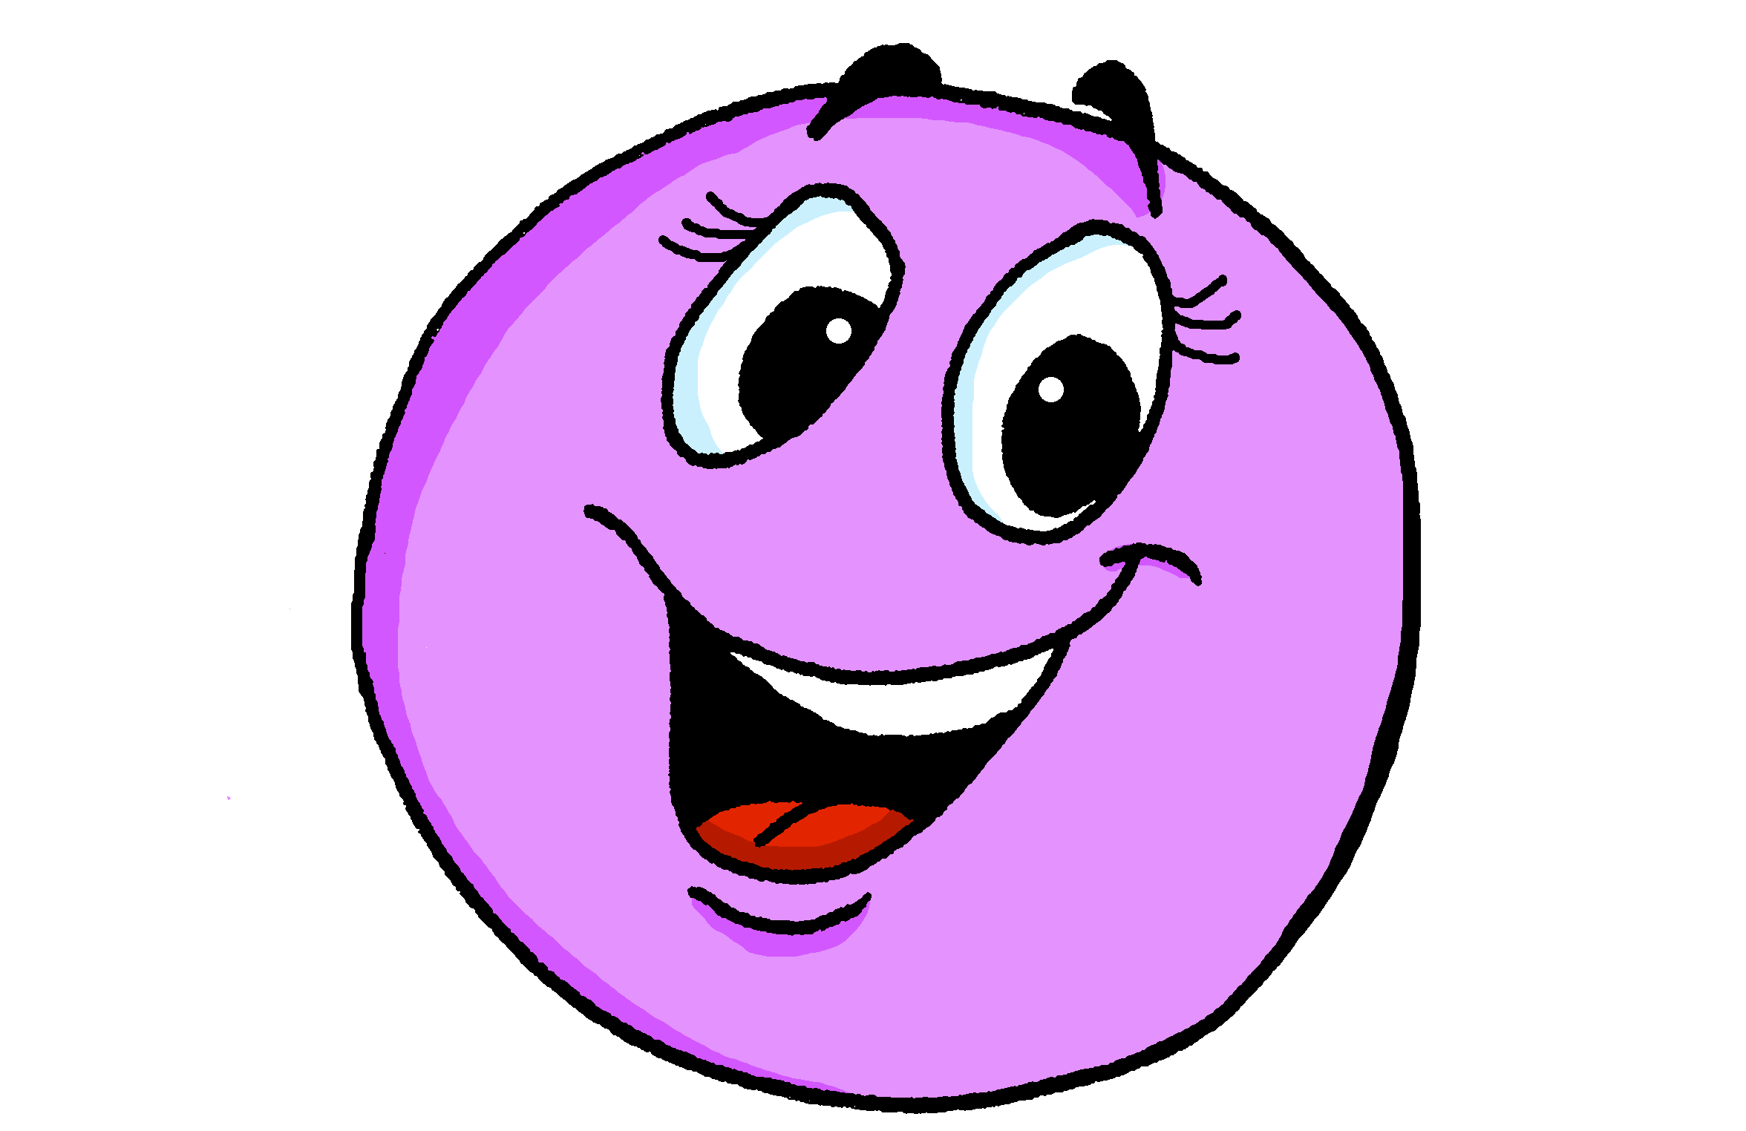
Rouge Knowledge Organiser - Autumn Term A
En classe (In class)
écouter – to listen|listening
parler – to speak|speaking
lire – to read|reading
écrire – to write|writing
être – to be|being
je suis – I am
tu es – you are
il est – he is
elle est – she is
c’est – it is, it’s
Monsieur – Mr, Sir(to a male teacher)
Madame – Mrs, Miss(to a female teacher)
présent, présente – present (m), present (f)
absent, absente – absent (m), absent (f)
ici – here
là – there
Bonjour ! – Hello!, Good morning!
Salut ! – Hi!
Au revoir ! – Goodbye!
Ça va ? – How’s it going?
bien – well, good
mal – bad(ly)
oui – yes
non – non
La description
petit, petite – short (m), short (f)
grand, grande – tall (m), tall (f)
anglais, anglaise – English (m), English (f)
français, française – French (m), French (f)
content, contente – pleased (m), (f)
intelligent, intelliente - intelligent (m), (f)
amusant, amusante – funny (m), funny (f)
méchant, méchante – naughty (m), (f)
triste – sad (m, f)
calme – quiet, calm (m, f)
malade – sick, ill (m,f)
sérieux, sérieuse – serious (m), serious (f)
heureux, heureuse – happy (m), happy (f)
curieux, curieuse – curious (m), curious (f)
courageux, courageuse – brave (m), (f)
La semaine (week)
aujourd’hui – today
lundi – Monday
mardi – Tuesday
mercredi – Wednesday
jeudi – Thursday
vendredi – Friday
samedi – Saturday
dimanche - Sunday
Phonics
[a] | [e] | [i] | [o] | [u]
banane
cheval
midi
moto
univers
[SFC] Silent Final Consonant | - t petit | - s mais | - d grand | - x deux
[but]
[an/en]
enfant
grand
maman
[child]
[mum]
[eu] | deux | un petit peu | un jeu
[a little bit]
[a game]
Personal pronouns je ➜ I tu ➜ you il ➜ he elle ➜ she | Describing people with the verb être | Adjective agreement for gender
More adjective patterns | Asking yes/no questions | Saying it is, it’s…
In French, adjectives often add –e to describe feminine nouns. People are nouns, too.
je suis
I am
tu es
être
you are
Il est grand.
il est
He is tall.
he is
elle est
Elle est grande.
➜
she is
She is tall.
The sound of the word changes as well.
Adjectives already ending in –e stay the same:
Change a statement into a question by raising your voice at the end.
To say it is or it’s, use c’est. Ce (this, that) ➜ c’ before a vowel.
Il est calme.
Tu es français.
C’est dimanche.
Elle est calme.
You are French.
Sun
It’s Sunday.
Adjectives ending in –eux change to –euse:
Tu es français ?
➜
Il est heureux.
Are you French?
He is happy.
In writing, add a ? In French, leave a space before ? and ! and :
Elle est heureuse.
She is happy.

Slide 2
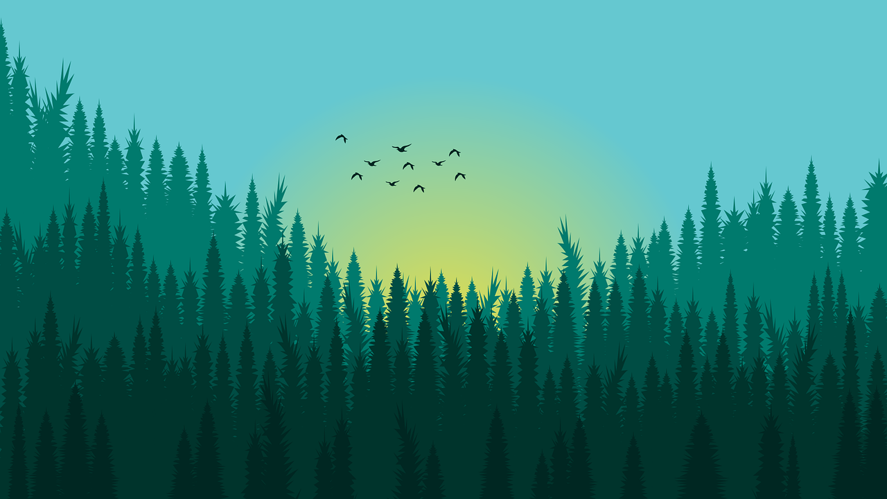
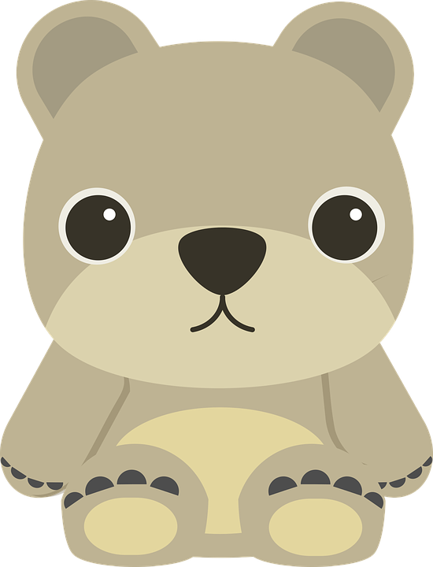
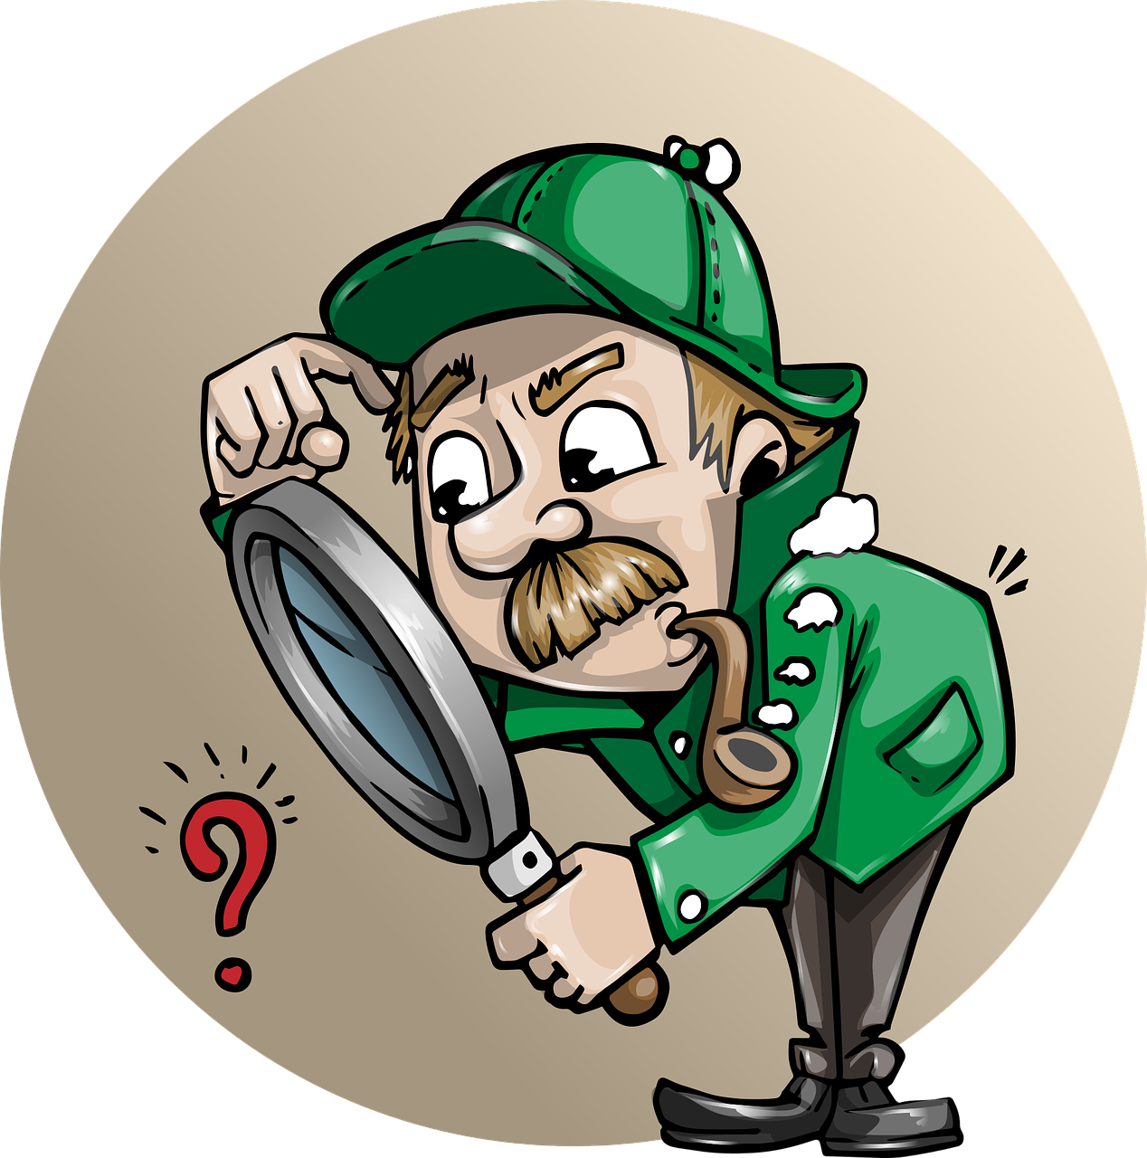
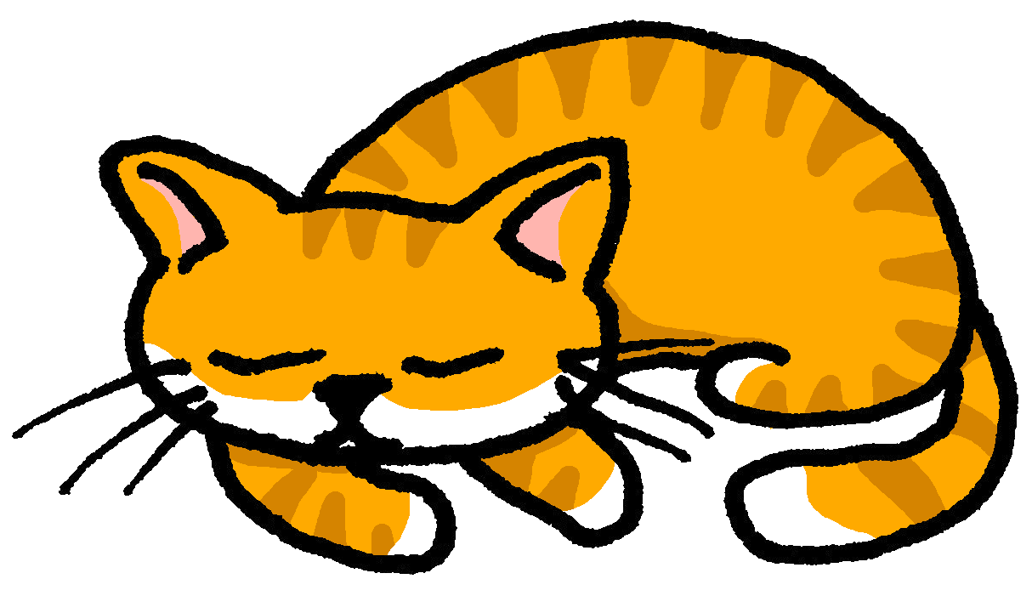
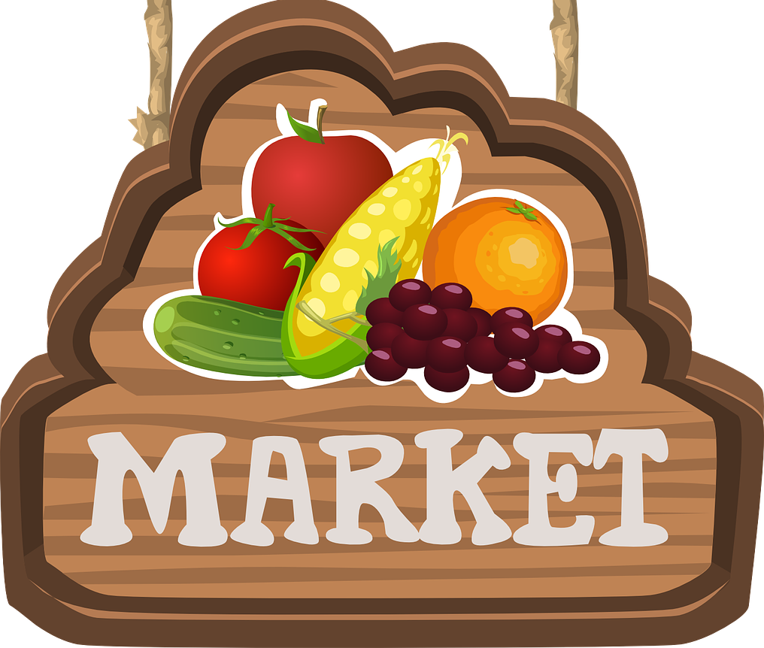
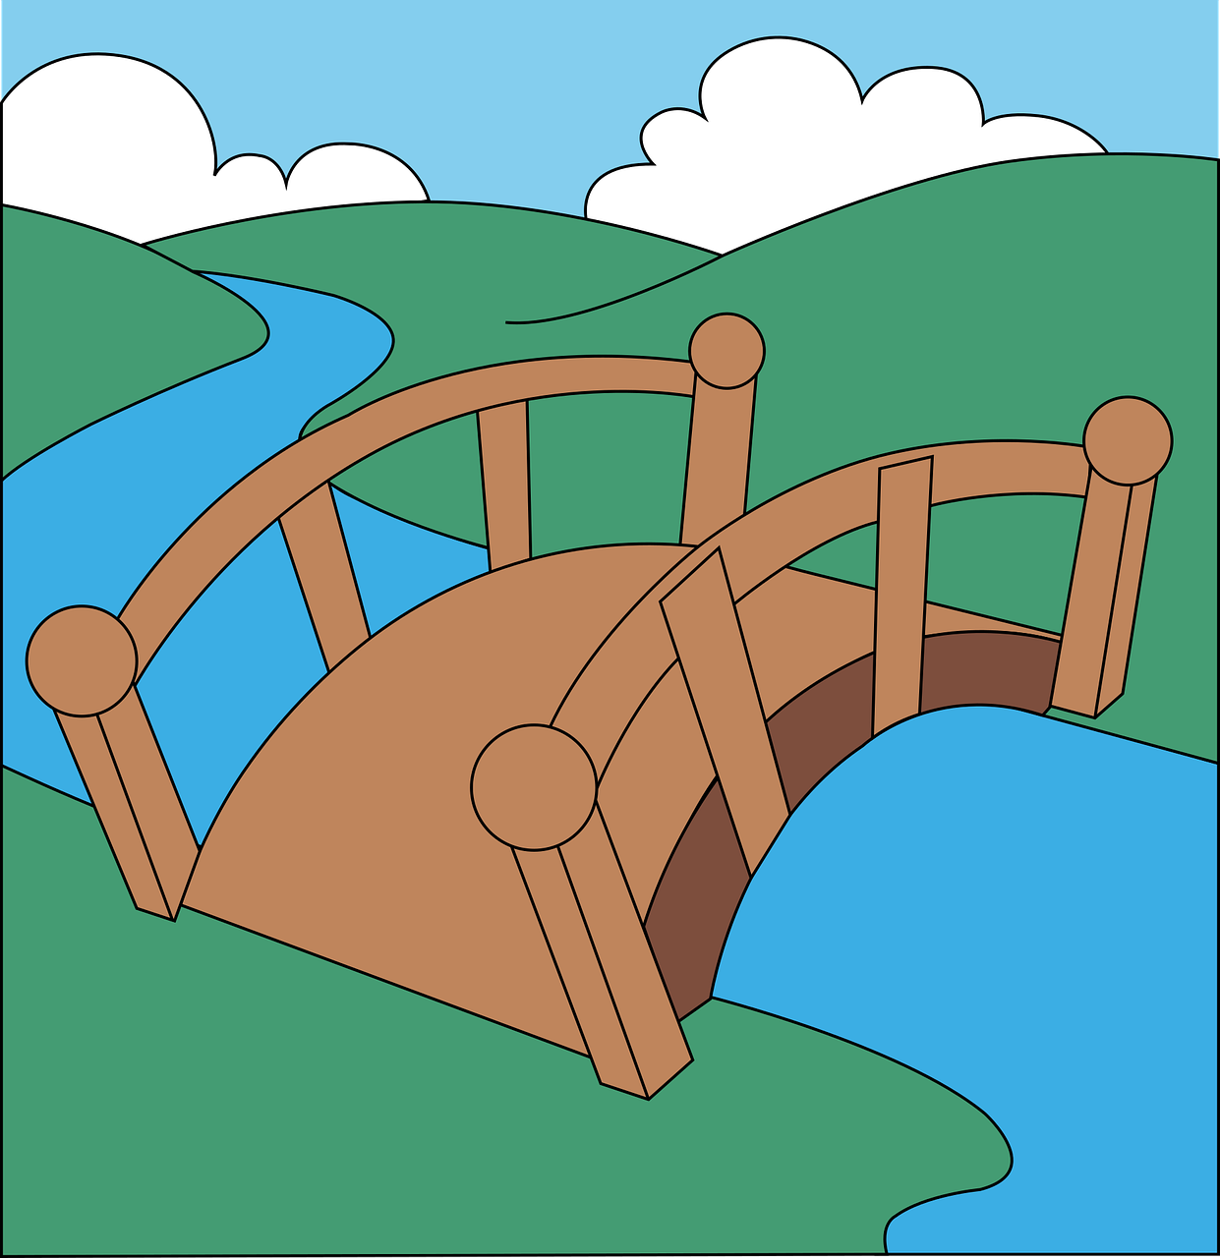
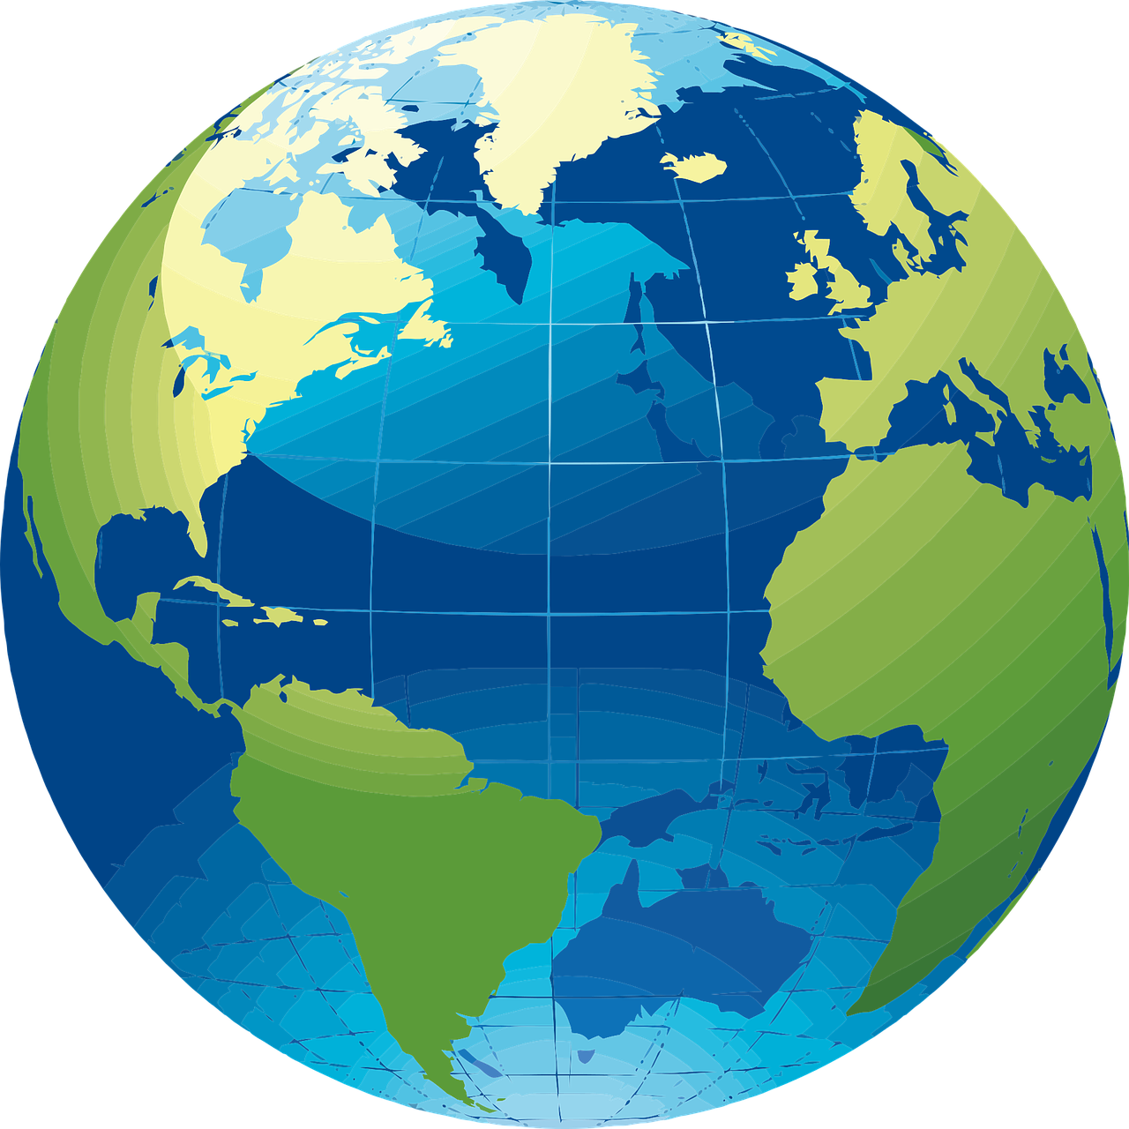
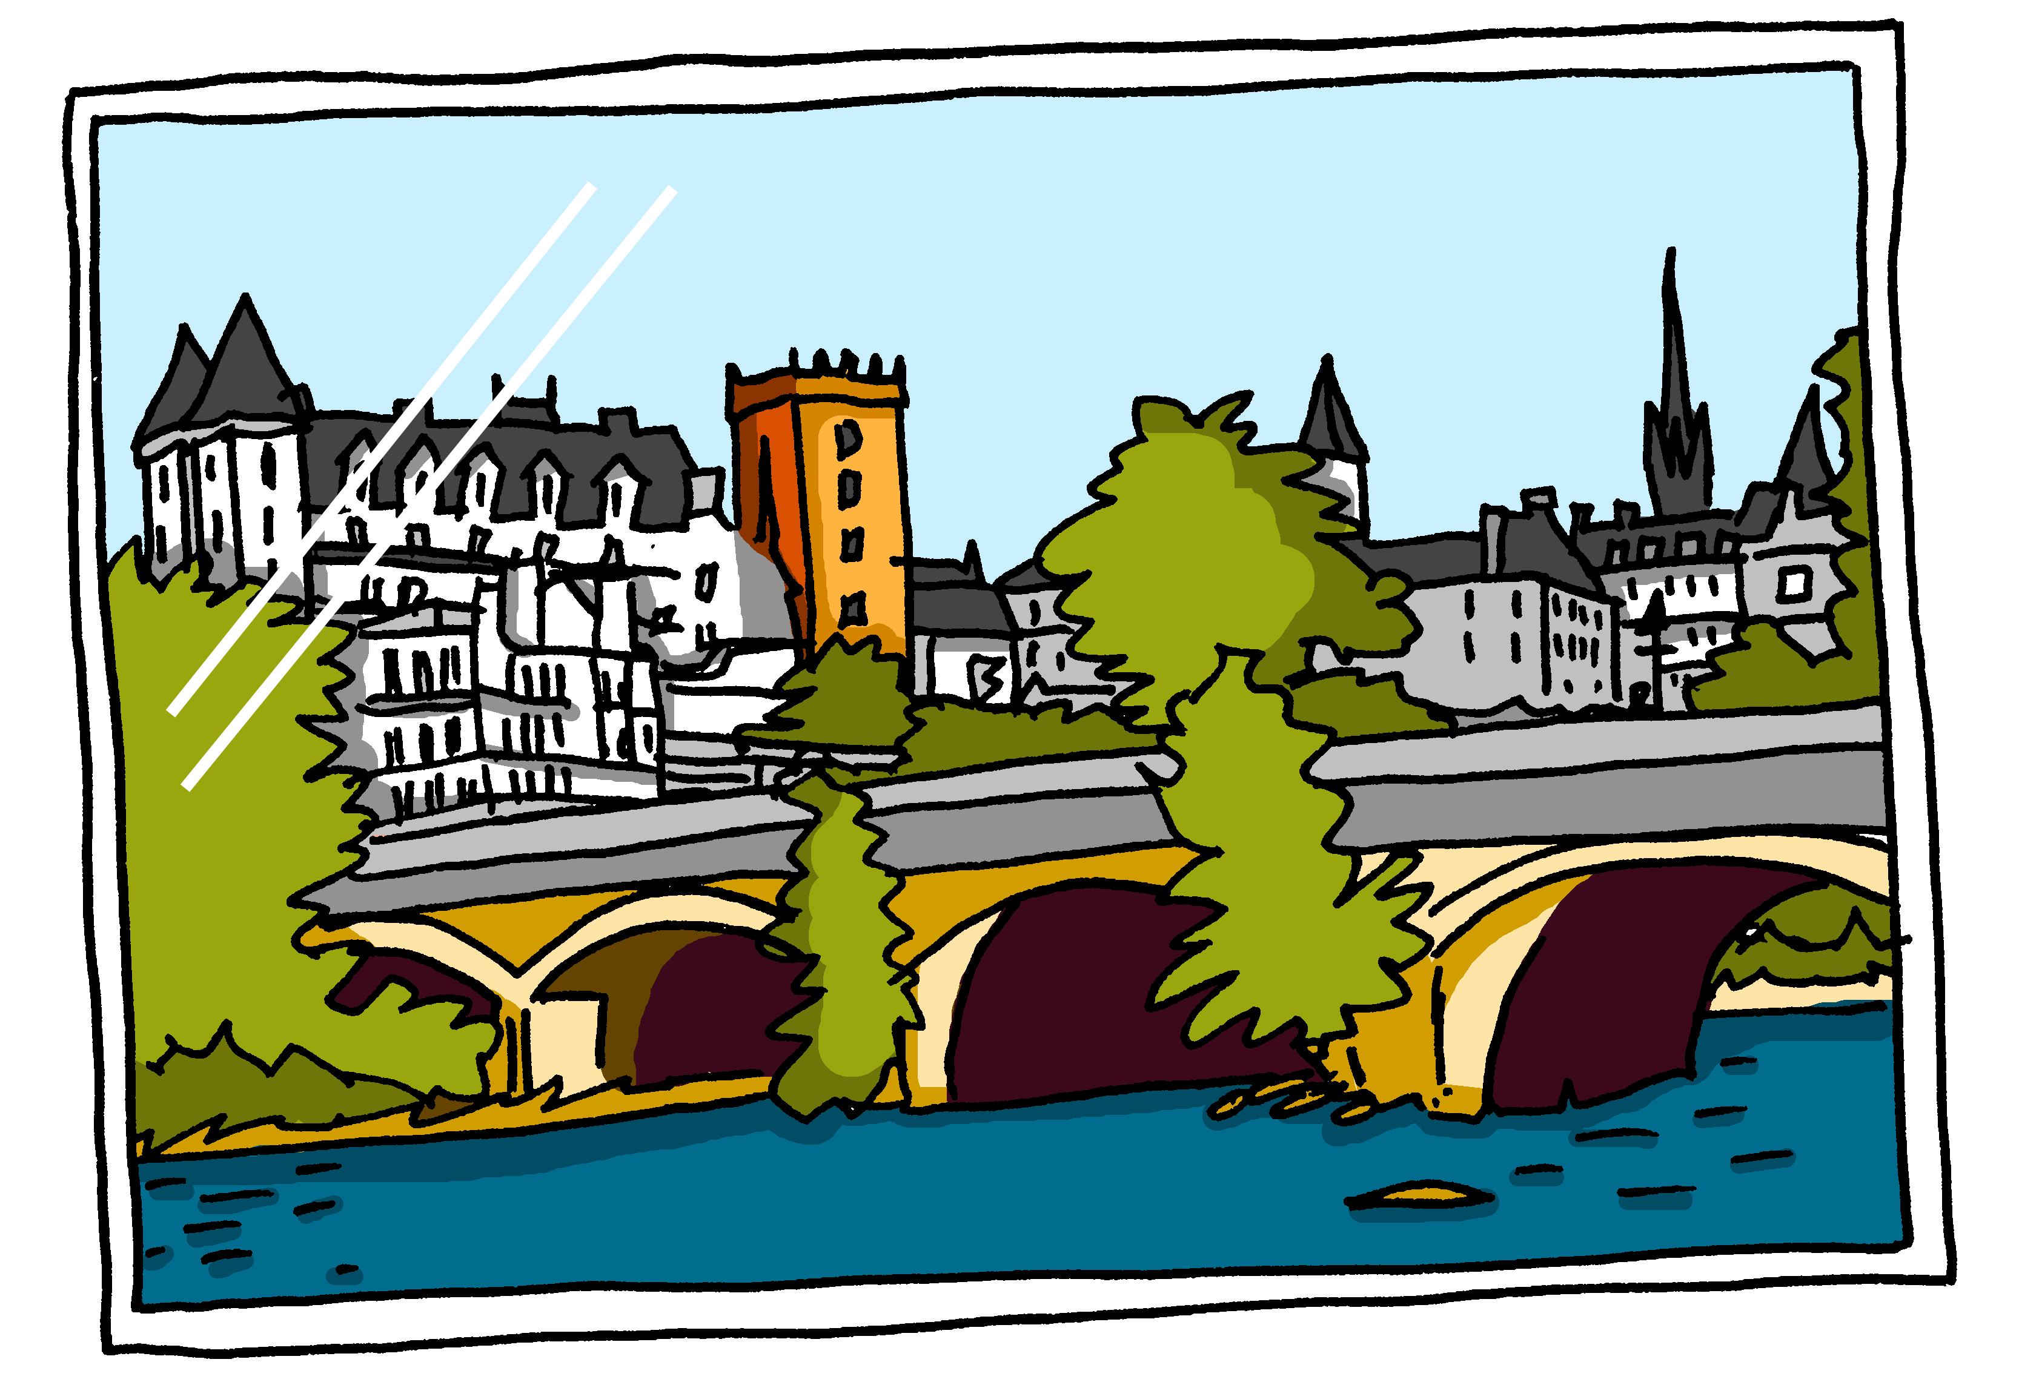
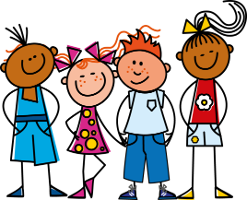
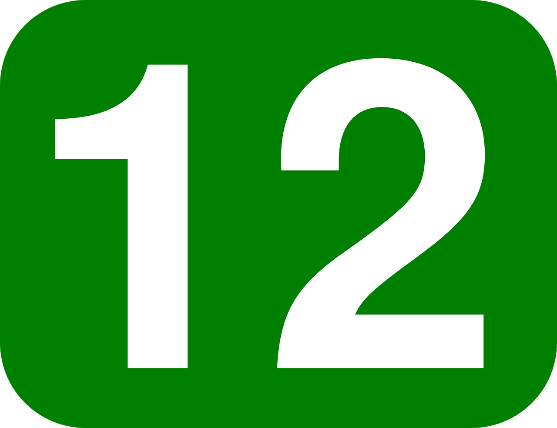
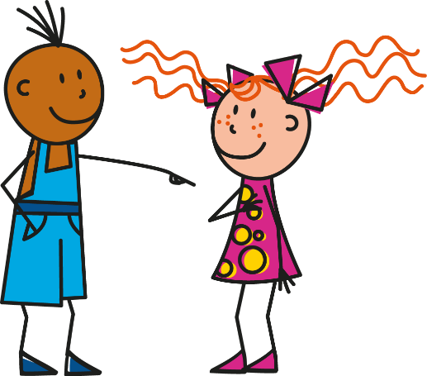
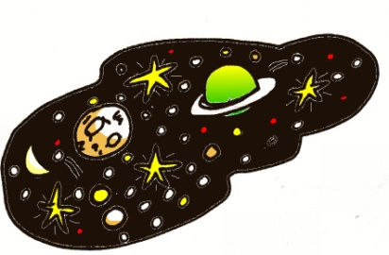
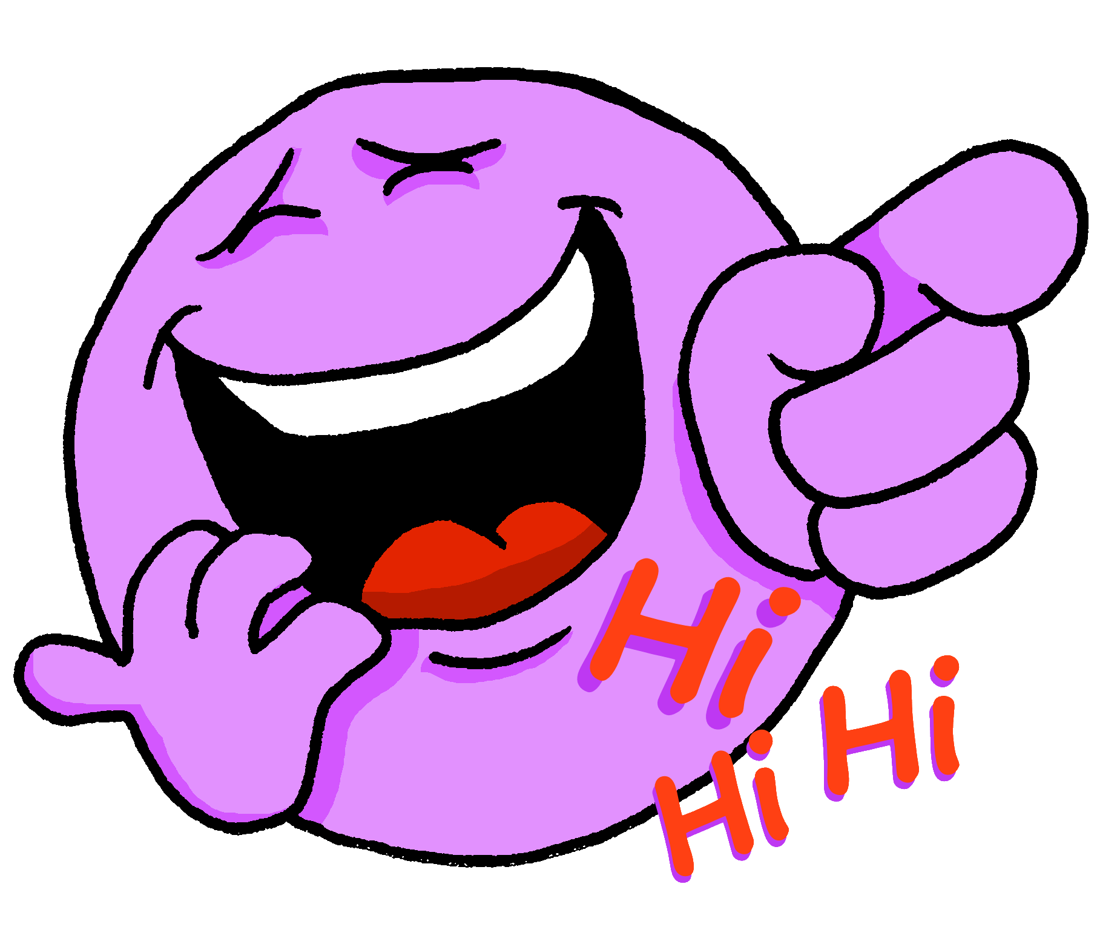
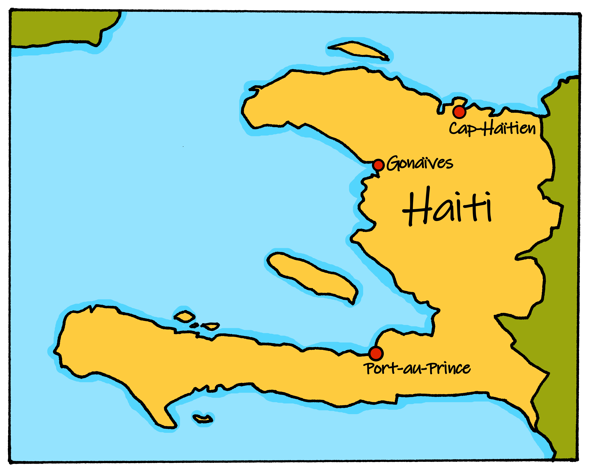
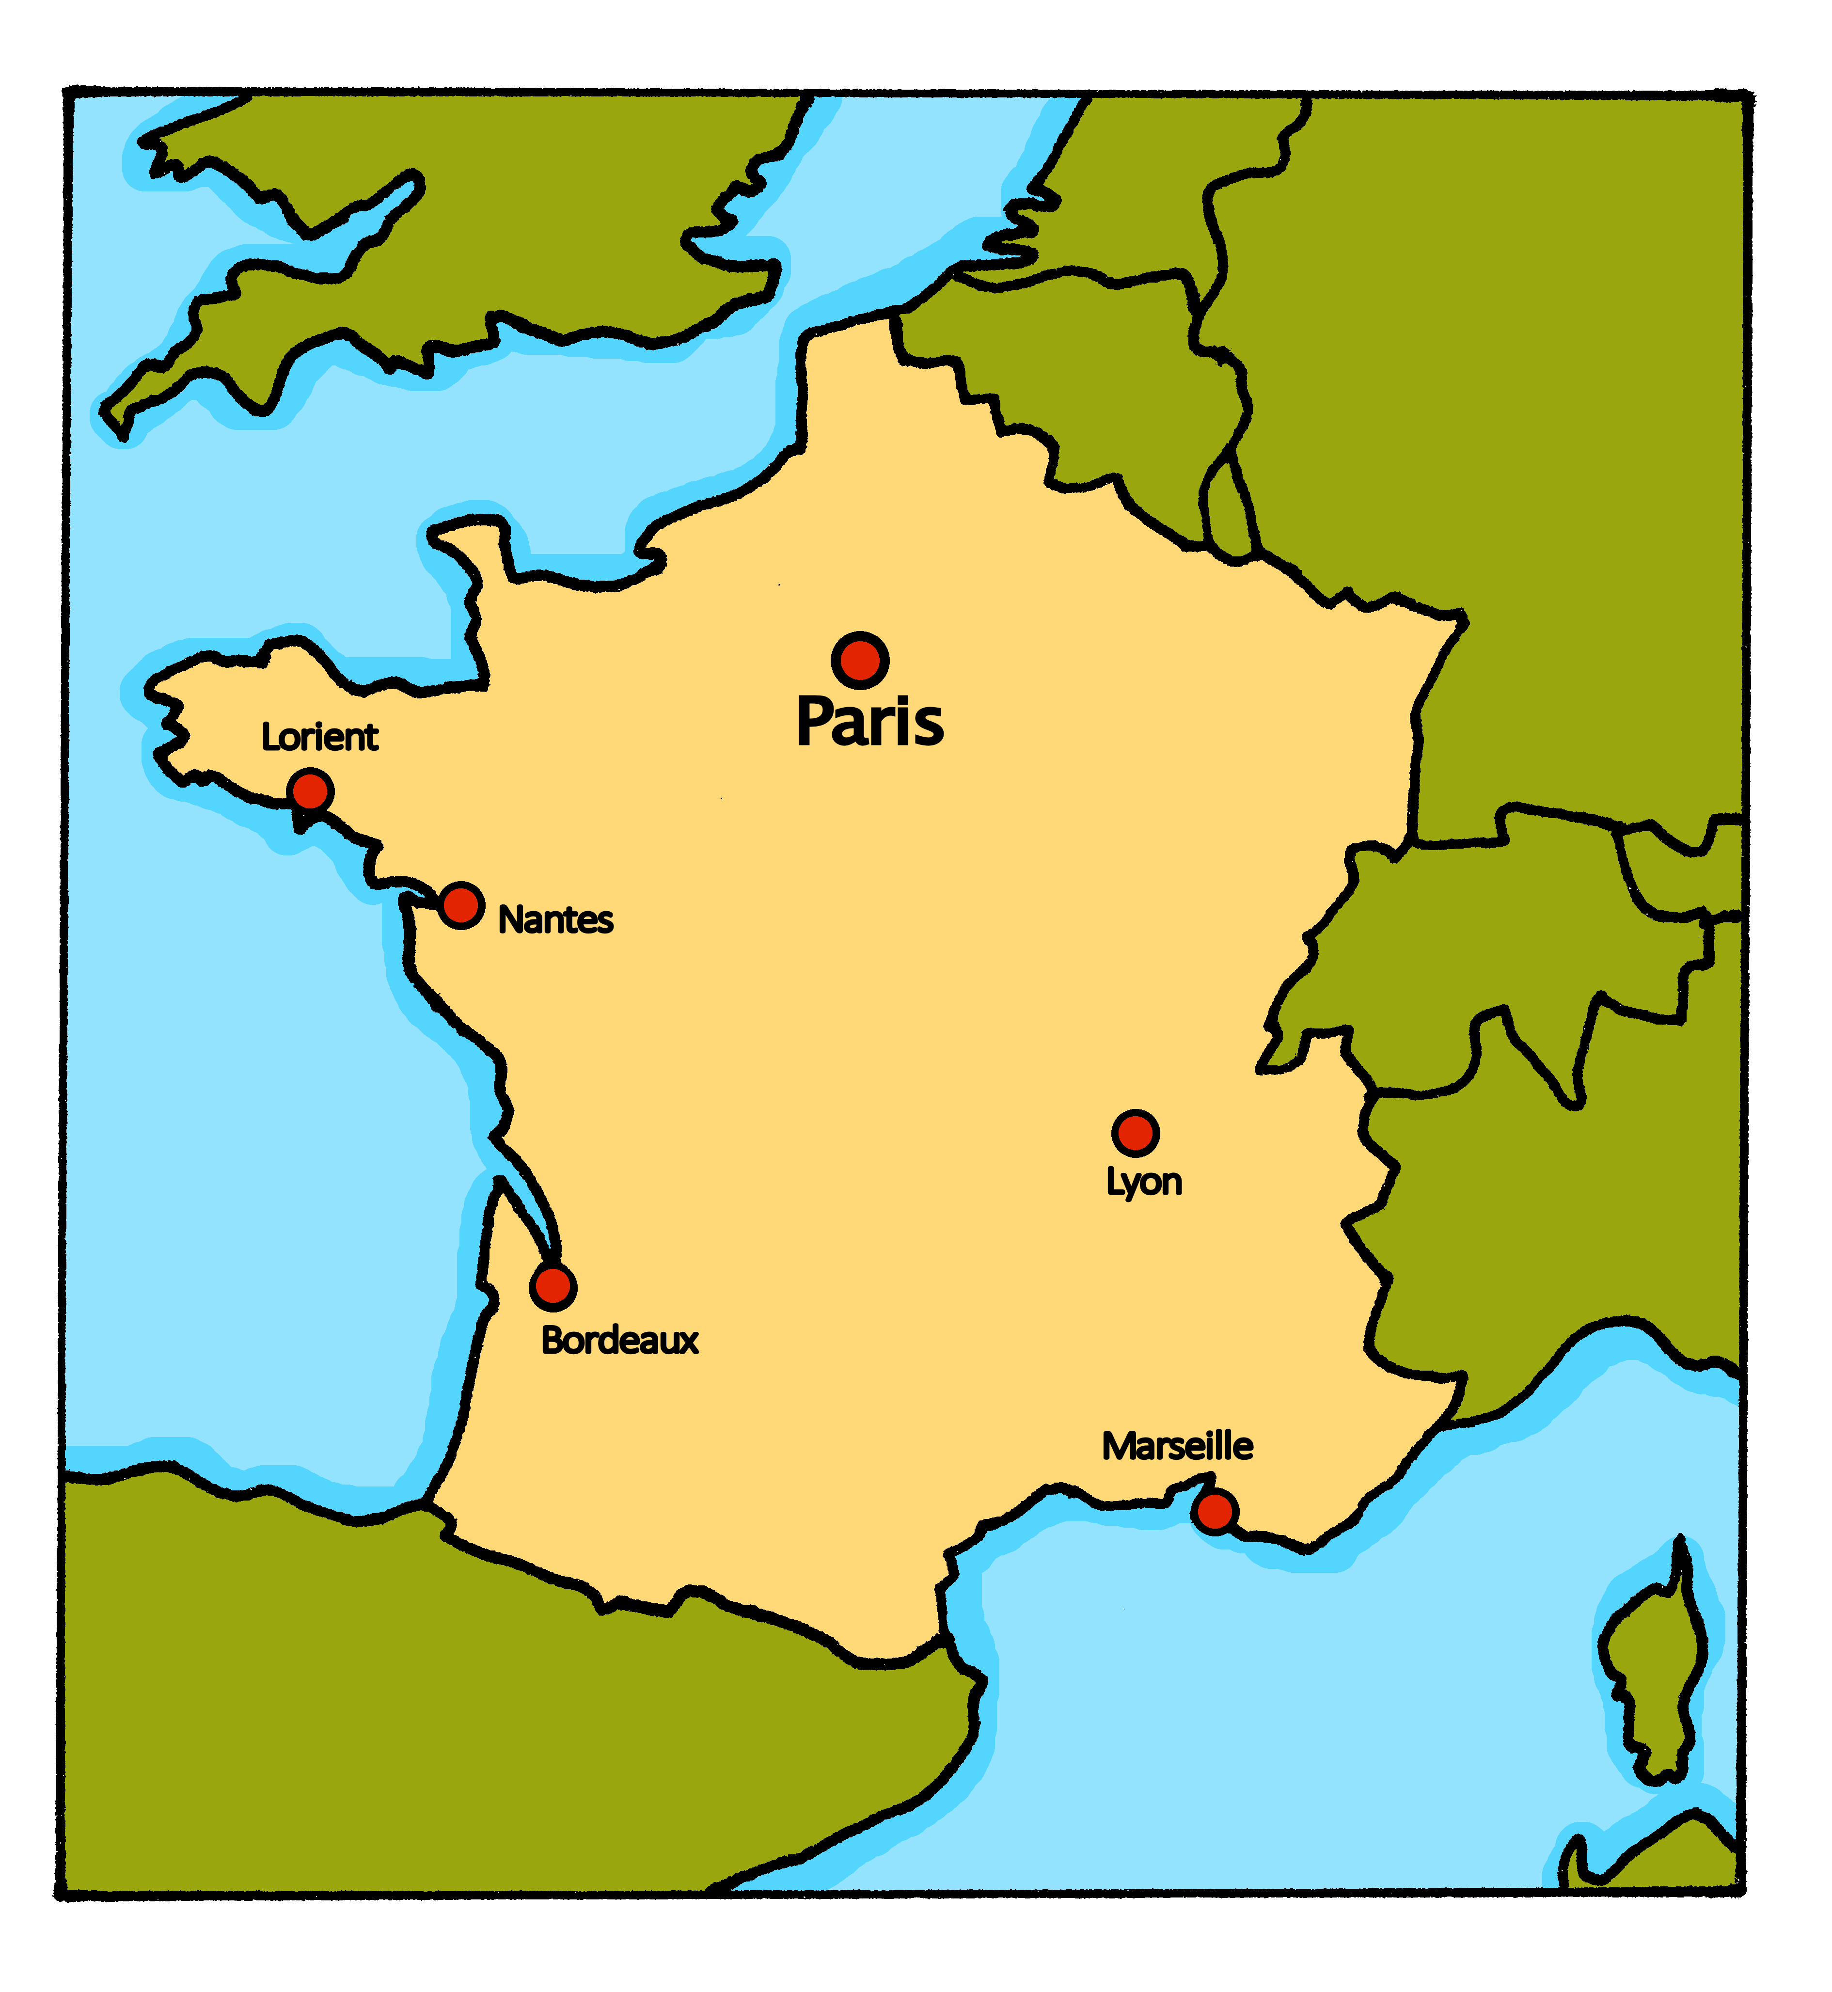
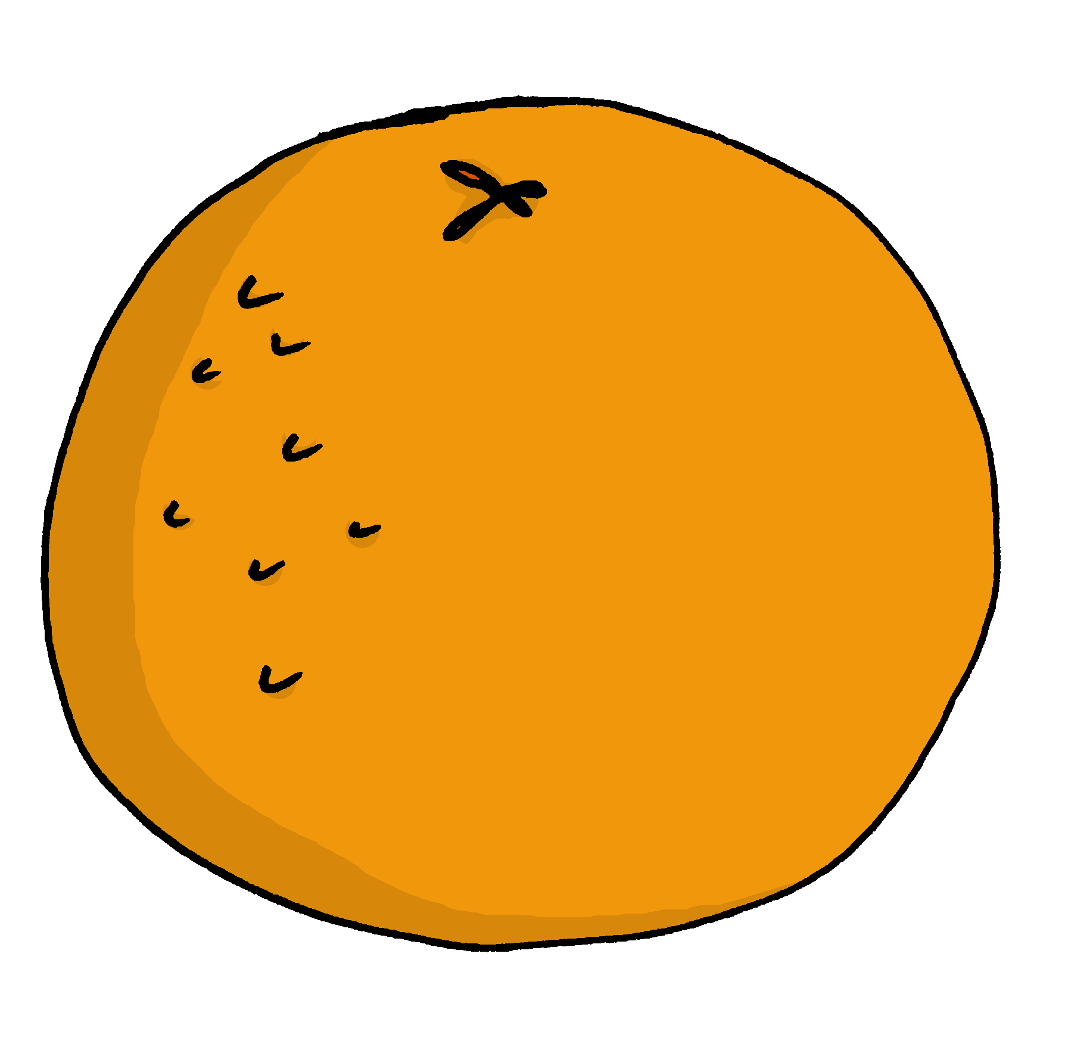
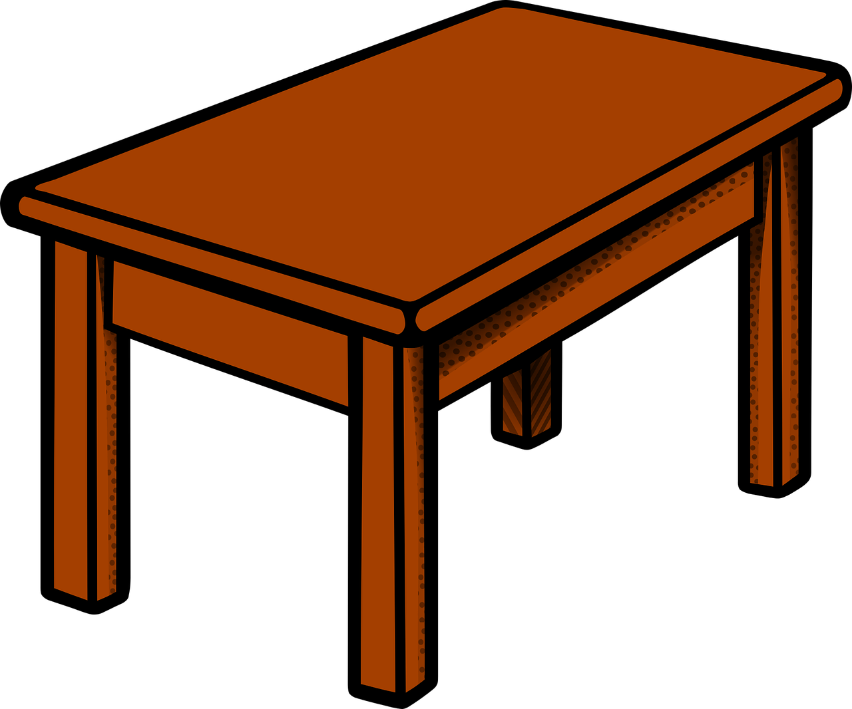
Rouge Knowledge Organiser - Autumn Term B
En classe (in class)
avoir – to have|having
j’ai – I have
tu as – you have
il a – he has
elle a – she has
un, une – a/an (m), a/an (f)
bouteille – bottle (f)
cahier – exercise book (m)
crayon – pencil (m)
gomme – rubber (f)
jeu – game (m)
livre – book (m)
orange – orange (f)
règle – ruler (f)
sac – bag (m)
stylo – pen (m)
À la maison (at home)
animal – pet, animal (m)
ballon – ball (m)
cadeau – present (m)
chat – cat (m)
chien – dog (m)
jour – day (m)
peluche – cuddly toy (f)
photo – photo (f)
table – table (f)
parfait, parfaite – perfect (m), perfect (f)
quoi – what
ou - or
chaque – each, every
pour – for
moi – me
toi – you
Phonics
[un]
un
lundi
Mon
brun
jungle
commun
Liaison | t-liaison with c’est before a vowel | C’est un livre. | C’est une peluche.
[ch]
chercher
dimanche
Sun
chat
marché
bouche
[on]
Non !
crayon
pont
monde
onze
[au/eau/o]
gauche
faux
eau
aussi
photo
[ou]
nous
Bonjour !
jour
Mon
douze
jouer
we
[u]
tu
univers
Salut !
amusant
utiliser
Gender of nouns In French, things, as well as people and animals, are either masculine or feminine. We say that they have gender. This is grammatical, not biological gender! A table (une table) is not female, it is a feminine noun. | Indefinite articles – ‘a’ To say a (or an) in French use un before a masculine noun and une before a feminine noun. un crayon une orange | Saying what people have with the verb avoir
Asking yes/no questions | Questions with quoi Put quoi at the end to make a what question: C’est quoi ? What is it? Tu as quoi ? What do you have?
Change a statement into a question by raising your voice at the end.
j’ai
I have
tu as
Il a une photo.
In Haiti the first day of the week
avoir
you have
He has a photo.
➜
C’est dimanche.
il a
Il a une photo ?
In France the first
day of the week
➜
he has
Does he have a photo?
elle a
Cognates are words that have the same spelling in both languages. How many can you think of?
C’est lundi.
➜
she has
➜

