Slide 1
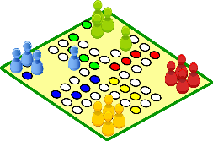
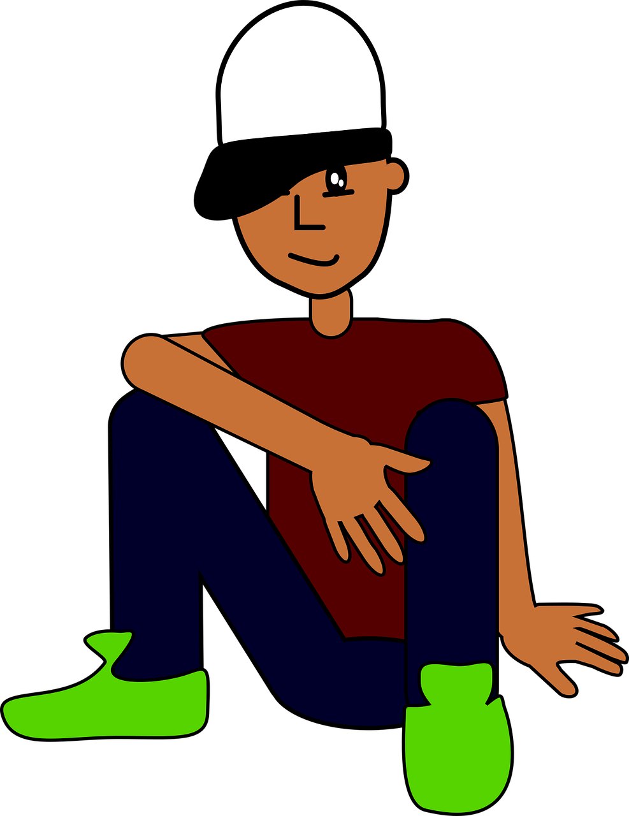
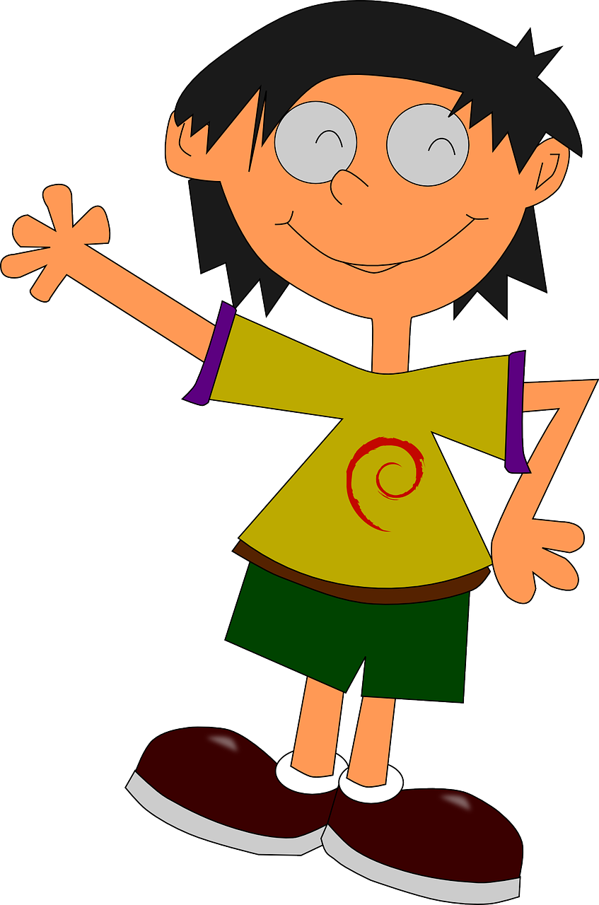
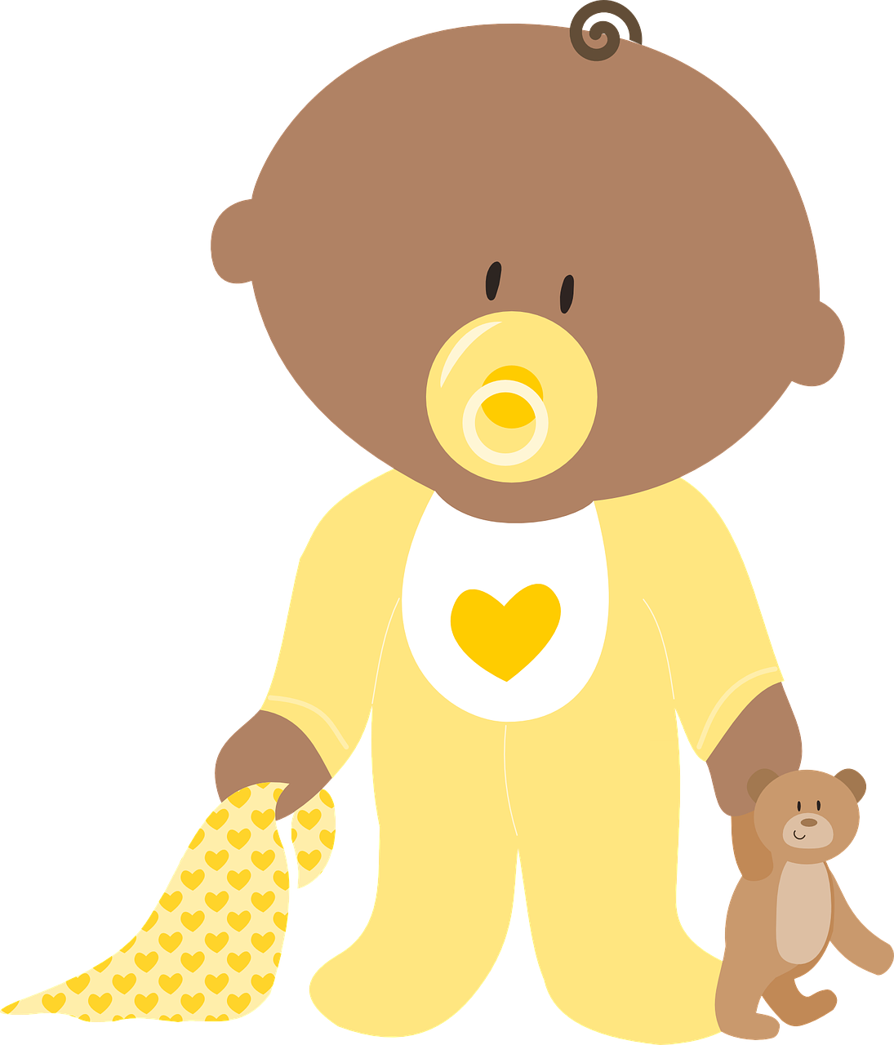
handout
Joyeux Noël !
Read aloud the French name and the Christmas present with the same final sound. You have not learnt these words so use what you know about how to pronounce French. Remember Silent Final Consonants!
Pupil name: _____________________
Total score: _____ / 16
Joyeux Noël !
Read aloud the French name and the Christmas present with the same final sound. You have not learnt these words so use what you know about how to pronounce French. Remember Silent Final Consonants!
Pupil name: _____________________
Total score: _____ / 16
 | Present | Name
1 | rat | Lilas
2 | seau | Coco
3 | vue | Prue
4 | jeu | Mathieu
5 | iglou | Ballou
6 | chanson | Vardon
7 | gants | Laurent
8 | cloche | Gavroche
 | Present | Name
1 | rat | Lilas
2 | seau | Coco
3 | vue | Prue
4 | jeu | Mathieu
5 | iglou | Ballou
6 | chanson | Vardon
7 | gants | Laurent
8 | cloche | Gavroche
Notes:
pupil handout / feedback sheet
1

