Slide 1
Français
Rouge Term 1
Nom : ……………………………………………….
Professeur(e) : ……………………………………..
Classe : ……………………………………………..

Slide 2
Contents
Contents | page
Introduction: La famille Kergosien | 1
Les phoniques | 2
Term 1 Learning Overview | 3
1. Les voyelles a – e – i – o - u | 4-5
2. Greeting and responding to the register | 6-8
3. Introducing yourself, saying goodbye, asking questions | 9-11
4. Describing myself, describing someone else | 12-14
5. Describing someone, asking questions | 15-17
6. Saying what day of the week it is today | 18-20
7. Describing someone | 21-22
8. Identifying things | 23-25
9. Saying what I have and someone else has | 26-28
10. Talking about having, asking yes/no questions | 29-31
11. Reading aloud a story in French | 32-34
12. Asking what? questions | 35-37
13 & 14. Christmas in France | 38-40

Slide 3
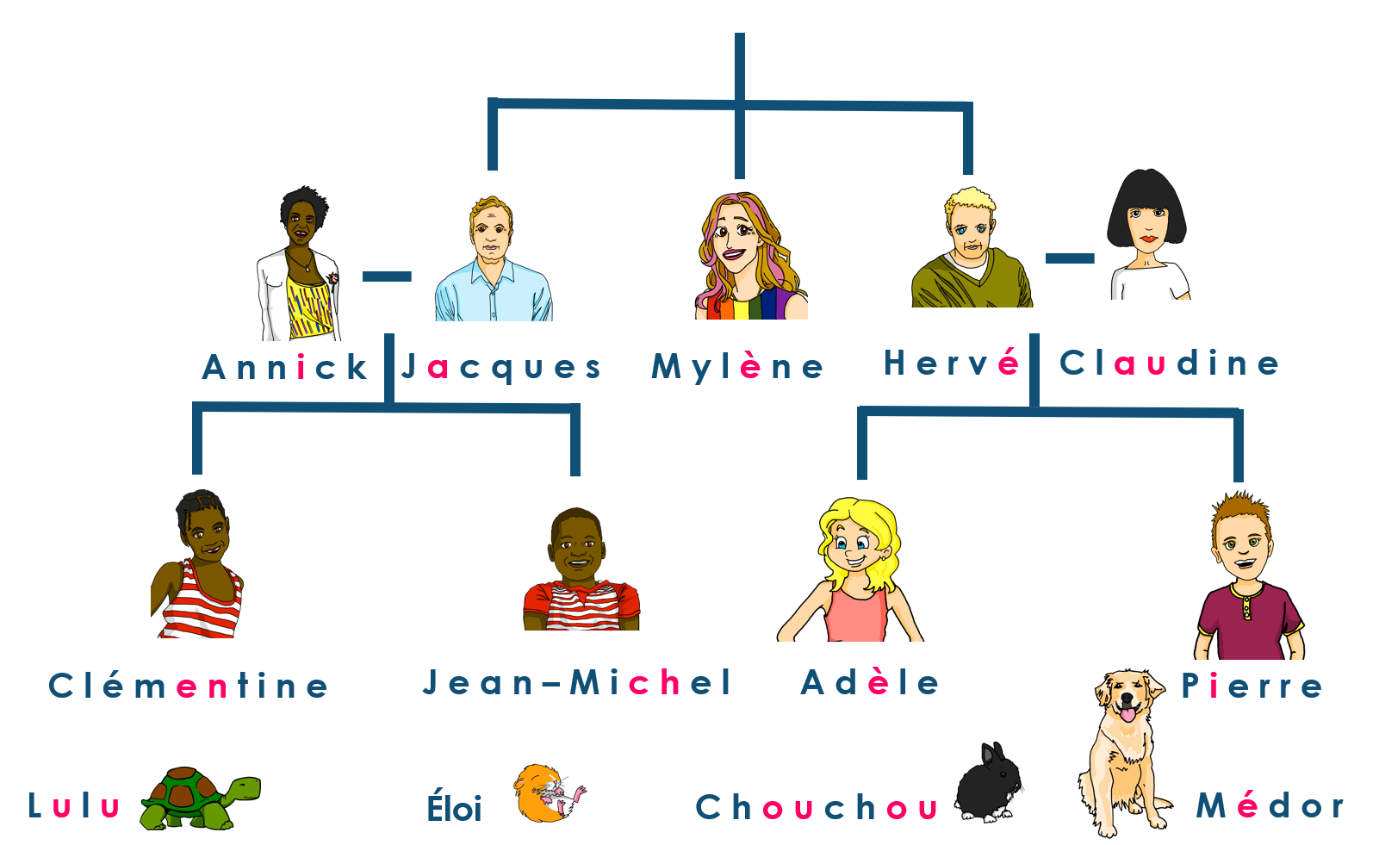
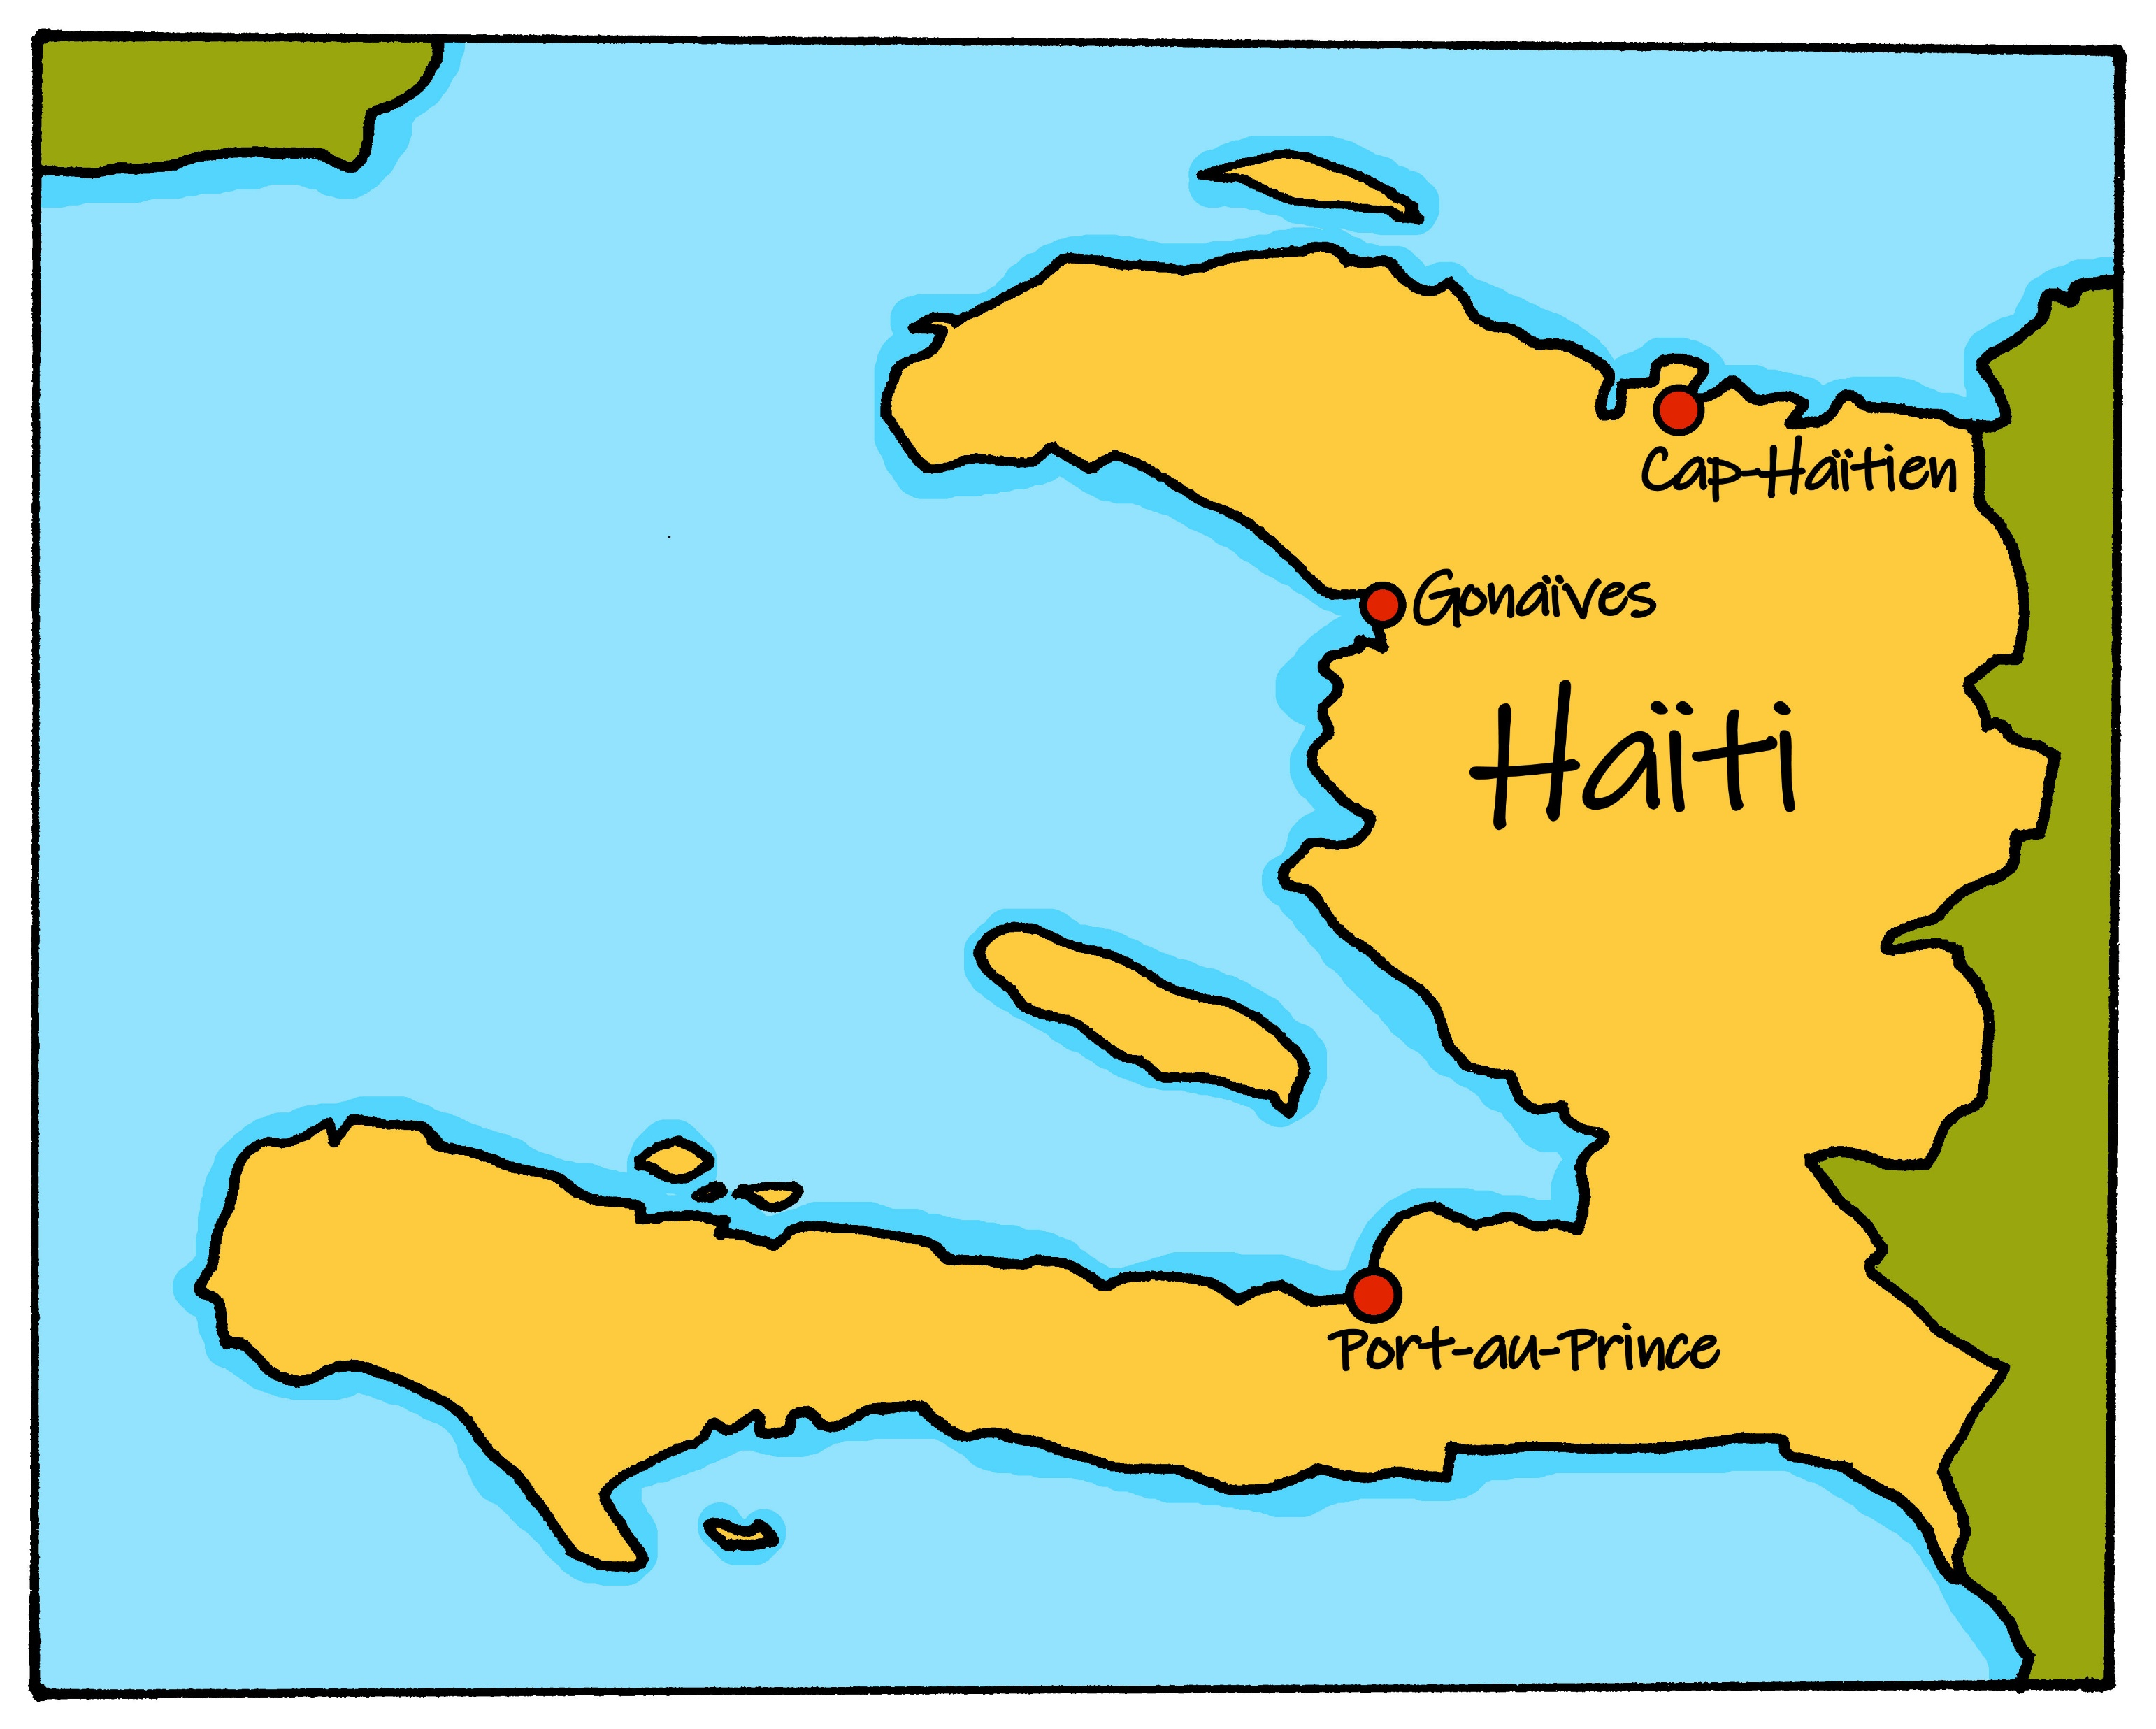
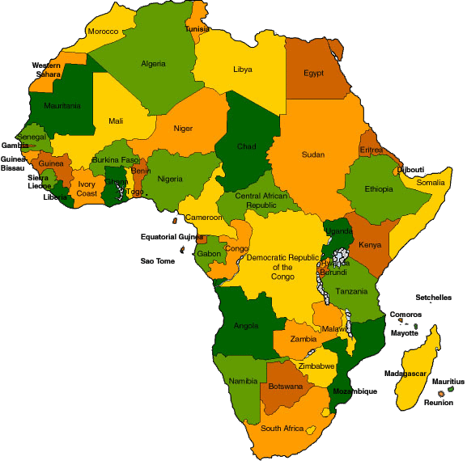
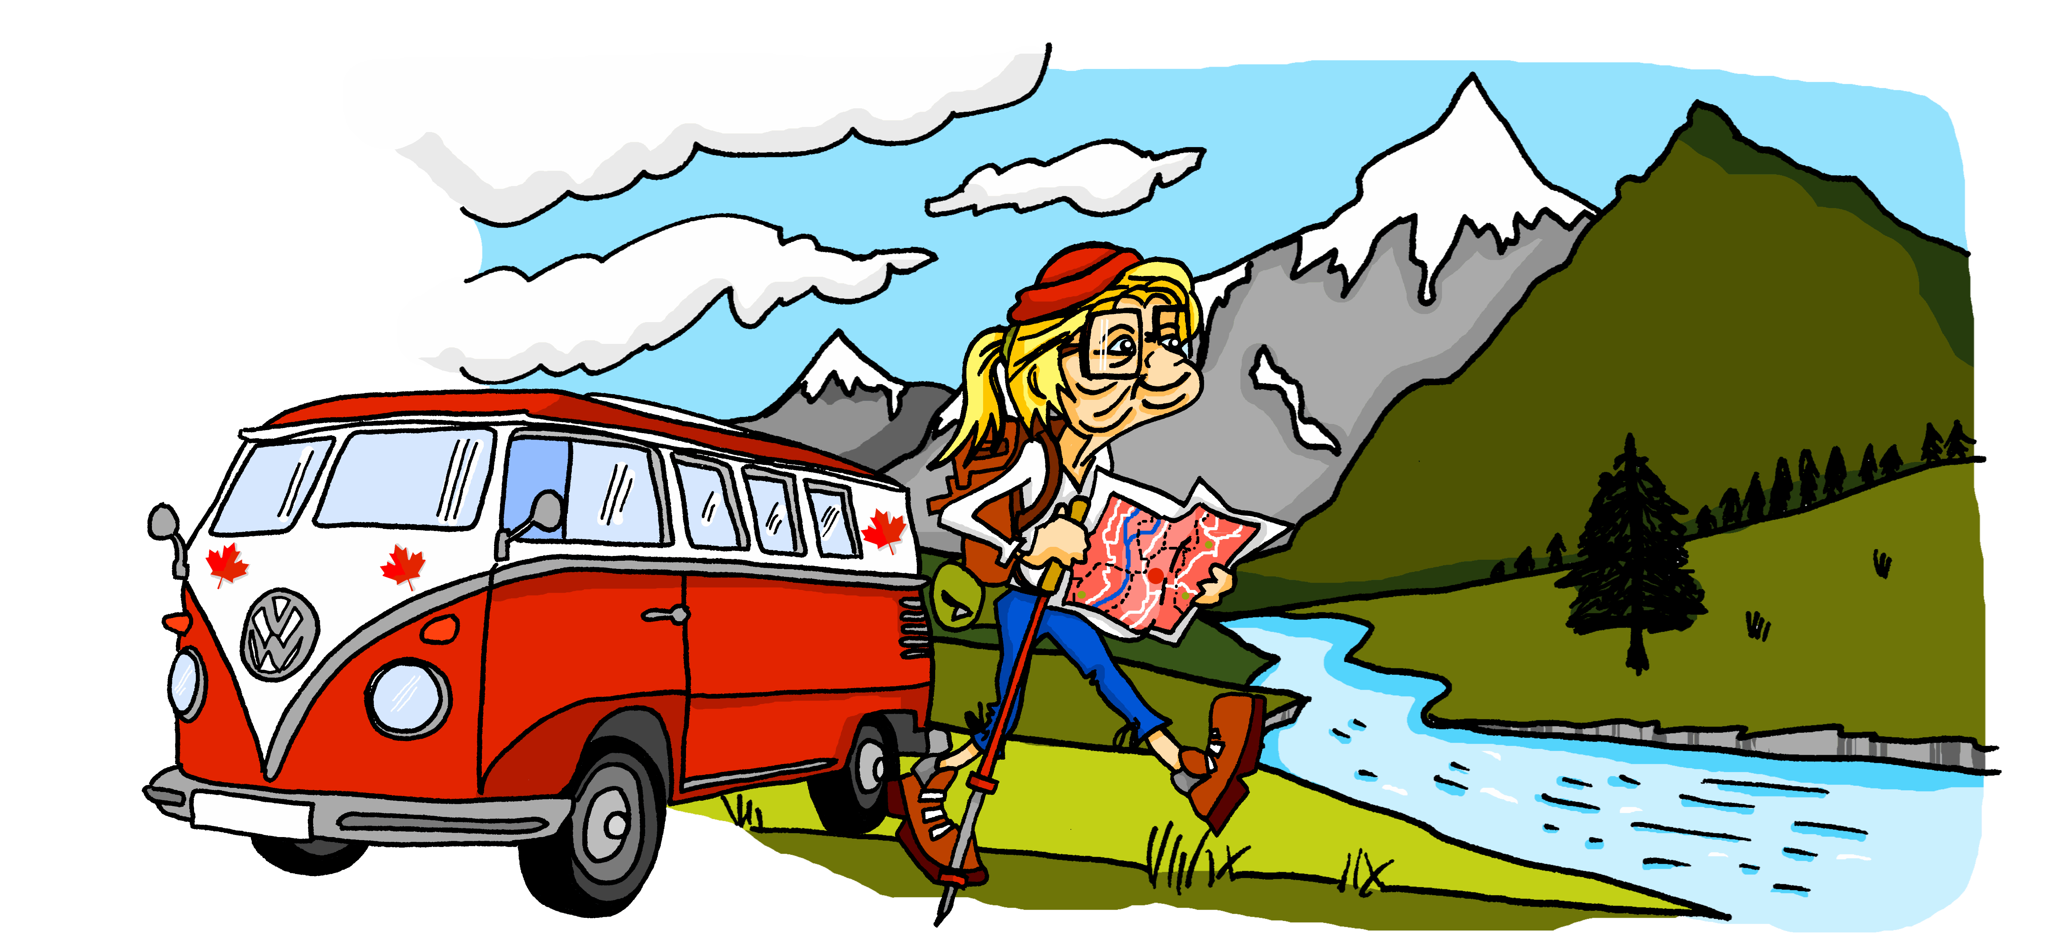
Characters
La famille Kergosien
Renée
We say ‘la Francophonie’ to mean French-speaking peoples and countries.
There are 29 countries with French as
an official language. 21 of these countries are in Africa. Five are in Europe. The other three are: Canada, Haiti and Vanuatu.

Slide 4
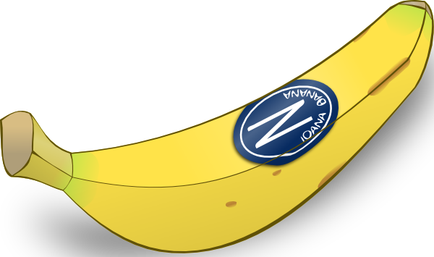
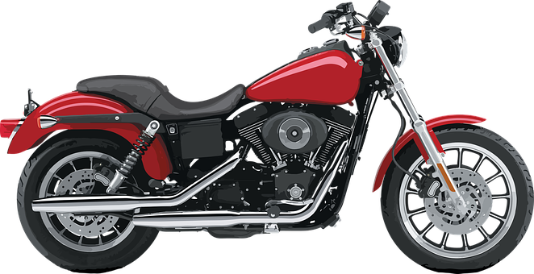
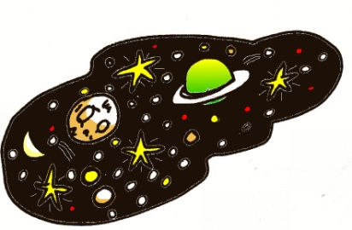
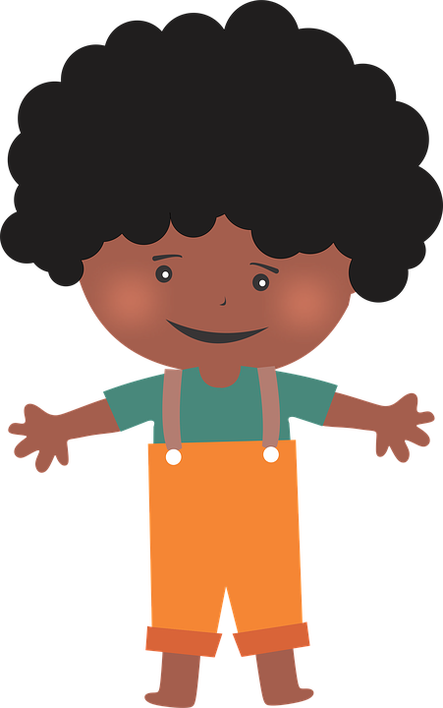
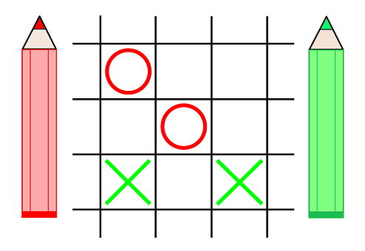
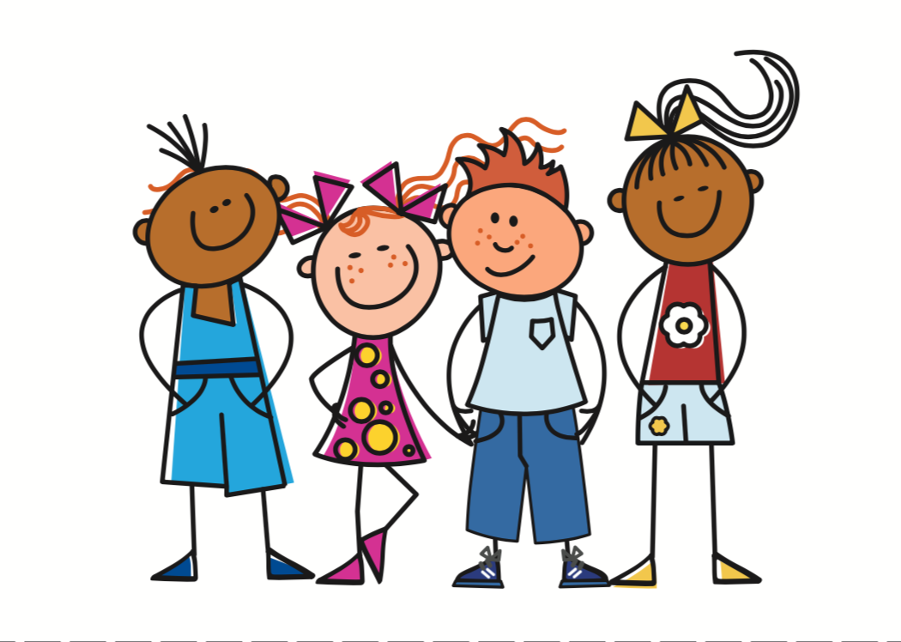
Phonics
Phonics
[a]
[e]
[i]
[o]
banane
cheval
midi
moto
[u]
[SFC -t]
[SFC -s]
[SFC -d]
[but]
univers
petit
mais
grand
[SFC -x]
[an/en]
closed[eu]
[un]
enfant
jeu
[a/an, one]
deux
un
[ch]
[on]
[au/eau/o]
[ou]
[to look for]
[we]
chercher
Non !
gauche
nous

Slide 5
Term overview
Term 1 learning
UNIT | Context CommunicationCulture | Key ideas (GRAMMAR) | PHONICS | VOCABULARY
Unit 1 (W1-7) | Describing me and others in class in Haiti and in France | Talking about being Essential verb: to be, being – ÊTRE I am – je suis you are – tu es he is – il est she is – elle est it is, it’s – c’est Adjective agreement for masculine/feminine Yes/no questions with raised intonation | Vowels [a] [e] [i] [o] [u] Silent final consonants [SFC] – t, s, d SSC [an/en] SSC closed [eu] | Simple greetings Verb être Range of adjectives Days of the week
Unit 2 (W8-12) | Saying what I and others have at home with friends | Talking about having Essential verb: to have, having – AVOIR I have – j’ai you have – tu as he has – il a she has – elle a Indefinite, singular articles and gender Talking about identifying C’est un/une… Intonation questions with quoi ? | Liaison (t) SSC [ch] SSC [on] SSC [au/eau/o] SSC [ou] [u] | Verb avoir Range of singular masculine and feminine nouns
Unit 3 (W13-14) | Revision Christmas | Revisit key ideas | Revisit SSC | Revisit vocabulary

Slide 6
Term 1 week 1
Describing me and others
1
Rouge term 1
🎯
Vowels
a – e – i – o - u
prononcer
[a]
[e]
[i]
[o]
[u]
banane
cheval
midi
moto
univers
écouter
A. Écoute. Which number is it?
Banane is number _______.
Moto is number _______.
Cheval is number _______.
Midi is number _______.
Univers is number _______.
écouter
parler
[to listen]
[to speak]
lire
écrire
[to read]
[to write]
écouter
B. Écoute. Draw it. Write the vowel.
[ _ ]
[ _ ]
[ _ ]
[ _ ]
[ _ ]
lire
A. Read the phrases.
1. Papa va à la cabane.
2. Le cheval aussi, à midi .
3. La moto perdue, dans l’univers.
4. a – e – i – o – u.
4

Slide 7
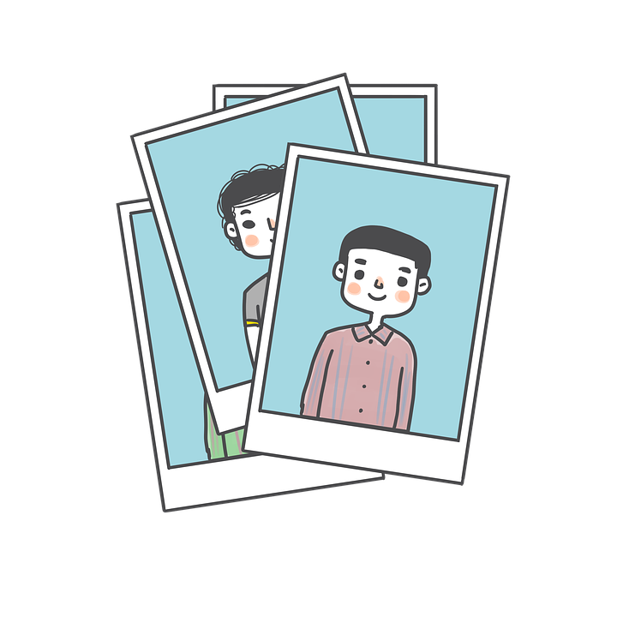
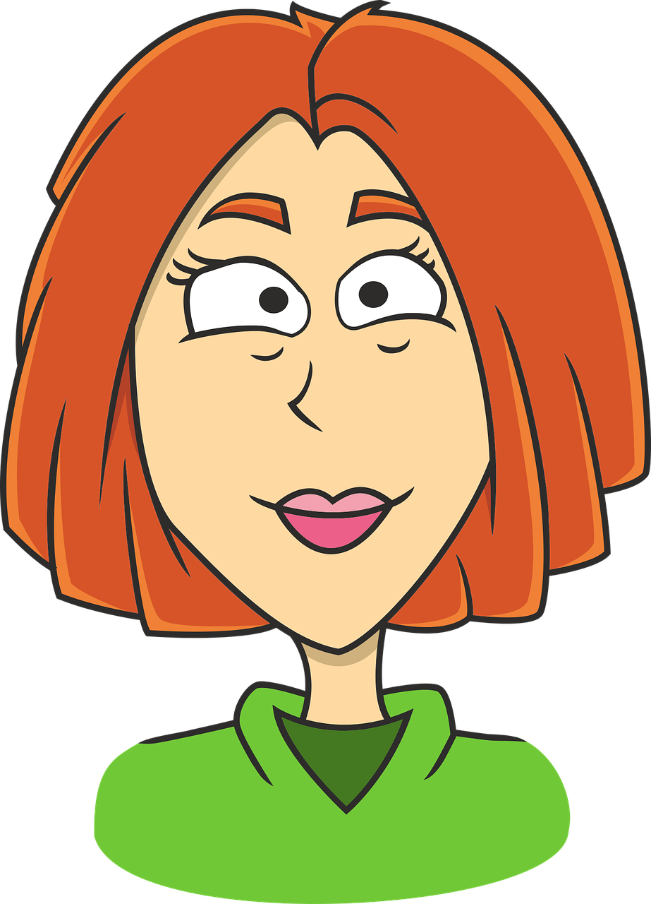
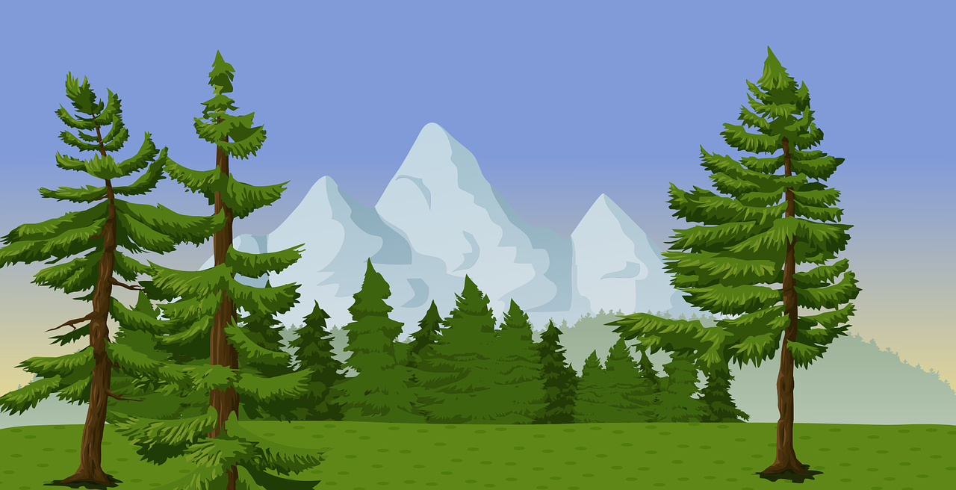
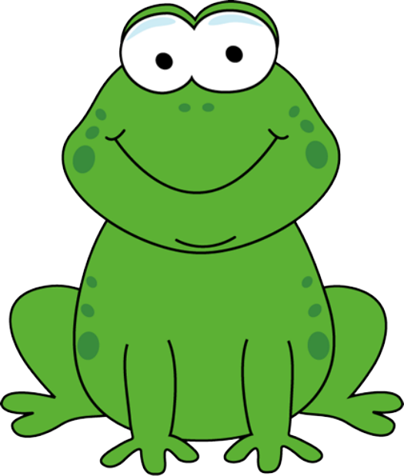
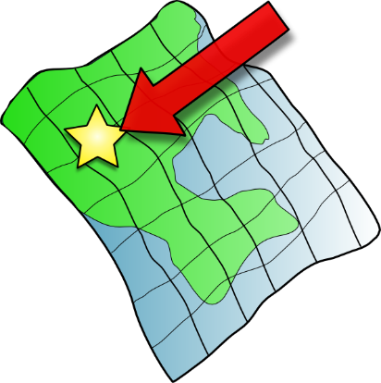
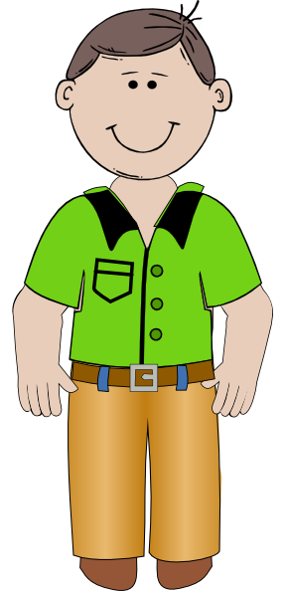
Term 1 week 1
Describing me and others
1
Rouge term 1
écouter
Écoute. Write the correct letter in each gap.
p h _ t _
_ d _ l t e
n _ t _ r e
1 | 2 | 3
4 | 5 | 6
7 | 8 | 9
s _ c _ n d
_ n _ m _ l
p _ b l _ c
_ c _
c _ l t _ r e
S _ l _ t
[here]
écouter
Écoute. What is it in English?
1
2
3
4
5
6
7
8
9
10
11
12
écrire
Écris.
1 Ana va _______________________
(Ana is going to speak).
2 Papa va _______________________
(Dad/Daddy is going to listen).
3 Ali va _______________________
(Ali is going to read).
5

Slide 8
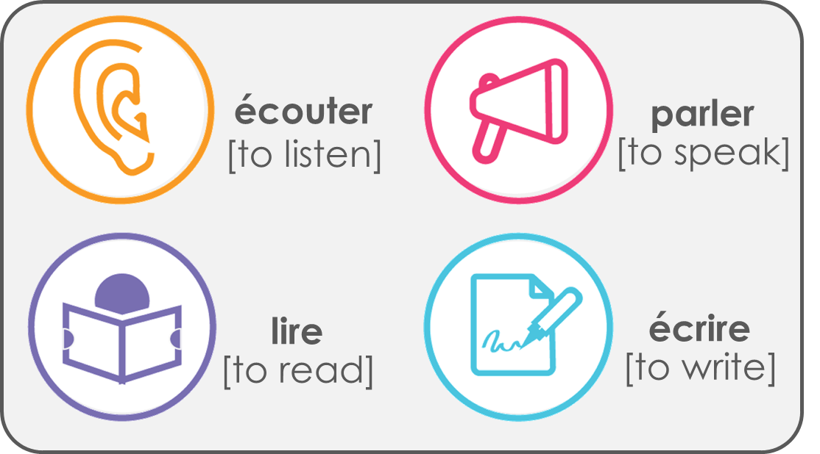
Term 1 week 2
Describing me and others
2
Rouge term 1
🎯
prononcer
Greeting
Understanding and responding to the register in class
[SFC -t]
petit
lire
Write down the key language for this week.
Bonjour ! |  | je suis
Salut ! |  | il est
ici |  | elle est
là |  | présent
être |  | absent
Bonjour ! (Hello!) is more formal than Salut ! (Hi!). You would say ‘Salut !’ to a friend and ‘Bonjour !’ to your teacher.
être
[to be | being]
grammaire
In French the verb être means ‘to be’.
I am, he is and she is are parts of the verb ‘to be’.
Je suis
I am
Il est
he is
elle est
she is
lire
Translate the examples.
➜
_______________________________.
Je suis ici.
Il est là.
_______________________________.
➜
Elle est là.
_______________________________.
➜
6

Slide 9
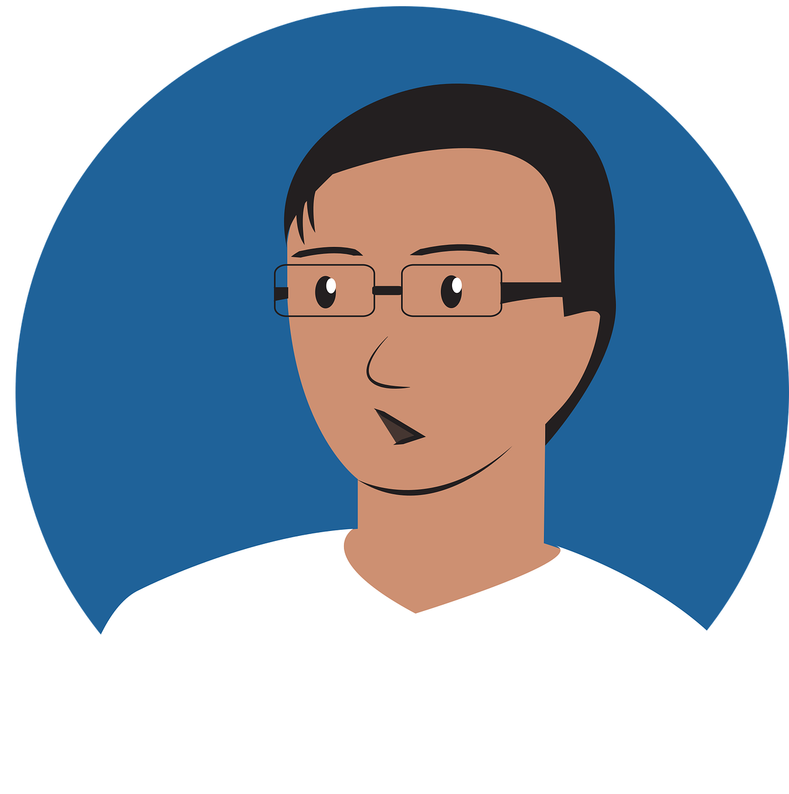
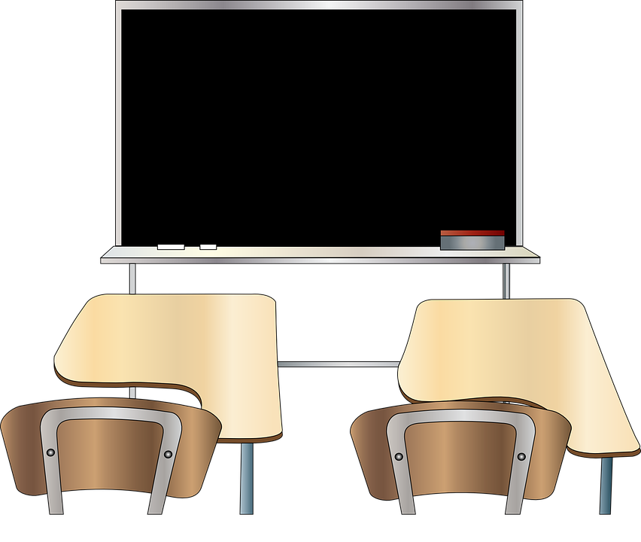
Term 1 week 2
Describing me and others
2
Rouge term 1
écouter
Écoute. Madame Vidal takes the register.
Écris.
 |  | Pupil (I) | Someone else (s/he)
Ex | Coralie
1 | Lara
2 | Marie-Laure
3 | Omar
4 | Charles
5 | Garice
6 | Océane
Verbe
suis
anglais
am
Madame Vidal =
Mrs Vidal
Using adjectives
grammaire
The spelling and sound of adjectives sometimes change.
We often add ‘e’ to the end for the feminine form.
Masculine
Je suis présent.
I (a boy) am present.
Il est absent.
He is absent.
Feminine
Je suis présente.
I (a girl) am present.
Elle est absente.
She is absent.
Pronounce the ‘t’.
lire
Monsieur Lemaire has also taken the register.
Ex | Adèle | Olivier | est présente.
1 | Anne | Milo | est présent.
2 | Lucas | Callie | est absent.
3 | Maxime | Hannah | est présente.
4 | Patrice | Naomie | est absente.
5 | Sophie | Oscar | est présent.
6 | Pascal | Mia | est absent.
7 | Odile | Ali | est présente.
8 | Charlotte | Amir | est présent.
Monsieur Lemaire =
Mr Lemaire
7

Slide 10
Term 1 week 2
Describing me and others
2
Rouge term 1
écouter
Écoute.
 | I or s/he? | boy or girl? | present or absent?
1 | I |  | present
2
3
4
5
6
7
8
Madame
Dior =
Mrs Dior
Monsieur Caput =
Mr Caput
écouter
Écoute. A. Circle the word that is mentioned.
E
present | here | present
lire
B. Write the number.
1
she is | I am | he is
présent ____ 4. ici ____
elle est ____ 5. là ____
présente ____ 6. je suis ____
2
absent | here | I am
3
there | here | Hi !
4
absent | present | present
5
hello | he is | there
écrire
Write the missing French word. Translate into English.
1 | Je [am] ici. suis
2 | [He] est là.
3 | [She] est absente.
4 | Il est [present].
5 | [I am] présente.
parler
You can
prepare your
answer first, and
practise saying it aloud a few times.
Be ready to respond to the register in French!
1 | Hello! I am here.
2 | [Name] is absent.
8

Slide 11
Term 1 week 3
Describing me and others
3
Rouge term 1
🎯
prononcer
Introducing yourself
Salut !
Saying goodbye
[SFC -s]
Intonation goes up  to mean ‘Hi!’
Asking questions
Salut !
[but]
Intonation goes down  to mean ‘Bye!’
mais
lire
Write down the key language for this week.
Ça va ? |  | oui
Ça va. |  | non
bien |  | Salut !
mal |  | Au revoir !
Asking questions
grammaire
To say I am, use je suis.
Je suis ici.
➜
Je suis ici ?
In French, change a statement into a question by raising your voice at the end.
I am here.
Am I here?
Il est là.
➜
Il est là ?
Notice that there is a space before a ? in French and also before a ! e.g. Salut !
He is here.
Is he here?
Elle est là.
➜
Elle est là ?
She is here.
Is she here?
.
écouter
Écoute Madame Vidal. Question ? or statement
Ex | Coralie est présente
1 | Lara est absente
2 | Omar est absent
3 | Charles est présent
4 | Garice est absent
5 | Marie-Laure est absente
6 | Océane est présente
Madame Vidal =
Mrs Vidal
9

Slide 12
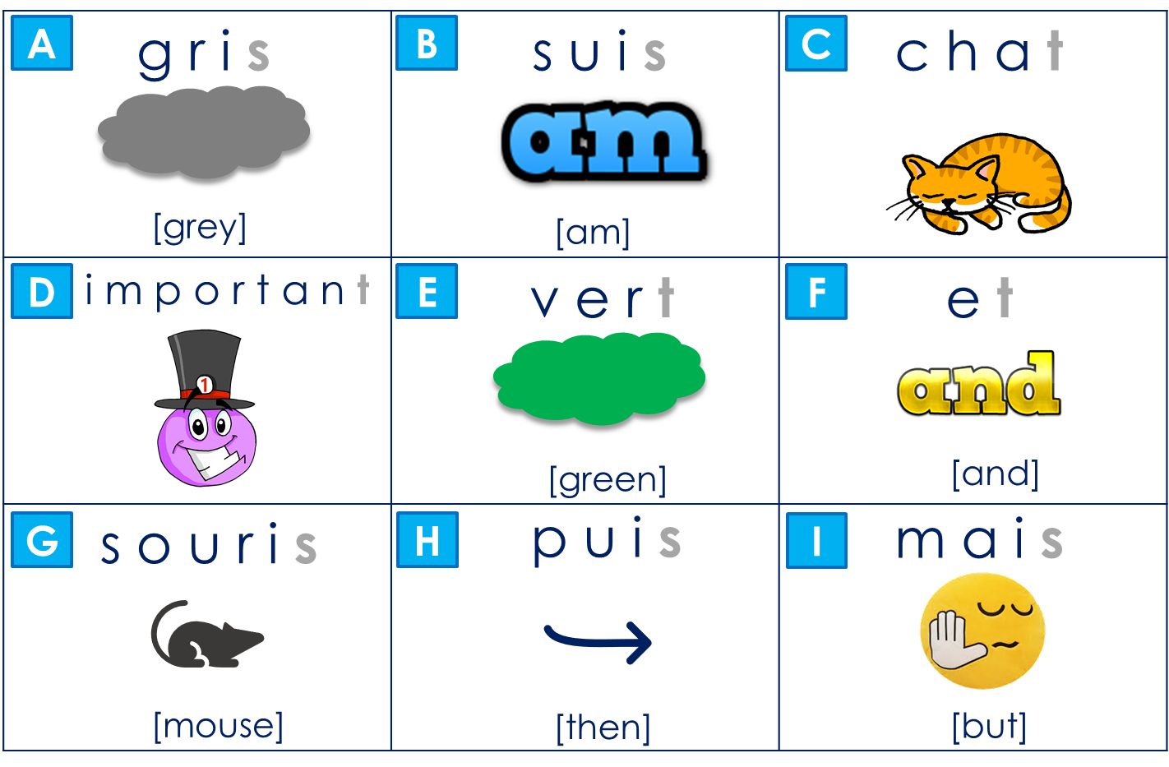
Term 1 week 3
Describing me and others
3
Rouge term 1
Introducing yourself
grammaire
To say who you are use je suis and your name.
Je suis Adèle.
➜
Je suis Adèle ?
Remember: you can turn statements into questions by raising your voice at the end.
I am Adèle.
Am I Adèle?
Il est Pierre.
➜
Il est Pierre ?
He is Pierre.
Is he Pierre?
Elle est Léa.
➜
Elle est Léa ?
She is Léa.
Is she Léa?
lire
Adèle gets lots of messages. What do they mean?
1
She is
Elle est ici ?
Is she
2
Am I
4
She is
Je suis là. ☺
I am
Elle est Mia.
Is she
3
He is
5
Is he
Il est absent ? ☹
Is he
Il est Marc ?
He is
écouter
Écoute. Écris la lettre correspondante.
1
2
3
4
5
6
7
8
9
10

Slide 13
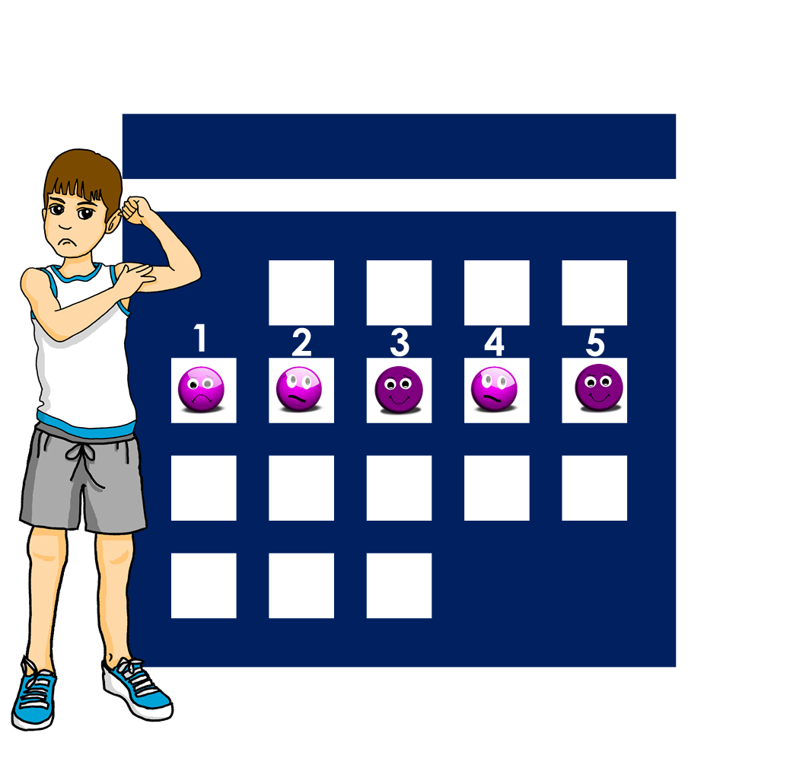
Term 1 week 3
Describing me and others
3
Rouge term 1
lire
Jean-Michel is too busy to write much in his diary.
Lis les phrases. Draw an emoji for each sentence.
1
Ça va bien.
2
Ça va.
Au revoir !
3
Ça va bien.
4
Ça va mal.
Oui.
Non.
5
Ça va.
écouter
Écoute. Écris la bonne lettre*.
la bonne lettre = the correct letter
1
2
3
4
5
6
A | Ça va ?
B | Ça va bien ?
C | Ça va mal ?
Madame
Dior =
Mrs Dior
écrire
Yves is having a hard week. He does a mood chart. Write a French phrase to describe how each day goes.

1
2
3
4
5




11

Slide 14
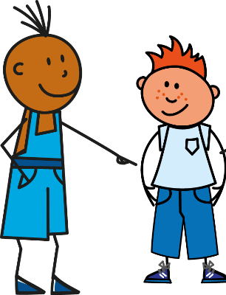
Term 1 week 4
Describing me and others
4
Rouge term 1
🎯
prononcer
Describing myself
Describing someone else
[an/en]
[SFC -d]
[child]
enfant
grand
lire
Write down the key language for this week.
petit |  | content
grand |  | triste
anglais |  | tu es
français
être
[to be | being]
grammaire
Remember, the verb être means ‘to be’.
je suis
I am
il est
he is
elle est
she is
You are is also part of the verb ‘to be’:
tu es
you are
lire
Translate the example.
Je suis ici mais tu es là.
➜
_______________________________.
lire
Complete the speech bubbles in English.
I am 1.____, 2. _________, 3. __________
Tu es français. | Tu es triste.
Tu es petit. | Je suis content.
Je suis grand. | Je suis français.
Yves
Pierre
You are 1._______, 2. _________, 3. __________
12

Slide 15
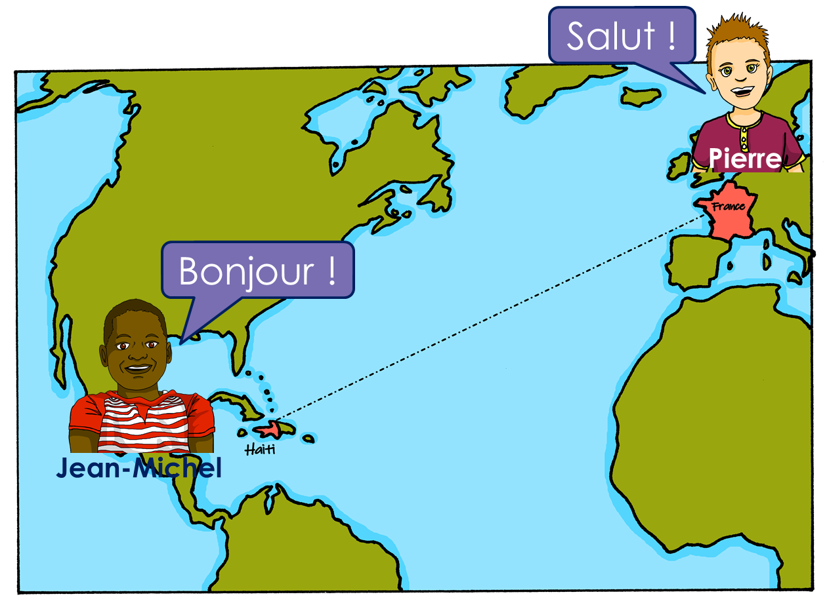
Term 1 week 4
Describing me and others
4
Rouge term 1
écouter
Écoute. Pierre parle à Jean-Michel.
 | You are… | I am… | ?
1
2
3
4
5
6
Pierre
lire
Écris en anglais. Can you get at least 15 points?
 | banane | moto | écouter
 | univers | cheval | midi
 | oui | bien | ça va ?
 | non | Au revoir ! | mal
 | petit | anglaise | content
 | tu | français | triste
 | grande | contente | es
vocabulaire
x3
x2
x1
écouter
Écoute. Which name has the SSC [an/en]?
1
2
3
4
Ange | Anne
André | Denis
Jeanne | Alexandre
Marianne | Laurence
5
6
7
8
Antoine | Stéphane
Henri | Alain
Jean | Gabin
Nathan | Hannah
13

Slide 16
Term 1 week 4
Describing me and others
4
Rouge term 1
lire
Monsieur Lemaire is asking questions, but to a boy or girl?
Ex. | Adèle | Olivier | tu es contente ?
1 | Anne | Milo | tu es français ?
2 | Lucas | Callie | tu es content ?
3 | Maxime | Hannah | tu es anglaise ?
4 | Patrice | Naomie | tu es petite ?
5 | Sophie | Oscar | tu es grand ?
6 | Pascal | Mia | tu es petit ?
7 | Odile | Ali | tu es grande ?
8 | Charlotte | Amir | tu es triste ?
Monsieur Lemaire =
Mr Lemaire
écouter
Écoute. Who is Pierre talking to?
1 | Adèle | Yves
2 | Jean-Michel | Adèle
3 | Adèle | Yves
4 | Yves | Adèle
5 | Adèle | Yves
6 | Adèle | Jean-Michel
Adèle
Yves
Jean-Michel
écrire
Écris. Complete each English sentence with an adjective. Then write your sentence in French.
1 _____________________________
Decide if you are talking to a boy or a girl.
(You are ____________).
2 _____________________________
Here talk about you.
(I am ____________).
How do you write the adjective to describe ‘she’?
3 _____________________________
(She is____________).
14

Slide 17
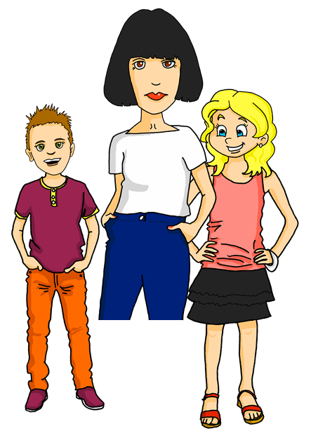
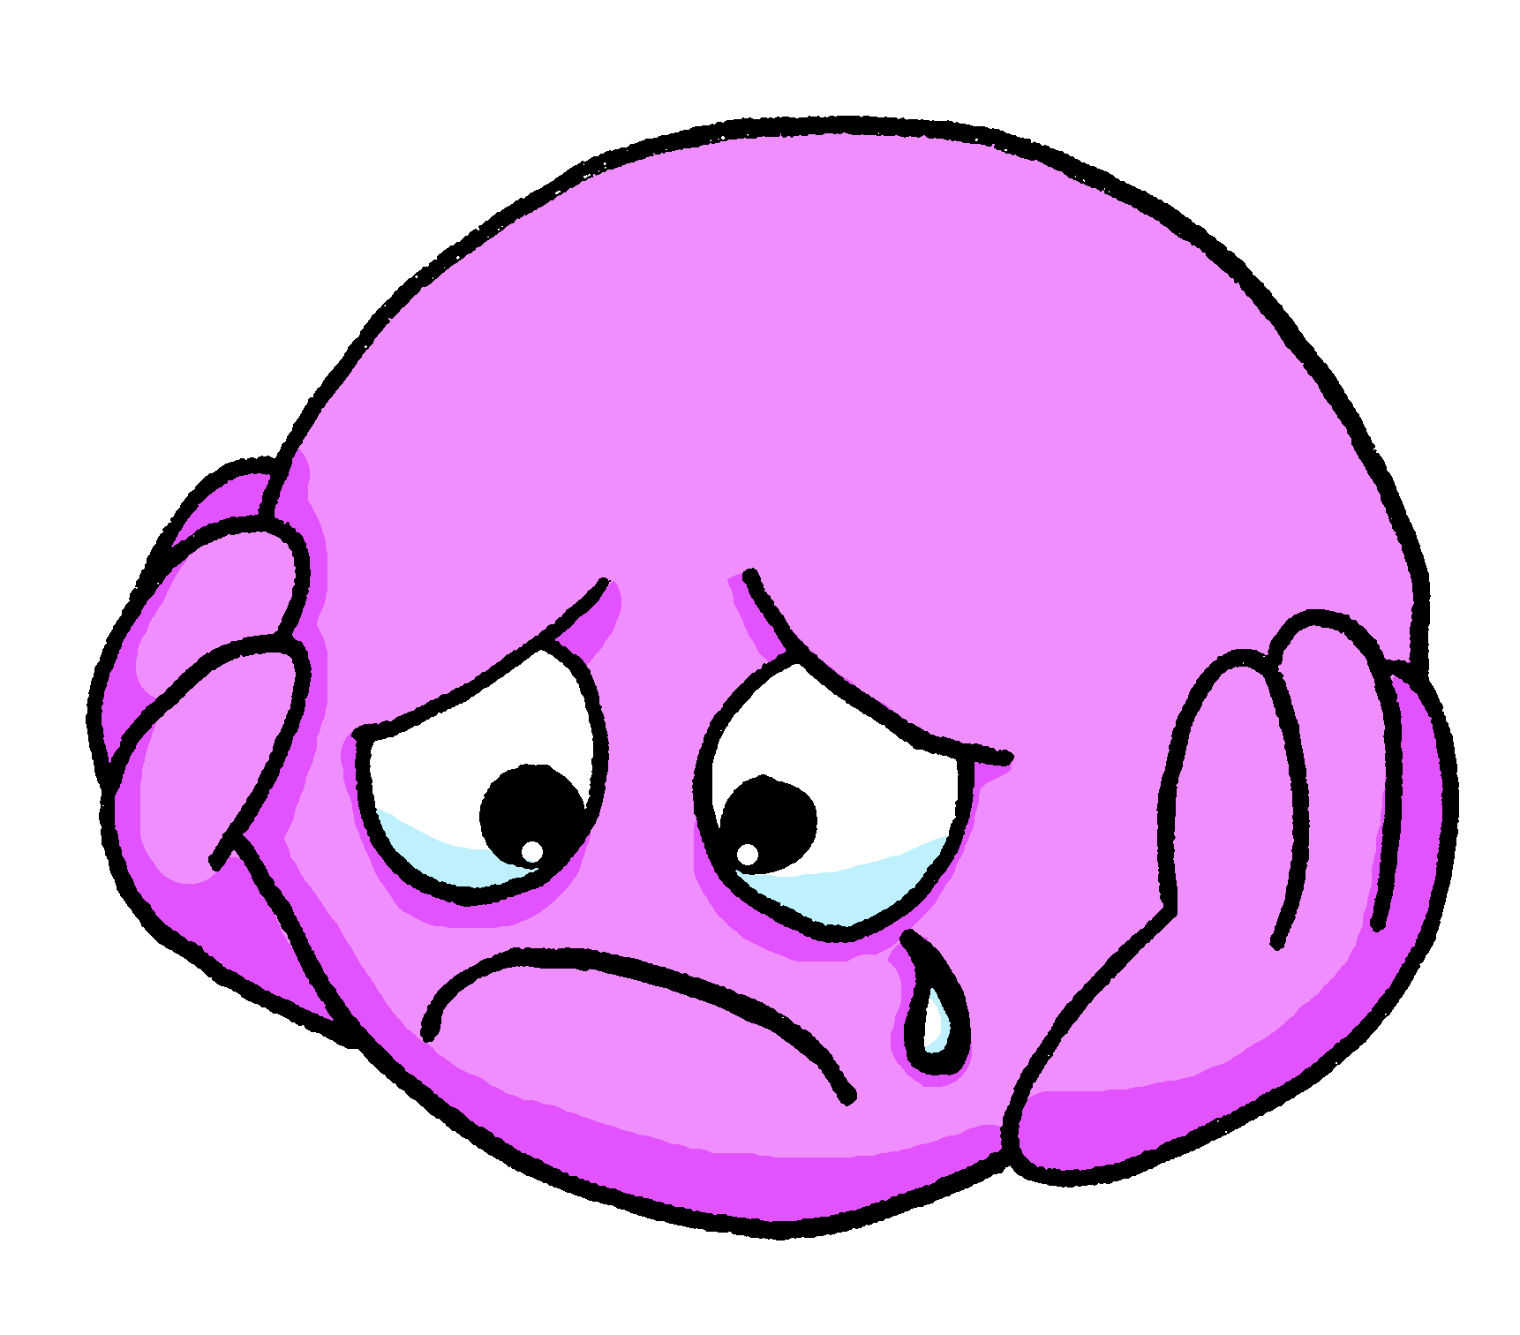
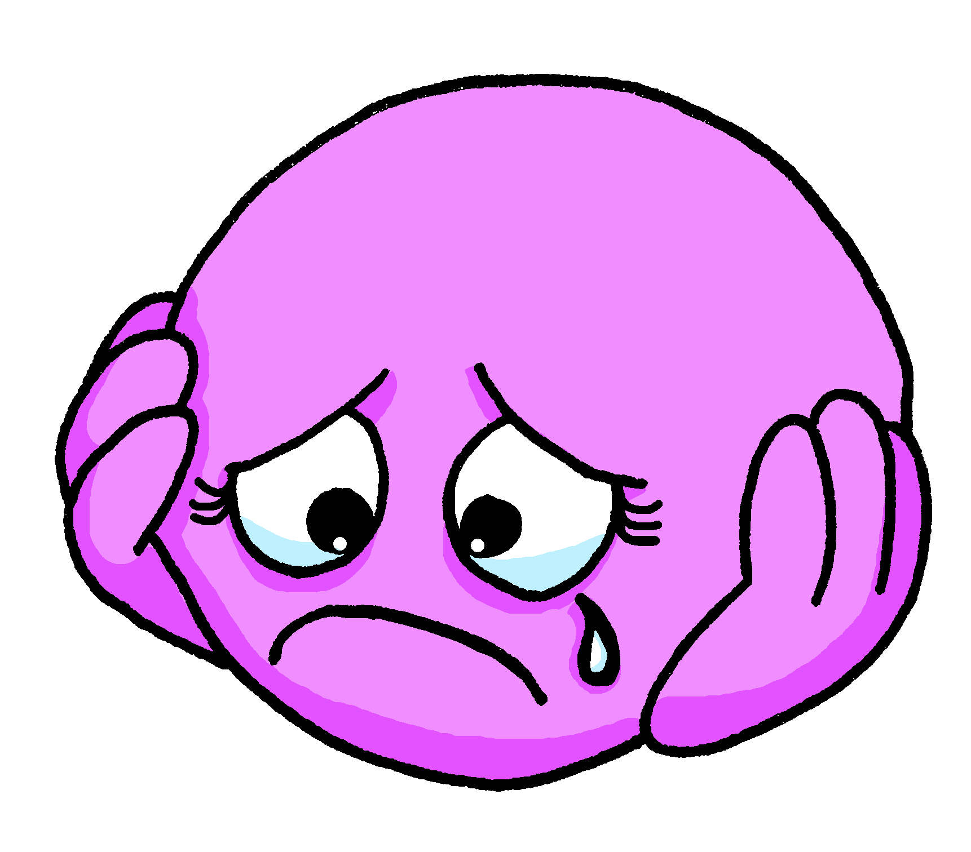
Term 1 week 5
Describing me and others
5
Rouge term 1
🎯
prononcer
Describing someone else
[an/en]
[a]
Asking questions
Voici Claudine, la maman de Pierre et Adèle.
maman
[child]
This word has the oral vowel [a] and nasal vowel in [an]
enfant
banane
lire
Write down the key language for this week.
amusant |  | malade
calme |  | méchant
intelligent
Pronounce the ‘t’ at the end of triste because of the ‘e’.
Using adjectives
grammaire
The spelling and sound of adjectives ending in e do not change.
Masculine
Je suis triste.
I (a boy) am sad.
Tu es triste.
You (a boy) are sad.
Il est triste.
He is sad.
Je suis triste.
I (a girl) am sad.
Feminine
Tu es triste.
You (a girl) are sad.
Elle est triste.
She is sad.
écouter
Écoute. Écris . Then write the adjective in English.
 | A (male) | B (female) | ?
1
2
3
4
5
6
7
8
15

Slide 18
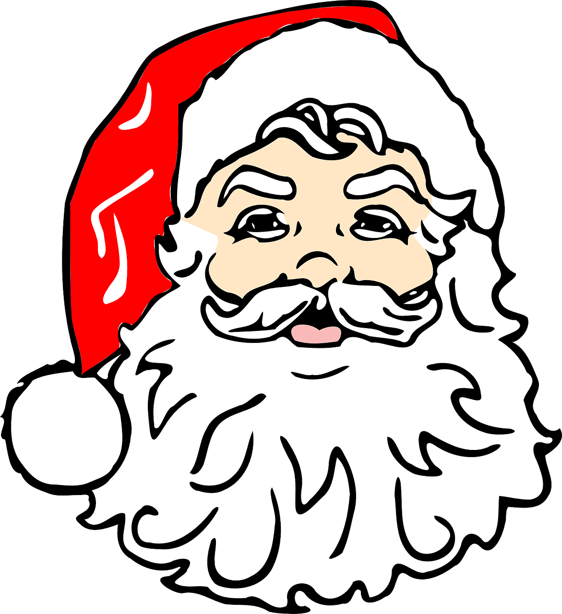
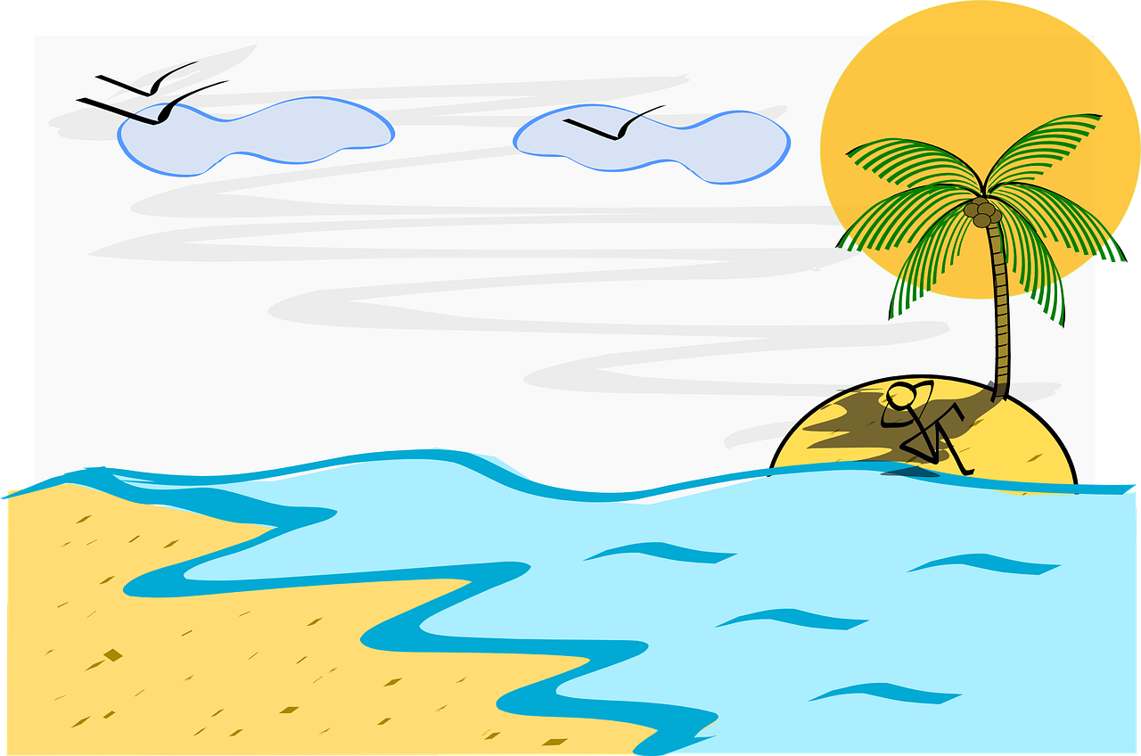
Term 1 week 5
Describing me and others
5
Rouge term 1
lire
Lis le texte. Léa (a girl) or Yves (a boy) or either?
aujourd’hui – today maintenant – now
Léa est petite.
Écris :
Léa, Yves ou les deux ?
Yves est français.
adjectif | Léa | Yves | either | anglais
petite
Léa est triste.
short
Yves est malade aujourd’hui.
Léa est intelligente.
Yves est calme maintenant.
lire
Lis. Quel est l’intrus ?
l’intru = the odd one out
1
2
3
4
5
6
amusant | grande | méchant
amusant | méchante | intelligente
calme | intelligent | malade
triste | amusant | calme
malade | calme | intelligente
triste | grand | amusante
écouter
Écoute. Does the word have [an/en]?
 |  |  |  | en anglais
1
2
3
4
5
6
7
8
16

Slide 19
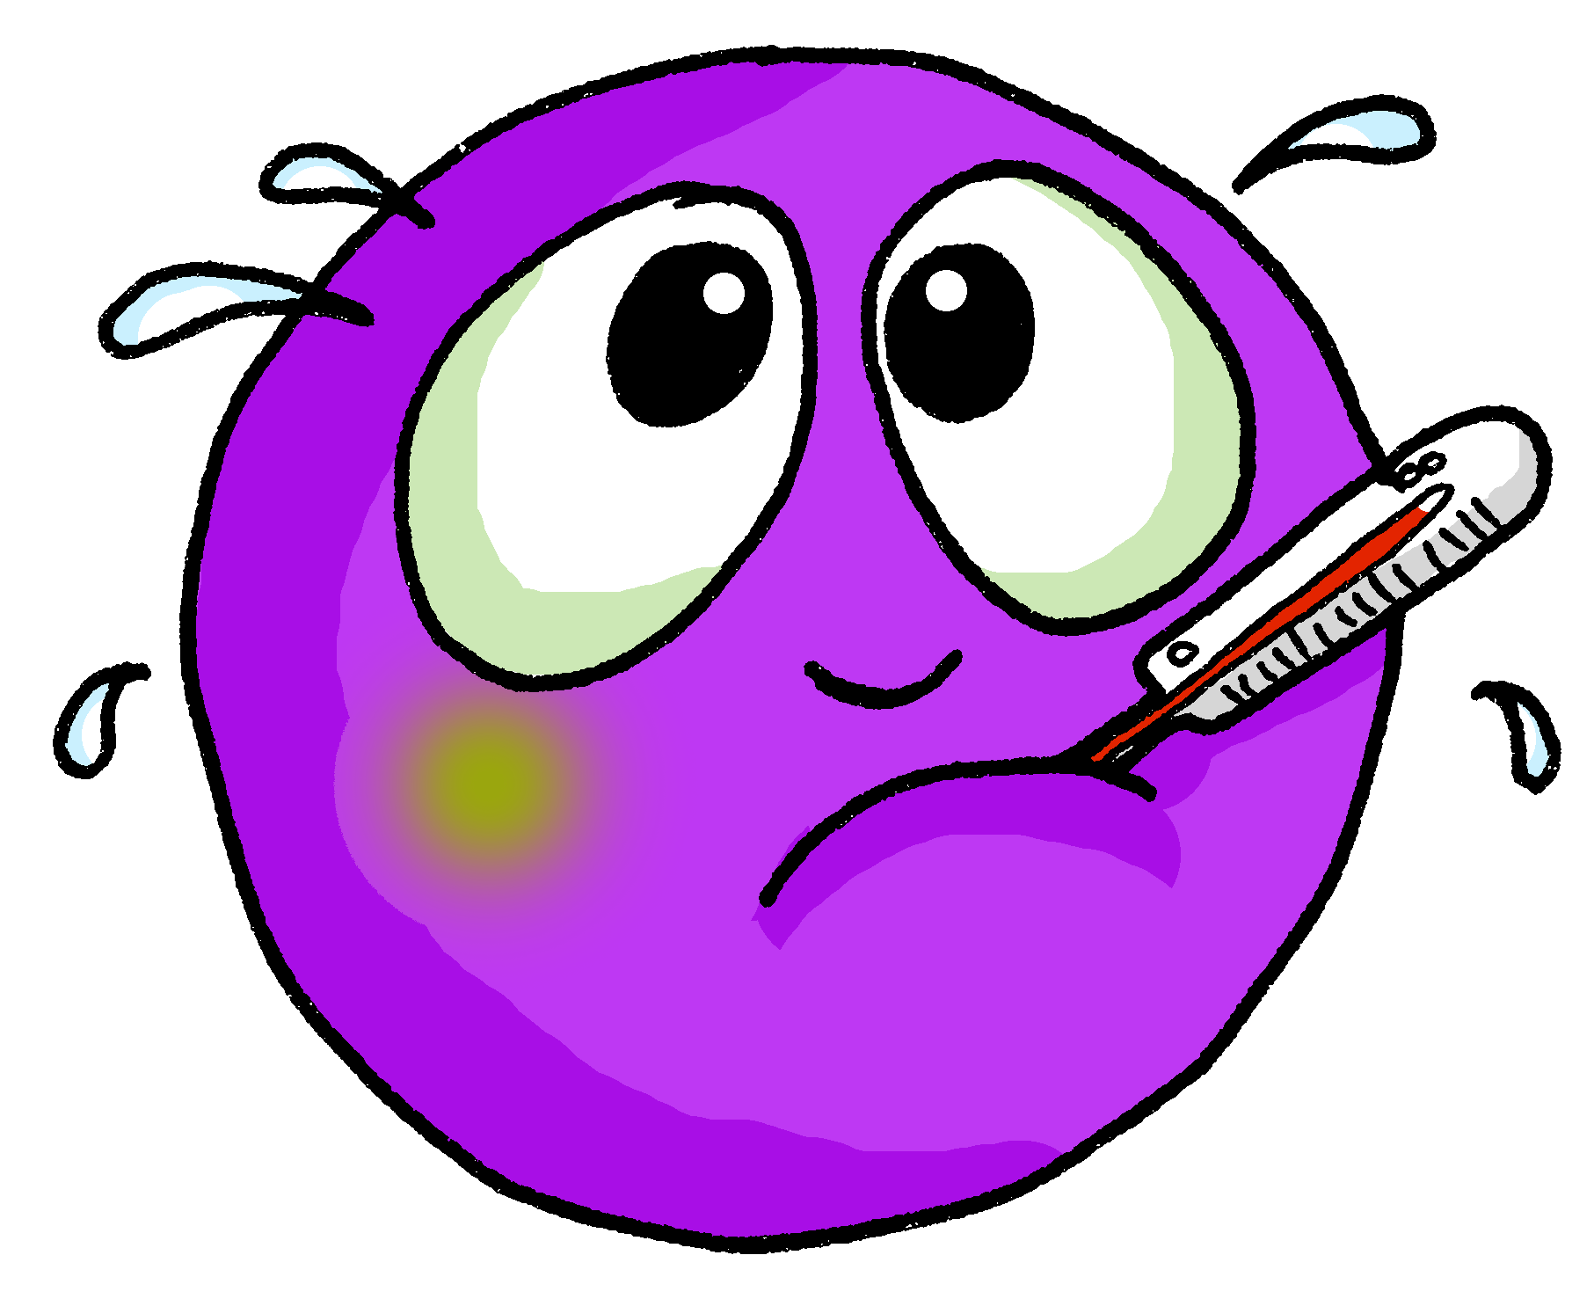
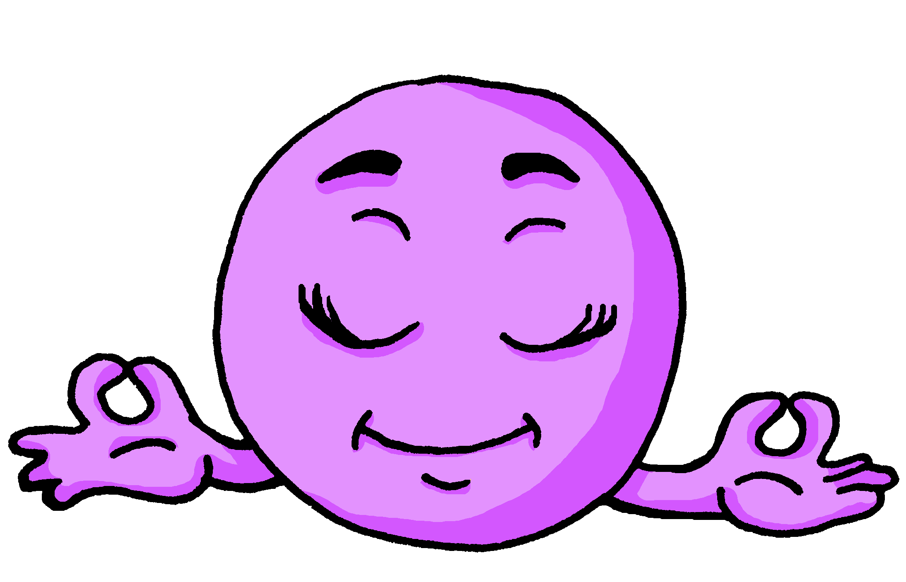
Term 1 week 5
Describing me and others
5
Rouge term 1
écouter
A. Écoute. Tick I, you, he or she. Write . or ?
.
 | I | You | She | He
Ex.
1
2
3
4
5
6
B. Écris le numéro.
.
sad | ______
short | ______
amusing | ______
tall | ______
English | ______
parler
Écoute. Write M (male), F (female) or M/F (could be either).
1
2
3
4
5
6
Write your favourite words in French, here.
vocabulaire
écrire
Écris. Complete each English sentence with an adjective. Then write your sentence in French.
1 _____________________________
4 _____________________________
(He is ____________).
(He is ____________).
2 _____________________________
5 _____________________________
(She is ____________).
(She is____________).
3 _____________________________
(She is____________).
17

Slide 20
Term 1 week 6
Describing me and others
6
Rouge term 1
🎯
prononcer
Saying what day of the week it is today
[SFC -x]
[eu]
Ce means it. Ce est (it is) becomes c’est to make it easier to say.
deux
jeu
lire
Write down the key language for this week.
aujourd’hui |  | jeudi
ce, c’ |  | vendredi
lundi |  | samedi
mardi |  | dimanche
mercredi
être
[to be | being]
grammaire
Remember, the verb être means ‘to be’.
C’est
It is
➜
It is is also part of the verb ‘to be’:
lire
Translate the examples.
C’est ici ?
_______________________________.
➜
Oui, c’est ici.
_______________________________.
➜
Non, c’est là !
_______________________________.
➜
Make any gesture. Your partner pronounces the day.
18

Slide 21
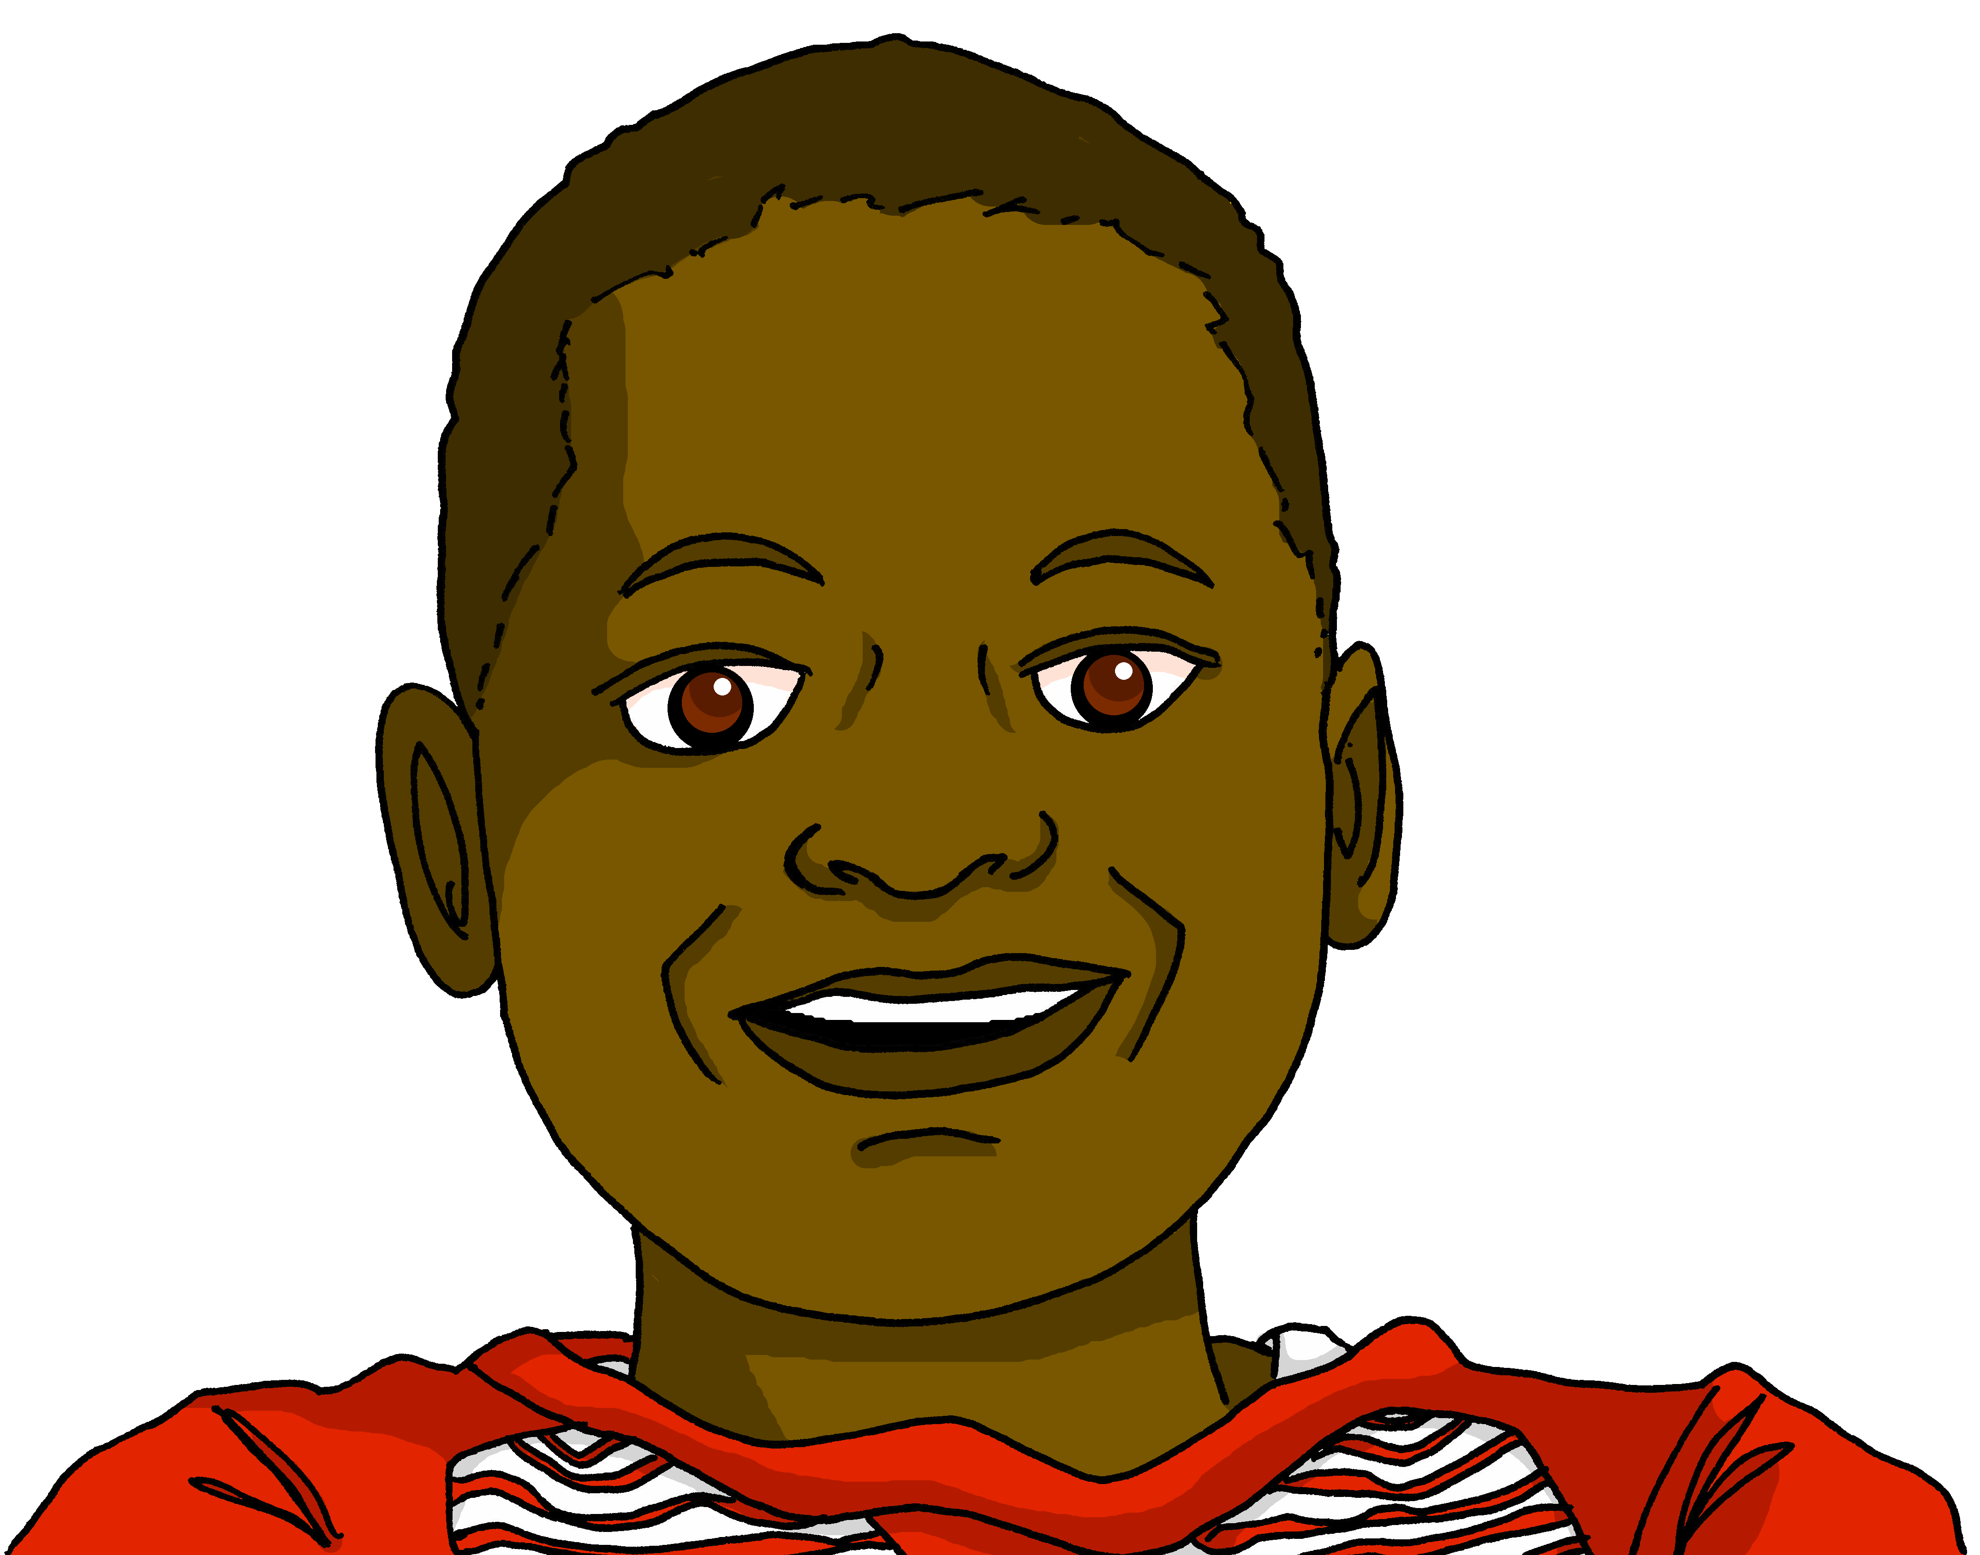
Term 1 week 6
Describing me and others
6
Rouge term 1
lire
Lis les messages de Pierre et Jean-Michel. Complète en anglais.
Jean-Michel, c’est lundi ?
Jean-Michel, ________ Monday?
Non, c’est dimanche !
_____, it’s _____________!
Jean-Michel, c’est mercredi ?
Non ! Aujourd’hui, c’est mardi !
No! __________ _______ Tuesday!
Jean-Michel, c’est vendredi ?
Jean-Michel, ________ __________?
Non ! Ici, c’est jeudi !
No! _______ it’s _____________!
Jean-Michel, c’est samedi ?
Jean-Michel, ________ ________?
Oui ! C’est samedi, à midi ! C’est le weekend. Hourra !
_____! ____ Saturday, at midday! _______ the weekend. Hurrah!
écouter
A. Écoute. Does the word have [eu] or [an|en] or both?
 | [eu] | [an|en]
Ex.
1
2
3
 | [eu] | [an|en]
4
5
6
quel mot – which word
écouter
A. Écoute. C’est quel mot ?
Ex.
1
2
3
I am | he is | you are
4
5
6
Friday | Saturday | Sunday
Monday | Tuesday | Thursday
day | today | there
today | Friday | Thursday
I am | you are | she is
you are | she is | it is
19

Slide 22
Term 1 week 6
Describing me and others
6
Rouge term 1
écouter
Use the correct words to write the sentences you hear.
Ex.
1
2
3
4
c’
samedi
es
aujourd’hui
est
Aujourd’hui, c’est samedi.
c’
mardi
est
mercredi
ici
c’
lundi
es
aujourd’hui
est
suis
contente
je
aujourd’hui
Bonjour, tout le monde ! Aujourd’hui, c’est…?
est
vendredi
c’
aujourd’hui
écouter
Écoute. Madame Vidal parle. C’est lundi ?
Ex. | Tuesday | Wednesday | Monday | Thursday
1 | Wednesday | Friday | Sunday | Saturday
2 | Tuesday | Sunday | Wednesday | Thursday
3 | Wednesday | Saturday | Monday | Friday
4 | Thursday | Monday | Sunday | Tuesday
5 | Sunday | Monday | Tuesday | Saturday
écrire
Écris : Lotto Write a French word from this week into each square.
yes | Thursday
no | Friday
it | Saturday
today | Sunday
is | How’s it going?
Monday | well/good
Tuesday | badly
Wednesday | Goodbye
20

Slide 23
Term 1 week 7
Describing me and others
7
Rouge term 1
🎯
prononcer
Describing someone else
[SFC -x]
[eu]
Most of our key language this week has these SSC.
deux
jeu
lire
Write down the key language for this week.
une semaine |  | heureux
courageux |  | sérieux
curieux
Using adjectives
grammaire
Adjectives ending in -eux change to –euse to describe feminine nouns.
Masculine
Je suis sérieux.
I (a boy) am serious.
Tu es sérieux.
You (a boy) are serious.
Il est sérieux.
He is serious.
Je suis sérieuse.
I (a girl) am serious.
Feminine
Tu es sérieuse.
You (a girl) are serious.
Elle est sérieuse.
She is serious.
lire
Lis le texte. C’est Léa ou Yves ou les deux ?
maintenant – now les deux – both
adjectif | Léa | Yves | either | anglais
courageuse
brave
21

Slide 24
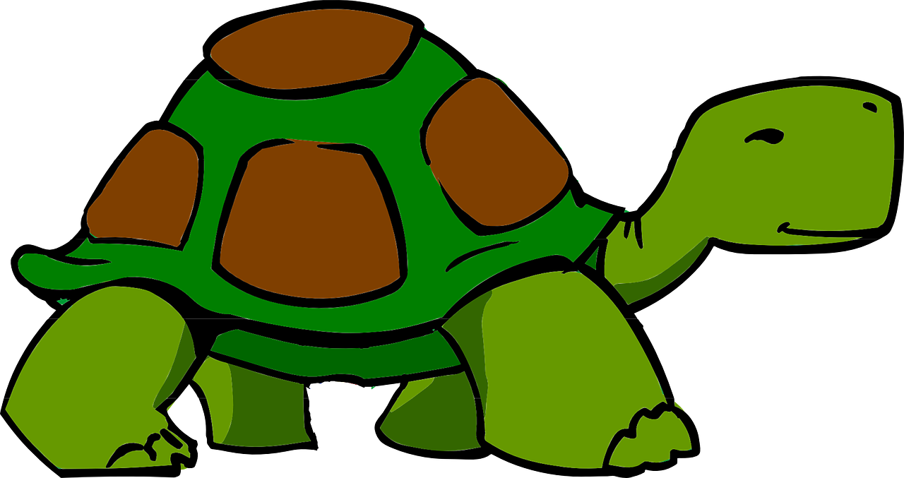
Term 1 week 7
Describing me and others
7
Rouge term 1
écouter
Écoute. Adèle parle. Écris en français.
C’est Lulu la tortue (female) ou Chouchou (male) ?
1
2
3
4
5
6
______ est _____________.
Now write the descriptors in English.
______ est _____________.
lire
______ est _____________.
Chouchou
Lulu
______ est _____________.
……………………………………………………....
______ est _____________.
……………………………………………………....
______ est _____________.
écouter
Écoute. Are they describing a masculine or feminine noun?
 |  |  | en anglais
Ex. |  |  | mysterious
1
2
3
4
5
6
écouter
Masculine or feminine?
1 | happy (f) | happy (m)
2 | curious (m) | curious (f)
3 | French (m) | French (f)
4 | serious (f) | serious (m)
5 | short (m) | short (f)
6 | brave (m) | brave (f)
écrire
Write a phrase stating the day of the week, and another phrase to describe how you are.
Aujourd’hui, c’est lundi.
Je suis _______
22

Slide 25
Term 1 week 8
Saying what I and others have
8
Rouge term 1
🎯
prononcer
Identifying things
When a ‘t’ is followed by a vowel you often pronounce it.
This is called liaison.
[un]
Liaison [t]
C’est un jeu.
[a/an, one]
un
lire
Write down the key language for this week.
un |  | un jeu
une |  | une orange
un ballon |  | une peluche
une bouteille |  | un sac
un cahier |  | un stylo
Gender
grammaire
Indefinite articles: a/an
In French, things as well as people and animals, are either masculine or feminine. We say that they have gender.
To say a (or an) in French use un before a masculine and une before a feminine noun.
écouter
Écoute. Écris un ou une. Then write the missing letters.
 | un / une | français | anglais
1 |  | s _ c | bag
2 |  | b a l l _ _ | ball
3 |  | o r _ _ g e | orange
4 |  | j _ _ | game
5 |  | p e l _ c h e | cuddly toy
6 |  | b _ _ t e i l l e | bottle
7 |  | s t y l _ | pen
8 |  | c a h _e r | exercise book
23

Slide 26
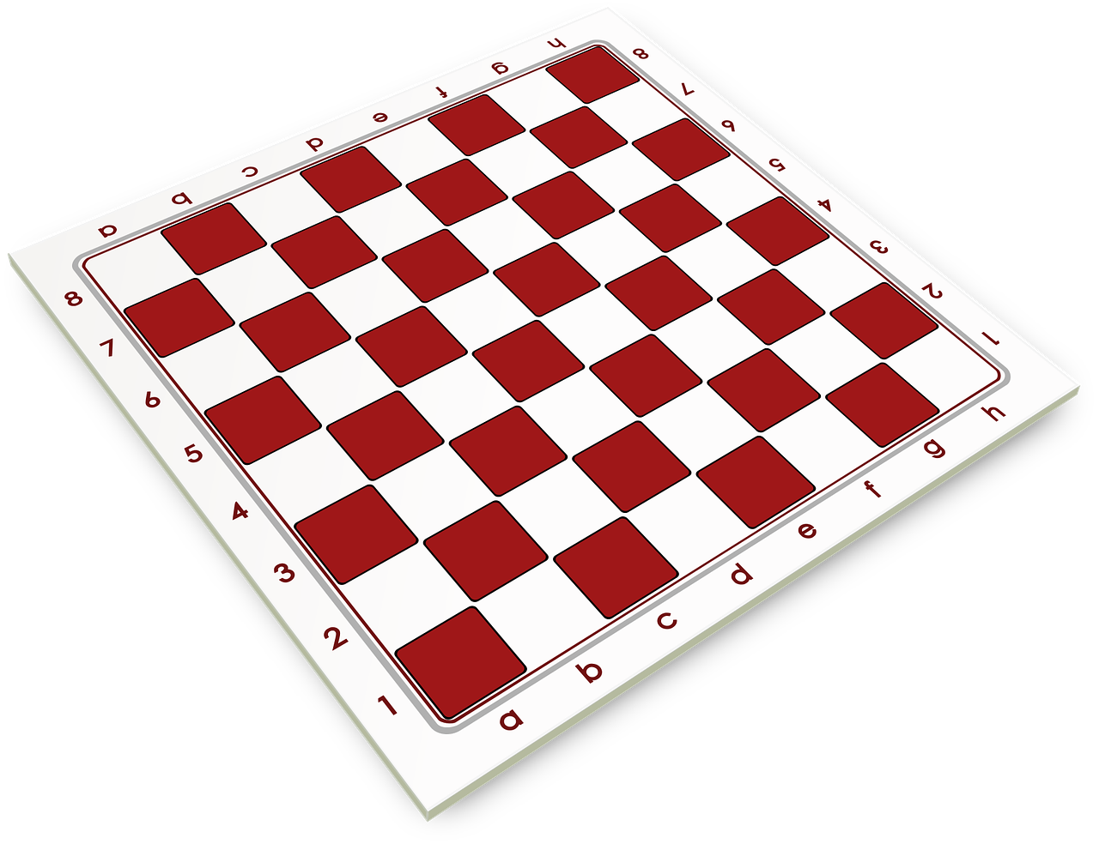
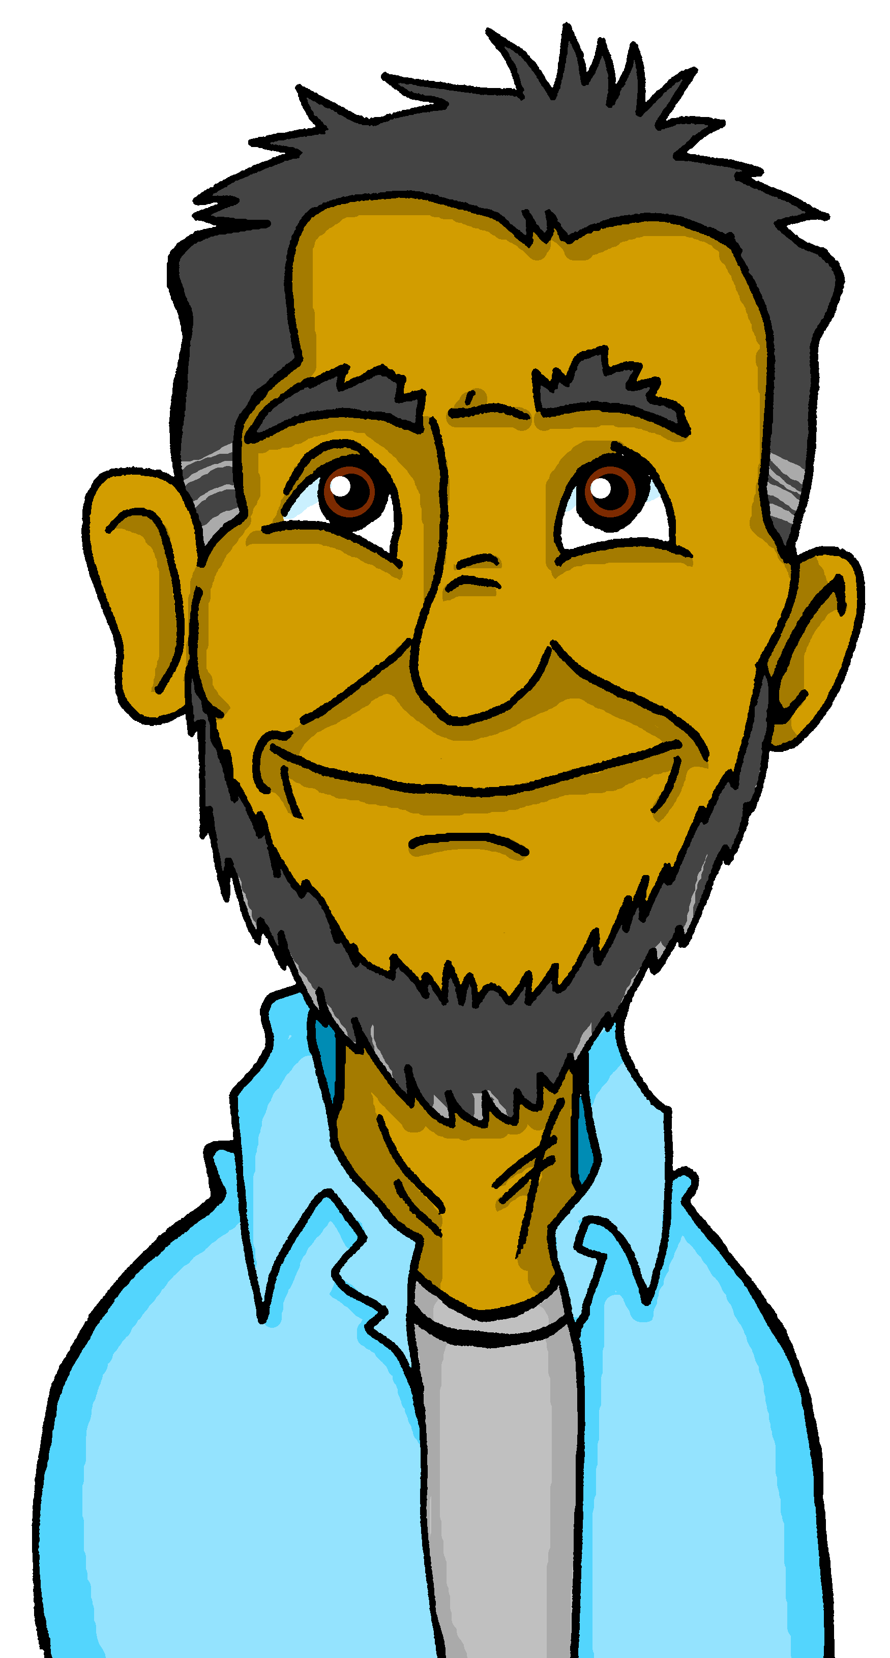
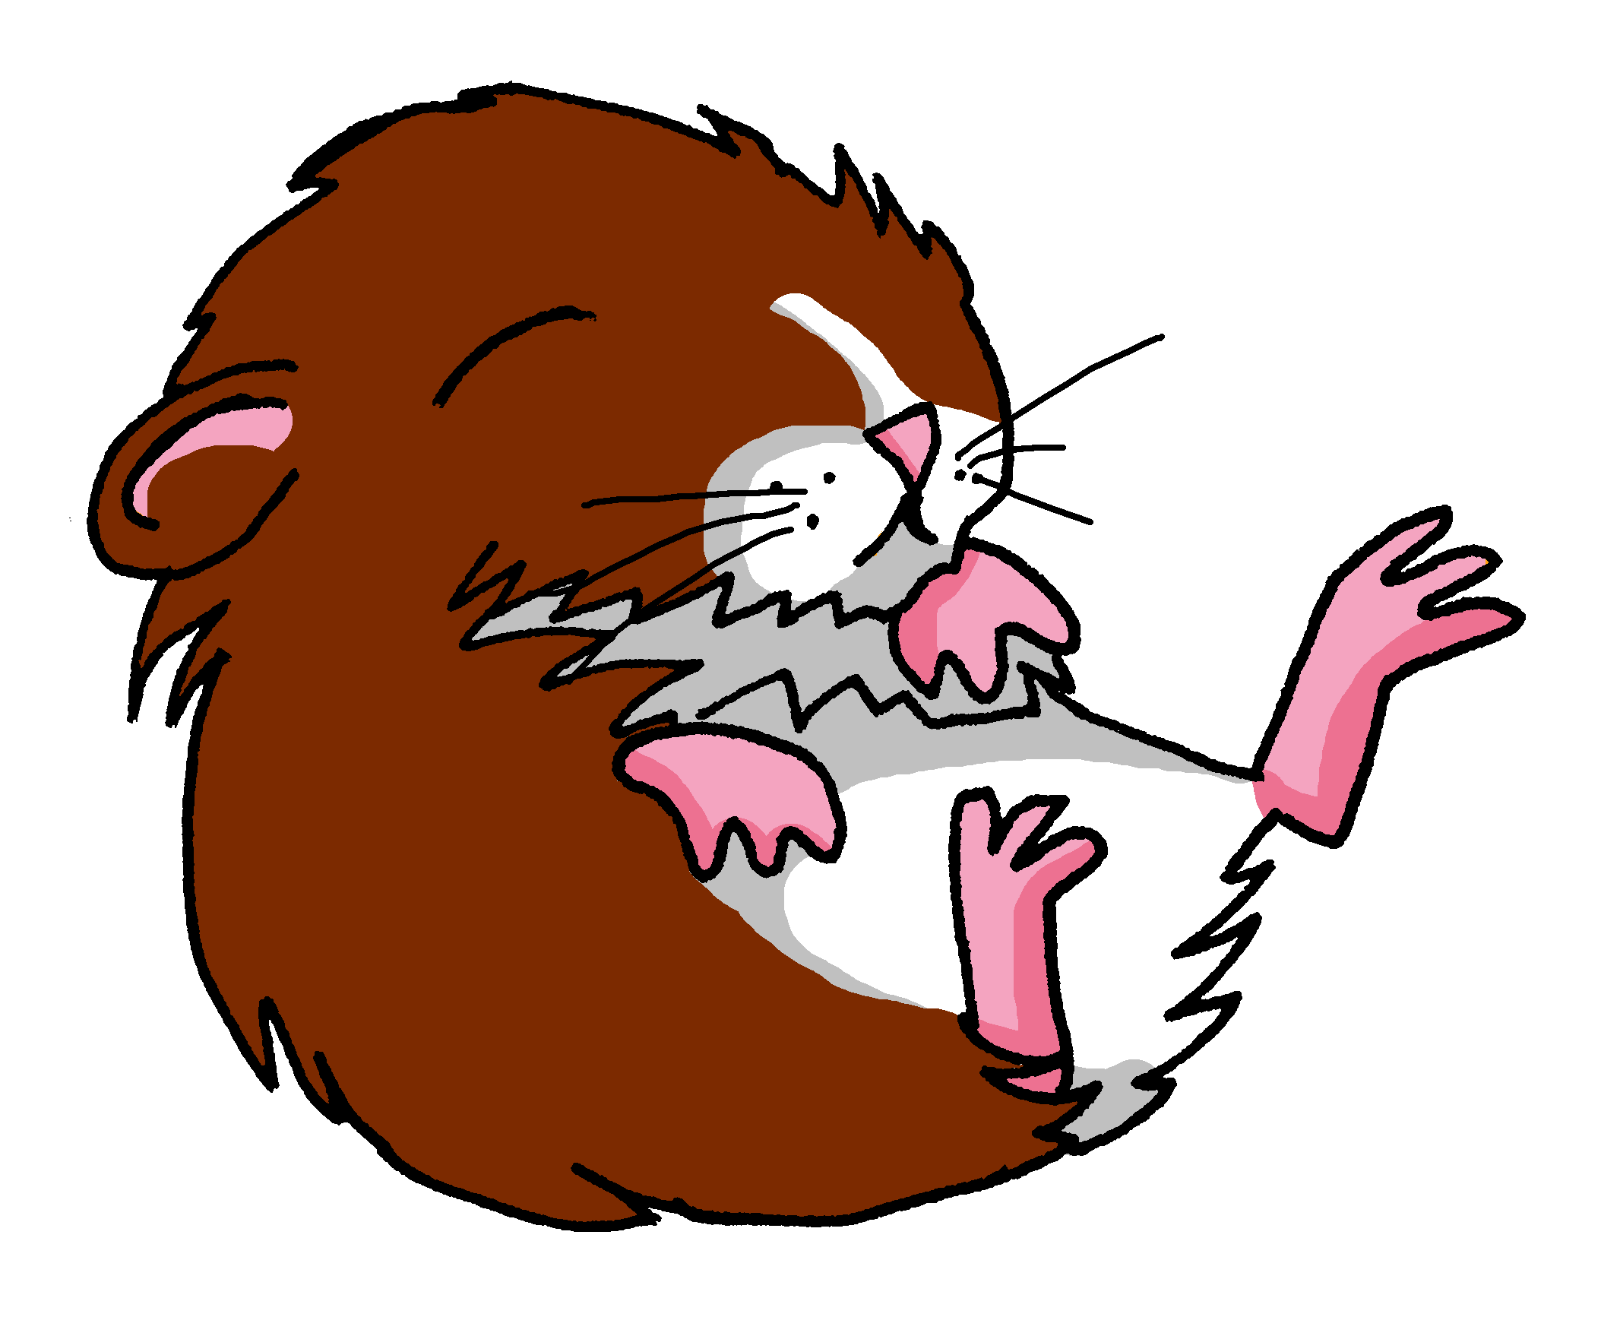
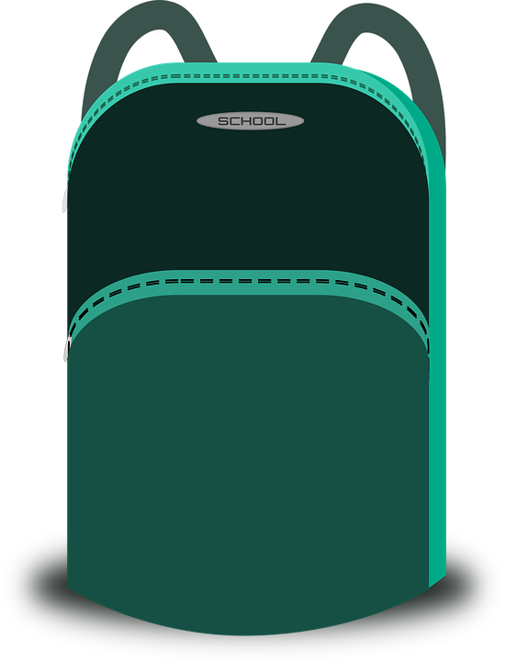
Term 1 week 8
Saying what I and others have
8
Rouge term 1
écouter
Écoute. Choose the correct end of the sentence.
1
2
3
4
5
6
C’est…
[sad]
[person]
[funny]
C’est…
C’est…
[curious]
[teacher]
C’est…
[small]
C’est…
[tall]
[animal]
C’est…
[bluel]
parler
Person A. (Person B – turn to the next page.)
Start each sentence. Pronounce the –t when it’s bold, otherwise for a Silent Final Consonant.
Now your turn to listen to your partner. Do you hear –t? If so, choose and say the sentence ending which starts with a vowel.
1 | C’est… (It is …………………).
2 | C’est… (It is …………………).
3 | C’est… (It is …………………).
4 | C’est… (It is …………………).
5 | C’est… (It is …………………).
6 | C’est… (It is …………………).
1 | …lundi. | …une peluche.
2 | …un ballon. | curieux.
3 | …une orange. | …triste.
4 | …mercredi. | …un jeu.
5 | …vendredi. | …un stylo.
6 | …grand. | …une bouteille.
C’est une peluche ?
3 _____________________________
C’est une orange ?
4 _____________________________
écrire
Écris des réponses.
C’est mardi ?
5 _____________________________
FRI
C’est une banane ?
C’est un cahier ?
1 _____________________________
6 _____________________________
C’est un jeu ?
2 _____________________________
24

Slide 27
Term 1 week 8
Saying what I and others have
8
Rouge term 1
parler
Person B. (Person A on previous page.)
Listen to your partner. Do you hear –t? If so, choose and say the sentence ending which starts with a vowel.
Now you start each sentence. Pronounce the –t when it’s bold, otherwise for a Silent Final Consonant.
1 | …un sac. | …dimanche.
2 | …sérieux. | aujourd’hui.
3 | …calme. | …un cahier.
4 | …une peluche. | …samedi.
5 | …une semaine. | …dangereux.
6 | …amusant. | …petit.
1 | C’est… (It is …………………).
2 | C’est… (It is …………………).
3 | C’est… (It is …………………).
4 | C’est… (It is …………………).
5 | C’est… (It is …………………).
6 | C’est… (It is …………………).
lire
Écris en anglais : Can you get at least 15 points?
vocabulaire
 | malade | calme | intelligente
 | méchant | amusante | méchante
 | oui | une banane | intelligent
 | non | amusant | un ballon
 | une bouteille | une orange | un jeu
 | un sac | un | une
 | un stylo | une peluche | un cahier
x3
x2
x1
25

Slide 28
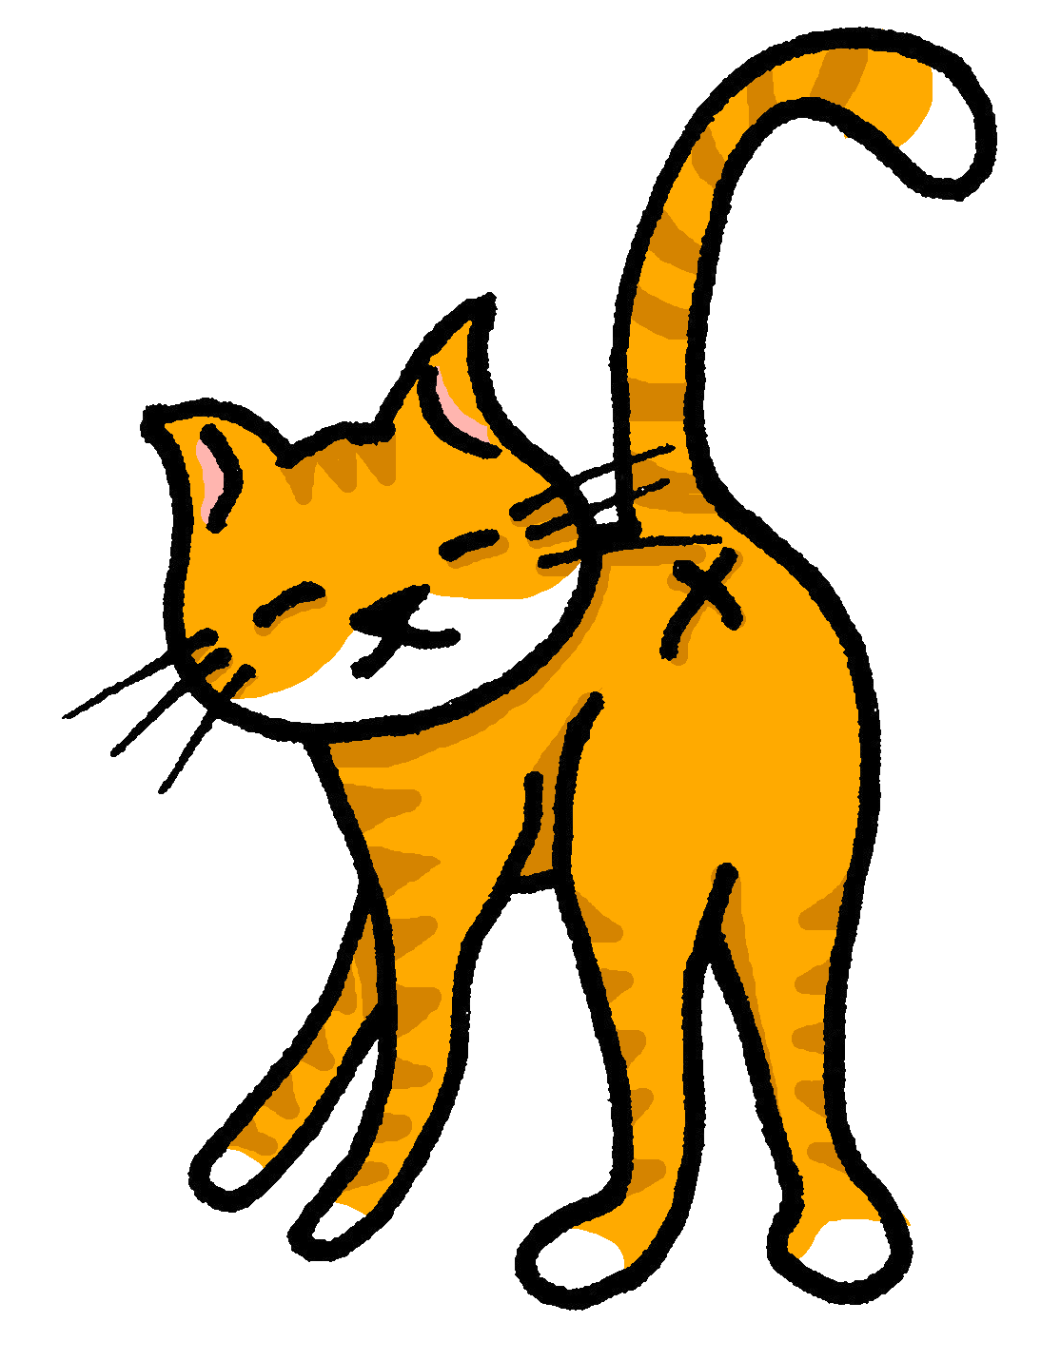
Term 1 week 9
Saying what I and others have
9
Rouge term 1
🎯
prononcer
If you have a different pet, write the French word for it, here.
Saying what I have and someone else has
[ch]
Asking what questions
[to look for]
chercher
lire
Write down the key language for this week.
avoir |  | un animal
j’ai |  | un chien
il a |  | un chat
elle a |  | une photo
quoi |  | ou
vocabulaire
Asking questions
grammaire
Remember! To change a statement into a yes/no question, raise your voice at the end.
C’est un chat.
C’est un chat ?
Non, c’est un chien.
It’s a cat.
Is it a cat?
No, it’s a dog.
To ask an information question (e.g., what?) raise your voice and put a question word at the end:
➜
It’s a cat.
➜
C’est un chat.
C’est quoi ?
What is it?
In English, we put the question words at the start.
lire
C’est ‘un’ ou ‘une’ ?
peluche
animal
cheval
un
____________
photo
ballon
____________
____________
cahier
____________
____________
orange
bouteille
____________
____________
chat
____________
____________
banane
____________
____________
chien
26

Slide 29
Term 1 week 9
Saying what I and others have
9
Rouge term 1
Avoir [to have, having]
je becomes j’ before a vowel.
grammaire
To say I have, use j’ai.
J’ai un chat.
I have a cat.
To say he has, use il a.
Il a un chien.
He has a dog.
To say she has, use elle a.
Elle a une peluche.
She has a cuddly toy.
lire
Pierre écrit des messages à Jean-Michel.
C’est ‘I have’ ou ‘she has’ ? Complète les deux listes en anglais.
1
4
J’ ai une photo.
Elle a un chien.
◆
◆
2
5
Elle a une mini moto.
Elle a un sac.
◆
◆
Pierre (I have)
 | ______
 | ______
 | ______
Adèle (she has)
 | ______
 | ______
 | ______
3
6
J’ ai une peluche.
◆
J’ ai un ballon.
◆
parler
Person A. (Person B – turn to the next page.)
Start each sentence in French. Write the English meaning of what your partner says.
Now your turn to listen to your partner. Do you hear j’ai or il a ? Say the correct noun.
 | Adèle (J’ai…) | Pierre (Il a…)
1 | …une bouteille. | …un sac.
2 | …un cahier. | …une cheval.
3 | …un jeu. | …un chien.
4 | …un ballon. | …un animal.
5 | …une banane. | …une photo.
6 | …un animal. | …un stylo.
1 | I have…………………..
2 | He has………………….
3 | He has………………….
4 | I have…………………..
5 | I have………………….
6 | He has………………….
27

Slide 30
Term 1 week 9
Saying what I and others have
9
Rouge term 1
écouter
Écoute. Tally the number of times you hear [ch].
écouter
lire
Écoute et lis. C’est quoi ?
1
2
3
4
5
6
1
2
3
4
5
6
C’est un animal. C’est petit.
[un cheval | un chat]
C’est dans un sac.
[un cahier | une moto]
C’est pour écrire.
[une photo | un stylo]
C’est un fruit. C’est comme un ballon.
[une banane | une orange]
C’est pour le football.
[une bouteille| un ballon]
C’est un animal. C’est Médor.
[un chien | Chouchou]
écouter
1
2
3
4
[ballon| peluche]
5
6
7
8
[sac| orange]
[stylo | photo]
[chat | peluche]
[bouteille| chien]
[sac| banane]
[banane | jeu]
[chien | photo]
parler
Person B. (Person A – on previous page.)
Listen to your partner. Do you hear j’ai or il a ? Say the correct noun.
Start each sentence in French. Write the English meaning of what your partner says.
 | Adèle (J’ai…) | Pierre (Il a…)
1 | …un chien. | …un stylo.
2 | …un animal. | …une photo.
3 | …un cheval. | …un jeu.
4 | …un chat. | …un sac.
5 | …une orange. | …une banane.
6 | …un ballon. | …une peluche.
1 | I have…………………..
2 | I have………………….
3 | He has………………….
4 | He has…………………..
5 | He has………………….
6 | I have………………….
4. __________________________________.
écrire
Écris des phrases.
1. __________________________________.
5. __________________________________.
2. __________________________________.
6. __________________________________.
3. __________________________________.
28

Slide 31
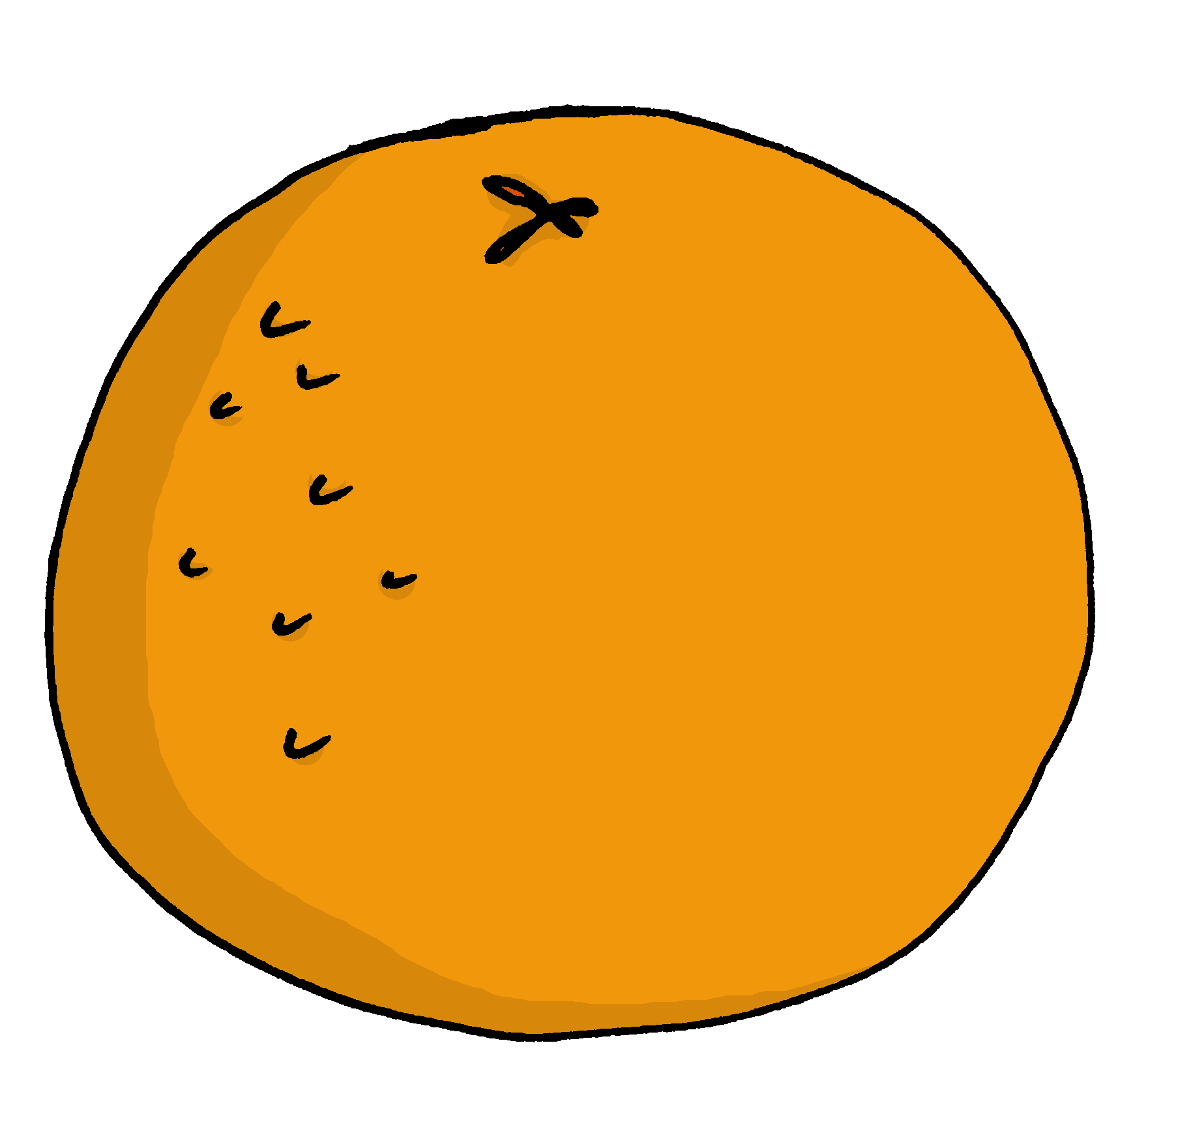
Term 1 week 10
Saying what I and others have
Rouge term 1
10
🎯
prononcer
Talking about having
[on]
[on] is another nasal vowel like [an|en].
[un] is nasal before a consonant and at the end of words.
Asking yes/no questions
When you say a nasal vowel, air passes through your nose as well as your mouth.
Non !
lire
Write down the key language for this week.
tu as |  | un livre
un crayon |  | une règle
une gomme
vocabulaire
écouter
Une excursion à la montage
Le professeur lit une liste.
C’est un ou une ? c’est quoi ?
1 | un | une | livre | règle
2 | un | une | bouteille | jeu
3 | un | une | gomme | crayon
4 | un | une | stylo | peluche
5 | un | une | cahier | orange
lire
C’est nécessaire ? Oui ou non ? Complète les deux listes.
29

Slide 32
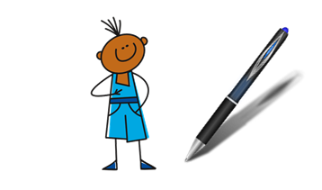
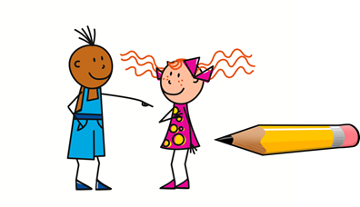
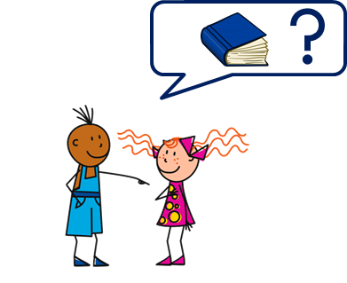
Term 1 week 10
Saying what I and others have
10
Rouge term 1
Avoir [to have, having]
je becomes j’ before a vowel.
grammaire
To say I have, use j’ai.
J’ai un stylo.
I have a pen.
To say you have, use tu as.
Tu as un crayon.
You have a pencil.
To ask a yes/no statement, just make your voice go up at the end:
Tu as un livre ?
Do you have a book?
écouter
Pierre prépare le sac. But he has lots of questions.
 | Do I have…? | Do you have…? | ??? (en anglais)
1
2
3
4
5
6
7
8
lire
Pierre is a bit worried. He messages Yves. Is he checking ‘you have’ with Yves or saying what Sophie (another friend) has.
1
4
Elle a un livre.
Tu as un stylo.
◆
◆
Complète les deux listes.
Yves (you have)
 | ______
 | ______
 | ______
Sophie (she has)
 | ______
 | ______
 | ______
2
Elle a une bouteille.
5
◆
Tu as un crayon.
◆
3
6
Elle a une gomme.
◆
Tu as un cahier.
◆
30

Slide 33
Term 1 week 10
Saying what I and others have
10
Rouge term 1
lire
Lis. Pierre a quoi ? Yves a quoi ?
Write ‘I’ or ‘he’ next to the pictures. Do they have two of anything? What have they packed that they don’t they need?
1. J’ai un stylo.
2. Il a une bouteille.
3. Il a un ballon.
4. J’ai un livre.
5. J’ai un cahier.
6. Il a une orange.
7. J’ai une bouteille.
8. Il a une règle.
vocabulaire
écrire
Écris en français : Can you get at least 15 points?
 | universe | to listen | to write
 | to read | to speak | midday
 | curious (m) | happy (m) | brave (f)
 | Monday | Tuesday | serious (f)
 | a book | a ruler | to have
 | she has | a pencil | a rubber
 | I have | you have | he has
x3
x2
x1
31

Slide 34
Term 1 week 11
Saying what I and others have
Rouge term 1
11
🎯
prononcer
écouter
Reading (aloud) a story in French
Écoute. C’est [au/eau/o] ou [eu] ?
[au/eau/o]
[un] is nasal before a consonant and at the end of words.
Talking about having and being
[left]
gauche
lire
Write down the key language for this week.
(pour) moi |  | un gâteau
(pour) toi |  | parfait
un cadeau |  | pour
vocabulaire
Avoir [to have, having]
Être [to be, being]
Tu _____ - you have
Il _____ - he has
Elle _____ - she has
Tu _____ - you are
Il _____ - he is
Elle _____ - she is
écouter
Écoute. C’est a(s) ou es(t) ? C’est A ou B ?
 | have | are has | is | A | B
1 | Tu as | Tu es | présent | un ballon
2 | Tu as | Tu es | une orange | rouge
3 | Il a | Il est | parfait | une peluche
4 | Il a | Il est | un cadeau | là
5 | elle a | elle est | un jeu | parfaite
6 | elle a | elle est | un chien | ici
7 | tu as | tu es | absent | une photo
8 | tu as | tu es | ici | un cahier
32

Slide 35
Term 1 week 11
Saying what I and others have
Rouge term 1
11
parler
Person A. (Person B – turn to the next page.)
[un] is nasal before a consonant and at the end of words.
écouter
Écoute. C’est [au/eau/o] ?
Mathieu
gâteau
piano
orange
docteur
stylo
jeu
bonjour
parler
Parle. C’est quoi ? Puis, écoute et vérifie.
vérifie - check
1. C’est un jeu de Bayeux.
2. C’est un livre de Sèvres.
3. C’est un stylo de Saint-Malo.
4. C’est un gâteau de Bordeaux.
5. C’est une photo de Pau.
6. C’est un ballon de Toulon.
7. C’est un cadeau de Meaux.
8. C’est une peluche de Béthune.
33

Slide 36
Term 1 week 11
Saying what I and others have
Rouge term 1
11
parler
Person B. (Person A – on previous page.)
[un] is nasal before a consonant and at the end of words.
écouter
Écoute. Écris l’objet en français en en anglais.
________________________
________________________
________________________
________________________
________________________
________________________
________________________
________________________
écrire
Écris en français : Can you get at least 15 points?
 | Hi! | Mrs, (Miss) teacher | Hello!
 | I am | he is | Mr, Sir (teacher)
 | a bag | an exercise book | I
 | a (m) | a (f) | a bottle
 | perfect | you have (singular) | she has
 | for | for me | for you
 | a present | a cake | from
x3
x2
x1
34

Slide 37
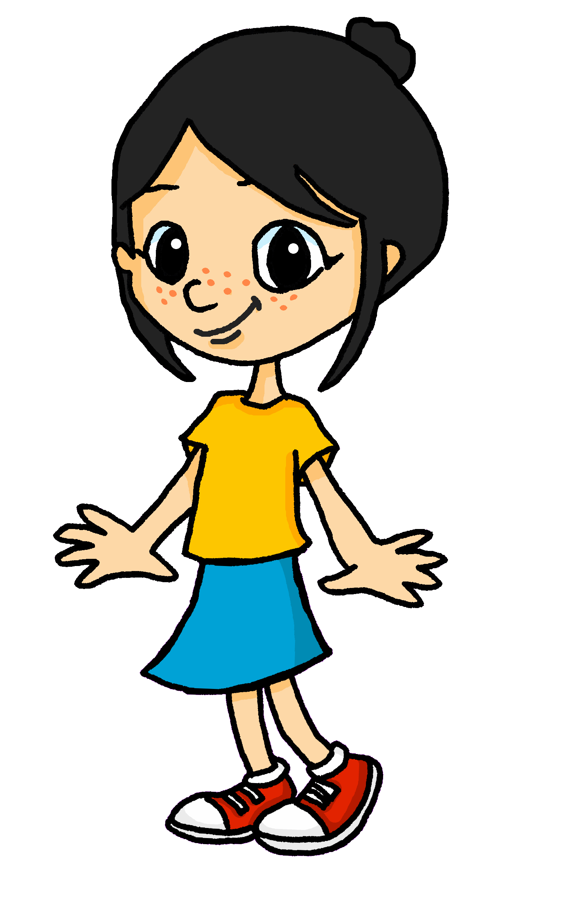
Term 1 week 12
Saying what I and others have
Rouge term 1
12
🎯
prononcer
Reading (aloud) a story in French
[ou]
[un] is nasal before a consonant and at the end of words.
Asking what? questions
[we]
nous
lire
Write down the key language for this week.
chaque |  | un jour
Questions with quoi
grammaire
Remember! To ask a ‘what’ question, use quoi at the end:
C’est quoi ?
Remember to make your voice go up at the end.
➜
What is it? (literally, it is what?)
To ask ‘what’ he or she has:
➜
Il a quoi ?
What does he have? (literally, he has what?)
➜
What does she have? (literally, she has what?)
Elle a quoi ?
écrire
Complète la conversation.
- Julien, ____ ____ _____? - _____ _____ un chien.
- Gavroche, ____ ____ _____? - _____ _____ une cloche.
- Lilou, ____ ____ _____? - _____ _____ un hibou.
- Thomas, ____ ____ _____? - _____ _____ deux chats.
- Margot, ____ ____ _____? - _____ _____ un piano.
- Amélie, ____ ____ _____? - _____ _____ une bougie.
- Hercule, ____ ____ _____? - _____ _____ un véhicule.
35

Slide 38
Term 1 week 12
Saying what I and others have
Rouge term 1
12
Now say the words. Your partner will check.
écouter
A. Écoute et écris. C’est [ou] ou [au] ?
lire
Adèle prépare une liste pour les vacances.
Lis la liste. C’est
‘I have’ (Adèle) ou ‘he has’ (Pierre) ?
I have… | He has…
écouter
Écoute. Écris l’object en anglais sur la liste correcte.
36

Slide 39
Term 1 week 12
Saying what I and others have
Rouge term 1
12
écouter
lire
les vacances – holidays
pas encore – not yet
Écoute et lis la conversation. Complète en anglais.
[un] is nasal before a consonant and at the end of words.
Salut Pierre, ça va ?
Hi Pierre, __________________?
Tu as aussi une liste pour les vacances, non ?
______ also ______ a list for the holidays, _____?
Non !?! Oh, pas encore !
No!?! Oh, not yet!
Mais tu as un cadeau pour Maman ? Bien.
_____ you have ___ __________ _______ mum? ________.
Elle a aussi un cadeau pour toi !
_____ ________ a present for _____, _________!
Moi, j’ai un cadeau pour Papa ! ☺
_______, ___ _______ a __________ _______ _______! ☺
écrire
Écris en français : Can you get at least 15 points?
 | yes | no | Goodbye!
 | well, good | how’s it going? | bad, badly
 | she has | you have | or
 | I have | to have, having | he has
 | Friday | Saturday | Sunday
 | Tuesday | Wednesday | Thursday
 | a day | each, every | Monday
vocabulaire
x3
x2
x1
37

Slide 40
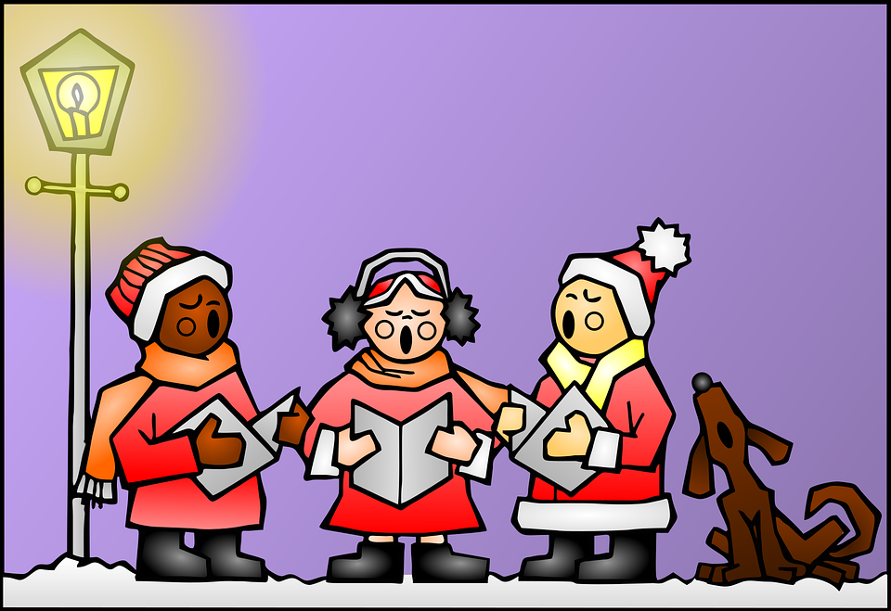
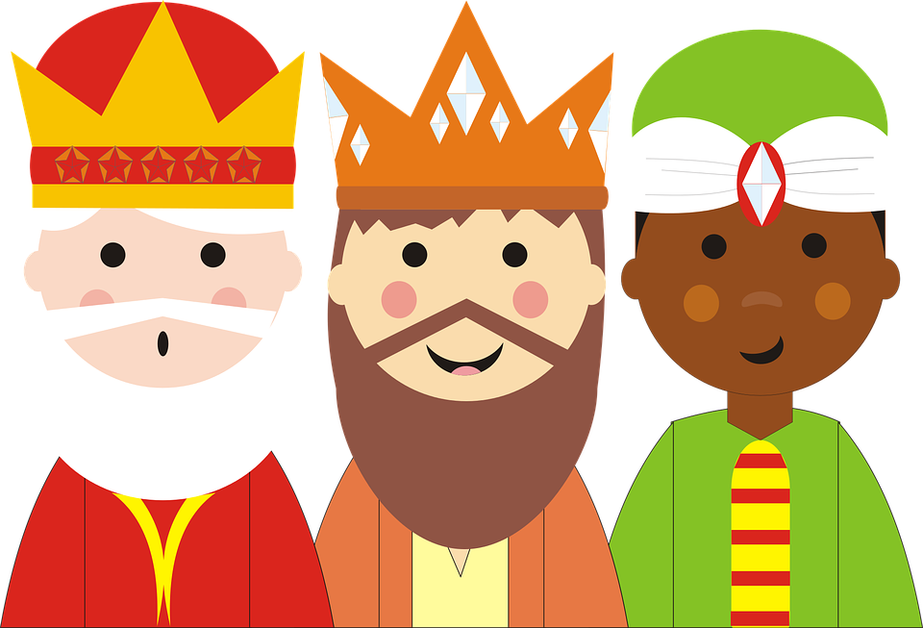
Term 1 week 13
Saying what I and others have
Rouge term 1
13
écouter
Écoute et complète. Puis, lis et chante.
Une chanson: Canon de Noёl
N N Voic_ venir les rennes.
O O N_ _s aurons des cad_ _ _x.
E E Les enfants s_ _t joy_ _x.
L L C'est l_ soir d_ Noël.-
Noël, Noël, N, O ,E, L.
Noël, Noël, N, O ,E, L.
le Noёl - Christmas
venir – to come, coming le renne –reindeer
aurons – (we) will have
sont – (they) are
le soir –evening
14
lire
A. Lis et complete le texte.
Adèle mange une galette des Rois. C’est _____ l’Épiphanie et l’arrivée des trois Rois mages : Balthazar, Gaspard et Melchior à Bethléem. _____________ tradition.
____________, en janvier, il y a des galettes dans le nord et des couronnes dans le sud.
________________contient une fève (ou figurine)et une couronne !
________ ‘ La Fête des Rois’, ___________va sous la _________ et décide qui a sa part de galette.
_______________ tradition.
Le 6 janvier, Adèle trouve la fève. _______ porte la couronne. Elle est très ______________.
Adèle eats a ‘cake of the Kings’. It is for Epiphany and the arrival of the three kings: Balthazar, Gaspard and Melchior in Bethlehem. It is a tradition.
In France, in January, there are ‘galettes’ in the north and ‘crowns’ in the south. Each cake contains a lucky charm (or figurine) and a crown!
For ‘La Fête des Rois’ a child goes under the table and decides who has their slice of galette. It is the tradition.
On the 6th January, Adèle finds the lucky charm. She wears the crown. She is very pleased. ☺
38

Slide 41
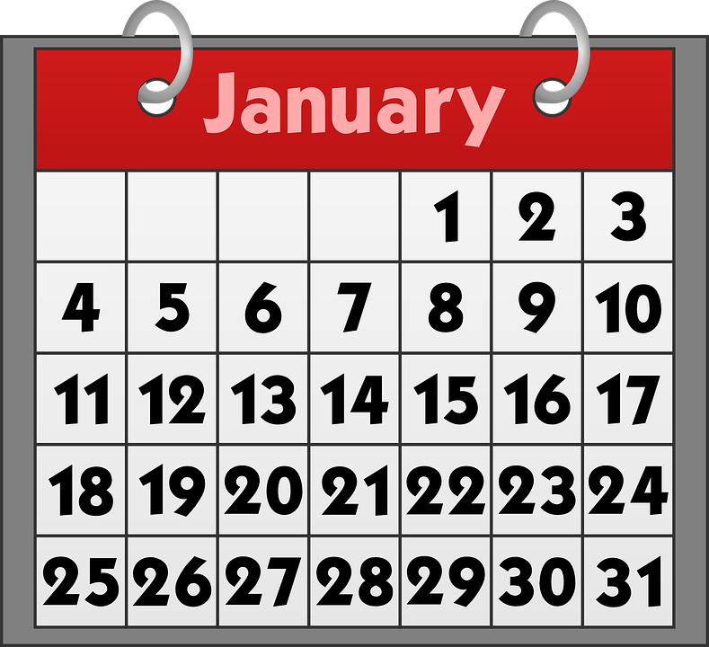
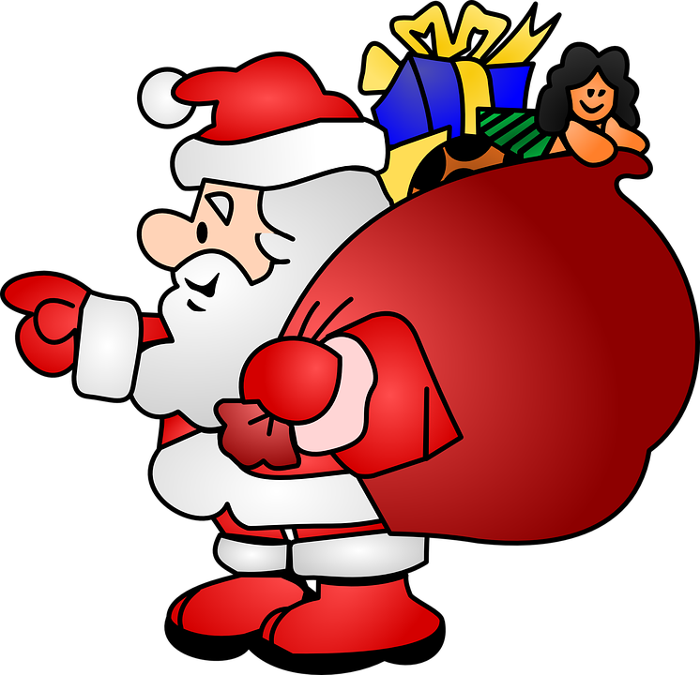
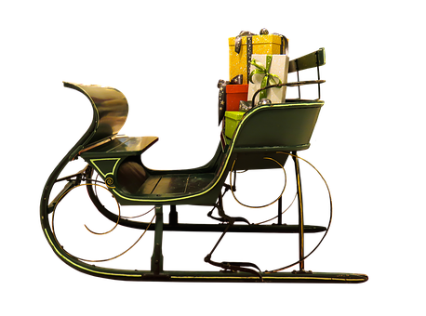
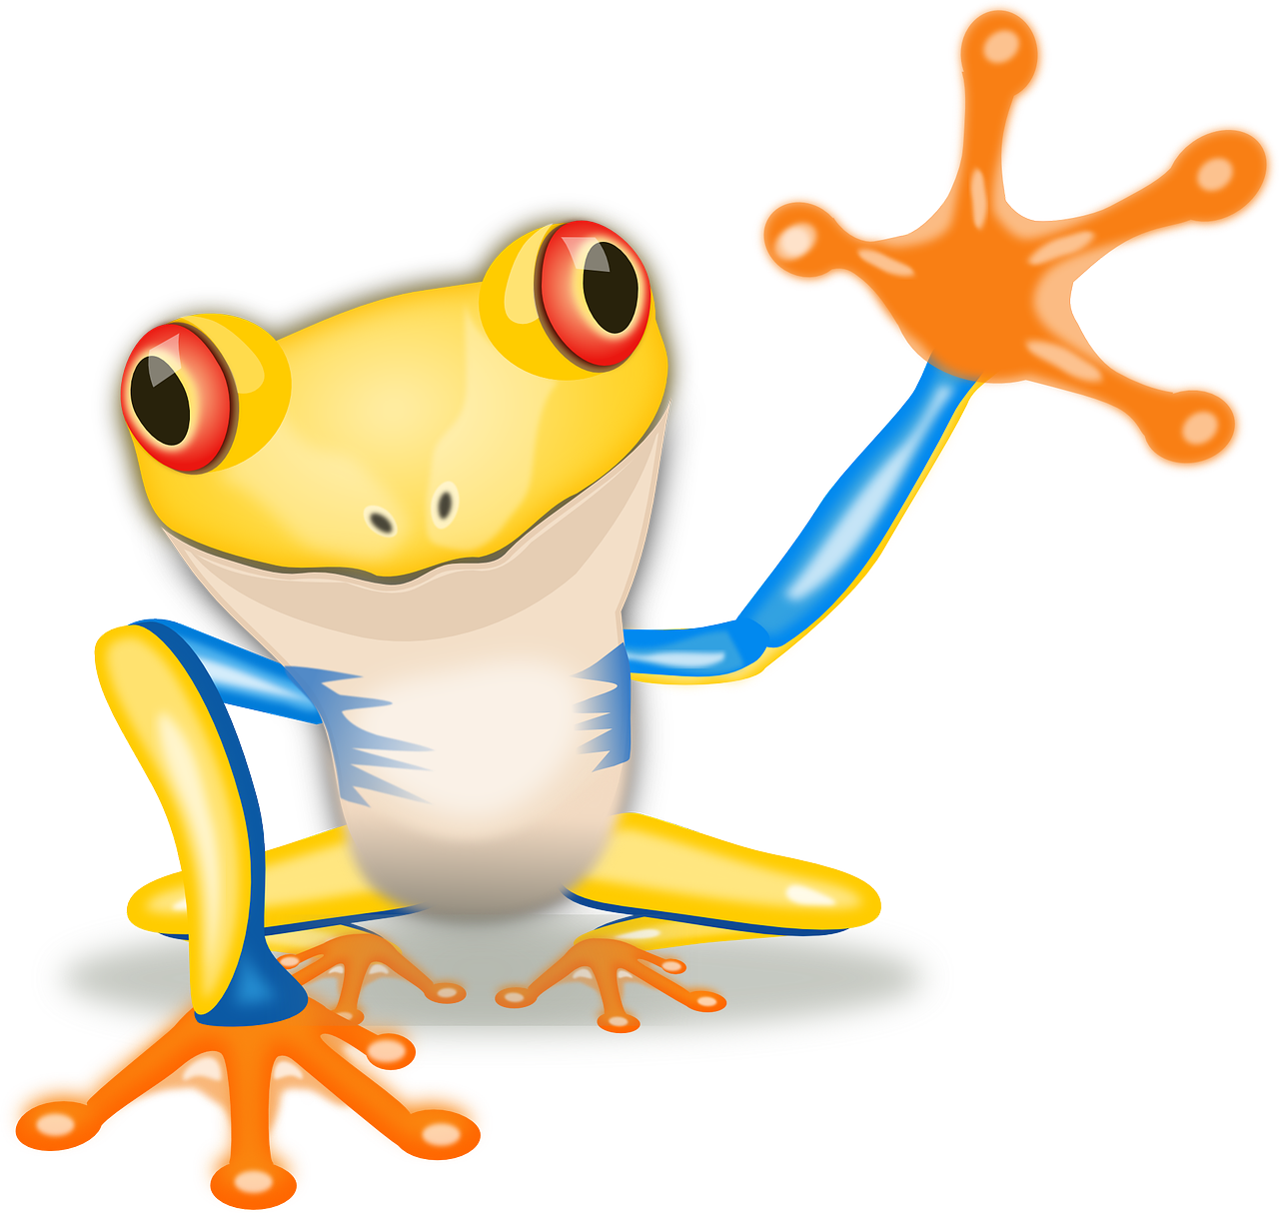
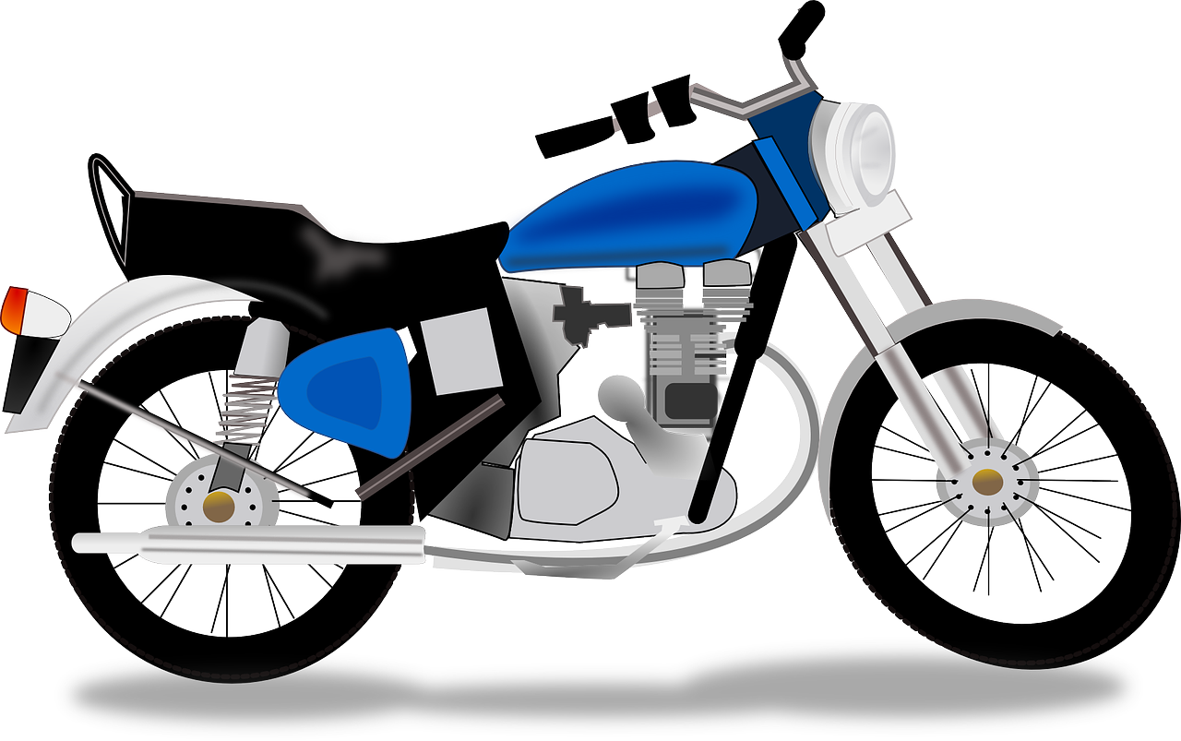
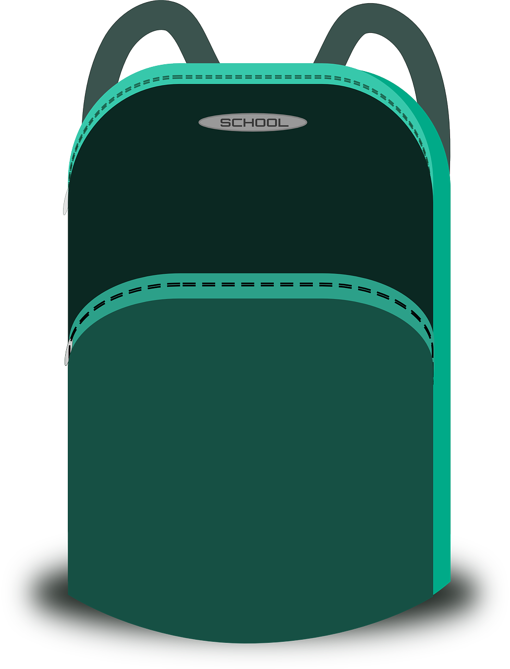
Term 1 week 14
Saying what I and others have
Rouge term 1
14
lire
B. Put the pictures in order according to the text.
Adèle mange une galette des Rois. C’est pour l’Épiphanie et l’arrivée des trois Rois mages : Balthazar, Gaspard et Melchior à Bethléem. C’est une tradition.
En France, en janvier, il y a des galettes dans le nord et des couronnes dans le sud.
Chaque gâteau contient une fève (ou figurine)et une couronne !
Pour ‘ La Fête des Rois’, un enfant va sous la table et décide qui a sa part de galette.
C’est la tradition.
Le 6 janvier, Adèle trouve la fève. Elle porte la couronne. Elle est très contente.
[A]
[B]
[E]
[1]
[C]
[F]
[D]
[G]
parler
Father Christmas prepares to deliver presents to French children.
A. Pronounce the presents. Which present is for which child?
un chat | un animal | une moto
un sac | un cahier | un crayon
____ __________ pour Sacha.
____ __________ pour Fanchon.
____ __________ pour Marceau.
____ __________ pour Amal.
____ __________ pour Jacques.
____ __________ pour Didier
B. Regarde. C’est quel mois ?
French children normally address their letters to Father Christmas before the 25th December. Here, the Père Noël decided to match the first letter of each of the children’s names with their birthday month.
What are the
corresponding
French
months?
Father Christmas travels by sleigh!
un traîneau
Le Père Noël
39

Slide 42
Term 1 week 14
Saying what I and others have
Rouge term 1
14
lire
La Galette des Rois
A ‘Galette des Rois’ is a traditional French flaky pastry and almond paste tart, eaten to celebrate the Epiphany on the 6th of January (12 days after Christmas day).
Hidden inside, there is a small figure. The person who finds the figure will be crowned king or queen for the day.
Originally this was a small bean (une fève) and this word is now used for the figurine.
A ‘couronne’ also accompanies the Galette, and the king or queen gets to wear it. ☺
une fève
In secret, choose a space and draw your ‘fève’. ✍
A
B
C
D
1
Do you have…?
2
S/he has…
3
You have…
4
I have…
A |  | B
English | French | English | French
a ball | un ballon | a cuddly toy | une peluche
a bottle | une bouteille | a bag | un sac
an exercise book | un cahier | a pen | un stylo
a game | un jeu | a pet | un animal
an orange | une orange | a dog | un chien
C |  | D
English | French | English | French
a cat | un chat | a ruler | une règle
a photo | une photo | a rubber | une gomme
a table | une table | a book | un livre
a pencil | un crayon | a present | un cadeau
40

