Slide 1
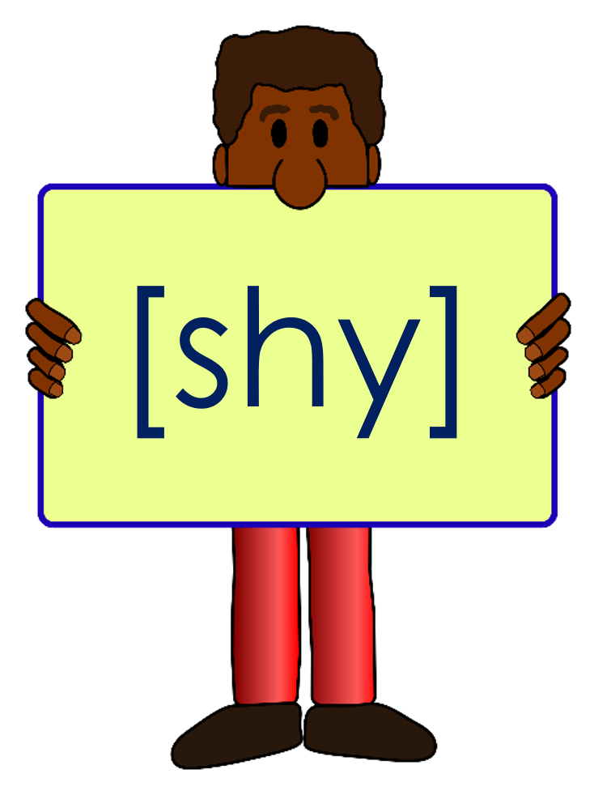
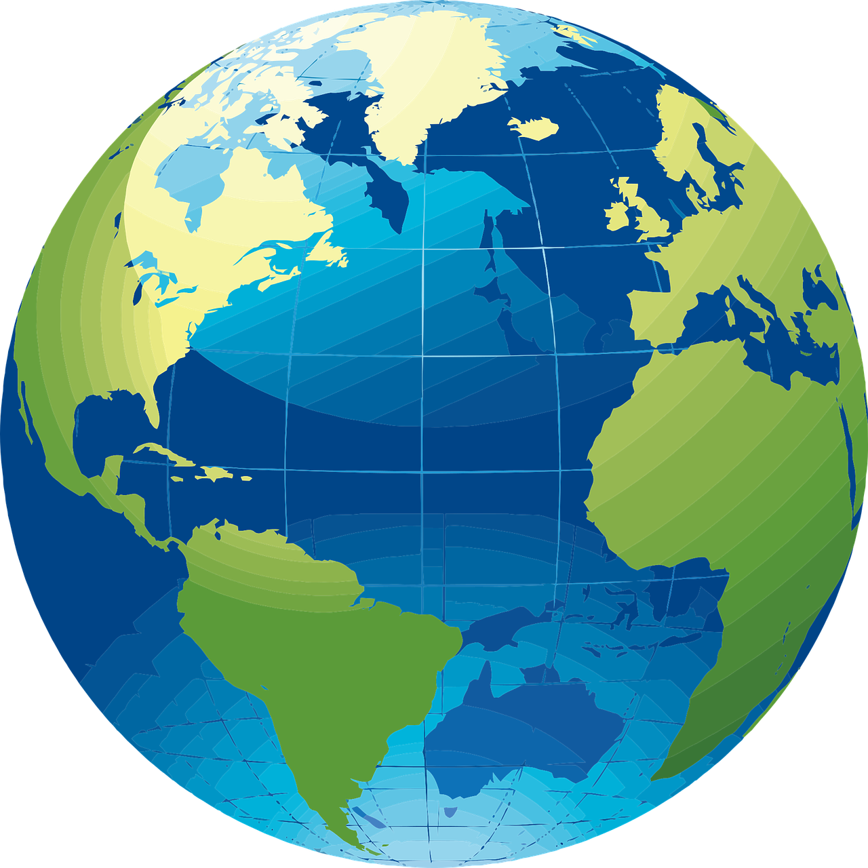
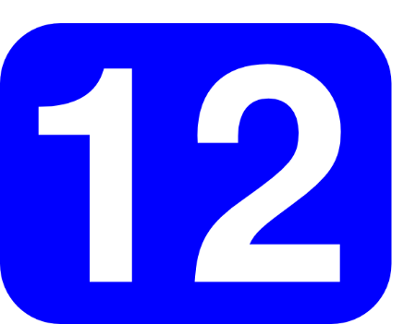
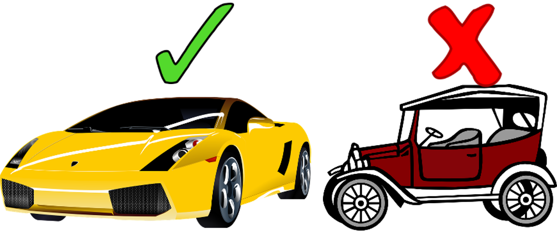
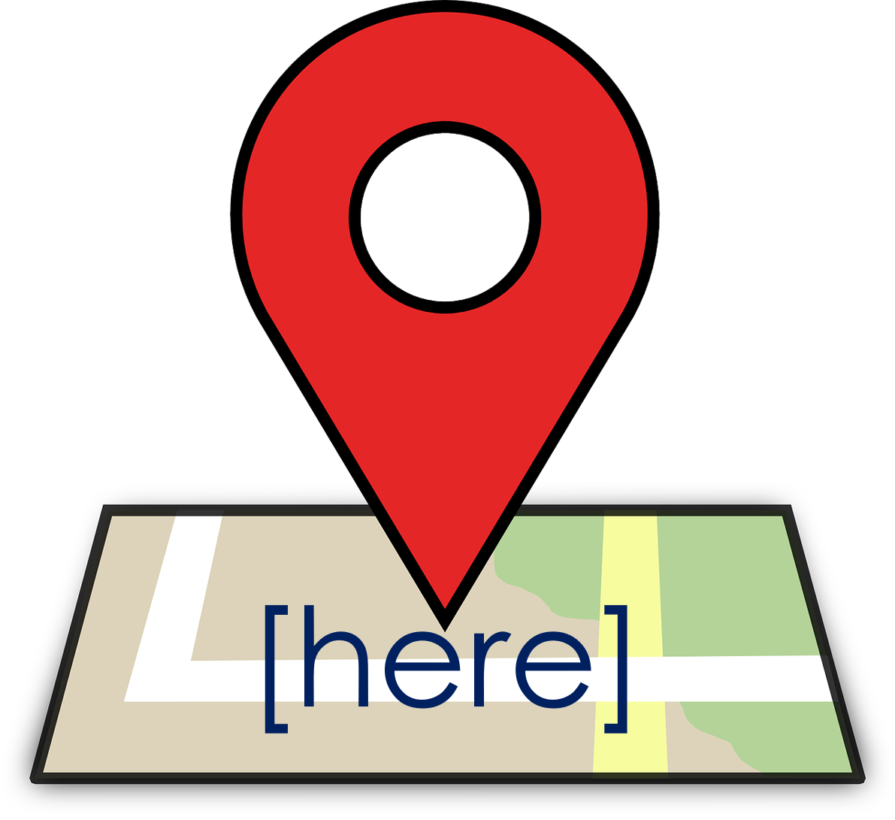
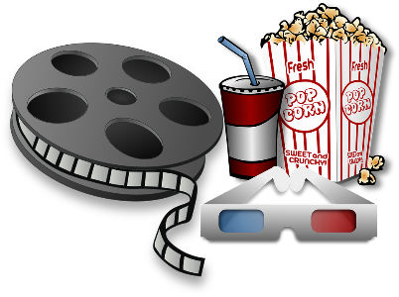
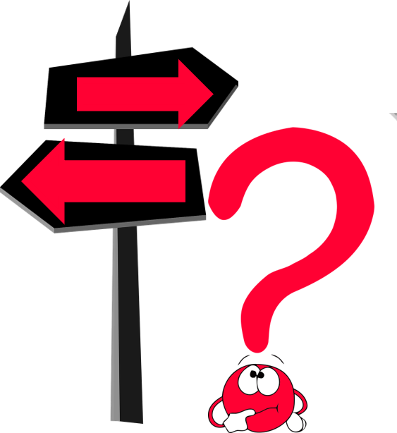
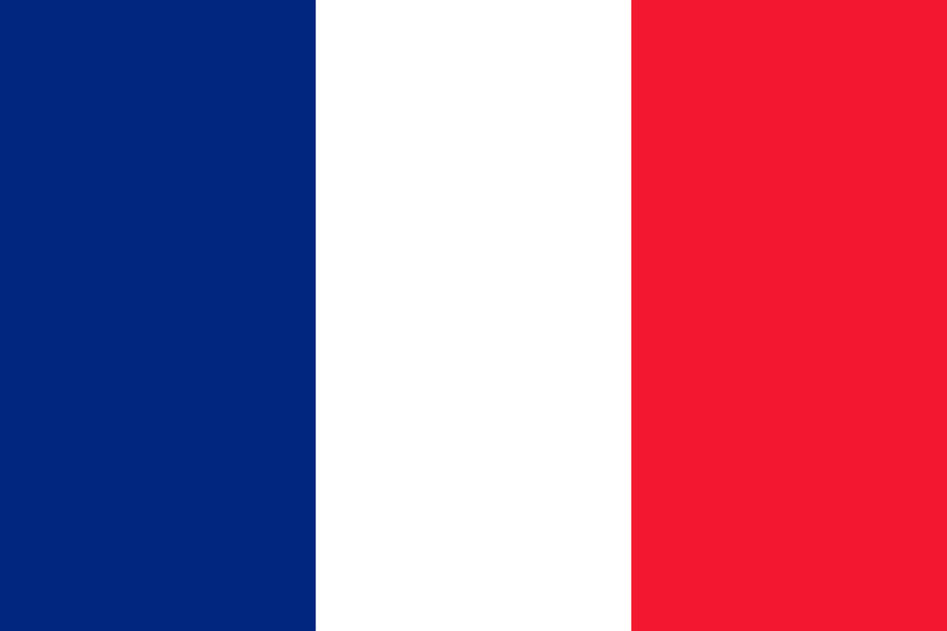
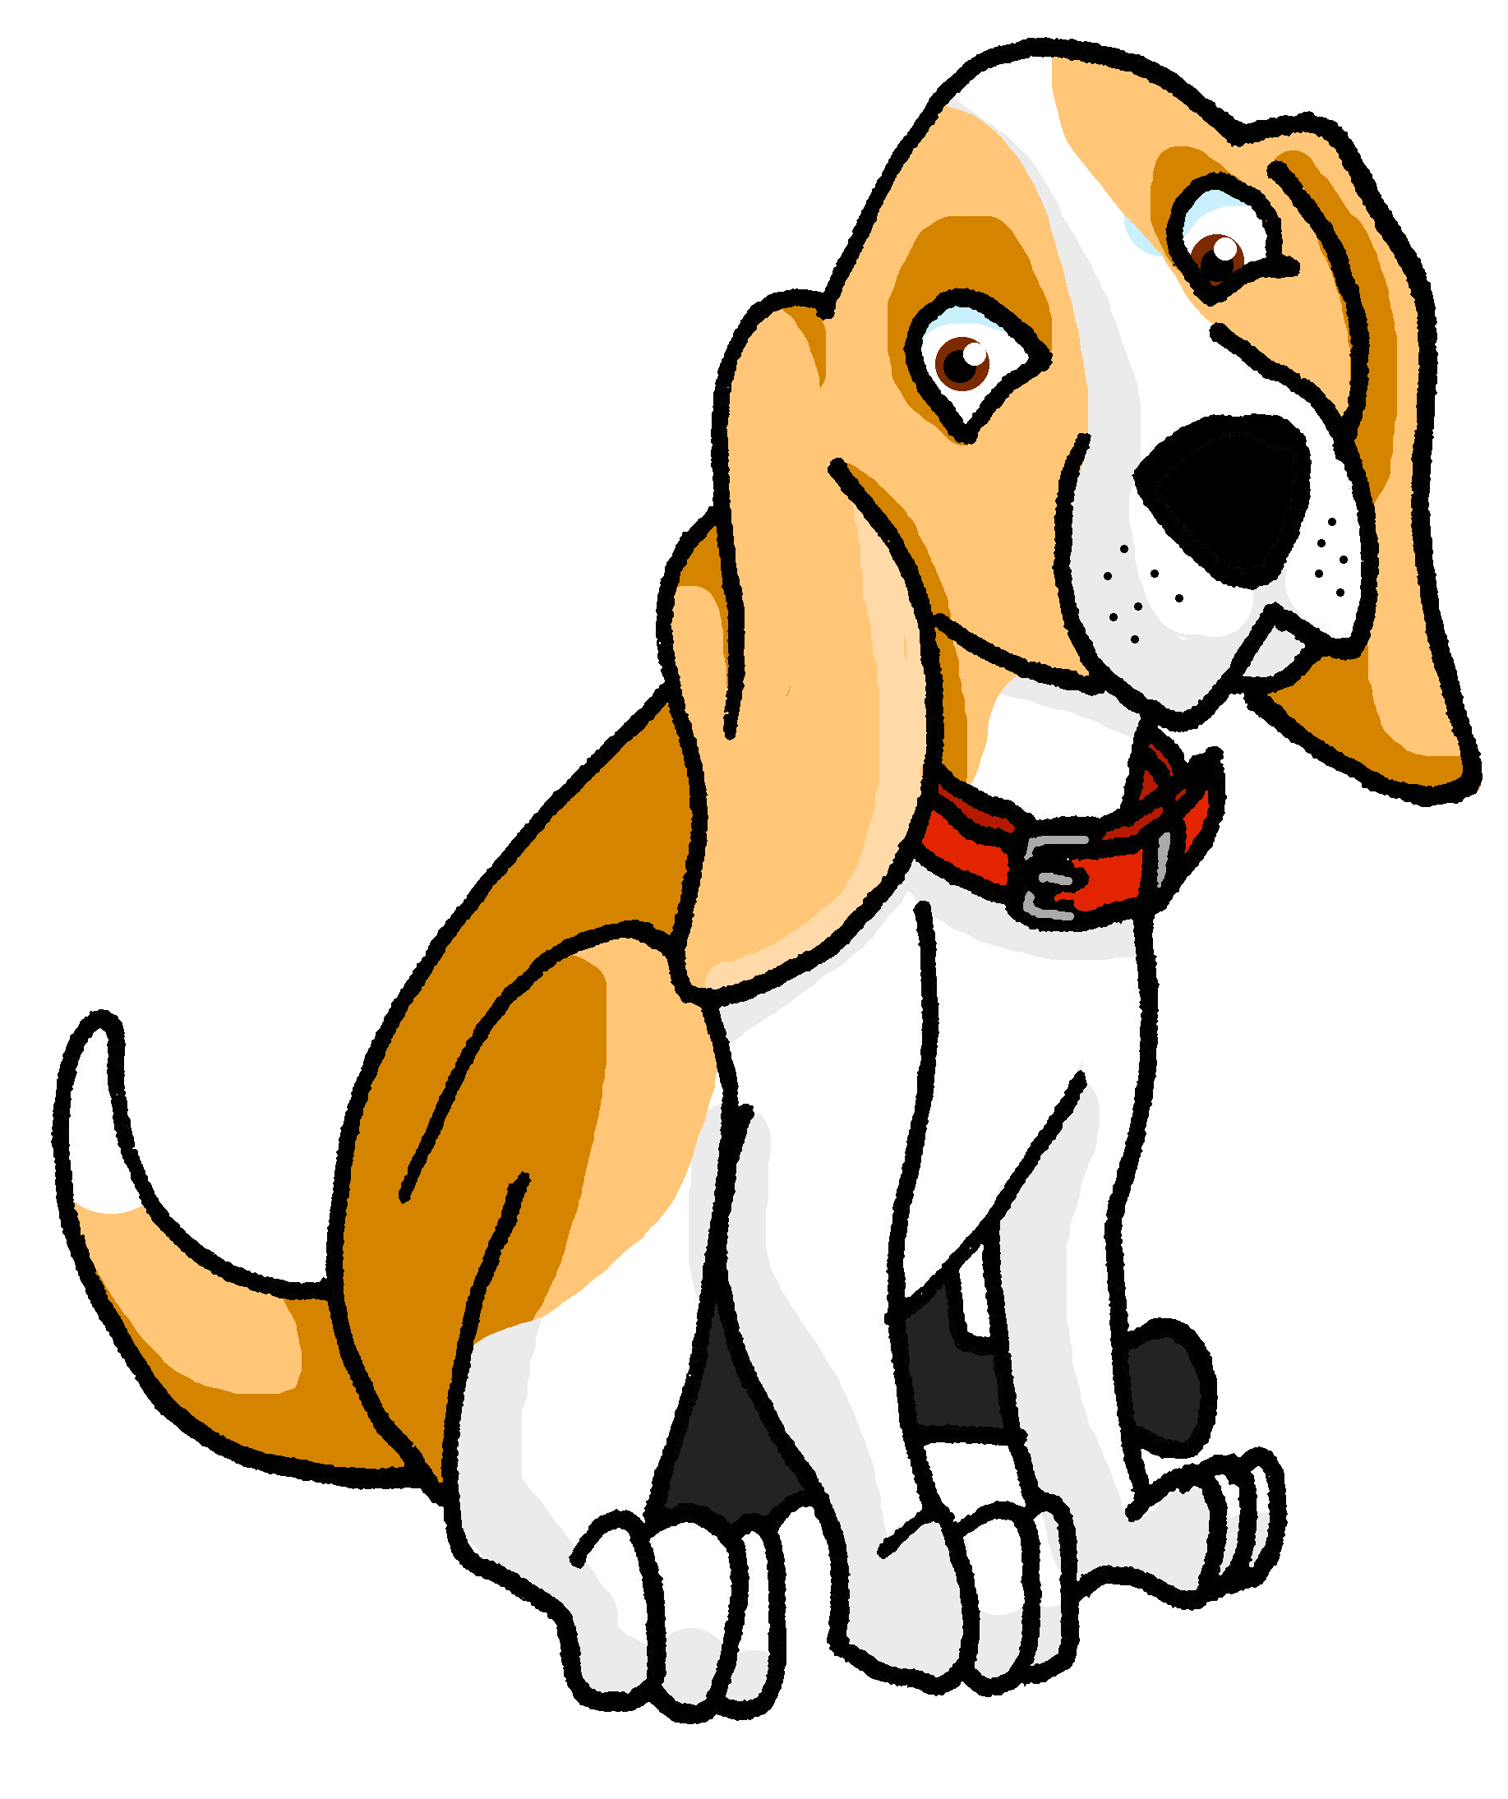
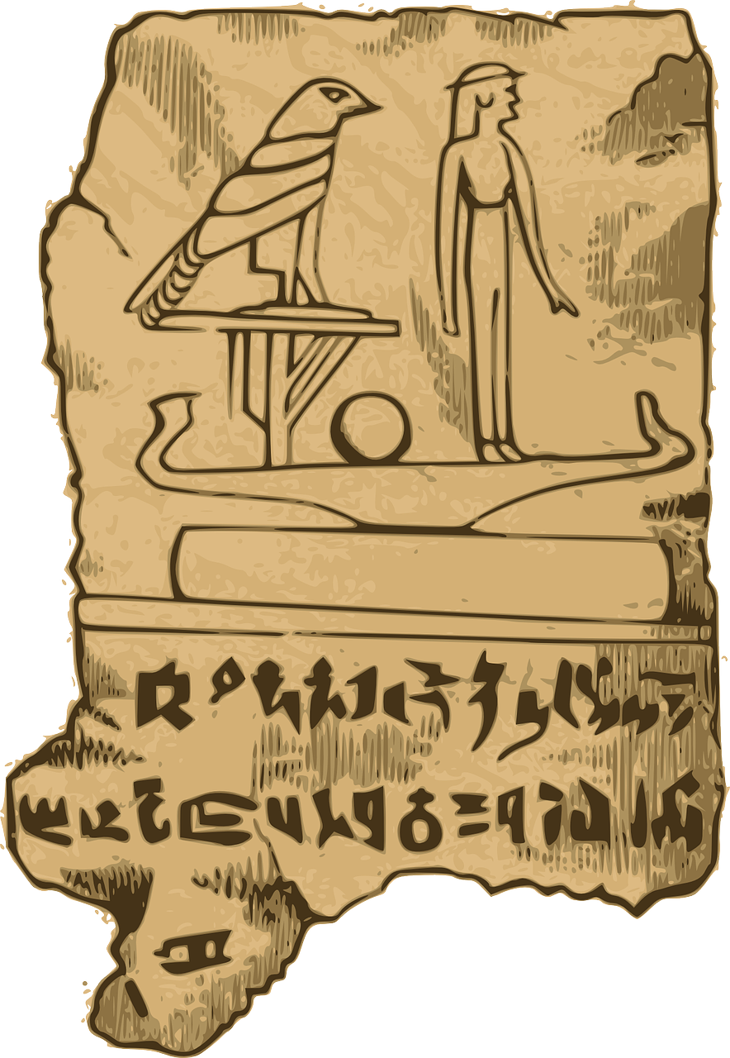
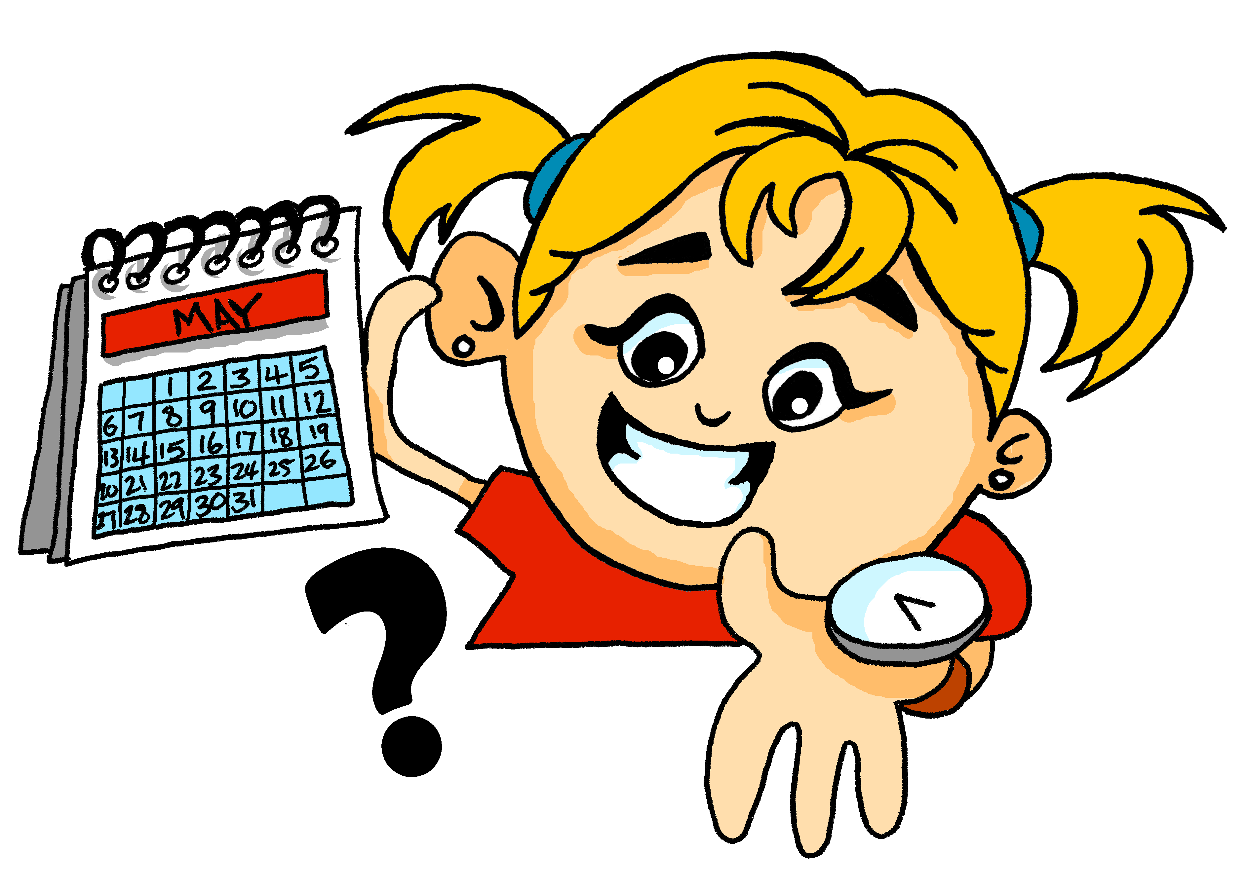
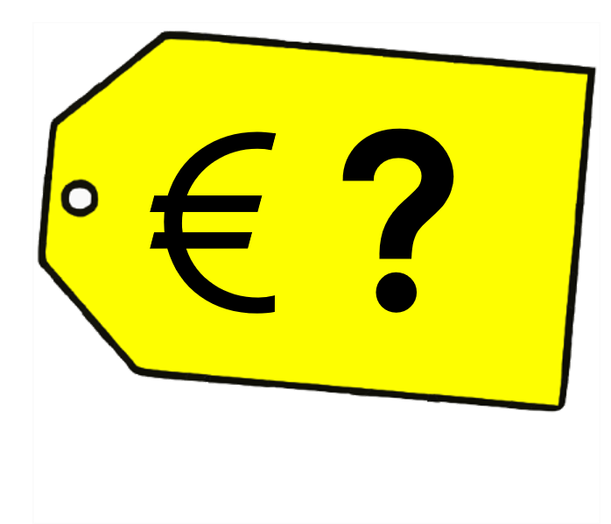
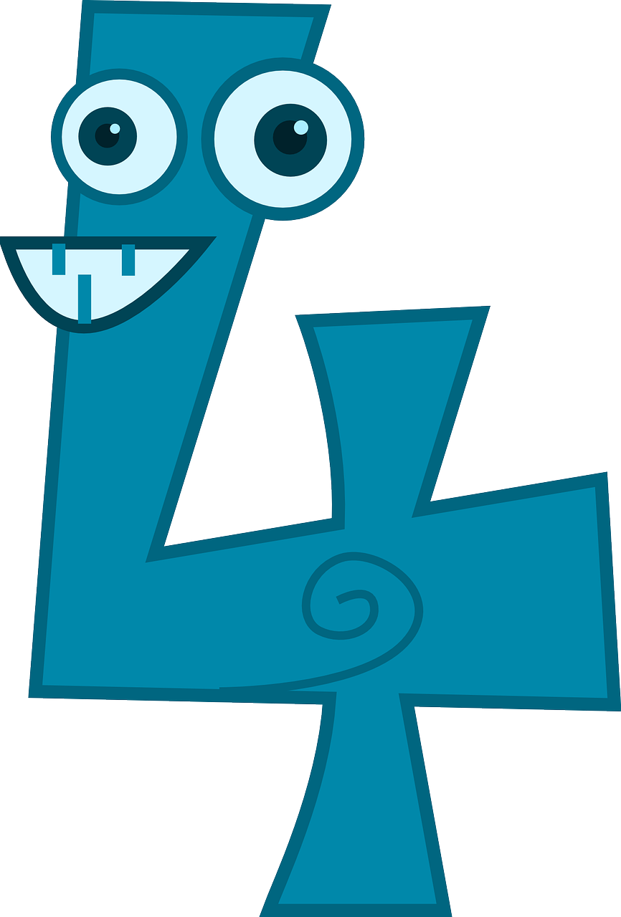
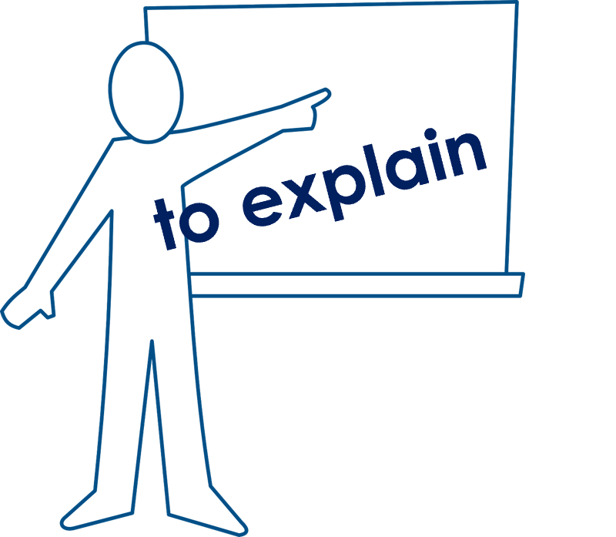
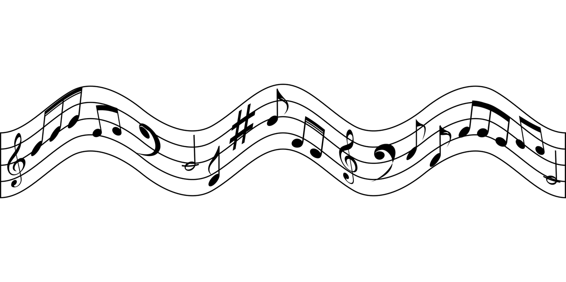
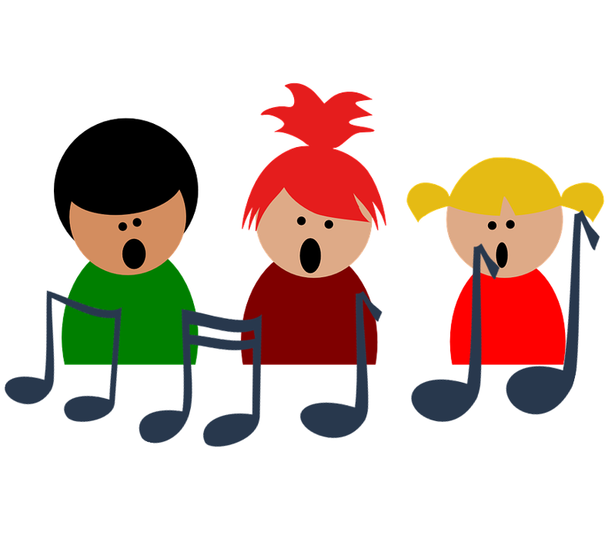
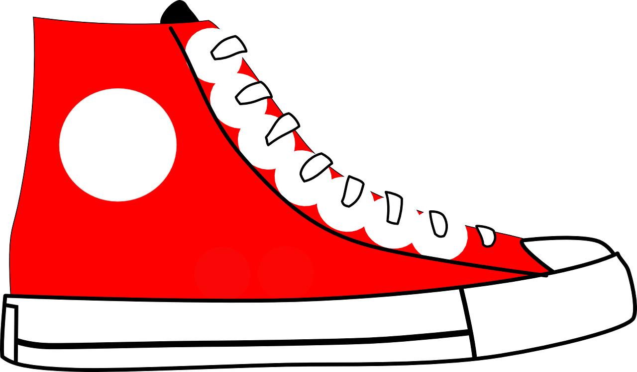
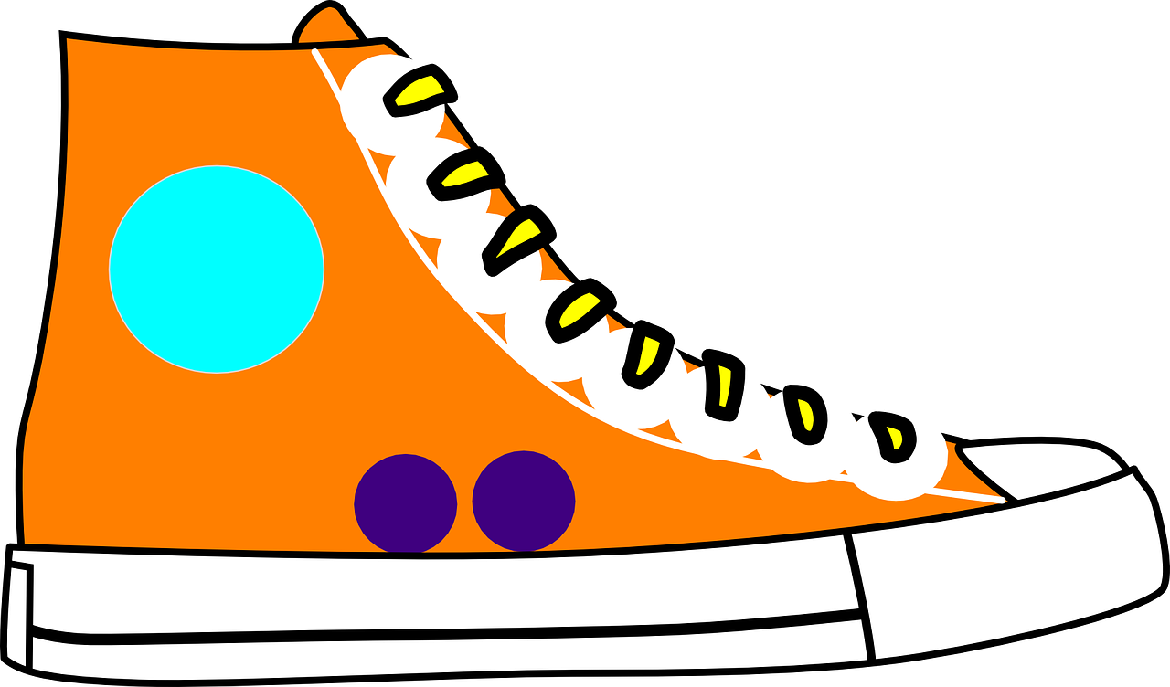
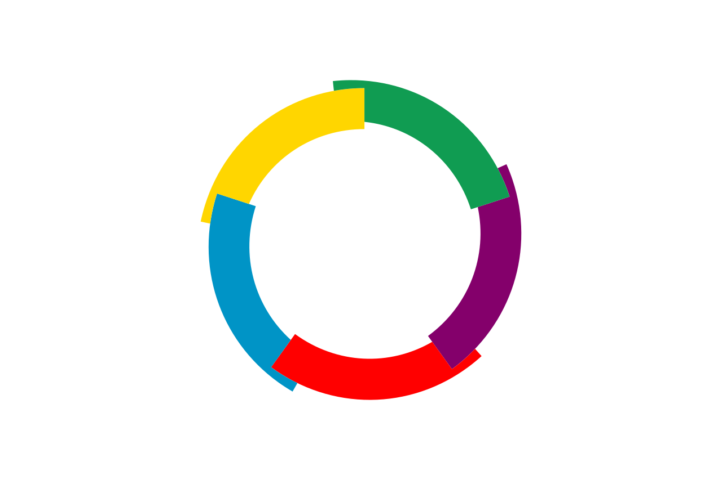
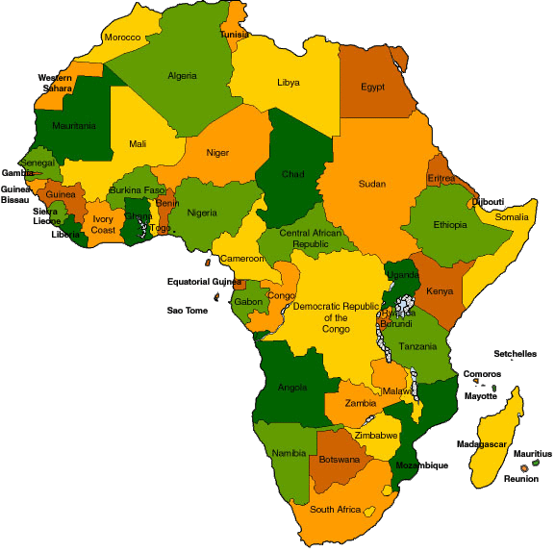
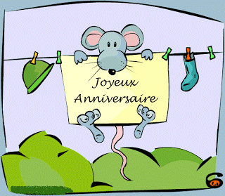
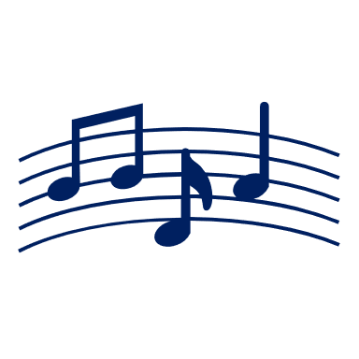
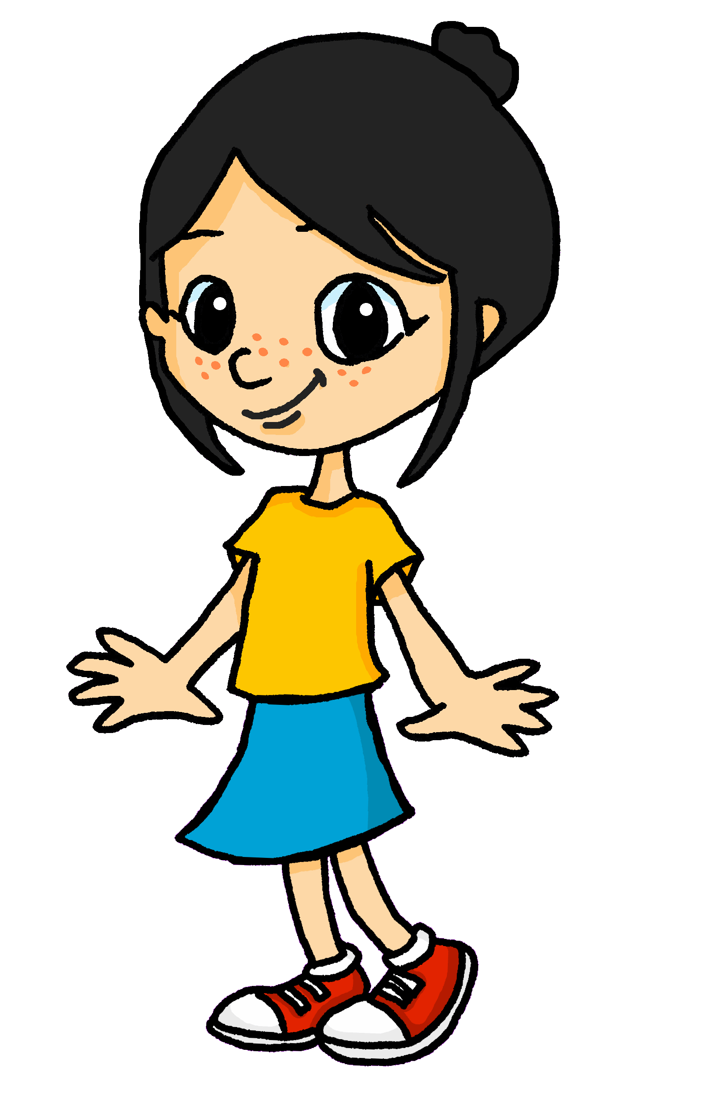
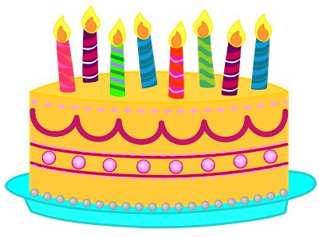
Jaune Knowledge Organiser - Summer Term A
La description
actif, active - active
blanc, blanche – white
massif, massive - massive
noir, noire - black
pratique - practical
préféré, préférée - favourite
propre - clean
sale - dirty
sportif, sportive - sporty
unique - unique
utile – useful
Les choses
l’anniversaire (m) – birthday
la chanson – song
la chose – thing
le groupe – group
la liste – list
le livre – book
le magazine – magazine
la personne – person
la porte – door
Phonics
Comment ? - How?
Silent Final ‘e’ [SFe] | timide | monde | douze | centre | moderne
[ç/c] soft ‘c’ | ici | cinéma | decider | français | garçon
Quand ? - When?
[ien] | bien | chien | ancien | bientôt | combien
[old/ancient]
[how much]
[qu] | question | quatre | expliquer | musique | unique
Adjectives after nouns In English adjectives come before the noun. In French adjectives normally come after the noun: a useful book un livre utile a unique song une chanson unique | Saying ‘it’ in French Remember il is ‘he’ and elle is ‘she’. Use il to mean ‘it’ for masculine nouns, too: Le livre est utile.➜ Il est utile. (It is useful.) Also use elle to mean ‘it’ for feminine nouns: La chanson est unique.➜ Elle est unique. (It is unique.)
Ask ‘when?’ | Ask ‘What is it like?’ Comment ? means How? but:
We say ‘la Francophonie’ to mean French-speaking peoples and countries.
très – very
beaucoup (de) – a lot (of) en - in
Les mois
le mois – month
janvier – January
février – February
mars – March
avril - April
mai – May
juin – June
juillet – July
aout – August
septembre – September
octobre – October
novembre – November
décembre - December
There are 29 countries with French as an official language.
In most French speaking countries, “Joyeux anniversaire” and “Bon anniversaire” are the most common ways to wish a happy birthday. In Québec, Canada, they also use “Bonne fête”.
21 of these countries are in Africa.
5 are in Europe.
This is the official flag of la Francophonie.
The other 3 are: Canada, Haiti and Vanuatu.
11 other places belong to France and have French as the official language. In addition, many more countries also speak French amongst other languages. In total, 88 countries belong to ‘la Francophonie’.
Quand est ton anniversaire ?
Informally, ask like this:
C’est quand, ton anniversaire ?
Il est comment ?
What is it (m) like?
➜
Many French-speaking children learn which months have 31 days by using their knuckles!
Mon anniversaire est en février.
Elle est comment ?
➜
What is it (f) like?

Slide 2
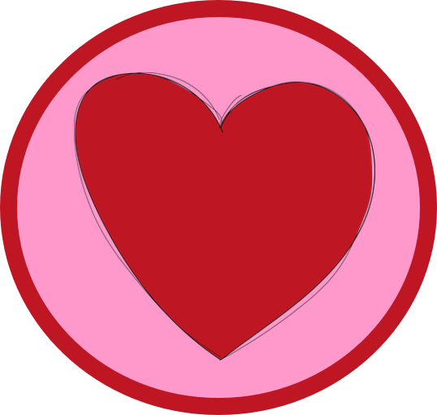
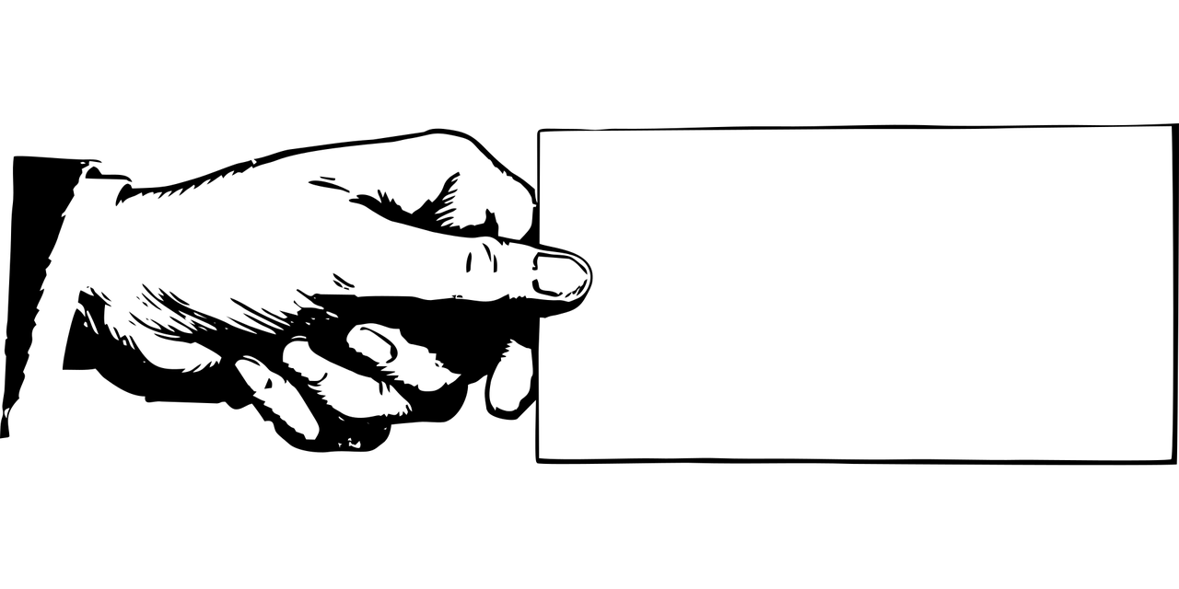
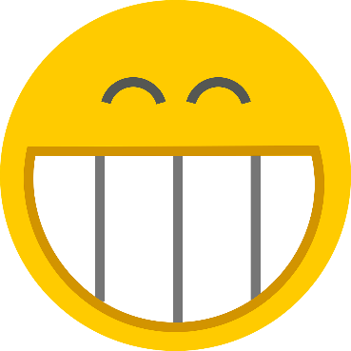
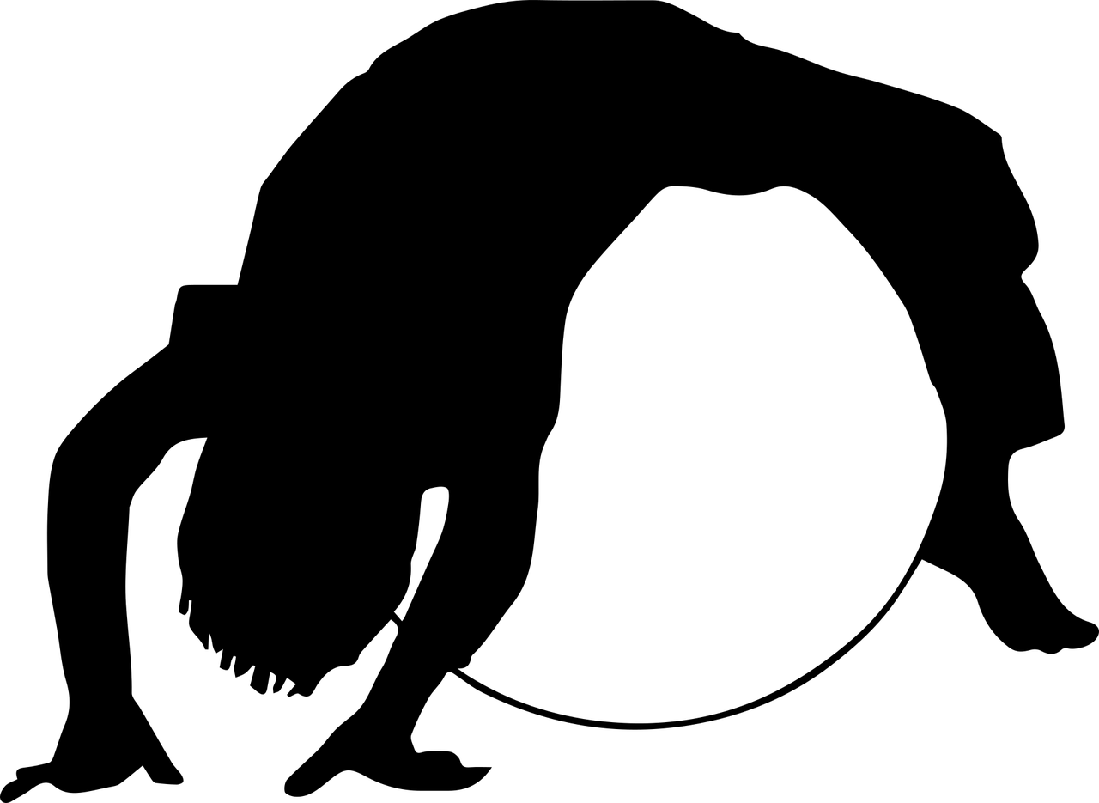
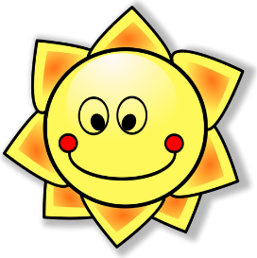
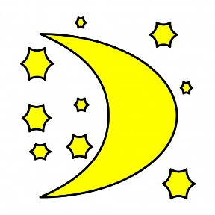
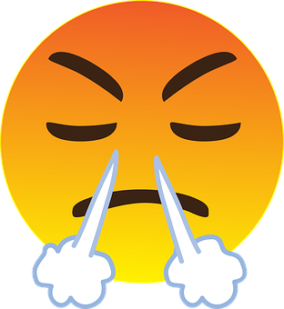
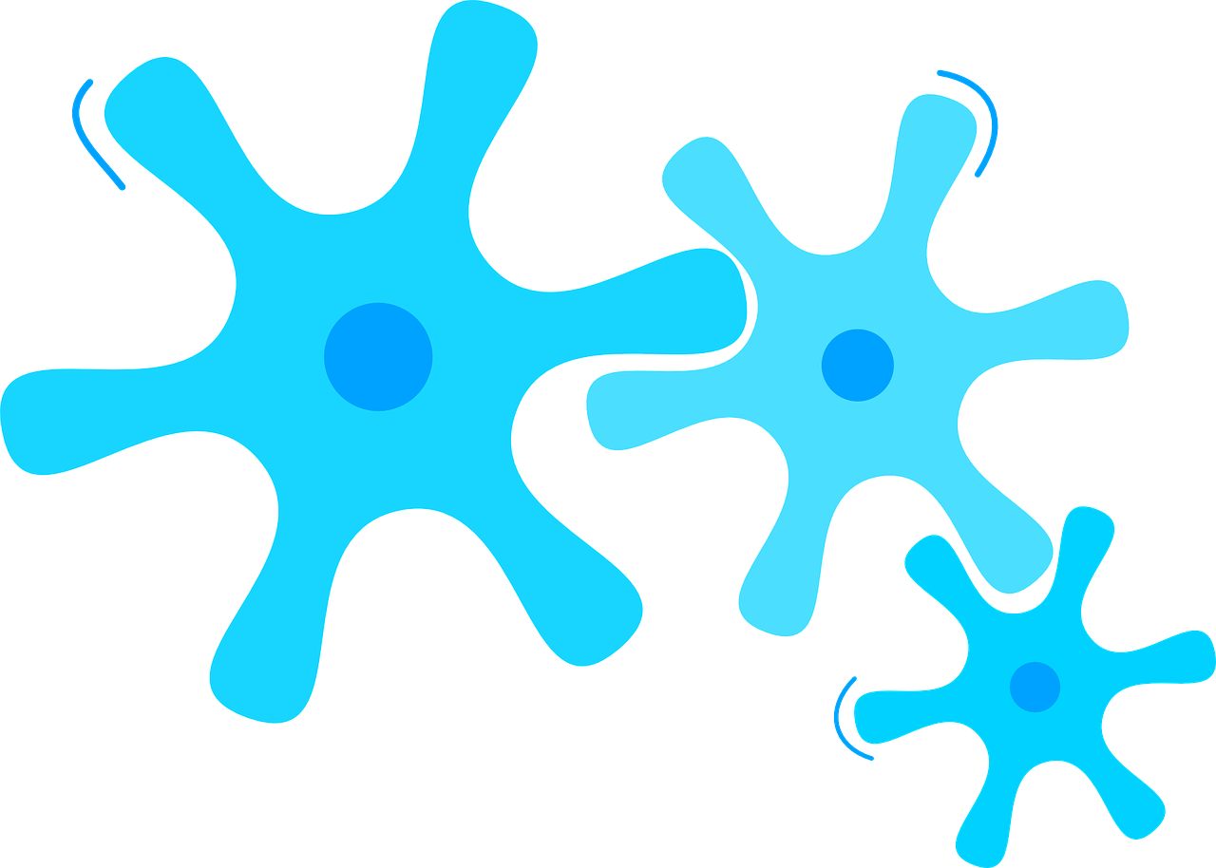
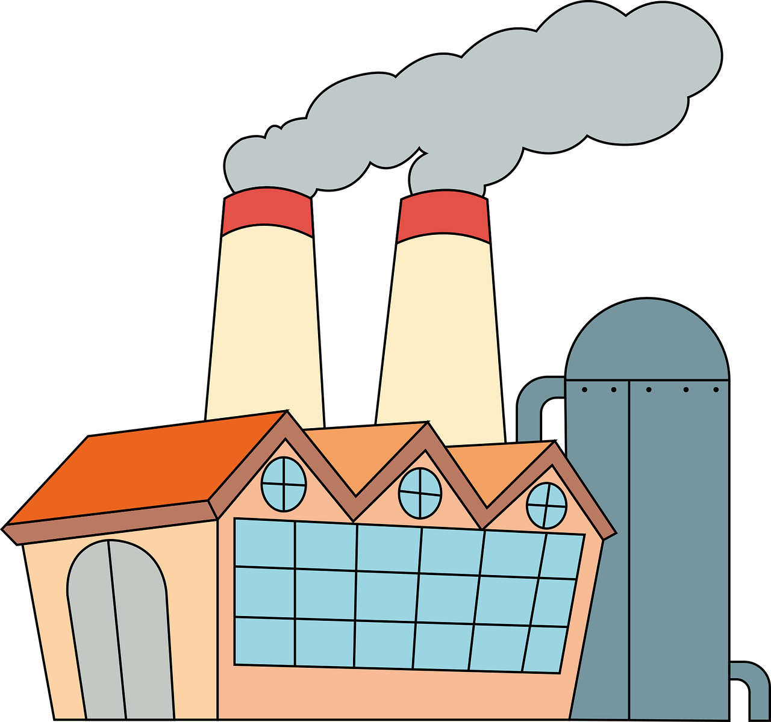
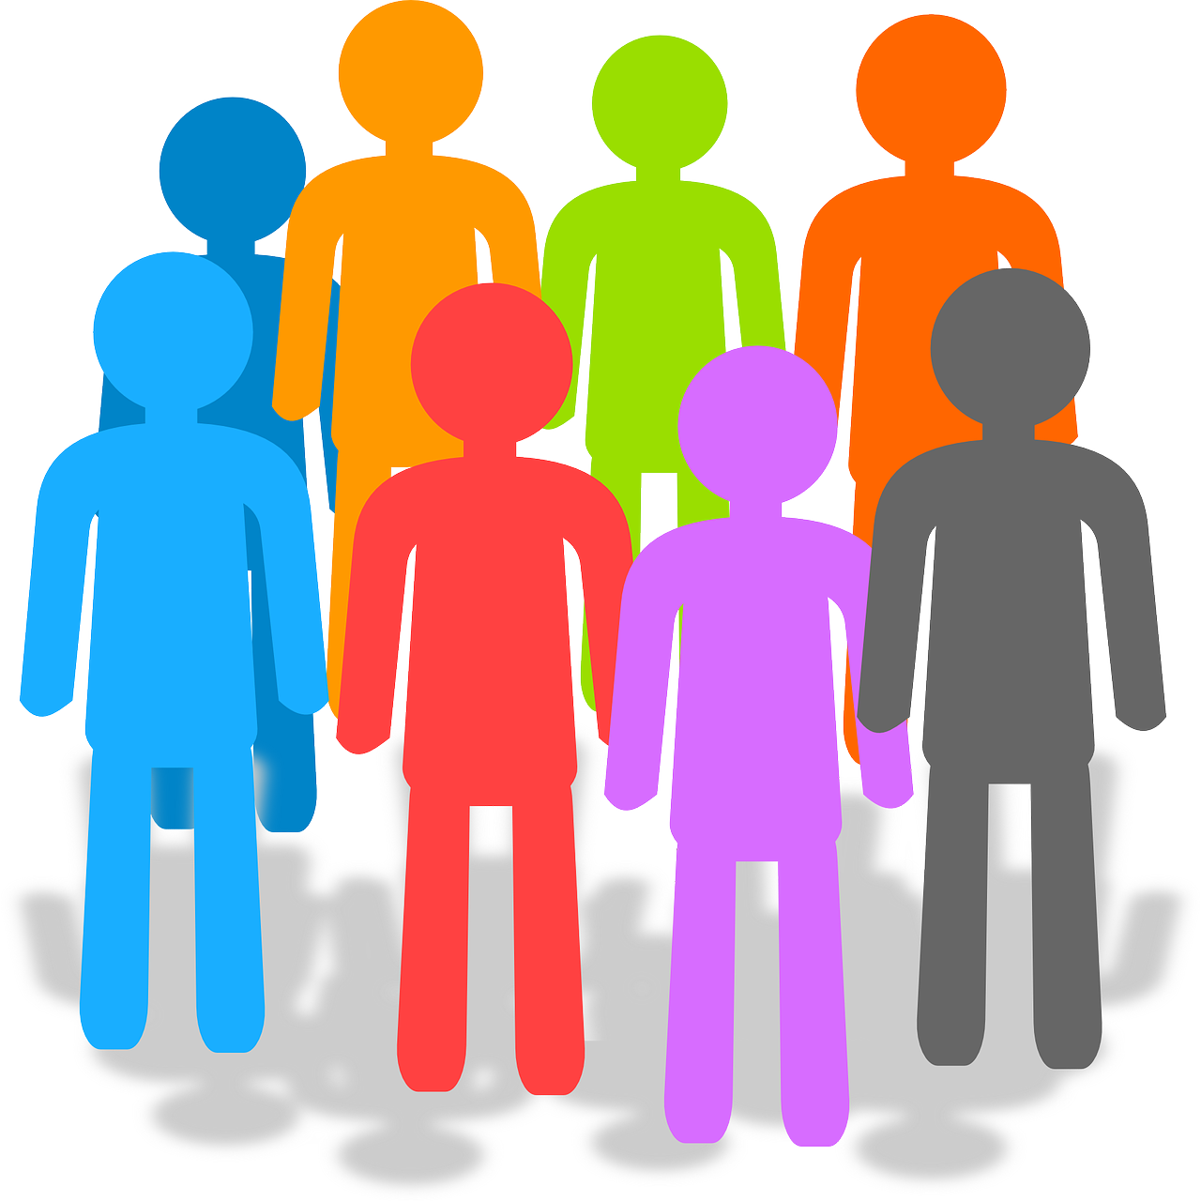
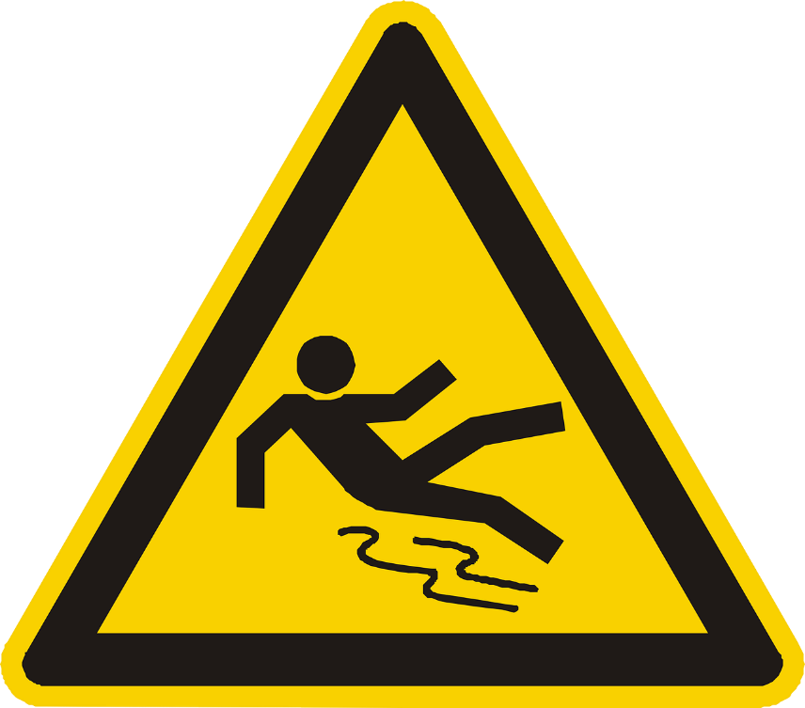
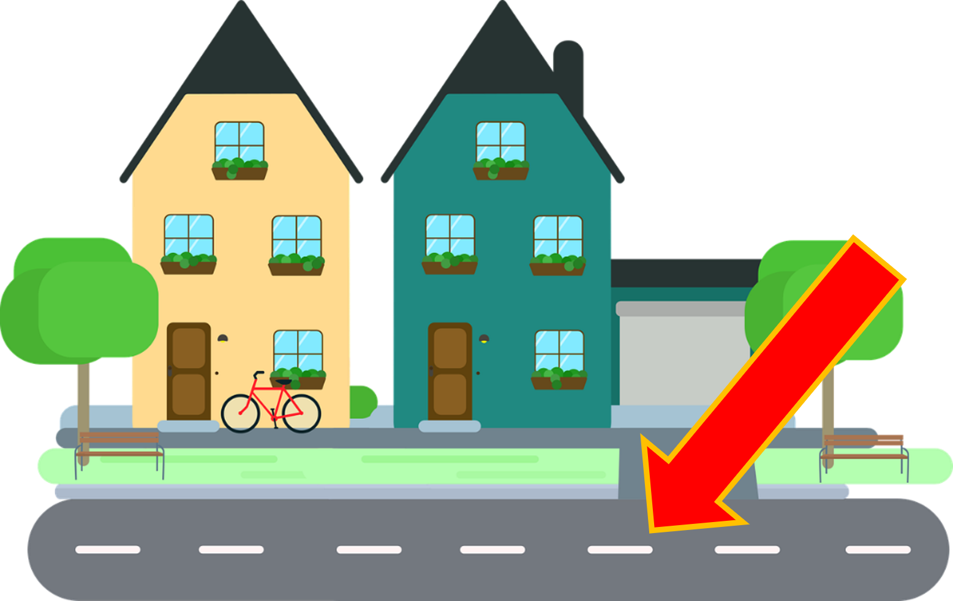
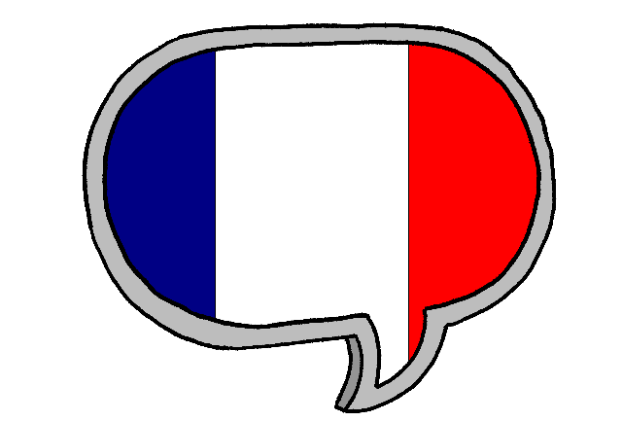
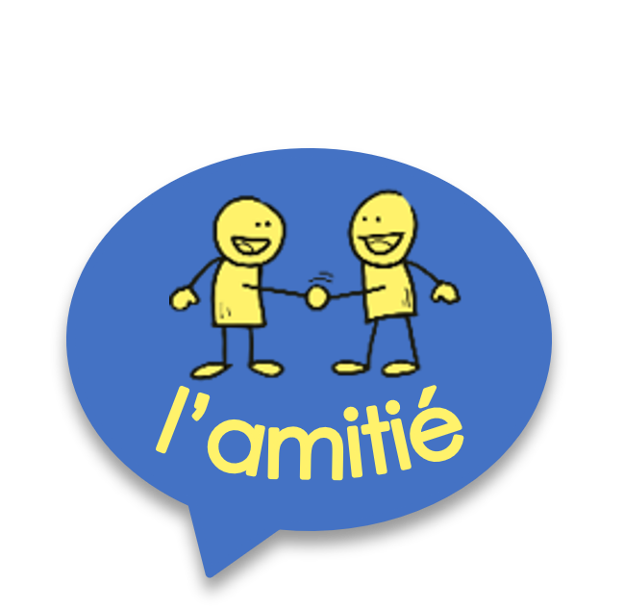
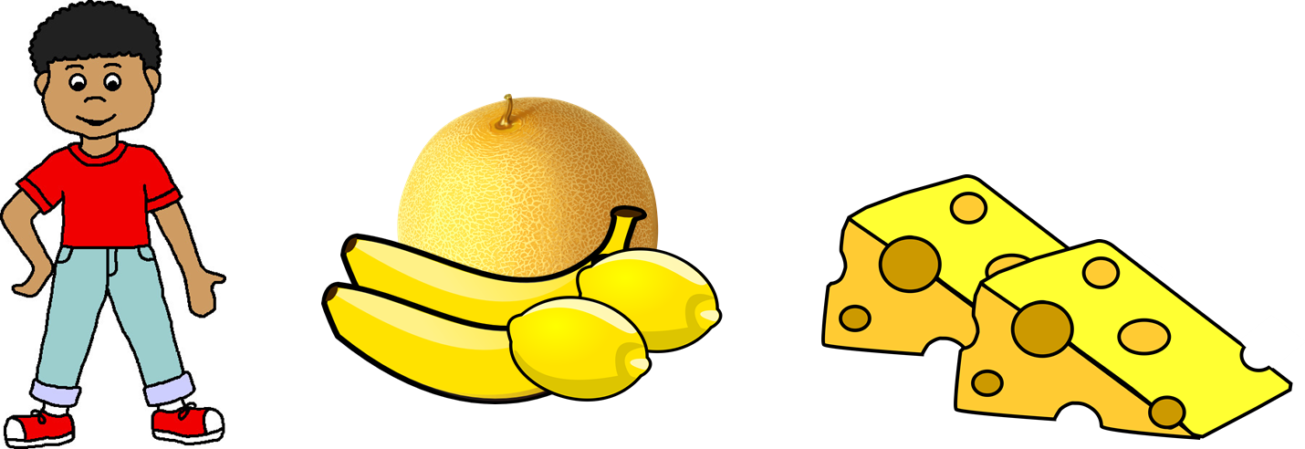
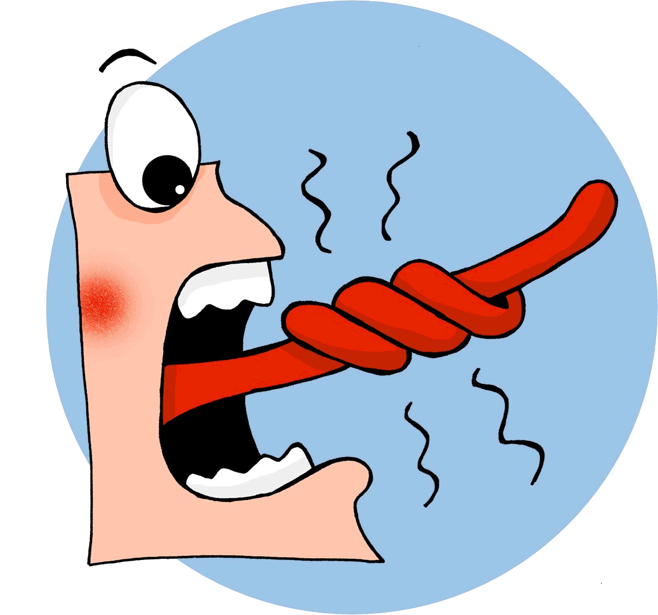
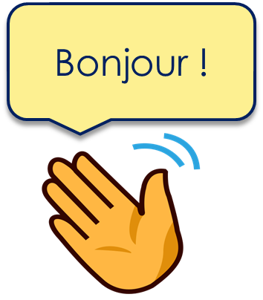
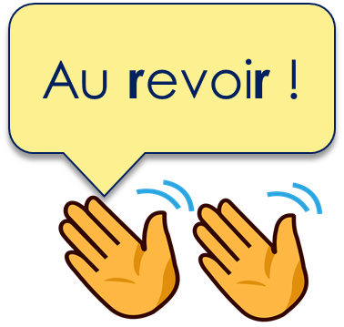
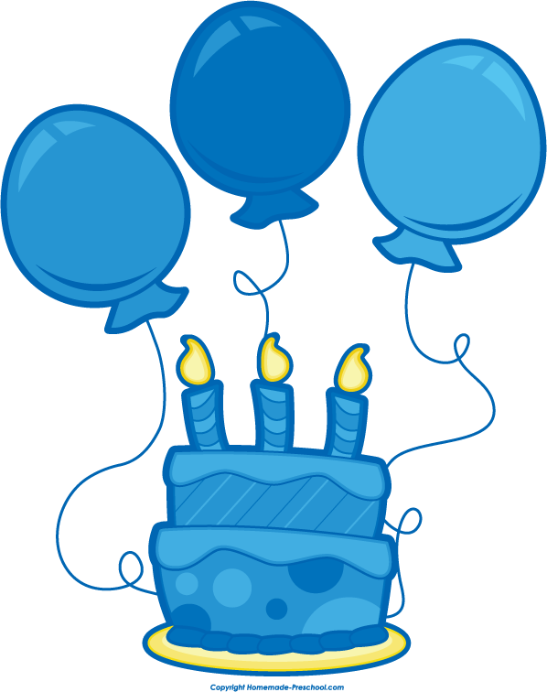
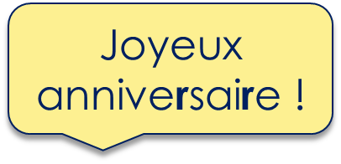
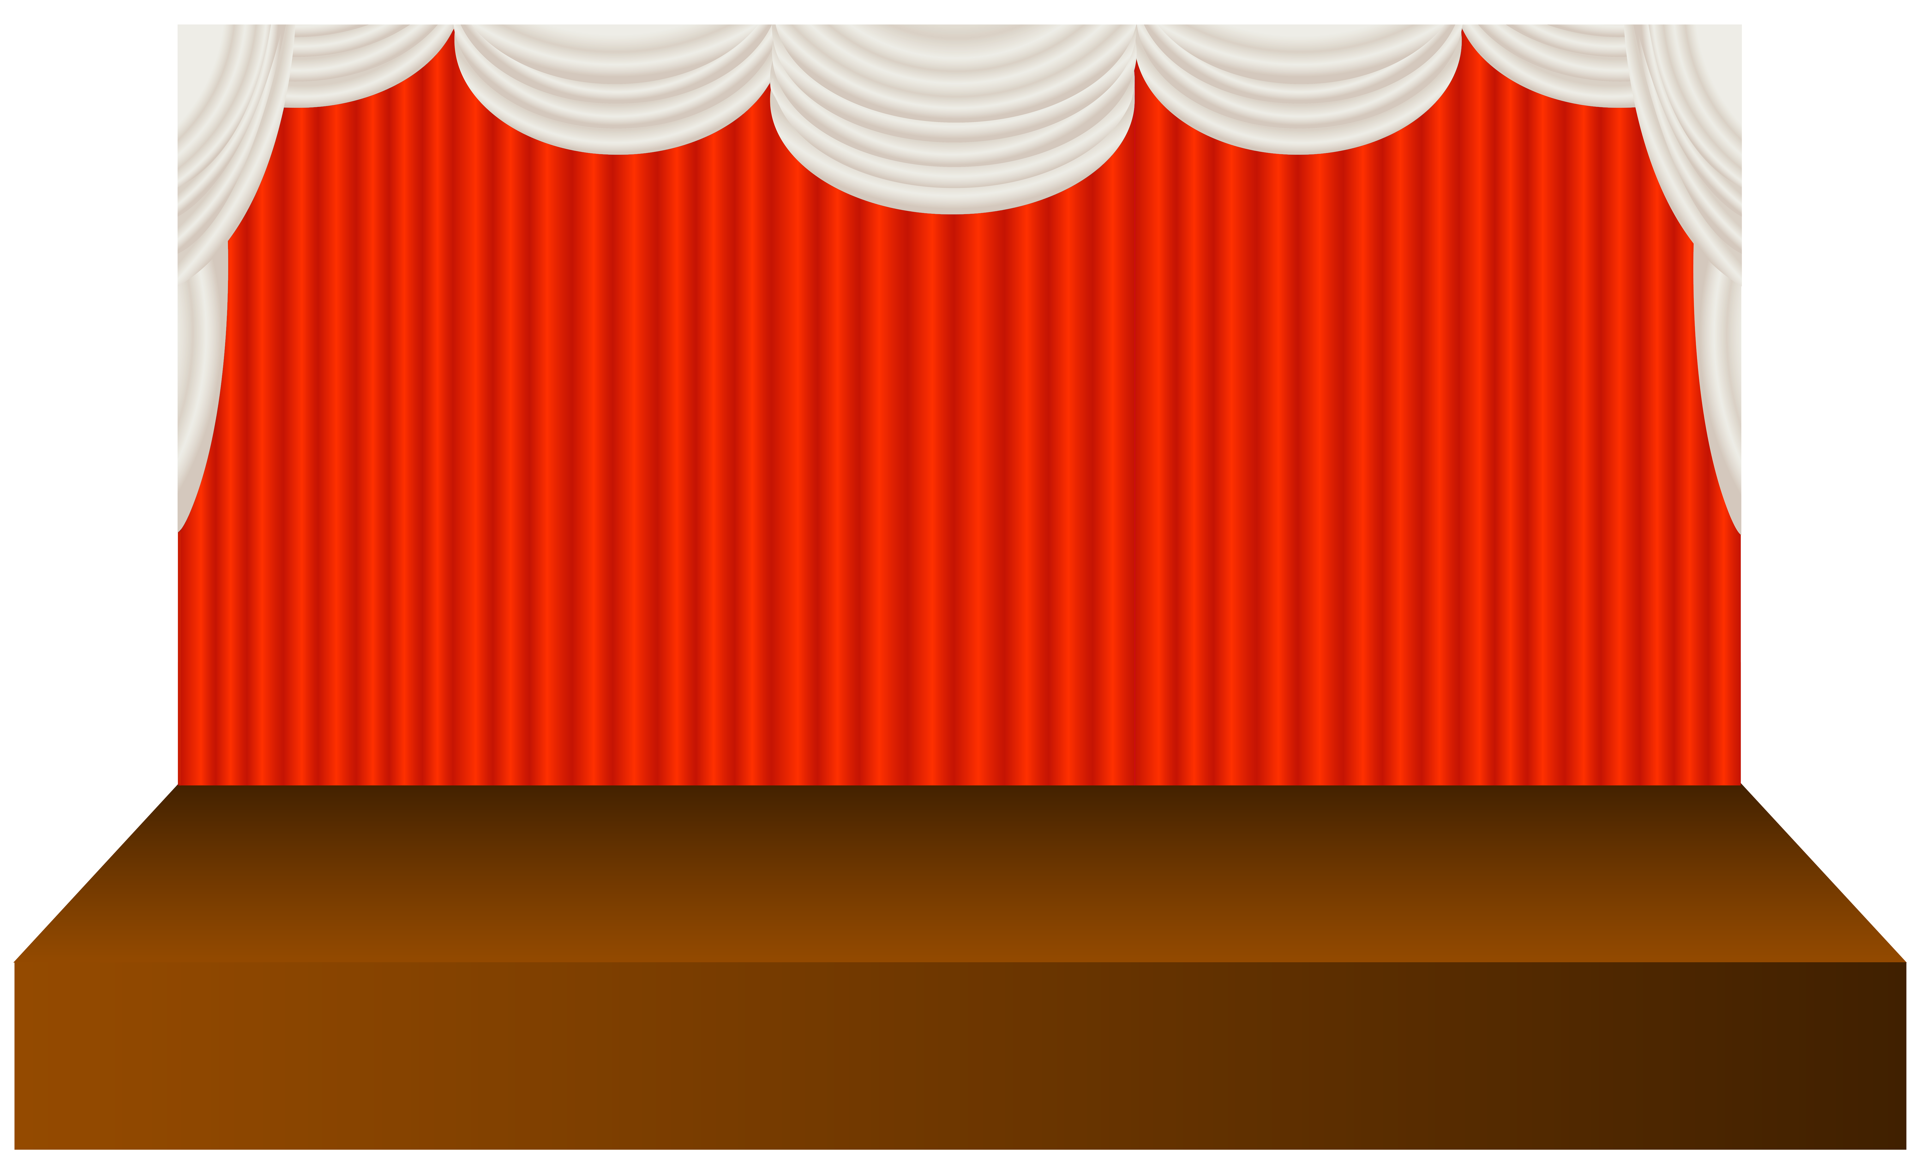
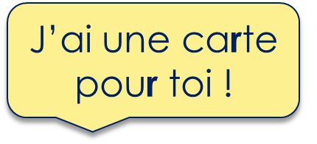
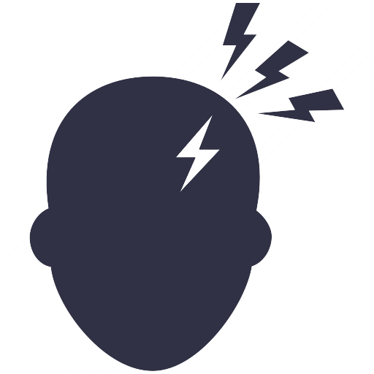
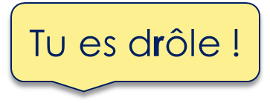
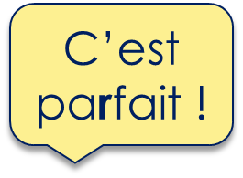
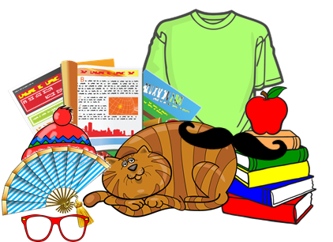
Jaune Knowledge Organiser - Summer Term B
Ça va comment ?
avoir – to have|having
j’ai – I have
tu as – you have
il a – he has
elle a – she has
la chaud – heat, warmth
le froid – cold
le mal – pain, ache
la peur – fear
Opinions et activités
adorer - to love, loving
détester – to hate, hating
apporter – to bring, bringing
étudier – to study, studying
le matin – morning
la langue – language
les – the (plural
merci – thank you
de rien – you’re welcome
Phonics
gymnastique
[j/soft g]
jour
j’ai
génial
déjà
I have
motion
pollution
population
[-tion]
Attention !
solution
Watch out!
⚠ There is no sound like this in English!
triste
moderne
être
parler
[r]
rue
French [r] is a raspy sound pronounced in the back of the throat.
Frédéric, mon frère, fabrique trois fruits en fromage !
Learning languages is about making friends.
You show kindness when you learn even a few words in another language.
Let’s remember some of the friendship sentences we have learnt already!
Knowing who does what | Infinitive verbs
 | Ask ‘What is it like?’ Comment ? means How? but:
We know the infinitive verb tells us the general meaning.
Remember that there are two ways to translate French infinitives into English:
Add‘de’ to link adjective and verb.
What else can you say?
parler ➜ to speak, speaking
C’est facile de parler français.
➜ It’s easy to speak French.
We can add a noun to say what hurts.
To mean ‘i’, you’, ‘s/he’, change the verb ending to match the pronoun:
Pupils prepare a show (un spectacle) for the end of the year. They rehearse in the big hall or gym. Sometimes
they wear a costume (un déguisement).
J’ai mal à la tête.
Parler français, c’est facile.
➜ Speaking French is easy.
J’ai mal à l’oreille.
je parle ➜ I speak
tu parles ➜ you speak il parle ➜ he speaks elle parle ➜ she speaks
Two verb structures
Avoir not être You know that avoir means ‘to have, having’: We also sometimes use avoir to mean ‘to be, being’:
J’ai mal au pied.
When a French sentence has two verbs, the 2nd verb is in infinitive form.
J’ai un chien. ➜
I have a dog.
Les – the (plural)
J’aime parler français. ➜
I like speaking French.
In English we usually say –ing in two-verb structures.
J’ai froid. ➜
I am cold.
⚠ These literally mean: I have cold. You have heat. He has fear.
She has pain.
We know the word ‘des’ means some for both masculine and feminine nouns:
Tu as chaud. ➜
You are hot.
Voici des groupes. ➜ Here are some groups.
J’aime le français. ➜
I like French.
Always use ‘le/la’+ noun after verbs of opinion.
Il a peur.➜
He is scared.
The plural word for ‘the’ is ‘les’. It is the same for both m and f nouns.
Elle a mal. ➜
She is in pain.
Voici les groupes. ➜ Here are the groups.
Et toi ? And you?
Use ‘Et toi ?’ to add a yes/no question to any statement.

