Slide 1
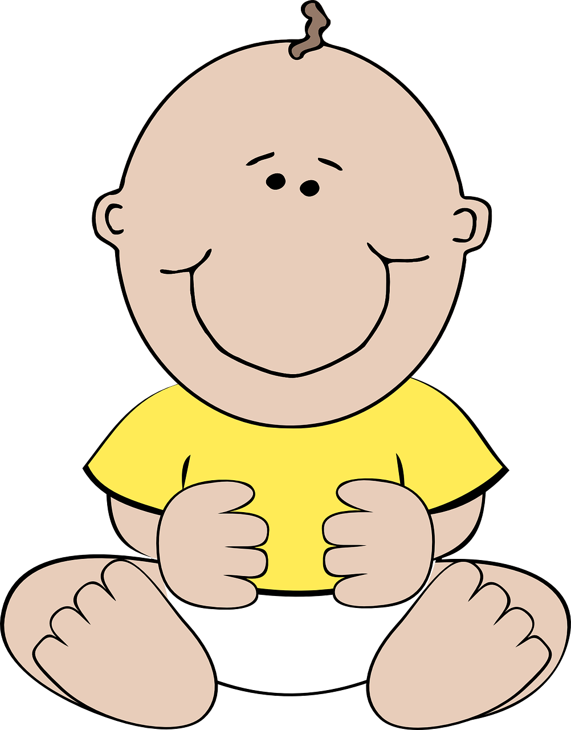
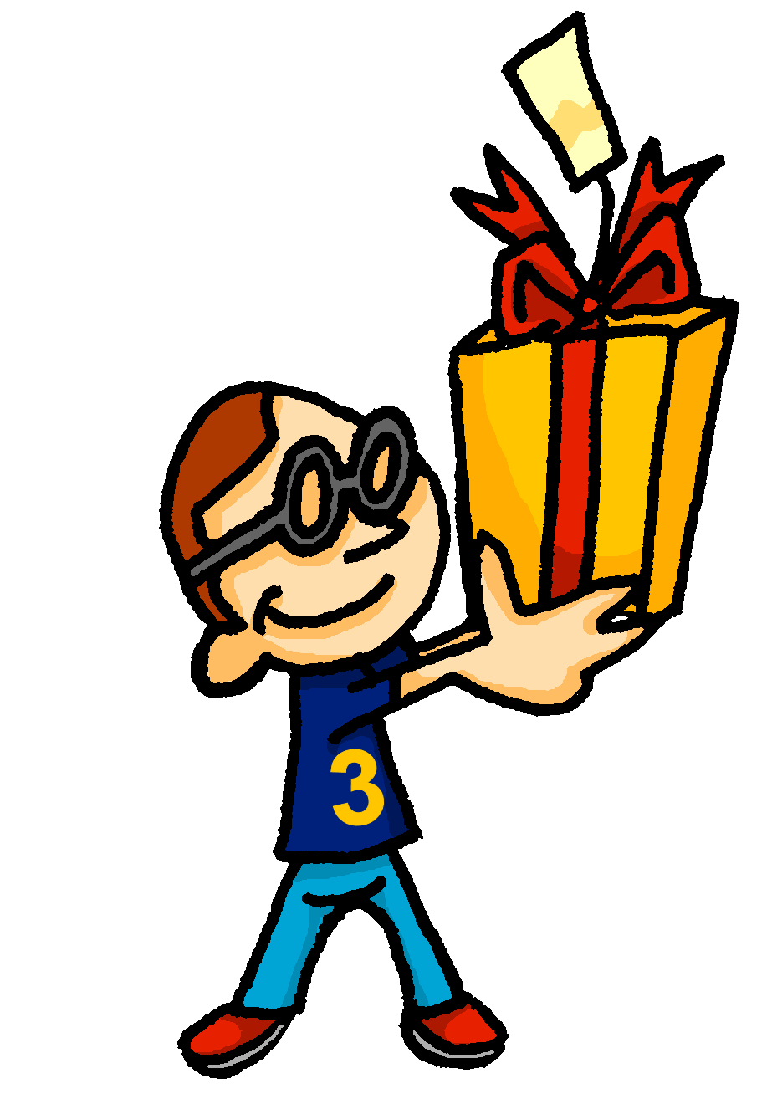
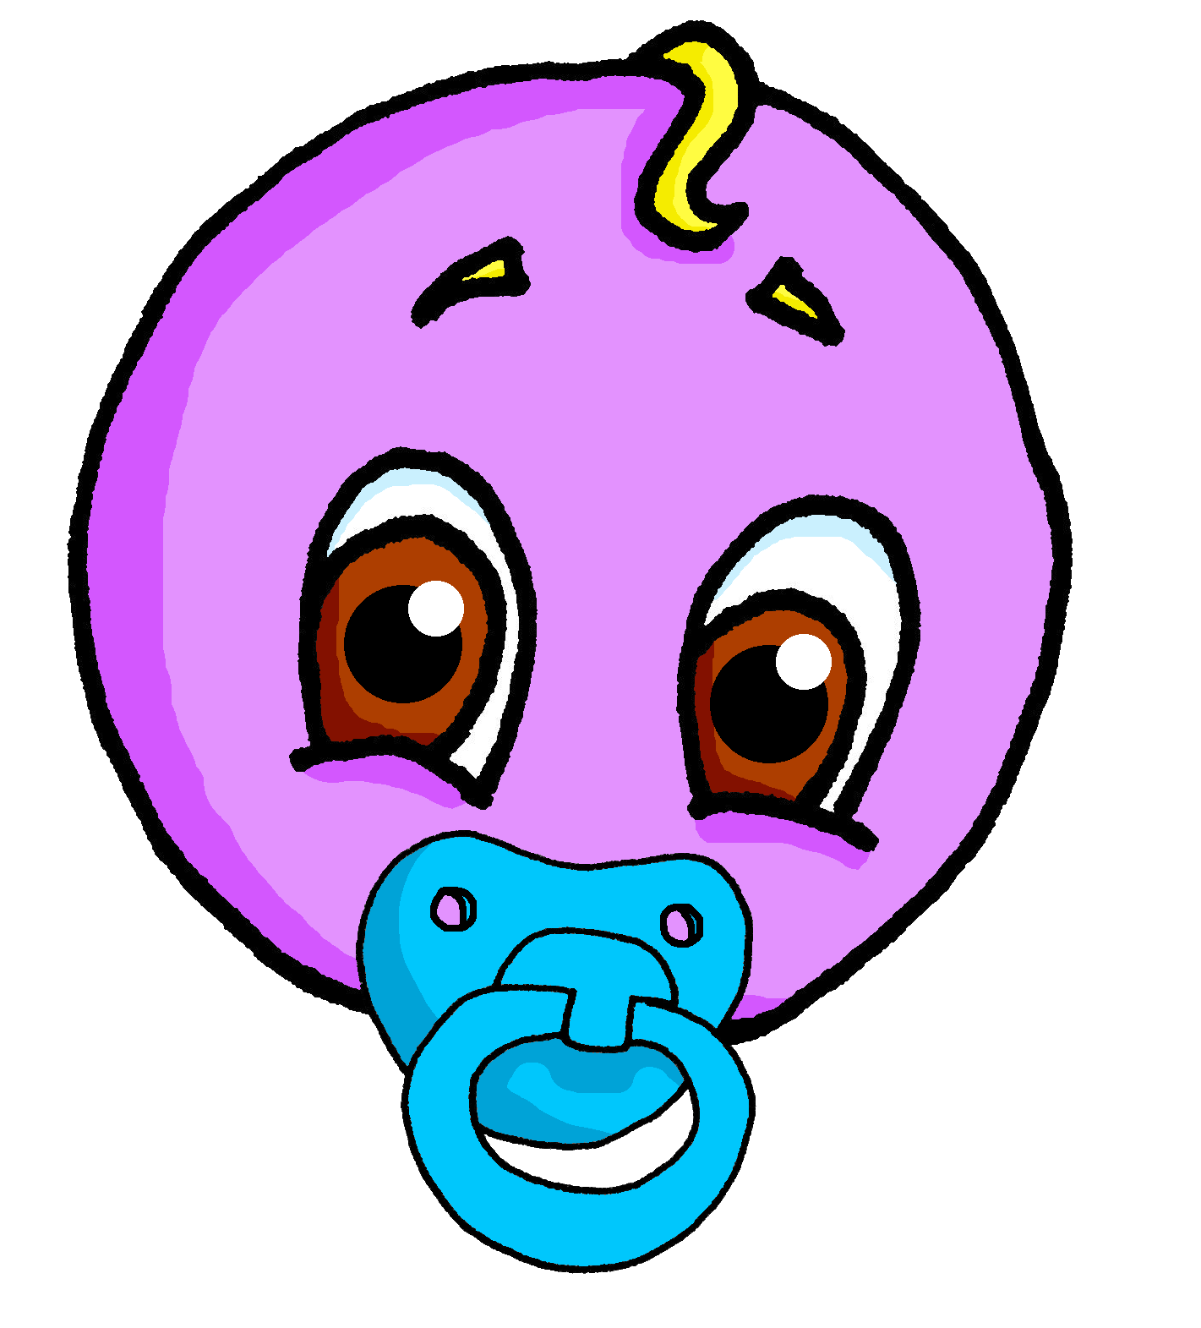
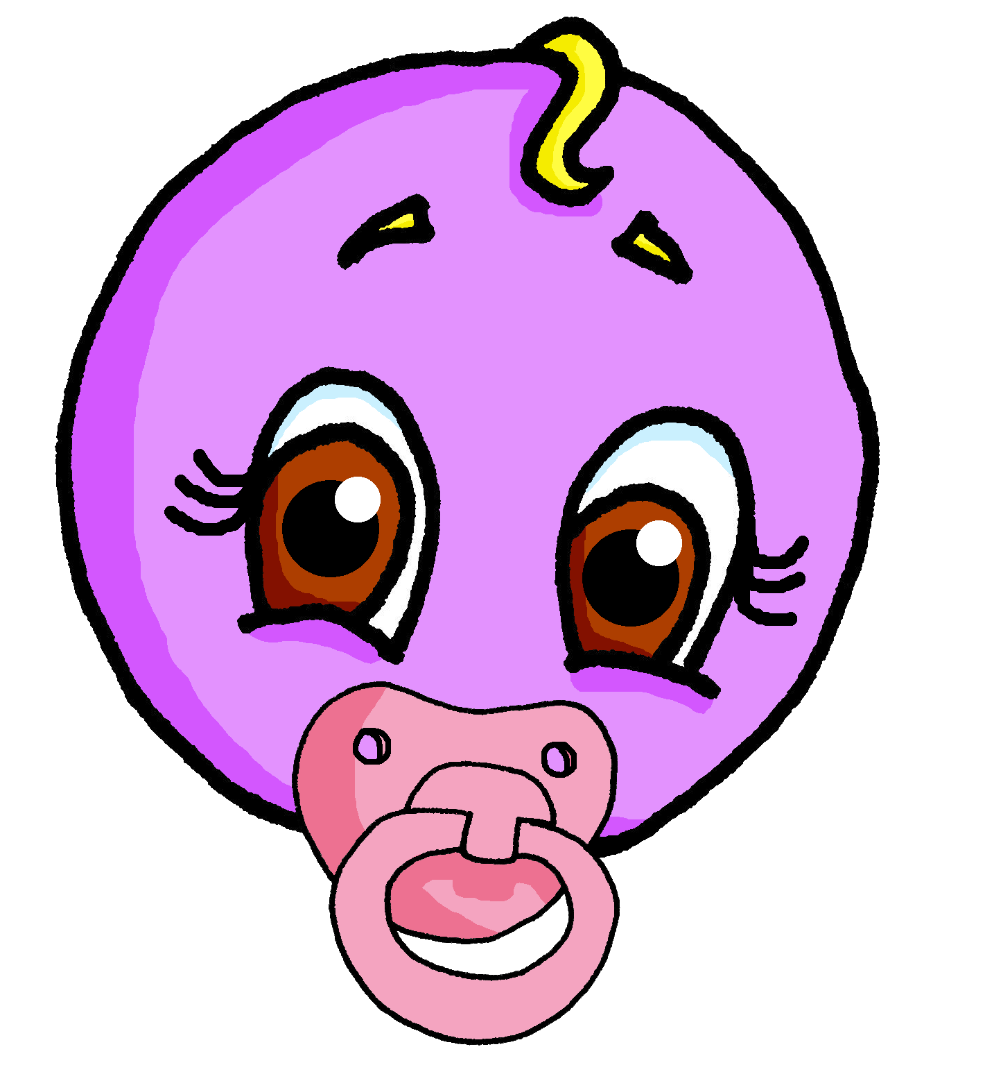
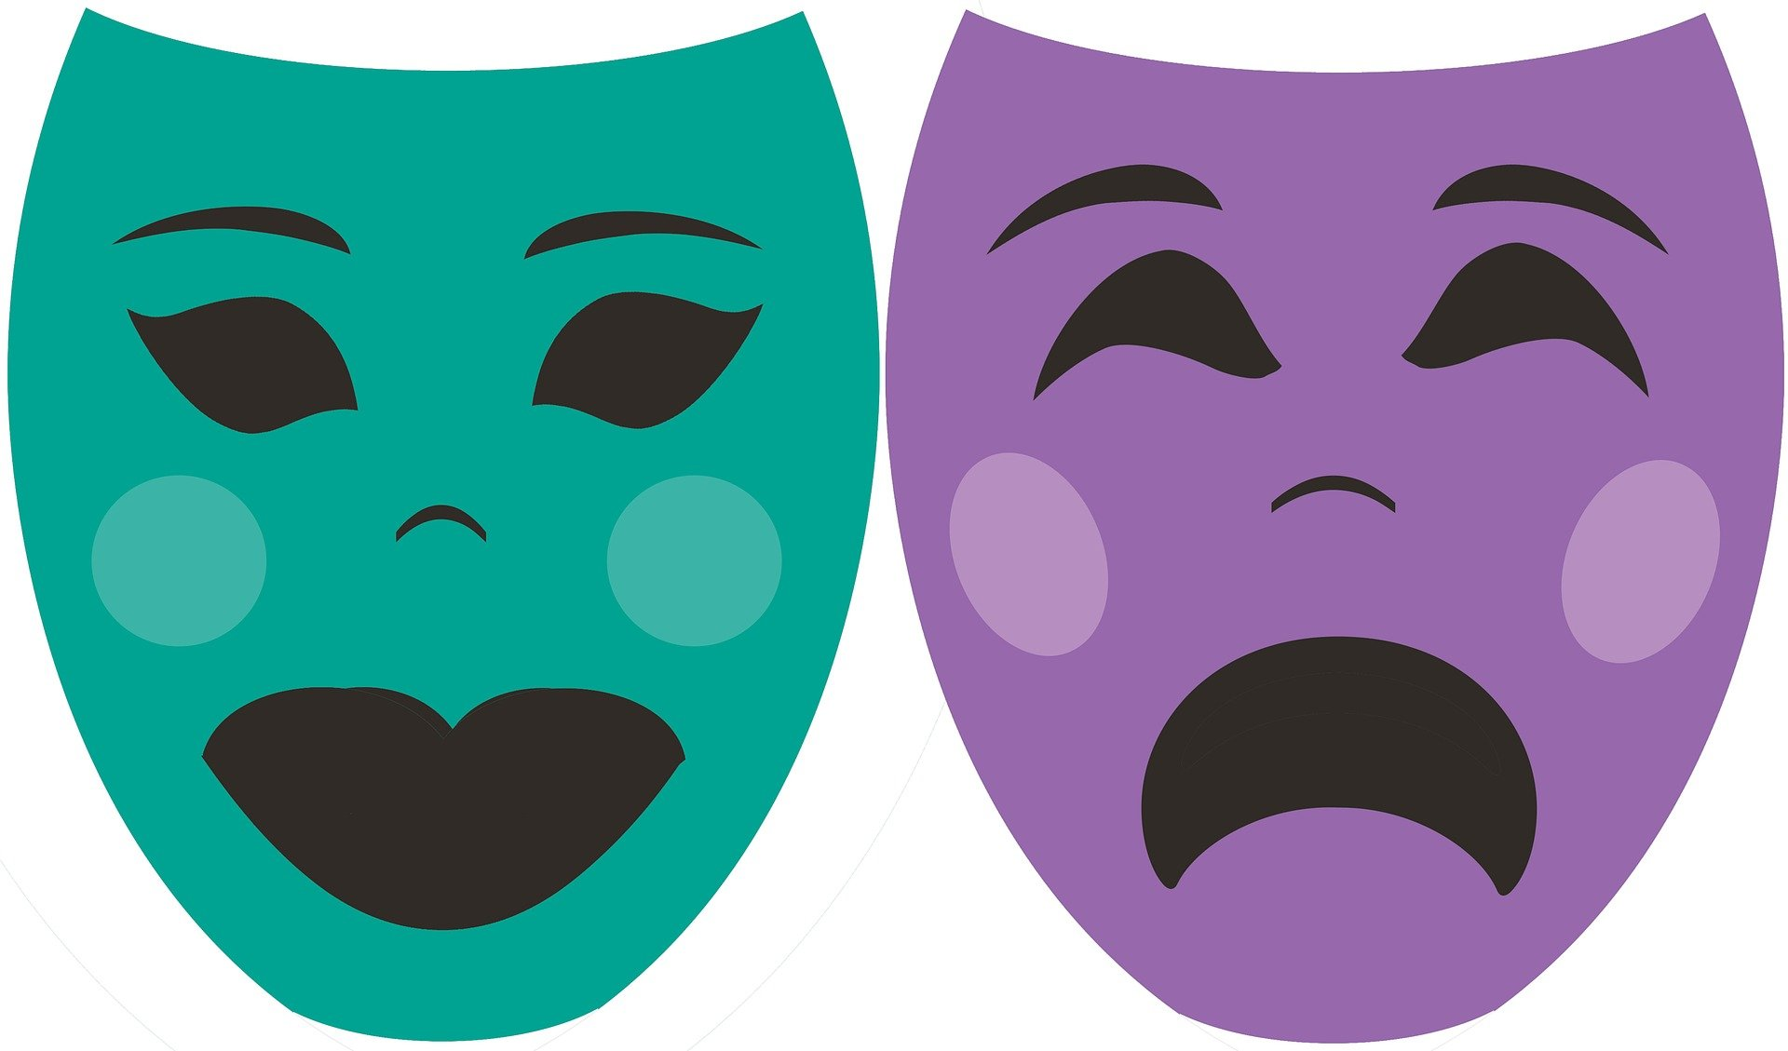
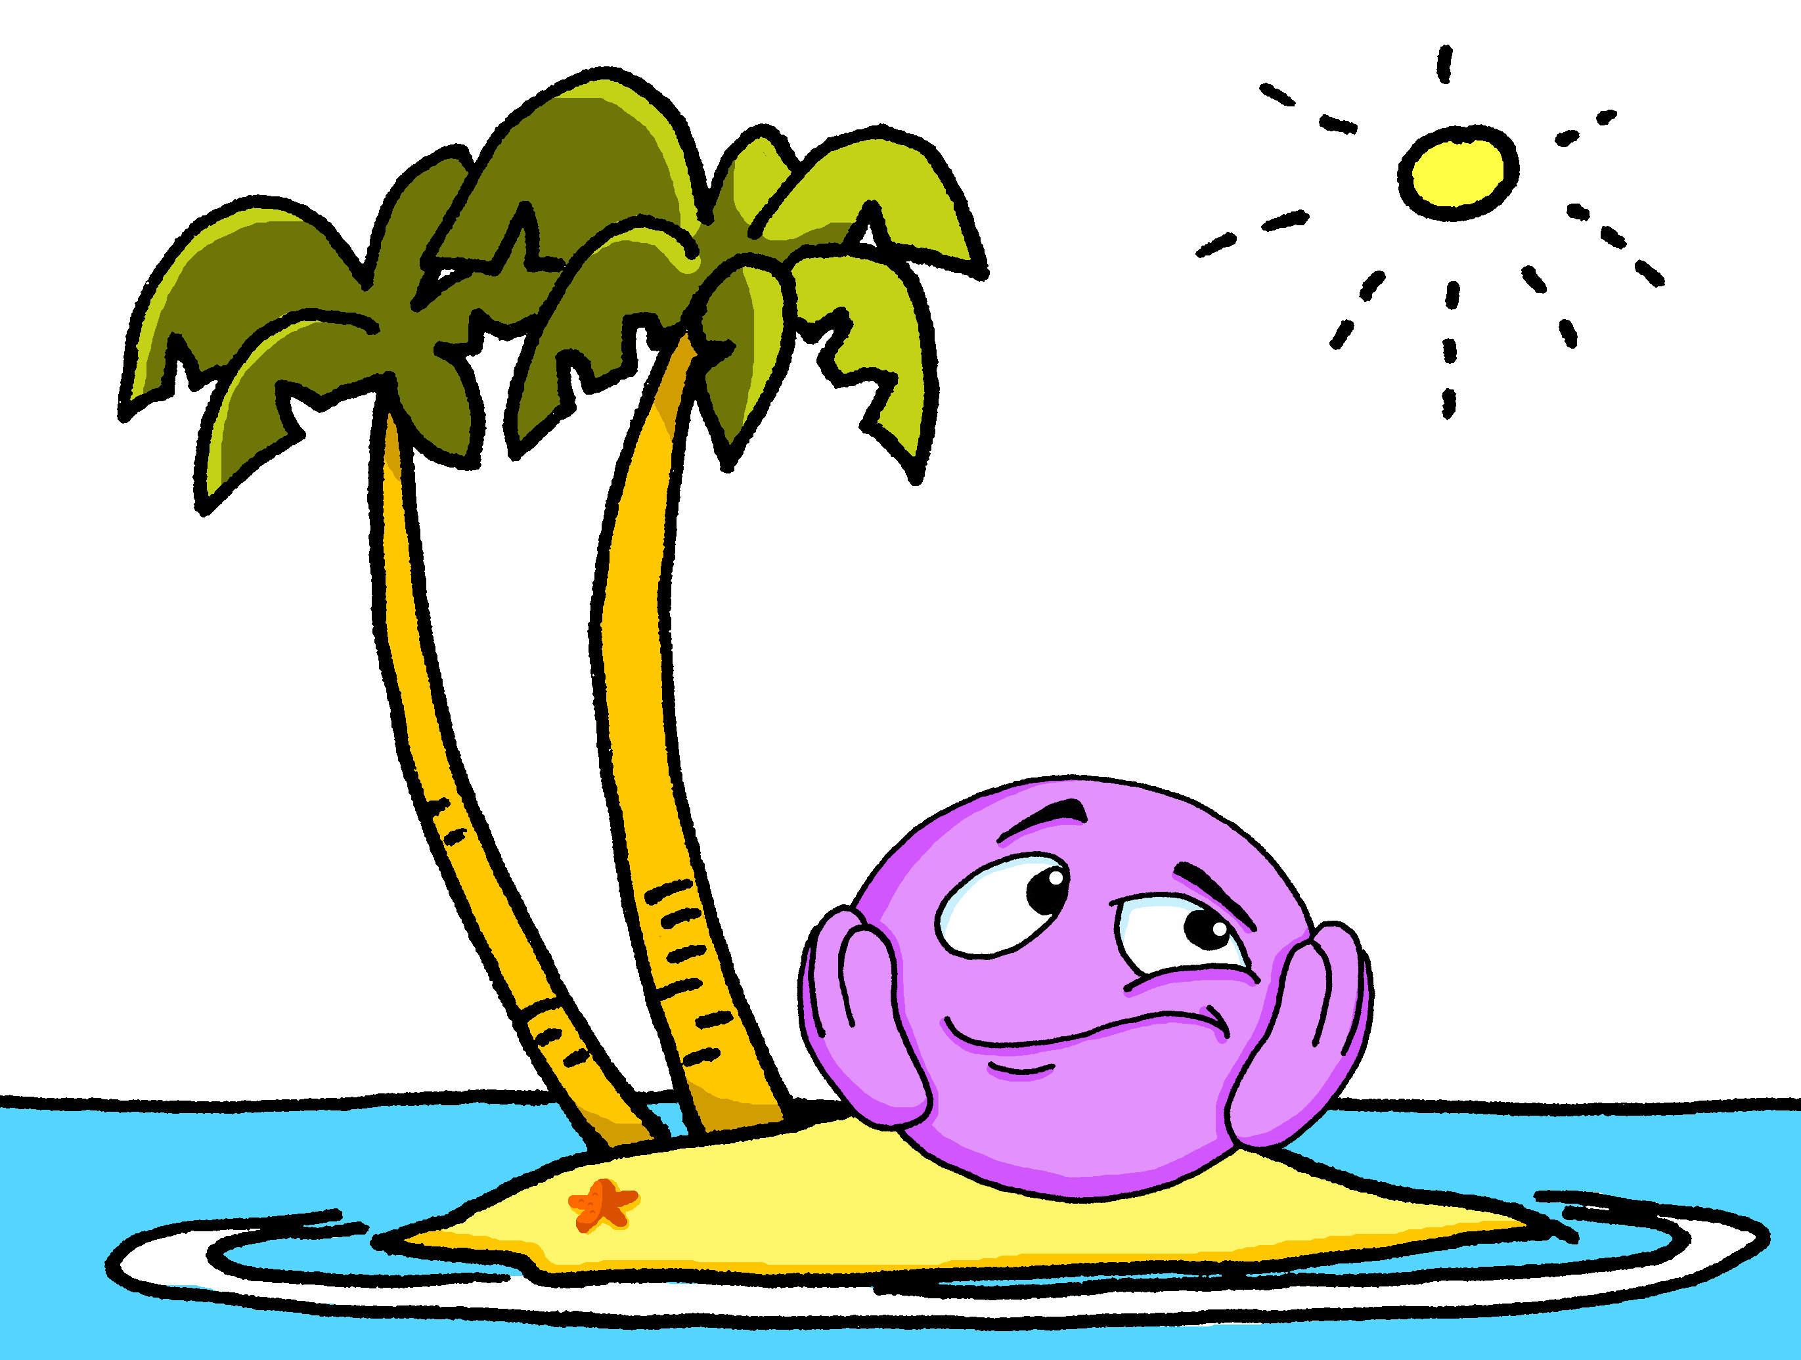
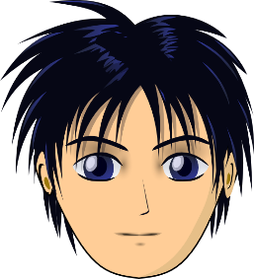
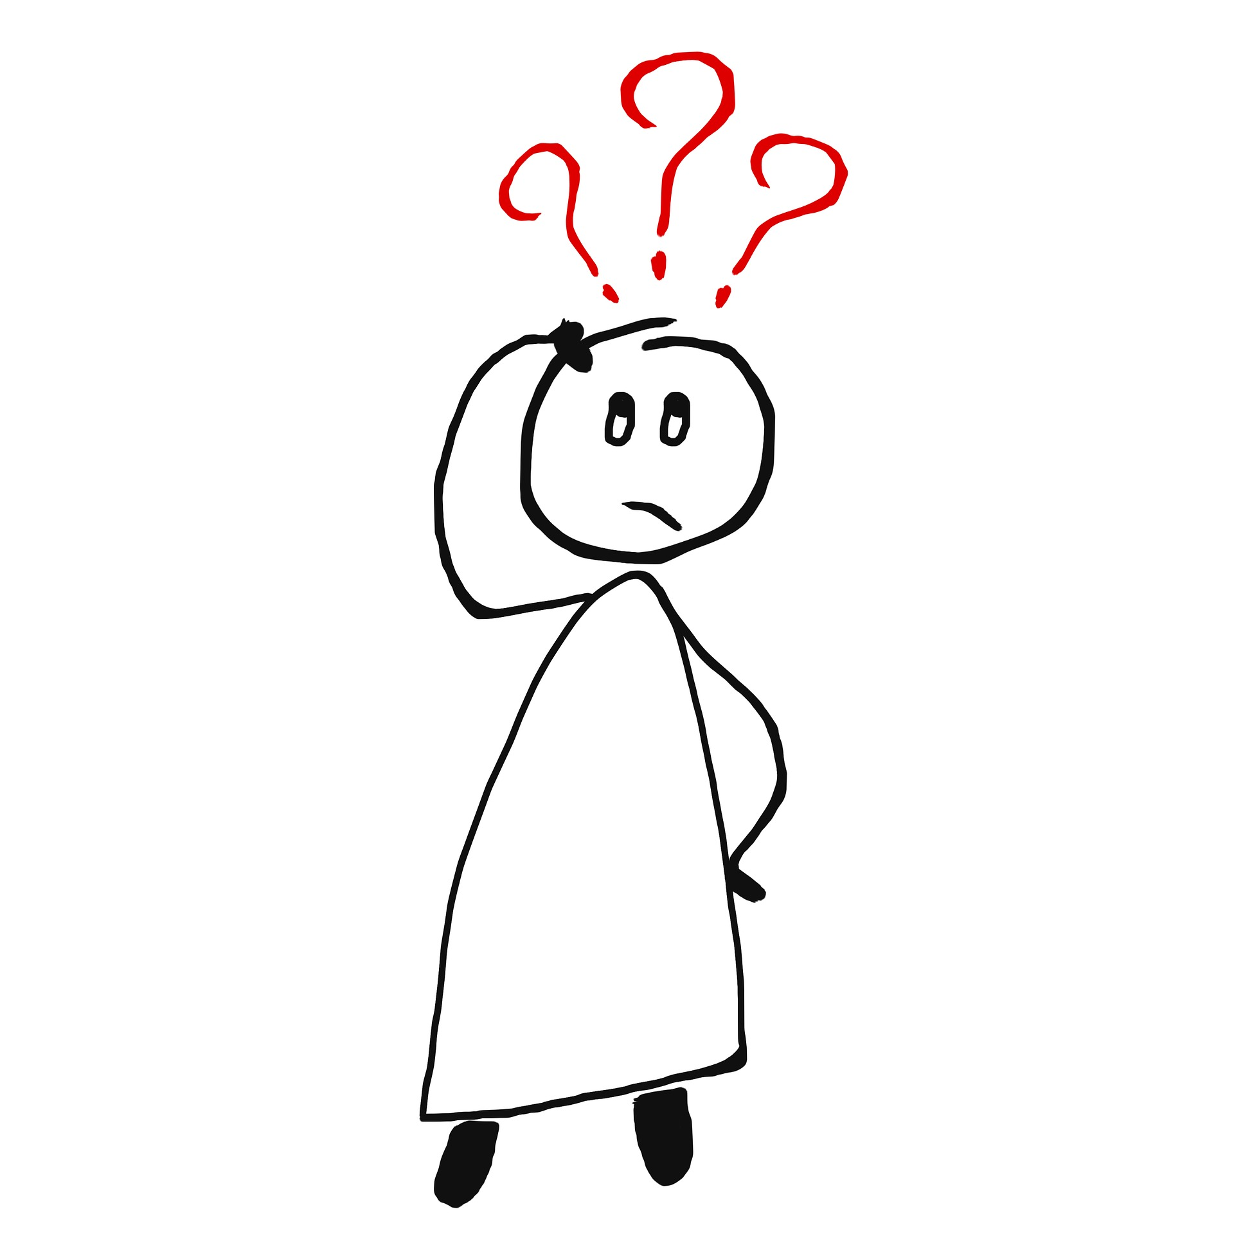
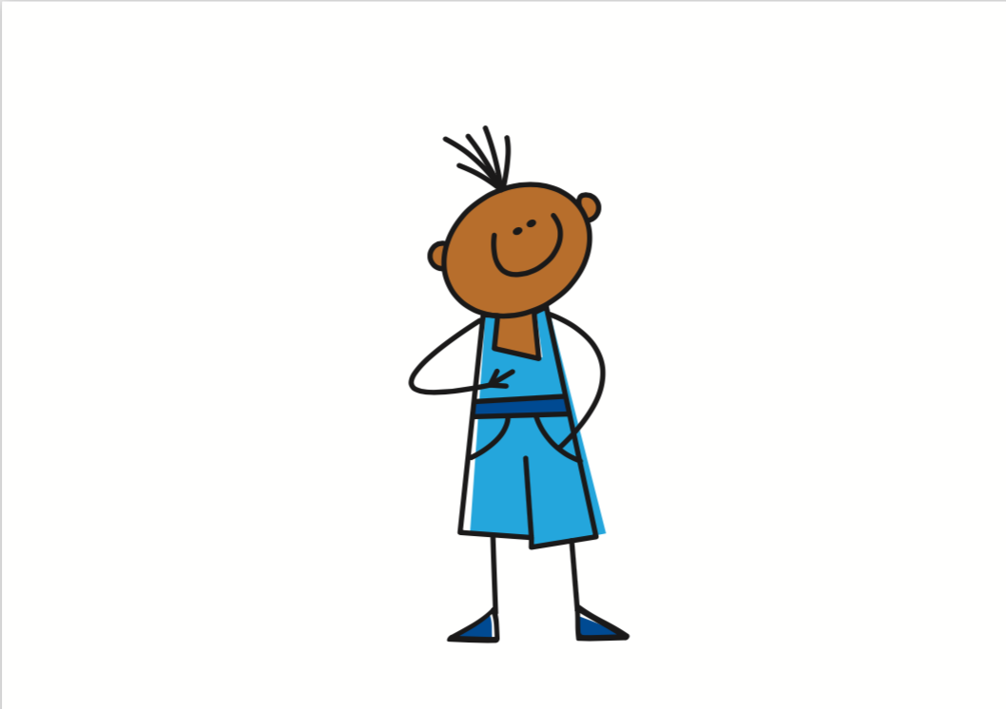
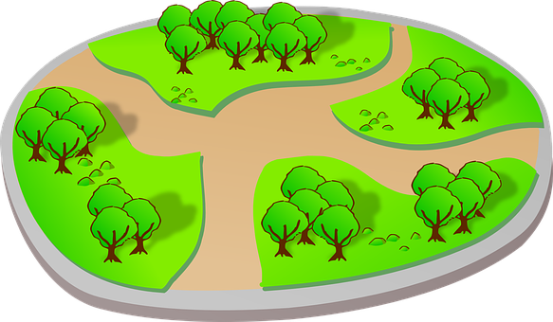
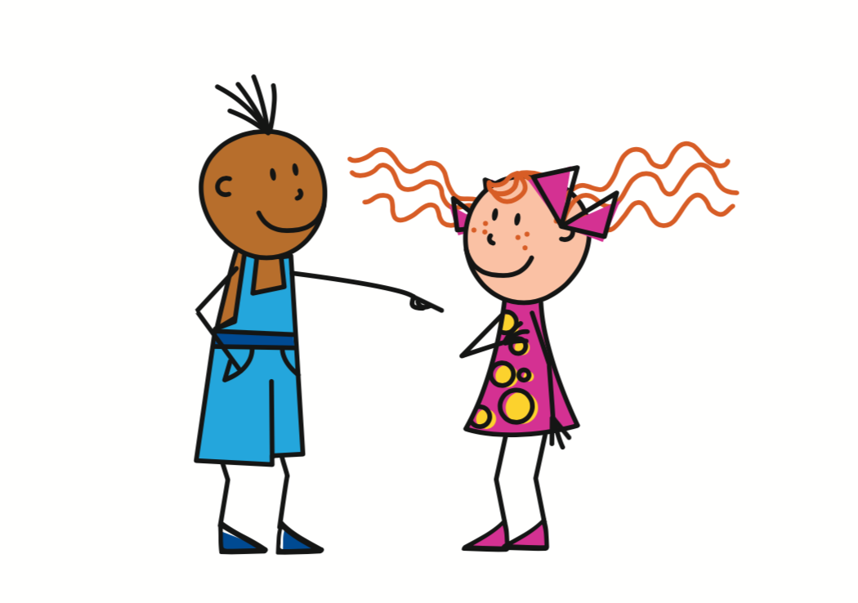
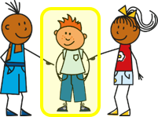
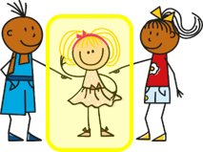
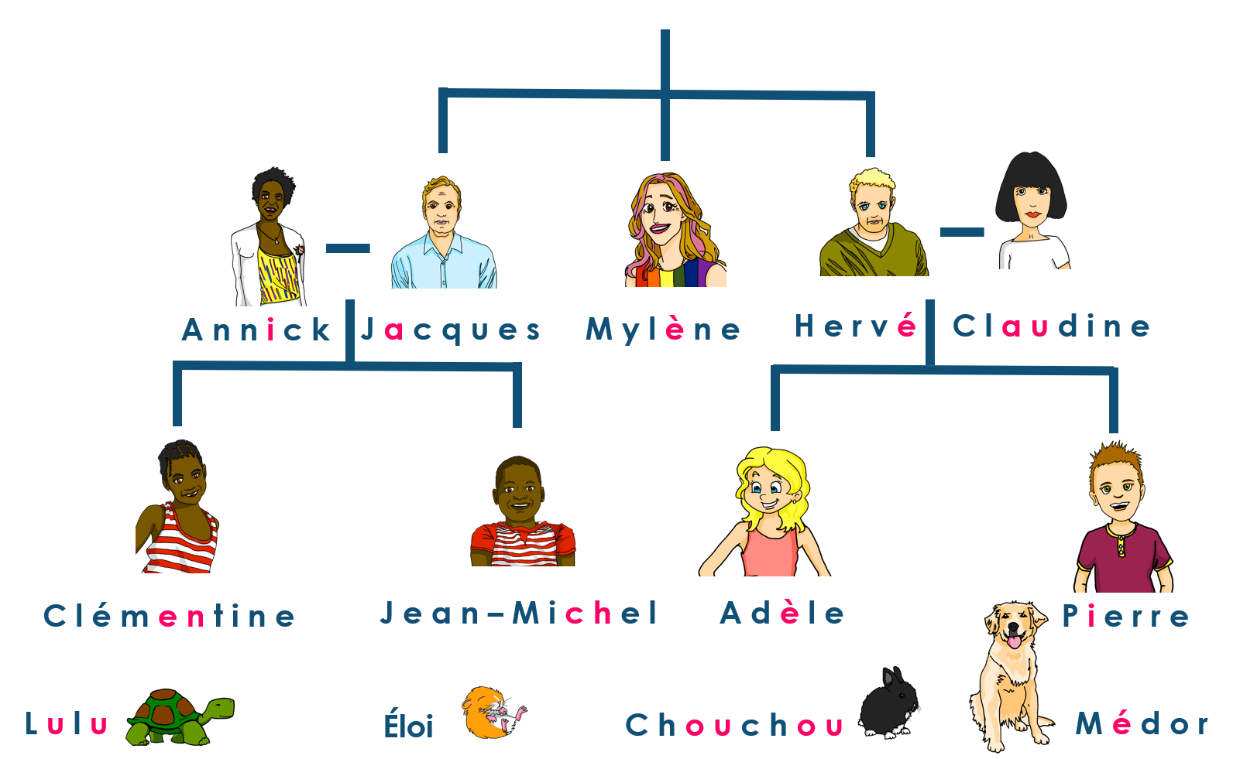
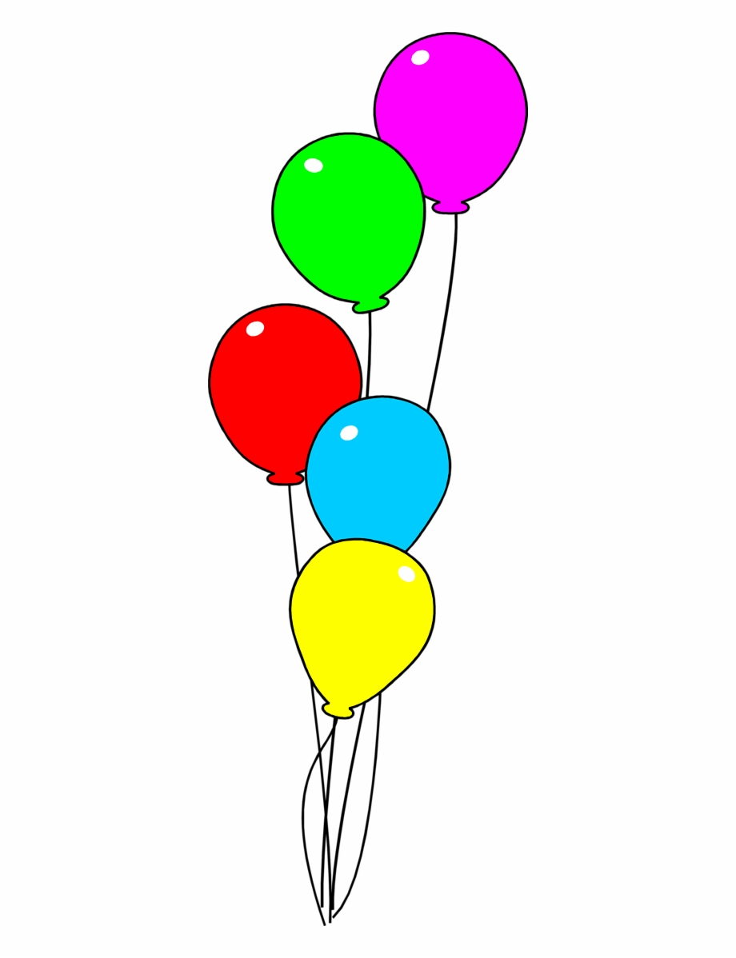
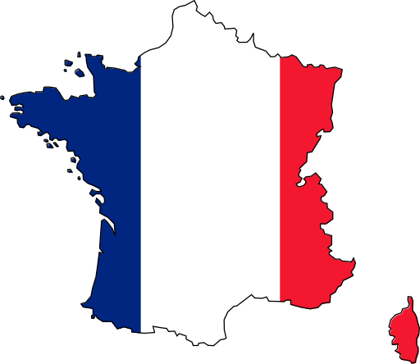
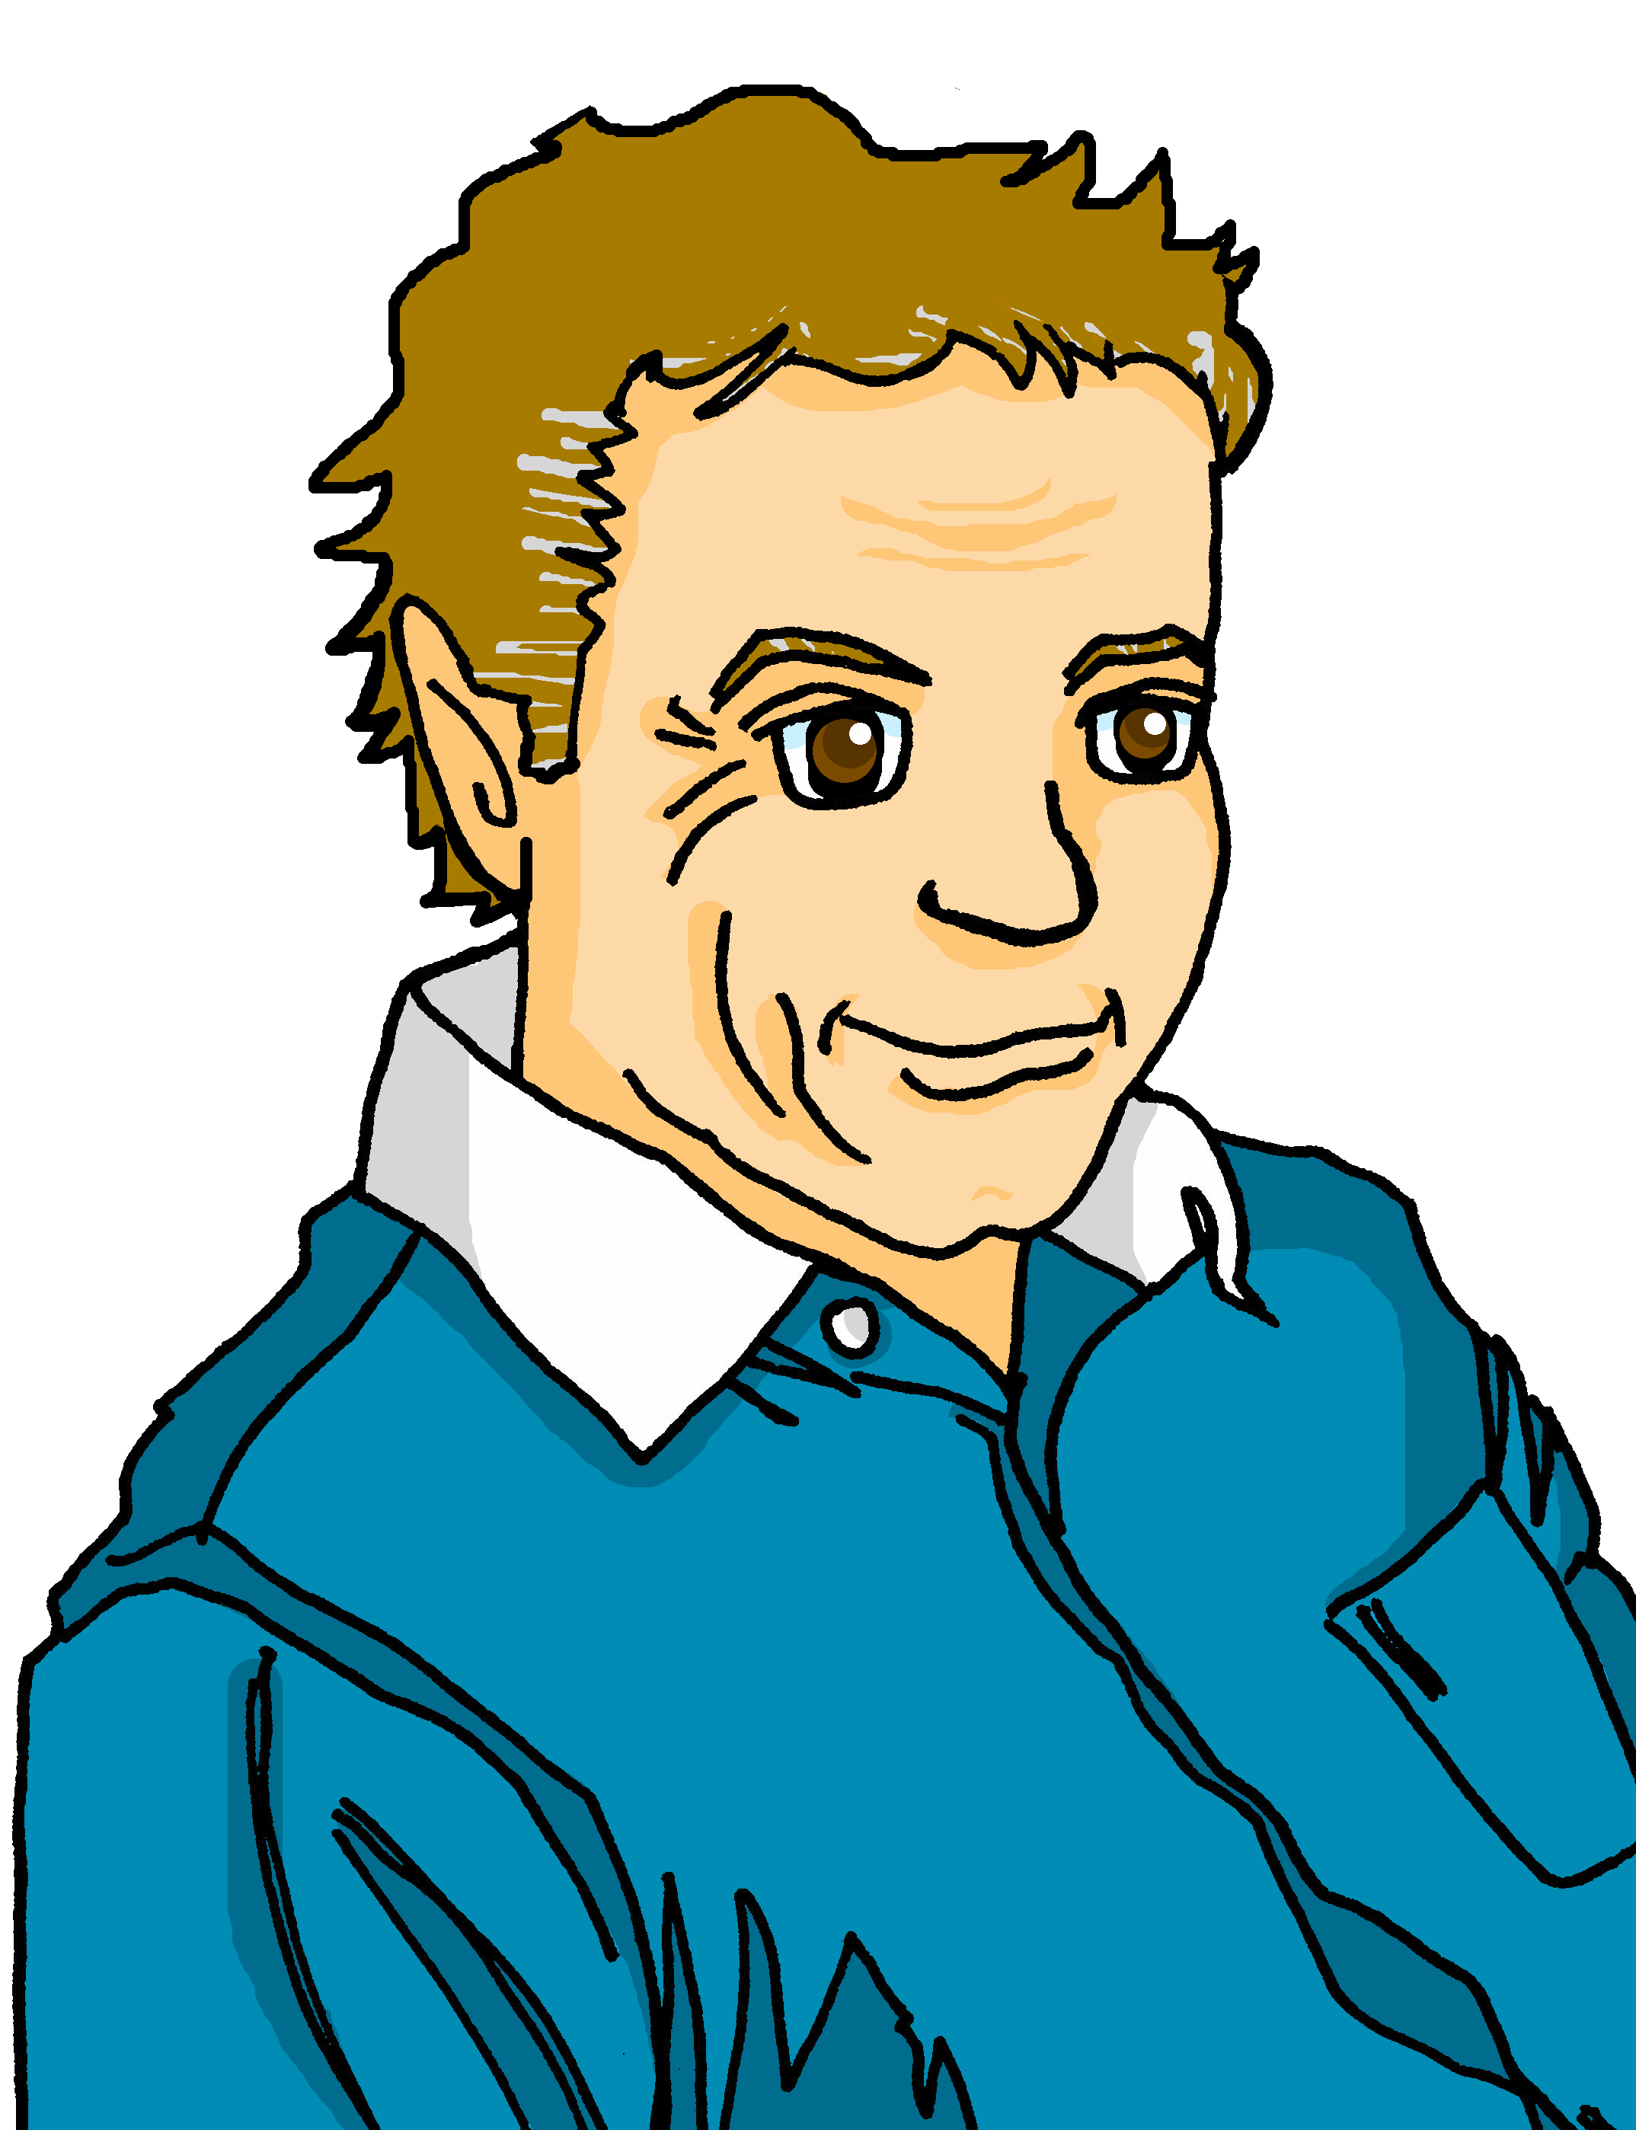
Jaune Knowledge Organiser - Spring Term A
Les activités
aimer – to like|liking
chanter – to sing|singing
chercher – to look for|looking for
dessiner – to draw|drawing
enseigner – to teach|teaching
jouer – to play|playing
organiser – to organise|organising
poser – to put (down), ask (question)
préférer – to prefer|preferring
préparer – to prepare|preparing
présenter – to present|presenting
prononcer – to pronounce, pronouncing
visiter – to visit|visiting (place)
La description
facile – easy
grand, grande – tall, big
intéressant, intéressante – interesting
petit, petite – short, small, little
le, la – the (m), the (f)
mon, ma – my (m), my (f)
ton, ta – your (m), your (f)
avec – with
en ligne – online
dehors - outside
À l’école (at school)
l’anglais (m) – English
le français – French
l’image (f) – image, picture
le mot - word
la musique – music
le sport – sport
le texte - text
la visite - visit
l’émission (f) – programme
la radio – radio
la television, télé – television, tv
Les lieux (places)
le musée – museum
le parc – park
le pays – country
l’université (f) – university
Voici – Here is, there is
l’ami (m) – (male) friend
l’amie (f) – (female) friend
la grand-mère – grandmother
le grand-père – grandfather
la tante - aunt
Phonics
[é] [er] | répéter | écrire | bébé
[et] [ez] | parler | donner | et | nez
[nose]
open [eu] | peur | jeune | neuf | acteur | seul
[fear]
[young]
[alone]
[è] [ê] | fête | tête | frère | être | problème
[head]
[to be, being]
Infinitive verbs Use two meanings in English for infinitive verbs in French: C’est facile de visiter un parc. ➜ It’s easy to visit a park. Visiter un parc, c’est facile. ➜ Visiting a park is easy. | Present tense –ER verbs préparer – to prepare|preparing je prépare ➜ I prepare tu prépares ➜ you prepare il prépare ➜ he prepares elle prépare ➜ she prepares | Definite articles – ‘the’ To say the in French use le before a masculine noun and la before a feminine noun. le sport la musique Use l’ for any noun that starts with a vowel or h-. l’anglais (m), l’émission (f).
Possessive adjectives The adjectives ‘my’ and ‘your’ have different forms to match the gender of the noun they describe: mon pays, ton pays ma tante, ta tante | Use of ‘de’ for possession Le grand-père de Pierre ➜ The grandfather of Pierre OR Pierre’s grandfather. There is no apostrophe for possession in French.
et – and mais – but aussi – also, too

Slide 2
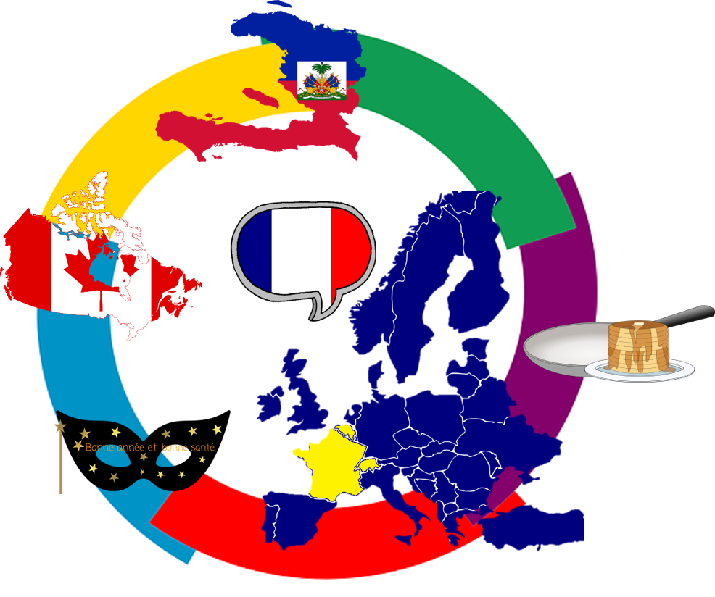
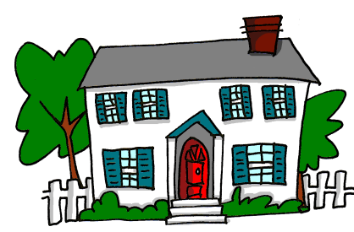
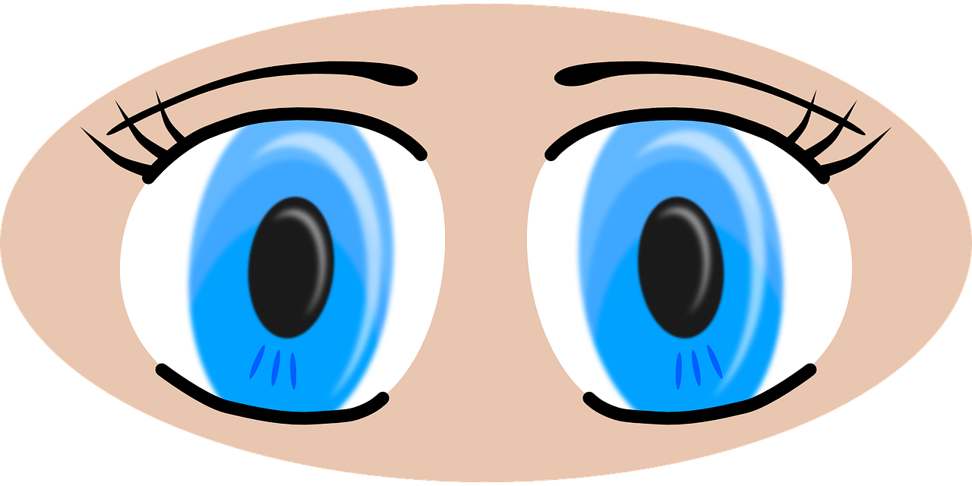
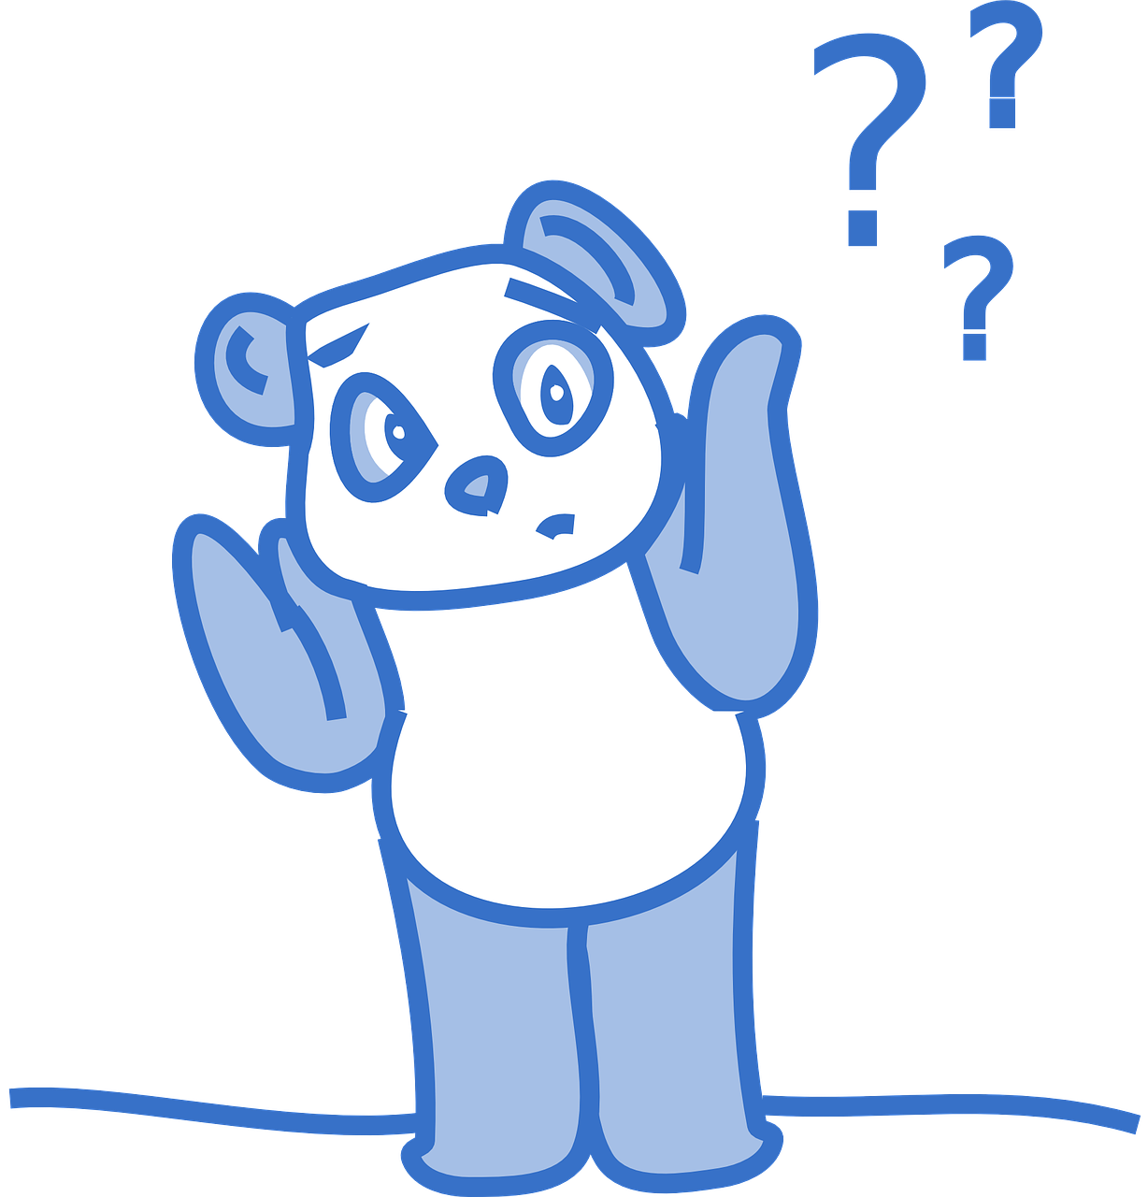
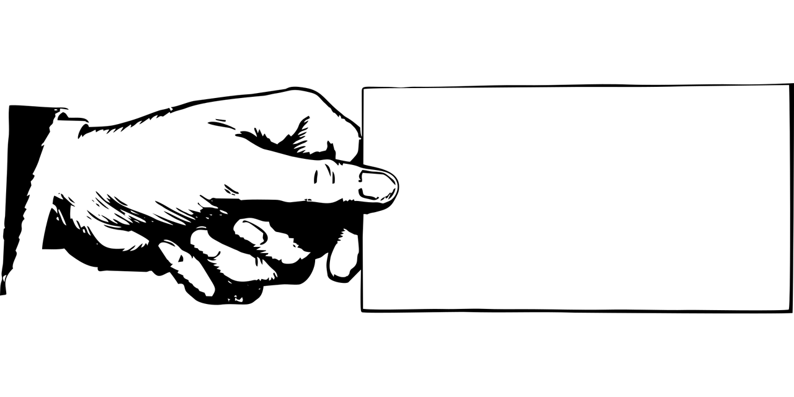
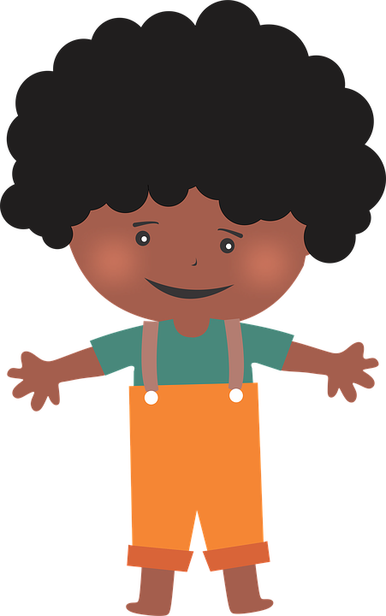
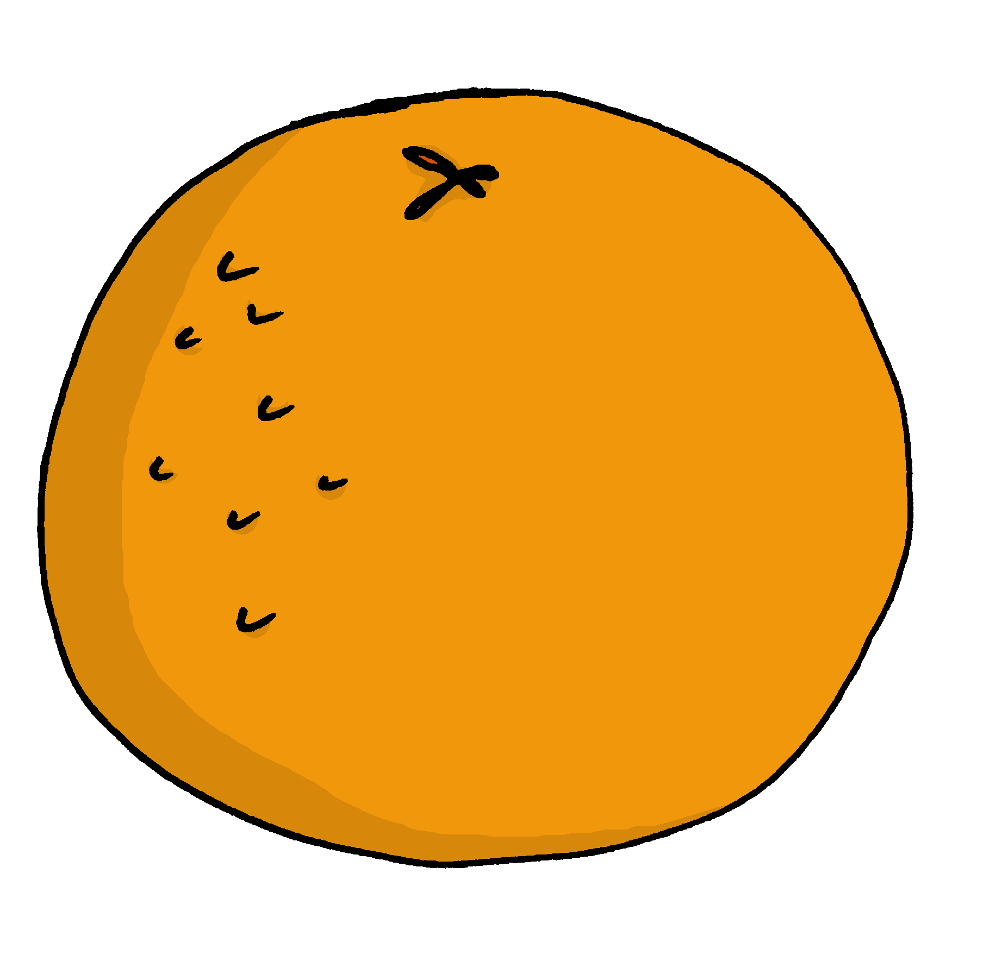
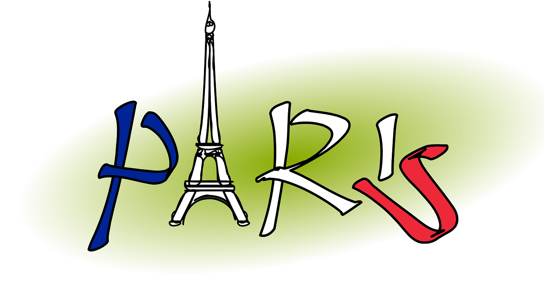
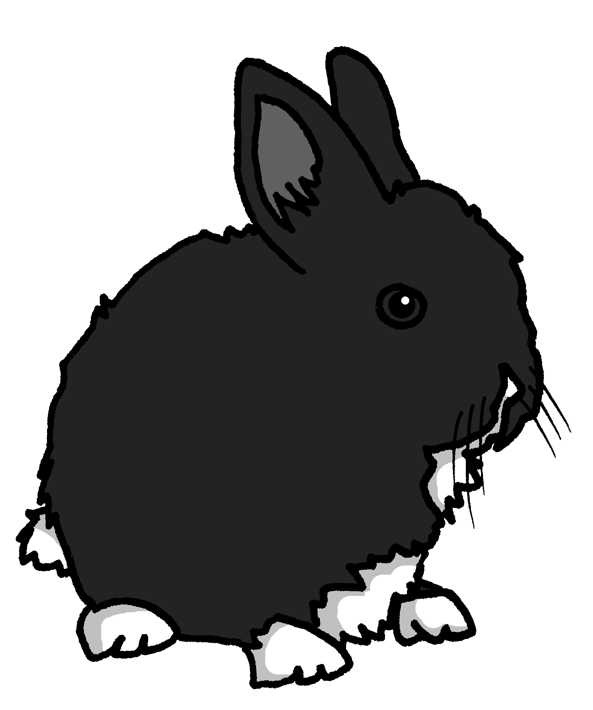
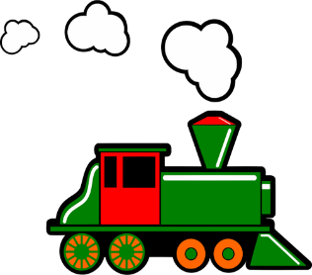
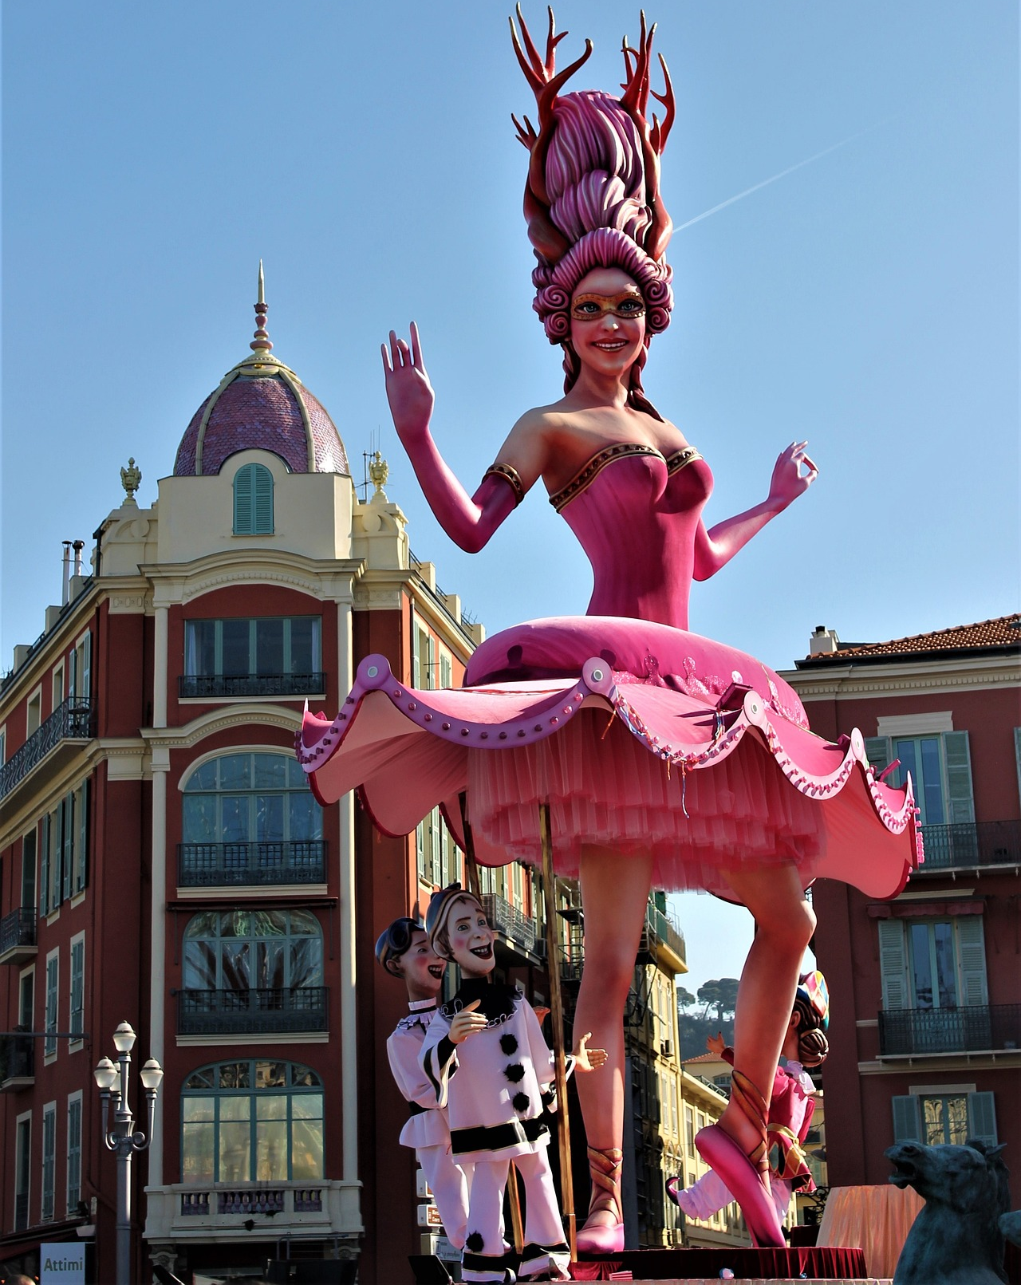
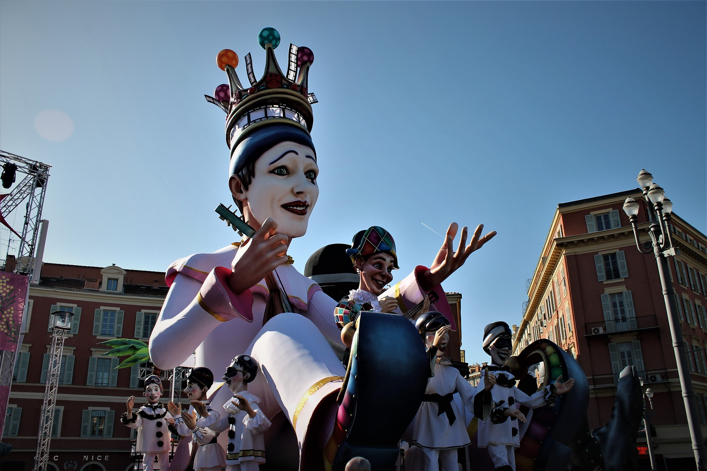
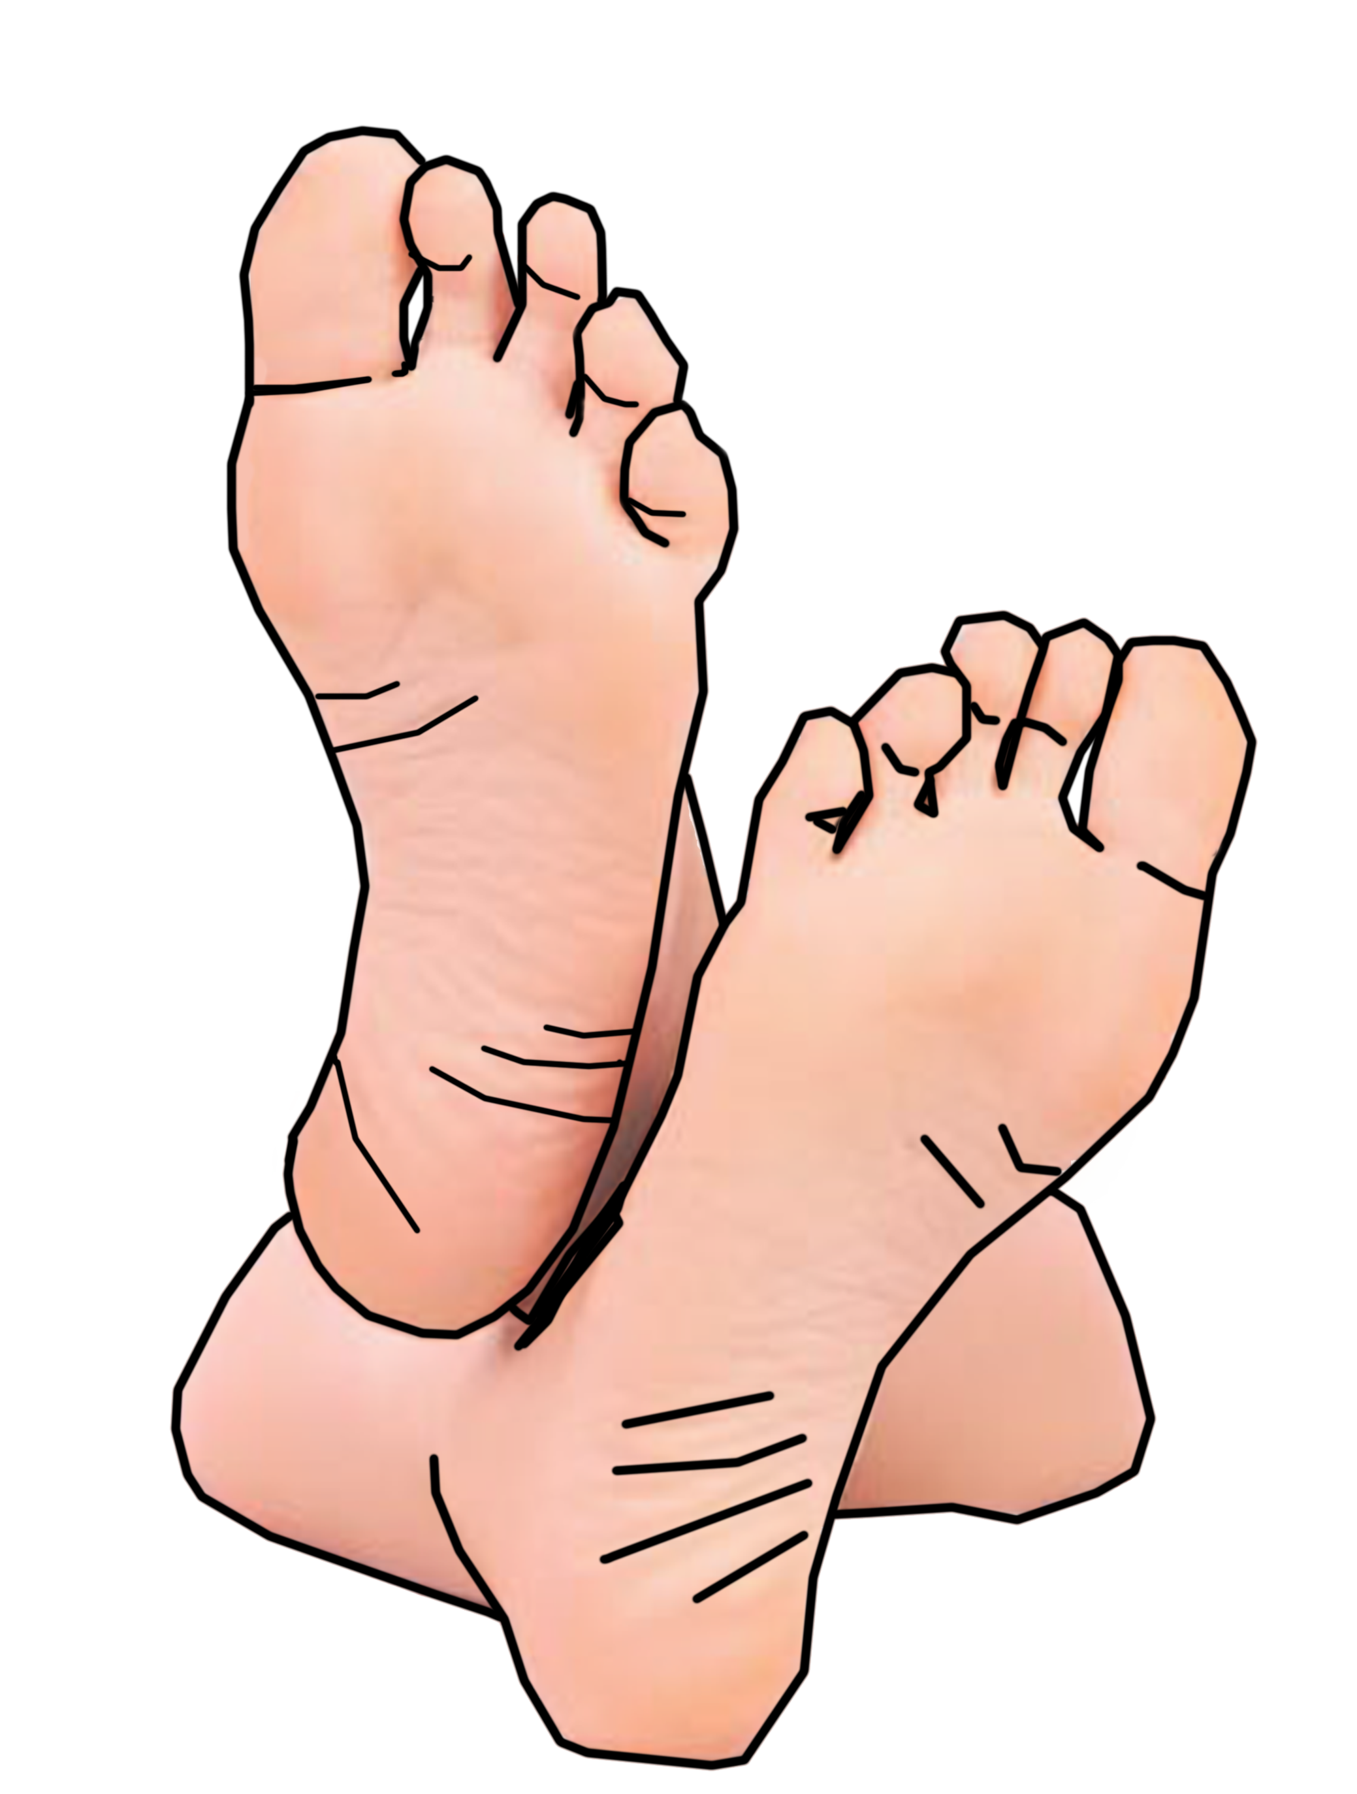
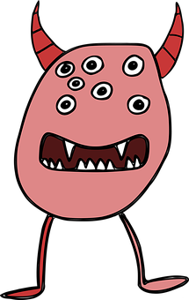
Jaune Knowledge Organiser - Spring Term B
Les activités
arriver – to arrive|arriving
montrer – to show|showing
rester – to stay, remain
à – to, at, on, in
Les nombres de 1 à 12
un – a/an (m), one (m)
une – a/an (f), one (f)
deux – two
trois – three
quatre – four
cinq – five
six – six
sept – seven
huit – eight
neuf – nine
dix – ten
onze – eleven
douze – twelve
combien (de) – how many
des – some
il y a – there is, there are
souvent - often
en ce moment – at the moment
Phonics
semaine
[ai]
vrai
maison
aider
aimer
to help, helping
to like, liking
week
[oi]
voir
avoir
to have, having
Au revoir !
pourquoi ?
trois
to see, seeing
why?
Liaison | s- and x-liaison before a noun starting with a vowel or h-. | deux enfants | trois oranges
le voyage | trip, journey
[(a)in]
train
vingt
main
fin
lapin
end
Translating the French present tense into English English has two present tense forms but French has one:
Indefinite article – ‘some’ Remember! To say a (or an) in French use un before a masculine noun and une before a feminine noun. To say some use des for all nouns: Il a des pieds. He/it has some feet. Il a des mains. He/it has some hands. Making nouns plural As in English, we can add an –s to the end of most French words to make them plural. However, the –s is silent in French! (SFC) You cannot tell by listening to a French noun whether it is singular or plural so always check its determiner.
Le Carnaval de Nice est une fête en février ou mars.
Tu parles à Pierre.
You speak to Pierre.
This is for a regular, repeated action in the present, like a routine.
You are speaking to Pierre.
Adverbs of time tell us which English meaning to use:
Tu parles à Pierre chaque semaine.
Le corps (body)
la bouche – mouth
la main – hand
l’œil (m) – eye
l’oreille (f) - ear
la tête – head
les yeux (mpl) - eyes
You speak to Pierre every week.
Tu parles à Pierre en ce moment.
This is for an ongoing action, now.
You are speaking to Pierre at the moment.

