Slide 1
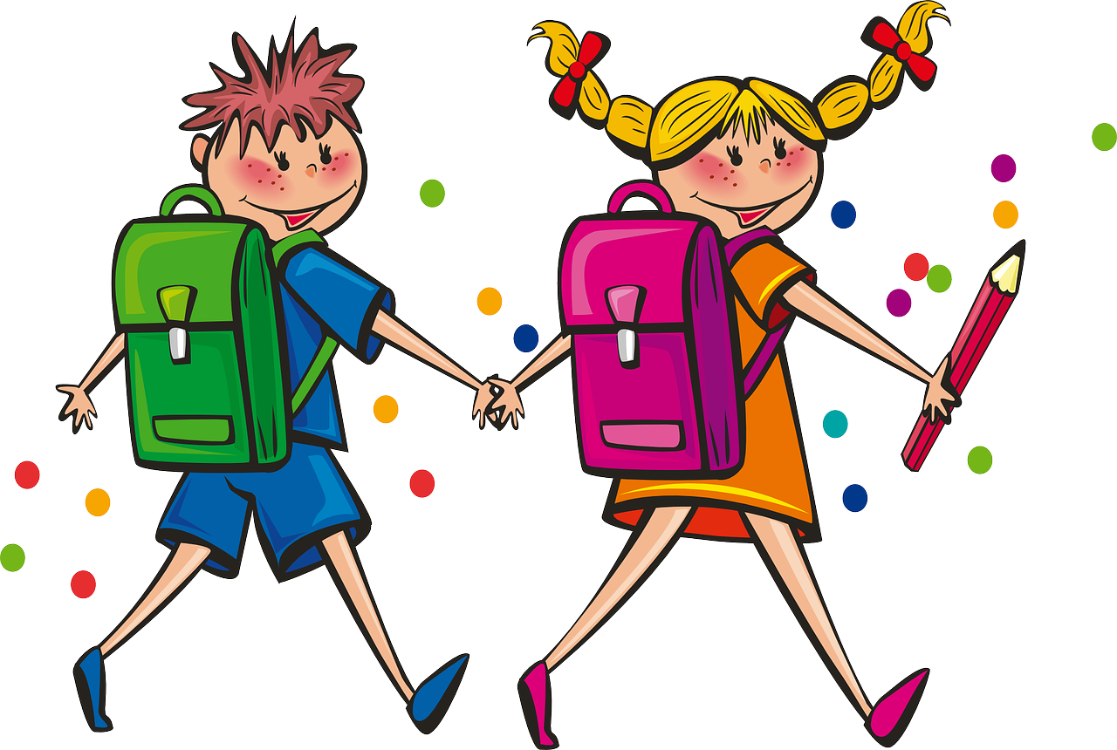
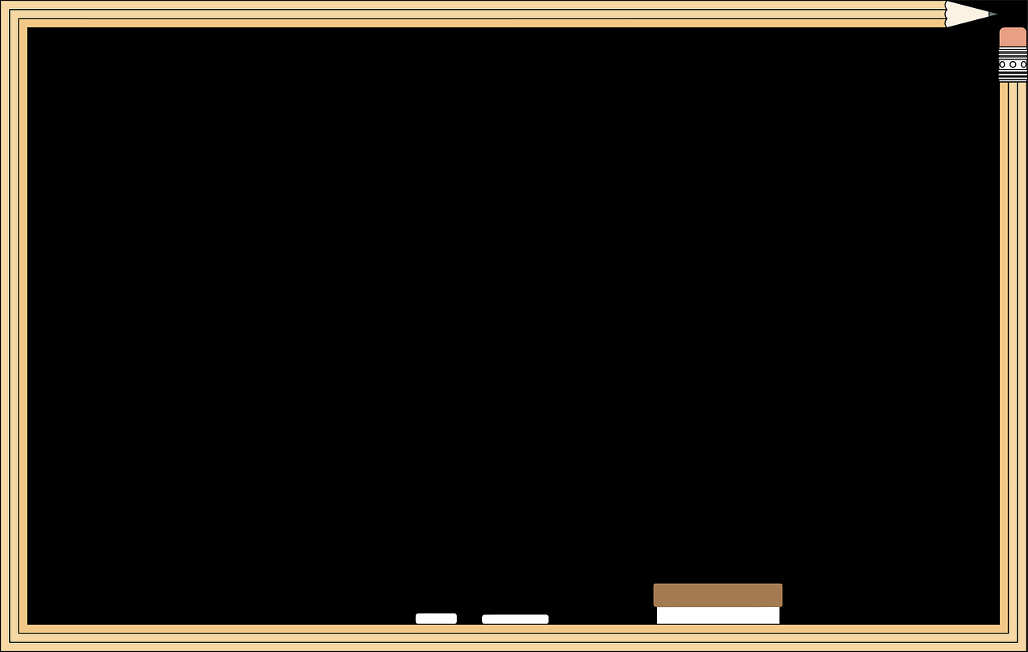
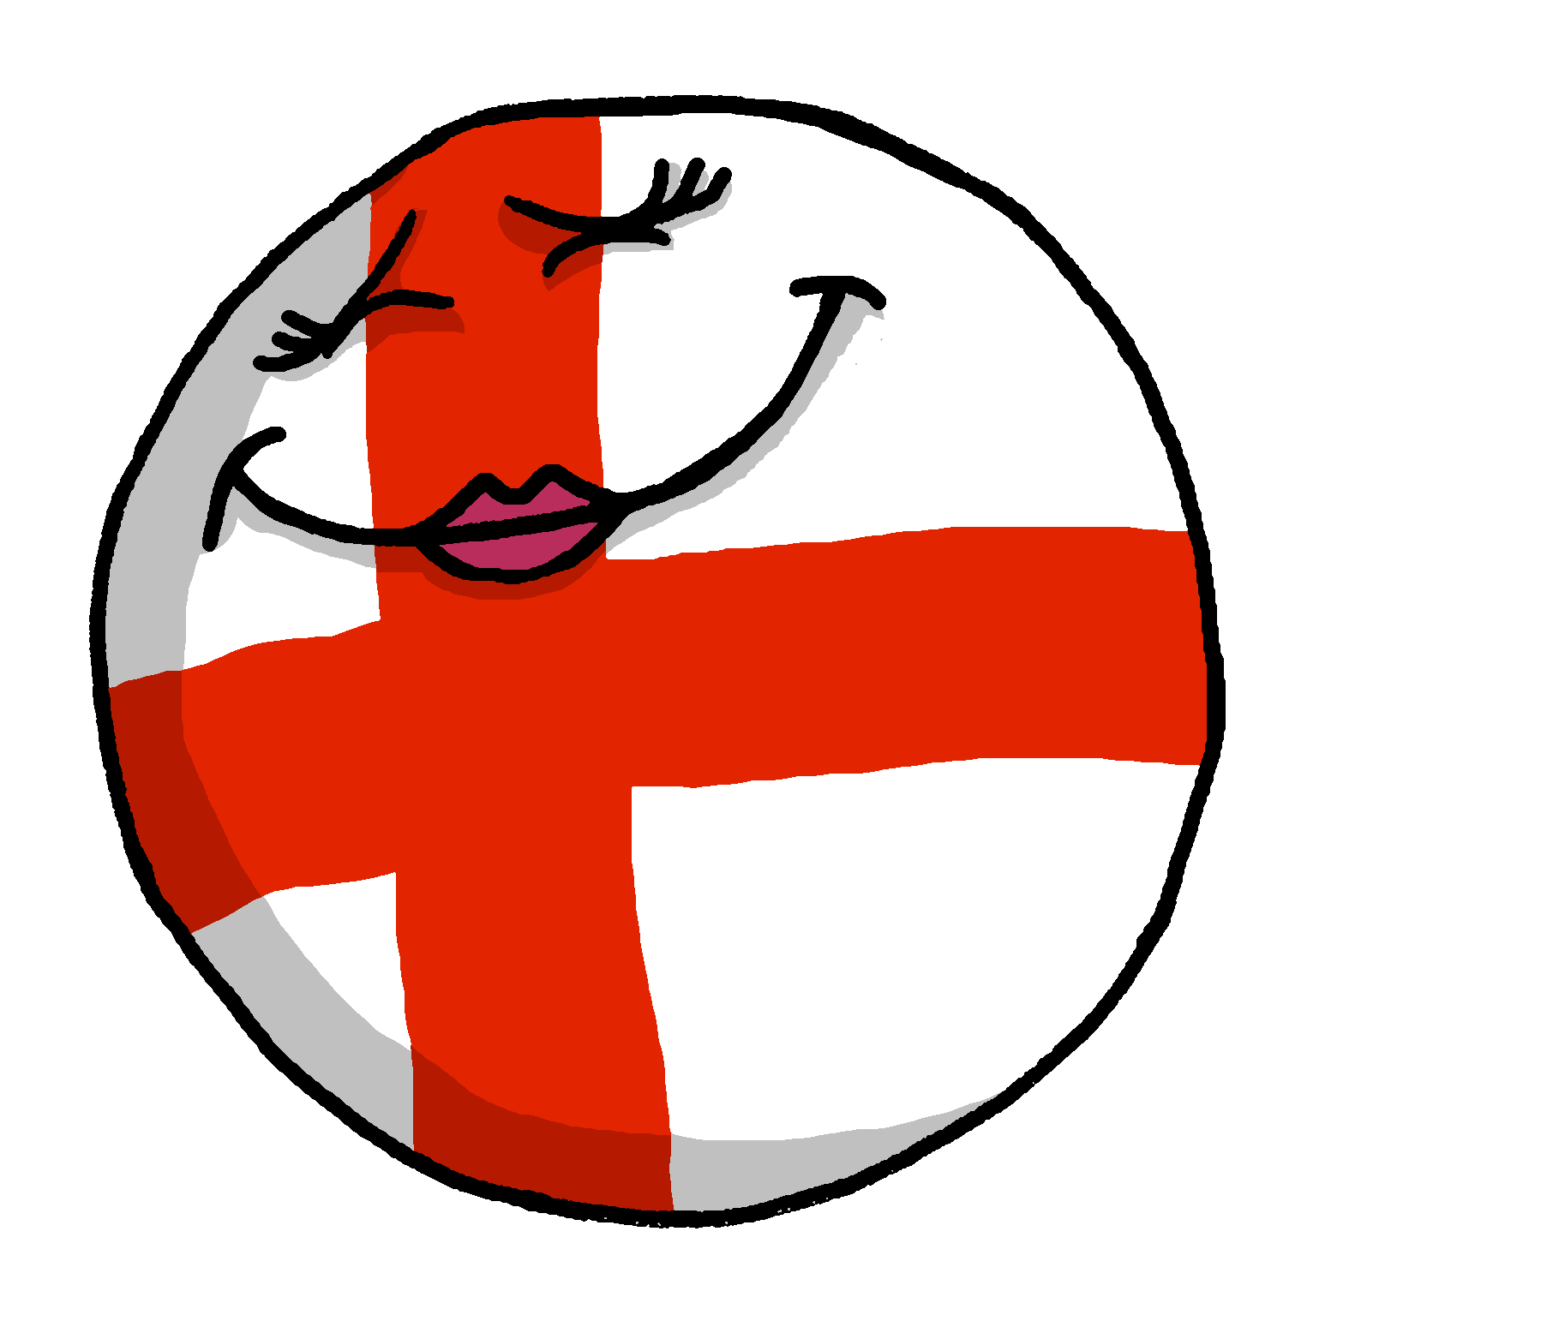
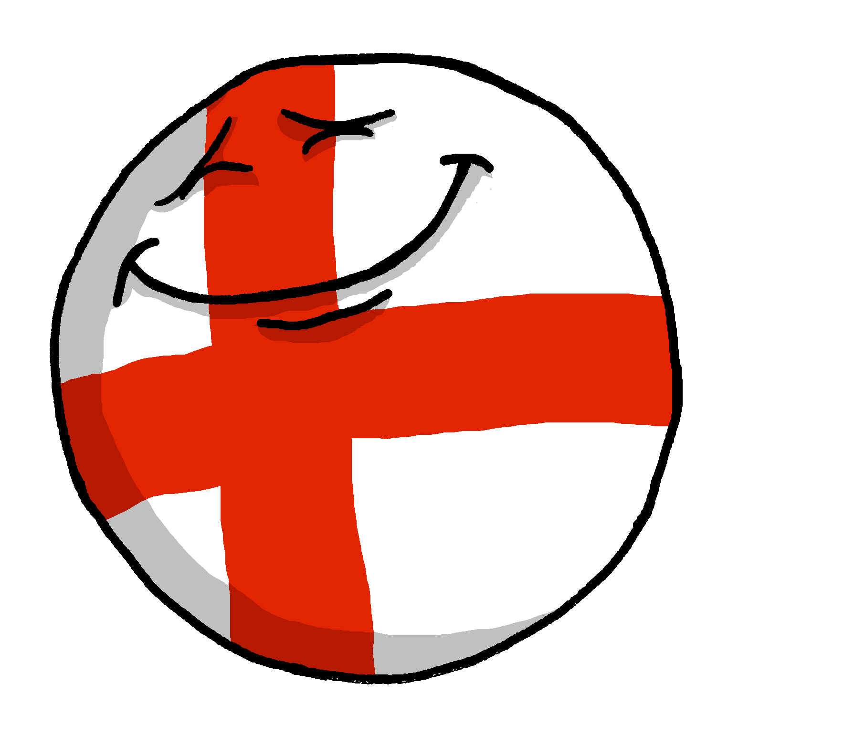
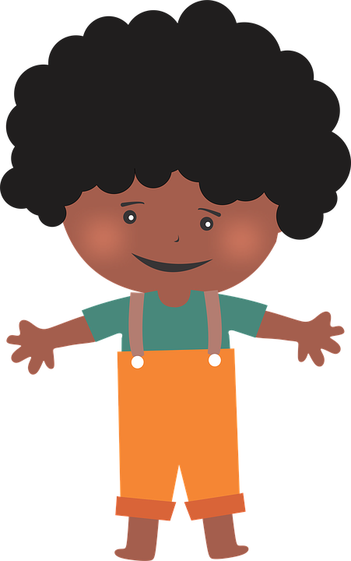
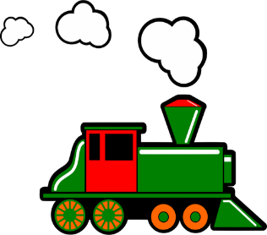
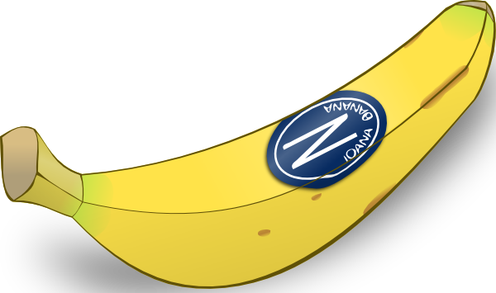
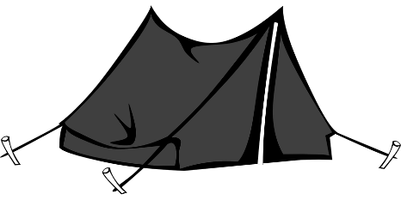
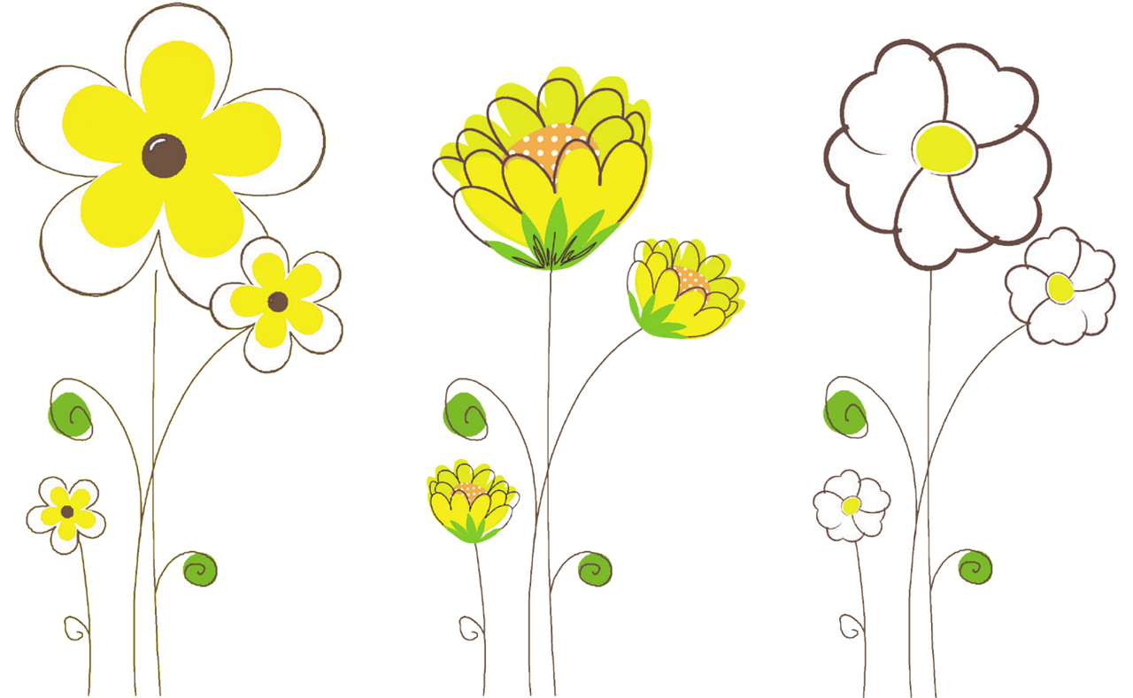
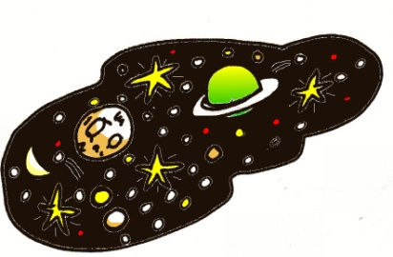
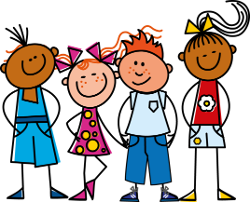
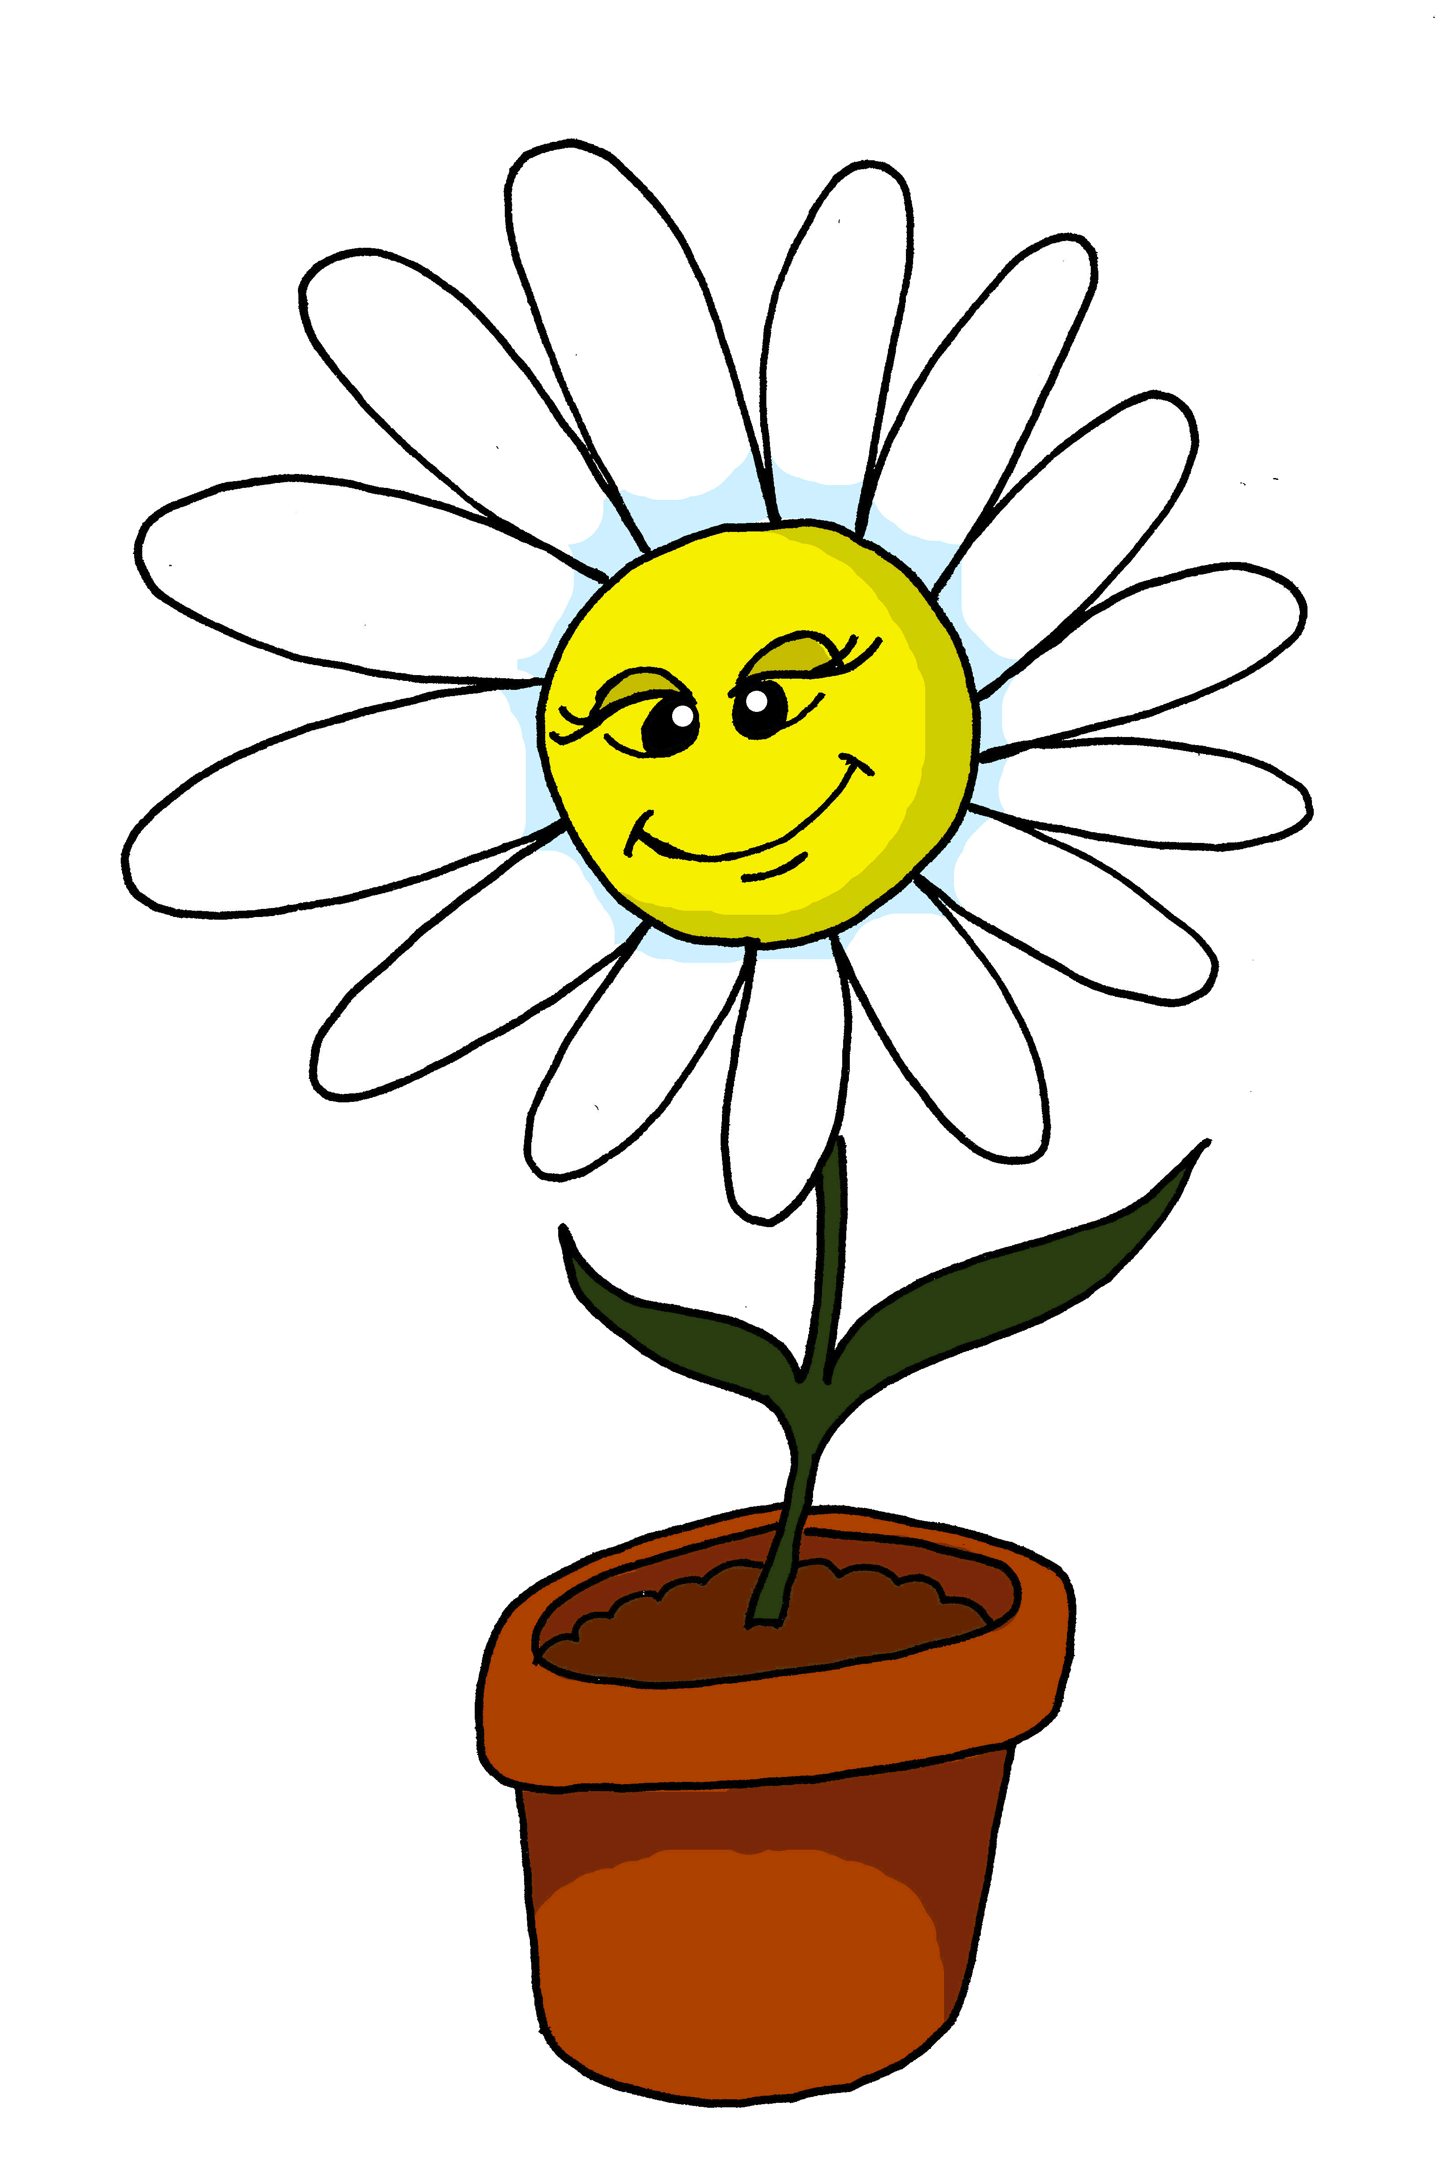
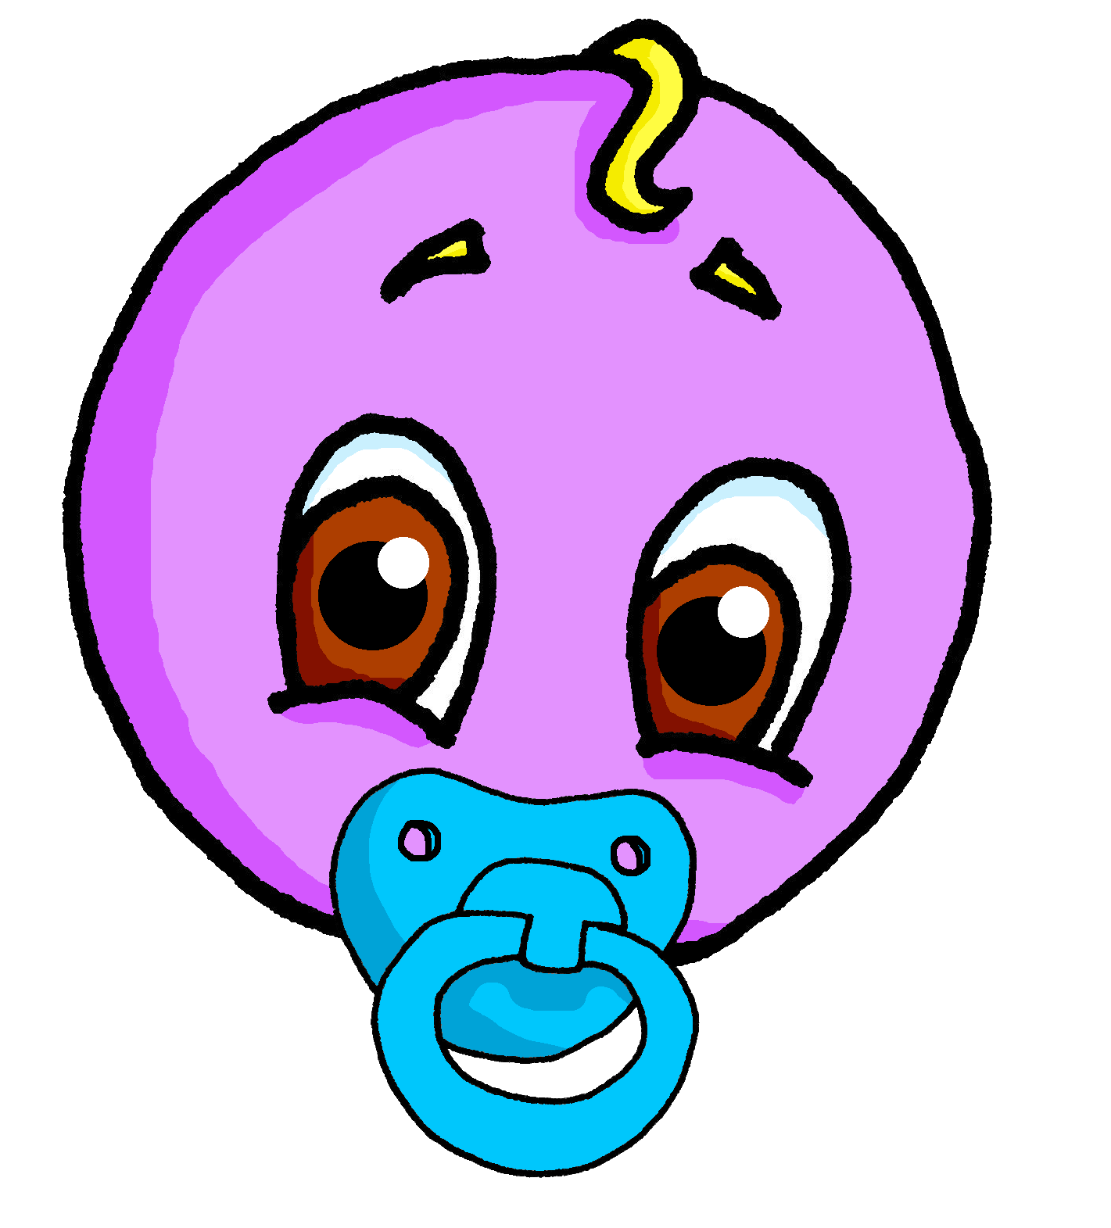
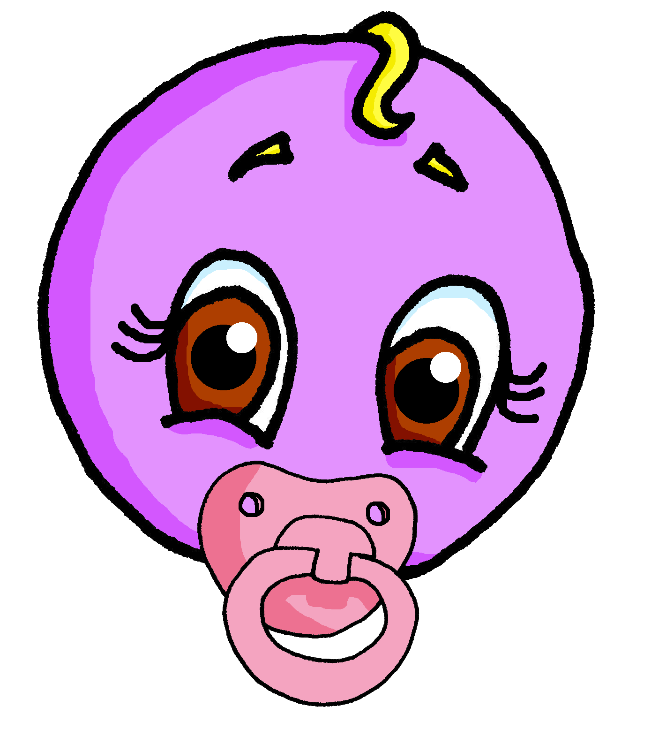
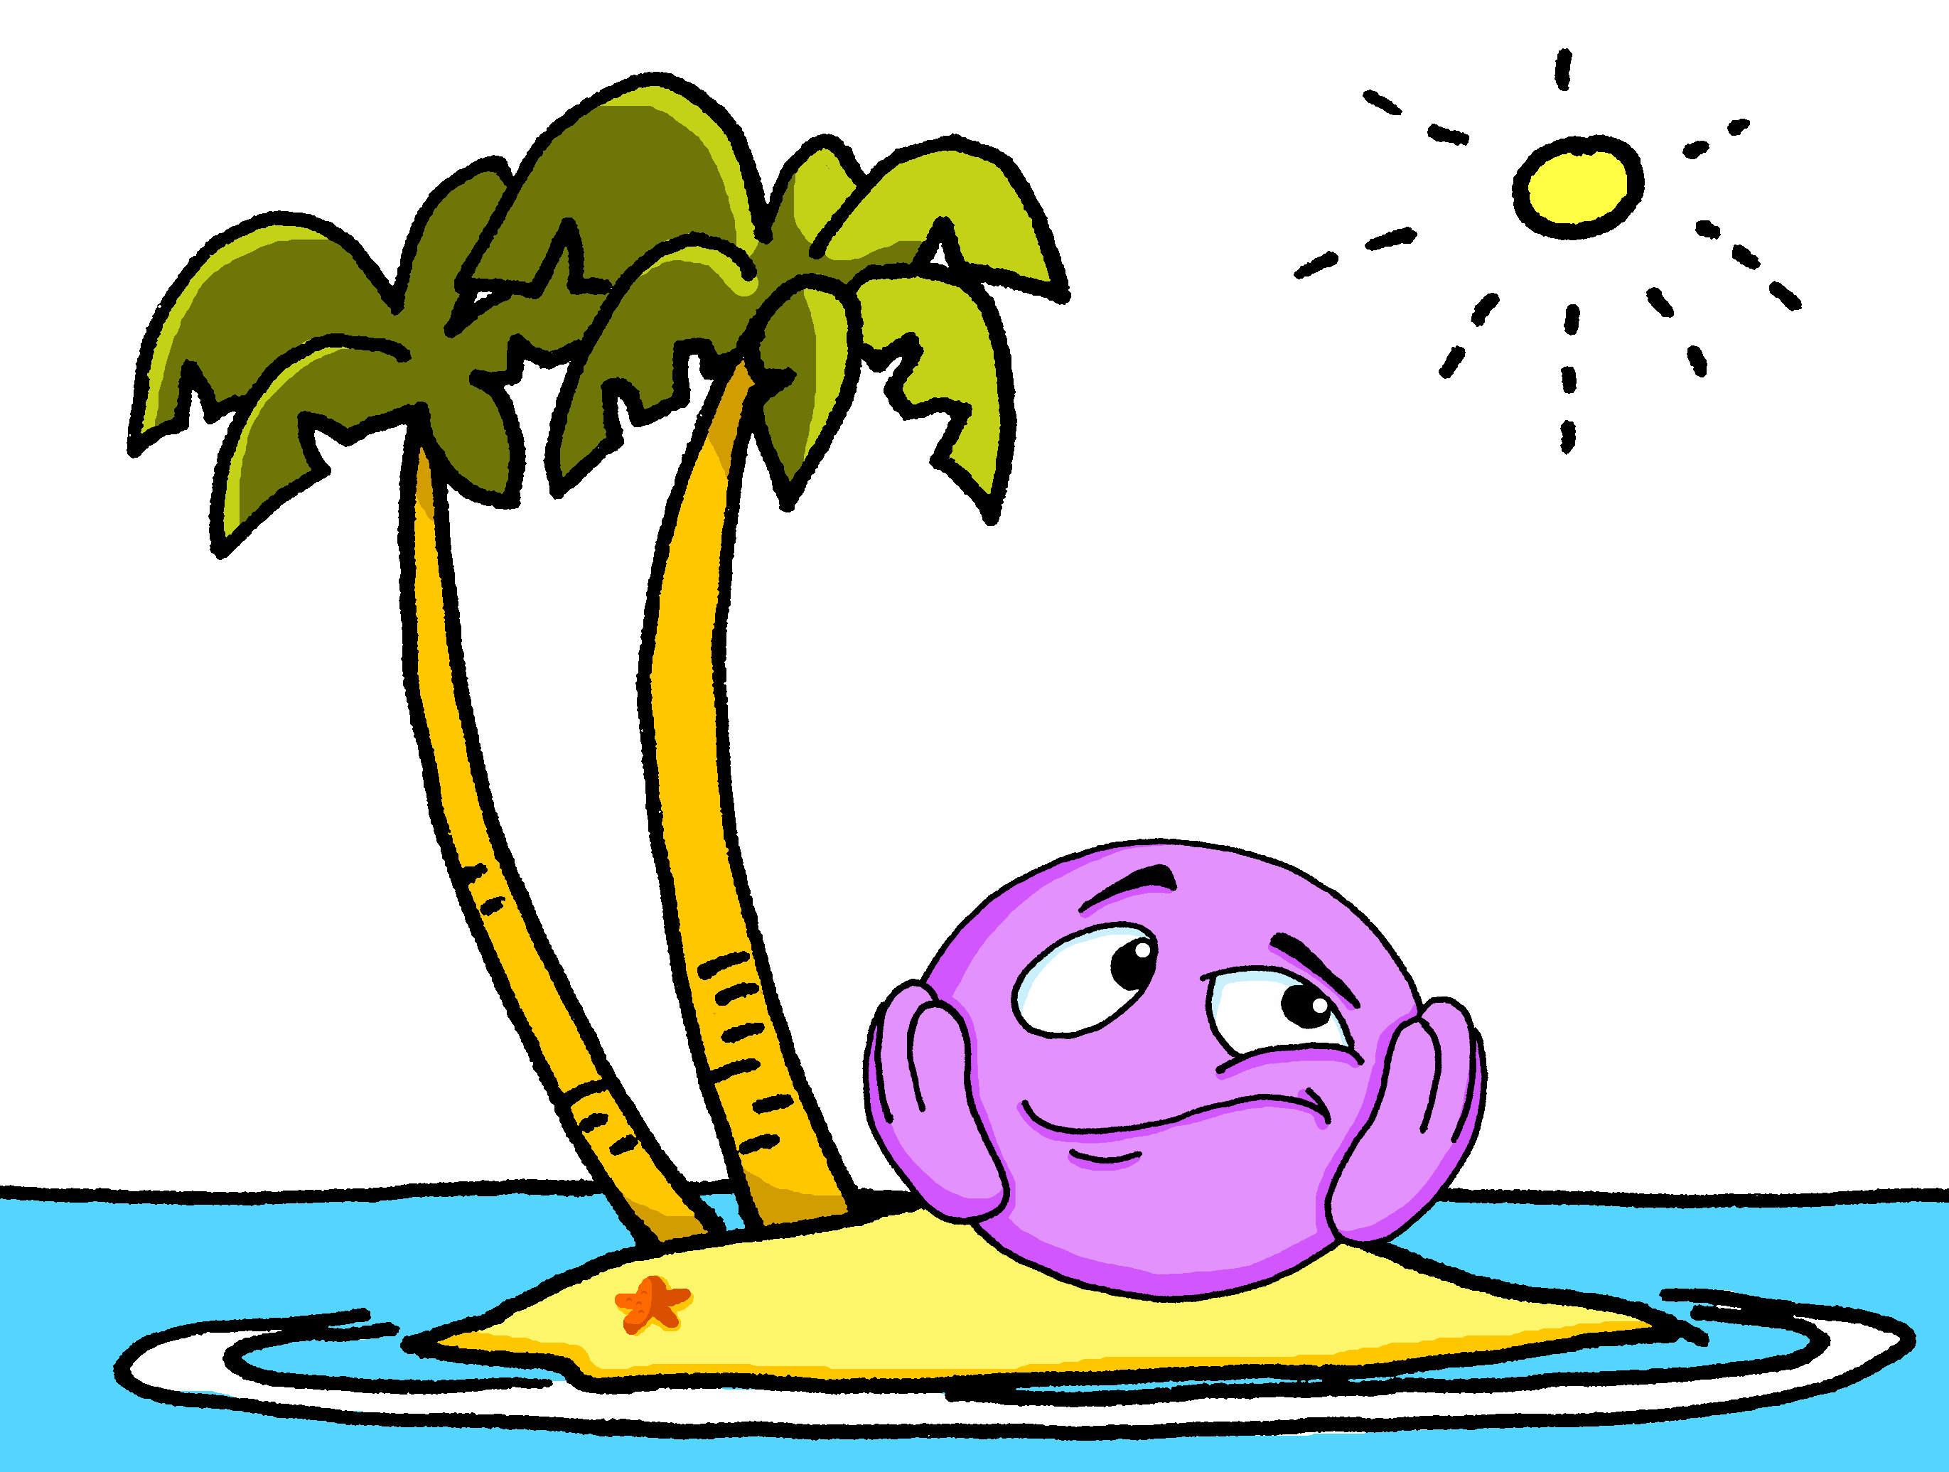
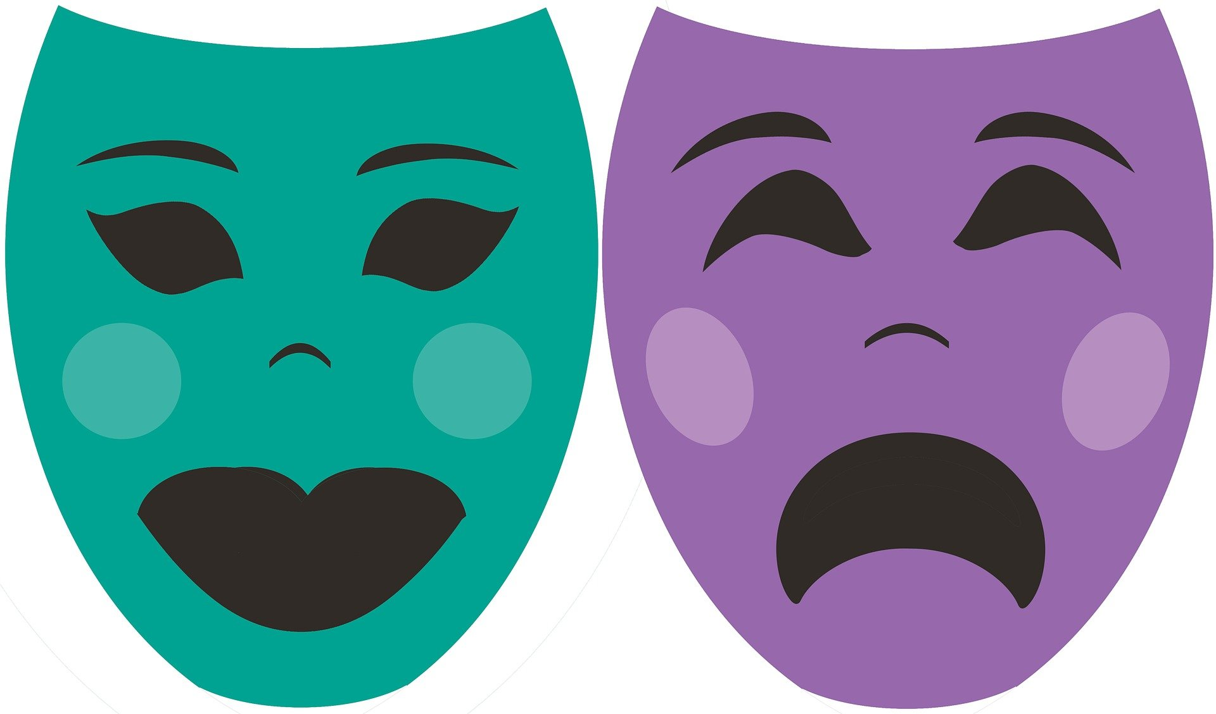
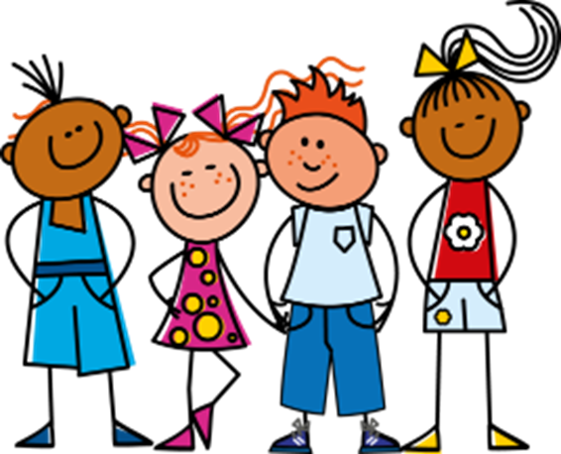
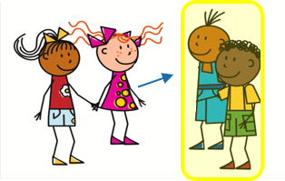
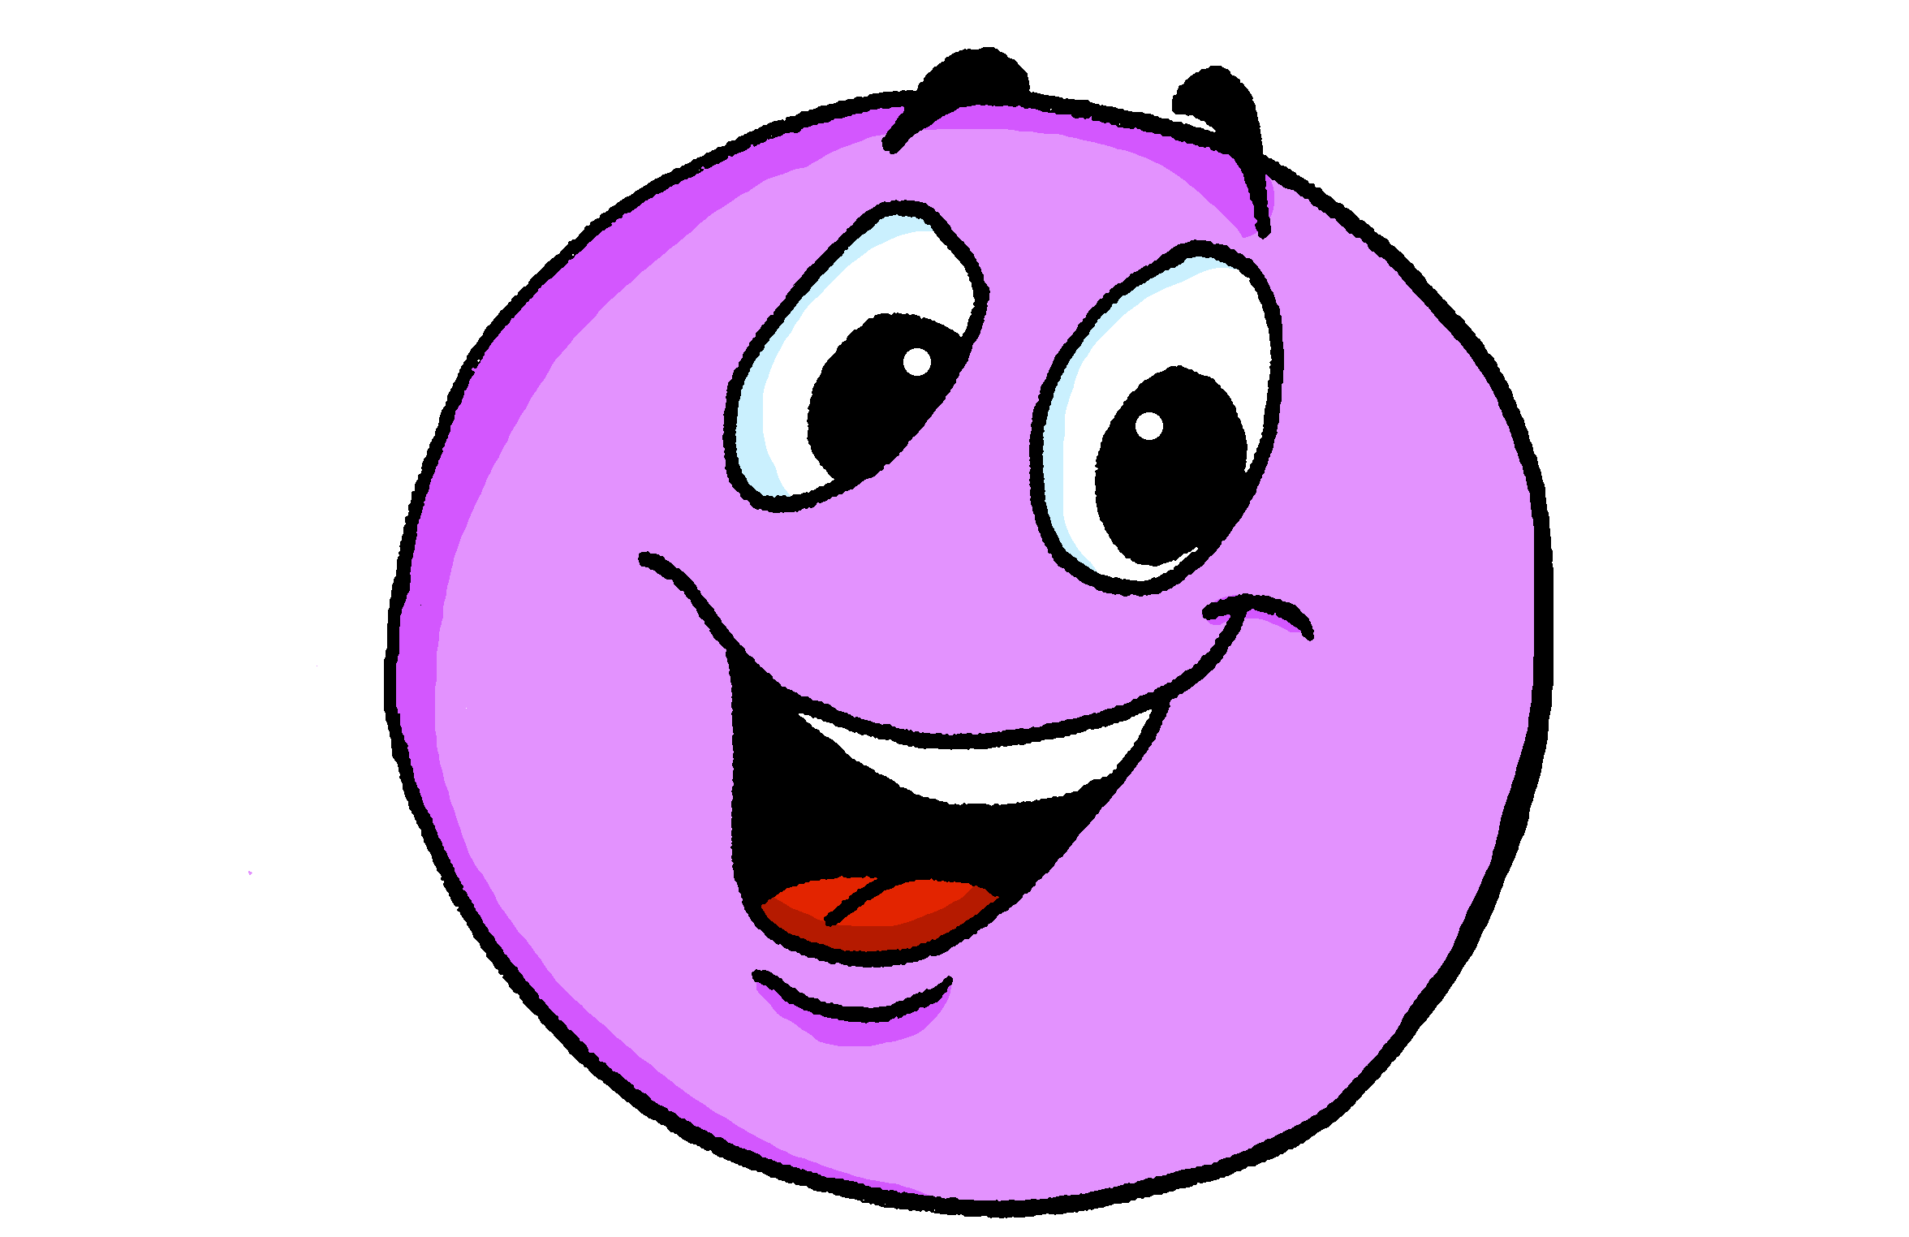
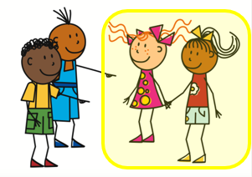
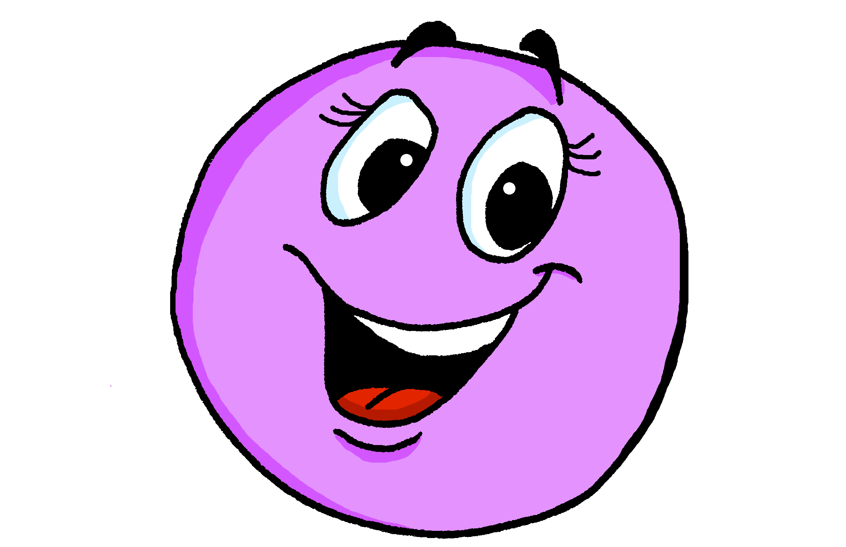
Bleu Knowledge Organiser - Autumn Term A
La description
très – very
inquiet, inquiète – worried
perdu, perdue – lost
prêt, prête – ready
sage – well-behaved
strict, stricte – strict
Les numéros - numbers
treize – 13
quatorze – 14
quinze – 15
seize – 16
dix-sept – 17
dix-huit – 18
dix-neuf – 19
vingt – 20, vingt-et-un – 21
trente – 30
La rentrée
être – to be|being
nous sommes – we are
vous êtes – you (pl) are
ils sont – they (m, m/f) are
elles sont – they (f) are
la date – date
l’école (f) – school
la fleur – flower
le mur – wall
l’ordinateur - computer
la saison – season
rarement – rarely
toujours – always
ensemble – together
qui ? – who?
quel, quelle ? – which?
Phonics
[SFC] Silent Final Consonant | - t petit | - s mais | - d grand | - x deux
[but]
Liaison is common here because it makes the language flow better.
Liaison | optional –s and –t liaison | je suis anglaise. | Il est anglais.
➜
oral vs nasal [a] | [en/an] [i] | [(a)in] | [a] banane | [en/an] enfant | [i] midi | [(a)in] train
same sounds [en/an] & [em/am] | camp | ensemble | chambre | printemps
enfant
temps
same sounds [on] & [om] | combat | tomber
Remember! [en/an] sounds the same as [em/am] and [on] the same as [om].
Non !
nom
Pierre
univers
Salut !
amusant
utiliser
different sounds [u] versus [ou]
tu
nous
Bonjour !
jour
Mon
douze
jouer
closed[eu] versus open [eu] | fleur | jeune | neuf | acteur | seul
peu
peur
Subject pronouns | Describing people with the verb être | Describing more than one
More plural adjectives | Asking WH-questions | Saying my
nous ➜ we
Use plural forms of adjectives to describe more than one noun:
Masculine adjectives ending in –eux stay the same in plural:
Add quand to ask when:
There are three words for my: mon, ma, mes.
tu es
il est
Ton anniversaire, c’est quand ?
They agree with the gender of the possession:
vous ➜ you (pl)
you are
elle est
Il sont contents.
s/he is
They (m, m/f) are pleased.
Ils sont heureux.
When is your birthday?
ils ➜ they
je suis
nous sommes
They (m, m/f) are happy.
Add quel, quelle to ask which:
mon problème
my problem
être
ma solution
my solution
I am
we are
Elles sont contentes.
Feminine adjective forms ending in –euse add –s:
Nous sommes quel jour ?
ils, elles sont
my problems
elles ➜ they
vous êtes
They (f) are pleased.
➜
Which (what) day is it?
mes problèmes
Use ‘ils’ (they) for all masculine nouns. Use ‘elles’ for all feminine nouns.
Elles sont heureuses.
mes solutions
my solutions
they are
you (pl) are
For feminine plural nouns, add-s to the feminine form.
They (f) are happy.
Nous sommes quelle date ?
Use mes for m. and f. plural nouns
Which (what) date is it?

Slide 2
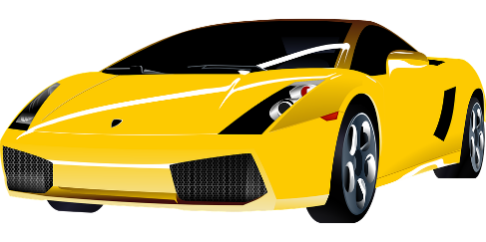
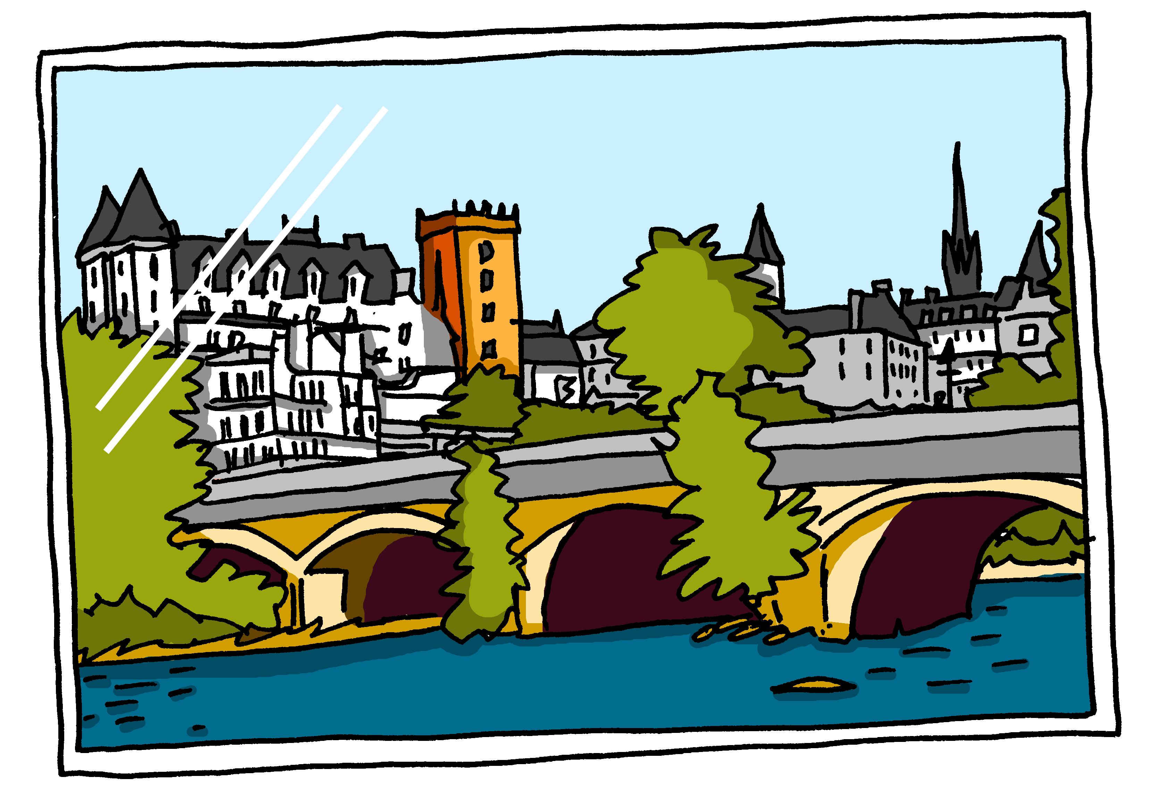
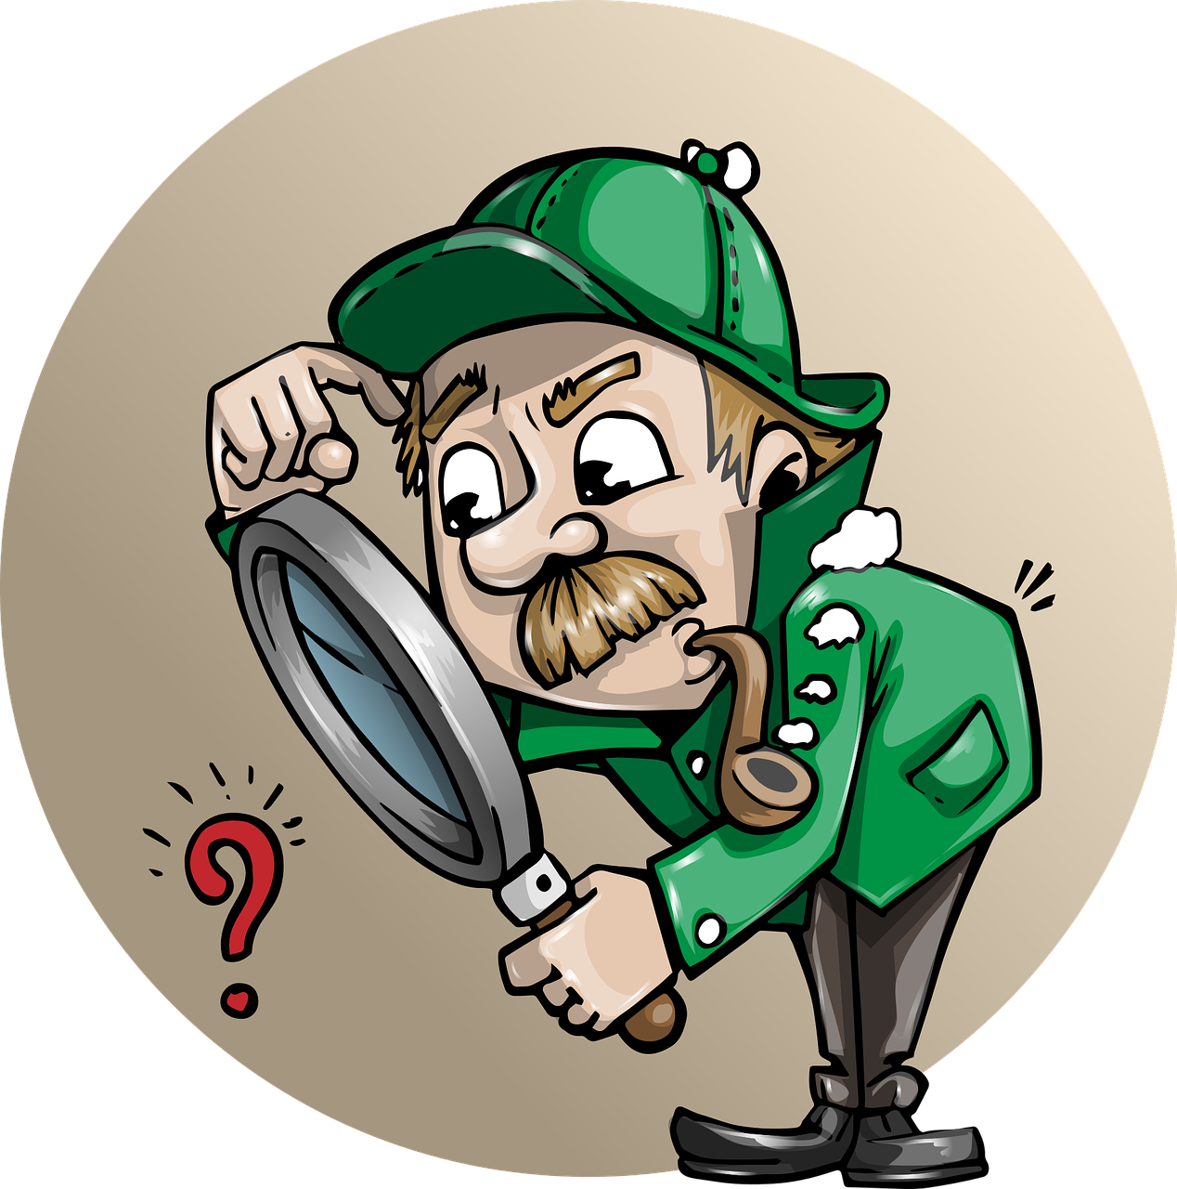
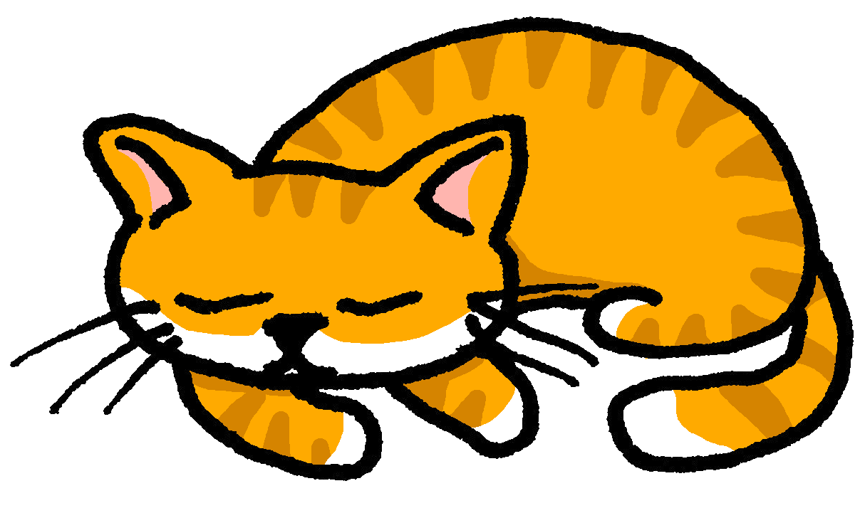
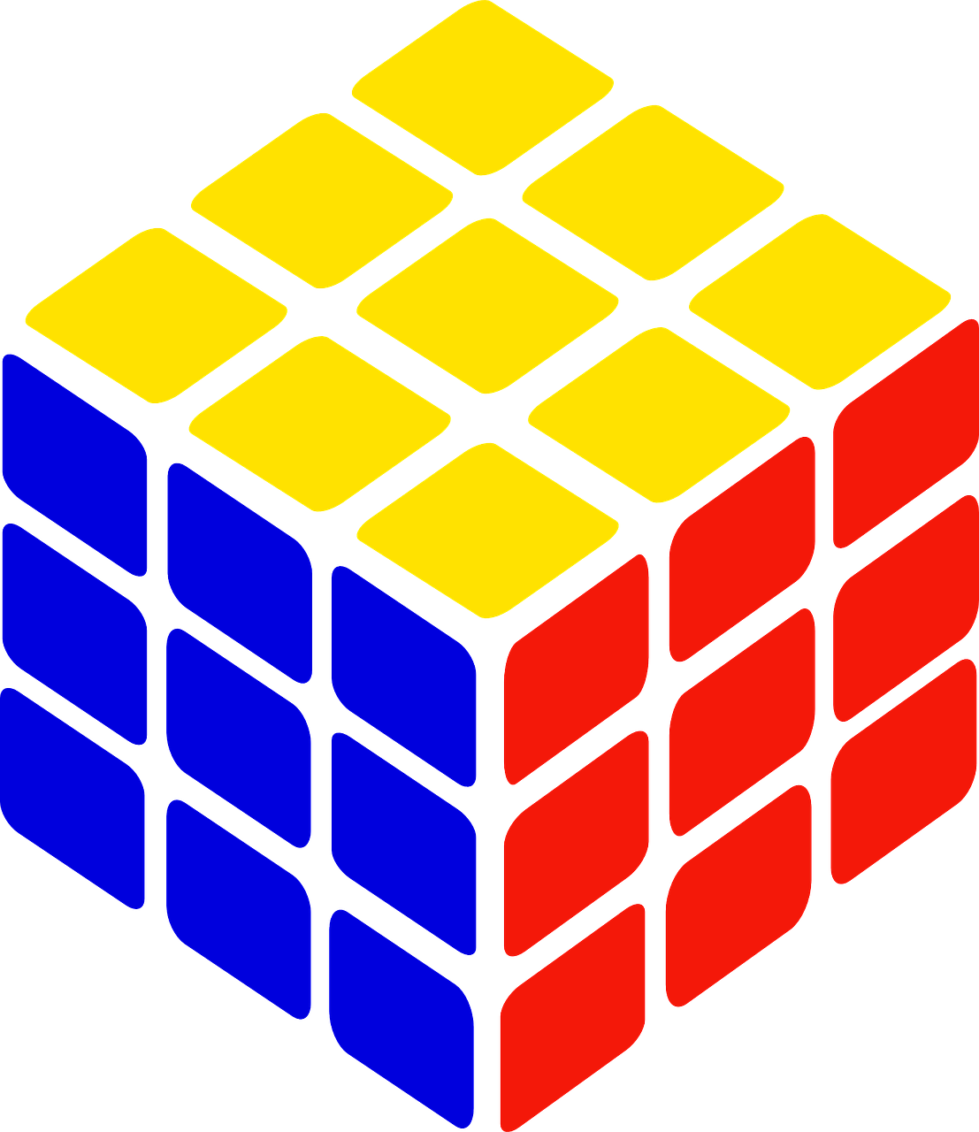
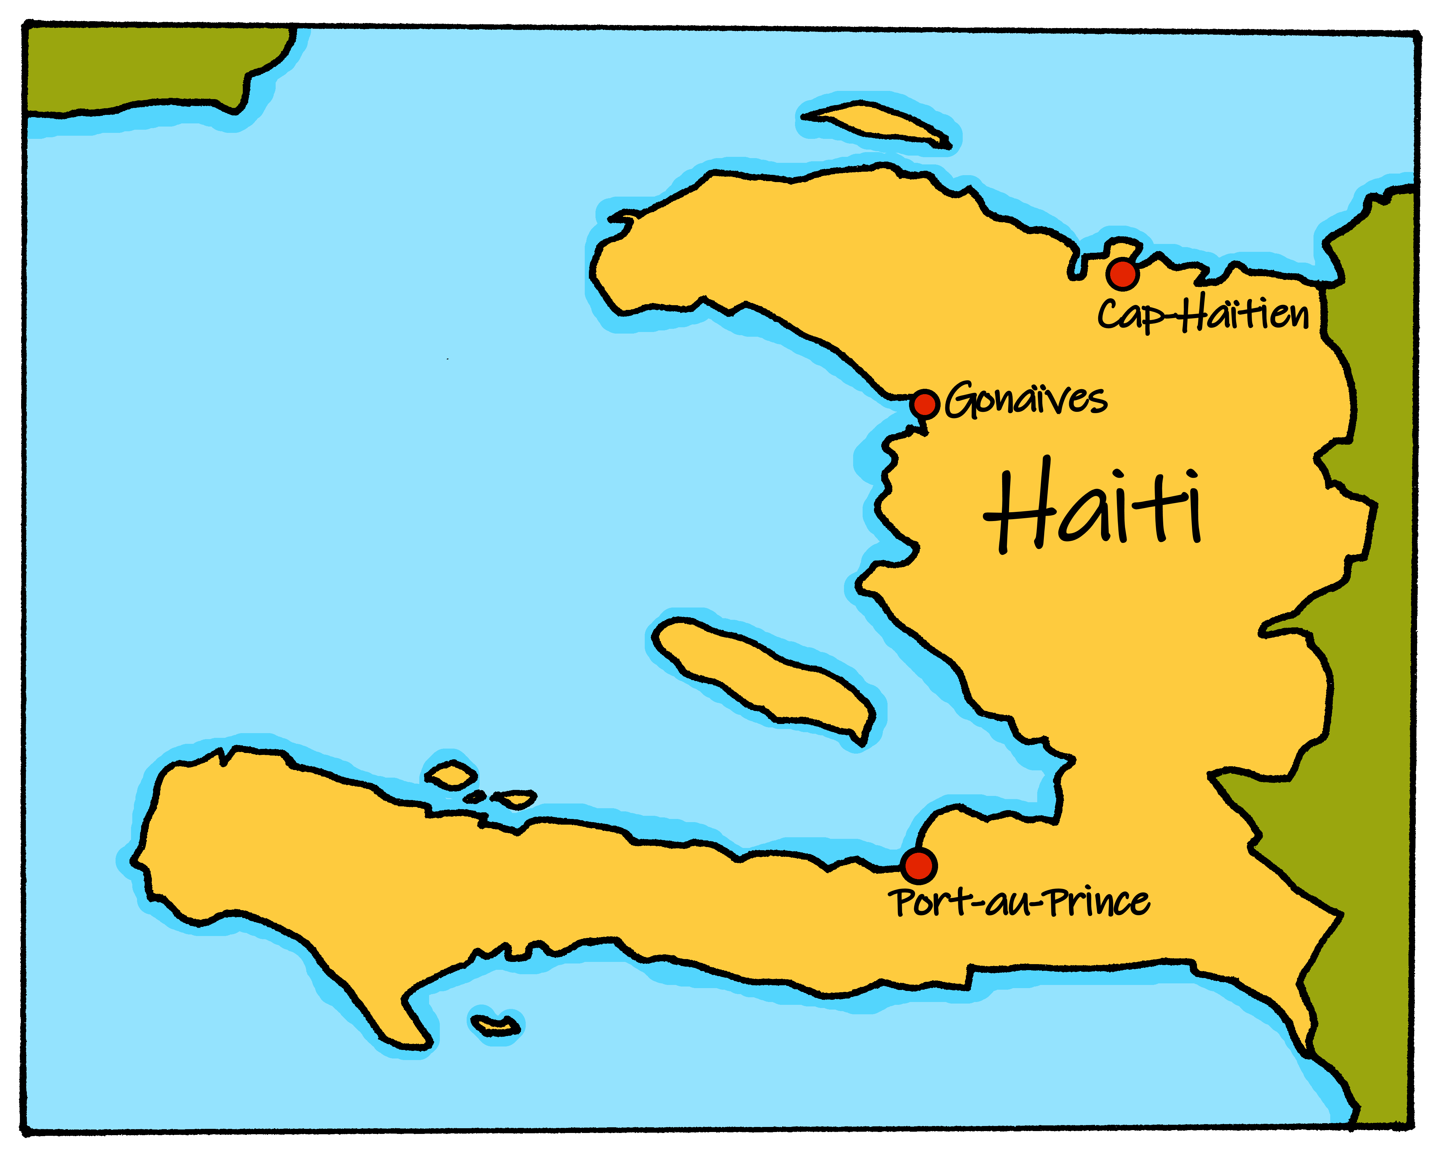
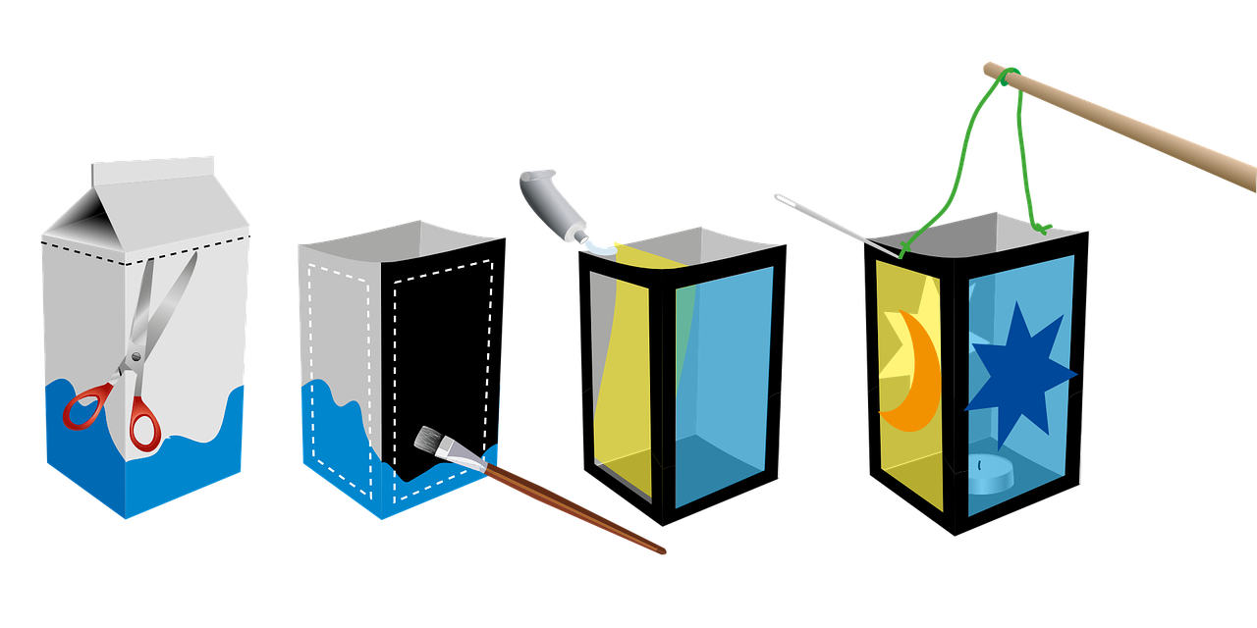
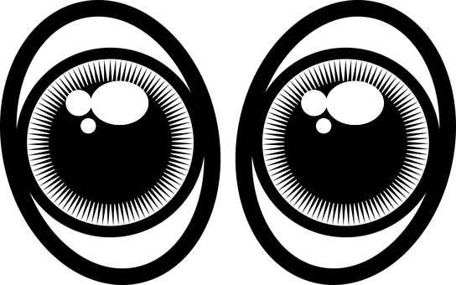
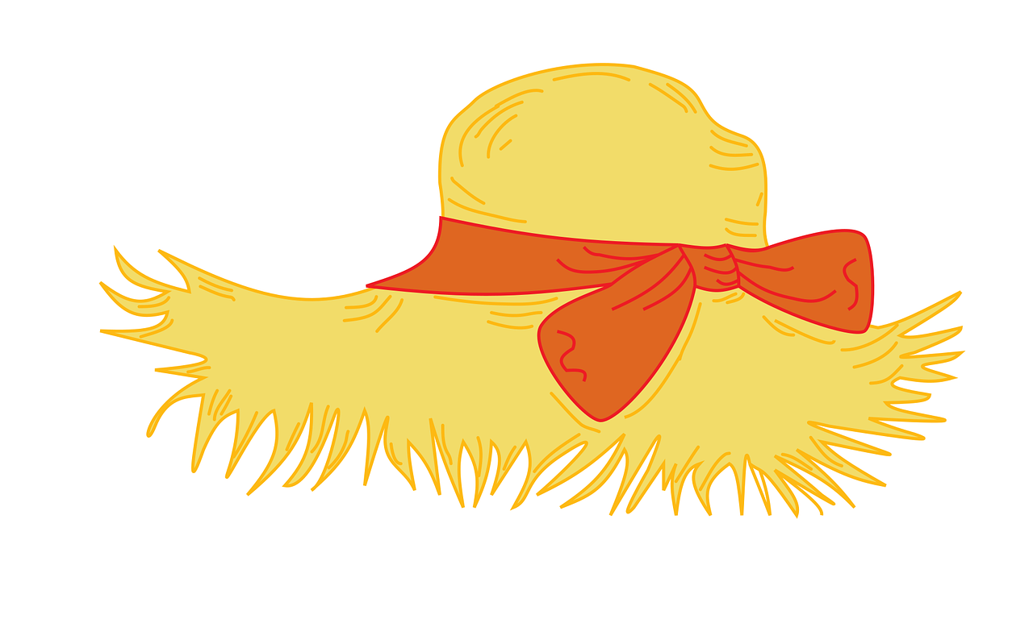
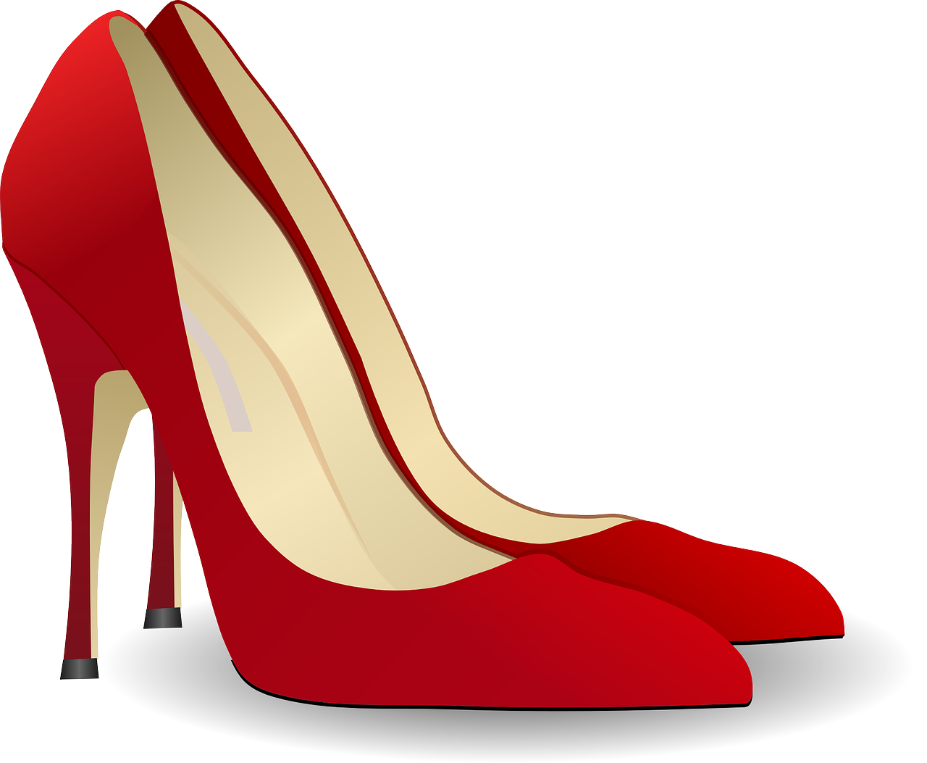
Bleu Knowledge Organiser - Autumn Term B
À l’école et chez nous (at home)
avoir – to have|having
nous avons – we have
vous avez – you (pl) have
ils ont – they (m, m/f) have
elles ont – they (f) have
le cours – lesson
l’espace (m) – space, room
l’exercice (m) – exercise
le problème – problem
la solution – solution
la tâche – task
le cheveu – (single) hair
les cheveux – hair(s)
le médecin – male doctor
la médecin – female doctor
le visage – face
des – some
chez – at (the house of), with
La description
blond – blond
court – short
crépu - frizzy
long, (longue) – long
lourd – heavy
ovale – oval
rond - round
roux, (rousse) – ginger, red
simple – simple
special, spéciale – special
Adjectives that go before the noun
beau – beautiful (m)
belle – beautiful (f)
bon – good (m)
bonne – good (f)
mauvais, mauvaise – bad (m), (f)
nouveau – new (m)
nouvelle – new (f)
vieux – old (m)
vieille – old (f)
Phonics
[SFe] Silent Final e
timide
shy
monde
moderne
centre
douze
[au/eau/o]
gauche
faux
eau
aussi
photo
chercher
dimanche
chat
marché
bouche
[ch]
Sun
Liaison is needed between pronoun and verb.
➜
 | nous avons | vous avez | ils ont | elles ont
Saying what people have with the verb avoir | Plural indefinite article des (some)
Adjectives before the noun | Definite article with physical description
il a
Remember! To say ‘a’ with masculine nouns, use ‘un’. Use ‘une’ with feminine nouns.
tu as
elle a
you have
s/he has
To say ‘some’ (plural) use ‘des’.
j’ai
avoir
nous avons
Il y a des livres. There are some books.
I have
we have
ils, elles ont
vous avez
Il y a des solutions. There are (some) solutions.
➜
you (pl) have
⚠ English can leave out ‘some’ but in French we always need ‘des’.
they have
Some adjectives go before the noun:
These adjectives refer to beauty, age, good/bad or size:
In French we can use the definite article ‘the’ for physical description. In English, we leave the article out or use ‘a’, e.g., has a round face.
In Haiti one tradition for celebrating festivals is to make ‘une lanterne’ in the shape of ‘une maison’.
un beau jardin a beautiful garden
une belle chambre a beautiful bedroom
B
A
un vieux professeur an old teacher
une jeune enfant a young (f) child
Il a le visage rond.
It is called ‘un fanal’ and is hung outside the house or paraded through the streets.
Balance Yaya is a Haitian Creole song that most Haitians know. Yaya is a girl’s name and ‘balance’ means ‘swing’ or ‘balance’.
He has a round face.
G
une bonne idée a good idea
une mauvaise question a bad question
Il a les yeux ronds.
S
un grand bureau a big desk
une petite maison a small house
He has round eyes.

