Slide 1

Learning beyond the classroom
Rachel Hawkes
Comberton Village College

Slide 2

Learning beyond the classroom
Competitions
Events and celebrations
Leadership activities
Comberton Village College
Rachel Hawkes

Slide 3
Competitions
Spanglovision (Y7)
Language BeatZ (Y8)
Spelling Bee (Y7)
Language on Film (Y9)
Vocab Express Championships (all)
Comberton Village College
Rachel Hawkes

Slide 4


Language BeatZ
Use language learnt in class to write lyrics for a song
Put lyrics to a ready-made backing track OR create own music track
Practise for performance
Enter in-school and/or regional competition
Rachel Hawkes

Slide 5

Rachel Hawkes

Slide 6


Language on Film
A foreign film-making competition for Y9 students

Slide 7
The basic film-making model
Stage 1 | Proposal and Pitch | What’s Your Idea? Formulating Your Proposal | Short written proposal and videoed pitch & Discussion
Stage 2 | Pre Production | Scriptwriting Storyboarding Shot Lists | Camera Lists Sound Lists Production Planning
Stage 3 | Production ‘The Shoot’ | Rehearsing Action | Takes & Shots Sound Recording
Stage 4 | Post Production | Picture & Sound Edit | Mixing Music
Stage 5 | Exhibition | Screening Your Film | Awards Ceremony
Rachel Hawkes

Slide 8
What students say….
“I really enjoyed the film project because it improved my teamwork and acting skills, as well as my linguistic skills and spontaneity. I chose to take up this project because I enjoy languages and acting. As this was a combination of both, I couldn’t say no. Also, my peers had very interesting and similar ideas to me, so we worked well together.”
Year 9 student, Comberton Village College
Comberton Village College

Slide 9

Possibilities for using the film-making model
Y8/9 Activities Week
Y8 Curriculum Extension Day
Spanish Exchange (2-day)
German Exchange (1-day)
Y9 Extra-curricular (Sept – May) → Regional Film Competition
Y9 Lower ability group (sustain motivation through Y9 – split class)
Rachel Hawkes

Slide 10

Vocabulary learning online
Text book and awarding body vocabulary lists
Built-in monitoring of individuals and by-class
EDL Championships (September) and national championship open to all (February)
Rachel Hawkes

Slide 11

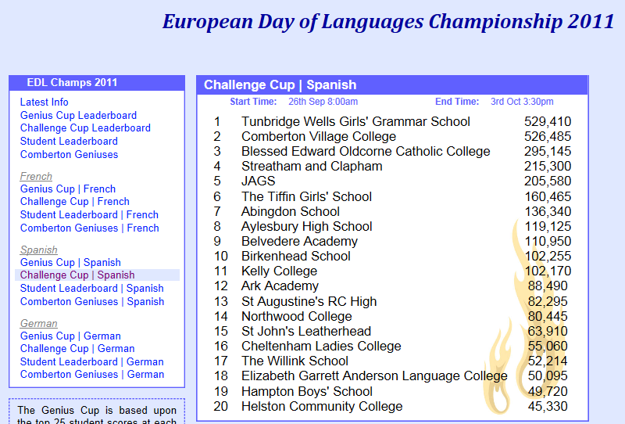
Comberton Village College
Vocab Express EDL Championships
Rachel Hawkes
Notes:
3.07p.m. 20,000 points approx ahead
Last minute steal from Tunbridge Well Girls’ Grammar School
Relate the excitement – the use of IT rooms at lunchtimes, breaks, before school!
Comberton answered 236,669 questions during the course of the competition (an average of almost 30,000 per day).

Slide 12
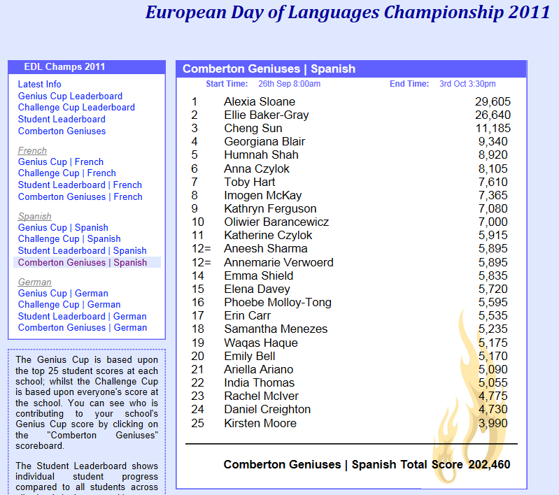
Comberton Village College
Vocab Express EDL Championships
Personal stories
Rachel Hawkes
Notes:
More than just the whole school this was also a week of extraordinary personal stories. Just pick out 3 x stories of these individuals – give their profiles and how they approached the competition etc…
Over 26 hours on vocab learning over the course of a week from Alexia Sloane is not bad (that’s an average of 3.3 hours per day for each of the eight days).

Slide 13
Events and celebrations
International Talent Evening
Mixed Age Learning
Parents into Spanish
Parents into lessons
European Day of Languages
Comberton Village College
Rachel Hawkes

Slide 14
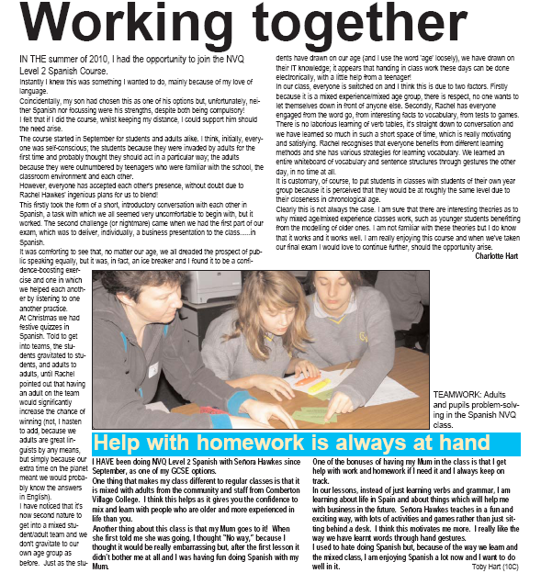
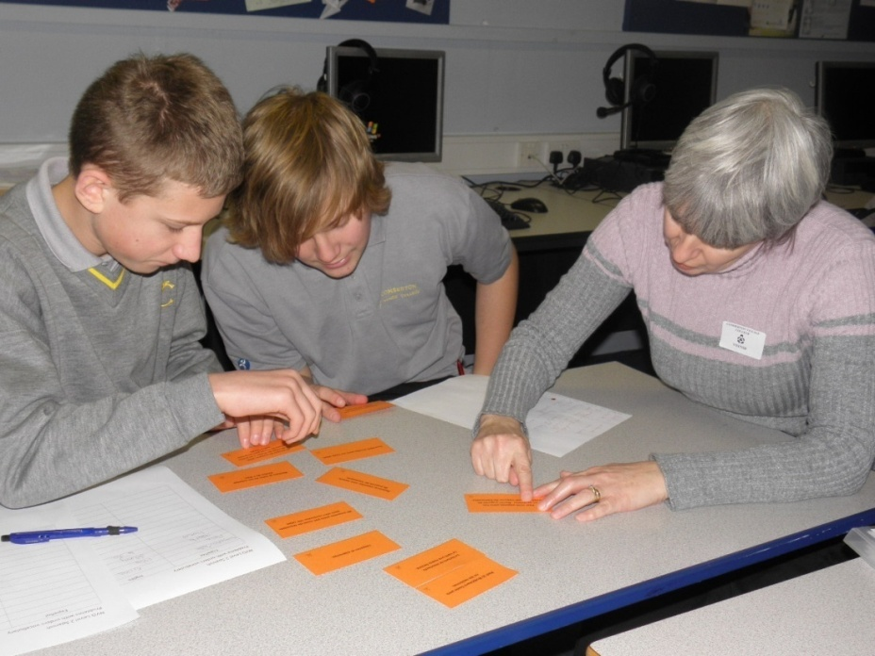
Mixed age learning
contributes to calm, mature learning environment
models ‘active engagement’ e.g. questioning
highlights the value of language learning
literacy levels and ‘world knowledge’ are shared by adults
linguistic and ICT skills are shared by students
Rachel Hawkes

Slide 15
Adults and Year 10 students working together at Comberton Village College
Notes:
Points to mention:
contributes to calm, mature learning environment
models ‘active engagement’ e.g. questioning
highlights the value of language learning
literacy levels and ‘world knowledge’ are shared by adults
linguistic and ICT skills are shared by students

Slide 16
Both students and adults highlight the benefits.
Rachel Hawkes

Slide 17
Behaviour –
even in cover lessons without adults!
“I was expecting a difficult cover lesson but behaviour was exemplary. They did ALL the work including the work from Tuesday which some of them hadn’t completed. I think they deserve praise from their teacher to make them realise teachers don’t only talk about bad behaviour.
Thanks
PS: Your plan of mixing adults and teenagers is working fantastically.”
Rachel Hawkes

Slide 18
Summary of successful outcomes
Positive effect on students’ attitudes, behaviour and therefore progress
Contribution to parent-whole school liaison and the community cohesion agenda overall
Quality of adults’ feedback generating improvements in teaching and provision
Strengthening of the role and reputation of the school within the community
Creation of a mixed age learning community – mutual sharing of knowledge and expertise
Rachel Hawkes
Notes:
In conclusion, despite the difference in the models implemented by Northgate and Comberton, they share many successful outcomes, including:
Personal commitment of the adults to learning Spanish and the positive effect this has on the students’ attitudes, behaviour and therefore progress.
The contribution this project has made to parent-whole school liaison and the community cohesion agenda overall. Adults from our classes are spreading positive messages about their learning experiences.
The quality of adults’ feedback that has pushed teachers in the project to improve their provision, creating tightly focused learning and maximising the opportunities for creative language use, as well as focusing on developing more opportunities and supplying better resources for independent learning and homework.
The role of the school within the community has been strengthened through this project and the school’s reputation within the community enhance.

Slide 19


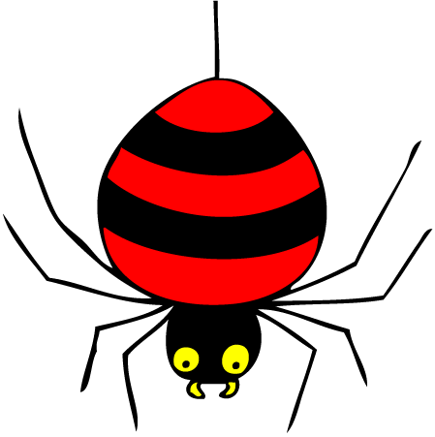




The sounds of Spanish
A one-hour session for parents new to Spanish
Learn how to pronounce Spanish words
Learn some memory techniques
Learn the skills you need to feel confident about supporting your child in Spanish
Have fun and get to know more year 7 parents
Introduction to Spanish for Parents

Slide 20
Parents into Spanish Evening
“I can honestly say that I can still remember most of the words that we were taught, and understand how this will help me to help my children with their pronunciation. Miss Hawkes also talked a little about the different ways that children learn, which was very interesting, and could prove useful over the coming years. The evening gave me an insight as to how the children are being taught, and a real sense that it all seems so much more fun than in my day. “
Parent of new Y7 pupil, September 2010
Rachel Hawkes

Slide 21
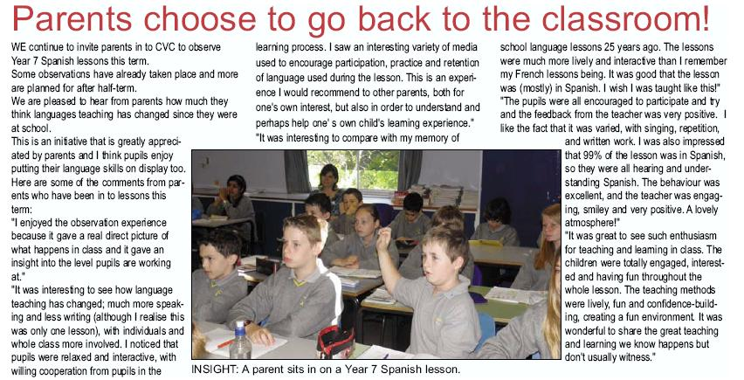
Rachel Hawkes

Slide 22

It was good that the lesson was (mostly) in Spanish. I wish I was taught like this!”
“The pupils were all encouraged to participate and try and the feedback from the teacher was very positive. I like the fact that it was varied, with singing, repetition, and written work. I was also impressed that 99% of the lesson was in Spanish, so they were all hearing and understanding Spanish. The behaviour was excellent, and the teacher was engaging, smiley and very positive. A lovely atmosphere!”
“ I enjoyed the observation experience because it gave a real direct picture of what happens in class and it gave an insight into the level pupils are working at.”
Rachel Hawkes

Slide 23
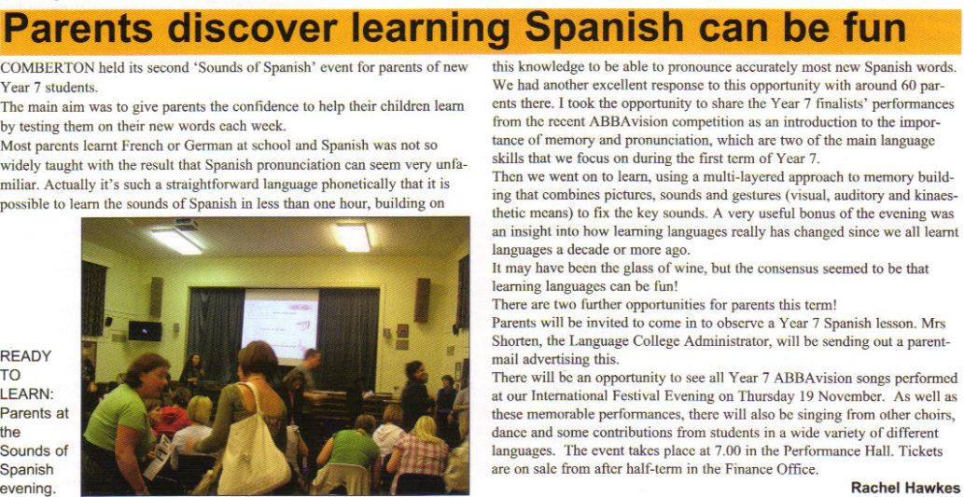
http://www.rachelhawkes.com/RPP/Parents/Parents.php
http://www.rachelhawkes.com/RPP/IntTalent/IntTalent.php
Rachel Hawkes

Slide 24
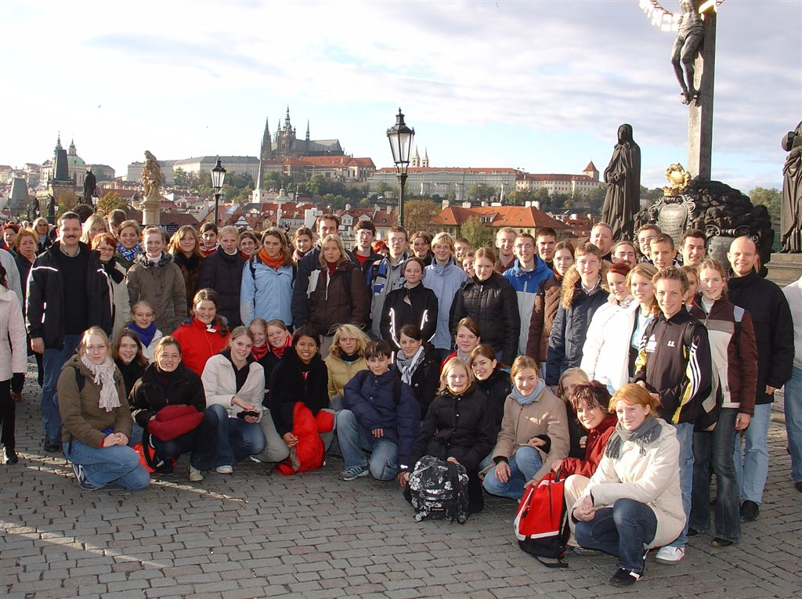
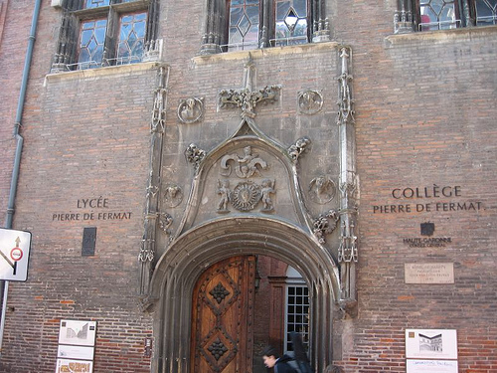
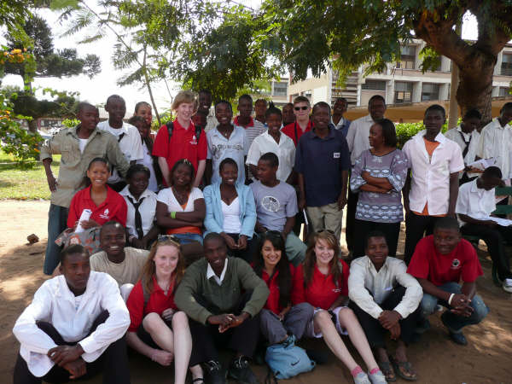
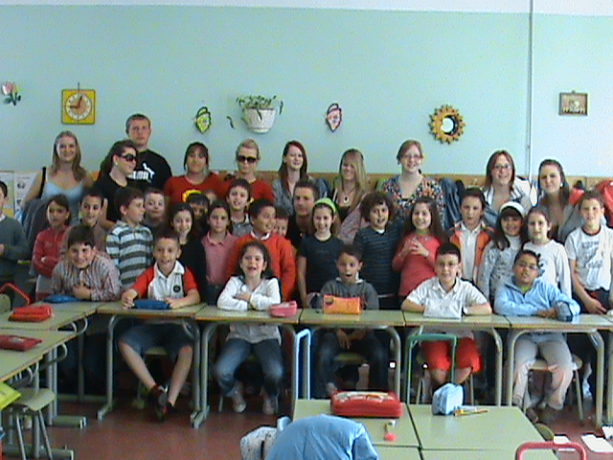
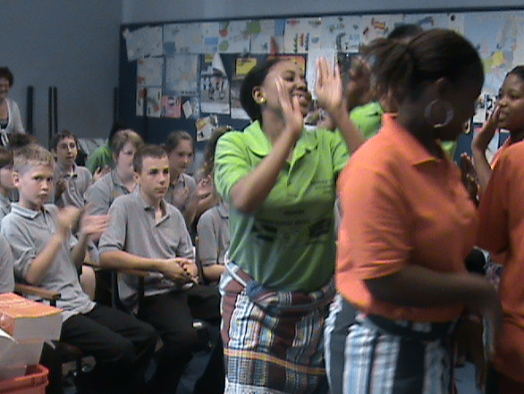

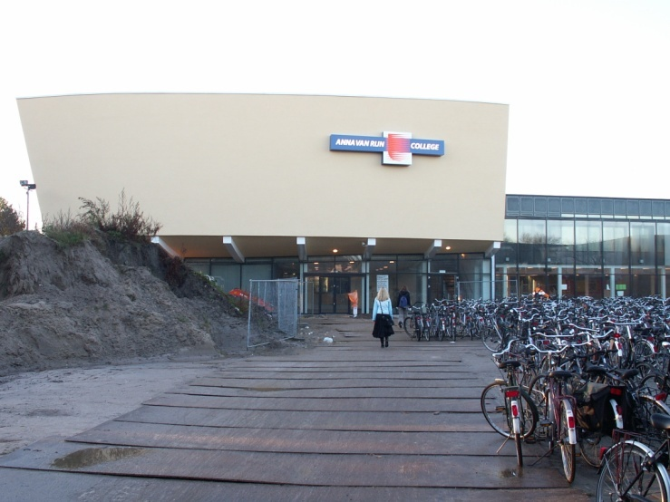
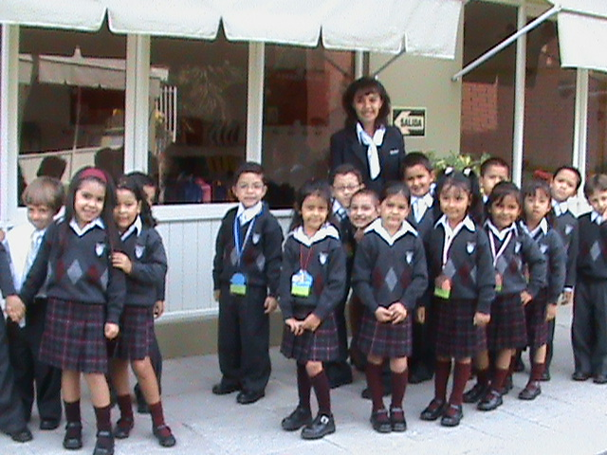
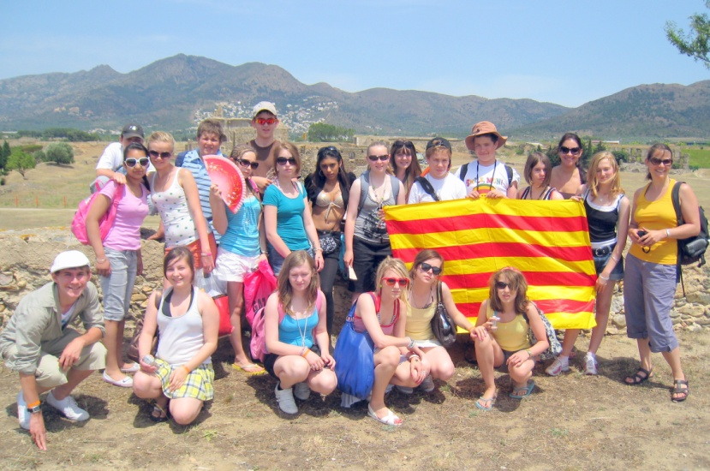
Collège Pierre de Fermat
Toulouse, France
Lycée Jean Jaurès
Reims, France
Modellschule & Gesamtschule,
Obersberg
Bad Hersfeld, Germany
Escola Secundaria do Noroeste 1
Maputo, Mozambique
Partner Schools
IES Emilio Alarcos
Gijón, Spain
Edendale School
Gauteng, South Africa
Instituto Lord Byron
Arequipa
Perú
Anna van Rijn College
Nieuwegein, Holland
Institut Ramon Muntaner
Figueras, Spain
Notes:
24

Slide 25
Events and celebrations
International Talent Evening
Mixed Age Learning
Parents into Spanish
Parents into lessons
Involvement in exchanges
European Day of Languages
Comberton Village College
Rachel Hawkes

Slide 26
Leadership activities
Language Leader Award
Spelling Bee leaders
Catch-up club
International Leaders → Interact
Comberton Village College
Rachel Hawkes

Slide 27

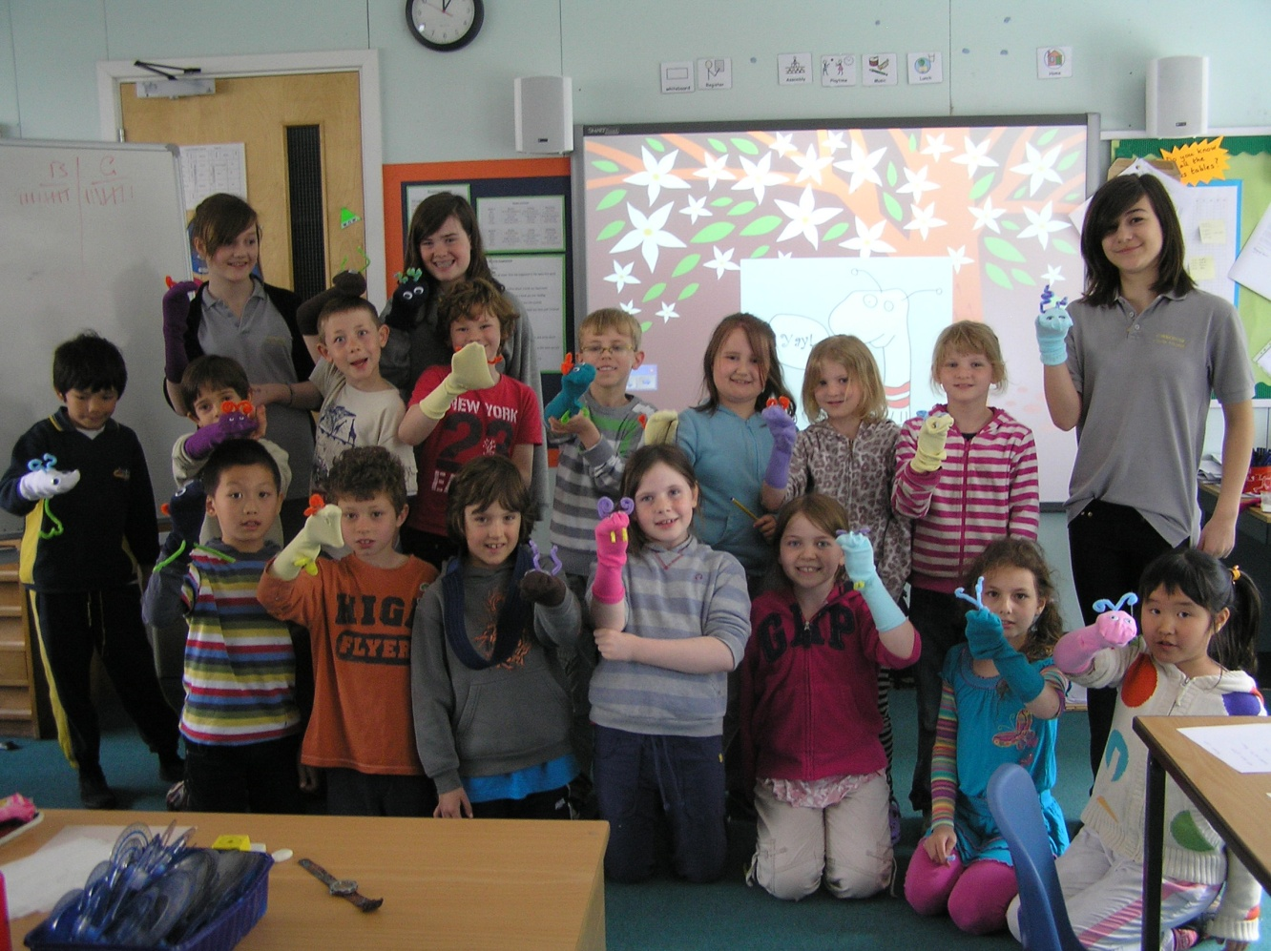
Language Leader Award
Rachel Hawkes

Slide 28
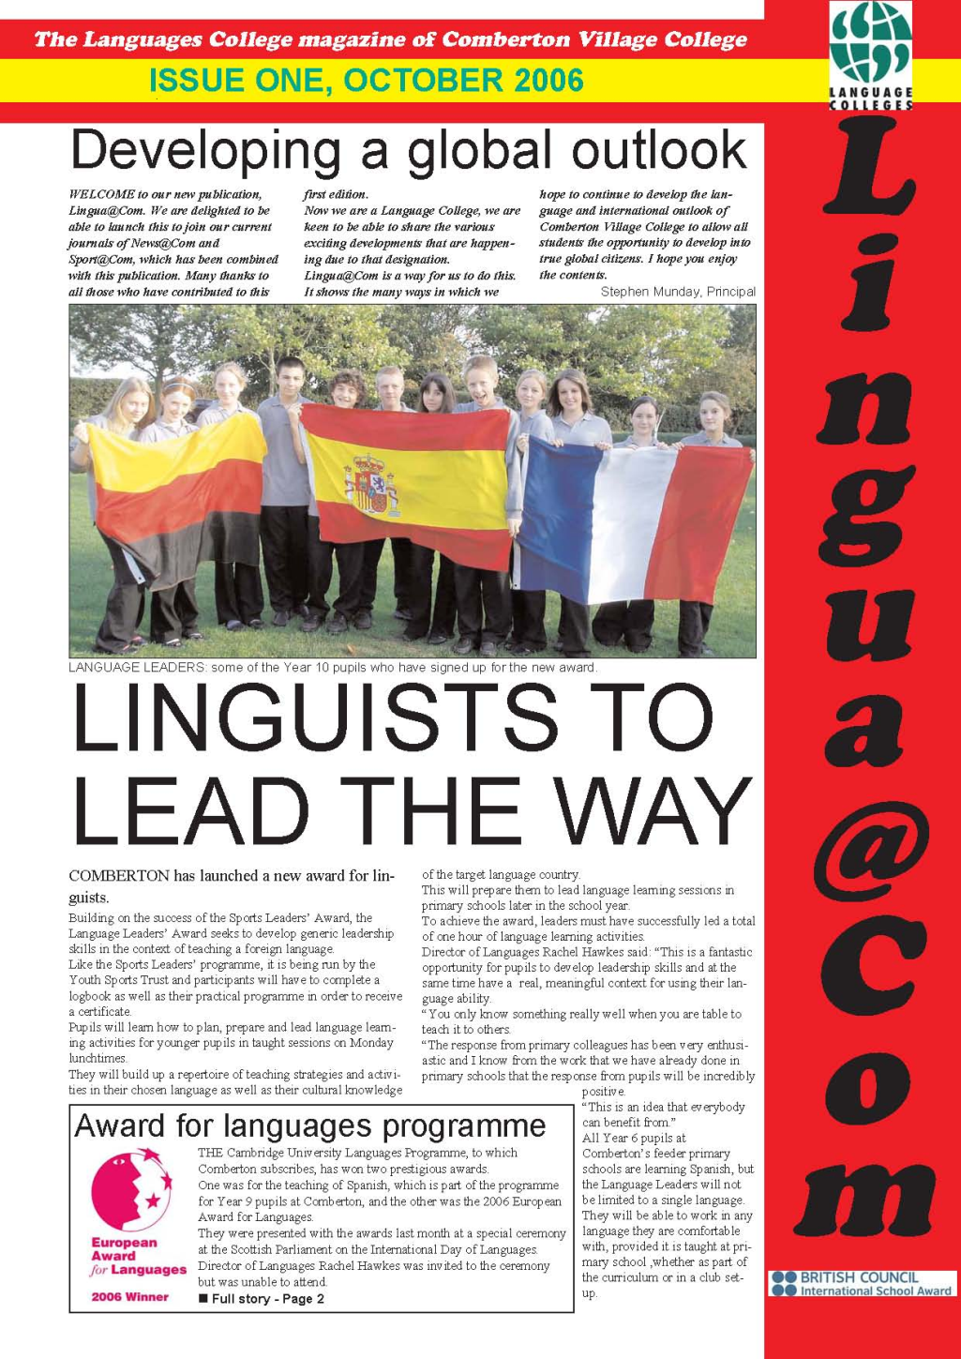
The Language Leader Award at CVC…
started in 2006
has been running for 5 years
is being implemented by other schools nationally
has been publicised in national language college magazine
Rachel Hawkes

Slide 29
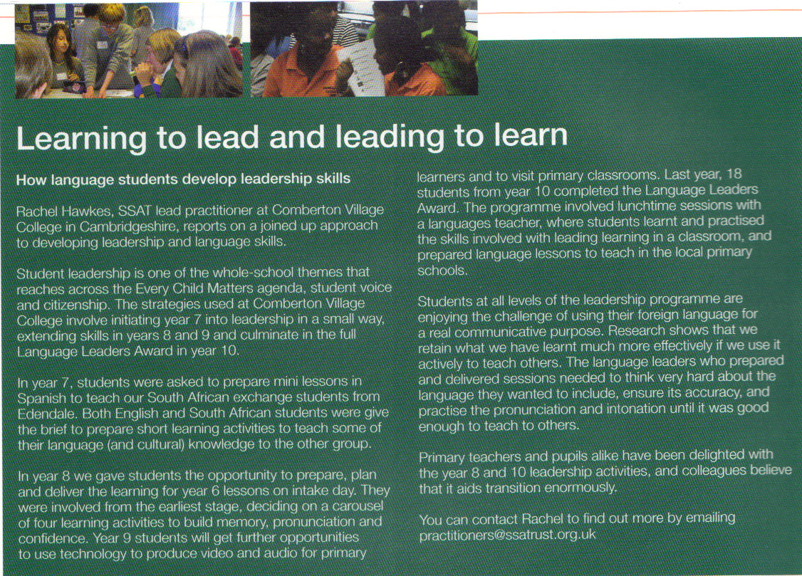
Rachel Hawkes

Slide 30
What does it do for students?
rewards language learning
gives them a practical way to use language skills
develops general communication and leadership skills
gives a better understanding of how people learn and including how they learn
enhances self-esteem and confidence
improves evaluative and analytical skills
increases skills in the language
Rachel Hawkes

Slide 31
What does it involve?
Weekly lunchtime sessions
Support from a languages teacher
Working in whole group to develop techniques for teaching
Working in pairs or trios to devise primary school lessons
3 visits to teach in primary school – January, April and May/June
Succeeding and gaining the leadership award!
Rachel Hawkes

Slide 32
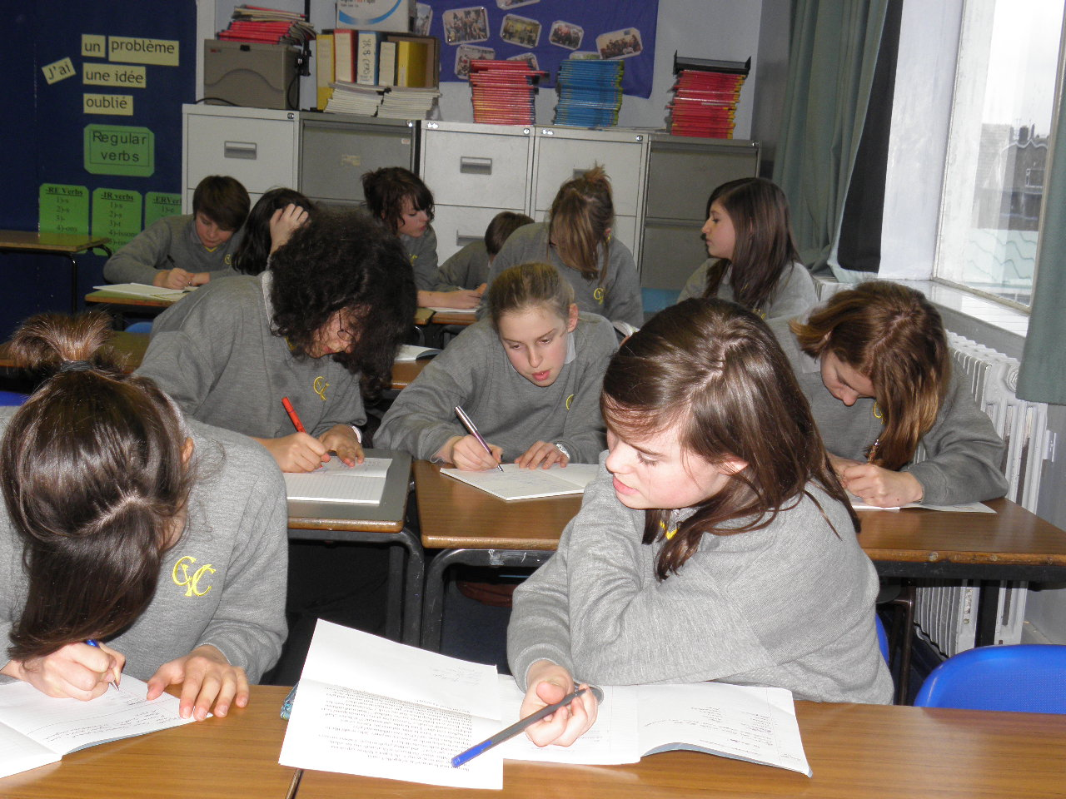
French Language Leaders lunchtime session

Slide 33
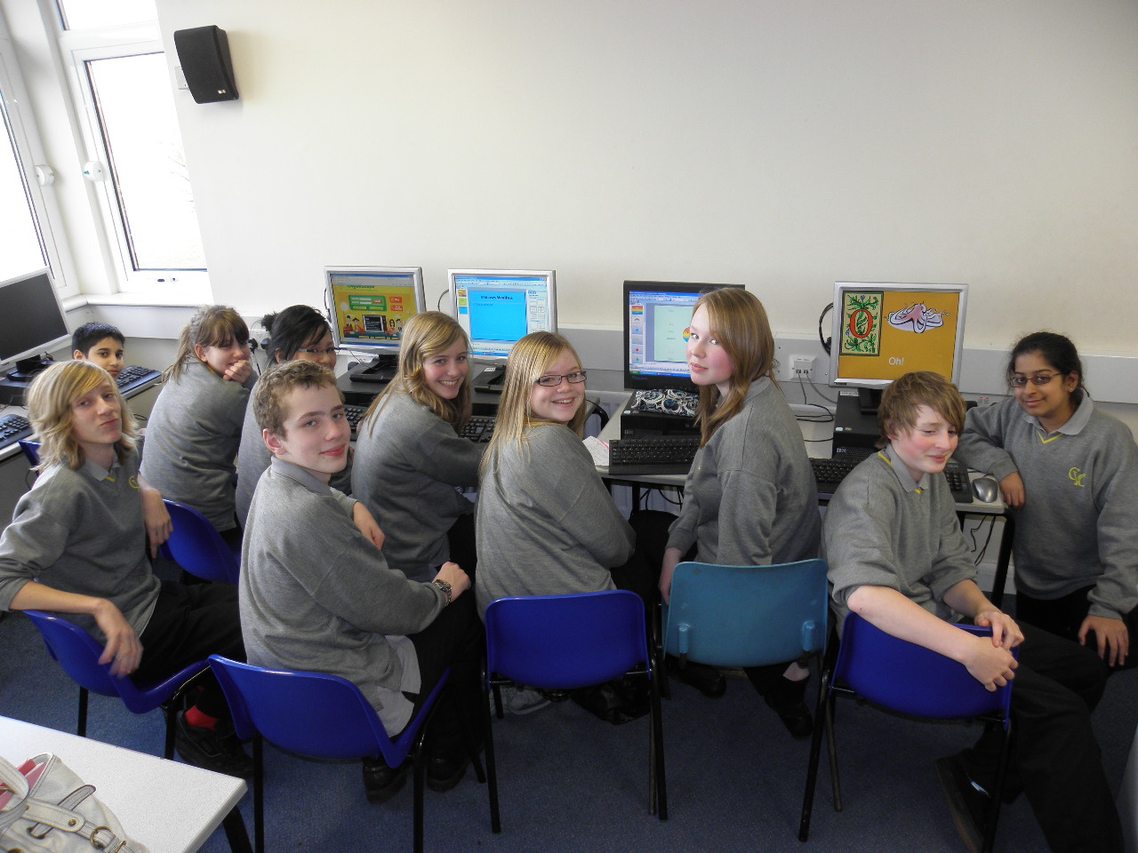
German Language Leaders lunchtime session

Slide 34

What is the process?
Assembly to ‘launch’ to Y8 in June/July
Parent letter
Completion/Submission of application form
Selection in time for September – start of Y9
Lunchtime Language Leader sessions once a week from September – June/July
3 visits to teach in primary school – January, April and May/June
Rachel Hawkes

Slide 35
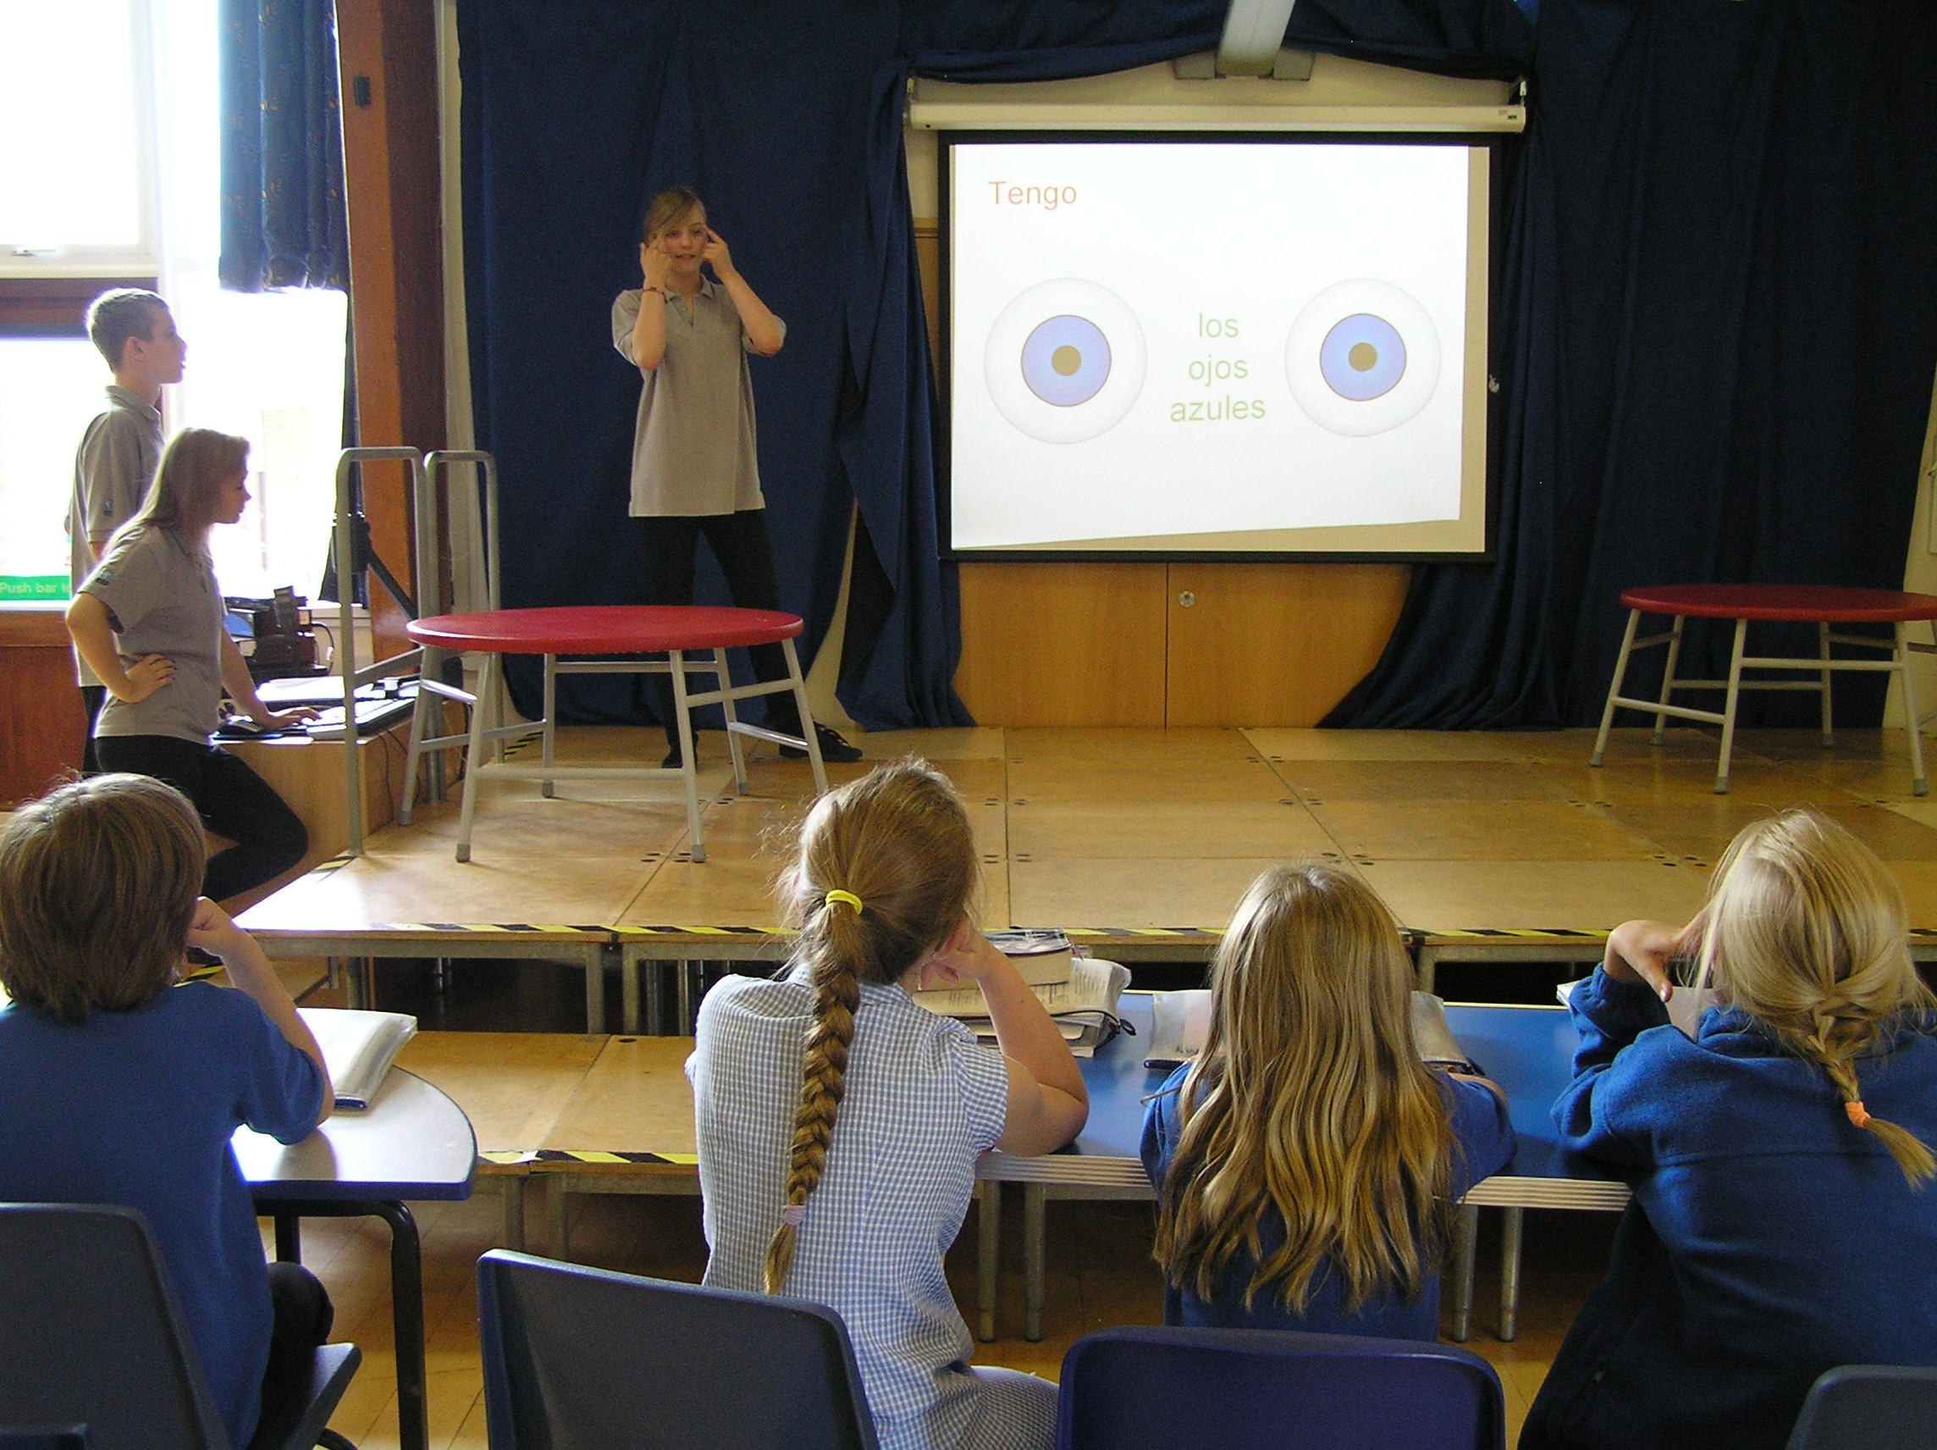
Language Leaders at Bourn Primary

Slide 36
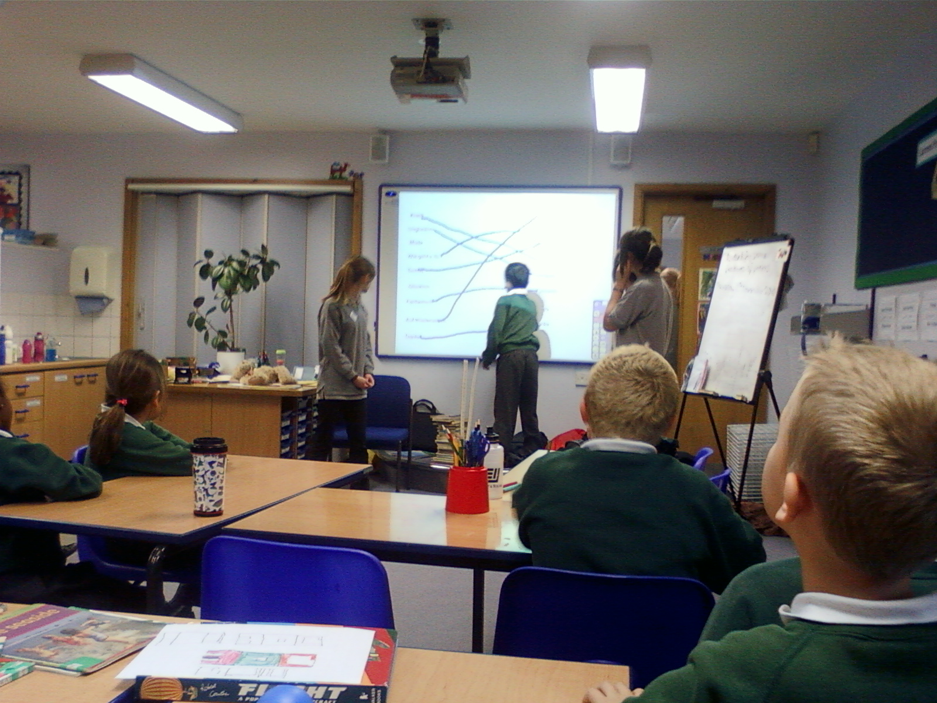
Language Leaders at Monkfield Park

Slide 37
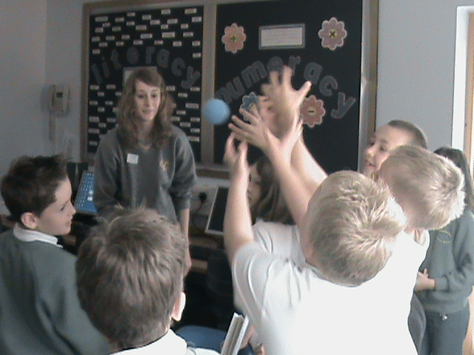
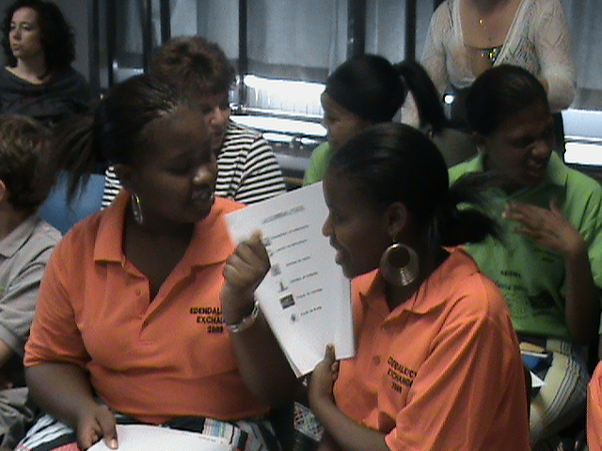

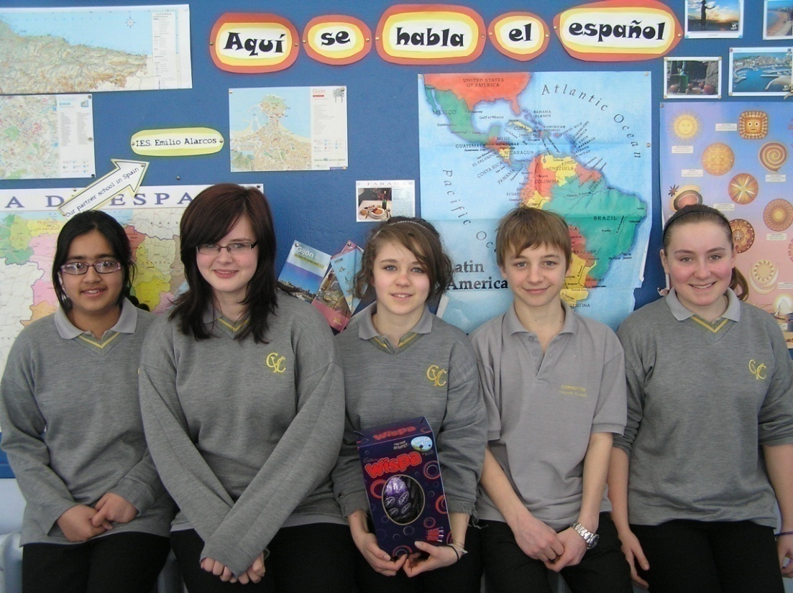
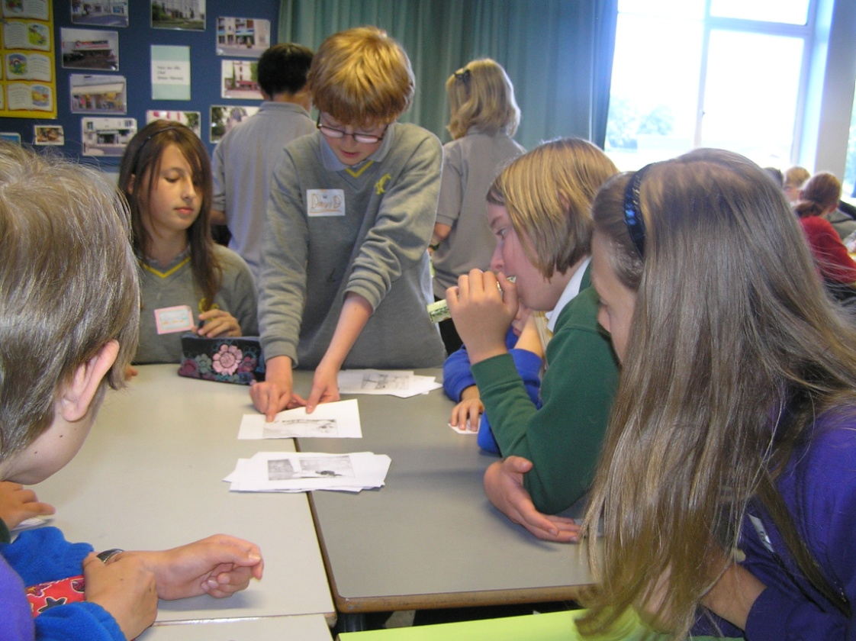
Language Leaders in Years 7, 8, 9 and 10

Slide 38
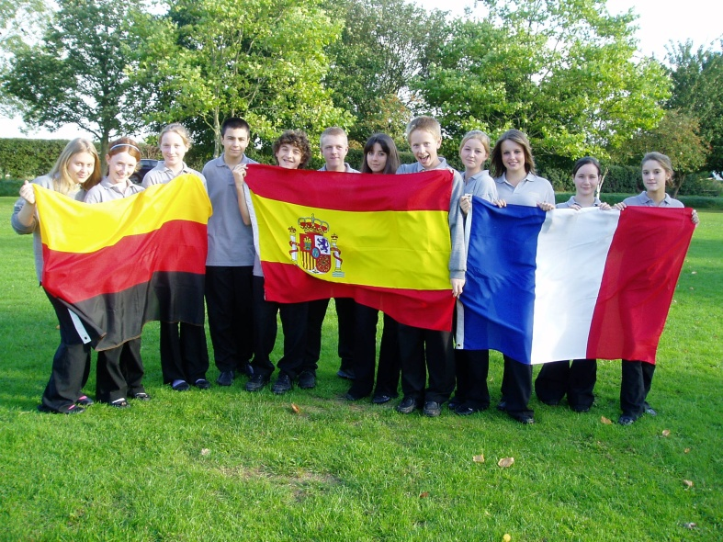
How do I introduce LL in my school?
Resources to support delivery of a Language Leader Award are available here: http://rilanguageleaderaward.wikispaces.com/
and here: http://www.rachelhawkes.com/RPP/LangLead/LanguageLeaders.php
These include an introduction to the award, model letter to parents, an assembly, application form, student log book and overview of the course.
Rachel Hawkes

Slide 39
What students say….
“Any language leader would agree that the experience is a fun and exciting way to improve your range of vocabulary, accuracy of pronunciation and leadership skills as we go into groups of two or three to teach three lessons to primary school students and I would recommend it to any students that were interested.”
Year 9 student, Comberton Village College
Rachel Hawkes

Slide 40
Leadership activities
Language Leader Award
Spelling Bee leaders
Catch-up club
International Leaders → Interact
Comberton Village College
Rachel Hawkes

Slide 41
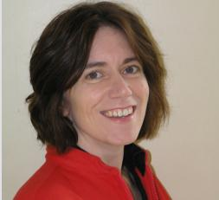



Comberton Village College
My contact details and links to resources
www.rachelhawkes.com www.tes.co.uk (type ‘rhawkes’ into search to pull up all resources)
Rachel Hawkes
rhawkes@comberton.cambs.sch.uk
01223 262503 ext.222
Notes:
There are obviously a lot more ideas – limit is only time to explore them, create them, try them out! And today, the time is limited to share the ideas, but I hope that’s been a useful session and you’ve taken at least one thought away to explore in your own practice.

