Slide 1



Comberton Village College
GCSE languages: How to raise achievement through high quality teaching
Independence in speaking Secure grasp of repertoire of key structures and reference skills in writing Perseverance in listening and link-making in reading Vocabulary!
Rachel Hawkes

Slide 2
Rachel Hawkes
Comberton Village College
Priorities
1 Strategies for Speaking
Strategies for Writing
3 Strategies for Listening and Reading Further discussion and planning

Slide 3
7 July 2011
GCSE reforms and the move to linear assessment
On Sunday 27 June 2011, Michael Gove, Secretary of State for Education, announced his support for a move to linear assessment of GCSEs. For two-year courses starting in September 2012, we expect that all GCSE examinations will be taken at the end of the course, with no modular examinations available. Retaking of units will therefore not be possible. The Secretary of State also announced his support for the strengthening of spelling, punctuation and grammar (SPAG) requirements for GCSE examinations. For these SPAG requirements, we expect that English Literature, Geography, History and RS will be the first subjects to be changed for assessments taken in the academic year 2012/13. Over the next few weeks, Ofqual, the qualifications and examinations regulator, will be working closely with all the awarding bodies to discuss the implementation of these changes. We very much welcome Ofqual’s commitment to ensuring that there is no unacceptable risk to students in this implementation, and its recognition that teachers need to have appropriate time to revise their teaching plans and strategies. As we find out more about these GCSE reforms, we will let you know. We'll also develop specific advice and support to help you implement these changes. Further information will be made available on the subject pages of our website. You can also find information and FAQs about GCSE reforms on the Ofqual website.
http://www.edexcel.com/quals/gcse/gcse09/mfl/italian/pages/viewNotice.aspx?notice=2487

Slide 4

Comberton Village College
QCDA Pilot CD: Sample Controlled Assessment
Rachel Hawkes
Notes:
Examiner comment: variety of structures, readily understood. Not initiate or develop the task, little explanation of ideas or extended replies. Most characteristic of Grade B.
Define initiate: not necessarily asking a question! It means extending the answers really, offering more information that was required for a minimal response to the question asked.
What could Pippa have done?
More factual information about the film itself and Jonny Depp too.
Narrate the story
More range of language to describe the type of film
Character Jonny plays in the film. Say why the film is amusant.
Other films Jonny has been in.
Other details about the actor – e.g. he speaks French, he’s been in a French film himself, he can’t see 3D films, not typical Hollywood star
More prepared to talk in depth about her own hobbies
Swimming – she swims for Oxfordshire! Since when? Family also into swimming? When/where does she train? Competitions? How often? Why does she like it? Take it further? Any other sports? Why prefer it to other sports?
Why does the question C’etait comment? Confuse her? Spontaneity is first and foremost about understanding – grasping the meaning of the question quickly.
What should classroom interaction look like? What can the teacher do?
More extended questioning with one student each lesson (aim to do this with 4-5 students per lesson). Deeper, sequential, unpredictable questioning. Perhaps this will need to be whilst others students are doing group work? So that it is not too much pressure in front of peers. However, research shows that other students benefit from the learning opportunities that are created from secondary participation in these spontaneous interactions. i.e. they have the time to attend to what is said and learn from it, when not fully involved themselves.

Slide 5
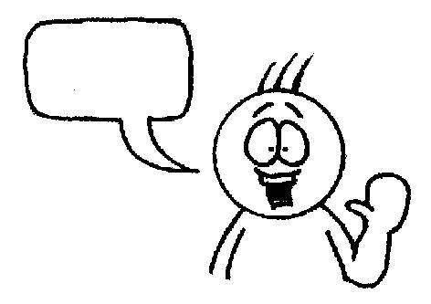
Comberton Village College
Session 2: Strategies for Speaking
Rachel Hawkes
Practising output
(fluency , pronunciation, automatization, memory)
Increasing interactivity
(spontaneity, sustaining the flow, filling pauses, intonation)
Manipulating language
(Sentence-building, creativity, improvisation)
Questioning
Developing quality
(Assessing, improving, enhancing, modelling)
Rewarding spontaneity

Slide 6
Comberton Village College
Practising output (fluency , pronunciation, automatization, memory)
Rachel Hawkes
Telepathy (trapdoor/bubbles)
Idea 1

Slide 7


Im Sommer bin ich
nach Portugal
nach Spanien
nach Frankreich
gefahren
bequem.
gemütlich.
sehr gut ausgestattet.
in einem Hotel
auf einem Campinplatz
in einer Ferienwohnung
Ich bin
und es war
geblieben
das Museum Guggenheim
das Museum Louvre
das Museum Dalí
Ich bin radgefahren.
Ich bin reiten gegangen
Ich bin im Meer geschommen.
Ich habe
besichtigt
und
Mir haben
die Strände
die Diskos
die Leute
gefallen,
aber
das Essen
die Hitze
das Verkehr
hat mir nicht gefallen
nach Schottland
nach Goa
nach Australien
fahren,um zu
klettern.
wandern.
rudern.
Nächstes Jahr werde ich
Notes:
Anna’s TES resources reminded me of this one! She calls it Trapdoor and it’s brilliant for a) memory and b) speaking (repetition with a reason!) It’s a competitive game in pairs. Each chooses and option for each sentence in their head. One starts reading out loud, trying to anticipate the other’s choices. Each time they make a choice, the partner either nods or shakes his/her head. If the choice is wrong, play passes to the partner who starts the same process. If it is the right choice, the student gets to continue. The aim is to get to the end first. Answers don’t change, so this is also a great memory developer.
I have used this recently in Year 9 to help develop narration skills, which is one thing AQA seems to prize highly in its markschemes for CA.

Slide 8

Érase una vez
una niña fea
una princesa
una niña bonita
que vivía con
su madrastra
su madre
Madre Nieve
su hermana malvada
su hermano malvado
su hermanastra malvada
y con
Angelina.
Agnes.
Dolores.
que se llamaba
Un día Clara tuvo que
en un castillo.
en la casa.
en el pozo.
una bruja.
una anciana.
un dragón.
entrar
Se encontró con
Notes:
This is a trapdoor activity to practise scene-setting language. It’s brilliant for a) memory and b) speaking (repetition with a reason!) It’s a competitive game in pairs. Each chooses and option for each sentence in their head. One starts reading out loud, trying to anticipate the other’s choices. Each time they make a choice, the partner either nods or shakes his/her head. If the choice is wrong, play passes to the partner who starts the same process. If it is the right choice, the student gets to continue. The aim is to get to the end first. Answers don’t change, so this is also a great memory developer.

Slide 9
lavó
limpió
fue de compras
Clara se quedó con Madre Nieve y
y/e
jugó.
hizo las camas.
cocinó.
Cuando volvió a casa, Madre Nieve le regaló
una gallina de oro.
un vestido de oro.
un plato de oro.
una idea.
un problema.
un plan retorcido.
La madrastra tuvo
Agnes también entró
oro.
alquitrán negro.
plata.
en el pozo pero no
cayó
trabajó
comió
bien y su recompensa fue
Notes:
This is a trapdoor activity to practise scene-setting language. It’s brilliant for a) memory and b) speaking (repetition with a reason!) It’s a competitive game in pairs. Each chooses and option for each sentence in their head. One starts reading out loud, trying to anticipate the other’s choices. Each time they make a choice, the partner either nods or shakes his/her head. If the choice is wrong, play passes to the partner who starts the same process. If it is the right choice, the student gets to continue. The aim is to get to the end first. Answers don’t change, so this is also a great memory developer.

Slide 10
Comberton Village College
Practising output (fluency , pronunciation, automatization, memory)
Rachel Hawkes
DICE/CHUNKING
Idea 2

Slide 11
Role the dice each time and move left to right through the boxes. Say your phrase out loud. Your partner will use the whiteboard to translate what you are saying. Take it in turns to produce these level 5 speeches.
A
B
C
1 El año pasado 2 El verano pasado 3 Hace dos años 4 Durante las vacaciones 5 En 2007 6 El invierno pasado | 1 fui a España 2 fui a Francia 3 fui a Escocia 4 fui a Norfolk 5 fui a Grecia 6 fui a Italia | 1 con mis amigos. 2 con mi familia. 3 con mis padres. 4 para dos semanas. 5 para una semana. 6 para un mes.
Me gustó mucho porque…….. 1 nadé en el mar 2 visité monumentos 3 descansé 4 jugué al voleibol 5 fui a la playa 6 comí platos típicos | 1 y mandé mensajes. 2 y saqué fotos. 3 y tomé el sol. 4 y bailé en la discoteca. 5 y monté en bici. 6 y escuché música. | 1 ¡Fue genial! 2 ¡Fue guay! 3 ¡Fue fantástico! 4 ¡Fue estupendo! 5 ¡Fue maravilloso! 6 ¡Fue fenomenal!
El año que viene, cuando vaya a España….. 1 voy a ……. 2 me gustaría.. 3 quiero.. 4 tengo ganas de.. 5 tengo pensado.. 6 espero.. | 1 ir de compras 2 ir a la piscina 3 hablar español 4 jugar al tenis 5 montar a caballo 6 acampar | 1 en la playa. 2 con mis amigos. 3 todo el tiempo. 4 todos los días. 5 por la noche. 6 y tomar el sol.
Where you went
Time phrase
Who with?
D
E
F
A second activity
One activity
An opinion
G
H
I
Next year’s plans
What you will do
Extra detail
Notes:
Speaking & memory lesson – instructions for teacher
1 Explain and ‘sell’ the concept of the lesson – students are going to aim to memorise one level 5 speech as a minimum by the end of the lesson. They are going to improve their Spanish speaking AND their memory skills in this lesson. (5 mins)
2 Show the sheet – for most groups the first step will be to take them through the meanings. Allow students to writing in the English meanings by the side of the Spanish if desired. (8 mins)
3 Next model a speech using the dice – display the sheet on the whiteboard as you do so and underline each part as you roll, emphasising the Spanish and repeating the whole speech from the beginning each time you roll so that by the end of 9 boxes you have said the first box part 9 times! This is excellent repetition practice and they will do this without noticing if you model it clearly as you show them what to do. (5 mins)
4 Elicit the English meaning from the students of the speech you have given (either taking oral contributions or on whiteboards) – this is what the partner will do when they do this is pairs so is important to model this part too. (3 mins)
5 Make clear that this is just the first activity and that they have 6 minutes to make as many sentences as they can, taking it in turns each time. (6 mins)
Speaking & memory lesson – instructions for teacher
cont’d
Now explain that you want them to use the scaffolding sheet to write their own 30-second marathon sentence. All will write using a phrase from each of the 9 boxes. (5 mins)
Now the challenge is to use some memory strategies to learn it off by heart. Explain that the first 6 boxes are compulsory (will make about 20 seconds) and adding in the final 3 boxes will be exceptionally good and will be about 30 seconds.
Suggest that one strategy (chunking) is already provided by the sheet itself and that building up the speech ‘chunk by chunk’ repeating each bit that they learnt before should help them to memorise.
Suggest also that they might split their page into 9 boxes.
Write each bit out with just the first letter to prompt in each box
Draw a picture instead of the words in each box
Use look, cover, say, check
Work in pairs to test each other
(5 mins)
Give them 14 minutes to work on their speeches – circulate to support
Plenary – hopefully there will just be time to hear 2 or 3 students ‘perform’ their speeches – plenty of praise at this point.
For homework, set them to work their speech into their longer term memory by repeating some of the activities that have worked for them in the lesson. Say you will begin next lesson by hearing and recording their speeches.

Slide 12
Comberton Village College
Practising output (fluency , pronunciation, automatization, memory)
Rachel Hawkes
VOKIS (or other)
Idea 3

Slide 13
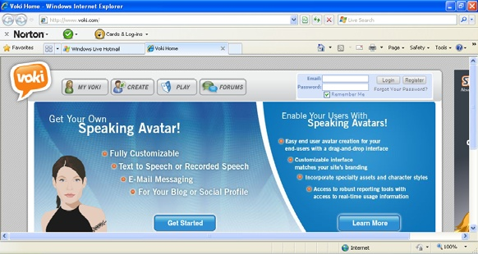
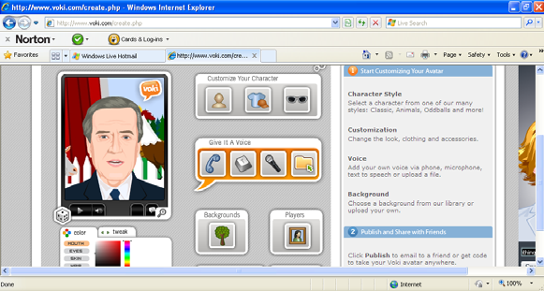

www.voki.com
http://text-to-speech.imtranslator.net/
http://www.cueprompter.com/
http://www.starwars.com/games/playnow/crawl_creator/
Notes:
Vokis are talking avatars. Using this free website you can either record and upload the mp3 audio file OR you can copy/paste corrected TL script and choose a voice to say your words.

Slide 14
Comberton Village College
Practising output (fluency , pronunciation, automatization, memory)
Rachel Hawkes
REPASO
Idea 4

Slide 15
Last year to I went on holiday to France with my family.
Notes:
It is hard to get students to use what they have learnt already sometimes. To focus them back on what is in their books, ask them to choose 9 sentences on the theme they have been covering and write them in English, making sure they know how they would be said in the TL (they will have this doubtless in their books). They then get up and go around the class, testing each other. When they find someone who can do a phrase correctly they write their name in one of the boxes next to that phrase. In this version each phrase needs 2 x different names. The plenary activity that follows is for the teacher to do a brief ‘spot check’ asking named individuals to do the phrase they have been signed up for. This gets students to think back to what they have covered and to fix it more deeply in their long term memories.

Slide 16
Comberton Village College
Practising output (fluency , pronunciation, automatization, memory)
Rachel Hawkes
PAIRED REVISION
Idea 5
Notes:
Some the most structured (and seemingly unimaginative!) tasks can work the best. I was told by my Y11 that this is an excellent activity and why couldn’t they do it more often in all the topics they’ve covered. Essentially, a list of core phrases (either whole of partial) with TL and English is produced on card and cut up. Students can do this themselves as the first step to familiarise themselves with the phrases, if that saves teacher time! They then work in pairs, either collaboratively or competitively, to memorise the phrases, turning them over when they think they know and taking themselves through them one by one until they can do them all in TL without referring to the TL version of the cards.

Slide 17
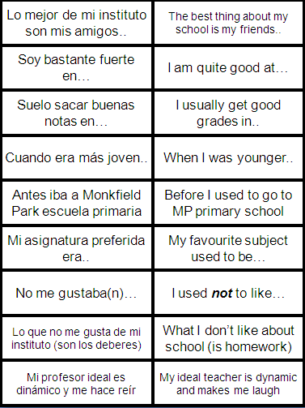
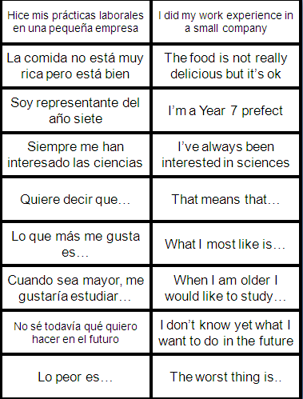

Slide 18
Comberton Village College
Practising output (fluency , pronunciation, automatization, memory)
Rachel Hawkes
3 – 2 - 1
Idea 6

Slide 19

Johnny Depp est né le 9 juin 1963 à Owensboro dans le Kentucky, aux États-Unis. Il est acteur américain, qui est déjà très célèbre. Il est en couple avec la chanteuse et actrice française Vanessa Paradis et ils vivent en France. Ils ont deux enfants ensemble. En 2010, il a refusé le titre de l'homme le plus sexy de l'année pour servir d'exemple à ses deux enfants.
Notes:
This is just an example. This activity works best when students have written their own paragraph and use it to play a talking game with their partner. This fulfils several purposes. Pronunciation practice with an added motivation. 2 x pairs of eyes concentrating on written work just produced – the chances are that spelling or other errors may be picked up this way. Students can learn from each others work – they may spot useful language that they can use in their own work.

Slide 20
Comberton Village College
Manipulating language (Sentence-building, creativity, improvisation)
Rachel Hawkes
ODD ONE OUT
Idea 7

Slide 21



Slide 22
1908
1992
2012
1948
Notes:
Pilla al intruso. Students may say anything from ‘2012 porque es futuro y los otros son pasados’ or ‘2012’ porque son ‘dos mil’ y los otros son ‘mil novecientos’. My answer is ‘1992’ porque los juegos olimpicos tuvieron lugar en Barcelona y los otros en Londres.

Slide 23

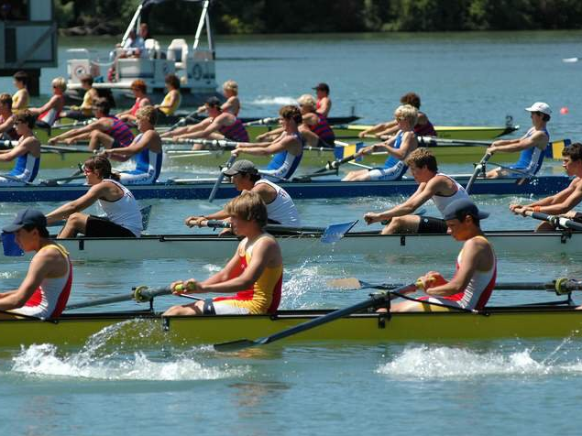
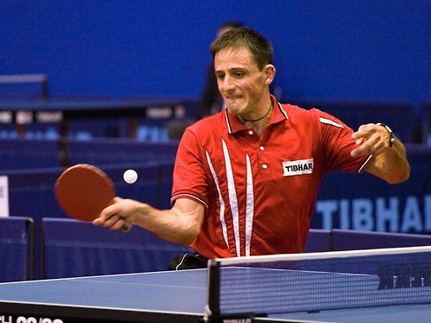
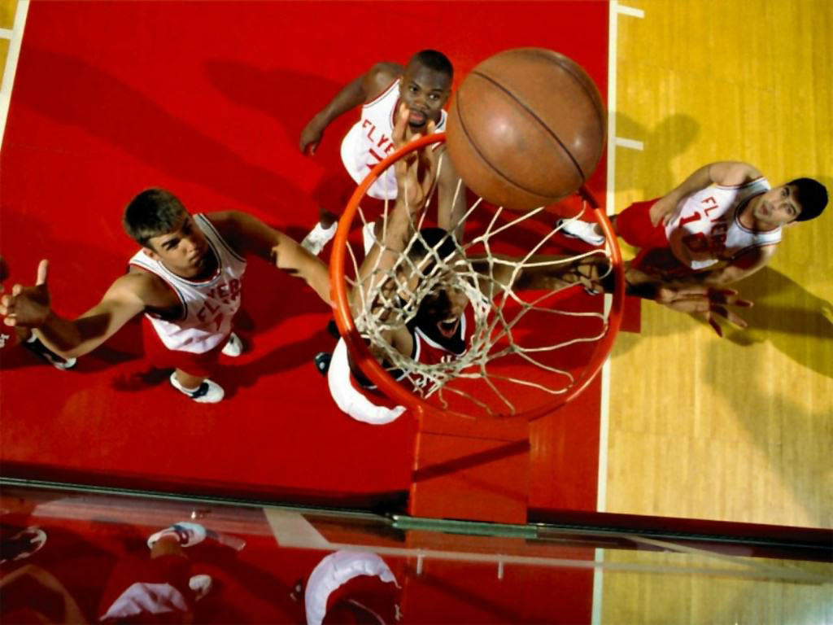
Notes:
Pilla al intruso. El hockey, el remo, el tenis de mesa o el baloncesto. El remo porque es el unico que necesita agua? El remo porque los otros tienen pelotas? El tenis de mesa porque es el unico deporte individual – los otros son deportes de equipo?

Slide 24

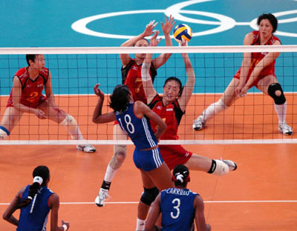


Notes:
Pilla al intruso. (el tenis, el voleibol, el badminton o el beisbol) Students could say anything but my answer is ‘el beisbol porque lo han sadado de los juegos olimpicos’.

Slide 25
Comberton Village College
Manipulating language (Sentence-building, creativity, improvisation)
Rachel Hawkes
READING IMAGES
Idea 8

Slide 26

Notes:
Reading images – a way to stimulate creative sentence-building, recycling of known languages in a new context and spontaneous responses. This can be a short or long a task as required, and the teacher can vary questions accordingly. A routine for this picture could be:
¿Cómo se llama esta chica? ¿Cuántos años tiene? ¿Es mayor o menor que vosotros (o la misma edad? ¿Qué tal está? ¿Tiene problemas? ¿Por qué? ¿Qué quiere hacer? ¿Qué tiene que hacer? ¿Qué le gustaría más hacer? ¿Qué planes tiene para el fin de semana?

Slide 27
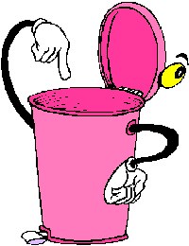
Cubo de basura
¿Qué vas a tirar?
¿Por qué?
Notes:
http://www.muchosgifs.com/1a1a1a/hogar/cubos/basura25.gif

Slide 28

¡Atasco!
¿Adónde ibas?
¿A qué hora saliste de casa?
¿Cuánto tiempo llevas esperando?
¿Qué harás mientras sigues esperando?
Notes:
http://www.cosasdemotor.es/images/novedades_ley_de_trafico.jpg

Slide 29
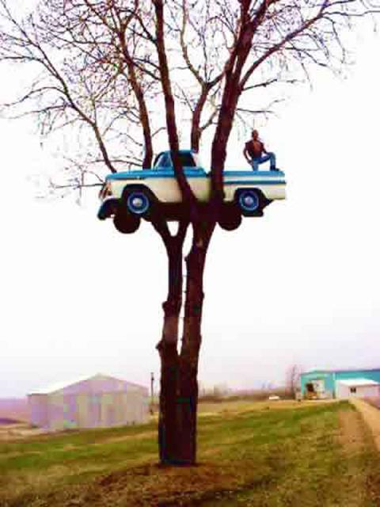
Qu’est-ce qu’il veut faire?
Qu’est-ce qu’il peut faire?
Was wird jetzt passieren?
Wo ist das?
Was ist gleich passiert?
Was sieht man im Foto?
Wer hat das Foto genommen?
Was sieht man nicht?

Slide 30
Comberton Village College
Manipulating language (Sentence-building, creativity, improvisation)
Rachel Hawkes
IN THE ZONE
Idea 9

Slide 31


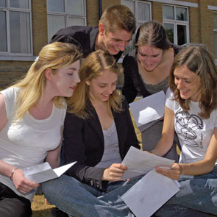


(nicht) bestehen
Letztes Jahr
wenn
wann
Was ich am liebsten mag
Notes:
Pairs work with this stimulus (within given time limit) to come up with as many statements/utterances using one or more of the picture or verbal prompts. This one has the theme of school.

Slide 32
Comberton Village College
Manipulating language (Sentence-building, creativity, improvisation)
Rachel Hawkes
TARGET TALK
Idea 10

Slide 33
Was ist dein Lieblingsfach?
Wie ist deine Schule?
Wie findest du die Schuluniform?
Was ist das größte Problem in deiner Schule ?
Welche Pläne hast du für nächstes Jahr?
Wie wäre die Schule der Zukunft?
NB: Du mußt 7 Wörter sagen.
Und jetzt, 10+ Wörter
Notes:
Give students the questions and 1 minute for question 1 to think through (not write down) an answer with exactly 7 words. Take a few answers in whole class feedback. Then give them 3 minutes to do the same for the next 2 questions. Then give them 3 minutes to choose 1 of the 3 remaining questions and try to come up with a sentence of 10 words – they will need either a connective for this, either ‘et’ or ‘mais’ or a ‘parce que’. They can be encouraged to use other forms of the verb other than 1st person too here. This highlights some of the different ways to extend answers.

Slide 34
Comberton Village College
Manipulating language (Sentence-building, creativity, improvisation)
Rachel Hawkes
PIMP MY FRENCH
Idea 11

Slide 35
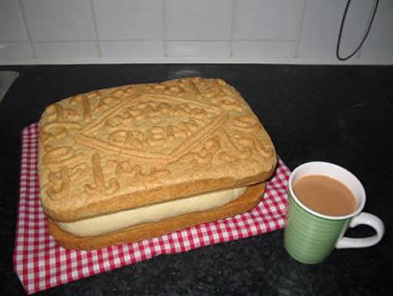
Pimp my sentence!
Je joue au tennis.
J’habite au nord de l’Angleterre.
Mon chien s’appelle Bob.

Slide 36
Comberton Village College
Manipulating language (Sentence-building, creativity, improvisation)
Rachel Hawkes
SAY SOMETHING ELSE
Idea 12

Slide 37


HAVE I GOT NEWS
FOR YOU
Hinesh, 14ans, va
jouer pour…
Chloe admet: Je fume…cigarettes
par jour
Selon Adam, Alex a acheté des
chocolats...
Abir fait… tous les jours, dit James.

Slide 38
Meine Schule ist eine gemischte Schule.
Meine Schule ist eine Schule,die sich in Naturwissenschaften spezialisiert.
Meiner Meinung nach sind die Schulregeln nicht zu streng.
Die besten Schulen haben eine Uniform.
Mein Lieblingsfach ist Englisch, weil ich gern Geschichten schreibe.
Um meine Schule zu verbessern, muß man mit den Strafen aufhören.
Nächstes Jahr möchte ich Spanisch studieren.
Notes:
Students have to change something in the sentence – it could be one detail, it could be the whole thing, it could be adding an additional detail to ‘grow’ the sentence.

Slide 39
Comberton Village College
Manipulating language (Sentence-building, creativity, improvisation)
Rachel Hawkes
THEN AND NOW
Idea 13

Slide 40
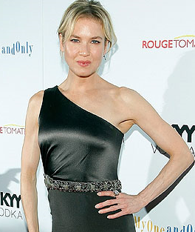
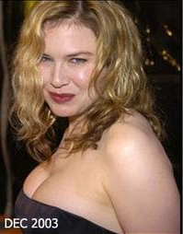
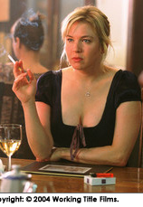
Antes…. | Ahora…
Cuando jugaba el papel de Bridget Jones… | Hoy en día …
Notes:
I used this after revising present and imperfect talking about healthy lifestyles so they could relate that
back to what they eat/drink.
I remember the girls being particularly enthusiastic, but the boys as well were quite quick to talk about era gorda porque comía muchas patatas fritas/comida rápida etc, no hacía deportes, era perezosa
Some also brought back in quite a lot that we had previously done on sports and related that in, so they started off with era gorda/es delgada but then extended into why - they just made it up obviously!
Using vocabulary they knew from talking about their own free time.

Slide 41
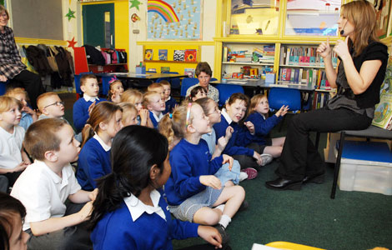

À mon école primaire, il y avait… | À mon école secondaire, il y a…

Slide 42
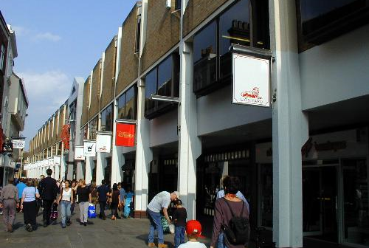
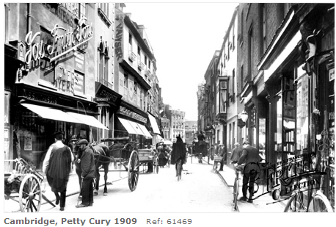
Cambridge, Petty Cury 2009
Il y a cent ans, il y avait des magasins dans cette rue. | Aujourd’hui, il y a encore plus de magasins ici.

Slide 43
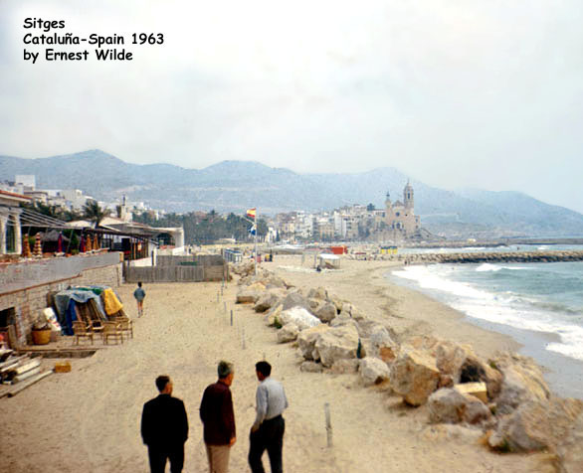
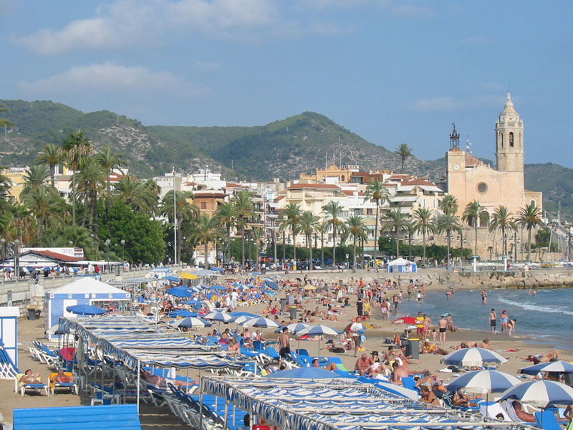
Sitges
Cataluña, Spain 2009
Hace 50 años, había más rocas en la playa. | Hoy no hay rocas en la playa.

Slide 44
Comberton Village College
Manipulating language (Sentence-building, creativity, improvisation)
Rachel Hawkes
MIND MAPPING
Idea 14
Notes:
This is an idea to get students to make links between language they learn and use in one topic in further topics. For example, when finishing the theme of holidays, students should be encouraged to do a mind map of key language, focusing on the verbs and sentences starters that they have practised and learnt during that topic. Then they should be given a new piece of paper and told the new theme. Their first task is to take all of the language they know from the context of holidays and adapt it to the new context. So, for example, I used to go on holiday to France can become I used to go to Milton Primary School. We went on holiday to Mallorca can become we went on an excursion to Alton Towers theme park with the school. It’s a very visual and practical way to get students to take stock of what they know already before starting a unit, so they never feel that they are beginning from scratch. If preferred, they could actually cross out the holidays related vocabulary and write the new possibilities (e.g. school/world of work) over the top.
This type of activity could also be done in different ways i.e the teacher could present them with a list of language from the holidays theme and they could highlight any language that they could use in the new theme.

Slide 45
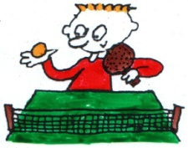
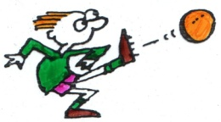



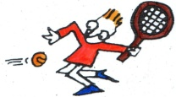







KS3
jugar al
comer
hacer
siempre
beber
porque
normalmente
a veces
nunca
sano | malsano
delicioso
bueno | malo
picante dulce salado amargo
i
divertido
cómico
guay
interesante
emocionante
aburrido
con = with
sin = without
en = in
porque
Notes:
Mind mapping activity. Aim to practise generating longer sentences about sports and food/drink and likes/dislikes. Here we are looking for something like: Me gusta jugar al baloncesto a veces con mis amigos porque es divertido = I like playing basketball at times with my friends because it’s fun.
Tell them that mind-mapping helps memory because it’s about elaboration – working the knowledge you’re trying to remember so that it sticks (like the activity about the elephant knowledge in Everlasting 1). It’s good to use pictures, words & lots of colour and have a logical order with arrows etc… In this one you start with an opinion in the middle and you then go either left or right, to talk about food or sports. Then you add in a time expression and extra detail and a reason. The pyramid on the next slide is just a different way to portray this visually. After they have made their mind map they should practise saying some sentences referring to it.

Slide 46
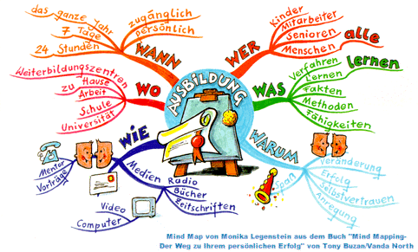

Slide 47
Cada equipo tiene dos laterales, dos extremos, un centro, un pivote y un portero.
Se juega en una cancha del balonmano, que tiene 20 de 40 metros.
El objetivo es meter goles en la portería contraría, pero se necesita también defender la portería propia.
KS4
El Balonmano
Hay dos tiempos de 25-30 minutos cada uno durante un partido. Hay tambien un descanso de 10 minutos a mediados del partido.
Hay una área de 6 metros delante de cada portería que todos los jugardores sino el portero no deben pisar.
Tiene mucho en común con el baloncesto y el fútbol.
Danny McNamee 10T
Notes:
47

Slide 48
Comberton Village College
Increasing interactivity (spontaneity, sustaining the flow, intonation) Questioning
Rachel Hawkes
TALKING PYRAMIDS
Idea 15

Slide 49




¡Pensar y hablar!
Notes:
The individual thought bubbles are for something that is only applicable to that 1 person and not the other two e.g. VB is a woman The starburst in the middle is for something common to all e.g. They are famous and the rectangles between the pairs are for something that pair has in common. E.g. TH and DB are sporty. With a zillion thanks to Jackie Howis, AST and SSAT LP in Kent for this lovely visual lay-out of this fab task type!

Slide 50
le fastfood
manger et boire
les légumes
J’adore
les sandwichs

Slide 51
Comberton Village College
Increasing interactivity (spontaneity, sustaining the flow, intonation) Questioning
Rachel Hawkes
FIND SOMEONE WHO
Idea 16

Slide 52
Findet eine Person, die………….
1. nicht gern Sport treibt
schon in Frankreich war
gern ins Kino geht
4. mehr als ein Haustier hat
KS3
Notes:
I think it’s a sign that classes are getting confident with asking questions when they can do one of these without asking if they can write down the questions and check them with you first. When you introduce the class to this type of activity first in Y7/8 then this might be a necessary step, but by KS4 (if they have had lots of practice with it) they should be able to do this activity spontaneously, either in a speaking line set up/a speed-dating arrangement or just walking around in the classroom.

Slide 53
Finde eine Person in der Klasse,die
am Samstag im Kino war
Ein Lied von Lady Gaga in seiner Sammlung hat
Mathe für das Abitur studieren möchte
KS4

Slide 54

Comberton Village College
Increasing interactivity (spontaneity, sustaining the flow, intonation) Questioning
Rachel Hawkes
WHAT ARE THE QUESTIONS
Idea 17

Slide 55

Quelles sont les questions?
1. Il fait beau.
2. La capitale de la Tunisie, c’est Tunis.
4. Je vais en Espagne pour aller à la plage.
3. S’il fait du soleil, je fais du cyclisme.
5. Oui, bien sûr. Et toi?
6. Hier je suis resté à la maison.
8. Je vais visiter le château
7. On peut faire du ski
9. Peut-être

Slide 56
Was sind die Fragen?
Ja. Ich habe eine Schwester und zwei Brüder.
Mein Lieblingsfach ist Deutsch!
Es ist neun Uhr dreißig.
Ab und zu…
Vielleicht…
Ich wohne in Hamburg in Deutschland.
In meiner Freizeit fahre ich gern Rad und ich besuche Freunde.
Das ist eine gute Frage!
Notes:
Eliciting a mixture of yes/no questions AND question word questions- towards end of Year 8.
56

Slide 57
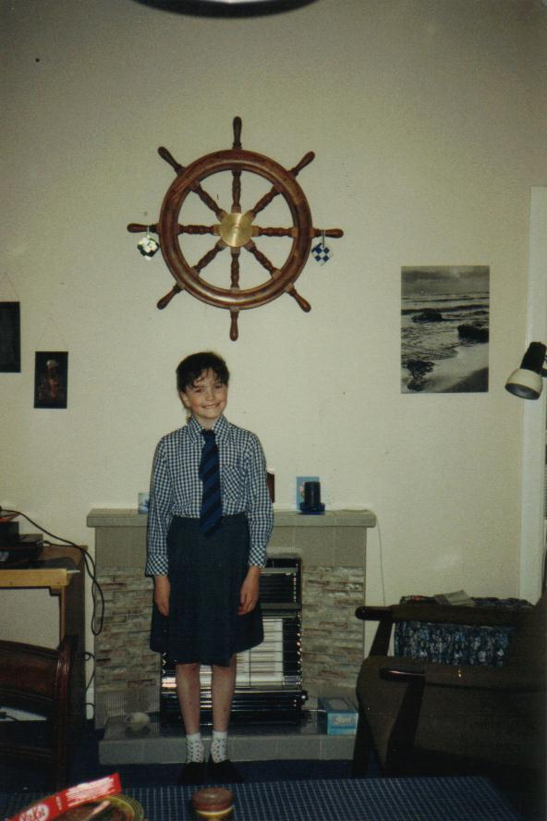
Mein Schultag beginnt um halb neun (1)
Nein. Deutsch ist natürlich mein Lieblingsfach. (2)
Das langweiligste Fach ist Englisch. (2)
Eine gute Frage. Ich finde Mathe nützlicher als Englisch. (2)
Ich habe Grammatik gelernt und ich habe gesungen (2)
Man darf niemanden hänseln oder ärgern (1)
Letztes Jahr war Geschichte sehr langweilig aber dieses Jahr ist es besser. (2)
Ja (5).
Manchmal ist es lustig aber leider ist Mathe oft nur langweilig. (2)
Ich werde immer pünktlich zur Deutschklasse kommen (1)
Nein. Ich muss Hausaufgaben machen (5)
Ich muss Hausaufgaben machen (2)

Slide 58
Deutsch ist schwierig, ja?
Hast du mein Goldfisch genommen?
Wie findest du Mathe?
Das langweiligste Fach ist Geschichte oder?
Magst du Pizzasaft?
Denkst du, dass Alex ist ein bisschen verrückt?
Was hast du in den Ferien gemacht?
Was ist das langweiligste Fach?
Was du in dein letztes Deutschfach gelernt?
Englisch ist interessant, oder?
Möchtest du ins Kino gehen?
Findest du Englisch langweilig, oder?
Später kannst du Schaflaufen ?
Was ist eine Schulregeln?
Warum kannst du nicht mit mir nach Cambridge gehen?
Magst du Geschichte?
Wie findest du Geschichte?
Frau Gillings, ist das du?
Was musst du nächstes Jahr gemachen?
Was musst du am Freitag machen?
Ist Mathe langweilig?
Variety of formulations
Mixture of tenses
Use of statements + oder?
Some more complex question structures
Some mistakes!
Message-oriented
Humour!
Like EFL sessions

Slide 59
Comberton Village College
Increasing interactivity (spontaneity, sustaining the flow, intonation) Questioning
Rachel Hawkes
SPEAKING LINES/SPEED DATING
Idea 18

Slide 60
Buenas vacaciones
KS4
A
Be prepared to answer questions about:
where you went on hoilday
how long you spent there
what the hotel was like
what the weather was like
B
Be prepared to answer questions about:
when you went on holiday
where you stayed
what there was in the hotel
what you did
Ask your partner these questions:
¿Cuándo fuiste de vacaciones?
¿Dónde te alojaste?
¿Qué había en el hotel?
¿Qué hiciste?
! ¿Adónde te gustaría ir en tus próximas vacaciones?
Ask your partner these questions:
¿Adónde fuiste de vacaciones?
¿Cuánto tiempo pasaste allí?
¿Cómo era el hotel?
¿Qué tiempo hizo?
! ¿Adónde vas a ir en tus próximas vacaciones?

Slide 61
Unplanned speaking strategies
Repeat back a couple of words of the question with raised intonation.
When you are beginning to run out of flow, ask a question!
Keep talking for as long as you can – it’s always easy to add in an example or an opinion.

Slide 62
Speaking spontaneously
Content and response (/18)
Detailed and relevant
Interacts (very) well
Speaks confidently (and with spontaneity)
(Frequently) takes initiative and develops elaborate responses
(very) little (/no) hesitation
Able to deal with unpredictable elements (without difficulty)
Range of language (/6)
Range of vocabulary and structures (some complex structures)
Unambiguous tenses (consistently competent)
Extended sentences
Accuracy (/6)
Generally accurate
Errors in more complex structures
(Consistently) good pronunciation and intonation
Notes:
Key points from Edexcel mark scheme for 2nd band marks (12-15;5;5)
Information in brackets is for top band marks (C&R: 16-18; RoL: 6; A: 6)

Slide 63
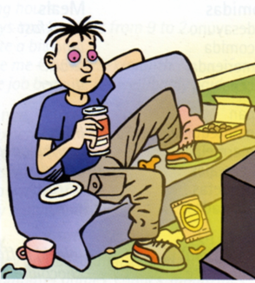
Est-ce que tu regardes la télé tous les
jours?
Quelle sorte d’émission préfères-tu?
Quel est ton émission préférée?
Qu’est-ce qur tu as regardé à la télé
hier soir?
Qu’est-ce que tu vas regarder ce soir?
Est-ce que tu lis une magazine
souvent? Quelle magazine préfères-
tu?
Est-ce qu tu vas au cinéma souvent?
Quel genres de film préfères-
tu?
Listen to the question VERY carefully
Buy yourself time with a ‘hesitation’ word
Think of something you know you can say quickly – e.g. Repeat back a couple of words of the question with raised intonation - Tous les jours?
Use what you know how to say
Keep talking for as long as you can – it’s always easy to add in a ‘par exemple’ or an opinion
When you are beginning to run out of flow, ask a question! (Et toi?)
Use other ‘help’ to get your message across well – i.e. Expression, emotion – sound like you mean it + facial expressions + body language + gestures
Don’t worry about any mistakes – keep talking!
Notes:
Here is the pair work task. This sheet is printed out and cut down the middle so that the respondent does NOT see the questions. S/he has to try to make this into a conversation though and is encouraged to ask questions back to their partner, who will therefore also need to be listening carefully and be ready to respond.

Slide 64
Education
1. Welche Fächer machst du? Was ist dein Lieblingsfach?
2. Beschreib deinen idealen Lehrer.
3. Wie lange studierst du jeden Tag?
4. Beschreib einen typischen Schultag.
5. Hast du Verantwortungen in der Schule?
6. Ist deine Schule gut?
7. Wann du mit deinem Studium hier fertig bist, was wirst du studieren? Wo? Warum?
8. Auf was wirst du dich spezialisieren?
9. Was für Arbeitserfahrung hast du?
10. Deiner Meinung nach,was sind die Unterschiede zwischen deiner Schule und einer deutschen Schule?
Notes:
I’ve put a whole range of discussion questions on this slide that would fit broadly into the theme of school and education – it might not be appropriate to have them all at once but it should be possible to build up to these, taking perhaps 3 per lesson to practise in a speaking line/speed-dating activity.

Slide 65
Comberton Village College
Increasing interactivity (spontaneity, sustaining the flow, intonation) Questioning
Rachel Hawkes
SPEND THE WORDS
Idea 19

Slide 66
gestern | auch | Meiner Meinung nach | Ich denke dass | Ist mehr als
Samstag | Nächstes Wochenende | dann | Ich war / ich bin gewesen | Ich glaube dass
Das wäre | Es erscheint mir | Das Beste | Ich habe gekauft | Ich könnte
Donnerstag | Zum Beispiel | Das Schlimmste | Ich habe | Er wollte
Ich ziehe…vor | Ich werde gehen | Ich hasse | In der Zukunft | Ich hätte gern
Notes:
These words/phrases are on cards and they are divided up equally between the pair or small group. Then a topic is given and the students have to try to ‘spend’ their cards naturally in conversation on the given topic.

Slide 67
Spend the Words
Take it in turns to ask and answer the same questions as before. This time, rather than speaking for as long as you can, you need to try and include the words below and ‘spend’ the words as you answer your 5 questions. Your partner will cross them off as you use them and you need to do the same for your partner. The first to use up all the words is the winner.
um...zu... | schwerer als | leicht | aufstehen | es würde...geben
man darf (nicht/kein(e)) | wir müssen | streng | nicht leiden | Mobbing
dreckig | meiner Meinung nach | AGs | ...fällt mir/fallen mir | gestern
letzte Woche | Deutschland | Schulregeln | weder…noch… | können
Mittagspause | gute Noten | vielleicht | Schuluniform | Gang

Slide 68
Comberton Village College
Increasing interactivity (spontaneity, sustaining the flow, intonation) Questioning
Rachel Hawkes
TELL THE STORY
Idea 20

Slide 69
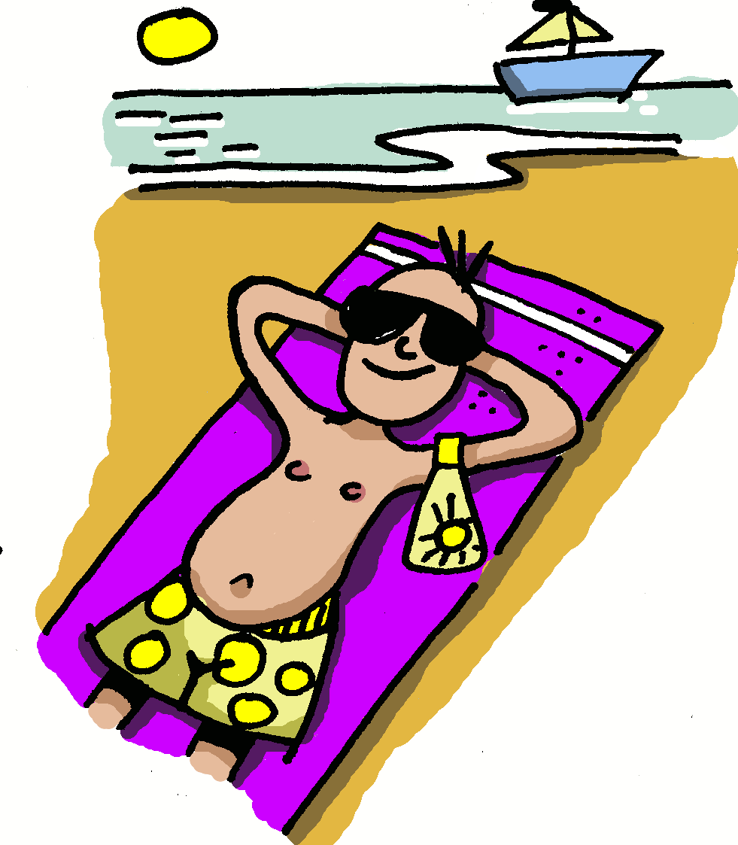
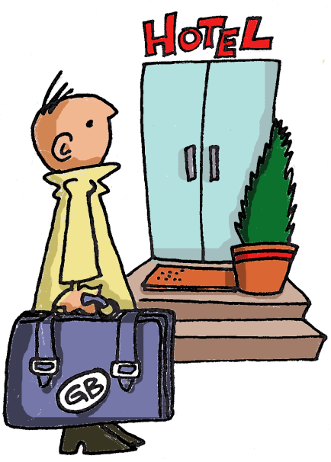
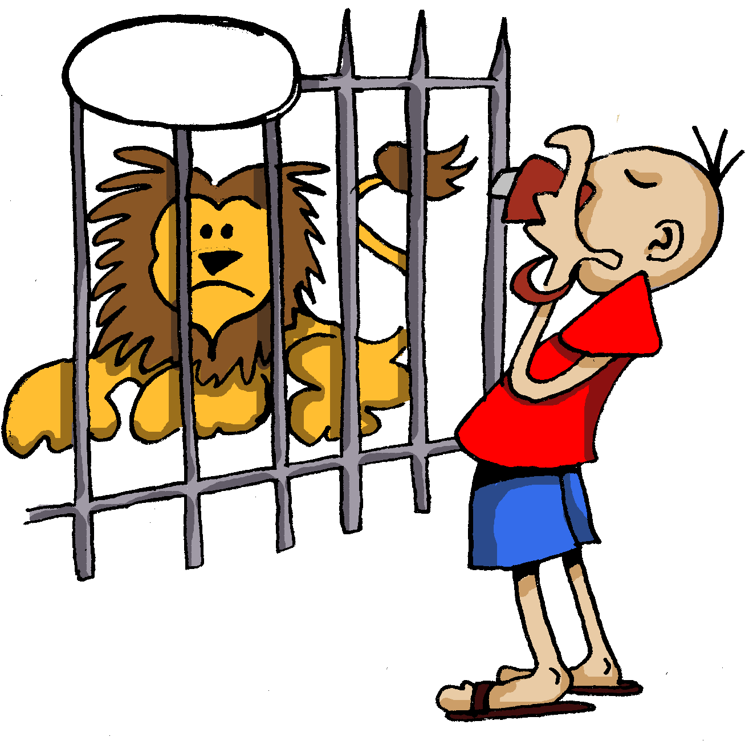

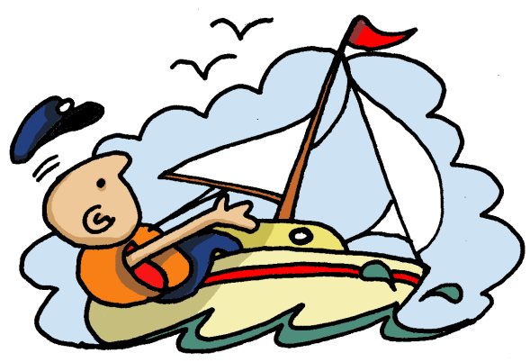
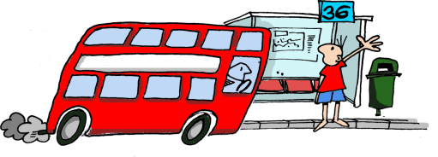
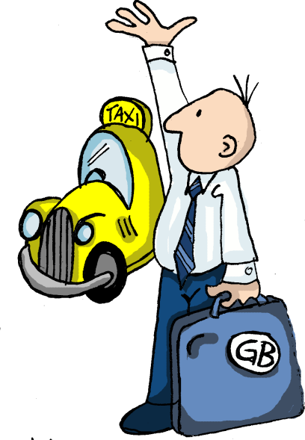
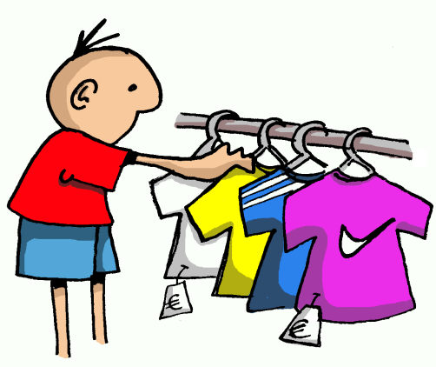
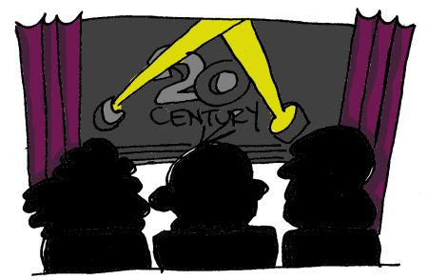
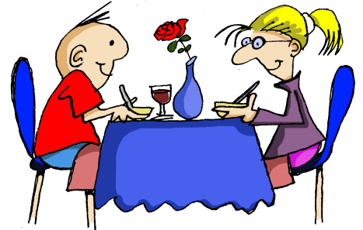
Notes:
Students have to narrate the story shown in the pictures.

Slide 70
Comberton Village College
Increasing interactivity (spontaneity, sustaining the flow, intonation) Questioning
Rachel Hawkes
JUST A MINUTE! (GROUPS)
Idea 21

Slide 71

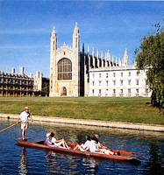


1
2
3
4
5
6
20
7
19
8
17
9
16
15
14
13
12
11
10
Notes:
A Keep Talking for 1 minute game. Can do this in groups but direct from the front. Click on ? To roll the dice. A player from each group then has to talk for 1 minute on that theme. 1 member of each group has a stop watch to time and others listen to make sure they keep talking. In this way, all engaged simultaneously.

Slide 72
1
2
3
opinión
normalmente..
pasado
futuro
porque
pregunta
4
5
6
Notes:
Although this could work as a whole class activity, this version where talking for one minute is the aim I think it works best in groups (up to 6 in one group). Each person chooses a category, tries to talk for one minute (one of group has stop watch) and they can colour in the coloured segment if they manage it. If the teacher chooses to display this on data project, each segment is triggered so if you click on it it turns the colour as indicated on the key in top left of the slide.

Slide 73
Comberton Village College
Increasing interactivity (spontaneity, sustaining the flow, intonation) Questioning
Rachel Hawkes
GROUP TALK
Idea 22

Slide 74

Es ist toll!
¡Es ist schrecklich!
Ich mag das (nicht)!
Wie findest du das?

Ja, das stimmt!
¡Nein, das stimmt nicht!
Ich auch!
Ich nicht!
X
X
X
Du bist verrückt!
Ich denke...
Gracias @ Greg Horton
Notes:
Year 7 Talking frame
74

Slide 75




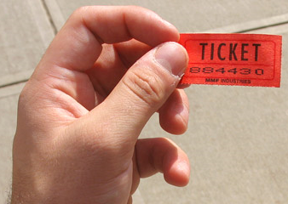
Comberton Village College
Increasing interactivity (spontaneity, sustaining the flow, intonation) Questioning
9Rachel Hawkes
REWARDING SPONTANEITY
Idea 23

Slide 76
Comberton Village College
Developing quality (Assessing, improving, enhancing, modelling)
Rachel Hawkes
TICK GRIDS
Idea 24

Slide 77
GCSE German | ☺ | ☹
present
past
future
opinions
WO1 conjunctions
WO2
WO3 conjunctions
wann? wie? wo?
prepositions + R2/3
modal verbs
um…zu +INF
adjective endings
no communication
spelling/capitals

Slide 78
How to use the tick grid
 | ☺ | ☹
present
present (other persons)
past (preterit)
past (imperfect)
past (perfect)
future
conditional
subjunctive
verb & infinitive
links
opinions
reasons
negatives
comp./sup.
idioms
subordination
vocabulary +
pronunciation
With text book listening tasks
With written text
When peer assessing
When completing speaking preparation for GCSE tasks
When listening to exam board sample material
When assessing model answer provided by the teacher

Slide 79
Comberton Village College
Developing quality (Assessing, improving, enhancing, modelling)
Rachel Hawkes
BINGO
Idea 25

Slide 80
Opinion | Present | Future
Reason | Time expression | Comparison
Complexity | Past | Reference to others
Rachel Hawkes
Notes:
Given a specific topic to talk about (or a set of questions if appropriate), students have to try to include each thing from the Bingo grid. When they do, they cross off the box and in their pairs, it’s the first person to cross everything off who wins (full house).

Slide 81
Comberton Village College
Developing quality (Assessing, improving, enhancing, modelling)
Rachel Hawkes
MODELLING
Idea 26

Slide 82
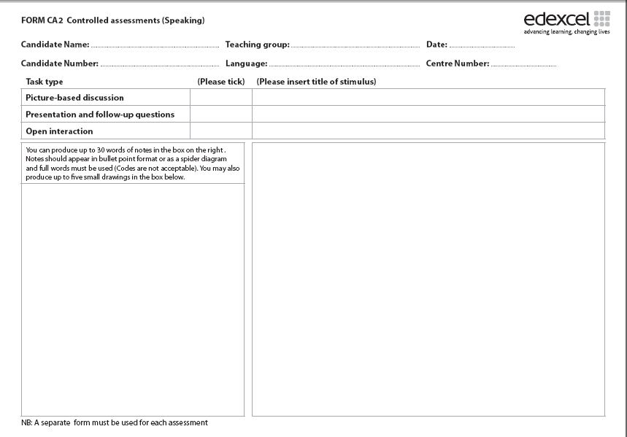
Prácticas laborales
escuela
horas de trabajo
primer día
no ganaba
ayudar a
jugaba
más me gustó
buena experiencia
trabajo a tiempo parcial
futuro
bachillerato
gente
al extranjero
no tengo ganas..
1. Students can generate possible questions to ask (if this is the prompt sheet).
2. They can answer the questions as if they were this person.
3. They can prepare a prompt sheet for a different topic.

Slide 83
Comberton Village College
Reflection
Think of perhaps 2 tasks or strategies for speaking that could be incorporated into your KS4 lessons over the next two weeks. Make a brief note of them and the topic you will need them to fit into.
Rachel Hawkes

