Slide 1

Assessing to learn and learning to assess
What should assessment look like in the languages classroom?
Rachel Hawkes

Slide 2
Professional Standards for teachers
Core
C12
Know a range of approaches to assessment, including the importance of formative assessment.
Post-threshold
P5
Have a more developed knowledge and understanding of their subjects/curriculum areas and related pedagogy including how learning progresses within them.
Core
C8
Have a creative and constructively critical approach towards innovation; being prepared to adapt their practice where benefits and improvements are identified.
Rachel Hawkes
Notes:
Introduction – me and to session. Share the professional standards that address teachers’ knowledge of assessment. Ask teachers to read Handout 1 – Introduction to AfL – 2 mins to read, think, pair and then we will share the essentials of AfL (flipchart if there is one).
What is important to know/remember about AfL?
This will generate a collection of ‘soundbites’
“Researcher, teachers, Ofsted and learners’ views about AfL are going to be aired and considered in this session and where relevant I include Ofsted quotes and student quotes within the presentation. I’ve also included some relevant Ofsted quotes taken from The changing landscape of languages report on Handout 2, which is for your interest/later reference. BUT for me this session needs to be about transforming ideas into practice. What do we and learners do together in the classroom that makes the theory of AfL into reality? Our focus is the methodology the pedagogy of AfL, not just the ideas behind it. To make that the focus, I need to ‘cut to the chase’ with what AfL means to me in language teaching and learning so that we can spend our time with the ‘how’ rather than the ‘what’ of AfL.

Slide 3
Sent: 31 October 2011 18:01
To: Alexandra Jarry; Agnieszka Barcz-Morgan; Maria Collado-Canas; Anna Halter; Gillian Heathcote; Rachel Hawkes; Marielle Burgess
Subject: lesson observation week 8
Dear teachers,
My theme for this week is "personalisation and the role of assessment" and I will be focusing on the following points when observing your classes:
- formative/summative testing methods
- records of pupils' learning
- marking
- homework timetables
- feedback to pupils
- self-correction
- differentiation
- targets
Best regards,
Sarah Kervella

Slide 4
Hi Sarah
A really good focus! It can be a hard one to pick up on from the 'action of the lesson'. Can I encourage you during period 6 with Y10 today to ask a couple of students to show you their books so you can see the marking, also to ask them about their hw timetable (in theory they should know how often they get homework, when it's set and how long they get to do it so I would be really interested to hear from you what responses they give to these questions!). Also, if you can, ask them when they do their homework and how long they spend on it! I'm still having to work very hard with individuals on the 'quality' of their homework.
If you can get there right for the start today, you'll see me showing them my spreadsheet with their latest set of hw marks and effort grades etc.. - as well as who is receiving a phone call home this week for excellent contributions in class.
Their latest hw was a learning - 30 words/phrases of own choice from the language we have covered so far this year. Have a look at their totals out of 60 - they are v variable. From this hw, their follow up target will be to record corrections and re-learn all those that they haven't 'nailed' yet. As it's the same target for all (but differentiated for the very top scorers to add 3 x 'juicy' expressions to their knowledge bank from my suggested list) I'm sharing this with the whole class so probably good for you to hear that part of the lesson.
During the lesson, they are working in pairs, practising some Q&A speaking. They have a peer assessment proforma for giving their partner feedback on each question. I will show you one of these, but listen in and have a look at the feedback they are giving.
The other part of the lesson is going to focus on them going back through their books to find all the good language they have covered, copy up corrected versions of things and create 'un saco mágico' for themselves of all the language they know on these topics.
Rachel

Slide 5
AfL is all about KNOWING…
Teachers need to know what learners need to know and share this with them (→ objectives and modelling)
Learners need (to be able to) ‘know what they know’ (→ peer and self assessment)
Teachers need to know learners individually and let them know how to improve (→ feedback)
Learners need the time to build on what they know (→ reflect, review, re-visit)
Rachel Hawkes
Notes:
These are for me the 4 key ideas and they all relate to knowing – in the mind of the teacher and in the minds of the learners. Before we look at these 4 aspects of AfL in the classroom, I just want to share one thing that has contributed (in my teaching at least) to creating a shared sense of responsibility for learning in the classroom. Explain the notion of ‘co-teachers’.

Slide 6

Setting the tone for learning
DOs
take risks
have a go
show good ‘audience’ skills
respond to others’ contributions
ask questions
make links
Co-teachers
Two rules for the classroom
1) Do everything to help yourself learn as much as you can
2) Do everything to help others learn
DONTs
think everyone else knows the answer
keep quiet when you’re not sure
get cross if you know the answer but don’t get to contribute
Rachel Hawkes

Slide 7
Learning objectives and Modelling
“Each teacher has a purpose; they have lesson plans and they have objectives that they must teach. In KS4, these objectives are given to pupils because they need to know how the course is outlined; but in KS3 it’s never really made clear when one module ends and another begins, and the pupil never knows what the next module is going to be. This means that the pupil never finds out what the purpose of learning each module is, or where each lesson fits in to the overall aim of the course. Pupils need to know the purpose the teachers have in order to share it with them.”
“The process of learning has to be in the minds of both learner and teacher.”
QCA, 10 principles of Assessment for Learning
Rachel Hawkes
Notes:
Quotes from learners and QCA, really saying the same thing!
2 minutes in pairs/groups to share how teachers typically set learning objectives – write down a recent learning objective you have used with a class. Depending on what emerges here (i.e. the specificity of objectives), it may be useful to do another ‘round’ of this, focusing on crafting a lesson objective so that others in the group can identify the year group it is aimed at.
I share a variety of different approaches to lesson objective setting, exploring the purpose and usefulness of each in turn. If the purpose of objective setting is to make sure that the process of learning is in the mind of the learners, are they better ways that ‘telling them what we’re going to do today’?
Quickly complete Handout 3 – Learning Objectives but no discussion at this stage

Slide 8




Hoy vamos a…
Sharing learning objectives
mirar
escuchar
pensar
osar
hablar
memorizar
Rachel Hawkes

Slide 9


Sharing learning objectives
Hola, hola, hola
Hola, hola, hola (x 2)
¿Cómo estás?
Bien, gracias (x 2)
Hola, hola, hola
Hola, hola, hola (x 2)
Hoy vamos a …

Slide 10
Hoy vamos a ..
Sharing learning objectives
aprender palabras y frases para describir el tiempo
practicar la pronunciación y estrategias para memorizar palabras nuevas
de vacaciones on holiday
Rachel Hawkes

Slide 11
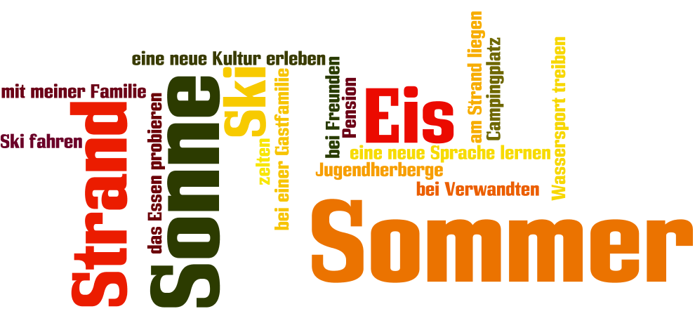
Sharing learning objectives
www.wordle.net
Rachel Hawkes

Slide 12

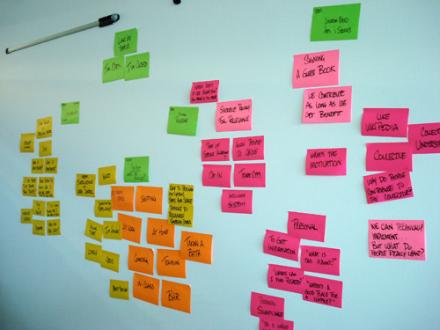
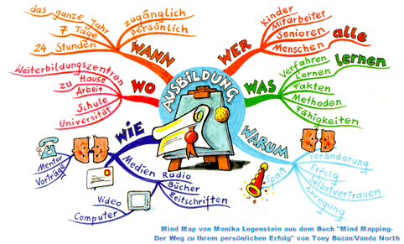
Sharing learning objectives
Post-its
Know – want to know – learned
Mind-mapping
Rachel Hawkes

Slide 13
Opiniones y preferencias
El año pasado…/hace 2 años
Mis vacaciones ideales son..
(no)ne gusta(n)
fui(mos)
Lo que más me gusta
viajamos
Lo mejor/lo peor
hicimos
Suelo preferir….
Siempre me ha interesado…
iba
Voy a…
era
Todavía no sé qué quiero hacer..
tenía
Sharing learning objectives
A lo mejor, iré a …
había
Cuando sea mayor, me gustaría
Cuando era más joven…
En el futuro………..
Rachel Hawkes

Slide 14

Opiniones y preferencias
El año pasado…/hace 2 años
Mi uniforme/
mi profe ideal es..
(no)ne gusta(n)
fui(mos)
Lo que más me gusta
viajamos
Lo mejor/lo peor
hicimos
Suelo preferir….
Siempre me ha interesado…
iba
Voy a…
era
Todavía no sé qué quiero hacer..
tenía
A lo mejor, iré a …
había
Cuando sea mayor, me gustaría
Sharing learning objectives
En el futuro………..
Cuando era más joven…

Slide 15

Mes préférences
Mes vacances dernières
Sharing learning objectives
Je m’intéresse à …
Ce que m’intéresse le plus c’est..
Mes vacances idéales sont…
Ma destination préférée, c’est…
A mon avis
Je pense que
Je trouve que
Je suis allé(e) à ….
pour…semaines
Après être arrivé
Avant de partir
J’ai joué au golf
Je joue au golf depuis 3 ans Après avoir (fini)
Je me suis bien amusée
Je viens de lire ta lettre…..
J’allais à….
avec ma famille
Quand il faisait beau je sortais…
Quand il faisait mauvais je restais…
j’aimais beaucoup….
A l’avenir
J’ai envie de…
J’ai l’intention de..
Je voudrais..
J’amerais…
Ji’irai…..
Si j’avais le choix, j’irai…
mais = but
parce que = because
aussi = also/as well
par exemple = for example
pendant = during/whilst
peut-etre = perhaps
qui = who
si = if
quand = when
et = and
probablement = probably
seulement = only
Quand j’étais plus jeune..
L’année prochaine………..
Rachel Hawkes
Notes:
Re-do this mind map with the theme of school and world of work in mind. How could you re-use the language in the new context?
This can be simplified or extended, depending on the level of your students and the grades they are targeting.

Slide 16
Sharing learning objectives
‘Can do’ statements
I can name ____ animals
I can say ‘I have’ and ‘I don’t have’
I can name _____ colours
I know ‘and’ and ‘but’ and ‘also’
I can pronounce new words correctly when I see them written
I have at least 1 good strategy for memorising
I can join words I know together to make new sentences
I can describe animals using colours and size adjectives
I can say if I like something or not
I can say why I like or dislike different animals
I know several words for describing animal characteristics
Rachel Hawkes
Notes:
At the start of a topic, particularly with a mixed intake in Year 7 from different primary feeders, it can be useful to introduce a list of ‘can do’ statements with some content and some skills-related statements, some clearly transferable language that you want students to know that they can ‘port’ from topic to topic and statements about the intent of the new topic you are starting. This helps learners to recognise that they never start completely from scratch in languages. It is always a mixture of something old, something new, something borrowed (i.e. high-frequency words and structures) plus the skills-base that stands them in good stead in every lesson. The students will all be in different places, (particularly in year 7) but you can use this list to lay out your planning too, to show them where you want them to be by the end of the unit.
This is the final Sharing objectives example – if time, ask teachers to look back to Handout 3 and see if their thinking has changed in relation to objective setting.

Slide 17
Modelling
“One of the main obstacles is that often pupils don’t recognise what a good piece of work looks like – they don’t have a sufficiently clear view of the aim to be able to steer themselves.”
Professor Paul Black
Interview with GTC, Assessment for Learning
“Students were required in one lesson to identify what would make different pieces of work better so that they could achieve better grades. “
p.22 The changing landscape of languages – Ofsted report 2004/2007
Rachel Hawkes
Notes:
As the teacher you can steer some of this implicitly through tasks that generate excellent responses, in terms of length, variety of language, fluency of delivery etc.. – I do think that there is a danger that in AfL focused teaching, if we are not imaginative, there could end up being far too much talk about learning and not enough active learning itself, so I as much as possible to focus my planning on tasks that are ‘informed doing’ activities – that is not to say that there won’t be reflection on what is good but that a lot of time will actually be spent producing lots of examples of what is good, rather than just talking about doing so.

Slide 18
Modelling
avec = with
et = and
mais = but
parce que = because
La pyramide
je
sujet (je, tu..)
Je déteste
+ opinion
Je déteste faire
+ verbe (infinitif)
Je déteste faire de la danse
+ sport
Je déteste faire de la danse au collège
+ extra
Je déteste faire de la danse au collège parce que c’est moche!
+ extra
Rachel Hawkes

Slide 19

Modelling
Target Talk
Tu as des frères ou des soeurs?
Your answer must contain EXACTLY 7 words!
Qu’est-ce que tu as fait le weekend dernier?
Your answer must contain more than 8 words!
Now make sure your answer contains an opinion!
This time make sure your answer contains the words ne…jamais!
Rachel Hawkes
Notes:
The conditions or ‘targets’ can be many and varied. It ALMOST doesn’t matter as the point of putting a condition there is to cause students to think their sentences through carefully as they build them. It makes them much more aware of what they’re saying. And making a sentence of exactly 8 words will involve usually a very short clause with ‘weil’ or two clauses linked with ‘und’ or additional details like when and where. So they focus on different ways to make their sentences longer. It also works well to set >9 words or <5 words at times too.
19

Slide 20
Modelling
Pimp my French!
Je joue au tennis.
J’habite au nord de l’Angleterre.
Mon chien s’appelle Bob.
Rachel Hawkes
Notes:
This is just a variation on the theme of improving your sentence by adding details, clauses, adjectives, anything really. Can be played as a class game with one team starting by providing a basic sentence and the other team having the opportunity to ‘pimp’ it, which, if successful done, allows them to steal the point, but if the effort is unsuccessful the first team gets the point. Or it could simply be a talk routine that starts a lesson. Teacher provides a sentence and students have to add to it. They could do this in table groups of 4 too, building up/altering each time. Then the teacher can ask for the pimped sentences after 2-3 minutes. The concept of ‘pimping’ meaning to supersize or superenhance something (as in the popular tv show ‘Pimp my ride’ which was about making over old cars into amazing luxury vehicles.

Slide 21
Modelling
The tick grid
 |  | ☺ | ☹
Present (reg)
Present (tener, ser, hay, estar)
adjectives
links
questions
opinions
reasons
negatives
Present (rad ch)
Future (ir a)
spelling errors
Develop self-assessment
Question-relevant
Involvement in task setting
Comment only marking on draft 1
Target setting from draft 1
Re-drafting → level
Rachel Hawkes

Slide 22

Modelling
Johnny Depp est né le 9 juin 1963 à Owensboro dans le Kentucky, aux États-Unis. Il est acteur américain, qui est déjà très célèbre. Il est en couple avec la chanteuse et actrice française Vanessa Paradis et ils vivent en France. Ils ont deux enfants ensemble. En 2010, il a refusé le titre de l'homme le plus sexy de l'année pour servir d'exemple à ses deux enfants.
 |  | ☺ | ☹
Present |  | //// /
Past |  | //
Future
Imperfect
Negatives
Opinions
Reasons |  | /
Links |  | ///
Clauses |  | /
Detail/Extras
Rachel Hawkes

Slide 23
Range of Language Accuracy | ☺ | ☹
present
present (other persons)
past (preterit)
past (imperfect)
past (perfect)
future
conditional
subjunctive
verb & infinitive
links
opinions
reasons
negatives
comp./sup.
idioms
Inter-action | Answer = / Elaboration = + Repetition of teacher feed = R Non communication = X
1
2
3
4
5
6
7
8
9
10
11
12
13
14
15
Range of Language Accuracy | ☺ | ☹
present
present (other persons)
past (preterit)
past (imperfect)
past (perfect)
future
conditional
subjunctive
verb & infinitive
links
opinions
reasons
negatives
comp./sup.
idioms
Inter-action | Answer = / Elaboration = + Repetition of teacher feed = R Non communication = X
1
2
3
4
5
6
7
8
9
10
11
12
13
14
15
Notes:
GCSE assessment grid I use to mark and moderate the new orals. Learners can use this to assess samples from the board. Either from transcripts or just from audio or from both together. They can then use the markscheme to judge the performance and gain a clearer understanding of what an A grade at speaking sounds like. A similar and related strategy is to provide a prepared transcript of a spoken presentation and ask students to prepare a 30-word prompt sheet for that presentation. This is ‘modelling’ in the sense of showing how to make the transition between written script and prompt notes.

Slide 24
Self and Peer Assessment
“Peer assessment is uniquely valuable because pupils may accept, from one another, criticisms of their work, which they would not take seriously if made by their teacher”
Working inside the black box
Dept of Education & Professional Studies, King’s College, London
Rachel Hawkes

Slide 25

Self assessment
How do I know what I know?
1 I can pronounce the word
2 I know what it means
3 I can spell the word
4 I can use the word in a sentence
Make a set of online flashcards & spend 20 mins using them to learn (50 pts)
Use your core language sheet and vocab book to create new sentences with the words
(50 pts = 5
100 pts = 10)
For example:
Work with a partner to
learn the words, testing
each other (50 pts)
Use the Look, Cover, Say/Write, Check method
(50 pts)
1 The word ‘mère’ is pronounced ‘mair’
2 It means ‘mother’
3 It is spelt m- è – r – e
4 It can be used in this sentence:
Ma mère s’appelle Jenny.
Record yourself saying the words and the English meaning – use this to test yourself
(50 pts)
Make own flashcards on card and use them to test yourself over and over
(50 pts)
Take your list of language and rate your knowledge of each. Then decide how you need to improve:
- Practise pronunciation
- Learn what the word means
- Practise how to spell the word
- Create sentences with the word
Use WordArt
and type words out in
alphabetical order(50 pts)
Write each
word 3 times &
translate once (50 pts)
Rachel Hawkes

Slide 26
KS3 French Core Language
avoir – to have
être – to be
faire – to do
Pronouns
je suis | I am
tu es | you are
il/elle/on est | he/she is/we are
nous sommes | we are
vous êtes | you are
ils / elles sont | they are
je fais | I do
tu fais | you do
il / elle/ on fait | he/she /we do
nous faisons | we do
vous faites | you do
ils / elles font | they/you do
j’ai | I have
tu as | you have
il /elle/on a | he/she/we have
nous avons | we have
vous avez | you have (formal or .pl.)
Ils/ elles ont | they have
je – I
tu – you (sing.)
il/elle – he/she
on – we / one
nous – we
vous – you (pl or formal.)
ils/elles – they
Time words
Referring to things
Referring to places
maintenant – now
avant – before
après – after
aujourd’hui – today
hier – yesterday
demain – tomorrow
encore une fois - again
toujours – always
souvent – often
quelquefois – sometimes
jamais – never
la semaine dernière – last week
la semaine prochaine – next week
une chose – a thing
ceci – this
cela – that
quelque chose– something
(un) autre – (an)other
beaucoup (de) – a lot (of)
(un) peu – (a) little
très – very
tout – all/everything
trop – too (much)
ici – here
là-(bas) – (over) there
Saying what you did
Je suis allé(e) – I went
j’ai fait– I did
J’ai vu – I saw
j’ai joué – I played
j’ai mangé – I ate
j’ai bu – I drank
J’ai regardé – I watched
J’ai travaillé – I worked
J’ai voyagé – I travelled
Making links
et – and
ou – or
aussi – also
mais – but
parce que – because
avec – with
sans - without
Sentence building
Je peux / on peut |  | I can / you/we can...
Je veux |  | I want to..
Je dois |  | I have to…
Je vais / on va | + verb | I’m going to/we’re going to…
J’aime /je n’aime pas |  | I like to / I don’t like to..
J’aime beaucoup |  | I love to…
Je voudrais |  | I would like to…
Asking questions
Porquoi? – why?
Qu’est-ce que? – what?
quand? – when?
où? – where?
Qui? – who?
Combien? – how much/many?
Comment? – how?
Opinions
Je pense que – I think that
Je crois que – I believe that
Il me semble que – it seems that..
A mon avis.. – in my opinion..
Rachel Hawkes
Notes:
Self-assessment leads very naturally into differentiation – the most advanced stage of knowing from my list of 4 is clearly number 4 – creating own sentences, combining the known words with other known words to make new meanings. This is something they can practise autonomously from the earliest stage with the help of a core language sheet (also dictionary and vocabulary book). If learners finish a class activity early they can be directed to engage in ‘creative transfer’ using the core language sheet. They love getting teacher oral feedback on their efforts too.

Slide 27
Self assessment
Activity 1
Look at the following list of words and give each one a number rating 1-5 based on how well you know the word.
Look at the VKS (Vocabulary Knowledge Scale) below:
1. I don’t remember having seen this word before.
2. I have seen this word before but I don’t know what it means.
3. I have seen this word before and I think it means….
4. I know this word: it means…….
5. I can use this word in a sentence, e.g……….
(ref: Wesche M & Paribakht T.S. (1996) “Assessing second language vocabulary knowledge: depth versus breadth”, The Canadian Modern Language Review 53, 1:28)
Rachel Hawkes

Slide 28
Look at the following Spanish words and award them a number (1 – 5) according to the criteria below:
1. I can pronounce this word and I know what it means
2. I know what it means
3. I think I know what it means
4. I know I have learnt this word but I can’t remember what it means
5. I have never seen that word before
1. Buenos días | 2. tengo | 3. dos | 4. muy bien
5. ¿Cómo estás? | 6. mi cumpleaños | 7. enero | 8. gracias
9. catorce | 10. un bolígrafo | 11. no tengo | 12. estoy mal
13. noviembre | 14. dieciocho | 15. ¿Qué tal? | 16. veinte

Slide 29
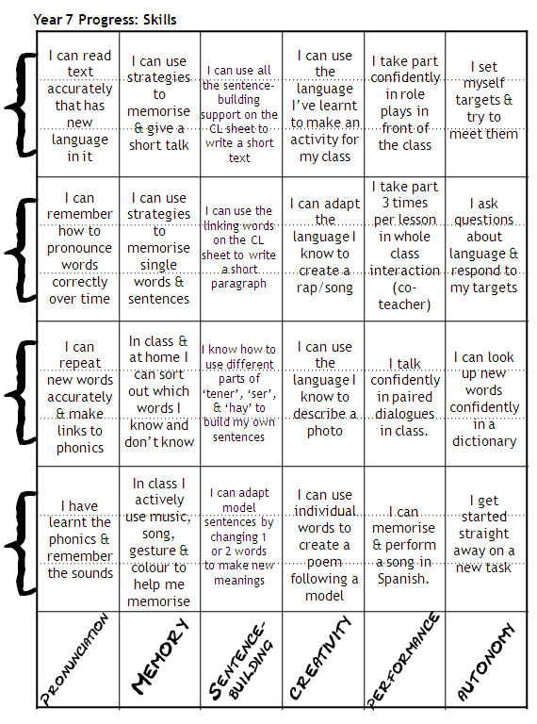
Self assessment
“Younger students have an assessment booklet in which they regularly tick off their accomplishments and set themselves targets, or teachers help them to do so.”
The changing landscape of languages, Ofsted report, 2008
Rachel Hawkes

Slide 30
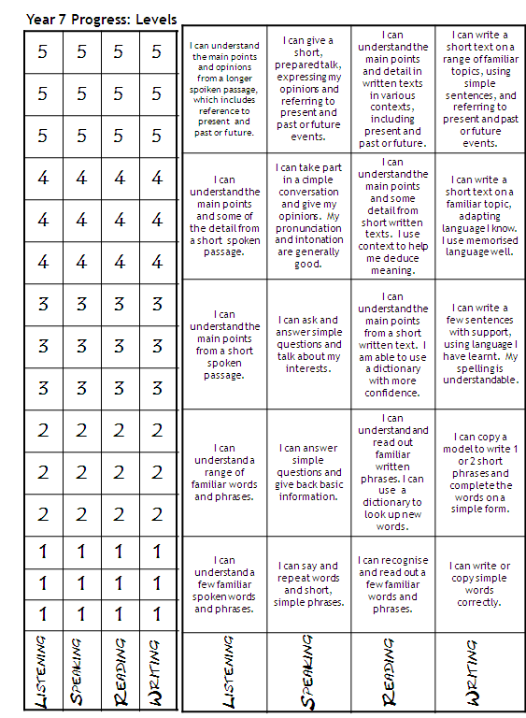
Self assessment
Rachel Hawkes

Slide 31
Self assessment
Envelope of key structures to use each lesson – learners put back as they use them
Spot the mistakes ‘auction’
Problem/suggestions box
Prompts to reflect at the end of each lesson or last lesson of the week
Checklist of ‘can do’ statements re-visited (+ traffic lights)
Time to look back at own work, complete the ‘learning log’ and set own targets (a ‘carousel’ activity)
Rachel Hawkes

Slide 32
Speaking Activity Student Reflection Sheet
Speaking Activity Student Reflection Sheet
School Name: ______________________
Year Group ____ Date: ______________
School Name: ______________________
Year Group ____ Date: ______________
Put a tick on the line to evaluate the speaking task.
Put a tick on the line to evaluate the speaking task.
1. Did you enjoy the activity?
1. Did you enjoy the activity?
2. How much did you say in whole class work?
2. How much did you say in whole class work?
3. How much did you say in pair/group work?
3. How much did you say in pair/group work?
4. Tick the language used in the task.
4. Tick the language used in the task.
Opinions
Reasons
Description
Asking questions
Comparisons
Past events
Future events
Discussion
5. In which topic could you use this language again?
Opinions
Reasons
Description
Asking questions
Comparisons
Past events
Future events
Discussion
5. In which topic could you use this language again?
6. Write here anything you
wanted to say but couldn’t.
6. Write here anything you
wanted to say but couldn’t.

Slide 33
Self assessment
1 thing I need more help with:
2 things I have learnt today:
3 things I knew before but am now more confident with:
Rachel Hawkes

Slide 34



Peer
assessment
Student 3
Triangles
2 stars and a wish
Wiki/blog comments
Group writing
End of project
Instead of teacher assessment?
Student 1
Student 2
Rachel Hawkes

Slide 35

Peer
assessment
Pienso que...
creativo/a
efectivo/a
relajado/a
seguro/a
inseguro/a
divertido/a
rápido/a
lento/a
imaginativo/a
organizado/a
interesante
tu presentación / rendimiento/ actuación
el ritmo
el ‘beat’
la letra
la música
la secuencia
la pronunciación
muy
bastante
relativamente
poco
fue
Rachel Hawkes

Slide 36

Y7 Speaking: Peer Assessment Sheet
Peer
assessment
You are going to assess the speaking of others in your class today. You are going to assess at least 3 different students in your class in a speaking line. Ask your partner all of the 7 questions listed below and then s/he will ask you 3 questions. For each answer or question give him/her either 2,1 or 0. At least 3 students will also assess your speaking.
 | Questions
1 | ¿Cómo te llamas?
2 | ¿Cómo estás ¿Qué tal?
3 | ¿Cómo se escribe?
4 | ¿De dónde eres?
5 | ¿Cuál es tu nacionalidad?
6 | ¿Qué idiomas hablas?
7 | ¿Dónde vives?
Rachel Hawkes

Slide 37
 | Name | Name | Name | Marksheme. Give 2, 1 or 0 for each answer
1 |  |  |  | 2 = full sentence answer (or question), ready response, not much hesitation, significant effort to sound Spanish 1 = answer that does communicate BUT might not be complete sentence, some attempt to sound Spanish 0 = cannot answer OR does not recognise the question so gives a different answer
2
3
4
5
6
7
?
?
?
Total | /20 | /20 | /20
Rachel Hawkes

Slide 38
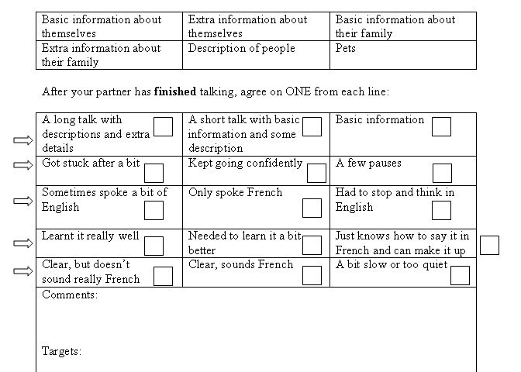
Speaking Assessment Grid
Name of the person doing the talk: _________________________
Name of the person listening: _______________________
Peer
assessment
Rachel Hawkes

Slide 39
Peer
assessment
Tally sheet
1 | Subject variety (other than ‘ich’)
2 | Number of present tenses
3 | Number of past tenses
4 | Number of future tenses
5 | Number of opinions
6 | Number of different adjectives
7 | Number of adjective endings
8 | Number of appropriate R2/R3 articles
9 | Number of inversions
10 | Number of WO3 constructions
11 | Number of modal verbs
12 | Number of um … zu … clauses
13 | Number of idioms
“In lessons, students are regularly required to check each other’s work, discuss it and spot errors before they look at the correct copy.”
paired assessment before handing in
whole class assessment of anonymous samples of student homework as starter
‘auction’ activities to spot errors/correct formulations
paired listenings
Rachel Hawkes
Notes:
Peer assessment before handing in homework can be very useful – students can use the tick grid OR they can do a Quality of Language check only as in this tally sheet.

Slide 40
Feedback
Feedback
“The teachers need to find an interest in each pupil and help it along. This means the teachers need to know each pupil as individuals and take the time to learn what each person needs to succeed. “
Comment only marking (Handout)
Using a ‘tick grid’ (Handout)
Oral feedback as lesson activity
Feedback → active learning
Electronic marking in word
ASL (average sentence length)
Making summative → formative
Rachel Hawkes

Slide 41
Feedback
Comment only marking
Groups of pupils given: | Improvement in Work | Interest in Subject
Marks/grades only | ------- | + for high attainers - for middle/low
Marks/grades + comments | ------- | + for high attainers - for middle/low
Comments only | 30% | + for all groups
Research findings, Black & Wiliam,1998
Rachel Hawkes
Notes:
This table shows that written feedback in the form of comments only is actually the most effective method for improving learning. This is because when comments are paired with marks, pupils tend to ignore the comments because their feelings of achievement or failure have already been reinforced by the mark. See Handout from teacher Afl project

Slide 42
Targets for improvement
Feedback
Example
Scaffold
Reminder
Implicit ----------------------------------------------------------------→ Explicit
Rachel Hawkes
Notes:
According to Vygotsky, support should be contingent – i.e. dependent on and responsive to learner need. One way to individualise/differentiate support is to move from implicit to explicit support in terms of prompts for improvement. Here are 3 different types of prompt that could be used to structure formative feedback/target:
reminder
scaffold
Example
Here is an example of each. Reminders are clearly the most implicit and examples the most explicit and supportive.
‘Say more about how you feel about this person.’
‘Can you describe how this person is a ‘good friend’?’
‘Describe something that happened that showed they are a good friend.’
‘Choose one of these or your own: “He is a good friend because he never says unkind things about me”, “My friend is a friend because he never tells me lies.’” (Shirley Clarke)
Handout – Decide which of the prompts belongs to where on the spectrum.

Slide 43
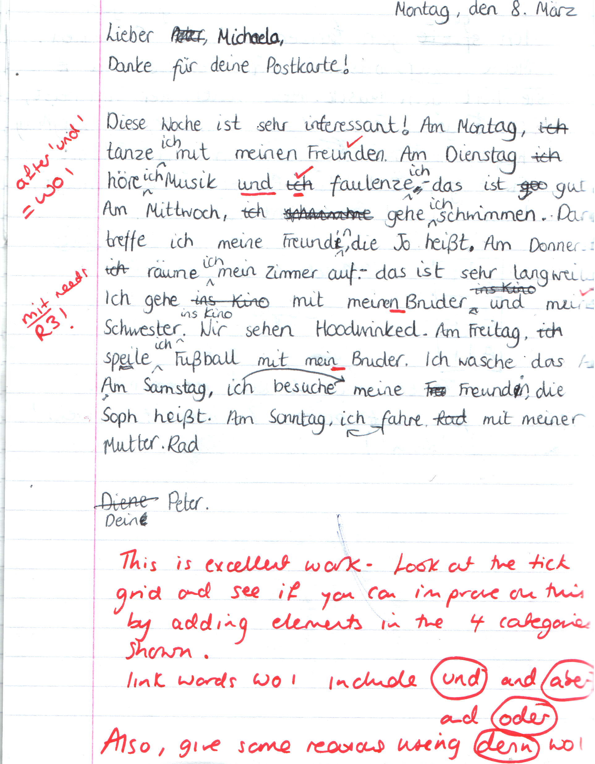
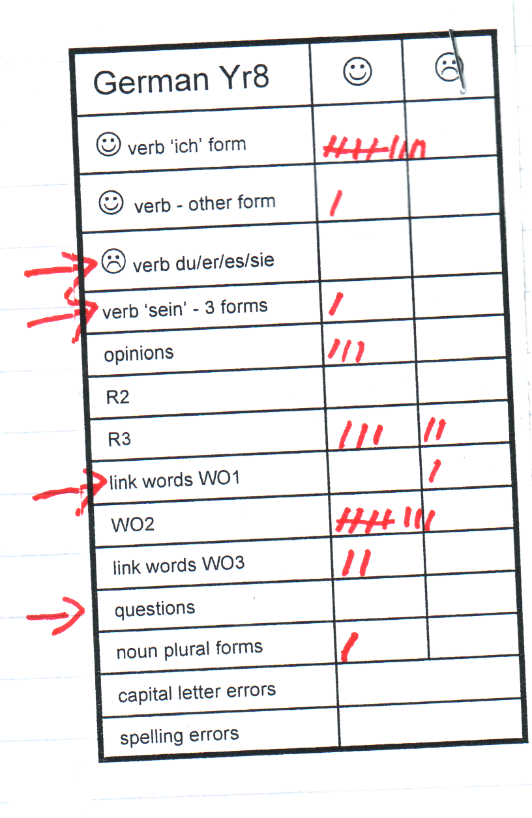
Feedback
Rachel Hawkes

Slide 44
How to use the tick grid
 | ☺ | ☹
present
present (other persons)
past (preterit)
past (imperfect)
past (perfect)
future
conditional
subjunctive
verb & infinitive
links
opinions
reasons
negatives
comp./sup.
idioms
subordination
vocabulary +
pronunciation
With text book listening tasks
With written text
When peer assessing
When completing speaking preparation for GCSE tasks
When listening to exam board sample material
When assessing model answer provided by the teacher
Rachel Hawkes

Slide 45

Feedback
“Things that are not motivating is your work being discouraged, marking that just gives a target without praise, teachers shouting, lots of mention about tests, pupils or teachers laughing when you get something wrong, and teachers adding pressure to your work. These things are not motivating because they make us feel bad about ourselves and we know we won’t do as well as we want to do.”
Student voice survey, 2010, Comberton Village College
Assessment and motivation
Rachel Hawkes

Slide 46
Reflection and Review
Reflection & Review
Make own assessments (e.g. listening)
Active revision (e.g. speaking grid, parts → whole → parts, speaking line )
Re-drafting
Creative transfer (e.g. mind-mapping task)
Rachel Hawkes

Slide 47
Sams Fragen:
Wie findet Sam Deutsch?
_____________________________________________________
2. Was ist Sams Lieblingsfach?
_____________________________________________________
3. Was macht Sam am Wochenende?
_____________________________________________________
4. Wer ist Zoe?
_____________________________________________________
5. Wie viele Hobbys hat Sam?
_____________________________________________________
6. Wie viele Haustiere hat Sam?
_____________________________________________________
7. Warum ist Sam nicht perfekt?
____________________________________________________
anstrengend/langweilig/Er mag Deutsch nicht.
Sport
Er spielt Sport.
Sams Schwester
vier/4
fünf/5
Er ist faul in Deutsch.
Rachel Hawkes

Slide 48
Last year to I went on holiday to France with my family.
Rachel Hawkes
Notes:
It is hard to get students to use what they have learnt already sometimes. To focus them back on what is in their books, ask them to choose 9 sentences on the theme they have been covering and write them in English, making sure they know how they would be said in the TL (they will have this doubtless in their books). They then get up and go around the class, testing each other. When they find someone who can do a phrase correctly they write their name in one of the boxes next to that phrase. In this version each phrase needs 2 x different names. The plenary activity that follows is for the teacher to do a brief ‘spot check’ asking named individuals to do the phrase they have been signed up for. This gets students to think back to what they have covered and to fix it more deeply in their long term memories.

Slide 49
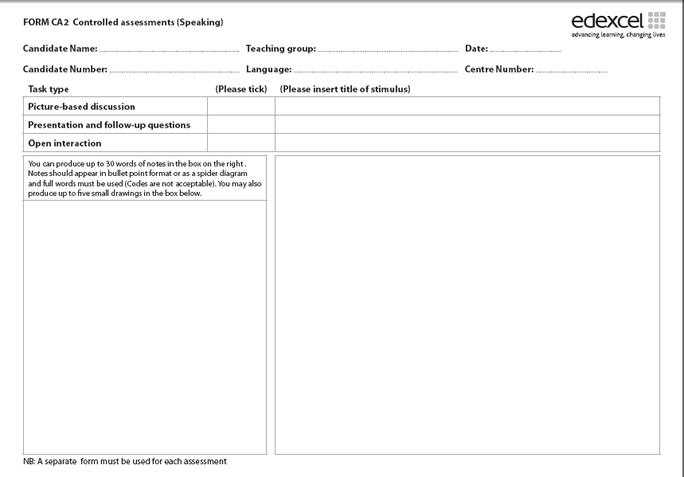
Prácticas laborales
escuela
horas de trabajo
primer día
no ganaba
ayudar a
jugaba
más me gustó
buena experiencia
trabajo a tiempo parcial
futuro
bachillerato
gente
al extranjero
no tengo ganas..
1. Students can generate possible questions to ask (if this is the prompt sheet)
2. They can answer the questions as if this was them
3. They can prepare a prompt sheet for a different topic
Rachel Hawkes

Slide 50
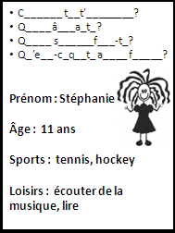
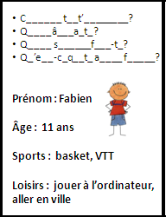
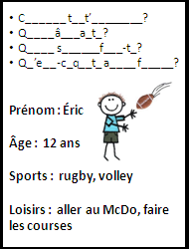
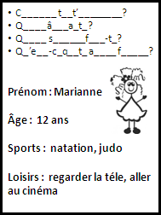
Speaking line
Rachel Hawkes
Notes:
These would be cut up into individual cards for a short speaking line activity. Learners ask and answer the questions and then move on to the next person. Finally they can answer also for themselves.

Slide 51
Questions for us!
What do we want our learners to be able to do with the language? (lesson, module, term, Key Stage)
How do we share that so that the ‘process of learning’ is in all our minds?
How do we find out who has ‘got there’ and who hasn’t?
How does that change our teaching? What do we do next?
Rachel Hawkes
Notes:
Complete the final handout from this section – Reflection and Action Planning. (10 minutes)

Slide 52
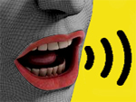
“Success should be measured by one person against what they could have done, their potential. NOT AGAINST OTHERS. You develop different attitudes when you succeed. “
Student voice survey, Assessment and motivation, Comberton Village College, 2010
Website: www.rachelhawkes.com
Email: rhawkes@comberton.cambs.sch.uk
Rachel Hawkes
Director of Language College / Assistant Principal / AST / SSAT MFL Lead Practitioner
Comberton Village College, Cambridgeshire
Rachel Hawkes

