Slide 1
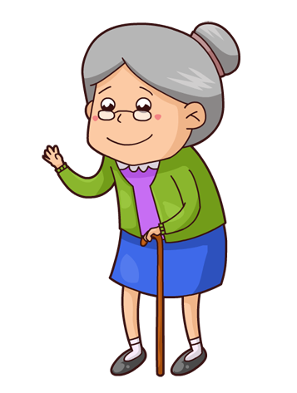
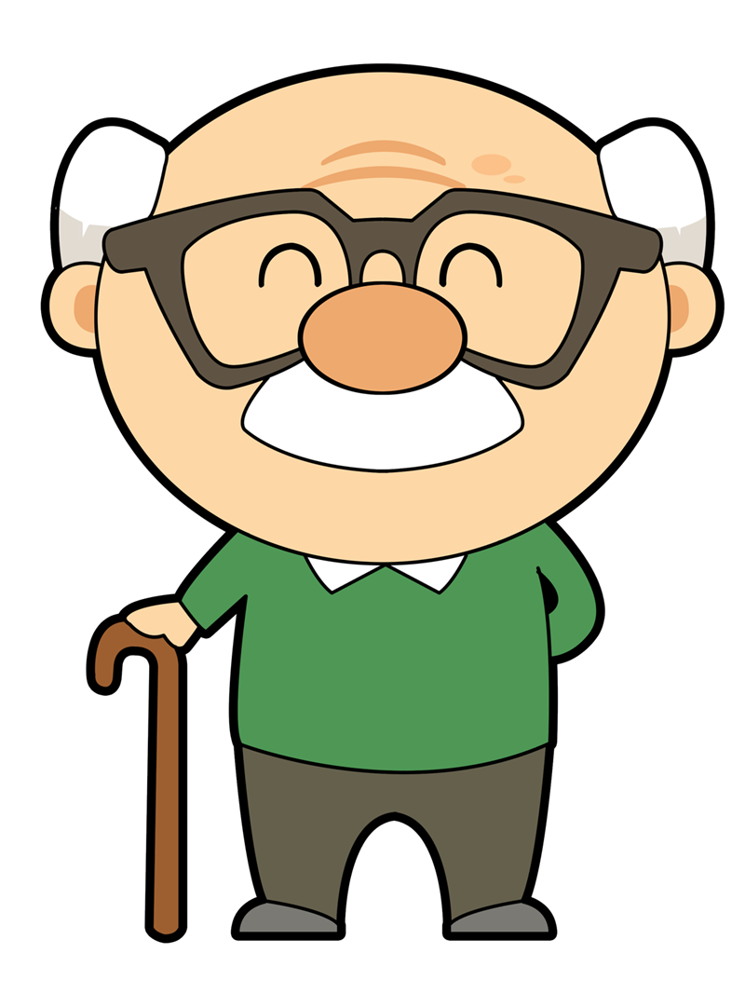
Talking about looking after others
indirect object pronouns ‘le’ and ‘les’
syllable stress [revisited]
Y9 Spanish
Term 1.1 - Week 7 - Lesson 13
Pete Watson / Louise Caruso / Nick Avery
Artwork: Mark Davies
Date updated: 29.02.24
Notes:
Note: all words (new and revisited) in this week of the SOW appear on all three GCSE wordlists, with the following exceptions:
AQA list does not have aproximadamente, guerra or simplemente
Edexcel list does not have pollo or guerra
Artwork by Mark Davies. All additional pictures selected are available under a Creative Commons license, no attribution required.
With thanks to Rachel Hawkes for her input on the lesson material and Amanda Izquierdo for native teacher feedback.
Learning outcomes (lesson 1)
Introduction of indirect object pronoun ‘les’
Consolidation of the following language features:
indirect object pronoun ‘le’
-ar verbs in 3rd person singular present (-a)
-er/-ir verbs in 3rd person singular present (-e)
a range of stress positions (final, penultimate, antepenultimate)
Frequency of rankings of vocabulary introduced this week (1 is the most common word in Spanish):
les [25]; mandar [588]; contar [172]; cocinar [3704]; dolor [591]; arroz [2882]; pollo [3577]; invierno [1813]; gris [1751]; naranja [2924]; camiseta [4130]; gafas [>5000]; tanto [88]
Frequency rankings of vocabulary revisited this week (1 is the most common word in Spanish):
Y8 3.2.6: guerra [282]; hoy en día [hoy-167]; cantidad [459]; tener lugar [lugar-144]; aproximadamente [1502]; comenzar [234]
Y8 3.1.6: fui [33]; fuiste [33]; fue [33]; apoyar [666]; celebrar [886]; zona [359]; septiembre [1150]; octubre [1242]; noviembre [1434]; diciembre [1165]; colegio [628]; avión [1399]; historia² [186]; directo [1029]; simplemente [731]; principalmente [1657]
Source: Davies, M. & Davies, K. (2018). A frequency dictionary of Spanish: Core vocabulary for learners (2nd ed.). Routledge: London
The frequency rankings for words that occur in this PowerPoint which have been previously introduced in NCELP resources are given in the NCELP SOW and in the resources that first introduced and formally re-visited those words. For any other words that occur incidentally in this PowerPoint, frequency rankings will be provided in the notes field wherever possible.

Slide 2
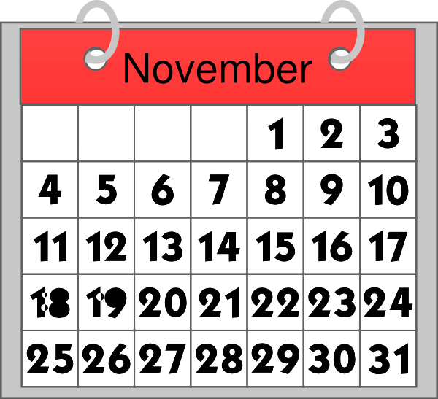
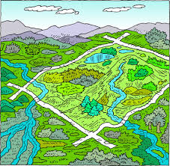
Vocabulario
simplemente
la zona
hoy en día
la cantidad
comenzar
la guerra
principalmente
la historia
noviembre
apoyar
to support, supporting
amount, quantity
mainly
November
war
simply
to start, starting
area, zone
nowadays
story, history
Notes:
Timing: 5 mins (slides 2-3)
Aim: to practise 10 words from this week’s revisited vocabulary sets (first receptively on this slide, then productively on the next slide).
Procedure:
Click to reveal the English word. Students in chorus say what the Spanish word is that matches it. Click again to hide the word.
Continue the process until the 10 words have been revealed and answers given. The order of images is below.
Order:
to start, starting
mainly
November
amount, quantity
simply
Story, history
area, zone
war
to support, supporting
nowadays

Slide 3
Vocabulario
simplemente
la zona
hoy en día
la cantidad
comenzar
la guerra
principalmente
la historia
apoyar
noviembre
Ok
to support
mainly
november
amount, quantity
war
simply
to start
nowadays
story
area, zone
Notes:
Procedure: This time the English words appear and students are prompted to give the Spanish word. This will be the more challenging than the last slide.
The order that the words appear in is below.
Order:
apoyar
simplemente
hoy en día
cantidad
historia
principalmente
comenzar
noviembre
guerra
zona
Notes:
Here are the answers
A-F: quiero, el número, a, das, ocho, el dinero
G-L: money, to, number, eight, I want, you give

Slide 4
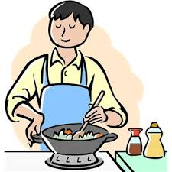
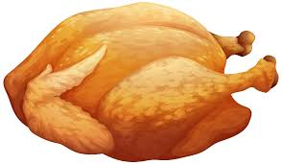
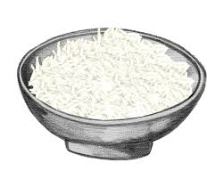
Vocabulario
Vocabulario
leer / hablar
[1/2]
to them
les
to cook, cooking
cocinar
The stem of ‘contar’ changes in the present tense, like encontrar (o->ue):
to send, sending
mandar
el pollo
encontrar (to find) →
encuentro (I find)
chicken
contar (to tell) →
cuento (I tell)
to tell, telling
contar
el arroz
rice
Notes:
Vocabulary practice slides (1/2)
Timing: 5 minutes (slides 4-5)
Aim: to introduce and embed this week’s new vocabulary.
Procedure 1. Pupils either work by themselves or in pairs, reading out the words and recapping their English meaning (1 minute).
2. Then the teacher removes the English words or pictures (one by one) and they try to recall the English orally (chorally), looking at the Spanish (1 minute).
3. Then the Spanish meanings are removed (one by one) and they to recall them orally (again, chorally), looking at the English (1 minute)
4. Further rounds of learning can be facilitated by one pupil turning away from the board, and his/her partner asking him/her the meanings (‘¿Cómo se dice X en español?’). This activity can work from L2 -> L1 or L1 -> L2.
Note: students could also be asked for the other word for ‘to send’ that they previously learnt (enviar).
Pictures free from clipart-library.com

Slide 5
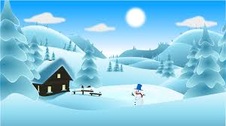
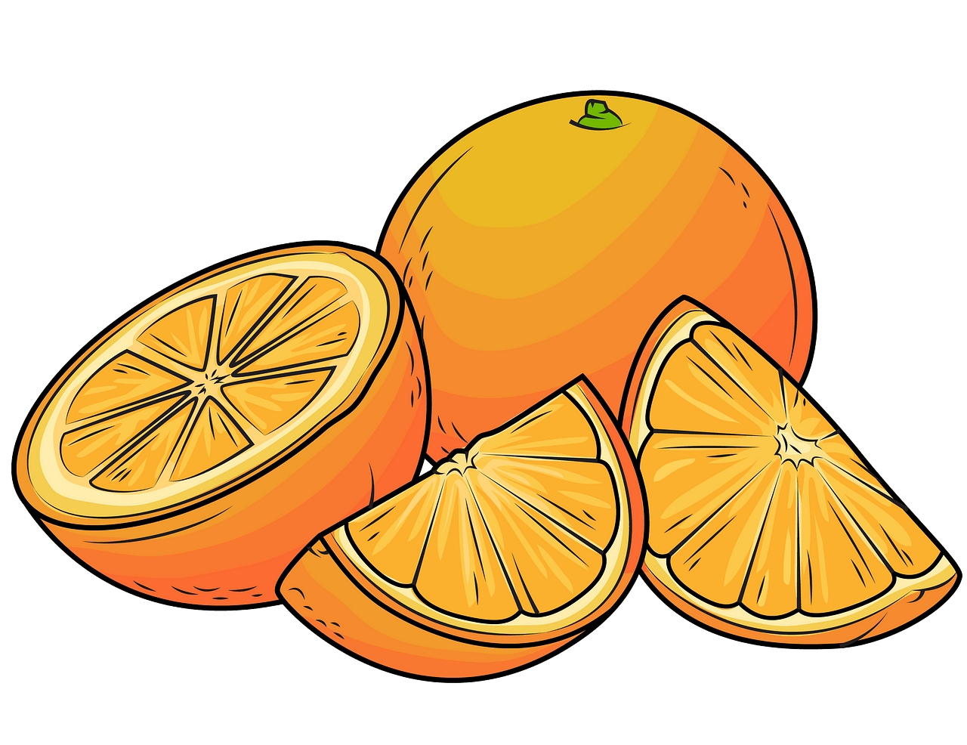
Vocabulario
leer / hablar
[2/2]
el invierno
so much,
so many
tanto
winter
When ‘tanto’ is used as an adjective, it agrees with the gender and number of the noun: e.g. tantas camisetas, tantos chicos.
Notice how it goes before the noun.
In Spanish you often use ‘tener’
(to have) with the word ‘dolor’:
ache, pain
el dolor
la camiseta
Tengo dolor de (la) cabeza.
This can be the fruit or the colour!
When used as an adjective (the colour), the ending is always –a.
e.g. un bolígrafo naranja
I have a headache.
gris
t-shirt
grey
la naranja
las gafas
orange
glasses
Notes:
Vocabulary practice slide (2/2)
Procedure: as described on previous slide.
Note: there is a callout about ‘tanto’ and adjective agreement as a first animation that appears on a click and then disappears on the next click.

Slide 6
Saying who is affected by an action
gramática
Remember, object pronouns (e.g., him, them) indicate the person or thing that is affected by the verb.
To refer to one person or thing indirectly affected by an action, use ___.
le
Le mando un regalo.
I send him/her/it a present.
I send a present to him/her/it.
If more than one person or thing is indirectly affected, use les.
Les mando un regalo.
‘Les’ can refer to all male, all female or mixed groups.
I send them a present.
In Spanish, these pronouns go before the verb.
Notes:
Timing: 2 minutes
Aim:
i) to recap the use of indirect object pronoun ‘le’
ii) to introduce the indirect object pronoun ‘les’.
Procedure:
Go through the grammar explanation with students, revealing each new sentence on a mouse click.

Slide 7
Lucía y los abuelos
leer
¿Qué hace Lucía? y ¿para quién(es)?
Elige la opción correcta.
Completa la traducción en inglés.
Who is affected by the action?
 | ‘him’ | ‘them’
1. Le compra gafas.
2. Le trae naranjas.
3. Les cocina platos de arroz.
4. Les cuenta cosas de su vida.
5. Les manda tantas cartas.
6. Le ofrece medicina para el dolor de cabeza.
Completa la traducción
1. She buys ____________ OR ________________.
2. She brings ____________ OR _______________.
3. She cooks_________________ OR ____________ __________.
4. She tells __________________________.
5. She sends ______________________ OR ________________________.
6. She offers _________________________________.
him glasses
glasses for him
him oranges
oranges to him
them rice dishes
rice dishes
for them
them things about her life
them so many letters
so many letters to them
him medicine for (his) headaches
Notes:
Timing: 7 minutes
Aim:
to practise understanding the indirect object pronouns ‘le’ and ’les’ in reading.
to recap the different ways of translating such sentences into English.
Procedure: 1. Students read each sentence and decide whether the action affects ‘him’ (el abuelo) or ‘them’ (las abuelas).
2. They also provide a possible translation for each sentence.
3. Give feedback and point out how more than one translation is often possible in English.
Note: if working with a higher-achieving group, the activity could be made for challenging by requiring students to write the whole sentence.
Frequency of unknown words or cognates:
poema [1430]; medicina [1474]

Slide 8
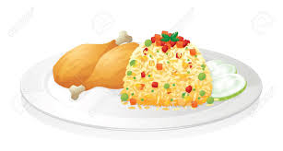
Lucía y los abuelos
escuchar
¿Qué hace Lucía? y ¿para quién(es)?
Escucha y elige la opción correcta.
Completa la traducción en inglés.
 | Who is affected by the action?
 | ‘him’ | ‘them’
¿Qué cosa? (en inglés)
1
chicken with rice
2
food from the market
3
help in the kitchen
4
things about the family
5
interesting magazines
6
so many things
Notes:
Timing: 7 minutes
Aim:
to recognise the indirect object and understand its meaning.
to consolidate understanding of vocabulary.
Procedure: 1. Students listen to each recording and decide who is affected by the action: ‘him’ (el abuelo) or ‘them’ (las abuelas).
2. Students listen again and write the direct object in each sentence.
3. During feedback, the teacher can also seek the full sentence translation from students. This will help to raise awareness of those sentences that may be translated with a preposition in English.
Transcript:
Le cocina pollo con arroz.
Les trae comida del mercado en invierno.
Les ofrece ayuda en la cocina.
Le cuenta cosas de la familia.
Les manda revistas interesantes.
¡Les trae tantas cosas!
Frequency of unknown words or cognates:
poema [1430]; medicina [1474]

Slide 9
Lucía y los abuelos
leer / escuchar
Cuidamos a los abuelos
Estudiante A lee frases en español.
Estudiante B completa la tabla con información.
Ejemplo:
Persona A habla:
Persona B escucha y escribe:
Le compra regalos.
 | the action affects ‘him or her’ | the action affects ‘them’ | ¿Qué actividad? (en inglés)
1
1
Le compra regalos.
buys presents
Después, Estudiante B lee las frases y Estudiante B completa la tabla.
Notes:
Timing: 8 minutes
Aims:
to successfully read aloud sentences with either ‘le’ or ‘les’
to understand the partner’s sentences and use the information to complete the grid.
Procedure:
Put students in pairs and distribute handouts to Person A and Person B in each pair (see slide 10 and 11).
Go through the instructions with students. Use this slide to model the activity.
Student A reads the out each sentence in Spanish.
Student B completes the grid.
Then students swap roles.
Give feedback using slide 12 and 13.
Notes: The first column of the grid refers to ‘him or her’. It is important for students to realise that ‘le’ can refer to either. If students ask what can be done to avoid this being confusing, teachers could say that one way around it is not to use a pronoun here, but to specify the person’s name instead. Later students will learn how to add additional information (a él/ella) to avoid any ambiguity. So far, ‘él’ and ‘ella’ are only known as subject pronouns.

Slide 10
leer / escuchar
Persona A
1
2
 | the action affects ‘him or her’ | the action affects ‘them’ | ¿Qué actividad? (en inglés)
1
2
3
4
5
6
Le compra camisetas grises.
Le regala un reloj.
3
4
Les da tantas revistas.
Le manda cartas del banco.
5
6
Les cocina el arroz.
Les organiza los libros.
Notes:
PROMPT CARDS - DO NOT DISPLAY DURING ACTIVITY

Slide 11
Persona B
leer / escuchar
 | the action affects ‘him or her’ | the action affects ‘them’ | ¿Qué actividad? (en inglés)
1
2
3
4
5
6
1
2
Les compra naranjas.
Le prepara el café.
3
4
Les dice muchas cosas.
Le prepara la medicina.
5
6
Le presta dinero.
Les manda fotos de pájaros
Notes:
PROMPT CARDS - DO NOT DISPLAY DURING ACTIVITY

Slide 12
hablar
Persona A - solución
Persona B - solución
 | the action affects ‘him’ or her’ | the action affects ‘them’ | ¿Qué actividad? (en inglés)
1
2
3
4
5
6
 | the action affects ‘him’ or her’ | the action affects ‘them’ | ¿Qué actividad? (en inglés)
1
2
3
4
5
6
buys oranges
buys grey t-shirts
makes / prepares coffee
gives a watch (as a gift)
tells (them) many things
gives so many magazines
prepares the medicine
sends letters from the bank
lends (her) money
cooks rice and chicken
sends photos of birds
organises the books
Notes:
ANSWER SLIDE - DO NOT DISPLAY DURING ACTIVITY

Slide 13
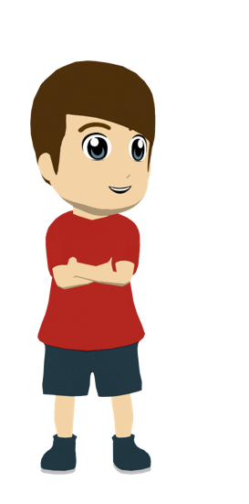
Daniel y los abuelos
escribir
Y Daniel, ¿cómo cuida a los abuelos? Escribe seis frases con ‘le’ o ‘les’.
1.
2.
3.
4.
5.
6.
He sends him letters.
He cooks them something every Sunday.
Le envía / manda cartas.
Les cocina algo cada domingo.
He buys them so many flowers!
He offers them help in winter because they can’t go out.
¡Les compra tantas flores!
Les ofrece ayuda en invierno porque no pueden salir.
He brings him the newspaper every day.
He buys him grey and orange t-shirts.
Le trae el periódico todos los días.
Le compra camisetas grises y naranjas.
Notes:
Timing: 8 minutes
Aim: to practise the use of ‘le’ and ‘les’ with verbs in the 3rd person singular.
Procedure: 1. Students translate each of the sentences (1-6) into Spanish. They should take care to choose the correct pronoun (either ‘le’ or ‘les’) in each case.
2. Click to reveal the answers.
Note: the sentences here are different from those heard on the previous slide to avoid production of identical sentences. This is to try to ensure use of a range of language.

Slide 14
Daniel y los abuelos
leer / hablar
[1/2]
Take turns to read the sentences aloud with a partner.
When reading words aloud in Spanish, stress the penultimate syllable for any word ending in a vowel, ‘n’ or ‘s’ (unless there is a written accent, when you should stress this syllable).
Le envía cartas porque está solo y no tiene móvil. Además, al abuelo le encanta saber más de la familia.
1
1
¡Les compra tantas flores! Según su abuelo, Daniel es un ángel así que el martes pasado, le compró dos cosas: un balón de fútbol* y una foto de su ídolo*, Lionel Messi.
2
2
el ídolo = idol
el balón = ball
Le trae el periódico todos los días después de la escuela. También, a veces, le lleva un dulce de la pastelería*.
3
3
la pastelería = cake shop
Notes:
Timing: 8 minutes (slide 14/15)
Aim: to improve fluency of pronunciation in sentences that have words in a range of stress positions (antepenultimate, penultimate, final)
Procedure:
1. Explain to students that they’ll now read longer versions of the sentences that they have already seen this lesson. Ask them to read the sentences and discuss the meaning in pairs.
2. Check understanding by eliciting oral translations into English.
3. Then ask students to take turns to read the sentences aloud. It may be helpful to remind them beforehand that a written accent indicates the part of the word that should be stressed (emphasised). The partner can give peer feedback on this.
4. Optionally, click one more time to reveal the beige action buttons. Students can then listen to this to compare their own production with that of a native speaker.
Note: porque is a word that often has equal stress on both syllables and so is an exception to the rule presented.
Frequency of unknown words or cognates:
ángel [1300]; pastelería [>5000]; ágil [>5000]; ídolo [4704]; equipación [>5000]

Slide 15
Daniel y los abuelos
leer / hablar
[2/2]
Les cocina algo cada domingo. La semana pasada también lavó los platos y les preparó un café.
4
4
Le ofrece ayuda en invierno porque su abuelo es muy débil y no puede salir. Daniel es más ágil*, así que es una solución práctica.
5
5
ágil = agile
Le compra camisetas grises y naranjas. Son los colores de la nueva equipación* de El Valencia Club de Fútbol, el equipo de su abuelo.
6
6
la equipación = kit
Notes:
Slide 2/2
Procedure as described on the previous slide.

Slide 16
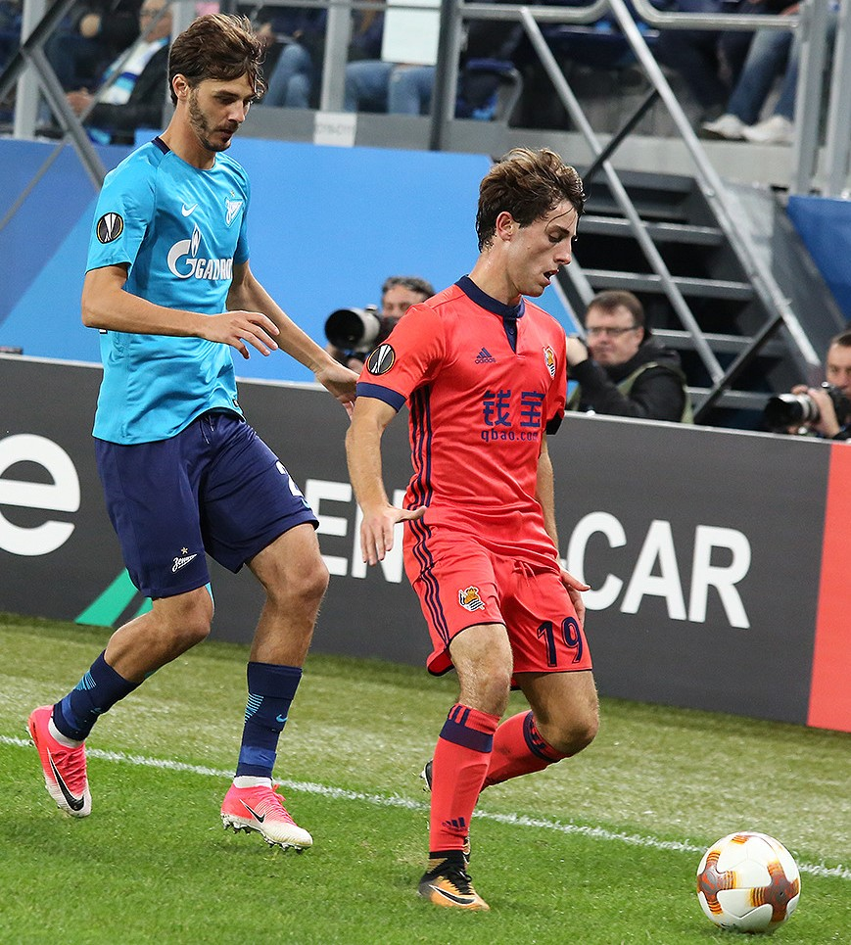
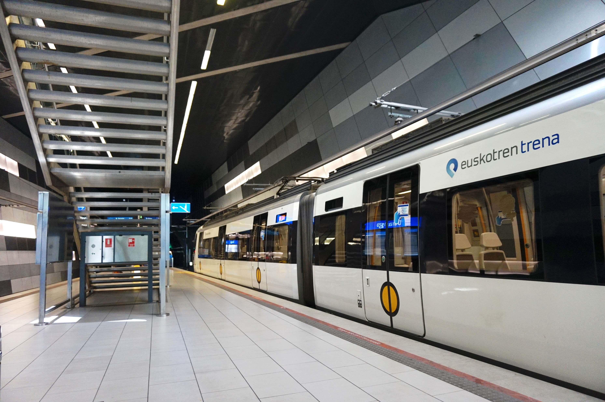
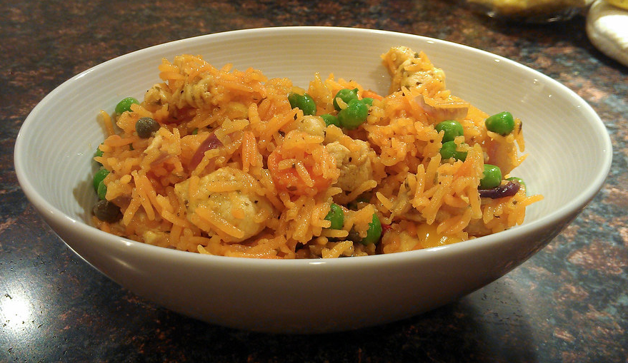
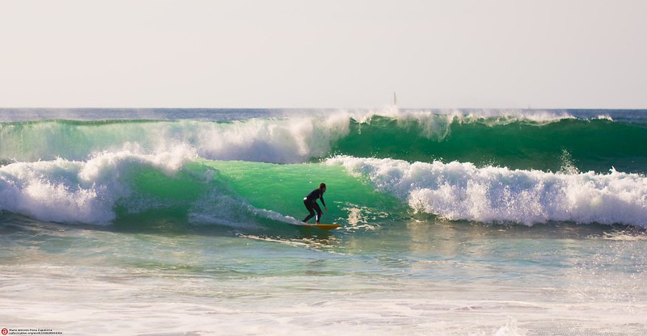
Talking about family and friends
indirect object pronoun ‘les’
object-first word order & personal ‘a’ [revisited]
Y9 Spanish
Term 1.1 - Week 7 - Lesson 14
Pete Watson / Louise Caruso / Nick Avery
Artwork: Mark Davies
Date updated: 09.07.21
Notes:
Note: all words (new and revisited) in this week of the SOW appear on all three GCSE wordlists, with the following exceptions:
AQA list does not have aproximadamente, guerra or simplemente
Edexcel list does not have pollo or guerra
Artwork by Mark Davies. All additional pictures selected are available under a Creative Commons license, no attribution required.
With thanks to Rachel Hawkes for her input on the lesson material and Amanda Izquierdo for native teacher feedback.
Learning outcomes (lesson 2)
Consolidation of the following language features:
pre-verbal position of indirect object pronoun in OV(S) sentences
personal ‘a’
indirect object pronoun ‘les’
-ar verbs in 3rd person plural present (-an)
-er/-ir verbs in 3rd person plural (-en)
a range of stress positions (final, penultimate, antepenultimate)
Frequency of rankings of vocabulary introduced this week (1 is the most common word in Spanish):
les [25]; mandar [588]; contar [172]; cocinar [3704]; dolor [591]; arroz [2882]; pollo [3577]; invierno [1813]; gris [1751]; naranja [2924]; camiseta [4130]; gafas [>5000]; tanto [88]
Frequency rankings of vocabulary revisited this week (1 is the most common word in Spanish):
Y8 3.2.6: guerra [282]; hoy en día [hoy-167]; cantidad [459]; tener lugar [lugar-144]; aproximadamente [1502]; comenzar [234]
Y8 3.1.6: fui [33]; fuiste [33]; fue [33]; apoyar [666]; celebrar [886]; zona [359]; septiembre [1150]; octubre [1242]; noviembre [1434]; diciembre [1165]; colegio [628]; avión [1399]; historia² [186]; directo [1029]; simplemente [731]; principalmente [1657]
Source: Davies, M. & Davies, K. (2018). A frequency dictionary of Spanish: Core vocabulary for learners (2nd ed.). Routledge: London
The frequency rankings for words that occur in this PowerPoint which have been previously introduced in NCELP resources are given in the NCELP SOW and in the resources that first introduced and formally re-visited those words. For any other words that occur incidentally in this PowerPoint, frequency rankings will be provided in the notes field wherever possible.

Slide 17
Vocabulario
Escucha. Identifica la imagen correcta y escribe su letra.
escuchar
1
2
3
4
5
6
7
8
9
10
11
12
F
I
C
A
K
G
E
B
H
D
L
J
A
B
C
D
E
F
[I went]
[to support, supporting]
[to take place]
[to celebrate, celebrating]
[October]
[war]
G
H
I
J
K
L
[s/he went, it went]
[approximately]
[story, history]
[plane]
[December]
[school]
Notes:
Timing: 6 minutes
Aim: to revisit vocabulary from one of this week’s revisited sets (8.3.1.6).
Procedure:
1. Give students a minute in pairs to try to anticipate the vocabulary items they hear. They could do this individually or in pairs.
2. Click the number triggers to play the audio.
3. Click to reveal each answer (i.e., the letter matching the number).
Transcript:
celebrar
diciembre
fui
octubre
avión
aproximadamente
tener lugar
apoyar
story
la guerra
11) el colegio
12) fue

Slide 18
Vocabulario
Vocabulario
leer
Escribe la palabra correcta en cada espacio en blanco:
cantidad
lugar
comenzar
aproximadamente
fuiste
principalmente
avión
celebrar
colegio
septiembre
fue
zona
celebrar
1. En diciembre vamos a __________ la Navidad*.
fuiste
2. ¿Dónde ________ de vacaciones el año pasado?.
lugar
3. La fiesta tiene _______ en las calles de Valencia.
principalmente
4. En esta comunidad hablan________________ el español. .
cantidad
5. Durante la Tomatina usan una gran _________ de tomates.
colegio
6. Hoy Enrique no quiere ir al ________.
avión
7. Viajar en ________ es más práctico que viajar en tren.
septiembre
8. En ___________ fui a un concierto de Shakira.
comenzar
9. La película va a __________ muy pronto.
zona
10. Andalucía es una_______ de España muy conocida.
*la Navidad = Christmas
Notes:
Timing: 8 minutes
Aim: to revisit this week’s vocabulary receptively in the written modality.
Procedure: 1. Students have to read the sentences and choose the most appropriate word from the list on the right to fill the gap. Explain to students that there are 12 words but only 10 spaces to fill, so 2 words won’t be needed.
2. Click to reveal the answers.
Note: the meaning of each sentence triggers one possible answer. Students need to understand the phrase to be able to choose the best possible answer among all the possible words. There are two distractors.
Frequency of unknown words or cognates:
Navidad [3513]

Slide 19
Saying who is affected by an action
gramática
Remember, object pronouns (e.g., him) indicate the person or thing that is affected by the verb.
To refer to one person or thing indirectly affected by an action, use ___.
le
Le traen chocolate.
They bring him/her/it chocolate.
If more than one person or thing is indirectly affected, use ___.
les
Les traen chocolate.
They bring them chocolate.
‘Les’ can refer to all male, all female or mixed groups.
In Spanish, these pronouns go before / after the verb.
Notes:
Timing: 2 minutes
Aim: to recap the use of indirect object pronouns ‘le’ and ‘les’.
Procedure:
Go through the grammar explanation with students, revealing each new sentence on a mouse click.
It may be useful here to ask students for the direct object (chocolate) and indirect object (him/them) to clarify the difference between these terms. Both have been previously taught.
Teachers might also elicit the alternative English translations: ‘They bring chocolate to him/her/it.’ and ‘They bring chocolate to them’.

Slide 20
Saying who does what
gramática
As you know, Spanish sentences can start with the subject (‘doer’) or with the object (‘receiver’).
Example 1: subject first
Los chicos les traen flores.
The boys bring them flowers.
Example 2: object first
A los chicos les traen flores.
They bring the boys flowers.
The personal ‘a’ is used before the object when it is a living thing.
Notes:
Timing: 2 minutes
Aim: to recap OV(S) word orders, as well as personal ‘a’.
Procedure:
Go through the grammar explanation with students, revealing each new sentence on a mouse click.
Prompt students for the 2nd possible English translation, too. i.e. The boys bring flowers to the grandparents. The boys bring flowers to them. They bring flowers to the boys.
Note: it is worth highlighting that in example #2, ‘les’ has no translation in English.

Slide 21
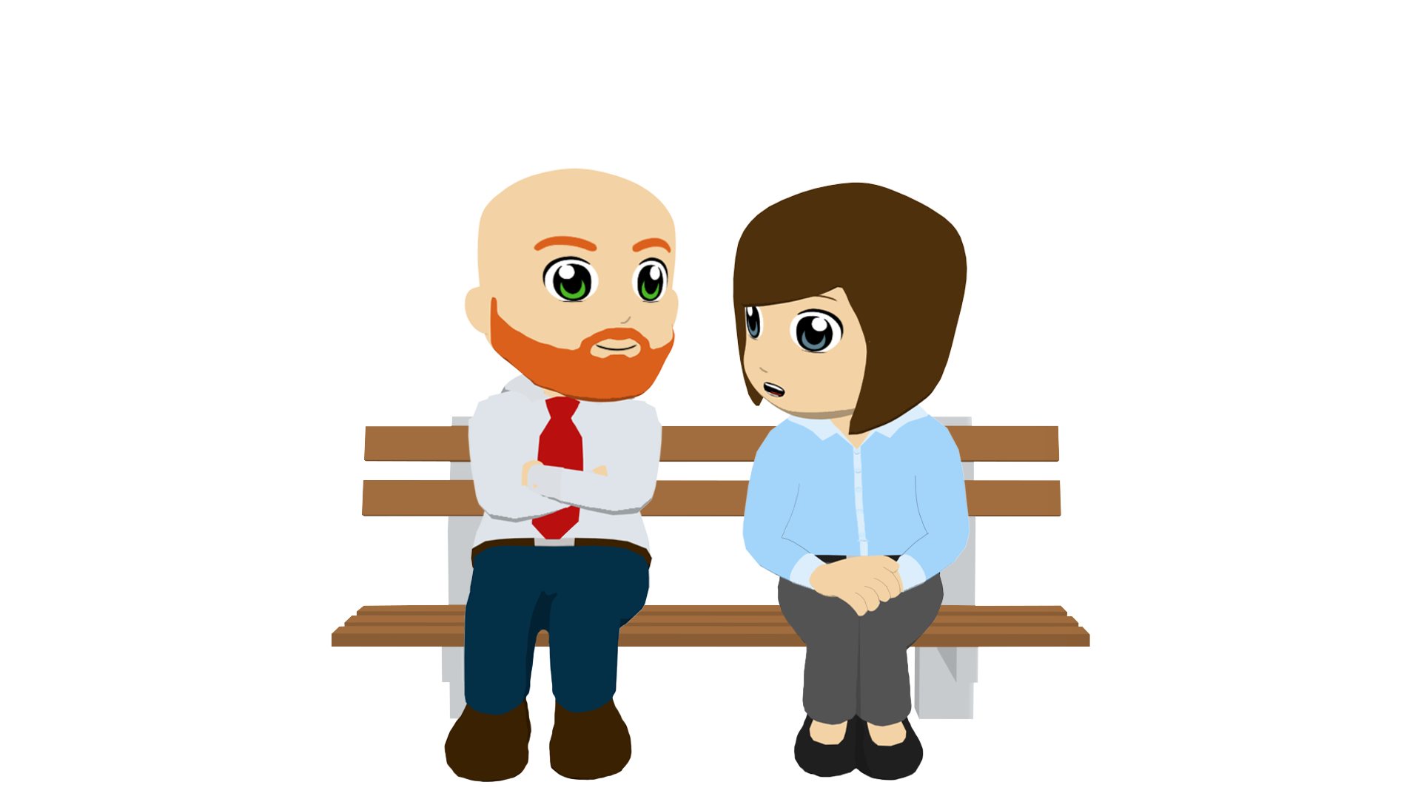
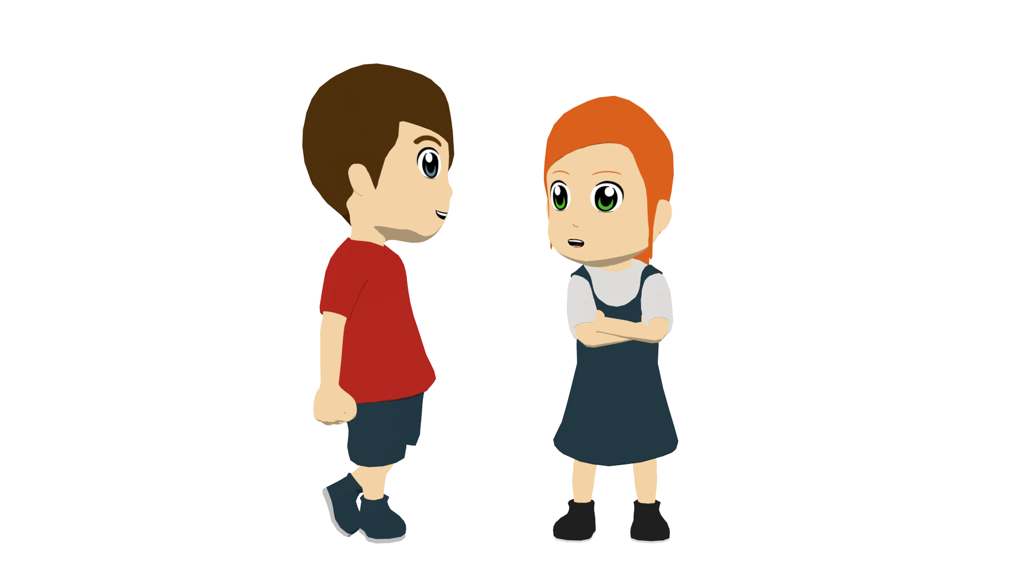
La vida en familia
You will read ‘Lucía y Daniel’ if they are the ‘doers’ and ‘A Lucía y Daniel’ if they are the ‘receivers’.
leer
Lee las frases y marca ‘a’ o ‘b’.
1 | A Lucía y Daniel les dan miedo. | They scare Lucía and Daniel. Daniel and Lucía scare them.
2 | Lucía y Daniel les cuentan historias sobre la Tomatina (la guerra de tomates). | Lucía and Daniel tell them stories about La Tomatina. They tell Lucía and Daniel stories about La Tomatina.
3 | Lucía y Daniel les dan vergüenza. | They embarrass Lucía and Daniel. Lucía and Daniel embarrass them.
4 | A Lucía y Daniel les preparan dulces tradicionales. | They make Lucía and Daniel traditional (sweet) pastries. Lucía and Daniel make them traditional (sweet) pastries.
5 | Lucía y Daniel les ofrecen apoyo. | a) They offer Lucía and Daniel support. b) Lucía and Daniel offer them support.
Notes:
Timing: 6 minutes
Aim: to correctly distinguish subject and object roles in subject and object-first sentences (written modality).
Procedure:
Students write 1-6 in their books.
They read the Spanish sentences and decide which of the two sentences translates the sentence correctly. To do this, they will need to pay attention to whether there is a personal ‘a’ at the start of the sentence (indicating the object) or no personal ‘a’ (indicating the subject).
Note: as an extension, and most likely only for high-ability groups, students could be asked how to translate the other answer into Spanish.

Slide 22
La vida en familia
escuchar
Escucha y decide cuál es la traducción correcta.
A
B
 | They give Lucía and Daniel headaches. | Lucía and Daniel give them headaches.
 | Lucía and Daniel offer them so many presents. | They offer Lucía and Daniel so many presents.
 | They lend Lucía and Daniel money. | Lucía and Daniel lend them money.
 | Lucía and Daniel give them jobs to do at the weekend. | They give Lucía and Daniel jobs at the weekend.
 | Lucía and Daniel buy them orange t-shirts. | They buy Lucía and Daniel orange t-shirts.
 | Lucía and Daniel leave them food in the kitchen. | They leave food in the kitchen for Lucía and Daniel.
1
c
2
3
4
5
6
Notes:
Timing: 7 minutes
Aim: to correctly distinguish subject and object roles in subject and object-first sentences (oral modality).
Procedure:
Students write numbers 1-6 in their books.
They listen to the Spanish sentences and write A or B, depending on which English sentence is the correct translation. Before each one, give students 10 seconds to read and process the answer options for ‘subject-first’ (Lucía and Daniel are doers) and ‘object-first’ (Lucía and Daniel are receivers).
Clicking reveals each answer.
Transcript:
A Lucía y Daniel les dan dolor de cabeza.
A Lucía y Daniel les ofrecen tantos regalos.
Lucía y Daniel les prestan dinero.
Lucía y Daniel les dan tareas los fines de semana.
A Lucía y Daniel les compran camisetas naranjas.
Lucía y Daniel les dejan comida en la cocina.

Slide 23
La familia y los amigos
leer
Nadia y Hugo
¿Quiénes hacen cada actividad y qué hacen?
[1/2]
Hoy Lucía y Daniel les prestan dinero para pagar los billetes del ‘euskotren’. Los trenes son modernos y cada billete cuesta más o menos un euro, así que es bastante barato y práctico viajar así.
1
Ana y Diego
2
A Lucía y Daniel les pasan unas camisetas naranjas. Las camisetas son de la Real Sociedad de Fútbol. ¡Toda la familia va a ir al partido el sábado para dar ánimo al equipo!
Lucía and Daniel give (‘pass’) some orange t-shirts to Ana and Diego. ¿Verdadero o falso?
Lucía and Daniel lend Nadia and Hugo money to pay for train tickets. ¿Verdadero o falso?
Notes:
Timing: 8 minutes (slides 23-24)
Aim:
to continue practice in understanding meaning and working out who is doing each activity to/for whom, this time in slightly longer texts
to learn more about a part of the Spanish-speaking world
to practise understanding previously taught vocabulary beyond sentence level
Procedure:
Ask students to read through the first two of the short texts.
On clicking a true and false question will come up in the middle of the slide. Teachers can decide how they would like students to answer (voting for true or false, students write on whiteboards, students write the answer in their books etc). The second click reveals the answer. Four questions appear in all, across the two slides.
Teachers can ask students which of the four paragraphs seems incorrect or most unlikely.
Teachers can also ask comprehension questions about the paragraphs to ensure the rest of the information is understood. Questions could include:
When are they going to play football? (Saturday)
What information is given about ticket prices for the train? (cheap, more or less a euro)
Why can’t the grandparents sometimes cook? (headache, tiredness)
Why is the Zurriola a good beach? (because the waves are big)
Picture of euskotren is licensed under the Creative Commons Attribution-Share Alike 3.0 Unported license. Retrieved from: https://commons.wikimedia.org/wiki/File:Durango_train_station.jpg
Picture of real sociedad is icensed under the Creative Commons Attribution-Share Alike 3.0 Unported license. Retrieved from: https://commons.wikimedia.org/wiki/File:ZENIT_VS._REAL_SOCIEDAD_3_-_1_(9).jpg

Slide 24
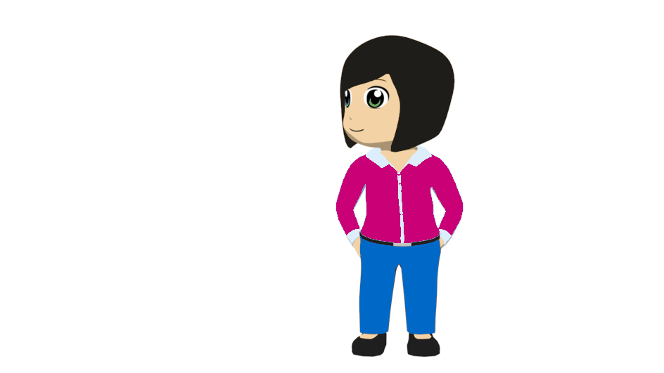
La familia y los amigos
leer
4
los profesores
[2/2]
los abuelos
3
A Lucía y Daniel les ofrecen apoyo en las actividades después de las clases. A veces los estudiantes van a hacer surf en la Playa de la Zurriola porque allí las olas* son grandes.
Lucía y Daniel les preparan arroz con pollo. En invierno hay días cuando están cansados o tienen dolor de cabeza y no pueden cocinar.
*la ola = wave
El arroz con pollo es un plato típico de muchos países de habla hispana*. A veces la gente le pone verduras y especies*.
Lucía and Daniel prepare rice with chicken for their grandparents. ¿Verdadero o falso?
Lucía and Daniel help their teachers after lessons. ¿Verdadero o falso?
*de habla hispana = Spanish-speaking
*la especie = spice
Notes:
Slide 2/2
Instructions are as described on the previous slide.
Picture of food is licensed by Attribution-NonCommercial 2.0 Generic (CC BY-NC 2.0). Retrieved from https://www.flickr.com/photos/dharder9475/14483517753
Picture of surfing is licensed by Attribution-NonCommercial 2.0 Generic (CC BY-NC 2.0). Retrieved from https://www.flickr.com/photos/oneras/29225984604
Frequency of unknown words or cognates:
especie [443]; ola [2425]

Slide 25
La familia y los amigos
What others do for Lucía and Daniel
What Lucía and Daniel do
Persona A (read aloud):
Persona B (listen):
Say these sentences in Spanish:
1. Lucía y Daniel les dan dinero.
A | B
1
Give money
Offer help
___
___
Tick the correct column.
Write the order in which you hear the English below (1 = first, 6 = last)
Notes:
Timing: 10 minutes
Aims:
to gain confidence and fluency in reading aloud
to practise aural recognition of known vocabulary and SV/OV word orders
Procedure
Get students into pairs. Distribute printed handouts (see slide 26 and 27) and ensure that all students know who is A and who is B.
Use this slide to model the activity.
Person A reads six sentences aloud to Person B.
Person B listens and completes grid (choosing A or B) and orders the English sentences from 1-6.
After this students swap roles.
Use the next slides to give feedback.

Slide 26
Persona A (read aloud):
What Lucía and Daniel do
What others do for Lucía and Daniel
Persona A (listen):
Say these sentences in Spanish
1. Lucía y Daniel les cuentan cosas sobre el partido de tenis.
2. ¡A Lucía y Daniel les regalan tanta ropa nueva!
3. Lucía y Daniel les mandan fotos de la playa.
4. Lucía y Daniel les traen naranjas del árbol.
5. A Lucía y Daniel les dejan tiempo para hacer los deberes.
6. A Lucía y Daniel les dan apoyo con actividades difíciles.
A | B
Tick the correct column.
Write the order in which you hear the English below (1 = first, 6 = last)
Offer support
Prepare tasty food
Give sweets
Buy presents
Tell stories
Lend money
___
___
___
___
___ ___
Notes:
Student A prompt sheet and blank listening grid

Slide 27
Persona B (read aloud):
What Lucía and Daniel do
What others do for Lucía and Daniel
Persona B (listen):
Say these sentences in Spanish
1. Lucía y Daniel les prestan dinero.
2. A Lucía y Daniel les ofrecen apoyo.
3. Lucía y Daniel les preparan comida rica.
4. A Lucía y Daniel les cuentan historias.
5. Lucía y Daniel compran regalos.
6. A Lucía y Daniel les dan dulces.
A | B
Tick the correct column.
Write the order in which you hear the English below (1 = first, 6 = last)
Bring oranges from tree
Give new clothes
Give support with activities
Leave time for homework
Send photos from the beach
Say things about tennis match
___
___
___
___
___ ___
Notes:
Student B prompt sheet and blank listening grid

Slide 28
Persona A (read aloud):
What Lucía and Daniel do
What others do for Lucía and Daniel
Persona A (listen):
Say these sentences in Spanish
1. Lucía y Daniel les cuentan cosas sobre el partido de tenis.
2. ¡A Lucía y Daniel les regalan tanta ropa nueva!
3. Lucía y Daniel les mandan fotos de la playa.
4. Lucía y Daniel les traen naranjas del árbol.
5. A Lucía y Daniel les dejan tiempo para hacer los deberes.
6. A Lucía y Daniel les dan apoyo con actividades difíciles.
A | B
Tick the correct column.
Write the order in which you hear the English below (1 = first, 6 = last)
2
Offer support
Prepare tasty food
Give sweets
Buy presents
Tell stories
Lend money
___
___
___
___
___ ___
3
6
5
4
1
Notes:
ANSWER SLIDE – PERSON A

Slide 29
Persona B (read aloud):
What Lucía and Daniel do
What others do for Lucía and Daniel
Persona B (listen):
Say these sentences in Spanish
1. Lucía y Daniel les prestan dinero.
2. A Lucía y Daniel les ofrecen apoyo.
3. Lucía y Daniel les preparan comida rica.
4. A Lucía y Daniel les cuentan historias.
5. Lucía y Daniel compran regalos.
6. A Lucía y Daniel les dan dulces.
A | B
Tick the correct column.
Write the order in which you hear the English below (1 = first, 6 = last)
4
Bring oranges from tree
Give new clothes
Give support with activities
Leave time for homework
Send photos from the beach
Say things about tennis match
___
___
___
___
___ ___
2
6
5
3
1
Notes:
ANSWER SLIDE – PERSON B

Slide 30
Deberes
Deberes
Vocabulary Learning Homework (Y9, Term 1.2, Week 1)
Audio file
Audio file QR code:
Student worksheet
Quizlet link
In addition, revisit: Year 9 Term 1.1 Week 4 Year 8 Term 3.2 Week 4
Notes:
To be updated

Slide 31
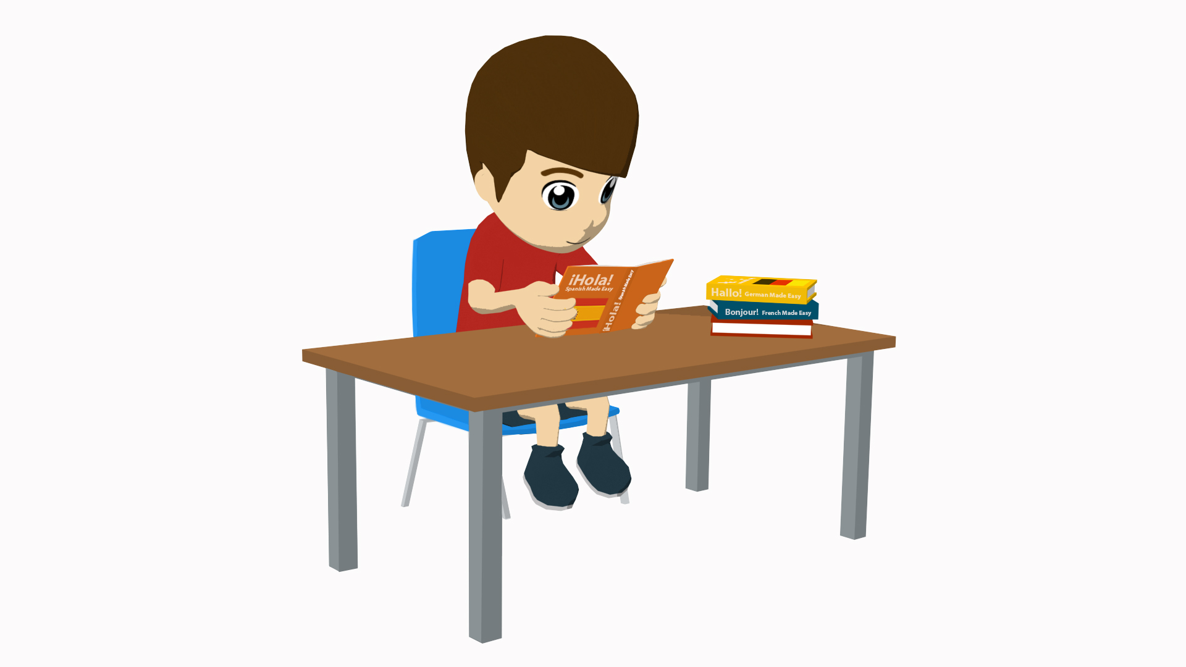
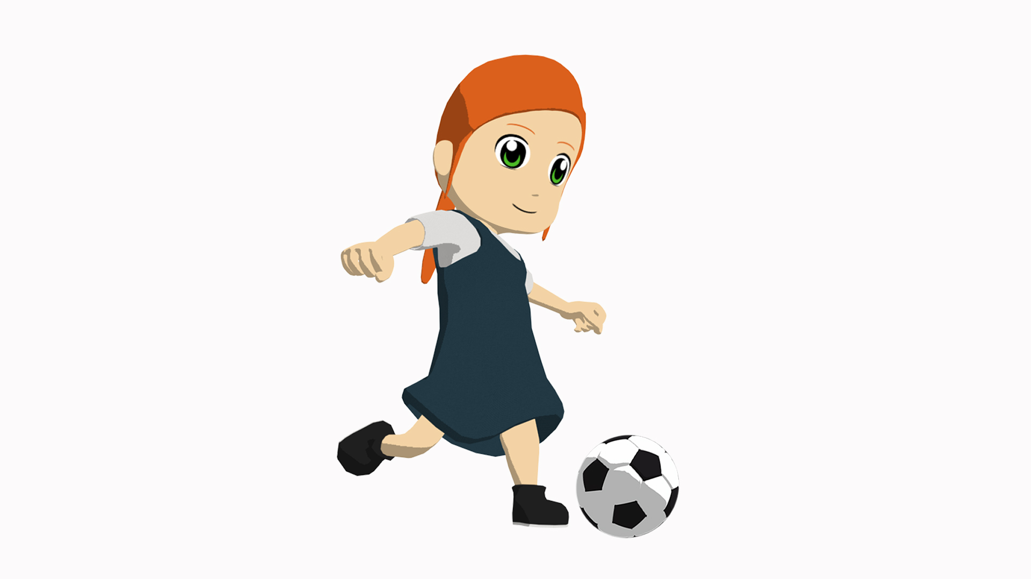
La familia y los amigos
escribir
Escribe las seis frases en español.
1. Lucía and Daniel tell them things about the tennis match.
Lucía y Daniel les cuentan cosas sobre el partido de tenis.
2. They give Lucía and Daniel so much new clothing (as a present)!
¡A Lucía y Daniel les regalan tanta ropa nueva!
Start with ‘Lucía y Daniel’ if they are the ‘doers’ and ‘A Lucía y Daniel’ if they are the ‘receivers’.
3. Lucía and Daniel send them photos from the beach
Lucía y Daniel les mandan fotos de la playa.
4. Lucía and Daniel bring them oranges from the tree.
Lucía y Daniel les traen naranjas del árbol.
5. They leave Lucía and Daniel time to do (the) homework.
A Lucía y Daniel les dejan tiempo para hacer los deberes.
6. They give Lucía and Daniel support with difficult activities.
A Lucía y Daniel les dan apoyo con actividades difíciles.
Notes:
OPTIONAL – written production of full sentences using subject and object-first word orders (for higher ability groups)
Note: some of these sentences are the same as in the read aloud/listening activity
Timing: 8 minutes
Aim:
i) to write full sentences using the two word orders practised this lesson.
ii) to consolidate productive use of the two word orders.
Procedure:
Students translate the sentences into Spanish.
Answers are revealed by clicking.

