Slide 1
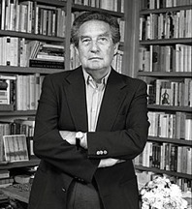
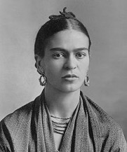
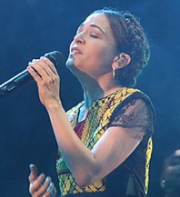
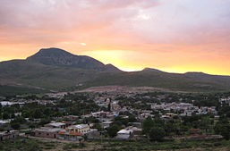
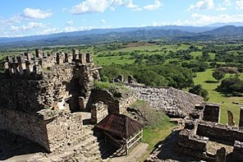
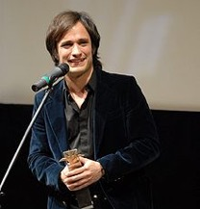
México Describing people and places in Mexico
Octavio Paz
possessive adjective ‘su’ (revisited)
SER – ‘es’ and ‘son’ (revisited)
Frida Kahlo
Natalia
Lafourcade
Aguascalientes
Y9 Spanish Term 1.1 – Week 4 – Lesson 7 Louise Caruso / Pete Watson / Nick Avery
Artwork: Mark Davies Date updated: 24.09.23
Toniná
Gael
García Bernal
Notes:
Note: all words in this week of the SOW appear on all three GCSE wordlists, with the following exceptions: i) AQA list does not have ligero, saltar.
ii) Edexcel list does not have muerte.
Note: there is no new grammar in this first lesson, but the reflexive pronoun ‘se’ is introduced in lesson 2. This week provides important consolidation of possessive adjective ‘su’ and singular/plural 3rd person forms of ser. If teachers feel that their classes have confident use of these features already, they may want to use this first lesson to do alternative activities. It is worth remembering, however, that this week revises relevant vocabulary from the GCSE lists so teachers may want to include revisiting activities for this. Plus, this lesson offers a very useful cultural rintroduction to Mexico.
Artwork by Mark Davies. All additional pictures selected are available under a Creative Commons license, no attribution required.
Native teacher feedback provided by Blanca Román.
Learning outcomes (lesson 1)
Introduction of new vocabulary
Cultural knowledge about a Spanish-speaking country
Consolidation of the following:
Possessive adjectives ‘su’ and ‘sus’
SER in 3rd person singular and plural present tense (‘es’ and ‘son’)
Penultimate syllable stress
Frequency rankings of vocabulary introduced this week (1 is the most common word in Spanish):
venir [118]; nivel [297]; tierra [259]; luz [278]; muerto [1103]; muerte [294]; comunidad [523]; costumbre [972]; forma [119]; mexicano [849]; especial [436]; hora [160]; único [214]; sentar [249]; acordar [535]; quedar² [100]
Frequency rankings of vocabulary revisited this week (1 is the most common word in Spanish):
Y8 3.1.4
parecer [89]; guardar [687]; pagar [377]; marca [1276]; falda [2743]; mitad [834]; precio [557]; tipo [168]; euro [2435]; ligero [1930]; práctico [2141]; este [24]
Y8 3.2.4
grabar [1560]; tocar [327]; mostrar [330]; bajar [484]; saltar [1160]; pierna [776]; brazo [470]; mano [135]; alguien [346]; ya² [39]; ahora mismo [81]
Source: Davies, M. & Davies, K. (2018). A frequency dictionary of Spanish: Core vocabulary for learners (2nd ed.). Routledge: London
The frequency rankings for words that occur in this PowerPoint which have been previously introduced in NCELP resources are given in the NCELP SOW and in the resources that first introduced and formally re-visited those words. For any other words that occur incidentally in this PowerPoint, frequency rankings will be provided in the notes field wherever possible.

Slide 2
Vocabulario
hablar
3
to keep,
keeping
Segundos
[to record, recording]
[to touch, touching]
grabar
tocar
guardar
0
INICIO
Notes:
[1/6]
Timing: 3 min Aim: to practise productive (oral) recall of three words within a given time.
Procedure:
1. Students say all three words before three seconds elapse.
2. Click to reveal answers.
3. Repeat if additional practice needed.

Slide 3
Vocabulario
hablar
3
Segundos
[to jump, jumping]
[leg]
[arm]
saltar
la pierna
el brazo
0
INICIO
Notes:
[2/6]

Slide 4
Vocabulario
hablar
3
Segundos
[hand]
[light (m)]
la mano
ligero
la marca
0
INICIO
Notes:
[3/6]

Slide 5
Vocabulario
hablar
3
Segundos
[to show, showing]
[skirt]
[to pay, paying]
mostrar
la falda
pagar
0
INICIO
Notes:
[4/6]

Slide 6
Vocabulario
hablar
3
someone
Segundos
[euro]
[half]
el euro
alguien
la mitad
0
INICIO
Notes:
[5/6]

Slide 7
Vocabulario
hablar
3
type
this (m)
Segundos
el precio
el tipo
este
0
INICIO
Notes:
[6/6]

Slide 8
Vocabulario
leer / hablar
[1/2]
When ‘Earth’ and ‘Tierra’ are used for the planet, they start with a capital letter.
muerto/a
level
el nivel
[dead]
[level]
‘Muerto/a’ can also be used as a noun with the meaning ‘dead person’ (m/f).
la Tierra
la muerte
Remember, the plural of words ending in –z is –ces: luz > luces.
[Earth]
[death]
la luz
la comunidad
[light]
Notes:
[1/2]
Timing: 8 minutes (slides 8-9)
Aim: to introduce and embed new vocabulary
Procedure: 1. Pupils either work by themselves or in pairs, reading out the words and recapping their English meaning (1 minute). 2. Then the teacher removes the English words or pictures (one by one) and they try to recall the English orally (chorally), looking at the Spanish (1 minute). 3. Then the Spanish meanings are removed (one by one) and they to recall them orally (again, chorally), looking at the English (1 minute) 4. Further rounds of learning can be facilitated by one pupil turning away from the board, and his/her partner asking him/her the meanings (‘¿Cómo se dice X en español?’). This activity can work from L2 → L1 or L1 → L2.

Slide 9
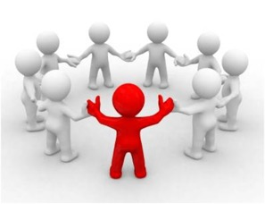
Vocabulario
leer / hablar
special
especial
[2/2]
custom, habit
la costumbre
This verb is similar to tener (e->ie for ‘you’, ‘s/he’ and ‘they’):
la hora
way
la forma
[hour, time]
Tú vienes
You come
To say ‘the way of doing something’ in Spanish say ‘la forma de hacer algo’.
Ella viene
She comes
único/a
Ellas vienen
They (f) come
[unique]
mexicano/a
to come,
coming
venir
¡Atención! Debes pronunciar la ‘x’ en esta palabra como ‘j’.
[Mexican (adj), Mexican person (m/f)]
Notes:
[2/2]
Aim: to introduce and embed new vocabulary
Procedure: 1. Pupils either work by themselves or in pairs, reading out the words and recapping their English meaning (1 minute). 2. Then the teacher removes the English words or pictures (one by one) and they try to recall the English orally (chorally), looking at the Spanish (1 minute). 3. Then the Spanish meanings are removed (one by one) and they to recall them orally (again, chorally), looking at the English (1 minute) 4. Further rounds of learning can be facilitated by one pupil turning away from the board, and his/her partner asking him/her the meanings (‘Cómo se dice X en español?’). This activity can work from L2 → L1 or L1 → L2.
Notes:
The additional meaning of ‘único’ (‘only’ when used before a noun) and ‘forma’ (‘shape’) will be taught in later weeks.
Venir is also similar to tener in its 1st person singular present tense form (vengo). However, that form is not used in this week’s lesson, and so it is not included on the slide itself.
The ability to understand and talk about cultural aspects of the Spanish-speaking world led to our decision to include the word ‘costumbre’. It may be useful to explain to students that ‘costumbre’ can be used for both for general ‘habits’ (e.g. tener la costumbre de hacer algo) and to refer to particular cultural customs that may be different from our own.

Slide 10
Talking about possessions Possessive adjectives ‘su’ and ‘sus’
gramática
To say ‘his’, ‘her’ or ‘its’ before a singular or uncountable noun use ‘su’.
It does not matter whether the noun is masculine or feminine.
Ejemplos:
¡Ojo! As su(s) has different meanings, you may need context to know if it refers to she, he or it.
His / her / its community is special.
Su comunidad es especial.
Remember to use ‘es’ for a singular noun and ‘son’ for a plural noun.
To say ‘his’, ‘her’ or ‘its’ before a plural noun use ‘sus’.
His / her / its customs are unique.
Sus costumbres son únicas.
Notes:
Timing: 2 minutes
Aim: to recap ‘su’ and ‘sus’.
Procedure:
1. Click to reveal each new part of explanation of ‘su’ and ‘sus’ and then the examples. Each example and answer is revealed by a click, so teachers can ask students for the answers.
2. Click to show explanation of ‘su’ or ‘sus’ and how this will inform the verb choice between ‘es’ or ‘son’.

Slide 11
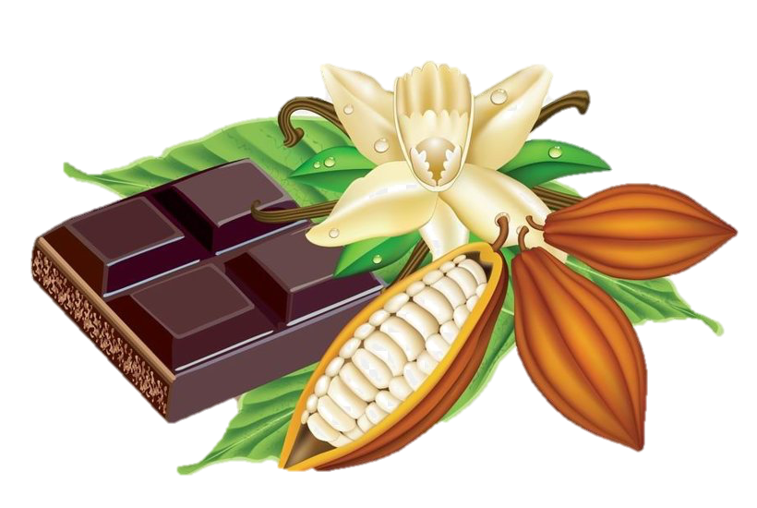
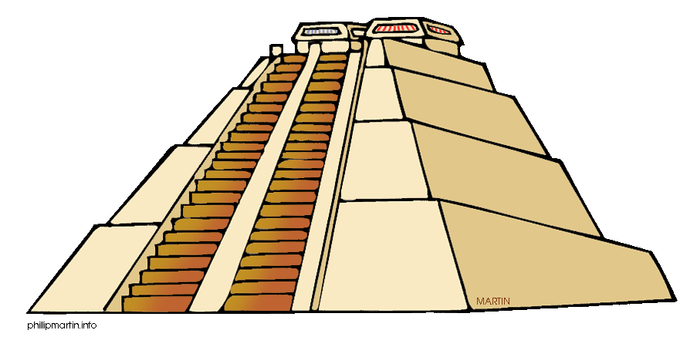
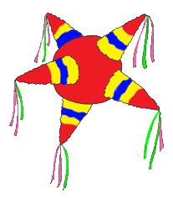
Cosas sobre México
leer
Lee estas frases sobre México. ¿Qué piensas? ¿Son verdaderas o falsas?
1. Originalmente el chocolate viene de México.
Verdadero
2. En México hay pirámides muy altas.
Verdadero
3. En México la gente solo habla español.
Falso
4. Romper una piñata* en una fiesta es una costumbre mexicana.
Verdadero
5. En una celebración popular las familias ofrecen comida a los muertos.
Verdadero
*A piñata is a soft container that is decorated and filled with sweets for celebrations.
The verb ‘ser’ is used for dates.
6. Una celebración, el Día de Muertos, es en octubre.
Falso
Piñata
Notes:
Timing: 6 minutes
Aim: to introduce students to some cultural information about Mexico.
Procedure:
Students read each sentence and give an oral translation.
Students decide if the sentence is true or false.
Note:
1. The teacher can clarify that this activity is not intended to be a test. It serves as an introduction to the topic and also to stimulate interest.
2. There are 69 languages in Mexico (68 native languages and Spanish). Source: https://blog.xcaret.com/en/indigenous-languages-spoken-in-mexico/#:~:text=According%20to%20official%20data%2C%20there,Tzotzil%2C%20Tzeltal%2C%20and%20Maya.
3. The ‘Día de Muertos’ may be used with or without an article according to the RAE. See https://twitter.com/RAEinforma/status/1190605751158476802.
Frequency of unknown words and cognates:
originalmente [>5000]; chocolate [3408]; pirámide [4615]; popular [790]; celebración [2711]
Pyramid image by Phillip Martin and licensed under a Creative Commons Attribution-NonCommercial-NoDerivs 3.0 Unported License.
Retrieved from http://architecture.phillipmartin.info/world_aztec_pyramid.htm
Other images also free to use from

Slide 12
México (1/2)
Lee las descripciones de personas, lugares y cosas de México. ¿Qué significa ‘su’?
leer
 | ¿Qué significa ‘su’?
 | his | her | its
1. Es una cantante* mexicana. Su canción «Mexicana hermosa» es muy famosa.
2. Es una ciudad en el centro de México. Su festival cultural es muy interesante.
3. Es una artista muy famosa. Su arte es muy conocido en todo el mundo.
4. Es un actor mexicano. Su película «Diarios de motocicleta» ganó muchos premios.
5. Es una pirámide muy antigua. Su altura es de 75 metros.
6. Es un autor mexicano. Su libro «El laberinto de la soledad» habla sobre la comunidad mexicana.
*el/la cantante – singer (m/f)
Notes:
Omit slides 12/13 with more able students, and instead do the reading on slide 15 that follows the listening.
Timing: 6 minutes
Aim: to recognise the gender and animacy of the noun and use this to decide the meaning of ‘su’.
Procedure:
Students read each sentence and write the correct of meaning of ‘su’ (e.g. 1=her), depending on the noun referred to in the first sentence (whether it is animate or inanimate, and, if animate, whether male or female).
Show the answers one by one and elicit oral translations of the sentences English.
Notes:
1. Students may also need to use the gender of the article to inform their choices here (e.g., seeing ‘una’ before ‘artista’, as the gender of this noun is invariable).
2. Some words are deliberately not glossed for two reasons: 1) they are not needed to work out the meaning of ‘su’ and 2) they are near-cognates (see below).
Frequency of unknown words and cognates:
Cantante [2105]; festival [3194]; cultural [714]; artista [817]; actor [1533]; pirámide [4615]; metro [798]
Mexico flag by Daniel Utz and licensed under CC BY-SA 4.0
Retrieved from https://openmoji.org/library/#search=mexico

Slide 13
México (2/2)
Lee las descripciones (1-6) otra vez y busca la imagen correcta (a-f).
leer
1. Es una cantante* mexicana. Su canción «Mexicana Hermosa» es muy famosa.
2. Es una ciudad en el centro de México. Su festival cultural es muy interesante.
3. Es una artista muy famosa. Su arte es muy conocido en todo el mundo.
4. Es un actor mexicano. Su película «Diarios de motocicleta» ganó muchos premios.
5. Es una pirámide muy antigua. Su altura es de 75 metros.
6. Es un autor mexicano. Su libro «El laberinto de la soledad» habla sobre la comunidad mexicana.
¿Qué letra?
a
b
d
c
Frida Kahlo
Octavio Paz
c
d
a
e
Natalia
Lafourcade
Aguascalientes
f
e
f
b
Gael
García Bernal
*el/la cantante – singer (m/f)
Toniná

Slide 14
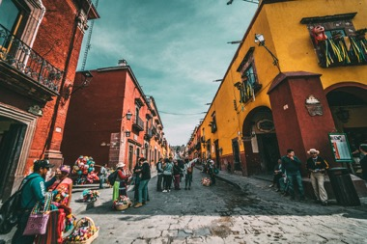
Lee este artículo y escribe el título correcto. Debes elegir ‘su’ o ‘sus’.
¿Por qué hacer un viaje a México? Aquí te damos cinco razones.
leer
gente
1. Su / sus________________
Si vienes a México es seguro que puedes hacer amigos. Los mexicanos son muy simpáticos y reciben a los visitantes* con los brazos abiertos.
2. Su / sus ________________
Los paisajes de México son geniales. Puedes visitar sus playas hermosas, sus montañas altas, sus lagos* grandes o sus bosques* llenos de vida.
3. Su / sus ________________
En sus calles vas a encontrar todo tipo de edificios: iglesias antiguas, plazas llenas de gente, mercados, teatros, tiendas con productos locales...
4. Su / sus ________________
México es conocido por sus platos deliciosos. Los mexicanos comen bien y preparan muchas cosas tradicionales: tacos, tamales, mole...
5. Su / sus ________________
Si te interesa la cultura, México es un lugar ideal. Las tradiciones son muy importantes para los mexicanos y sus celebraciones son muy especiales.
Opciones
gente
costumbres
museos
ciudades
música
comida
bebidas
naturaleza
naturaleza
ciudades
comida
*el/la visitante - visitor
costumbres
*el bosque - forest
*el lago - lake
Notes:
Omit this activity with lower proficiency students and instead do the previous reading.
Timing: 7 minutes
Aims:
to correctly identify the section headers.
to use the correct form of the possessive adjective (‘su’ or ‘sus’).
Procedure: 1. Students read each section and decide on the correct title from the options available. Note that there are eight options but students will only need to choose five.
2. Show the answers one by one and give feedback. As part of feedback, oral translations could be given in English for each short section.
Frequency of unknown words and cognates:
visitante [2428]; lago [2151]; bosque [1444]; local [734]; ideal [2388]
Image from Pixabay (free to use)

Slide 15
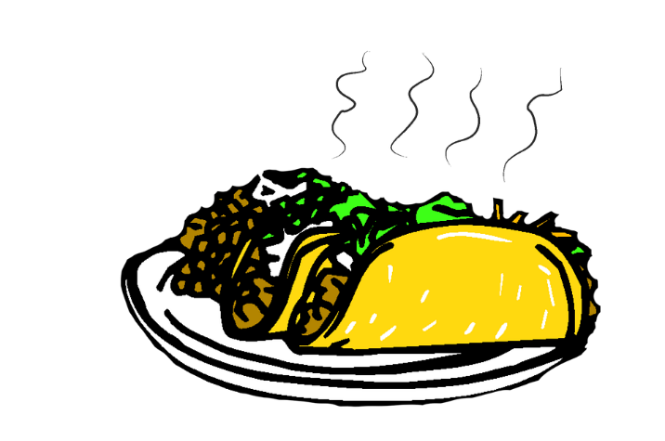
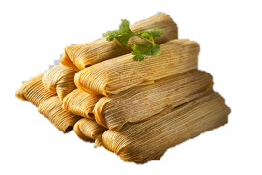
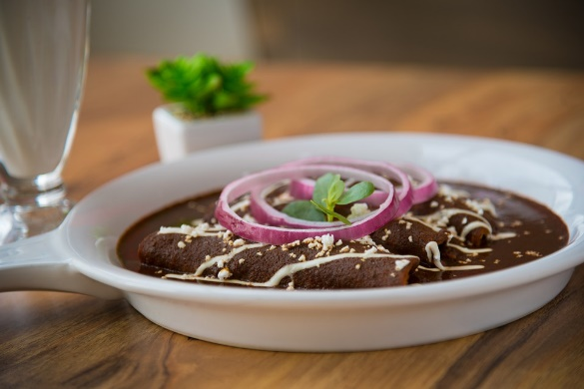
Comida típia de México
México es conocido por sus platos deliciosos. Los mexicanos comen bien y preparan muchas cosas tradicionales: tacos, tamales, mole...
Tamales
Tacos
Mole
Mole (‘mo-le’) is a traditional Mexican sauce. It may be made with chilli peppers, nuts, dried fruits, spices and seeds. The ingredients are roasted before being mixed with liquids to make a thick sauce. The sauce can be used with a range of dishes.
Tamales are made of corn-based dough with a meat, bean or cheese filling. They are usually steamed and come wrapped in a banana leaf.
Tacos are a type of small tortilla wrap that can have all kinds of fillings (e.g., ground beef, cheese, vegetables).
Notes:
OPTIONAL
This slide can be used to explain the references to food on the previous slide.
Mole image and Tacos image from Pixabay.com and free to use.
Tamal image from Clipart Library and free to use.

Slide 16
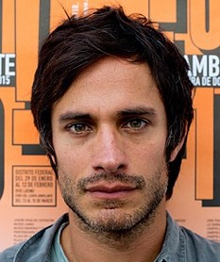
Más cosas sobre México
Escucha las frases sobre personas, lugares y cosas de México.
escuchar
¿Es A o B? ¿Qué significa ‘su(s)’: ‘his’, ‘her’ or ‘its’?
 | ¿Su o sus? | A | B | ‘His’, ‘her’ o ‘its’
 |  | costumbre | costumbres
 |  | canción | canciones
 |  | película | películas
 |  | poema | poemas
 |  | forma | formas
 |  | edificio | edificios
1
1
Sus
its
Natalia
Lafourcade
Gael
García Bernal
2
2
Su
her
3
3
Sus
his
4
4
Sus
his
Octavio Paz
Frida Kahlo
5
5
Su
her
El Premio Nobel de Literatura es un premio cada año para un/a autor/a de mucho éxito.
6
6
Sus
its
*fue = it was, it went|*el símbolo = symbol| el sol = sun
Notes:
Timing: 8 minutes
Aims:
to identify the form of ‘su’ (singular or plural) and use this to decide which noun (A or B) is missing.
to recognise the animacy and gender of the subject and use this to work out the meaning of ‘su’ (his, her or its).
to understand the sentences in their entirety.
Procedure:
1. Students copy the grid into their books.
2. Click on the blue action button to play the sentence. Students will hear the sentence with the noun in column A or B bleeped out. They will need to pay attention to the possessive adjective (su or sus) to establish which word (A or B) is missing. They may wish to write the possessive adjective down to help them do this.
3. Students listen again. This time they decide whether ‘su’ means ‘his’, ‘her’ or ‘its’, based on the subject that they hear. To help them do this, pictures of the four people mentioned are provided, too.
4. Answers can be checked by listening to the full audio (beige buttons) or simply by clicking. This is also a chance to check understanding of the sentences via oral translation into English.
Transcript:
Words in brackets are bleeped out.
Gold buttons (gapped audio)
México es un país con mucha cultura. Sus [beep] son conocidas en todas partes del mundo.
Natalia LaFourcade canta muy bien. Su [beep] Un Canto por México, es muy popular.
Gael García Bernal es actor, pero también es director. Sus [beep] tienen mucho éxito.
Octavio Paz es un autor mexicano con un Premio Nobel de Literatura. Sus [beep] hablan sobre la vida y la naturaleza.
Frida Kahlo es una artista muy especial. Su [beep] de pintar es única.
La zona de Toniná fue muy importante para la comunidad mexicana. Sus [beep] son un símbolo del Sol y la Tierra.
Beige buttons (full audio)
México es un país con mucha cultura. Sus costumbres son conocidas en todas partes del mundo.
Natalia LaFourcade canta muy bien. Su canción Un Canto por México, es muy popular.
Gael García Bernal es actor, pero también es director. Sus películas tienen mucho éxito.
Octavio Paz es un autor mexicano con un Premio Nobel de Literatura. Sus poemas hablan sobre la vida y la naturaleza.
Frida Kahlo es una artista muy especial. Su forma de pintar es única.
La zona de Toniná fue muy importante para la comunidad mexicana. Sus edificios son un símbolo del Sol y la Tierra.
Photos from wikipedia.org
Frida Kahlo. Author died in 1954 and image is now public domain and available at https://commons.wikimedia.org/wiki/File:Frida_Kahlo,_by_Guillermo_Kahlo.jpg
Octavio Paz. Photo usable by CC BY-SA 4.0 and available at https://es.wikipedia.org/wiki/Octavio_Paz
Natalia Lafourcade. Image by Martinbayo usable by CC BY-SA 4.0 and available at https://es.wikipedia.org/wiki/Natalia_Lafourcade#/media/Archivo:Natalia_Lafourcade_2018_Gran_Rex_37_(Cropped).jpg
Gael García Bernal. Image by Festival Incernacional de Cine en Guadalajara usable by CC BY 2.0 and available at https://es.wikipedia.org/wiki/Gael_Garc%C3%ADa_Bernal#/media/Archivo:Gael_Garc%C3%ADa_Bernal_(Guadalajara_Film_Festival).jpg
Image by David Cabrera usable by CC BY 2.0 and available at https://es.wikipedia.org/wiki/Tonin%C3%A1#/media/Archivo:Lo_M%C3%A1s_Alto_-_Tonin%C3%A1.jpg
Frequency of unknown words and cognates:
sol [383]; símbolo [2027]; fue (ser) [7]

Slide 17
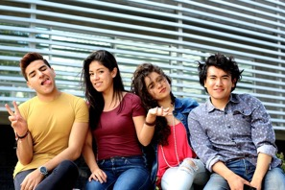
En parejas, lee las frases.
leer / hablar / escuchar
When reading words aloud in Spanish, stress the penultimate syllable for any word ending in a vowel, ‘n’ or ‘s’ (unless there is a written accent).
¿Qué palabras tienen el énfasis en la penúltima sílaba? Escucha y comprueba.
Los mexicanos son muy amables* y reciben a los visitantes con los brazos abiertos.
1
Los mexicanos son muy amables* y reciben a los visitantes con los brazos abiertos.
Puedes visitar sus playas hermosas, sus montañas altas, sus lagos impresionantes* y sus bosques llenos de vida.
2
Puedes visitar sus playas hermosas, sus montañas altas, sus lagos impresionantes* y sus bosques llenos de vida.
Las tradiciones son muy importantes para los mexicanos y sus celebraciones son muy especiales.
3
Las tradiciones son muy importantes para los mexicanos y sus celebraciones son muy especiales.
*amable - friendly
*impresionante - impressive
Notes:
Timing: 5 minutes
Aim: to practise stressing the correct syllable (penultimate).
Procedure: 1. Students read out each fragment trying to focus on which is the correct syllable to stress.
2. Students listen to the recording to check against their pronunciation.
Note: the sentences have been changed very slightly from slide 15 in order to incorporate more words with penultimate syllable stress (amables, impresionantes).
All photos from Pixabay.com and free to use.
Frequency of unknown words and cognates:
amable [2707]; impresionante [2720]

Slide 18
Escribe las seis frases sobre México en español para una página web de viajes:
escribir
1
2
Remember, ‘people’ in Spanish is singular.
3
Its cities are interesting places.
You can look at the old buildings and enjoy the atmosphere.
Su naturaleza es muy especial y sus paisajes son preciosos/hermosos.
Sus ciudades son lugares interesantes. Puedes mirar los edificios antiguos y disfrutar del ambiente.
Its nature is very special and its landscapes are beautiful.
Su gente es muy simpática/amable. Es fácil hacer muchos amigos.
Its people are very kind. It’s easy to make a lot of friends.
4
5
6
Its customs are unique, especially the way of celebrating the dead.
Sus costumbres son únicas, especialmente la forma de celebrar a los muertos.
Su comida es muy rica; puedes comer muchos tipos de platos.
Sus museos son geniales si te gusta aprender sobre historia.
Its food is very tasty; you can eat many types of dishes.
Its museums are great if you like to learn about history.
Use personal ‘a’ if the direct object is a living thing (or was once alive!).
*especially – especialmente
Notes:
Timing: 8 minutes
Aims:
to practise agreement of singular and plural nouns with the possessive adjectives ‘su’ and ‘sus’.
to practise agreement of singular and plural nouns with the verbs ‘es’ and ‘son’.
Procedure: 1. Students write each sentence in Spanish.
2. Shows answers one by one and give feedback.
Notes:
1. In the SOW the use of the definite article in cases where English omits the article has not yet been covered. For this reason, item 6 refers to ‘historia’ without an article.
2. the activity involves use of the pattern –mente as equivalent of –ly after an adjective of invariable gender (see item 5). This affix was taught in Year 8, and ‘especial’ is a new vocabulary item this week. Earlier activities in this lesson did not focus on this aspect of language, and so a gloss is given in the bottom right hand corner to give students support.

Slide 19
Solución
Its nature is very special and its landscapes are beautiful.
Su naturaleza es muy especial y sus paisajes son preciosos/hermosos.
Its people are very kind. It’s easy to make a lot of friends.
Su gente es muy simpática/amable. Es fácil hacer muchos amigos.
Its cities are interesting places.
You can look at the old buildings and enjoy the atmosphere.
Sus ciudades son lugares interesantes. Puedes mirar los edificios antiguos y disfrutar del ambiente.
Its food is very tasty; you can eat many types of dishes.
Su comida es muy rica; puedes comer muchos tipos de platos.
Its customs are unique, especially the way of celebrating the dead.
Sus costumbres son únicas, especialmente la forma de celebrar a los muertos.
Its museums are great if you like to learn about history.
Sus museos son geniales si te gusta aprender sobre historia.
*especially – especialmente
Notes:
ALTERNATIVE ANSWER SLIDE
This slide allows both the English and Spanish sentences to be seen at the same time during feedback.
Click to bring up each answer.
Note that it would be easy to adapt this slide for lower proficiency students by gapping the English and the Spanish to create a jigsaw translation, instead of the full sentence translations on the previous slide.

Slide 20
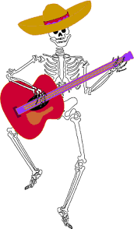
El Día de Muertos Describing a Mexican tradition
reflexive pronoun ‘se’ possessive adjective ‘su’ (revisited)
Y9 Spanish Term 1.1 – Week 4 – Lesson 8 Amanda Izquierdo / Rachel Hawkes / Nick Avery
Artwork: Mark Davies Date updated: 24.09.23
Notes:
Note: all words in this week of the SOW appear on all three GCSE wordlists, with the following exceptions: i) AQA list does not have ligero, saltar.
ii) Edexcel list does not have muerte.
Note: there is no new grammar this week. This week provides important consolidation of possessive adjective ‘su’ and singular/plural 3rd person forms of ser. If teachers feel that their classes have confident use of these features already, they may want to use this week to do alternative activities. It is worth remembering, however, that this week revises relevant vocabulary from the GCSE lists so teachers may want to include revisiting activities for this.
Artwork by Mark Davies. All additional pictures selected are available under a Creative Commons license, no attribution required.
Native teacher feedback provided by Blanca Román.
Learning outcomes (lesson 1)
Introduction of new vocabulary
Cultural knowledge about a Spanish-speaking country
Consolidation of the following:
Possessive adjectives ‘su’ and ‘sus’
SER in 3rd person singular and plural present tense (‘es’ and ‘son’)
Penultimate syllable stress
Frequency rankings of vocabulary introduced this week (1 is the most common word in Spanish):
venir [118]; nivel [297]; tierra [259]; luz [278]; muerto [1103]; muerte [294]; comunidad [523]; costumbre [972]; forma [119]; mexicano [849]; especial [436]; hora [160]; único [214]; sentar [249]; acordar [535]; quedar² [100]
Frequency rankings of vocabulary revisited this week (1 is the most common word in Spanish):
Y8 3.1.4
parecer [89]; guardar [687]; pagar [377]; marca [1276]; falda [2743]; mitad [834]; precio [557]; tipo [168]; euro [2435]; ligero [1930]; práctico [2141]; este [24]
Y8 3.2.4
grabar [1560]; tocar [327]; mostrar [330]; bajar [484]; saltar [1160]; pierna [776]; brazo [470]; mano [135]; alguien [346]; ya² [39]; ahora mismo [81]
Source: Davies, M. & Davies, K. (2018). A frequency dictionary of Spanish: Core vocabulary for learners (2nd ed.). Routledge: London
The frequency rankings for words that occur in this PowerPoint which have been previously introduced in NCELP resources are given in the NCELP SOW and in the resources that first introduced and formally re-visited those words. For any other words that occur incidentally in this PowerPoint, frequency rankings will be provided in the notes field wherever possible.

Slide 21
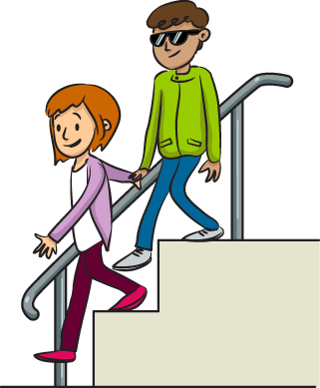
Vocabulario
hablar
a _ _ _ _ _ _
someone
7.
alguien
b _ _ _ _
1.
bajar
[to go down,
to lower]
la mano
8.
la m _ _ _
[hand]
ya
2.
y _
already
s _ _ _ _ _
[to jump,
jumping]
9.
saltar
a _ _ _ _ m _ _ _ _
3.
ahora mismo
right now
t _ _ _ _
[to touch,
touching]
p _ _ _ _ _ _
10.
tocar
4.
parecer
to seem, seeming
ligero
práctico
l _ _ _ _
[light (m)]
p _ _ _ _ _ _ _
11.
5.
practical, useful (m)
la falda
guardar
to keep, keeping
la f _ _ _ _
6.
g _ _ _ _ _ _
12.
[skirt]
Notes:
Vocabulary recall activity
Timing: 3 minutes
Aim: to revisit this week’s revisited vocabulary.
Procedure:
1. Teachers asks students to try to say the word in Spanish represented by each image. To encourage learners to recall this vocabulary only the first letter of each word is provided.

Slide 22
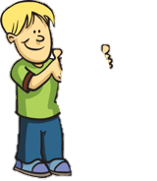
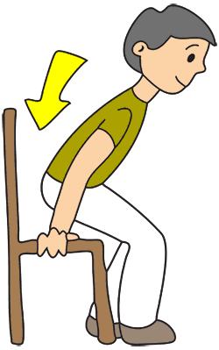
Doing something to ‘herself’/’himself’: Reflexive pronoun ‘se’
gramática
When the ’doer’ (subject) and ‘receiver’ (object) of the verb are not the same person, we use an ‘a’ after the verb:
‘Sentar’ means ‘to sit, to sit down’. The stem sometimes changes (e->ie) for ‘I’, ‘you’, ‘s/he’ and ‘they’, like querer.
Sienta al niño.
S/he sits the child down.
When the ‘doer’ (subject) and ‘receiver’ (object) of an action are the same person we use a reflexive pronoun. For example:
S/he sits himself/herself down.
To mean ‘herself’ or ‘himself’ in Spanish, use ‘se’ before a verb.
In English, the reflexive pronouns are sometimes optional.
Se sienta.
S/he sits (himself/herself) down.
Notes:
Timing: 2 minutes
Aim:
to introduce the reflexive pronoun ‘se’.
to recap the function of reflexive pronouns.
Procedure:
Teacher goes through the grammar explanation with students, revealing each new sentence on a mouse click.

Slide 23
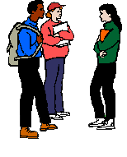
Using verbs with reflexive pronouns
gramática
Some Spanish verbs have a completely different meaning when used with a reflexive pronoun!
Quedar =
to meet up
Queda con amigos.
S/he meets up with friends.
to remain, to stay
This verb has a change(o>ue) in the stem (the beginning of the verb) for ‘I’, ‘you (singular)’, ‘he/she/it’ and ‘they’.
yo me acuerdo I remember
tú te acuerdas you remember
él/ella se acuerda he/she/it remembers
ellos/ellas se acuerdan they remember
You may remember that ’encontrar’ and ‘volver’ follow the same pattern.
Quedarse =
Se queda en casa.
S/he stays at home.
Acordar =
to agree on
Acuerda el precio.
S/he agrees on the price.
¿5 euros?
Acordarse =
to remember
Se acuerda.
S/he remembers.
¡Vale!
Notes:
Timing: 2 minutes
Aim: to introduce the difference in meaning of two specific verbs when used with reflexive pronouns.
Procedure:
Teacher goes through the grammar explanation with students, revealing each new sentence on a mouse click.
Explain to students that infinitive + ‘se’ is often used as the dictionary entry for the reflexive form a verb. This will be the first time that students see a pronoun attached to an infinitive, so it is important to point out.
Note: ‘quedar’ is already known from Year 8.

Slide 24
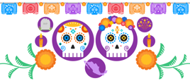
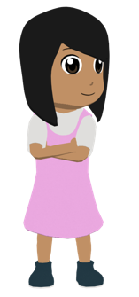
Nadia celebra el Día de Muertos. Lee las frases y marca el significado correcto del verbo. ¿Qué significa cada frase?
leer
 | to meet up | to stay | to agree on | to remember | ¿Qué significa la frase?
1. Queda con unos primos.
2. Se acuerda del pasado.
3. Queda con alguien para preparar comida.
4. Acuerda la hora de la fiesta.
5. Se queda en casa por la mañana.
6. Se acuerda de personas especiales.
She meets up with some cousins.
She remembers the past.
She meets up with someone to prepare food.
She agrees on the time of the party.
She stays at home in the morning.
She remembers special people.
Notes:
Timing: 5 minutes
Aims:
to practise understanding the difference between verbs ‘acordar(se)’ and ‘quedar(se)’ in reflexive and non reflexive forms.
to introduce the topic of the lesson: ‘Día de Muertos’.
Procedure:
Students read each sentence and decide which meaning is correct for the verb.
Students say the meaning of each sentence.

Slide 25
Talking about possessions Possessive adjectives ‘su’ and ‘sus’
gramática
Remember: to say ‘his’, ‘her’ or ‘its’ before a singular or uncountable noun use ______.
su
It does not matter whether the noun is masculine or feminine.
Ejemplos:
His / her / its family is Mexican.
Su familia es mexicana.
To say ‘his’, ‘her’ or ‘its’ before a plural noun use ______.
sus
His / her / its grandparents are Mexican.
Sus abuelos son mexicanos.
Notes:
Timing: 2 minutes
Aim: to recap ‘su’ and ‘sus’.
Procedure:
1. Click to reveal each new part of explanation of ‘su’ and ‘sus’ and then the examples. Each example and answer is revealed by a click, so teachers can ask students for the answers.

Slide 26
Lee unas frases sobre cómo Nadia celebra el Día de Muertos. ¿Necesitas ‘se’ o ‘su’? Escribe la opción correcta. ¿Qué significan las frases?
leer
 | Las frases en inglés
1
2
3
4
5
6
She stays
1 | a) Se... b) Su... | ... queda en la cocina para organizar la comida.
2 | a) Se... b) Su... | ... familia prepara un altar* con papeles de colores y luces.
3 | a) Se... b) Su... | ... casa está llena de flores.
4 | a) Se... b) Su... | ... sienta en la habitación para ver las fotos.
5 | a) Se... b) Su... | ... acuerda de momentos felices.
6 | a) Se... b) Su... | ... hermano participa en el festival.
_________ in the kitchen to organize the food.
Her family
__________ prepares an altar with coloured papers and lights.
Her house
_________ is full of flowers.
She sits down
_____________ in the room to see the photos.
She remembers
_______________ happy moments.
Her brother
___________ participates in the festival.
*An altar is a type of table used for religious ceremonies or spiritual offerings.
Notes:
If needed, omit this activity. Timing: 6 minutes
Aim:
to understand the difference between ‘se’ and ‘su’.
to understand the vocabulary in the sentences.
Procedure:
Students read each question and decide whether the correct option is ‘se’ or ‘su’ depending on what comes after.
Students complete the start of each question in English.
Check answers ‘su’ or ‘se’ for each item. Furthermore, to check understanding, elicit an oral translation of each sentence.

Slide 27
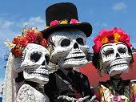
escuchar / leer
Lee las frases sobre el Día de Muertos.
¿Cuál es la opción correcta?
Escribe 1-8, a o b, y se o su.
 |  | ¿Cuál es la opción correcta?
 |  | …tradición es muy conocida. b) ... prepara para la fiesta.
 |  | ... levanta temprano para ayudar. … abuela prepara la comida.
 |  | ... sienta con la gente del pueblo. … comunidad es muy importante.
 |  | ... familia celebra el Día de Muertos. ... queda en casa por la tarde.
 |  | ¿Cuál es la opción correcta?
 |  | … abuelo está muerto. … acuerda de la familia.
 |  | ... ropa es divertida. ... pone ropa divertida.
 |  | ... barrio celebra un festival. ... queda en la calle con unos amigos.
 |  | ... pinta de blanco y negro. ... altar es blanco y negro.
1
su
5
se
2
se
6
se
3
su
7
su
4
su
8
se
Notes:
Timing: 10 minutes
Aims:
to practise understanding the difference between ‘se’ and ‘su’.
to correctly transcribe the two words.
Procedure:
1. Click the number trigger to play the audio.
2. Students listen to the beginning of the sentence and decide which is the correct continuation. They write 1-8 a/b and either se or su.
3. Check answers and elicit the English meanings of the sentences orally.
Transcript:
Su...
Se...
Su...
Su
Se...
Se...
Su...
Se...

Slide 28
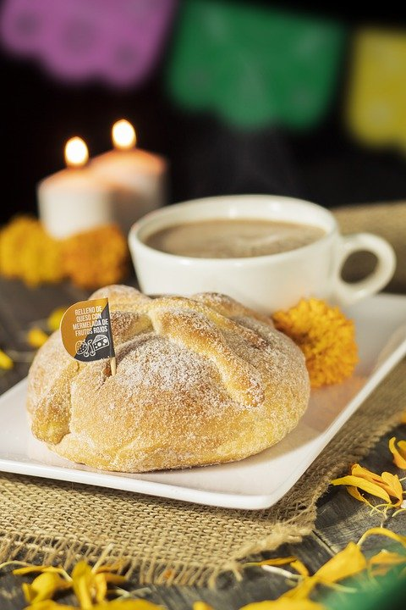
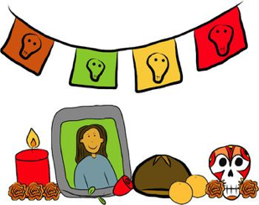
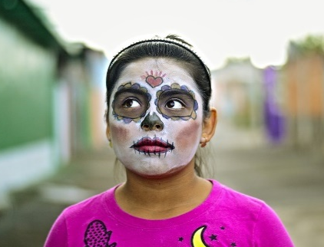
Una tradición mexicana: el Día de Muertos
leer / escuchar
Lee y escucha el texto sobre el Día de Muertos:
1
5
‘Pan de muerto’ es un tipo de pan tradicional en este día.
México tiene muchas tradiciones, pero su tradición del Día de Muertos es especialmente conocida. Es una costumbre única y muy importante para su comunidad porque es una forma de pensar en los muertos. Para los mexicanos, los muertos vienen a la tierra este día.
Nadia es mexicana y celebra el Día de Muertos con su familia. Por la mañana se levanta temprano para ayudar a su abuela: preparan pan* de muerto y un poco de fruta para el altar. Su altar tiene varios* niveles. Los niveles del altar son las diferentes partes del mundo: el primer nivel es la tierra y el segundo nivel es el cielo*. Nadia pone allí fotos de su abuelo y se sienta al lado de su abuela. Se queda unas horas en casa con su familia y se acuerda de su abuelo muerto.
Por la tarde se pone ropa divertida, se pinta de blanco y negro y va a la calle con su hermano. En su barrio hay un festival con música fuerte y luces de colores. ¡Es muy divertido!
…
2
6
…
3
7
4
…
…
…
…
…
…
…
…
…
…
…
…
…
*el pan = bread; *el cielo = sky, heaven; *varios = various
Notes:
Timing: 8 minutes
Aims:
to reinforce understanding of the difference between ‘se’ and ‘su’.
to help students to connect the spoken and written forms of the language more securely.
to consolidate vocabulary and grammar knowledge by eliciting suggested changes to the text.
Procedure:
Students read the text and write ‘se’ or ‘su’ for each space.
Click on the audio button to play the text. Read and listen.
Note: There is a full version of the audio top right with a player. Alternatively, the audio is in 6 sections with a pause just after the words 1-5 below, to facilitate easy stop/start.
To support segmentation, stop the audio and ask students to say: a) the next word b) the previous word
In addition, to develop understanding, vocabulary and grammar knowledge, pause at key points and ask students to suggest an alternative word that could replace the next word. This is a chance to draw on previously taught grammar and vocabulary knowledge.
Es una costumbre única y muy importante para su... (students volunteer other possible nouns – e.g., gente, historia, país).
y celebra el Día de Muertos con su…..(students volunteer other possible nouns – e.g., padre, madre, primo etc.).
de su abuelo y se... (students volunteer verbs in third person singular that fit after ‘se’ – e.g., se acuerda de..., se queda, se prepara (para), etc)
en casa con su familia y se ... (students volunteer other possible verbs that fit after ‘se’ – e.g., se saca (fotos), se mira en el espejo, se presenta a otra gente).
Por la tarde se…… (students are prompted other possible verbs that fit after ‘se’)
va a la calle con su…. (students volunteer other possible nouns)
Notes:
1. The word for ‘bread’ (‘pan’) will be introduced in the next week’s vocabulary set.
Transcript
México tiene muchas tradiciones, pero su tradición del Día de Muertos es especialmente conocida. Es una costumbre única y muy importante para su comunidad porque es una forma de pensar en los muertos. Para los mexicanos, los muertos vienen a la tierra este día.
Nadia es mexicana y celebra el Día de Muertos con su familia. Por la mañana se levanta temprano para ayudar a su abuela: preparan pan* de muerto y un poco de fruta para el altar. Sualtar tiene varios niveles. Los niveles del altar son las diferentes partes del mundo: el primer nivel es la tierra y el segundo nivel es el cielo. Nadia pone allí fotos de su abuelo y se sienta al lado de su abuela. Se queda unas horas en casa con su familia y se acuerda de su abuelo muerto.
Por la tarde se pone ropa divertida, sepinta de blanco y negro y va a la calle con su hermano. En su barrio hay un festival con música fuerte y luces de colores. ¡Es muy divertido!
Frequency of unknown words and cognates:
pan [1342]; cielo [620]; varios [386]
Photos:
Photo of the child by Christian Newman, from Unsplash.
Photo of ‘Pan de muertos’ by Alejandro Ávila Cortez, from Pixabay.

Slide 29
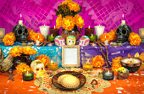
Hablamos sobre las costumbres de Nadia
escuchar / hablar
A: turns away from the board and says either ‘se’ or ‘sus’
B: listens and says the appropriate Spanish sentence.
A: transcribes B’s Spanish sentence.
Se…
Se sienta al lado del altar.
B
A
La frase: Se sienta al lado del altar.
 | Habla en español:
1 | She sits next to the altar. Her family is next to the altar.
Notes:
Timing: 15 minutes (for slides 31-34)
Aim:
to practice distinguishing between ‘se’ and ‘su’ in oral production and listening.
to practise producing and understanding vocabulary.
Procedure:
Students work in pairs.
Teachers should give out the cards and use this slide to explain the activity with an example
Student A looks at their card and reads out the word (either ‘se’ or ‘su’). Student B listens and then reads out the correct sentence on their card, translating orally into Spanish.
Student A listens and transcribes the sentence (writes it in Spanish).
If student B reads out the wrong answer and it is clearly ungrammatical, student A should say ‘Otra vez, por favor’.
Then swap. Note that when Student B is speaking the contrast is between ‘se’ and ‘sus’. This facilitates use of other vocabulary items that have been introduced this week (fotos, costumbres, platos).
Give feedback. Note that on slide 34, the English translations also appear (and are animated separately) so that understanding of every sentence can be checked.

Slide 30
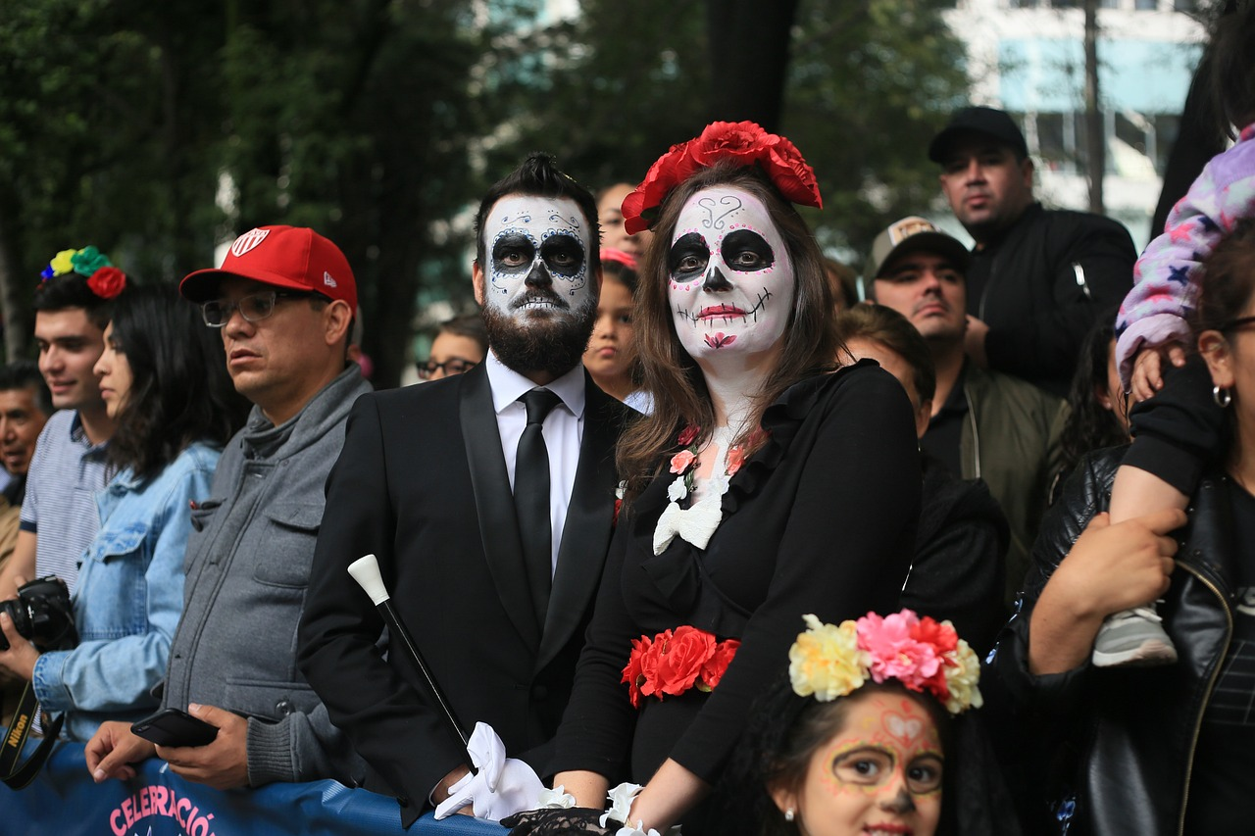
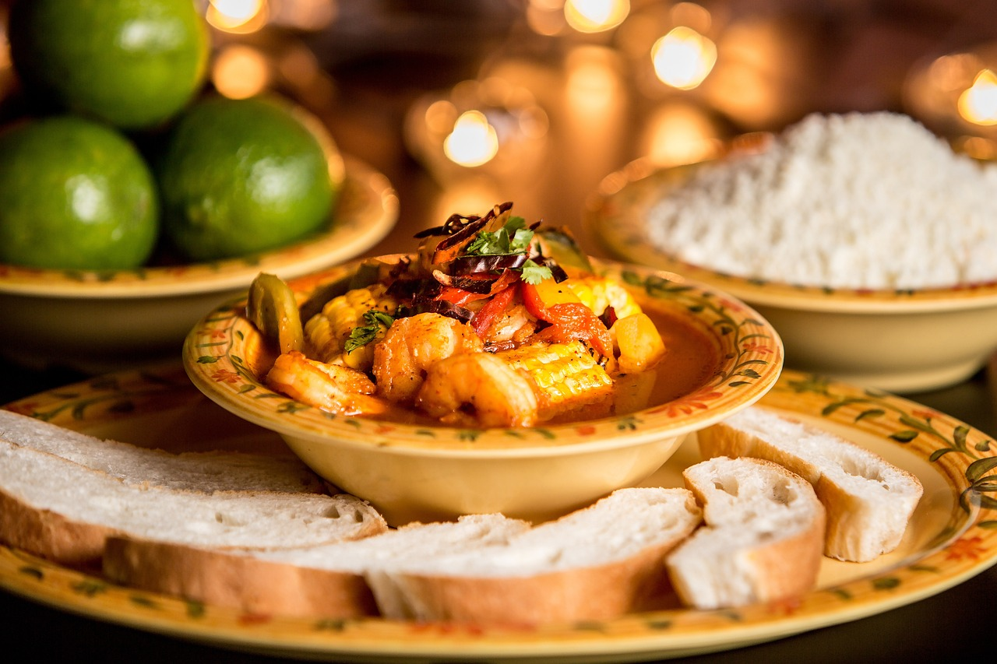
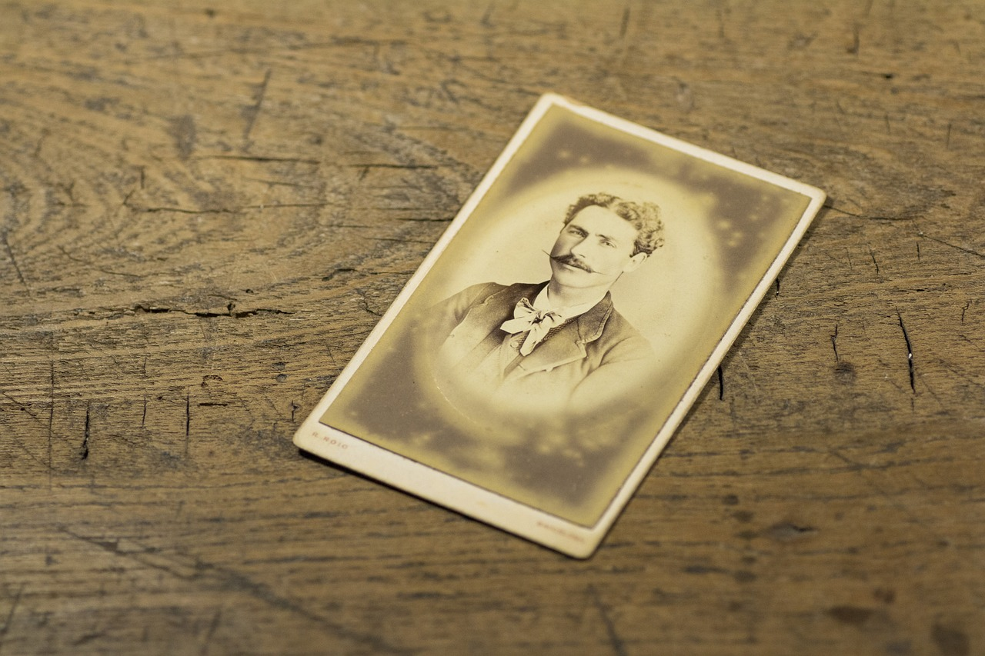
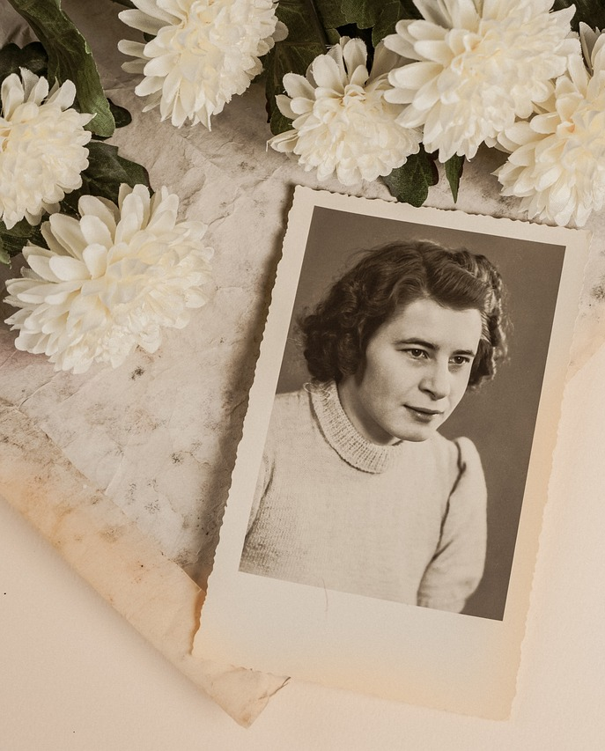
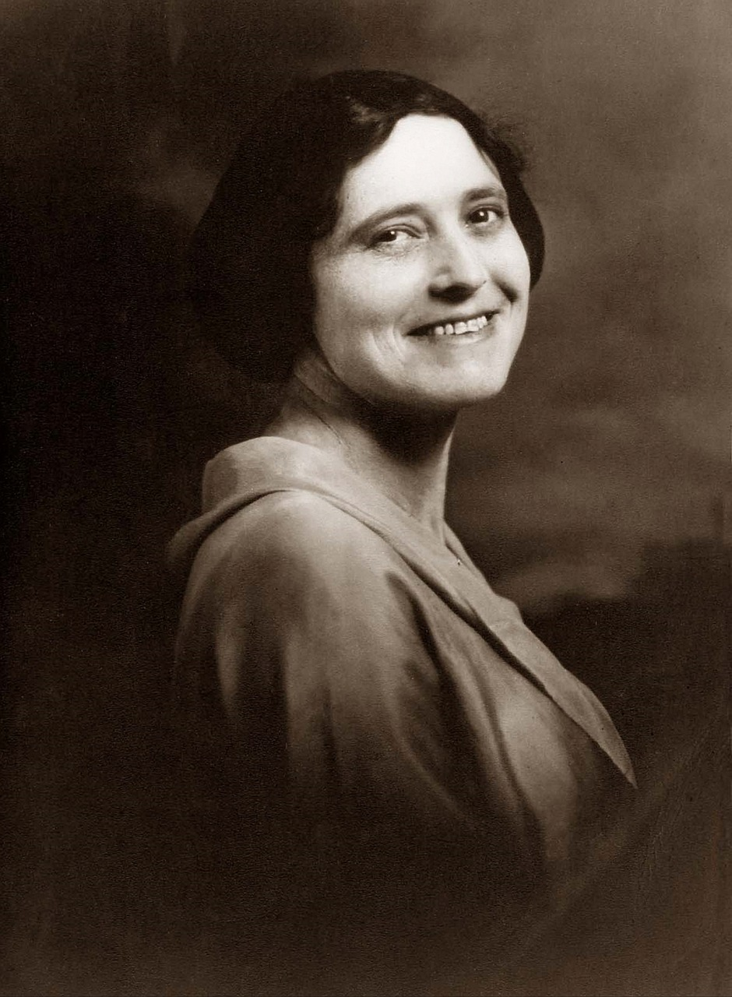
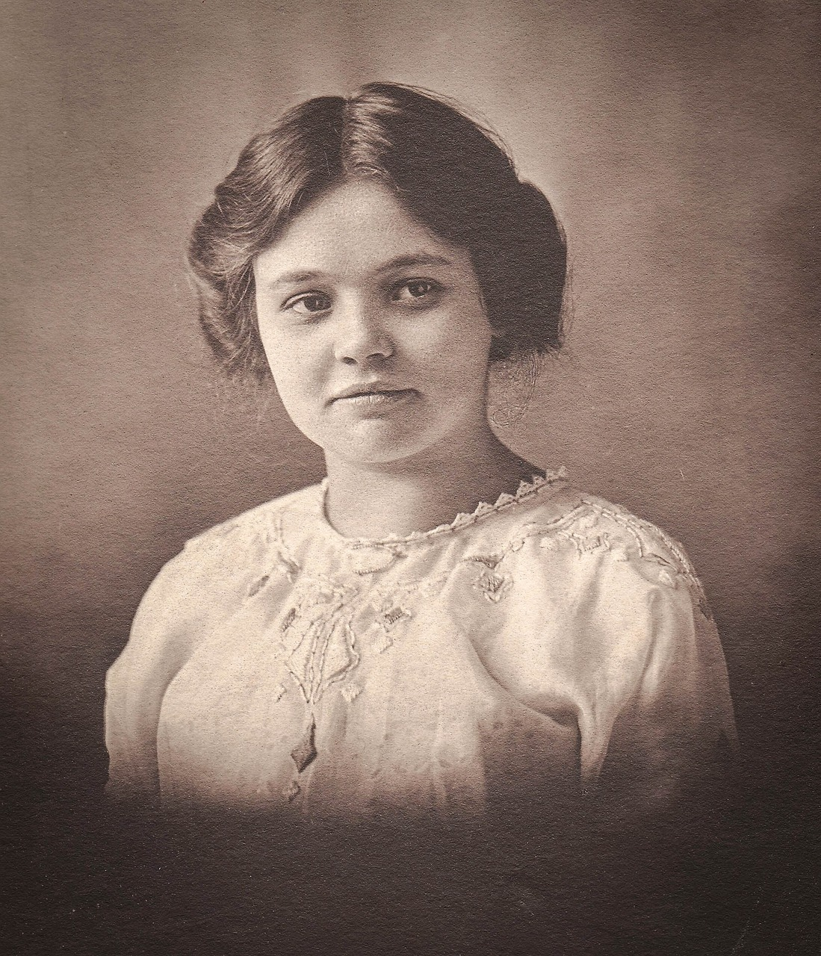
Día de Muertos (1/2)
hablar
1
2
3
[She sits down to see] fotos de familia.
[She remembers] las costumbres.
[Her] fotos de familia [are very special.]
[Her] costumbres [are unique.]
[Her] amigos [are] en la calle.
[She stays] en la calle.
4
5
6
[Her] platos [are very tasty.]
[She sits down to prepare] platos ricos.
[She paints herself] en la calle.
[She remembers] los bisabuelos.
[Her] primos [paint] en la calle.
[Her] bisabuelos[are important.]
los bisabuelos = great grandparents
Notes:
Procedure:
Student As turn away – they know they are going to say ‘se’ or ‘sus’ (their choice), listen for a Spanish sentence and translate it into English.
Bs face the board. As say either ‘se’ prompting for a reflexive sentence or ‘sus’ to prompt a noun.
Bs respond in Spanish, translating the bold part of the appropriate sentence.
As transcribe the Spanish sentence they hear.
Interactions continue until all 6 questions have been asked and answered.
Students swap role and move to the next slide.
Note: it’s important students realise that there are no clues in the pictures – they could apply to either sentence. They can only know which sentence to translate based on how their partner starts the sentence.

Slide 31
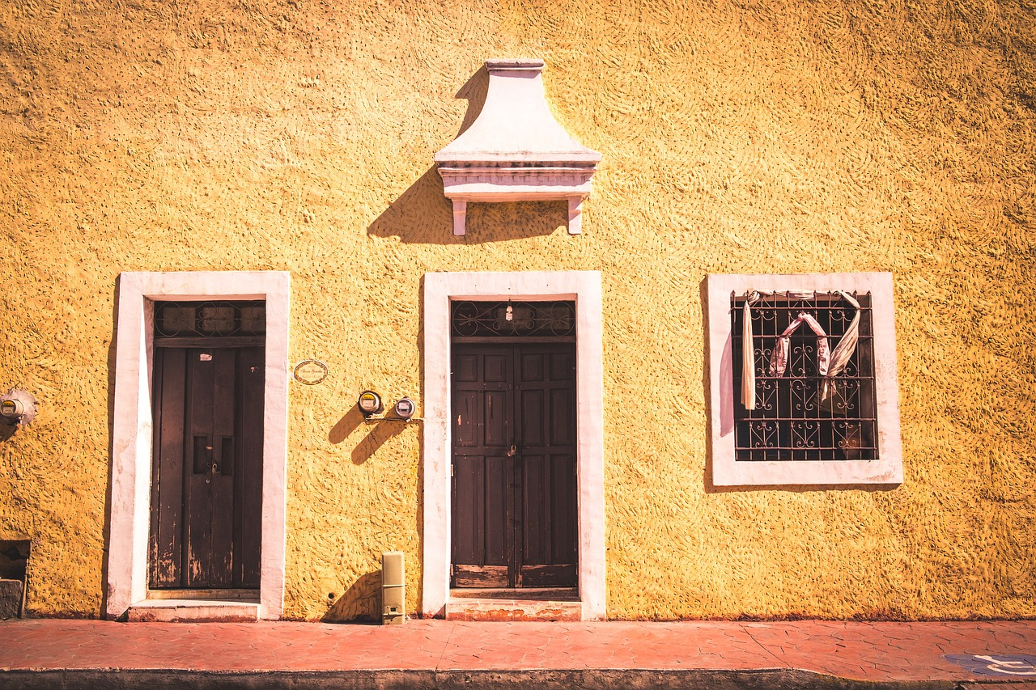
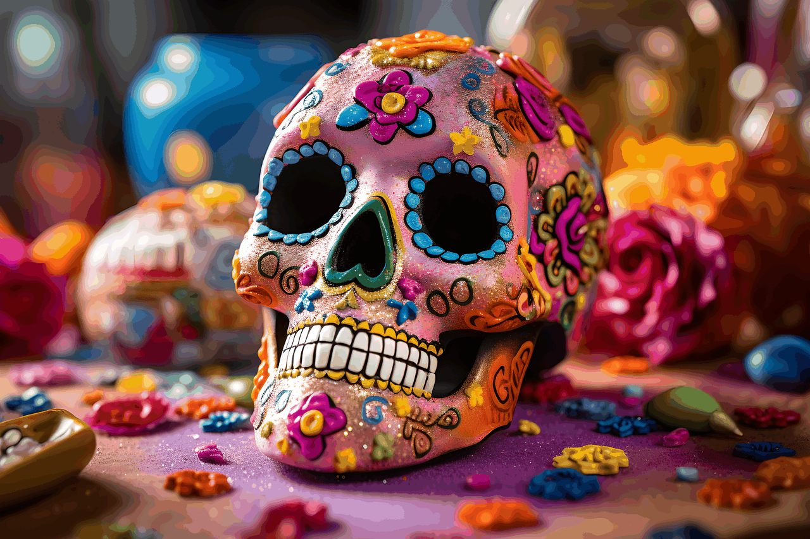
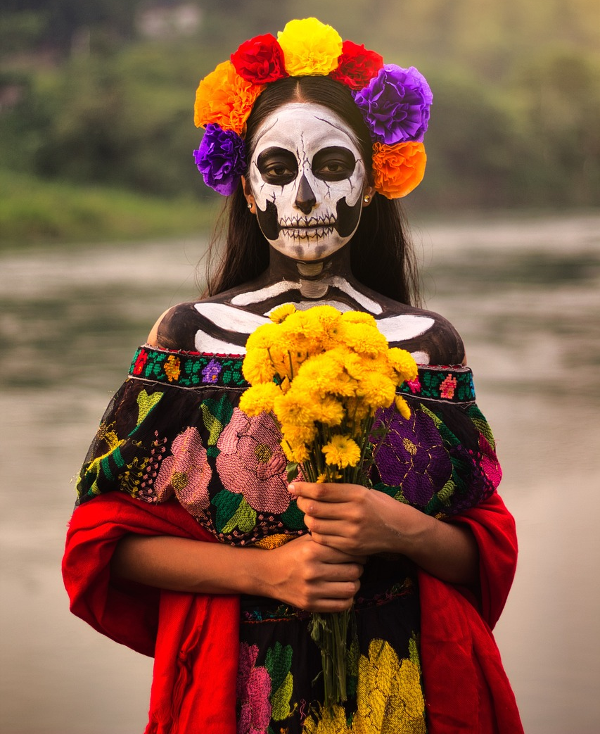
Día de Muertos (2/2)
hablar
1
2
3
[She gets up] temprano.
[Her] hermano [helps] temprano.
[She stays] en casa por la tarde.
[Her] casa [is full of people].
[She remembers] a los Muertos.
[Her] familia [comes to the party].
4
5
6
[She sits] con la comunidad.
[Her] comunidad [is very special].
[Her] comunidad [organises] la fiesta.
[Her] ropa y zapatos [are unique.]
[She paints herself before] la fiesta.
[She puts on] ropa especial.
Notes:
[2/2]
Note: it’s important students realise that there are no clues in the pictures – they could apply to either sentence. They can only know which sentence to translate based on how their partner starts the sentence.

Slide 32
Deberes
Vocabulary Learning Homework (Y9 Term 1.1, Week 5)
Audio file
Student worksheet
Quizlet link
In addition, revisit: Year 8, Term 3.2, Week 5
Year 8, Term 3.1, Week 5
Notes:
Note: HW for Y9 is usually made up of pre-learning of vocabulary 15-30 minutes (depending on school policy on HW time) plus 20-30 minutes vocabulary activities to deepen word knowledge, provided on a student homework sheet (which also contains a clickable link to the audio file). Answer sheets are also provided. The answer sheet for the Y9 vocabulary learning HW sheet Week 5 is here: https://rachelhawkes.com/LDPresources/Yr9Spanish/Spanish_Y9_Term1i_Wk5_audio_HW_sheet_answers.docx
Notes:
With the LDP SOW the vocabulary for Years 9 – 11 is provided on Quizlet.
ii) There are other free apps, and new ones are always appearing. Teachers have told us that they are currently using: Flippity, Wordwall (where using previously-created activities is free).
iii) Gaming Grammar has been acquired by Language Nut. Its original content should still be available to teachers and much of it is appropriate for Y9 learners. From this lesson, for example, learners could practise:
Adjectives: number in the ‘Adjective agreement’ menu

Slide 33
Hablamos sobre las costumbres de Nadia
escuchar / hablar
Estudiante A: mira su tarjeta y dice ‘su(s)’ o ‘se’.
Estudiante B: escucha y lee la frase correcta en su tarjeta.
Estudiante A: completa la frase en español.
Se…
Se sienta al lado del altar.
Estudiante A
Estudiante B
 | Escribe la frase en español
1 | Say: Se... La frase: _________________________
 | Lee la frase correcta en español:
1 | She sits next to the altar. Her family is next to the altar.
 | Escribe la frase en español
1 | Say: Se… La frase: Se sienta al lado del altar.
Notes:
ALTERNATIVE VERSION OF LESSON 2 SPEAKING WITH HANDOUTS
Timing: 15 minutes (for slides 31-34)
Aim:
to practice distinguishing between ‘se’ and ‘su’ in oral production and listening.
to practise producing and understanding vocabulary.
Procedure:
Students work in pairs.
Teachers should give out the cards and use this slide to explain the activity with an example
Student A looks at their card and reads out the word (either ‘se’ or ‘su’). Student B listens and then reads out the correct sentence on their card, translating orally into Spanish.
Student A listens and transcribes the sentence (writes it in Spanish).
If student B reads out the wrong answer and it is clearly ungrammatical, student A should say ‘Otra vez, por favor’.
Then swap. Note that when Student B is speaking the contrast is between ‘se’ and ‘sus’. This facilitates use of other vocabulary items that have been introduced this week (fotos, costumbres, platos).
Give feedback. Note that on slide 34, the English translations also appear (and are animated separately) so that understanding of every sentence can be checked.

Slide 34
Persona A
hablar
 | Escribe la frase en español:
1 | Say: Se... La frase:
2 | Say: Su... La frase:
3 | Say: Su... La frase:
4 | Say: Su... La frase:
5 | Say: Se... La frase:
6 | Say: Se... La frase:
 | Lee la frase correcta en español:
1 | She sits down to see family photos. Her family photos are special.
2 | Her customs are unique. She remembers the customs of the past.
3 | She stays in the street after the festival. Her friends stay in the street.
4 | Her dishes are very tasty. She sits down in the kitchen to prepare food.
5 | She paints herself before going to the street. Her cousins paint in the street.
6 | Her grandparents are important. She remembers important people.
Notes:
STUDENT CARD FOR PERSONA A
DO NOT SHOW DURING THE ACTIVITY
These cards can be downloaded and printed off from a separate word document.
Translations:
1.
a. Se sienta para ver fotos de la familia.
b. Sus fotos de la familia son especiales.
2.
a. Sus costumbres son únicas.
b. Se acuerda de las costumbres del pasado.
3.
a. Se queda en la calle después del festival.
b. Sus amigos quedan en la calle.
4.
a. Sus platos son deliciosos.
b. Se sienta en la cocina para preparar la comida.
5.
a. Se pinta antes de ir a la calle.
b. Sus primos pintan en la calle.
6.
a. Sus abuelos son importantes.
b. Se acuerda de gente importante.

Slide 35
Persona B
hablar
 | Escribe la frase en español:
1 | Say: Sus... La frase:
2 | Say: Sus... La frase:
3 | Say: Se... La frase:
4 | Say: Sus... La frase:
5 | Say: Se... La frase:
6 | Say: Se... La frase:
 | Lee la frase correcta en español:
1 | She gets up early to help. Her brother helps early.
2 | Her house is full of people. She stays at home in the evening.
3 | She remembers the dead. Her family comes to the party.
4 | She sits with the community. Her community is very special.
5 | Her community organizes a festival. She paints herself before going to the festival.
6 | Her clothes are unique. She puts on special clothes on this day.
Tip: ‘clothes’ is singular in Spanish!
Notes:
STUDENT CARD FOR PERSONA B
DO NOT SHOW DURING THE ACTIVITY
These cards can be downloaded and printed off from a separate word document.
Translations:
1.
a. Se levanta temprano para ayudar.
b. Su hermano ayuda temprano.
2.
a. Su casa está llena de gente.
b. Se queda en casa por la tarde.
3.
a. Se acuerda de los muertos.
b. Su familia viene a la fiesta.
4.
a. Se sienta con la comunidad.
b. Su comunidad es muy especial.
5.
a. Su comunidad organiza un festival.
b. Se pinta antes de ir al festival.
6.
a. Su ropa es única.
b. Se pone ropa especial este día.

Slide 36
Respuestas
Persona A
Persona B
hablar
 | Escribe la frase en español:
1
2
3
4
5
6
 | Escribe la frase en español:
1
2
3
4
5
6
Se levanta temprano para ayudar.
Sus fotos de familia son especiales.
(She gets up early to help.)
(Her family photos are special.)
Su casa está llena de gente.
Sus costumbres son únicas.
(Her house is full of people.)
(Her customs are unique.)
Su familia viene a la fiesta.
Se queda en la calle después del festival.
(Her family comes to the party.)
(She stays in the street after the festival.)
Su comunidad es muy especial.
Sus platos son muy ricos.
(Her community is very special.)
(Her dishes are very tasty.)
Se pinta antes de ir al festival.
Se pinta antes de ir a la calle.
(She paints herself before going to the festival.)
(She paints herself before going to the street.)
Se pone ropa especial este día.
Se acuerda de gente importante.
(She puts on special clothes on this day.)
(She remembers important people.)
Notes:
ANSWER SLIDE FOR SPEAKING / LISTENING ACTIVITY
Do not show during the exercise.

