Slide 1
¿Dónde están mis cosas? Saying where things are
possessive adjectives ‘mi(s)’ and ‘tu(s)’ (revisited)
ESTAR – ‘está’ and ‘están’ (revisited)
Y9 Spanish Term 1.1 – Week 3 – Lesson 5 Louise Caruso / Pete Watson / Nick Avery
Artwork: Mark Davies Date updated: 15.09.23
Notes:
Note: all words in this week of the SOW appear on all three GCSE wordlists, with the following exception: i) AQA list does not have desayunar, espejo, moneda.
ii) Edexcel list does not have desayunar, espejo, sacar (though it does have the phrase ‘sacar buenas /malas notas’)
Note: there is no new grammar or phonics focus this week. This week provides important consolidation of possessive adjectives and singular/plural 3rd person forms of estar. If teachers feel that their classes have confident use of these features already, they may want to use this week to do alternative activities. It is worth remembering, however, that this week revises relevant vocabulary from the GCSE lists so teachers may want to include revisiting activities for this.
Artwork by Mark Davies. All additional pictures selected are available under a Creative Commons license, no attribution required.
Native teacher feedback provided by Blanca Román.
Learning outcomes (lesson 1)
Consolidation of the following features:
possessive adjectives ‘mi(s)’ and ‘tu(s)’
ESTAR in 3rd person singular and plural present tense (está, están)
adverbs of position with ‘del’ and ‘de la’
final syllable stress
a subset of vocabulary from Y7 and Y8 (see below)
Frequency rankings of vocabulary revisited this week (1 is the most common word in Spanish):
por² [15]; sucio [1855]; limpio [1710]; ahora [81]; me [22]; te [48]; despertar [894]; levantar [354]; llamar [122]; presentar² [235]; desayunar [>5000]; espejo [1232]; cocina [1214]; tirar [685]; jardín [1195]; grabar [1560]; reloj [1683]; pantalón [1814]; vestido [1697]; juego [409]; antes [190]; dentro [548]; encima [1140]; mi [37]; tu [53]; móvil [2143]; llave [1853]; perdido [1899]; moneda [1577]; cama [609]; casa [106]; nuevo [94]; papel [393]; libro [230]; botella [1878]; revista [920]; periódico [1026]; amigo [210]; zapato [1477]; cosa [69]; mesa [525]; silla [1271]; ventana [752]; puerta [274]; clase [320]; apoyar [666]; lavar [1676] sacar [273]; delante [1742]; fuera [299]; detrás [2044]; debajo [1366]
Source: Davies, M. & Davies, K. (2018). A frequency dictionary of Spanish: Core vocabulary for learners (2nd ed.). Routledge: London
The frequency rankings for words that occur in this PowerPoint which have been previously introduced in NCELP resources are given in the NCELP SOW and in the resources that first introduced and formally re-visited those words. For any other words that occur incidentally in this PowerPoint, frequency rankings will be provided in the notes field wherever possible.

Slide 2
Mi día ayer y hoy
Persona A lee su versión del texto.
Persona B escucha y toma apuntes*.
¿Cuáles son las diferencias?
hablar
despertar
moneda
desayunar
pantalones
cosa
Ayer no quedé con mis primos. Pasé todo el día en casa. Me levanté a las nueve de la mañana, comí algo en la cocina y bebí un vaso de agua. Leí un libro interesante después de hablar por teléfono con mi novio.
Hoy voy a hacer unos trabajos para ayudar a mi madre. Mi habitación está bastante limpia pero siempre tiro los zapatos debajo de la silla y hay papeles por todas partes. También debo limpiar las ventanas. Y tengo un problema. ¿Dónde está mi llave? Estoy muy enojada porque no la puedo encontrar. Quiero salir con unos compañeros y ver el partido.
botella
revista
concierto
sacar
sucio
jardín
apoyar
llamar
cama
vestido
mesa
Which other words did you need to change?
nuevo
antes
detrás
amigo
*apuntes = notes
Notes:
Timing: 12 minutes (2 slides) Aims: i) to review the homework task set last week (9.1.1.2).
ii) to develop fluency in decoding by reading aloud the student versions, including pronunciation of words with final syllable stress (quedé, levanté, pasé, después, comí, bebí, leí, habitación, está). iii) to listen attentively, noting differences in the original text. iv) to make judgements about the replacements made by a peer, and engage in peer feedback. Procedure: 1. Student A reads his/her adapted HW text. 2. Student B follows along with the original and makes a note of any substituted words s/he hears (on his/her copy of the HW sheet)
3. Swap roles.
4. Compare and contrast the two versions. Scrutinise any differences and offer opinions about the correctness of the choices.
5. Move to the next slide, which has a possible answer version, using all of the viable words. Note: the HW task set a time limit and asked students to try to replace at least ten of the words, so it’s to be expected that they might not have got them all.
Frequency of unknown language:
apunte [4865]

Slide 3
Mi día ayer y hoy
Persona A lee su versión del texto.
Persona B escucha y toma apuntes*.
¿Cuáles son las diferencias?
hablar
desperté
(las) monedas
moneda
desayunar
despertar
desayuné
pantalones
pantalones
cosas
cosa
Ayer no quedé con mis primos. Pasé todo el día en casa. Me levanté a las nueve de la mañana, comí algo en la cocina y bebí un vaso de agua. Leí un libro interesante después de hablar por teléfono con mi novio.
Hoy voy a hacer unos trabajos para ayudar a mi madre. Mi habitación está bastante limpia pero siempre tiro los zapatos debajo de la silla y hay papeles por todas partes. También debo limpiar las ventanas. Y tengo un problema. ¿Dónde está mi llave? Estoy muy enojada porque no la puedo encontrar. Quiero salir con unos compañeros y ver el partido.
botella
una botella
una revista
revista
concierto
concierto
abrí
a
sacar
sucia
sucio
el jardín
jardín
porque
apoyar
apoyar
llamar
llamar
cama
cama
vestido
vestido
mesa
lo
mesas
Which other words did you need to change?
nuevo
antes
amigo
nueva
antes
detrás
amigos
detrás
Notes:
Procedure: 1. On successive clicks the bold words are underlined and the appropriate substitute word is highlighted. If a change is needed to its form, or an article is needed, this is highlighted in bold. 2. Note that sometimes changes are needed to other words in the sentence. All of these changes revisit previously taught grammar, which teachers can elicit and/or explain as needed.
3. When concluded, students see that 20 replacements were possible.
4. Note that alternative substitutions are possible. Teachers should make this clear and elicit students’ suggestions.
Note: in one place, two answer options appear simultaneously (for ‘monedas’ and ‘pantalones’). This is intended as both options are possible and neither has yet been used.

Slide 4
Talking about belongings Possessive adjectives [revisited]
gramática
Remember, to say ‘my’ before a singular or uncountable noun, use ______.
mi
My sister is at home.
Mi hermana está en casa.
To say ‘my’ before a plural noun, use _____.
mis
I left my things at school.
Dejé mis cosas en la escuela.
To say ‘your’ before a singular or uncountable noun, use _____.
tu
Your bottle is on the table.
Tu botella está en la mesa.
Remember, you can use ‘mi(s)’ and ‘tu(s)’ with masculine and feminine nouns.
To say ‘your’ before a plural noun, use _____.
tus
Your friends are in class.
Tus amigos están en clase.
Notes:
Timing: 2 minutes
Aim: to recap the possessive adjectives ‘mi’, ‘mis’, ‘tu’ and ‘tus’ before practising these features in reading and listening.
Procedure:
Click to bring up each part of the explanation. Gaps are left in the sentences to elicit the possessive adjectives from students.
Note: other previously taught vocabulary from this week’s revisited set could be practised here by asking students how they would say, for example, ‘my coin’, ‘your game’, or by eliciting translations of phrases like ‘mi moneda’, ‘mis zapatos’ etc.

Slide 5
Talking about places and locations Using ‘del’ and ‘de la’ with adverbs
gramática
Remember, you can give locations in Spanish by using adverbs like ‘cerca’.
You often use ‘de’ after these adverbs to refer to a person, place or thing.
My phone is under the bed.
Mi móvil está debajo de la cama.
Your friend (m) is outside the shop.
Tu amigo está fuera de la tienda.
del
To refer to a singular masculine noun (e.g. el cine), change de + el to _____.
My school is behind the cinema.
Mi casa está detrás del cine.
To refer to a singular feminine noun (e.g. la estación), use ‘de la’.
Your house is near the station.
Tu casa está cerca de la estación.
Notes:
Timing: 2 minutes
Aim: to recap the rules on ‘del’ vs ‘de la’. These features were introduced in Year 7.
Procedure:
Go through the grammar explanation with students, revealing each new sentence on a mouse click.

Slide 6
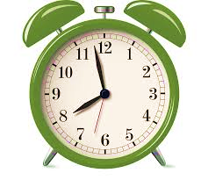
¿Dónde están mis cosas?
Daniel y Lucía deben volver al colegio hoy. Daniel no sabe dónde están sus cosas, ¡pero Lucía sí! Ella le dice a Daniel dónde está todo. Lee las frases. Elige ‘A’ o ‘B’ y completa la tabla.
leer
1. “Están detrás de la planta.”
2. “Está debajo de la mesa.”
 | A | B | ¿Qué? | ¿Dónde?
1. | tu llave | tus llaves
2. | mis libros | mi libro
3. | tus revistas | tu revista
4. | tus bolígrafos | tu bolígrafo
5. | mis papeles | mi papel
6. | mis bolsas | mi bolsa
7. | mis zapatos | mi zapato
3. “Están cerca del teléfono.”
your keys
behind the plant
4. “Está encima de la silla.”
my book
under the table
5. “Están dentro de la caja.”
your magazines
near the phone
6. “Están delante del espejo.”
7. “Está al lado de la puerta.”
your pen
on top of the chair
my papers
in the box
my bags
in front of the mirror
my shoe
next to the door
Notes:
For more time in the lesson, select either this reading OR the next listening activity, rather than doing both, noting that this reading activity practices está/están and the listening focuses on the contrast mi(s)/tu(s).
Timing: 8 minutes
Aims:
i) to use the verb ending (está or están) to identify the correct subject (singular or plural).
ii) to understand the meaning of vocabulary (the possessive adjectives, nouns and adverbs of position).
Procedure: 1. Students read the sentences to work out whether the subject described is singular or plural.
2. They select the correct item from either column A or column B. They could simply write ‘A’ or ‘B’ here.
3. For each sentence, they also write the translation of ‘A’ or ‘B’ (the correct option) in English, as well as its location.
4. Click to reveal each answer.
5. Go through answers with students and give feedback.

Slide 7
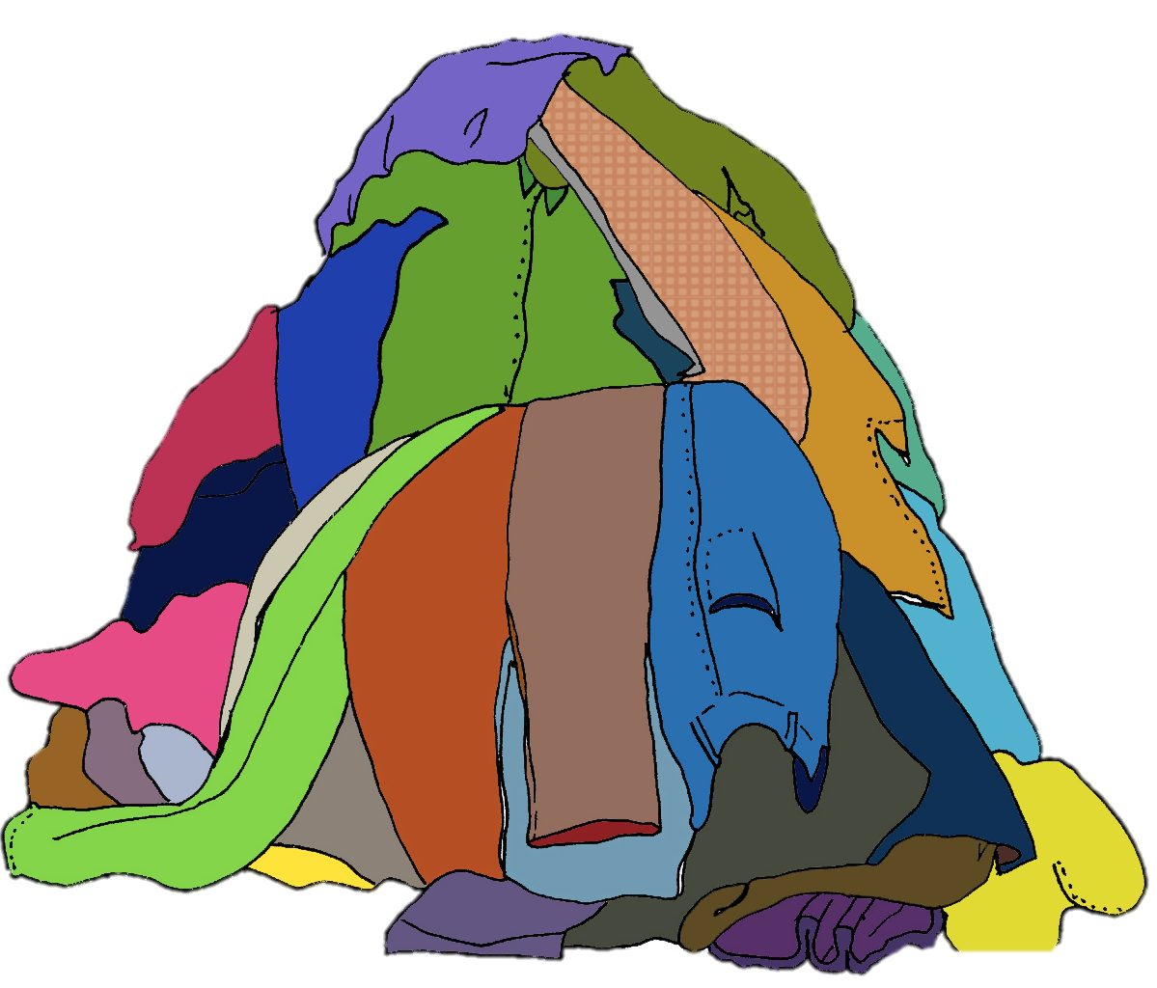
Daniel le pregunta a Lucía dónde están otras cosas. Escucha y escribe ‘my’ o ‘your’. También escribe ‘A’ o ‘B’, según la imagen.
escuchar
 | Las cosas de Daniel (‘my’) | Las cosas de Lucía (‘your’) | A | B
1
[under the table]
[on top of the table]
2
[behind the coffee]
[in front of the coffee]
3
[in front of the window]
[outside the window]
4
[on top of the newspaper]
[under the newspaper]
5
[next to the fruit]
[behind the fruit]
6
[out of the bag]
[inside the bag]
Notes:
Timing: 8 minutes
Aim: to understand ‘mi(s)’ and ‘tu(s)’ in spoken Spanish as well as adverbs of position.
Procedure:
1. Students listen for ‘mi(s)’ or ‘tu(s)’ in order to tick the correct column, indicating if the items belong to Lucía or Daniel.
2. They should also listen for the adverb or position and circle the appropriate picture in column A or B. To avoid printing, they could just write their answers, e.g., 1. my - B.
3. Click to reveal each answer.
4. To prepare students for the next activity, where they will be producing similar language, point to various pictures in random order and ask students for the item and location (e.g. debajo de la mesa).
Transcript:
¿Dónde están mis camisas? – Encima de la mesa.
¿Dónde está tu comida? – Detrás del café.
¿Dónde está tu botella? – Delante de la ventana.
¿Dónde están mis fotos? – Debajo del periódico.
¿Dónde está mi dinero? – Al lado de la fruta.
¿Dónde están tus bolígrafos? – Fuera de la bolsa.

Slide 8
Ahora las cosas están en otro lugar. ¿Dónde? Escribe seis frases.
escribir
1.
2.
3.
4.
5.
6.
Your shirts are under the table.
My photos are on top of the newspaper.
Tus camisas están debajo de la mesa.
Mis fotos están encima del periódico.
Your coffee is behind the food.
My money is behind the book.
Tu café está detrás de la comida.
Mi dinero está detrás del libro.
Your bottle is next to the window.
My pens are inside the bag.
Tu botella está al lado de la ventana.
Mis bolígrafos están dentro de la bolsa.
Notes:
Note: if time is short, ask students to select 3 of 4 of the sentences to complete.
Timing: 8 minutes
Aim: to practise the use possessive adjectives ‘mi(s)’ and ‘tu(s)’ with ‘estar’ and adverbs of position in written production.
Procedure: 1. Students translate each of the sentences (1-6) into Spanish. They should take care to choose the correct possessive adjective and the correct form or ‘estar’ in each case.
2. Click to reveal the answers.
Note: the sentences here are different from those heard on the previous slide to avoid production of identical sentences. This is to try to ensure use of a range of language.

Slide 9
hablar / escuchar
¿Dónde están las cosas?
Persona A: pregunta en español. Usa ‘tu’ o ‘tus’, según la tarjeta.
Persona B: escucha y contesta las preguntas.
Luego cambia.
Un ejemplo:
¿Dónde están tus bolígrafos?
Persona A
(pregunta):
Están encima de la mesa.
Persona B
(contesta):
Ask your partner these questions.
Listen for whether it’s ‘está tu’ or ‘están tus’, then give the corresponding information in Spanish.
Write down the answer.
1. Where are your pens?
Partner asks: “Where is your...?”
Partner asks:
“Where are your…?”
on top of the table
under the table
on top of the table
Notes:
Timing: 10 minutes (including answer check)
Aims:
to practise the use possessive adjectives ‘mi(s)’ and ‘tu(s)’.
to practise the use of ‘está’ and ‘están’.
to practise the use adverbs of position.
Procedure:
Person A uses their prompt sheet to ask a question in Spanish. The question will either prompt the singular or plural form of the verb estar and the possessive adjective (‘mi’ or ‘mis’).
Student B listens carefully and gives the answer that matches the question. For example, does the partner ask “where is your…” (using ‘tu’) or “where are your…” (using ‘tus’)?
Student A then writes down their answer in Spanish.
Students then swap roles. This time, student B’s questions will use ‘mi’ and ‘mis’. The activity follows the same steps as before.
Use the answer slide (slide 12) to give feedback.
Notes: 1. An active choice will be needed by the listener depending on the question asked. This makes the identification of the correct form of the verb estar + possessive adjective essential for task completion.
2. If teachers wish to make the task easier (e.g. for a lower ability group), they could give Spanish prompts for the questions.

Slide 10
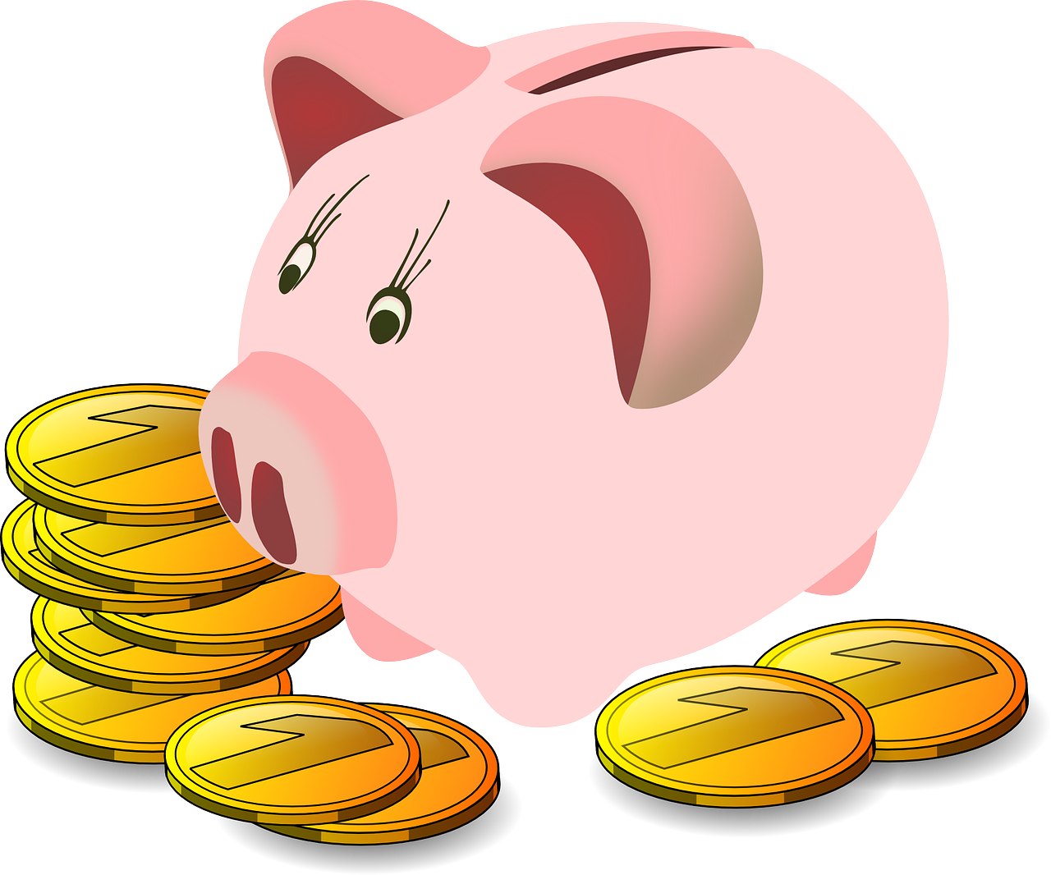
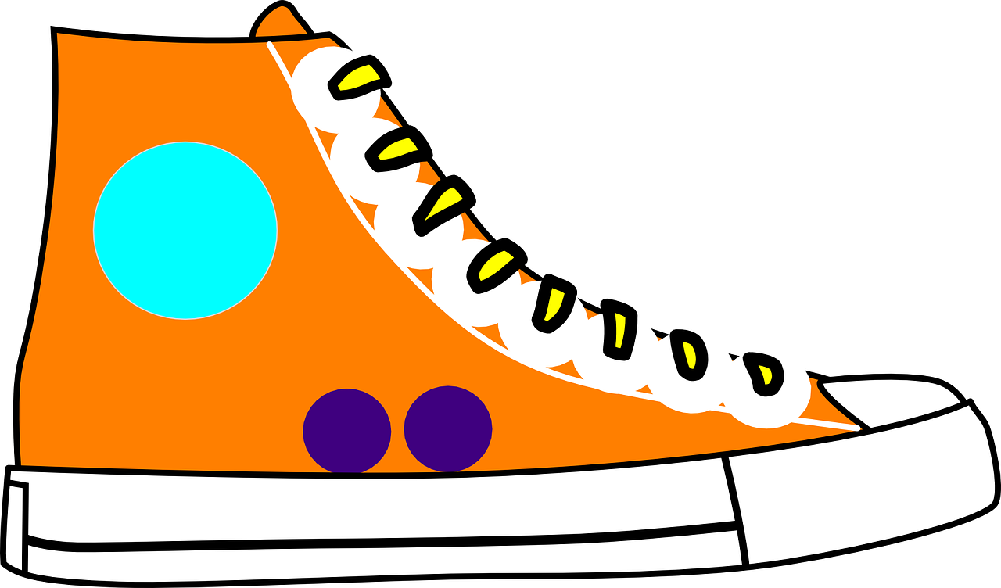
En clase (1/2)
hablar
1
2
3
under the table
on top of the table
outside the box
inside the box
on top of the
chair
behind the chair
4
5
6
in front of the window
next to the window
inside your bag
next to your bag
in front of the door
near the door
Notes:
Procedure:
Student As turn away – they have a hand out with question prompts.
Bs face the board. As ask either, for example, either Dónde está or Dónde están tu(s) bolígrafo(s)?
Bs respond in Spanish, giving the position, depending on whether they hear singular or plural questions.
As write down in English the position of the item(s).
Interactions continue until all 6 questions have been asked and answered.
Students swap role and move to the next slide.
Adaption:
More proficient student pairs could ask their questions in any order. This would additionally assess understanding of the different nouns.

Slide 11
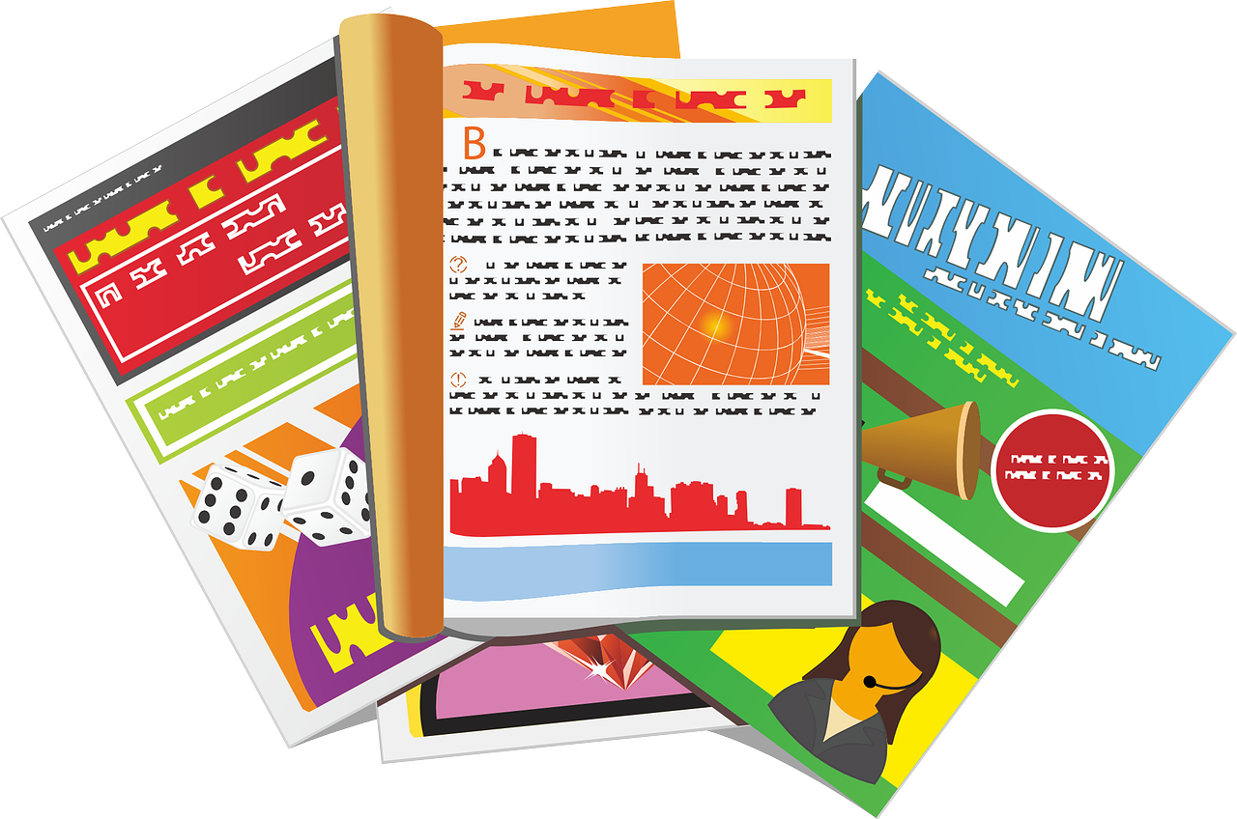
En clase (2/2)
hablar
1
2
3
out(side) of the bag
inside the bag
on top of the bed
under the bed
on top of the
chair
behind the chair
4
5
6
near the dog
in front of the dog
outside of the box
inside the box
next to the mirror
under the mirror
Notes:
[2/2]

Slide 12
Persona A
Person B
Ask your partner these questions.
Ask your partner these questions.
Write down the answer.
Write down the answer.
1. Where is your pen?
1. Where are my magazines?
Under the table.
Outside of the bag.
2. Where are your Spanish books?
2. Where are my black trousers?
Outside the box.
On top of the bed.
3. Where is your bag?
3. Where is my shirt?
Behind the chair.
Behind the chair.
4. Where is your key?
4. Where is my English book?
Next to the window.
Near the dog.
5. Where are your coins?
5. Where is my photo?
Inside your bag.
Inside the box.
6. Where are your new shoes?
6. Where are my drawings?
In front of the door.
Under the mirror.
Notes:
ANSWER SLIDE

Slide 13
Persona A
Person B
Ask your partner these questions.
Ask your partner these questions.
Write down the answer.
Write down the answer.
1. Where is your pen?
1. Where are my magazines?
2. Where are your Spanish books?
2. Where are my black trousers?
3. Where is your bag?
3. Where is my shirt?
4. Where is your key?
4. Where is my English book?
5. Where is your coins?
5. Where is my photo?
6. Where are your new shoes?
6. Where are my drawings?
Notes:
SINGLE HANDOUT TO PRINT – DO NOT DISPLAY

Slide 14
Talking about routines
-AR verbs in the present (revisited)
subject pronouns (revisited)
Y9 Spanish Term 1.1 – Week 3 – Lesson 6 Louise Caruso / Pete Watson / Nick Avery
Artwork: Mark Davies Date updated: 15.09.23
Notes:
Note: all words in this week of the SOW appear on all three GCSE wordlists, with the following exception: i) AQA list does not have desayunar, espejo, moneda.
ii) Edexcel list does not have desayunar, espejo, sacar (though it does have the phrase ‘sacar buenas /malas notas’)
Note: there is no new grammar or phonics focus this week. This week provides important consolidation of possessive adjectives and singular/plural 3rd person forms of estar. If teachers feel that their classes have confident use of these features already, they may want to use this week to do alternative activities. It is worth remembering, however, that this week revises relevant vocabulary from the GCSE lists so teachers may want to include revisiting activities for this.
Artwork by Mark Davies. All additional pictures selected are available under a Creative Commons license, no attribution required.
Native teacher feedback provided by Blanca Román.
Learning outcomes (lesson 2)
Consolidation of the following features:
reflexive pronoun ‘me’ (contrasted with ‘mi’)
reflexive pronoun ‘te’ (contrasted with ‘tu’)
-ar verbs in 1st person singular present tense (-o)
-ar verbs in 2nd person singular present tense (-as)
a subset of Y7 and Y8 vocabulary (see below)
final syllable stress
Frequency rankings of vocabulary revisited this week (1 is the most common word in Spanish):
por² [15]; sucio [1855]; limpio [1710]; ahora [81]; me [22]; te [48]; despertar [894]; levantar [354]; llamar [122]; presentar² [235]; desayunar [>5000]; espejo [1232]; cocina [1214]; tirar [685]; jardín [1195]; grabar [1560]; reloj [1683]; pantalón [1814]; vestido [1697]; juego [409]; antes [190]; dentro [548]; encima [1140]; mi [37]; tu [53]; móvil [2143]; llave [1853]; perdido [1899]; moneda [1577]; cama [609]; casa [106]; nuevo [94]; papel [393]; libro [230]; botella [1878]; revista [920]; periódico [1026]; amigo [210]; zapato [1477]; cosa [69]; mesa [525]; silla [1271]; ventana [752]; puerta [274]; clase [320]; apoyar [666]; lavar [1676] sacar [273]; delante [1742]; fuera [299]; detrás [2044]; debajo [1366]
Source: Davies, M. & Davies, K. (2018). A frequency dictionary of Spanish: Core vocabulary for learners (2nd ed.). Routledge: London
The frequency rankings for words that occur in this PowerPoint which have been previously introduced in NCELP resources are given in the NCELP SOW and in the resources that first introduced and formally re-visited those words. For any other words that occur incidentally in this PowerPoint, frequency rankings will be provided in the notes field wherever possible.

Slide 15
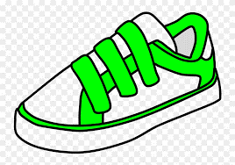
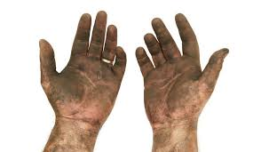
Vocabulario
escuchar
escuchar / hablar
a
b
c
d
1
j
7
e
before
2
k
8
I (L)
[shoe]
[mirror]
3
a
9
c
e
f
g
h
4
h
10
i
thing
outside
5
g
11
b
[to record]
[clean]
6
f
12
d
i
j
k
L
to take
out
above
[dirty]
[behind]
Notes:
Timing: 8 minutes
Aim: to revisit Y7 vocabulary receptively and productively in the oral modality
Procedure 1. Students write 1-12 in their exercise books. They listen to the recordings (played by clicking the number buttons) and write the letter of the words that they hear in the order that they hear them.
2. Answers are shown by clicking.
3. Then, students work in pairs, one student says a letter corresponding to one of the pictures and the other student produces that word aloud in Spanish. This will ensure that students also practise productive oral recall.
Transcript:
sacar
detrás
el zapato
fuera
limpio
la cosa
grabar
encima
la cama
sucio
el espejo
antes
All pictures free from clipart-library.com

Slide 16
Reflexive pronouns: ‘myself’ and ‘yourself’
gramática
Remember, to say that I do something to ‘myself’ in Spanish we use the reflexive pronoun _____.
me
I wake (myself) up.
Me despierto.
I introduce myself.
Me presento.
te
To say you do something to ‘yourself’ use ____ before the verb:
You take a photo of yourself.
Te sacas una foto.
You are called (‘you call yourself’) Daniel.
Te llamas Daniel.
Notes:
Timing: 2 minutes
Aim: to recap the use of the reflexive pronoun ‘te’.
Procedure:
Go through the grammar explanation with students, revealing each new sentence on a mouse click.

Slide 17
Me / te vs. mi/tu
gramática
Remember, ‘me’ looks very similar to ‘mi’, but the two are used differently.
‘Me’ (myself) is followed by a verb.
I wash myself.
Me lavo.
Mi libro es nuevo.
‘Mi’ (my) is usually followed by a noun.
My book is new.
‘Te’ and ‘tu’ also have different meanings and uses.
‘Te’ (yourself) is followed by a verb.
You look at yourself.
Te miras.
‘Tu’ (your) is usually followed by a noun.
Your phone is red.
Tu móvil es rojo.
Remember, tu (your) and tú (you) are also different. The accent is important!
Notes:
Timing: 2 minutes
Aim: to recap the differences between the reflexive pronouns ‘me’ and ‘te and the possessives ‘mi and ‘tu’.
Procedure:
Go through the grammar explanation with students, revealing each new sentence on a mouse click.

Slide 18
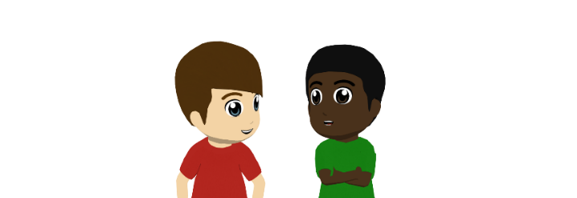
¿Es ‘te’ o ‘tu’?
Daniel pregunta a Hugo sobre la vida en casa.
leer
Lee las frases y elige la palabra correcta, ‘te’ o ‘tu’.
 | Escribe las preguntas en inglés
1
2
3
4
5
1 | a) ¿Te... b)¿Tu... | ... levantas antes de tu hermana?
2 | a) ¿Te... b)¿Tu... | ... padre prepara una bebida?
3 | a) ¿Te... b)¿Tu... | ... madre lee el periódico en la mesa?
4 | a) ¿Te... b)¿Tu... | ... lavas antes de desayunar?
5 | a) ¿Te... b)¿Tu... | ... casa está cerca de la escuela?
6 | a) ¿Te... b)¿Tu... | ...?
Do you get up before your sister?
Does your father prepare/make a drink?
Does your mother read the newspaper on/at the table?
Do you wash before having breakfast?
Is your house close to the school?
¡Escribe una pregunta!
Notes:
Timing: 6 minutes
Aim: to consolidate understanding of the difference between ‘te’ (as used for reflexive actions) and ‘tu’ (used for possession).
Procedure:
Students read each question and decide whether the correct option is ‘te’ or ‘tu’ depending on what comes after (noun or verb).
Students also write each question in English.
Finally, students are encouraged to write another question beginning with ‘te’ or ‘tu’ and ask their partner how it should begin. They may need to write it in the same way as the items presented on the slide (i.e. as sentence endings) in order to avoid giving the answer (‘te’ or ‘tu’) away.
During feedback, students understanding of the sentences should also be checked, in addition to the correct senence starter.

Slide 19
La rutina de Lucía
Lucía habla con Diego antes de salir de la casa.
escuchar
Escribe 1-10, a o b, y mi o me.
 | ¿Cuál es la opción correcta?
 | …reloj dice que son las ocho. b) ... despierto a las ocho.
 | ... levanto ahora. … móvil está debajo la cama.
 | …hermano está en la cocina. ... preparo un café.
 | ¿Cuál es la opción correcta?
 | ... llave está encima de la mesa. ... lavo más tarde.
 | …preparo para el colegio. …vestido está limpio.
 | ... pregunto qué hora es. ... llave, ¿dónde está?
1
4
2
5
3
6
Notes:
Timing: 6 minutes
Aims:
to practise understanding the difference between ‘me’ and ‘mi’.
to correctly transcribe the two words.
Procedure:
Explain the task to students.
Click the number trigger to play the audio.
Students listen to the beginning of the sentence or question and decide how the sentence must continue. For each item they write a/b and either mi or me.
Elicit the English meanings of the sentences and give feedback.
Notes:
Transcribing ‘mi’ and ‘me’ is an important part of the activity as the Spanish ‘mi’ sounds similar to the English ‘me’ and can therefore lead to inaccurate spelling. We don’t focus on ‘te’ vs ‘tu’ in the listening activity because of the fact that the subject pronoun ‘tú’ sounds identical to the possessive adjective and could potentially appear in the same position.
Transcript:
Mi...
Me..
Mi...
Me…
Me...
Mi…

Slide 20
Un viaje de trabajo
Ana está en Madrid. Habla con Lucía y pregunta sobre la familia.
leer / escuchar
¡Hola, Lucía! ¿Qué haces esta tarde?
Hago mis deberes. Mañana me
presento al nuevo director del colegio.
Lucía
Ana
¿De verdad? ¿Y tu hermano?
Tu hijo está bien pero, ¡me da rabia cuando usa mi ordenador!
¡Je, je! ¿Y las mañanas? ¿Te levantas temprano para sacar al perro a caminar?
Sí, sí, mamá. Me despierto siempre a las siete y media, me pongo la ropa y voy con el perro al parque.
1
2
Bueno. ¿Y te preparas algo de comer antes de salir de casa?
La verdad es que mis amigas y yo compramos el desayuno y una botella de agua en la tienda.
3
4
Mm…entiendo. ¿Y mi casa está limpia? ¿Mi jardín?
5
Mi papá limpia la casa y lava los platos cada día y en tu jardín las flores están muy bonitas. ¿Cuándo vas a volver?
6
Ahora me preparo para volver mañana. Hasta pronto.
Notes:
Note: if teachers want to have time for students to do the writing task in class time, in addition to the two role plays, they might consider omitting the previous two activities (reading and listening), and just doing this one before the role plays and then the writing. This selection is likely to be more appropriate for higher proficiency students.
Timing: 8 minutes
Aims:
to help students to connect the spoken and written forms of the language more securely.
to consolidate vocabulary and grammar knowledge by eliciting suggested changes to the text.
Procedure:
Click on the audio button to play the text. Read and listen.
Note: There is a full version of the audio top right with a player. Alternatively, the audio is in 6 sections with a pause just after the words 1-5 in bold in the transcript below, to facilitate easy stop/start.
To support segmentation, stop the audio and ask students to say: a) the next word b) the previous word
In addition, to develop understanding, vocabulary and grammar knowledge, pause at key points and ask students to suggest an alternative word that could replace the next word. This is a chance to draw on previously taught grammar and vocabulary knowledge.
Note: students may need a reminder about the meaning of ‘media’. It was seen in one lesson of Year 8 where students were introduced to telling the time, but hasn’t otherwise been used as vocabulary.
Transcript:
¡Hola, Lucía! ¿Qué haces esta tarde? Hago mis deberes porque mañana me presento al nuevo director del colegio. ¿De verdad? ¿Y (1) tu hermano? Tu hijo está bien pero, ¡me da rabia cuando usa (2) mi ordenador! ¡Je, je! ¿Y las mañanas? ¿Te levantas temprano para sacar al perro a caminar? Sí, sí, mamá. (3) Me despierto siempre a las siete y media, me pongo la ropa y voy con el perro (4) al parque. Bueno. ¿Y te preparas algo de comer antes de salir de casa? La verdad es que mis amigas y yo compramos el desayuno y una botella de agua en la tienda. Mm…entiendo. ¿Y mi casa está limpia? ¿Mi jardín? Mi papá limpia la casa y lava los platos (5) cada día y en tu jardín las flores están muy bonitas. ¿Cuándo vas a volver? Ahora me preparo para volver mañana. Hasta pronto.
Suggestions for posible changes: 1) tu – primo/a, tío/a, abuelo/a, amigo/a, novio/a; 2) mi – móvil, bici, habitación, cámara; 3) me – levanto, lavo, preparo un café; 4) al – parque, centro, campo, río, jardín; 5) lava los platos – los martes, todos los días, a veces, sin/con + persona, porque + reason etc.

Slide 21
Ahora lee el texto con en español un/a companero/a. Traduce las frases.
leer / hablar
¡Hola, Lucía! ¿Qué haces esta tarde?
Hago mis deberes. Mañana (1)
[I introduce myself] al nuevo director del colegio.L
Hago mis deberes. Mañana (1) me presento al nuevo director del colegio.
¿De verdad?
¿(2) Y [your brother]? A
¿De verdad? ¿Y (2) tu hermano?
Ana
(3) [Your son] está bien pero, ¡me da rabia cuando usa (4) [my computer]! L
(3) Tu hijo está bien pero, ¡me da rabia cuando (4) mi ordenador!
¡Je, je! ¿Y las mañanas? ¿(5) Te levantas temprano para sacar al perro a caminar?
¡Je, je! ¿Y las mañanas?
¿(5) [Do you get up] temprano para sacar al perro a caminar? A
Sí, sí, mamá. (6) Me despierto siempre a las siete y media, (7) me pongo la ropa y voy con el perro al parque.
Sí, sí, mamá. (6) [I wake up] siempre a las siete y media, (7) [I put on] la ropa y voy con el perro al parque.L
Bueno. ¿Y (8) [do you make (‘prepare’) yourself] algo de comer antes de salir de casa? A
Bueno. ¿Y (8) te preparas algo de comer antes de salir de casa?
La verdad es que mis amigas y yo compramos el desayuno y una botella de agua en la tienda.
Mm…entiendo. ¿Y mi casa está limpia?
¿(9) [My garden]? A
Mm…entiendo. ¿Y mi casa está limpia? ¿(9) Mi jardín?
Mi papá limpia la casa y lava los platos cada día. En (10) [your garden] las flores están
muy bonitas. ¿Cuándo vas a volver?
Mi papá limpia la casa y lava los platos cada día. En (10) tu jardín las flores están muy bonitas. ¿Cuándo vas a volver?
Ahora (11) [I’m getting ready (‘preparing myself’)] para volver mañana. Hasta pronto. A
Ahora (11) me preparo para volver mañana. Hasta pronto.
Lucía
Notes:
Timing: 3 minutes
Aims:
i) to consolidate oral production of the vocabulary and grammar (mi, me, tu, te).
ii) to also practise of pronunciation of words with final syllable stress.
Procedure:
Students recreate the dialogue between Ana y Lucía in pairs.
Students read each message aloud in turn. Where there is an English prompt, they give the phrase in Spanish.
Click to reveal the answers. Although students will primarily have focused on the oral translation of the prompts, feedback can also be given on the pronunciation of words in the text with final syllable stress (jardín, está, están, mamá, papá).

Slide 22
Un diálogo
escribir / hablar / escuchar
Say hello. Ask: how are you?
3. Ask: What is your day like usually?
5. Ask: What do you do after?
7. Ask: Do you have breakfast?
9. Ask: What classes do you have this morning?
2. Greet your partner and respond to the question.
4. Reply: Normally I wake up at…
6. Reply: I put on my (the) clothing.
8. Say: if I have time
10. Say: This morning, I have …, … and …
Notes:
Timing: 15 minutes (two slides) Aim: to practise productive use of this week’s revisited structures and some vocabulary in a role play interaction about daily routines.
Procedure: 1. Give students 6 minutes in pairs to write the dialogue in their books. They can work together – they will need to be able to play both roles in the dialogue.
2. For 4 minutes, ask students to turn their notes over and carry out the interaction using the English prompts on the board, and glancing at their notes only if they get stuck.
3. Move to the next slide. Ask them to repeat the task, swapping roles, but this time without writing their answers first.

Slide 23
Un diálogo
escribir / hablar / escuchar
Say hello. Ask: What’s your name?
3. Ask: What is your day like usually?
5. Ask: What do you do after?
7. Ask: When do you wash?!
9. Ask: What classes do you have this morning?
2. Say hello and respond to the question.
4. Reply: Normally I get up at…
6. Reply: I go to the kitchen to have breakfast.
8. Say: After waking my brother.
10. Say: This morning, I have …, … and …
¡Otra vez!
Notes:
[2/2]
Note: if students have additional time, they can repeat this 2nd dialogue, swapping roles with their partner.

Slide 24
Mi rutina
Escribe un mensaje.
Either use Daniel’s message for ideas or use your own.
escribir
Hello, I’m Daniel.
Mention:
what time you get up
two activities you do every morning before going to school
what you do when you arrive at school
what your first lesson on Monday is and what you think of it
Normally I get up at 7.
I get dressed → I put (myself) clothing (on).
I wash and I get dressed. I have breakfast if I have time.
With two verbs together, the 2nd verb is an infinitive.
I walk to school. When I arrive, I talk with my friends.
On Monday in the morning I have history. I like history although the teacher is a bit strange!
Write 1- 2 sentences for each bullet.
What about you?
Notes:
Timing: 10 minutes
Aim: to write a short text about routines; to practise written production of vocabulary and structures from this week and previous learning.
Procedure:
1. Students respond to the English prompts in Spanish.
2. Encourage students wherever possible to write from memory. Some students might be directed to use their language guides or Kos, as appropriate.

Slide 25
Deberes
Vocabulary Learning Homework (Y9 Term 1.1, Week 4)
Audio file
Student worksheet
Quizlet link
In addition, revisit: Year 8 Term 3.1 Week 4 Year 8 Term 3.2 Week 4
Notes:
Note: HW for Y9 is usually made up of pre-learning of vocabulary 15-30 minutes (depending on school policy on HW time) plus 20-30 minutes vocabulary activities to deepen word knowledge, provided on a student homework sheet (which also contains a clickable link to the audio file). Answer sheets are also provided. The answer sheet for the Y9 vocabulary learning HW sheet Week 4 is here: https://rachelhawkes.com/LDPresources/Yr9Spanish/Spanish_Y9_Term1i_Wk4_HW_sheet_answers.docx
Notes:
With the LDP SOW the vocabulary for Years 9 – 11 is provided on Quizlet.
ii) There are other free apps, and new ones are always appearing. Teachers have told us that they are currently using: Flippity, Wordwall (where using previously-created activities is free).
iii) Gaming Grammar has been acquired by Language Nut. Its original content should still be available to teachers and much of it is appropriate for Y9 learners. From this lesson, for example, learners could practise:
Possessive adjectives: number in the ‘Possessive adjective agreements’ menu

