Slide 1
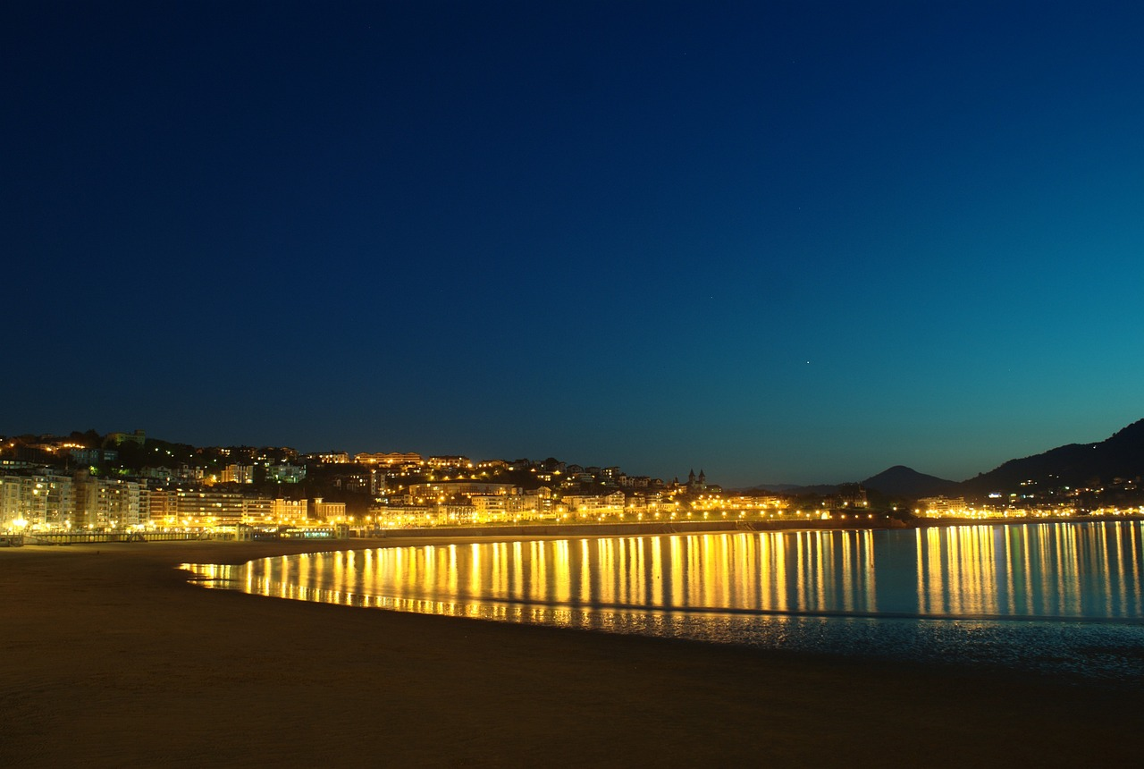
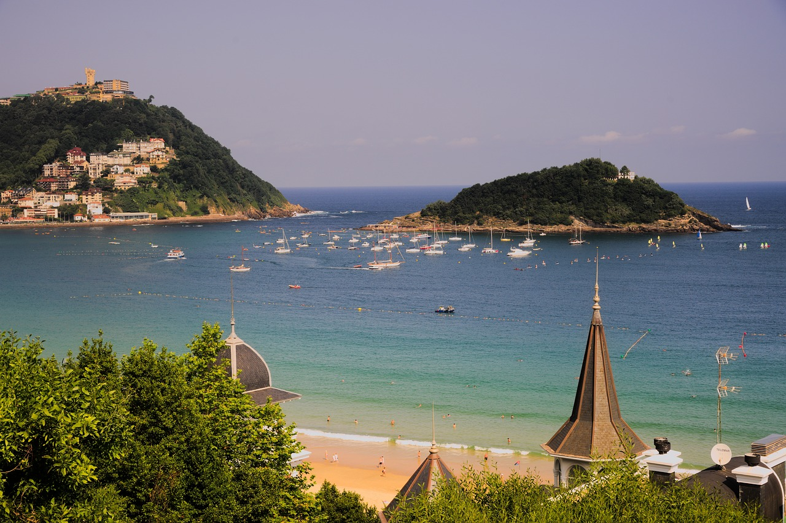
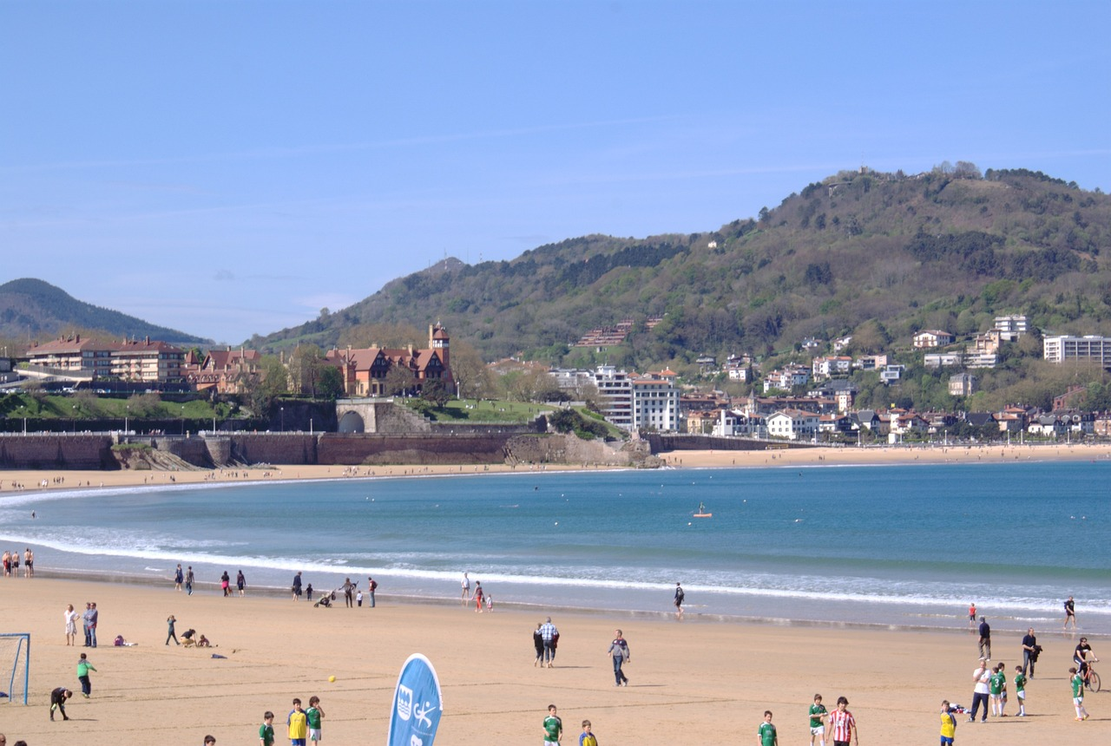
Describing past holidays
–er & -ir verbs (preterite – revisited)
final syllable stress (revisited)
Y9 Spanish Term 1.1 – Week 2 – Lesson 3 Amanda Izquierdo / Nick Avery / Rachel Hawkes
Artwork: Mark Davies Date updated: 10.09.23
Notes:
Note: all words in this week of the SOW appear on all three GCSE wordlists, with the following exception: i) Edexcel list does not have genial. Artwork by Mark Davies. All additional pictures selected are available under a Creative Commons license, no attribution required.
Native teacher feedback provided by Blanca Román.
Learning outcomes (lesson 1)
Cultural knowledge of a city in the Spanish-speaking world
Consolidation of the following language features:
-er/-ir verbs in 1st , 2nd and 3rd person singular preterite (-í, iste & -ió);
negatives
final syllable stress
a subset of Y7 and Y8 vocabulary (see below)
Frequency rankings of vocabulary revisited this week (1 is the most common word in Spanish):
sin embargo [embargo-203]; coger [1001]; concierto [1456]; premio [1090]; además [155]; gente [137]; genial [2890]; permitir [218]; decidir [368]; compartir [579]; fuerte² [435] salir [114]; perder [195]; recoger [828]; entrada [767]; billete [2992]; conocer [128]; ofrecer [351]; conocido [759]; ambiente [729]; zona [359]; directo [1029]; tener lugar [lugar-144]; lado [214]; así que [que-3]; (a) pie [365]; julio [659]; norte [624]; España [N/A]; ¿cómo? [151]; isla [810]; pequeño [202]; centro [316]; plaza [806]; el, la [1]; hermano [333]; hermana [3409]; río [496]; hermoso [980]; naturaleza [712]; actividad [344]; comida [906]; comer [347]; correr [343]; playa [1475]; descubrir [414]; parte¹ [92]; calle [269]; barco [1384]; allí [197]; ¿dónde? [161]; ¿cuándo? [57]; (por) ¿qué? [50]; ¿quién? [289]
Source: Davies, M. & Davies, K. (2018). A frequency dictionary of Spanish: Core vocabulary for learners (2nd ed.). Routledge: London
The frequency rankings for words that occur in this PowerPoint which have been previously introduced in LDP resources are given in the LDP SOW and in the resources that first introduced and formally re-visited those words. For any other words that occur incidentally in this PowerPoint, frequency rankings will be provided in the notes field wherever possible.

Slide 2
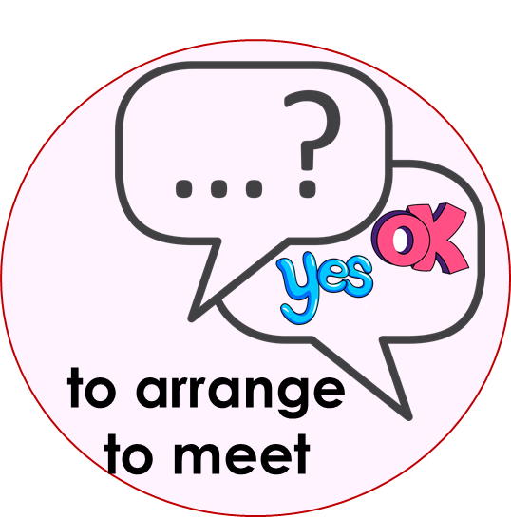
De vacaciones(1/2)
A: Ask ‘Did you… in the summer?’ (activities in any order)
B: Answer truthfully ‘yes, I …’ or ‘no, I didn’t…’ depending on the question.
hablar
karaoke
some things
party
Notes:
Timing: 8 minutes (two slides) Aim: to practise asking and answering about past summer holiday activities (using –AR verbs from last week)
Procedure:
Student As ask Bs these 6 questions but in any order. ¿Montaste en bici?
Bs answer the question personally - No, no monté en bici.
After all 6 pictures have been spoken about, students swap roles and move to the next slide.

Slide 3
De vacaciones(2/2)
B: Ask ‘Did you… in the summer?’ (activities in any order)
A: Answer truthfully ‘yes, I …’ or ‘no, I didn’t…’ depending on the question.
hablar
another country
beach
museum
along the coast
Notes:
[2/2]

Slide 4
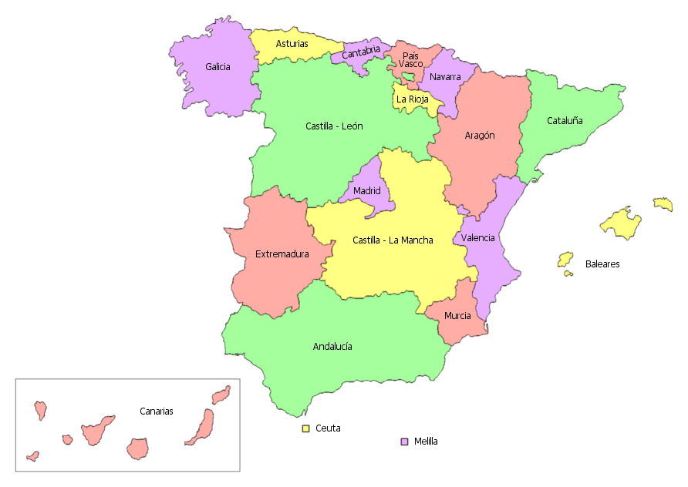
Hoy estamos en…
¡Es San Sebastián! La ciudad tiene otro nombre en el idioma vasco: Donostia.
leer
¿Qué ciudad es? Lee las frases para descubrir cosas sobre una ciudad española.
1. Es una ciudad [small].
pequeña.
Gijón
San Sebastián
parte
2. Un [river] pasa por la [part] del [center].
río
centro
3. Hay una [island] muy cerca. Puedes conocer la isla [on foot] en poco tiempo.
isla
a pie
Orense
4. Puedes hacer [activities] en [boat] porque hay una [beach].
Teruel
actividades
barco
playa
5. Está en el [north] de [Spain].
Albacete
norte
España.
6. La [people] en esta [area] habla dos idiomas diferentes.
gente
zona
Las palabras en español
Málaga
la gente el centro la actividad pequeño/a
el norte el río la zona el barco
España a pie la parte
Notes:
Timing: 5 minutes
Aims:
i) to engage students and allow them to identify the city we are going to talk about in this lesson.
ii) to practise some of the revisited Y7/Y8 vocabulary for this week, either receptively or productively.
Procedure:
Students read out each sentence chorally in Spanish, translating the words in English into Spanish.
Encourage students to say which city it is out of all the options after reading sentence number six. The sentences allow students to narrow the options down to Gijón and San Sebastián as these are the only two cities on the map that are in the north of Spain and might have a beach. Last week, in 9.1.1.1, students also learnt a little about San Sebastián which may also help them (e.g., the fact that San Sebastián has a beach, and also that it is located in the Basque Country, an autonomous community where two languages are spoken). This slide aims to engage students (and practise vocabulary), rather than to test them.
Notes:
Teachers can delete the box with the Spanish words in higher-achieving classes. This would allow for productive (rather than receptive) vocabulary revisiting.
In Galician, ‘Orense’ is spelt ‘Ourense’.

Slide 5
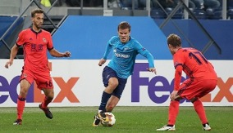
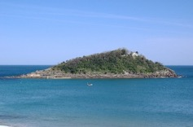
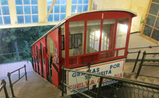
Actividades en San Sebastián
leer
La Real Sociedad
Santa Clara
Funicular
Lee la información sobre actividades en San Sebastián y contesta las preguntas:
San Sebastián
San Sebastián es una ciudad genial: por la mañana puedes pasar tiempo en la naturaleza, porque hay unas playas y un río hermosos, por la tarde puedes comer la comida tradicional en la parte vieja y por la noche puedes aprovechar el ambiente en la zona del centro. ¡También puedes coger un barco y visitar una isla pequeña, Santa Clara! O también puedes subir a la montaña en el funicular para disfrutar de unas vistas preciosas.
San Sebastián es un lugar con mucha cultura y arte, con muchos monumentos, edificios antiguos y festivales de cine y música. Además, si te gusta el fútbol puedes ver un partido del equipo de la zona: La Real Sociedad de Fútbol.
1. What can you do in the morning? Why?
2. What can you eat in the afternoon? Where?
3. What can you do at night?
4. What can you do on the mountain?
5. Which places and events are mentioned in the last paragraph?
Notes:
Timing: 8 mins (two slides)
Aims:
i) to practise some of this week’s revisited vocabulary receptively.
ii) to learn more about San Sebastián.
Procedure:
1. Before the activity, explain the meaning of the word ‘funicular’. Many students will not know what it means, even though the same word is used in English and Spanish. It is a railway that goes up a steep mountainside, sometimes in a straight line, with two passenger cars that are counterbalanced (when one goes up, the other goes down). It is a common transportation system in the Alps and other mountainous places.
2. Students read the text.
3. Students work individually or in pairs to answer the questions in English.
4. Answers can be checked orally in English, with reference to the Spanish in the text. Some model answers are provided below, but students may of course word these slightly differently.
Note:
1. An additional use of the text would be to use it for a paired read aloud. It could also be used for a dictation or note-taking task.
2. In this text, ‘disfrutar’ is followed by ‘de’. It has in other texts been seen as a transitive verb (i.e. without ‘de’). We recommend explaining to students that it may be used either with or without a preposition.
https://www.rae.es/dpd/disfrutar
Answers:
You can spend time in nature because there are beautiful beaches and a beautiful river. (Puedes pasar tiempo en la naturaleza, porque hay unas playas y un río hermosos.)
You can eat traditional food in the old part of the city. (Por la tarde puedes comer la comida tradicional en la parte vieja.)
You can make the most of the atmosphere in the centre. (Por la noche puedes aprovechar el ambiente en la zona del centro.)
You can enjoy the beautiful views. (Puedes subir a la montaña […] para disfrutar de unas vistas preciosas.)
The monuments, old buildings, music and cinema festivals and football matches. (…con muchos monumentos, edificios antiguos y festivales de cine y música. Además, si te gusta el fútbol puedes ver un partido del equipo de la zona.)
Photo of Isla De Santa Clara on Pixabay.com (no attribution required)
https://pixabay.com/es/photos/isla-santa-clara-primavera-104732/
Photo of funicular by Raimundo Pastor, own work, CC BY-SA 4.0, https://commons.wikimedia.org/w/index.php?curid=41992294
Photo of Real Sociedad by Кирилл Венедиктов with permission fron soccer.ru. File licensed under CC BY-SA 3.0, https://commons.wikimedia.org/wiki/File:ZENIT_VS._REAL_SOCIEDAD_3_-_1_(1).jpg#filelinks

Slide 6
Respuestas
leer
1. What can you do in the morning? Why?
You can spend time in nature because there are beautiful beaches and a beautiful river. (Puedes pasar tiempo en la naturaleza, porque hay unas playas y un río hermosos.)
2. What can you eat in the afternoon? Where?
You can eat traditional food in the old part of the city.
(Por la tarde puedes comer la comida tradicional en la parte vieja.)
3. What can you do at night?
You can make the most of the atmosphere in the centre.
(Por la noche puedes aprovechar el ambiente en la zona del centro.)
4. What can you do on the mountain?
You can enjoy the beautiful views.
(Puedes subir a la montaña […] para disfrutar de unas vistas preciosas.)
5. Which places and events are mentioned in the last paragraph?
The monuments, old buildings, music, cinema festivals and football matches.
(…con muchos monumentos, edificios antiguos y festivales de cine y música. Además, si te gusta el fútbol puedes ver un partido del equipo de la zona.)
Notes:
Answer slide
This optional slide displays the answers in written form. The relevant parts of the text in Spanish are also included in italics.
Each click reveals the answer and supporting part of the text.

Slide 7
Describing completed events in the past -er/-ir verbs in the preterite
gramática
Remember, some Spanish infinitives end in –er, some in –ir.
The verb ending changes depending on who the verb refers to.
To mean ‘I’ for a completed event in the past, remove –er or –ir and add _____.
–í
I offered
Compartí = __________
Ofrecí = __________
I shared
To mean ‘s/he’ for a completed event in the past, remove –er or –ir and add ____.
–ió
s/he shared
s/he offered
Compartió = ____________
Ofreció = ______________
Notes:
Timing: 2 minutes
Aim: to recap 1st and 3rd person singular form of preterite tense for –er/–ir verbs (-í) and (-ió).
Procedure:
Go through the grammar explanation with students, revealing each new sentence on a mouse click.

Slide 8
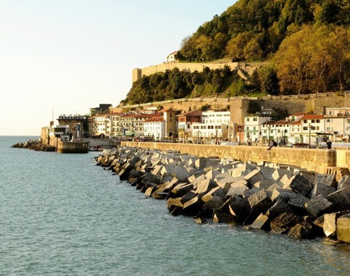
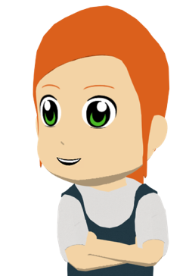
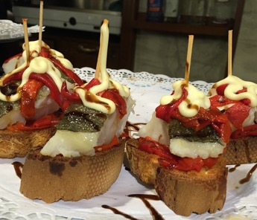
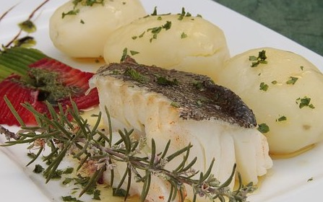
Las vacaciones de Lucía y Daniel
Lee y completa el texto con los verbos correctos.
Después, escucha y comprueba las respuestas:
En julio decidí pasar tiempo en San Sebastián con mis amigos. Salí todas las tardes al centro, sin embargo, mi hermano 1) _______ siempre por las mañanas para hacer ejercicio. ¡Corrió en la playa todos los días! Incluso a veces subió a la montaña a pie. Pero yo solo 2) _______ un poco al lado del río Urumea los sábados.
¿Sabes? En San Sebastián hay un festival muy famoso de música jazz durante la tercera semana de julio. Pues el lunes cogí el autobús, recogí las entradas y 3) _______ una a Daniel. ¡En un concierto él 4) ________ a un artista famoso y yo 5) _______ mi reloj favorito!
Un día Daniel 6) __________ un restaurante genial: yo
7) _______ unos pintxos de carne y él 8) _______ bacalao.
Los pintxos y el bacalao son dos platos típicos del País Vasco:
salió
corrí
Verbos
comió salió descubrió corrí conoció perdí ofrecí comí
Pintxos
Bacalao (cod)
ofrecí
conoció
perdí
descubrió
comí
comió
Notes:
Note: for a simpler reading activity that practises recognition of preterite endings í and ío, see the end of this slide deck.
Timing: 10 mins
Aims:
i) to consolidate understanding of the difference between preterite verb endings –í and –ió.
ii) to understand the text in its entirety.
Procedure:
Students begin by reading the text and thinking of possible words for the gaps. In giving suggestions, they can also be encouraged to focus on the verb ending and whether it would be –í or –ió. This will be indicated by the subject and the vocabulary context.
Then, students can see the verb options and select the most suitable verb for each gap.
Students listen to the recording and check their answers. Click to also reveal each answer in written form.
Additionally, as part of feedback, focus students the presence/absence of subject pronouns (yo, él) in the text. Elicit the reasons why they are or aren’t used. For example, absence of pronoun when there is no change of subject – “recogí las entradas y ofrecí…” but presence of pronoun when it changes “yo comí unos pintxos de carne y él comió bacalao”.
Explain to students the meaning of ‘pintxo’ (see below) and ‘bacalao’ (cod), which are both unknown terms. This could alternatively be done before the activity.
Notes:
‘Conocer’ is used in this text with the meaning ‘to meet’ (for the first time). It may be helpful to make this explicit to students. Previously in the SOW, it was seen as to ‘to get to know’ (a place or person).
If appropriate, more of the verbs ending in –i and –ió could be gapped. Options would need to be added to the options box.
Here is some more information that can be given in relation to the callout. The word is given here with its Basque spelling (as would most commonly be seen in San Sebastián). It is a variation on the spelling of the same word in Spanish (pincho), which literally means ‘skewer’ and can be used in a similar sense to ‘tapa’, which students saw in Year 8. There is similarity with tapas in that pintxos tend to be small dishes that are mixed and matched with others, and are served on bar counters.
Frequency of unknown words/cognates:
pintxo [>5000]; bacalao [>5000]; favorito [2360]

Slide 9
El uso de los acentos
gramática
Remember:
Remember, if the stress falls on the final syllable, and the word ends in any consonant except ‘___’ or ‘___’, there is no written accent.
n
s
Por ejemplo:
hablar
estación
actividad
después
Estas palabras no necesitan tilde.
Estas palabras terminan en ‘n’ y ‘s’ y tienen énfasis en la última sílaba. Necesitan tilde.
Notes:
Note: correct application of stress patterns is part of the requirement at Higher Tier. Teachers might choose to omit this and the next slide for certain classes, particularly if short of time. The text fits in well with the cultural context (Holidays in the north of Spain) but the main learning idea of this lesson is secure knowledge of preterite verb endings in the 1st and 3rd persons singular, so teachers can prioritise this.
Timing: 1 min
Aim: to recap spelling rules related to stress position.
Procedure:
Click to reveal each part of the explanation. The word ‘tilde’ was used in Year 8 resources, but explain its meaning again if necessary.
If appropriate, ask students for further examples of words with final syllable stress that require / do not require a written accent.

Slide 10
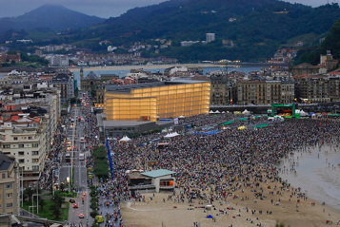
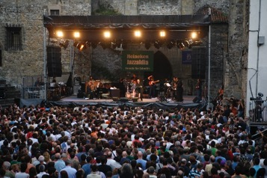
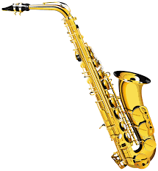
El festival de Jazz
escuchar
Hay un Festival de Jazz cada año (Jazzaldia).
Escucha. ¿Cuántas palabras hay con énfasis en la última sílaba?
Luego escucha otra vez y completa las frases. ¿Qué palabras necesitan tilde?
la programación = line-up
la calidad = quality
1
festival
Sebastián
El ________ de jazz de San __________ es muy antiguo.
actividad
cultural
programación
calidad
2
Es una __________ ________ con una ______________ de buena ________ .
espectador
actuación
3
Cada ___________ viene a la playa para ver la __________ frente al mar.
la actuación = performance
cantó
canción
alemán
4
El año pasado un artista _______ una ________ en ________.
descubrir
edición
_____ puedes __________ música nueva en cada ________.
5
Aquí
Notes:
Timing: 7 mins
Aims:
i) to consolidate recognition of final syllable stress.
ii) to consolidate the first rule about the use of the written accent in words with final syllable stress.
Procedure:
Students listen to each sentence and tally how many words they hear with a final syllable stress.
Click to reveal the gapped sentence.
Students listen to each sentence again and write the missing words, deciding whether an accent is needed or not.
Teacher shows the answers. Explain the meaning of ‘frente’ in item 3 (frente al mar) as this word is not yet known.
Note: some words are known and others are unknown, making this a hybrid vocabulary/sounds of the language task.
Frequency of unknown words/cognates:
festival [3194]; cultural [714]; programación [3617]; calidad [637]; espectador [2438]; actuación [1835]; edición [1449]
Photos from Wikipedia, Vidartereyes - CC BY-SA 4.0

Slide 11
Los estudiantes hablan de las vacaciones
escribir
Lee los comentarios en la clase de inglés de Lucía sobre las vacaciones de los estudiantes.
Completa la traducción de las frases en inglés y en español.
________ todas las noches con su hermana en ___ ________ de Lanzarote.
She went out _____ ______ with her sister on the island ___ Lanzarote.
Salió
every night
my brother
la
In July ___ ________decided to go to the north of Spain. _____________, I took a direct bus to a city ___ _____ ____________ with my parents.
isla
of
1
However
in
the south
julio
En _____ mi hermano __________ ir al norte de España. Sin embargo, yo _______ un autobús directo a _____ ___________ en el sur con mis padres.
decidió
cogí
una ciudad
2
Notes:
Note: there are two versions of this task. This, more supported version, has two jigsaw translation sentences and three full sentences (of which teachers can decide how many students can complete in the time. The 2nd more challenging version has 5 comments to translate from English into Spanish, with an answer slide at the end.
Timing: 10 mins
Aims:
to consolidate first and third person singular verb endings in the preterite.
to consolidate the use of negatives.
to consolidate this week’s set of revisited vocabulary.
Procedure:
Students translate each phrase into Spanish or English.
Teachers elicit and show the answers one by one.

Slide 12
Los estudiantes hablan de las vacaciones
escribir
Ahora traduce estos comentarios. Escribe en español.
One day I lost my train ticket on the beach.
He offered to help in/at a concert but he didn’t meet famous people.
3
4
I discovered many areas with a good atmosphere so I went with a friend.
5
Notes:
[2/2]

Slide 13
Los estudiantes hablan de las vacaciones
escribir
Lee los comentarios en la clase de inglés sobre las vacaciones de los estudiantes.
Escribe la traducción de las frases en español.
One day I lost my train ticket on the beach.
She went out every night with her sister on the island of Lanzarote.
In July my brother decided to go to the north of Spain. However, I took a direct bus to a city in the south with my parents.
2
3
1
I discovered many areas with a good atmosphere so I went with a friend.
He offered to help in/at a concert but he didn’t meet famous people.
4
5
Notes:
Version 2 – more challenging
Timing: 10 mins
Aims:
to consolidate first and third person singular verb endings in the preterite.
to consolidate the use of negatives.
to consolidate this week’s set of revisited vocabulary.
Procedure:
Students translate each sentence into Spanish.
Teachers show the answers one by one.
Note:
1. Teachers can draw attention to the use of the personal pronoun ‘yo’ in the second comment. In this instance, the personal pronoun is needed as it presents a contrast between the aforementioned ‘he’ (my brother) and ‘I’.

Slide 14
Solución
She went out every night with her sister on the island of Lanzarote.
Salió todas las noches con su hermana en la isla de Lanzarote.
In July my brother decided to go to the north of Spain. However, I took a direct bus to a city in the south with my parents.
En julio mi hermano decidió ir al norte de España. Sin embargo, yo cogí un autobús directo a una ciudad en el sur con mis padres.
One day I lost my train ticket on the beach.
Un día perdí mi billete de tren en la playa.
He offered to help in/at a concert but he didn’t meet famous people.
Ofreció ayudar en un concierto pero no conoció a gente famosa.
I discovered many areas with a good atmosphere so I went with a friend.
Descubrí muchas zonas con un buen ambiente así que fui con un/a amigo/a.
Notes:
ANSWER SLIDE
This slide allows both the English and Spanish sentences to be seen at the same time during feedback.
It has all five messages.
Click to bring up each answer.

Slide 15
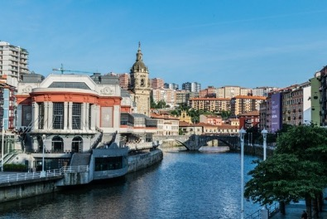
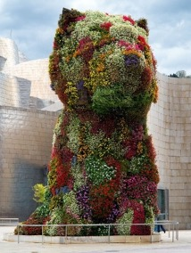
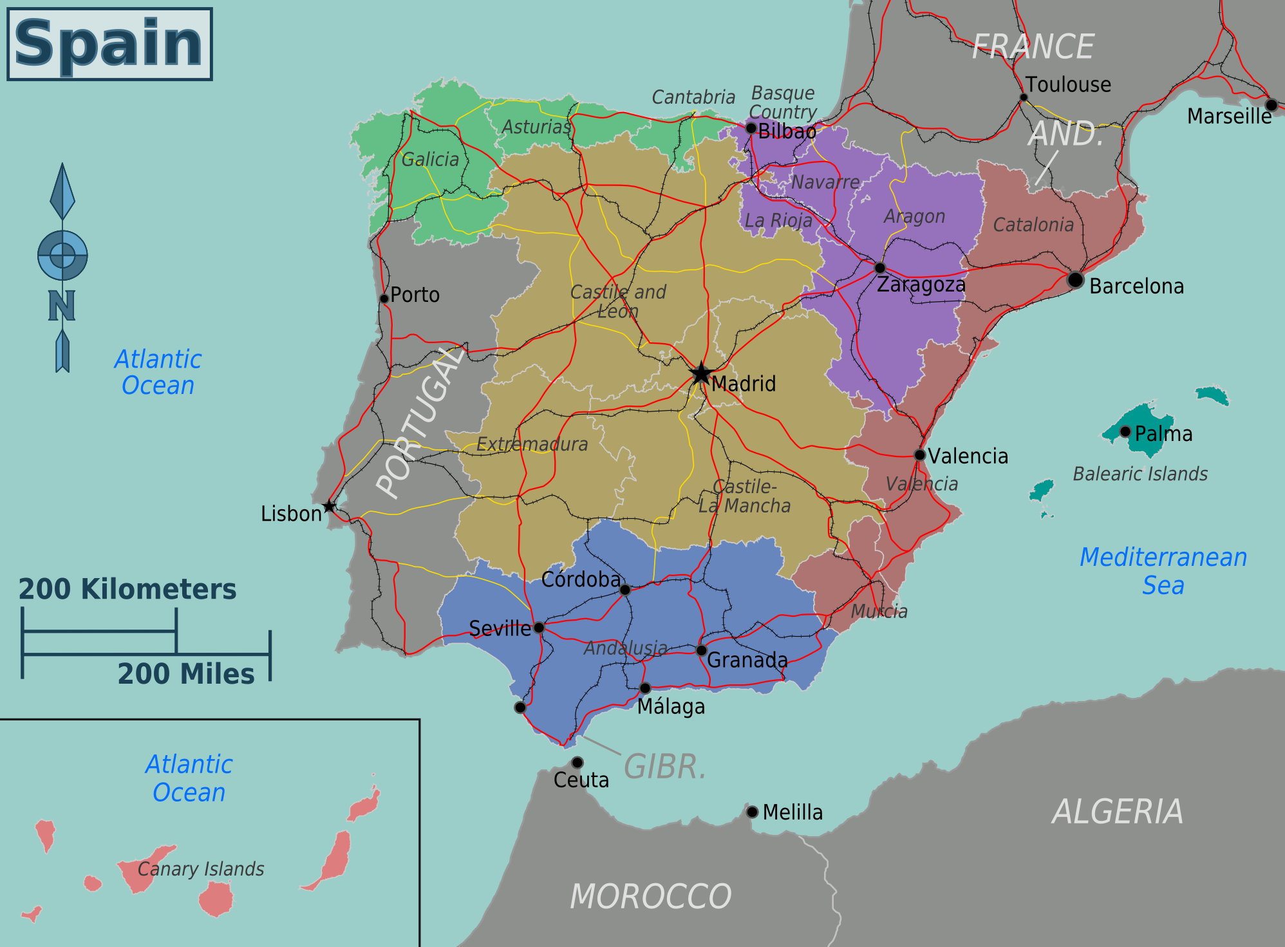
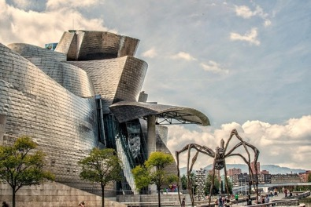
Asking questions about past holidays
Ría de Bilbao
–er & -ir verbs (preterite – revisited)
question words (revisited)
Puppy
Y9 Spanish Term 1.1 – Week 2 – Lesson 4 Amanda Izquierdo / Nick Avery / Rachel Hawkes
Artwork: Mark Davies Date updated: 10.09.23
Museo Guggenheim
Notes:
Artwork by Mark Davies. All additional pictures selected are available under a Creative Commons license, no attribution required.
Native teacher feedback provided by Blanca Román.
Learning outcomes (lesson 2)
Consolidation of the following:
-er/-ir verbs in preterite: 2nd person –iste
question words
awareness raising of 'did' auxiliary
a subset of Y7 and Y8 vocabulary (see below)
Frequency rankings of vocabulary revisited this week (1 is the most common word in Spanish):
sin embargo [embargo-203]; coger [1001]; concierto [1456]; premio [1090]; además [155]; gente [137]; genial [2890]; permitir [218]; decidir [368]; compartir [579]; fuerte² [435] salir [114]; perder [195]; recoger [828]; entrada [767]; billete [2992]; conocer [128]; ofrecer [351]; conocido [759]; ambiente [729]; zona [359]; directo [1029]; tener lugar [lugar-144]; lado [214]; así que [que-3]; (a) pie [365]; julio [659]; norte [624]; España [N/A]; ¿cómo? [151]; isla [810]; pequeño [202]; centro [316]; plaza [806]; el, la [1]; hermano [333]; hermana [3409]; río [496]; hermoso [980]; naturaleza [712]; actividad [344]; comida [906]; comer [347]; correr [343]; playa [1475]; descubrir [414]; parte¹ [92]; calle [269]; barco [1384]; allí [197]; ¿dónde? [161]; ¿cuándo? [57]; (por) ¿qué? [50]; ¿quién? [289]
Source: Davies, M. & Davies, K. (2018). A frequency dictionary of Spanish: Core vocabulary for learners (2nd ed.). Routledge: London

Slide 16
vocabulary
p _ _ _ _ _ _ _
hablar
el p_ _ _ _ _
el premio
o_ _ _ _ _ _
d_ _ _ _ _ _
c_ _ _ _ _ _ _
a_ _ _ _ _
la h_ _ _ _ _ _
prize
f_ _ _ _ _
la p_ _ _ _
e_ / l_
h_ _ _ _ _ _
a_ _ _
Notes:
Note: if students don’t seem to recall these securely, rewind the slides and repeat 2-3 times. There is time allowed for this in the time allocation for the activity. In addition, teachers might bring this activity back at the end of the lesson for further retrieval practice.
Timing: 5 minutes (12 slides)
Aim: productive oral recall of vocabulary revisited this week.
Procedure:
Students look at prompt (the word or image in the centre).
They say the Spanish word aloud.
The teacher clicks anywhere on the screen to reveal the answer.

Slide 17
vocabulary
p _ _ _ _ _ _ _
hablar
el p_ _ _ _ _
o_ _ _ _ _ _
d_ _ _ _ _ _
c_ _ _ _ _ _ _
the
a_ _ _ _ _
la h_ _ _ _ _ _
f_ _ _ _ _
la p_ _ _ _
el / la
e_ / l_
h_ _ _ _ _ _
a_ _ _
Notes:
Vocabulary revision

Slide 18
vocabulary
p _ _ _ _ _ _ _
hablar
el p_ _ _ _ _
o_ _ _ _ _ _
d_ _ _ _ _ _
c_ _ _ _ _ _ _
a_ _ _ _ _
la h_ _ _ _ _ _
strong, loud
f_ _ _ _ _
fuerte
la p_ _ _ _
e_ / l_
h_ _ _ _ _ _
a_ _ _
Notes:
Vocabulary revision

Slide 19
vocabulary
p _ _ _ _ _ _ _
hablar
el p_ _ _ _ _
o_ _ _ _ _ _
d_ _ _ _ _ _
c_ _ _ _ _ _ _
beautiful
a_ _ _ _ _
la h_ _ _ _ _ _
f_ _ _ _ _
la p_ _ _ _
e_ / l_
hermoso/a
h_ _ _ _ _ _
a_ _ _
Notes:
Vocabulary revision

Slide 20
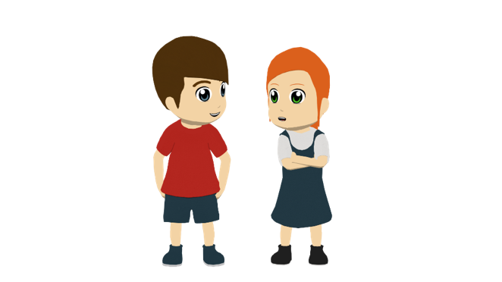
vocabulary
p _ _ _ _ _ _ _
hablar
el p_ _ _ _ _
o_ _ _ _ _ _
d_ _ _ _ _ _
c_ _ _ _ _ _ _
a_ _ _ _ _
la h_ _ _ _ _ _
la hermana
sister
f_ _ _ _ _
la p_ _ _ _
e_ / l_
h_ _ _ _ _ _
a_ _ _
Notes:
Vocabulary revision

Slide 21
vocabulary
p _ _ _ _ _ _ _
hablar
el p_ _ _ _ _
o_ _ _ _ _ _
d_ _ _ _ _ _
conocido/a
c_ _ _ _ _ _ _
well-known
a_ _ _ _ _
la h_ _ _ _ _ _
f_ _ _ _ _
la p_ _ _ _
e_ / l_
h_ _ _ _ _ _
a_ _ _
Notes:
Vocabulary revision

Slide 22
vocabulary
permitir
hablar
p _ _ _ _ _ _ _
el p_ _ _ _ _
o_ _ _ _ _ _
d_ _ _ _ _ _
c_ _ _ _ _ _ _
a_ _ _ _ _
to allow, allowing
la h_ _ _ _ _ _
f_ _ _ _ _
la p_ _ _ _
e_ / l_
h_ _ _ _ _ _
a_ _ _
Notes:
Vocabulary revision

Slide 23
vocabulary
p _ _ _ _ _ _ _
hablar
el p_ _ _ _ _
ofrecer
o_ _ _ _ _ _
d_ _ _ _ _ _
c_ _ _ _ _ _ _
a_ _ _ _ _
la h_ _ _ _ _ _
to offer, offering
f_ _ _ _ _
la p_ _ _ _
e_ / l_
h_ _ _ _ _ _
a_ _ _
Notes:
Vocabulary revision

Slide 24
vocabulary
p _ _ _ _ _ _ _
hablar
el p_ _ _ _ _
o_ _ _ _ _ _
d_ _ _ _ _ _
directo
c_ _ _ _ _ _ _
a_ _ _ _ _
direct (m)
la h_ _ _ _ _ _
f_ _ _ _ _
la p_ _ _ _
e_ / l_
h_ _ _ _ _ _
a_ _ _
Notes:
Vocabulary revision

Slide 25
vocabulary
p _ _ _ _ _ _ _
hablar
el p_ _ _ _ _
o_ _ _ _ _ _
d_ _ _ _ _ _
c_ _ _ _ _ _ _
además
besides, as well
a_ _ _ _ _
la h_ _ _ _ _ _
f_ _ _ _ _
la p_ _ _ _
e_ / l_
h_ _ _ _ _ _
a_ _ _
Notes:
Vocabulary revision

Slide 26
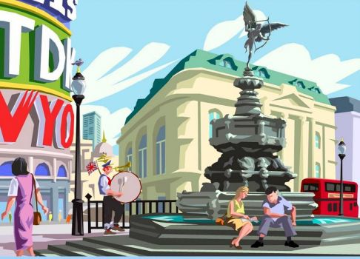
vocabulary
p _ _ _ _ _ _ _
hablar
el p_ _ _ _ _
o_ _ _ _ _ _
d_ _ _ _ _ _
c_ _ _ _ _ _ _
a_ _ _ _ _
la h_ _ _ _ _ _
square
f_ _ _ _ _
la plaza
la p_ _ _ _
e_ / l_
h_ _ _ _ _ _
a_ _ _
Notes:
Vocabulary revision

Slide 27
vocabulary
p _ _ _ _ _ _ _
hablar
el p_ _ _ _ _
o_ _ _ _ _ _
d_ _ _ _ _ _
c_ _ _ _ _ _ _
a_ _ _ _ _
there
la h_ _ _ _ _ _
f_ _ _ _ _
la p_ _ _ _
e_ / l_
h_ _ _ _ _ _
a_ _ _
allí
Notes:
Vocabulary revision

Slide 28
Describing completed events in the past -er & -ir verbs in the preterite
gramática
Let’s remember how –er and –ir verbs work in the past (preterite):
to go out
salir
All regular –er and –ir verbs work like this to talk about completed events in the past.
I went out.
Salí.
You went out.
Saliste.
She/he went out.
Salió.
Notes:
Timing: 2 minutes
Aim: to recap the 1st, 2nd and 3rd person singular endings for –er and –ir verbs in the preterite tense.
Procedure:
1. Click to go through the rules for each verb ending. Gaps are left for teachers to elicit answers from students for the endings and translated sentences.

Slide 29
Yes/no questions
gramática
Remember that to ask a question in Spanish, you use the same verb, but with raised intonation.
Listen and compare:
1
Comiste algo.
You ate something.
2
¿Comiste algo?
Did you eat something?
3
¿Qué comiste?
What did you eat?
Notice how in English we use the verb ‘did’ to ask these questions in the past.
Notes:
Timing: 2 minutes
Aim: to remind students of English vs Spanish question formation differences, in particular the use of the auxiliary ‘do’ (which becomes ‘did’ in past).
Procedure:
Click to reveal each part of the explanation.

Slide 30
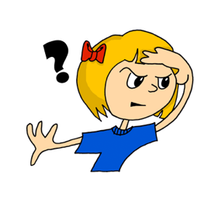
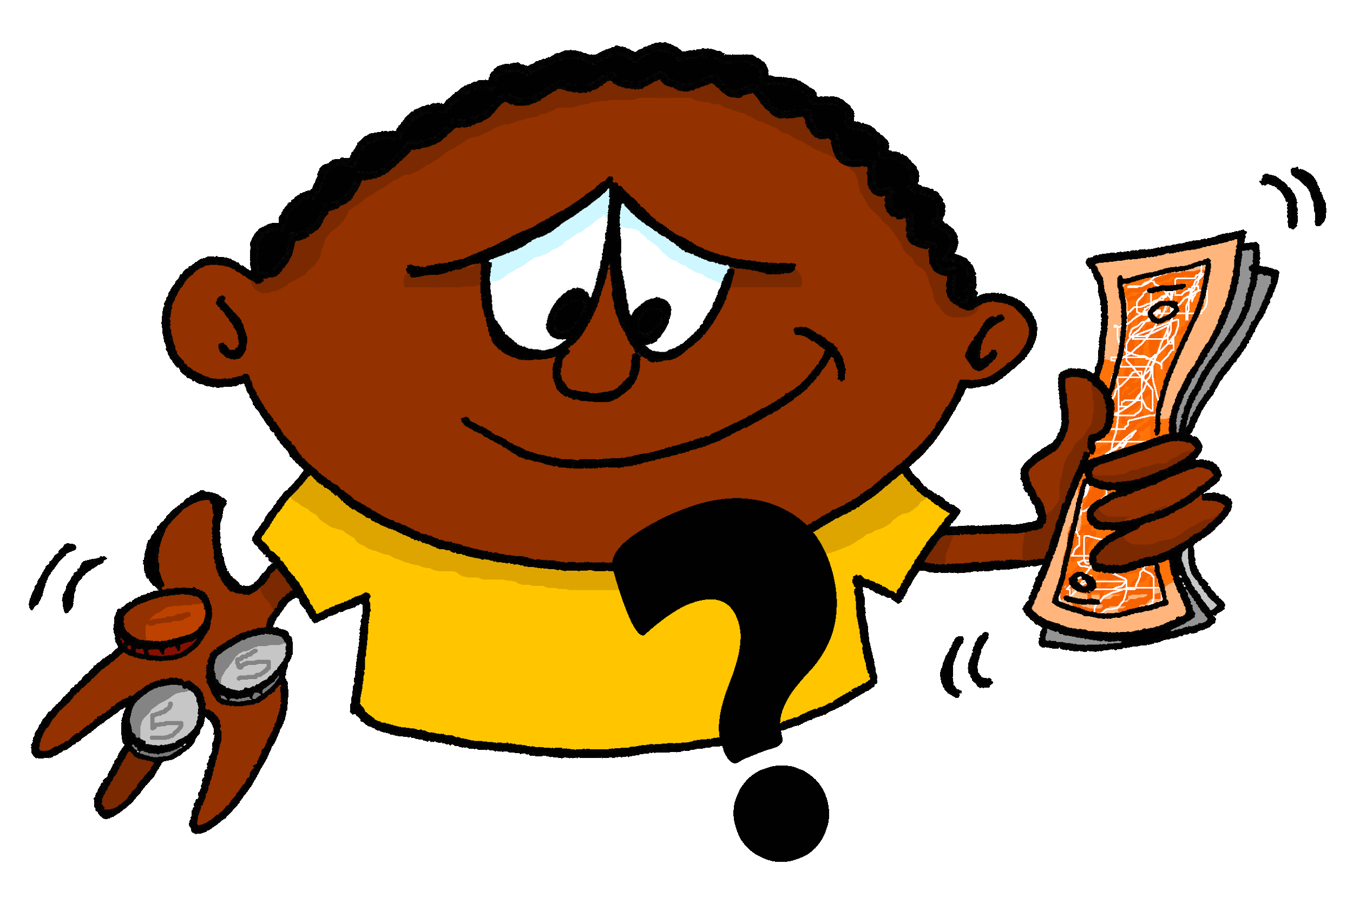
Preguntas
Identifica la pregunta correcta.
leer / hablar
How?
Who?
Where?
Which?
1
2
3
4
¿cómo?
¿quién?
¿dónde?
¿cuál?
What?
How many?
When?
5
6
7
¿qué?
¿cuántos/as?
¿cuándo?
¿quién?
¿qué?
¿cómo?
¿cuál?
¿dónde?
¿cuándo?
¿cuántos/as?
Notes:
THIS SLIDE (WITH SUPPORT) OR THE NEXT SLIDE (MORE CHALLENGING, WITHOUT SUPPORT) Timing: 2 minutes
Aim: to refresh understanding of seven previously taught question words ahead of the next activity.
Procedure:
Ask students to volunteer answers orally, in chorus.
Click for the Spanish word to float to the correct English word.
Note:
On the next slide there is another version of this activity without the answers at the bottom (a more challenging version). Teachers can choose which to do.

Slide 31
Preguntas
Identifica la pregunta correcta.
hablar
How?
Who?
Where?
Which?
1
2
3
4
¿cómo?
¿quién?
¿dónde?
¿cuál?
What?
How many?
When?
5
6
7
¿qué?
¿cuántos/as?
¿cuándo?
Notes:
ALTERNATIVE
Here students have to recall the question words themselves. Teachers ask students to provide the answers orally, in chorus.

Slide 32
Preguntas sobre las vacaciones
leer / escuchar
Lee las preguntas. ¿Es ‘yo’, ‘tú’ o ‘él/ella’?
Escucha las respuestas. ¿Cuál es la pregunta correcta?
Escribe el número (e.g. pregunta 3, pregunta 5).
 | ‘I’ | ‘you’ | ‘s/he’
1. ¿Dónde corrió?
2. ¿Cuándo recogí las entradas?
3. ¿Cuántos billetes decidiste comprar?
4. ¿Por qué cogiste un barco?
5. ¿Qué perdí?
6. ¿Quién salió a la plaza?
Respuestas
A
pregunta 2
B
pregunta 5
C
pregunta 1
D
pregunta 6
E
pregunta 4
F
pregunta 3
Notes:
Timing: 8 minutes
Aims:
i) to consolidate understanding of 1st, 2nd and 3rd person singular verb endings for preterite and question words (receptive mode, written modality).
ii) to consolidate understanding of other vocabulary (receptive mode, oral and written modalities).
Procedure:
Students read each sentence and decide on the person referred to.
Click to reveal each answer to the first part of the activity. Elicit oral translations of the questions in English to check understanding.
Students then listen to the responses (A, B, C...) and decide which question the answer must refer to.
Ask students about the difference in meaning between ‘entrada’ (ticket for a venue or event) and ‘billete’ (ticket for transport). Although students have not yet learnt further meanings, they may be interested to know that ‘billete’ can also mean ‘banknote’ in other contexts.
Note: alternatively, answers could be checked after both parts of the activity have been done. This may suit a higher-achieving group.
Transcript:
El doce de julio.
La entrada para el concierto.
En el centro.
Mi prima.
Para ver la isla.
Dos: uno para mi hermana y otro para tu hermano.
Clipart from https://openmoji.org

Slide 33
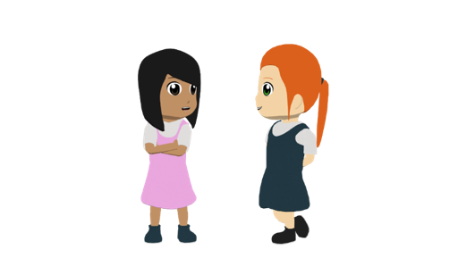
leer / escuchar
Lee el diálogo y escribe la palabra correcta. Las opciones son: ¿qué?/¿cómo?/¿dónde?/¿cuándo?/¿quién?/¿por qué?/¿cuál?/ ¿cuánto?
cómo
Cómo / dónde
Hola, Nadia. 1) ¿________ estás? 2) ¿________________ decidiste pasar las vacaciones?
¡Hola! Muy bien. Pues *al final decidí coger un tren a Bilbao para estar allí unos días.
¡Ah! ¡Qué bien! 3) ¿________ cogiste el tren?
En la última semana de julio.
4) ¿Y ________ hiciste?
¡Muchas cosas! Descubrí una zona nueva con unos restaurantes baratos muy buenos.
¿Ah, sí? 5) ¿________ comiste?
Yo comí pintxos, *claro. Sin embargo, mi hermano comió carne. También salí por la noche a la plaza en el centro.
6) ¿Y ________ por la noche?
Porque cada fin de semana en julio tiene lugar un concierto con música fuerte. Además, recogí entradas para el museo.
¡Genial! ¿Un museo? 7) ¿ ________ exactamente?
El Museo Guggenheim. Me encanta el edificio y ¡también me gusta ver a Puppy!
cuándo
*al final – in the end
Ría de Bilbao
*claro – of course
qué
Qué
Puppy
por qué
Cuál
Museo Guggenheim
Notes:
Timing: 15 minutes (teachers select their activities from the suggestions below or their own ideas)
Aims:
i) to consolidate understanding of question words used in discourse.
ii) to consolidate the use of 1st, 2nd and 3rd person singular verb endings for –er and –ir verbs in the preterite.
Procedure:
Students read the dialogue and decide which is the correct question word for each gap. They may use the same question word more than once.
Play the recording so that students can check their answers. The audio could be paused after each phrase or sentence and students could be asked to give an oral translation in English.
Other uses of the text could be one or more of the following:
search for all examples of –er and –ir verbs that have the –í, -iste and –ió endings. How many are there in total in the text, counting infinitives? Answer: 7 (decidir, coger, descubrir, comer, comer, salir, recoger). ‘Hacer’ is only very slightly irregular in the form ‘hiciste’, so arguably this is 8! How many verbs refer to ‘I’, ‘you’ and ‘s/he’, respectively? Answer: 5 for ‘I’ (decidí, descubrí, comí, recogí, salí); 4 for ‘you’ (decidiste, cogiste, hiciste, comiste); 1 for ‘s/he’ (comió).
for vocabulary practice, remove the verbs, give these as answer options and ask students to do a matching exercise.
remove question words and ask students to do a paired read aloud, recalling the correct question word for each gap.
dictation/transcription activity with a section of the text to practise using SSC knowledge (going from sound to spelling) and spelling rules (remembering to write a written accent for words with final syllable stress ending in a vowel in the preterite, e.g., recogí, comió). See next slide for the latter.
chop the text up into segments – either on the screen or printed out – and ask students to re-order sections of it in order to practise matching questions to answers.
give students an English translation of sections of the text and ask them to translate back into Spanish in order to practise producing the –er/–ir verb forms in preterite (-í, -iste, -ió).
Notes:
1. Puppy is a large sculpture of a dog (12 metres high!) outside the Guggenheim Museum in Bilbao. The flowers used to decorate it are changed every season. Different flowers are used to decorate it depending on the time of year.
2. It is worth pointing out that ‘ría’ here refers to a long estuary or ‘tidal river’. It is the mouth of several rivers and extends about 10 miles inland from the sea.
3. Bilbao is a city with an industrial past, but the city underwent a major regeneration and is now a very famous cultural hub.
Sources: https://www.bilbaoturismo.net/BilbaoTurismo/en/arte-al-aire-libre/puppy#:~:text=Puppy%2C%20a%20West%20Highland%20terrier,that%20tourists%20take%20of%20Bilbao.&text=It%20could%20be%20seen%20as,main%20icons%20of%20modern%20Bilbao.
https://blog.ferrovial.com/en/2017/10/flower-puppy-bilbao-guggenheim-museum/
https://www.visitbiscay.eus/en/-/la-ria-columna-vertebral-de-bilbao
Frequency of unknown words/cognates:
final [366]
Photos from Pixabay.com

Slide 34
El uso de los acentos
fonética
Remember:
Remember, if the stress falls on the final syllable, and the word ends in any consonant except ‘___’ or ‘___’, there is no written accent.
n
s
Por ejemplo:
hablar
estación
actividad
después
Estas palabras no necesitan tilde.
Estas palabras terminan en ‘n’ y ‘s’. Necesitan tilde.
Notes:
OPTIONAL (this and the next slide) Understanding and correct use of stress and associated spelling rules is assessed in the new GCSE at Higher Tier (see below). However, the knowledge is useful to all students for development of written accuracy in particular, and for making themselves understood clearly when speaking, i.e., for communication. This knowledge will be recapped and practised again, several times at KS4. Teachers will decide whether to include a focus on it now, in Y9, for their classes.
Timing: 1 min
Aim: to recap spelling rules related to stress position.
Procedure:
Click to reveal each part of the explanation. The word ‘tilde’ was used in Year 8 resources, but explain its meaning again if necessary.
If appropriate, ask students for further examples of words with final syllable stress that require / do not require a written accent.
HIGHER TIER
Key stress positions and associated spelling rules
The list which follows specifies key spelling rules determined by the position of stress, which students will need to learn at GCSE.
When reading words aloud in Spanish:
stress any vowel that has a written accent
stress the final syllable in a word, except:
stress the penultimate syllable for any word ending in a vowel, ‘n’, or ‘s’ (unless there is a written accent)
When transcribing Spanish, only write an accent on the stressed vowel for:
words with stress on a final syllable ending in a vowel, ‘n’, or ‘s’
words with stress on penultimate (second to last) syllable for a word ending in a consonant (other than ‘n’ or ‘s’)
all words with stress on the antepenultimate (third to last) syllable

Slide 35
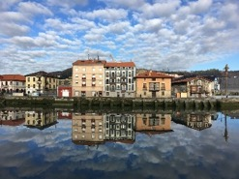
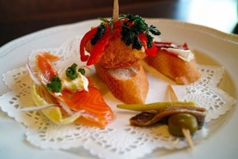
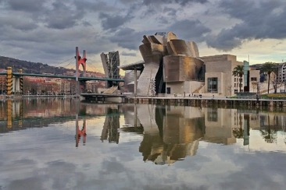
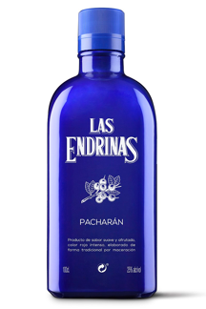
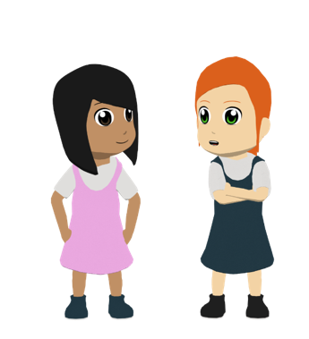
Bilbao
fonética
El pacharán es una bebida alcohólica típica en el norte de España.
Lee y escucha estas frases. En cada frase hay palabras con énfasis en la última sílaba. ¿Cuáles son? ¿Necesitan una tilde o no?
Bilbao es un destino internacional sin comparación.
1
Bilbao es un destino internacional sin comparacion.
2
¡Un menu genial! Yo comi pintxos y mi hermano comio carne.
¡Un menú genial! Yo comí pintxos y mi hermano comió carne.
3
Pues al final decidi coger el funicular y observar toda la poblacion.
Pues al final decidí coger el funicular y observar toda la población.
la población =
city, town, population
4
También salió al corazón de la ciudad y bebió pacharán.
Tambien salio al corazon de la ciudad y bebio pacharan.
5
el corazón = heart
Además, subí al edificio Bailén porque es muy peculiar.
Ademas, subi al edificio Bailen porque es muy peculiar.
Notes:
OPTIONAL Timing: 5 minutes
Aims:
i) to consolidate recognition of final syllable stress.
ii) to consolidate the use of the written accent in words with final syllable stress.
Procedure:
Students listen to each sentence. They write the words that have final syllable stress.
Click once and show the sentence with words with final syllable stress. These appear in bold. At this stage, all of the accents have been removed.
Students think which of those words need a written accent. Here they will need to apply the spelling rule by looking at the final letter of each word.
Click again to show the words in bold in their correct form (with or without written accents). Bailén is the name of a building in Bilbao.
Note: some words are known and others are unknown, making this a hybrid vocabulary/sounds of the language task.
El edificio Bailén is a real building in Bilbao. At the time of being built, it was the tallest building in Bilbao (43 metres).
Frequency of unknown words/cognates:
destino [960]; internacional [463]; comparación [2458]; menú [4112]; funicular [>5000]; observar [556]; corazón [475]; peculiar [4148]

Slide 36
Un email de Daniel
Daniel writes to you in English about his summer holiday. Write back.
escribir
Escribe un mensaje.
Just have a go! Write any of these English words or sentences in Spanish or use your own ideas.
Hello, I’m Daniel.
I spent the summer holidays in the north of Spain with my sister.
Mention:
where you spent the summer holidays
what transport you took
what the place is like
what you did there
one event on one particular day
Instead of ‘get’ we ‘arrive’ there in Spanish.
I caught a train in order to get there.
The place is beautiful, with beaches and lots of nature.
With two verbs together, the 2nd verb is an infinitive.
I decided to go to the beach every morning and discover the area in the afternoon.
One day in the holidays, I went out to the centre. I picked up the tickets for a concert in the square and I went with Lucía. It was amazing!
Write 1 sentence for bullets 1-3 and at least two sentences for the bullets 4 & 5.
What about you?
Notes:
EITHER THIS WRITING OR THE ROLE PLAY ACTIVITY ON THE FOLLOWING SLIDES
Timing: 15 minutes
Aim: to write a short text about a past summer holiday; to practise written production of vocabulary and structures from this week and previous learning.
Note: Students can either use the English message as their content and translate it into Spanish, making some minor changes of detail, or they can write their own text, responding to the bullets in a more open-ended way. Teachers can direct their students to do whatever is most appropriate for their students at the moment.
Procedure:
Students read the message from Daniel in the blue text box.
Students use Daniel’s message to a greater or lesser extent to support their own writing.
They write a similar length text.
Encourage students wherever possible to write from memory. It could be useful, however for them to have this English content in view and to give them 10 minutes planning time using their KO or Language Guide or dictionaries to look up words they will need. Then give them 5 full minutes to write what they can from their planning notes.
The source text targets the following vocabulary from this week:
sin embargo [embargo-203]; coger [1001]; concierto [1456]; premio [1090]; además [155]; gente [137]; genial [2890]; permitir [218]; decidir [368]; compartir [579]; fuerte² [435] salir [114]; perder [195]; recoger [828]; entrada [767]; billete [2992]; conocer [128]; ofrecer [351]; conocido [759]; ambiente [729]; zona [359]; directo [1029]; tener lugar [lugar-144]; lado [214]; así que [que-3]; (a) pie [365]; julio [659]; norte [624]; España [N/A]; ¿cómo? [151]; isla [810]; pequeño [202]; centro [316]; plaza [806]; el, la [1]; hermano [333]; hermana [3409]; río [496]; hermoso [980]; naturaleza [712]; actividad [344]; comida [906]; comer [347]; correr [343]; playa [1475]; descubrir [414]; parte¹ [92]; calle [269]; barco [1384]; allí [197]; ¿dónde? [161]; ¿cuándo? [57]; (por) ¿qué? [50]; ¿quién? [289] –

Slide 37
Un diálogo
escribir / hablar / escuchar
Say hello. Ask: how are you?
3. Ask: Where did you spend the holidays?
5. Ask: What is the place like?
7. Ask: What did you do?
9. Ask: How was it/did it go?
2. Greet your partner and respond to the question.
4. Reply: I spent the holidays in…
6. Reply: The place is …
8. Say: I … and I also…
10. Say: it was/went …
Extra challenge: include these words somewhere in your answers.
decidir | conocer | ofrecer |comer | además | sin embargo zona | ambiente | premio | entrada | hermoso | conocido billete | zona | río | comida | barco | pequeño | fuerte
¡Otra vez!
Notes:
Timing: 15 minutes Aim: to practise productive use of this and last week’s revisited structures and some vocabulary in a role play interaction about past summer holidays.
Procedure: 1. Give students 8 minutes in pairs to write the dialogue in their books. They can work together – they will need to be able to play both roles in the dialogue.
2. In the remaining 5 minutes, ask students to turn their notes over and carry out the interaction using the English prompts on the board, and glancing at their notes only if they get stuck.
3. Ask them to repeat the task, swapping roles.

Slide 38
Deberes
Vocabulary Learning Homework (Y9 Term 1.1, Week 3)
Quizlet link
Quizlet QR code
Student worksheet
Notes:
Note: HW for Y9 is usually made up of pre-learning of vocabulary 15-30 minutes (depending on school policy on HW time) plus 20-30 minutes vocabulary activities to deepen word knowledge, provided on a student homework sheet (which also contains a clickable link to the audio file). Answer sheets are also provided. The answer sheet for the Y9 vocabulary learning HW sheet Week 3 is here: https://rachelhawkes.com/LDPresources/Yr9Spanish/Spanish_Y9_Term1i_Wk3_HW_sheet_answers.docx
Notes:
With the LDP SOW the vocabulary for Years 9 – 11 is provided on Quizlet.
ii) There are other free apps, and new ones are always appearing. Teachers have told us that they are currently using: Flippity, Wordwall (where using previously-created activities is free).
iii) Gaming Grammar has been acquired by Language Nut. Its original content should still be available to teachers and much of it is appropriate for Y9 learners. From this lesson, for example, learners could practise:
Verbs: 1st and 3rd person past tense in the ‘Verb agreement (past)’ menu

Slide 39
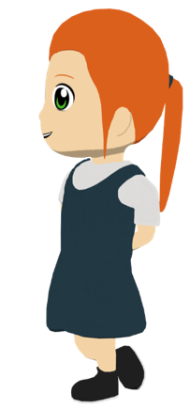
Las vacaciones de Lucía y Daniel
leer
Lucía habla con Nadia. Lucía describe las vacaciones en San Sebastián.
Lee las frases y escribe quién hizo cada actividad.
Who… | Lucía (‘I’) | Daniel (‘he’)
1. decided to spend time in San Sebastián?
2. went out every afternoon/evening?
3. ran every day on the beach?
4. took the bus on Monday?
5. went up the mountain on foot?
6. picked up the tickets (for an event)?
1. En julio decidí pasar tiempo en San Sebastián.
2. Salí todas las tardes.
3. ¡Corrió en la playa todos los días!
4. El lunes cogí el autobús.
5. Subió la montaña a pie.
6. Recogí las entradas.
Notes:
ADDITIONAL READING ACTIVITY WHICH COULD BE HW.
Timing: 7 minutes
Aim: reading activity to practise connecting the 1st and 3rd person singular –er and –ir preterite verb forms with their meanings.
Procedure:
Students read the extracts in order to fill in the table, ticking the column for the person who did each action. If working in their exercise books, they can just write, e.g., 1. I.
Click to reveal the answers.
The full text is shown on the next slide.
Notes:
The activity could easily be adapted for a higher-achieving group by changing the order of the questions, which currently appear in the same order as in the text.
The text has been slightly adapted to facilitate grammar practice (e.g. by omitting pronouns).

