Slide 1
Following instructions at work [2]
il faut + infinitive
SSC [i] [revisited]
Y9 French
Term 1.1 - Week 5 - Lesson 9
Catherine Salkeld / Catherine Morris / Amber Dudley
Artwork by: Chloé Motard
Date updated: 10.10.23
Notes:
Note: no new vocabulary is introduced (continue to practise with vocabulary introduced in 9.1.1.4)
Artwork by Chloé Motard. All additional pictures selected are available under a Creative Commons license, no attribution required.
Native speaker feedback provided by Sarah Brichory.
With thanks to Rachel Hawkes for her input on the lesson material.
Learning outcomes (lesson 1):
Consolidation of SSCs [i]
Introduction of il faut + infinitive
Word frequency (1 is the most frequent word in French):
9.1.1.4 (introduce) devons, devez, doivent [39], peuvent [20], savent1,2 [67], veulent [57], attitude [834], collègue [1099], directeur2 [640], entreprise [298], stage [4007], piscine [>5000], actif [1289], négatif [1502], positif [949], sportif [2670]
8.3.2.4 (revisit) commencer [139], expliquer [252], emprunter [1121], quitter [507], bibliothèque [2511], cours [169], fois [49], tâche [887], déjà¹ [58], enfin [349], toujours [103]
8.3.1.2 (revisit) décision [370], soin [1109], dur [1029], facilement [1194], lentement [2637], mal¹ [277], mieux [217], vite [711]
Source: Lonsdale, D., & Le Bras, Y. (2009). A Frequency Dictionary of French: Core vocabulary for learners London: Routledge.
The frequency rankings for words that occur in this PowerPoint which have been previously introduced in NCELP resources are given in the NCELP SOW and in the resources that first introduced and formally re-visited those words.
For any other words that occur incidentally in this PowerPoint, frequency rankings will be provided in the notes field wherever possible.

Slide 2
i
midi
Notes:
Timing: 1 minute
Aim: To consolidate SSC [i]
Procedure: 1. Present the letter(s) and say the [i] sound first, on its own. Students repeat it with you. 2. Bring up the word ”midi” on its own, say it, students repeat it, so that they have the opportunity to focus all of their attention on the connection between the written word and its sound.
3. A possible gesture for this would be to draw a circle representing a clock face with one hand, with the other arm and hand pointing straight up (representing the hands on 12) within the circle. 4. Roll back the animations and work through 1-3 again, but this time, dropping your voice completely to listen carefully to the students saying the [i] sound, pronouncing ”midi” and, if using, doing the gesture.
Word frequency (1 is the most frequent word in French):
midi [2483].
Source: Londsale, D., & Le Bras, Y. (2009). A Frequency Dictionary of French: Core vocabulary for learners London: Routledge.

Slide 3
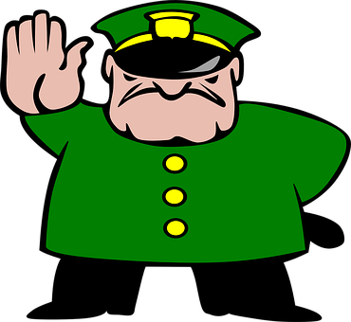
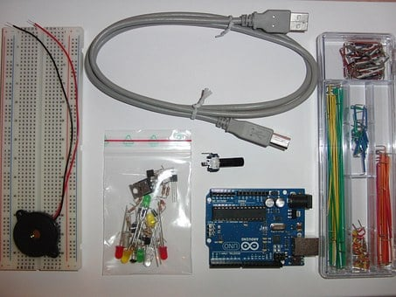
SSCs [i] in English and French
When you make these sounds, notice how your tongue is higher in French than in English.
phonétique
Below are three words that have the same meaning and spelling in English and French. They are cognates.
kit
film
strict
First, say the words aloud in English. Then, listen to the words in French and repeat.
Notice how the SSC [i] sounds different in English and French.
In English, the SSC [i] sounds like ‘ih’. But in French, it sounds like ‘ee’.
Notes:
Timing: 2 minutes
Aim: To draw attention to cross-linguistic differences in pronunciation of SSC [i].
Procedure:
1. Click to animate the explanation.
2. Students say the cognate words aloud in English and French. You can click on the words in orange to hear them read aloud in French by a native speaker.
3. Encourage students to compare the position of their tongue when saying the words in English and French. Because the French SSC [i] is a more ‘closed’ vowel than the English SSC [i], the position of the tongue should be higher in French than in English.
Transcript:
kit
film
strict
Word frequency of cognates used (1 is the most frequent word in French):
kit [>5000]
Source: Londsale, D., & Le Bras, Y. (2009). A Frequency Dictionary of French: Core vocabulary for learners London: Routledge.

Slide 4
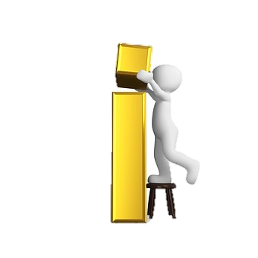
SSCs: [e] vs. [i]
Remember! In English, the SSC [i] sounds like ‘ih’. But in French, it sounds like ‘ee’.
écouter
Écoute ces mots et remplis les blancs avec la bonne SSC.
C’est quoi en anglais ?
 | French | English | [e] | [i]
 | mégabit | megabyte
 | rebelle | rebel
 | menu | menu
 | bip | beep
 | riche | rich
 | rejeté | rejected
1
_
2
_
3
_
4
_
5
_
6
_
Notes:
Timing: 5 minutes
Aim: Aural recognition of SSCs [e] and [i]; raising awareness of cross-linguistic differences in pronunciation between cognates and near-cognates; to ‘break’ the association between English SSC [i] and the sound ‘ih’ and to connect this sound with its nearest French equivalent, SSC [e].
Procedure:
1. Depending on the needs of the class, click to bring up the reminder about pronunciation.
2. Click the number button on the left to hear the French word read aloud.
3. Students fill in the gap with the correct SSC. Note that these words have specifically been chosen because they are near cognates.
4. Click to reveal the missing SSC and a tick in the correct column.
5. Click to reveal the next task instruction.
6. Students try to volunteer the English translation.
7. Students say the pairs of words, first in French and then in English.
Transcript:
1. mégabit
2. rebelle
3. menu
4. bip
5. riche
6. rejeté
Word frequency of cognates used (1 is the most frequent word in French):
mégabit [>5000], rebelle [2621], menu [3470], bip [<5000], riche [599], rejeter [981]
Source: Londsale, D., & Le Bras, Y. (2009). A Frequency Dictionary of French: Core vocabulary for learners London: Routledge.

Slide 5
Vocabulaire
parler / écrire
we have to, must
nous devons
you (pl/fml) have to, must
vous devez
they must
ils doivent
swimming pool
la piscine
they can, are able to
ils peuvent
they know how to
ils savent
they want (to)
ils veulent
company
l’entreprise (f)
attitude
l’attitude (f)
colleague (m)
le collègue
manager (f)
la directrice
work experience
le stage
energetic (m)
actif
negative (f)
négative
positive (m)
positif
sporty (f)
sportive
Notes:
Timing: 4 minutes
Aim: Oral or written production of new vocabulary.
Procedure:
1. Click to start. The first box spins.
2. Students call out or write the French for that box before it stops spinning.
3. The French appears.
4. Repeat until all French words have been revealed.

Slide 6
Il faut + infinitive
grammaire
‘Devoir’ changes to tell us who must do something.
We already know one way to talk about necessity:
Nous devons regarder les messages. We must look at the messages.
On doit regarder les messages. You/we have to look at the messages.
Here is another way:
Il faut regarder les messages. It is necessary to look at the messages.
‘Il faut’ is a special verb form that is only used in the 3rd person singular.
‘Il faut’ never changes form. It does not give information about who must do something.
It is the same for one person or multiple people. It simply states that it is necessary to do it.
Il faut corriger les erreurs. It is necessary to correct the mistakes.
‘Il faut’ stays the same. It doesn’t tell us who must do something.
Notes:
Timing: 3 minutes
Aim: Introduction of il faut + infinitive as an alternative structure to devoir + infinitive.

Slide 7
Le stage à la piscine
écouter
Océane parle de l’attitude d’Amir.
Is she talking about what Amir does, or what everyone needs to do?
Write the activities in English.
 | Everyone needs to … | But Amir … | Activity
 |  |  | has a negative attitude
 |  |  | have a positive attitude
 |  |  | uses social media in the office
 |  |  | leaves work early every day
 |  |  | work hard
 |  |  | works slowly
R
1
1
2
2
3
3
4
4
5
5
6
6
Notes:
Timing: 8 minutes
Aim: Aural recognition of il faut + long form contrasted with il + short form and connecting these with meaning (what it is necessary to do vs what somebody is doing). Listening comprehension.
Procedure:
1. Click the numbers on the left to hear audio with a beep before the verb.
2. Students write 1-6. Explain that they need to decide in each case whether Océane is talking about what Amir does (il + short form) or what it’s necessary to do (il faut + long form).
3. Click to reveal the answers.
4. Students listen again and note the activity mentioned in English.
5. The full audio (without beeps) is provided in the last column.
Transcript:
1) Parfois, il [-] a une attitude négative.
2) Il [faut] avoir une attitude positive au travail !
3) Il [-] utilise les réseaux sociaux dans le bureau.
4) Il [-] quitte tôt le travail chaque jour !
5) Il [-] travaille lentement.
6) Il [faut] travailler dur !

Slide 8
Le stage à la piscine
lire
Océane regarde son collègue et prend des notes. Que fait ce collègue ? Et que doit-on faire en général ? Écris ‘faut’ ou ‘[-]’ et fais deux listes en anglais.
what her colleague does | what everyone needs to do
arrives early | go to the office
writes notes | read the notes
organises swimming lessons | choose groups of pupils
Il [-] arrive tôt.
Il faut aller au bureau.
Il faut lire les notes.
Il [-] écrit des notes.
Il [-] organise les cours de natation.
Il faut choisir des groupes d’élèves.
?
?
?
?
?
?
Notes:
Timing: 8 minutes
Aim: Written recognition of il faut + long form contrasted with il + short form and connecting these with meaning (what it is necessary to do vs what somebody is doing). Reading comprehension.
Procedure:
1. Students write 1-6. They read the sentences and decide whether the question mark covers faut or ‘nothing’. Ensure they know that faut is followed by the long form.
2. Click to reveal answers.
3. Students read the sentences again and list in English what the Océane’s colleague does (il + short form) and what it’s necessary for everyone to do (il faut + long form).
4. Click to reveal answers.
Word frequency of cognates used (1 is the most frequent word in French): groupe [187]
Source: Lonsdale, D., & Le Bras, Y. (2009). A Frequency Dictionary of French: Core vocabulary for learners London: Routledge.

Slide 9
Océane parle de son stage
Océane écrit à Léa et Sophie. Écris les verbes en français.
écrire
Salut, Léa et Sophie !
Enfin, je fais mon stage à la piscine avec Amir ! Nous travaillons les samedis. Il faut travailler dur, mais Amir n’est pas travailleur ! Souvent, nous voulons aller au café le matin, mais il faut manger seulement* pendant l’heure du déjeuner. Nous pouvons prendre un cours de natation après* le travail, mais Amir préfère aller au cinéma. C’est ridicule ! Il faut faire de l’exercice!
Un stage en entreprise est idéal pour vous puisque vous savez utiliser
un ordinateur et vous prenez des décisions avec soin. Il faut être professionnel au bureau. Vous devez vite acheter des vêtements élégants.
À bientôt !
Océane
1) work
2) work
3) go
4) eat
5) take
6) prefer
7) do
8) be
9) use
10) take
11) be
12) buy
*seulement = only
*après = after
Notes:
Timing: 8 minutes
Aim: Written production of a range of known verbs in either the short form or the infinitive, depending on the presence or absence of a preceding modal verb.
Procedure:
1. Students write 1-12 and translate the translate the English verbs using either the short or long form, depending on what words appear immediately before them. At more advanced levels, this activity could be conducted as a read-aloud/sight translation exercise. If this option is selected, teacher should run through the pronunciation of the cognate words before beginning.
2. Click to reveal answers. Explain choice of long form or short form for each answer.
Word frequency of cognates used (1 is the most frequent word in French):
ridicule [2411], élégant [4747], professionnel [1000]
Source: Londsale, D., & Le Bras, Y. (2009). A Frequency Dictionary of French: Core vocabulary for learners London: Routledge.
Word frequency of unknown words used (1 is the most frequent word in French):
seulement [130], après [82]
Source: Londsale, D., & Le Bras, Y. (2009). A Frequency Dictionary of French: Core vocabulary for learners London: Routledge.

Slide 10
Océane parle de son stage
écrire
Salut, Léa et Sophie !
Enfin, je fais mon stage à la piscine avec Amir ! Nous travaillons les samedis. Il faut travailler dur, mais Amir n’est pas travailleur ! Souvent, nous voulons aller au café le matin, mais il faut manger seulement* pendant l’heure du déjeuner. Nous pouvons prendre un cours de natation après* le travail, mais Amir préfère aller au cinéma. C’est ridicule ! Il faut faire de l’exercice!
Un stage en entreprise est idéal pour vous puisque vous savez utiliser un ordinateur et vous prenez des décisions avec soin. Il faut être professionnel au bureau. Vous devez vite acheter des vêtements élégants.
À bientôt !
Océane
Ces phrases sont-elles vraies ou fausses?
Océane is doing work experience at the beach. FAUX
Océane is not doing her work experience with Amir. FAUX
Océane works every Saturday. VRAI
Océane can go to the café in the morning. FAUX
Amir prefers to go to the cinema after work. VRAI
Léa and Sophie know how to use a computer. VRAI
*seulement = only
*après = after
Notes:
Timing: 4 minutes
Aim: Written comprehension of text from the previous slide.
Procedure:
Students re-read the text from the previous slide and decide whether or not the sentences on the right are true or false.
Click to reveal the answers.
Word frequency of cognates used (1 is the most frequent word in French):
ridicule [2411], élégant [4747], professionnel [1000]
Source: Londsale, D., & Le Bras, Y. (2009). A Frequency Dictionary of French: Core vocabulary for learners London: Routledge.
Word frequency of unknown words used (1 is the most frequent word in French):
seulement [130], après [82]
Source: Londsale, D., & Le Bras, Y. (2009). A Frequency Dictionary of French: Core vocabulary for learners London: Routledge.

Slide 11
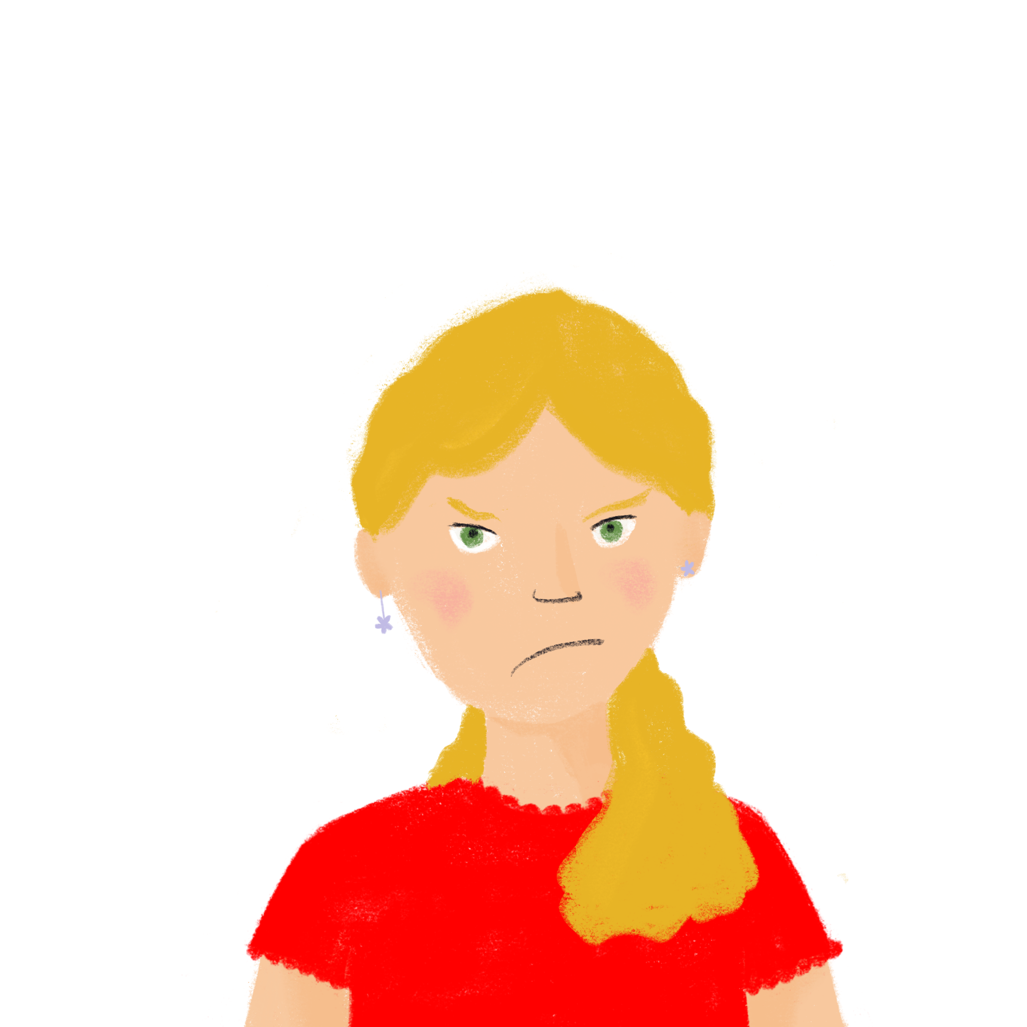
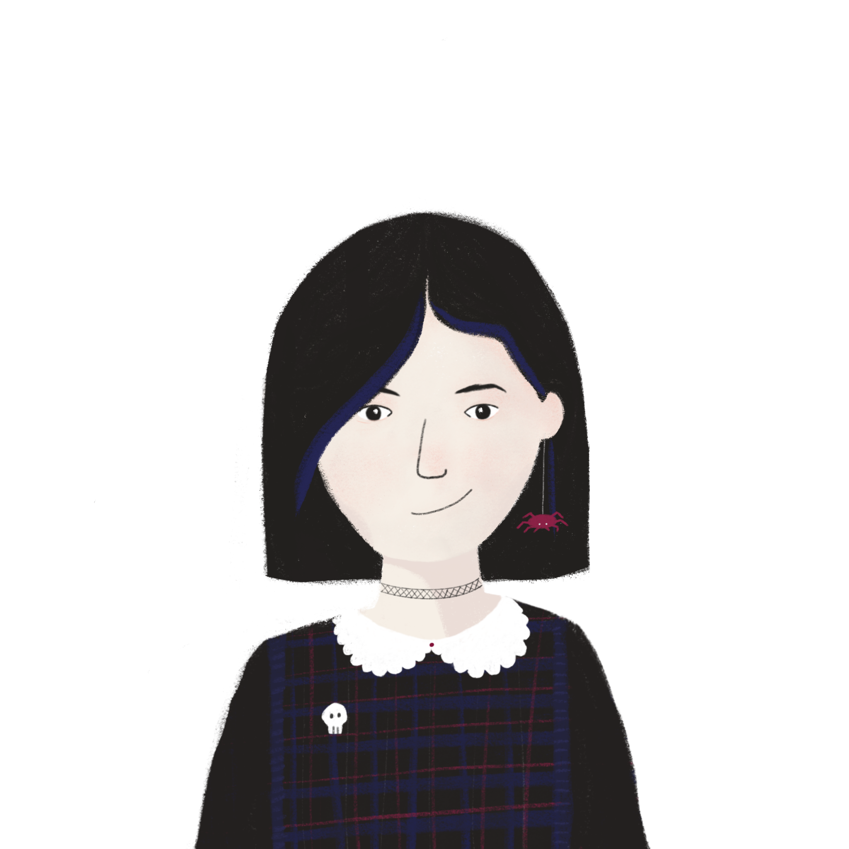
Un podcast sur le stage
parler
Léa et Sophie font un podcast sur le stage au bureau. Elles ne sont pas d’accord ! Léa veut utiliser « devoir » et Sophie préfère « il faut ». Léa traduit les phrases comment ? Et Sophie? Dis dix phrases.
Nous devons utiliser « devoir » !
Il faut utiliser « il faut » !
After saying these sentences with ‘devoir’, try to say them using ‘il faut’.
We must work hard at the office.
I must read lots of messages.
The secretary (m) must organise the company.
Amir and Océane must take care of the swimming pool.
You (pl) must choose a job.
Notes:
Timing: 10 minutes. This is slide 1/2.
Aim: Oral production of devoir+ long form and il faut + long form to reinforce the idea that the form of devoir changes for all persons, whereas il faut stays the same.
Procedure:
1. Check students understand the context – they may not yet have encountered the use of d’accord with être to mean ‘agree’.
2. Students translate each sentence in two different ways: with the conjugated form of devoir and with il faut.
3. Check answers using the suggested translations on the next slide.
4. Emphasise the use of devoir in conjugated form and the use of il faut for all persons.
Word frequency of cognates used (1 is the most frequent word in French):
podcast [>5000]
Source: Londsale, D., & Le Bras, Y. (2009). A Frequency Dictionary of French: Core vocabulary for learners London: Routledge.

Slide 12
Un article sur le stage
parler
devoir | il faut
1. Nous devons travailler dur au bureau. | 1. Il faut travailler dur au bureau.
2. Je dois lire beaucoup de messages. | 2. Il faut lire beaucoup de messages.
3. Le secrétaire doit organiser l’entreprise. | 3. Il faut organiser l’entreprise.
4. Amir et Océane doivent prendre soin de la piscine. | 4. Il faut prendre soin de la piscine.
5. Vous devez choisir un emploi. | 5. Il faut choisir un emploi.
Notes:
Suggested answers to the activity on the previous slide.
This is slide 2/2.

Slide 13
Following instructions at work [2]
il ne faut pas + infinitive
feminine adjectives: -f ➜ -ve
SSC [i] [revisited]
Y8 French
Term 1.1 - Week 5 - Lesson 10
Catherine Salkeld / Catherine Morris / Amber Dudley
Artwork by: Chloé Motard
Date updated: 10.10.23
Notes:
Note: no new vocabulary is introduced (continue to practise with vocabulary introduced in 9.1.1.4)
Artwork by Chloé Motard. All additional pictures selected are available under a Creative Commons license, no attribution required.
Native speaker feedback provided by Sarah Brichory.
With thanks to Rachel Hawkes for her input on the lesson material.
Learning outcomes (lesson 2):
Consolidation of SSC [i]
Introduction of il ne faut pas + infinitive
Introduction of feminine adjective agreement rule 6: -f ➜ -ve
Word frequency (1 is the most frequent word in French):
9.1.1.4 (introduce) devons, devez, doivent [39], peuvent [20], savent1,2 [67], veulent [57], attitude [834], collègue [1099], directeur2 [640], entreprise [298], stage [4007], piscine [>5000], actif [1289], négatif [1502], positif [949], sportif [2670]
8.3.2.4 (revisit) commencer [139], expliquer [252], emprunter [1121], quitter [507], bibliothèque [2511], cours [169], fois [49], tâche [887], déjà¹ [58], enfin [349], toujours [103]
8.3.1.2 (revisit) décision [370], soin [1109], dur [1029], facilement [1194], lentement [2637], mal¹ [277], mieux [217], vite [711]
Source: Londsale, D., & Le Bras, Y. (2009). A Frequency Dictionary of French: Core vocabulary for learners London: Routledge.
The frequency rankings for words that occur in this PowerPoint which have been previously introduced in NCELP resources are given in the NCELP SOW and in the resources that first introduced and formally re-visited those words.
For any other words that occur incidentally in this PowerPoint, frequency rankings will be provided in the notes field wherever possible.

Slide 14
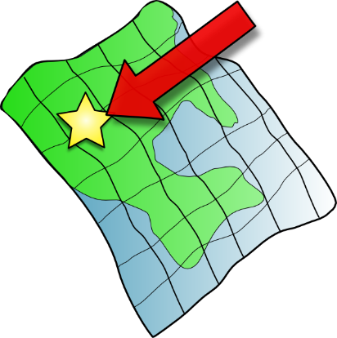
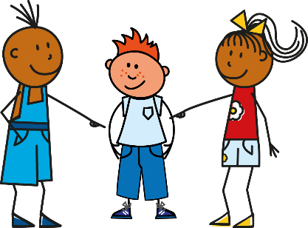
i
petit
lit
midi
ici
qui ?
il
?
Notes:
Timing: 1 minute
Aim: To consolidate SSC [i]
Procedure:
1. Introduce and elicit the pronunciation of the individual SSC [i] and then the source word again ‘midi’ (with gesture, if using). 2. Then present and elicit the pronunciation of the five cluster words.
The cluster words have been chosen for their high-frequency, from a range of word classes, with the SSC (where possible) positioned within a variety of syllables within the words (e.g. initial, 2nd, final etc.). Additionally, we have tried to use words that build cumulatively on previously taught SSCs (see the Phonics Teaching Sequence document) and do not include new SSCs. Where new SSCs are used, they are often consonants which have a similar symbol-sound correspondence in English.
Word frequency (1 is the most frequent word in French): midi [2483]; petit [138]; lit [1837] ici [167]; il[13]; qui [14]. Source: Londsale, D., & Le Bras, Y. (2009). A Frequency Dictionary of French: Core vocabulary for learners London: Routledge.

Slide 15
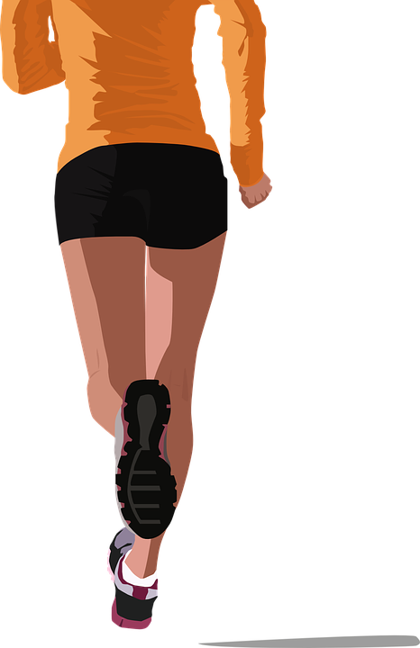
Mots qui finissent par –if
word patterns
This week, you have learnt several French words ending in –if.
These words contain the SSC [i].
actif (active)
négatif (negative)
positif (positive)
You may have noticed that these words are spelled similarly in English and French and have the same meaning. This is because they are cognates.
The only difference is the last syllable. It looks and sounds different.
In French it’s –if, but in English it’s –ive. How are these two endings pronounced?
Notes:
Timing: 2 minutes
Aim: To introduce the English ‘-ive’ ➜ French ‘-if’ word pattern and connect these with SSC [i].
Procedure:
1. Click to reveal the explanation.
2. Remind students that SSC [i] sounds different in English and French. Practice pronouncing the endings French ‘-if’ and English ‘-ive’, focusing on the [i].
3. Click on the French words to hear them said by a native speaker. Students repeat, and then say the English.
Transcript:
actif
négatif
positif

Slide 16
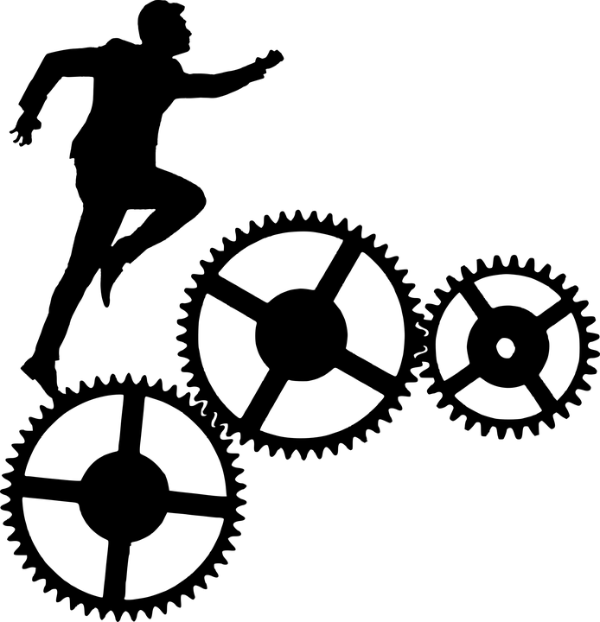
C’est quoi en français ?
parler
 | English | French
 | motive | motif
 | productive | productif
 | attentive | attentif
 | radioactive | radiactif
 | alternative | alternatif
 | exclusive | exclusif
1
2
3
4
5
6
Notes:
Timing: 3 minutes
Aim: oral production of words ending in –if in French; application of English-French word patterns.
Procedure:
1. Students use the rule English ‘-ive’ ➜ French ‘-if’ from the previous slide to translate the words into French.
2. Click to reveal the English translations.
3. Click the number to hear a French native speaker to pronounce the words.
4. Students repeat, and then say the English.
Transcript:
motif
productif
attentif
radioactif
alternatif
exclusif
explosif
massif
Word frequency of cognates used (1 is the most frequent word in French): motif [1369], productif [3975], attentif [2850], radioactif [4294], alternatif [4415], exclusif [2558], explosif [3558], massif [1760]
Source: Londsale, D., & Le Bras, Y. (2009). A Frequency Dictionary of French: Core vocabulary for learners London: Routledge.

Slide 17
Il ne faut pas
grammaire
You already know how to make negative sentences with modal verbs:
We can also add ne … pas to ‘il faut’ to say what must not be done:
Il ne faut pas arriver en retard. You must not arrive late.
il ne sait pas | il ne veut pas | il ne peut pas | il ne doit pas
he doesn’t know how to | he doesn’t want to | he cannot/is not able to | he must not
‘You’ in the sense of ‘people in general’.
Notes:
Timing: 2 minutes
Aim: Introduction of il ne faut pas + infinitive as an alternative structure to ne devoir pas + infinitive.
Procedure:
1. Recap negative structures with modal verbs.
2. Introduce il ne faut pas.

Slide 18
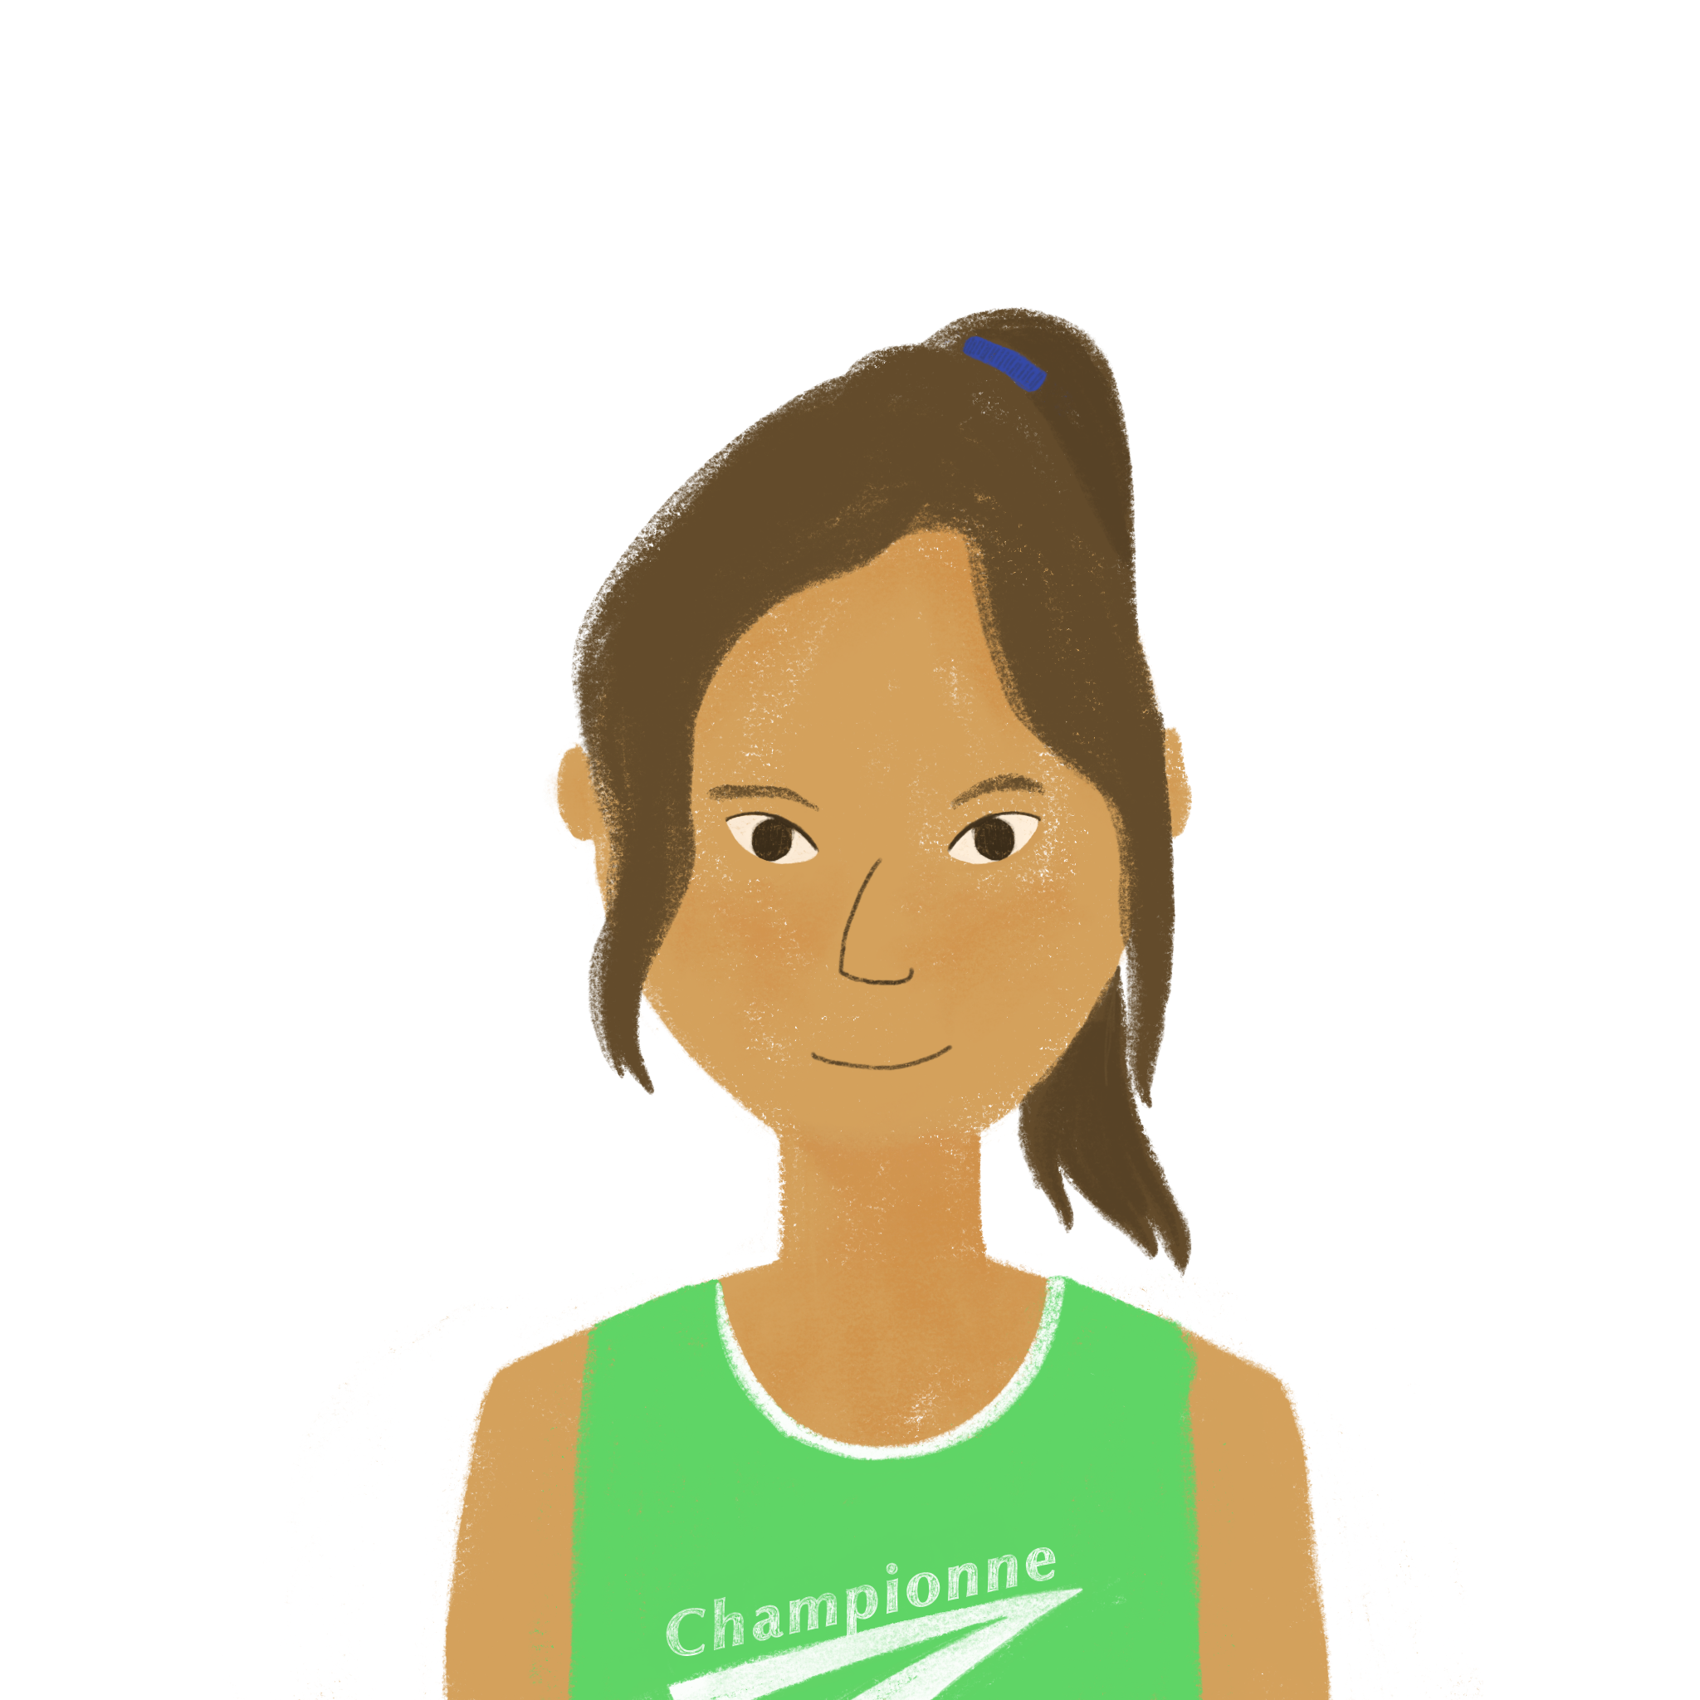
Les règles de la piscine
lire
Océane prend des notes sur les règles de la piscine. Parle-t-elle d’Amir ou des règles en général ?
Amir ne respecte pas les règles de la piscine !
1. Il ne doit pas prendre l’autobus.
2. Il ne veut pas répondre aux questions du directeur.
3. Il ne faut pas écouter de musique.
4. Il ne sait pas utiliser l’ordinateur.
5. Il ne faut pas regarder les réseaux sociaux.
6. Il ne faut pas aller au café le matin.
 | Amir | general rules
1.
2.
3.
4.
5.
6.
Notes:
Timing: 8 minutes (slide 1 of 2).
Aim: Written recognition of il ne faut pas and modal verbs in 3rd person singular negative sentences.
Procedure:
1. Students read Océane’s notes and tick whether each statement refers to Amir [il ne doit pas/il ne sait pas/il ne peut pas/il ne veut pas] or people in general [il ne faut pas].
2. Click to reveal answers.
3. Students read the text again and note the activities in English (slide 2).
4. Click to reveal answers.
Word frequency of cognates used (1 is the most frequent word in French):
respecter [673], note [1161]

Slide 19
Les règles de la piscine
Qui fait quoi ?
Écris des notes en anglais.
lire
Amir ne respecte pas les règles de la piscine !
1. Il ne doit pas prendre l’autobus.
2. Il ne veut pas répondre aux questions du directeur.
3. Il ne faut pas écouter de musique.
4. Il ne sait pas utiliser l’ordinateur.
5. Il ne faut pas regarder les réseaux sociaux.
6. Il ne faut pas aller au café le matin.
Amir | rules in general
must not take the bus doesn’t want to answer the manager’s questions doesn’t know how to use the computer | must not listen to music must not look at social networks must not go to the café in the morning
Notes:
Slide 2 of 2
Answers to the activity on the previous slide.

Slide 20
Les règles du bureau
écouter
Léa et Sophie écoutent une collègue qui parle des règles du bureau.
Qu’est-ce qu’il faut faire ? Qu’est-ce qu’il ne faut pas faire ?
Q | you must | you must not | activity in English
 |  |  | leave the office early
 |  |  | eat in the office
 |  |  | wear a coat
 |  |  | use a mobile phone
 |  |  | work at the weekend
 |  |  | talk about the tasks
1
2
3
4
5
6
Notes:
Timing: 8 minutes
Aim: Aural recognition of il faut + infinitive and il ne faut pas + infinitive and connecting these with meaning.
Procedure:
1. Check students understand the questions in the task rubric. Break down the est-ce que questions into known single words, e.g. Qu’est-ce qu’il faut faire ? What is it that it is necessary to do?
2. Click the buttons to play audio. Students listen and tick whether they hear something that one must or must not do.
3. Students listen again and note the activity in English.
4. Click to reveal answers.
Transcript:
1. Il ne faut pas quitter tôt le bureau.
2. Il faut manger dans le bureau.
3. Il ne faut pas porter un manteau.
4. Il ne faut pas utiliser le portable.
5. Il faut travailler le week-end.
6. Il ne faut pas parler des tâches.
Word frequency of cognates used (1 is the most frequent word in French): week-end [2475]
Source: Lonsdale, D., & Le Bras, Y. (2009). A Frequency Dictionary of French: Core vocabulary for learners London: Routledge.

Slide 21
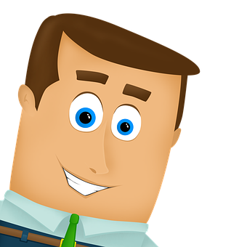
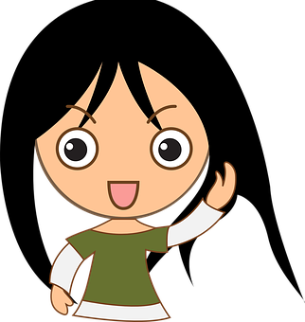
L’emploi d’Abdel
parler
Change les phrases au négatif.
Il veut devenir professeur d’anglais.
Il faut être travailleur.
Normalement il veut aller au café.
Il sait faire le travail difficile.
Il doit parler anglais.
Il sait expliquer des choses en anglais.
Il faut arriver tôt.
Il peut manger dans le bureau.
Il ne veut pas devenir professeur d’anglais.
Il ne sait pas faire le travail difficile.
Il ne doit pas parler anglais.
Il ne sait pas expliquer des choses en anglais.
Il ne faut pas être travailleur.
Normalement il ne veut pas aller au café.
Il ne peut pas manger dans le bureau.
Il ne faut pas arriver tôt.
Notes:
Timing: 5 minutes
Aim: Oral production of negative statements with il faut and modal verbs.
Procedure:
1. Students work in pairs. Student A faces the board, student B turns away.
2. Click to reveal a sentence from the previous exercise. Student A reads it aloud.
3. Student B listens, then says the sentence again in the negative.
4. Student B turns back to the board to check their answer, revealed on a click.
5. Students swap roles.
6. Repeat steps 1-5 for the remaining sentences.

Slide 22
La féminisation des adjectifs
grammaire
You already know various ways to make a masculine adjective feminine.
Here is another rule:
masculine feminine
change –if to –ive actif active
négatif négative
Notes:
Timing: 1 minute
Aim: To introduce –if/-ive adjective endings.
Procedure:
1. Introduce –if/-ive adjective endings.
2. Ensure students connect them with masculine/feminine.

Slide 23
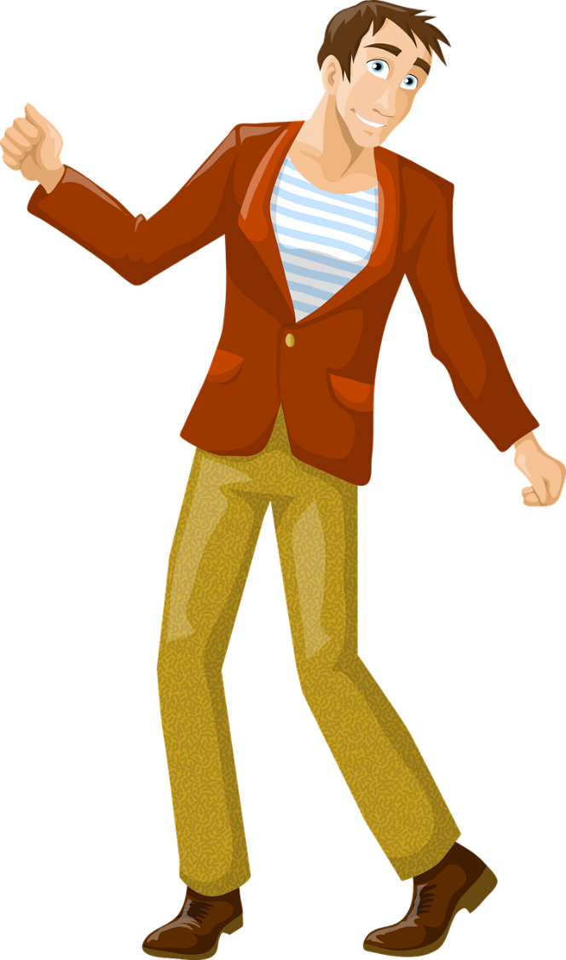
C’est qui ?
lire
Jennifer
Yannick
__________ est active.
Jennifer est active.
Notes:
Timing: 2 minutes (This is slide 1/4).
Aim: Written recognition of –if/-ive adjectives and connecting these with meaning (masculine/feminine).
Procedure:
1. Students read the sentence and decide whether it refers to the male character or the female character.
2. Click to reveal the answer.
3. Click again to reveal the full sentence.
Word frequency (1 is the most frequent word in French):
Source: Londsale, D., & Le Bras, Y. (2009). A Frequency Dictionary of French: Core vocabulary for learners London: Routledge.

Slide 24
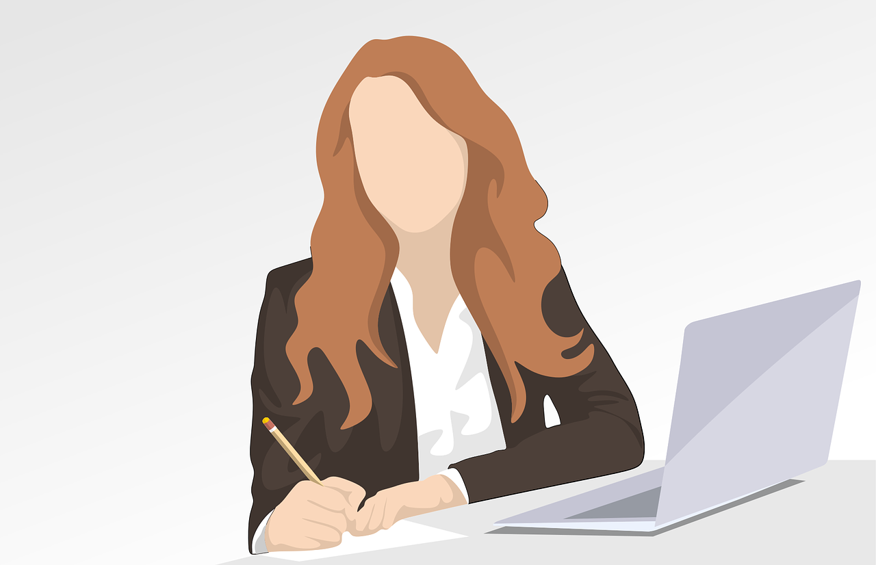
C’est qui ?
lire
*compréhensif = understanding
This links to a verb you already know: ‘comprendre’ = to understand
__________ est compréhensif.
Jeanne
Simon est compréhensif.
Simon
Notes:
This is slide 2/4.
Word frequency of unknown words used (1 is the most frequent word in French):
compréhensif [<5000]
Source: Londsale, D., & Le Bras, Y. (2009). A Frequency Dictionary of French: Core vocabulary for learners London: Routledge.

Slide 25
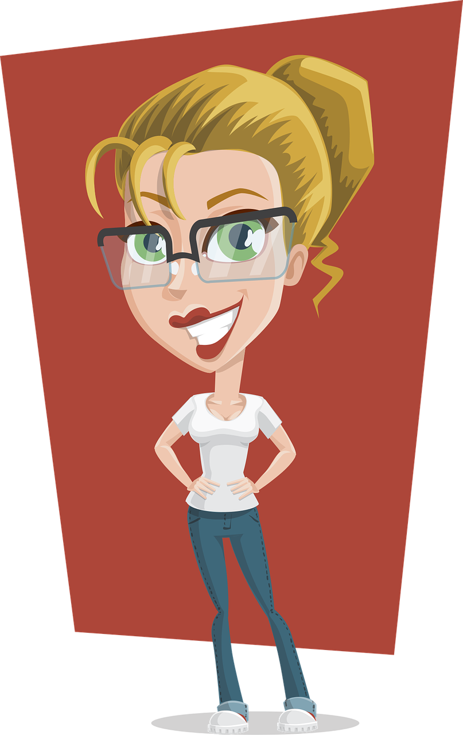
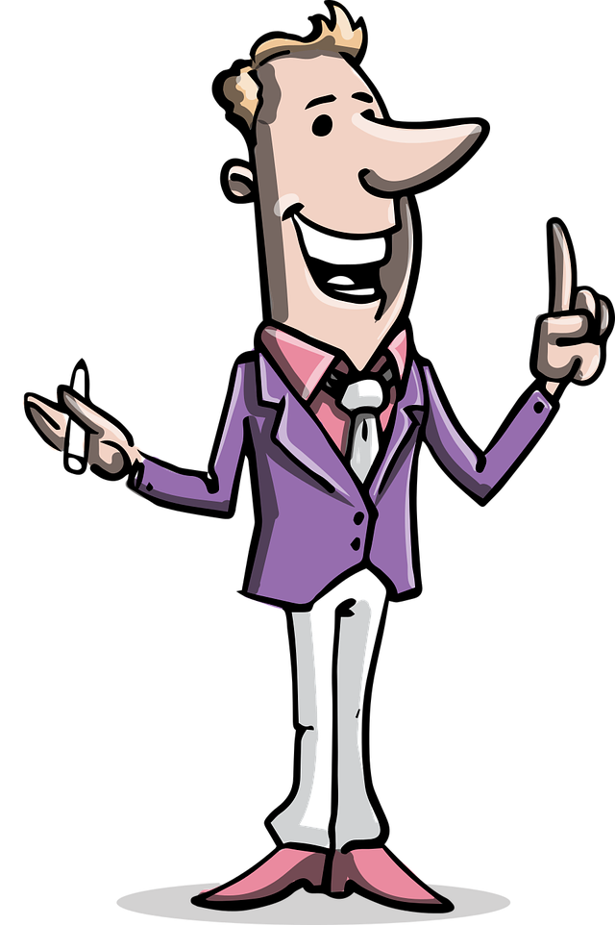
C’est qui ?
lire
Pascal
Thérèse
__________ est créatif.
Pascal est créatif.
Notes:
This is slide 3/4.
Word frequency of cognates used (1 is the most frequent word in French):
créatif [<5000]
Source: Londsale, D., & Le Bras, Y. (2009). A Frequency Dictionary of French: Core vocabulary for learners London: Routledge.

Slide 26
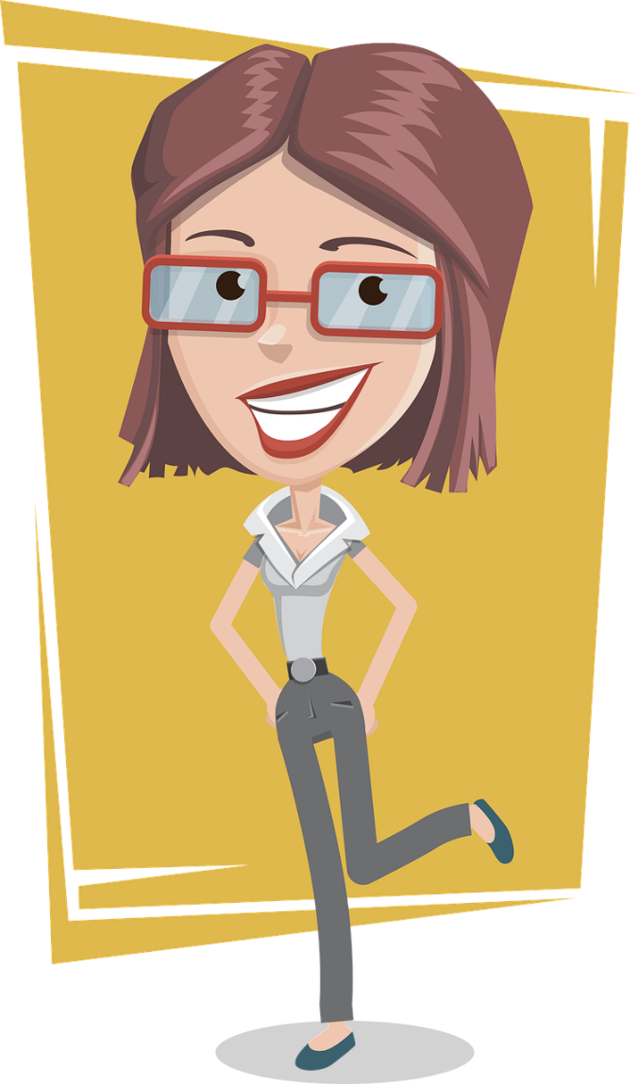
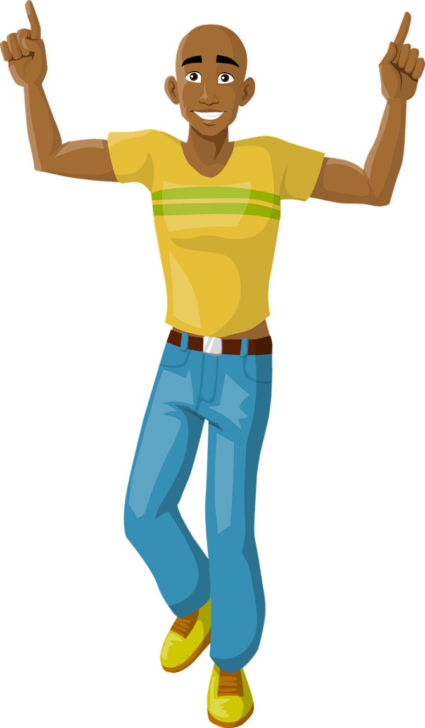
C’est qui ?
lire
Denise
Francis
Denise est sportive.
__________ est sportive.
Notes:
This is slide 4/4.

Slide 27
Les collègues
écouter / écrire
Léa et Sophie décrivent ses collègues. De qui parlent-elles ?
Écris des phrases pour décrire Anne et Christophe.
 | Anne | Christophe | English | les réponses
 |  |  | athletic
 |  |  | active
 |  |  | creative
 |  |  | a bit aggressive
 |  |  | understanding
 |  |  | active
1
1
Christophe est sportif.
2
2
Anne
Anne est toujours active.
3
3
Anne est créative.
4
4
Christophe est un peu agressif.
5
5
Anne est compréhensive.
6
6
Christophe
Christophe est actif.
Notes:
Timing: 5 minutes
Aim: Aural recognition of adjectives ending in -if/-ive and connecting these with meaning (people identifying as male/female). Written production adjectives ending in -if/-ive.
Procedure:
1. Click the numbers to hear audio with the name of the character obscured. Note cognates (rather than known words) are used in examples 3., 4. and 5.
2. Students listen and decide based on the adjective they hear whether they think Léa and Sophie are describing Anne or Christophe.
3. Students listen again and note the adjective in English.
4. Click to reveal English.
5. Students reconstruct the original French sentences from their notes to describe Anne and Christophe.
6. Listen and check. Click the numbers in the last column to play the full audio.
Differentiation: Classes who need more support could listen to the full audio first, then try to reconstruct the French from their notes (i.e., swap steps 5 & 6 in the list above).
Transcript:
1. [Christophe] est sportif.
2. [Anne] est toujours active.
3. [Anne] est créative.
4. [Christophe] est un peu agressif.
5. [Anne] est compréhensive.
6. [Christophe] est actif.
Word frequency of cognates used (1 is the most frequent word in French): agressif [3059], créatif [>5000]
Source: Lonsdale, D., & Le Bras, Y. (2009). A Frequency Dictionary of French: Core vocabulary for learners London: Routledge.

Slide 28
Un(e) candidat(e) parfait(e)
parler/ écrire
Tu cherches un emploi ! Écris cinq phrases pour décrire ta personnalité.
Je suis assez …
Je ne suis pas très …
Add more detail to your answers using :
un peu
assez
très
toujours
souvent
rarement
normalement
sportif/sportive
drôle
agressif/agressive
travailleur/travailleuse
calme
créatif/créative
gentil(le)
méchant(e)
actif/active
ambitieux/ambitieuse
intelligent(e)
prudent(e)
Notes:
Timing: 5 minutes
Aim: Written and oral production of sentences containing a mix of adjective types.
Procedure:
1. Students write five sentences to describe themselves, using adjectives and qualifiers and adverbs from this slide.
2. Remind students that the qualifiers appear before the adjective and the adverbs after the verb (and before the qualifier, if using both).
3. Use the sentences in the follow-up oral activity on the next slide.
Word frequency of cognates used (1 is the most frequent word in French):
parfait [1600], personnalité [1963], agressif [3059], créatif [>5000]
Source: Lonsdale, D., & Le Bras, Y. (2009). A Frequency Dictionary of French: Core vocabulary for learners London: Routledge.

Slide 29
Un(e) candidat(e) parfait(e)
Fais des questions avec inversion!
parler/ écrire
Es-tu ambitieux/ambitieuse ?
Nous cherchons un(e) médecin !
Il faut être ambitieux/ambitieuse.
Il/Elle doit être intelligent(e).
Il ne faut pas être agressif/agressive.
Oui, je suis/Non, je ne suis pas toujours ambitieux/ambitieuse.
Es-tu intelligent(e) ?
Oui, je suis/Non, je ne suis pas très intelligent(e).
Es-tu agressif/agressive?
Oui, je suis/Non, je ne suis pas souvent agressif/agressive.
Notes:
Timing: 8 minutes
Aim: Written and oral production of sentences containing a mix of adjective types.
Procedure:
1. Use the example on this slide to model the task. Elicit the inversion questions necessary to find the information, and the yes/no answers.
2. Click to reveal suggested questions/answers.
3. Print role cards from next three slides – one set of 6 for each group of 6.
4. Students work in groups of 6. Each student in the group has a different role card.
5. Each student interviews the others in the group to find out if they have the required qualities for the job on their card.
6. Students answer the questions using the sentences they wrote in the previous activity as a prompt.
7. Students make notes about each person’s answers so they can find the person who fits their job advert best.
Word frequency of cognates used (1 is the most frequent word in French):
parfait [1600], personnalité [1963], agressif [3059], créatif [>5000], inversion [>5000]
Source: Lonsdale, D., & Le Bras, Y. (2009). A Frequency Dictionary of French: Core vocabulary for learners London: Routledge.

Slide 30
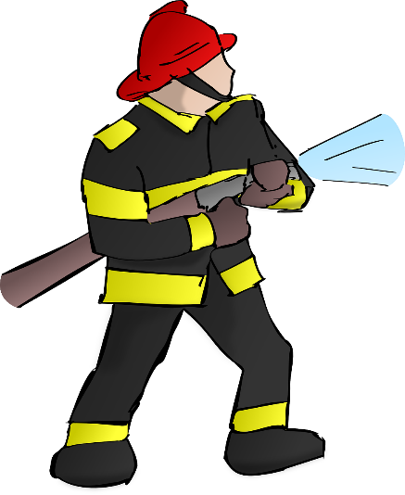
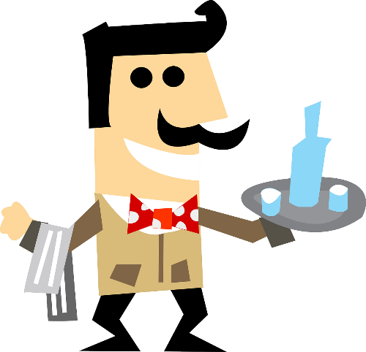
Un(e) candidat(e) parfait(e)
parler/ écrire
Nous cherchons
un(e) pompier/pompière* !
Il faut être prudent(e) pour travailler avec les feux.
Il/Elle doit être calme puisque le travail peut être dangereux.
Il ne faut pas être
agressif/agressive.
Nous cherchons un(e) serveur/serveuse !
Il/Elle doit être travailleur/travailleuse.
Il/Elle doit être actif/active.
Il ne faut pas être méchant(e).
*pompier/pompière = firefighter
Notes:
Rolecards for printing

Slide 31
Un(e) candidat(e) parfait(e)
parler/ écrire
Nous cherchons un(e) avocat(e) !
Il faut être intelligent, parce que c’est un emploi difficile.
Il/Elle ne doit pas être sportif/sportive.
Il ne faut pas être drôle : nous
ne pouvons pas jouer !
Nous cherchons un(e) secrétaire pour l’hôpital !
Il/Elle doit être travailleur/travailleuse.
Il faut être actif/active.
Il/Elle ne doit pas être ambitieux/ambitieuse.
Notes:
Rolecards for printing

Slide 32
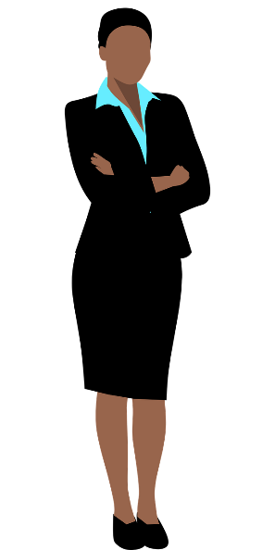
Un(e) candidat(e) parfait(e)
parler/ écrire
Nous cherchons un(e) acteur/actrice !
Il faut être très créatif/creative.
Il/Elle doit être sportif/sportive, puisque c’est un film d’action.
Il/Elle ne doit pas être gentil(le).
Nous cherchons
un(e) directeur/directrice !
Il/Elle doit être ambitieux/ambitieuse.
Il faut être intelligent(e).
Il/Elle peut être drôle mais
il ne faut pas être méchant(e).
Notes:
Rolecards for printing

Slide 33
Devoirs
Vocabulary Learning Homework (Y9, Term 1.1, Week 6)
Audio file
Student worksheet
Quizlet link
In addition, revisit: Y8 Term 3.2 Week 6
Y8 Term 3.1 Week 4
Notes:
Vocabulary learning homework answers for 9.1.1.6 can be found on the portal at https://rachelhawkes.com/LDPresources/Yr9French/French_Y9_Term1i_Wk6_HW_sheet_answers.docx

Slide 34
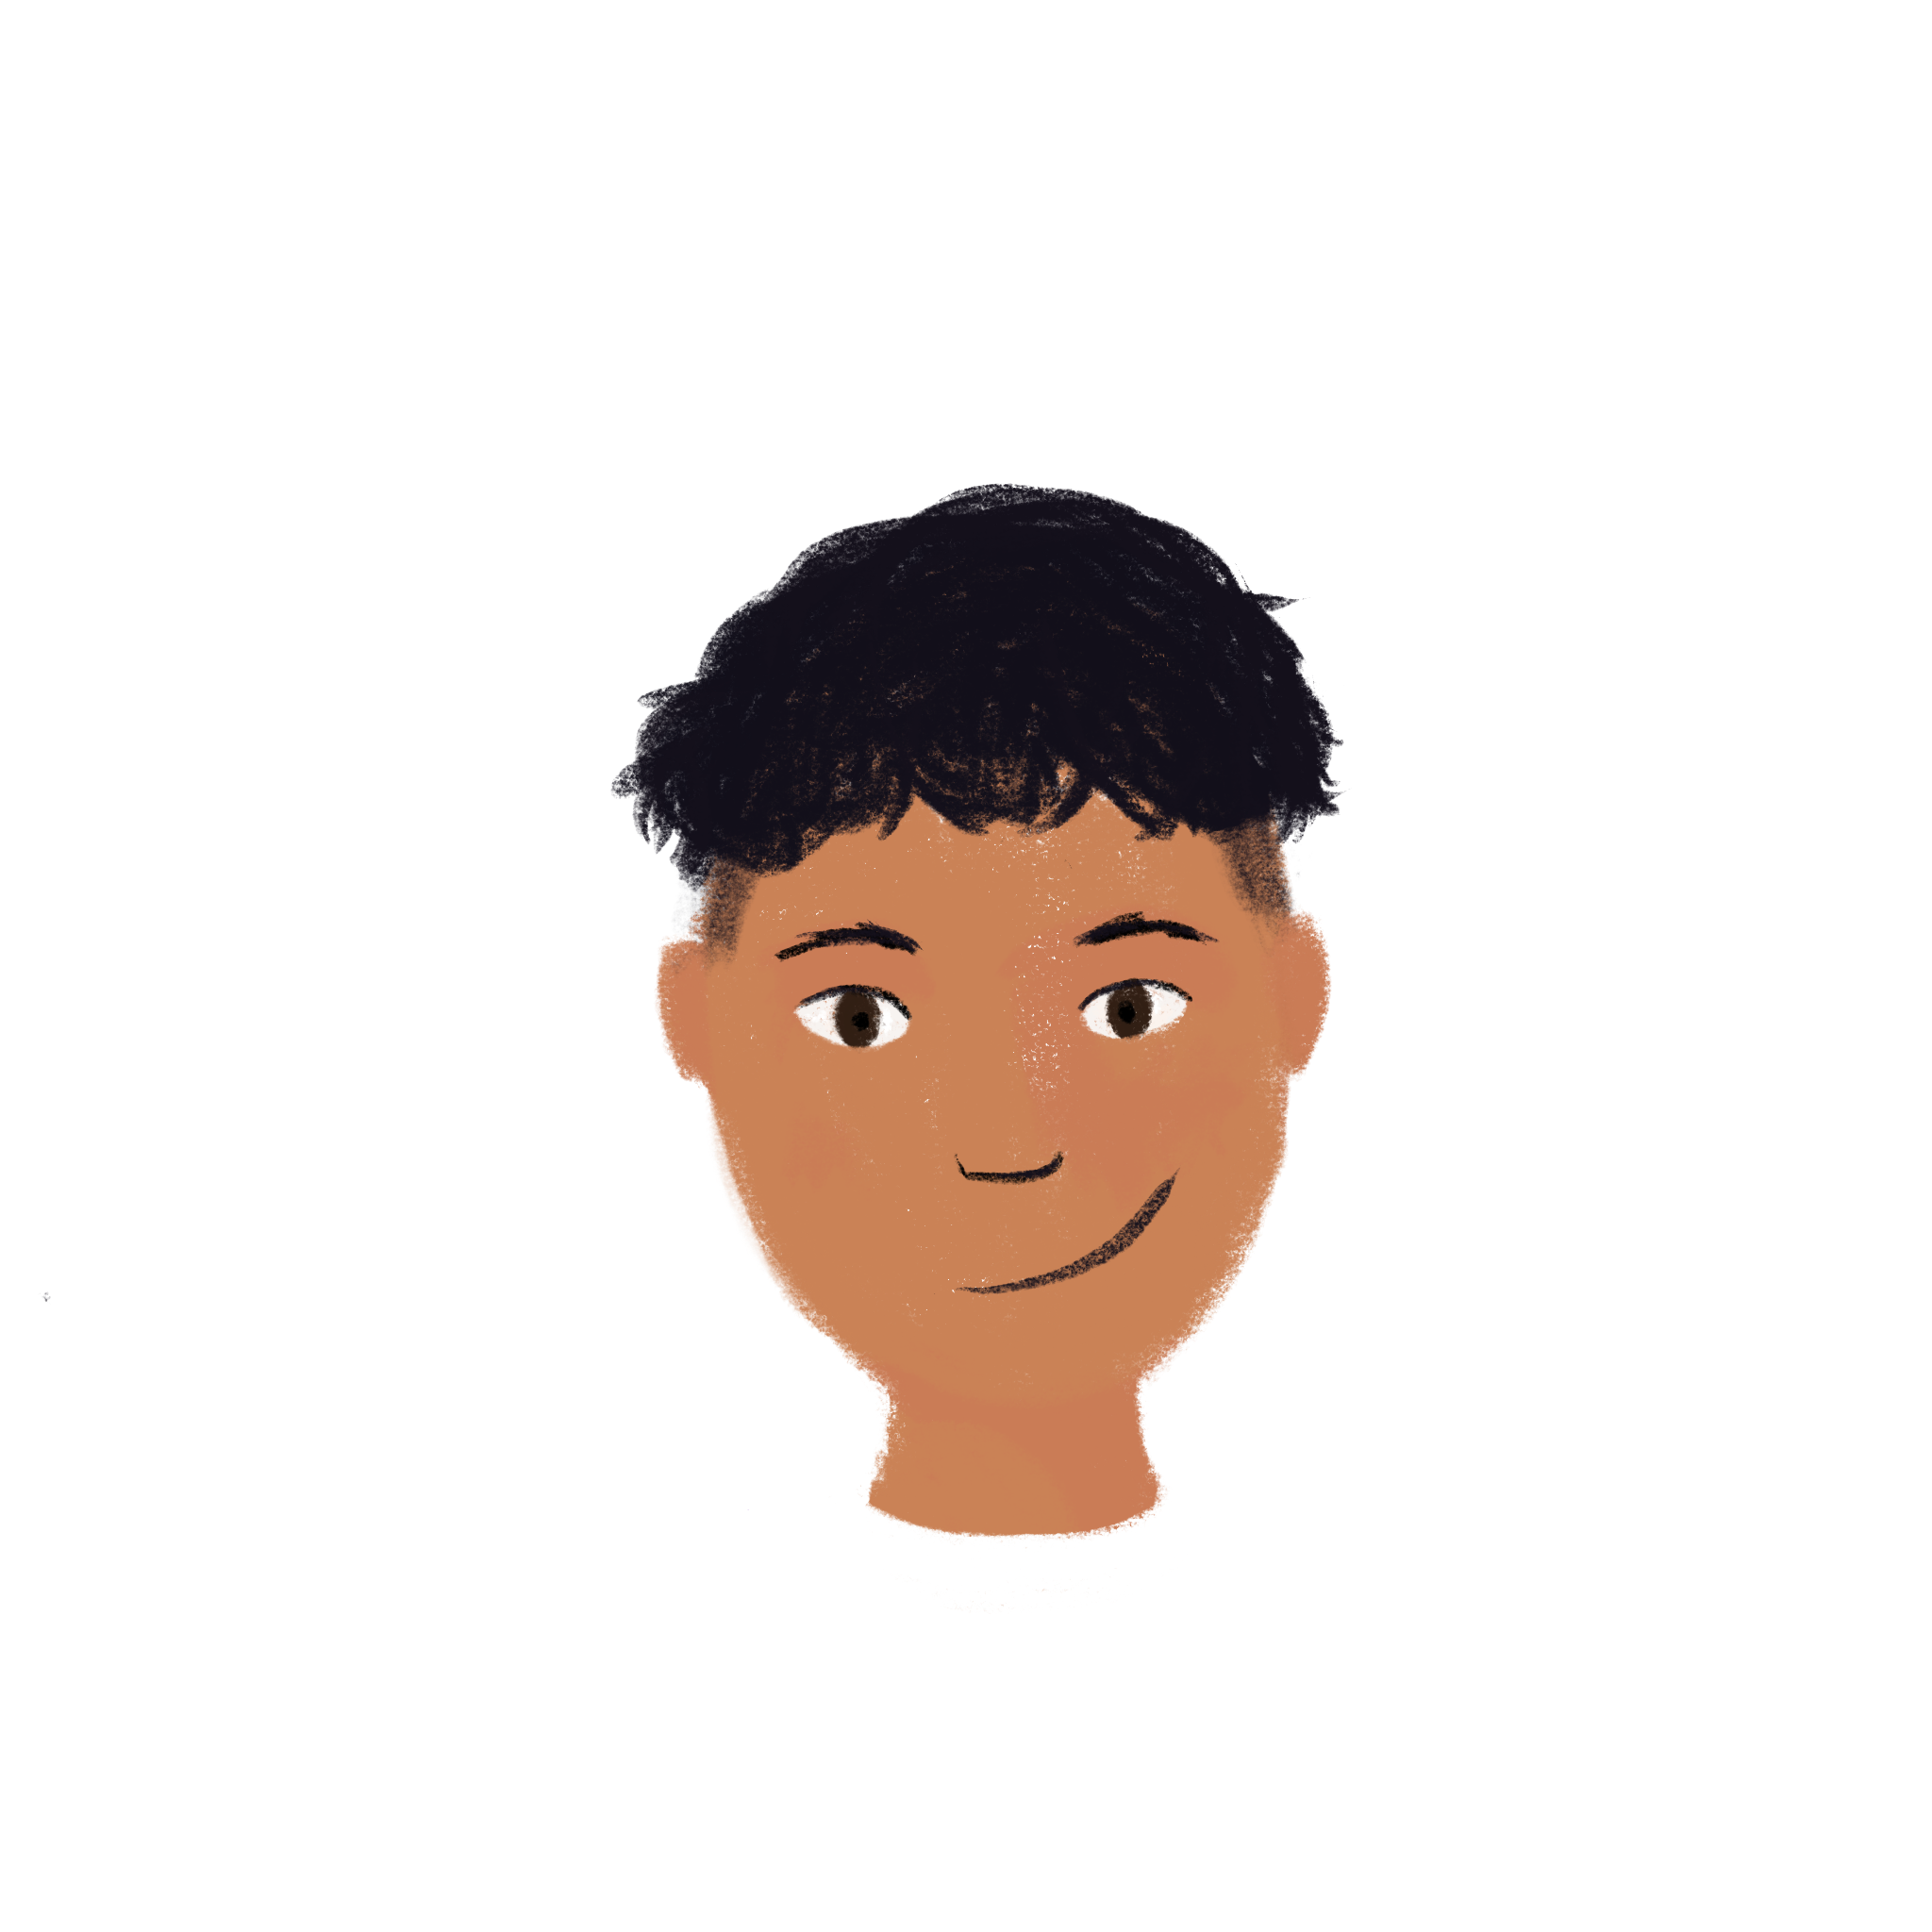
Une annonce
*le boulanger – baker
*le coiffeur = the hairdresser
écrire
Remember, chez means at the place of:
chez Abdel at Abdel’s place
chez l’avocat at the lawyer’s place (office)
Écris une annonce pour trouver un stagiaire. Tu peux prendre une idée du tableau, ou tu peux utiliser le dictionnaire.
Pour un stage chez le dentiste, il faut/il ne faut pas…
Un dentiste doit…
Pour un stage chez le boulanger*, il faut/il ne faut pas…
Un boulanger doit…
Pour un stage chez…
le mécanicien
le coiffeur*
le cuisinier
Il faut…
Il ne faut pas…
Il/Elle doit être…
Il/Elle sait…
Il/Elle peut…
Il/Elle veut…
Notes:
Timing: 10 minutes Note: This is optional and not included in the 50 minutes for the rest of the lesson activities.
Aim: Written production of il faut and modals in both affirmative and negative sentences.
Procedure:
1. Students choose a type of work experience placement, either from the suggestions on the slide or from the dictionary.
2. Students use rolecard structure to write a similar advert for a stagiaire.
Word frequency of unknown words used (1 is the most frequent word in French):
boulanger [>5000]
Word frequency of cognates used (1 is the most frequent word in French):
dentist [>5000]
Source: Lonsdale, D., & Le Bras, Y. (2009). A Frequency Dictionary of French: Core vocabulary for learners London: Routledge.

