Slide 1
Au travail
Following instructions at work
modal verbs (nous, vous)
SSCs [ou] and [u]
Y9French
Term 1.1 - Week 4 - Lesson 7 Catherine Salkeld / Catherine Morris / Amber Dudley
Artwork by: Chloé Motard
Date updated: 24.09.23
Notes:
Artwork by Chloé Motard. All additional pictures selected are available under a Creative Commons license, no attribution required.
Native speaker feedback provided by Sarah Brichory.
With thanks to Rachel Hawkes for her input on the lesson material.
Note: all words (new and revisited) in this week of the SOW appear on all three GCSE wordlists, with these exceptions: i) Edexcel list does not have collègue, directeur, stage, tâche, soin, lentement (though it has lent and –ment is a suffix listed within the derivational morphology patterns of the grammar annex so lentement may appear (unglossed) in the reading paper)
ii) Eduqas list does not have sportif
Artwork by Chloé Motard. All additional pictures selected are available under a Creative Commons license, no attribution required.
Native speaker feedback provided by Sarah Brichory.
With thanks to Rachel Hawkes for her input on the lesson material.
Learning outcomes (lesson 1):
Consolidation of SSCs [ou] and [u]
Introduction of modal verbs (nous, vous)
Word frequency (1 is the most frequent word in French):
9.1.1.4 (introduce) devons, devez, doivent [39], peuvent [20], savent1,2 [67], veulent [57], attitude [834], collègue [1099], directeur2 [640], entreprise [298], stage [4007], piscine [>5000], actif [1289], négatif [1502], positif [949], sportif [2670]
8.3.2.4 (revisit) commencer [139], expliquer [252], emprunter [1121], quitter [507], bibliothèque [2511], cours [169], fois [49], tâche [887], déjà¹ [58], enfin [349], toujours [103]
8.3.1.2 (revisit) décision [370], soin [1109], dur [1029], facilement [1194], lentement [2637], mal¹ [277], mieux [217], vite [711]
Source: Londsale, D., & Le Bras, Y. (2009). A Frequency Dictionary of French: Core vocabulary for learners London: Routledge.
The frequency rankings for words that occur in this PowerPoint which have been previously introduced in NCELP resources are given in the NCELP SOW and in the resources that first introduced and formally re-visited those words.
For any other words that occur incidentally in this PowerPoint, frequency rankings will be provided in the notes field wherever possible.

Slide 2
ou
nous
Notes:
Timing: 1 minute [2 slides]
Aim: To consolidate SSC [ou]
Procedure: 1. Present the letter(s) and say the [ou] sound first, on its own. Students repeat it with you. 2. Bring up the word ”nous” on its own, say it, students repeat it, so that they have the opportunity to focus all of their attention on the connection between the written word and its sound.
3. A possible gesture for this would be to have both hands draw semi-circles out away from the body. Hands start by the sides of the body, circle swiftly outwards and join up again in front, indicating the inclusion of the self in a larger group. 4. Roll back the animations and work through 1-3 again, but this time, dropping your voice completely to listen carefully to the students saying the [ou] sound, pronouncing ”nous” and, if using, doing the gesture.
Word frequency (1 is the most frequent word in French):
nous [31]
Source: Londsale, D., & Le Bras, Y. (2009). A Frequency Dictionary of French: Core vocabulary for learners London: Routledge.

Slide 3
u
tu
Notes:
Timing: 1 minute
Aim: To consolidate SSC [u]
Procedure: 1. Present the letter(s) and say the [u] sound first, on its own. Students repeat it with you. 2. Bring up the word ”tu” on its own, say it, students repeat it, so that they have the opportunity to focus all of their attention on the connection between the written word and its sound.
3. A possible gesture for this would be to point to someone else as though addressing him/her ‘you’. 4. Roll back the animations and work through 1-3 again, but this time, dropping your voice completely to listen carefully to the students saying the [u] sound, pronouncing ”tu” and, if using, doing the gesture.
Word frequency (1 is the most frequent word in French):
tu [112]
Source: Londsale, D., & Le Bras, Y. (2009). A Frequency Dictionary of French: Core vocabulary for learners London: Routledge.

Slide 4
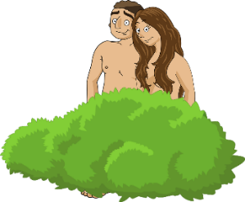
SSCs [ou] and [u]
phonétique
To talk about what we or you _{formal/plural} are doing, we need SSC [ou].
Be careful not to mix SSC [ou] and SSC [u] up!
It could be the difference between saying:
OR
OR
nous pouvons (we can, are able to)
vous pouvez (you all can, are able to)
nous (we)
nu (naked)
vous (you)
vue (view)
Notes:
Timing: 3 minutes
Aim: To differentiate between SSCs [ou] and [u] with a focus on pronouns nous and vous, as well as two new modal verb forms introduced this week which contain this SSC.
Procedure:
1. Click to reveal the explanation. Highlight that you need to use the SSC [ou] whenever you want to talk about what you and another person are doing, or when you want to address more than one person on someone you don’t know.
2. Draw attention to the difference between SSCs [ou] and [u] using the examples on the slide (click on orange words to hear them).
3. Students repeat.
Transcript:
nous pouvons
vous pouvez
nous
nu
vous
vue
Word frequency of unknown words used (1 is the most frequent word in French): nu [3207]
Source: Londsale, D., & Le Bras, Y. (2009). A Frequency Dictionary of French: Core vocabulary for learners London: Routledge.

Slide 5
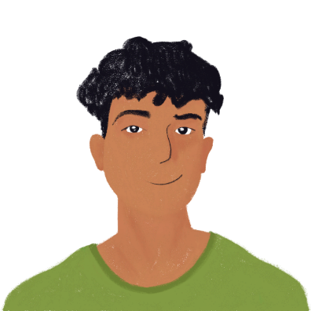
Ils cherchent des stages
écouter
Amir et Océane cherchent des stages sur internet. Ils trouvent quels emplois ?
 | stage | [ou] | [u]
 | trad u cteur [translator]
 | journaliste [journalist]
 | agric u lteur [farmer]
 | j u ge [judge]
 | nounou [nanny]
 | boulanger [baker]
1
__
2
__
3
__
4
__
5
__
__
6
__
Notes:
Timing: 5 minutes
Aim: To distinguish aurally between SSCs [ou] and [u].
Procedure:
1. Click to hear occupations read aloud.
2. Students must decide whether the missing SSC is [ou] or [u].
3. Elicit answers from students.
4. Click to reveal answers.
5. Replay audio. Students repeat.
Transcript:
traducteur
journaliste
agriculteur
juge
nounou
boulanger
Word frequency of unknown words used (1 is the most frequent word in French): traducteur [>5000], journaliste [1337], agriculteur [2306], juge [1323], nounou [>5000], boulanger [>5000]
Source: Lonsdale, D., & Le Bras, Y. (2009). A Frequency Dictionary of French: Core vocabulary for learners London: Routledge.

Slide 6
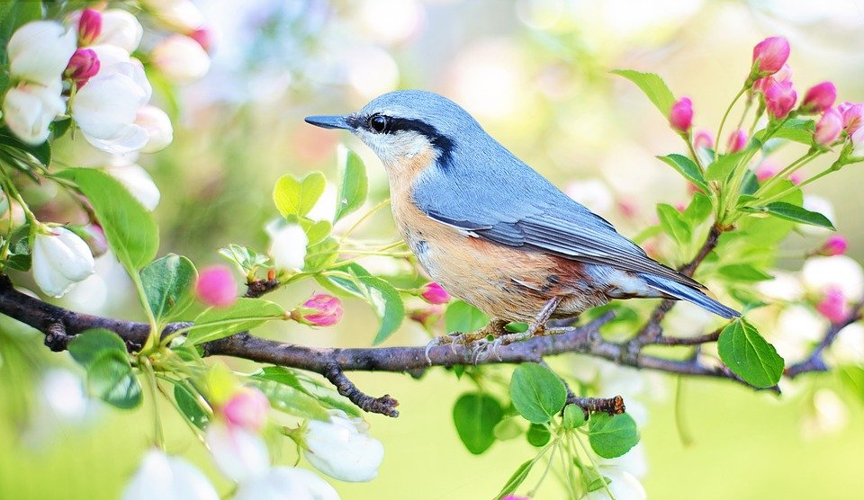
Trouve l’image !
écouter
 | 1 | 2 | 3 | 4
A
B
C
D
audio:
active (m.)
headteacher, manager (m.)
they can, they are able to
?
?
?
?
positive (m.)
1A
2A
3A
4A
you
_{(plural/formal)} must, have to
work experience
company
they must, they have to
?
?
?
?
1B
2B
3B
4B
attitude
swimming pool
colleague (m.)
sporty (m)
?
?
?
?
1C
2C
3C
4C
negative (m)
they want (to)
they know (how to)
we must, we have to
?
?
?
?
1D
2D
3D
4D
Notes:
Timing: 5 minutes
Aim: Aural recognition of new vocabulary at word level.
Procedure:
1. Students volunteer (in French) a letter/number combination relating to a square on the grid.
2. Click the corresponding audio button on the right-hand side.
3. The whole class say the English translation in chorus. Click the blue box to reveal the answer.
4. If the majority of the class says the correct answer, click the yellow box to reveal part of the underlying image.
5. Students guess what the image represents as more is revealed.
Transcript:
1a - positif
2a - actif
3a - le directeur
4a – ils/elles peuvent
1b - vous devez
2b - le stage
3b - l’entreprise
4b – ils/elles doivent
1c - l’attitude
2c – la piscine
3c - le collègue
4c - sportif
1d - négatif
2d – ils/elles veulent
3d – ils/elles savent
4d - nous devons
Answer: oiseau

Slide 7
Modal verbs in the singular
grammaire
You already know the je, tu and il/elle forms of the modal verbs devoir, savoir, pouvoir and vouloir:
je dois | je sais | je peux | je veux
I must, have to | I know how to | I can, am able to | I want to
tu dois | tu sais | tu peux | tu veux
you must, have to | you know how to | you can, are able to | you want to
il/elle doit | il/elle sait | il/elle peut | il/elle veut
s/he must, has to | s/he knows how to | s/he can, is able to | s/he wants to
Notes:
Timing: 2 minutes
Aim: Revising forms and usage of the first-, second- and third-person singular forms of modal verbs.
Procedure:
1. Recap the je, tu and il/elle forms of the four verbs. Click to reveal the English and elicit French from students chorally. Click to reveal the French.

Slide 8
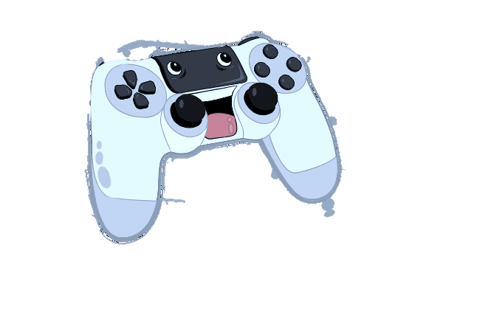
Modal verbs (nous, vous)
grammaire
The plural nous and vous forms of all modal verbs are formed in the same way:
Remove –oir from the infinitive: devoir → dev
Remember the sentence structure with modal verbs:
modal verb in short form + main verb in long form (infinitive)
Nous voulons jouer le jeu. We want to play the game.
nous devons | vous devez
we must, have to | you must, have to (plural/formal)
Add –ons for nous.
Add –ez for vous.
The other modal verbs follow the same pattern.
Notes:
Timing: 1 minutes
Aim: Introducing forms and usage of the first- and second- person plural forms of modal verbs.

Slide 9
Une offre* d'emploi
*l’offre (f.) d’emploi = job advertisement
lire
Amir et Océane trouvent une offre d’emploi dans le journal local.
Lis le texte et écris nous ou vous.
Qui fait quoi, les directeurs (nous) ou le candidat/la candidate (vous) ?
Écris en anglais.
Vous savez faire de la natation ? Vous voulez travailler à la piscine ? Nous voulons trouver un(e) candidat(e) actif/ive et sportif/ive pour faire un stage ! Vous devez avoir une passion pour la natation. Nous ne pouvons pas accepter une attitude négative dans cette entreprise ! Si vous pouvez travailler les samedis, c’est mieux. Nous devons trouver le/la collègue idéal(e)* et nous savons créer une expérience très positive !
1
2
3
4
5
6
7
8
Notes:
Timing: 8 minutes This is slide 1/2.
Aim: Written recognition of 1st and 2nd person plural forms of modal verbs and connecting these with meaning. Written recognition of new vocabulary in longer contexts (reading comprehension).
Procedure:
1. Check students understand which modal verb endings correspond to nous and vous.
2. Students read the advert, write 1-8, and decide whether the company is referring to themselves (nous) or the candidate (vous).
3. Click to reveal the pronouns. (With more advanced classes, you may wish to proceed directly to stage 4).
4. Students then sketch a 2x2 grid with the headings ‘les directeurs de la piscine’ and ‘le candidat/la candidate’. They write English bullet points to describe the details for each.
5. Move on to the next slide to bring up answers to the comprehension element.
6. Draw students’ attention to pronunciation of the cognate words.
Word frequency of cognates used (1 is the most frequent word in French): candidat [1328], passion [1866], accepter [210], expérience [679] Source: Lonsdale, D., & Le Bras, Y. (2009). A Frequency Dictionary of French: Core vocabulary for learners London: Routledge.
Word frequency of unknown words used (1 is the most frequent word in French): offre [1346]
Source: Londsale, D., & Le Bras, Y. (2009). A Frequency Dictionary of French: Core vocabulary for learners London: Routledge.

Slide 10
Une offre d'emploi
lire
Que font les directeurs de la piscine ?
Que fait le candidat/la candidate ?
les directeurs de la piscine | le candidat/la candidate
want to find an active and sporty candidate
knows how to swim
wants to work at the swimming pool
can’t accept a negative attitude
must find the perfect candidate
must have a passion for swimming
know how to create a positive experience
can work on Saturdays, ideally
Notes:
This is slide 2/2.
Answer slide for the comprehension part of the activity on the previous slide.

Slide 11
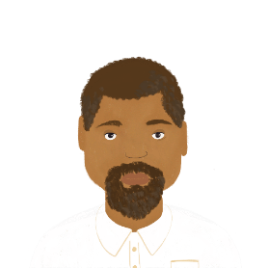
À la piscine
*le/la stagiaire = work experience student
écouter
Amir et Océane arrivent à la piscine pour commencer le stage !
Le directeur explique qui fait quoi.
Parle-t-il des directeurs, ou des stagiaires* ?
Écris l’anglais.
Q | Quoi? | directeurs (nous) | stagiaires (vous) | R
 | must explain the rules
 | must read the instructions
 | know how to swim
 | can learn a lot
 | know how to help
 | want to work hard
 | want to be kind
1
1
2
2
3
3
4
4
5
5
6
6
7
7
Notes:
Timing: 8 minutes
Aim: Written recognition of 1st and 2nd person plural forms of modal verbs and connecting these with meaning.
Procedure:
1. Check students understand which verb endings correspond to things les directeurs do (nous) and things les stagiaires are expected to do (vous). Draw attention to the vocabulary callout and encourage students to make the link between stage and stagiaire.
2. Click the numbers to play the audio. The subject pronouns are obscured by beeps.
3. Students write 1-7 and choose nous or vous for each.
4. Click to reveal the pronouns. (With more advanced classes, you may wish to proceed directly to stage 5).
5. Students listen again and note the activities in English.
6. Click to reveal the answers.
7. The full audio (without beeps) is provided in the final column.
Transcript:
1. Aujourd’hui, [nous] devons expliquer les règles.
2. [Vous] devez lire les instructions.
3. Évidemment, [vous] savez faire de la natation…
4. …mais [vous] pouvez beaucoup apprendre.
5. [Nous] savons aider les stagiaires.
6. Bien sûr, [vous] voulez travailler dur…
7. …mais [nous] voulons être gentils.
Word frequency of cognates used (1 is the most frequent word in French): instruction [1632], évidemment [1340]
Source: Londsale, D., & Le Bras, Y. (2009). A Frequency Dictionary of French: Core vocabulary for learners London: Routledge.
Word frequency of unknown words used (1 is the most frequent word in French):
stagiaire [>5000]
Source: Lonsdale, D., & Le Bras, Y. (2009). A Frequency Dictionary of French: Core vocabulary for learners London: Routledge.

Slide 12
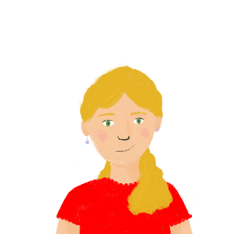
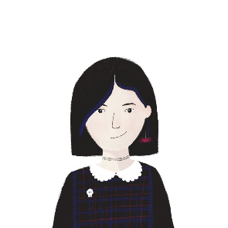
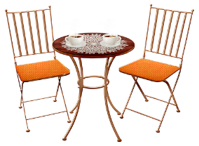
Un stage au bureau
parler
Léa and Sophie have an interview for work experience in an office. Take turns to play the interviewers and Léa and Sophie. As this is a formal situation, use inversion questions.
For yes/no questions: modal verb (in short form) + pronoun + long form Voulez-vous prendre ... ?
Voulez-vous prendre le déjeuner ici ou dehors ?
Groupe A les directeurs | Groupe B Léa et Sophie
want to have lunch here or outside? | want to have lunch
can have lunch at the café | can have lunch where?
Nous voulons prendre le déjeuner dehors.
outside
For information questions: add a question word before the modal: Où pouvons-nous prendre … ?
here
outside
Où pouvons-nous prendre le déjeuner ?
Vous pouvez prendre le déjeuner au café.
Notes:
Note: there is an alternative, more scaffolded version of this role play after this one.
Timing: 10 minutes
Aim: Oral production of modal verbs in the nous/vous form.
Procedure:
1. Split students into groups of four. Two students are interviewers, and two are Léa and Sophie. Remind students that it is appropriate to use inversion questions in an interview as these are more formal than intonation questions.
2. Use the example rolecard on this slide to walk the students through the exercise. Elicit the questions needed to find the information. A reminder about inversion question structure with modal verbs appears on a click.
3. Click to reveal suggested questions and answers.
4. Print and distribute the role cards on slides 15-16.
5. Students in pair A take turns asking questions to find out the missing information on their card. Cards are designed so that students must ask two yes/no questions (options are given) and two open questions (question words provided) each.
6. Pair B gives the answers on their card.
7. The pairs swap roles and use the second set of cards. Note: if time is short, just do Round 1 of the activity.

Slide 13
Un stage au bureau
parler
GROUP A - directeurs
Ask group B questions to find out the missing information. | Listen to group B’s questions and make sentences to answer them.
1. know how to use a mobile phone or a computer ? | 5. must start
2. can work when? | 6. must wear a shirt
want to learn what ? | 7. can leave
4. are funny or well-behaved? | 8. can easily buy lunch
GROUP B – Léa and Sophie
Listen to group A’s questions and make sentences to answer them. | Ask group A questions to find out the missing information.
1. know how to use a computer | 5. must start when?
2. can work | 6. must wear what?
3. want to learn English | 7. can leave together or alone?
4. are funny | 8. can easily buy a coffee or lunch?
5th May
Saturdays
together
Notes:
Round 1 First set of role cards for printing

Slide 14
Un stage au bureau
parler
GROUP A – Léa and Sophie
Ask group B questions to find out the missing information. | Listen to group B’s questions and make sentences to answer them.
1. can drink what? | 5. know how to organise
2. must use books or a mobile phone? | 6. are calm
3. have to borrow a mobile phone or a computer? | 7. want to work
4. can finish when? | 8. have to travel by bus
GROUP B – directeurs
Listen to group A’s questions and make sentences to answer them. | Ask group A questions to find out the missing information.
1. can drink coffee | 5. know how to listen and organise?
2. must use a mobile phone | 6. are calm and intelligent?
3, have to borrow a computer | 7. want to work when?
4. can finish | 8. have to travel how ?
Tuesdays
July
Notes:
Round 2
Second set of role cards for printing

Slide 15
Un stage au bureau
écrire / parler
Say hello. Ask: how’s it going?
3. Ask: Do you (both) know how to use a computer?
5. Ask: When can you (both) work?
7. Ask: What do you want to learn?
9. Say: Thank you and goodbye.
2. Greet your partners and respond to the question.
4. Reply: Yes, we know…
6. Reply: We can work on Saturdays.
8. Say: We want to learn English.
10. Respond appropriately.
Notes:
Note: this is the more straightforward activity design, with time built-in to script answers.
Timing: 10 minutes (two slides) Aim: Oral production of modal verbs in the nous/vous form.
Procedure: 1. Give students 6 minutes in pairs to write the dialogue in their books. They can work together – they will need to be able to play both roles in the dialogue.
2. For 4 minutes, ask students to turn their notes over and carry out the interaction using the English prompts on the board, and glancing at their notes only if they get stuck.
3. Move to the next slide. Ask them to repeat the task, swapping roles, but this time without writing their answers first.

Slide 16
Un stage au bureau
parler
Say hello. Introduce yourself, giving your name.
3. Ask: What can we drink?
5. Ask: Must we use books or a mobile phone?
7. Ask: Do we have to borrow a computer or a phone?
9. Ask: When can we finish?
2. Say hello and respond appropriately.
4. Reply: You (both) can drink coffee.
6. Reply: You (both) must use a phone.
8. Say: You (both) have to borrow a computer.
10. Say: You (both) can finish in July.
Notes:
[2/2]

Slide 17
Des messages d’une collègue
Une collègue a fait une
liste d’instructions. Traduis les verbes et complète la liste !
écrire
Je dois aller à la banque ce matin.
M. Faure, vous devez lire ces instructions.
Mme Aziz, vous pouvez demander un café si
vous voulez.
Léa, tu dois lire les lettres.
1. I must
3. you can
2. you must
5. you must
*passer un appel = make a call
4. you want
Sophie, peux-tu aider le directeur avec l’ordinateur ? Il ne sait pas écrire un e-mail.
Nous devons parler aux clients au téléphone aujourd’hui. Si vous ne savez pas passer
un appel* professionnel,
je peux aider.
8. We must
6. can you
9. you (pl) don’t know how to
7. He doesn’t know how to
10. I can
Notes:
Note: with classes that need more time and support, teachers may want to spend more time on the writing/speaking role play on slides 15/16 and omit this activity.
Timing: 8 minutes
Aim: Written production of modal verbs in all known forms. Recapping formal and informal address with tu and vous.
Procedure:
1. Remind student the word ‘you’ has two different translations in French, depending on context. Highlight to students that they are told here when the plural form is intended, but they will have to think about which form to use when ‘you’ is used in the singular. Students may need a reminder of the abbreviations ‘M.’ and ‘Mme’ (monsieur and madame) to be able to apply this knowledge.
2. Students translate the modal verbs and pronouns into French.
3. Click to reveal answers.
Word frequency of cognates used (1 is the most frequent word in French): instruction [1632], verbe [>5000], e-mail [>5000], client [917], telephone [1366], professionnel [1000]
Word frequency of unknown words used (1 is the most frequent word in French):
appel [567]
Source: Lonsdale, D., & Le Bras, Y. (2009). A Frequency Dictionary of French: Core vocabulary for learners London: Routledge.

Slide 18
Au travail
Following instructions at work
modal verbs (nous, vous)
SSCs [ou] and [u]
Y9French
Term 1.1 - Week 4 - Lesson 8 Catherine Salkeld / Catherine Morris / Amber Dudley
Artwork by: Chloé Motard
Date updated: 24.09.23
Notes:
Artwork by Chloé Motard. All additional pictures selected are available under a Creative Commons license, no attribution required.
Native speaker feedback provided by Sarah Brichory.
With thanks to Rachel Hawkes for her input on the lesson material.
Note: all words (new and revisited) in this week of the SOW appear on all three GCSE wordlists, with these exceptions: i) Edexcel list does not have collègue, directeur, stage, tâche, soin, lentement (though it has lent and –ment is a suffix listed within the derivational morphology patterns of the grammar annex so lentement may appear (unglossed) in the reading paper)
ii) Eduqas list does not have sportif
Artwork by Chloé Motard. All additional pictures selected are available under a Creative Commons license, no attribution required.
Native speaker feedback provided by Sarah Brichory.
With thanks to Rachel Hawkes for her input on the lesson material.
Learning outcomes (lesson 1):
Consolidation of SSCs [ou] and [u]
Introduction of modal verbs (nous, vous)
Word frequency (1 is the most frequent word in French):
9.1.1.4 (introduce) devons, devez, doivent [39], peuvent [20], savent1,2 [67], veulent [57], attitude [834], collègue [1099], directeur2 [640], entreprise [298], stage [4007], piscine [>5000], actif [1289], négatif [1502], positif [949], sportif [2670]
8.3.2.4 (revisit) commencer [139], expliquer [252], emprunter [1121], quitter [507], bibliothèque [2511], cours [169], fois [49], tâche [887], déjà¹ [58], enfin [349], toujours [103]
8.3.1.2 (revisit) décision [370], soin [1109], dur [1029], facilement [1194], lentement [2637], mal¹ [277], mieux [217], vite [711]
Source: Londsale, D., & Le Bras, Y. (2009). A Frequency Dictionary of French: Core vocabulary for learners London: Routledge.
The frequency rankings for words that occur in this PowerPoint which have been previously introduced in NCELP resources are given in the NCELP SOW and in the resources that first introduced and formally re-visited those words.
For any other words that occur incidentally in this PowerPoint, frequency rankings will be provided in the notes field wherever possible.

Slide 19
Léa est triste !
lire / parler
Léa et Sophie commencent un stage dans une entreprise locale. Elles ne sont pas contentes ! Elle trouvent le monde du travail très difficile.
Partenaire A lit les phrases (1-4), et Partenaire B remplit les blancs.
Après quatre phrases, les partenaires changent de rôle.
Partenaire B lit les phrases (5-8), et Partenaire A remplit les blancs.
Nous ne voulons pas étudier.
N__s ne v__lons pas ét__dier.
Partner A
Partner B
Notes:
Timing: 8 minutes
Aim: Oral production and recognition of words containing SSCs [ou] and [u] in sentences.
Procedure:
1. Print and distribute the rolecards on the following slide.
2. Partner A reads sentences 1-4 from their card. Partner B fills in the blanks on their card with the SSCs they hear.
3. Partner B reads sentences 5-8 from their card. Partner A fills in the blanks on their card with the SSCs they hear.
4. Proceed to slides 21-22 to check answers.
5. Click on the number buttons to hear each sentence read aloud by a native speaker.
Note: if teachers prefer, they could use some of the material instead as a dictation.
Word frequency of unknown words used (1 is the most frequent word in French): disputer [2725], lutter [1031], boulot [2929], coucher [2160], soutenir [578], utile [1003]
Source: Londsale, D., & Le Bras, Y. (2009). A Frequency Dictionary of French: Core vocabulary for learners London: Routledge.
Word frequency of cognates used (1 is the most frequent word in French): accuser [1147], adulte [1580], exclure [1457], encourager [1437], refuser [271]
Source: Londsale, D., & Le Bras, Y. (2009). A Frequency Dictionary of French: Core vocabulary for learners London: Routledge.

Slide 20
Léa est triste !
lire / parler
Partenaire A: Nous nous disputons tout le temps. Un collègue nous accuse de lutter. Tous les adultes nous excluent au boulot. Il n’y a personne p__r n__s enc__rager. T__t le monde ref__se de n__s s__tenir. Ce stage n’était pas d__ t__t __tile. | Partenaire B: N__s n__s disp__tons t__t le temps. Un collèg__e n__s acc__se de l__tter. T__s les ad__ltes n__s excl__ent au b__lot. Il n’y a personne pour nous encourager. Tout le monde refuse de nous soutenir. Ce stage n’était pas du tout utile.
Partenaire A: Nous nous disputons tout le temps. Un collègue nous accuse de lutter. Tous les adultes nous excluent au boulot. Il n’y a personne p__r n__s enc__rager. T__t le monde ref__se de n__s s__tenir. Ce stage n’était pas d__ t__t __tile. | Partenaire B: N__s n__s disp__tons t__t le temps. Un collèg__e n__s acc__se de l__tter. T__s les ad__ltes n__s excl__ent au b__lot. Il n’y a personne pour nous encourager. Tout le monde refuse de nous soutenir. Ce stage n’était pas du tout utile.
Notes:
To print – do not display
Slide 2/4

Slide 21
Léa est triste !
lire / parler
1. Nous nous disputons tout le temps.
[We are arguing all the time.]
2. Un collègue nous accuse de beaucoup de choses stupides.
[A colleague is accusing us of lots of stupid things.]
3. Tous les adultes nous excluent au boulot.
[All the adults are excluding us at work.]
1
1
2
3
Notes:
Slide 3/4
Transcript:
1. Nous nous disputons tout le temps.
2. Un collègue nous accuse de lutter.
3. Tous les adultes nous excluent au boulot.

Slide 22
Léa est triste !
lire / parler
4. Il n’y a personne pour nous encourager.
[There isn’t anyone to encourage us.]
5. Tout le monde refuse de nous soutenir.
[Everyone refuses to support us.]
6. Ce stage n’est pas du tout utile.
[This work experience isn’t useful at all.]
4
5
6
Notes:
Slide 4/4
Transcript:
4. Il n’y a personne pour nous encourager.
5. Tout le monde refuse de nous soutenir.
6. Ce stage n’est pas du tout utile.

Slide 23
Au bureau
lire / écrire
collègue
Mathieu et la ______1______ anglaise ______2______ trouver un élève pour faire un ______3______. Ils ne ______4______ pas gérer une ______5______ !
veulent
Le ______6______ a une attitude très ______7______ !
directeur
stage
négative
savent
entreprise
Ils ______9_______ travailler le week-end ! _____10_____ avoir une _____11_____ plus _____12_____ !
peuvent
Les élèves ______8______ aller au collège toute la semaine.
doivent
on doit
attitude
positive
Nous _____13_____ chercher un élève _____14_____ et _____15_____.
Vous ne _____16_____ pas faire mon travail !
devons
devez
actif
sportif
devons
devez
doivent
on doit
peuvent
savent
veulent
attitude
collègue
directeur
entreprise
stage
actif
négative
positive
sportif
Notes:
Timing: 8 minutes
DIFFERENTIATION: This is a more challenging version of the task. The next slide provides the English for each gap for students who may need more support.
Aim: Written production of new vocabulary. Reading comprehension.
Procedure:
1. Students read the sentences and fill the gaps with an appropriate word from the pool of distractors at the bottom of the slide.
2. Elicit answers chorally.
3. Answers appear on clicks.
N.B. The positions of actif and sportif are interchangeable. Students may need a reminder that when using two post-nominal adjectives with et, it doesn’t matter which way round they go.

Slide 24
Au bureau
lire / écrire
Mathieu et la 1) colleague anglaise 2) want to trouver un élève pour faire un 3) work experience. Ils ne 4) know how to pas gérer une 5) company !
collègue
Le 6) manager a une attitude très 7) negative !
veulent
directeur
stage
savent
négative
entreprise
Ils 9) can travailler le week-end ! 10) you have to avoir une
11) attitude plus 12) positive !
Les élèves 8) have to aller au collège toute la semaine.
peuvent
doivent
on doit
attitude
positive
Nous 13) must chercher un élève 14) energetic et 15) sporty.
Vous ne 16) have to pas faire mon travail !
devons
devez
actif
sportif
devons
devez
doivent
on doit
peuvent
savent
veulent
attitude
collègue
directeur
entreprise
stage
actif
négative
positive
sportif
Notes:
DIFFERENTIATION: This slide provides the English for each gap for students who may need more support. The previous slide is a more challenging version of the task.
Aim: Written production of new vocabulary
Procedure:
1. Students read the sentences and replace the English word with a French words from the pool of distractors at the bottom of the slide.
2. Elicit answers chorally.
3. Answers appear on clicks.
N.B. The positions of actif and sportif are interchangeable. Students may need a reminder that when using two post-nominal adjectives with et, it doesn’t matter which way round they go.

Slide 25
Modal verbs: ils/elles
grammaire
You already know how to form the ‘nous’ and ‘vous’ forms of the modal verbs:
Remove –oir, add –ons or –ez. devoir → nous devons, vous devez
The ‘ils/elles' form adds –ent. ‘devoir’, ‘pouvoir’, and ‘vouloir’ change their stems.
devoir
pouvoir
vouloir
savoir
The stem goes back to doi- like the singular forms and adds v:
The stem goes back to peu- like the singular forms and and adds v:
The stem goes back to veu- like the singular forms adds l:
The stem stays the same as the other plural forms.
ils/elles doivent
ils/elles peuvent
ils/elles veulent
ils/elles savent
Notes:
Timing: 3 minutes
Aim: Introducing forms and usage of the third person plural forms of modal verbs.
Procedure:
1. Recap the nous and vous forms of the modal verbs. Present the formula for the formation of devoir and elicit the nous and vous forms of the other modal verbs from students.
2. Introduce the ils/elles form of the modal verbs, drawing attention to the stem changes and pronunciation.

Slide 26
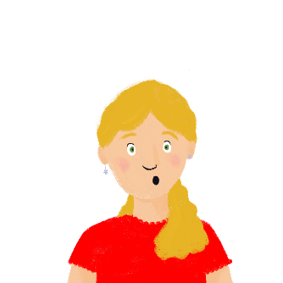
Au bureau
écouter
Une femme veut aider les filles. Elle explique les rôles du directeur et des autres collègues. C’est qui ?
 | le directeur | les collègues | les détails
 |  |  | read several local newspapers
 |  |  | organise the office
 |  |  | manage the work placements
 |  |  | borrow books
 |  |  | write letters
 |  |  | work on Saturdays
1
2
3
4
5
6
Notes:
Timing: 8 minutes
Aim: Aural recognition of singular il doit + infinitive and plural ils doivent + infinitive and connecting these with meaning (what one male person must do and what a group of male or mixed-gender people must do.)
Procedure:
1. Click to play the audio. Nothing is obscured as il and ils sound identical before the d-.
2. Students listen to the verb form and tick whether they think it refers to what le directeur (il) must do or what les collègues (ils) must do. Note the liaison between the short form doit and following vowels in 2. and 8. Teachers may wish to remind students of –t liaison, and practice using a few short phrases (e.g. il doit envoyer, il doit utiliser, il doit arriver)
3. Students listen again and note in English what everyone must do.
4. Click to reveal answers.
Transcript:
1. Ils doivent lire plusieurs journaux locaux.
2. Il doit organiser le bureau.
3. Il doit gérer plusieurs stages.
4. Ils doivent emprunter des livres.
5. Ils doivent écrire des lettres.
6. Il doit travailler les samedis.
Word frequency of cognates used (1 is the most frequent word in French): rôle [371], détail [318]
Source: Lonsdale, D., & Le Bras, Y. (2009). A Frequency Dictionary of French: Core vocabulary for learners London: Routledge.

Slide 27
Une interview avec les filles
*une lettre de motivation = a letter of application
lire
Il y a une interview avec Léa et Sophie dans le journal scolaire. Remplis les blancs avec ‘nous’, ‘vous’, ou ‘ils’. Puis, traduis le texte en anglais.
Cette semaine vous pouvez trouver beaucoup d’informations sur les stages. Nous parlons avec Léa et Sophie, et comme toujours, nous savons poser toutes les questions importantes !
Si nous voulons faire un stage, qu’est-ce que nous devons faire ?
Vous devez parler aux profs. Ils savent trouver un bon stage.
Peuvent- ils aider si nous ne savons pas écrire une bonne lettre de motivation* ?
Oui, ils doivent lire les lettres. Ils veulent aider les élèves.
Pouvez-vous expliquer le stage que vous faites ? Savez-vous faire le travail ?
Oui, nous devons aller au bureau et nous pouvons apprendre beaucoup.
1
2
3
4
5
6
7
8
9
10
11
12
13
14
15
Notes:
Timing: 15 minutes. This is slide 1/2.
Aim: Written recognition of plural forms of modal verbs and connecting these with meaning; French to English translation.
Procedure:
1. Students write 1-15 and nous, vous, or ils.
2. Click to reveal answers. Choral repetition of each modal verbs form to practice pronunciation.
3. Students translate interview into English.
4. Check answers with suggested translation on the next slide.
Word frequency of cognates used (1 is the most frequent word in French): interview [3186], motivation [3522], poser [218]
Source: Lonsdale, D., & Le Bras, Y. (2009). A Frequency Dictionary of French: Core vocabulary for learners London: Routledge.

Slide 28
Une interview
*une lettre de candidature = a letter of application
lire
This week you can find lots of information about work experience. We’re talking to Léa and Sophie, and as always, we know how to ask all the important questions!
If we want to do work experience, what do we have to do?
You must talk to the teachers. They know how to find good work experience.
Can they help if we don’t know how to write a good letter of application?
Yes, they must read the letters. They want to help the pupils.
Can you explain the work experience you’re doing? Do you know how to do the work?
Yes, we have to go to the office and we can learn a lot.
Notes:
SUGGESTED TRANSLATION
This is slide 2/2.

Slide 29
Modal verbs in the negative
grammaire
Remember: to make a sentence with two or more verbs negative, we add ne…pas around the first verb in short form.
nous voulons visiter la France.
we want to visit France.
nous ne voulons pas visiter la France.
we don’t want to visit France.
vous devez chanter.
you must, have to chanter.
vous ne devez pas chanter.
you must not, do not have to chanter.
ils savent jouer du piano.
they know how to play the piano.
ils ne savent pas jouer du piano.
they don’t know how to play the piano.
elles peuvent aller à la plage.
they can, are able to go to the beach.
ils ne peuvent pas aller à la plage.
they can, are able to go to the beach.
Notes:
Timing: 1 minute
Aim: Revising negation in two-verb structures with modal verbs.
Procedure:
Recap the negation in two-verb structures with modal verbs.
Click to reveal the affirmative sentence. Click again to reveal the negated sentence. Repeat three times for each of the modal verbs.

Slide 30
Les règles du zoo
*le soigneur = zookeeper
écrire
Voici un article sur Quentin, qui fait un stage au zoo. C’est un journal anglais. Traduis l’article en français.
At the zoo, you must not eat in front of the animals. The zookeepers know how to feed the animals well. The birds can leave the zoo if they want, but they have to come back for lunch. You must wear a uniform, but you can’t wear a hat.
Au zoo, on ne doit pas manger devant les animaux. Les soigneurs savent bien nourrir les animaux. Les oiseaux peuvent quitter le zoo s’ils veulent, mais ils doivent revenir pour le déjeuner. On doit porter un uniforme, mais on ne peut pas porter un chapeau.
1) must not
2) know how to
3) can
4) want
5) have to
6) must
7) can’t
Notes:
DIFFERENTIATION: Slide 16/17 is a full translation activity that can be used as an alternative with more advanced groups.
Timing: 10 minutes. This is slide 1/2.
Aim: Scaffolded written production of affirmative and negative sentences with modal verbs. Written recall of known vocabulary. Scaffolded English to French translation.
Procedure:
1. Remind students of the use of on to address people in general (you).
2. Students translate the missing text into French.
3. Click to reveal translations.
Word frequency of cognates used(1 is the most frequent word in French): zoo [>5000]
Source: Lonsdale, D., & Le Bras, Y. (2009). A Frequency Dictionary of French: Core vocabulary for learners London: Routledge.
Word frequency of unknown words used(1 is the most frequent word in French): soigneur [>5000]
Source: Lonsdale, D., & Le Bras, Y. (2009). A Frequency Dictionary of French: Core vocabulary for learners London: Routledge.

Slide 31
Les règles du zoo
*le soigneur = zookeeper
écrire
Quentin doesn’t want to work in the office, but he can’t play with the animals all the time. The zookeepers can take photos of the animals but they must not share the photos on social media. Quentin says “I want to work with animals. You_{[pl]} can have a positive experience here.”
Quentin ne veut pas travailler dans le bureau, mais il ne peut pas jouer avec les animaux tout le temps. Les soigneurs peuvent prendre des photos des animaux, mais ils ne doit pas partager les photos sur les réseaux sociaux. Quentin dit « Je veux travailler avec les animaux. Vous pouvez avoir une expérience positive ici. »
7) doesn’t want to
8) he can’t
9) can
10) they must not
11) I want
12) You [pl] can
Notes:
This is slide 2/2.

Slide 32
Les règles du zoo
*le soigneur = zookeeper
écrire
Voici un article sur Quentin, qui fait un stage au zoo. C’est un journal anglais. Traduis l’article en français.
At the zoo, you must not eat in front of the animals. The zookeepers know how to feed the animals well. The birds can leave the zoo if they want, but they have to come back for lunch. You must wear a uniform, but you can’t wear a hat. Quentin doesn’t want to work in the office, but he can’t play with the animals all the time. The zookeepers can take photos of the animals but they must not share the photos on social media. Quentin says “I want to work with animals. You_{[pl]} can have a positive experience here.”
Notes:
DIFFERENTIATION: This full translation activity can be used as an alternative to slides 14-15 with more advanced groups.
Timing: 10 minutes. This is slide 1/2.
Aim: Written production of affirmative and negative sentences with modal verbs. Written recall of known vocabulary. English to French translation.
Procedure:
1. Students translate the text into French.
2. Check answers using the suggested translation on the next slide.
Word frequency of cognates used(1 is the most frequent word in French): zoo [>5000]
Source: Lonsdale, D., & Le Bras, Y. (2009). A Frequency Dictionary of French: Core vocabulary for learners London: Routledge.
Word frequency of unknown words used(1 is the most frequent word in French): soigneur [>5000]
Source: Lonsdale, D., & Le Bras, Y. (2009). A Frequency Dictionary of French: Core vocabulary for learners London: Routledge.

Slide 33
Les règles du zoo
écrire
Au zoo, on ne doit pas manger devant les animaux. Les soigneurs savent bien nourrir les animaux. Les oiseaux peuvent quitter le zoo s’ils veulent, mais ils doivent revenir pour le déjeuner. On doit porter un uniforme, mais on ne peut pas porter un chapeau. Quentin ne veut pas travailler dans le bureau, mais il ne peut pas jouer avec les animaux tout le temps. Les soigneurs peuvent prendre des photos des animaux, mais il ne doit pas partager les photos sur les réseaux sociaux. Quentin dit « Je veux travailler avec les animaux. Vous pouvez avoir une expérience positive ici. »
Notes:
SUGGESTED TRANSLATION: slide 2/2

Slide 34
Devoirs
Vocabulary Learning Homework (Y9 Term 1.1, Week 5)
Continue learning and revisiting the vocabulary set last week.
Audio file
Quizlet link
In addition, revisit: Year 8 Term 3.2 Week 4
Year 8 Term 3.1 Week 2
Notes:
Note: HW for Y9 is usually made up of pre-learning of vocabulary 15-30 minutes (depending on school policy on HW time) plus 20-30 minutes vocabulary activities to deepen word knowledge, provided on a student homework sheet (which also contains a clickable link to the audio file). Answer sheets are also provided. This week there is no new vocabulary – Students are asked to continue learning the vocabulary from last week.
Notes:
With the LDP SOW the vocabulary for Years 9 – 11 is provided on Quizlet.
ii) There are other free apps, and new ones are always appearing. Teachers have told us that they are currently also using: Flippity, Wordwall (where using previously-created activities is free).
iii) Gaming Grammar has been acquired by Language Nut. Its original content should still be available to teachers and much of it is appropriate for Y9 learners. From this lesson, for example, learners could practise:
Verbs (present): 1st person singular/plural (Verb agreement (present))
Verbs (present): 2nd person singular/plural (Verb agreement (present))
Verbs (present): 3rd person singular/plural (Verb agreement (present))
Questions: Subject-verb inversion

