Slide 1
Talking about identity (1)
être (je, tu, il/elle), ne…pas feminine adjective agreement SFC, SFe
Y9French
Term 1.1 - Week 1 - Lesson 1 Catherine Salkeld / Natalie Finlayson
Artwork by: Chloé Motard
Date updated: 11.09.23
Notes:
Artwork by Chloé Motard. All additional pictures selected are available under a Creative Commons license, no attribution required.
Native speaker feedback provided by Sarah Brichory.
With thanks to Rachel Hawkes for her input on the lesson material.
Note: all words (new and revisited) in this week of the SOW appear on all three GCSE wordlists, with these exceptions: i) None of the lists has ambitieux.
ii) AQA list does not have algérien (though word may be used as a cognate in reading).
ii) Edexcel list does not have algérien, belge, communauté, intelligent (though two of these may be used as cognates in reading).
iii) Eduqas list does not have intelligent (though word may be used as a cognate in reading).
Learning outcomes (lesson 1):
Revision of SFC, SFe
Revision of singular forms of être
Revision of ne…pas with être
Revision of feminine adjective agreement
Word frequency (1 is the most frequent word in French):
9.1.1.1 (revisit) algérien [4163], ambitieux [2905], assez [321], aussi [44], avec [23], beau [393], belge [2795], belle [393], bon [94], chanter [1820], chanteur [3251], choisir [226], communauté [558], écouter [429], écrire [382], ensemble [124], femme [154], fille [629], finir [534], fois [49], gentil [2832], heureux [764], homme [136], instrument [1650], intelligent [2509], international [282], jouer [219], langue [712], mais [30], moderne [1239], monde [77], montrer [108], musique [1139], naturel [760], nouveau [52], nouvelle [52], ouvert [897], parler [106], plusieurs [213], préféré [préférer 597], quand [119], sûr [270], travailler [290], travailleur [1341], travailleuse [1341], très [66], triste [1843], vêtement [2383], vieille [671], vieux [671]
Source: Lonsdale, D., & Le Bras, Y. (2009). A Frequency Dictionary of French: Core vocabulary for learners London: Routledge.
The frequency rankings for words that occur in this PowerPoint which have been previously introduced in LDP resources are given in the LDP SOW and in the resources that first introduced and formally re-visited those words.
For any other words that occur incidentally in this PowerPoint, frequency rankings will be provided in the notes field wherever possible.

Slide 2
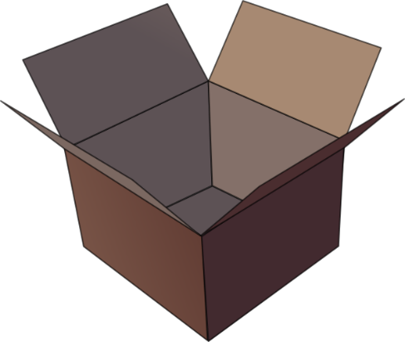
SFC
petit
prix
€15.95
grand
mot
dans
X
mais
[but]
Notes:
Aim: To consolidate SSC [SFC]
Procedure:
1. Introduce and elicit the pronunciation of the individual SSC [SFC] (in this case is SFC – silent final consonant so nothing to pronounce as an individual sound!) and then the source word again ‘dans’ (with gesture, if using). 2. Then present and elicit the pronunciation of the five cluster words.
The cluster words have been chosen for their high-frequency, from a range of word classes, with the SSC (where possible) positioned within a variety of syllables within the words (e.g. initial, 2nd, final etc.). Additionally, we have tried to use words that build cumulatively on previously taught SSCs (see the Phonics Teaching Sequence document) and do not include new SSCs. Where new SSCs are used, they are often consonants which have a similar symbol-sound correspondence in English.
Word frequency (1 is the most frequent word in French): dans [11]; petit [138] prix [310]; mot [220]; mais [30]; grand [59]. Source: Londsale, D., & Le Bras, Y. (2009). A Frequency Dictionary of French: Core vocabulary for learners London: Routledge.

Slide 3
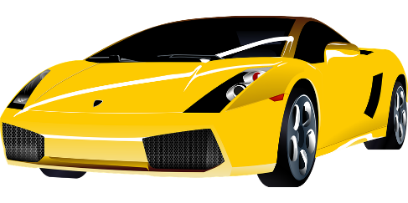
SFE
monde
moderne
[silent final –e]
[shy]
centre
timide
douze
vie
[life]
Notes:
Aim: To consolidate SSC [SFE]
Procedure:
1. Introduce and elicit the pronunciation of the individual SSC [SFE] and then the source word again ‘timide’ (with gesture, if using). 2. Then present and elicit the pronunciation of the five cluster words.
The cluster words have been chosen for their high-frequency, from a range of word classes, with the SSC (where possible) positioned within a variety of syllables within the words (e.g. initial, 2nd, final etc.). Additionally, we have tried to use words that build cumulatively on previously taught SSCs (see the Phonics Teaching Sequence document) and do not include new SSCs. Where new SSCs are used, they are often consonants which have a similar symbol-sound correspondence in English.
Word frequency (1 is the most frequent word in French): monde [77]; moderne [1239] centre [491]; vie [132]; douze [1664]; timide [3835]. Source: Londsale, D., & Le Bras, Y. (2009). A Frequency Dictionary of French: Core vocabulary for learners London: Routledge.

Slide 4
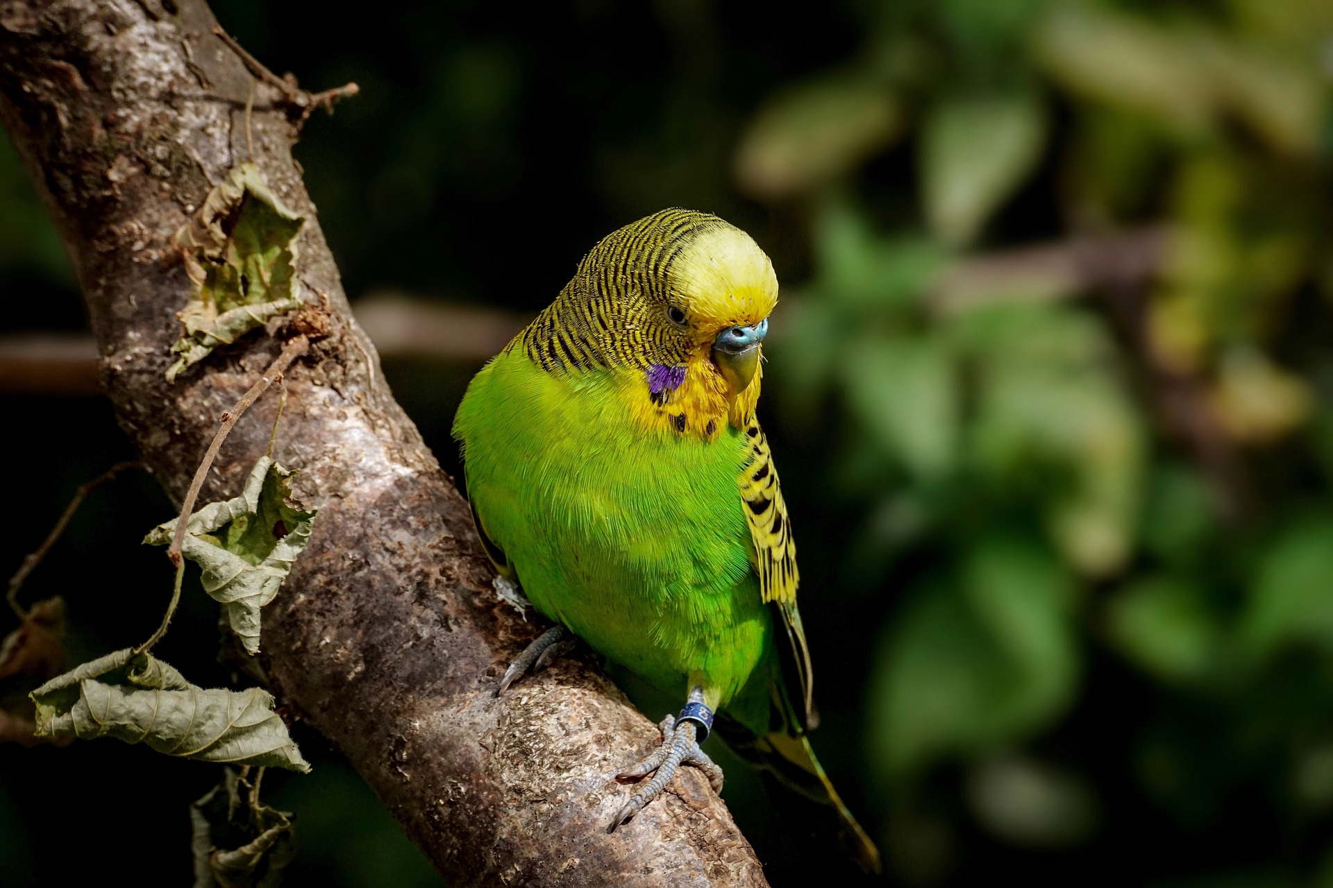
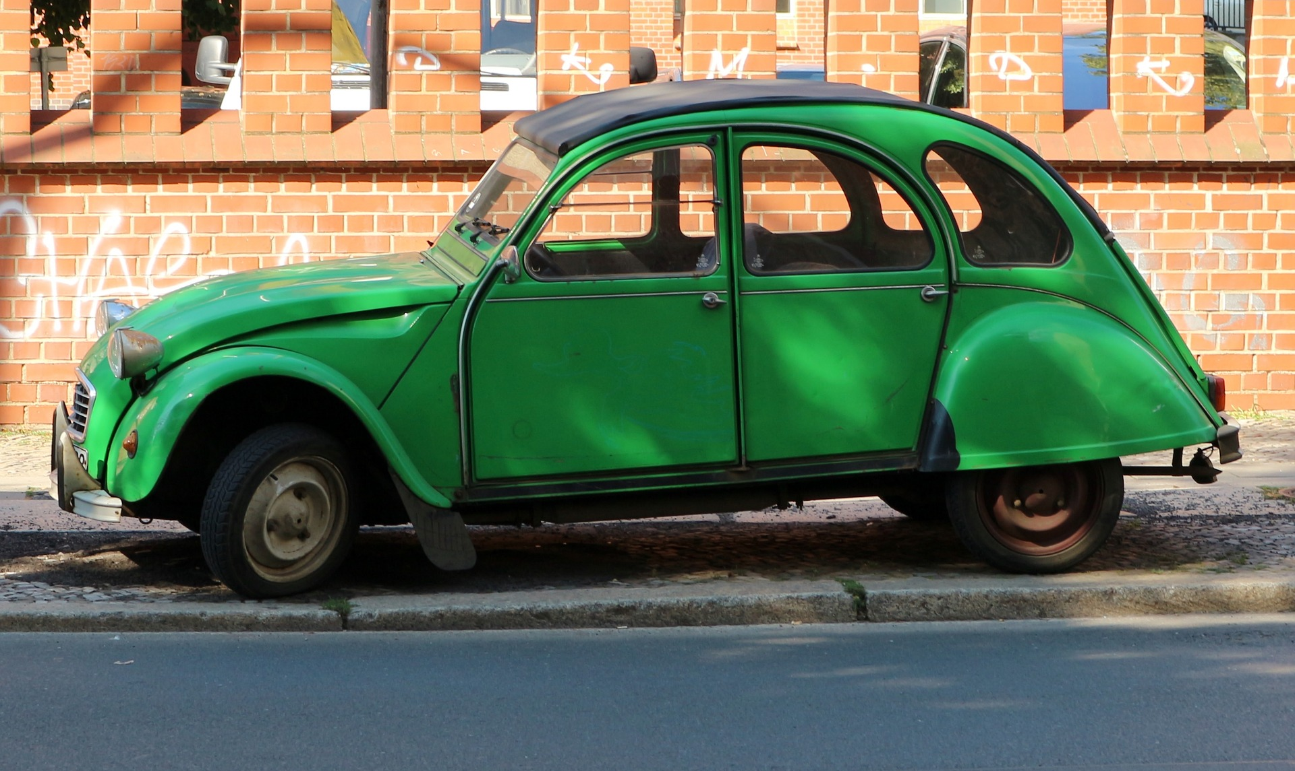
La féminisation des adjectifs
grammaire
Remember that adjectives change when they describe a feminine noun.
The most common change is to add ‘e’ to the end of the adjective.
un oiseau vert
a green bird
une voiture verte
a green car
When we add ‘e’, the SFC is no longer silent, and the ending is SFe instead.
Notes:
Timing: 3 minutes
Aim: Revision of feminine adjective agreement rule 1: add –e
Procedure:
1. Click through explanations and examples, eliciting knowledge where possible.
2. Ensure understanding of rule.
3. Click pictures to hear audio.
Transcript:
un oiseau vert une voiture verte
Word frequency of cognates used (1 is the most frequent word in French):
féminisation [>5000], adjectif [>5000]
Source: Lonsdale, D., & Le Bras, Y. (2009). A Frequency Dictionary of French: Core vocabulary for learners London: Routledge.

Slide 5
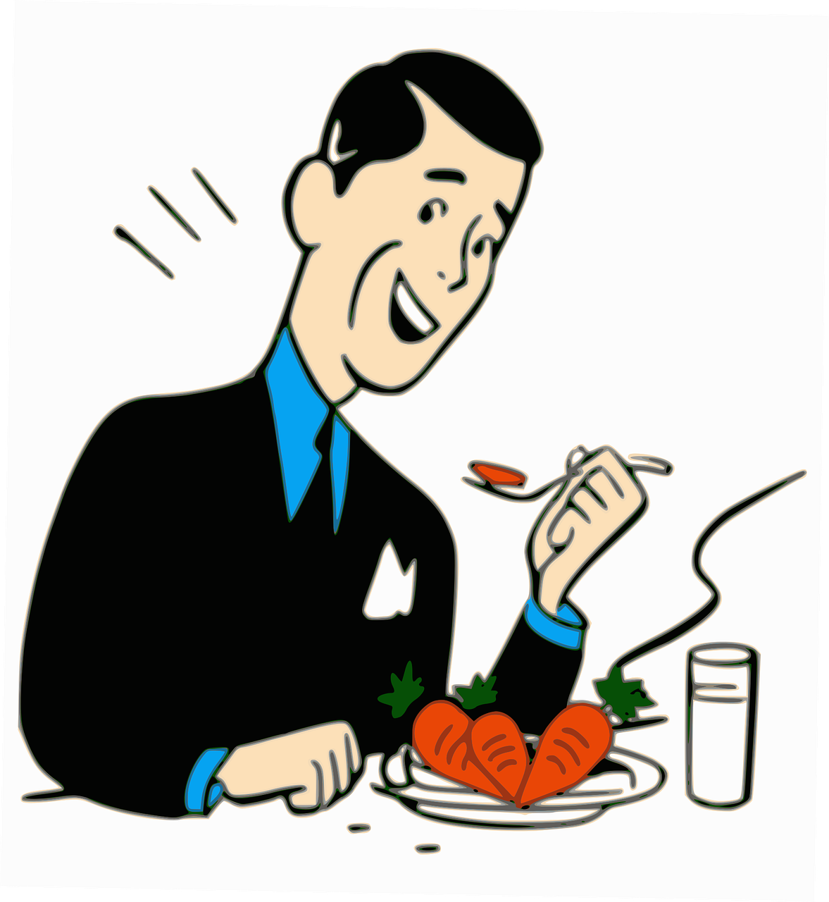
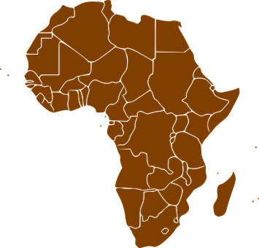
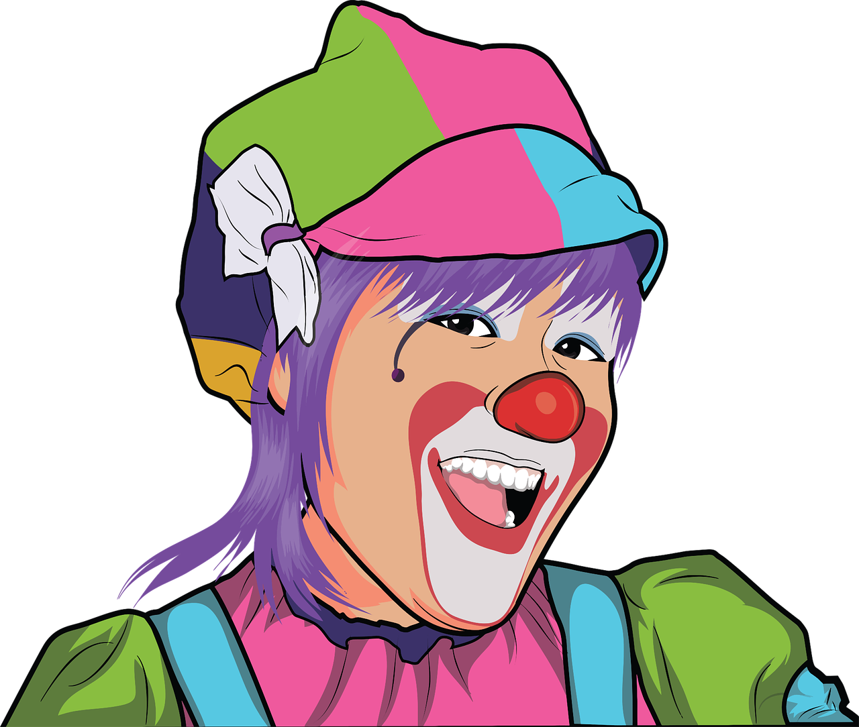
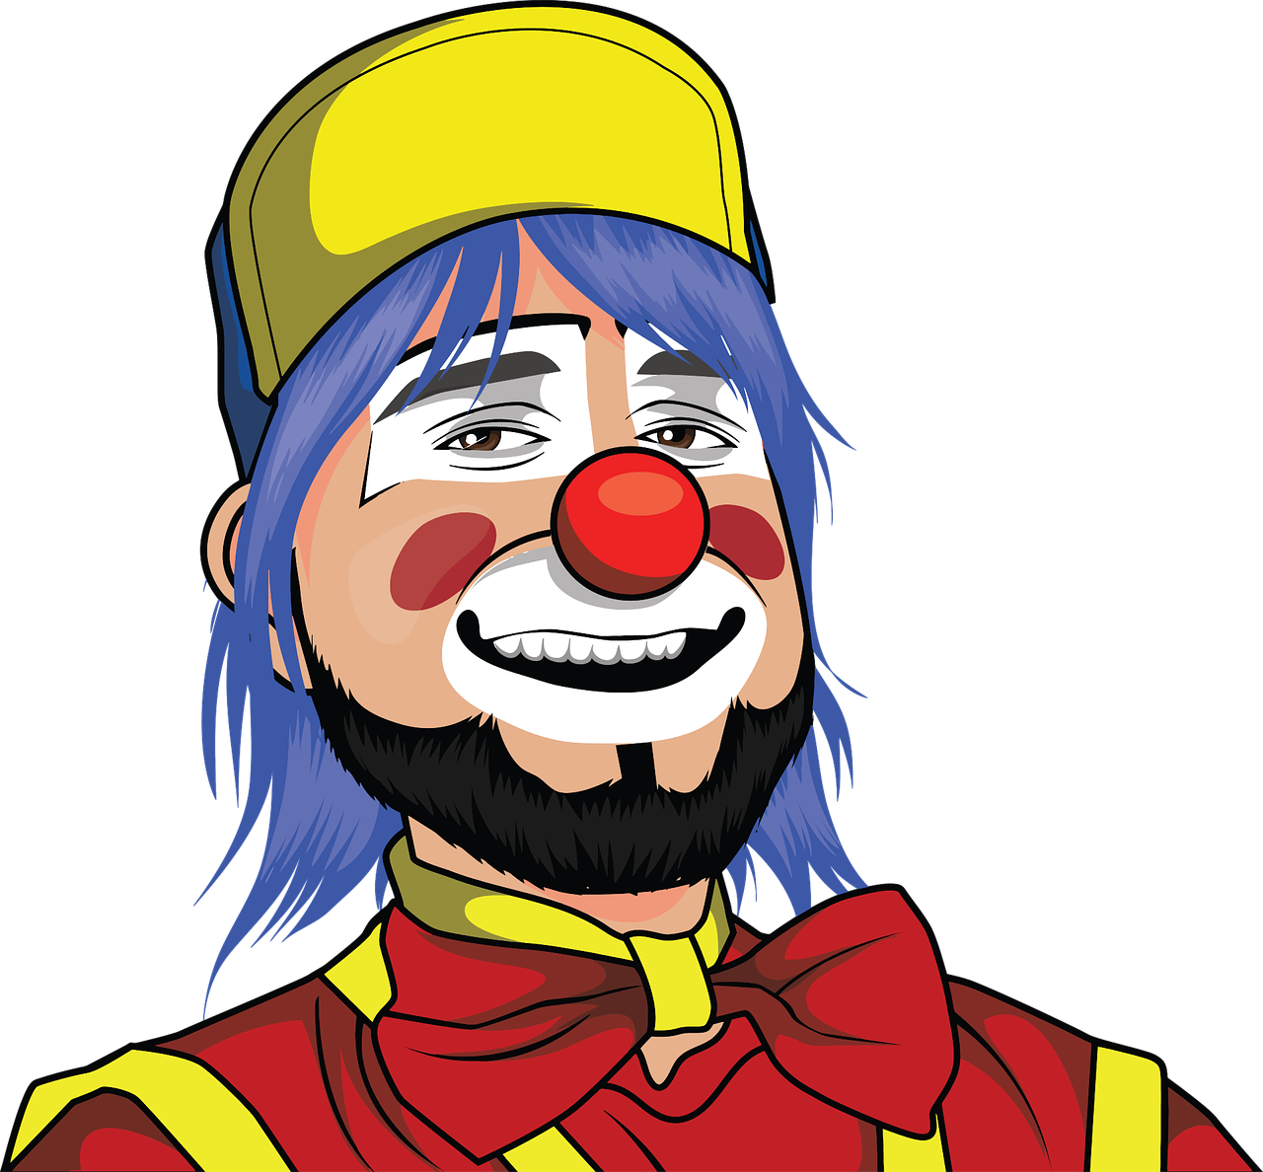
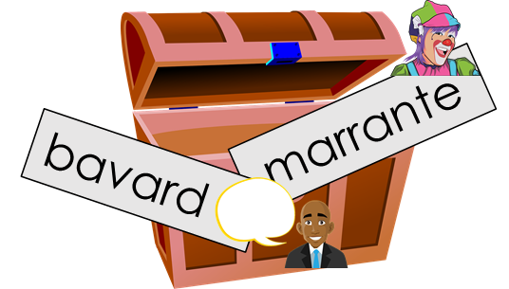
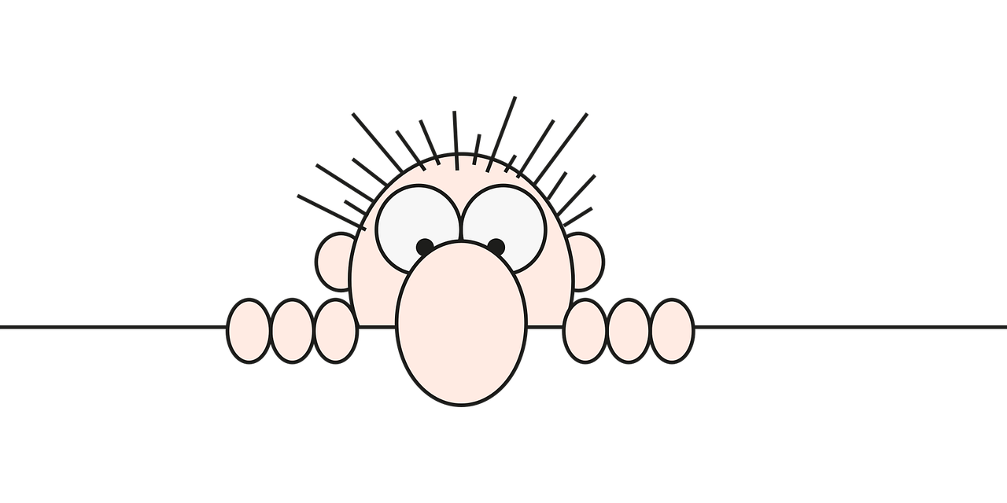
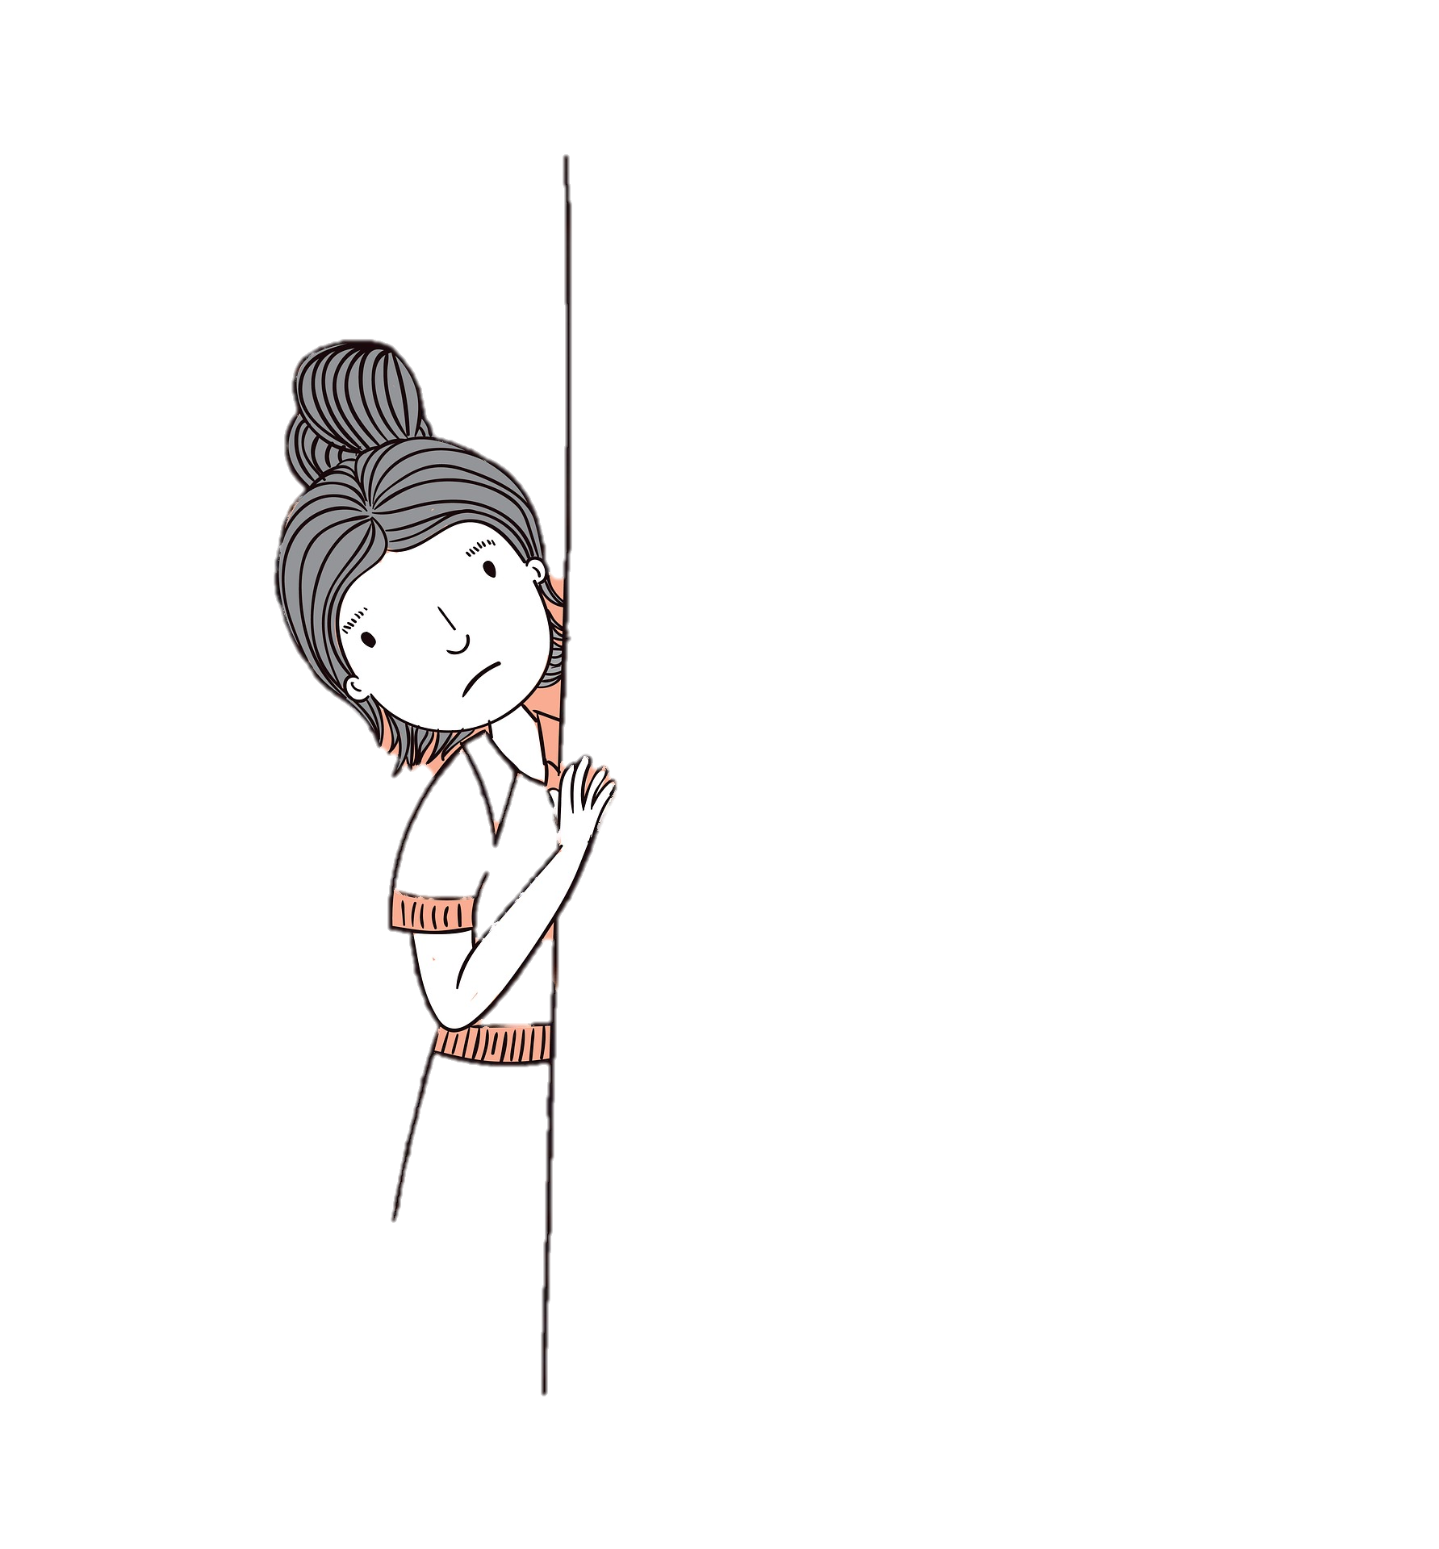
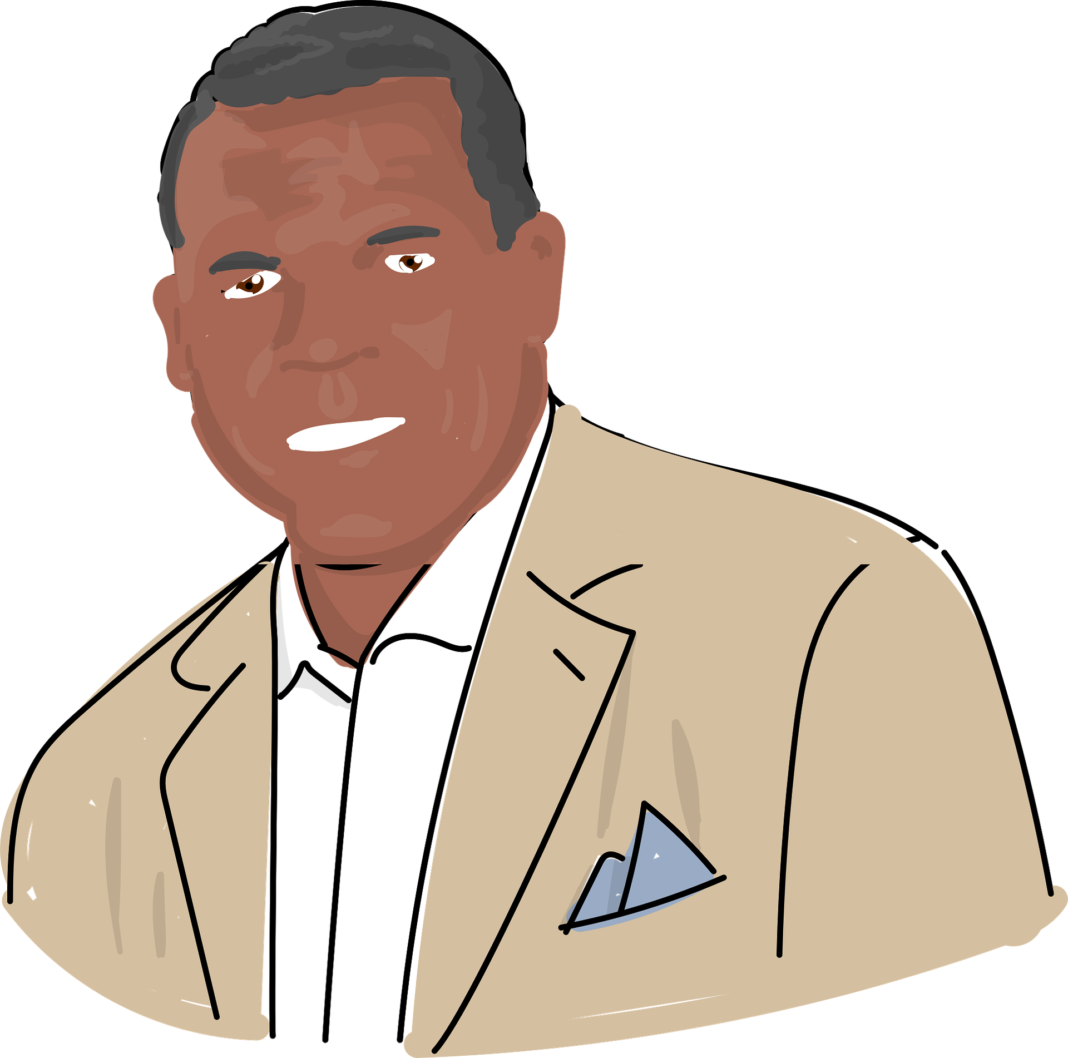
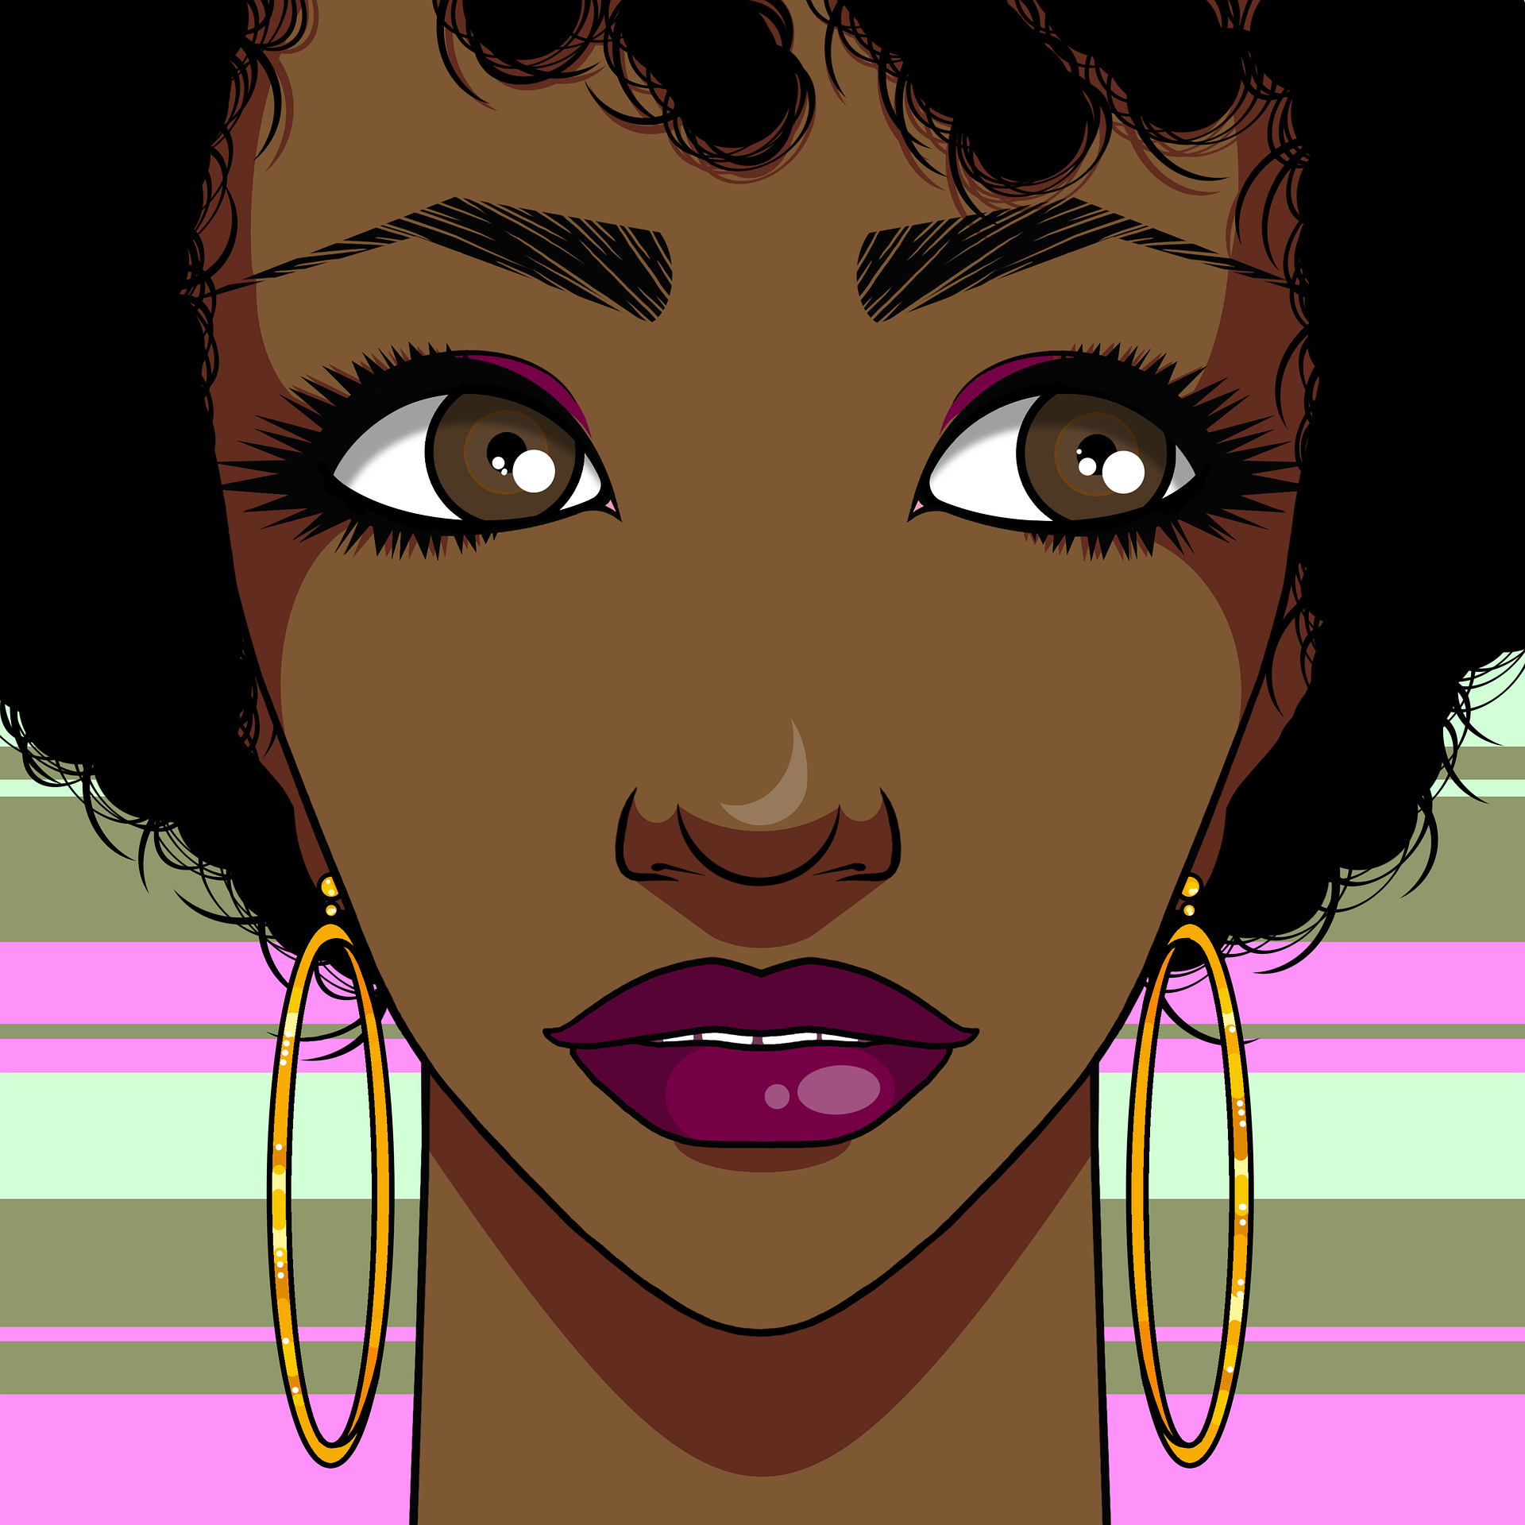
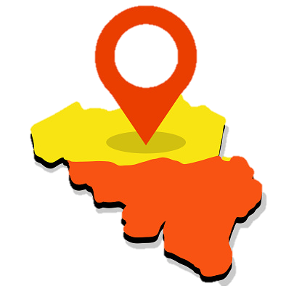
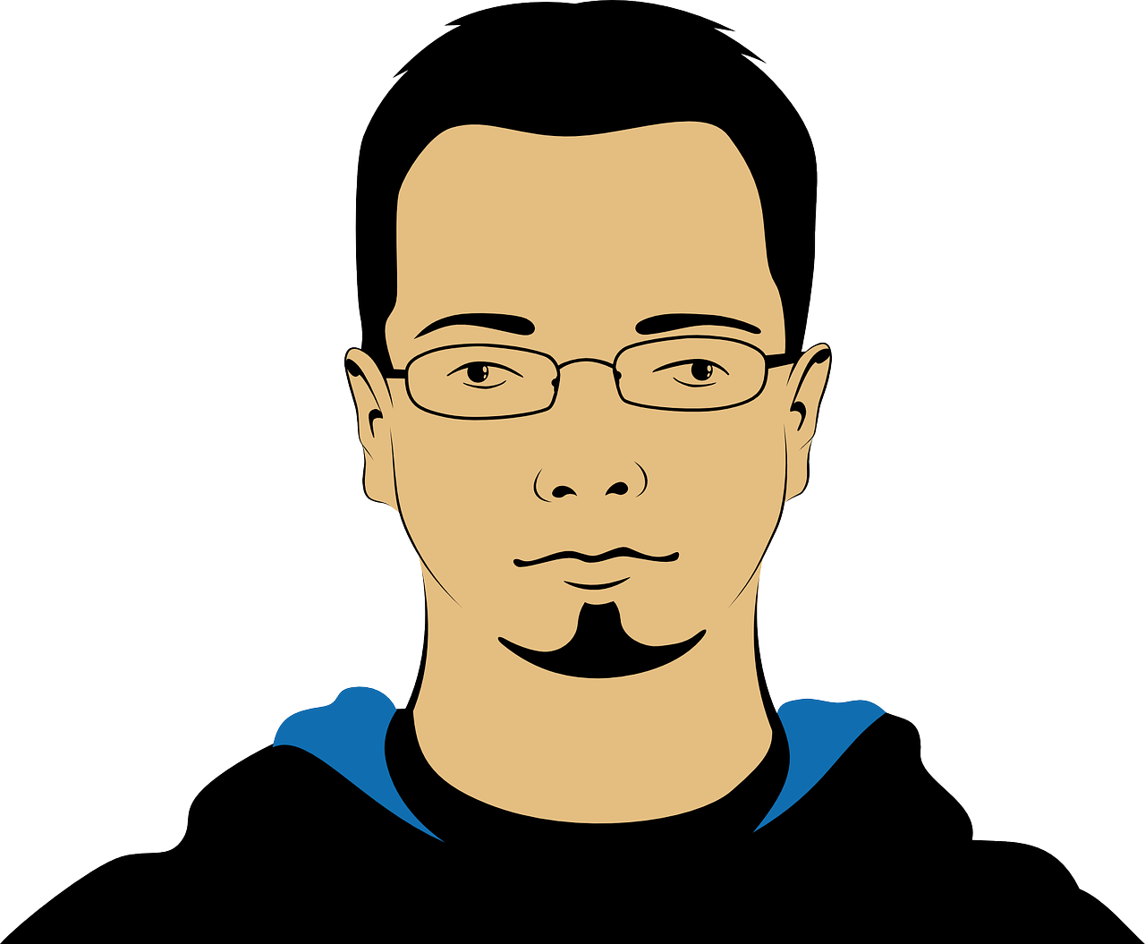
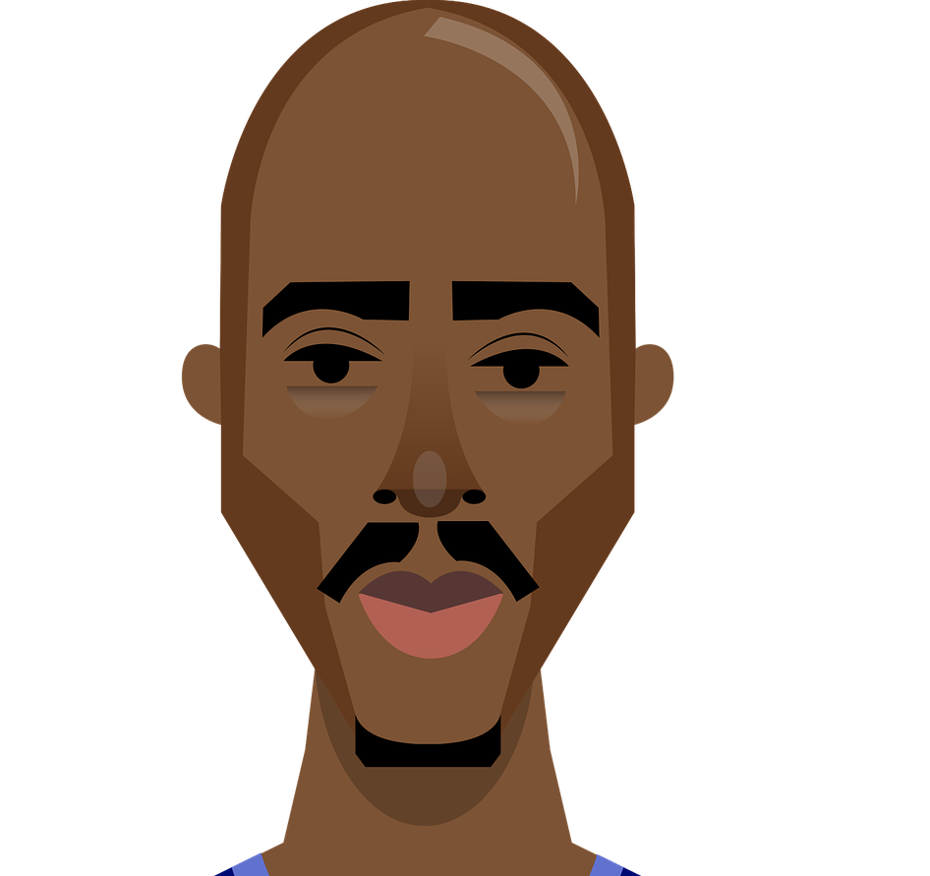
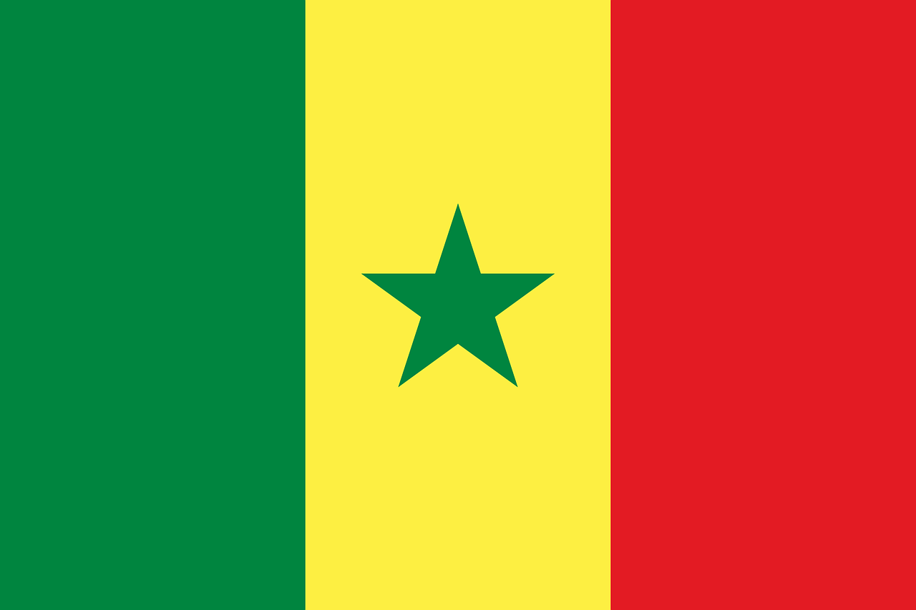
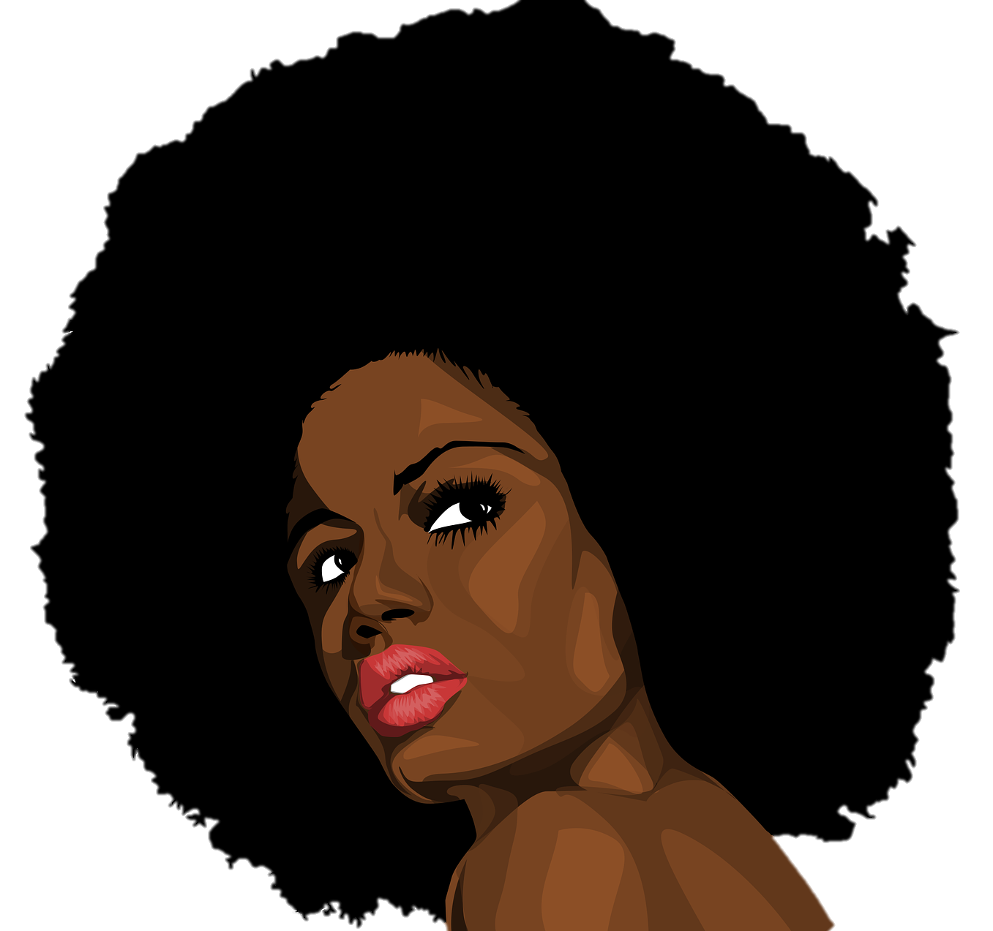
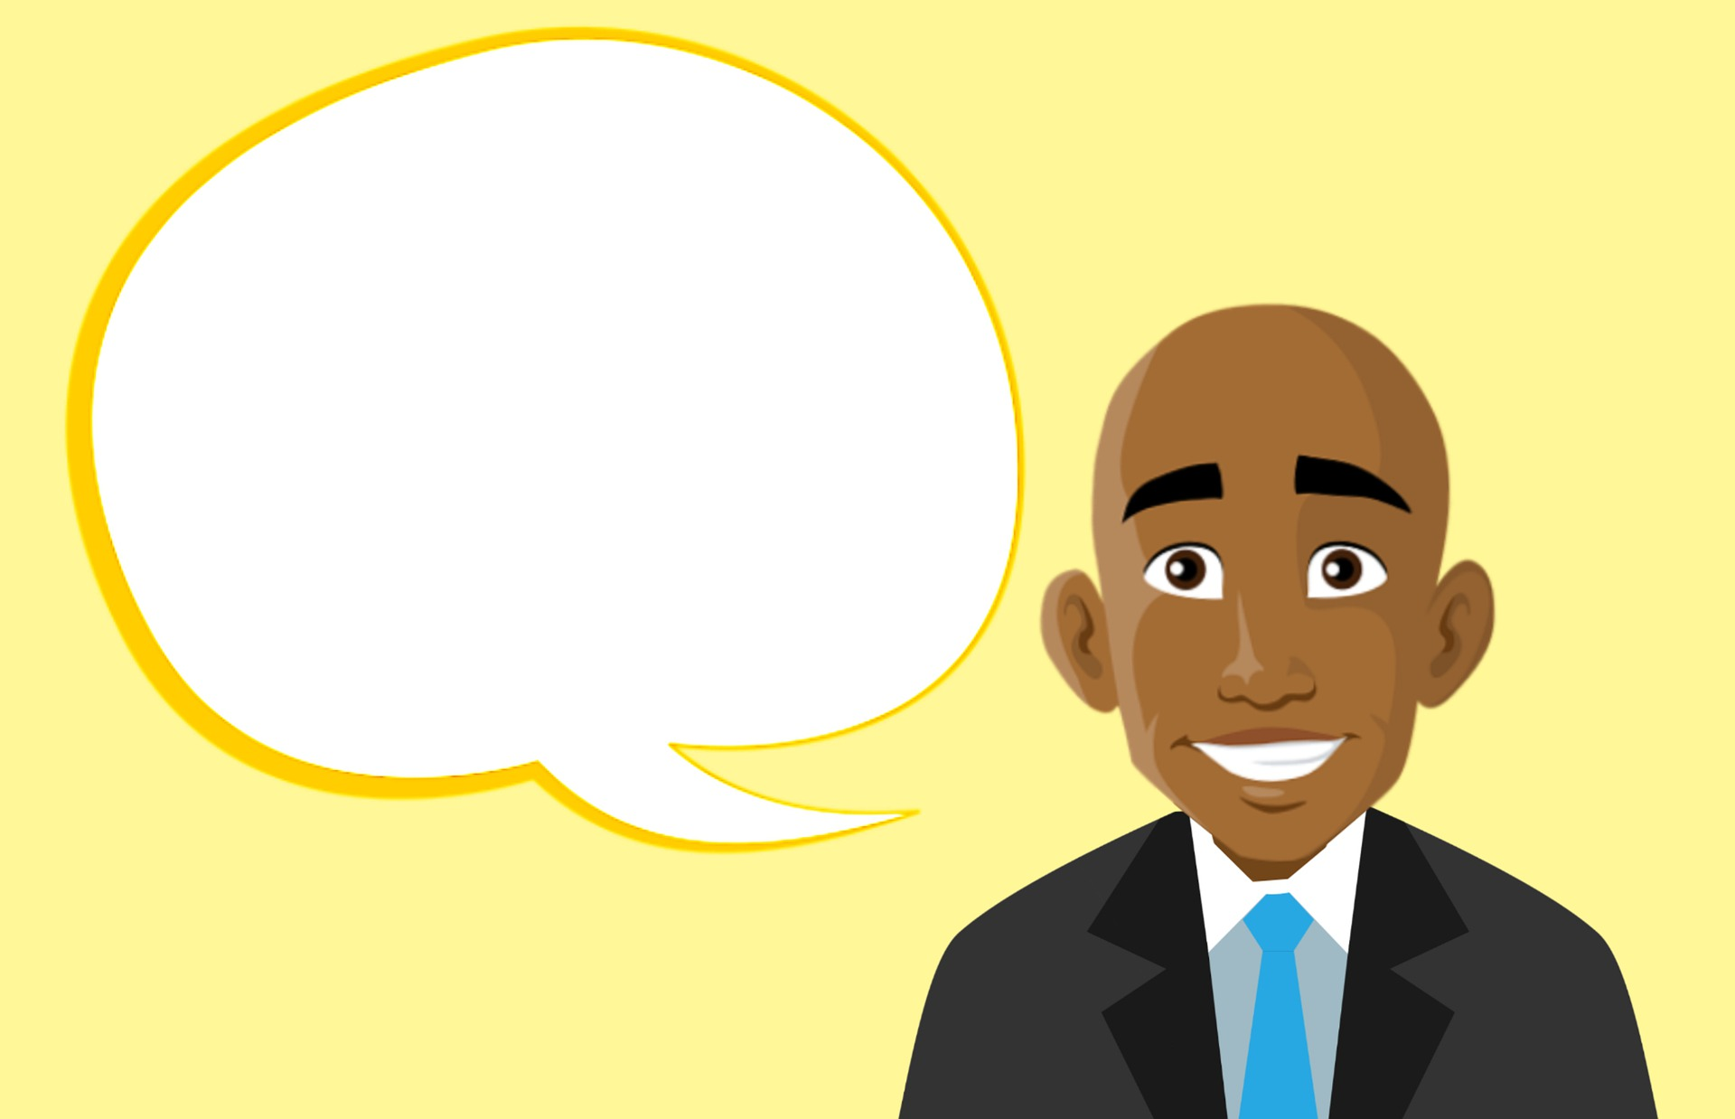
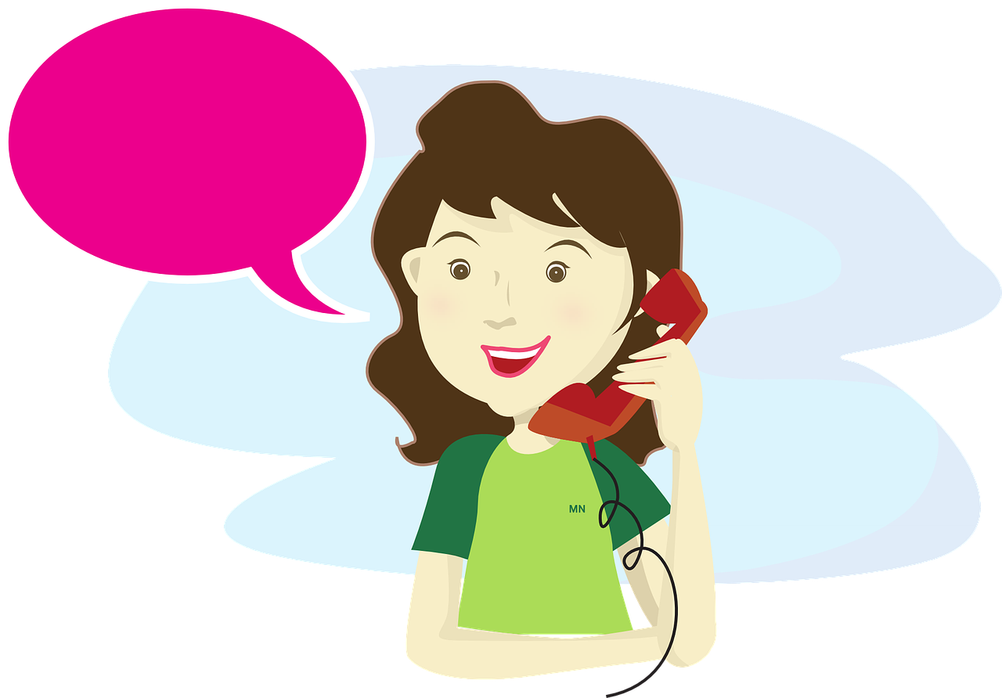
C’est qui ?
Écoute. On décrit qui ? La dernière lettre de l'adjectif, c’est SFC ou SFE ?
écouter
Le Rwanda est un pays en Afrique. On parle français au Rwanda.
Remember! Add words that are important to you to your personal word bank.
Q | il | elle | Q | il | elle
 | gourmand (fond of food) |  |  | marrant (funny)
 | rwandais (Rwandan) |  |  | méfiant (wary, distrustful)
 | fort (strong) |  |  | flamand (Flemish)
 | sénégalais (Senegalese) |  |  | bavard (talkative)
1
5
La Flandre est une région de Belgique. On parle flamand en Flandre.
2
6
Le Sénégal est un pays en Afrique. On parle français au Sénégal.
3
7
4
8
Notes:
Timing: 5 minutes
Aim: Aural recognition of masculine (SFC) and feminine (SFe) forms of adjectives (following pattern 1).
Procedure:
1. Remind students of the association between SFC and masculine adjectives, and SFe and feminine adjectives.
2. Click to play audio.
3. Students write 1-8 and il or elle, depending on whether they hear a masculine or feminine form of the (unknown) adjective given.
4. Click to reveal answers. Hear full audio by clicking on tick.
5. Click to bring up some cultural information about the places mentioned. Explain that la Flandre is called ‘Flanders’ and it is the northern part of Belgium which borders the Netherlands. Explain that flamand is called ‘Flemish’ in English and that it is a language similar to Dutch.
6. Finally, click to bring up a reminder to students about continuing to personalise their vocabulary knowledge. This is something they were encouraged to do, from the start of Y7.
Transcript:
1. [Elle] est gourmande.
2. [Il] est rwandais.
3. [Il] est fort.
4. [Elle] est sénégalaise.
5. [Il] est marrant.
6. [Elle] est méfiante.
7. [Elle] est flamande.
8. [Il] est bavard.
Word frequency of unknown words used (1 is the most frequent word in French):
gourmand [>5000], rwandais [>5000], fort [107], sénégalais [>5000], marrant [>5000], méfiant [>5000], flamand [>5000], bavard [>5000] Source: Lonsdale, D., & Le Bras, Y. (2009). A Frequency Dictionary of French: Core vocabulary for learners London: Routledge.
Word frequency of cognates used (1 is the most frequent word in French):
adjectif [>5000], lettre [480] Source: Lonsdale, D., & Le Bras, Y. (2009). A Frequency Dictionary of French: Core vocabulary for learners London: Routledge.

Slide 6
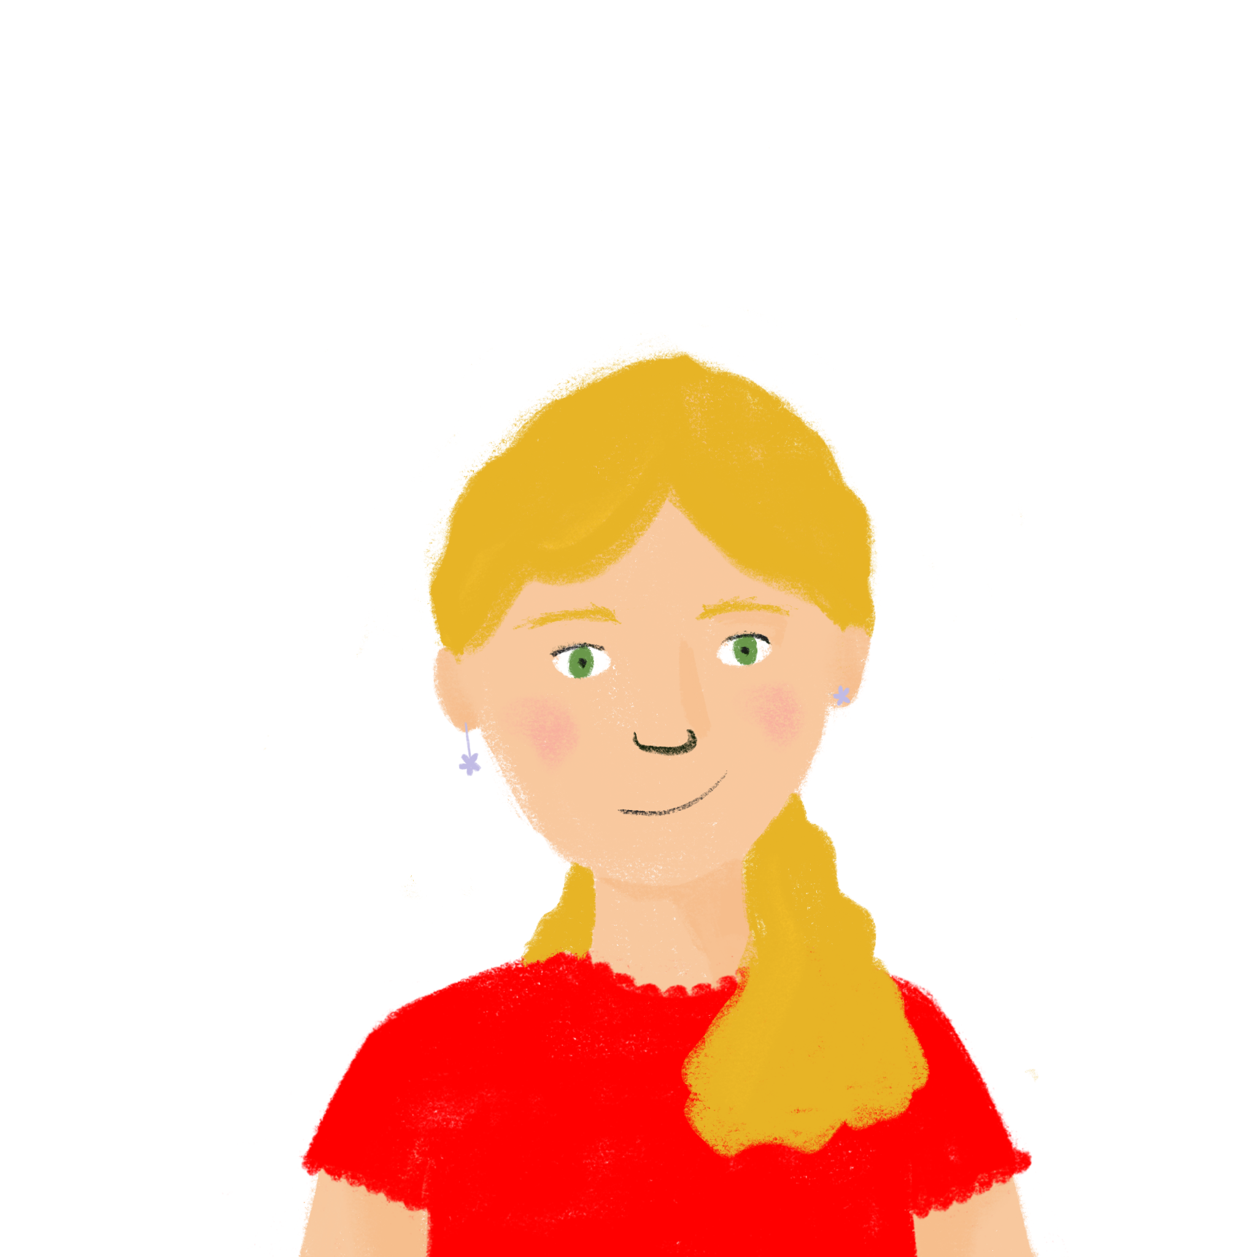
Les pronoms et être (sing.)
grammaire
Remember! Put ne … pas around the verb to say what doesn’t happen.
Je ne suis pas italien.
I am not Italian.
Tu n’es pas anglais. You are not English.
Elle n’est pas grande.
She is not tall.
Remember the singular subject pronouns:
I you (sing.) he/she/people, we
je tu il/elle/on
Remember the singular forms of être:
I am you (sing.) are he/she is people, we are
je suis tu es il/elle est on est
Remember! Ne becomes n’ before a verb form beginning with a vowel or h-.
Notes:
Timing: 2 minutes
Aim: Revision of singular subject pronouns, singular forms of être, and placement of ne…pas with form of être + adjective.
Procedure:
Click through explanations, eliciting knowledge where possible.

Slide 7
la lange neutre*
* neutre = neutral
info
Quels pronoms pour une personne non-binaire ?
French is a more gendered language than English, so it is more challenging to find ways to express non-binary identities. For example, there is no gender-neutral ‘they’ in French (ils/elles).
Some people who identify as non-binary use the following as gender-neutral pronouns, in the same way we can use ‘they’ for one person in English:
iel (or yel/yelle), which is a combination of ‘il’ and ‘elle’;
ol, which is a separate and new pronoun.
Some people use other gender-neutral pronouns, and others switch between pronouns.
Everyone is different, so it is always best to ask the person how they would like to be addressed.
This gender-neutral language is still being developed, and there is no officially correct way to do it. The flexibility of the language allows everyone to define themselves.
Notes:
Timing: 2 minutes
Aim: Introduction to gender-neutral language and pronouns. NB: This slide is for information only and use of gender-neutral language will not be tested in LDP assessments. Students are encouraged to use gender-neutral language to describe themselves if wished and should be consistent within their work if they choose to do so. Consistent use of gender-neutral pronouns to describe oneself should be credited in assessments.
Procedure:
1. Click through explanations, eliciting knowledge where possible.
2. Discuss use of gender-neutral pronouns. Emphasise that this language is still evolving, that it is up to individuals to decide how they would like to be addressed.
Further information on gender-neutral language can be found here:
Quels pronoms pour une personne non-binaire ? - Princesse répond
Gender neutral language wiki
Manuel d'écriture inclusive
Word frequency of unknown words used (1 is the most frequent word in French): neutre [2785]
Source: Lonsdale, D., & Le Bras, Y. (2009). A Frequency Dictionary of French: Core vocabulary for learners London: Routledge.

Slide 8
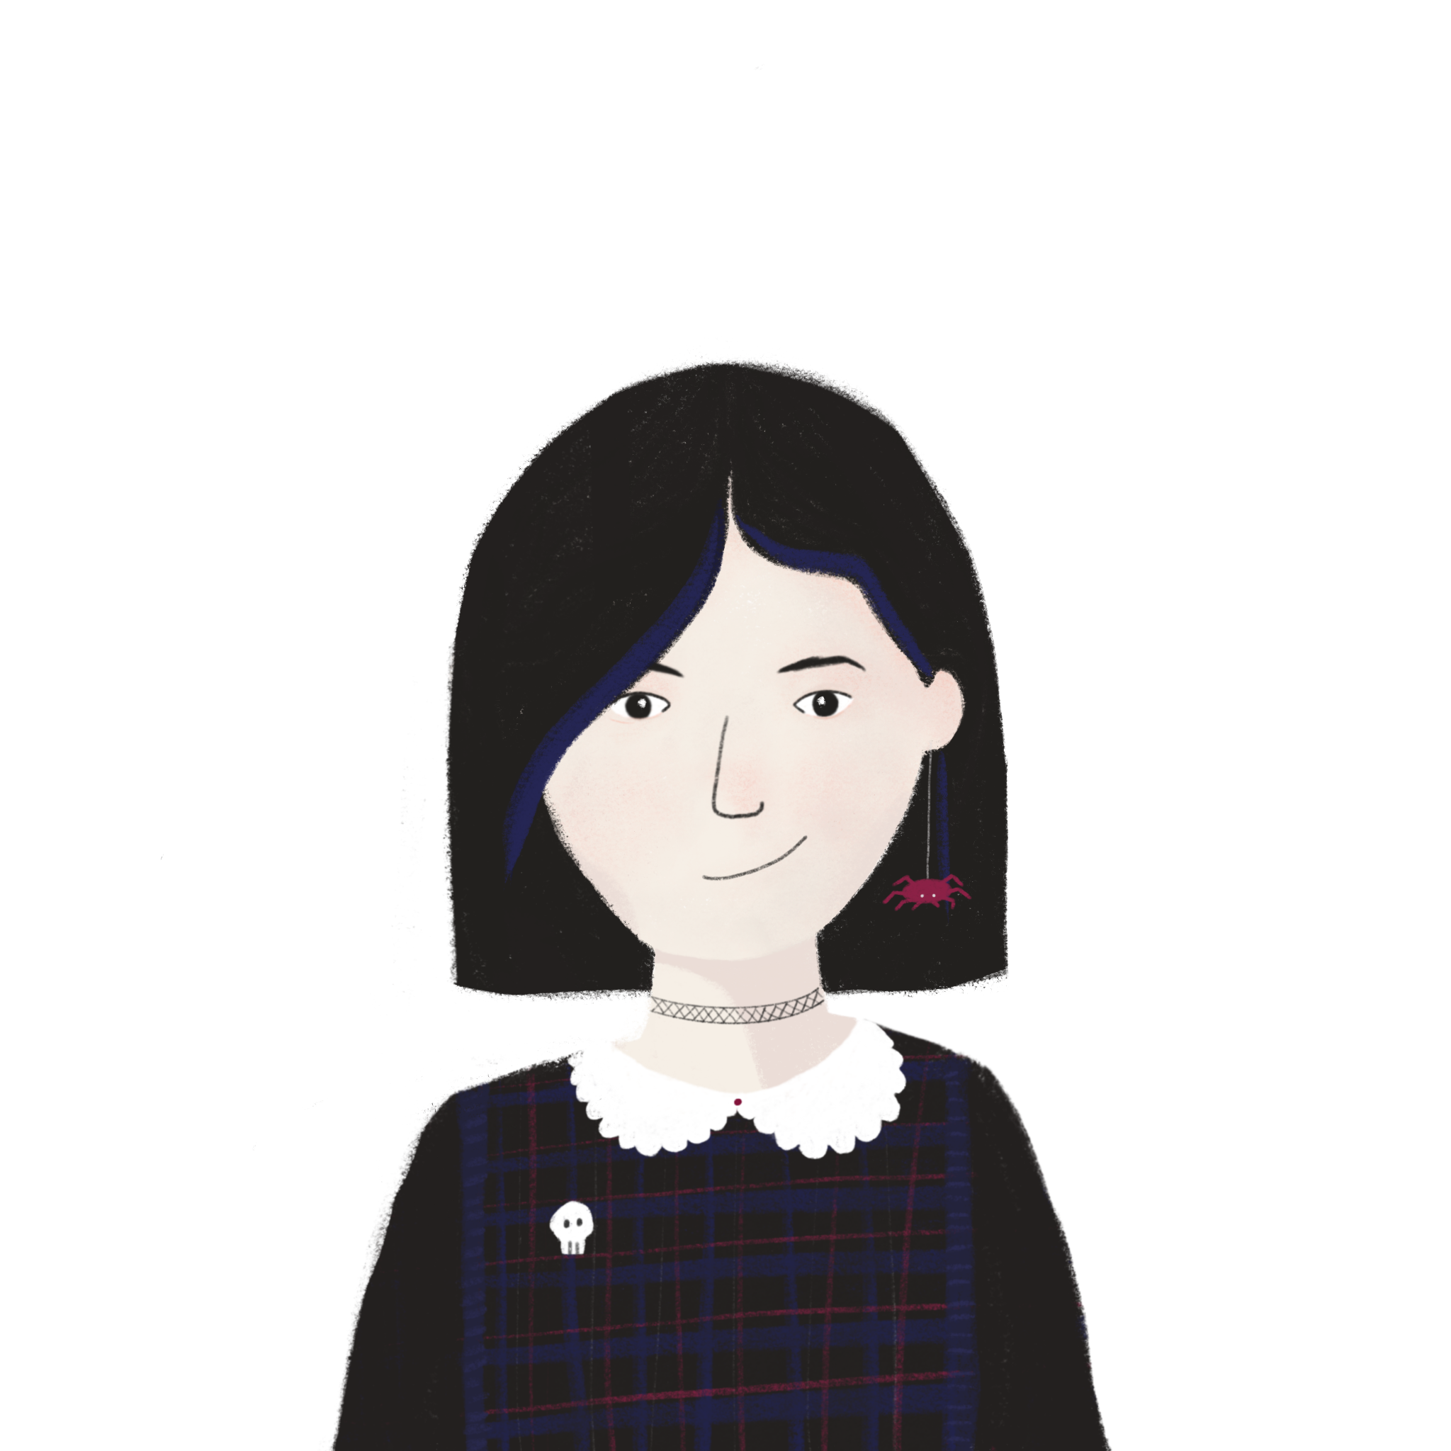
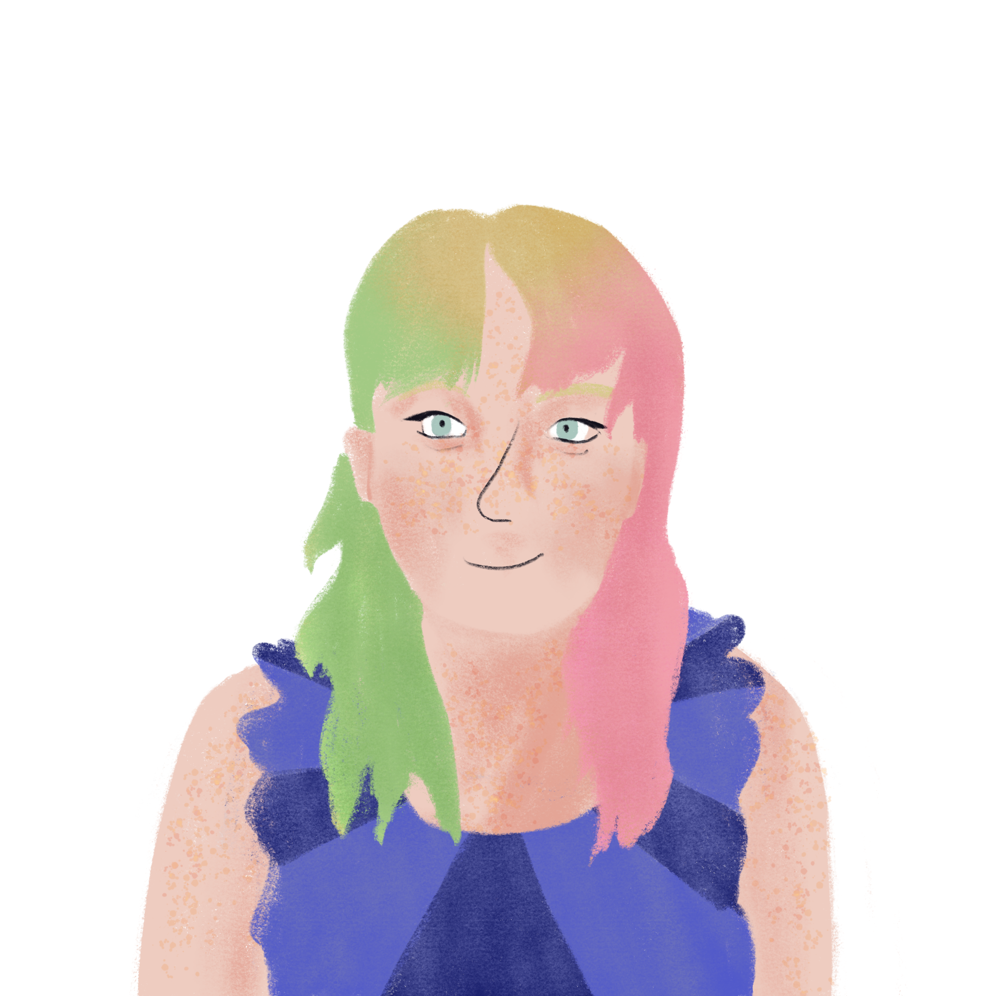
La copine* de Léa
*la copine = girlfriend
*tout = everything
lire
Léa envoie une photo de sa copine à Sophie, et Sophie veut tout* savoir !
Lis les messages et écris trois listes d’adjectifs en anglais.
Sophie | Léa | Stéphanie
We can add ‘pas’ before an adjective to mean ‘not’, e.g.: pas mal – not bad.
Write what each person is not as well as what they are.
Notes:
Timing: 8 minutes. This is slide 1/3.
Aim: Written recognition of singular forms of être and connecting these with meaning (I, you, he/she).
Procedure:
1. Students draw a 3x2 in their books as shown on this slide.
2. Students read the messages on the next slide, and list which adjectives refer to each person, writing them in English if possible.
3. Elicit the correct pronouns orally (a-o). A more challenging addition would be to ask students to read the dialogue aloud in pairs (perhaps simultaneously – i.e., whole class at once), inserting the correct pronouns as they go.
4. Check answers to the adjective lists activity on the following slide.
Word frequency of cognates used (1 is the most frequent word in French):
adjectif [>5000]
Word frequency of unknown words used (1 is the most frequent word in French): copine (copain) [3020]
Source: Lonsdale, D., & Le Bras, Y. (2009). A Frequency Dictionary of French: Core vocabulary for learners London: Routledge.

Slide 9
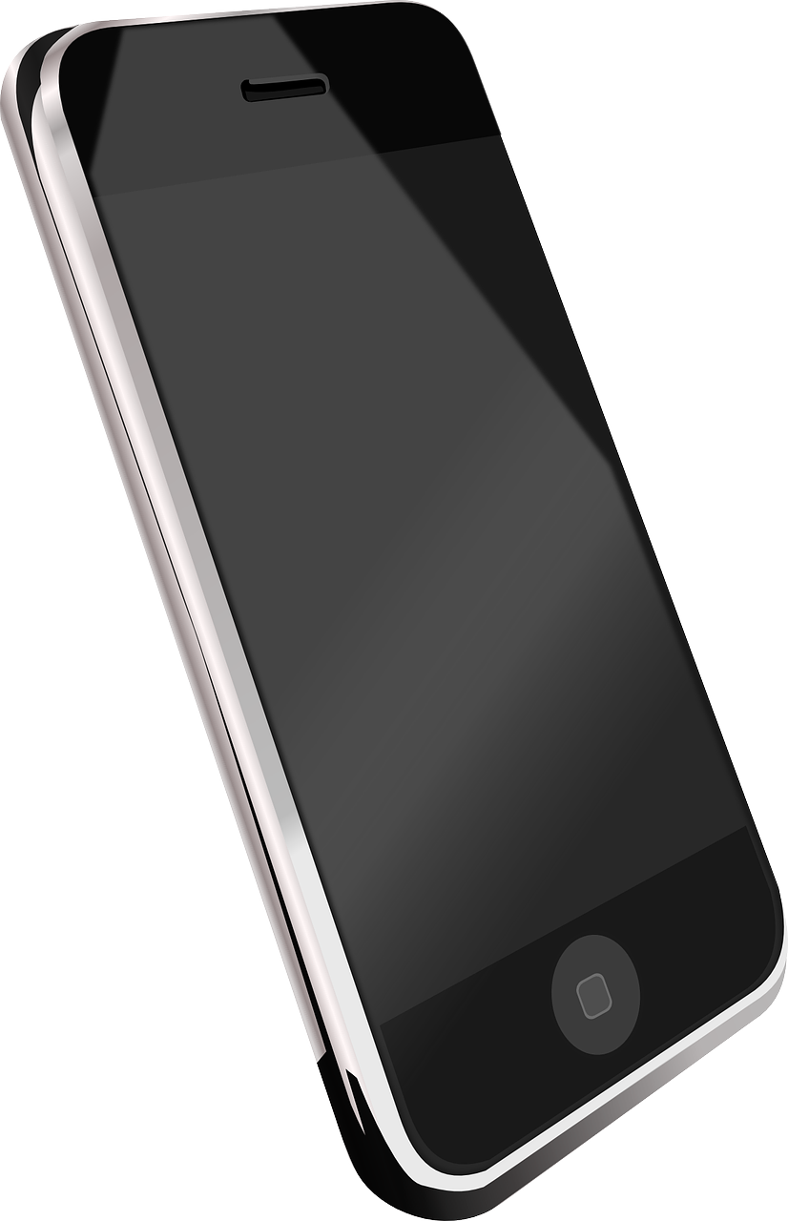
La copine* de Léa
*la copine = girlfriend
lire
Voici une photo de ma copine, Stéphanie.
a
b
Oh ! Je suis contente parce que tu es contente ! Elle est comment ?
c
Elle est amusante et intelligente.
d
e
C’est parfait - tu es amusante et je suis intelligente !
Oui, elle est ma copine idéale.
f
Est-elle française ?
g
h
Oui, mais elle n’est pas parisienne.
i
j
Je suis grande et tu es assez grande. Est-elle grande aussi ?
Non, elle est assez petite.
k
l
m
Et est-elle ta personne préférée maintenant ? Ou suis-je encore ta personne préférée ?
Je ne suis pas sûre*…
n
o
Notes:
Slide 2/3
Word frequency of cognates used (1 is the most frequent word in French):
adjectif [>5000], parfait [1600], parisien [2549]
Word frequency of unknown words used (1 is the most frequent word in French): copine (copain) [3020],
Source: Lonsdale, D., & Le Bras, Y. (2009). A Frequency Dictionary of French: Core vocabulary for learners London: Routledge.

Slide 10
La copine* de Léa
*la copine = girlfriend
*sûr = sure
lire
Lis les messages et écris trois listes d’adjectifs en anglais.
Sophie | Léa | Stéphanie
pleased intelligent tall | pleased funny tall not sure | funny intelligent ideal French not Parisian short/small
Notes:
Slide 3/3 - answers

Slide 11
La féminisation des adjectifs
grammaire
You know some other patterns to make adjectives agree with feminine nouns:
Adjectives ending in SFe stay the same. triste → triste
Adjectives ending in –x change to –se. heureux → heureuse
Adjectives ending in –el change to –elle. naturel → naturelle
Adjectives ending in –en change to –enne. italien → italienne
Some adjectives don’t follow these patterns:
travailleur → travailleuse gros → grosse
Notes:
Timing: 2 minutes
Aim: Revision of feminine adjective agreement rules 2 (no change with adjectives ending in mute –e); 3 (-x ➜ -se), 4 (-el ➜ -elle) and 5 (-en ➜ -enne)
Procedure:
Click through explanations
Word frequency of cognates used (1 is the most frequent word in French):
féminisation [>5000], adjectif [>5000]
Source: Lonsdale, D., & Le Bras, Y. (2009). A Frequency Dictionary of French: Core vocabulary for learners London: Routledge.

Slide 12
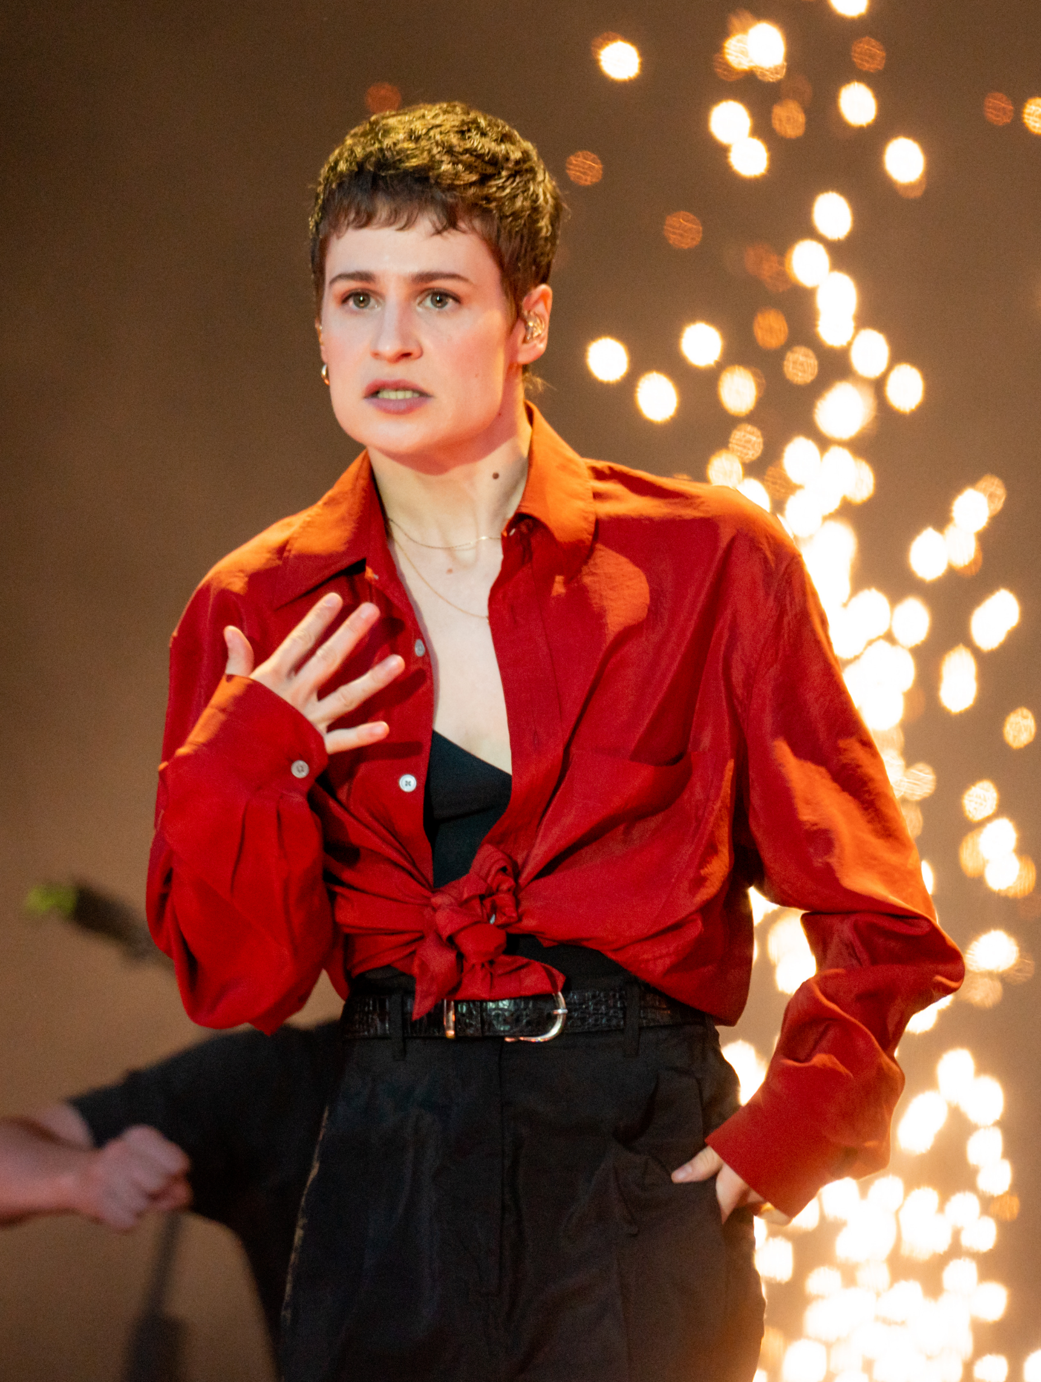
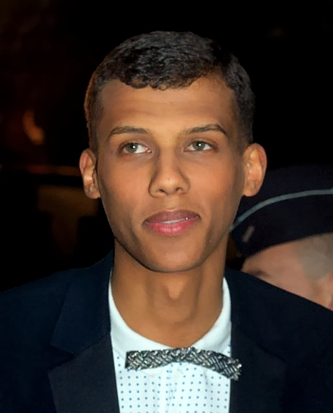
Deux musiciens
1
2
3
4
5
6
7
8
écouter
Attention ! ‘Christine and the Queens’ looks plural, but is a stage name for one person. Christine and the Queens is a French singer.
Christine and the Queens est une chanteuse française.
Stéphanie décrit ses musiciens préférés. Écoute les adjectifs. Ils décrivent qui ?
Écris les adjectifs si tu peux.
Christine and the Queens | Stromae
4. différente 5. française 7. importante 8. intelligente | 1. amusant 2. bon 3. content 6. travailleur
4
1
5
2
7
3
8
6
Notes:
Timing: 5 minutes
Aim: Aural recognition of masculine and feminine forms of adjectives following a mix of agreement patterns 2-5.
Procedure:
1. Draw attention to the info bubble. Explain that the stage name ‘Christine and the Queens’ sounds plural, but because it refers to just one person, it takes third person singular agreement in both English and French. Acknowledge that this might sound strange! Reinforce that the verb agrees with the person, rather than the name. If students find this confusing, encourage them to focus on the picture.
2. Students sketch two columns as shown on the slide.
3. Click on the number buttons at the top of the screen to play with the pronoun obscured audio.
4. Students list the adjectives in correct column. At lower levels, this slide could be adapted to make this a recognition activity, rather than recall. To do this, display the adjectives in English on the slide, and ask students to write ‘C’ or ‘S’ next to each, to indicate who they refer to.
5. Click to reveal answers.
6. Click to bring up 2nd set of number buttons with full sentence audio and listen again. Students repeat, focussing on the adjective ending.
Transcript:
1. [Elle] est ambitieuse.
2. [Il] est amusant.
3. [Il] est bon.
4. [Il] est content.
5. [Elle] est différente.
6. [Elle] est française.
7. [Il] est intelligent.
8. [Elle] est importante.
9. [Elle] est intelligente.
10. [Il] est travailleur.
Word frequency of cognates used(1 is the most frequent word in French): musicien [3100], adjectif [>5000]
Source: Lonsdale, D., & Le Bras, Y. (2009). A Frequency Dictionary of French: Core vocabulary for learners London: Routledge.
Primavera19_-48 by Raph_PH is licensed under CC BY 2.0
Stromae_2011 by George Biard is licensed under CC BY-SA 3.0

Slide 13
Deux musiciens
*flamand = Flemish
lire /écrire
Stéphanie a donné un magazine de musique à Léa. Léa lit des articles sur Christine and the Queens et Stromae. Lis et, si nécessaire, complète les adjectifs.
Héloïse Letissier est chanteuse. Quand elle chante, elle est différente : elle devient Christine and the Queens, ou Chris. Elle est française, mais elle chante souvent en anglais. Elle est très intelligente et travailleuse. Elle est calme et très petite.
1
Remember! ‘C’est’ means ‘he is’ or ‘she is’ when used with an article + job title.
Stromae est belge, mais aussi rwandais et flamand*. Il est très grand. Quand il chante, il n’est pas mauvais, mais c’est un très bon rappeur. Il est travailleur .
2
7
3
4
5
8
6
9
10
11
Notes:
Timing: 8 minutes. This is slide 1/2.
Aim: Written production of adjective endings.
Procedure:
1. Students read the articles and, if necessary, write the appropriate adjective ending. Ensure that students are aware that not every adjective needs an additional ending – some are fine as they are.
2. Click to reveal answers.
Word frequency of unknown words used (1 is the most frequent word in French):
flamand [>5000], necessaire [451]
Word frequency of cognates used (1 is the most frequent word in French): magazine [2033], adjectif [>5000], rwandais [>5000], rappeur [>5000], completer [2034]
Source: Lonsdale, D., & Le Bras, Y. (2009). A Frequency Dictionary of French: Core vocabulary for learners London: Routledge.

Slide 14
Deux musiciens
*genre = gender
*soigneux = thorough, careful
écrire
Écris les adjectifs au masculin ou au féminin.
Quand elle danse, elle est moderne. Elle est très stricte quand elle pratique la danse. Elle est très importante dans la communauté LGBT, parce qu’elle est très ouverte et intéressante quand elle parle de son genre* et de sa sexualité.
a) modern
b) strict
Quand il écrit sa musique, il est très
intelligent et amusant. Quand il choisit ses vêtements, il est soigneux, parce qu’il aime le style britannique mais aussi les styles africains. C’est un artiste international. ll est content parce qu’il a travaillé avec Kanye West et HAIM.
c) important
f) intelligent
g) funny
d) open
e) interesting
h) thorough*
i) international
j) glad
Notes:
This is slide 2/2.
Aim: Written production of adjectives in the masculine and feminine forms.
Procedure:
1. Students write 1-10 and translate the adjectives in the green boxes into French.
2. Click to reveal answers.
3. Click to reveal adjectives in green boxes.
4. Students change the adjectives into the appropriate form.
5. Click to reveal answers.
Word frequency of unknown words used (1 is the most frequent word in French):
genre [556], soigneux [>5000]
Word frequency of cognates used (1 is the most frequent word in French): adjectif [>5000], masculin [3741], féminin [2381], danser [2934], pratiquer [1268], LGBT [>5000], sexualité [>5000], style [1999], britannique [1296], africain [2289]
Source: Lonsdale, D., & Le Bras, Y. (2009). A Frequency Dictionary of French: Core vocabulary for learners London: Routledge.

Slide 15
Deux musiciens
Remember! The name Christine and the Queens refers to one person, and so needs the il/elle form.
écrire
Traduis ces phrases en français.
Christine and the Queens is strict and Stromae is hardworking.
He is intelligent and she is intelligent.
He is a good rapper and she is a good singer.
He is important in the world of clothes and she is important in the LGBT community.
Write sentences to compare:
5) Their nationalities
6) Their heights
Notes:
Timing: 8 minutes (slide 1/2)
Aim: Structured and semi-structured written production of sentences with various kinds of adjectival agreement.
Procedure:
1. Students translate sentences 1-4 into French.
2. Students write sentences for 5-6. They may use et/mais, or they may write comparative sentences.
3. Check answers on next slide.

Slide 16
Réponses
Remember! The name Christine and the Queens refers to one person, and so needs the il/elle form.
écrire
Suggested translations:
Christine and the Queens est stricte et Stromae est travailleur.
Il est intelligent et elle est intelligente.
C’est un bon rappeur et c’est une bonne chanteuse.
Il est important dans le monde des vêtements et elle est importante dans la communauté LGBT.
Suggested answers:
5) Il est belge et elle est française.
6) Elle est très petite mais il est très grand.
Notes:
Slide 2/2

Slide 17
C’est quel(le) professeur(e) ?
When we are speaking, or writing informally, we can shorten tu es to t’es.
parler
Choisis un(e) professeur(e) de ton collège.
Ton partenaire a 10 questions pour trouver ton identité !
Tu es un homme ?
Oui, je suis un homme.
T’es strict ?
Non, je ne suis pas strict.
T’es amusant ?
Oui, je suis amusant.
T’es Monsieur Bower ?
Oui, je suis Monsieur Bower !
Notes:
Timing: 5 minutes
Aim: Oral production of questions and statements containing the je and tu forms of être and adjectives. Introduction of the tu → t’ contraction before a vowel.
Procedure:
1. Partner B thinks of a teacher in their school and pretends to be that person. Fictional characters can be used if preferred.
2. Partner A asks closed questions in the tu form. Encourage partner A to vary between the tu and t’ so students get used to how this feels and sounds.
3. Partner B answers the questions in the je form, in the character of their chosen person.
4. Partner A guesses who the person is.
5. Partners swop roles and repeat steps 1-4.
Word frequency of cognates used (1 is the most frequent word in French): identité [1437]
Source: Lonsdale, D., & Le Bras, Y. (2009). A Frequency Dictionary of French: Core vocabulary for learners London: Routledge.

Slide 18
Talking about identity (1)
être (nous, vous, ils/elles) plural adjective agreement SFC, SFe
Y9French
Term 1.1 - Week 1 - Lesson 2 Catherine Salkeld / Natalie Finlayson
Artwork by: Chloé Motard
Date updated: 11.09.23
Notes:
Artwork by Chloé Motard. All additional pictures selected are available under a Creative Commons license, no attribution required.
Native speaker feedback provided by Sarah Brichory.
With thanks to Rachel Hawkes for her input on the lesson material.
Note: all words (new and revisited) in this week of the SOW appear on all three GCSE wordlists, with these exceptions: i) None of the lists has ambitieux.
ii) AQA list does not have algérien (though word may be used as a cognate in reading).
ii) Edexcel list does not have algérien, belge, communauté, intelligent (though two of these may be used as cognates in reading).
iii) Eduqas list does not have intelligent (though word may be used as a cognate in reading).
Learning outcomes (lesson 2):
Revision of SFC, SFe
Revision of plural forms of être
Revision of ne…pas with être
Revision of plural adjective agreement
Word frequency (1 is the most frequent word in French):
9.1.1.1 (revisit) algérien [4163], ambitieux [2905], assez [321], aussi [44], avec [23], beau [393], belge [2795], belle [393], bon [94], chanter [1820], chanteur [3251], choisir [226], communauté [558], écouter [429], écrire [382], ensemble [124], femme [154], fille [629], finir [534], fois [49], gentil [2832], heureux [764], homme [136], instrument [1650], intelligent [2509], international [282], jouer [219], langue [712], mais [30], moderne [1239], monde [77], montrer [108], musique [1139], naturel [760], nouveau [52], nouvelle [52], ouvert [897], parler [106], plusieurs [213], préféré [préférer 597], quand [119], sûr [270], travailler [290], travailleur [1341], travailleuse [1341], très [66], triste [1843], vêtement [2383], vieille [671], vieux [671]
Source: Lonsdale, D., & Le Bras, Y. (2009). A Frequency Dictionary of French: Core vocabulary for learners London: Routledge.
The frequency rankings for words that occur in this PowerPoint which have been previously introduced in LDP resources are given in the LDP SOW and in the resources that first introduced and formally re-visited those words.
For any other words that occur incidentally in this PowerPoint, frequency rankings will be provided in the notes field wherever possible.

Slide 19
Des mots apparentés
parler
Some French nouns and adjectives look the same as the English, but with SFe added to the end. This spelling change sometimes means that we are forced to pronounce the consonant in the same way as in English.
Say the phrases below. In which words is the last consonant pronounced like English? In which words is it pronounced differently?
une adresse moderne un journaliste calme
un concert secret un film normal
un adulte modeste un incident dans la prison
une bombe nucléaire une demande de groupe
Notes:
Timing: 5 minutes
Aim: Raising awareness of a En-Fr word pattern (adding –e to English nouns and adjectives) and how this affects pronunciation.
Procedure:
1. Discuss the possible meaning of the activity title (the French translation may in fact be more transparent than the English translation ‘cognate!’) Explain that a cognate is a word that looks and/or sounds very similar in two different languages, normally because it has been absorbed into one language from the other.
2. Ensure understanding of the explanation.
3. Students say example phrases to practise pronunciation of SFe and SFC.
Word frequency of unknown words used (1 is the most frequent word in French): apparenté [>5000]
Source: Lonsdale, D., & Le Bras, Y. (2009). A Frequency Dictionary of French: Core vocabulary for learners London: Routledge.
Word frequency of cognates used (1 is the most frequent word in French): artiste [1797], groupe [187], journaliste [1337], concert [1697], secret [796], normal [833], adulte [1580], modeste [1540], incident [1885], prison [1010], bombe [1751], nucléaire [1130], demande [490]
Source: Lonsdale, D., & Le Bras, Y. (2009). A Frequency Dictionary of French: Core vocabulary for learners London: Routledge.

Slide 20
Les pronoms et être (pl.)
grammaire
Remember we can use ne … pas around the verb to say what doesn’t happen.
Nous ne sommes pas petits.
We are not small.
Vous n’êtes pas italiennes.
You (pl./fml) are not Italian.
Ils ne sont pas tristes.
They are not sad.
Remember the plural subject pronouns:
we you (pl./fml) they
nous vous ils/elles
Remember the plural forms of être:
we are you (pl./fml) are they are
nous sommes vous êtes ils/elles sont
Remember! Ne becomes n’ before a verb form beginning with a vowel or h-.
Notes:
Timing: 2 minutes
Aim: Revision of plural subject pronouns, plural forms of être, and placement of ne…pas with form of être + adjective.
Procedure:
1. Click through information, eliciting knowledge where possible

Slide 21
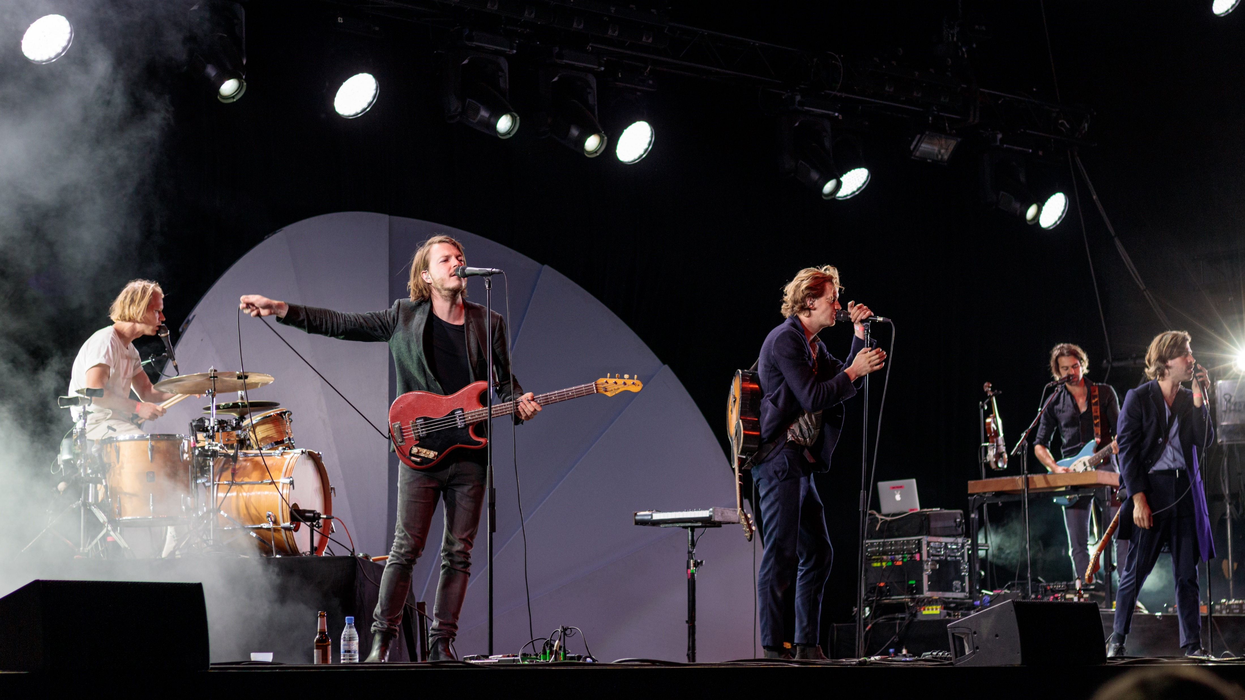
Rock En Seine (1/9)
*célèbre = famous
lire
Léa et Stéphanie vont au festival Rock en Seine !
Rock en Seine est un festival de musique rock. C’est au Parc de Saint-Cloud à Paris chaque année. Le festival est sur trois jours en août. Il y a toujours des chanteurs et des groupes très célèbres*, comme Balthazar et Alpha Wann.
Alpha Wann est un rappeur français. Il a travaillé avec beaucoup d’autres rappeurs, comme Nekfeu et Sneazzy.
Balthazar est un groupe belge de cinq Flamands. Il y avait une femme mais elle a quitté le groupe.
Notes:
Timing: 8 minutes. This is slide 1/9. Note: if time is short, finish this exercise after number 6.
Aim: Cultural background for the activity.
Procedure:
Read through the information.
Ensure understanding.
Oral translation as a class if time allows.
Word frequency of unknown words used (1 is the most frequent word in French):
célèbre [1689]
Source: Lonsdale, D., & Le Bras, Y. (2009). A Frequency Dictionary of French: Core vocabulary for learners London: Routledge.
Word frequency of cognates used (1 is the most frequent word in French):
festival [3858], groupe [187], fameux [2060], rappeur [>5000], flamand [>5000]
Source: Lonsdale, D., & Le Bras, Y. (2009). A Frequency Dictionary of French: Core vocabulary for learners London: Routledge.
Balthazar on the Mainstage at Haldern Pop Festival 2019 by Alexander Kellner is licensed under CC BY-SA 4.0
miembros del grupo by Le Garage is licensed under CC BY-SA 4.0 (cropped)

Slide 22
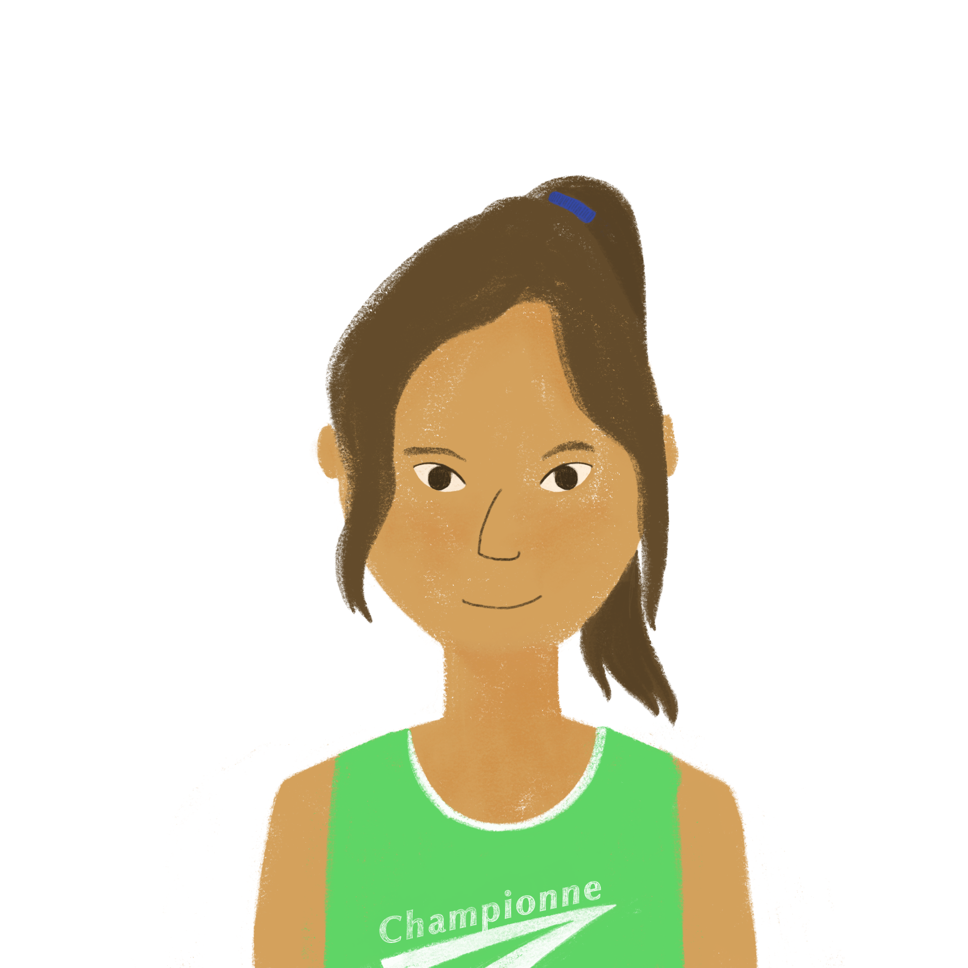
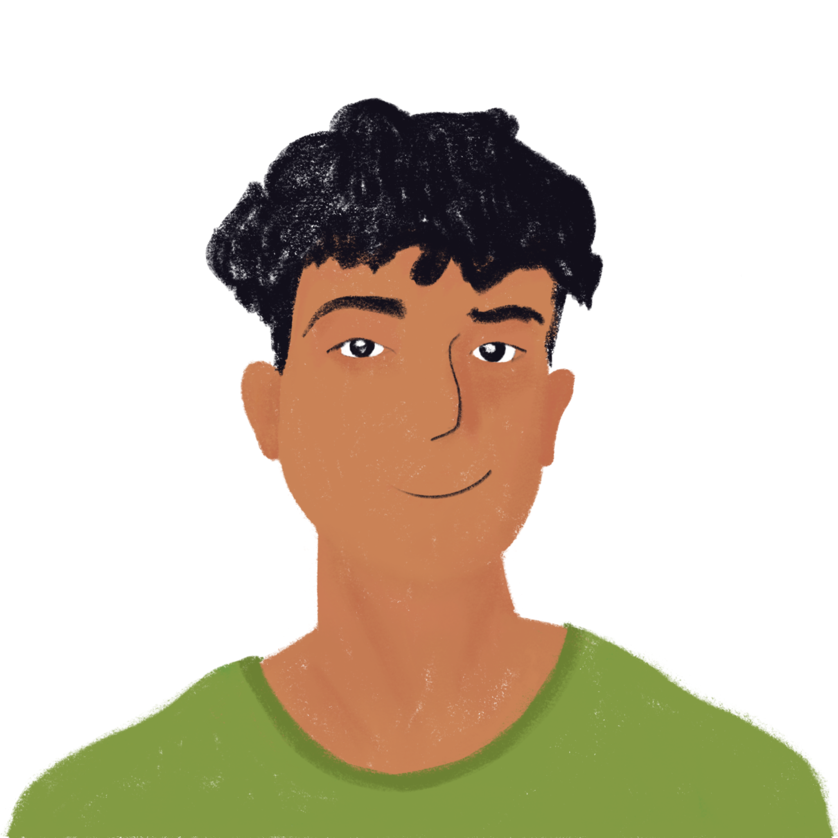
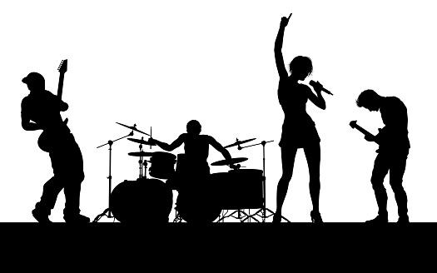
Rock En Seine (2/9)
écouter
Léa et Stéphanie sont au festival. Ils parlent avec Amir et Océane au téléphone. De qui parlent-ils ? Que disent-ils ?
Hi! We’re at Rock En Seine festival to listen to Balthazar and Alpha Wann !
 | (nous)
 | (vous)
 | (ils)
1
1
Notes:
This is slide 2/9.
Aim: Aural recognition of plural forms of être, and connecting these with meaning (nous, vous and ils/elles).
Procedure:
1. Click on the number button to play audio with the pronoun obscured.
2. Students tick the group of people referred to.
3. Click to reveal answer and button with full audio.
4. Click to hear full audio. Students listen again and make notes in English. At higher levels, the teacher may wish to skip step 3, and complete steps 2-4 in one go.
5. Click to see English translation.
Transcript
1. Salut ! [Nous] sommes au festival Rock En Seine pour écouter Balthazar et Alpha Wann !
Word frequency of cognates used (1 is the most frequent word in French):
festival [3858], telephone [1366], week-end [2475], panique [3230] Source: Lonsdale, D., & Le Bras, Y. (2009). A Frequency Dictionary of French: Core vocabulary for learners London: Routledge.

Slide 23
Rock En Seine (3/9)
écouter
Léa et Stéphanie sont au festival. Ils parlent avec Amir et Océane au téléphone. De qui parlent-ils ? Que disent-ils ?
 | (nous)
 | (vous)
 | (ils)
2
Oh! They are very good!
2
Notes:
This is slide 3/9.
Transcript
2. Oh ! [Ils] sont très bons !

Slide 24
Rock En Seine (4/9)
écouter
Léa et Stéphanie sont au festival. Ils parlent avec Amir et Océane au téléphone. De qui parlent-ils ? Que disent-ils ?
 | (nous)
 | (vous)
 | (ils)
But you’re not here … where are you?
3
3
Notes:
This is slide 4/9.
Transcript
3. Mais [vous] n’êtes pas ici… [vous] êtes où ?

Slide 25
Rock En Seine (5/9)
écouter
Léa et Stéphanie sont au festival. Ils parlent avec Amir et Océane au téléphone. De qui parlent-ils ? Que disent-ils ?
 | (nous)
 | (vous)
 | (ils)
We’re sorry! We don’t have a lot of time this weekend …
4
4
Notes:
This is slide 5/9.
Transcript
4. [Nous] sommes désolées ! Nous n'avons pas beaucoup de temps ce week-end …

Slide 26
Rock En Seine (6/9)
écouter
Léa et Stéphanie sont au festival. Ils parlent avec Amir et Océane au téléphone. De qui parlent-ils ? Que disent-ils ?
 | (nous)
 | (vous)
 | (ils)
But you’re in front of the television!
5
5
Notes:
This is slide 6/9.
Transcript
5. Mais [vous] êtes devant la télévision !

Slide 27
Rock En Seine (7/9)
écouter
Léa et Stéphanie sont au festival. Ils parlent avec Amir et Océane au téléphone. De qui parlent-ils ? Que disent-ils ?
 | (nous)
 | (vous)
 | (ils)
We’re sad!
6
6
Notes:
This is slide 7/9.
Transcript
6. [Nous] sommes tristes !

Slide 28
Rock En Seine (8/9)
*pas de panique ! = don’t worry!
écouter
Léa et Stéphanie sont au festival. Ils parlent avec Amir et Océane au téléphone. De qui parlent-ils ? Que disent-ils ?
 | (nous)
 | (vous)
 | (ils)
Well … they’re here all weekend, don’t worry!
7
7
Notes:
This is slide 8/9.
Transcript
7. Bah … [ils] sont ici tout le week-end … pas de panique !

Slide 29
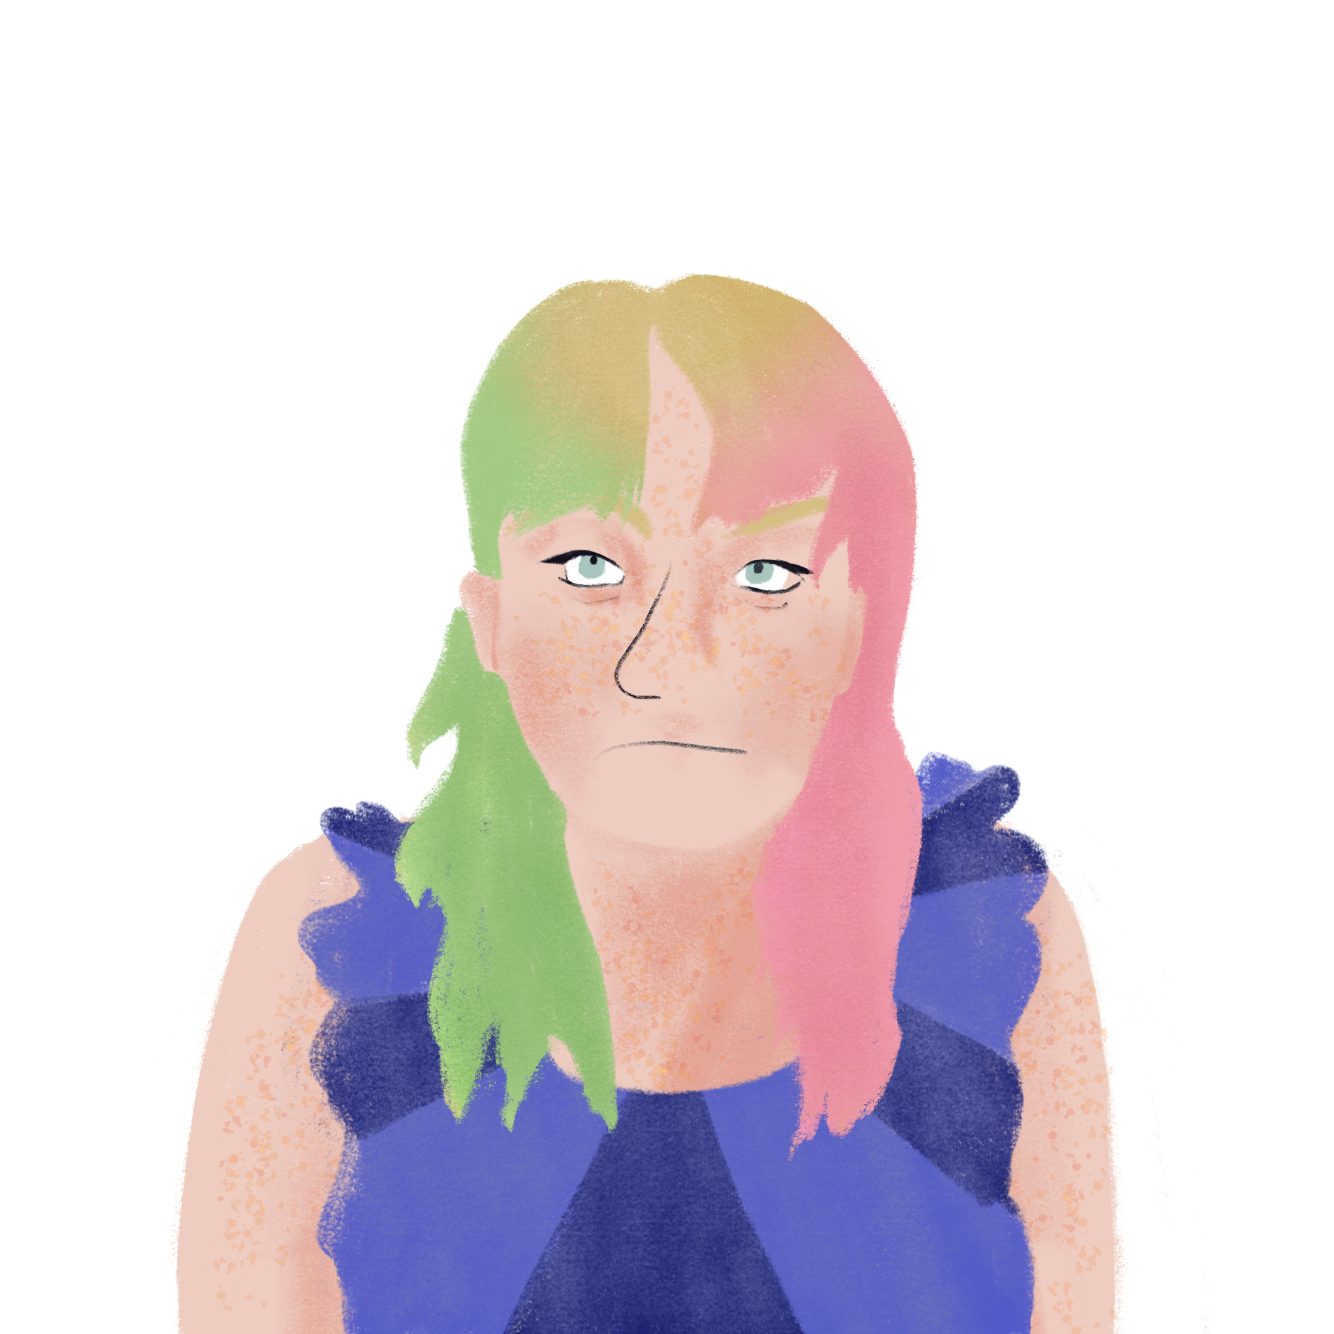
Rock En Seine (9/9)
écouter
Léa et Stéphanie sont au festival. Ils parlent avec Amir et Océane au téléphone. De qui parlent-ils ? Que disent-ils ?
 | (nous)
 | (vous)
 | (ils)
8
So, you’re happy at home?
8
Notes:
This is slide 9/9.
Transcript
8. [Vous] êtes contents à la maison alors?

Slide 30
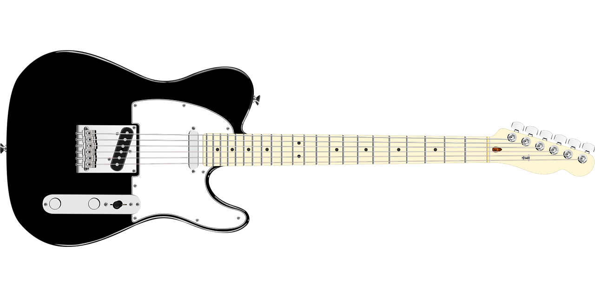
Les adjectifs au pluriel
grammaire
Remember, we often add –s to make adjectives agree with plural nouns.
des chats noirs des guitares noires
(some) black cats (some) black guitars
Plural nouns which follow this pattern sound the same as the singular, because they still end in SFC.
Notes:
Timing: 1 minute
Aim: Revision of patterns of plural adjectival agreement 1 (add –s)
Procedure:
1. Click through the information, eliciting knowledge where possible.
Word frequency of cognates used (1 is the most frequent word in French): adjectif [>5000], pluriel [>5000]
Source: Lonsdale, D., & Le Bras, Y. (2009). A Frequency Dictionary of French: Core vocabulary for learners London: Routledge.

Slide 31
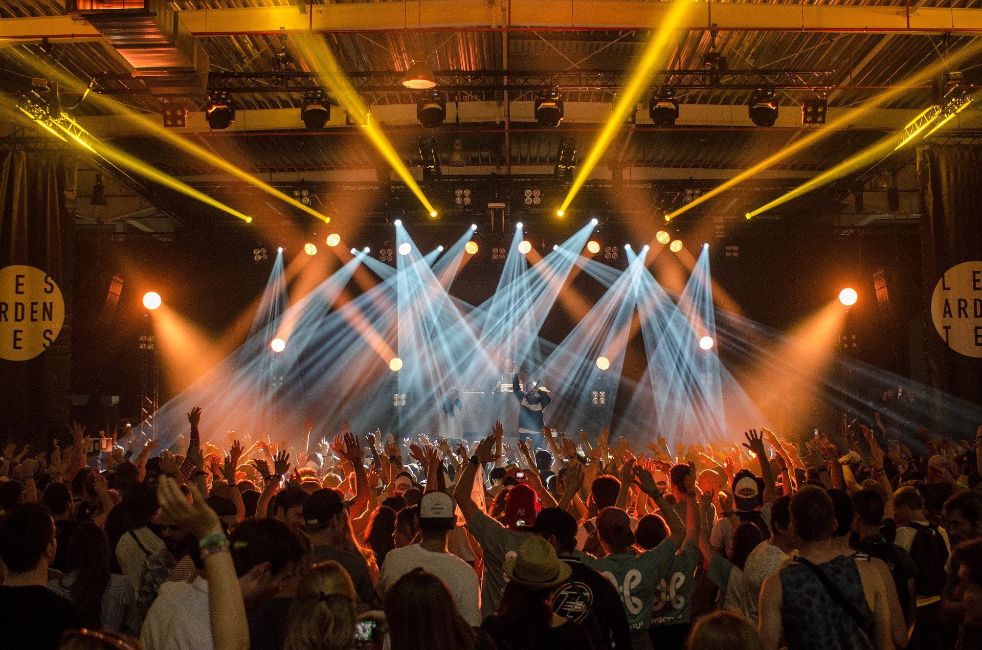
Les adjectifs au pluriel
*célèbre = famous
grammaire
Remember the other ways to make adjectives agree with plural nouns:
Adjectives ending in –s or –x stay the same:
un groupe français → des groupes français
a French group → (some) French groups
un rappeur célèbre* → des rappeurs célèbres*
a famous rapper → (some) famous rappers
Adjectives ending in –al change to –aux for masculine plural:
un concert local → des concerts locaux
a local concert → (some) local concerts
Plurals which follow this pattern sound the same as the singular, because they still end in SFC.
Plurals which follow this pattern sound different.
Notes:
Timing: 1 minute
Aim: Revision of patterns of plural adjectival agreement 2 (no change with -s or -x in masculine) and 3 (-al ➜ -aux in masculine)
Procedure:
1. Click through the information, eliciting knowledge where possible.
2. Pay particular attention to pronunciation, in preparation for the exercise that follows.
Word frequency of unknown words used (1 is the most frequent word in French):
célèbre [1689]
Source: Lonsdale, D., & Le Bras, Y. (2009). A Frequency Dictionary of French: Core vocabulary for learners London: Routledge.

Slide 32
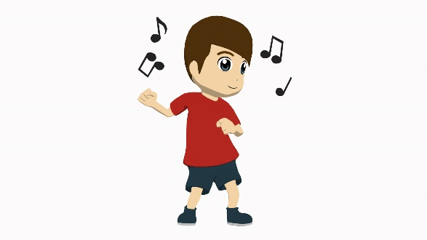
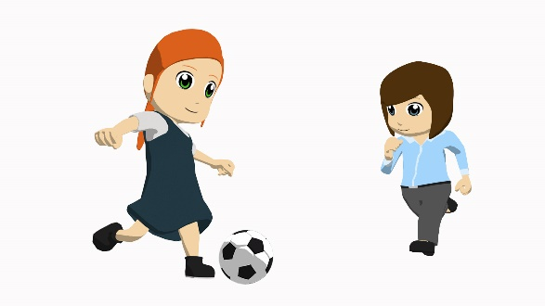
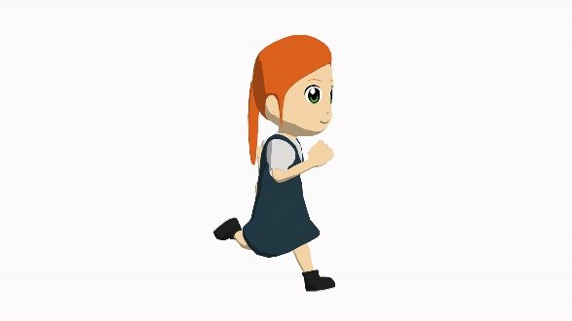
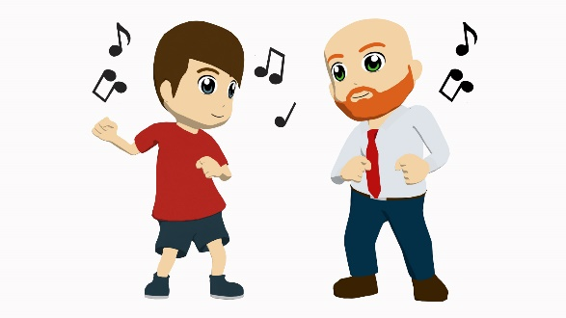
L’accord des adjectifs
parler
gentil
anglais
calme
dangereux
beau
algérien
idéal
vieux
anglais
dangereux
nouveau
idéal
beau
vieux
algérien
nouveau
gentil
calme
idéal
nouvelles
gentil
nouveau
anglais
anglaise
vieux
dangereux
calme
calme
vieilles
idéales
algérien
algériennes
gentils
dangereuse
idéal
belle
idéaux
beaux
Notes:
Timing: 5 minutes
Aim: Oral production of masculine and feminine adjectives following plural agreement rules 1-3.
Procedure:
1. Click to reveal adjective and arrow.
2. Class says the form of the adjective for the person or people indicated by the arrow.
3. Repeat for each adjective.

Slide 33
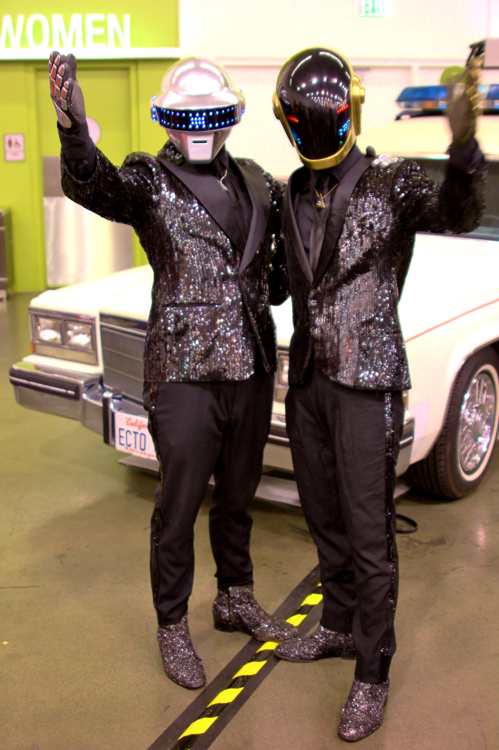
Deux groupes
écouter
Amir parle de ses groupes préférés. Daft Punk est un groupe de deux hommes. Star Feminine Band est un groupe de sept filles. Écoute. De qui parle-t-on ?
Q | Daft Punk | Could be either | Star Feminine Band | A
1
1
2
2
3
3
Daft Punk usually wore helmets in public because they didn’t want their faces to be seen.
4
4
5
5
6
6
7
7
8
8
Notes:
Timing: 5 minutes
Aim: Aural recognition of masculine and feminine adjectives following plural agreement rules 1-3.
Procedure:
1. Click on the numbers on the left to play the audio with the pronouns obscured.
2. Students sketch the grid and add ticks to indicate whether the sentence refers to Daft Punk (ils), Star Feminine Band (elles), or either.
3. Click to reveal answers.
4. Click to reveal full audio buttons to listen to answers
Transcript:
1. [Ils] ne sont pas vieux.
2. [Elles] sont très intelligentes.
3. [Ils] sont des artistes locaux.
4. [Elles] sont des artistes internationales.
5. [Elles] sont très ambitieuses.
6. [Ils] sont tristes. [Elles] sont tristes.
7. [Ils] ne sont pas très ouverts.
8. [Ils] sont modernes. [Elles] sont modernes.
daft punk! by RyC - Behind The Lens is licensed under CC-BY 2.0
Word frequency of cognates used (1 is the most frequent word in French):
artiste [1797]
Source: Lonsdale, D., & Le Bras, Y. (2009). A Frequency Dictionary of French: Core vocabulary for learners London: Routledge.

Slide 34
Star Feminine Band (1/3)
lire
Amir parle de Star Feminine Band. Angélique est une fille dans le groupe. Il décrit qui ? Écris la traduction de chaque expression dans la colonne correcte.
The girls in Star Feminine Band are… | Angélique is…
very intelligent. |  | très intelligentes.
 | very young. | très jeune.
always happy. |  | toujours heureuses.
 | hard-working. | travailleuse.
 | very short/small. | très petite.
very modern. |  | très modernes.
Notes:
Timing: 10 minutes. This is slide 1/3.
Aim: Written recognition of singular and plural forms of adjectives. This introductory exercise primes students from comprehension of the longer text on the slide that follows.
Procedure:
1. Students read the ends of the sentences and decide whether each adjective refers to the group or just Angélique.
2. They write the English translation of each phrase in the correct column to complete the sentences.
3. Click to reveal answers.
Word frequency of cognates used (1 is the most frequent word in French):
groupe [187], expression [952], colonne [2931] Source: Lonsdale, D., & Le Bras, Y. (2009). A Frequency Dictionary of French: Core vocabulary for learners London: Routledge.

Slide 35
Star Feminine Band (2/3)
*Bénin = Benin
*béninois = Beninese
lire
Écris en anglais:
4 choses sur le groupe, 2 choses sur Bénin, et 2 choses sur Angélique.
Bénin est un pays en Afrique.
Star Feminine Band est un groupe de sept filles. Elles sont béninoises*. Elles chantent en plusieurs langues parce qu’elles sont très intelligentes. Ce sont de bonnes musiciennes. Au Bénin*, les femmes ne jouent pas d’instruments normalement, mais les filles du groupe sont très modernes. Elles sont naturelles quand elles dansent, et elles sont toujours heureuses. Angélique est la plus jeune : elle a 10 ans ! Elle est très petite mais elle est aussi travailleuse.
Notes:
This is slide 2/3.
Aim: Reading comprehension of a text with a focus on singular and plural forms of être and adjectives in singular and plural feminine forms.
Procedure:
Explain where Benin is, displaying the map in the information bubble.
Click to remove information bubble.
Students summarise the text in English using the prompts given.
Check answers with next slide.
Word frequency of cognates used (1 is the most frequent word in French):
groupe [187], béninois [>5000], musicien [3100], Bénin [>5000], danser [2934] Source: Lonsdale, D., & Le Bras, Y. (2009). A Frequency Dictionary of French: Core vocabulary for learners London: Routledge.

Slide 36
Star Feminine Band (3/3)
*Bénin = Benin
*béninois = Beninese
lire
SUGGESTED ANSWER
Star Feminine Band is a group of seven girls; they are Beninese; they sing in several languages because they are very intelligent; they are good musicians; the girls in the group are very modern; they are natural when they dance;they are always happy.
Benin is a country in Africa; in Benin, women don’t normally play instruments. Angélique is the youngest: she is ten years old; she is very short/small; she is also hardworking.
Notes:
This is slide 3/3.
SUGGESTED ANSWERS

Slide 37
Mon groupe préféré
écrire
Écris des phrases sur les membres de ton groupe préféré.
Mon groupe préféré est…
Ils/Elles sont… [nationality]
Ils/Elles sont… [appearance]
Ils/Elles sont… [young/old]
Ils/Elles sont… [personality]
Ils/Elles ne sont pas… [personality]
Extension – try to include some of these words
un peu
assez
très
et
mais
aussi
Notes:
Timing: 5 minutes
Aim: Semi-structured written production using structures re-visited in this lesson.
Procedure:
1. Students write sentences about their favourite group, using ils/elles forms.
2. More confident students can go beyond the prompts.

Slide 38
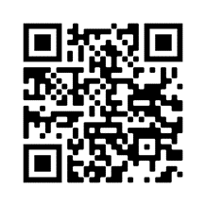
Devoirs
Vocabulary Learning Homework (Y9 Term 1.1, Week 2)
Vocabulary on Quizlet
Student worksheet
Notes:
Note: HW for Y9 is usually made up of pre-learning of vocabulary 15-30 minutes (depending on school policy on HW time) plus 20-30 minutes vocabulary activities to deepen word knowledge, provided on a student homework sheet (which also contains a clickable link to the audio file). Answer sheets are also provided. The answer sheet for the Y9 vocabulary learning HW sheet Week 2 is here: https://rachelhawkes.com/LDPresources/Yr9French/French_Y9_Term1i_Wk2_HW_sheet_answers.docx
Don’t share this link with students ☺
Notes:
With the LDP SOW the vocabulary for Years 9 – 11 is provided on Quizlet.
ii) There are other free apps, and new ones are always appearing. Teachers have told us that they are currently also using: Flippity, Wordwall (where using previously-created activities is free).
iii) Gaming Grammar has been acquired by Language Nut. Its original content should still be available to teachers and much of it is appropriate for Y9 learners. From this lesson, for example, learners could practise:
Adjectives: Number (Adjective agreement)
To have and to be: 1st person and 3rd person singular

Slide 39
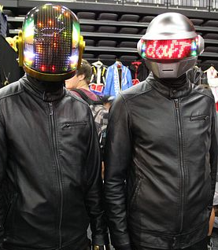
Daft Punk
Remplis les blancs avec un adjectif au pluriel.
*le visage = face
*leur(s) = their
lire / écrire
Daft Punk sont deux hommes ambitieux qui font de la musique éléctro. Ce sont les musiciens préférés de Christine and the Queens. Ils sont tristes parce qu’ils ont quitté le groupe en 2021. Ils ne sont pas vieux, mais ils ont travaillé ensemble pour la première fois en 1993 ! Ils sont français mais ce sont des artistes internationaux. Ils sont très importants dans le monde de la musique : ils ont travaillé avec Kanye West, Pharrell Williams, et The Weeknd. Ils ne sont pas très ouverts quand ils parlent. Ils ne montrent pas les visages* parce qu’ils sont très prudents avec leurs* identités.
1)
2)
3)
4)
ambitious
careful
5)
favourite
6)
important
sad
old
7)
open
8)
international
Notes:
ADDITIONAL OPTIONAL READING TASK – EXTENSION, HW etc.. Timing: 8 minutes
Aim: Written production of masculine and feminine adjectives following plural agreement rules 1-3; reading comprehension.
Procedure:
Do the first one with students to model the activity.
Students then read the text and decide where each adjective could fit.
3. Students write 1-8 and write the French adjectives in the correct form.
4. Click to reveal suggested answers. NB: there are multiple possible places where the adjectives could go. Discuss this with students. Praise should be given for adjectives that are correctly spelled and formed, and inserted into a gap where they make sense.
Word frequency of unknown words used (1 is the most frequent word in French):
visage [1292], leur [35]
Word frequency of cognates used (1 is the most frequent word in French):
éléctro [>5000], musicien [3100], groupe [187], artiste [1797], identité [1437] Source: Lonsdale, D., & Le Bras, Y. (2009). A Frequency Dictionary of French: Core vocabulary for learners London: Routledge.

