Slide 1
Routines
Talking about what you do in daily life
Reflexive ‘me’ SSC [ge] [gi] [j] (revisited)
Y8 Spanish
Term 2.1 - Week 6 – Lesson 37
Amanda Izquierdo / Rachel Hawkes / Nick Avery Artwork: Mark Davies
Date updated: 20.02.24
Notes:
Note: all words (new and revisited) in this week of the SOW appear on all three GCSE wordlists, with the following exceptions: i) AQA list does not have adelante, ánimo, atrás, desayunar, espejo, Estados Unidos, rabia, tristeza.
ii) Edexcel list does not have adelante, ánimo, apenas, atrás, desayunar, espejo, Estados Unidos, rabia, risa, tristeza, vergüenza.
Artwork by Mark Davies. All additional pictures selected are available under a Creative Commons license, no attribution required.
Native teacher feedback provided by Blanca Román.
Learning outcomes (lesson 1): Introduce reflexive ‘me’ and contrast reflexive and non-reflexive verb forms and meanings. Consolidate SSCs ge/gi /j - soft [g]. Word frequency (1 is the most frequent word in Spanish):
New vocabulary (introduce in lesson 1): me [22]; despertar [894]; levantar [354]; presentar² [235]; desayunar [>5000]; el espejo [1232] el pantalón [1814]; el vestido [1697]; demasiado [494]
Revisiting Y8 2.1.2: conocer [128]; ofrecer [351]; sufrir [504]; romper [733]; cultura [469]; apenas [486]; accidente [1661]; Estados Unidos [N/A]; ya [39]; pasar³ [68]
Y8 1.2.4: paso [279]; apoyo [866]; adelante [722]; atrás [599]; izquierda [1352]; derecha [1573]; así que [que-3] nouns of emotion commonly used after da / dan pena [743]; vergüenza [1979]; rabia [2500]; tristeza [1993]; risa [1101]; ánimo [1855]; alegría [1220] feminine nouns ending in -ción traducción [2822]; intención [1171];
Source: Davies, M. & Davies, K. (2018). A frequency dictionary of Spanish: Core vocabulary for learners (2nd ed.). Routledge: London

Slide 2
Fonética
escuchar / escribir
Escucha las palabras. ¿Escuchas [ge] o [gi]?
Completa cada palabra.
prote _ _ r
[to protect]
1
g e
g i
2
estrate _ _ a
[strategy]
g i
[to demand]
4
exi _ _ r
g é
3
_ _ nero
[sort, gender]
g i
[regime, diet]
5
ré _ _ men
su _ _ rir
6
g e
[to suggest]
Notes:
Timing: 5 minutes
Aim: To revisit SSCs [ge], [gi]
Procedure: 1. Students listen to the recording and complete the words with ‘ge’ or ‘gi’ depending on what they hear. There is the option to transcribe the whole word. To do so, students turn away from the board.
2. Teacher clicks to bring up the Spanish gapped words, and English meanings. 3. Teacher plays either the full recording (inserted with mp3 player with playback control) or individual words by clicking the action buttons. With the full recording, students hear each word twice.. 4. Teacher clicks to reveal answers
Transcription:
proteger
estrategia
género
exigir
régimen
sugerir
Note: these words have not been previously taught. The aim is not to rely on word knowledge and focus on SSC knowledge instead. However, with the exception of ‘estrategia’, all words appear on the AQA and Eduqas wordlists. Proteger and género are on the Edexcel list.
Frequency of unknown/glossed words (1 is the most common word in Spanish):
proteger [1107]; estrategia [1460]; género [1238]; exigir [854]; régimen [1167]; sugerir [1680].
Source: Davies, M. & Davies, K. (2018). A frequency dictionary of Spanish: Core vocabulary for learners (2nd ed.). Routledge: London

Slide 3
Viaje a los Estados Unidos
leer
Lee el mensaje de la escuela sobre un viaje y completa con las palabras correctas. Después, escucha y comprueba las respuestas.
Las palabras
paso
cultura
ofrecer
pasar
intención
conocer
apenas
traducción
Estados Unidos
adelante
así que
apoyo
¡Atención, atención! La escuela quiere
1) _____ un viaje a 2) _________ para practicar inglés y 3) _________ la 4) _______ . La 5) _________ es 6) ________ dos semanas en el país. Hay un problema: 7) _______ hay dinero para diez billetes, 8) _______ vamos a organizar un premio. Debes hacer una 9) _________ de un poema con el 10) _______ de tu profesor. ¿Quieres participar? Entonces debes dar un 11) _______ 12) ________ .
ofrecer
[offer]
Estados Unidos
conocer
[culture]
[get to know]
cultura
intención
pasar
[intention]
[to spend]
apenas
[barely]
así que
[so]
apoyo
traducción
[support]
[translation]
paso
adelante
[step]
[forward]
Notes:
Timing: 7 minutes.
Aim: to practise written recall (either receptive or productive) of 12 words from this week’s revisited vocabulary.
Procedure: 1. Students read the message and try to fill in the gaps with the corresponding words from the column.
2. Teacher plays the audio (see audio button at the top) and students check their answers.
3. Teacher reveals the answers with further clicks.
4. Students are encouraged to discuss the meaning of the text orally.
Adaptive teaching: i) Depending on class ability, some or all English words could be removed so students have to consider which is the most suitable word for that specific gap, considering the context.
ii) Alternatively, to create a productive recall task, teachers might remove the column of Spanish words, or provide them with first letter prompts, only. iii) There is, of course, the most challenging option, i.e., to remove some / all English and Spanish words. iv) Note: if the Spanish words are removed, the ‘listen and check’ also acquires more challenge, as students may also engage in some transcription. To facilitate transcription, the audio is slightly slower than that provided for some other Year 8 texts.
Revisiting:
Y8 2.1.2 conocer [128]; ofrecer [351]; cultura [469]; apenas [486]; Estados Unidos [N/A]; pasar³ [68]
Y8 1.2.4 paso [279]; apoyo [866]; adelante [722]; así que [que-3] feminine nouns ending in -ción traducción [2822]; intención [1171];

Slide 4
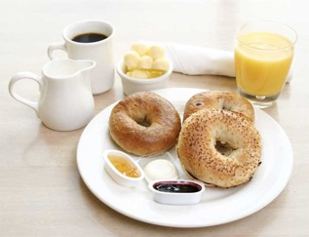
Vocabulario
hablar
‘Demasiado’, like ‘mucho’ and ‘poco’, can be both an adjective and an adverb. As an adverb it needs no agreement; as an adjective it does:
come demasiado
→ come demasiados helados
el espejo
demasiado
[too much, too many]
el pantalón
desayunar
[to have breakfast, having breakfast]
el vestido
Notes:
Timing: 3 minutes
Aim: to practise five of the words from this week’s new vocabulary set.
Procedure 1. Pupils either work by themselves or in pairs, reading out the words and recapping their English meaning (1 minute). 2. Then the teacher removes the English words or pictures (one by one) and they try to recall the English orally (chorally), looking at the Spanish (1 minute). 3. Then the Spanish meanings are removed (one by one) and they to recall them orally (again, chorally), looking at the English (1 minute) 4. Further rounds of learning can be facilitated by one pupil turning away from the board, and his/her partner asking him/her the meanings (‘¿Cómo se dice X en español?’). This activity can work from L2 → L1 or L1 → L2.
Word frequency (1 is the most frequent word in Spanish):
New vocabulary (introduce in lesson 1): desayunar; [>5000]; el espejo [1232] el pantalón [1814]; el vestido [1697]; demasiado [494]
Source: Davies, M. & Davies, K. (2018). A frequency dictionary of Spanish: Core vocabulary for learners (2nd ed.). Routledge: London

Slide 5
Saying what you do to others: Personal ‘a’
gramática
Remember: use an ‘a’ after the verb in Spanish when the direct object is a specific person or an animal (an animate object).
I help the teacher.
Ayudo al profesor.
I look after the girl.
Cuido a la niña.
You only need the personal ‘a’ when the direct object is a specific animate object.
I look for Daniel.
Busco a Daniel.
I look for a book.
Busco un libro.
Notes:
Timing: 2 minutes
Aim: to recap the use of the personal ‘a’
Procedure:
Teacher goes through the grammar explanation with students, revealing each new sentence on a mouse click.

Slide 6
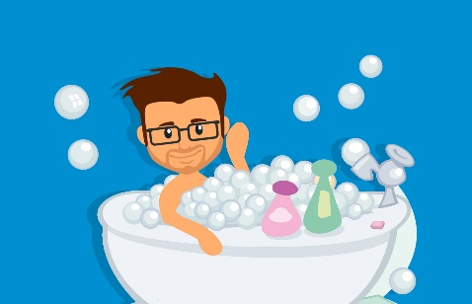
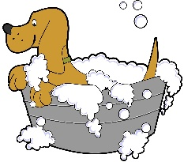
Doing something to myself: Reflexive ‘me’
gramática
Sometimes, the ‘doer’ (subject) and ‘receiver’ (object) of an action are the same person.
For example, ‘I wash myself’ or ‘you introduce yourself’.
Words like ‘myself’ or ‘yourself’ are called reflexive pronouns.
To mean ‘myself’ in Spanish use ‘me’ before a verb.
Compare:
Me lavo. =
Lavo a mi perro. =
I wash my dog.
I wash myself.
Notes:
Timing: 2 minutes
Aim: to introduce the reflexive pronoun ‘me’.
Procedure:
Teacher goes through the grammar explanation with students, revealing each new sentence on a mouse click.
Note:
In Spanish, it is very common to use the indirect object pronoun even when the indirect object is present. For example, it's perfectly grammatical to say 'Pongo un vestido a mi prima', but it's more frequent to say 'Le pongo un vestido a mi prima'. This happens with verbs that have both a direct object and an indirect object: decir, regalar, poner...
This is from the RAE (in pronombres personales átonos): a) En el caso del complemento indirecto, la coaparición del pronombre átono es normalmente opcional y suele ser lo más frecuente, especialmente en la lengua oral: No (les) da importancia a los problemas; (Les) he contado nuestro secreto a unos amigos; (Le) han denegado la beca a Juan; (Le) he dicho la verdad a mi madre.
This will be formally taught once indirect object pronouns have been introduced and practised in Y8 Term 2.2.

Slide 7
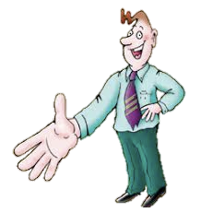
Vocabulario
Lee las frases. Escribe 1-6 y la letra a-f. ¿Qué significa en inglés?
Es el director.
leer
¡Hola!
Verbos |  | Letra |  | Letra
presentar to introduce | 1. Me presento. |  | 2. Presento a [...]
levantar to get up | 3. Me levanto. |  | 4. Levanto a [...]
despertar to wake up | 5. Me despierto. |  | 6. Despierto a [...]
a
b
f
a
In singular persons, the first ‘e’ changes to ‘ie’ in ‘despertar’ (like ‘perder’ and ‘empezar’): perder → pierdo empezar → empiezo despertar → despierto
I introduce [someone].
I introduce myself.
c
d
c
d
I get up.
I get [someone] up.
Soy Pepe.
b
e
I wake up.
I wake [someone] up.
e
f
Notes:
Timing: 3 minutes
Aim: to introduce and practise three of the new verbs for this week, modelling their reflexive and non-reflexive forms and meanings.
Procedure 1. Teacher presents the task, and the additional information about the stem change in despertar.
2. Students read the verbs with a reflexive pronoun and those with a personal ‘a’ and match them with the most appropriate picture. They write 1-6 and match a-f. 3. Teacher clicks to reveal the correct letter, and then elicits the English meaning from students, clicking to provide written confirmation.
Word frequency (1 is the most frequent word in Spanish):
New vocabulary (introduce in lesson 1): me [22] despertar [894] levantar [354] presentar² [235]
Source: Davies, M. & Davies, K. (2018). A frequency dictionary of Spanish: Core vocabulary for learners (2nd ed.). Routledge: London

Slide 8
Escucha las frases. No están completas.
¿Cuál es la imagen correcta para cada frase? Escribe 1-8 y A o B.
escuchar
 | Imagen A | Imagen B
1
2
3
4
5
6
7
8
Notes:
Timing: 8 minutes
Aim: to listen out for verbs with and without reflexive pronoun; to consolidate understanding of the meaning conveyed by these verbs in their reflexive and their non-reflexive form.
Procedure: 1. Students copy the basic table on this slide into their books before starting the activity.
2. Students listen to each recording (1 recording per slide on slides 9-16) and decide whether the picture refers to the image A or B.
3. Teacher reveals answers.
Transcript:
presento...
me despierto...
lavo...
me levanto...
me miro...
saco fotos...
escondo...
me preparo...

Slide 9
escuchar
1
1a.
1b.
Él es Juan.
Hola, soy Pedro.
¡Hola, Juan!
Notes:
Audio: presento...

Slide 10
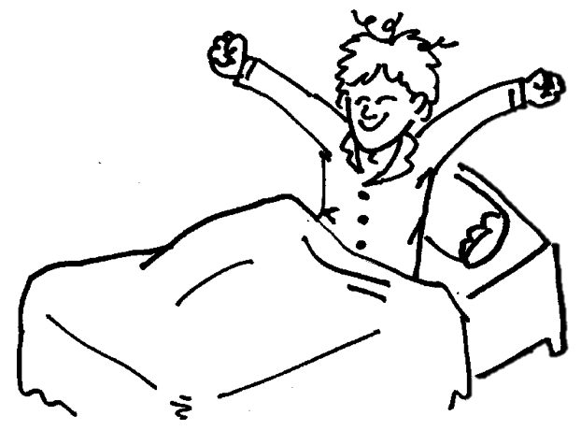
escuchar
2
2a.
2b.
Notes:
Audio: me despierto...

Slide 11
escuchar
3
3a.
3b.
Notes:
Audio: lavo...

Slide 12
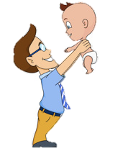
escuchar
4
4a.
4b.
Notes:
Audio: me levanto...

Slide 13
escuchar
5
5a.
5b.
Notes:
Audio: me miro...

Slide 14
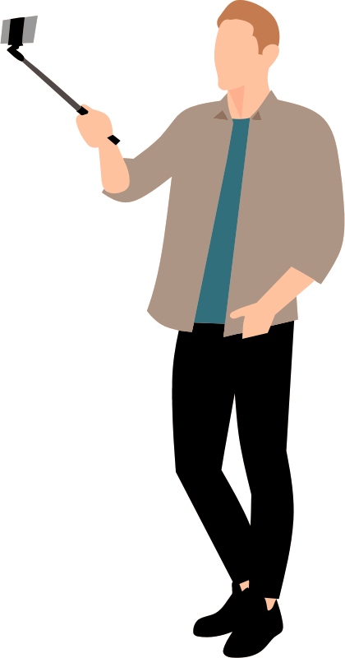
escuchar
6
6a.
6b.
Notes:
Audio: saco fotos.

Slide 15
escuchar
7
7a.
7b.
Notes:
Audio: escondo...

Slide 16
escuchar
8
8a.
8b.
Notes:
Audio: me preparo...

Slide 17
Respuestas
escuchar
 | Imagen A | Imagen B
1
2
3
4
5
6
7
8
Notes:
RESPUESTAS

Slide 18
Daniel escribió sobre las actividades de cada día en su diario, pero el gato caminó encima y ahora no puedes leer las frases completas.
leer
Read the sentences and tick true or false. Some language might be missing.
 | V | F
I always get up early.
I hide my partner during the class.
It’s good to make friends, so I introduce myself.
On Mondays I wake someone up.
I never wash my dog too much.
In the square I introduce myself.
Before breakfast I look at myself in the mirror.
I hide myself under the table.
1. Siempre me levanto temprano.
2. Me escondo durante la clase.
3. Es bueno hacer amigos, así que me presento.
4. Los lunes despierto a
5. Nunca me lavo demasiado.
6. En la plaza presento a
7. Antes de desayunar me miro en el espejo.
8. Escondo a debajo de la mesa.
Notes:
Timing: 7 minutes
Aim: to compare the use of verbs with a reflexive pronoun or with a personal ‘a’; to put newly introduced verbs into practice along with previously taught verbs which can also work reflexively and non-reflexively.
Procedure: 1. Students read the sentences in Spanish and try to figure out if there could be some language missing or not.
2. Students read the phrases in English and decide whether they are true or false depending on what the phrases in Spanish say.
3. Teacher shows the answers.
4. Students can be asked for suggestions for what might be behind the obscured bits of the sentences where the action is being done to someone else. This can be left to students’ imagination, but it’s a good chance for the teacher to check their understanding of personal ‘a’ (i.e. whether they are using it when referring to animate objects).
Revisiting:
Y8 1.2.4
así que [que-3]

Slide 19
hablar
To myself or to someone else?
Hablamos sobre actividades de todos los días.
El estudiante A lee unas frases.
Note: in English we don’t always say ‘myself’ but in Spanish always use me for actions you do to yourself.
El estudiante B escucha y marca en la tabla.
Is it to myself or to someone else?
El estudiante B también escribe en inglés la frase.
Ejemplo:
Los fines de semana me despierto temprano.
Estudiante B escribe
 | To myself | To someone else | Frase en inglés
1
Estudiante A habla
1 | Los fines de semana me despierto temprano.
At the weekend I wake up early.
Notes:
Timing: 10 minutes
Aim: to consolidate understanding of the use of verbs in their reflexive and non-reflexive form.
Procedure: 1. Student A reads out each phrase.
2. Student B ticks the correct option: is it to myself or to someone else?
3. Student B writes the phrase in English.
4. Students swap roles.

Slide 20
Estudiante A - Round 1
Estudiante B – Round 1
Lee cada frase a tu compañero/a. Repite la frase, si es necesario.
Escucha a tu compañero/a. Decide si la acción es ‘to myself’ o ‘to someone else’ y luego escribe la frase en inglés.
1 | Me saco fotos con mis amigos.
2 | Todos los días me preparo para la escuela.
3 | Los sábados me despierto tarde.
4 | Nunca lavo a mi gato.
5 | Presento a mi hermano en clase.
 | To myself | To someone else | Frase en inglés
1
2
3
4
5
Estudiante A – Round 2
Escucha a tu compañero/a. Decide si la acción es ‘to myself’ o ‘to someone else’ y luego escribe la frase en inglés.
 | To myself | To someone else | Frase en inglés
1
2
3
4
5
Estudiante B - Round 2
Lee cada frase a tu compañero/a. Repite la frase, si es necesario.
1 | Saco fotos a mis amigos.
2 | Me lavo por la mañana.
3 | Nunca despierto a mis padres.
4 | Me presento en la escuela.
5 | Los martes preparo a mi hermano.
Notes:
DO NOT DISPLAY This sheet is to be printed.

Slide 21
Respuestas – Round 1
hablar
Estudiante B
1 | Me saco fotos con mis amigos.
2 | Todos los días me preparo para la escuela.
3 | Los sábados me despierto tarde.
4 | Nunca lavo a mi gato.
5 | Presento a mi hermano en clase.
 | To myself | To someone else | Frase en inglés
1
2
3
4
5
Estudiante A
I take photos of
myself with my friends.
I get myself ready for school every day.
On Saturdays I wake up late.
I never wash my cat.
I introduce my brother in class.
Notes:
Answers – Round 1

Slide 22
Respuestas – Round 2
A more usual way to say ‘preparo a mi hermano’ in English would be…
hablar
Estudiante A
I get my brother ready
1 | Saco fotos a mis amigos.
2 | Me lavo por la mañana.
3 | Nunca despierto a mis padres.
4 | Me presento en la escuela.
5 | Los martes preparo a mi hermano.
 | To myself | To someone else | Frase en inglés
1
2
3
4
5
Estudiante B
I take photos of my friends.
I wash myself in the morning.
I never wake my parents up.
I introduce myself in school.
On Tuesdays I prepare my brother.
Notes:
Answers – Round 2

Slide 23
Routines (2)
Talking about what you do in daily life
Reflexive ‘me’
Y8 Spanish
Term 2.1 - Week 6 – Lesson 38
Amanda Izquierdo / Rachel Hawkes / Nick Avery Artwork: Mark Davies
Date updated: 20.02.24
Notes:
Note: all words (new and revisited) in this week of the SOW appear on all three GCSE wordlists, with the following exceptions: i) AQA list does not have adelante, ánimo, atrás, desayunar, espejo, Estados Unidos, rabia, tristeza.
ii) Edexcel list does not have adelante, ánimo, apenas, atrás, desayunar, espejo, Estados Unidos, rabia, risa, tristeza, vergüenza.
Artwork by Mark Davies. All additional pictures selected are available under a Creative Commons license, no attribution required.
Native teacher feedback provided by Blanca Román.
Learning outcomes (lesson 2): Consolidate reflexive ‘me’ and introduce reflexive ‘te’. Revisit ‘mi’ and ‘tu’ and contrast with ‘me’ and ‘te’. Consolidate SSCs ge/gi /j - soft [g].
Word frequency (1 is the most frequent word in Spanish):
New vocabulary (introduce in lesson 2): te [48] llamar [122]; poner² [91]
Revisiting Y8 2.1.2: conocer [128]; ofrecer [351]; sufrir [504]; romper [733]; cultura [469]; apenas [486]; accidente [1661]; Estados Unidos [N/A]; ya [39]; pasar³ [68]
Y8 1.2.4: paso [279]; apoyo [866]; adelante [722]; atrás [599]; izquierda [1352]; derecha [1573]; así que [que-3] nouns of emotion commonly used after da / dan pena [743]; vergüenza [1979]; rabia [2500]; tristeza [1993]; risa [1101]; ánimo [1855]; alegría [1220] feminine nouns ending in -ción traducción [2822]; intención [1171];
Source: Davies, M. & Davies, K. (2018). A frequency dictionary of Spanish: Core vocabulary for learners (2nd ed.). Routledge: London

Slide 24
Escribe la letra correcta para cada palabra en español.
hablar
 |  | Letra
1 | sufrir
2 | romper
3 | accidente
4 | ya
5 | atrás
6 | derecha
7 | da ánimo
8 | da pena / tristeza
9 | da vergüenza
10 | da rabia
11 | da alegría
G
A
B
C
B
[to break]
[backwards]
[it’s saddening]
I
F
D
E
F
C
[right]
[it’s embarrasing]
D
K
G
H
I
A
[accident]
[to suffer]
[it brings happiness/joy]
E
J
J
K
H
[it’s infuriating]
[it’s encouraging]
Notes:
Timing: 10 minutes
Aim: to practise receptive recall of vocabulary in the written modality, then productive recall in the oral modality
Procedure 1. Students write the correct to letter for each word.
2. The teacher can call out letters, so students say the corresponding word in Spanish.
3. The Spanish words are then obscured so that students have to recall the word themselves for oral production. This could be done in pairs or as a whole-group activity.
Word frequency (1 is the most frequent word in Spanish):
Revisiting:
Y8 2.1.2
sufrir [504]; romper [733]; accidente [1661]; ya [39];
Y8 1.2.4
atrás [599]; derecha [1573]; nouns of emotion commonly used after da / dan pena [743]; vergüenza [1979]; rabia [2500]; tristeza [1993]; ánimo [1855]; alegría [1220]
Source: Davies, M. & Davies, K. (2018). A frequency dictionary of Spanish: Core vocabulary for learners (2nd ed.). Routledge: London

Slide 25
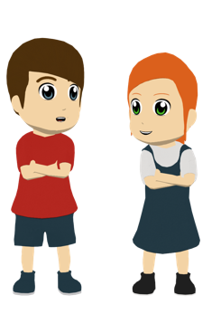
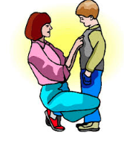
Vocabulario
I call my sister ‘Lucy’.
leer
Lee las frases. Escribe 1-4 y a-d.
Verbos |  | Letra |  | Letra
llamar to call | 1. Me llamo... |  | 3. Llamo a [...] ..
poner to put | 3. Me pongo... |  | 4. Pongo… a [...]
a
b
c
a
I am called Lucía!
I call [someone]
+ nickname
I call [someone]
I am called... My name is...
d
b
d
I put [something] on
I put [something] on [someone]
c
Notes:
Timing: 3 minutes
Aim: to introduce the two remaining items of new vocabulary for this sequence.
Procedure 1. Students read the verbs with a reflexive pronoun and those with a personal ‘a’ and match them with the most appropriate picture.
2. Teacher reveals the answers and elicits the translation into English.
Word frequency (1 is the most frequent word in Spanish):
New vocabulary (introduce in lesson 1): llamar [122]; poner² [91]
Source: Davies, M. & Davies, K. (2018). A frequency dictionary of Spanish: Core vocabulary for learners (2nd ed.). Routledge: London

Slide 26
Doing something to ‘yourself’: reflexive ‘te’
gramática
Remember that to express that I do something to ‘myself’ in Spanish we use the reflexive pronoun _____.
me
Me despierto. =
I wake up.
Me presento. =
I introduce myself.
To say ‘you do something to yourself’ use te before the verb:
Te pones un vestido. =
You put a dress on.
Te llamas Daniel. =
You are called Daniel (your name is Daniel).
Notes:
Timing: 2 minutes
Aim: to introduce the reflexive pronoun ‘te’.
Procedure:
Go through the grammar explanation with students, revealing each new sentence on a mouse click.

Slide 27
Doing something to ‘yourself’: reflexive ‘te’
gramática
Note that ‘me’ and ‘te’ look very similar to the possessive adjectives ‘mi’ and ‘tu’, but their meanings are different.
‘Me’ is followed by a verb.
Me escondo. =
I hide myself.
my trousers
‘Mi’ is usually followed by a noun.
Mi pantalón =
‘Te’ is followed by a verb.
Don’t confuse tu (your) with tú (you). The accent is very important!
Te levantas =
you get up
‘Tu’ is usually followed by a noun
Tu espejo =
your mirror
Notes:
Timing: 2 minutes
Aim: to note the differences between the reflexive pronouns ‘me’ and ‘te and the possessives ‘mi and ‘tu’.
Procedure:
Go through the grammar explanation with students, revealing each new sentence on a mouse click.

Slide 28
¿Es ‘te’ o ‘tu’?
leer
Lee las frases y elige la palabra correcta, ‘te’ o ‘tu’.
 | Escribe las preguntas en inglés
1
2
3
4
5
6
1 | a) ¿Te... b)¿Tu... | ... pones la ropa antes de desayunar?
2 | a) ¿Te... b)¿Tu... | ... vida es muy divertida?
3 | a) ¿Te... b)¿Tu... | ... vestido es demasiado corto?
4 | a) ¿Te... b)¿Tu... | ... presentas delante de toda la clase?
5 | a) ¿Te... b)¿Tu... | ... llamas Sofía?
6 | a) ¿Te... b)¿Tu... | ...?
Do you put on your clothes before breakfast?
Is your life very fun?
Is your dress too short?
Do you introduce yourself in front of all of the class?
Are you called Sofía?
Is your name Sofía?
¡Escribe una pregunta!
To ask someone’s name, say ¿Cómo te llamas?, literally ‘How you call yourself?
Notes:
Timing: 6 minutes
Aim: to focus on the difference between ‘te’ and ‘tu’.
Procedure:
Students read each question and decide whether the correct option is ‘te’ or ‘tu’ depending on what comes after.
Students are encouraged to write another question beginning with ‘te’ or ‘tu’ and ask their partner what the correct option is.
Finally, students write each question in English.

Slide 29
escuchar / leer
Escucha el audio y decide cuál es la opción correcta.
Escribe 1-10, a o b, y mi o me.
 | ¿Cuál es la opción correcta?
 | a) ... vestido es nuevo? b) ... levanto demasiado tarde?
 | ... miro en el espejo. ... espejo está sucio.
 | ... saco fotos con el móvil. ... móvil es nuevo.
 | ... preparo para el fin de semana. ... prima va a una fiesta.
 | ¿Cuál es la opción correcta?
 | ... pongo un pantalón? ... casa está a la izquierda?
 | ... gato da risa. ... despierto temprano.
 | ... escuela es grande. ... llamo Lucía.
 | ... pongo una camisa roja. ... camisa es roja.
1
5
2
6
3
7
4
8
Notes:
Timing: 8 minutes
Aim: to practise aurally (and in transcription) the difference between ‘me’ and ‘mi’.
Procedure:
1. Click the number trigger to play the audio.
2. Students listen to the beginning of the sentence or question and decide which is the correct continuation. They write 1-10 a/b and either mi or me.
3. Teachers elicit the English meanings of the sentences, in oral feedback.
Notes: transcribing ‘mi’ and ‘me’ is an important part of the activity as the Spanish ‘mi’ sounds similar to the English ‘me’ and can therefore lead to inaccurate spelling.
We don’t focus on ‘te’ vs ‘tu’ in the listening activity because of the fact that the subject pronoun ‘tú’ sounds identical to the possessive adjective and could potentially appear in the same position.
Transcript:
¿Me...
Mi...
Mi...
Me...
¿Mi
Me...
Mi...
Me...

Slide 30
Mi rutina
hablar
Practica el diálogo con una pareja.
1 | ¡Hola! ¿Cómo te llamas?
2 | ¿Cómo estás?
3 | Estoy bien. ¿Qué haces primero por la mañana?
4 | Yo también. También levanto a mi hermano. Te lavas?
5 | Mi padre, pero yo preparo mi comida para la escuela.
¡otra vez!
1 | ¡Hola! Me llamo…
2 | Bien, gracias. ¿Y tú?
3 | Me despierto, me levanto, me pongo la ropa, desayuno y me preparo para la escuela.
4 | ¡Sí, claro! ¿Quién prepara la comida en tu casa por la mañana?
5 | Yo también. ¡Hasta luego!
Notes:
Timing: 10 minutes (1-3 slides, as needed)
Aim: to practise oral recall of key new and revisited vocabulary and structures in a spoken role play interaction about daily life / morning routines.
Procedure:
Teacher reads the dialogue through with students OR students read it aloud in pairs.
Teacher clarifies any meanings. Note that the question formation ‘Cómo te llamas’ is new and not a word for word translation from English, so this is worth highlight again (it was mentioned earlier in the lesson).
Students practise the dialogue a couple of times through in pairs, swapping roles so each has a turn at both roles.
Move to the next slide.
Note: all of the words and grammar features implicated in the interaction have been learned this week or previously. All of the language appears on all three GCSE word lists.
¡Hola! ¿Cómo te llamas?
¡Hola! Me llamo ¿Cómo estás? Bien, gracias. ¿Y tú? Estoy bien. ¿Qué haces primero por la mañana? Me despierto, me levanto, me pongo la ropa, desayuno y me preparo para la escuela.
Yo también. También levanto a mi hermano. Te lavas?
¡Sí, claro! ¿Quién prepara la comida en tu casa por la mañana? Mi padre, pero yo preparo mi comida para la escuela. Yo también. ¡Hasta luego!

Slide 31
Mi rutina
hablar
Practica el diálogo con una pareja.
1 | ¡Hola! ¿Cómo te llamas?
2 | ¿Cómo estás?
3 | Estoy bien. ¿Qué haces primero por la mañana?
4 | Yo también. También levanto a mi hermano. Te lavas?
5 | Mi padre, pero yo preparo mi comida para la escuela.
¡otra vez!
1 | ¡Hola! Me llamo…
2 | Bien, gracias. ¿Y tú?
3 | Me despierto, me levanto, me pongo la ropa, desayuno y me preparo para la escuela.
4 | ¡Sí, claro! ¿Quién prepara la comida en tu casa por la mañana?
5 | Yo también. ¡Hasta luego!
Notes:
[2/3]
Procedure:
Students practise the dialogue again, twice through, swapping roles.

Slide 32
Mi rutina
hablar
Practica el diálogo con una pareja.
1 | Hello! What are you called?
2 | How are you?
3 | I’m fine. What do you do first in the morning?
4 | Me too. Also, I get my brother up. Do you wash?
5 | My dad, but I prepare my food for school.
¡otra vez!
1 | Hello! I’m called …
2 | Fine, thanks. And you?
3 | I wake up, I get up, I put on clothes, I have breakfast and I get ready for school.
4 | Yes, of course! Who prepares the food in your house in the morning?
5 | Me, too. Bye!
Notes:
[3/3]
Procedure:
Students practise the dialogue again, twice through, swapping roles. This time they are prompted only in English.
Answers:
¡Hola! ¿Cómo te llamas?
¡Hola! Me llamo ¿Cómo estás? Bien, gracias. ¿Y tú? Estoy bien. ¿Qué haces primero por la mañana? Me despierto, me levanto, me pongo la ropa, desayuno y me preparo para la escuela.
Yo también. También levanto a mi hermano. Te lavas?
¡Sí, claro! ¿Quién prepara la comida en tu casa por la mañana? Mi padre, pero yo preparo mi comida para la escuela. Yo también. ¡Hasta luego!

Slide 33
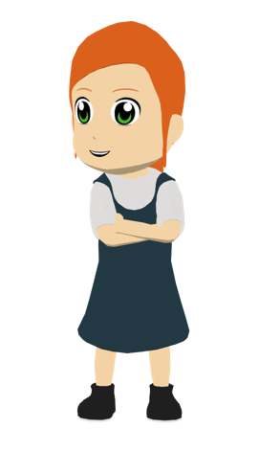
leer / escuchar
Lucía escribe correos a una amiga en Inglaterra para practicar el idioma. Aquí tienes un correo de Amelia, una amiga nueva.
Lucía lee el correo.
¡Hola, Lucía!
¿Qué tal? Yo estoy bien. Me presento: me llamo Amelia, soy de Estados Unidos pero vivo con mi familia en Inglaterra. Tu familia vive en el norte de España, ¿verdad? En este correo quiero hablar de un día normal en mi vida. Primero, me despierto muy temprano para ir a clase, aunque los fines de semana me levanto tarde. ¿Te levantas temprano o tarde? Después me lavo, me pongo un vestido, me miro en el espejo y luego desayuno. ¿Te pones un vestido o un pantalón para ir a la escuela? Mi padre prepara la comida mientras que mi madre toma café. ¿Quién prepara la comida en tu casa por la mañana?
Quiero leer tu respuesta. ¡Hasta pronto!
1
4
2
5
3
6
Deberes: escribe un correo similar sobre un día normal en tu vida.
Notes:
OPTIONAL / ADDITIONAL HOMEWORK ACTIVITY OR RESOURCE FOR LATER REVISITING
Timing: 9 minutes
Aim: to help students to connect the spoken and written forms of the language more securely; to consolidate vocabulary and grammar knowledge by eliciting suggested changes to the text.
Procedure:
Click on the audio button to play the text. Read and listen.
Note: There is a full version of the audio top right with a player. Alternatively the audio is in 6 sections with a pause just after the words 1-5 in bold in the transcript below, to facilitate easy stop/start.
To support segmentation, stop the audio and ask students to say: a) the next word b) the previous word
In addition, to develop understanding, vocabulary and grammar knowledge, pause at key points and ask students to suggest an alternative word that could replace the next word. This is a chance to draw on previously taught grammar and vocabulary knowledge.
Note: the lesson adds up to 40 minutes. If time remains at the end, students could begin writing their own email to describe their daily routine, as suggested for homework on the slide.
Transcript
¡Hola, Lucía!
¿Qué tal? Yo estoy bien. Me presento: me llamo Amelia, soy de Estados Unidos pero vivo con mi familia en Inglaterra. Tu familia vive en el norte de España, ¿verdad? En este correo quiero hablar de un día normal en mi vida. Primero, me despierto muy temprano para ir a clase, aunque los fines de semana me levanto tarde. ¿Te levantas temprano o tarde? Después me lavo, me pongo un vestido, me miro en el espejo y luego desayuno. ¿Te pones vestido o pantalón para ir a la escuela? Mi padre prepara la comida mientras que mi madre toma café. ¿Quién prepara la comida en tu casa por la mañana?
Quiero leer tu respuesta. ¡Hasta pronto!

Slide 34
Deberes
Vocabulary Learning Homework (Y8 Term 2.2 Week 1)
Audio file
Student worksheet
In addition, revisit: Y8 Term 1.2 Week 5
Notes:
The answer sheet for the Y8 vocabulary learning HW is here: https://rachelhawkes.com/LDPresources/Yr8Spanish/Spanish_Y8_Term2ii_Wk1_audio_HW_sheet_answers.docx
Notes:
i) Teachers may, in addition, want to recommend use of a particular online app for the pre-learning of each week’s words. ii) Quizlet now requires parental involvement / registration / permissions for users below the age of 13, so it is perhaps most suitable for Y9 – 11 students. iii) Language Nut hosts LDP vocabulary lists and these are free for schools to use, though there is a registration process. One benefit is that all of the student tracking data that Language Nut offers are also available to schools that use the LDP lists for practice. Perhaps this makes it a good option for Y7/8.
iv) There are other free apps, and new ones are always appearing. Teachers have told us that they are currently using: Flippity, Wordwall (where using previously-created activities is free).
v) Gaming Grammar has been acquired by Language Nut. Its original content should still be available to teachers and much of it is appropriate for Y8 learners. This week: Possessive adjectives: number in the ‘Possessive adjective agreement’ menu

