Slide 1
Friendships and relationships
Talking about what you do for others
Personal ‘a’ SSC [go] [ga] [gu] (revisited)
Y8 Spanish
Term 2.1 - Week 5 – Lesson 35
Amanda Izquierdo / Nick Avery / Rachel Hawkes Artwork: Mark Davies
Date updated: 20.02.24
Notes:
Note: all words (new and revisited) in this week of the SOW appear on all three GCSE wordlists, with the following exceptions: Edexcel list does not have lado. It has ‘al lado (de)’ as a multiword phrase with the meaning ‘next to’.
Artwork by Mark Davies. All additional pictures selected are available under a Creative Commons license, no attribution required.
Native teacher feedback provided by Blanca Román.
Learning outcomes (lesson 1):
Introduction of personal ‘a’
Consolidation of SSCs [ga], [go], [gu]
Consolidation of present tense verbs (-ar, -er, -ir) in 1st person singular present
Word frequency (1 is the most frequent word in Spanish):
New vocabulary (introduce in lesson 1): cuidar [751]; olvidar [415]; traer [341]; salud [613]; novio [1322]; novia [1996]; cumpleaños [3372]; casi [166]
Revisiting Y8 2.1.1: crear [239]; publicar [453]; dejar [86]; enviar [704]; comentario [497]; foto [882]; red [744]; poco (now as adj.) [76]; ayer [617]; lado [214]; encima [1140]
Y8 1.2.3: cine [952]; abierto [654]; cerrado [1201]; miedo [491]; razón [360]; suerte [723]; éxito [708]; sueño [450]; calor [945]; en cambio [cambio-329]
numbers 13-20: trece [2700]; catorce [2411]; quince [1215]; dieciséis [3373]; diecisiete [3430]; dieciocho [2730]; diecinueve [4232]; veinte [819]
Source: Davies, M. & Davies, K. (2018). A frequency dictionary of Spanish: Core vocabulary for learners (2nd ed.). Routledge: London
The frequency rankings for words that occur in this PowerPoint which have been previously introduced in NCELP resources are given in the NCELP SOW and in the resources that first introduced and formally re-visited those words.
For any other words that occur incidentally in this PowerPoint, frequency rankings will be provided in the notes field wherever possible.

Slide 2
Fonética
escuchar / escribir
¡Atención! No conoces las palabras en el audio.
Escucha las palabras. ¿Escuchas [ga], [go] o [gu]?
Marca la columna correcta.
Luego escucha otra vez. Intenta escribir la palabra en español.
 | [ga] | [go] | [gu]
 | Palabras en español | Palabras en inglés
1
2
3
4
5
6
1
riesgo
risk
2
orgullo
pride
3
enemigo
enemy
4
pagar
to pay, paying
5
seguridad
security, safety
6
garantizar
to guarantee, guaranteeing
Notes:
Timing: 6 minutes.
Aim: to consolidate understanding of the SSCs [ga], [go], [gu].
Procedure: 1. Students listen to each word. 2. Students tick the correct column depending on the sound they hear.
3. Students listen to each word again and try to write it down correctly.
Transcription:
riesgo.
orgullo.
enemigo
pagar.
seguridad.
garantizar.
Note: these words have not been previously taught. The aim is not to rely on word knowledge and to focus on SSC knowledge instead. However, the words are mostly on some or all of the GCSE lists (exception – garantizar).
Frequency of unknown/glossed words:
pagar [377]; riesgo [877]; enemigo [1066]; garantizar [1615]; seguridad [538]; orgullo [2156]

Slide 3
Vocabulario
leer
11) cerrado, cerrada 12) catorce 10) la suerte
8) enviar 9) quince
6) encima 7) la red
5) trece
3) publicar 4) dejar
1) crear 2) abierto, abierta
Notes:
Vocabulary: Spanish → English (receptive mode) - SLOW VERSION
Timing: 10 minutes in total for the Spanish → English activity and the English → Spanish activity
Aim: to consolidate vocabulary from this week’s revisited sets (8.2.1.1 and 8.1.2.3) receptively and in production
Procedure:
1. Students write 1-12 in their books.
2. There are three versions of this slide (this and the next two slides), getting progressively faster. Teachers decide before the lesson which version is most suitable for their students.
3. Students are challenged to note the English for the twelve vocabulary items, taken from those to be revisited, before the blocks cover the Spanish words.
4. If students don’t immediately know the English, they should write down the Spanish word, as the meaning may come to them later during the activity.
5. Before viewing the answers on the slide following this set of three, students could engage in a one-minute ‘pair-share’ with a partner, to compare answers.
6. Students are then challenged to produce the same words in Spanish, either in speaking (slide 7) OR in writing (slide 8) in the same format.
Note: to challenge a higher-achieving group, the teacher may wish to skip the receptive activity (slides 3-6) and go straight to the production activity (slides 7-9).

Slide 4
Vocabulario
leer
11) cerrado, cerrada 12) catorce 10) la suerte
8) enviar 9) quince
6) encima 7) la red
5) trece
3) publicar 4) dejar
1) crear 2) abierto, abierta
Notes:
Vocabulary: Spanish → English (receptive mode) - MEDIUM VERSION

Slide 5
Vocabulario
leer
11) cerrado, cerrada 12) catorce 10) la suerte
8) enviar 9) quince
6) encima 7) la red
5) trece
3) publicar 4) dejar
1) crear 2) abierto, abierta
Notes:
Vocabulary: Spanish → English (receptive mode) - FAST VERSION

Slide 6
Respuestas
1) to create, creating
2) open (adjective)
3) to post, to publish
4) to leave, leaving (e.g. in a place)
5) thirteen
6) on top
7) network
8) to send, sending
9) fifteen
10) luck
11) closed
12) fourteen
Notes:
ANSWERS

Slide 7
Vocabulario
hablar
11) to leave, leaving (e.g. in a place) 12) fourteen 10) on top
8) thirteen 9) to create, creating
6) luck 7) to send, sending
5) fifteen
3) closed 4) open (adj.)
1) network 2) to post, to publish
Notes:
Vocabulary: English → Spanish (productive mode) – SPEAKING – VERY SLOW VERSION
Students are now challenged to say the Spanish from the English for the vocabulary items introduced this week, before the blocks cover the English words.
Teachers may wish to ask their students to close their books here, to ensure that words are recalled.

Slide 8
Vocabulario
escribir
11) to leave, leaving (e.g. in a place) 12) fourteen 10) on top
8) thirteen 9) to create, creating
6) luck 7) to send, sending
5) fifteen
3) closed 4) open (adj.)
1) network 2) to post, to publish
Notes:
Vocabulary: English → Spanish (productive mode) – WRITING – VERY SLOW VERSION
Students are challenged to write the Spanish from the English for the vocabulary items introduced this week, before the blocks cover the English words.
Again, it may help to have students write 1-12 in their books before starting.

Slide 9
Respuestas
1) la red
2) publicar
3) cerrado, cerrada
4) abierto, abierta
5) quince
6) la suerte
7) enviar
8) trece
9) crear
10) encima
11) dejar
12) catorce
Notes:
ANSWERS

Slide 10
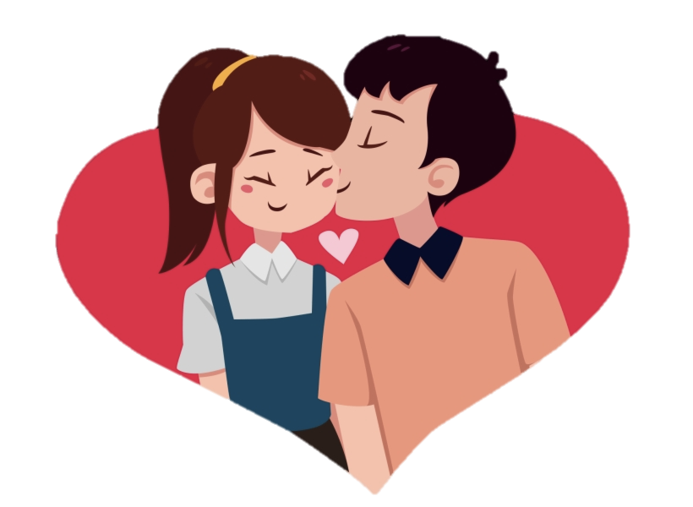
Vocabulario (1/2)
hablar
cuidar
el novio
[to look after, looking after]
[boyfriend]
The word ‘cumpleaños’ always ends in –s, whether it is singular or plural.
[to forget, forgetting]
olvidar
[success]
el éxito
la salud
el cumpleaños
[health]
Notes:
Timing: 4 minutes (slides 10-11)
Aim: to introduce and embed new vocabulary; to consolidate understanding of several vocabulary items from this week’s revisited sets (éxito, sueño, razón)
Procedure 1. Pupils either work by themselves or in pairs, reading out the words and recapping their English meaning (1 minute). 2. Then the teacher removes the English words or pictures (one by one) and they try to recall the English orally (chorally), looking at the Spanish (1 minute). 3. Then the Spanish meanings are removed (one by one) and they to recall them orally (again, chorally), looking at the English (1 minute) 4. Further rounds of learning can be facilitated by one pupil turning away from the board, and his/her partner asking him/her the meanings (‘Cómo se dice X en español?’). This activity can work from L2 → L1 or L1 → L2.

Slide 11
Vocabulario (2/2)
hablar
[I bring; I am bringing]
‘Traer’ is ‘traigo’ in 1st person singular present. This verb ending is like others that you have seen before:
hacer → hago
poner → pongo
traigo
la novia
[girlfriend]
[to bring, bringing]
traer
[sleepiness]
el sueño
[almost]
casi
[reason]
la razón
Notes:
[2/2]

Slide 12
Direct object and personal ‘a’
gramática
What is a direct object?
A direct object is the person, animal or thing that receives the action of the verb.
Olvido las fotos.
I forget the photos.
You can often ask ‘what’ or ‘who’ to identify the direct object.
Traigo unas bebidas.
I bring some drinks.
Question: What do I bring?
Answer: some drinks
The direct object in this sentence is ‘some drinks’.
→
Notes:
Timing: 2 minutes
Aim: to introduce the concept of the direct object ahead of the introduction of personal ‘a’
Procedure:
Go through the grammar explanation with students, revealing each new sentence on a mouse click.
Note: the ‘who’ or ‘what’ rule has some exceptions in English and Spanish. For example, English often asks questions with ‘who’ or ‘what’ followed by a preposition at the end of the sentence (e.g. What did you eat with?). In this case, ‘what’ doesn’t refer to the direct object in the sentence. Similarly, Spanish also has questions with a preverbal preposition (e.g. ¿A quién…?), which can signal an indirect object rather than a direct object. Indirect objects will be taught in Term 2.2 of Year 8, so there is no need to dwell on this here.

Slide 13
Direct object and personal ‘a’
This is also called an ‘animate object’.
gramática
In Spanish, when the direct object is a living thing (e.g. a person or an animal) you need to use an ‘a’ after the verb. This doesn’t happen in English.
Cuido a mi novia.
I look after/am looking after my girlfriend.
Traigo a mi perro.
I bring/am bringing my dog.
This is also called an ‘inanimate object’.
When the direct object is not a living thing, ‘a’ is not used.
Visito la ciudad.
I visit/am visiting the city.
Olvido las fotos.
I forget/am forgetting the photos.
Notes:
Timing: 2 minutes.
Aim: to introduce the personal ‘a’
Procedure:
Go through the grammar explanation with students, revealing each new sentence on a mouse click.

Slide 14
Unos comentarios
leer
Lucía publica unos comentarios en redes sociales. ¿Debe usar ‘a’ o no?
¿Puedes ayudar a Lucía? Marca las frases que necesitan la ‘a’.
 | ¿Necesita una ‘a’?
1. Cuido a mi abuelo.
2. No olvido los cumpleaños.
3. No dejo mi móvil en casa.
4. Ayudo a mi hermano con los deberes.
5. Lavo a mi gato casi todos los días.
6. Busco unas fotos de Daniel.
?
?
?
?
?
?
Notes:
Timing: 6 minutes (slides 14-15)
Aim: to correctly identify whether the personal ‘a’ is needed or not through reading
Procedure: 1. Students read each sentence and decide whether the personal ‘a’ is needed or not.
2. The teacher gives feedback by clicking anywhere on the screen to make a tick or cross appear.
3. For further reinforcement, teachers may wish to also click on each question box to make it disappear and show the full sentence. This can be done in any order.
3. The teacher asks students to translate each sentence orally into English to check understanding of meaning. The next slide can be used to check the answers.

Slide 15
¿Qué significan las frases?
leer
español | inglés
1. Cuido a mi abuelo. | I look after my grandfather.
2. No olvido los cumpleaños. | I don’t forget birthdays.
3. No dejo mi móvil en casa. | I don’t leave my mobile at home.
4. Ayudo a mi hermano con los deberes. | I help my brother with (his) homework.
5. Lavo a mi gato casi todos los días. | I wash my cat almost every day.
6. Busco unas fotos de Daniel. | I look for some photos of Daniel.
?
?
?
?
?
?
Notes:
Answer slide
Click on the beige question box to reveal the English translation. This can be done in any order.

Slide 16
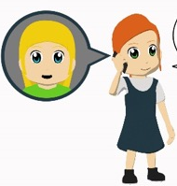
Unos mensajes
escuchar
Lucía escucha unos mensajes de una amiga en el móvil.
¿Cómo termina cada frase? Marca la opción correcta.
 | ¿Cuál es el final del mensaje?
 | a) Elizabeth b) la ciudad
 | a) un día en la playa b) mi madre
 | a) los viajes b) mi novio
 | a) un bolígrafo b) una periodista
 | a) los deberes b) la profesora de alemán
 | a) un museo b) mis amigos
Escribe las frases completas en inglés
1
1
I know Elizabeth.
2
2
I need a day on the beach.
3
3
I love my boyfriend.
4
4
I look for/am looking for a pen.
5
5
I don’t understand the German teacher.
6
6
I almost always visit my friends.
Notes:
Timing: 8 minutes
Aim: to correctly identify the sentence ending through listening
Procedure:
The teacher clicks on the orange action button to play each sentence starter. Students decide how each sentence must continue. Their decision will require them to pay attention to 1) whether ‘a’ is heard or not and 2) which object is animate and which is animate. This may require a couple of plays. It may also help to initially do one or two of these items with students as examples.
Students listen again and write the full sentences in English. Depending on the group, they may need to first transcribe the sentence (i.e. write in Spanish), before translating into English.
Each click will reveal answers to the first part of the activity. Additionally, for further reinforcement, the teacher can play the full audio recording of the sentence, using the beige action buttons. Further clicks then reveal each of the English translations.
Notes
It may be worth highlighting that some words naturally translate with either the present simple/present continuous in English, whereas others are much more likely to be present simple due to being stative verbs (know, love, understand, need). Such verbs aren’t commonly used in English in the present continuous, at least in the sentence contexts above.
‘Amar’ was used as a Year 7 phonics practice word. Students may need to be reminded of its meaning.
Transcript
Conozco a...
Necesito…
Amo a...
Busco...
No entiendo a...
Casi siempre visito a...

Slide 17
¿Cómo se dice en español?
hablar
Creamos frases posibles con combinaciones de palabras.
Frases en español
I help | new clothes | because it’s fun.
I look after | other countries | generally.
I understand | the teacher (f) | although she’s not interesting.
I take | the family | sometimes.
I visit | my health | at the weekend.
I look for | my boyfriend | to school.
1
Ayudo a la profesora a veces.
Visito otros países porque es divertido.
2
3
Busco ropa nueva el fin de semana.
Cuido mi salud generalmente.
4
5
Entiendo a la profesora aunque no es interesante.
6
Llevo a mi novio a la escuela.
Notes:
Timing: 8 minutes
Aim: to practise deciding when and when not to use the personal ‘a’ in oral production; to consolidate 1st person singular verbs in oral production
Procedure:
The teacher clicks anywhere on the screen to show students the three parts of the sentence to translate into Spanish. These won’t appear on the same row as they are combinations from different rows.
Students say the full sentence in Spanish.
The teacher clicks again (anywhere on the screen) to reveal the answer. The sequence of animations allows for interactive item-by-item feedback.
Clicking again makes the answer disappear, then a further click brings up the next set of prompts.
To facilitate further feedback, a separate slide is also provided that shows all the English prompts and Spanish answers together. Here, the prompts don’t disappear after the answer is given, so feedback happens under less time pressure.
The animations bring up the following combinations:
I help the teacher sometimes.
I visit other countries because it’s fun.
I look for new clothes at the weekend.
I look after my health generally.
I understand the teacher (f), although she’s not interesting.
I take my boyfriend to school.
Note: This lesson totals 46 minutes. If time permits in the final few minutes, students could be encouraged to write and/or say new sentences using other combinations of the prompts. These may or may not sound sensible/plausible! To focus on the meaning, students could be asked to think about how likely it would be to say such sentence. As one of the prompts (‘my family’) is not used in the six sentences, students could be challenged to write a sentence using it.

Slide 18
¿Cómo se dice en español?
1. I help the teacher (f) sometimes.
Ayudo a la profesora a veces.
?
2. I visit other countries because it’s fun.
Visito otros paises porque es divertido.
?
3. I look for new clothes at the weekend.
Busco ropa nueva el fin de semana.
?
4. I look after my health generally.
Cuido mi salud generalmente.
?
5. I understand the teacher (f), although she’s not interesting.
Entiendo a la profesora aunque no es interesante.
?
6. I take my boyfriend to school.
Llevo a mi novio a la escuela.
?
Notes:
Alternative feedback slide
Click on the beige rectangle to reveal the Spanish. This can be done in any order.

Slide 19
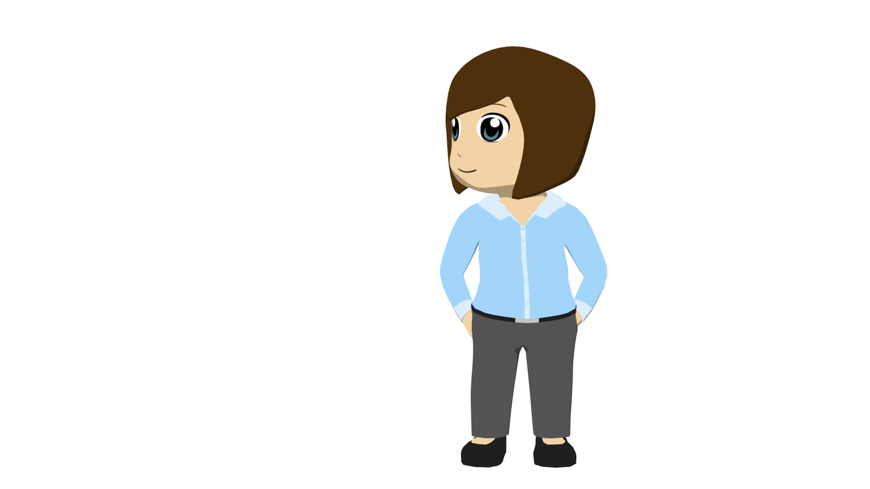
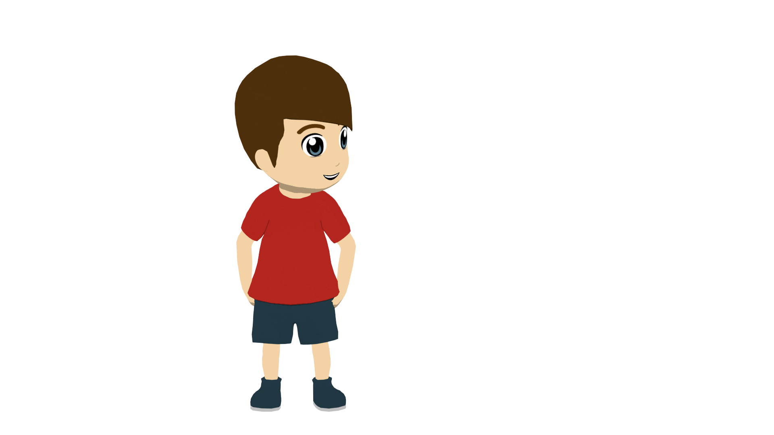
Friendships and relationships (2)
Talking about what you do for others
Personal ‘a’ (and ‘al’) SSC [go] [ga] [gu] (revisited)
Y8 Spanish
Term 2.1 - Week 5 – Lesson 36
Amanda Izquierdo / Nick Avery / Rachel Hawkes Artwork: Mark Davies
Date updated: 20.02.24
Notes:
Note: all words (new and revisited) in this week of the SOW appear on all three GCSE wordlists, with the following exceptions: Edexcel list does not have lado. It has ‘al lado (de)’ as a multiword phrase with the meaning ‘next to’.
Artwork by Mark Davies. All additional pictures selected are available under a Creative Commons license, no attribution required.
Native teacher feedback provided by Blanca Román.
Learning outcomes (lesson 2):
Consolidation of personal ‘a’ (now including ‘al’)
Consolidation of SSCs GA-GO-GU
Consolidation of prenominal adjectives
Consolidation of present tense verbs (-ar, -er, -ir) in 2nd person singular present.
Word frequency (1 is the most frequent word in Spanish):
New vocabulary (introduce in lesson 1): cuidar [751]; olvidar [415]; traer [341]; salud [613]; novio [1322]; novia [1996]; cumpleaños [3372]; casi [166]
Revisiting Y8 2.1.1: crear [239]; publicar [453]; dejar [86]; enviar [704]; comentario [497]; foto [882]; red [744]; poco (now as adj.) [76]; ayer [617]; lado [214]; encima [1140]
Y8 1.2.3: cine [952]; abierto [654]; cerrado [1201]; miedo [491]; razón [360]; suerte [723]; éxito [708]; sueño [450]; calor [945]; en cambio [cambio-329]
numbers 13-20: trece [2700]; catorce [2411]; quince [1215]; dieciséis [3373]; diecisiete [3430]; dieciocho [2730]; diecinueve [4232]; veinte [819]
Source: Davies, M. & Davies, K. (2018). A frequency dictionary of Spanish: Core vocabulary for learners (2nd ed.). Routledge: London
The frequency rankings for words that occur in this PowerPoint which have been previously introduced in NCELP resources are given in the NCELP SOW and in the resources that first introduced and formally re-visited those words.
For any other words that occur incidentally in this PowerPoint, frequency rankings will be provided in the notes field wherever possible.

Slide 20
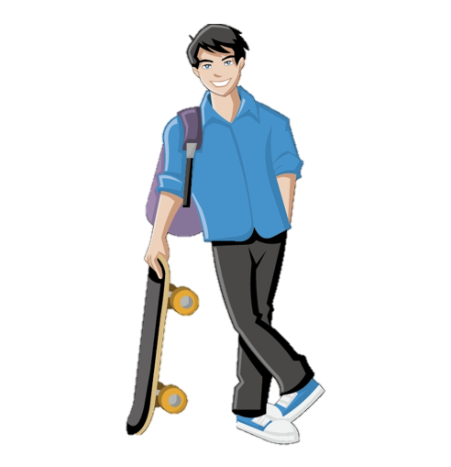
El jugador guapo
hablar
El jugador guapo jugó el domingo pero no ganó porque organizó el juego en un lugar antiguo sin agua. ¿Pregunto al jugador guapo si tiene vergüenza?
1
2
3
Notes:
Timing: 4 minutes
Aim: to gain confidence in producing the SSCs [ga], [go], [gu] orally in sentences
Procedure:
The teacher first asks students to read the short text and think about what it means.
The teacher reads the text aloud in fragments, eliciting the meanings from students. Note that all words have been previously taught as vocabulary items or used for phonics practice.
Students then practise saying the sentence in pairs, at increasing speed.
The teacher can have students listen to a native speaker read the text at three different speeds (1=slow; 3=very fast). Each time, students can be challenged to say it at the same speed.
Notes:
In several cases, the SSC [gu] is followed by a strong vowel to create a diphthong. It may be worth asking students why this happens (answer=because [u] is a weak vowel and weak vowels combine with a strong vowel to make a single syllable) and how many examples of this they can identify (answer=3, guapo, antiguo, agua).
This slide could alternatively be used for an SSC tallying activity, where students count the number of times they hear the target SSCs. The text itself would need to be covered/removed during the activity.
To focus on meaning, students could work on the text as a dictation (running, paired or student-led) or be asked to write a written translation of the text displayed on the board. Students could also write alternative versions of it, adding other known words with the SSCs [go], [ga] and gu] (see the SoW for ideas of which known words could be used).

Slide 21
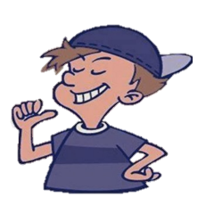
Vocabulario
Escucha. Identifica la imagen correcta y escribe su letra.
escuchar
1
2
3
4
5
6
7
8
9
10
11
12
C
F
K
G
I
E
J
A
L
B
H
D
A
B
C
D
E
F
The cinema is closed.
I am right.
She is successful.
I am hot.
You are sleepy.
I am scared.
G
H
I
J
K
L
I post seventeen comments.
You send twenty photos.
You leave eighteen gifts.
I create sixteen pages.
I am next to the computer.
You are lucky.
Notes:
Timing: 6 minutes
Aim: to recap vocabulary from this lesson and sets Y8 2.1.1 and Y8 1.2.3 as per the SoW cycle of revisiting.
Procedure:
The teacher gives students 1-2 minutes in pairs to try to anticipate the vocabulary items they will hear, based on the English prompts. Five of the twelve items are examples of idiomatic uses of ‘tener’ + noun.
The teacher plays the audio by clicking on the the number triggers.
Feedback is given to students on their answers.
As a final step, the Spanish sentences can be elicited from students in oral production using the prompts. Encourage retrieval from memory where possible (e.g. by asking students to close their books, where they may have written sentences down).
Transcript:
El cine está cerrado.
Tengo miedo.
Tienes suerte.
Envias veinte fotos
Publico diecisiete comentarios
Tiene éxito.
Creo dieciséis páginas.
Tengo calor.
Estoy al lado del ordenador
Tienes sueño.
Dejas dieciocho regalos.
Tengo razón.

Slide 22
Direct object and personal ‘a’
gramática
Remember, in Spanish you need to use an ‘a’ between the verb and direct object if the direct object is a _______ ______ (e.g. a person or an animal).
living
thing
You forget your friends.
Olvidas a tus amigos.
You bring/bring back your dog.
Traes a tu gato.
Remember that the article ‘el’ (the) refers to a singular masculine / feminine noun. If ‘a’ is followed by ‘el’ (the), use _____.
al
Cuidas al niño.
You look after the child.
¡Atención! The words ‘al’ and ‘el’ look very similar! Be careful not to mix them up ☺.
Buscas el móvil.
You look for the mobile.
Notes:
Timing: 2 minutes
Aim: to recap the use of the personal ‘a’ and extend understanding of how ‘al’ is used
Procedure:
Go through the grammar explanation with students, revealing each new sentence on a mouse click.

Slide 23
Daniel habla con su madre, Ana. Ella dice cómo Daniel ayuda a otras personas. Lee y completa el texto. ¿Necesitas ‘al’ o ‘el’? Luego escribe cuándo pasa cada actividad.
leer y escuchar
Actividad | ¿Cuándo? En inglés
help the teacher
take the dog out
take Hugo’s friend to the cinema
wash the car
don’t forget Grandfather (e.g. call him/see him)
look after the cat
Los lunes ayudas 1) ____ profesor después de la clase y dejas 2) ____ libro en su lugar. Por la tarde, sacas 3) ____ perro de la casa. Los viernes llevas 4) ____ amigo de Hugo al cine y después siempre traes 5) ____ periódico a casa. Los sábados lavas 6) ____ coche y los domingos no olvidas 7) ____ abuelo. También cuidas 8) ____ gato durante las vacaciones. ¡Eres un buen chico!
al
on Mondays
el
in the afternoon
al
al
on Fridays
el
el
on Saturdays
al
al
on Sundays
during the holidays
Notes:
Timing: 8 minutes
Aim: to practise with the features ‘el’ and ‘al’ in reading
Procedure:
Students read the text and try to work out if they need to write ‘el’ o ‘al’. This decision will depend on the animacy of the noun that follows.
Then, students write in English when the actions take place.
The teacher plays the recording, which allows students to check answers. Since ‘el’ and ‘al sound similar, and might be misheard, the missing words are also animated to appear on a click.
The teacher could also go through the text phrase by phrase, asking students for an oral translation into English.
Notes:
The use of ‘de’ for possession appears in this text (‘…al amigo de Hugo’). Its meaning may need to be given. This feature will be taught in Y8 Term 3.
‘No olvidas al abuelo’ implies that time is spent with the grandfather. A slight inference is needed here, so the meaning is explained in the ‘actividad’ column.
All words in the text have been previously taught as vocabulary items.
To increase the challenge, ask students to write the words in the ‘actividad’ column themselves.

Slide 24
Prenominal adjectives
gramática
Remember that in Spanish some adjectives can come before the noun.
same
last
first
second
third
own
mismo
último
primero
segundo
tercero
propio
Un ejemplo:
These adjectives all have the ending (-a) when referring to a singular feminine noun (e.g. misma).
the same boyfriend
el mismo novio
–o
As you know, most adjectives end in ____ when they refer to a masculine noun. However, some lose this ending when before a masculine noun:
the third comment
el tercer comentario
a good cinema
un buen cine
These adjectives can be used straight after the personal ‘a’.
Describes a tu propio profesor =
you describe your own teacher
Ayudas a la misma persona =
you help the same person
Notes:
Timing: 2 minutes
Aim: to recap prenominal adjectives and how they are used with the personal ’a’.
Procedure:
Go through the grammar explanation with students, revealing each new sentence on a mouse click.

Slide 25
Prenominal adjectives
gramática
The adjectives that lose the –o before the noun are the following:
primero
tercero
bueno
malo
Unos ejemplos:
his/her first birthday
su primer cumpleaños
a bad day
un mal día
These adjectives may appear in sentences with personal ‘a’ (or ‘al’).
Conoces a un buen autor.
You know a good author (m).
Describes al primer chico.
You describe/are describing the first boy.
Notes:
Timing: 2 minutes
Aim: to recap prenominal adjectives and how they are used with the personal ’a’.
Procedure:
Go through the grammar explanation with students, revealing each new sentence on a mouse click.
Ask students why, in the final example, ‘al’ is used rather than ‘a’. This was already recapped earlier in the lesson, so should be quite fresh in students’ minds (=when ‘a’ is followed by the singular masculine article ‘el’, the two words merge).

Slide 26
Un problema con los mensajes de audio
escuchar
¿Puedes escuchar a Lucía? Hay un problema con los mensajes de audio.
Escribe ‘al’ o ‘el’, según el nombre. También marca la posición del adjetivo.
 | ¿‘al’ o ‘el’? | Adjective before the noun | Adjective after the noun
Adjetivo y nombre en inglés
1
1
al
first boyfriend
2
2
al
third student
3
3
el
red pen
4
4
al
interesting people
5
5
el
perfect present
6
6
el
bad day
Notes:
Timing: 8 minutes
Aim:
to focus students on the difference between ‘el’ and ‘al’ through listening to animate/inanimate nouns
to raise awareness of the position of the different Spanish adjectives in relation to nouns
to accurately translate pairs of nouns and adjectives into English
Procedure:
1. The teacher clicks on the orange number trigger to play the audio.
2. The first time students listen, they focus on whether the noun they hear in the sentence is animate or animate and whether the missing word must be ‘el’ o ‘al’.
3. The teacher gives feedback step 2.
4. The next time students listen, they decide whether
a) the adjective comes before noun
b) the adjective comes after noun
5. Students also write the English for the adjective and noun (they may need to listen again for this).
6. Feedback is given on steps 4-5.
4. The audio for the full version of the sentence then appears on a further click (beige action buttons). This may be useful to play to students during feedback.
Transcript (words in brackets are beeped out)
Traes [al] primer novio.
Ayudas [al] tercer estudiante.
Llevas [el] bolígrafo rojo.
Visitas [al] chico interesante.
Buscas [el] regalo perfecto.
Olvidas [el] mal día.

Slide 27
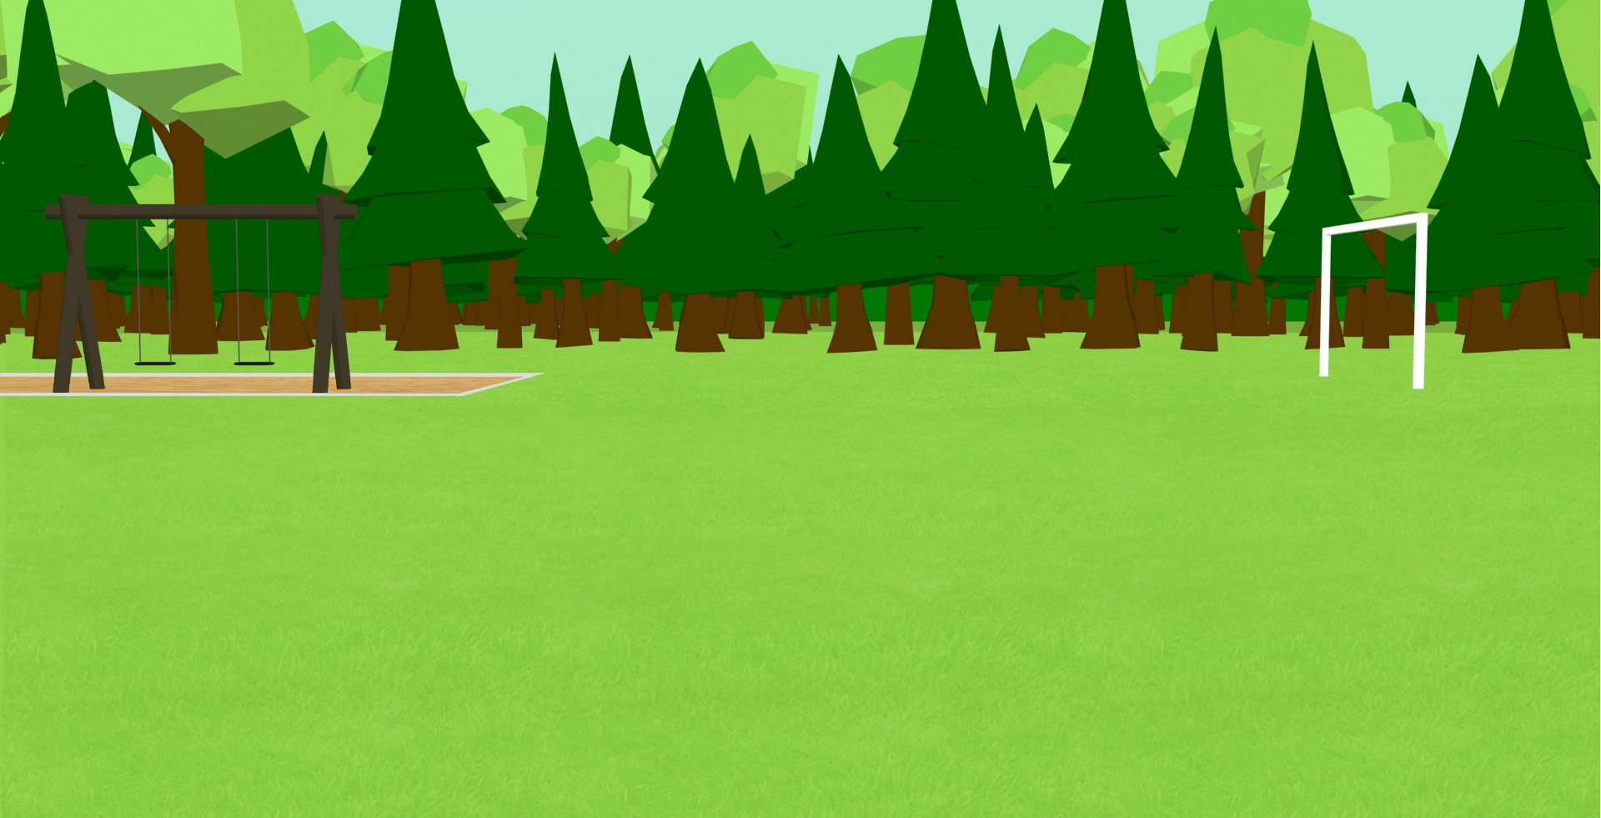
İA escribir! (1/2)
escribir
Escribe las frases en español.
1 | I bring the good dog to the park.
2 | You look after the small child.
3 | I don’t forget the first present .
4 | You help the short boy.
5 | You understand the second message.
Traigo al buen perro al parque.
Cuidas al niño pequeño.
No olvido el primer regalo.
Ayudas al chico bajo.
Entiendes el segundo mensaje.
Notes:
Timing: 15 minutes
Aim: to bring the two features practised across the two lessons together in written production
1st and 2nd person singular forms of a range of regular verbs (-ar, -er, -ir)
Personal ‘a’ (focusing on ‘al’, as it has been the predominant focus this lesson)
Prenominal and post-nominal adjectives
Vocabulary used in preceding activities/lesson 1
Procedure:
1. Students write the sentence in Spanish
2. The English is revealed on a mouse click.
Note:
If time is short, the final five sentences could be completed for homework.
If pupils finish ahead of others, they could be encouraged to write their own sentences incorporating the features above.

Slide 28
İA escribir! (2/2)
escribir
6 | I look for the same cat.
7 | You wash the red car almost every day.
8 | I take the second newspaper to my grandparents.
9 | I don’t leave the animal at home with my girlfriend.
10 | You put the expensive book in its place.
Busco al mismo gato.
Lavas el coche rojo casi todos los días.
Llevo el segundo periódico a mis abuelos.
No dejo al animal en casa con mi novia.
Pones el libro caro en su lugar.
Notes:
[2/2]

Slide 29
Deberes
Vocabulary Learning Homework (Y8 Term 2.1 Week 6)
Audio file
Student worksheet
In addition, revisit: Y8 Term 2.1 Week 2 Y8 Term 1.2 Week 4
Notes:
The answer sheet for the Y8 vocabulary learning HW is here: https://rachelhawkes.com/LDPresources/Yr8Spanish/Spanish_Y8_Term2i_Wk6_audio_HW_sheet_answers.docx
Notes:
i) Teachers may, in addition, want to recommend use of a particular online app for the pre-learning of each week’s words. ii) Quizlet now requires parental involvement / registration / permissions for users below the age of 13, so it is perhaps most suitable for Y9 – 11 students. iii) Language Nut hosts LDP vocabulary lists and these are free for schools to use, though there is a registration process. One benefit is that all of the student tracking data that Language Nut offers are also available to schools that use the LDP lists for practice. Perhaps this makes it a good option for Y7/8.
iv) There are other free apps, and new ones are always appearing. Teachers have told us that they are currently using: Flippity, Wordwall (where using previously-created activities is free).
v) Gaming Grammar has been acquired by Language Nut. Its original content should still be available to teachers and much of it is appropriate for Y8 learners.

