Slide 1
Talking about community activities
Things that helped the environment
–ar verbs in the preterite (revisited)
Y8 Spanish
Term 2.1 - Week 3 – Lesson 33
Amanda Izquierdo / Nick Avery / Rachel Hawkes Artwork: Mark Davies
Date updated: 17.02.24
Notes:
Note: all words (new and revisited) in this week of the SOW appear on all three GCSE wordlists, with the following exceptions: i) AQA list does not have Inglaterra, pues, voluntario ii) Edexcel list does not have fin, Inglaterra, sacar, voluntario
Artwork by Mark Davies. All additional pictures selected are available under a Creative Commons license, no attribution required.
Native teacher feedback provided by Blanca Román.
Learning outcomes (lesson 1):
Consolidation of –ar, –er & –ir verbs in the preterite: 1st, 2nd, 3rd person singular singular (-é, -aste, -ó)
Consolidation of a subset of the Year 7 vocabulary (see below)
Vocabulary to be revisited:
Y8 1.2.2: salir [114]; subir [410]; perder [195]; recoger [828]; partido [302]; fútbol [1471]; entrada [767]; billete [292]; pues¹ [73]; fin [182]; semana [301]; inglés² [583]; jugador [1019]; (a) pie [365]
Y8 1.2.7: n/a (consolidation week)
Year 7 vocabulary to revisit (50 items): árbol [748]; producto [394]; voluntario [2732]; ayuda [784]; campo [342]; bolsa [1581]; cosa [69]; bicicleta [3684]; basura [2479]; naturaleza [712]; extranjero [675]; mundo [123]; problema [145]; barrio [940]; playa [1475]; periódico [1026]; caminar [514]; sacar [273]; limpiar [1713]; montar [1446]; viajar [902]; pasar² [68]; recibir [316]; abrir [246]; importante [171]; verde [812]; nuevo [94]; divertido [2465]; luego [150]; lejos [833]; solo [95]; allí [197]; cerca [1042]; para [16]; como [20]; y [4]; Inglaterra [N/A]; muy [43]; otra vez [vez-59]; completamente [1185]; sin [54]; mi [37]; tu [53]; detrás [2044]; un [6]; una [6]; lunes [1370]; martes [3101]; jueves [1650]; domingo [693]
Source: Davies, M. & Davies, K. (2018). A frequency dictionary of Spanish: Core vocabulary for learners (2nd ed.). Routledge: London
The frequency rankings for words that occur in this PowerPoint which have been previously introduced in NCELP resources are given in the NCELP SOW and in the resources that first introduced and formally re-visited those words. For any other words that occur incidentally in this PowerPoint, frequency rankings will be provided in the notes field wherever possible.

Slide 2
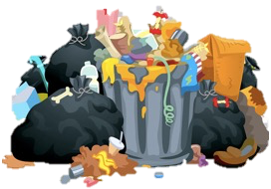
leer / hablar
Escribe la letra correcta para cada palabra en español.
Después, las palabras van a desaparecer. Debes decir una letra en español. Tu compañero debe decir la palabra en español. ¡Toma turnos!
[1/2]
 | Palabras | ¿Qué letra?
1 | jugador/a
2 | verde
3 | viajar
4 | playa
5 | mundo
6 | sacar
7 | caminar
8 | basura
9 | importante
10 | limpiar
11 | divertido
12 | nuevo
a)
b)
c)
d)
i
b
c
[green]
[to travel]
[rubbish]
e
e)
f)
g)
h)
g
f
j
[beach]
[to take out]
[world]
d
i)
j)
k)
l)
h
k
[player (m/f)]
l
[to walk]
[to clean]
a
Notes:
Timing: 10 minutes (two slides)
Aim: To revisit Y7 vocabulary in both receptive and productive modes of language use. To consolidate understanding of word classes.
Procedure 1. Students either work by themselves or in pairs, matching up words with the corresponding picture (1 minute) 2. Then the teacher shows the answers one by one (1 minute).
3. After one more click, the Spanish words are covered up.
4. Students work in pairs. One says a random letter and the other says the word in Spanish as fast as possible. Students take turns (2 minutes). 5. Move to the next slide. Finally, students write each of the 12 words in the corresponding column depending on the category it belongs to (2 minutes).
6. Teacher shows the answers (1 minute) on the next slide.
Note:
Articles are not given in the Spanish words as this would make it very easy to identify the nouns.
To increase the level of difficulty for a higher-ability group, students could pass steps 1-3 and go straight to step 4 (production).

Slide 3
escribir
Ahora escribe cada palabra en español en la categoría correcta.
e)
f)
[2/2]
a)
b)
c)
d)
[green]
[to travel]
[rubbish]
[beach]
[to take out]
g)
h)
i)
j)
k)
l)
[player (m/f)]
[world]
[to walk]
[to clean]
Nombres | Adjetivos | Verbos
la basura
verde
viajar
la playa
nuevo
sacar
el mundo
importante
caminar
el/la jugador/a
divertido
limpiar
Notes:
OPTIONAL
Part [2/2] of the activity
Note that some classes will not be able to complete both slides in 10 minutes and teacher may decide to omit this slide.

Slide 4
Talking about things completed in the past: regular –AR verbs in the preterite
gramática
Remember that to mean ‘I’ for a completed action in the past, remove –ar and add _____.
–é
Viajé
Caminé
I travelled = _______.
I walked = __________.
To mean ‘you’ for a completed action in the past, remove –ar and add ______.
–aste
Which of these endings have
final syllable stress?
a) caminé b) sacaste c) montó
Sacaste
Limpiaste
You took out = _________.
You cleaned = _________.
To mean ‘s/he’ or ‘it’ for a completed action in the past, remove –ar and add _____.
–ó
Montó
S/he or it passed, spent (time) = _____.
S/he or it rode = ________.
Pasó
Notes:
Timing: 2 minutes
Aim: to recap 1st, 2nd, and ^{rd} person singular form of preterite tense for –ar/–er/–ir verbs.
Procedure:
Go through the grammar explanation with students, revealing each new sentence on a mouse click.

Slide 5
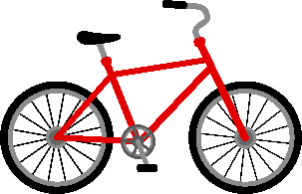
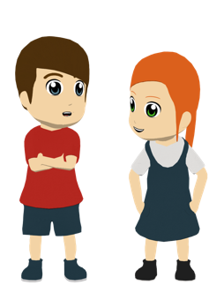
¡Hoy es un día especial para ayudar al planeta! Lucía habla con Daniel y Nadia sobre las actividades. Decide si las frases en inglés están en el texto. Luego, escribe el pronombre (e.g. yo), según el verbo.
leer
 | ¿Está en el texto?
1. I walked to school. | Sí / No
2. I rode a bike. | Sí / No
3. She didn’t travel by car. | Sí / No
4. I took out some bags. | Sí / No
5. You helped with the rubbish. | Sí / No
6. I worked in a different team. | Sí / No
7. She cleaned the streets. | Sí / No
8. You cleaned the countryside. | Sí / No
Pues por la mañana 1) ____ caminé a la escuela porque no está muy lejos y 2) ____ montaste en bicicleta porque es bueno para el planeta.
3) ____ no viajó en coche; llegó allí a pie. Luego 4) ____ sacaste unas bolsas y 5) ____ ayudó con la basura cerca del parque, mientras que 6) ____ trabajé en un equipo diferente.
Por la tarde, 7) ____ limpié las calles con otros voluntarios y con la profesora, aunque 8) ____ limpiaste en el campo porque la basura en la naturaleza es un problema importante también.
yo
tú
Ella
tú
ella
yo
yo
tú
Notes:
Timing: 10 minutes
Aim: to consolidate understanding of the 1st, 2nd and 3rd person singular endings for –ar verbs and the use of subject pronouns in Spanish.
Procedure: 1. Students first read the text and write down any examples of things that one can do to help the planet. At this stage, the focus is on the meaning of vocabulary (e.g. walk to school), rather than particular verb forms.
2. Students then decide which of the English sentences on the right are present in the text or not. It may help them to know that the true/false element here is the subject of the verb, rather than the vocabulary.
3. When checking this part of the activity, students should be encouraged to explain why some of the sentences are not in the text (e.g. ¿Por qué no puede ser ‘she’? Sí, exacto, porque el verbo termina en –é).
4. Finally, students write in the missing subject pronouns from 1 to 8. The verb in the text gives them the cue for each one. Ask students why we need to add these subject pronouns (anticipate: because the verbs in the text refer to different people and subject pronouns emphasise who is being referred to).
Note:
This text is written using close to 100% previously taught language. The only unknown word, ‘planeta’ [1496], is a near-cognate.
If working with a higher-attaining group, the 8 sentences on the right could be presented in a jumbled order. This would require students to locate the vocabulary related to each English statement within the text.
To automatise this knowledge in oral production, the teacher could remove the subject pronouns and verbs from the text and replace them with English prompts. Students then read the text aloud to a partner, translating the English prompts into Spanish as they go. A slide with this option follows.

Slide 6
Lee el texto con tu compañero/a de clase. Traduce* los verbos y los pronombres al español.
*traducir - translate
hablar
Pues por la mañana 1) [I walked] a la escuela porque no está muy lejos y 2) [you rode/went] en bicicleta porque es bueno para el planeta.
3) [she didn’t travel] en coche; llegó allí a pie. Luego 4) [you took out] unas bolsas y 5) [she helped] con la basura cerca del parque, mientras que 6) [I worked] en un equipo diferente.
Por la tarde, 7) [I cleaned] las calles con otros voluntarios y con la profesora, aunque 8) [you cleaned] en el campo porque la basura en la naturaleza es un problema importante también.
Notes:
Timing: 1-2 minutes
Aim: to automatise knowledge in oral production.
Procedure: 1. Students read the text aloud to a partner, translating the English prompts into Spanish as they go. They swap after each sentence, taking it in turns.

Slide 7
Lucía describe cómo cada persona continuó a ayudar al planeta. Escucha las frases: ¿quién es? Luego, escribe la información extra en inglés.
escuchar
 | yo | tú | ella
¿cuándo? | ¿qué?
To talk about a day of the week in the past, you can use ‘pasado/a’.
e.g. el lunes pasado last Monday
However, you can also just say ‘el lunes’ (on Monday). In context, the speaker will understand whether you are referring to the past or present.
1
on Monday
needed help (in order) to collect rubbish
2
on Sunday
taught interesting things about trees
3
on Tuesday
cleaned the streets in the neighbourhood
4
on Thursday
took a plant to class
spent time abroad with a team of volunteers
5
in July
6
in summer
didn’t buy new clothes
7
last week
travelled by bike
8
at the weekend
only used green products
Notes:
Timing: 10 minutes
Aim: to consolidate understanding of the difference between the 1st, 2nd and 3rd person singular preterite through listening; to consolidate understanding of vocabulary.
Procedure:
Students listen to each recording and tick the correct column depending on the verb ending that they hear.
Students listen again to each recording and write in English the extra information: what happened and when.
Teacher shows the answers one by one.
The teacher could ask students why in this activity subject pronouns aren’t used (=because only one person is referred to in the sentence; it is already clear from the verb who is being referred to)
Transcript
El lunes necesitaste ayuda para recoger basura.
El domingo enseñó cosas interesantes sobre los árboles.
El martes limpié las calles en el barrio.
El jueves llevó una planta a la clase.
En julio pasó tiempo en el extranjero con un equipo de voluntarios.
En verano no compraste ropa nueva.
La semana pasada viajaste en bicicleta.
El fin de semana solo usé productos verdes.

Slide 8
En pareja
Escribe 5 frases en español. Habla en español.
escribir /hablar
¿Cómo ayudaste en tu barrio?
On Saturday Last week At the weekend In April Yesterday On Thursday | i you he she | helped to collect rubbish. didn’t use the car. didn’t buy new things. cleaned the neighbourhood. spent time in nature. rode a bike.
Notes:
Timing: 15 minutes
Aim: to written and spoken production and aural comprehension of new and revisited language and grammar from this and previous weeks.
Procedure:
Both pupils write 5 sentences (in Spanish) made up of translations of words from the table.
Partner A says their sentences to partner B in Spanish (challenging him/herself not to look at their Spanish notes but just use the English prompts displayed on the board, if possible).
Partner B listens. If they have exactly the same sentence (by chance) they respond e.g., Yo también…..
They swap roles and repeat the activity.

Slide 9
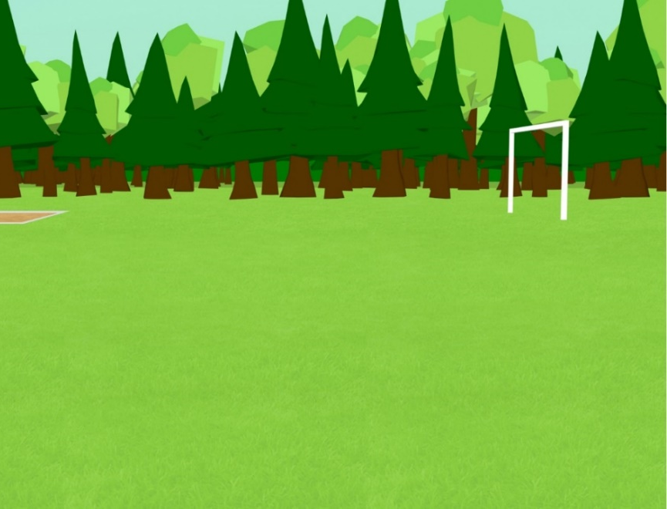
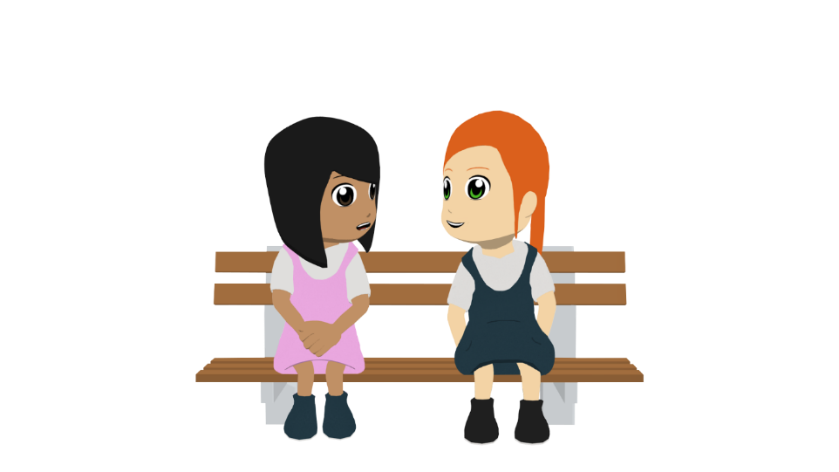
Talking about community activities (2)
Things that helped the environment
–er & -ir verbs in the preterite (revisited)
SSC [qui] revisited
Y8 Spanish
Term 2.1 - Week 3 – Lesson 34
Amanda Izquierdo / Nick Avery / Rachel Hawkes Artwork: Mark Davies
Date updated: 17.02.24
Notes:
Note: all words (new and revisited) in this week of the SOW appear on all three GCSE wordlists, with the following exceptions: i) AQA list does not have Inglaterra, pues, voluntario ii) Edexcel list does not have fin, Inglaterra, sacar, voluntario
Artwork by Mark Davies. All additional pictures selected are available under a Creative Commons license, no attribution required.
Native teacher feedback provided by Blanca Román.
Learning outcomes (lesson 2):
Consolidation of –er & –ir verbs in the preterite: 1st, 2nd and 3rd person singular (-í, -iste, -ió)
Consolidation of SSC [qui] (contrasted with [que])
Consolidation of a subset of the Year 7 vocabulary (see below)
Vocabulary to be revisited:
Y8 1.2.2: salir [114]; subir [410]; perder [195]; recoger [828]; partido [302]; fútbol [1471]; entrada [767]; billete [292]; pues¹ [73]; fin [182]; semana [301]; inglés² [583]; jugador [1019]; (a) pie [365]
Y8 1.2.7: n/a (consolidation week)
Year 7 vocabulary to revisit (50 items): árbol [748]; producto [394]; voluntario [2732]; ayuda [784]; campo [342]; bolsa [1581]; cosa [69]; bicicleta [3684]; basura [2479]; naturaleza [712]; extranjero [675]; mundo [123]; problema [145]; barrio [940]; playa [1475]; periódico [1026]; caminar [514]; sacar [273]; limpiar [1713]; montar [1446]; viajar [902]; pasar² [68]; recibir [316]; abrir [246]; importante [171]; verde [812]; nuevo [94]; divertido [2465]; luego [150]; lejos [833]; solo [95]; allí [197]; cerca [1042]; para [16]; como [20]; y [4]; Inglaterra [N/A]; muy [43]; otra vez [vez-59]; completamente [1185]; sin [54]; mi [37]; tu [53]; detrás [2044]; un [6]; una [6]; lunes [1370]; martes [3101]; jueves [1650]; domingo [693]
Source: Davies, M. & Davies, K. (2018). A frequency dictionary of Spanish: Core vocabulary for learners (2nd ed.). Routledge: London
The frequency rankings for words that occur in this PowerPoint which have been previously introduced in NCELP resources are given in the NCELP SOW and in the resources that first introduced and formally re-visited those words. For any other words that occur incidentally in this PowerPoint, frequency rankings will be provided in the notes field wherever possible.

Slide 10
Vocabulario (1/12)
¿Cuál es la palabra en español?
leer
luego
Inglaterra
otra vez
entrada
tu
completamente
recibir
abrir
como
cosa
periódico
billete
[to receive]
Notes:
Timing: 3 minutes (12 slides)
Aim: To identify previously taught vocabulary
Procedure:
Students look at the picture or read the word in English and say out loud the corresponding word in Spanish from the list. NB: if the words are nouns, teachers should require students to produce the correct definite article as well. e.g. el periódico.
Teacher brings up the correct answer.
Note: this activity focuses on identification of vocabulary. The next activity (slide 30) requires students to recall the vocabulary themselves. Teachers might wish to use these 12 slides as a lead in/recap ahead of the next activity. Alternatively, with a higher ability group, it may be preferable to go straight to slide 24.

Slide 11
Vocabulario (2/12)
¿Cuál es la palabra en español?
leer
luego
Inglaterra
otra vez
entrada
tu
completamente
recibir
abrir
como
cosa
periódico
billete
Notes:
2/12

Slide 12
Vocabulario (3/12)
¿Cuál es la palabra en español?
leer
luego
Inglaterra
otra vez
entrada
tu
completamente
recibir
abrir
como
cosa
periódico
billete
Notes:
3/12

Slide 13
Vocabulario (4/12)
¿Cuál es la palabra en español?
leer
luego
Inglaterra
otra vez
entrada
tu
completamente
recibir
abrir
como
cosa
periódico
billete
Notes:
4/12

Slide 14
Vocabulario (5/12)
¿Cuál es la palabra en español?
leer
luego
Inglaterra
otra vez
entrada
tu
completamente
recibir
abrir
como
cosa
periódico
billete
ticket (for a venue)
Notes:
5/12

Slide 15
Vocabulario (6/12)
¿Cuál es la palabra en español?
leer
luego
Inglaterra
otra vez
entrada
tu
completamente
recibir
abrir
como
cosa
periódico
billete
Notes:
6/12

Slide 16
Vocabulario (7/12)
¿Cuál es la palabra en español?
leer
luego
Inglaterra
otra vez
entrada
tu
completamente
recibir
abrir
como
cosa
periódico
billete
Notes:
7/12

Slide 17
Vocabulario (8/12)
¿Cuál es la palabra en español?
leer
luego
Inglaterra
otra vez
entrada
tu
completamente
recibir
abrir
como
cosa
periódico
billete
[to open]
Notes:
8/12

Slide 18
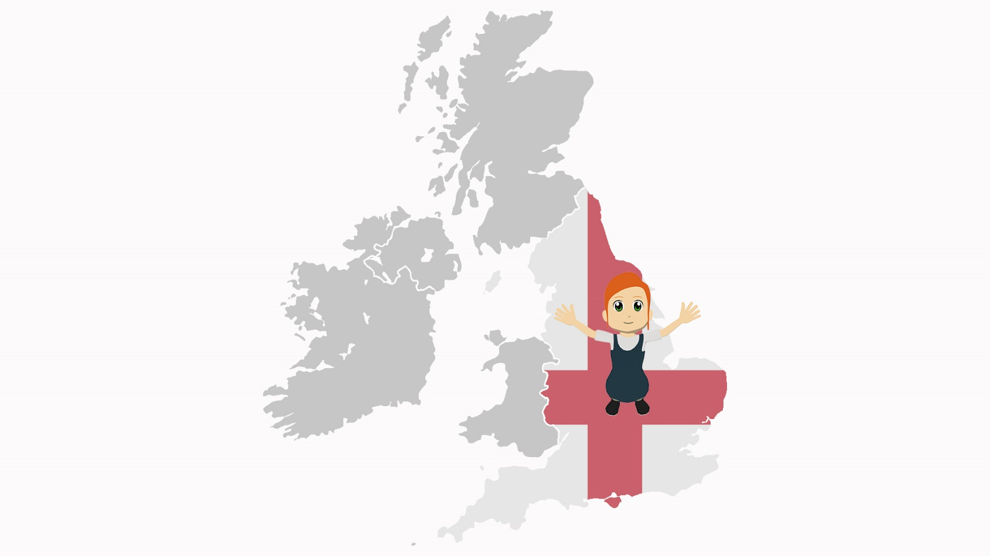
Vocabulario (9/12)
¿Cuál es la palabra en español?
leer
luego
Inglaterra
otra vez
entrada
tu
completamente
recibir
abrir
como
cosa
periódico
billete
Notes:
9/12

Slide 19
Vocabulario (10/12)
¿Cuál es la palabra en español?
leer
luego
Inglaterra
otra vez
entrada
tu
completamente
recibir
abrir
como
cosa
periódico
billete
Notes:
10/12

Slide 20
Vocabulario (11/12)
¿Cuál es la palabra en español?
leer
luego
Inglaterra
otra vez
entrada
tu
completamente
recibir
abrir
como
cosa
periódico
billete
ticket (for transport)
Notes:
11/12

Slide 21
Vocabulario (12/12)
¿Cuál es la palabra en español?
leer
luego
Inglaterra
otra vez
entrada
tu
completamente
recibir
abrir
como
cosa
periódico
billete
(for comparisons, e.g. England is not like Spain)
Notes:
12/12

Slide 22
Ahora vamos a decir las palabras en español. Usa la palabra para ‘the’ si es un nombre.
hablar
el billete
1
?
?
England
Inglaterra
7
ticket (for transport)
2
abrir
8
?
la entrada
to open, opening
ticket (for an event)
?
3
completamente
9
?
como
completely
like (for comparisons)
?
?
4
recibir
10
la cosa
to receive, receiving
thing
?
?
5
tu
11
again
?
your
otra vez
luego
6
?
?
then
12
newspaper
el periódico
Notes:
Timing: 3 minutes
Aim: to recall previously taught vocabulary
Procedure:
The teacher says the item number in Spanish. This can be done in any order, so can be useful for additional practice with numbers.
Students say the target Spanish word in chorus, with definite article if referring to a noun.
The teacher clicks on the pink text box to reveal the answer.
Further rounds could be done as a class or in pairs, with one partner saying a number and the other then saying the word. This could be done under time pressure to help automatisation (e.g. number of words that can be achieved in one minute by partner/team A vs partner/team B).

Slide 23
Fonética
escuchar / escribir
Escucha las frases. Escribe las palabras con [qui] en la primera columna y las palabras con [que] en la segunda columna.
Luego escribe el significado de las palabras en inglés.
 | [qui]
[que]
español
inglés
español
inglés
1
esquina
corner
quedó
[he] met up
2
quitó
[s/he] took off, removed
3
quince
fifteen
así que
paquete
so
packet
quieren
they want
4
quizás
maybe
tranquilo
calm
5
quinta
fifth
¿por qué?
why?
6
ataque
attack
equipo
izquierda
team
left
Notes:
Timing: 10 minutes (two slides)
Aim: To revisit SSC [qui] and contrast it with [que]. To also revisit previously taught vocabulary.
Procedure: 1. Students listen to each sentence.
2. Students write down the words with [qui] in the first column and the words with [que] in the second column.
3. Students write the meaning of known words in English. The meaning of unknown words is already given in the table. The meanings of these unknown words may be learnt incidentally.
Note: Unknown words are included to ensure that SSC knowledge is needed to accurately spell some of the words. Other target words have been used in earlier phonics and/or vocabulary activities, so the task is also a chance to consolidate understanding of the meaning of these words.
Adaptive teaching: To reduce the challenge students could be asked only to write the words with [qui]. Teachers would remove the table with [que].
Transcript:
¿El inglés quedó con Lucía en la esquina?
¿Quién quitó la comida de la mesa?
El costo de un paquete es quince euros, así que compré dos.
Quizás quieren pasar un fin de semana tranquilo.
¿Por qué no subiste la quinta montaña a pie?
El equipo empieza el ataque por la izquierda.
Frequency of unknown/glossed words:
quinto [1586]; esquina [1536]; ataque [1116]; paquete [2325]

Slide 24
Vocabulario
escuchar
Escucha y completa las frases.
Did the English person (m) meet up with Lucía
1
______________________________________________on the corner?
Who
the food
the table
2
_______ took __________off___________?
The cost of a
is
so I bought two
3
_______________packet_____fifteen euros, __________________.
4
Maybe they want to have a calm/quiet weekend.
______________________________________________________.
Why didn’t you go up
mountain on foot
5
______________________the fifth____________________?
The team starts
on/up the left
6
________________the attack_______________.
Notes:
Aim: to focus on other vocabulary items from the sentences used in the previous task.
Procedure:
1. Students listen to the sentences and complete them. The meanings of previously untaught words is given.
Transcript:
El inglés quedó con Lucía en la esquina?
¿Quién quitó la comida de la mesa?
El costo de un paquete es quince euros, así que compré dos.
Quizás quieren pasar un fin de semana tranquilo.
¿Por qué no subiste la quinta montaña a pie?
El equipo empieza el ataque por la izquierda.

Slide 25
Talking about completed actions in the past: -er/-ir verbs in the preterite
gramática
To mean ‘I’ for a completed action in the past, remove –er or –ir and add _____.
–í
decidí
elegí
I decided (to) = ________
I chose (to) = ________
To mean ‘you’ for a completed action in the past, remove –er or –ir and add _____.
Which of these endings have
final syllable stress?
a) abrí b) comiste c) corrió
–iste
recogiste
saliste
you picked up = ___________
you went out = _______
To mean ‘s/he’ or ‘it’ for a completed action in the past, remove –er or –ir and add _____.
–ió
perdió
subió
s/he or it lost = ________
s/he or it went up = _______
Notes:
Timing: 2 minutes
Aim: to recap 1st, 2nd, and 3rd person singular form of past tense for –er/–ir verbs.
Procedure:
Go through the grammar explanation with students, revealing each new sentence on a mouse click.

Slide 26
Lucía habla con Nadia. ¿Qué palabras pueden ir en las partes en blanco? Luego escucha y completa el texto.
leer / escuchar / escribir
There is often an ‘a’ between ‘ayudar’ and the direct object. English doesn’t have this.
Don’t forget the written accents!
Es importante hacer cosas para ayudar al planeta. La semana pasada yo 1) ________ un blog con información para una vida verde y mi madre 2) ___________ un artículo sobre la naturaleza.
Ella 3) ___________ ideas para preparar platos sin productos animales, mientras que yo 4) ________ preparar la comida. Además, 5)_________ la comida entre mis amigos!
También, mi hermano 6) ___________ limpiar la basura en la playa y tú 7) ___________ tu ayuda como voluntaria para terminar antes. Él 8) __________las bolsas, en cambio
tú 9) ___________ las botellas.
leí
escribió
compartió
elegí
repartí
decidió
ofreciste
recogió
recogiste
Notes:
Timing: 10 minutes
Aim: to consolidate understanding of the 1st, 2nd, and 3rd person singular form of –er/–ir verbs in the preterite; to consolidate understanding of vocabulary
Procedure:
Students first read the text and try to work out what words might go in the gaps, based on language in the rest of each sentence. They may be able to think of more than one possibility for a particular gap. Items 4 and 5 have infinitives after the gap, which give them a clue about which verb might be needed (decidir, elegir).
Students then listen to the audio (see audio icon in top right for audio player) and write down the words they hear. They can then verify their predictions. A key focus here is also to accurately write the verb ending, which may or may not need a written accent.
The teacher checks answers with students and elicits oral translations of the sentences with these target words.
Notes:
This text is written using close to 100% previously taught language.
A callout highlights the presence of personal ‘a’ after ‘ayudar’. This feature will be taught in the next teaching week of the scheme of work (8.2.1.5).
Frequency of unknown/glossed words:
blog [929]; artículo [458]

Slide 27
Escucha y lee. Lucía y Nadia comparan las actividades para ayudar al planeta. ¿Puedes reemplazar* las palabras en el texto?
leer / escuchar
Es importante hacer cosas para ayudar al planeta. La semana pasada yo leí un blog con información para una vida verde y mi madre escribió un artículo sobre la naturaleza.
Ella compartió ideas para preparar platos sin productos animales, mientras que yo elegí preparar la comida. Además, ¡repartí la comida entre mis amigos!
También, mi hermano decidió limpiar la basura en la playa y tú ofreciste tu ayuda como voluntaria para terminar antes. Él recogió las bolsas, en cambio tú recogiste las botellas.
1
5
2
6
3
7
4
*reemplazar = to replace
Notes:
Timing: 8 minutes
Aim: to help students to connect the spoken and written forms of the language more securely; to consolidate vocabulary and grammar knowledge by eliciting suggested changes to the text.
Procedure:
Click on the audio button to play the text. Read and listen.
Note: There is a full version of the audio top right with a player. Alternatively the audio is in 7 sections with a pause just after the words 1-6 below, to facilitate easy stop/start.
To support segmentation, stop the audio and ask students to say: a) the next word b) the previous word
In addition, to develop understanding, vocabulary and grammar knowledge, pause at the key points and ask students to suggest an alternative word that could replace the next word. This is a chance to draw on previously taught grammar and vocabulary knowledge.
y mi madre….. (students volunteer third person singular preterite).
compartió ideas para… (infinitive, following ‘para’).
sin productos animales, mientras que yo…. (first person singular preterite).
También, mi hermano… (third person singular preterite)
para…… (infinitive, following ‘para’).
En cambio, tú…. (students volunteer second person singular preterite).
Transcript:
Es importante hacer cosas para ayudar al planeta. La semana pasada yo leí un blog con información para una vida verde y mi madre escribió un artículo sobre la naturaleza. Ella compartió ideas para preparar platos sin productos animales, mientras que yo elegí preparar la comida. Además, ¡repartí la comida entre mis amigos! También, mi hermano decidió limpiar la basura en la playa y tú ofreciste tu ayuda como voluntaria para terminar antes. Él recogió las bolsas, en cambio tú recogiste las botellas.

Slide 28
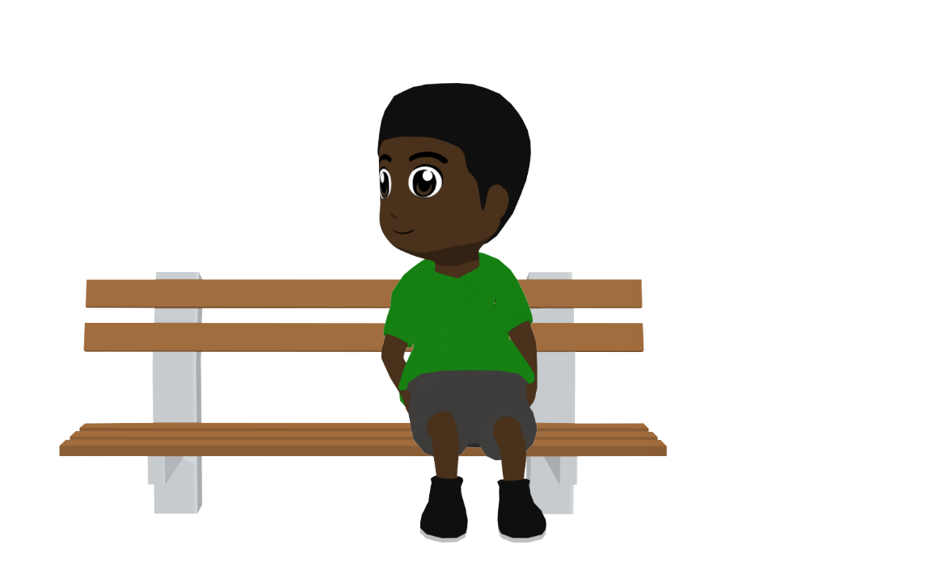
Unos días después del día para ayudar al planeta, todos los amigos comparan las actividades. ¿Puedes decir las frases en español?
hablar
¡(Él) decidió ir a pie!
He decided to go on foot!
¡(Yo) escribí sobre mi equipo de voluntarios!
I wrote about my team of volunteers!
Hugo
¡(Tú) recogiste la basura!
You picked up the rubbish!
Lucía
Daniel
¡(Yo) elegí limpiar la playa!
I chose to clean the beach!
Nadia
Notes:
Timing: 4 minutes
Aim: to practise productive oral recall of –er/–ir verbs in the preterite and vocabulary that was recapped in lesson 1 and lesson 2
Procedure:
Students talk to their partners for two minutes about how they would say the sentences in Spanish.
To keep the focus on oral production; students should be encouraged not to write down the translations.
To reveal an answer, click on the relevant textbox. Answers can be volunteered in any order. Alternatively, the answers are also provided on the next slide (see below).
Notes:
Because the sentences here are in isolation, the translations in Spanish leave the use of subject pronouns as optional. However, they would often be used in the context of making comparisons between what different people do, and will appear in the next activity, so it is worth pointing out why they could be included.
The answers are also provided on a separate answer slide (see next slide). This may be useful if the teacher wishes to display both the Spanish and English while giving feedback.

Slide 29
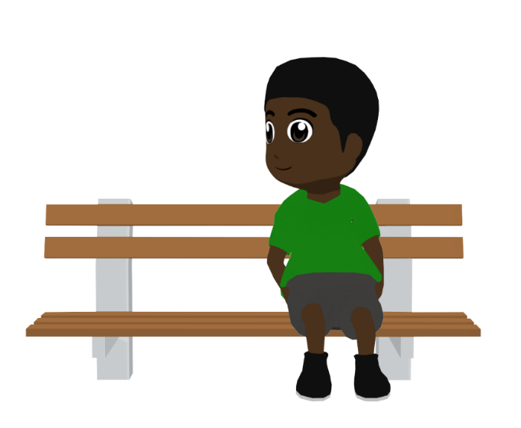
Solución
hablar
He decided to go on foot!
I wrote about my team of volunteers!
¡(Él) decidió ir a pie!
¡(Yo) escribí sobre mi equipo de voluntarios!
Hugo
Daniel
I chose to clean the beach!
You picked up the rubbish!
¡(Yo) elegí limpiar la playa!
¡(Tú) recogiste la basura!
Nadia
Lucía
Notes:
Alternative answer slide
The Spanish and English are both displayed on this slide. This may be useful if the teacher wishes to display both the prompts and answers while giving feedback (e.g. to compare specific aspects of the two languages).

Slide 30
¡Ahora tú escribes!
escribir / hablar / escuchar
Escribe el texto otra vez, pero debes cambiar cosas.
Puedes usar una persona diferente (yo, tú, él, mi padre...).
También puedes cambiar los verbos y usar otros verbos en –er o –ir:
aprender
subir
perder
entender
recibir
permitir
decidir
cubrir
repartir
dividir
leer
comer
correr
vender
abrir
beber
abrir
Usa ‘leyó’ para ‘él’ o ‘ella’
Notes:
Timing: 10 minutes
Aim: to allow students to write more freely and creatively using 1st, 2nd and 3rd person singular forms of –er and –ir verbs; to further consolidate use of subject pronouns
Procedure:
After going through the instructions on this slide, the full text can be displayed (see next slide).
Students write a new version of the text. They should replace or modify the information in the 9 underlined parts of the text. This will include some or all of the following: 1) subject pronoun/person; 2) verb, including its ending; 3) vocabulary. Students can consider the surrounding discourse, e.g., the language that comes after the underlined sections, when they think about how they will change the sentence.
The teacher circulates around the classroom to give feedback, monitoring and responding to any questions.
Notes:
Depending on the ability of the group / how they have coped with producing verbs in the last activity, teachers may wish to ask students to conjugate these verbs before beginning the next activity (i.e. as a warm-up).
If working with a higher-attaining group, the teacher could ask students to adapt more parts of the text than those that are already underlined on the next slide. Students could also also be asked to add time markers in the text (e.g. el lunes, el fin de semana, en verano etc.) An even freer variation of the activity would be for students to imagine that they just took part in an environment day themselves and to write a dialogue between two people saying what ‘I’, ‘you’ and ‘s/he’ did to help the planet (using the –er and –ir verbs on this slide and the –ar verbs from lesson 1, if desired).

Slide 31
Escribe otra versión del texto. Puedes cambiar las partes subrayadas.
escribir / hablar / escuchar
Es importante hacer cosas para ayudar al planeta. La semana pasada yo leí un blog con información para una vida verde y mi madre escribió un artículo sobre la naturaleza.
Ella compartió ideas para preparar platos sin productos animales, mientras que yo elegí preparar la comida. Además, ¡repartí la comida entre mis amigos!
También, mi hermano decidió limpiar la basura en la playa y tú ofreciste tu ayuda como voluntaria para terminar antes. Él recogió las bolsas, en cambio tú recogiste las botellas.
Notes:
DISPLAY DURING ACTIVITY
Underlined parts are those that students can change.
Note: ‘subrayado’ is not a previously taught vocabulary item but has featured multiple times in task instructions, so a gloss is not given. Its meaning should be clarified as necessary.

Slide 32
Deberes
Vocabulary Learning Homework (Y8 Term 2.1 Week 4)
There is no new vocabulary this week. There are three Y8 vocabulary mashups.
Notes:
The three mashups of Y8 vocabulary are here: https://quizlet.com/gb/540857651/year-8-spanish-term-21-week-4-vocabulary-mashup-a-flash-cards/?new
https://quizlet.com/gb/540864234/year-8-spanish-term-21-week-4-vocabulary-mashup-b-flash-cards/
https://quizlet.com/gb/540867516/year-8-spanish-term-21-week-4-vocabulary-mashup-c-flash-cards/
Notes:
i) Teachers may, in addition, want to recommend use of a particular online app for the pre-learning of each week’s words. ii) Quizlet now requires parental involvement / registration / permissions for users below the age of 13, so it is perhaps most suitable for Y9 – 11 students. iii) Language Nut hosts LDP vocabulary lists and these are free for schools to use, though there is a registration process. One benefit is that all of the student tracking data that Language Nut offers are also available to schools that use the LDP lists for practice. Perhaps this makes it a good option for Y7/8.
iv) There are other free apps, and new ones are always appearing. Teachers have told us that they are currently using: Flippity, Wordwall (where using previously-created activities is free).
v) Gaming Grammar has been acquired by Language Nut. Its original content should still be available to teachers and much of it is appropriate for Y8 learners. This week: Verbs: 1st and 3rd person past tense in the ‘Verb agreement (past)’ menu

