Slide 1
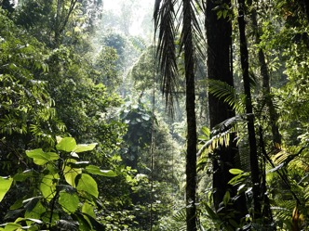
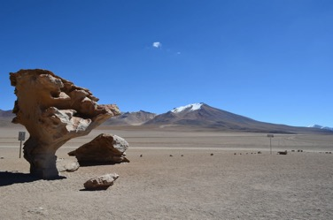
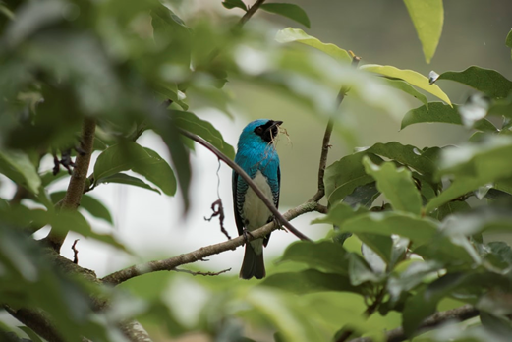
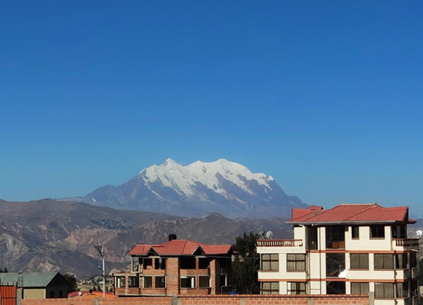
Bolivia: un país diverso
Extended reading
Y8 Spanish
Term 1.2 - Week 6 – Lesson 25
Amanda Izquierdo / Nick Avery / Jack Peacock Date updated: 01.02.23
Notes:
Note: all words (new and revisited) in this week of the SOW appear on all three GCSE wordlists.
With thanks to Rachel Hawkes and Emma Marsden for reviewing the text and lesson material.
Learning outcomes (lesson 1):
Introduction of new vocabulary items and consolidation of those previously taught
Consolidation of present tense –er/–ir verbs in 3rd person singular and plural (-e, -en);
Consolidation of SSCs [l], [ll]
Word frequency (1 is the most frequent word in Spanish):
New vocabulary (introduce, lesson 1): el paisaje [1685]; desaparecer [655]; seco [1183]; la lluvia [986]; el clima [1675]; la frontera [1507]; mil [191]; la altura [970]; suficiente [781]
Revisited vocabulary:
Y8 1.2.3: cine [952]; abierto [654]; cerrado [1201]; miedo (de algo) [491]; razón [360]; suerte [723]; éxito [708]; sueño [450]; calor [945]; en cambio² [cambio-329]
numbers 13-20: trece [2700]; catorce [2411]; quince [1215]; dieciséis [3373]; diecisiete [3430]; dieciocho [2730]; diecinueve [4232]; veinte [819]
Y8 1.1.5: cambio [319]; ruido [1034]; esfuerzo [601]; viaje [519]; gesto [928]; amable [2707]; genial [2890]; mientras que [mientras-127]; entonces [74]; subject pronouns yo [28]; tú [184] él [9]; ella [72]; nosotros/as [164]; ellos/as [9-él]
Source: Davies, M. & Davies, K. (2018). A frequency dictionary of Spanish: Core vocabulary for learners (2nd ed.). Routledge: London
Note: The following sources were consulted in writing the text.
https://www.theguardian.com/environment/2016/nov/28/shrinking-glaciers-state-of-emergency-drought-bolivia
http://documents1.worldbank.org/curated/en/997641468187732081/pdf/97834-REVISED-BRI-PUBLIC-ADD-AUTHORS-Box393179B.pdf
https://worldpopulationreview.com/languages/bolivia

Slide 2
Vocabulario
hablar
trip, journey
he
we (f)
so
funny
gesture
we (m)
effort
she
you
they (f)
noise
change
I
great
whereas
they (m)
e_ _ _ _ _ _ _
e_ _ _ _
entonces
ellos
tú
t_
g_ _ _ _ _
genial
gracioso
g _ _ _ _ _ _ _
el e_ _ _ _ _ _ _
ellas
mientras que
el esfuerzo
e_ _ _ _
m_ _ _ _ _ _ _ q _ _
e_ _ _
é_
el r_ _ _ _
ella
él
el ruido
el g_ _ _ _
el gesto
el c_ _ _ _ _
el cambio
n_ _ _ _ _ _ _
nosotros
yo
el v_ _ _ _
n_ _ _ _ _ _ _
y_
el viaje
nosotras
Notes:
Timing: 5 minutes
Aim: to revise items of vocabulary from one of this week’s revisited vocabulary sets. Only the first letter is provided so that students have to recall the word.
Procedure:
1. The teacher clicks for the English prompt to appear.
2. Students say the word in Spanish in choral response to match the English.
3. Clicking again reveals the answer.
Vocabulary from revisited sets: 8.1.1.5: cambio [319]; ruido [1034]; esfuerzo [601]; viaje [519]; gesto [928]; gracioso [3874]; genial [2890]; mientras que [mientras-127]; entonces [74]; yo [28]; tú [184] él [9]; ella [72]; nosotros/as [164]; ellos/as [9-él]

Slide 3
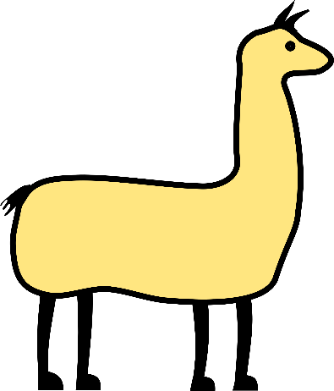
__a _ ama amari__a __ega tarde por la __uvia y no tiene __ ave. Llama a __as otras __amas, pero no están. ¿Por qué __as otras llamas no llevan __a __ave a __a llama amari__a?
escuchar
La llama amarilla
L
ll
ll
ll
ll
ll
ll
l
l
l
ll
l
ll
1
2
3
Notes:
A tonguetwister
Timing: 5 mins
Aim: to practise aural recognition of SSC [ll] (contrasted with [l])
Procedure:
Click one of the action buttons to play the audio.
Students complete the text with either ‘l’ or ‘ll’. For additional challenge, students could be asked to transcribe the whole word, rather than only the missing letters.
Click to reveal each answer.
Then read the text aloud in fragments, eliciting the meanings from students. Note that all words have been previously taught as vocabulary items or used for phonics practice. ‘Llama’ (animal) is a cognate.

Slide 4
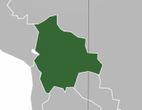
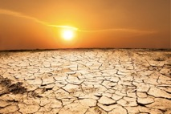
Vocabulario
leer / hablar
el clima
el paisaje
[weather, climate]
[landscape]
‘Suficiente’ is an adjective, so it needs to agree in number with the noun:
suficiente agua = enough water
suficientes árboles = enough trees
‘Suficiente’ often goes before the noun, but you might sometimes see it after.
la frontera
desaparecer
[border]
mil
[to disappear]
seco, seca
la altura
[dry]
[height, altitude]
la lluvia
suficiente
[rain]
Notes:
Timing: 5 minutes
Aim: to introduce and embed the new vocabulary
Procedure: 1. Pupils either work by themselves or in pairs, reading out the words and recapping their English meaning (1 minute). 2. Then the teacher removes the English words or pictures (one by one) and they try to recall the English orally (chorally), looking at the Spanish (1 minute). 3. Then the Spanish meanings are removed (one by one) and they to recall them orally (again, chorally), looking at the English (1 minute) 4. Further rounds of learning can be facilitated by one pupil turning away from the board, and his/her partner asking him/her the meanings (‘Cómo se dice X en español?’). This activity can work from L2 → L1 or L1 → L2. (2 minutes)
Note: ‘suficiente’ may be used before or after the noun in Spanish with broadly synonymous meaning. It is frequently used before the noun in the same way as other quantifiers (demasiado, mucho, poco) that refer to an indeterminate quantity. When used after the noun, the word may suggest a more precise meaning (‘enough’, in relation to a specific point of reference, e.g, a previously mentioned figure). However, there is no hard and fast rule. Some native speakers may also choose to use ‘suficiente’ postnominally for stylistic or discursive reasons. Given the dependency of its use on context, and the subtlety of meaning, we don’t go into detail on this in the lesson material, but do highlight that students may encounter the word in both positions.
Word frequency (1 is the most frequent word in Spanish):
New vocabulary (introduce): el paisaje [1685]; desaparecer [655]; seco [1183]; la lluvia [986]; el clima [1675]; la frontera [1507]; mil [191]; la altura [970]; suficiente [781]

Slide 5
Hoy vamos a leer un texto sobre un país de Sudamérica.
leer
Lee las frases. ¿Qué país es?
1. El español es un idioma oficial.
Venezuela
2. Es un país en el centro de Sudamérica.
Colombia
Ecuador
3. No tiene costa.
Brasil
Perú
Bolivia
4. Tiene una frontera con Perú, Chile, Argentina, Paraguay y Brasil.
Paraguay
Chile
Uruguay
B_ _ _ _ _ _
Argentina
Bolivia
Notes:
Timing: 3 minutes
Aim: to create a sense of anticipation and to reactivate prior knowledge of concepts relevant to the text.
Procedure 1. Reveal each sentence to give information about the country.
2. Students can volunteer answers.

Slide 6
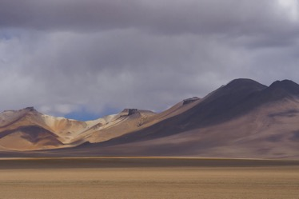
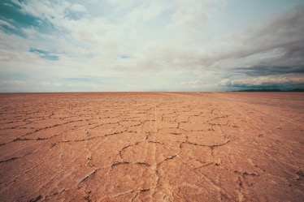
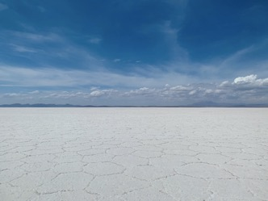
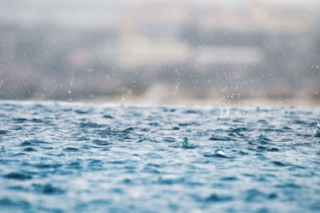
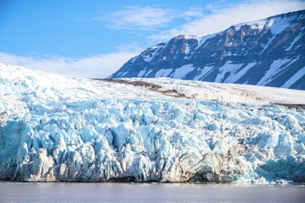
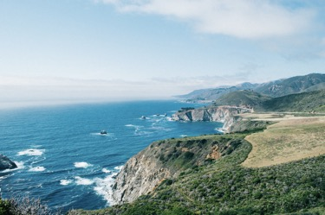
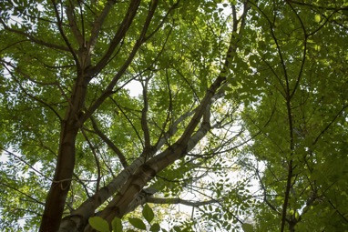
¿Cómo es Bolivia?
hablar
Mira las fotos, ¡hacemos predicciones!
Bolivia (no) tiene / es...
En Bolivia (no) hay...
Ejemplo: En Bolivia no hay lluvia.
montañas
seca
paisajes diferentes
selva
lluvia
glaciares
costa
árboles
Notes:
Timing: 6 minutes
Aim: To predict some of the content in the first text of the lesson. To recycle irregular verbs from Y7 (es, está, tiene, hay) and to support understanding of relevant vocabulary.
Procedure 1. Look at the pictures and try to make some predictions about what Bolivia is like before reading the text.
2. Formulate predictions using the structures ‘Bolivia (no) tiene / es’, ‘En Bolivia (no) hay...’.
Pictures from Unsplash:
Photo of mountains in Bolivia by @sthomanns
Photo of dry Bolivia by @tobey_j
Photo of glacier in Bolivia @vincegx
Photo of the Salar de Uyuni by @agnieszkam
Photo of Stone tree by @gabrielrojas
Photo of rain by @fivepointseven
Photo of coast @gregjjurgajtis
Photo of trees @calvoregis

Slide 7
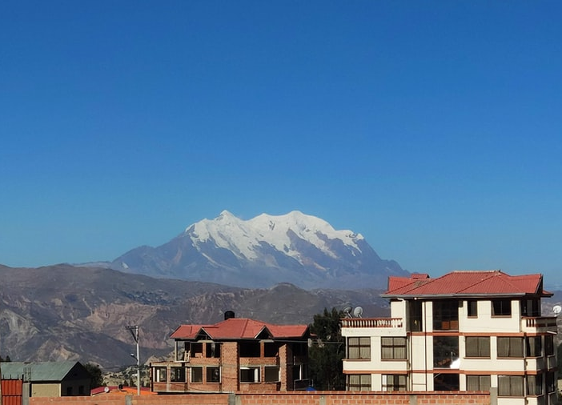
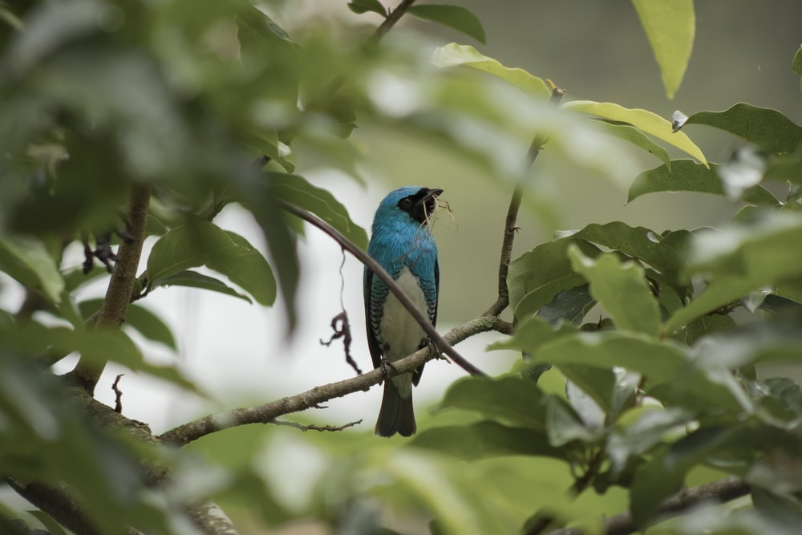
Geografía
leer
Lee el texto. ¿Tus predicciones son correctas?
Bolivia es un país en el centro de Sudamérica. Tiene una frontera con Perú, Chile, Argentina, Paraguay y Brasil. No tiene costa.
Una parte de Bolivia está en los Andes. Las montañas son muy altas allí. ¡Muchas tienen una altura de cinco o seis mil metros! La región alta de Bolivia es bastante seca. A veces no tiene mucha agua porque desaparecen los glaciares.
Otra parte de Bolivia está en el Amazonas. Los paisajes y el clima son completamente diferentes allí. En la selva, hay ríos, árboles y normalmente mucha lluvia. La selva cubre todo el este de Bolivia.
Notes:
Timing: 6 minutes (slide 7-8)
Aim: to verify predictions and to learn about the geography of Bolivia.
Procedure 1. Students read the text.
2. Students check if their predictions about what Bolivia is like are true or false.
The teacher should actively engage students here, asking, e.g.,
¿Cómo es la region alta (=bastante seca)
¿Hay glaciares? (=Sí, pero desaparecen)
¿Tiene paisajes diferentes? (=Sí, en el Amazonas hay… y en los Andes hay…).
3. The teacher can then use the next slide to ask true or false questions to check understanding. Students will need a printed copy of the text as the true/false questions appear on a different slide.
Pictures from Unsplash:
Photo by Jose David on Unsplash
Photo by Harold Martinez on Unsplash

Slide 8
¿Verdadero o falso?
leer
Bolivia borders four countries.
Bolivia has a coastline.
In Bolivia there are very high mountains.
It rains a lot in the mountains.
Part of Bolivia is in the Amazon.
The jungle covers the south of Bolivia.
“No tiene costa”
“La región alta … no tiene mucha agua”
“La selva cubre todo el este de Bolivia”
Notes:
See previous slide notes for instructions

Slide 9
Persona A: lee las frases a un compañero. Persona B: toma apuntes* en inglés.
leer / escuchar
Ejemplo:
1. Bolivia es un país grande.
Bolivia is a large country
*toma apuntes = take notes
Notes:
Timing: 8 minutes
Aim: to improve read-aloud confidence and aural comprehension.
Procedure: 1. Use this slide to model the activity.
2. Student A begins by reading 5 sentences aloud to Student B. These can be read from the board. Student B turns away from the board and takes notes in English about what s/he hears.
3. After reading all five sentences, swap roles. Student B looks at the board (slide 11) and Student A takes notes.
4. Answers appear on clicks on slides 10 and 11.

Slide 10
Persona A: lee las frases a un compañero. Persona B: toma apuntes* en inglés.
leer / escuchar
Bolivia no tiene costa.
Tiene montañas.
No tiene muchos glaciares.
Tiene paisajes interesantes.
Tiene selva.
Bolivia doesn’t have any coastline.
Bolivia has mountains.
It doesn’t have glaciars.
It has interesting landscapes.
It has jungle.
*toma apuntes = take notes
Notes:
Read aloud/listening activity
See slide 9 notes

Slide 11
Persona A: lee las frases a un compañero. Persona B: toma apuntes* en inglés.
leer / escuchar
Bolivia es bonito.
La región alta es seca.
El clima en la selva es diferente.
El Amazonas está en el este.
La capital, La Paz, está en el oeste.
Bolivia is beautiful.
The high region is dry.
The climate in the jungle is different.
The Amazon is in the east.
The capital, La Paz, is in the west.
*toma apuntes = take notes
Notes:
Read aloud/listening activity
See slide 9 notes

Slide 12
Escribe 6 frases en español.
escribir
Bolivia is a beautiful country.
It has a border with Paraguay*.
The jungle is in the east.
The weather/climate is dry in the mountains.
There are lots of landscapes.
La Paz* is a city in the west.
Bolivia es un país bonito.
Tiene una frontera con Paraguay.
La selva está en el este.
El clima es seco en las montañas.
Hay muchos paisajes.
La Paz es una ciudad en el oeste.
*The place names ‘Paraguay’, ‘La Paz’ are the same in Spanish and English!
Notes:
Timing: 10 minutes
Aim: to improve written production of grammar and vocabulary relevant to this week’s lessons
Procedure: 1. Explain to students that they will be translating the English sentences into Spanish.
2. Allow students to use knowledge organisers / language guides for support, if needed.
3. Click to reveal each answer.

Slide 13
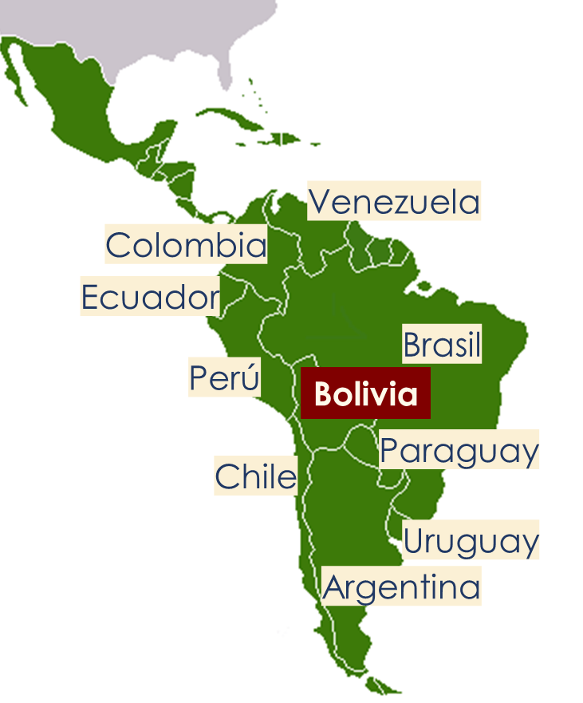
Work on a challenging text
Bolivia: un país diverso
Y8 Spanish
Term 1.2 - Week 6 – Lesson 26
Amanda Izquierdo / Nick Avery / Jack Peacock Date updated: 11/10/20
Notes:
Note: all words (new and revisited) in this week of the SOW appear on all three GCSE wordlists.
Learning outcomes (lesson 2):
Introduction of new vocabulary items and consolidation of those previously taught
Consolidation of 3rd person singular/plural forms of different verbs
Consolidation of SSC [ll]
New vocabulary (introduce, lesson 2): crecer [560]; mejor [116]; ganar² (to win, to earn) [295]; dice [decir-31]; más [23]; la vida [85]
Vocabulary from revisited sets:
Y8 1.2.3: cine [952]; abierto [654]; cerrado [1201]; miedo (de algo) [491]; razón [360]; suerte [723]; éxito [708]; sueño [450]; calor [945]; en cambio² [cambio-329]
numbers 13-20: trece [2700]; catorce [2411]; quince [1215]; dieciséis [3373]; diecisiete [3430]; dieciocho [2730]; diecinueve [4232]; veinte [819]
Y8 1.1.5: cambio [319]; ruido [1034]; esfuerzo [601]; viaje [519]; gesto [928]; amable [2707]; genial [2890]; mientras que [mientras-127]; entonces [74]; subject pronouns yo [28]; tú [184] él [9]; ella [72]; nosotros/as [164]; ellos/as [9-él]

Slide 14
La llama amarilla llega tarde por la lluvia y no tiene llave. Llama a las otras llamas, pero no están. ¿Por qué las otras llamas no llevan la llave a la llama amarilla?
hablar
La llama amarilla
1
2
3
Notes:
A tonguetwister
Timing: 5 mins
Aim: to gain confidence in practising the SSC [ll] in sentences
Procedure:
Students first saw this text in the previous lesson. It was used for a listening activity, focussing on SSC [ll].
The same text is used again, but this time students practise saying the sentence in pairs, at increasing speed.
Students can listen to a native speaker read the text at three different speeds (1=slow; 3=very fast). Each time, students can be challenged to say it at the same speed.

Slide 15
leer
leer
Remember, the translation of some Spanish nouns can depend on whether they appear with ‘tener’ or not.
Escribe en inglés las partes subrayadas*.
[1/3]
1
Por qué está aquí? Pues, hay muchas razones.
reasons.
Why is he/she here? Well, there are many __________.
Tienes razón, no es una buena idea.
You’re right
____________, it’s not a good idea.
2
Siempre hay miedo en la ciudad.
fear
There is always ________ in the city.
¿Ella tiene miedo? Yo no.
Is she scared
_______________? I’m not.
*underlined
Notes:
Vocabulary revisiting activity
Timing: 8 mins (slides 17-19)
Aim: to identify the two meanings of each Spanish noun, depending on whether or not it is accompanied by ‘tener’.
Procedure:
1. It may be useful to review words used with ‘tener’ before starting, and how the meaning changes depending on context (e.g. ‘razón’ = reason but ‘tener razón’ = to be right).
Students translate the underlined parts of the Spanish sentences, taking note of the context. They do not need to write the full sentence.
2. Reveal answers at the end of the exercise with each click.
Note: The activity could easily be adapted for higher ability groups by requiring the full sentence to be written, rather than just the gaps. It could also be adapted by making it into a multiple choice activity.
Words from revisited vocabulary sets:
8.1.2.3 miedo (de algo) [491]; razón [360];

Slide 16
leer
Escribe en inglés las partes subrayadas.
[2/3]
3
La suerte va a decidir el partido.
_______ is going to decide the match.
Luck
Tienes suerte, puedes ir al cine sin tus padres.
You’re lucky
_____________, you can go to the cinema without your parents.
4
La película es un éxito.
success
The film is a ___________.
Cada estudiante quiere tener éxito en la escuela.
to succeed
Every student wants ____________ at school.
Notes:
2/3
Words from revisited vocabulary sets:
8.1.2.3: suerte [723]; éxito [708]; cine [952]

Slide 17
Vocabulario
leer
Escribe en inglés las partes subrayadas.
[3/3]
5
El sueño es un problema en clase.
Sleepiness
___________ is a problem in class.
¡El teatro está finalmente abierto, pero ahora tienes sueño!
you are sleepy
The theatre is finally open, but now _______________!
6
El calor hoy es intenso. ¿Dónde están las bebidas?
heat
The ________ today is intense. Where are the drinks?
Las tiendas están cerradas. Sin embargo, tenemos calor, así que vamos a ir a la playa.
we are hot
The shops are closed. However,____________, so we are going to go to the beach.
Notes:
3/3
Words from revisited vocabulary sets:
8.1.2.3: sueño [450]; calor [945]; en cambio² [cambio-329]; abierto [654]; cerrado [1201]

Slide 18
Vocabulario
el clima
el paisaje
[weather, climate]
[landscape]
la frontera
desaparecer
[border]
mil
[to disappear]
seco, seca
[dry]
la altura
[height, altitude]
la lluvia
suficiente
[rain]
Notes:
Timing: 3 minutes
Aim: to review the words introduced in lesson 1
Procedure:
Display words on the screen
Ask students to look at them individually or in pairs, and to try to recall the words.
Click to reveal each answer.

Slide 19
Vocabulario
hablar
It says
He says
She says
dice
crecer
[to grow, growing]
mejor
más
ganar
la vida
[to win, to earn]
Notes:
New vocabulary
Timing: 2 minutes
Vocabulary practice slide
Procedure 1. Pupils either work by themselves or in pairs, reading out the words and recapping their English meaning (1 minute). 2. Then the teacher removes the English words or pictures (one by one) and they try to recall the English orally (chorally), looking at the Spanish (1 minute). 3. Then the Spanish meanings are removed (one by one) and they to recall them orally (again, chorally), looking at the English (1 minute) 4. Further rounds of learning can be facilitated by one pupil turning away from the board, and his/her partner asking him/her the meanings (‘Cómo se dice X en español?’). This activity can work from L2 → L1 or L1 → L2.
Word frequency (1 is the most frequent word in Spanish):
New vocabulary (introduce): crecer [560]; mejor [116]; ganar² (to win, to earn) [295]; dice [decir-31]; más [23]; la vida [85]
Source: Davies, M. & Davies, K. (2018). A frequency dictionary of Spanish: Core vocabulary for learners (2nd ed.). Routledge: London

Slide 20
¡Hacemos predicciones! ¿Verdadero o falso?
Paragraph 1
Spanish is an official language of Bolivia.
Other languages are also spoken.
People’s languages aren’t related to their culture.
Paragraph 2
Students learn both Spanish and an indigenous language at school.
There are enough teachers to teach indigenous languages.
Notes:
Timing: 2 minutes
Aim: to predict the content of the text used in this lesson
Procedure:
Display predictions on the screen
Ask students to discuss whether they think they are true or false
Take answers from students

Slide 21
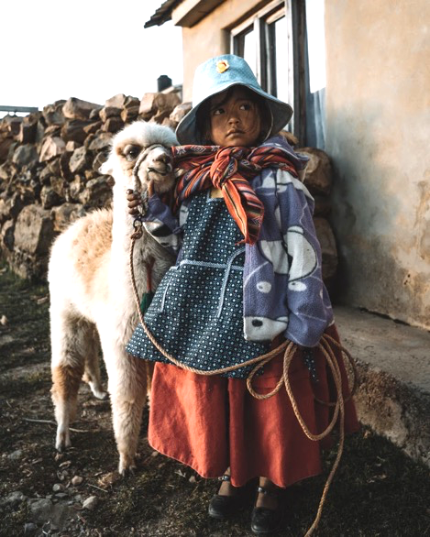
Idiomas y educación
leer
Lee el texto. ¿Cuántos verbos terminan en –e o –en?
El español es un idioma oficial de Bolivia, aunque otros idiomas existen. Mucha gente de origen indígena habla aymara y quechua, dos idiomas muy antiguos. El idioma puede ser una parte importante de su identidad y cultura.
En muchas escuelas, la educación cambia: ahora, los estudiantes deben aprender español y también un idioma indígena*. Sin embargo, a veces no hay suficientes profesores para enseñar los idiomas indígenas.
*indigenous
Notes:
Timing: 7 minutes
Aim: to learn about language education in Bolivia
Procedure 1. Students read the text and try identify as many examples as they can of verbs ending in –e and –en.
2. The teacher then brings up the text box at the bottom and elicits the meanings of the two verb endings. 3. To ensure understanding of the information in the text, use the true/false questions on the next slide. Alternatively, use one of the options below:
i. whole class oral English translation, phrase by phrase ii. Individual summary of the text, with the instruction – Note three key facts from the first paragraph and two from the second paragraph about languages in Bolivia. ii. Ask direct questions to elicit the key information. 1. How many languages are mentioned as being spoken in Bolivia? 2. Which? 3. What does it say about Aymara and Quechua in the first paragraph? 4. What are languages important for? 5. Why is it not straightforward for students to learn Quechua or Aymara at school?
Note: Many Y8 students will not be clear on the meaning of ‘indigenous’ in English, perhaps, so worth checking and giving a definition, if needed:
Indigenous peoples are ethnic groups who are the original or earliest known inhabitants of an area, in contrast to groups that have settled, occupied or colonized the area more recently.
Pictures taken from Unsplash:
Photo of Bolivian child by @alexazabache

Slide 22
¿Verdadero o falso?
Paragraph 1
Spanish is an official language of Bolivia.
Other languages are also spoken.
People’s languages aren’t related to their culture.
Paragraph 2
Students learn both Spanish and an indigenous language at school.
There are enough teachers to teach indigenous languages.
“El idioma puede ser una parte importante de su identidad y cultura.”
“A veces no hay suficientes profesores”
Notes:
True or false comprehension questions
See slide 20 notes

Slide 23
-er verbs
‘s/he’
‘it’
Use the verb ending –e to mean ______ or ____ with present tense –er / –ir verbs.
The language can be…
“El idioma puede ser…”
‘they’
Use the verb ending –en to mean to mean ______.
“Los estudiantes deben aprender…”
“The students must learn…”
Notes:
Timing: 2 minutes
Aim: to recap -er verbs using two examples from the text
Procedure:
Click to reveal each line of text.
Elicit previously taught information from students (verb endings –e and –en).

Slide 24
Elige ‘a’ or ‘b’.
Completa la frase en inglés.
leer
Tiene una frontera con cinco países.
a) It has…
b) They have…
a border with five countries.
Notes:
Slide 1/8
Timing: 4 minutes
Aim:
to practise understanding the difference between –e and –en
to practise comprehension of previously taught vocabulary
Procedure:
Click to reveal each line of text.
Elicit previously taught information from students (verb endings –e and –en).

Slide 25
leer
Tienen una altura de seis mil metros.
a) It has…
b) They have…
a height of six thousand metres.
Notes:
Slide 2/8

Slide 26
leer
Pueden ser importantes en las escuelas.
be important in schools.
It can…
They can…
Notes:
Slide 3/8

Slide 27
leer
Puede tener mucha lluvia.
It can…
They can…
have a lot of rain.
Notes:
Slide 4/8

Slide 28
leer
No tiene una frontera con Bolivia.
It doesn’t have…
They don’t have…
a border with Bolivia.
Notes:
Slide 5/8

Slide 29
leer
El clima puede cambiar mucho, según la región.
It can change/vary…
They can change/vary…
a lot, depending on the region.
Notes:
Slide 6/8

Slide 30
leer
Dice cosas en quechua.
S/he says
They say
things in quechua.
Notes:
Slide 7/8

Slide 31
leer
Quieren una vida mejor.
S/he wants
They want
a better life.
Notes:
Slide 8/8

Slide 32
Escucha. El verbo es singular (-e) o plural (-en)? Después elige el verbo en inglés.
escuchar
Ejemplo:
Opciones:
have/has
cover/covers
 | ‘It’ (singular) or ‘they’ (plural)?
El verbo (en inglés):
1
it
B
Notes:
Listening
Slide 1/2
Timing: 7 min.
Aim: to improve aural comprehension of 3rd person singular vs plural verb forms of –er and –ir verbs
Procedure:
Use this slide to model the activity.
Students listen to the audio and decide if it refers to a singular or a plural subject.
Students listen again and decide which of the words on the right hand side is the correct translation of the sentence.

Slide 33
Escucha. El verbo es singular (-e) o plural (-en)? Después elige el verbo en inglés.
escuchar
 | ‘It’ or ‘they’?
El verbo en inglés
Opciones:
have/has
disappear(s)
cover(s)
don’t/doesn’t have
can
exist(s)
1
it
F
2
they
E
3
it
C
4
they
D
5
it
A
6
they
B
Notes:
Slide 2/2
Main activity
Transcript:
Existe en Bolivia, y el español también.
Pueden aprender dos idiomas.
Cubre una parte grande del país.
No tienen suficientes profesores de idiomas indígenas.
Tiene una frontera con Bolivia.
Desaparecen por los cambios del clima.
Cubren la parte alta de Bolivia.
Debe tener poca lluvia porque todo está muy seco allí.

Slide 34
Hablamos sobre Bolivia en parejas.
leer / escuchar
Persona A: lee la frase.
Persona B: escucha y elige la opción correcta para completar la frase.
Luego, escribe la frase en inglés.
Ejemplo:
Estudiante A
Estudiante B
 | Las montañas pueden…
 | ser muy altas.
The mountains can … be very high.
Notes:
Slide 1/4
Timing: 10 min.
Aim: to correctly match the sentence halves, working in pairs; to then accurately translate the sentences into English.
Procedure:
Students A and B are given their prompt cards.
The first time round, Student A reads the sentence fragment aloud (e.g. Las montañas pueden…). Student B listens and searches for and then says the correct sentence ending (ser muy altas).
The students then work together to translate the sentence into Spanish.
Students repeat for the rest of items 1-5, then swap roles. This time, Student B will repeat the sentence starter and Student A will listen and complete it.

Slide 35
Estudiante A: Read this sentence starter aloud. Your partner will complete the sentence.
Estudiante A: listen to your partner start the sentence, then read aloud the correct ending.
1. El calor…
a. puede cambiar mucho, según la región.
2. Un paisaje seco…
b. deben aprender español y otro idioma.
3. Bolivia…
c. no tiene una frontera con Bolivia.
4. Las montañas…
d. desaparecen en las montañas.
5. El aymara y el quechua…
e. puede tener mucha lluvia.
Estudiante B: Read this sentence starter aloud.
Your partner will complete the sentence.
Estudiante B: listen to your partner start the sentence, then read aloud the correct ending.
6. La selva…
a. tienen una altura de seis mil metros.
7. Colombia…
b. cubre la parte alta de la región.
8. El clima…
c. pueden ser importantes en las escuelas.
9. Los estudiantes…
d. tiene una frontera con cinco países.
10. Los paisajes verdes…
e. desaparece en la parte alta del país.
Notes:
Slide 2/4
DO NOT DISPLAY DURING ACTIVITY
Read aloud cards
Print these for students

Slide 36
Solución
[1/2]
1. El calor desaparece en la parte alta del país.
The heat disappears in the high part of the country.
2. Un paisaje seco cubre la parte alta de la región.
The dry landscape covers the high part of the región.
3. Bolivia tiene una frontera con cinco países.
Bolivia has a border with five countries.
4. Las montañas tienen una altura de seis mil metros.
The mountains have an altitude of six thousand metres.
5. El aymara y el quechua pueden ser importantes en las escuelas.
Aymara and Quechua can be important in schools.
Notes:
Slide 3/4
Feedback slide

Slide 37
Solución
[2/2]
6. La selva puede tener mucha lluvia.
The rainforest can have a lot of rain.
7. Colombia no tiene una frontera con Bolivia.
Colombia doesn’t have a border with Bolivia.
8. El clima puede cambiar mucho, según la región.
The climate can change a lot, according to the region.
9. Los estudiantes deben aprender y otro idioma.
The students must learn Spanish and another language.
10. Los paisajes verdes desaparecen en las montañas.
The green landscapes disappear in the mountains.
Notes:
Slide 4/4
Feedback slide

Slide 38
Deberes
Vocabulary Learning Homework (Y8 Term 1.2, Week 7)
Revisit: Y7 vocabulary mashup #1
In addition, revisit: Y8 Term 1.2 Week 3 Y8 Term 1.1 Week 5
Notes:
There is no new vocabulary for next week, hence no audio HW sheet. However, the link to the Y7 revisited vocabulary set is here: https://quizlet.com/gb/528160906/y8-spanish-term-12-week-7-y7-vocabulary-mashup-1-flash-cards/
Notes:
i) Teachers may, in addition, want to recommend use of a particular online app for the pre-learning of each week’s words. ii) Quizlet now requires parental involvement / registration / permissions for users below the age of 13, so it is perhaps most suitable for Y9 – 11 students. iii) Language Nut hosts LDP vocabulary lists and these are free for schools to use, though there is a registration process. One benefit is that all of the student tracking data that Language Nut offers are also available to schools that use the LDP lists for practice. Perhaps this makes it a good option for Y7/8.
iv) There are other free apps, and new ones are always appearing. Teachers have told us that they are currently using: Flippity, Wordwall (where using previously-created activities is free).
v) Gaming Grammar has been acquired by Language Nut. Its original content should still be available to teachers and much of it is appropriate for Y8 learners.

Slide 39
Optional slides

Slide 40
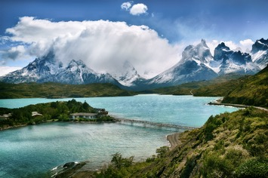
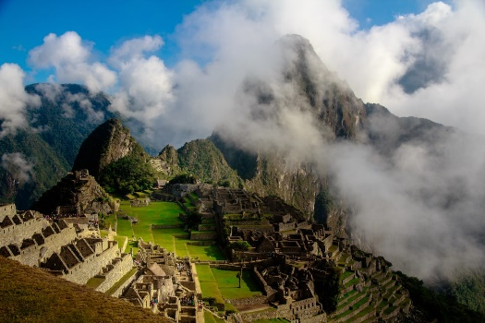
Deberes
escribir
Ahora puedes escribir tu propio texto sobre otro país de Sudamérica.
Si quieres, puedes encontrar inspiración en el texto de Bolivia.
Quizás puedes intentar contestar unas preguntas:
¿Cómo es la geografía?
¿Tiene fronteras con otros países?
Chile
¿Cuántos idiomas existen allí?
¿Hay mucho turismo? ¿Por qué (no)?
¿Cuáles son las industrias importantes?
Perú
Notes:
OPTIONAL
Aim: To produce the new and revisited features in writing about another Spanish speaking country.
Procedure:
Go through all the prompts to ensure that each is understood.
Encourage students to write their own text about another South American country based on the text about Bolivia.
Note: There may be time to begin this activity in class, but it can otherwise be set as homework.
Pictures taken from Unsplash:
Photo of Chile by @stalskaya
Photo of Peru by Scott Umstattd

Slide 41
Complete the sentences.
escribir
desaparece
1. El calor ______________ en la parte alta del país.
The heat disappears in the high part of the country.
cubre
2. Un paisaje seco _____________ la parte alta de la región.
The dry landscape covers the high part of the región.
tienen
3. Las montañas ____________ una altura de seis mil metros.
The mountains have an altitude of six thousand metres.
pueden
4. El aymara y el quechua ___________ ser importantes en las escuelas.
Aymara and Quechua can be important in schools.
deben
5. Los estudiantes _____________ aprender y otro idioma.
The students must learn Spanish and another language.
desaparecen
6. Los paisajes verdes ______________ en las montañas.
The green landscapes disappear in the mountains.
Notes:
Timing: 5 minutes
Aim: to produce –er and –ir verbs in 3rd person singular and plural
Procedure:
Display slides on the board
Students complete sentences by producing an –er / - ir verb with the correct ending. This could be written in books or on whiteboards.
Note: the language used is the same as the read-aloud/listening activity on slides 33-36

