Slide 1
Places – where people are going to go and why
Using ‘para’ + infinitive
‘IR’ in 3rd person plural (van)
Y8 Spanish
Term 1.2 - Week 5 - Lesson 23
Victoria Hobson / Nick Avery / Jack Peacock Artwork: Mark Davies
Date updated: 25.01.24
Notes:
Note: all words (new and revisited) in this week of the SOW appear on all three GCSE wordlists, with the following exceptions:
AQA list does not have pues or tapa
Edexcel list does not have tapa, fin or periodista
Artwork by Mark Davies. All additional pictures selected are available under a Creative Commons license, no attribution required.
Learning outcomes (lesson 2):
Consolidation of SSCs [cue], [cua], [cui]
Introduction of van a + infinitive
Introduction of ‘ir de + noun’ expressions
Word frequency (1 is the most frequent word in Spanish):
8.1.2.6 (introduce) vocab set: van [ir-33]; país [109]; café [961]; costa [896]; para² [16]; tomar² [133]; presentar [235]; enseñar [610]; el tema [240]; pronto [376]; próximo [466]; paseo [2126]; compra [1162]; tapa [3645]; copa [1514]
8 1.2.2 (revisit) salir [114]; subir [410]; perder [195]; recoger [828]; partido [302]; el fútbol [1471]; entrada [767]; billete [292]; pues¹ [73]; fin [182]; semana [301]; inglés² [583]; jugador [1019]; (a) pie [365]
8 1.1.4 (revisit) vender [528]; entender [229]; creer (en) [83]; esconder [1130]; poner [91]; noticia [859]; periodista [1235]; entrevista [1653]; página [598]; sobre¹ [62]; que [3] realidad [260]; sociedad [353]
Source: Davies, M. & Davies, K. (2018). A frequency dictionary of Spanish: Core vocabulary for learners (2nd ed.). Routledge: London
The frequency rankings for words that occur in this PowerPoint which have been previously introduced in NCELP resources are given in the NCELP SOW and in the resources that first introduced and formally re-visited those words.
For any other words that occur incidentally in this PowerPoint, frequency rankings will be provided in the notes field wherever possible.

Slide 2
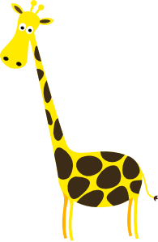
CU + vowel [revisited]
hablar
Remember, the vowel [u] merges with another vowel to make a single syllable. This is called a ________ vowel.
weak
Words with ‘cu’ + vowel follow this pattern.
cuerpo
escuela
cuello
to look after
50
cuidar
cuatro
cincuenta
cuadro
cuarenta
40
consecuencia
[consequence]
Notes:
Timing: 2 minutes
Aim: to recap weak vowels and apply this understanding to a sound-spelling correspondence that was taught in Year 7: [cu] + vowel
Procedure:
Bring up the explanation and elicit the missing word from students (weak vowels were taught in 8.1.1.3).
Bring up the example words. Some of these were already taught as phonics and/or vocabulary words in Year 7. Others (cuello, cuarenta, cincuenta, consecuencia) are new and included to broaden the range of practice words. All words are within the 2000 most frequent in Spanish. Pronunciation of the word each word modelled by a native speaker.

Slide 3
CU + vowel [revisited]
escuchar / escribir
Escucha y escribe la palabra en español.
 | Palabra en español
 | Palabra en español
escuela
cuello
1
4
cuidar
cuerpo
2
5
3
cuarenta
cincuenta
6
Notes:
Timing: 3 minutes
Aim: to consolidate understanding of the SSC [cu+vowel]
Procedure:
Students listen to the word and write it in Spanish.
At the end of the listening activity, give students a minute in pairs to translate the words to reinforce meanings in English.
Transcript:
escuela
cuidar
cuarenta
cuello
cuerpo
cincuenta

Slide 4
Vocabulario
hablar
5
Segundos
[about]
[to believe, believing]
[news item]
la noticia
creer
sobre
0
INICIO
Notes:
Timing: 2 minutes for the next five slides
Aim: to practise productive (oral) recall of three words within a given time. This is slide 1/5.
Procedure:
1. Say all three words before five seconds elapse.
2. Click to reveal answers.
3. Repeat if additional practice needed.
Vocabulary from revisited sets:
8.1.1.4: noticia [859]; creer [83]; sobre¹ [62]

Slide 5
Vocabulario
hablar
5
Segundos
[to put, putting]
[page]
[society]
poner
la página
la sociedad
0
INICIO
Notes:
This is slide 2/5.
Vocabulary from revisited sets:
8.1.1.4: poner [91]; página [598]; sociedad [353]

Slide 6
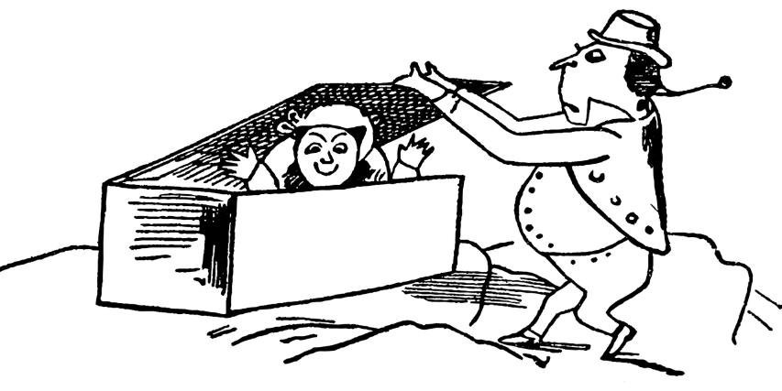
Vocabulario
hablar
5
[that]
Segundos
[to hide, hiding]
esconder
el/la periodista
que
0
INICIO
Notes:
This is slide 3/5.
Vocabulary from revisited sets:
8.1.1.4: esconder [1130]; que [3]; periodista [1235]

Slide 7
Vocabulario
hablar
5
[to sell]
[reality]
Segundos
[interview]
vender
la entrevista
la realidad
0
INICIO
Notes:
This is slide 4/5.
Vocabulary from revisited sets:
8.1.1.4: vender [528]; entrevista [1653]; realidad [260]

Slide 8
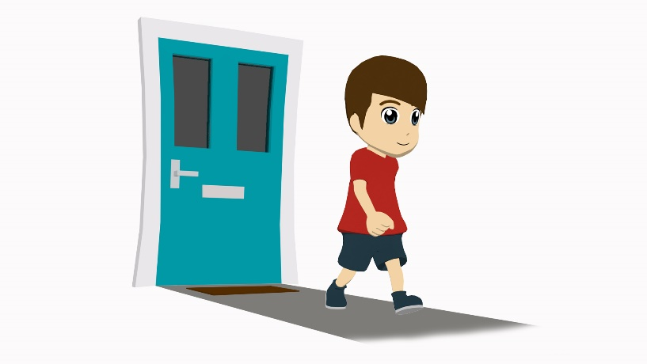
Vocabulario
hablar
5
Segundos
[to understand, understanding]
[to go out]
[to go up]
entender
salir
subir
0
INICIO
Notes:
This is slide 5/5.
Vocabulary from revisited sets:
8.1.1.4: entender [229];
8.1.2.2: salir [114]; subir [410]

Slide 9
Vocabulario
leer
 | Word | English meaning
1 | van | they go, are going
2 | el país | country
3 | el café | coffee
4 | la costa | coast
5 | para | for, in order to
6 | tomar | to take, to drink
7 | presentar | to present, presenting
8 | el tema | topic, issue
9 | pronto | soon
10 | próximo, próxima | next
‘Tema’ ends in –a but is a masculine noun.
Próximo is commonly used before the noun
(e.g. la próxima clase).
Notes:
Timing: 4 minutes
Aim: to embed word knowledge of this week’s vocabulary set.
Procedure 1. Pupils either work by themselves or in pairs, reading out the words and studying their English meaning (1 minute). 2. Then the English meanings are removed and they try to recall them, looking at the Spanish (1 minute). 3. Then the Spanish meanings are removed and they to recall them, looking at the English (1 minute) 4. Further rounds of learning can be facilitated by one pupil turning away from the board, and his/her partner asking him/her the meanings. This activity can work from L2 → L1 or L1 → L2.
Note:
paseo [2126]; compra [1162]; tapa [3645]; copa [1514] are to be introduced in lesson 2
According to an analysis of the Corpus del Español (the same corpus used for A frequency dictionary of Spanish: Core vocabulary for learners), ‘próximo’ was found to be used both prenominally and postnominally. However, it was one of the 10 adjectives that most commonly preceded nouns, and we therefore emphasise its prenominal position in the callout above. http://spanishlinguist.us/tag/before-or-after-noun/

Slide 10
IR [revisited]
gramática
Remember, to mean ‘to the’, use use ‘a la’ for singular feminine nouns and ‘al’ for singular masculine nouns..
voy
I go, am going = _____
you go, are going = _____
s/he or it goes, is going = _____
vas
va
To talk about what someone is going to do (future plans), use part of the verb ‘ir’ + a + infinitive:
Voy
a
tomar
un café.
=
I am going to drink a coffee.
Vas
a
ir
You are going to go to the cinema.
al cine.
=
Va
a
ir
a la costa.
=
S/he is going to go to the coast.
Notes:
Timing: 2 minutes
Aim:
To recap previously learnt singular persons of the verb ‘ir’.
To recap ir + a + infinitive to talk about future plans.
To recap al vs. a la for ‘to the’.
Procedure:
Read through the slide, eliciting the Spanish and translations. These include some of the language introduced on the last slide (tomar, costa) for further reinforcement.

Slide 11
¿Qué vas a hacer?
gramática
Lee las frases. Elige escribe quién es.
Después empareja las frase en español (1-6) con las frases en inglés (a-f).
 |  | Who?
1. | Va al ir al centro para tomar un café rico.
2. | Vas a ir a otro país para enseñar inglés.
3. | Voy a ir a la costa para ver el mar.
4. | ¿Vas a enseñar inglés?
5. | ¿Va a ir pronto?
6. | Voy a leer la entrevista para entender la noticia.
Frases en inglés:
s/he
see the sea
understand the news
go soon
go to another country
teach English
drink tasty coffee
1 = f
2 = e
3 = a
4 = e
5 = c
6 = b
you
I
you
s/he
I
Notes:
Timing: 6 minutes
Aims:
1. to consolidate understanding of the verb ‘ir’ in singular persons
2. to consolidate understanding of new and revisited vocabulary
Procedure:
Students read the sentences and decide who the verb is referring to: ‘I, ‘you’ or ‘s/he’.
They then re-read them and match the English phrases with the Spanish sentences that have the same meaning.

Slide 12
¿Qué vas a hacer?
Lee las frases. Elige escribe quién es.
Después empareja la frase (1-6) con las palabras en inglés (a-f).
Es
escuchar
escuchar
 | I | you | s/he
Frases en inglés:
A. pick up a clean shirt for the interview
1 = E
2 = F
3 = A
4 = D
5 = B
6 = C
1
2
B. Travel to the coast to relax on the beach
3
C. Buy new clothes for the holidays
4
D. Go to another country to look for work
5
E. buy tickets for the journey
6
F. Go to Madrid to see a football match
Notes:
Timing: 8 min
Aim:
to consolidate understanding of the verb ‘ir’ in singular persons
To consolidate understanding of new and revisited vocabulary
Procedure:
Students listen to each sentence and identify the correct form of the verb ‘ir’ (I, you or s/he).
Students listen again and match the English phrases with the Spanish sentences that they hear.
Note: Some students may be able to complete both parts as they go.
Transcript:
1. Voy a comprar billetes para el viaje.
2. Vas a ir a Madrid para ver un partido de fútbol.
3. Voy a recoger una camisa limpia para la entrevista.
4. Va a ir a otro país para buscar trabajo.
5. Voy a viajar a la costa para descansar en la playa.
6. Va a comprar ropa nueva para las vacaciones.

Slide 13
¿Qué vas a hacer?
escribir
escuchar
Solución:
You are going to go to another country.
Vas a ir a otro país.
2. I am going to go to the coast.
2. Voy a ir a la costa.
3. You are going to drink coffee.
3. Vas a beber café.
4. She is going to buy some tickets (transport).
4. Va a comprar unos billetes.
5. I am going to take the next train.
5. Voy a coger el próximo tren.
6. She is going to present a topic.
6. Va a presentar un tema.
Notes:
Timing: 7 minutes
Aim:
to use the following in written production:
verb ‘ir’ in singular persons
future tense ir + a + infinitive
new and revisited vocabulary
Procedure:
Students read the six English sentences.
They translate them into Spanish.
Note: the next slide has a scaffolded version of the same activity.

Slide 14
¿Qué vas a hacer?
escribir
escuchar
Solución:
Vas a
país
You are going to go to another country.
_________ ir a otro _________.
2. I am going to go to the coast.
Voy a
costa
2. _________ ir a la _________.
café
3. _________ beber _________.
3. You are going to drink coffee.
Vas a
Va a
billetes
4. She is going to buy some tickets (transport).
4. _________ comprar unos _________.
Voy a
próximo
5. I am going to take the next train.
5. _________ coger el _________ tren.
Va a
un tema
6. She is going to present a topic.
6. _________ presentar _________.
Notes:
Scaffolded version of the activity on the previous slide

Slide 15
¡Tres en cadena! (3 in a row)
leer
escuchar
Take turns to read a sentence aloud. Try to read three in a row. Your partner will try to block you and read three of their own!
Vas a buscar un regalo | Voy a descubrir otro país. | Va a ir a descansar en la playa. | Va a quedar con una amiga.
Voy a ir al centro. | Va a enseñar inglés. | Va a comprar billetes de autobús. | Vas a coger el próximo tren.
Va a comprar entradas de concierto. | Va a visitar Italia muy pronto. | Vas a presentar unos temas. | Voy a tomar café.
Vas a viajar a la costa en barco. | Voy a caminar en las montaña. | Voy a ver el sur de España. | Va a aprender un idioma.
Va a bailar. | Voy a escuchar música en español. | Va a cantar en la iglesia. | Vas a comer cosas deliciosas.
Notes:
Timing: 7 minutes
Aim:
to gain confidence and accuracy in reading aloud in Spanish
to demonstrate understanding of the sentences
Procedure:
Students take turns to read a sentence in Spanish.
The aim is read three in a row.
To ensure comprehension, students can only claim a tile as their own if they also say the English meaning of the sentence.
Each time that this is done successfully, the student writes their name on a tile or can put a nought or cross on it.
Note: it is recommended that this slide be printed so that students can tick off tiles as they go.

Slide 16
¡Tres en cadena! (3 in a row)
hablar
escuchar
Ahora traduce las frases al español.
¿Cuántas puedes traducir?
You are going to eat delicious things. | You are going to learn a language. | I am going to drink coffee. | You are going to take the next train.
S/he is going to meet up with a friend. | S/he is going to sing in the church. | I am going to see the south of Spain. | You are going to present some topics.
S/he is going to buy bus tickets. | S/he is going to rest on the beach. | I am going to listen to music in Spanish. | I am going to walk in the mountains.
S/he is going to visit Italy very soon. | S/he is going to teach English. | I am going to discover another country. | S/he is going to dance.
You are going to look for a present. | I am going to go to the centre. | S/he is going to buy concert tickets. | S/he is going to travel to the coast by boat.
Palabras útiles
Buscar (to look for)
Comer (to eat)
Quedar (to meet up)
Comprar (to buy)
Cantar (to sing)
Descansar (to rest)
Tomar (to drink)
Descubrir (to discover)
Viajar (to travel)
Enseñar (to teach)
Ir (to go)
Caminar (to walk)
Notes:
Timing: 8 minutes
Aim: to practise oral production of ‘ir’ + a + infinitive
Procedure:
Students take turns to read a sentence in Spanish. Each time they do this, they could get a certain number of points and so make it into a competition.
If support is needed, the ‘useful words’ could be revealed to students before and/or during the activity.

Slide 17
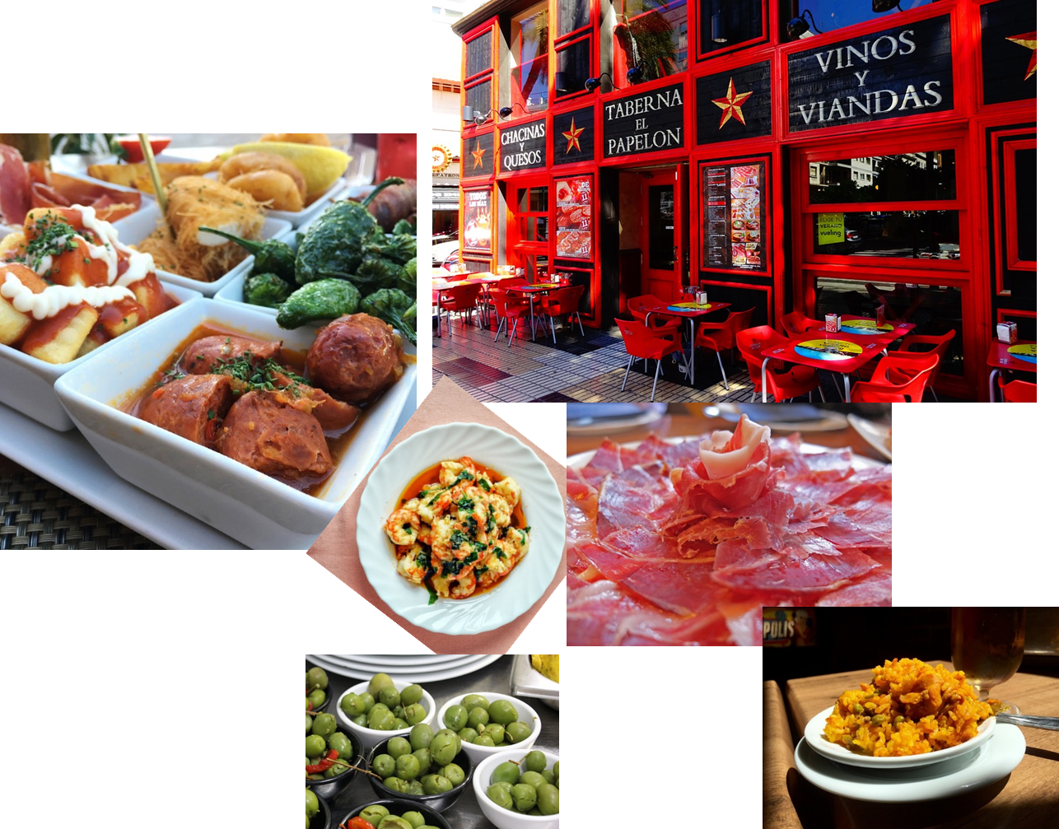
Places – where people are going to go and why [2]
Using ‘para’ + infinitive
‘IR’ in 3rd person plural (van)
Y9 Spanish
Term 1.2 - Week 5 – Lesson 24
Victoria Hobson / Nick Avery / Rachel Hawkes Artwork: Mark Davies
Date updated: 26.01.24
Notes:
Note: all words (new and revisited) in this week of the SOW appear on all three GCSE wordlists, with the following exceptions:
AQA list does not have pues or tapa
Edexcel list does not have tapa, fin or periodista
Artwork by Mark Davies. All additional pictures selected are available under a Creative Commons license, no attribution required.
Learning outcomes (lesson 2):
Consolidation of SSCs [cue], [cua], [cui]
Introduction of van a + infinitive
Introduction of ‘ir de + noun’ expressions
Word frequency (1 is the most frequent word in Spanish):
8.1.2.6 (introduce) vocab set: van [ir-33]; país [109]; café [961]; costa [896]; para² [16]; tomar² [133]; presentar [235]; enseñar [610]; el tema [240]; pronto [376]; próximo [466]; paseo [2126]; compra [1162]; tapa [3645]; copa [1514]
8 1.2.2 (revisit) salir [114]; subir [410]; perder [195]; recoger [828]; partido [302]; el fútbol [1471]; entrada [767]; billete [292]; pues¹ [73]; fin [182]; semana [301]; inglés² [583]; jugador [1019]; (a) pie [365]
8 1.1.4 (revisit) vender [528]; entender [229]; creer (en) [83]; esconder [1130]; poner [91]; noticia [859]; periodista [1235]; entrevista [1653]; página [598]; sobre¹ [62]; que [3] realidad [260]; sociedad [353]
Source: Davies, M. & Davies, K. (2018). A frequency dictionary of Spanish: Core vocabulary for learners (2nd ed.). Routledge: London
The frequency rankings for words that occur in this PowerPoint which have been previously introduced in NCELP resources are given in the NCELP SOW and in the resources that first introduced and formally re-visited those words.
For any other words that occur incidentally in this PowerPoint, frequency rankings will be provided in the notes field wherever possible.

Slide 18
Fonética
leer
Completa las frases.
Después, lee en voz alta con un/a compañero/a.
Cuántos
1. ¿_________ estudiantes hay? ¿Quince, cuarenta o ___________?
cincuenta
tranquilos
parque
2. Cuatro chicos __________ quedan en el _________.
quieres
3. ¿Por qué _________ estudiar español?
Quién
4. ¿_______ va a ir al partido de fútbol?
Opciones:
cuidar | quieres | quién | cuántos | cincuenta | parque
Notes:
Timing: 5 minutes
Aim: to revisit words with SSC [cu] + vowel (cua/cue/cui)
Procedure:
Check understanding of the six words at the bottom of the slide. These appeared last lesson.
Ask students to decide which word should go in each gap. Elicit meanings of the sentences in English to check comprehension.
After checking answers, ask students to practise reading these sentences aloud, focussing on pronunciation of words with cu + vowel and ‘que’ and ‘qui’.

Slide 19
Vocabulario
el partido
la semana
el fútbol
pues
el fin de semana
el/la jugador/a
el billete
salir
el pie
recoger
perder
la entrada
subir
el inglés
escribir
el fin
A
B
C
D
E
[English, English person (m)]
[to lose, losing]
[foot]
[week]
[match]
F
G
H
I
J
[ticket (for a venue)]
[to go out, going out]
[football (sport)]
[player (m)]
[well…]
K
L
M
N
O
[to pick up, collect]
[ticket (for transport)]
[to go up, going up]
[end]
[weekend]
Notes:
Timing: 8 minutes
Aim: to revise in productive mode/written modality the 8.1.2.2 revisited vocabulary, this time within a limited time frame.
This activity builds on receptive practice of a number of these vocabulary items in lesson 1 and leads into the final oral production activity.
Procedure:
1. Write A-O in books.
2. Click / press enter to flash an English prompt (e.g. foot). It will disappear after 5 seconds. Note that the pictures do not appear in alphabetical order to increase the challenge.
3. Write down the Spanish translation before the English disappears.
4. Click to reveal the Spanish and click to have it disappear before revealing the next.
Notes:
This activity could also be done in oral production with a higher-proficiency group.
Vocabulary from revisited sets:
8.1.2.2 salir [114]; subir [410]; perder [195]; recoger [828]; partido [302]; el fútbol [1471]; entrada [767]; billete [292]; pues¹ [73]; fin [182]; semana [301]; inglés² [583]; jugador [1019]; pie [365]

Slide 20
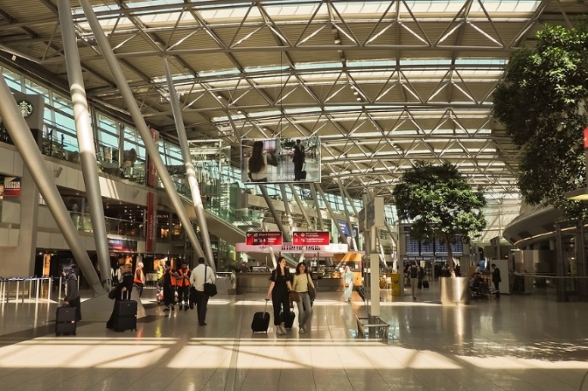
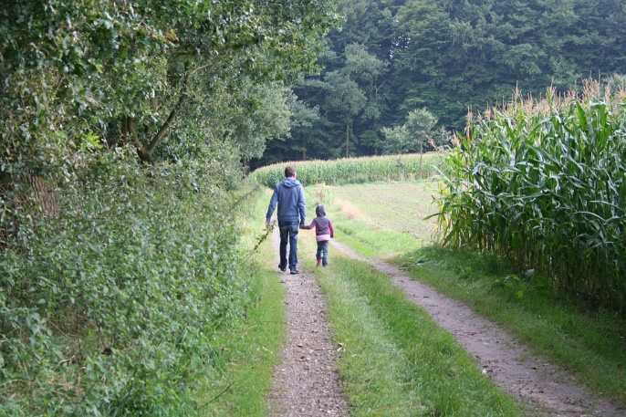
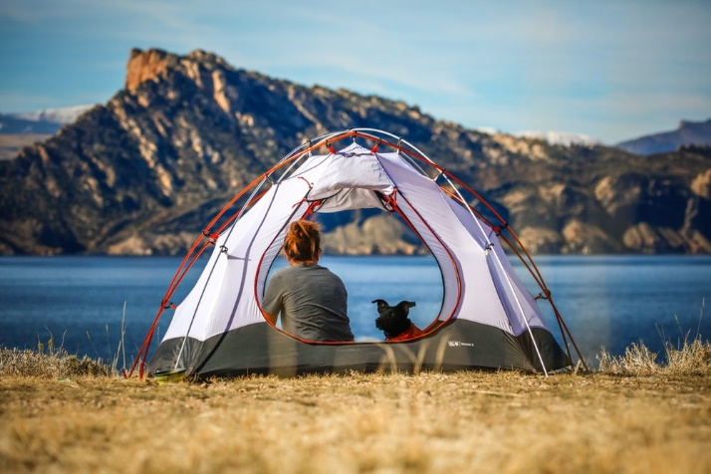
Saying what you go and do Expressions with ‘ir de’ + noun
vocabulario
to go on holiday
to go partying
ir de vacaciones
ir de fiesta
to go for an outing
to go camping
ir de paseo
ir de camping
Notes:
Timing: 2 minutes
Aim: to embed word knowledge of the ‘ir + noun’ expressions from this week’s vocab set
Procedure:
1. Introduce the picture with the word, asking students to listen and repeat.
2. Solicit English translations from students.
Note: ‘ir de camping’ is included as a further example, drawing on a cognate.

Slide 21
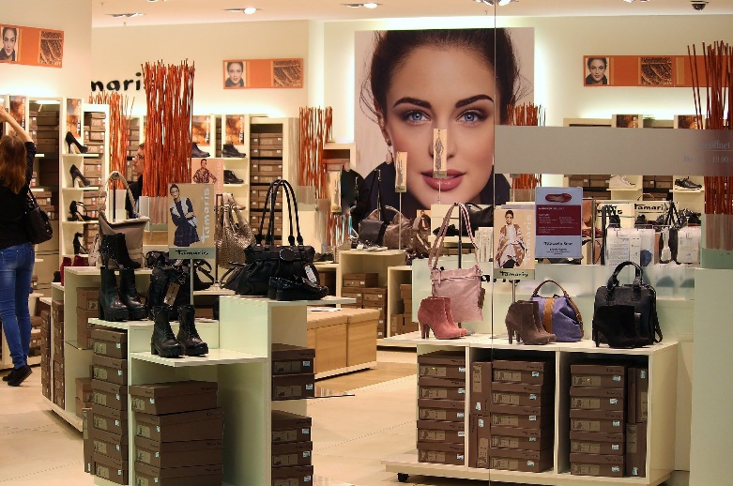
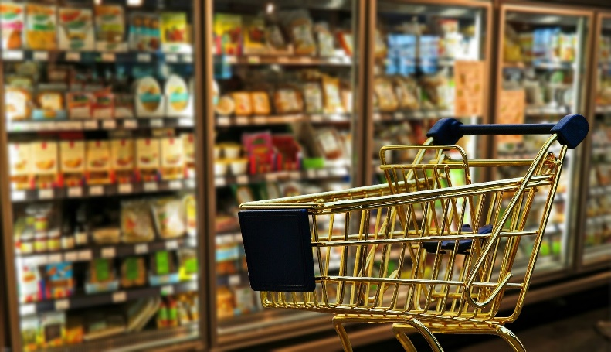
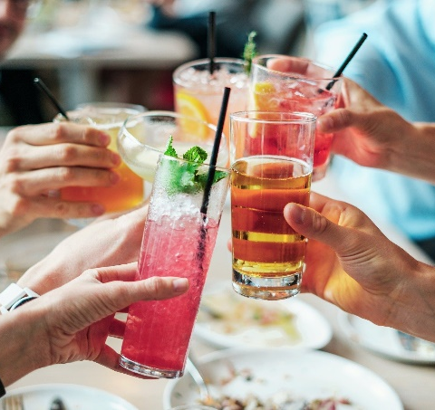
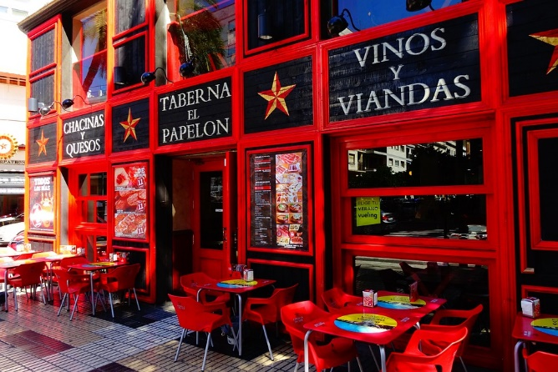
Saying what you go and do Expressions with ‘ir de’ + noun
vocabulario
to go shopping
to go shopping (e.g. to browse, window-shop)
ir de compras
ir de tiendas
Una ‘copa’ puede ser una bebida o puede ser un vaso.
to go for drinks
to go for tapas
ir de copas
ir de tapas
Notes:
Timing: 2 minutes
Aim: to embed word knowledge of the ‘ir + noun’ expressions from this week’s vocab set
Procedure:
1. Introduce the picture with the word, asking students to listen and repeat.
2. Solicit English translations from students.
Notes: directly following this there is an explanatory slide on what ‘tapas’ are. Spanish also uses the phrase ‘hacer la compra’ for grocery shopping. This will be taught later.

Slide 22
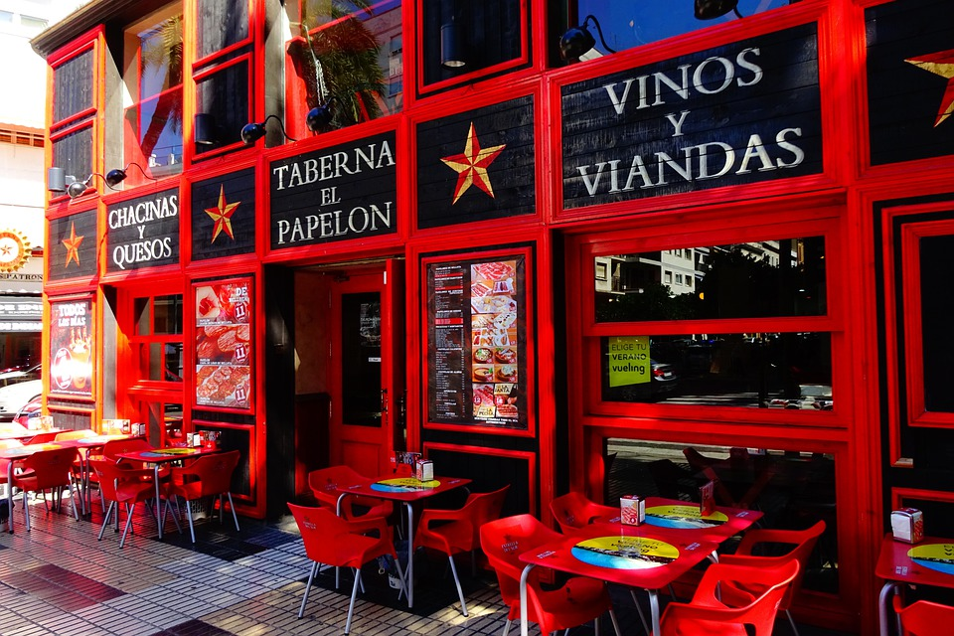
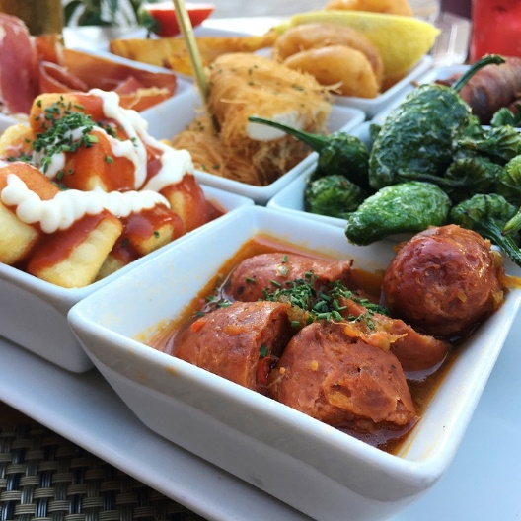
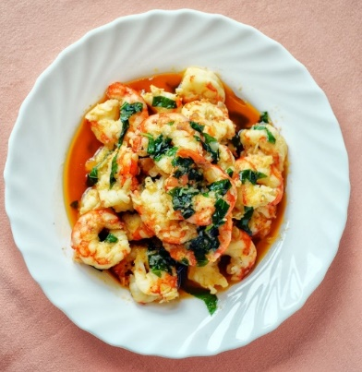
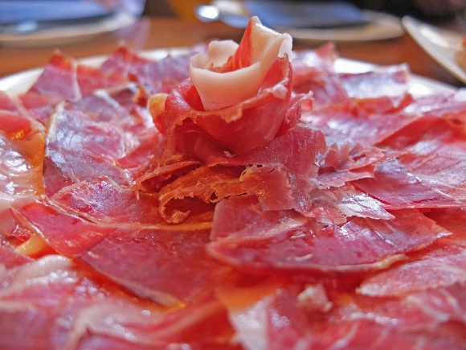
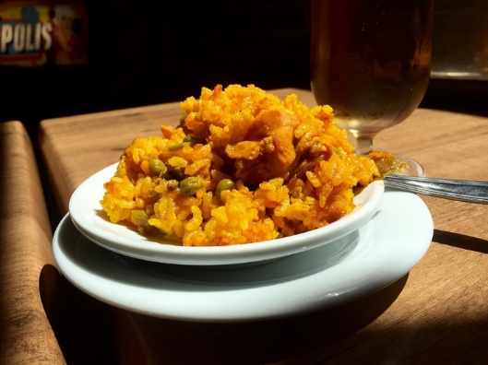
Tapas
‘Tapas’ are small plates of food, such as olives, meatballs, prawns, cured meats and cheeses. These are very popular as an evening snack in bars (the Spanish often have dinner at 9 or 10pm!).
The word ‘tapa’ translates as ‘cover’ or ‘lid’. There are different theories about why it is called this. Some think that tapas were originally served on top of a glass of wine as a way to keep out dust or insects!
Notes:
Timing: 2 minutes
Aim: to explain to students what ‘tapas’ are.
Procedure:
1. Click to bring up the explanation

Slide 23
Vocabulario
hablar
ir de paseo
Notes:
Timing: 2 minutes for the next seven slides
Aim: to promote recall of the expressions ‘ir de’ +noun
Procedure:
1. click to slowly reveal the image on square at a time
2. students give the Spanish for the image

Slide 24
Vocabulario
hablar
ir de compras

Slide 25
Vocabulario
hablar
ir de tapas

Slide 26
Vocabulario
hablar
ir de fiesta

Slide 27
Vocabulario
hablar
ir de vacaciones

Slide 28
Vocabulario
hablar
ir de copas

Slide 29
Vocabulario
hablar
ir de tiendas

Slide 30
Saying where people go ‘IR’ in 1st and 3rd person plural
gramática
vamos
We go, are going = _____________
They go, are going = _____________
van
Notes:
Timing: 1 minute
Aim:
to recap the previously learnt first person plural of the verb ‘ir’
to introduce third person plural
Procedure:
Read through the slide.

Slide 31
vamos
[we go | are going]
van
[they go |are going]
Notes:
Timing: 3 minutes for sequence of six verbs
Procedure
Bring up the 1st person plural, students repeat it, and remind them of the phonics. Draw attention to the SSC [v]
Try to elicit the meaning from the students.
Then bring up the English translations.
Bring up the 3rd person plural say it, students repeat it. Draw attention to the SSC [v]
Try to elicit the meaning from the students.

Slide 32
vamos
[we go | are going]
van
[they go |are going]
Notes:
Cycle through both forms again.

Slide 33
vamos
[we go | are going]
Vamos a ir de compras.
[We are going to go shopping.]
Notes:
Introduce the first person plural in a sentence with future meaning.

Slide 34
van
[they go | are going]
Van a ir de paseo.
[They are going to go for a stroll / outing.]
Notes:
Introduce the third person plural in a sentence with future meaning.

Slide 35
vamos
[we go | are going]
Vamos
_______ a ir de compras.
[We are going to go shopping.]
Notes:
Cycle through the first person plural in context again.

Slide 36
van
[they go | are going]
Van
_____ a ir de paseo.
[They are going to go for a stroll / outing.]
Notes:
Cycle through the third person plural in context again.

Slide 37
El próximo fin de semana
leer
Daniel y Lucia hablan de los planes de la familia. Lee las frases y escribe quién hace la actividad. Escribe también la actividad en inglés.
 |  | ‘We’ | ‘They’ | Actividad en inglés
1. | Por la tarde van a ir de copas.
2. | El sábado van a ir de tiendas .
3. | Quizás vamos a ir de fiesta.
4. | También van a ir de tapas.
5. | Vamos a ir de paseo después de comer.
6. | El dómingo van a ir de compras.
to go for drinks
to go shopping (for fun)
to go partying
to go for tapas
to go for a stroll / outing
to go shopping (e.g. groceries)
Notes:
Timing: 7 minutes
Aim: to consolidate understanding of ‘ir’ (in 1st and 3rd person plural) and of the newly learnt expressions: ‘ir de’ + noun (written modality).
Procedure:
1. Students read the sentences and decide the subject of the verb (we/they).
2. Students write the activity in English (e.g. to go for tapas)

Slide 38
Talking about intentions Using ‘para’ + infinitive
gramática
You have already learnt one meaning of the word ‘para’:
El regalo es para mi madre.
=
The present is for my mum.
‘Para’ can also mean ‘in order to’.
We often leave out the words ‘in order’ in spoken English.
Voy a ir al parque para ver un partido de fútbol.
I am going to go to the park (in order) to watch a football match.
Vas a viajar a la costa para comprar un barco.
You are going to travel to the coast (in order) to buy a boat.
When used in this way, ‘para’ is always followed by an infinitive.
Notes:
Timing: 1 minute
Aim:
To introduce the two meanings of ‘para’ (‘for’ and ‘in order to’)
Procedure:
Read through the slide, eliciting the translations of the example sentences.

Slide 39
Un partido de fútbol
escuchar
Escucha y escribe ‘we’ o ‘they’.
También completa la frase en español.
 | We | They
Completa la frase (en inglés)
…a la costa _________________ el partido de fútbol.
….llegar temprano __________________de tapas antes del partido.
…buscar billetes baratos ____________________ en autobús.
…ir a la tienda ______________________ las entradas.
…comprar entradas ______________________ exclusiva con los jugadores.
…llevar dinero ______________________ después.
1
para ver
2
para ir de tapas
3
para el viaje
4
para recoger
5
para una entrevista
6
para ir de fiesta
Notes:
Timing: 8 min
Aim: to consolidate understanding of verb ‘ir’ (in first and third person plural) and the two meanings of ‘para’ (oral modality). To also consolidate receptive understanding of several ‘ir de + noun’ expressions.
Procedure:
Students listen to each sentence and decide if the verb is referring to ‘we’ or ‘they’
They listen again and decide if ‘para’ means ‘for’ or ‘in order to’ depending on whether it is followed by an infinitive or not.
This time, students also write the sentence ending in English, including ‘for’ / ‘(in order) to’
Transcript:
El próximo fin de semana vamos a viajar a la costa para ver el partido de fútbol.
Pues, creo que van a llegar temprano para ir de tapas antes del partido.
Primero, vamos a buscar billetes baratos para el viaje en autobús.
Luego, van a ir a la tienda para recoger las entradas.
También vamos a comprar entradas para una entrevista exclusiva con los jugadores.
Van a llevar dinero para ir de fiesta después.
No van a ir de tiendas; no tienen tiempo para otras actividades.
¡Vamos a ir a otro país muy pronto para el próximo partido!
Note: ‘amar’ was a year 7 phonics word. Students may need a reminder of its meaning.
Vocabulary from revisited sets: 8.1.2.2: recoger [828]; partido [302]; fútbol [1471]; entrada [767]; billete [292]; pues¹ [73]; fin [182]; semana [301]; jugador [1019]
8.1.1.4: creer [83]; entrevista [1653]; sobre¹ [62]; que [3]

Slide 40
escribir
Escribe las frases en español.
1. | They are going to visit Barcelona (in order) to go for tapas with some friends.
2. | We are going to go to another country for the next match. We are not going to lose!
3. | My parents are going to go for drinks (in order) to celebrate the news.
4. | He is going to do an interview (in order) to speak about some important issues.
5. | I am going to buy a ticket for the interview with the football players.
6. | Next weekend you are going to go shopping (window-shopping).
Van a visitar Barcelona para ir de tapas con unos amigos.
Vamos a ir a otro país para el próximo partido. İNo vamos a perder!
Mis padres van a ir de copas para celebrar las noticias.
Va a hacer una entrevista para hablar sobre unos temas importantes.
Voy a comprar una entrada para la entrevista con los jugadores de fútbol.
El próximo fin de semana, vas a ir de tiendas.
Notes:
Timing: 10 minutes
Aim: to bring together in written production the five forms of ‘ir’ practised across the two lessons, the two uses of ‘para’ and the ‘ir de + noun’ expressions.
Procedure:
1. Students translate the sentences into Spanish
Note: ‘celebrar’ was used as a phonics practice word in year 7. It is a near-cognate, though students may need to be reminded of it before the activity.

Slide 41
escribir
Escribe las frases en español.
1. | They are going to visit Barcelona (in order) to go for tapas with some friends.
2. | We are going to go to another country for the next match. We are not going to lose!
3. | They are going to go for drinks (in order) to celebrate the news.
4. | He is going to do an interview (in order) to speak about some important issues.
5. | I am going to buy a ticket for the interview with the football players.
6. | Next weekend you are going to go shopping (window-shopping).
Van a
para ir de tapas
____________ visitar Barcelona __________________ con unos amigos.
para el próximo partido
______________ ir a otro país ___________________________ . İNo vamos a perder!
Vamos a
Van a
para celebrar
______________ ir de copas_______________ las noticias.
Va a
para hablar
______________ hacer una entrevista _______________ sobre unos temas importantes.
Voy a
para la entrevista
______________ comprar una entrada ____________________ con los jugadores de fútbol.
vas a ir de tiendas
El próximo fin de semana ______________________.
Notes:
Timing: 10 minutes
Aim: to bring together in written production the five forms of ‘ir’ practised across the two lessons, the two uses of ‘para’ and the ‘ir de + noun’ expressions.
Procedure:
1. Students translate the sentences into Spanish
Note: ‘celebrar’ was used as a phonics practice word in year 7. It is a near-cognate, though students may need to be reminded of it before the activity.

Slide 42
Deberes
Vocabulary Learning Homework (Y8 Term 1.2, Week 6)
Audio file
Student worksheet
In addition, revisit: Y8 Term 1.2 Week 3 Y8 Term 1.1 Week 5
Notes:
The answer sheet for the Y8 vocabulary learning HW is here: https://rachelhawkes.com/LDPresources/Yr8Spanish/Spanish_Y8_Term1ii_Wk5_audio_HW_sheet_answers.docx
Notes:
i) Teachers may, in addition, want to recommend use of a particular online app for the pre-learning of each week’s words. ii) Quizlet now requires parental involvement / registration / permissions for users below the age of 13, so it is perhaps most suitable for Y9 – 11 students. iii) Language Nut hosts LDP vocabulary lists and these are free for schools to use, though there is a registration process. One benefit is that all of the student tracking data that Language Nut offers are also available to schools that use the LDP lists for practice. Perhaps this makes it a good option for Y7/8.
iv) There are other free apps, and new ones are always appearing. Teachers have told us that they are currently using: Flippity, Wordwall (where using previously-created activities is free).
v) Gaming Grammar has been acquired by Language Nut. Its original content should still be available to teachers and much of it is appropriate for Y8 learners.

