Slide 1
Describing events in the past and present (Free time activities)
-er/-ir verbs in 2nd person singular preterite (-iste)
final syllable stress [revisited]
Y8 Spanish
Term 1.2 - Week 2 - Lesson 17 Amanda Izquierdo / Nick Avery / Jack Peacock Artwork: Mark Davies
Date updated: 02/11/23
Notes:
Note: all words in this week of the SOW appear on all three GCSE wordlists, with the following exceptions: pues is only on edexcel; fin is only on AQA
Artwork by Mark Davies. All additional pictures selected are available under a Creative Commons license, no attribution required.
Learning outcomes (lesson 1):
Introduction of ante-penultimate syllable stress and spelling rules
Introduction of past tense (preterite) –er/-ir verbs in 2nd person singular (-iste)
Consolidation of past tense (preterite) –er/-ir verbs in 1st person singular (-í)
Word frequency (1 is the most frequent word in Spanish):
New vocabulary (introduce): salir [114]; subir [410]; perder [195]; recoger [828]; partido [302]; fútbol [1471]; entrada [767]; billete [292]; pues¹ [73]; fin [182]; semana [301]; inglés² [583]; jugador [1019]; (a) pie [365]
8 1.1.6 (revisit): empezar [175]; terminar [253]; decir [31]; ver [38]; minuto [478]; ejemplo [187]; opinión [578]; verdad [176]; estudiante [795]; alemán [761]; todo² [472]
8 1.1.1 (revisit): aprovechar [885]; quedar [100]; pintar [1329]; ayudar [328]; pared [778]; verano [1139]; pasado (adj.) [932]; libre [473]; máximo [935]; antes [190]; sin embargo [embargo-203]; poco (as adverb only) [76]; negro [307]

Slide 2
Fonética
Some words in Spanish have stress on third-last syllable.
This means that the third-last syllable is pronounced with most emphasis.
1
pájaro
máximo
página
último
Words with stress on the third-last syllable have an accent on the stressed vowel.
2
cámara
periódico
diálogo
teléfono
Notes:
Timing: 2 min.
Aim: To introduce ante-penultimate syllable stress and spelling rules.
Procedure:
Click to reveal each sentence to introduce ante-penultimate syllable stress (stress on the third-last syllable).
Students listen to the examples and say the words aloud.
Click to reveal the spelling rule for words with ante-penultimate stress.
Students listen to the second set of examples and say the words aloud.
Note: all 8 words were previously taught in the scheme of work.
Transcript:
pájaro máximo, página, último.
cámara, periódico, diálogo, teléfono.

Slide 3
Fonética
escuchar / escribir
Words with stress on the third-last syllable have an accent on the stressed vowel.
Escucha cada palabra y escribe la/s letra/s que no está/n. ¿Tienen acento o no?
Ahora pronuncia las palabras con un compañero.
1
4
__ntender
s__bado
e
á
5
e
2
o
entr__vista
c__ntento
3
á
6
p__gina
peri__dista
o
Notes:
Timing: 6 min.
Aim: to practise listening out for ante-penultimate syllable stress in words; to successfully write the missing letters with correct accents.
Procedure:
Click on the orange number to play the audio for each word.
Students listen and write the missing letter for each word, adding an accent if needed.
Reveal the answers one by one.
Practise pronunciation: students read each word out loud, trying to mimic/emphasise the ante-penultimate syllable stress heard in the recording.
Transcript:
sábado
contento
página
entender
entrevista
pájaro
América
teléfono
diálogo
periodista

Slide 4
Vocabulario
escuchar / escribir
español
inglés
1
empezar
to start, starting
2
terminar
to finish, finishing
3
decir
to say, saying
4
ver
to see, seeing
5
el minuto
minute
6
el ejemplo
example
7
la opinión
opinion
8
la verdad
truth
9
el/la estudiante
student
10
el alemán
German
11
todo
all, everything
Notes:
Vocabulario
Timing: 5 minutes
Aim: to revisit previously taught adjectives in the oral and written modalities. In later activities, students will be using these words in production.
Procedure: 1. Click to hear the word in Spanish. 2. Students write down the word in Spanish.
3. Students write down the translation in English. 3. Click to check answers. Transcript: 1. empezar
2. terminar
3. decir
4. ver
5. el minuto
6. el ejemplo
7. la opinión
8. la verdad
9. el/la estudiante
10. el alemán
11. todo
REVISITED vocabulary: 8.1.1.6: empezar [175]; terminar [253]; decir [31]; ver [38]; minuto [478]; ejemplo [187]; opinión [578]; verdad [176]; estudiante [795]; alemán [761]; todo² [472]

Slide 5
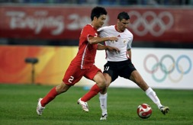
Vocabulario
leer / hablar
el fin
salir
[to go out]
la semana
subir
[to go up]
el billete
el partido
[match]
el fútbol
'Ticket’ (event) → la entrada
‘Ticket’ (transport) → el billete
la entrada
Notes:
Timing: 4 minutes
Vocabulary practice slide
Procedure 1. Pupils either work by themselves or in pairs, reading out the words and recapping their English meaning (1 minute). 2. Then the teacher removes the English words or pictures (one by one) and they try to recall the English orally (chorally), looking at the Spanish (1 minute). 3. Then the Spanish meanings are removed (one by one) and they to recall them orally (again, chorally), looking at the English (1 minute) 4. Further rounds of learning can be facilitated by one pupil turning away from the board, and his/her partner asking him/her the meanings (‘Cómo se dice X en español?’). This activity can work from L2 → L1 or L1 → L2.
New vocabulary (introduce): salir [114]; subir [410]; perder [195]; recoger [828]; partido [302]; fútbol [1471]; entrada [767]; billete [292]; pues¹ [73]; fin [182]; semana [301]; inglés² [583]; jugador [1019]; (a) pie [365]
Note: we initially present ‘fin’ and ‘semana’ separately so that students learn the meanings of these words separately before learning ‘fin de semana’ (see lesson 2).

Slide 6
Vocabulario
leer / hablar
This verb has a change (e>ie) in the stem (the beginning of the verb) for ‘I’, ‘you singular’, ‘he/she’ and ‘they’:
yo pierdo I lose
tú pierdes you lose
él /ella pierde he /she loses
ellos /ellas pierden they lose
‘Want to say ‘on foot’? Use ‘a pie’.
perder
el pie
[to lose]
recoger
el inglés, la inglesa
[to pick up, collect]
[English person]
el/la jugador/a
pues
[player]
Notes:
Timing: 4 minutes
Vocabulary practice slide
Procedure 1. Pupils either work by themselves or in pairs, reading out the words and recapping their English meaning (1 minute). 2. Then the teacher removes the English words or pictures (one by one) and they try to recall the English orally (chorally), looking at the Spanish (1 minute). 3. Then the Spanish meanings are removed (one by one) and they to recall them orally (again, chorally), looking at the English (1 minute) 4. Further rounds of learning can be facilitated by one pupil turning away from the board, and his/her partner asking him/her the meanings (‘Cómo se dice X en español?’). This activity can work from L2 → L1 or L1 → L2.
New vocabulary (introduce): salir [114]; subir [410]; perder [195]; recoger [828]; partido [302]; fútbol [1471]; entrada [767]; billete [292]; pues¹ [73]; fin [182]; semana [301]; inglés² [583]; jugador [1019]; (a) pie [365]
Note: we initially present ‘fin’ and ‘semana’ separately so that students learn the meanings of these words separately before learning ‘fin de semana’ (see lesson 2).

Slide 7
Preterite tense -er/-ir verbs: 1st and 2nd person singular
gramática
Remember, some Spanish infinitives end in –er, some in –ir.
The verb ending changes depending on who the verb refers to.
To mean ‘I’ for a completed action in the past, remove –er or –ir and add _____.
–í
I went out
I lost
Salí = _____________.
Perdí = _________.
To mean ‘you’ for a completed action in the past, remove –ir and add –iste.
subiste
subir
sub
(you went up)
Notes:
Timing: 3 minutes
Aim: to recap 1st person singular form of preterite tense for –er/-ir verbs (-í) and introduce the 2nd person singular (-iste)
Procedure:
Go through the grammar explanation with students, revealing each new sentence on a mouse click.

Slide 8
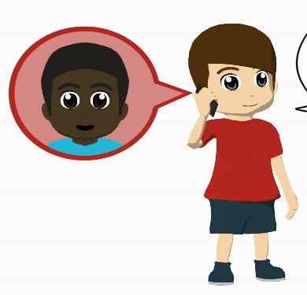
leer
Daniel habla sobre la semana pasada con un amigo inglés.
Lee las frases: ¿es Daniel o el amigo?
 | Daniel (‘I’) | el amigo (‘you’)
Who did not see the football match?
Who decided to help at home?
Who printed the tickets?
Who collected the tickets?
Who chose to paint the walls blue?
Who lost the tickets?
Who shared a moment with an English player?
1. “Pues, la semana pasada no viste el partido de fútbol porque decidiste ayudar un poco en casa.”
2. “Sin embargo, imprimiste las entradas.”
3. “Recogí las entradas el sábado.”
4. “El domingo elegiste pintar de azul las paredes.”
5. “¡Perdí las entradas! Aunque después del partido compartí un momento con un jugador inglés!”
Notes:
Timing: 7 min.
Aim: Compare the difference between 1st and 2nd singular past.
Procedure:
1. Students read the phrases.
2. They decide who did the actions: Daniel (’I’) or Nick (‘you’).
Revisited vocabulary:
8 1.1.6: ver [38];
8 1.1.1: pintar [1329]; ayudar [328]; pared [778]; verano [1139]; pasado (adj.) [932]; sin embargo [embargo-203].

Slide 9
Completa las frases.
escribir
You went up the mountain on foot.
Subiste
_________ la montaña a pie.
¿Necesitas ayuda?
to go up = subir

Slide 10
Completa las frases.
escribir
You went out in the afternoon.
Saliste
_________ por la tarde.
¿Necesitas ayuda?
to go out = salir

Slide 11
Completa las frases.
escribir
I decided to do exercise.
Decidí
_________ hacer ejercicio.
¿Necesitas ayuda?
to decide = decidir

Slide 12
Completa las frases.
escribir
You lost your mobile phone.
Perdiste
_________ tu móvil.
to lose = perder
¿Necesitas ayuda?

Slide 13
Completa las frases.
escribir
I sold the tickets.
Vendí
_______ las entradas.
to sell = vender
¿Necesitas ayuda?

Slide 14
Completa las frases.
escribir
I decided to help at home.
Decidí
_______ ayudar en casa.
to decide = decidir
¿Necesitas ayuda?

Slide 15
En pareja
Escribe 5 frases en inglés. Habla en español.
leer / hablar
salir decidir elegir subir perder recoger comer | ayudar en casa ir al centro unas entradas el partido de fútbol con unos amigos una montaña mucho
Change the infinitive verb to ‘I’ or ‘you’ in the preterite
Notes:
Timing: 8 minutes
Aim: to practise comprehension and read aloud of language and grammar from this and previous weeks.
Procedure:
Both pupils write 5 sentences (in English) made up of words from the table.
They swap sentences.
Partner A tries to say all B’s sentences in Spanish as quickly as possible.
Then Partner B tries to say all A’s sentences in Spanish.
Adaption:
The person speaking can face the board or face away from the board for greater challenge.

Slide 16
¿Cómo se dice…?
Escribe frases en español.
escribir
I ate / you ate I chose / you chose I decided / you decided I picked up / you picked up I went out / you went out I went up / you went up I lost / you lost I sold / you sold | the food to help at home the drinks with some friends the phone the mountain the tickets
Notes:
Timing: 6 minutes
Aim: to practise written production of language and grammar from this and previous weeks.
Procedure:
Teacher explains to students that they will now be creating their own sentences in Spanish, using the words in each column.
Students write the sentences in Spanish.
Teacher asks for answers and gives feedback. As part of this, examples can be shared with the rest of the class to practise aural comprehension.
Notes:
If there is more time, students can continue the activity in pairs OR the teacher can continue to give prompts for further sentences. 2) If more support is needed, students could use the Knowledge Organiser or their Language Guide, but encourage most students to work from memory. Tell them it is not a test and they will learn more by trying to remember the words, than by copying them across from a written source.

Slide 17
Describing events in the past and present (Free time activities) [2]
-er/-ir verbs in 2nd person singular preterite (-iste)
ante-penultimate syllable stress
Y8 Spanish
Term 1.2 - Week 2 – Lesson 18
Amanda Izquierdo / Nick Avery / Rachel Hawkes Artwork: Mark Davies
Date updated: 02/11/23
Notes:
Note: all words in this week of the SOW appear on all three GCSE wordlists, with the following exceptions: pues is only on edexcel; fin is only on AQA
Artwork by Mark Davies. All additional pictures selected are available under a Creative Commons license, no attribution required.
Learning outcomes (lesson 2):
Consolidation of past tense (preterite) –er/–ir verbs in 2nd person singular (-iste)
Consolidation of present tense –er/–ir verbs in 2nd person singular (-es)
Consolidation of question words
Consolidation of ante-penultimate syllable stress and spelling rules.
Word frequency (1 is the most frequent word in Spanish):
New vocabulary (introduce): salir [114]; subir [410]; perder [195]; recoger [828]; partido [302]; fútbol [1471]; entrada [767]; billete [292]; pues¹ [73]; fin [182]; semana [301]; inglés² [583]; jugador [1019]; (a) pie [365]
8 1.1.6 (revisit): empezar [175]; terminar [253]; decir [31]; ver [38]; minuto [478]; ejemplo [187]; opinión [578]; verdad [176]; estudiante [795]; alemán [761]; todo² [472]
8 1.1.1 (revisit): aprovechar [885]; quedar [100]; pintar [1329]; ayudar [328]; pared [778]; verano [1139]; pasado (adj.) [932]; libre [473]; máximo [935]; antes [190]; sin embargo [embargo-203]; poco (as adverb only) [76]; negro [307]
Source: Davies, M. & Davies, K. (2018). A frequency dictionary of Spanish: Core vocabulary for learners (2nd ed.). Routledge: London

Slide 18
Fonética
A: Lee las frases a tu pareja. B: Escucha.
leer / hablar / escuchar
 | Frases de Persona A
1 | ¿Escribiste tu opinión en el periódico?
2
3
4
1
2
3
4
Write the word with stress on the third-last syllable
periódico
La semana pasada elegiste música divertida.
música
Saliste el sábado sin tu móvil.
sábado
Recogiste las páginas del libro.
página
Notes:
Round 1
Timing: 8 minutes Aim: To strengthen awareness of antepenultimate syllable stress.
Procedure:
Click to show that Bs need to turn around.
Do the first one as an example.
3. As read the sentence aloud, focusing on pronouncing the words with the stress in the right place.
4. Bs listen and write down the word they hear with antepenultimate syllable stress.
5. Bs turn back to the board – click to show correct answers.
6. Swap roles.
Note: it may be also useful to elicit the translation of the example sentence.

Slide 19
Fonética
A: Lee las frases a tu pareja. B: Escucha.
leer / hablar / escuchar
 | Frases de Persona B
1
2
3
4
Write the word with stress on the third-last syllable
1
2
3
4
El jugador inglés es el número doce.
número
¿Viste el pájaro en el árbol?
pájaro
Recibiste muchos correos electrónicos.
electrónicos
En mi opinión el estudiante es muy simpático.
simpático
Notes:
Round 2 Procedure: 3. Bs read the sentence aloud, focusing on pronouncing the words with the stress in the right place.
4. As listen and and write down the word they hear with antepenultimate syllable stress.
5. As turn back to the board – click to show correct answers.

Slide 20
Vocabulario
hablar
to help, helping
to paint, painting
to meet up, meeting up
to make the most of
wall
black (m)
summer
before
maximum
black (f)
past, last
free
however
little
pasado
p_ _ _ _ _
poco
p_ _ _
a_ _ _ _ _ _ _ _ _
aprovechar
ayudar
a_ _ _ _ _
sin embargo
s_ _ _ _ _ _ _ _ _
negro
p_ _ _ _ _
n_ _ _ _
pintar
el v_ _ _ _ _
el verano
el máximo
l_ _ _ _
el m_ _ _ _ _
libre
n_ _ _ _
negra
a_ _ _ _
q_ _ _ _ _
antes
quedar
la p_ _ _ _
la pared
Notes:
Vocabulario
Timing: 5 minutes
Aim: To revise items of vocabulary from this week’s revisited vocabulary set. Only the first letter is provided so that students have to recall the noun.
Procedure:
1. Click for next English term.
2. Students say the word in Spanish in choral response to match the English.
3. Click again for answer.
Revisited vocabulary: 8.1.1.1: aprovechar [885]; quedar [100]; pintar [1329]; ayudar [328]; pared [778]; verano [1139]; pasado (adj.) [932]; libre [473]; máximo [935]; antes [190]; sin embargo [embargo-203]; poco (as adverb only) [76]; negro [307]

Slide 21
Talking about ‘you’ in present and past: -er/-ir verbs in 2nd person singular
gramática
Remember, some Spanish infinitives end in –er, some in –ir.
The verb ending changes depending on when the action takes place.
¡Cuidado! Los verbos pueden cambiar.
To mean ‘you’ for actions in the present, remove –er or –ir and add _____.
–es
Elegir
→
Eliges
you collect
Perder
→
Pierdes
you go out
Recoges = _____________.
Sales = _____________.
To mean ‘you’ for a completed action in the past, remove –ir and add _____.
–iste
you collected
you went out
Recogiste = ______________.
Saliste = _____________.
Notes:
Timing: 2 minutes
Aim: to recap 2nd person singular form of present and preterite tense for –er/–ir verbs.
Procedure:
Go through the grammar explanation with students, revealing each new sentence on a mouse click.

Slide 22
Lucía habla con Daniel sobre actividades de tiempo libre.
leer
¿Es el presente o el pasado?
 | Frases | Presente | Pasado
1 | Pues un día en las vacaciones de verano subiste a pie un edificio muy alto.
2 | Perdiste un partido de tenis en el colegio el fin de semana pasado.
3 | Eliges viajar en tren. Recoges los billetes de tren cada semana.
4 | Decidiste terminar la clase de alemán un poco antes.
5 | Sales con la bicicleta de montaña en tu tiempo libre.
6 | Siempre compartes las entradas de concierto con tus amigos.
Notes:
Timing: 7 minutes
Aim: to consolidate –er/-ir verbs in 2nd person singular in the present and preterite
Procedure:
Students read each sentence and decide whether the verb refers to the present or to the past.
Revisited vocabulary:
8.1.1.6: terminar [253]; alemán [761].
8.1.1.1: verano [1139]; pasado [932]; libre [473]; antes [190]; poco [76]
Note: We use the near-cognate ‘tenis’ [4856] to facilitate practice with noun modifiers.

Slide 23
Talking about types of things Using ‘de’ between two nouns
gramática
In English, we often use one noun before another to describe a particular type of something.
football match
train ticket
summer clothes
In Spanish, it is common to use ‘de’ between these two nouns.
partido de fútbol
billete de tren
ropa de verano
The order of these nouns is different from English.
‘Partido de fútbol’ literally means ‘match of football’!
Notes:
Timing: 2 minutes
Aim: to recap 2nd person singular form of present and preterite tense for –er/–ir verbs.
Procedure:
Go through the grammar explanation with students, revealing each new sentence on a mouse click.

Slide 24
leer
Lee las frases otra vez y escribe las partes subrayadas en inglés.
 | Frases
1 | Pues un día en las vacaciones de verano subiste a pie un edificio muy alto.
2 | Perdiste un partido de tenis en el colegio el fin de semana pasado.
3 | Eliges viajar en tren. Recoges los billetes de tren cada semana.
4 | Decidiste terminar la clase de alemán un poco antes.
5 | Sales con la bicicleta de montaña en tu tiempo libre.
6 | Siempre compartes las entradas de concierto con tus amigos.
¿Cómo se dice la parte subrayada en inglés?
summer holidays
tennis match
weekend
train tickets
German class
mountain bike
concert tickets
Notes:
Timing: 7 minutes
Aim: to correctly translate noun modifiers into English
Procedure:
Students re-read each sentence and write the underlined phrases in English. They will need to Pay attention to the use of ‘de’ and the order of the nouns, which is different in English.
Revisited vocabulary:
8.1.1.6: terminar [253]; alemán [761].
8.1.1.1: verano [1139]; pasado [932]; libre [473]; antes [190]; poco [76]
Note: We use the near-cognate ‘tenis’ [4856] to facilitate practice with noun modifiers.

Slide 25
¿cuándo?
when?
Cuándo
¿ _______ decidiste estudiar alemán?
[When did you decide to study German?]
Notes:
Timing: 5 minutes (slides 22-29)
Aim: to recap previously taught question words ahead of the subsequent activities; to further embed the 2nd person singular preterite form of –er/–ir verbs
Procedure:
Teacher brings up the English prompt in the centre of the screen.
Teacher elicits the Spanish from students.
Teacher brings up the sentence in English at the bottom of the screen.
Teacher then either elicits the full sentence OR clicks again and elicits the missing question word only, depending on the ability of the students.

Slide 26
¿qué?
what?
¿____ billetes perdiste?
Qué
[What tickets did you lose?]

Slide 27
¿por qué?
why?
¿ ___ ____ subiste a pie?
Por qué
[Why did you go up on foot?]

Slide 28
¿cuál?
which?
¿ _____ escondiste?
Cuál
[Which did you hide?]

Slide 29
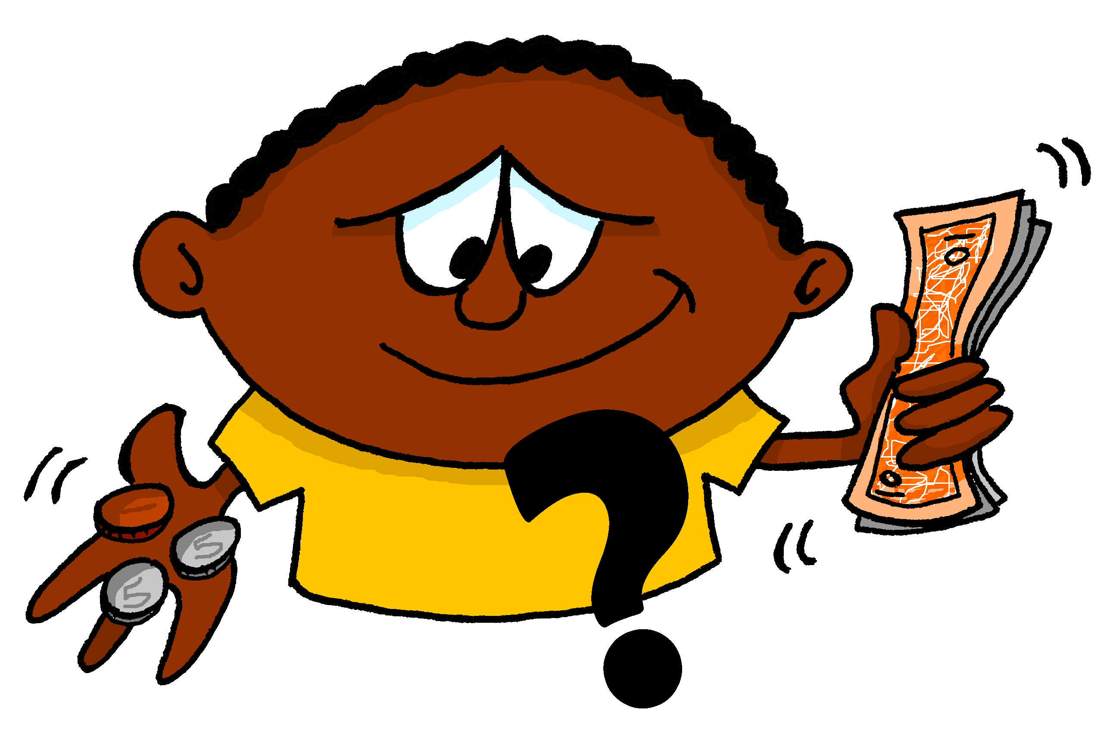
¿cuánto?
how much?
Cuánto
¿ _______ entendiste?
[How much did you understand?]

Slide 30
¿cuántos?
how many?
Cuántos
¿ ________ días saliste?
[How many days did you go out?]

Slide 31
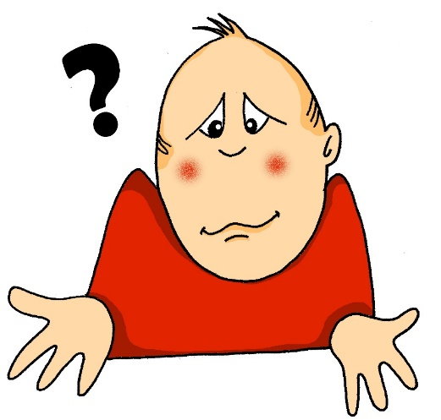
¿cómo?
how?
¿ ______cubriste el costo?
Cómo
[How did you cover the cost?]

Slide 32
¿dónde?
where?
Dónde
¿ _______escribiste tus libros?
[Where did you write your books?]

Slide 33
İHabla en parejas!
hablar
¿Cómo ¿Qué ¿Cuándo ¿Dónde ¿Por qué ¿Cuál | Decides Decidiste Sales Saliste Aprendes Aprendiste Eliges Elegiste | alemán? con la familia? español? por la noche? ayudar en casa? comer? ver una película?
Notes:
Timing: 8 minutes
Aim: to practise comprehension and read aloud of new and revisited language and grammar from this and previous weeks.
Procedure:
Both pupils write 5 sentences (in English) made up of words from the table.
They swap sentences.
Partner A tries to say all B’s sentences in Spanish as quickly as possible.
Then Partner B tries to say all A’s sentences in Spanish.
Adaption:
The person speaking can face the board or face away from the board for greater challenge.
Timing: 10 minutes
Aim: to produce questions in Spanish using –er/-ir verbs in the 2nd person singular present and past (preterite)
Procedure:
Player A rolls the dice twice to generate 1) a question word and 2) the cue for a question in the present or past (‘do you’ or ‘did you’). To complete the question, Player A chooses a word or phrase from the square. The verb will change depending on whether the question is in the present (-es) or in the past (-iste). Each word/phrase from the square can only be used once.
For example, 1 + 6 + subir la montaña generates ‘¿Cómo subiste la montaña?
Players can keep a note of their correctly formed sentences in their exercise books if teachers wish (to then translate into English to finish the activity). Once a word is used it can be crossed out. As the number of possible words decreases, players may have to ‘knock’ if there is no appropriate word to finish their sentence. In this case, play passes to their partner. The player who is able to make the most sentences within the time or until all the words run out is the winner.
In the first instance, students will agree between themselves whether the questions produced make sense. Teachers may need to arbitrate over the validity of certain sentences. As the remaining words decrease, there will be increased creativity! To bring the learning to a close, students should translate into English the sentences that they made. If teachers did not make this a requirement during the speaking activity, teachers could ask students to write sentences with given combinations (an example is given on the next slide), or have students write six of their own choice – the best six that they came up with for example.
Note: ‘perder’ and ‘elegir’ are stem-changing in the 2nd person singular present. Since this hasn’t yet been taught, the verb forms are given as a gloss.
Revisited vocabulary:
8 1.1.6 (revisit): ver [38]; opinión [578]; alemán [761]

Slide 34
Escribe la pregunta
escribir
Ahora escribe las preguntas en español.
Palabras útiles
1 | How do you go up the mountain?
2 | What did you decide to do in summer?
3 | When did you pick up the tickets?
4 | Where do you go out at the weekend?
5 | Why do you learn Chinese?
6 | Which did you decide to study?
Subir , montaña
Decidir, hacer, verano
Recoger, entradas
Salir, el fin de semana
Aprender, chino
Decidir, estudiar
Notes:
Timing: 5 minutes (slides 32-33)
Aim: to practise written production of -er/-ir verbs in the second person singular and question words.
Procedure:
Students write a sentence in Spanish and English from the number combinations on the slide.
The next slide can be used to check answers.

Slide 35
Respuestas
escribir
 | En español | En inglés
1 | ¿Cómo subes la montaña?
2 | ¿Qué decidiste hacer en verano?
3 | ¿Cuándo recogiste las entradas?
4 | ¿Dónde sales el fin de semana?
5 | ¿Por qué aprendes chino?
6 | ¿Cuál decidiste estudiar?
How do you go up the mountain?
What did you decide to do in summer?
When did you collect the tickets?
Where do you go out at the weekend?
Why do you learn Chinese?
Which did you decide to study?
Notes:
ANSWERS

Slide 36
Deberes
Vocabulary Learning Homework (Y8 Term 1.2, Week 3)
Audio file
Student worksheet
In addition, revisit: Y8 Term 1.1 Week 7 Y8 Term 1.1 Week 2
Notes:
The answer sheet for the Y8 vocabulary learning HW is here: https://rachelhawkes.com/LDPresources/Yr8Spanish/Spanish_Y8_Term1ii_Wk3_audio_HW_sheet_answers.docx
Notes:
i) Teachers may, in addition, want to recommend use of a particular online app for the pre-learning of each week’s words. ii) Quizlet now requires parental involvement / registration / permissions for users below the age of 13, so it is perhaps most suitable for Y9 – 11 students. iii) Language Nut hosts LDP vocabulary lists and these are free for schools to use, though there is a registration process. One benefit is that all of the student tracking data that Language Nut offers are also available to schools that use the LDP lists for practice. Perhaps this makes it a good option for Y7/8.
iv) There are other free apps, and new ones are always appearing. Teachers have told us that they are currently using: Flippity, Wordwall (where using previously-created activities is free).
v) Gaming Grammar has been acquired by Language Nut. Its original content should still be available to teachers and much of it is appropriate for Y8 learners.

