Slide 1
Describing events in the past and present (At school)
-er & -ir verbs: 1st person singular preterite (-í)
final syllable stress [revisited]
Y8 Spanish
Term 1.2 - Week 1 - Lesson 15 Amanda Izquierdo / Nick Avery / Jack Peacock Artwork: Mark Davies
Date updated: 09/11/23
Notes:
Note: all words in this week of the SOW appear on all three GCSE wordlists, with the following exceptions: diálogo is only on AQA; describir and imprimir are on neither AQA nor edexcel
Artwork by Mark Davies. All additional pictures selected are available under a Creative Commons license, no attribution required.
Learning outcomes (lesson 1):
Introduction of –er/–ir verbs in past tense (preterite) first person singular
Consolidation of –er/–ir verbs in present simple, first person singular
Consolidation of final syllable stress
Word frequency (1 is the most frequent word in Spanish):
8.1.2.1 (introduce) vocab set: elegir [561]; elijo [elegir-561]; describrir [1272]; compartir [579]; imprimir [2736]; diálogo [1466]; corto [1055]; largo [300]; finalmente [948]
prenominal adjectives: mismo [55]; último [188]; primero [82]; segundo [223]; tercero [450]; propio [183];
8.1.1.5 (revisit) cambio [319]; ruido [1034]; esfuerzo [601]; viaje [519]; gesto [928]; gracioso [3874];
yo [28]; tú [184] él [9]; ella [72]; nosotros/as [164]; ellos/as [9-él]; mientras [127]; mientras que [mientras-127]
7.3.2.6 (revisit) cielo [620]; cenar [3087]; dormir [403]; pelo [873]
Source: Davies, M. & Davies, K. (2018). A frequency dictionary of Spanish: Core vocabulary for learners (2nd ed.). Routledge: London

Slide 2
Vocabulario
hablar
Want to say ‘to choose to do something’?
Use ‘elegir + infinitive’.
 | Word | English meaning
1 | elegir | to choose, choosing
2 | elijo | I choose, am choosing
3 | describir | to describe, describing
4 | imprimir | to print, printing
5 | compartir | to share, sharing
6 | el diálogo | dialogue
7 | corto, corta | short
8 | largo, larga | long
9 | finalmente | finally
Notice the change in spelling!
‘Elijo’ doesn’t follow the normal pattern of verb formation.
Notes:
Timing: 2-4 minutes
Vocabulary practice slide
Aim: to embed word knowledge of this week’s vocabulary set.
Procedure 1. Pupils either work by themselves or in pairs, reading out the words and studying their English meaning (1 minute). 2. Then the English meanings are removed and they try to recall them, looking at the Spanish (1 minute). 3. Then the Spanish meanings are removed and they to recall them, looking at the English (1 minute) 4. Further rounds of learning can be facilitated by one pupil turning away from the board, and his/her partner asking him/her the meanings. This activity can work from L2 → L1 or L1 → L2.
Notes:
1. We introduce ‘elijo’ as a separate lexical item due the spelling changes needed to turn the would-be regular form ‘elego’ into ‘elijo’). This brings it below the threshold for verb regularity used by NCELP (Levenshtein distance).
2. Prenominal adjectives are also introduced as vocabulary items this week (see lesson 2).
Word frequency (1 is the most frequent word in Spanish): elegir [561]; elijo [elegir-561]; describrir [1272]; imprimir [2736]; el diálogo [1466]; corto [1055]; largo [300]; compartir [579]
Source: Davies, M. & Davies, K. (2018). A frequency dictionary of Spanish: Core vocabulary for learners (2nd ed.). Routledge: London

Slide 3
Vocabulario
¿Quién?
hablar / escribir
I
you
he
yo
tú
él
she
we
boys / mixed group
we
all girls
they
boys / mixed group
ella
nosotros
nosotras
ellos
they
all girls
while
(for things happening at the same time)
whereas
(for comparisons)
ellas
mientras
mientras que
Notes:
Timing: 2 minutes
Aim: to revisit subject pronouns (as per the SoW vocabulary revisiting cycle), challenging students to recall the Spanish
Procedure:
1. Students offer answers orally or write the Spanish down
2. The Spanish is revealed by clicking on the text box. Answers can be volunteered in any order.
Words from revisited vocabulary sets 8.1.1.5: yo [28]; tú [184] él [9]; ella [72]; nosotros/as [164]; ellos/as [9-él]; mientras [127]; mientras que [mientras-127]

Slide 4
Saying what I do and I did -er/-ir verbs in present & past (preterite)
Some Spanish infinitives end in –er and –ir.
Remember, the verb ending changes depending on who the verb refers to.
This is the present tense.
o
I learn in class.
Aprend__ en clase.
I write a little.
o
Escrib__ un poco.
To mean ‘I’ with an action completed in the past, remove –er/–ir and add –í.
This is the past tense (preterite).
Aprender
Aprendí
1
I learnt
Escribir
I wrote
2
Escribí
Notes:
Timing: 2 minutes
Revision slide to elicit the rules on 1st person singular present for –er/–ir verbs (-o) and introduce the 1st person singular preterite (-í) for completed actions in past.
Click on the orange action buttons to hear a native speaker model the final syllable stress.

Slide 5
elijo
[I choose | am choosing]
elegí
[I chose]
Notes:
Timing: 3 minutes for sequence of six slides
Aim: to reinforce the 1st person singular form of ‘elegir’ in the present tense and present the 1st person singular form of the verb in the preterite (í).
Procedure
Bring up the form ‘elijo’ on its own, say it, students repeat it, and remind them of the phonics. Draw attention to the SSC [j] and the spelling changes in first person singular present tense.
Try to elicit the meaning from the students.
Then bring up the English translation. Emphasise the two meanings of choose and am choosing.
Bring up the form ‘elegí’, say it, students repeat it. Draw attention to [gí].
Try to elicit the meaning from the students.

Slide 6
elijo
[I choose | am choosing]
elegí
[I chose]
Notes:
Cycle through the first person singular present and preterite tense again.

Slide 7
elijo
[I choose |am choosing]
Elijo una camisa.
[I choose / am choosing a shirt.]
Notes:
Reinforce the present tense in a sentence.

Slide 8
elegí
[I chose]
Elegí una camisa azul.
[I chose a blue shirt.]
Notes:
Introduce the preterite tense in a sentence.

Slide 9
leer
Los amigos de Daniel hablan de sus experiencias en la escuela.
La acción, ¿cuándo es? Escribe la acción en inglés en la columna correcta.
1
[…] aprendo mucho en clase, pero […] decidí hablar con mis amigos.
2
[…] elegí no ayudar, mientras que […] reparto los libros.
3
[…] comparto mis respuestas, pero […] descubrí que es mejor trabajar sola.
 | Normalmente | En la última clase
1
2
3
4
4
decided to speak with friends
[…] escribí muy poco. Sin embargo, […] respondo a muchas preguntas.
learns a lot in class
hands out books
chose not to help
shares her answers
discovered that it’s better to work alone
replies to many questions
wrote very little
Notes:
Timing: 5 minutes
Aim: to make the connection between the –er/–ir verb ending and the corresponding tense (-o for habitual actions in present; -í for completed actions in the past).
Procedure:
Students draw a basic 2-column grid in their books, numbered 1-4, with headers ‘normalmente’ and ‘la última clase’.
Teacher checks understanding of the meaning of the column headers. All language in these headers has been previously taught.
Students read the sentences and complete the table in English, making sure to write the correct action in the correct column. This makes attention to the meaning of the vocabulary task-essential.
Revisited vocabulary
8.1.1.5 mientras que [mientras-127]

Slide 10
Fonética
Final Syllable Stress
Remember, if the final syllable is stressed and the word ends in a vowel or ‘n’ or ‘s’, there is an accent on the final vowel.
also
I wrote
café
también
escribí
–er / –ir verbs in the 1st person singular preterite always have an accent on the final vowel.
Notes:
Timing: 1 minute
Aim: to recap the spelling rules for words with final syllable stress ahead of the next activity

Slide 11
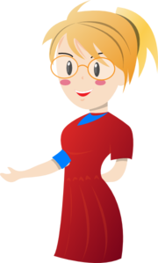
İEn clase!
escuchar y escribir
Escucha y marca la opción correcta.
Luego, escribe la frase en español.
 | Normalmente | En la última clase | Frase en español
te
1
Aprendí palabras largas en inglés.
2
Bebí un café con el profesor.
3
Reparto los libros y otros materiales.
4
Elijo estudiar alemán también.
5
Escribí un diálogo en español.
6
Leí un libro de un autor genial.
Notes:
Timing: 10 minutes
Aim: to practice distinguishing between first person singular present tense and first person singular preterite tense of –er and –ir verbs when listening.
Procedure:
Students first listen decide if the sentence happens normally (‘normalmente’) or last class (‘en la última clase’).
Students listen again and write the sentence in Spanish, focusing in particular on the spelling of words with final syllable stress. All words with final syllable stress ending in a vowel or ‘n’ or ‘s’ will require an accent on the final vowel.
Transcript:
Aprendí palabras largas en inglés.
Bebí un café con el profesor.
Reparto los libros y otros materiales.
Elijo estudiar alemán también.
Escribí un diálogo en español.
Leí un libro de un autor genial.

Slide 12
¿Quién es?
hablar y escuchar
Persona A habla. Persona B identifica la persona correcta.
I write very little in class.
I wrote very little in class.
Señora
Moliner
Asun
¿Eres Asun?
Persona A
Escribí muy poco en clase.
Persona B
Persona A
İSí correcto!
o
İNo! Intenta otra vez
Notes:
Timing: 10 minutes
Aim: to practise using first person singular present tense (-o) and first person singular preterite (-í) of –er and –ir verbs when speaking; to practise retrieving the new vocabulary in oral production
Procedure:
Student A writes numbers 1-6 in their books. Next to each number they write the name of one character. This will determine the order in which to give the sentences.
Student A then says each sentence, one at a time. They will be using the ‘I’ form in every sentence.
Student B listens, looks at the board and gives the name of the person which the sentence corresponds to.
Student A gives feedback to student B according to whether the answer is correct or not (Sí, correcto OR ‘No, intenta otra vez.)
Students swap roles (see next slide for prompts)

Slide 13
¿Quién es?
hablar y escuchar
Persona A habla. Persona B identifica la persona correcta.
I print my homework before class.
I describe the activity to the students.
I wrote a short dialogue in Spanish.
Asun
Señora Perez
Rafa
I write a short dialogue in Spanish.
I printed my homework before class.
I described the activity to the students.
María
Carlos
Señora
Moliner
Notes:
Student A’s prompts
DISPLAY DURING ACTIVITY

Slide 14
¿Quién es?
hablar y escuchar
Persona B habla. Persona A identifica la persona correcta.
I share a book with my friend.
I drink a coffee before class.
I choose to write a long dialogue.
Asun
Señora Perez
Rafa
I chose to write a long dialogue.
I shared a book with my friend.
I drank a coffee before class.
María
Señora
Moliner
Carlos
Notes:
Student B’s prompts
DISPLAY DURING ACTIVITY

Slide 15
Describing events in the past and present (At school)
-er & -ir verbs: 1st person singular preterite (-í)
prenominal adjectives
Y8 Spanish
Term 1.2 - Week 1 - Lesson 16
Victoria Hobson / Nick Avery / Jack Peacock Artwork: Mark Davies
Date updated: 20.10.2023
Notes:
Note: all words in this week of the SOW appear on all three GCSE wordlists, with the following exceptions: diálogo is only on AQA; describir and imprimir are on neither AQA nor edexcel
Artwork by Mark Davies. All additional pictures selected are available under a Creative Commons license, no attribution required.
Learning outcomes (lesson 2):
Consolidation of final syllable stress words
Consolidation of first person singular of –er/-ir verbs in present tense and preterite
Introduction of prenominal adjectives
Word frequency (1 is the most frequent word in Spanish):
8.1.2.1 (introduce) vocab set: elegir [561]; elijo [elegir-561]; describrir [1272]; compartir [579]; imprimir [2736]; diálogo [1466]; corto [1055]; largo [300]; finalmente [948]
prenominal adjectives
mismo [55]; último [188]; primero [82]; segundo [223]; tercero [450]; propio [183];
8.1.1.5 (revisit) cambio [319]; ruido [1034]; esfuerzo [601]; viaje [519]; gracioso [3874]; genial [2890];
yo [28]; tú [184] él [9]; ella [72]; nosotros/as [164]; ellos/as [9-él]; mientras [127]; mientras que [mientras-127]
7.3.2.6 (revisit) cielo [620]; cenar [3087]; dormir [403]; pelo [873]
Source: Davies, M. & Davies, K. (2018). A frequency dictionary of Spanish: Core vocabulary for learners (2nd ed.). Routledge: London

Slide 16
Fonética
escuchar / escribir
Final Syllable Stress
a vowel
If the stress is on the final syllable and the word ends in _________ or the consonants ___ or ___, then there will be an accent.
‘n’
‘s’
Escucha y escribe la palabra en español.
 | cubrí
 | feliz
 | realidad
 | según
 | decidí
 | comer
1
2
3
4
5
6
Notes:
Timing: 7 minutes
Aim: to identify correctly whether the word needs an accent or not.
Procedure:
1. Play the audio.
2. Students write the word in Spanish.
3. Elicit meanings in English during the feedback.
Transcript:
cubrí
feliz
realidad
según
decidí
comer

Slide 17
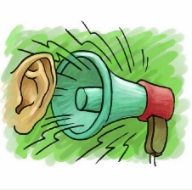
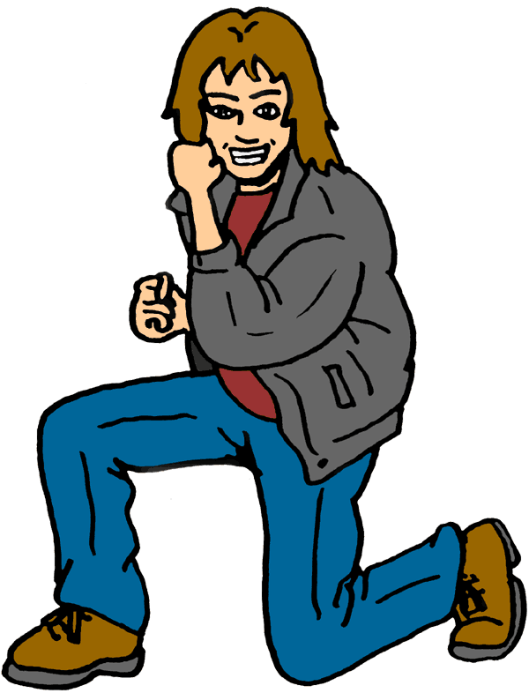
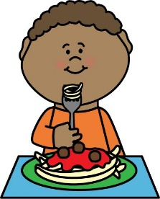
escuchar
Escucha. Identifica la imagen correcta y escribe su letra.
1
2
3
4
5
6
7
8
9
10
11
12
F
J
A
G
E
H
B
I
D
L
C
K
A
B
C
D
E
F
[to make an effort]
[to make
noise]
[to make a
funny gesture]
[to make a great change]
[long hair]
[to go on a long trip]
G
H
I
J
K
L
[to go on a short trip]
[a long dialogue]
[to have dinner alone]
[to sleep alone]
[short hair]
[blue sky]
Notes:
Timing: 7 minutes
Aim: to recap vocabulary from this lesson and sets Y8 1.1.5 and Y7 3.2.6 as per the SoW cycle of revisiting.
Procedure:
1. Give students a minute in pairs to try to anticipate the vocabulary items they hear. This gives the teacher a chance to gauge students’ understanding of the pictures and offer help where necessary.
2. Click the number triggers to play the audio.
3. Go through the answers drawing attention to the vocabulary items.
Transcript:
hacer un cambio genial
cenar solo
el pelo largo
hacer un viaje corto
hacer un gesto gracioso
el pelo corto
hacer un esfuerzo
un diálogo largo
hacer un viaje largo
el cielo azul
11) hacer ruido
12) dormir solo
Vocabulary from revisited sets
8.1.1.5: cambio [319]; ruido [1034]; esfuerzo [601]; viaje [519]; gesto [928]; gracioso [3874]; genial [2890];
7.3.2.6: cielo [620]; pelo [873]; cenar [3087]; dormir [403]

Slide 18
Saying what I do and I did -er/-ir verbs in present & past (preterite)
Remember, the verb ending changes if you are referring to a completed action in the past.
o
I learn the vocabulary.
Aprend__ el vocabulario.
Aprend__ el vocabulario.
I learnt the vocabulary.
í
I describe the activity.
Describo
la actividad.
I described the activity.
Describí
la actividad.
Notes:
Timing: 2 minutes
Grammar revision slide to elicit the rules on 1st person singular present for –er/-ir verbs (-o) and elicit the new form (-í) for completed actions in the past.

Slide 19
Prenominal adjectives
gramática
¿Cómo se dice en español?
As you know, the adjective often comes after the noun.
u_ d_ _ _ _ _ _ c_ _ _ _
u_ d_ _ _ _ _ _ l_ _ _ _
un diálogo corto
un diálogo largo
However, some other adjectives can come before the noun, just like in English.
mismo
último
primero
segundo
tercero
propio
same
last
first
second
third
own
Notes:
Timing: 2 minutes
Grammar explanation slide – prenominal adjectives
Notes:
1. Some adjectives’ meanings change depending on whether they appear before or after the noun (e.g. grande – big, great). We will introduce these later in the KS3 Spanish scheme of work.
2: ‘Propio’ is always used prenominally with a possessive adjective to mean ‘own’ (mi propio, tu propia etc.) It is in this context that we intend to teach it.

Slide 20
Prenominal adjectives
gramática
Por ejemplo:
el último mensaje
the last message
la última llamada
la última llamada
the last call
As you know, most adjectives end in -o when they refer to a masculine noun & -a for a feminine noun.
However, there are several exceptions:
primero
→
primer
before a singular masculine noun
tercero
→
tercer
before a singular masculine noun
Notes:
Timing: 2 minutes
Grammar explanation slide – prenominal adjectives continued.

Slide 21
Prenominal adjectives
gramática
Por ejemplo:
el primer diálogo
the first dialogue
el tercer diálogo
the third dialogue
The feminine form follows its usual pattern (ending in –a):
Two other adjectives also lose the –o ending before a singular masculine noun:
la primera actividad
a good day
un buen día
the first activity
la tercera actividad
a bad day
un mal día
the third activity
Notes:
Timing: 2 minutes
Grammar explanation slide – prenominal adjectives continued

Slide 22
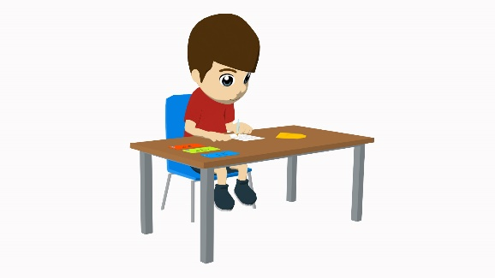
leer
Daniel escribe cartas a unos amigos.
Lee el adjetivo. ¿Cuál debe ser la palabra después?
Y la acción, ¿cuándo es? Marca la opción correcta.
presente
pasado
presente
pasado
1 | Elijo el primer | texto
 |  | actividad
2 | Decidí escribir en inglés el tercer | palabra
 |  | diálogo
3 | Describo a mi propio | ciudad
 |  | profesor
4. | Aprendí sobre el mismo | canción
 |  | lugar
5. | Imprimo la segunda | mensaje
 |  | imagen
6. | Compartí la misma | material
 |  | opinión
Notes:
Timing: 10 minutes
Aim: to use the form of the adjective to decide on the gender of the noun that must follow; to consolidate understanding of –er/–ir verb forms in present and past (preterite)
Procedure:
Students write 1-6.
Students write the correct noun for each sentence, depending on the form of the adjective
Students also write whether the sentence is in the present (presente) or past (pasado).
The teacher elicits English translations of the sentences during feedback to check understanding of vocabulary.
Notes:
Depending on the ability of the group, the two parts of the activity could be completed individually or at the same time.
If students don’t remember the gender of the noun, this can be given or elicited from a fellow student. Recalling the gender of the nouns is not the main aim of the activity.
Definite articles are obscured since this could otherwise be used to decide on the noun, without reference to the form of the adjective.

Slide 23
En clase
escuchar
Escucha a la Señora Moliner.
Marca la posición del adjetivo.
También escribe el nombre y el adjetivo en inglés.
 | Adjective before the noun | Adjective after the noun | Noun + adjective in English
 |  |  | the last class
 |  |  | the famous author
 |  |  | my own mobile
 |  |  | the first activity
 |  |  | the interesting dialogue
 |  |  | the long message
1
2
3
4
5
6
Notes:
Timing: 8 minutes
Aim: to raise awareness of the position of the adjectives in relation to nouns; to accurately translate these pairs of nouns and adjectives into English
Procedure:
1. Click the number trigger to play the audio
2. Students listen to a sentences that either have pre or post-nominal adjectives and decide whether
a) adjective comes before noun
b) adjective comes after noun
3. Students then write the English for the adjective and noun
Note: Higher ability groups could write the whole sentence, if appropriate, to further practise the verb inflections (-o and –í).
Transcript:
Descibí la última clase
Aprendí sobre el autor famoso.
Recibo mi propio móvil.
Elijo la primera actividad
Escribí en inglés el diálogo interesante.
Imprimo el mensaje largo.

Slide 24
İA escribir!
escribir
Traduce las frases al español.
Imprimí el tercer mensaje.
1 | I printed the third message.
2 | I share the same idea.
3 | I received the second present.
4 | I decided to sleep in the small bed.
5 | I write a lot with my blue pen.
6 | I choose to have dinner in the first place.
7 | I read strange books.
Comparto la misma idea.
Recibí el segundo regalo.
Decidí dormir en la cama pequeña.
Escribo mucho con mi bolígrafo azul.
Elijo cenar en el primer lugar.
Leo libros raros.
Notes:
Timing: 10 minutes
Aim: to bring the two features practised across the two lessons together in written production
first person singular present (-o) and preterite (-í) of –er/-ir verbs
prenominal vs post-nominal adjectives
Procedure:
1. Students write the sentence in Spanish
2. The English is revealed on a mouse click.
Vocabulary from revisited sets:
7.3.2.6: dormir [403]; cenar [3087]

Slide 25
Deberes
Vocabulary Learning Homework (Y8 Term 1.2, Week 2)
Audio file
Student worksheet
In addition, revisit: Y8 Term 1.1 Week 6 Y8 Term 1.1 Week 1
Notes:
The answer sheet for the Y8 vocabulary learning HW is here: https://rachelhawkes.com/LDPresources/Yr8Spanish/Spanish_Y8_Term1ii_Wk2_audio_HW_sheet_answers.docx
Notes:
i) Teachers may, in addition, want to recommend use of a particular online app for the pre-learning of each week’s words. ii) Quizlet now requires parental involvement / registration / permissions for users below the age of 13, so it is perhaps most suitable for Y9 – 11 students. iii) Language Nut hosts LDP vocabulary lists and these are free for schools to use, though there is a registration process. One benefit is that all of the student tracking data that Language Nut offers are also available to schools that use the LDP lists for practice. Perhaps this makes it a good option for Y7/8.
iv) There are other free apps, and new ones are always appearing. Teachers have told us that they are currently using: Flippity, Wordwall (where using previously-created activities is free).
v) Gaming Grammar has been acquired by Language Nut. Its original content should still be available to teachers and much of it is appropriate for Y8 learners. Gaming Grammar mini-game Verbs: 1st person in the present & past tense in the ‘Verb agreement (past)’ menu practises aspects of this week’s lessons.

