Slide 1
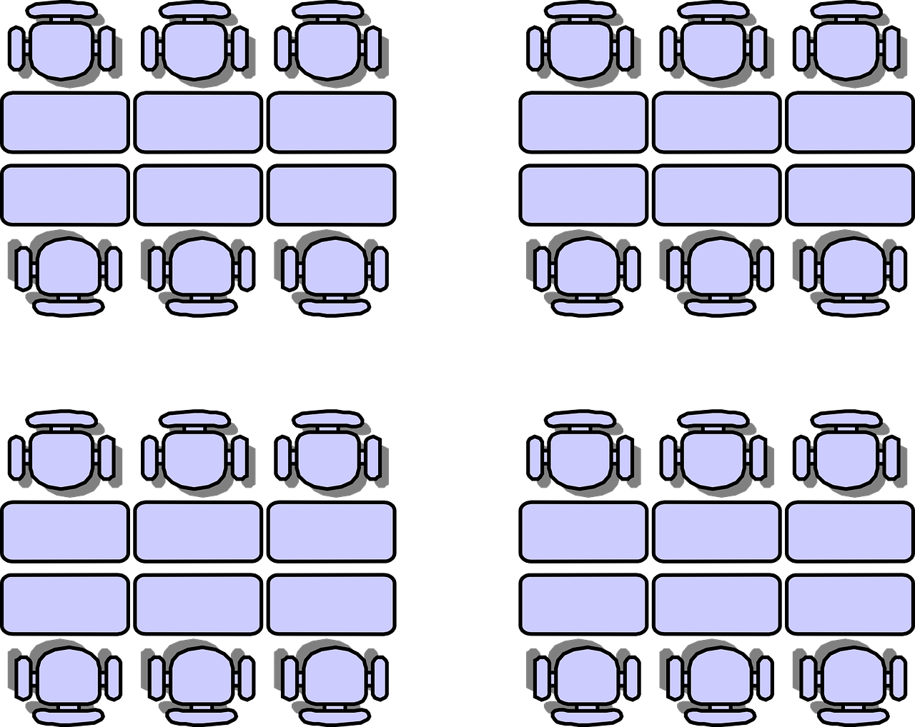
Talking about what people can and must do
In class Using the modal verb ‘PODER Penultimate stress
Y8 Spanish Term 1.1 – Week 6 – Lesson 11 Amanda Izquierdo / Nick Avery / Rachel Hawkes Artwork: Mark Davies Date updated: 27.08.23
Notes:
Note: all words in this week of the SOW appear on all three GCSE wordlists, with the following exceptions: Italia is not on any of the lists; alemán is on AQA and Eduqas, not Edexcel; generalmente on Edexcel and Eduqas, not AQA (though AQA list has general so generalmente can be tested in reading paper.
Learning outcomes (lesson 1):
Consolidation of previously taught forms of PODER (puedo; puede; pueden)
Introduction of the new verb form, podemos.
Consolidation of possessives (mi, mis, tu, tus).
Introduction of penultimate syllable stress and a related spelling rule.
Word frequency (1 is the most frequent word in Spanish):
New vocabulary (introduce): empezar [175]; terminar [253]; decir [31]; ver [38]; minuto [478]; ejemplo [187]; opinión [578]; verdad [176]; estudiante [795]; alemán [761]; todo² [472]
8.1.1.3 (revisit): gente [137]; malo² [360]; sucio [1855]; limpio [1710]; precioso [1777]; listo² [1684]; contento [1949]; triste [1371]; seguro² [407]; igual [263]; quizás [346]; según [237]; así [67]; generalmente [1387]; ahora [81]
7.3.2.4 (revisit): ir [33]; voy; vas; va; barrio [940]; al [a-8]; problema [145]; Italia [N/A]; playa [1475]; enero [1173]; febrero [1419]; sin [54]; día [65]
The frequency rankings for words that occur in this powerpoint which have been previously introduced in NCELP resources are given in the NCELP SOW and in the resources that first introduced and formally re-visited those words.
For any other words that occur incidentally in this powerpoint, frequency rankings will be provided in the notes field wherever possible.
Source: Davies, M. & Davies, K. (2018). A frequency dictionary of Spanish: Core vocabulary for learners (2nd ed.). Routledge: London

Slide 2
Fonética
escuchar / hablar
Some words in Spanish have the stress on the last syllable.
This means that the last syllable is pronounced with more emphasis.
1
caminé
quizás
igual
autor
Many other words have stress on the penultimate (second-last) syllable.
2
amigo
playa
problema
barrio
Notes:
Timing: 2 minutes
Aim: To consolidate understanding of final-syllable stress and to introduce penultimate syllable stress.
Procedure:
Reveal each sentence to recap final-syllable stress.
Listen to the examples and say the words.
Bring up the example words with further clicks.
Learn about penultimate syllable stress.
Listen to the second set of examples and bring up the written words.
Transcript:
caminé, quizás, igual, autor.
amigo, playa, problema, barrio
Note: In lesson 2, we will introduce and practise the spelling rule for words with penultimate syllable stress. In lesson 1, the aim is solely to raise awareness of the two stress patterns.

Slide 3
Fonética
hablar
Escucha y decide. Is the stress on the final syllable or on the penultimate syllable?
 | Penultimate syllable, like ‘playa’ | Final syllable, like ‘igual’
1
2
3
4
5
6
Notes:
Timing: 5 minutes
Aim: To practise identification of final-syllable stress and penultimate syllable stress.
Procedure:
Listen to each word. Is the stress in the penultimate syllable or in the last syllable?
Transcript:
balcón
triste
según
después
seguro
contento

Slide 4
Vocabulario
leer / hablar
el ejemplo
empezar
la opinión
This verb has a change (e>ie) in the stem (the beginning of the verb) in the following forms:
yo empiezo I started
tú empiezas you (singular) started
él/ella empieza he/she/it started
ellos/ellas empiezan they started
terminar
la verdad
[to finish]
to say
el / la estudiante
decir
[student]
[to see]
ver
[German]
el alemán
all, everything
el minuto
todo
Notes:
Timing: 3 minutes
Aim: to develop receptive and productive knowledge of this week’s vocabulary set.
Procedure: 1. Pupils either work by themselves or in pairs, reading out the words and recapping their English meaning (1 minute). 2. Then the teacher removes the English words or pictures (one by one) and they try to recall the English orally (chorally), looking at the Spanish (1 minute). 3. Then the Spanish meanings are removed (one by one) and they to recall them orally (again, chorally), looking at the English (1 minute) 4. Further rounds of learning can be facilitated by one pupil turning away from the board, and his/her partner asking him/her the meanings (‘Cómo se dice X en español?’). This activity can work from L2 → L1 or L1 → L2.
Notes:
The individual subparts of the verb ‘decir’ will be introduced later as they are irregular. For now, we will just practise using the infinitive with modal verbs.
‘Todo’ was previously introduced as an adjective. It is reintroduced here as a pronoun, hence the additional translation ‘everything’.

Slide 5
puedo
[I can| I am able to]
podemos
[we can | we are able to]
Notes:
Poder is one of the 25 most frequent verbs in Spanish. Both the 1st person singular (previously taught) and 1st person plural (new) are presented here in order to familiarise students over the next few slides.
Bring up the word ‘poder’ on its own, say it, students repeat it, and remind them of the phonics.
Try to elicit the meaning from the students.
Then bring up the English translations. Emphasise the two meanings.
Bring up the word ‘podemos’, say it, students repeat it.
Try to elicit the meanings from the students. Emphasise the two meanings.

Slide 6
puedo
[can| to be able to]
podemos
[we can | we are able to]
Notes:
Cycle through the 1st person singular and plural again.

Slide 7
puedo
[I can | I am able to]
Puedo aprender alemán en mi escuela.
[I can learn German in my school.]
Notes:
Introduce the 1st person singular in a sentence.

Slide 8
podemos
[we can| we are able to]
Podemos terminar cinco minutos antes.
[We can finish five minutes before.]
Notes:
Introduce the 1st person plural in a sentence.
Note: in this sentence, ‘antes’ could also be translated as ‘early’. This will be pointed out in later slides. Students previously learnt ‘antes’ as ‘before’, so we use this as the translation to avoid any possible confusion.

Slide 9
puedo
[I can | I am able to]
Puedo
______ aprender alemán en mi escuela.
[I can learn German in my school.]
Notes:
Cycle through the 3rd person singular in context again.

Slide 10
podemos
[we can| we are able to]
Podemos
_________ terminar cinco minutos antes.
[We can finish five minutes before.]
Notes:
Cycle through the 1st person plural in context again.

Slide 11
En clase
La profesora escucha las preguntas de los estudiantes.
leer
¿Quién habla, un estudiante o todos los estudiantes?
¿Podemos empezar en cinco minutos?
Who asks...? | Un estudiante (‘I’) | Los estudiantes (‘we’)
to see an example?
to do do everything in English?
to start in five minutes?
to say things in German?
to finish the activity now?
to give their opinion?
¿Puedo terminar la actividad ahora?
¿Puedo ver un ejemplo?
¿Puedo dar mi opinión?
¿Puedo hacer todo en inglés?
¿Podemos decir cosas en alemán?
Notes:
Timing: 7 minutes
Aim: to practise connecting the 1st person singular and plural forms of ‘poder’ with their meanings.
Procedure:
1. Read the phrases.
2. Answer the questions. Who asks these questions, ‘I’ or ‘we’?
Note: as the speech bubbles are not numbered, attention to the vocabulary is also made task-essential.

Slide 12
Puede and pueden (revisited)
gramática
puede
Remember that to say ‘s/he can’ or ‘it can’, use _______.
pueden
To say ‘they can’, use ________. Compare:
She can say everything in German.
Puede decir todo en alemán.
They can give examples.
Pueden dar ejemplos.
Also, remember that to say ‘my’ in singular, use ____
To say ‘my’ in plural, use ____. Compare:
mi
mis
My friend can tell the truth.
Mi amigo puede decir la verdad.
My students can finish.
Mis estudiantes pueden terminar.
Notes:
Timing: 1 minute
Aim: To recap the 3rd person singular and plural of the modal verb ‘poder’ ahead of subsequent activities. Also, to revise the singular ‘mi’ and the plural ‘mis’ for ‘my’ in English.
Procedure:
Reveal each sentence to show students the English phrases and elicit the Spanish translation.

Slide 13
En clase
Escucha. ¿Es ‘puede’o ‘pueden’?
escuchar
Escucha otra vez. Ahora escribe la información en inglés.
 | ‘puede' | ‘pueden’
¿Quién o qué? En inglés | ¿Qué actividad? En inglés
1
My classmates
speak Spanish
2
My friend Daniel
be very silly in class
go to school on Monday
3
My sister
finish the class 10 minutes before / early
4
My (female) teachers
5
to win again without a problem
My team
6
My homework
be very dirty
Notes:
Timing: 10 minutes
Aim: Consolidate understanding of 3rd person singular and plural forms of ‘poder’ in the oral modality. Consolidate understanding of the agreement between the possessive adjectives ‘mi’ and ‘mis’ and the 3rd person singular/plural verb forms.
Procedure:
Listen to each phrase and decide if it the missing word would be ‘puede’ or ‘pueden’ depending on the subject that you hear.
Then, listen again and write in English who or what the phrase refers to.
Lastly, write in English what activity each phrase refers to.
Note: the Spanish for ‘x minutes early’ is ‘x minutos antes’.
Transcript:
Mis compañeros [beep] hablar español.
Mi amigo Daniel [beep] ser muy tonto en clase.
Mi hermana no [beep] ir al colegio los lunes.
Quizás mis profesoras [beep] terminar la clase diez minutos antes.
Estoy seguro: mi equipo [beep] ganar otra vez sin problema.
Es verdad, a veces mis deberes [beep] estar muy sucios.

Slide 14
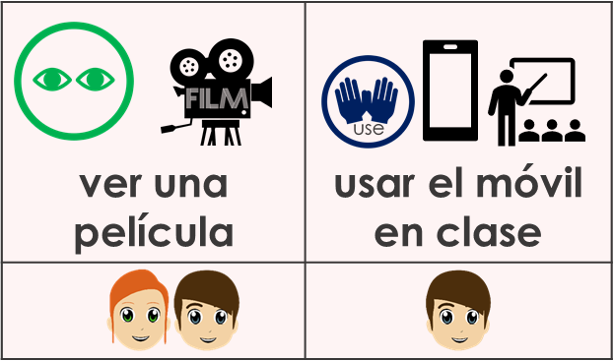
En clase y en casa
hablar / escuchar
A: Turn away from the board. Say ‘he can’ or ‘they can’ in Spanish to start a sentence.
B: Finish the sentence in Spanish, using the prompts, according to which verb form you have heard.
A: Write in Spanish what you hear, then translate into English.
Puede …
Puede usar el móvil en clase.
Persona B
(habla):
Un ejemplo:
Persona A (habla):
 Puede usar el móvil en clase. He can use his/a phone in class.
Puede = s/he can Pueden = they can
Notes:
Timing: 12-20 minutes (three slides) – timing can be flexible depending on number of rounds. Aim: to practise making and understanding 2-verb statements with poder in 3rd persons singular and plural.
Procedure:
Use this slide to model the activity.
Student As will turn away from the board. They are going to start 6 sentences – either ‘puede’ or ‘pueden’ (their own choice each time).
Student Bs face the board and, working in number order 1-6, they answer the question differently, according to the verb and whether they hear ‘puede’ or ‘pueden’.
Student As note down the response in Spanish (and then English). This practises transcription and then comprehension.
When all 6 statements have been made, As turn back to the board and check their responses – checking that the responses match the prompts.
Then they swap roles and move to the next slide for Round 2.
NB: there are two versions of the activity; one has Spanish verbal phrase prompts and pictures; the other has pictures only. If students have started with the supported version, and there is time, they should repeat the task with just picture prompts. Teachers will select the most appropriate entry point in this activity for their students. It would be possible to adapt the support further, e.g., giving first letter prompts and pictures, instead of full phrases.

Slide 15
En clase 1/2)
A: Say ‘he can’ or ‘they can’ in Spanish to start.
escuchar / hablar
B: Finish the sentence in Spanish, according to these prompts, depending on the start.
llevar libros a casa | quedar con amigos
terminar temprano los viernes | caminar a casa
coger el autobús | empezar a aprender alemán
1
2
3
4
disfrutar las vacaciones | hacer los deberes
5
dormir hasta tarde | jugar
6
ver una película | usar el móvil en clase
Notes:
Round 1 – less challenging
Note: i) there is an alternative version of this activity, with handouts and full sentences, at the end of this slide deck. ii) there is a more challenging version of this activity on the next slide, with just picture prompts.
Timing: 8 minutes (two slides) – timing can be flexible depending on number of rounds. Aim: to practise making and understanding 2-verb statements with poder in 3rd persons singular and plural.
Procedure:
Student As turn away from the board. They are going to start 6 sentences – either ‘puede’ or ‘pueden’ (their own choice each time).
Student Bs face the board and, working in number order 1-6, they answer the question differently, according to the verb and whether they hear ‘puede’ or ‘pueden’.
Student As note down the response in Spanish (and then English). This practises transcription and then comprehension.
When all 6 statements have been made, As turn back to the board and check their responses with B – checking that the responses match the prompts.
Then swap roles and move to the next slide for Round 2.

Slide 16
En clase 1/2)
A: Say ‘he can’ or ‘they can’ in Spanish to start.
escuchar / hablar
B: Finish the sentence in Spanish, according to these prompts, depending on the start.
1
2
3
4
5
6
Notes:
This is Round 1 – more challenging.

Slide 17
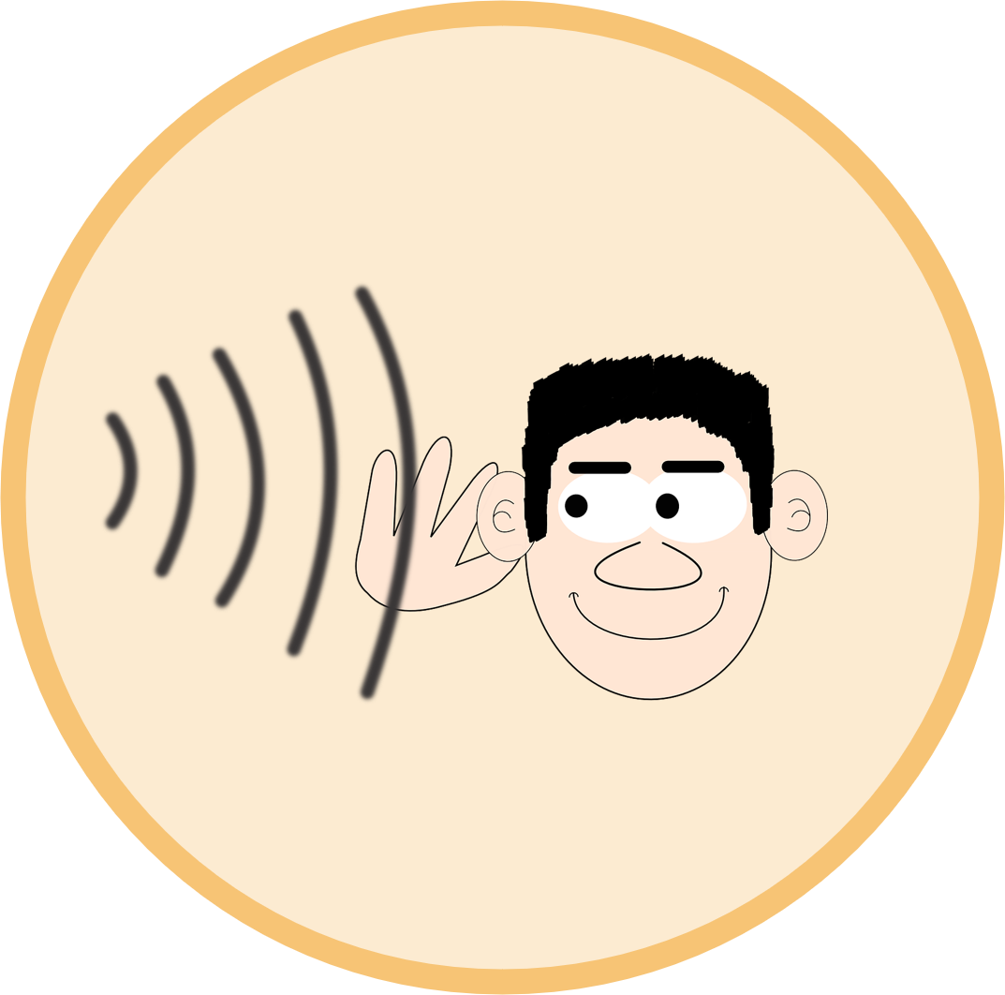
En clase (2/2)
A: Say ‘he can’ or ‘they can’ in Spanish to start.
hablar
B: Finish the sentence in Spanish, according to these prompts, depending on the start.
leer en casa | ir al barrio en bici
hablar con gente en alemán | empezar a aprender inglés
1
3
1
2
2
terminar temprano los miércoles
llegar tarde los lunes
6
4
quedar con los amigos | jugar con los amigos
5
6
5
coger el autobús | hacer los deberes
escuchar música en casa | bailar juntos en casa
Notes:
[2/2] Round 2 – less challenging

Slide 18
En clase (2/2)
A: Say ‘he can’ or ‘they can’ in Spanish to start.
hablar
B: Finish the sentence in Spanish, according to these prompts, depending on the start.
1
3
1
2
2
6
4
5
6
5
Notes:
[2/2] Round 2 – more challenging

Slide 19
Talking about what people can and must do (2)
In class Using the modal verb ‘DEBER’ Penultimate stress
Y8 Spanish Term 1.1 – Week 6 – Lesson 12 Amanda Izquierdo / Nick Avery / Rachel Hawkes Artwork: Mark Davies Date updated: 27.08.23
Notes:
Note: all words in this week of the SOW appear on all three GCSE wordlists, with the following exceptions: Italia is not on any of the lists; alemán is on AQA and Eduqas, not Edexcel; generalmente on Edexcel and Eduqas, not AQA (though AQA list has general so generalmente can be tested in reading paper.
Learning outcomes (lesson 2):
Consolidation of DEBER (debo, debes, debe, deben)
Introduction of ‘debemos’
Introduction of spelling rules based on penultimate syllable stress
Word frequency (1 is the most frequent word in Spanish):
New vocabulary (introduce): empezar [175]; terminar [253]; decir [31]; ver [38]; minuto [478]; ejemplo [187]; opinión [578]; verdad [176]; estudiante [795]; alemán [761]; todo² [472]
8.1.1.3 (revisit): gente [137]; malo² [360]; sucio [1855]; limpio [1710]; precioso [1777]; listo² [1684]; contento [1949]; triste [1371]; seguro² [407]; igual [263]; quizás [346]; según [237]; así [67]; generalmente [1387]; ahora [81]
7.3.2.4 (revisit): ir [33]; voy; vas; va; barrio [940]; al [a-8]; problema [145]; Italia [N/A]; playa [1475]; enero [1173]; febrero [1419]; sin [54]; día [65]
Source: Davies, M. & Davies, K. (2018). A frequency dictionary of Spanish: Core vocabulary for learners (2nd ed.). Routledge: London

Slide 20
Fonética
leer / hablar
As you know, some words in Spanish have a written accent.
The written accent depends on which syllable is stressed and on what the last letter of the word is.
Rule: if the penultimate syllable is stressed and the word ends in any vowel or ‘n’ or ‘s’, then there is no accent on the stressed vowel.
martes
triste
lápiz
Compare:
móvil
These words end in consonants other than ‘n’ and ‘s’, so they need an accent.
Notes:
Timing: 2 minutes
Aim: To introduce the first rule of accentuation in Spanish.
Procedure:
Reveal each sentence to introduce the first rule of accentuation.
Observe, listen and compare the examples.
Transcript:
martes, móvil, triste, lápiz

Slide 21
Fonética
Escucha las palabras y escribe. ¿Necesitan un acento o no?
escuchar / escribir
Rule: If the penultimate (2nd to last) syllable is stressed and the word ends in any vowel OR ‘n’ or ‘s’ then there is no accent. On words (with 2nd to last syllable stress) ending in any other consonant, write an accent.
 | Palabra en español
1
ejemplo
2
fútbol
3
difícil
4
árbol
5
minuto
6
Cádiz
Notes:
Timing: 6 minutes
Aim: to practise with the first rule regarding accentuation in Spanish. Do these words need written accents according to the rule?
Procedure:
Work the first one through together as an example.
Continue with items 2-6. Students listen to each word and write them down. Do these words need a written accent?
Transcript:
ejemplo
fútbol
difícil
árbol
minuto
Cádiz
Adaption: To provide more support in this activity, remove the accents and provide the words (minus accents) so that students just focus all their attention on whether the words need an accent or not, as they list.

Slide 22
¿Cómo se dice en español?
hablar
[according to]
[bad]
según
malo
s_ _ _ _
1.
m_ _ _
8.
limpio
[like that, like that]
l_ _ _ _
a_ _
a_ _
2.
9.
así
p_ _ _ _ _ _ _
g_ _ _ _ _ _ _ _ _ _
3.
precioso
10.
generalmente
a_ _ _ _
listo
ahora
4.
l_ _ _ _
or
[smart]
11.
s_ _
contento
sin
5.
c_ _ _ _ _ _
[happy]
12.
enero
t_ _ _ _ _
e_ _ _ _
6.
triste
[sad]
13.
same
febrero
f_ _ _ _ _ _
igual
14.
f_ _ _ _ _ _
7.
i_ _ _ _
Notes:
Timing: 5 minutes
Aim: to recall previously taught vocabulary, including words from lesson 1, that will be used in this lesson.
Procedure:
Ask students to try to say the word in Spanish represented by each image. To encourage learners to recall this vocabulary only the first letter of each word is provided.

Slide 23
The modal verb ‘deber’
gramática
To say that someone ‘must’ do something, use the the verb ‘deber’.
Compare:
debo
I must = _______
debe
S/he must = ______
deben
They must = _______
debemos
To refer to ‘we’ with the verb ‘deber’, use__________
We must finish now =
Debemos terminar ahora
Notes:
Timing: 2 minutes
Aim: To revise the 1st person singular, 3rd person singular and plural of the verb ‘deber’, and to introduce its form in 1st person plural.
Note that the –emos ending was also previously taught in 8.1.1.4, so should have some familiarity already.
Procedure:
Reveal each word/sentence and elicit the Spanish translation.

Slide 24
Un trabajo en grupo
Lucía y Daniel preparan un trabajo en grupo. İEl ordenador tiene un problema, quizás un virus!
leer
¿Quién debe hacer cada tarea? Lee las frases. ¿Están en el texto o no? Escribe 1-8 y ‘verdadero’ o ‘falso.’
[Lucía y Daniel - nosotros] debemos decir las tareas de cada estudiante. Después, [Virginia - ella] debe buscar información y [los estudiantes] deben trabajar juntos. [Lucía y Daniel – nosotros] debemos pedir la opinión de los compañeros y [los estudiantes - ellos] deben empezar todo. Pero antes [Virginia - ella] debe hablar con la profesora y [Lucía y Daniel – nosotros] debemos comprar material.
kihiujnkwdkw
1) “…she must say the tasks of each student.”
2) “…we must search for information.”
3) “…they must work together.”
4) “…we must ask for classmates’ opinions.”
5) “…she must start everything.”
6) “…she must speak with the teacher.”
7) “…they must buy material.”
rwfshsq
wqlñpfcv
qwazxcym
qzxm
shkhnftj
enmo
çfarew
rwqfgbg
wqvd
Notes:
Timing: 10 minutes (two slides)
Aim: To identify different forms of the verb ‘deber’ (‘debe’, ‘debemos’, ‘deben’) within a longer text.
Procedure:
1. Read the text.
2. Read the statements 1-7.
3. Decide if the statements are true or false according to the text.
4. Answers are revealed on the next slide.
Note:
The task is designed so that subjects are obscured. The true/false questions are based only on whether the verb ‘deber’ refers to ‘we’, ‘s/he’ or ‘they’. This means that the only way to complete the task is to pay attention to the verb form.

Slide 25
Un trabajo en grupo
Lucía y Daniel preparan un trabajo en grupo. İEl ordenador tiene un problema, quizás un virus!
leer
¿Quién debe hacer cada tarea? Lee las frases. ¿Están en el texto o no? Escribe 1-8 y ‘verdadero’ o ‘falso.’
[Lucía y Daniel - nosotros] debemos decir las tareas de cada estudiante. Después, [Virginia - ella] debe buscar información y [los estudiantes] deben trabajar juntos. [Lucía y Daniel – nosotros] debemos pedir la opinión de los compañeros y [los estudiantes - ellos] deben empezar todo. Pero antes [Virginia - ella] debe hablar con la profesora y [Lucía y Daniel – nosotros] debemos comprar material.
kihiujnkwdkw
1) “…she must say the tasks of each student.”
2) “…we must search for information.”
3) “…they must work together.”
4) “…we must ask for classmates’ opinions.”
5) “…she must start everything.”
6) “…she must speak with the teacher.”
7) “…they must buy material.”
rwfshsq
wqlñpfcv
qwazxcym
qzxm
shkhnftj
enmo
çfarew
rwqfgbg
wqvd
Notes:
ANSWER SLIDE

Slide 26
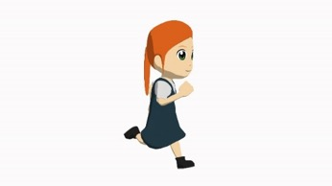
Lucía habla del colegio
Lucía habla del colegio con la abuela.
escuchar
Escucha. ¿Quién es? Marca la persona correcta.
Who must…? | Lucía y Daniel (‘we must’) | La profesora (‘she must’) | Los otros estudiantes (‘they must’)
1. do the homework?
2. give many examples?
3. study more?
4. help?
5. say everything in German?
6. always finish five minutes early?
más = more
Notes:
There are TWO versions of the activity, with the SAME AUDIO. This is the more straightforward version.
Timing: 10 minutes
Aim: to practise listening in a holistic way (1 minute audio). See note below.
Procedure:
Read the statements 1-10.
Listen to the recording.
Tick who must do each task according to the use of the verb ‘deber’.
Listen again
Allow time to finish completing the grid.
Answers are revealed with further clicks.
Transcript:
Daniel y yo tenemos una clase de alemán. Generalmente debemos ser limpios y, además, debemos hacer siempre los deberes. La profesora debe dar muchos ejemplos.
Según la profesora, ¡debemos estudiar más! Debemos aprender palabras nuevas. Los otros estudiantes no tienen problemas, entonces deben ayudar. Ellos deben decir todo en alemán.
La profesora siempre debe terminar la clase cinco minutos antes. Los otros estudiantes deben ir a otra clase después.
Notes:
One aim of such activities is to help students to become familiar and comfortable with listening beyond the level of the individual sentence. While there is a focus on person agreement (‘who does what’), the activity does not strictly adhere to the principles of input processing in other grammar activities. This is because the aim is not solely to focus on the verb, but to also listen carefully for referents.
‘Más’ [23] will be introduced in Year 8. All other words have been previously taught in the scheme of work.

Slide 27
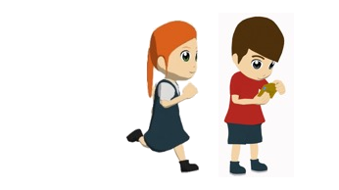
Lucía habla del colegio
Lucía habla del colegio con la abuela.
escuchar
Escucha. ¿Quién es? Marca la persona correcta.
Who must…? | Lucía y Daniel (‘we must’) | La profesora (‘she must’) | Los otros estudiantes (‘they must’) | The story doesn’t say
1. do the homework?
2. say the truth?
3. give many examples?
4. study more?
5. start an exchange?
6. help?
7. say everything in German?
8. always finish five minutes early?
9. go to another class after?
más = more
Notes:
There are TWO versions of the activity, with the SAME AUDIO. This is the more challenging version. Note: if teachers want to do both versions simultaneously WITHOUT printing the sheets, they should display this version and put the six questions from the previous slide in BOLD, and direct certain students to those six questions.
Timing: 10 minutes
Aim: to practise listening in a holistic way (1 minute audio). See note below.
Procedure:
Read the statements 1-10.
Listen to the recording.
Tick who must do each task according to the use of the verb ‘deber’.
Listen again
Allow time to finish completing the grid.
Answers are revealed with further clicks.
Transcript:
Daniel y yo tenemos una clase de alemán. Generalmente debemos ser limpios y, además, debemos hacer siempre los deberes. La profesora debe dar muchos ejemplos.
Según la profesora, ¡debemos estudiar más! Debemos aprender palabras nuevas. Los otros estudiantes no tienen problemas, entonces deben ayudar. Ellos deben decir todo en alemán.
La profesora siempre debe terminar la clase cinco minutos antes. Los otros estudiantes deben ir a otra clase después.
Notes:
One aim of such activities is to help students to become familiar and comfortable with listening beyond the level of the individual sentence. While there is a focus on person agreement (‘who does what’), the activity does not strictly adhere to the principles of input processing in other grammar activities. This is because the aim is not solely to focus on the verb, but to also listen carefully for referents and to consider what is and isn’t said (see the final column, ‘the story doesn’t say’). Such tasks are necessary in natural language use.
‘Más’ [23] will be introduced in Year 8. All other words have been previously taught in the scheme of work.

Slide 28
¡A escribir!
escribir
[terminar]
[empezar]
I can
I must
[llevar]
win a prize
S/He can
[ir]
[decir]
S/He must
We can
[hacer]
[dar]
[ver]
We must
Puedo ganar un premio.
They can
[pedir]
[estar]
They must
[ser]
Notes:
Timing: 5-15 minutes (slides 26-35) Note: teachers can decide how many examples (1-10) of these to do, using the remainder of the time flexibly, for example, for a vocabulary test OR homework feedback. Or this written activity can also be completed as a ‘low stakes’ assessment.
Aim: to produce sentences (either orally or written) with accurate use of both ‘poder’ and ‘deber’, bringing together the different forms practised across the two lessons.
Procedure:
Write (or say aloud) the sentence revealed on the white board with the correct choice of verb in the correct tense.
The answer is revealed on a mouse click.

Slide 29
¡A escribir!
escribir
[terminar]
[empezar]
I can
I must
[llevar]
say the truth
S/He can
[ir]
[decir]
S/He must
We can
[hacer]
[dar]
[ver]
We must
Debemos decir la verdad.
They can
[pedir]
[estar]
They must
[ser]
Notes:
[2/10]

Slide 30
¡A escribir!
escribir
[terminar]
[empezar]
I can
I must
[llevar]
give an example
S/He can
[ir]
[decir]
S/He must
We can
[hacer]
[dar]
[ver]
We must
Deben dar un ejemplo.
They can
[pedir]
[estar]
They must
[ser]
Notes:
[3/10]

Slide 31
¡A escribir!
escribir
[terminar]
[empezar]
I can
I must
[llevar]
start early
S/He can
[ir]
[decir]
S/He must
We can
[hacer]
[dar]
[ver]
We must
Podemos empezar temprano.
They can
[pedir]
[estar]
They must
[ser]
Notes:
[4/10]

Slide 32
¡A escribir!
escribir
[terminar]
[empezar]
I can
I must
[llevar]
see the beach
S/He can
[ir]
[decir]
S/He must
We can
[hacer]
[dar]
[ver]
We must
Pueden ver la playa.
They can
[pedir]
[estar]
They must
[ser]
Notes:
[5/10]

Slide 33
¡A escribir!
escribir
[terminar]
[empezar]
I can
I must
[llevar]
go to the neighbourhood
S/He can
[ir]
[decir]
S/He must
We can
[hacer]
[dar]
[ver]
We must
Debe ir al barrio.
They can
[pedir]
[estar]
They must
[ser]
Notes:
[6/10]

Slide 34
¡A escribir!
escribir
[terminar]
[empezar]
I can
I must
[llevar]
take my materials
S/He can
[ir]
[decir]
S/He must
We can
[hacer]
[dar]
[ver]
We must
Debo llevar mis materiales.
They can
[pedir]
[estar]
They must
[ser]
Notes:
[7/10]

Slide 35
¡A escribir!
escribir
[terminar]
[empezar]
I can
I must
[llevar]
ask for your opinion
S/He can
[ir]
[decir]
S/He must
We can
[hacer]
[dar]
[ver]
We must
Podemos pedir tu opinión.
They can
[pedir]
[estar]
They must
[ser]
Notes:
[8/10]

Slide 36
¡A escribir!
escribir
[terminar]
[empezar]
I can
I must
[llevar]
finish 10 minutes early
S/He can
[ir]
[decir]
S/He must
We can
[hacer]
[dar]
[ver]
We must
Puede terminar diez minutos antes.
They can
[pedir]
[estar]
They must
[ser]
Notes:
[9/10]

Slide 37
¡A escribir!
escribir
[terminar]
[empezar]
I can
I must
[llevar]
do everything like this/that
S/He can
[ir]
[decir]
S/He must
We can
[hacer]
[dar]
[ver]
We must
Deben hacer todo así.
They can
[pedir]
[estar]
They must
[ser]
Notes:
[10/10]

Slide 38
Deberes
Vocabulary Learning Homework (Y8 Term 1.1, Week 7)
Audio file
Student worksheet
In addition, revisit: Y8 Term 1.1 Week 4 Y7 Term 3.2 Week 5
Notes:
The answer sheet for the Y8 vocabulary learning HW is here: https://rachelhawkes.com/LDPresources/Yr8Spanish/Spanish_Y8_Term1i_Wk7_audio_HW_sheet_answers.docx
Notes:
i) Teachers may, in addition, want to recommend use of a particular online app for the pre-learning of each week’s words. ii) Quizlet now requires parental involvement / registration / permissions for users below the age of 13, so it is perhaps most suitable for Y9 – 11 students. iii) Language Nut hosts LDP vocabulary lists and these are free for schools to use, though there is a registration process. One benefit is that all of the student tracking data that Language Nut offers are also available to schools that use the LDP lists for practice. Perhaps this makes it a good option for Y7/8.
iv) There are other free apps, and new ones are always appearing. Teachers have told us that they are currently using: Flippity, Wordwall (where using previously-created activities is free).
v) Gaming Grammar has been acquired by Language Nut. Its original content should still be available to teachers and much of it is appropriate for Y8 learners.

Slide 39
hablar / escuchar
¿Quién puede hacer las actividades? ¿Daniel o Lucía y Daniel?
Use your cards to
say ‘puede’ or ‘pueden’, depending on the information on the card.
read out the activities. Don’t say the person’s name!
Your partner will say sentences. Take turns.
Un ejemplo:
Puede caminar al colegio.
Persona A (habla):
Persona B
(escribe en inglés):
caminar al colegio | X
 |  | En inglés
‘they can’
‘he can’
X
walk to school
Notes:
ALTERNATIVE VERSION OF SPEAKING ACTIVITY FROM LESSON 1
Timing: 12 minutes
Aim: To practise forms ‘puede’ and ‘pueden’, the use of infinitives and this week’s vocabulary.
Procedure:
Person A uses their prompt cards to say ‘puede’ or ‘pueden’ and the rest of the sentence in Spanish.
Student B listens and ticks the right column (Daniel – ’puede’ or Daniel and Lucía – ‘pueden’). Then, student B writes the activity in English.
Students swap roles.

Slide 40
Persona A
llevar libros a casa. | X
terminar temprano los viernes. |  | X
empezar a aprender alemán. |  | X
disfrutar las vacaciones en Italia. | X
coger el autobús juntos. |  | X
quedar con amigos del colegio. | X
 |  | En inglés
‘they can’
‘he can’
Notes:
Person A prompt cards and answer grid
DO NOT DISPLAY DURING ACTIVITY
See accompanying Word doc for printable version.
Words revisited from 7.3.2.4:
Italia

Slide 41
Persona B
ver una película en la cama. |  | X
usar el móvil en clase todos los días. | X
dormir hasta tarde los domingos. |  | X
hablar con gente en otros idiomas. |  | X
ir al barrio en bicicleta. | X
jugar después de terminar los deberes. |  | X
 |  | En inglés
‘they can’
‘he can’
Notes:
Person B prompt cards and answer grid
DO NOT DISPLAY DURING ACTIVITY
See accompanying Word doc for printable version.
Words revisited from 7.3.2.4:
Ir [33]; al; barrio [940]; día [65]

Slide 42
Persona A - Solución
Persona B - Solución
 |  | En inglés
 |  | En inglés
‘they can’
‘he can’
‘they can’
‘he can’
X
watch a film in bed
X
take books home
use the phone in class everyday
¿Cómo se dice en español?
I go:
s/he goes:
you go:
X
X
finish early on Fridays
voy
sleep until late on Sundays
X
X
start to learn German
va
speak with people in other languages
to enjoy holidays in Italy
X
vas
X
go to the neighbourhood by bike
X
X
take the bus together
play after finishing (the) homework
meet with friends from school
X
X
Notes:
ANSWER SLIDE
DO NOT DISPLAY DURING ACTIVITY
See accompanying Word doc for printable version.
The three forms of IR in present tense singular persons are revisited here as they were taught as lexical items in 7.3.2.4, which is revisited this week.

