Slide 1
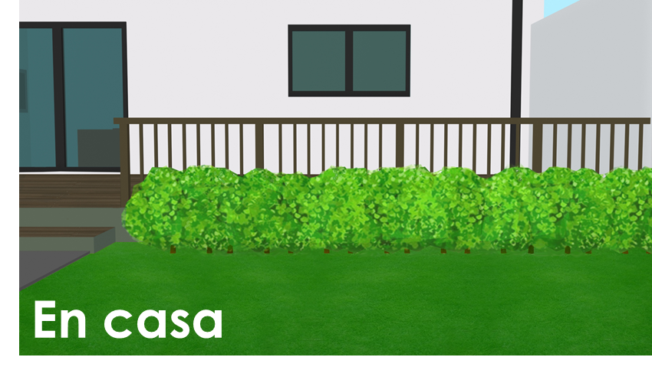
Describing what people do
At home HACER (revisited) Subject pronouns Final syllable stress
Y8 Spanish Term 1.1 – Week 5 – Lesson 9 Victoria Hobson / Nick Avery / Rachel Hawkes Artwork: Mark Davies Date updated: 27.08.23
Notes:
Artwork by Mark Davies. All additional pictures selected are available under a Creative Commons license, no attribution required.
Note: all words in this week of the SOW appear on all three GCSE wordlists, with the following exceptions: gesto is only on the Eduqas list: esfuerzo, gracioso, genial are on AQA and Eduqas but not Edexcel list.
Learning outcomes (lesson 1):
Introduction of final syllable stress for words ending with a vowel.
Introduction of subject pronouns: yo, tú, él, ella.
Consolidation of ‘hacer’ in singular persons
Word frequency (1 is the most frequent word in Spanish):
8.1.1.5 (introduce) vocab set: hacemos [26-hacer]; hacen [26]; cambio [319]; ruido [1034]; esfuerzo [601]; viaje [519]; gesto [928]; gracioso [3874]; genial [2890]; mientras que [mientras-127]; entonces [74]
Subject pronouns
yo [28]; tú [184] él [9]; ella 72]; nosotros [164]; ellos [9-él]; ellas [72-ella]
Y8, 1.1.2 (revisit) cantar [717]; tomar [133]; coger [1001]; intentar [411]; ganar¹ [295]; concierto [1456]; premio [1090]; año [46]; autobús [3709]; hasta¹ [60]; además [155]; por² [15]; canción [982]
Y7, 3.2.3 (revisit) mi [37]; tu [53]; móvil [2143]; llave [1853]; perdido [1899]; completamente [1185]; calle [269]; niño [173]
The frequency rankings for words that occur in this powerpoint which have been previously introduced in NCELP resources are given in the NCELP SOW and in the resources that first introduced and formally re-visited those words.
For any other words that occur incidentally in this powerpoint, frequency rankings will be provided in the notes field wherever possible.
Source: Davies, M. & Davies, K. (2018). A frequency dictionary of Spanish: Core vocabulary for learners (2nd ed.). Routledge: London

Slide 2
Fonética
hablar
Final Syllable Stress
İPilla al intruso!
también
comer
Madrid
también
después
después
realidad
autobús
autobús
Remember, if the final syllable is stressed, and the word ends in any consonant except ‘n’ or ‘s’, there is no accent.
Notes:
Timing: 2 minutes
Aim: to recap the accent vs. no accent rule on final syllable stress words ending in a consonant.
Procedure:
Ask students to identify the odd one out in the two examples. Ensure that students understand that this will be based on spelling and not on meaning.
Use this as a platform to recap the rule which appears on a mouse click.
Note: this rule was introduced and practised last week (8.1.1.4)

Slide 3
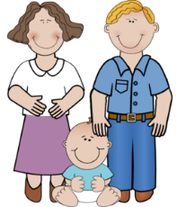
Fonética
leer / hablar
Final Syllable Stress
If the final syllable is stressed and the word ends in a vowel, then there is an accent on the final vowel.
I sang
café
papá
canté
Notes:
Timing: 1 minute
Aim: to explain the rule of final stress syllable words: if the word ends in a vowel, there will be an accent on the final vowel.
Procedure:
Read the explanation.
Introduce the example words to exemplify the rule.

Slide 4
¿Cómo se escribe?
escuchar / escribir
Escucha y escribe las palabras en español.
 | profesor
 | gané
 | canción
 | además
 | mamá
 | ideal
1
2
3
4
5
6
Notes:
Timing: 6 minutes
Aim: to practise applying the final stress rule by listening to the words and writing them, deciding which needs an accent.
Procedure:
Explain to students that they will be practising the spelling of all three types of word with final syllable stress: 1) words that end in a consonant other than –n/-s; 2) words that end in –n/-s; and 3) words that end in a vowel.
Play the audio be clicking on the number trigger. (Play each word twice.)
Students write the word in Spanish.
At the end of the listening activity, give students 1 minute in pairs to give the meanings of these words in English.
Take feedback and clarify any meanings students cannot recall.
Transcript:
profesor
gané
canción
además
mamá
ideal

Slide 5
Vocabulario
leer / hablar
el ruido
el esfuerzo
el gesto
el cambio
mientras que
genial
mientras
gracioso
while
funny
effort
whereas
gesture
change
noise
great
Notes:
Timing: 2 minutes
Aim: to consolidate students’ knowledge of this week’s vocabulary
Procedure:
Click to reveal the English.
Students say out loud the word in Spanish from the selection.
Note: ‘hacemos’ and ‘hacen’ will be introduced separately, as will the subject pronouns. The words ‘viaje’ and ‘entonces’ will be introduced in lesson 2.

Slide 6
mientras | mientras que
hablar
Use mientras to talk about two things that happen at the same time.
e.g. Ana escribe mientras Daniel estudia.
Ana writes while Daniel studies.
Use mientras que to contrast two things.
e.g. Ana escribe mucho, mientras que Daniel solo escribe en la escuela.
Ana writes a lot, whereas Daniel only writes at school.
Notes:
Timing: 1 minute
Aim: to make explicit the difference in meaning between ‘mientras’ and ‘mientras que’
Procedure: go through the explanation clicking to bring up each part of it in order

Slide 7
Vocabulario
leer
while
gesture
effort
great
whereas
noise
change
funny
mientras que
el cambio
mientras
whereas
el esfuerzo
while
change
genial
great
effort
funny
noise
gesture
Notes:
Timing: 2 minutes
Aim: to promote recall of meanings in English of this week’s vocabulary.
Procedure:
1. Give students 30 seconds to consider the options, then remove these with a click of the mouse
2. Students write the translation into English of the 8 words.

Slide 8
Vocabulario
escribir
while
gesture
effort
change
el esfuerzo
el cambio
mientras
el gesto
whereas
funny
noise
great
mientras que
gracioso
el ruido
genial
Notes:
Timing: 2 minutes
Aim: to promote recall from English to Spanish with correct spellings of this week’s vocabulary.
Procedure:
Students write the word in Spanish for the eight vocabulary items.

Slide 9
Using subject pronouns yo (I) and tú (you)
gramática
In Spanish, remember the verb (or its ending) tells us who it refers to.
Here is an example with the verb hacer (to do/make):
I do / make
you do / make
Hago = _________________.
Haces = _________________.
When comparing different people, Spanish uses a subject pronoun (e.g. I, you, he) before the verb. This makes it clear who the verb refers to.
Yo hago la cama, mientras que tú no haces tareas.
I make the bed, whereas you don’t do tasks.
In English, we always use the subject pronoun here too!
So, ‘yo’ means ‘I’ and ‘tú’ means ‘you’.
Notes:
Timing: 1 minute
Aim:
to recap the first and second person singular forms of ‘hacer’
to introduce one function of subject pronouns: to add clarity about who the verb refers to when verbs are used to refer to different people (‘He does X, but I do Y’).
Procedure:
Click to bring up each part of the explanation.

Slide 10
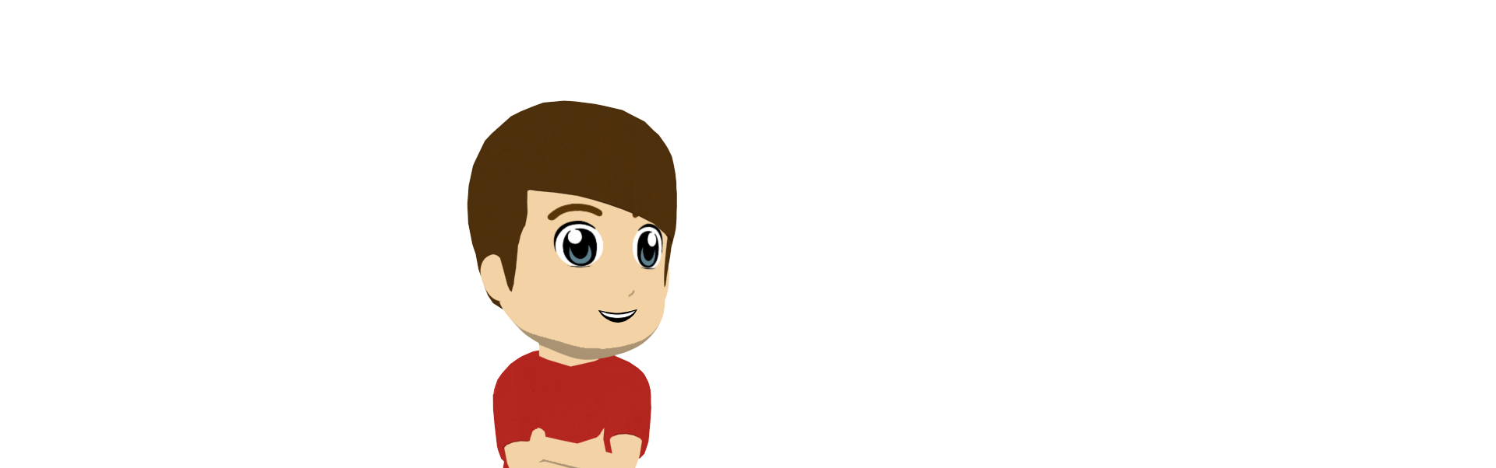
La semana de Lucía y Daniel
Lucía y Daniel comparan sus actividades durante la semana. Los verbos no están.
leer
Lee cada frase. ¿Quién hace la actividad, ‘tú’ o ‘yo’?
Escribe las actividades en inglés.
‘I’
‘You’
 | septiembre |  | septiembre
lunes | Yo vídeos y tú entrevistas. | jueves | Yo deporte y tú los deberes.
martes | Tú la comida mientras que yo ……..la cama | viernes | Tú ejercicio. Yo gestos graciosos.
miércoles | Yo un esfuerzo, pero tú solo ruido. | Notas
Mon
Tues
Weds
Thurs
Fri
make
videos
do
interviews
make the
bed
make the food
make an effort
(only) make
noise
do
sport
do homework
make funny gestures
do exercise
İConcierto de Jason Darulo en octubre!
Notes:
Timing: 8 minutes
Aim:
to practise connecting the subject pronouns ‘yo’ and ‘tú’ with the meanings ‘I’ and ‘you’
to decide, in each instance, whether hacer + noun translates as ‘do’ or ‘make’
Procedure:
1. Students read the texts and write the activity for ‘I’ and the activity for ‘you’ in the correct day of the week on the grid.
Note: attention to the vocab items is also made task-essential in this activity, as students have to write the English translation. This will reinforce understanding of vocabulary.

Slide 11
Using subject pronouns él (he) and ella (she)
gramática
hace
To say ‘s/he does’ or ‘s/he makes’ you say: _________.
Sometimes it is unclear from the verb alone whether it refers to ‘he’ or ‘she’.
1
2
So, we can use the subject pronouns:
él (he) and ella (she)
Él hace la comida mientras ella hace deporte.
He makes the food while she does sport.
Notes:
Timing: 2 minutes
Aim: to introduce a second function of subject pronouns: to make clear who the verb refers to when the referent is ambiguous
Procedure: click to bring up each part of the explanation in order. Click on the orange action buttons to hear the difference in pronunciation between él and ella.

Slide 12
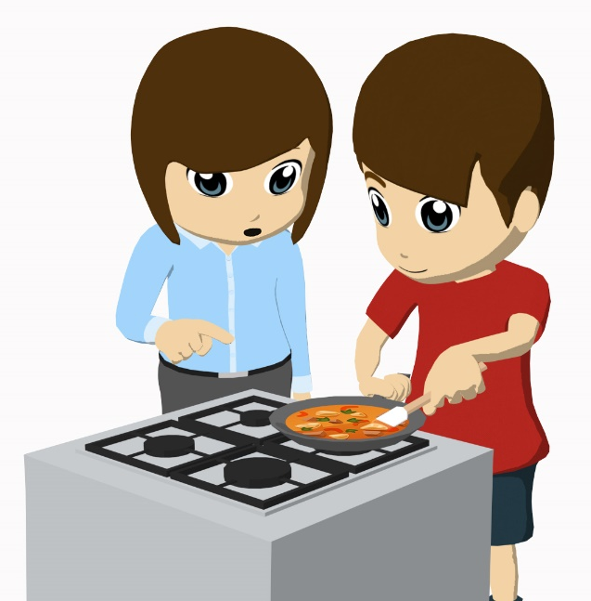
Las actividades en casa
Ana, la madre de Daniel, habla sobre las actividades en casa.
escuchar/ leer
Escucha. ¿Quién hace la actividad? Escribe en inglés ‘he’ o ‘she’.
Luego, escribe ‘does’ o ‘makes’ y la actividad en inglés.
 | Actividad | ‘he’ or ‘she’ | does / makes | Activity in English
 | dibujo
Ej.
she
does
drawing
Notes:
Timing: 10 minutes (two slides)
Aim: to model the task requirements ahead of the listening on the following slide
Procedure:
Listen to the example and decide whether ‘he’ or ‘she’ refers to the activity given in Spanish.
Play the audio again to give students a second time to listening for ‘I’ or ‘you’.
Students then write the English for the activity and decide whether, in context, ‘hacer’ refers to ‘do’ or ‘make’.
Transcript
Ejemplo: Él hace karate, pero ella hace dibujo.

Slide 13
Las actividades en casa
Ana, la madre de Daniel, habla sobre las actividades en casa.
escuchar/ leer
Escucha. ¿Quién hace la actividad? Escribe en inglés ‘he’ o ‘she’.
Luego, escribe ‘does’ o ‘makes’ y la actividad en inglés.
 | Actividad | ‘he’ or ‘she’ | does / makes | Activity in English
 | deporte
 | los deberes
 | películas
 | ruido
 | un esfuerzo (a veces)
 | un cambio
1
she
does
sport
2
he
does
homework
3
he
makes
films
4
he
makes
noise
an effort (sometimes)
5
she
makes
6
she
makes
a change
Notes:
Aim: Increase aural awareness of the subject pronouns ‘él’ and ’ella’ and understanding of which person each refers to. To also reinforce knowledge of the translation into English of ‘hacer’ in context.
Procedure:
Listen to the audio and decide whether ‘he’ or ‘she’ refer to the activity given in Spanish.
Play the audio again to give students a second time to listening for ‘he’ or ‘she’.
Students then write the English for the activity and decide whether, in context, ‘hacer’ refers to ‘does’ or ‘makes’.
Transcript
1) Ella hace deporte todos los días, pero él hace otras cosas.
2) Él hace los deberes por la tarde, mientras (que) ella hace vídeos.
3) Ella hace planes por la tarde, mientras que él hace películas.
4) Ella hace entrevistas, pero hay un problema: él hace ruido.
5) Él siempre hace ejercicio; ella solo hace un esfuerzo a veces.
6) Él hace amigos durante las vacaciones, pero ella hace un cambio: quiere estar con la familia.

Slide 14
Las actividades en casa
hablar
B: Pregunta en español? ‘What does he do?’ OR ‘What does she do?’ A: Responde según tus cartas. B: Escribe la respuesta en español e inglés.
¿Qué hace ella?
Hace entrevistas.
Ej.
[makes videos]
[does interviews]
Es importante usar ‘él’ o ‘ella’.
1. Hace entrevistas.
She does interviews.
You know it is ‘she’ because you asked ‘ella’.
Notes:
Timing: 10 minutes
Aim: to practise asking and answering about activities in the 3rd person singular, using pronouns to make it clear who the question is targeting, and understanding the replies.
Procedure:
Model the activity using this slide.
A turns away from the board.
Move to the next slide to display A’s 5 prompt cards (not to be printed, just viewed on screen).

Slide 15
Las actividades en casa
hablar
Persona A
1.
[does homework]
[does drawing]
2.
[makes tasty dishes]
[makes the bed]
3.
[makes an effort in class]
[makes an effort at home]
4.
[does a lot of sport]
[makes a lot of noise]
5.
[makes funny gestures]
[makes a big change]
Notes:
[2/3] A’s prompts. B must not see these – s/he should be facing away from the board.
Procedure:
1. Student B asks. 2. Student A answers based on picture 1 and the pronounce heard. 3. Student B writes down the answer in Spanish and English.
4. After 5 questions, B turns to see the board and checks own answers.

Slide 16
Las actividades en casa
hablar
Persona B
1.
[makes a big effort]
[makes a small change]
2.
[makes a lot of noise]
[makes funny gestures]
3.
[does drawing]
[does karate]
4.
[makes a call]
[makes a film]
5.
[does homework]
[makes the food]
Notes:
[3/3] B’s prompts. A must not see these – s/he should be facing away from the board.
Procedure:
1. Student A asks. 2. Student B answers based on picture 1 and the pronounce heard. 3. Student A writes down the answer in Spanish and English.
4. After 5 questions, A turns to see the board and checks own answers.

Slide 17
Describing what people do
At home [2] HACER - hacemos, hacen
Subject pronouns (cont’d.)
Final syllable stress (cont’d.)
Y8 Spanish Term 1.1 – Week 5 – Lesson 10 Victoria Hobson / Nick Avery / Rachel Hawkes Artwork: Mark Davies Date updated: 27.08.23
Notes:
Artwork by Mark Davies. All additional pictures selected are available under a Creative Commons license, no attribution required.
Note: all words in this week of the SOW appear on all three GCSE wordlists, with the following exceptions: gesto is only on the Eduqas list: esfuerzo, gracioso, genial are on AQA and Eduqas but not Edexcel list.
Learning outcomes (lesson 2):
Consolidation of final syllable stress of words ending with a vowel.
Introduction of subject pronouns: nosotros/as, ellos/as
Introduction of hacemos, hacen.
Word frequency (1 is the most frequent word in Spanish):
8.1.1.5 (introduce) vocab set: hacemos [26-hacer]; hacen [26]; cambio [319]; ruido [1034]; esfuerzo [601]; viaje [519]; gesto [928]; gracioso [3874]; genial [2890]; mientras que [mientras-127]; entonces [74]
Subject pronouns
yo [28]; tú [184] él [9]; ella 72]; nosotros [164]; ellos [9-él]; ellas [72-ella]
Y8, 1.1.2 (revisit) cantar [717]; tomar [133]; coger [1001]; intentar [411]; ganar¹ [295]; concierto [1456]; premio [1090]; año [46]; autobús [3709]; hasta¹ [60]; además [155]; por² [15]; canción [982]
Y7, 3.2.3 (revisit) mi [37]; tu [53]; móvil [2143]; llave [1853]; perdido [1899]; completamente [1185]; calle [269]; niño [173]
Source: Davies, M. & Davies, K. (2018). A frequency dictionary of Spanish: Core vocabulary for learners (2nd ed.). Routledge: London

Slide 18
Fonética
hablar / escuchar / escribir
Trabaja en parejas.
Remember, if the word has final syllable stress and it ends in a vowel or ‘n’ or ‘s’, it will need an accent.
La primera vez:
Persona A
Lee cada frase a tu pareja.
Persona B
Escribe cada frase en español, İsin mirar la pizarra!
Luego, ¡a cambiar de papel!
Notes:
Timing: 10 minutes (3 slides)
Aim: to practise pronouncing and spelling words with final-syllable stress correctly (at sentence level)
Procedure:
1. Use this slide to explain the activity and before moving on to the next slide, student B turns away from the board.
2. Student A reads aloud each of the four sentences one at a time.
3. Student B writes each sentence down.
4. After all 4 sentences have been said by his/her partner, student B turns around to see the board to check his/her spellings (focusing in particular on the use of accents).
5. Before swapping roles, check students’ understanding of the meanings by giving pairs one minute to think about the translations into English.
Note:
Ask the student to turn away from the board (first B, then A) before the sentences are displayed on the board.

Slide 19
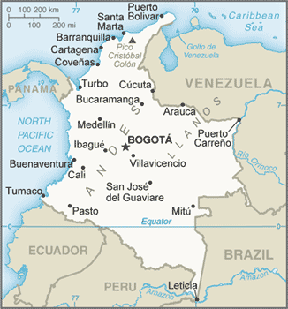
Fonética
hablar / escuchar / escribir
Persona A
Lee cada frase a tu pareja.
Persona B
Escribe cada frase en español, İsin mirar la pizarra!
1 | Intenté hablar con un profesor sobre el premio.
2 | Según mi mamá, coger el autobús es ideal.
3 | El año pasado, viajé a Bogotá en avión.
4 | ¿Quién está detrás del director?
Bogotá es la capital de Colombia
Notes:
Student A’s sentences for student B
Image retrieved from
https://www.cia.gov/library/publications/the-world-factbook/geos/co.html

Slide 20
Fonética
hablar / escuchar / escribir
Persona B
Lee cada frase a tu pareja.
Persona A
Escribe cada frase en español, İsin mirar la pizarra!
1 | Tomé el autobús hasta la estación.
2 | Es genial estudiar español en Madrid.
3 | Beber un café en el balcón es una opción.
4 | Quedé con mi papá después de la actividad.
Notes:
Student B’s sentences for student A

Slide 21
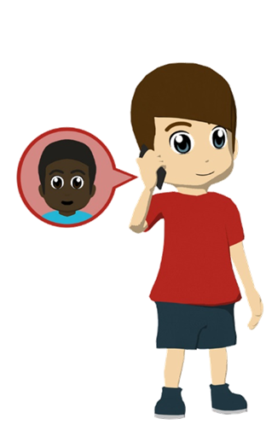
Daniel habla con un amigo
escuchar
1
Escucha. ¿Las frases son verdaderas (V) o falsas (F)?
1. Daniel is lost.
F
‘no estoy perdido’
2. He is in the street.
V
‘estoy en la calle’
3. He talks about ‘my’ house.
F
‘…cerca de tu casa’
4. The dog is calm.
F
‘un perro completamente loco’
5. He doesn’t have the key.
V
‘no tengo la llave’
6. He asks his friend to open the door.
V
…¿puedes abrir la puerta?’
Notes:
Note: either do this listening activity OR the reading one at the end of this slide deck. Timing: 6 minutes
Aim: to revisit vocabulary as per the SoW revisiting cycle
Procedure:
Students listen to the short recording.
They then answer the true/false questions
Students listen again. They note down the words/phrases they hear in the text that makes them decide if it’s true or false.
Transcript:
¡Hola! No estoy perdido. Estoy en la calle cerca de tu casa, según mi móvil. Hay unos niños aquí y ¡un perro completamente loco! No tengo la llave, entonces ¿puedes abrir la puerta en un momento? ¡Chao!

Slide 22
hacemos
[we do | we make]
hacen
[they do | they make]
Notes:
Timing: 3 minutes for sequence of six slides
Aim: to introduce 1st and 3rd person plural of ‘hacer’
Procedure
Bring up the form ‘hacemos’ on its own, say it, students repeat it, and remind them of the phonics. Draw attention to the SSC [ce]
Try to elicit the meaning from the students.
Then bring up the English translation. Emphasise the two meanings of do/make and doing/making.
Bring up the form ‘hacen’, say it, students repeat it. Draw attention to [ce]
Try to elicit the meaning from the students. Emphasise the two meanings of do/make and doing/making.

Slide 23
hacemos
[we do | we make]
hacen
[they do | they make]
Notes:
Cycle through the forms hacemos and hacen again.

Slide 24
hacemos
[we do | we make]
Hacemos mucho ruido.
[We make a lot of noise.]
Notes:
Introduce the form hacemos in a sentence.

Slide 25
hacen
[they do | they make]
Hacen un esfuerzo grande.
[They make a big effort.]
Notes:
Introduce the form hacen in a sentence.

Slide 26
hacemos
hacemos
[we do | we make]
[we do | we make]
__________ mucho ruido.
Hacemos
__________ mucho ruido.
Hacemos
[We make a lot of noise.]
[We make a lot of noise.]
Notes:
Cycle through the form hacemos in context again.

Slide 27
hacen
hacen
[they do | they make]
Hacen
________ un esfuerzo grande.
[They make a big effort.]
Notes:
Cycle through the form hacen in context again.

Slide 28
¿Qué hace Daniel con los amigos?
Y ¿Y qué hacen los amigos sin él? Lee el texto y escribe ‘we’ o ‘they’.
leer
Estudiar es importante, entonces hacemos un esfuerzo en clase.
Note: hacer un viaje translates into English as ‘to go on a trip’.
Hacen un gesto amable todos los domingos.
 | We | They
Who does homework everyday?
Who makes a kind gesture every Sunday?
Who is making an effort in class?
Who makes noise in concerts?
Who goes on a trip every year in summer?
Who is making a change?
Hacemos un viaje cada año en verano.
Hacemos un viaje cada año en verano.
Hacen un cambio de dieta por los animales .
Hacen los deberes todos los días.
Hacemos ruido en los conciertos.
Notes:
Timing: 8 minutes
Aim: to practise connecting the verb endings –emos and –en to the meanings ‘we’ and ‘they’
Procedure:
1. Students read the texts.
2. Students indicate, by ticking or writing ‘we’ or ‘they’ for the different actions in the table.
3. If the vocabulary revisiting activity earlier was the listening, draw attention to ‘entonces’ [74], which is introduced this week as ‘so’ (for consequences).
Note:
The questions and speech bubbles don’t appear in a particular order. Therefore, for each item, students will need to search for the lexical verb corresponding to their question. This will help to reinforce understanding of vocabulary.
It may be necessary to explain that the use of ‘él’ in the instruction refers to ‘him’ rather than ‘he’, but there is no need to dwell on this.

Slide 29
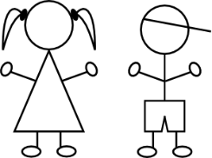
Using subject pronouns nosotros, nosotras (‘we’) & ellos, ellas (‘they’)
gramática
él
ella
To say ‘he’, use : _____. To say ‘she’, use _______.
To say ‘we’, use nosotros
for an all male / mixed group.
1
Use nosotras for an all female group.
2
To say ‘they’, use ellos
for an all male / mixed group.
3
Use ellas for an all female group.
4
Notes:
Timing: 2 minutes
Aim: to recap ‘él’ and ‘ella’; to introduce ‘nosotros/as’ and ‘ellos/as’
Procedure: go through the explanation. Click on the orange action button to hear the pronunciation modelled.

Slide 30
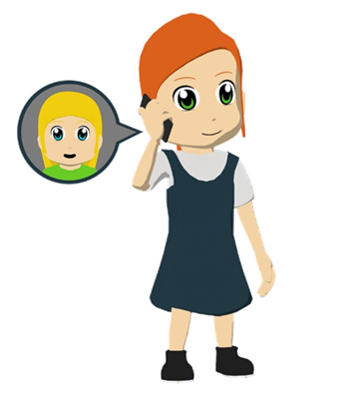
Lucía habla ahora. ¿Quién hace las actividades?
Escucha y escribe ‘we’ o ‘they’.
escuchar
Escucha otra vez. ¿Es un grupo mixto/de chicos o chicas?
chicos y chicas / chicos
solo chicas
 | Who….? | We | They | /
 | goes on trips to Argentina
 | makes a change in August
 | does homework every day
 | does little sport
 | makes noise in the house
te | makes an effort in science classes
1
2
3
4
5
6
Notes:
Timing: 10 minutes
Aim: 1) to practise connecting the subject pronouns nosotros/as and ellos/as with their meanings ‘we’ and ‘they’; 2) to focus on the agreement of the endings ‘–os’ and ‘–as’ with male/mixed group and female only group.
Procedure:
1. Students listen for the subject pronoun connected with the activity indicated in each number and tick the correct response.
2. Students listen a second time for the –os or –as ending to indicate the gender make-up of the group.
Transcript:
Nosotros [beep] viajes a Francia. Ellas [beep] viajes a Argentina
Ellos [beep] un cambio en agosto y nosotras [beep] un cambio en febrero.
Ellos [beep] deberes los domingos y nosotros [beep] deberes todos los días.
Ellas [beep] poco deporte y nosotras ¡[beep] mucho!
Nosotros [beep] ruido en casa, mientras que ellos [beep] ruido fuera.
Nosotras [beep] un esfuerzo en las clases de ciencias, pero ellas [beep] un esfuerzo en todas las clases.

Slide 31
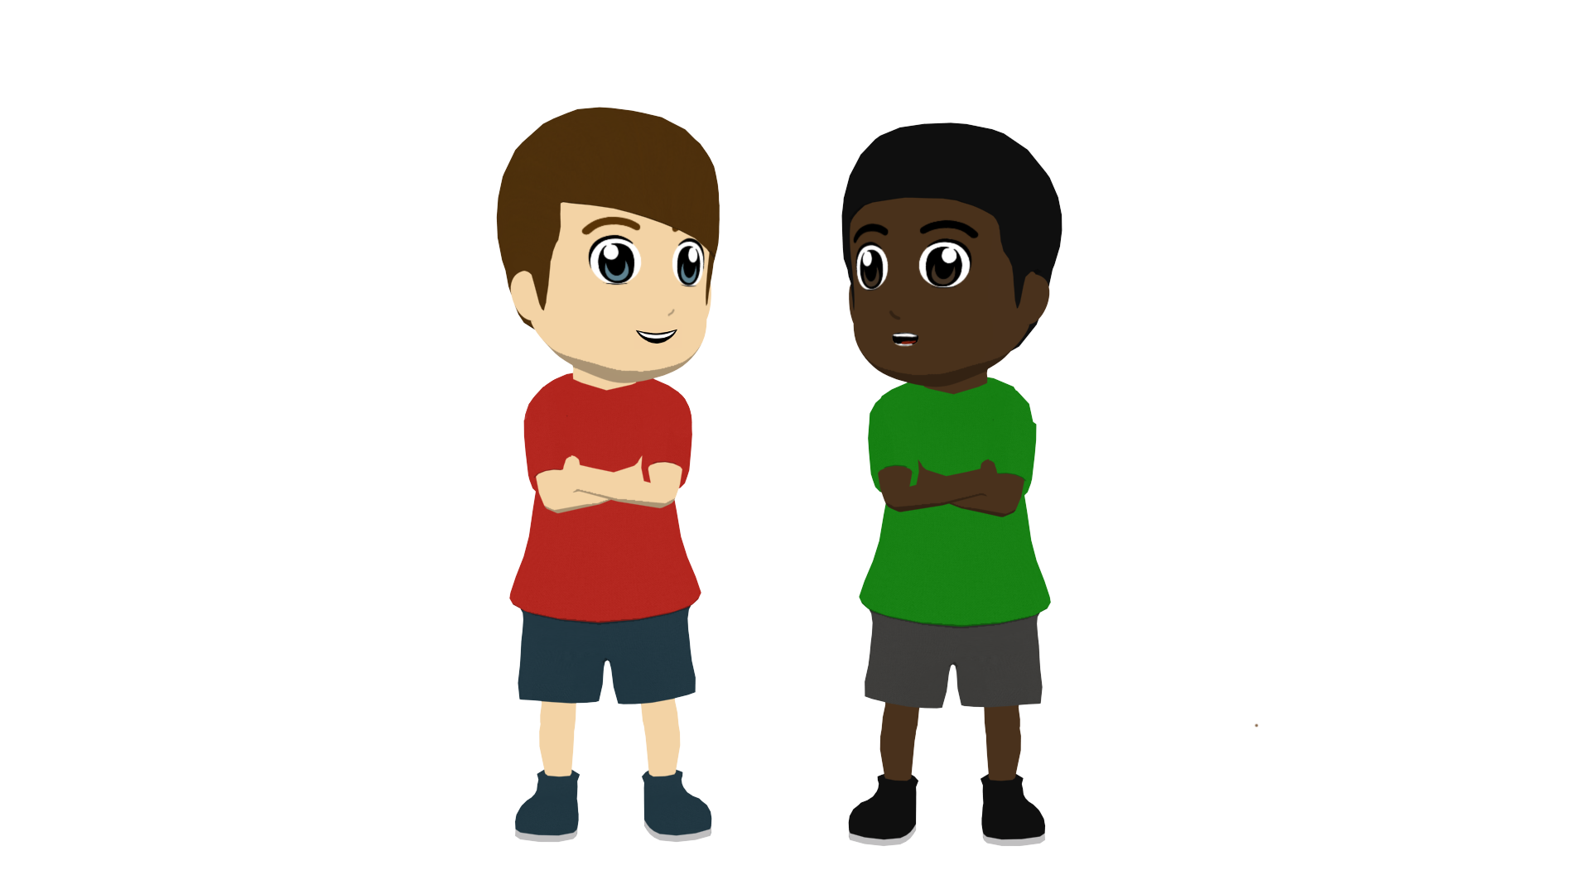
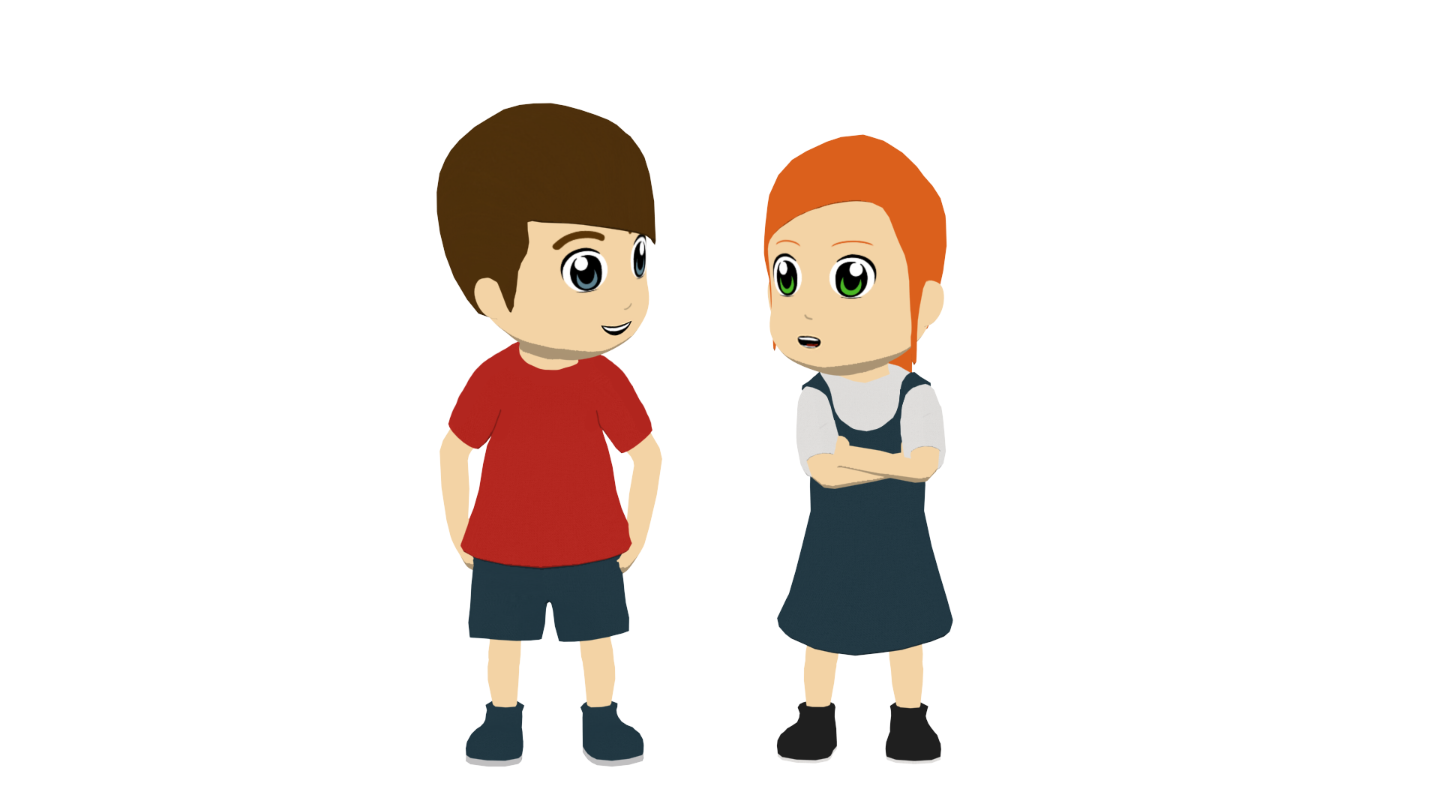
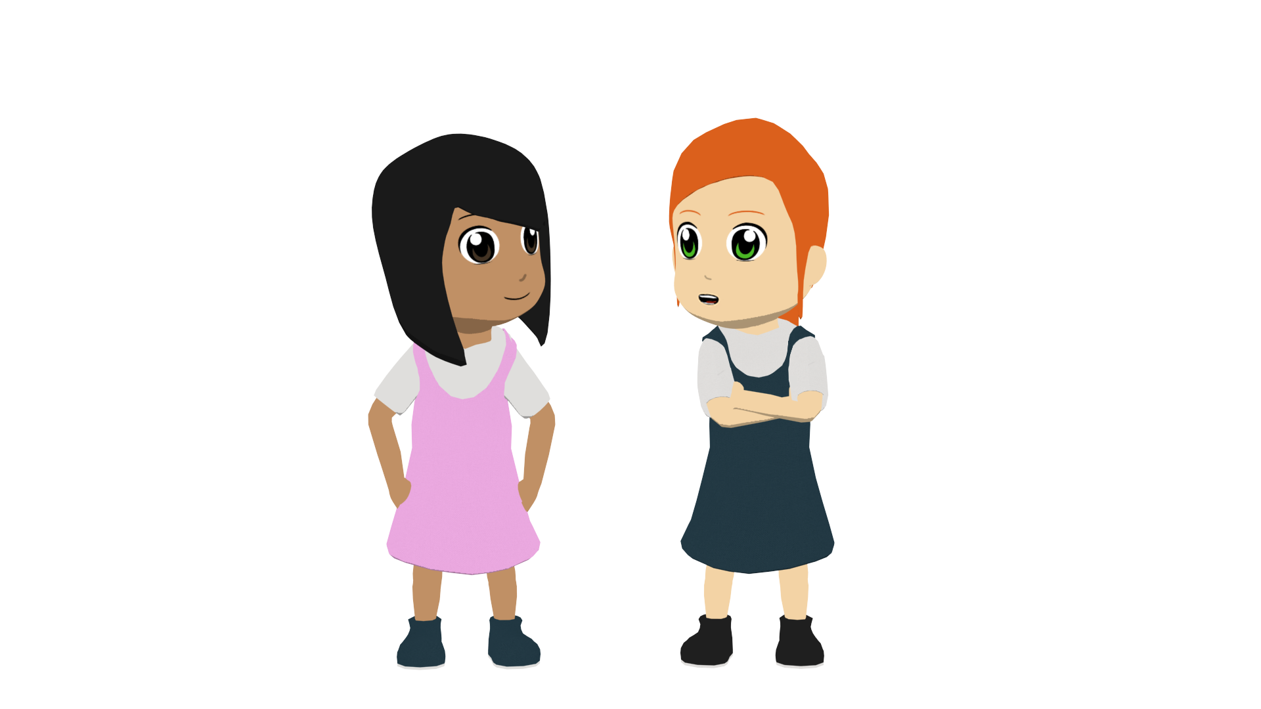
¿Nosotros/nosotras o ellos/ellas?
hablar
Describe las actividades de Daniel y Lucía con los amigos.
Usa nosotros/nosotras, ellos/ellas con la parte correcta del verbo ‘hacer’.
Notes:
Timing: 10 minutes (4 extended sentences)
Aim: to achieve successful written sentences using ‘hacemos’ and ‘hacen’ with the correct subject pronouns for the six slides that follow..
Procedure:
1. Students write the sentence in Spanish as indicated by the text/images.

Slide 32
¿Nosotros/nosotras o ellos/ellas?
hablar
We
go on trips in summer,
Nosotros hacemos viajes en verano, mientras que ellas hacen mucho deporte.
whereas
they
do a lot of sport.
Notes:
[1/4]

Slide 33
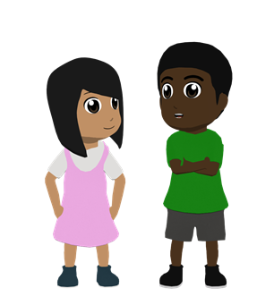
¿Nosotros/nosotras o ellos/ellas?
hablar
We
make an effort in class,
Nosotros hacemos un esfuerzo en clase, mientras que ellos hacen un esfuerzo en casa.
whereas
they
make an effort at home.
Notes:
[2/4]

Slide 34
¿Nosotros/nosotras o ellos/ellas?
hablar
They
make the food,
Ellos hacen la comida mientras nosotros hacemos las camas.
while
we
we make/are making the beds.
Notes:
[3/4]

Slide 35
¿Nosotros/nosotras o ellos/ellas?
hablar
We
make noise outside,
Nosotros hacemos ruido fuera, mientras ellas hacen ruido en casa.
while
they
make/are making noise in the house.
Notes:
[4/4]

Slide 36
Deberes
Vocabulary Learning Homework (Y8 Term 1.1, Week 6)
Audio file
Student worksheet
In addition, revisit: Y8 Term 1.1 Week 3 Y7 Term 3.2 Week 4
Notes:
The answer sheet for the Y8 vocabulary learning HW is here: https://rachelhawkes.com/LDPresources/Yr8Spanish/Spanish_Y8_Term1i_Wk6_audio_HW_sheet_answers.docx
Notes:
i) Teachers may, in addition, want to recommend use of a particular online app for the pre-learning of each week’s words. ii) Quizlet now requires parental involvement / registration / permissions for users below the age of 13, so it is perhaps most suitable for Y9 – 11 students. iii) Language Nut hosts LDP vocabulary lists and these are free for schools to use, though there is a registration process. One benefit is that all of the student tracking data that Language Nut offers are also available to schools that use the LDP lists for practice. Perhaps this makes it a good option for Y7/8.
iv) There are other free apps, and new ones are always appearing. Teachers have told us that they are currently using: Flippity, Wordwall (where using previously-created activities is free).
v) Gaming Grammar has been acquired by Language Nut. Its original content should still be available to teachers and much of it is appropriate for Y8 learners. From this lesson, for example, learners could practise:
Indefinite articles: Gender (Article agreement)
Definite articles: Gender (Article agreement)
Possessive adjectives: 1st person gender (Possessive adjective agreement)
Possessive adjectives: Number (Possessive adjective agreement)

Slide 37
Daniel habla con un amigo
leer
¡Hola! No estoy perdido. Estoy en la calle cerca de tu casa, según mi móvil. Hay unos niños aquí y ¡un perro completamente loco!
No tengo la llave, entonces* ¿puedes abrir la puerta en un momento? ¡Chao!
Escribe el texto en inglés.
Hello! I’m not lost. I’m in the street near your house, according to my phone. There are some children here and a completely crazy dog!
I don’t have the key, so can you open the door in a moment? Bye!
*entonces - so
Notes:
Alternative vocabulary revisiting activity from Lesson 1 – to replace the listening.
Timing: 6 minutes
Aim: to revisit vocabulary as per the SoW revisiting cycle
Procedure:
Students read the text alone or in whole-class format with the teacher
They then translate the short text into English.
The translation of a new vocabulary item, entonces [74], is given. The teacher should draw attention to this. ‘So’ here refers to a consequence.
Vocabulary revisited:
From 3.2.3 mi [37]; tu [53]; móvil [2143]; llave [1853]; perdido [1899]; completamente [1185]; calle [269]; niño [173]

