Slide 1
Comparing what I and we do
News and media Present tense -er verbs: 1st plural (-emos)
Final syllable stress
Y8 Spanish Term 1.1 – Week 4 – Lesson 7 Victoria Hobson / Nick Avery / Rachel Hawkes Artwork: Mark Davies Date updated: 26.08.23
Notes:
Note: all words in this week of the SOW appear on all three GCSE wordlists. Exceptions: periodista, pared are not on the Edexcel list; Aprovechar is not on the AQA list. Learning outcomes (lesson 1):
Introduction of final syllable stress
Introduction of present tense –er verbs: first person plural (-emos)
Word frequency (1 is the most frequent word in Spanish):
8.1.1.4 (introduce) vender [528]; entender [229]; creer (en) [83]; esconder [1130]; poner [91]; noticia [859]; periodista [1235]; entrevista [1653]; página [598]; que [3]; sobre¹ [62]; realidad [260]; sociedad [353]
8.1.1.1 (revisit) aprovechar [885]; quedar¹ [100]; pintar [1329]; ayudar [328]; pared [778]; verano [1139]; pasado (adj.) [932]; libre [473]; máximo [935]; antes [190]; sin embargo [embargo-203]; poco (as adverb only) [76]; negro [307]
7.3.1.6 (revisit) responder (a) [464]; recibir [216]; abrir [246]; correo [1638]; electrónico [1619]; mensaje [847]; ordenador [2624]; llamada [1324]; todo¹ [472]
Source: Davies, M. & Davies, K. (2018). A frequency dictionary of Spanish: Core vocabulary for learners (2nd ed.). Routledge: London
Artwork by Mark Davies. All additional pictures selected are available under a Creative Commons license, no attribution required.

Slide 2
Fonética
leer / hablar
Many words in Spanish have stress on the final syllable, for example:
Rule: If the stress is on the final syllable, and the word ends in the consonant ‘n’ or ‘s’, there will be an accent on the last vowel.
comer
beber
Madrid
feliz
color
español
sociedad
igual
realidad
Some words in Spanish have stress on the final syllable and have an accent to show this:
también
también
después
opción
según
después
opción
según
quizás
quizás
inglés
inglés
quizás
estación
quién
quizás
quién
autobús
estación
autobús
Notes:
Timing: 3 minutes
Aim: to introduce final syllable stress with previously learnt words.
Procedure:
Teachers explain the slide, asking students to listen and repeat the items to practise putting the stress on the final syllable.
Students are given one minute in pairs to think about the meanings in English.
Elicit meaning in English of the words before moving on.

Slide 3
Fonética
leer / hablar
realidad
30
comer
feliz
opción
Madrid
también
estación
igual
Segundos
español
color
quizás
autobús
después
según
sociedad
perdón
0
quién
inglés
beber
INICIO
Notes:
Timing: 2 minutes
Aim: to practise the final syllable stress with previously learnt words
Procedure:
1. Teachers start the timer. In pairs students take it in turns to say the words in alphabetical order. Partner A begins.
2. Pairs begin again, but this time partner B begins
3. This can be repeated two more times to allow students to increase their fluency.

Slide 4
Vocabulario
leer / hablar
la noticia
Many jobs in Spanish can be masculine or feminine, depending on the person!
pintar
el/la periodista
[journalist]
quedar
that
que
el máximo
la entrevista
maximum
[interview]
Accents matter!
¿qué? – what?
que – that
la página
negro, negra
Notes:
Timing: 5 minutes
Aim: to practise recognition and accurate read aloud of some of this week’s vocabulary; to further practise oral recall of the vocabulary.
Procedure 1. Pupils either work by themselves or in pairs, reading out the words and recapping their English meaning (1 minute). 2. Then the teacher removes the English words or pictures (one by one) and they try to recall the English orally (chorally), looking at the Spanish (1 minute). 3. Then the Spanish meanings are removed (one by one) and they to recall them orally (again, chorally), looking at the English (1 minute) 4. Further rounds of learning can be facilitated by one pupil turning away from the board, and his/her partner asking him/her the meanings (‘Cómo se dice X en español?’). This activity can work from L2 to L1 or L1 to L2.

Slide 5
Present tense –er verbs 1st person plural (-emos)
gramática
Remember, some Spanish infinitives end in –er.
–o
To mean ‘I’ with an –er verb, remove –er and add ___.
I reply
I learn
Respondo = _____________.
Aprendo = _____________.
To mean ‘we’ with an –er verb, remove –er and add –emos.
responder
respond
respondemos
(we answer)
Notes:
Timing: 2 minutes
Aim: to recap 1st person singular form of present tense –er/-ir verbs (-o) and introduce the 1st person plural (-emos).
Procedure:
Go through the grammar explanation with students, revealing each new sentence on a mouse click.
Notes: This will be the first time that students see –er verbs in isolation from –ir verbs. Previously they have always been practised together.
We will introduce the different –IR forms later.

Slide 6
vender
[to sell | selling]
vendemos
[we sell]
Notes:
Timing: 3 minutes for sequence of six slides
Aim: to introduce the verb ‘vender’ more explicitly. Vender is a prototypical verb in Spanish. Prototypical verbs are common verbs that illustrate the typical characteristics of a class of verb (in this case, -er verbs). Both the long form (infinitive) and the 1st person plural are introduced in order to familiarise students with various forms of the same verb.
Procedure
Bring up the word vender on its own, say it, students repeat it, and remind them of the phonics.
Try to elicit the meaning from the students.
Then bring up the English translations. Emphasise the two meanings for the infinitive.
Bring up the 1st person plural, say it, then students repeat it.
Try to elicit the meaning from the students. Emphasise the two meanings for the short form.

Slide 7
vender
[to sell | selling]
vendemos
[we sell]
Notes:
Cycle through the long and short form again.

Slide 8
vender
[to sell | selling]
Ana quiere vender libros.
[Ana wants to sell books.]
Notes:
Introduce the short form in a sentence.

Slide 9
vendemos
[we sell]
Vendemos libros.
[We sell books.]
Notes:
Introduce the long form in a sentence.

Slide 10
vender
[to sell | selling]
vender
Ana quiere ________ libros.
[Ana wants to sell books.]
Notes:
Cycle through the short form in context again.

Slide 11
vendemos
[we sell]
Vendemos
___________ libros.
[We sell books.]
Notes:
Cycle through the long form in context again.

Slide 12
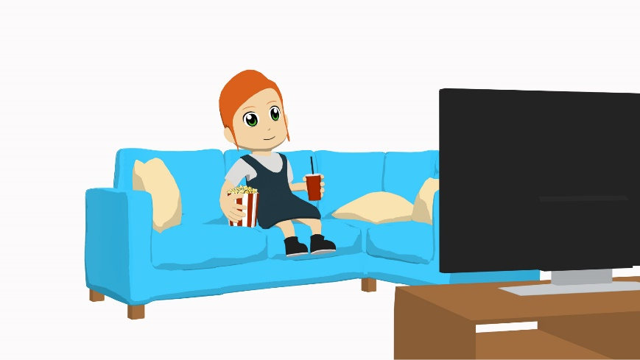
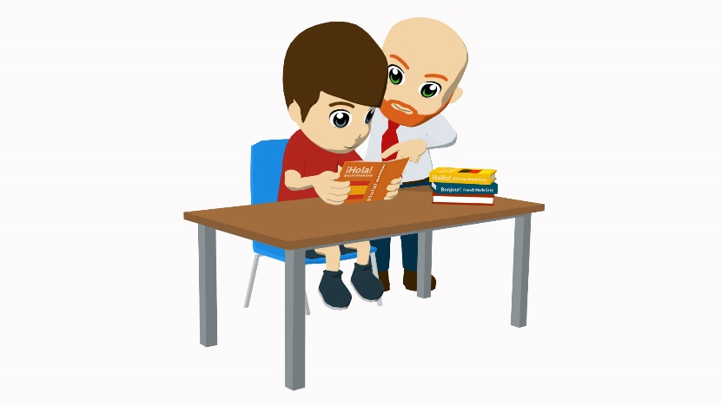
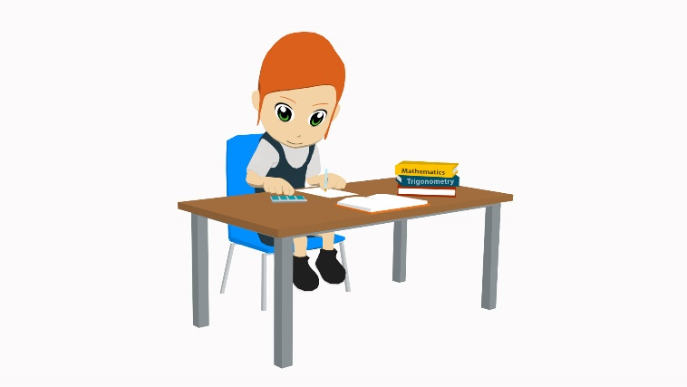
Vocabulario
leer / hablar
esconder
[to hide (something)]
entender
[to understand]
poner
[to put]
creer
[to believe, to think]
After ‘esconder’, say what you are hiding. For example…
Escondo unas cosas.
I hide some things.
Escondo el dinero.
I hide the money.
Notes:
Timing: 2 minutes
Aim: to embed the meanings in English of these infinitives and promote student recall of the Spanish.
Procedure:
1. Introduce the four verbs on a mouse click
2. Use the sequences of custom animation to elicit the Spanish from students.
Note: the speech bubble is included to avoid suggesting that ‘esconder’ can be used as an intransitive verb (e.g. I hide). In this case, the verb would need a reflexive pronoun.

Slide 13
Present tense –er verbs 1st person singular and plural
gramática
escondo
[I hide]
entiendo
[I understand]
creo
[I believe, I think]
escondemos
[we hide]
entendemos
[we understand]
ponemos
[we put]
creemos
[we believe, we think]
pongo
[I put]
These four verbs all have the ‘–emos’ ending in the ‘we’ form.
This is similar to ‘hago’ (hacer) &
‘tengo’ (tener)
In the ‘I’ form, two follow the usual pattern of adding –o.
The other two add –o but also have a stem change.
Notes:
Timing: 2 minutes
Aim: to explain the first person irregularities of: entender, poner
Procedure:
Go through the grammar explanation with students, revealing each new sentence on a mouse click.
When the final callout appears, elicit meanings in English of these verbs. (They were learnt in Y7.)

Slide 14
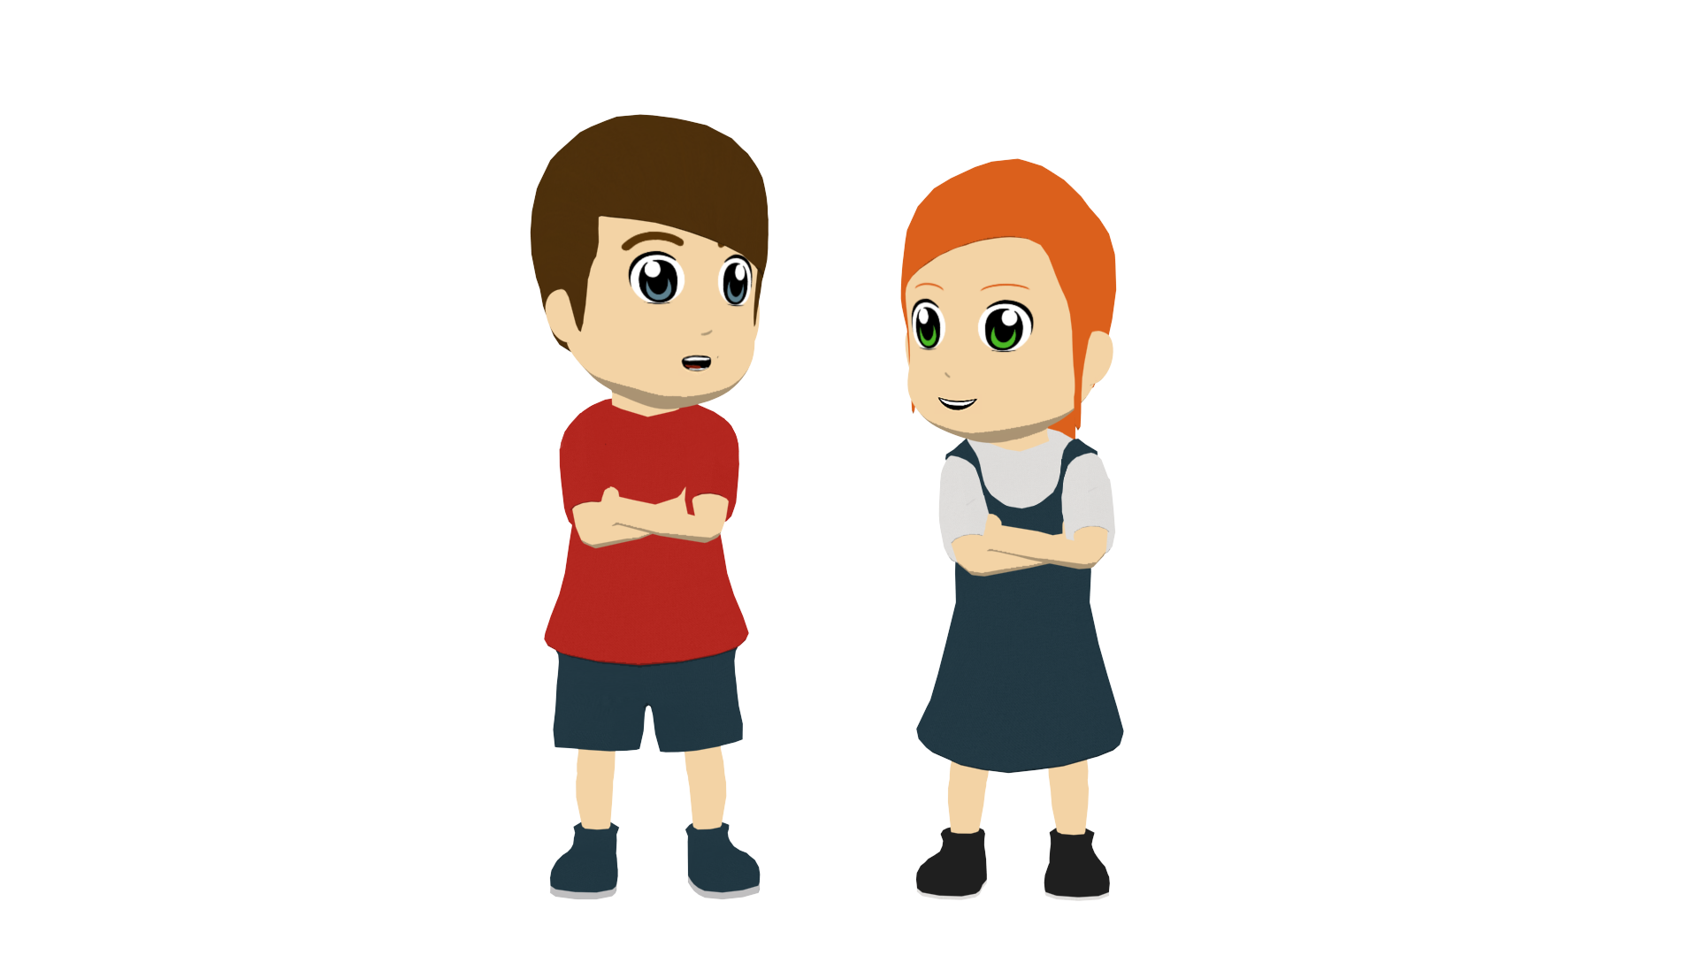
Visita en el colegio
Unas personas visitan la escuela de Daniel y Lucía.
Trabajan para un periódico famoso español, El Mundo.
leer
Lee. ¿Habla una persona (‘I’) o hablan dos personas (‘we’)?
Luego, escribe en inglés las tres frases subrayadas*.
 |  | ‘I’ | ‘We’
1. | Hacemos entrevistas con gente famosa.
2. | Pongo las entrevistas en una página web.
3. | No vendo los periódicos en la calle.
4. | Creemos que el trabajo es importante.
5. | İNo leo las entrevistas, no tengo tiempo!
6. | No escondemos la verdad.
I don’t sell the newspapers in the street.
I don’t read the interviews, I don’t have time!
We don’t hide the truth.
* underlined
Notes:
Timing: 8 minutes
Aim: to practise connecting the verb ending ‘–o’ with the meaning ‘I’ and ‘–emos’ with ‘we’ for –er verbs; to raise awareness of the English auxiliary ‘do’ in negative statements.
Procedure:
1. Students read the sentences and decide if the verb refers to ‘I’ or ‘we’ by focusing on the verb ending.
2. Students then translate the underlined sections into English.
Note: The sentences to translate verbs include negatives, which are translated using the English auxiliary ‘do’. It is worth once again highlighting this difference between English and Spanish. Later in the lesson, students will work from prompts that translate sentences with the auxiliary ‘do’ back into Spanish.

Slide 15
La visita de los periodistas
leer
Las personas del periódico visitan la clase.
Escucha y marca la opción correcta.
¿Habla una persona (‘I’) o hablan dos personas (‘we’)?
Escucha otra vez. Escribe en inglés la actividad y cuando es.
‘I’
‘we’
 |  |  | ¿Qué? | ¿Cuándo?
Ej.
do interviews
on Mondays
Notes:
Timing: 2 minutes
Aim: to conduct a worked example with students ahead of the grammar practice listening activity.
Procedure:
1. Play the audio example by clicking on the trigger EG.
2. Answers appear on a mouse click.
Transcript:
Ejemplo: Hago entrevistas los lunes.

Slide 16
La visita de los periodistas
escuchar
Escucha y marca la opción correcta.
Escucha otra vez. Escribe en inglés la actividad y cuando es.
‘I’
‘we’
 |  |  | ¿Qué? | ¿Cuándo?
1
don’t reply to emails
on Sundays
2
make calls to famous people
in the morning
3
sell magazines
in the summer
4
believe in the journalists
always
5
make calls
before eating
6
put videos on the web page
in the afternoon
Notes:
Timing: 8 minutes
Aim: To practise focusing on person agreement of present tense –er verbs in the oral modality.
Procedure:
1. Click on the number trigger to play the audio.
2. Students listen for the verb ending for number and tick the correct box.
3. Play the audio a second time.
4. Students note what the activity is in English and when it happens.
Transcript:
1) No respondemos a los correos los domingos
2) Hago llamadas a gente famosa por la mañana.
3) Vendemos revistas en el verano.
4) Siempre creo en los periodistas.
5) Hacemos llamadas antes de comer.
6) Pongo vídeos en la pagina web por la tarde.

Slide 17
Ahora, ¡eres el/la periodista!
Escribe en español.
escribir / hablar
I | sell | the news | in summer
We | understand | newspapers | in the holidays
I don’t | believe in | magazines | on Sundays
We don’t | hide | the truth | on Saturdays
 | put | the journalists | in the morning
 | do | reality | in the afternoon
 | read | society | every day
 | have | pages | on Thursdays
 | answer | interviews | on Fridays
No entiendo las noticias los domingos.
Leemos periódicos por la mañana.
Creo en los periodistas.
Hacemos entrevistas por la tarde.
No escondemos la verdad en las vacaciones.
No vendo revistas los sábados.
Notes:
Timing: 10-12 minutes
Aim: to create 6 sentences with –er verbs in first person singular and first person plural based on the prompts; to practise producing both affirmative and negative sentences
Procedure:
Bring up each combination of sentence parts
Ask students to the Spanish on mini-whiteboards or in their books, then volunteer the answer orally.
Students then create a number of their own sentences, using new combinations of words in the grid.
After writing the six sentences, teachers could encourage an oral simultaneous translation task, where students say a sentence and their partner translates it. Some may find this challenging to do on the spot, so this oral component could be done by some students, while other students continue to practise writing.
Sentences:
1) Leemos periódicos por la mañana.
2) Creo en los periodistas.
3) No escondemos la verdad.
4) No entiendo las noticias los domingos.
5) Hacemos entrevistas por la tarde.
6) No vendo revistas los sábados.

Slide 18
Comparing what I and we do (2)
News and media Present tense -er verbs: 1st plural (-emos)
Use of present simple for unfinished actions
Y8 Spanish Term 1.1 – Week 4 – Lesson 8 Victoria Hobson / Nick Avery / Rachel Hawkes Artwork: Mark Davies Date updated: 26.08.23
Notes:
Note: all words in this week of the SOW appear on all three GCSE wordlists. Exceptions: periodista, pared are not on the Edexcel list; Aprovechar is not on the AQA list. Learning outcomes (lesson 2):
Consolidation of final syllable stress
Consolidation of present tense –er verbs: first person plural (-emos)
Introduction of use of present simple for ongoing meaning
Word frequency (1 is the most frequent word in Spanish):
8.1.1.4 (introduce) vender [528]; entender [229]; creer (en) [83]; esconder [1130]; poner [91]; noticia [859]; periodista [1235]; entrevista [1653]; página [598]; a menudo [menudo-958]; sobre¹ [62]; realidad [260]; sociedad [353]
8.1.1.1 (revisit) aprovechar [885]; quedar¹ [100]; pintar [1329]; ayudar [328]; pared [778]; verano [1139]; pasado (adj.) [932]; libre [473]; máximo [935]; antes [190]; sin embargo [embargo-203]; poco (as adverb only) [76]; negro [307]
7.3.1.6 (revisit) responder (a) [464]; recibir [216]; abrir [246]; correo [1638]; electrónico [1619]; mensaje [847]; ordenador [2624]; llamada [1324]; todo¹ [472]
Source: Davies, M. & Davies, K. (2018). A frequency dictionary of Spanish: Core vocabulary for learners (2nd ed.). Routledge: London

Slide 19
Fonética
Final syllable stress
escuchar / escribir
Remember: when the stress is on the final syllable, and the word ends in ‘n’ or ‘s’, then there will be an accent on the last vowel.
Escucha y escribe la palabra en español.
 | beber
 | opción
 | color
 | sociedad
 | también
 | después
1
2
3
4
5
6
Notes:
Timing: 7 minutes
Aim: to identify correctly whether the word needs an accent or not.
Procedure:
1. Play the audio.
2. Students write the word in Spanish.
3. Elicit meanings in English during the feedback.
Notes: i) at GCSE correct application of the stress rules regarding accents will only be assessed at Higher Tier. We practise it here as most/many classes are mixed proficiency at KS3, and because the words we use here for practice are on all three GCSE word lists for both tiers; the focus on accurate spelling will therefore support learners of all proficiencies. ii) all words were previously taught within the SoW.
Transcript:
beber
opción
color
sociedad
también
después

Slide 20
Vocabulario
¿Cómo se dice en español?
leer / hablar
It’s the same in English, too.
These two words share a common root. We can say they belong to the same ‘word family’.
activo
actividad
active
activity
When these patterns are predictable, it makes learning words quicker and easier.
seguro
seguridad
secure
security
seguro
popular
popularidad
When the adjective ends in a vowel, remove it and add -idad. Otherwise, just add –idad. The English equivalent noun meaning ends in –ity.
Notes:
Timing: 2 minutes
Aim: to explain the ‘–(i)dad’ suffix in Spanish and its correspondence to ‘–(i)ty’ in English.
Procedure:
Teacher elicits the Spanish for ‘activo’ and ‘actividad’ (both words were learnt in Y7).
Teacher presents the remaining information, eliciting the English for the Spanish examples.
Finish with the pattern/rule.
Note: this is one of the derivational morphology patterns included in the new GCSE Subject content for both tiers. Rule (F/H): Nouns created by adding -idad to singular adjectives ending in a consonant (e.g., real) or with the final vowel removed (e.g., segur-), only where the English equivalent is ‘-(i)ty’ (e.g., seguridad)
For Reading only. Derivational morphology patterns listed in the GCSE indicate that even if only the base form (e.g., real) is listed in the Vocabulary List, a derived form that follows this pattern may be included in reading texts at Foundation and Higher tier (or if only the specific affixed form is listed, the base form may be included in reading texts). Note, if derived forms are included in listening material or required for production, they will be listed separately in the Vocabulary List.

Slide 21
Vocabulario
All nouns ending in –idad or –dad are feminine. The stress always falls on the final syllable, too.
¿Cómo se dice en español?
escribir / leer
1
4
la claridad
la nacionalidad
claro | ___________ (clarity)
nacional | ___________ (nationality)
2
5
If you know the noun, you can take off the –idad to get to the adjective. ☺
positivo | ___________ (positivity)
la positividad
__________ (real) | la realidad
real
3
6
personal | ___________ (personality)
tranquilo | ___________ (tranquility)
la personalidad
la tranquilidad
Notes:
Timing: 5 minutes
Aim: to develop knowledge of the ‘–(i)dad’ suffix in Spanish and its correspondence to ‘–(i)ty’ in English, by practising with examples, starting with previously taught words (and one cognate).
Procedure:
Students work in pairs to apply the rule and generate the missing words.
Teacher elicits responses, clicking to bring up the callouts with additional new information.
Note: i) There are many adjectives at both tiers on all three AO GCSE wordlists that have this pattern, and one or two nouns from which the base adjective could be extrapolated (e.g., la personalidad → personal). ii) Some words are on the list in both forms and these can then be expected to be tested in listening, speaking and writing, in addition to reading. (e.g., común, comunidad; oscuro, oscuridad – Eduqas lists both, AQA just has oscuro). iii) Examples of Foundation adjectives (in addition to those in this activity) that do not list the noun (but where the noun could be tested in the Reading paper) are: active, popular, musical, eléctrico, negative, práctico, enorme, especial, general iv) Further examples of Higher adjectives with this pattern are: puro, capaz, professional, profundo, mental, público, particular
v) There are many other words that are related in this way in Spanish, but are not eligible for assessment at GCSE because the English translation is not a word ending in –(i)ty. E.g., débil (listed on all lists) – la debilidad couldn’t be tested if débil is listed as weak, only if it is listed as frail (which would give rise to ‘frailty’), or religioso as la religiosidad in English is ‘religiousness’. None of the three awarding bodies has listed ‘pious’ as a 2nd meaning so we wouldn’t expect students to arrive at ‘piety’ in the derived noun.
The multilingprofiler can be used to check for these patterns, and LDP offers training on this as part of its GCSE CPD.

Slide 22
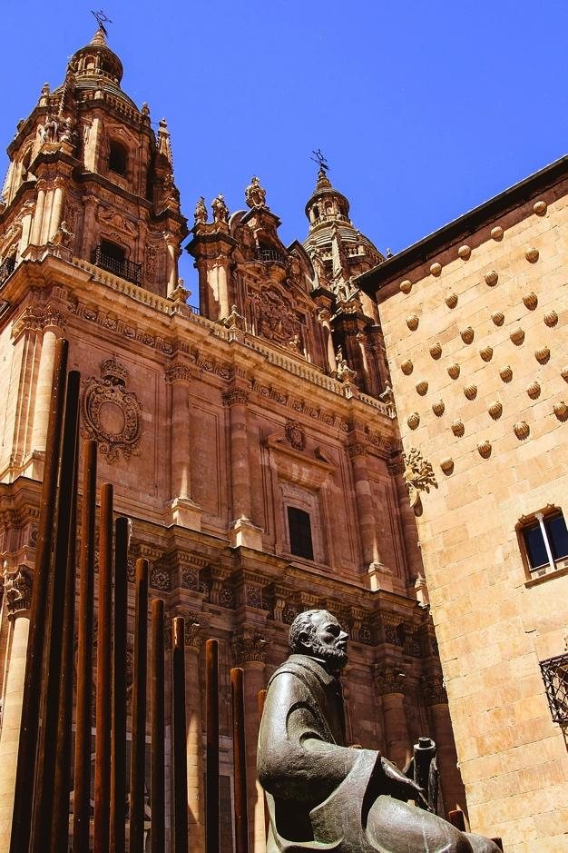
Vocabulario
Escribe en español.
escribir
La Universidad de Salamanca is the oldest university in Spain. It was founded in 1134!
Want to say ‘the opportunity to (do something)?
Use ‘la oportunidad de (hacer algo).
Salamanca has a famous university.
2) I make the most of the opportunity to use a computer.
3) In reality, receiving messages every day is normal.
4) In my free time I do not have a lot of responsibility. However, I have to/must help at home a little.
Salamanca tiene una universidad famosa.
Aprovecho la oportunidad de usar un ordenador.
En realidad, recibir mensajes todos los días es normal.
En mi tiempo libre no tengo mucha responsabilidad. Sin embargo, debo ayudar en casa un poco.
Notes:
Timing: 10 minutes
Aim: to use ‘-(i)dad’ words in context plus revisit 9 other items of revisited vocabulary from this week. NB: Universidad, oportunidad and responsabilidad are not subject to the pattern we have just practised, but they are –idad words that appear on all three GCSE lists (Universidad and oportunidad at F tier (the latter is H only on Edexcel), and responsabilidad is H tier).
Procedure:
1. Students translate the sentences into Spanish.
2. Teachers reveal the answers on a mouse click.
Notes: i) If students need more support with this task, one obvious adaption would be a jigsaw translation, whereby students are asked to translate into Spanish only the 9 revisited words for this week, plus any very basic words (e.g., tiene) and the remainder are provided for them to translate from Spanish into English. ii) Be tolerant of errors around oportunidad ‘de’.
Word frequency of unknown words (1 is the most frequent word in Spanish): universidad [387]; oportunidad [564]; responsabilidad [915]
Source: Davies, M. & Davies, K. (2018). A frequency dictionary of Spanish: Core vocabulary for learners (2nd ed.). Routledge: London

Slide 23
Routine vs ongoing/current actions
gramática
English has two present tense forms.
We make calls every Monday. We are making calls at the moment.
In Spanish, you can use the same verb for routine actions and current/ongoing actions.
Hacemos llamadas cada lunes. Hacemos llamadas en este momento.
Hacemos = We make AND
we are making
Present simple – routine, normally
Present continuous (BE + -ing) - ongoing; current
Adverbs of time tell us which English tense to choose.
We make
We are making
This is a routine action.
This is an ongoing/current action.
Notes:
Timing: 2 minutes
Aim: to explain to students ….(present continuous forms will be explicitly taught later in Y8)
Procedure:
1. Teacher to highlight the distinction in English between present simple for routine actions and present continuous for current/ongoing actions.
2. Teacher to stress that the ‘routine’ or ‘current/ongoing’ nature of the action is the way to decide which English tense to use and that it is the adverbs of time that give the pointer on this.
3. Teacher to explain that the same tense in Spanish can be used for both routine and current/ongoing actions.

Slide 24
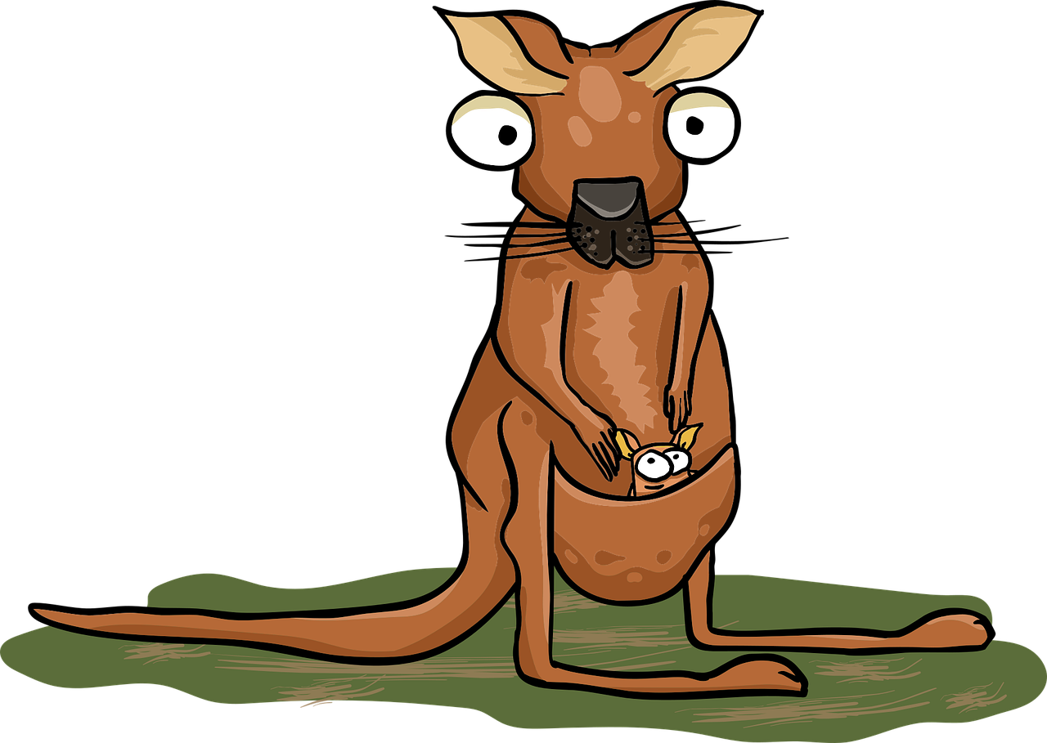
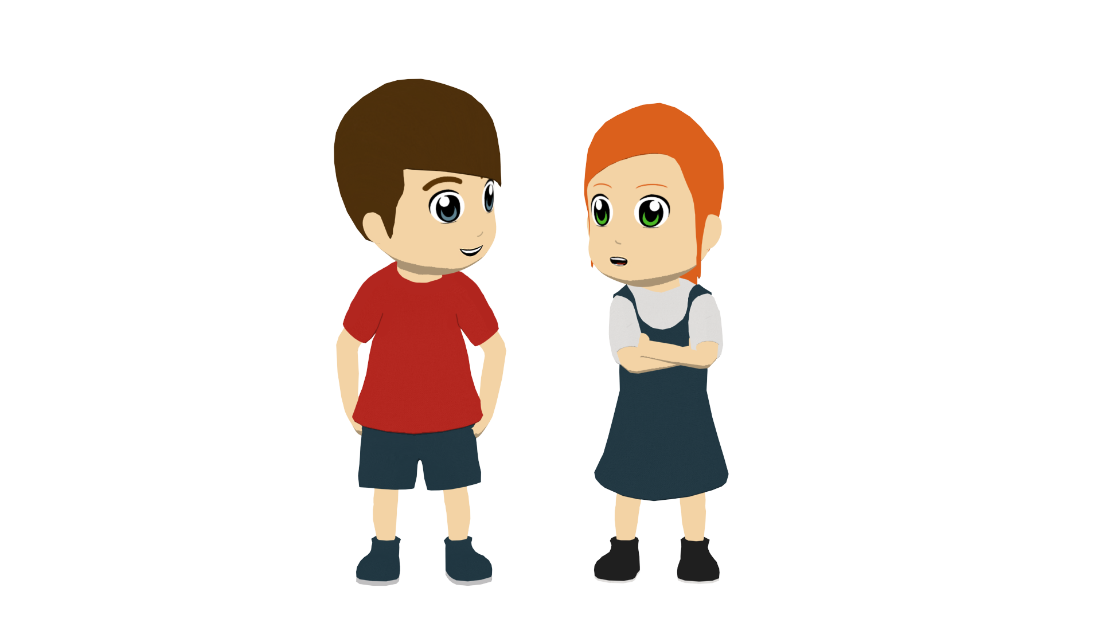
Hacer de canguro*
el canguro is kangaroo, but el/la canguro also means babysitter in Spain. In Latin America, babysitter is usually niñera and el canguro means bum bag!
leer
If you do babysitting, add this phrase to your repertoire!
Nico is on a gap year in Spain and babysitting for the López family.
He makes notes about the children, Lucía and Daniel.
Choose the correct verb in English: routine action or ongoing/current action?
1. Daniel washes | is washing up at the moment.
2. Lucía meets up with | is meeting up with friends every day.
3. Lucía plays |is playing with her friends at the moment.
4. Daniel reads |is reading a book now.
5. Lucía sings |is singing on Saturdays.
*hacer de canguro – to babysit
Notes:
Timing: 5 minutes
Aim: to raise awareness in a brief English exercise, practising connecting temporal adverbs with the two types of present tense; this will help students to arrive at the best English meaning when translating from the Spanish simple present into English.
Procedure:
Set the context by introducing students to the idiom – hacer de canguro, which is something many/most students will end up doing at some point during KS3/4. Remind them again about personalizing their repertoire with language that they think will be useful to them.
Click to bring up the activity and instructions.
Students choose the correct verb in each sentence.
4. Teacher elicits and confirms the responses.

Slide 25
Hablan los periodistas
escuchar
Back in school, the journalists give more detailed information about their jobs.
Decide if the verb refers to ‘I’ or ‘we’. Then choose the translation of the verb in English according to whether it is a routine action or an ongoing/current action.
You will know this from the adverb of time.
Remember ‘en este momento’ is used to describe current/unfinished actions and is translated into English using ‘be’ –ing.
 |  | ‘I’ | ‘We’
Ej. 1
respond / are responding
Ej. 2
make / am making
Notes:
Timing: 8 minutes (two slides)
Aim: to practise distinguishing between routine and current/unfinished actions through listening, and to pay attention to person agreement (‘I’ or ‘we’)
Procedure:
1. Click on the Ejs button to play the audio.
2. Student make a note of the verb ending for number (‘I’ or ‘we’).
3. Students listen firstly for the adverb, to indicate the best translation of the verb into English.
4. Play the audio a second time for students.
Transcript:
Respondemos llamadas todos los días
Hago una llamada en este momento.

Slide 26
Hablan los periodistas
Los periodistas dan más información sobre el trabajo que hacen.
escuchar
Escucha y marca las opciones correctas.
 |  | ‘I’ | ‘We’
te
1
do / are doing
2
sell / am selling
3
put / are putting
4
reply / are replying
5
learn / am learning
6
make / am making
Notes:
Procedure:
1. Click on the number trigger to play the audio.
2. Student make a note of the verb ending for number (‘I’ or ‘we’).
3. Students listen firstly for the adverb, to indicate the best translation of the verb into English.
4. Play the audio a second time for students.
Transcript:
1. Hacemos entrevistas en este momento.
2. Vendo revistas todos los días.
3. Ponemos imágenes en la página web en este momento.
4. Respondemos los correos electrónicos en este momento.
5. Aprendo sobre la sociedad cada día.
6. Hacemos vídeos con periodistas todos los días.

Slide 27
Una emergencia en las noticias
The Amazon rainforest covers a vast area in Latin America. 60% is in Portuguese-speaking Brazil, but it is also in Peru, Colombia, Ecuador, Bolivia and Venezuela. Forest fires are an annual problem.
escribir
Lees en un periódico sobre los terribles incendios* en el Amazonas en Ecuador y quieres hacer algo con tus compañeros de la escuela para ayudar.
Explica la situación y tus planes para ayudar.
İIncendios* en Ecuador!
* el incendio - fire
Notes:
Timing: 11 minutes (two slides)
Aim: to translate accurately into Spanish using 1st person plural –er verbs showing that only one tense is needed in Spanish.
Procedure:
Teachers explain the context of the writing task using this introductory slide.
Teachers explain that in this activity students will use the present simple tense for routine/timeless and unfinished actions
A callout appears with information about the Amazon and the problem of forest fires.
Note: teachers may need to explain the use of ‘para’ + infinitive here. This feature will be taught in 8.1.2.6.

Slide 28
Una emergencia en las noticias
escribir
Escribe el texto en español para la página web de la escuela.
İIncendios en Ecuador!
The situation
We understand the reality in Ecuador. We must do something because there is a problem. We believe that it is important to help.
What are we doing today?
We are making calls to people with money. We are putting information on a web page and notices* on the walls. We are selling things in front of school.
La situación
Debemos
Entendemos la realidad en Ecuador.
Creemos
hacer algo porque hay un problema.
que es importante ayudar.
¿Qué hacemos hoy?
Ponemos
Hacemos llamadas a personas con dinero.
información en una página web y anuncios en las
Vendemos cosas delante de la escuela.
paredes.
* el anuncio - notice
Notes:
Procedure:
1. Students translate the English sentences into Spanish.
2. The Spanish is revealed on a mouse click, one sentence at a time.
Notes: i) if time is short, students could finish this for homework, (though there is always the chance that, even if they have started the task in class, they will use an online translation tool to finish it). ii) the teacher could work this through with students all together in class. iii) an earlier slide could be omitted (e.g. slide 22 - written translation OR slide 24 – awareness-raising on present tense), depending on the needs of the class.

Slide 29
Deberes
Vocabulary Learning Homework (Y8 Term 1.1, Week 5)
Audio file
Student worksheet
In addition, revisit: Y8 Term 1.1 Week 2 Y7 Term 3.2 Week 3
Notes:
The answer sheet for the Y8 vocabulary learning HW is here: https://rachelhawkes.com/LDPresources/Yr8Spanish/Spanish_Y8_Term1i_Wk5_audio_HW_sheet_answers.docx
Notes:
i) Teachers may, in addition, want to recommend use of a particular online app for the pre-learning of each week’s words. ii) Quizlet now requires parental involvement / registration / permissions for users below the age of 13, so it is perhaps most suitable for Y9 – 11 students. iii) Language Nut hosts LDP vocabulary lists and these are free for schools to use, though there is a registration process. One benefit is that all of the student tracking data that Language Nut offers are also available to schools that use the LDP lists for practice. Perhaps this makes it a good option for Y7/8.
iv) There are other free apps, and new ones are always appearing. Teachers have told us that they are currently using: Flippity, Wordwall (where using previously-created activities is free).
v) Gaming Grammar has been acquired by Language Nut. Its original content should still be available to teachers and much of it is appropriate for Y8 learners. From this lesson, for example, learners could practise:
verbs (present) 1st person singular/plural in the ‘Verbs agreement (present)’ menu

