Slide 1
Talking about people and places
now vs in general ESTAR vs SER in singular persons (revisited)
weak vowel [u]
Y8 Spanish Term 1.1 – Week 3 – Lesson 5 Amanda Izquierdo / Nick Avery / Rachel Hawkes Artwork: Mark Davies Date updated: 26.08.23
Notes:
Note: all words (new and revisited) in this week of the SOW appear on all three GCSE wordlists, with the following exceptions: i) Edexcel list does not have cenar, chino. ii) AQA list does not have generalmente.
Note: there is no new grammar this lesson, though there is new vocabulary. Depending on the class, teachers may prefer to vary the content of this lesson (e.g., they might instead give learners an extended opportunity to write the holiday text they started to plan at the end of last lesson. It is important that students complete the vocabulary learning and, at some point, that they practise the phonics in focus this week (weak vowels [u] and [i]). Learning outcomes (lesson 1):
Consolidation of SER (for traits) vs ESTAR (for state/mood) in singular and plural persons;
Introduction of weak vowel [u]
New vocabulary (introduce): gente [137]; malo² [360]; sucio [1855]; limpio [1710]; precioso [1777]; listo² [1684]; contento [1949]; triste [1371]; seguro² [407]; igual [263]; quizás [346]; según [237]; así [67]; generalmente [1387]; ahora [81]
Revisit Y7, 3.2.6: cielo [620]; cenar [3087]; dormir [403]; pelo [873]
Revisit Y7, 3.1.5: correr [343]; por¹ [15]; escribir [198]; algo [110]; aprender (a) [428]; mujer [120]; carta¹ [627]; idioma [1159]; chino [1349]; parque [1354]; después [115]; siempre [96]
Source: Davies, M. & Davies, K. (2018). A frequency dictionary of Spanish: Core vocabulary for learners (2nd ed.). Routledge: London

Slide 2
Fonética
hablar
[a]
[e]
When they appear next to each other, the Spanish vowels ____, ____ and _____are pronounced separately. These are ‘strong’ vowels.
[o]
In contrast, the vowel [u] merges with [a], [e] and [o] to make a single syllable. This is a ‘weak’ vowel.
Escucha unos ejemplos:
1
antiguo
‘Igual’ means ‘(the) same’.
e.g. Las casas son iguales.
The houses are the same.
2
puerta
3
igual
Notes:
Timing: 2 mins
Aim: to recap ‘strong’ vowels and introduce the ‘weak’ vowel [u]. This attaches to a strong vowel to create a diphthong, where one vowel ‘glides’ into another.
Procedure:
Teacher gives explanation
Teacher models pronunciation and/or plays audio.
Students say the three words in chorus.
Teacher introduces igual [263]. This is a new vocabulary item this week.
Note: the weak vowel [i] will be introduced in lesson 2

Slide 3
Fonética
hablar
Escucha cada palabra y escribe las dos letras.
Because the [u] is ‘gliding’ into the next vowel, it sounds like a [w]!
Ahora pronuncia las palabras.
u
a
1
u
a
4
ag__ __ntar
ig__ __l
2
u
5
g __ __rdar
e
u
a
p __ __rta
u
o
6
u
a
3
antig__ __
leng__ __
Notes:
Timing: 7 minutes
Aim: To practise mapping sound to spelling with strong + weak vowel combinations, focusing specifically on words that have [u].
Procedure:
1. Play the audio for each word and write the two missing vowels. Is it [a], [e], [o], [i] or [u]?
2. See the answers for each word, one by one.
3. Practise pronunciation with in pairs: read each word out loud. Try to mimic the sounds as close to the recording as you can.
Transcript:
igual
puerta
antiguo
aguantar
guardar
lengua
Note: all words are on all three GCSE wordlists. Exception: aguantar is not on Edexcel, but is on the other two lists.

Slide 4
Vocabulario
leer
Organiza los adjetivos.
Normalmente ¿describen lugares y cosas, gente (people) o los dos?
bonito, feo, hermoso, tranquilo, raro, serio, alegre, simpático, feliz, tonto, nervioso, guapo, azul, rojo, amarillo
gente
both (los dos)
lugares y cosas
Vocabulario nuevo:
la gente = people
sucio = dirty
limpio = clean
precioso = precious, beautiful
triste = sad
contento = content, happy
feo
contento
hermoso
serio
simpático
bonito
triste
azul
tranquilo
feliz
raro
limpio
amarillo
Contento describes a state, so is only used with ‘estar’.
guapo
rojo
alegre
sucio
precioso
nervioso
tonto
Notes:
Timing: 10 minutes
Aim: To group adjectives considering their meaning: do they normally describe people, places/things or both?
Procedure:
Teacher ensures that ‘gente’ is understood
Students sketch the overlapping circles and write the listed adjectives into their Venn diagram.
Click to bring up suggested answers and clarify any misconceptions.
Note: ‘Rojo’ was used in Y7 with ‘estar’ to described sunburnt people, so we include it in the ‘los dos’ column.

Slide 5
SER and ESTAR (revisit) -ar verbs – 1st person singular past (preterite)
gramática
estar
ser
to be (location|state) = ______________
to be (trait) = ______________
 | I am
 | you are
 | s/he, it is
 | I am
 | you are
 | s/he, it is
estoy
soy
estás
eres
está
es
soy
estoy
estar
es
estás
ser
eres
está
Notes:
Timing: 2 minutes
Aim: to elicit the singular forms of both SER and ESTAR as preparation for the next activity.
Procedure: 1. Students may be asked to sketch the two tables, if they are to complete this as a written task.
2. Alternatively, teachers may prefer to elicit responses orally, after 10 seconds, once all the prompts have disappeared. NB: the verb form prompts at the bottom are timed to fade out over 10 seconds.
Note: teachers may decide this recap is not needed for their students or conversely, more support is required. They should adapt the slide to create the appropriate point of challenge for their classes. E.g., all the forms could be a) removed for greater challenge b) unanimated for more support.

Slide 6
¿Quién es quién?
Lee las frases y marca la opción correcta. Escribe la palabra en inglés.
leer
Daniel está en el colegio. Va a jugar a Quién es quién. Prepara unas preguntas.
Remember that in Spanish, the word order is the same for questions and statements: La chica está triste. ¿La chica está triste?
 |  | Am I...? | Are you...? | Ahora | Generalmente
1. | ¿Soy serio?
2. | ¿Estás contento?
3. | ¿Estoy alegre?
4. | ¿Eres guapa?
5. | ¿Estoy limpio?
6. | ¿Eres tranquilo?
Escribe en inglés.
serious
glad
cheerful
good-looking
clean
calm
¿Quién es quién? = Guess who?
Notes:
Timing: 7 minutes
Aim: To focus on the contrast between ‘soy/estoy’ and ‘eres/estás’. Specifically, to attend to the meaning of the verb (1st vs 2nd person singular, and then state vs trait).
Procedure: 1. Read each phrase and decide if its meaning refers to ‘Am I...’ or ‘Are you...’ .
2. Then, read them again and decide and if they refer to ‘now’ or ‘generally’.
3. Write the adjectives in English.
4. Check the answers.
Note:
Some students may be able to 1 and 2 above at the same time. Answers are animated for these two parts separately to support those who do one step at a time.
Free clipart source: http://clipart-library.com/search2/?q=guess%20who#gsc.tab=1&gsc.q=guess%20who&gsc.page=1

Slide 7
¿Quién es quién?
Escucha las preguntas y marca la opción correcta. Escribe la palabra en inglés.
escuchar
Daniel juega Quién es quién. Qué preguntas hace?
 | ‘Are you...’? | ‘Is s/he, Is it...’? | Ahora | Generalmente | Escribe en inglés.
1.
2.
3.
4.
5.
6.
1
famous
2
interesting
3
nervous
4
strange
5
blue
6
silly
Notes:
Timing: 7 minutes
Aim: To focus on the contrast between ‘soy/estoy’ and ‘eres/estás’. Specifically, to attend to the meaning of the verb (1st vs 2nd person singular, and then state vs trait).
Procedure: 1. Read each phrase and decide if its meaning refers to ‘Am I...’ or ‘Are you...’ .
2. Then, read them again and decide and if they refer to ‘now’ or ‘generally’.
3. Write the adjectives in English.
4. Check the answers.
Note:
Some students may be able to 1 and 2 above at the same time. Answers are animated for these two parts separately to support those who do one step at a time.
All words are on all three GCSE lists. Exceptions are raro and tonto, which are not on the Edexcel list, but on the other two.
Free clipart source: http://clipart-library.com/search2/?q=guess%20who#gsc.tab=1&gsc.q=guess%20who&gsc.page=1

Slide 8
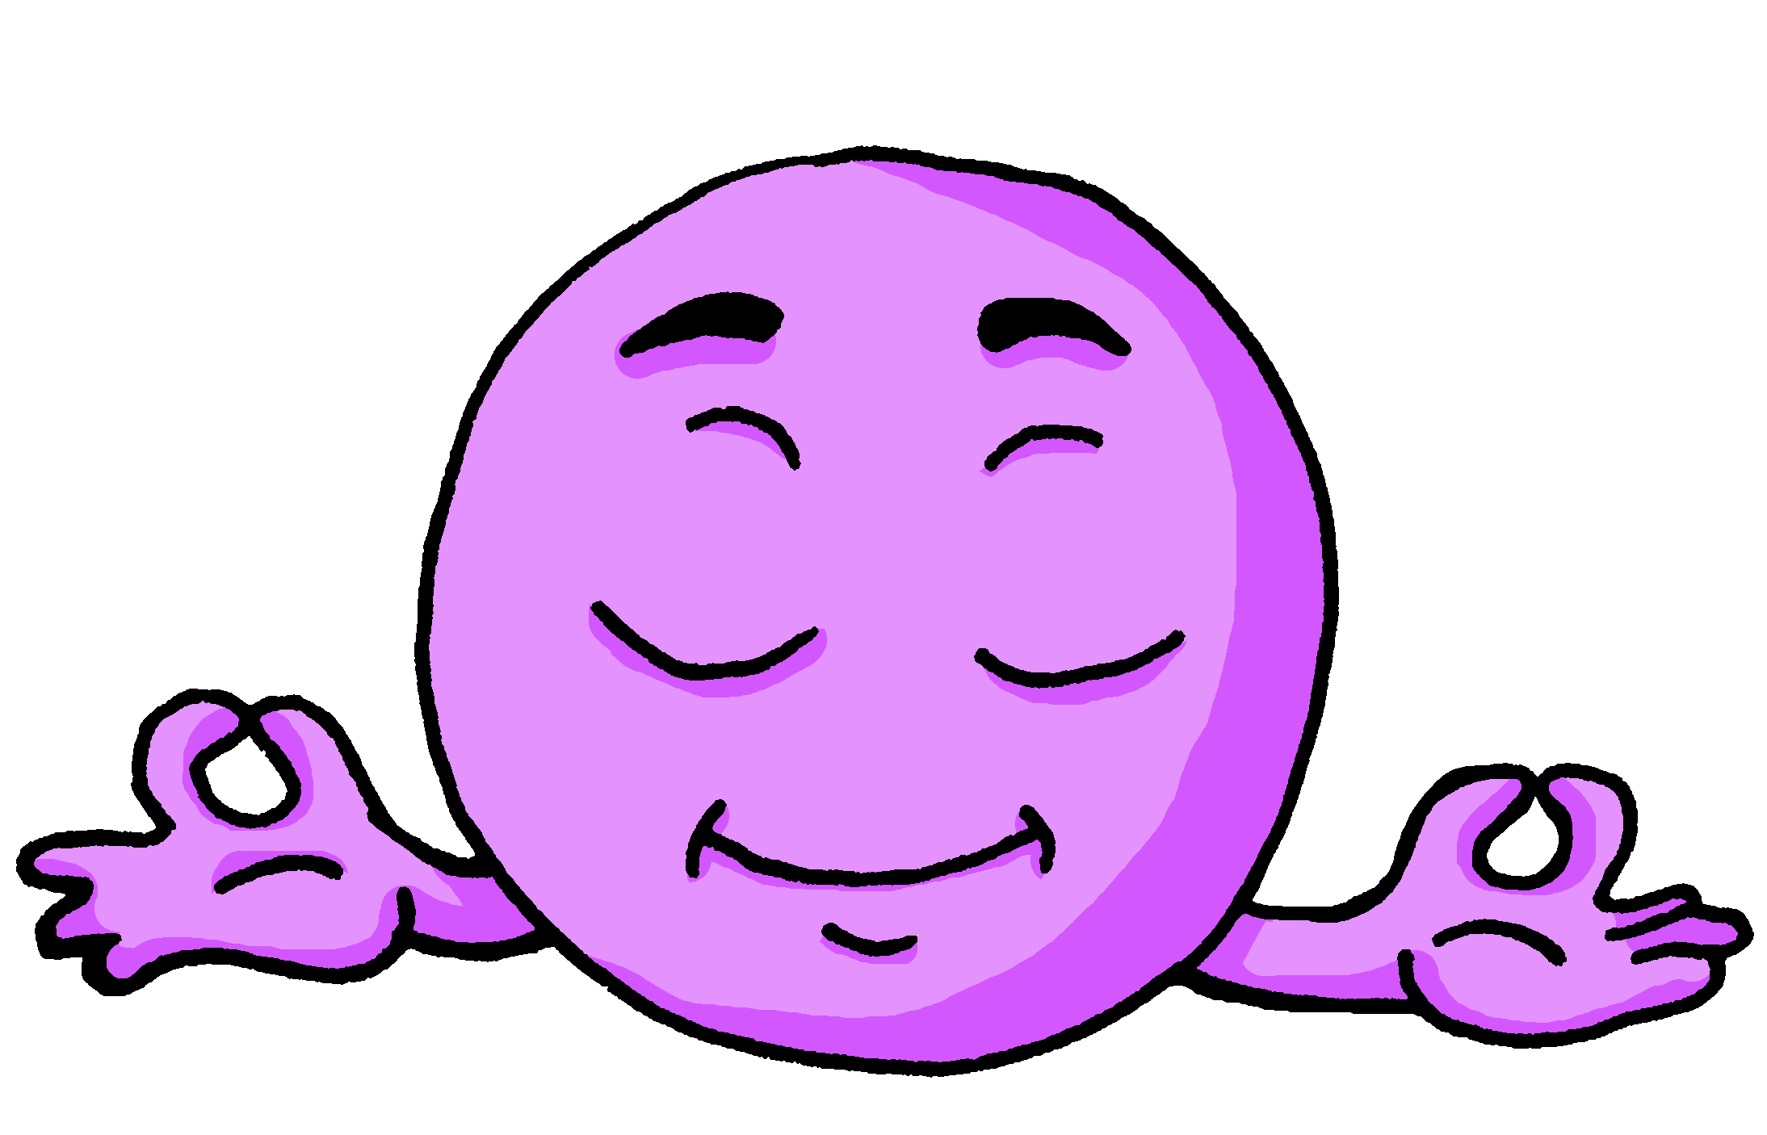
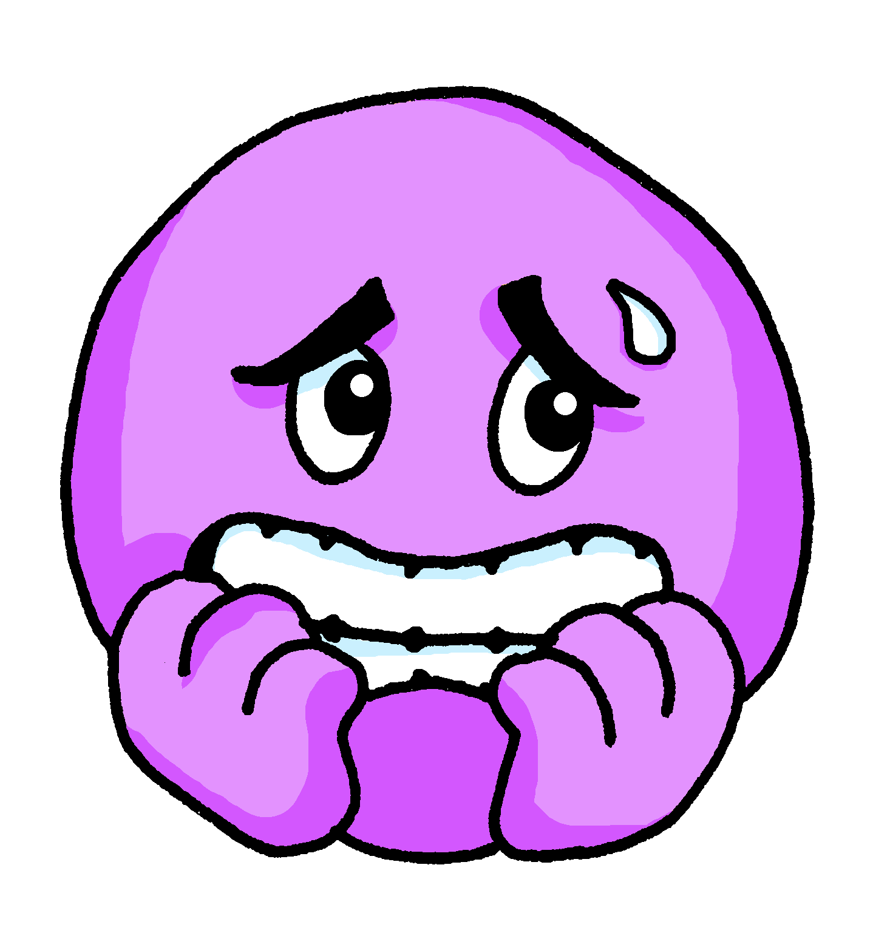
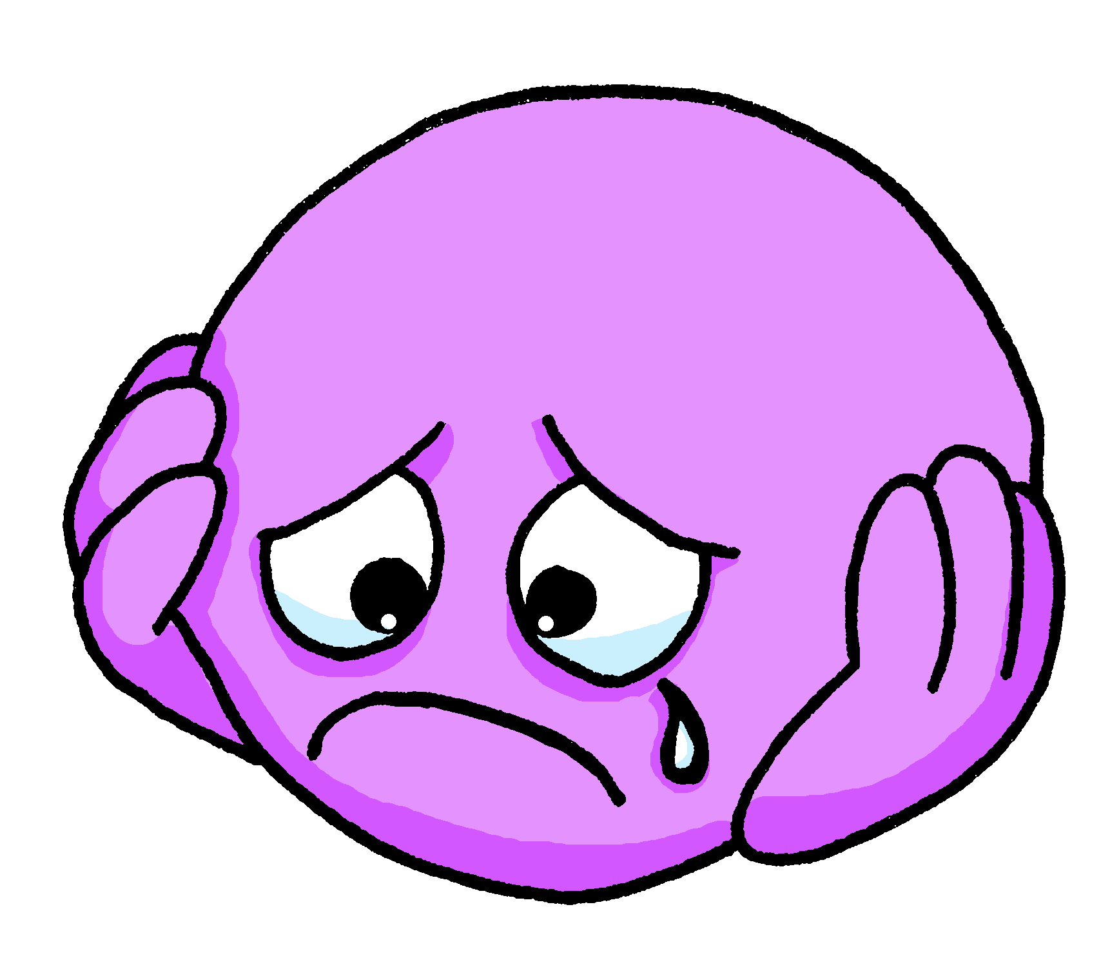
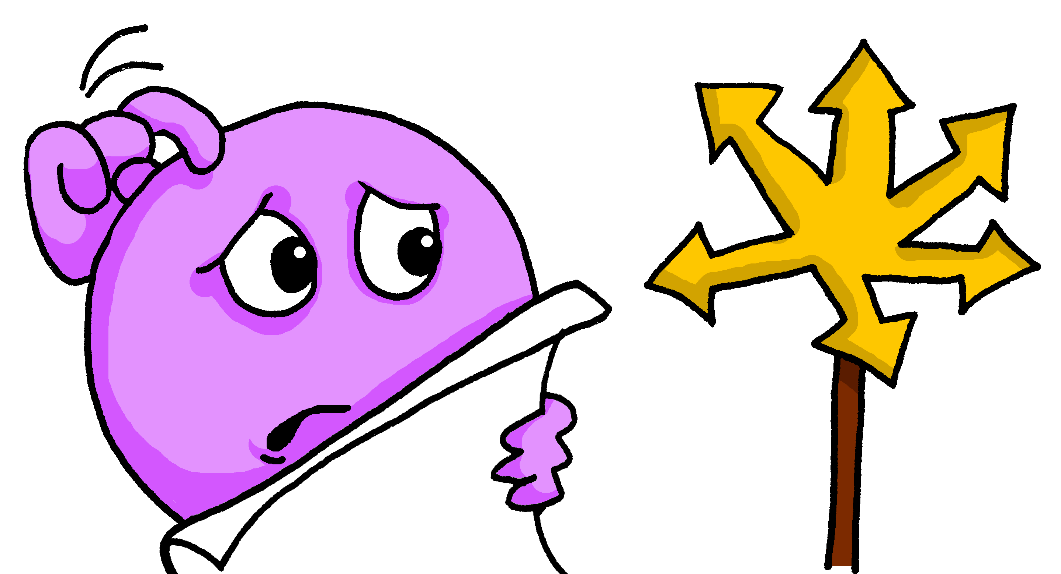
¿Cómo…?(1/2)
A: Ask ‘How are you?’ or ‘What are you like?’
hablar
B: Answer depending on the question.
Ahora | Normalmente
Ahora | Normalmente
Ahora | Normalmente
1
2
3
4
Ahora | Normalmente
5
Ahora | Normalmente
6
Ahora | Normalmente
Notes:
Timing: 8 minutes (two slides) – timing can be flexible depending on number of rounds. Aim: to practise asking and answering about moods and traits using 1st and 2nd persons singular of SER and ESTAR.
Procedure:
Student As turn away from the board. They are going to ask 6 questions – either ‘How are you?’ (¿Cómo estás?) or ‘What are you like?’ (¿Cómo eres?). They should each time.
Student Bs face the board and, working in number order 1-6, they answer the question differently, according to the verb and whether they are being asked about their state/mood now or what they are like as a person, either ‘Estoy…’ or ‘Soy…’
Student As note down the response in Spanish (and then English). This practises transcription and then comprehension.
When all 6 questions have been asked, As turn back to the board and check their responses with B – checking that the answers are what B meant.
Then swap roles and move to the next slide for Round 2.
Note: i) Students could be asked to respond honestly and invited to make their responses negative when they don’t apply. ii) It would be easy to replace the pictures with English words (or add the words to the pictures) and this may avoid students asking for definitive adjectives for each one, but we have used emojis here as students would be likely to catch sight of words at some point during the activity and it reduces the need to listen to what their partner says. Reassure students that some of these pictures could give rise to several similar adjectives (feliz, alegre, contento) and that this is fine, there are no categorically correct answers – the emojis are just prompts to say something appropriate.
Suggested adjectives could be as follows: 1. tranquilo / nervioso 2. contento (feliz, alegre)/ serio 3. triste / feliz (alegre) 4. guapo / raro (tonto) 5. tonto (raro) / alegre (feliz, positive) 6. perdido / fuerte
The images are the same on the next slide, but re-organised.

Slide 9
¿Cómo…?(2/2)
B: Ask ‘How are you?’ or ‘What are you like?’
hablar
A: Answer depending on the question.
Ahora | Normalmente
Ahora | Normalmente
Ahora | Normalmente
1
2
3
4
Ahora | Normalmente
5
Ahora | Normalmente
6
Ahora | Normalmente
Notes:
[2/2]

Slide 10
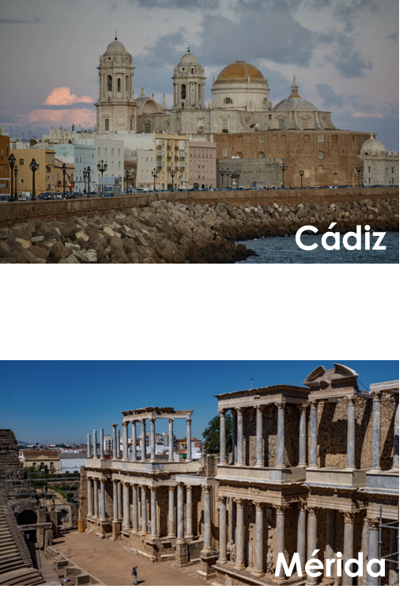
Talking about people and places
now vs in general ESTAR vs SER in singular persons (revisited)
weak vowel [i]
Y8 Spanish Term 1.1 – Week 3 – Lesson 6 Amanda Izquierdo / Nick Avery / Rachel Hawkes Artwork: Mark Davies Date updated: 26.08.23
Notes:
Learning outcomes (lesson 2):
Consolidation of SER (for traits) vs ESTAR (for state/mood) in singular and plural persons
Consolidation of adjectival agreement for gender & number
Introduction of weak vowel [i]
Note: In this lesson there will be a continued focus on what people are like at the moment vs in general but also including some focus on location and places.
New vocabulary (introduce): gente [137]; malo² [360]; sucio [1855]; limpio [1710]; precioso [1777]; listo² [1684]; contento [1949]; triste [1371]; seguro² [407]; igual [263]; quizás [346]; según [237]; así [67]; generalmente [1387]; ahora [81]
Revisit Y7, 3.2.6: cielo [620]; cenar [3087]; dormir [403]; pelo [873]
Revisit Y7, 3.1.5: correr [343]; por¹ [15]; escribir [198]; algo [110]; aprender (a) [428]; mujer [120]; carta¹ [627]; idioma [1159]; chino [1349]; parque [1354]; después [115]; siempre [96]
Source: Davies, M. & Davies, K. (2018). A frequency dictionary of Spanish: Core vocabulary for learners (2nd ed.). Routledge: London

Slide 11
Fonética
hablar
[u]
a, e, o
Last lesson, we saw that the vowel ____ merges with [a], [e] and [o] to make a single syllable. This makes it a ‘weak’ vowel.
a, e, o
The same happens with [i]:
a, e, o = strong/open vowels
1
bien
2
sucio
i, u
3
seria
i = weak/closed vowel
Notes:
Timing: 2 minutes
Aim: to introduce the ‘weak’ vowel [i]. This attaches to a strong vowel to create a diphthong, where one vowel ‘glides’ into another.
Procedure:
Teacher gives explanation.
Teacher models pronunciation and/or plays audio.
Students say the three words in chorus.

Slide 12
Fonética
escuchar / escribir
Escucha las frases. ¿Escuchas IA, IO or IE?
i, u
 | IA | IO | IE
i, u =
weak/closed vowels
1
2
a, e, o
3
4
5
a, e, o = strong/open vowels
6
Notes:
Timing: 7 minutes
Aim: To recap weak vowels [i], [u] and to practice specifically with [i] – weak or closed vowels attach to a strong vowel to create a diphthong, where one vowel ‘glides’ into another.
Procedure:
1. Play the audio for each phrase and tick the correct column depending on what you hear.
2. See the answers for each phrase.
3. Practise pronunciation: read each phrase out loud. Try to mimic the sounds as close to the recording as you can. The sentences appear on the next slide.
Transcript:
La mujer seria aprende chino.
Está nervioso cuando habla el idioma.
No entiendo bien la pregunta diez.
Viajo con mi familia a Francia y a Italia en verano.
El edificio está en un barrio precioso.
¿Quién va a la tienda después? Voy a comprar algo.

Slide 13
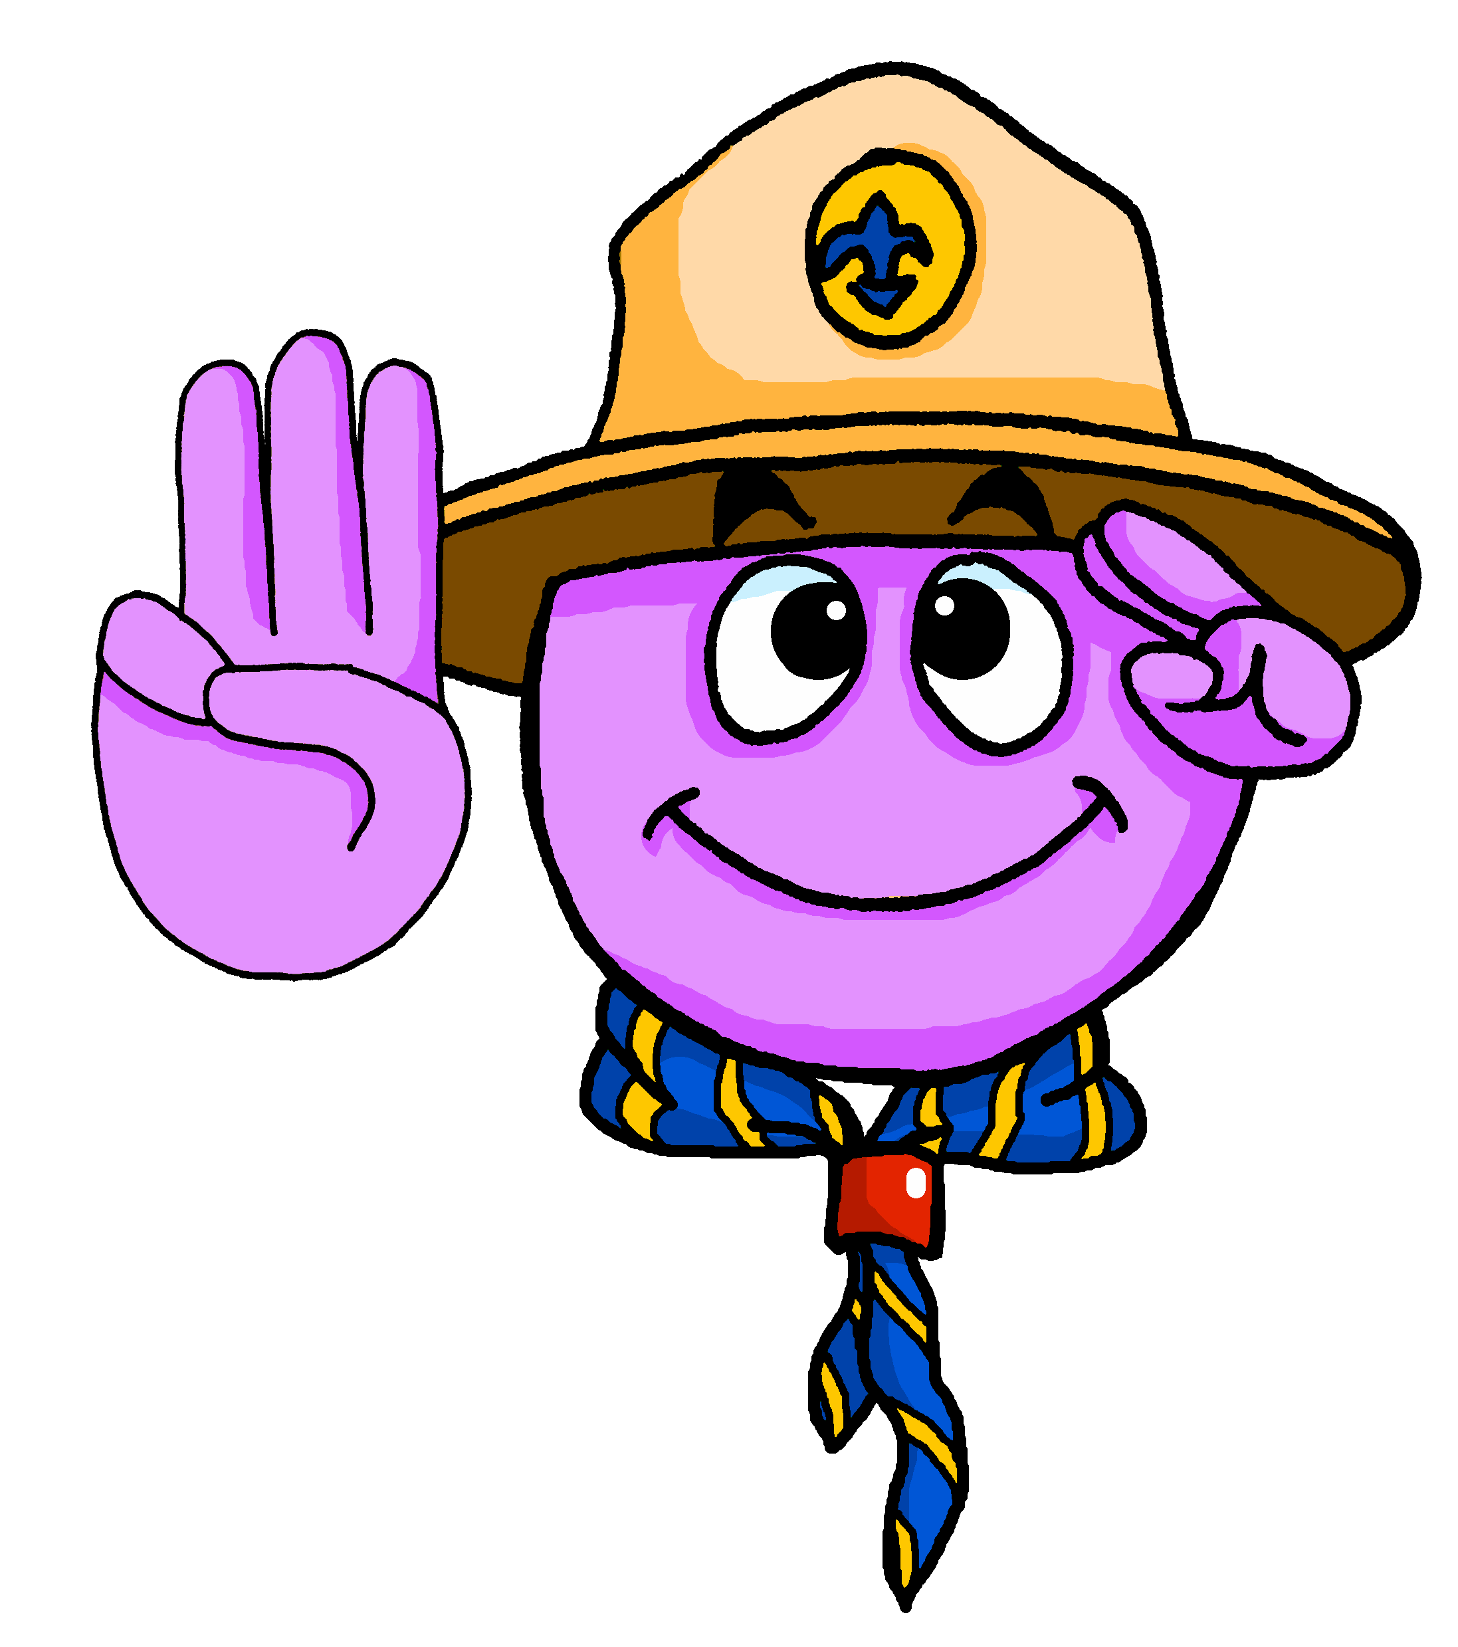
Vocabulario
leer
Some adjectives in Spanish can have different meanings depending on the verb ‘ser’ or ‘estar’. Compare:
Soy malo.
I’m a bad person.
‘Está seguro/a’ can also mean ‘s/he or it is safe’ (as a state).
Estoy malo.
I’m ill/sick.
Está seguro/a.
It is sure, certain.
Es seguro.
It’s safe.
This meaning only works with ‘estar’.
Estoy listo.
I’m ready.
Soy listo.
I’m intelligent, smart.
Notes:
Timing: 1 minute
Aim: To learn about the differences in meaning of certain adjectives depending on their use with ‘ser’ or ‘estar’.
Procedure:
Read the example sentences and compare the differences.
Notes:
These three adjectives were introduced in Y7 with the first meaning in each pair of examples. They are reintroduced here with the meaning in the second sentence.

Slide 14
Vocabulario
leer
 | ¿Qué significan las palabras?
1. Bianca no quiere cenar porque está mala. Solo quiere dormir.
2. Papá está triste, pero quizás su amigo no está así.
3. Según la gente la ciudad es muy bonita. Voy a ir a mediodía.
4. El parque está sucio y la calle está igual.
5. No está lista para escribir una carta.
6. La playa es preciosa, pero no está limpia.
mala =
ill, sick
triste =
sad
así =
like that
quizás =
maybe
según =
according to
gente =
people
sucio =
dirty
igual =
the same
lista =
ready
preciosa =
beautiful
limpia =
clean
Notes:
Timing: 7 minutes
Aim: To further embed the meaning of new vocabulary and present three new words from this week’s set in context.
Procedure:
Read the sentences and try to think of the meaning of the words in bold. Most of these have been presented and practised already this week.
Write the meaning of the bold words in English.
Three words (quizás, así, según) are new this week, so their meanings are given upfront. Teachers should draw students’ attention to these.
Additional notes:
Words introduced this week: malo [368]; triste [1371]; quizás [346]; así [67]; según [237]; gente [137]; sucio [1855]; igual [263]; listo [1684]; seguro [407]; precioso [1777]; limpio [1710]
Words revisited from 3.2.6 [revisited in SoW this week]: cenar [3087]; dormir [403]. Other words from the poem are included for further exposure to words that have been previously encountered in the poem: playa [1475]; mediodía [2647]; papá [865]; su [12]
Words revisited from 3.1.5 [revisited in SoW this week]: parque [1354]; correr [343]; escribir [198]; carta [627]
From other Y7 weeks: querer [58]; porque [40]; pero [30]; ciudad [178]; muy [43]; bonito [891]; calle [269]
Source: Davies, M. & Davies, K. (2018). A frequency dictionary of Spanish: Core vocabulary for learners (2nd ed.). Routledge: London

Slide 15
SER and ESTAR (revisited)
gramática
In Spanish, there are two ways to say ‘they are’: ________ and _______
están
son
están
Use ‘______’ for location and for state or mood.
son
Use ‘_______’ for traits.
They are on the beach (location).
Están en la playa.
They are bad (trait).
Son malos.
Notes:
Timing: 1 minute
Aim: To revise the meanings of the 2nd person plural for the verb ‘estar’ and ’ser’.
Procedure:
Reveal each sentence to show students the English sentences and elicit the Spanish translation.

Slide 16
Lucía describe dos ciudades
Lee las frases. ¿Cuál es la opción correcta?
leer
A veces las dos opciones son correctas.
1. | Cádiz y Mérida son... | ciudades antiguas. en España.
2. | Según Daniel, la arena en la playa está... | bastante sucia. muy grande.
3. | Los parques están... | en el centro. limpios.
4. | El edificio es... | seguro. cerca de la escuela.
5. | El cielo y los barrios son... | preciosos. lejos de la escuela.
6. | Daniel y Lucía están... | en el pueblo. contentos.
Cádiz
Mérida
Notes:
Timing: 8 minutes
Aim: Consolidate the meaning of ‘es’, ‘está’, ‘son’, ‘están’.
Procedure:
Read each phrase and compare both options. Decide which one is correct, considering that sometimes both could be correct.
Check the answers. In particular, check understanding of ‘Según Daniel’ and ‘El edificio es seguro’ because these words have just been (re)introduced.

Slide 17
SER and ESTAR (revisited)
gramática
In Spanish, there are two ways to say ‘we are’: __________ and _________
estamos
somos
estamos
Use ‘_________’ for location and for state or mood.
somos
Use ‘________’ for traits.
Also, remember that adjectives change (-o, -a) to agree in gender with what we are talking about.
We are smart/intelligent (feminine).
Somos listas.
We are sick/ill (masculine).
Estamos malos.
Notes:
Timing: 1 minute
Aim: To revise the meanings of the 1st person plural for the verb ‘estar’ and ’ser’.
Procedure:
Reveal each sentence to show students the English phrases and elicit the Spanish translation.

Slide 18
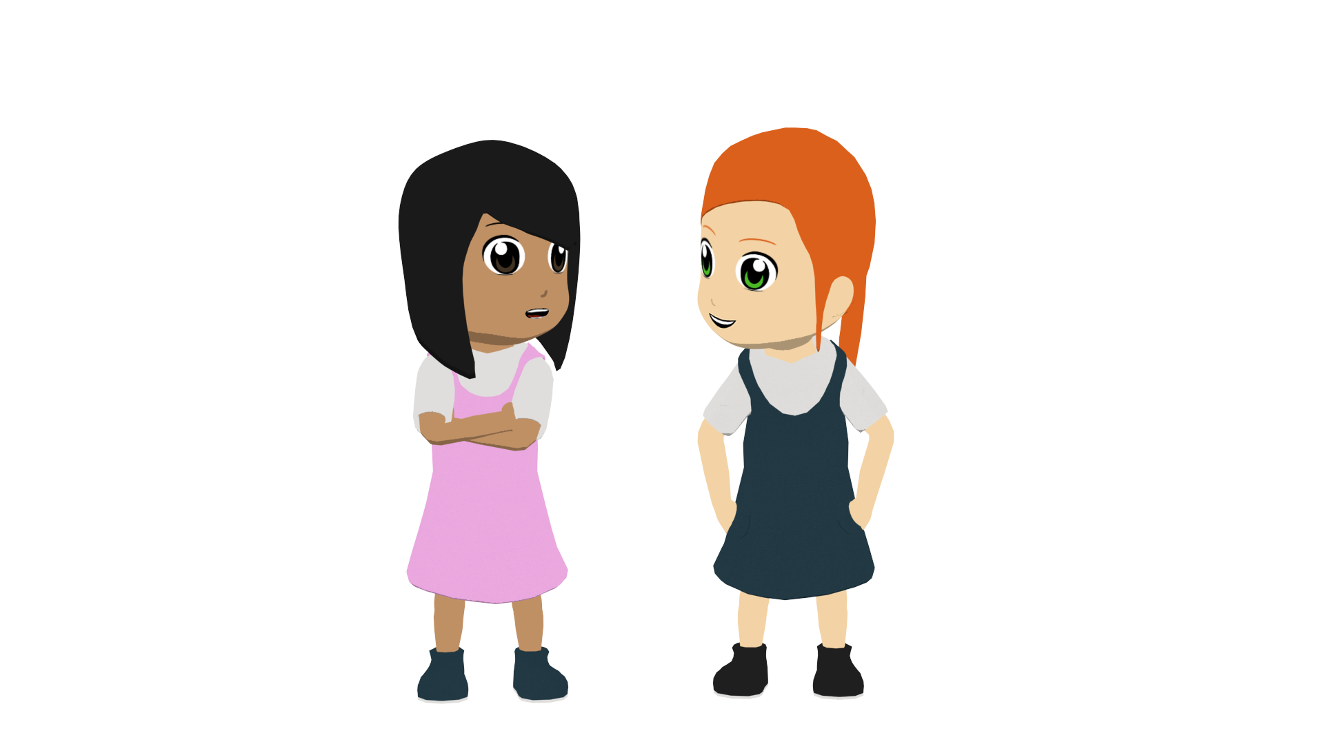
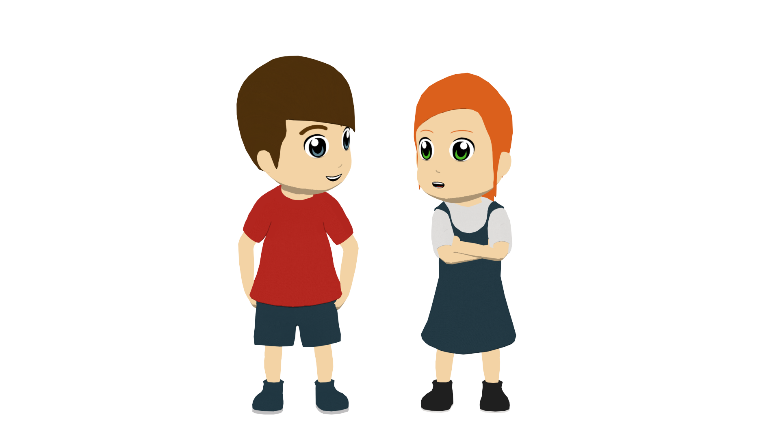
Lucía habla
Escucha. Lucía habla de ‘ahora’ o ‘en general’? ¿Habla de Lucía y Nadia o Lucía y Daniel?
leer
 | ‘We’ (state) | ‘We’ (traits) | A (chicas) | B (chicos/chico y chica)
1
2
3
4
5
6
Notes:
Timing: 8 minutes
Aim: to identify the verb forms ‘somos’ and ‘estamos’ and their meanings; to practise attending to gender agreement marking on adjectives.
Procedure:
Students write 1-6.
Students listen to each recording and write ‘state’ or ‘trait’, depending on what is heard.
Listen again. Who is talking? Write ‘A’ (the girls) or ‘B’ (the boys/boy+girl).
Transcript:
Somos malas.
Somos listos.
Estamos contentas.
Somos felices
Estamos limpios.
Estamos seguras.

Slide 19
Un nuevo profesor
Escribe las frases en español.
escribir
Your school is recruiting a new teacher and you overhear a few conversations between the candidates. You challenge yourself to translate what you hear into Spanish.
Are you (feeling) nervous today?
Generally we’re calm, but today we’re (feeling) sick.
The teachers are always very nice here, I’m sure.
Are you ready now?
Is he smart/intelligent?
The school is (looking) clean.
Oh, no! My hair is dirty.
We are here because of a friend.
The classroom is beautiful! (trait)
*classroom – la clase
Notes:
OPTIONAL WRITING ACTIVITY (an alternative activity follows this one) Timing: 15 minutes (two slides)
Aim: To consolidate all singular forms of verbs ‘ser’ and ‘estar’ plus first person plural; to also consilidate adjectival agreement and vocabulary (e.g temporal adverbs and preposition ‘por’).
Note: a gloss is provided for ‘classroom’ because ‘clase’ has only been used as ‘class’ so far in the SoW.
Procedure:
Imagine you are overhearing these conversations. Translate each phrase into Spanish.
Check your answers on the next slide.

Slide 20
Respuestas
escribir
Generalmente somos tranquilos, pero hoy estamos malos.
Are you (feeling) nervous today?
Generally we’re calm, but today we’re (feeling) sick.
¿Estás nervioso/a?
Los profesores son siempre simpáticos aquí, estoy seguro/a.
The teachers are always very nice here, I’m sure.
¿Estás listo/a ahora?
Are you ready now?
The school is (looking) clean.
¿Es listo/a?
La escuela está limpia.
Is he smart/intelligent?
We are here because of a friend.
Estamos aquí por un amigo.
Oh, no! My hair is dirty.
¡Oh, no! Mi pelo está sucio.
The classroom is beautiful! (trait)
¡La clase es preciosa!
*classroom – la clase
Notes:
ANSWER SLIDE

Slide 21
Mis vacaciones
escuchar / escribir
Escribe un texto.
Add words you want to your repertoire!
Write a short text about your summer.
Include:
Where you travelled to and where it is exactly
How long you spent there
What you visited and your opinion
Two questions about holidays to your friend
Write 5 sentences Use at least 2 past and 2 present verbs Use a conjunction (and, or, but, also) or adverb (however) | Write 6-8 sentences Use at least 5 different past and 2 present verbs Use 2 different conjunctions Use 1 negative
vocabulario
un día – one day
viajar|tomar | visitar
pasar | cantar | pienso que
comprar
Make a list of language to use!
Notes:
OPTIONAL IN CLASS WRITING (ASSESSMENT) OPPORUNITY
This is from students’ preparation at the end of last week. Timing: 15 minutes Aim: to revisit previously taught vocabulary and grammar in the context of a short piece of writing, bringing together some language from Y8 Term 1 so far.
Note: students had some time to plan this activity last week. Teachers may now want to give students the opportunity to write in class. Teachers will choose the resources that they allow students access to, but it is helpful to remember that when students work to retrieve language from memory and use it in a communicative task, it develops their knowledge further, as well as simply assessing it. It is always worth reminding students of this, both to make the activity less ‘high stakes’ but also to clarify the purpose of writing from their own resources (i.e., from memory).

Slide 22
Deberes
Vocabulary Learning Homework (Y8 Term 1.1, Week 4)
Audio file
Student worksheet
In addition, revisit: Y8 Term 1.1 Week 1 Y7 Term 3.1 Week 6
Notes:
The answer sheet for the Y8 vocabulary learning HW is here: https://rachelhawkes.com/LDPresources/Yr8Spanish/Spanish_Y8_Term1i_Wk4_audio_HW_sheet_answers.docx
Notes:
i) Teachers may, in addition, want to recommend use of a particular online app for the pre-learning of each week’s words. ii) Quizlet now requires parental involvement / registration / permissions for users below the age of 13, so it is perhaps most suitable for Y9 – 11 students. iii) Language Nut hosts LDP vocabulary lists and these are free for schools to use, though there is a registration process. One benefit is that all of the student tracking data that Language Nut offers are also available to schools that use the LDP lists for practice. Perhaps this makes it a good option for Y7/8.
iv) There are other free apps, and new ones are always appearing. Teachers have told us that they are currently using: Flippity, Wordwall (where using previously-created activities is free).
v) Gaming Grammar has been acquired by Language Nut. Its original content should still be available to teachers and much of it is appropriate for Y8 learners. From this lesson, for example, learners could practise:
Adjectives: Number in the ‘Adjective agreement’ menu

Slide 23
hablar / escuchar
¿Cómo eres? ¿Cómo estás? Un juego de preguntas.
Use your cards to
ask your partner questions – does the prompt refer to ‘ahora’ (now) or ‘generalmente’?
answer questions with ‘soy’ or ‘estoy’.
Say ‘Sí …’ or 'No …’, and ‘soy’ or ‘estoy’ depending on the information on your card.
Your partner will also ask you. Take turns.
Un ejemplo:
¿Estás nerviosa?
Persona A (pregunta):
No. Soy nerviosa.
Persona B (contesta):
Ask these questions
Your answers
 | Ahora | General-mente | Respuesta
Are you nervous? | X
 | Ahora | General-mente
1. |  | X
¿ o ?
Notes:
ALTERNATIVE SPEAKING TASK FORMAT FROM LESSON 1 Timing: 12 minutes (four slides)
Aim: To practise using ‘ser’ and ‘estar’ in the 1st and 2nd person singular in the oral modality. An active choice will be needed between these two verb forms in each interaction, both by the speaker and listener. This makes the choice of verb essential to completion of the task. Other features practised here include: question intonation, gender agreement on adjectives and vocabulary drawn from previous weeks.
Procedure:
Person A uses their prompt card to ask a question that either starts with ‘estás’ or ‘eres’.
Person B listens and says ‘sí’ or ‘no’, the corresponding verb (‘soy’ or ‘estoy’) and the adjective in the questions. The answers depend on the information on the table.
Try to answer in full sentences, if possible. Student A then completes their card accordingly, adding a tick or cross after each question.

Slide 24
Persona A
Ask these questions
Use this grid to give your answers
 | Ahora | General-mente | Respuesta
Are you sad? | X
Are you happy? |  | X
Are you serious? | X
Are you famous? |  | X
Are you clean? | X
Are you ugly? |  | X
 | Ahora | General-mente
1. |  | X
2. | X
3. | X
4. | X
5. |  | X
6. | X
¿ o ?
Notes:
DO NOT DISPLAY DURING ACTIVITY
Target answers for Person A during speaking, based on Person B’s questions:
Sí, soy alegre.
No, estoy guapo.
Sí, estoy tranquilo.
No, estoy raro.
Sí, soy simpático.
No, soy limpio.

Slide 25
Persona B
Ask these questions
Use this grid to give your answers
 | Ahora | General-mente | Respuesta
Are you cheerful? |  | X
Are you good looking? |  | X
Are you calm? | X
Are you strange? |  | X
Are you nice? |  | X
Are you clean? | X
 | Ahora | General-mente
1. | X
2. | X
3. |  | X
4. |  | X
5. |  | X
6. | X
¿ o ?
Notes:
DO NOT DISPLAY DURING ACTIVITY
Target answers for Person B during speaking, based on Person B’s questions:
Sí, estoy triste.
No, estoy feliz.
No, soy serio.
Sí, soy famoso.
No, soy limpio.
No, estoy feo.

Slide 26
Persona A
Persona B
 | Ahora | General-mente | Respuesta
Are you sad? | X
Are you happy? |  | X
Are you serious? | X
Are you famous? |  | X
Are you clean? | X
Are you ugly? |  | X
 | Ahora | General-mente | Respuesta
Are you cheerful? |  | X
Are you good looking? |  | X
Are you calm? | X
Are you strange? |  | X
Are you nice? |  | X
Are you clean? | X
¿ o ?
¿ o ?
Notes:
DO NOT DISPLAY DURING ACTIVITY
ANSWER SLIDE

