Slide 1
Comparing past experiences
past tense (preterite) -ar verbs:
2nd person singular (-aste)
Y8 Spanish Term 1.1 – Week 2 – Lesson 3 Amanda Izquierdo / Nick Avery / Rachel Hawkes Artwork: Mark Davies Date updated: 25.08.23
Lucía habla del año pasado.
Los abuelos hablan de los años de colegio.
Notes:
Note: all words (new and revisited) in this week of the SOW appear on all three GCSE wordlists, with no exceptions.
Learning outcomes (lesson 1):
Introduction of –ar verbs in 2nd person singular preterite (-aste).
Consolidation of –ar verbs in 1st person singular preterite (-é)
Awareness raising of English auxiliary ‘did’
Word frequency (1 is the most frequent word in Spanish):
New vocabulary (introduce): cantar [717]; tomar¹ [133]; coger [1001]; intentar [411]; ganar¹ [295]; concierto [1456]; premio [1090]; año [46]; autobús [3709]; hasta¹ [60]; además [155]; por² [15]; canción [982]
3.2.5 (revisit): vamos [ir-33]; marzo [1231]; abril [1064]; porque [40]; por qué; mañana² [215]; divertido [2446]; visitar [792]; descubrir [414]; parte¹ [92]; extranjero¹ [765]; mundo [123]
3.1.4 (revisit): beber [1085]; comer [347]; leer [209]; vivir [142]; hombre [97]; ejercicio [1162]; fruta [1925]; carne [860]; rico² [398]; agua [204]; nunca [158]; a veces [vez-59]
Source: Davies, M. & Davies, K. (2018). A frequency dictionary of Spanish: Core vocabulary for learners (2nd ed.). Routledge: London

Slide 2
¿Cuál es el verbo lógico?
leer
cantar
una canción
ganar
Notes:
Timing: 5 minutes (9 slides) Aim: to introduce new and recap previously taught vocabulary in the written modality, practising read aloud at the same time.
Procedure: 1. Click to bring up two verb options. Ask, for example, ¿cantar o ganar?
2. Students respond with the most appropriate option and give the noun in Spanish as well, if they are able. 3. Either way, the teacher clicks to star the correct verb and either elicitis or provides the Spanish word for the noun as well, to consolidate learning. 4. Continue with all nine items.

Slide 3
¿Cuál es el verbo lógico?
leer
intentar
tomar
un autobús
Notes:
2/9

Slide 4
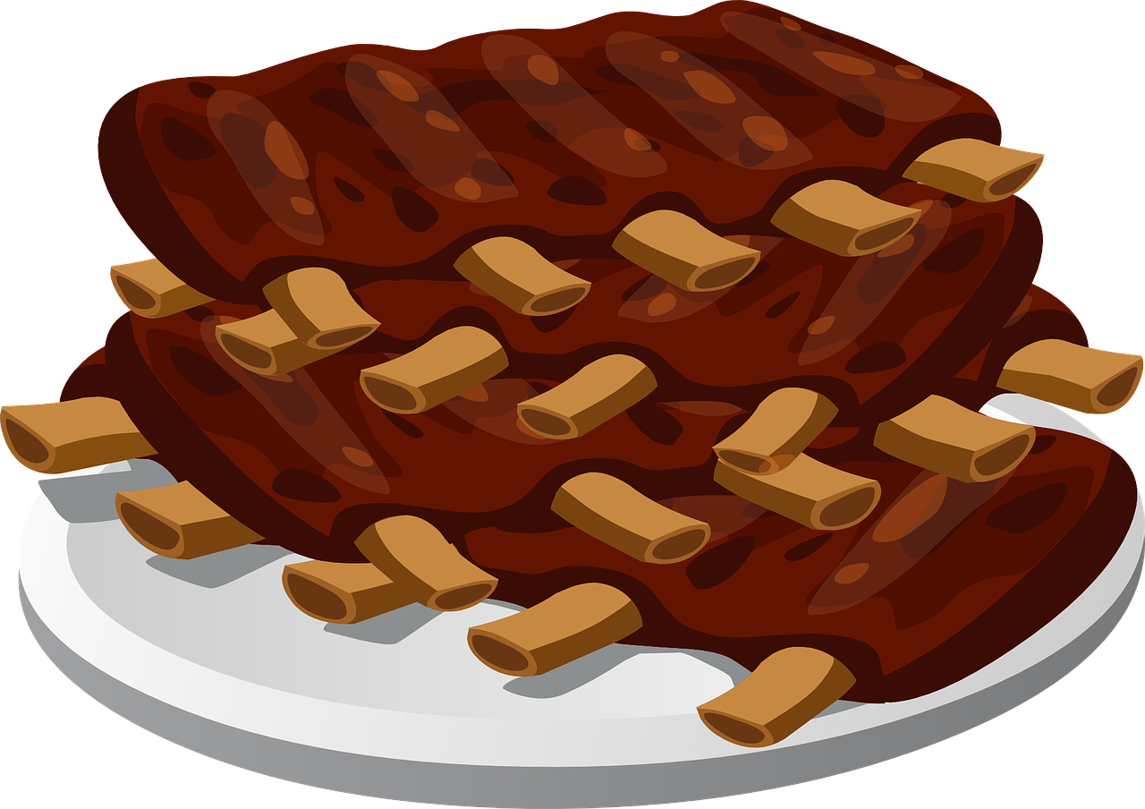
¿Cuál es el verbo lógico?
leer
beber
comer
carne
Notes:
3/9

Slide 5
¿Cuál es el verbo lógico?
leer
leer
un libro
vivir
Notes:
4/9

Slide 6
¿Cuál es el verbo lógico?
leer
visitar
ganar
un premio
Notes:
5/9

Slide 7
¿Cuál es el verbo lógico?
leer
viajar
intentar
un ejercicio
Notes:
6/9

Slide 8
¿Cuál es el verbo lógico?
leer
beber
agua
cantar
Notes:
7/9

Slide 9
¿Cuál es el verbo lógico?
leer
comer
fruta
descubrir
Notes:
8/9

Slide 10
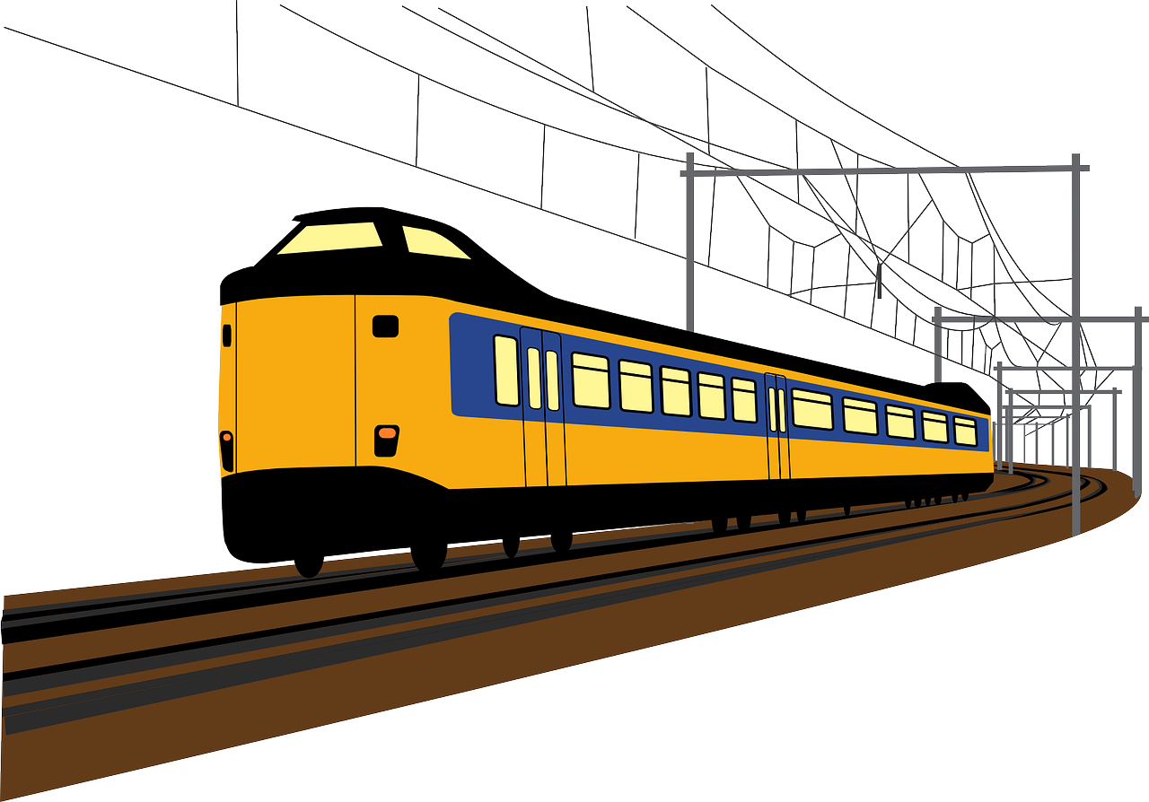
¿Cuál es el verbo lógico?
leer
‘Coger’ is used more in Spain. ‘Tomar’ is more common in Latin America.
coger
un tren
tomar
un tren
Notes:
9/9

Slide 11
Vocabulario
 | Español | Inglés
1 | cantar | to sing, singing
2 | tomar | to take, taking
3 | coger | to take, taking
4 | intentar | to try to, trying to
5 | ganar | to win, winning
6 | el concierto | concert, gig
7 | el premio | prize, award
8 | el año | year
9 | el autobús | bus
10 | hasta | as far as, up to
11 | además | besides, as well
12 | por | around, because of
13 | la canción | song
leer / hablar
60
Use an infinitive after ‘intentar’.
E.g. Intento jugar.
I try to play.
0
INICIO
Notes:
Timing: 4 minutes Aim: To reactivate and strengthen vocabulary knowledge. Note: Students in Y8 pre-learn their vocabulary on Quizlet, additionally completing several tasks to build their knowledge. This task assists recall of the new vocabulary. Procedure: Round 1: Look at the Spanish, recall the English meanings, saying them aloud. [1 minute] Round 2: Look at the English, recall the Spanish meanings, saying them aloud. [1 minute] Repeat for two further minutes, to speed up recall.
Note:
Some aspects of ‘por’ will be explained in further detail in following slides.

Slide 12
Giving reasons for things Using the preposition ‘por’
gramática
Remember that ‘por’ is used to express movement:
Viajé por el mundo.
I travelled around the world.
Caminé por la playa.
I walked along the beach.
‘Por’ is also used to give reasons for things.
No puedo visitar por la situación.
I can’t visit because of the situation.
No como carne por los animales.
I don’t eat meat because of the animals.
Notes:
Timing: 2 minutes
Aim: To understand a second use of the preposition ‘por’ and to see it in varied contexts.
Procedure: 1. Teacher reads the explanations
2. Students give English translations when prompted.
Note:
‘Por’ is a difficult preposition because of its multiple functions and translations into English. We teach ‘por’ here only as ‘because of’ and not also as ‘for’. Although the English ‘for’ may be used to express reasons, it can also be an ambiguous term. Consider ‘voy por trabajo’. If we translate this as ‘I go because of work’, it is clear the work is a reason, whereas ‘I go for work’ could imply that work is either the reason (i.e. the person already has work) or an objective/end (i.e. the person is going to find work). We will later directly juxtapose ‘por’ and ‘para’ but will first teach the uses and translations of ‘por’ that avoid this complex issue.

Slide 13
Using por and porque
gramática
Por and porque both give reasons.
Typically, we use por to mean because of followed by a noun or pronoun.
And we use porque to mean because followed by a verb.
Llego tarde por el tráfico.
I arrive late because of the traffic.
Llego tarde porque hay tráfico.
I arrive late because there is traffic.
Notes:
Timing: 2 minutes
Aim: To understand a second use of the preposition ‘por’ and to see it in varied contexts.
Procedure: 1. Teacher reads the explanations
2. Students give English translations when prompted.
Note:
‘Por’ is a difficult preposition because of its multiple functions and translations into English. We teach ‘por’ here only as ‘because of’ and not also as ‘for’. Although the English ‘for’ may be used to express reasons, it can also be an ambiguous term. Consider ‘voy por trabajo’. If we translate this as ‘I go because of work’, it is clear the work is a reason, whereas ‘I go for work’ could imply that work is either the reason (i.e. the person already has work) or an objective/end (i.e. the person is going to find work). We will later directly juxtapose ‘por’ and ‘para’ but will first teach the uses and translations of ‘por’ that avoid this complex issue.

Slide 14
¿Qué significa?
leer
Lee las frases. ¿Cuál es el significado de ‘por’ y ‘porque’? Luego, escribe las frases en inglés.
 |  | because | because of | En inglés
1. | El hombre está aquí por la crisis.
2. | Gano premios porque mis canciones son buenas.
3. | Está nerviosa por el examen.
4. | Coge el aútobus porque no tiene bicicleta.
5. | No puede viajar al extranjero por el dinero.
The man is here because of the crisis.
I win prizes because my songs are good.
S/he is (feeling) nervous because of the exam.
S/he takes the bus because she doesn’t have a bike.
S/he can’t travel abroad because of the money.
Notes:
Timing: 5 minutes
Aim: To practise with the different uses of ‘por’ and ‘porque’.
Procedure: 1. Read each phrase and decide if its meaning refers to ‘because’, ‘because of’ or ‘for’ in English.
2. Translate each phrase into English.
3. Check your answers with further clicks.

Slide 15
Talking about finished actions in the past 2nd person singular preterite (-aste)
gramática
To say ‘I’ with finished actions in the past, use the verb ending ____.
-é
Caminé hasta el colegio.
I walked up to/as far as the school.
To talk about ‘you’ with finished actions in the past, use the verb ending ‘–aste’.
Cantaste en el concierto.
You sang in the concert.
Visitaste la ciudad.
You visited the city.
Notes:
Timing: 1 minute
Aim: To recap the 1st person singular part (-é) and to introduce the 2nd person singular past (-aste).
Procedure:
Reveal each sentence to show students the Spanish phrases and elicit the English translation.
Ask students to listen to you modelling the final-syllable stress for each ending (-é is stressed, -aste is not).

Slide 16
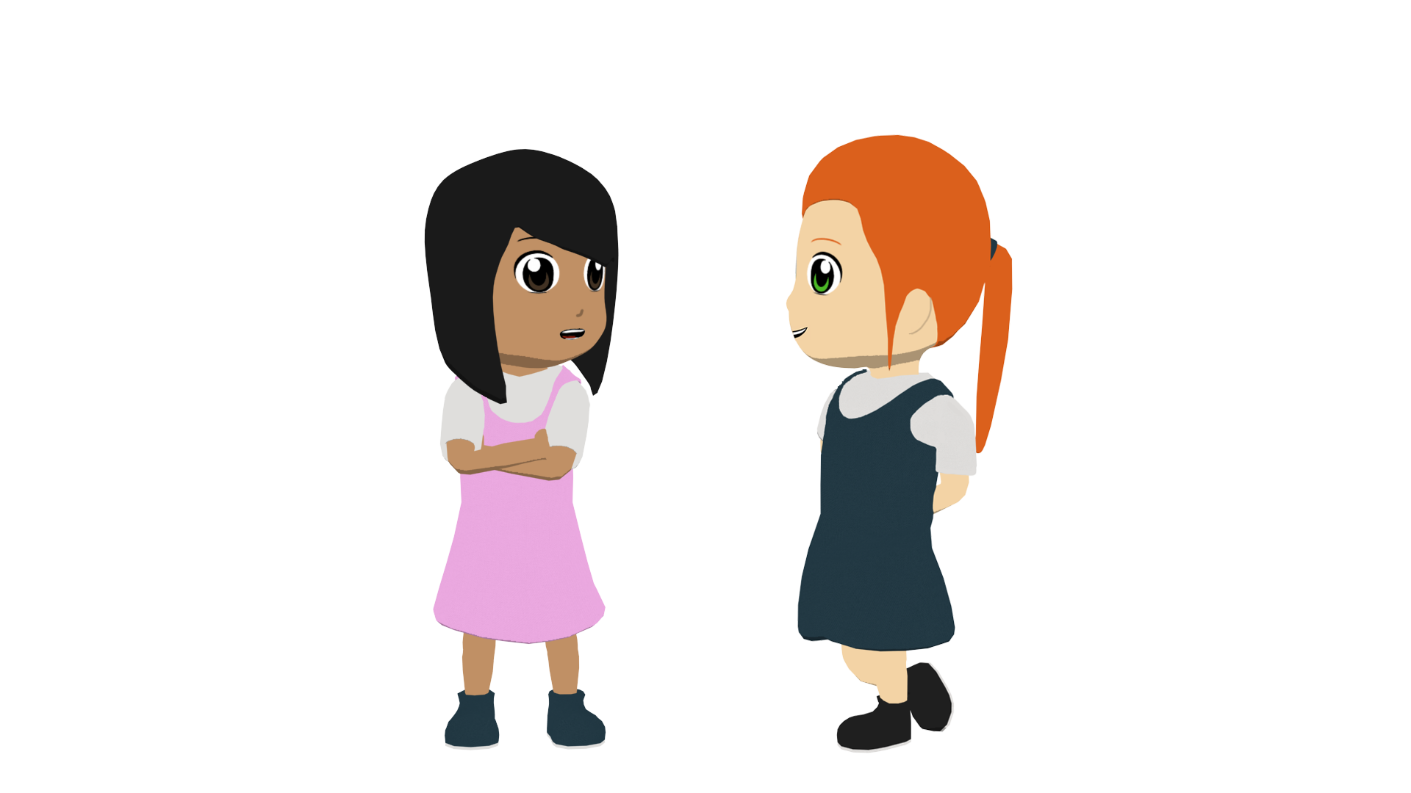
Lucía habla del año pasado
leer
Lucía habla con Nadia.
Lee las frases. ¿Es Lucía o Nadia?
El año pasado no trabajaste durante el verano y organizaste una excursión a un festival.
 | Lucía (‘I’) | Elizabeth (‘you’)
Who travelled by public transport?
Who met up with another girl?
Who sang in the concert?
Who took fruit and water?
Who tried to help?
Who did not work last summer?
Who won a prize?
Tomé el autobús hasta el lugar.
Intenté ayudar y quedé con Virginia para preparar las cosas.
Llevé fruta y agua para todos los amigos.
¡Cantaste en el concierto y ganaste un premio!
Notes:
Timing: 8 minutes
Aim: To focus on the verb forms used to express 1st and 2nd person singular preterite meaning.
Procedure:
1. Read the sentences.
2. Answer the questions. Who did these actions, Lucía (’I’) or Elizabeth (‘you’)?
Notes:
The questions and speech bubbles don’t appear in a particular order. Therefore, for each item, students will need to search for the lexical verb corresponding to their question. This will help to reinforce understanding of vocabulary.
‘Para’ + infinitive will be taught in 8.1.2.6. This construction appears in one of the items but understanding of it is not needed to complete the task.

Slide 17
Intonation questions
gramática
Remember that to ask a question in Spanish, you use the same verb, but with raised intonation.
Listen and compare:
1
Viajaste a un pueblo.
You travelled to a town.
2
¿Viajaste a un pueblo?
Did you travel to a town?
Notice how in English we use the verb ‘did’ to ask these questions in the past.
Notes:
Timing: 1 minute
Aim: to remind students of English vs Spanish question formation differences, in particular the use of the auxiliary ‘do’ (which becomes ‘did’ in past).
Procedure:
Click through the animations.
Elicit English for the Spanish examples.

Slide 18
Rafaela y Noel hablan de los años de colegio
leer
It’s been a long time and they can’t remember who did what!
Escucha. ¿Es una pregunta o una afirmación? Y ¿quién es?
Escucha otra vez y escribe la frase en inglés.
 | ¿Pregunta o afirmación? | Is it ‘I’ or ‘you’?
¿Cómo se dice en inglés?
1
Pregunta
I
Did I sing in a concert?
2
Pregunta
you
Did you study art or science?
3
Afirmación
I
I participated in team sports.
4
Pregunta
I
Did I win a prize?
5
Afirmación
you
One day you took a cat to the class.
6
Afirmación
you
You danced to a song with your sister.
Notes:
Timing: 8 minutes
Aim: To focus on the verb forms used to express 1st and 2nd person singular preterite meaning; to consolidate question vs statement intonation; to raise awareness of auxiliary ‘do’ in English questions
Procedure:
Listen to the audio and decide if it’s a question or a statement. Is it ‘I’ or ‘ you’?
Listen again and translate the phrases into English.
Transcript:
¿Canté en un concierto?
¿Estudiaste arte o ciencias?
Participé en deportes de equipo.
¿Gané un premio?
Un día llevaste un gato a la clase.
Bailaste una canción con tu hermana

Slide 19
¿Cómo se dice en español?
Escribe 5 frases en inglés. Habla en español.
leer / hablar
Change the verb to ask: Did I…? or Did you…?
cantar ganar tomar visitar viajar intentar ayudar participar bailar trabajar pasar buscar hablar | en clase el autobús / el tren en español una ciudad diferente en un día en el campo tiempo con amigos un trabajo un premio en un concierto canciones ayudar en una excursión después de la escuela
Notes:
Note: this task can be the only speaking activity completed this lesson, and its level of challenge/support can be adapted (see below). Alternatively, teachers could progress students to the activity on the next slides. There is a lot of flexibility here to help teachers to meet the needs of different classes, and different students proficiencies within the same class. The original speaking task (which requires handouts) is also still available, at the end of this slide deck. Timing: 8 minutes
Aim: to practise comprehension, read aloud and production of new and revisited language and grammar from this and previous weeks.
Procedure:
Teacher models the task by writing a preterite question on the board made up of language from the grid, emphasising the need to change the verb. E.g. Did you win a prize? (and perhaps adding ‘last year’ (el año pasado))
The teacher then models the role of the student who receives that English question from a partner and has to translate it. → Ganaste un premio el año pasado? and the teacher prompts the listening student to answer the question for real: Sí gané un premio. No, no gané un premio.
The teacher then tells both students to write 5 sentences (in English) made up of words from the table.
They swap sentences.
Partner A tries to say all B’s sentences in Spanish as quickly as possible.
Then Partner B tries to say all A’s sentences in Spanish.
Note: the level of challenge can be adjusted here. i) To increase the challenge, the student translating the questions from English into Spanish could face away from the board AND/OR the listening student who is responding to the questions could also face away from the board.
ii) To increase the support, teachers could use this slide to do some further practice – either oral or written (e.g., on mini whiteboards), setting the English question prompts themselves for students to respond to. They can vary the challenge within this activity, too, by inviting some students to face away from the board to complete the questions.

Slide 20
En el colegio (1/2)
A: Ask ‘Did I… last year?’ or ‘Did you… last year?’
hablar
B: Answer ‘yes, I …’ or ‘no, I didn’t…’ depending on the question.
= yes
= no
(I) | (you)
(I) | (you)
(I) | (you)
1
2
3
sing a sing
win a prize
take the bus
4
(I) | (you)
5
(I) | (you)
6
(I) | (you)
visit a different town/city
travel to the beach
try to help
Notes:
OPTIONAL/ADDITIONAL/ALTERNATIVE SPEAKING ACTIVITY
Timing: 10 minutes (two slides) – timing can be flexible depending on number of rounds. This task can also be reprieved in the following lesson, to continue the practice. Aim: to practise asking and answering about past events in the 1st and 2nd persons singular.
Procedure:
Student As quickly write down 1-6 and their own choice of I or you for each question, without showing the other. They should use a mix of I and you questions.
Then As ask their chosen questions (adding ‘el año pasado’) – e.g. 1 you ¿Cantaste una cancion?
Bs answer the question according to whether they are asked ‘Did I..’ or ‘Did you’? In this example Bs answer: No, no canté una canción. As check that their partner has answered correctly, according to the question they asked.
After all 6 pictures have been spoken about, students swap roles and move to the next slide.
Note: i) if they finish quickly, they should repeat the task but this time, they should answer personally for themselves/ their partner. The answering students could increase the challenge by facing away from the board. This compels them to understand not just the verb forms but also the vocabulary meanings. ii) with a high proficiency class, teachers might consider removing the English and leaving only the images as prompts, compelling students to focus on both vocabulary and verb forms at the same time.

Slide 21
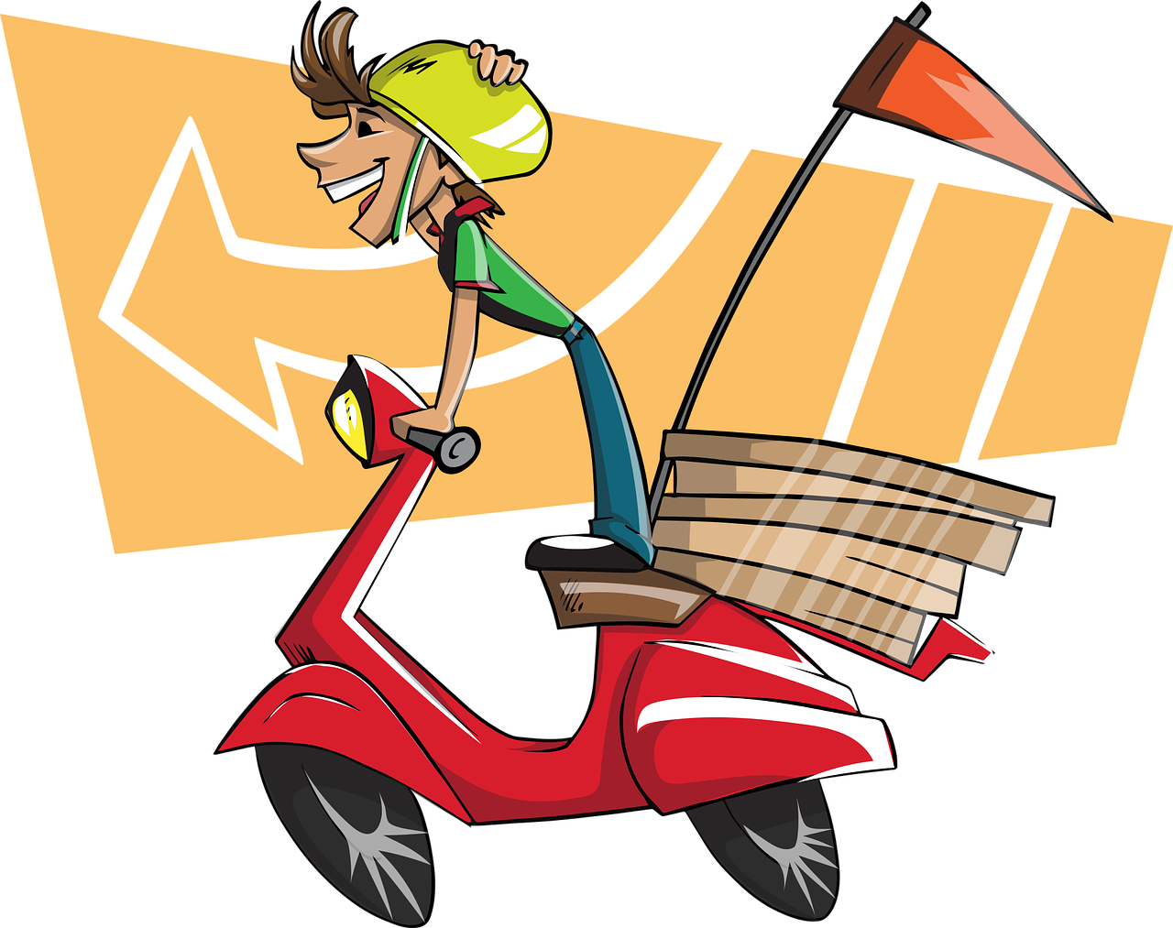
En el colegio (2/2)
B: Ask ‘Did I… last year?’ or ‘Did you… last year?’
hablar
A: Answer ‘yes, I …’ or ‘no, I didn’t…’ depending on the question.
= yes
= no
(I) | (you)
(I) | (you)
(I) | (you)
1
2
3
participate in a trip
spend time with friends
dance in class
4
(I) | (you)
5
(I) | (you)
6
(I) | (you)
speak in Spanish
look for a job
study after school
Notes:
[2/2]

Slide 22
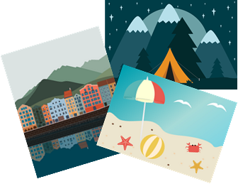
Comparing past experiences (2)
past tense (preterite) -ar verbs:
2nd person singular (-aste)
Y8 Spanish Term 1.1 – Week 2 – Lesson 4 Amanda Izquierdo / Nick Avery / Rachel Hawkes Artwork: Mark Davies Date updated: 25.08.23
Notes:
Learning outcomes (lesson 2):
Consolidation of -ar verbs in past tense (preterite): 2nd person singular (-aste)
2nd person singular present (-as);
Consolidation of question words
Introduction to and practice of strong vowels [a], [e], [o]
Word frequency (1 is the most frequent word in Spanish):
New vocabulary (introduce): cantar [717]; tomar¹ [133]; coger [1001]; intentar [411]; ganar¹ [295]; concierto [1456]; premio [1090]; año [46]; autobús [3709]; hasta¹ [60]; además [155]; por² [15]; canción [982]
3.2.5 (revisit): vamos [ir-33]; marzo [1231]; abril [1064]; porque [40]; por qué; mañana² [215]; divertido [2446]; visitar [792]; descubrir [414]; parte¹ [92]; extranjero¹ [765]; mundo [123]
3.1.4 (revisit): beber [1085]; comer [347]; leer [209]; vivir [142]; hombre [97]; ejercicio [1162]; fruta [1925]; carne [860]; rico² [398]; agua [204]; nunca [158]; a veces [vez-59]
Source: Davies, M. & Davies, K. (2018). A frequency dictionary of Spanish: Core vocabulary for learners (2nd ed.). Routledge: London

Slide 23
Fonética
escuchar / leer / hablar
When they appear next to each other, the Spanish vowels [a], [e] and [o] are pronounced separately.
This is why we call them ‘strong’ vowels!
a, e, o
Escucha unos ejemplos:
1
idea
Spanish vowels are often short, crisp and open!
2
teatro
3
oeste
Notes:
Timing: 2 mins
Aim: to introduce the idea of ‘strong’ vowels and their pronunciation. Generally, Spanish vowels are very much more ‘open-mouth’ than English. The word ‘i-de-a’ is a good example for this as you get a very physically obvious dropping down of the jaw as you pronounce through the word.
Procedure:
Teacher gives explanation
Teacher models pronunciation and/or plays audio.
Students say the three words in chorus, opening their mouth fully and pronouncing the strong vowels separately.

Slide 24
Fonética
escuchar / leer / hablar
Escucha y escribe cada palabra.
Ahora pronuncia las palabras con un compañero.
1
leer
5
aeropuerto
a, e, o
a, e, o
2
idea
6
traer
3
museo
7
real
Spanish vowels are often short, crisp and open!
4
feo
8
oeste
Notes:
Timing: 6 minutes
Aim: to practise listening out for pairs of strong vowels in words and to successfully transcribe them.
Procedure:
Students listen and write the missing word.
The teacher shows the answers for each word, one by one.
Students practise pronouncing the words, reading each one aloud. They should try to mimic the open vowel sounds in the recording.
Notes: i) words were taught as vocabulary items in Y7 and/or used for phonics practice, with the exception of ‘traer’ (to be introduced in Y8) and the cognates/near-cognates ‘real’ and ‘aeropuerto’. ii) all words appear on all three GCSE wordlists, with the exception of ‘feo’, which is not on the Edexcel list, but is on the other two.
Transcript:
leer
idea
museo
feo
aeropuerto
traer
real
oeste

Slide 25
Fonética
escuchar / leer / hablar
fea
correo
60
creer
teatro
tarea
leer
idea
museo
feo
oeste
real
traer
0
aeropuerto
INICIO
Notes:
Timing: 2 minutes
Aim: To practise pronouncing a number of words that have two ‘strong’ vowels next to each other.
Procedure: 1. Students say the words alternately out loud with a partner or on your own, building up speed, over one minute’s intensive practice. 2. Students say the words in any order, but not repeating the word said in the last turn.
3. Teacher can circulate to listen into their SSC knowledge. Ensure that each strong vowel is pronounced as a separate syllable.
Notes: i. All words were previously taught in Y7, except for ‘creer’, ‘aeropuerto’, ‘traer’ which will be taught in Y8. ii. All words are on all three GCSE wordlists (exception: feo/fea not on Edexcel).

Slide 26
Asociaciones
leer
Which word is most closely connected with the word in bold?
Escribe 1-6 y ‘a’, ‘b’, ‘c’ o ‘d’.
1) cantar | a) mañana
 | b) rico
 | c) canción
 | d) abril
4) agua | a) por
 | b) beber
 | c) visitar
 | d) parte
2) el mundo | a) descubrir
 | b) por qué
 | c) ganar
 | d) intentar
5) la carne | a) marzo
 | b) vamos
 | c) ejercicio
 | d) comer
3) coger | a) vivir
 | b) a veces
 | c) autobús
 | d) nunca
6) jugar | a) fruta
 | b) hombre
 | c) pared
 | d) divertido
Notes:
Timing: 5 minutes
Aim: to identify semantic connections between words; to revisit this week’s revisited vocabulary sets. (This type of activity is included in LDP achievement tests).
Procedure:
Students read the word in bold and try to identify which word has a clear semantic connection with it.
Teachers review meanings of all words during feedback.

Slide 27
–AR verbs in 2nd person singular present (-as) and preterite (-aste)
gramática
When we talk about present and past in English, the verb endings change. The verb endings also change on Spanish –ar verbs.
Compare:
Caminas
You walk (routine action in present) = ___________
Caminaste
You walked (completed action in past) = ____________
-as
To refer to ‘you’ (singular) in the present, use the verb ending ____
To refer to ‘you’ (singular) with finished actions in the past, use the verb ending _______
-aste
Notes:
Timing: 2 minutes
Aim: To revise the 2nd person singular present (-as) and the 2nd person singular past (-aste).
Procedure:
Teacher reveals each sentence to show students the English examples and rules.
Teacher elicits the Spanish translation/verb ending where appropriate.

Slide 28
cómo
¿cómo?
how?
Cómo
¿ _______pasaste las vacaciones?
[How did you spend the holidays?]
Notes:
Timing: 6 minutes (9 slides)
Aim: to revise question words and consolidate the 2nd person singular preterite form of –ar verbs
Procedure:
Teacher brings up the English prompt in the centre of the screen.
Teacher elicits the Spanish from students.
Teacher brings up the sentence in English at the bottom of the screen.
Teacher then either elicits the full sentence OR clicks again and elicits the missing question word only, depending on the ability of the students.

Slide 29
dónde
¿dónde?
where?
Dónde
¿ _______organizaste el concierto?
[Where did you organize the concert?]

Slide 30
cuándo
¿cuándo?
when?
Cuándo
¿ _______ viajaste a Francia?
[When did you travel to France?]

Slide 31
quién
¿quién?
who?
¿ ______ es María?
Quién
[Who is María?]

Slide 32
qué
¿qué?
what?
¿ ____ música escuchas?
Qué
[What music do you listen to?]

Slide 33
Por qué
¿por qué?
why?
Por qué
¿ ___ ____ sacaste la comida?
[Why did you take out the food?]

Slide 34
cuál
¿cuál?
which?
¿ _____ compraste?
Cuál
[Which did you buy?]

Slide 35
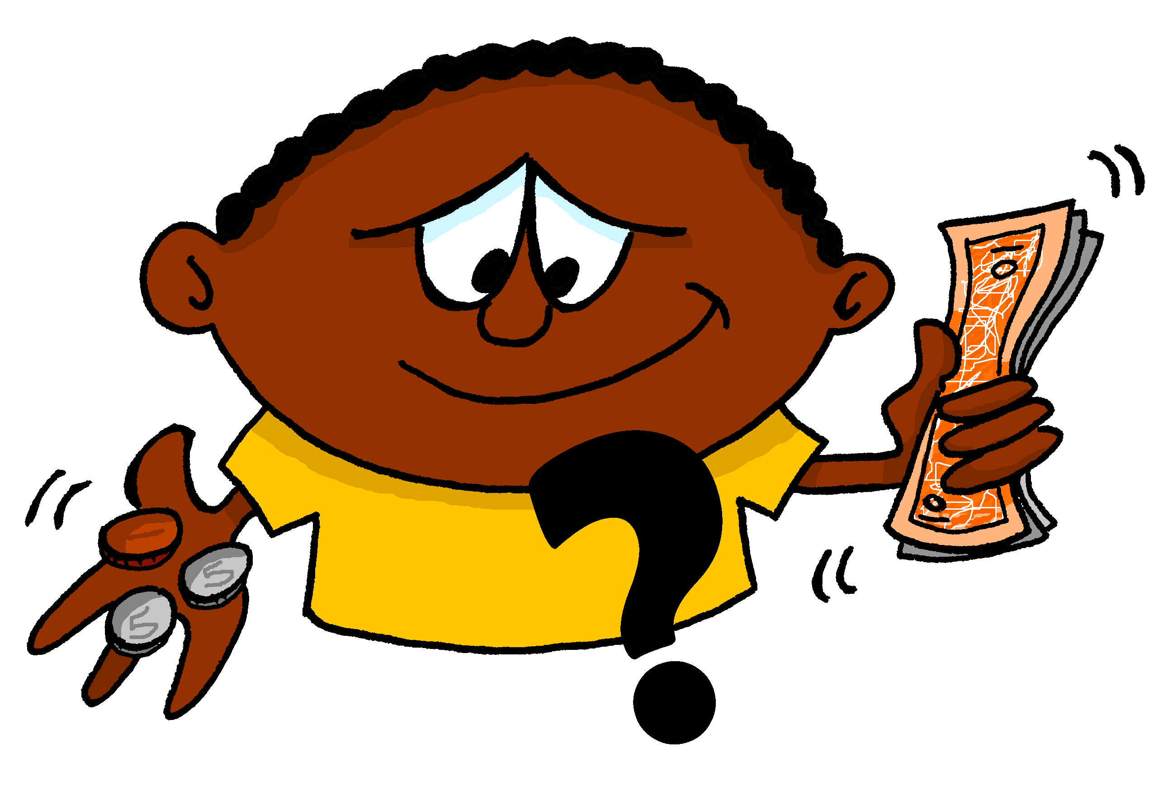
cuánto
¿cuánto?
¿cuánto?
how much?
how much?
¿ _______ estudiaste?
Cuánto
¿ _______ estudiaste?
[How much did you study?]

Slide 36
cuántos
Remember that ‘cuánto’ also needs to agree in gender with the noun.
Use ‘cuántos’ for nouns that are plural and ____________.
Use ‘cuántas’ for nouns that are plural and ____________.
¿cuántos?
masculine
feminine
how many?
Cuántos
¿ ________ autobuses tomas?
[How many buses do you take?]

Slide 37
¿Normalmente o el verano pasado?
leer / escuchar
Lee las frases. ¿Es en el presente o en el pasado?
Ahora escucha las respuestas. ¿Cuál es la pregunta correcta?
Escribe el número (e.g. pregunta 3, pregunta 5).
 | el presente | el pasado
1. ¿Dónde viajaste?
2. ¿Qué cantas?
3. ¿Cuál compras?
4. ¿Por qué quedaste con María?
5. ¿Cuándo visitaste Italia?
6. ¿Cómo pintas la pared?
Respuestas
A
pregunta 2
B
pregunta 4
C
pregunta 6
D
pregunta 5
E
pregunta 1
F
pregunta 3
Notes:
Timing: 8 minutes
Aim: to connect 2nd person singular verb endings (-as, -aste) with their present or past (preterite) meaning; to consolidate understanding of question words and vocabulary in the oral and written modalities.
Procedure:
Read each sentence and decide if it refers to the present or to the past.
Then, listen to the responses (A, B, C...) and decide which question it must refer to.
Transcript:
Canciones famosas.
Por los deberes.
Azul y blanca.
En marzo.
Francia.
La camisa amarilla.

Slide 38
¿Presente o pasado?
escuchar / escribir
Escucha cada pregunta y su respuesta. ¿Es en el presente o en el pasado?
Ahora escucha otra vez. Write the corresponding question word.
 | el presente | el pasado
Question word
1
¿Cuándo?
2
¿Cuántos?
3
¿Cómo?
4
¿Qué?
5
¿Dónde?
6
¿Por qué?
Notes:
Timing: 8 minutes
Aim: To connect 2nd person singular verb endings (-as, -aste) with their present or past (preterite) meaning; to consolidate understanding of question words and vocabulary in the oral and written modalities.
Procedure:
First, listen out for the verb ending. Is it present or past?
Then, listen again and write the missing question word depending on what the answer is.
Notes
Some students might be able to do both steps at the same time; others will need to do it step by step. ‘Restaurante’ [2636] hasn’t yet been taught but is a cognate.
If students need it, the teacher might consider displaying the question words as options to choose from, rather than asking them to recall them from memory. Since question words were taught and revisited several times in Year 7, and also included in preceding activities here, we can generally expect students to often be able to recall them here.
Transcript:
¿[beep] ayudas? [3 second pause] Por la tarde.
¿[beep] libros llevaste a Italia? [3 second pause] Cuatro.
¿[beep] viajas al extranjero? [3 second pause] En tren.
¿[beep] comida preparaste ayer? [3 second pause] Carne.
¿[beep] trabajaste el domingo? [3 second pause] En un restaurante.
¿[beep] cantas en conciertos? [3 second pause] ¡Porque es muy divertido!

Slide 39
Mis vacaciones
escuchar / escribir
Escribe un texto.
Add words you want to your repertoire!
Write a short text about your summer.
Include:
Where you travelled to and where it is exactly
How long you spent there
What you visited and your opinion
Two questions about holidays to your friend
Write 5 sentences Use at least 2 past and 2 present verbs Use a conjunction (and, or, but, also) or adverb (however) | Write 6-8 sentences Use at least 5 different past and 2 present verbs Use 2 different conjunctions Use 1 negative
vocabulario
un día – one day
viajar|tomar | visitar
pasar | cantar | pienso que
comprar
Make a list of language to use!
Notes:
Timing: 20 minutes (10 minutes in class to plan, they will write it in class next week), with their notes in front of them (but not Language Guides or Kos) Aim: to revisit previously taught vocabulary and grammar in the context of a short piece of writing, bringing together some language from Y7 Term 1 so far.
Procedure: 1. Clarify the activity with students.
2. Suggest they build their text by writing one sentence for each bullet first, and if they have time they could add another one.
3. Suggest that students have 10 minutes (the rest of the lesson) to plan the task out, and then tell them they will write the text without referring next lesson. Clearly teachers may want to differentiate the level of challenge for different students within their classes. Perhaps allow students to use their KO as it will have individual words for them to check, but they won’t fall into the habit of memorising a full set of sentences. All levels of adaption are possible, here, including for example just asking pupils to make a list of words that they would need to do this task, but not asking them to do it. It is also possible to provide a ‘example letter’ in English, written to demonstrate use of the target structures and vocabulary. The revised LDP resources have several examples of this style framework. See 7.1.2.1 for an example.
5. Prompt students to consider adding words that are important to them in this context to their repertoire, and to include them in this task, and to record them in the space they have for that in their exercise books. (e.g., back pages).

Slide 40
Deberes
Vocabulary Learning Homework (Y8 Term 1.1, Week 3)
Audio file
Student worksheet
In addition, revisit: Y7 Term 3.2 Week 6 Y7 Term 3.1 Week 5
Notes:
The answer sheet for the Y8 vocabulary learning HW is here:
https://rachelhawkes.com/LDPresources/Yr8Spanish/Spanish_Y8_Term1i_Wk3_audio_HW_sheet_answers.docx
Notes:
i) Teachers may, in addition, want to recommend use of a particular online app for the pre-learning of each week’s words. ii) Quizlet now requires parental involvement / registration / permissions for users below the age of 13, so it is perhaps most suitable for Y9 – 11 students. iii) Language Nut hosts LDP vocabulary lists and these are free for schools to use, though there is a registration process. One benefit is that all of the student tracking data that Language Nut offers are also available to schools that use the LDP lists for practice. Perhaps this makes it a good option for Y7/8.
iv) There are other free apps, and new ones are always appearing. Teachers have told us that they are currently using: Flippity, Wordwall (where using previously-created activities is free).
v) Gaming Grammar has been acquired by Language Nut. Its original content should still be available to teachers and much of it is appropriate for Y8 learners. From this lesson, for example, learners could practise:
Indefinite articles: Gender (Article agreement)
Definite articles: Gender (Article agreement)
Possessive adjectives: 1st person gender (Possessive adjective agreement)
Possessive adjectives: Number (Possessive adjective agreement)

Slide 41
hablar / escuchar
Rafaela y Noel hablan más y preguntan otras cosas.
hablar / escuchar
Use your cards to
ask whether ‘I’ or ‘you’ did something
say if ‘I’ or ‘you’ did or didn’t do it
Say “Sí …” or “No …”, and the verb with the corresponding ending depending on what you can see in your card.
Your partner will also ask you. Take turns.
¿Siempre tomaste el tren al colegio?
Un ejemplo:
Persona A - Rafaela (pregunta):
Sí, siempre tomé el tren al colegio.
Persona B - Noel (contesta):
Ask your partner these questions.
Persona B
Is your partner asking about ‘you’ (Rafaela) or ‘I’ (Noel)? Say whether you / I did it ( ) or not ( ) :
Tick ( ) if that person did it and cross out ( ) if that person didn’t.
my partner
me
1. Did you always take the train to school?
[always take the train to school]
Notes:
ALTERNATIVE VERSION OF THE SPEAKING FOR LESSON 1 Timing: 12 minutes
Aim: To practise endings –é and –aste. An active choice will be needed between these two verb forms in each interaction, both by the speaker and listener. This makes the choice of verb essential to completion of the task.
Other features practised here include: question intonation, negative ‘no’ and vocabulary drawn from previous weeks
Procedure:
Person A uses their prompt cards to ask a question that either starts with ‘’did I’ or ‘did you’.
Student B listens and says ‘sí’ and the corresponding verb ending if the question is represented on their card and ‘no’ and the corresponding verb ending if the person referenced did not do the action.
Encourage full sentences in responses, if possible. Student A then completes their card accordingly, adding a tick or cross after each question.
Note:
1. Two of the –ar verbs are have slight changes in the past (jugar -> jugué, buscar -> busqué) but these are spelling changes that shouldn’t affect students’ ability to use the verbs orally.

Slide 42
hablar / escuchar
Persona A - Rafaela
hablar / escuchar
Persona A
Is your partner asking ‘Did I…’ or ‘Did you…’ ?
Say if that person did it ( ) or not ( ) :
Ask your partner these questions.
Tick ( ) if that person did it and cross out ( ) if that person didn’t.
1. Did I organise a day in the countryside?
my partner
me
[work after school]
2. Did you look for a job in the afternoons?
[try to help in school activities]
3. Did I try to win a prize?
[make the most of the classes]
4. Did you sing songs in concerts?
[spend a lot of time with friends]
5. Did I take the bus sometimes?
[also study English]
6. Did you play a lot in the river?
[buy a bike]
Notes:
DO NOT DISPLAY DURING ACTIVITY
See accompanying Word doc for printable version.
Target answers for Person A during speaking, based on Person B’s questions:
No, no trabajé después de la escuela.
Sí, intentaste ayudar en las actividades de la escuela.
Sí, aproveché las clases.
No, no pasaste mucho tiempo con amigos.
No, no estudié inglés.
Sí, compré una bicicleta.

Slide 43
hablar / escuchar
Persona B – Noel
hablar / escuchar
Ask your partner these questions.
Persona B
Is your partner asking ‘Did I…’ or ‘Did you…’ ?
Say if that person did it ( ) or not ( ) :
Tick ( ) if that person did it and cross out ( ) if that person didn’t.
1. Did you work after school?
my partner
me
[organise a day in the countryside]
2. Did I try to help in school activities?
[look for a job in the afternoons]
3. Did you make the most of the classes?
[try to win a prize]
4. Did I spend a lot of time with friends?
[sing songs in concerts]
5. Did you study English?
[take the bus sometimes]
6. Did you buy a bike?
[play a lot in the river]
Notes:
DO NOT DISPLAY DURING ACTIVITY
See accompanying Word doc for printable version.
Target answers for Person B during speaking, based on Person A’s questions:
Sí, organizaste un día en el campo.
No, no busqué un trabajo por las tardes.
No, no intentaste ganar un premio.
Sí, canté canciones en conciertos.
Sí, tomaste el autobús a veces.
No, no jugué mucho en el río.

Slide 44
hablar / escuchar
Respuestas
hablar / escuchar
Persona A - Rafaela
Persona B - Noel
Persona A - Rafaela
Ask your partner these questions.
Ask your partner these questions.
Tick ( ) if that person did it and cross out ( ) if that person didn’t.
Tick ( ) if that person did it and cross out ( ) if that person didn’t.
1. Did I organize a day in the countryside?
1. Did you work after school?
2. Did you look for a job in the afternoons?
2. Did I try to help in school activities?
3. Did I try to win a prize?
3. Did you make the most of the classes?
4. Did you sing songs in concerts?
4. Did I spend a lot of time with friends?
5. Did I take the bus sometimes?
5. Did you study English?
6. Did you play a lot in the river?
6. Did you buy a bike?
Notes:
DO NOT DISPLAY DURING ACTIVITY

Slide 45
Hablas de las vacaciones
hablar
Use your cards to
ask questions in Spanish.
answer questions. Is your partner asking about routine in the present (‘normalmente’) or a completed action in the past (‘el año pasado’)?
Your partner will also ask you. Take turns.
Choose your answer depending on the verb in the question.
Un ejemplo:
¿Dónde viajaste?
Persona A
(pregunta):
A la montaña.
Persona B
(contesta):
Ask your partner these questions.
Listen for whether it’s –as (present) or –aste (past) and then say the corresponding information in Spanish.
Write down the answer.
el año pasado
normalmente
1. ¿Dónde viajaste?
A la montaña
[where?]
to the beach
to the mountain
Notes:
ALTERNATIVE SPEAKING TO REPLACE THE WRITING AT THE END OF LESSON 2 Timing: 10 minutes
Aim: To practise using verbs with the endings –as and –aste and understanding their meanings. To also consolidate question words and vocabulary.
Procedure:
Person A uses their cards to ask a question in Spanish.
Student B listens and says the corresponding answer depending on the question – does the question refer to the present (-as) or to the past (-aste)?
Student A then writes down their answer in Spanish.
Teacher uses the answer slide (slide 35) to give feedback.
Notes: 1. An active choice will be needed by the listener depending on the question asked. This makes the identification of the verb ending essential for the completion of the task.
2. If teachers wish to increase the level of difficulty, they can easily replace the question word and/or add an English prompt for the verb used on the speaking cards for the person that is asking the question. This will be a judgement based on the ability of the group.

Slide 46
Persona A
Ask your partner these questions.
Persona A
Listen for whether it’s –as (present) or –aste (past) and then say the corresponding information in Spanish.
Write down the answer.
el año pasado
1. ¿Dónde viajaste?
normalmente
2. ¿Qué llevas?
[where?]
Spain
abroad
[what?]
books
t-shirts
3. ¿Cuánto tiempo pasaste allí?
[how much time?]
many days
7 days
4. ¿Cómo llegaste?
by train
by bus
[how?]
5. ¿Por qué visitas pueblos?
because there are museums
for the shops
[why?]
6. ¿Cuál disfrutas más*?
the beach in the south
the beach in the north
[which one?]
*más = more
Notes:
DO NOT DISPLAY DURING ACTIVITY
See accompanying Word doc for printable version.
Target answers for Person A during speaking, based on Person B’s questions:
España.
Libros.
Muchos días.
En autobús.
Por las tiendas.
La playa en el sur.

Slide 47
Persona B
Ask your partner these questions.
Persona B
Listen for whether it’s –as (present) or –aste (past) and then say the corresponding information in Spanish.
Write down the answer.
el año pasado
1. ¿Dónde viajas?
normalmente
2. ¿Qué llevas?
[where?]
Italy
France
[what?]
magazines
clothes
3. ¿Cuánto tiempo pasas allí?
[how much time?]
5 days
12 days
4. ¿Cómo llegaste?
By bus
[how?]
By train
5. ¿Por qué visitaste la ciudad?
because it’s fun
because of the food
[why?]
6. ¿Cuál disfrutas más*?
the town in the mountains
the town in the south
[which one?]
*más = more
Notes:
DO NOT DISPLAY DURING ACTIVITY
See accompanying Word doc for printable version.
Target answers for Person B during speaking, based on Person A’s questions:
A Francia.
Revistas.
Doce días.
En tren.
Porque es divertido.
El pueblo en la montaña.

Slide 48
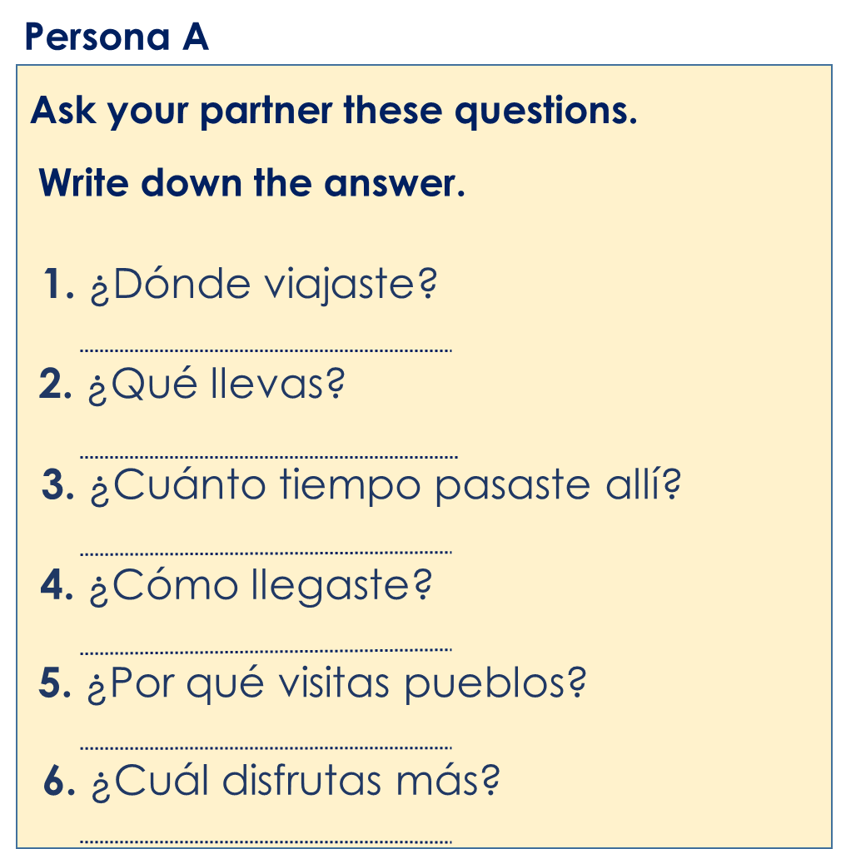
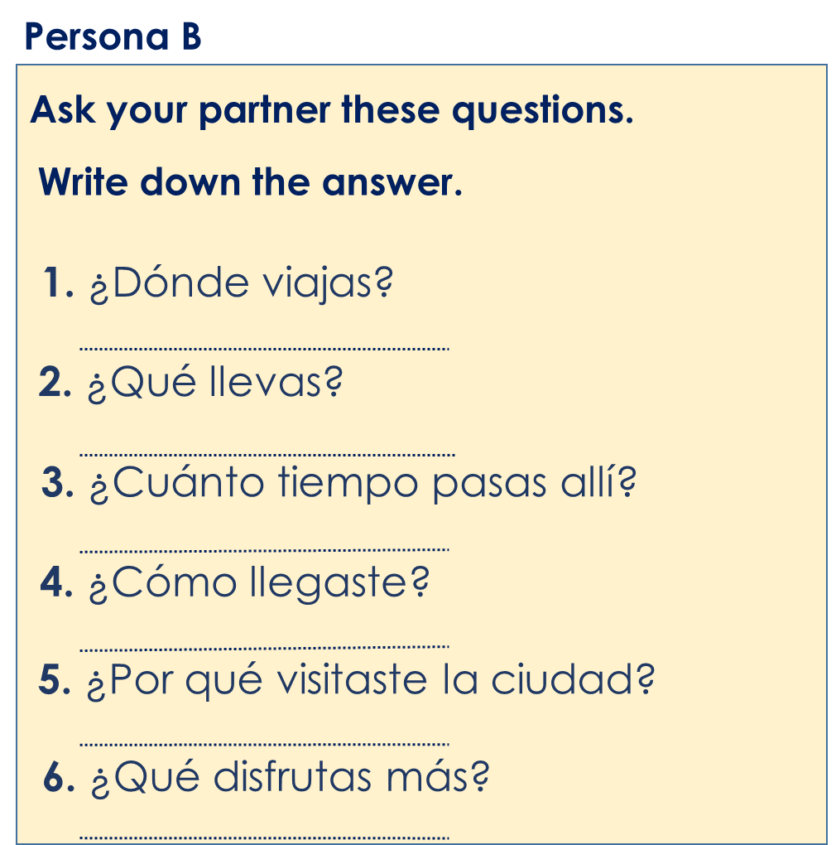
Respuestas
Francia
España
Revistas.
Libros.
Cinco días.
Muchos días.
En tren.
En autobús.
Porque es divertido.
Por las tiendas.
El pueblo en la montaña.
La playa en el sur.
Notes:
ANSWER SLIDE
Teacher can use this to give feedback.

