Slide 1
Talking about past and present events
–ar verbs: 1st person singular preterite (–é) 1st person singular present (-o) [revisited]
Y8 Spanish Term 1.1 – Week 1 – Lesson 1 Nick Avery / Victoria Hobson / Rachel Hawkes Artwork: Mark Davies Date updated: 24.08.23
Notes:
Note: all words (new and revisited) in this week of the SOW appear on all three GCSE wordlists, with the following exceptions: i) AQA does not have aprovechar, amar. ii) Edexcel does not have pared, Italia, besar. iii) Eduqas does not have máximo, Italia (both cognates).
Learning outcomes (lesson 1):
Introduction of –ar verbs in first person singular preterite (-é)
Consolidation of –ar verbs in 1st person singular present (-o)
Revisit negative 'no'
Word frequency (1 is the most frequent word in French):
8.1.1.1 (introduce) vocab set: aprovechar [885]; quedar¹ [100]; pintar [1329]; ayudar [328]; pared [778]; verano [1139]; pasado (adj.) [932]; libre [473]; máximo [935]; antes [190]; sin embargo [embargo-203]; poco (as adverb only) [76]; negro [307]
Y7 3.2.4 (revisit) ir [33]; voy; vas; va; barrio [940]; al [a-8]; problema [145]; Italia [N/A]; playa [1475]; enero [1173]; febrero [1419]; sin [54]; día [65]
Y7 3.1.2 (revisit) hombre [97], cabeza [265], problema [145], pensar [105], usar [317], amar [700], cantar [717], besar [1591], sin [54], entender [229], leer [209], comer [347]
Source: Davies, M. & Davies, K. (2018). A frequency dictionary of Spanish: Core vocabulary for learners (2nd ed.). Routledge: London

Slide 2
¿Qué vas a hacer ?
Lee. ¿Qué imagen es?
leer
¿Qué vas a hacer en español en año 8?
¿Qué vas a hacer en español en año 8?
A
A
B
1 | leer
2 | estar
3 | usar
4 | pensar
5 | entender
6 | cantar
7 | comer
8 | bailar
D
B
C
C
G
B
D
E
A
F
F
G
H
H
E
el año - year
Notes:
Timing: 8 minutes (two slides) Aim: to set the context for learning for the new year, using a structure taught in Term 3 Y7 (ir + infinitive), and to revisit eight infinitive verbs, five of which are on this week’s revisiting schedule (cantar, comer, leer, pensar, usar), plus three other previously-taught verbs. Procedure: 1. Students think-pair-share to match the infinitive verbs to their meanings.
2. Teacher elicits answers orally, and clicks to provide feedback.
3. Depending on the teacher and the class, the teacher may want to begin to exploit the verbs here to ask students to suggest what they will do in Spanish this year, and what they will not do. (The next slide provides a structured way to support students in talking about their likely activities in Spanish this year, but the teacher may want to pre-empt that by a few questions here. E.g., Qué ideas temenos, qué vas a hacer en clase de español en año 8? Note: año is glossed here – it will be formally taught next week.

Slide 3
¿Qué vas a hacer ?
Lee. ¿Qué imagen es?
hablar
¿Qué vas a hacer en español en año 8?
Voy a …
No voy a …
mucho textos la cabeza un diccionario chicle* nervioso tranquilo salsa en español en clase
chicle – chewing gum
Notes:
Note: There are many ways to exploit this slide – see ‘adaptions’ below for some ideas. Here is one possible procedure: 1. In this version of the activity, students will work in pairs to state what they will and won’t do in Spanish this year.
2. Teacher models the activity with a student (or with themselves, playing two roles). E.g., teachers says: En español en año 8 voy a pensar mucho. Then models what a partner could say: En español en año 8 no voy a estar nervioso.
3. Students tally the number of sentences they come up with in 3 minutes.
4. Teacher asks members of the class: ¿Cuántas frases tienes? ¿Diez? ¿Más de diez?
Note: i) all verbs are on all three GCSE lists ii) most other vocabulary also appears on all lists. Exceptions are: diccionario, chicle, salsa, the latter two of which are added here to build in some gentle humour and suggest to students somethings that they can usefully say they won’t be doing. Of course, teachers should feel 100% free to adapt this slide to suit them and their classes, retaining the vocabulary that is core but varying any additions as they see fit, and extending or contracting this activity as appropriate to the class in front of them!
Adaptions: i) Structure the activity as writing (e.g., with mini whiteboards) and prompt with English sentences, either initially as a way in to the task, or do the activity in writing only for now, and reprieve it later as a speaking activity. ii) Tell students to write 5 sentences in English using words/ideas from the board. Then students exchange English notes and have to speak each other’s sentences. iii) Turn the spoken activity into a memory game – students work in pairs, building up the number of sentences adding one each time (using ‘y’ (and) before adding the final sentence in the list).

Slide 4
Vocabulario
 | Word | English meaning
1 | aprovechar | to make the most of
2 | quedar | to meet up, meeting up
3 | pintar | to paint, painting
4 | ayudar | to help, helping
5 | la pared | wall
6 | el verano | summer
7 | pasado | past, last
8 | libre | free
9 | máximo | maximum
10 | antes (de) | before
11 | sin embargo | however
12 | (un) poco | (a) little
13 | negro, negra | black
hablar
Verb + ‘al máximo’ literally means ‘to the max’!
In English, we can say this in different ways:
disfrutar al máximo
to enjoy to the full/max
aprovechar al máximo
to really make the most of
Notes:
Timing: 2-4 minutes
Vocabulary practice slide
Aim: to embed word knowledge of this week’s vocabulary set.
Procedure 1. Students either work by themselves or in pairs, reading out the words and studying their English meaning (1 minute). 2. Then the English meanings are removed and they try to recall them, looking at the Spanish (1 minute). 3. Then the Spanish meanings are removed and they to recall them, looking at the English (1 minute) 4. Further rounds of learning can be facilitated by one pupil turning away from the board, and his/her partner asking him/her the meanings. This activity can work from L2 to L1 or L1 to L2.
Note
1. The use of ‘antes de + infinitive’ is explained in lesson 2
Word frequency (1 is the most frequent word in Spanish): aprovechar [885]; quedar¹ [100]; pintar [1329]; ayudar [328]; pared [778]; verano [1139]; pasado (adj.) [932]; libre [473]; máximo [935]; antes [190]; sin embargo [embargo-203]; poco (as adverb only) [76]; negro [307]
Source: Davies, M. & Davies, K. (2018). A frequency dictionary of Spanish: Core vocabulary for learners (2nd ed.). Routledge: London

Slide 5
Saying what I do and did -ar verbs – 1st person singular past (preterite)
gramática
Many Spanish infinitives end in –ar.
Remember, the verb ending changes depending on who the verb refers to.
This is the present tense.
o
1
Ayud__ en casa.
I help at home.
To talk about ‘I’ with an action completed in the past, remove –ar and add –é.
Notice the stress on the final -é.
Ayudé
Ayudar
2
I helped
This past tense is called the ‘preterite’.
Pintar
Pinté
I painted
Listen carefully to how each verb sounds.
Notes:
Timing: 2 minutes
Aim: to recap 1st person singular formation in the present tense and introduce the new preterite tense form (-é) for completed actions in the past.
Procedure:
Teacher elicits the rules on 1st person singular present for –ar verbs (-o) and introduce the new form (-é) for completed actions in past.
Click on the action buttons to hear the difference in pronunciation modelled.

Slide 6
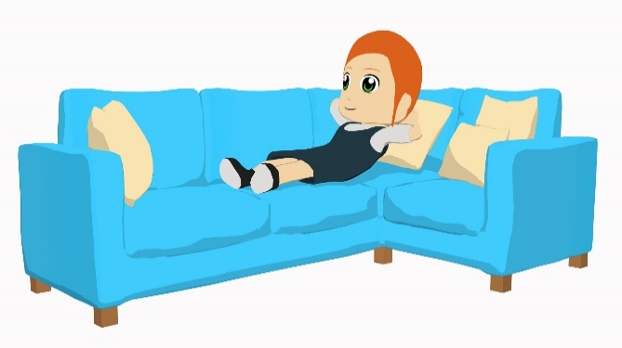
Lucía habla con unos amigos
leer
Lucía escribe mensajes a unos amigos.
La acción, ¿cuándo es? Marca la opción correcta. ¿Y dónde? Escribe en inglés.
 |  | Normalmente | El verano pasado | ¿Dónde?
1. | Aprovecho al máximo el tiempo libre en casa.
2. | Pinté de negro la pared de la escuela.
3. | Quedo con mis amigos en el centro.
4. | Pasé tiempo con mi familia en la playa.
5. | Bailé un poco en Italia.
6. | Ayudo con unas tareas fuera de la casa.
7. | Viajé al extranjero en tren.
8. | Visito lugares interesantes por el barrio.
at home
at school
in the centre
at the beach
in Italy
We can use a verb + un poco. Here it means, ‘I danced a little.’
outside the house
abroad
the neighbourhood
Notes:
Timing: 10 minutes
Aim: students pay attention to first person singular –ar verb endings in present tense versus past tense to make the connection between each form and the tense it marks.
Procedure:
Students read the sentences and note whether Lucía is describing what she normally does or whether she is talking abut last summer.
Students also note in English where the activity takes/took place.
Teacher elicits and reveals answers in oral class feedback, including English sentence meanings.
Note: almost all vocabulary appears on all 3 GCSE lists. Exceptions are: i) pared not in Edexcel ii) aprovechar not in AQA iii) máximo not in Eduqas

Slide 7
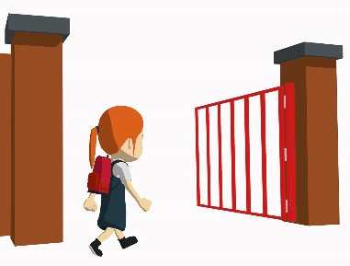
En el colegio
escuchar
Es septiembre. Lucía está en el colegio y habla con unas amigas.
La acción, ¿cuándo es? Marca la opción correcta. ¿Y qué actividaad no hace? Escribe en inglés.
 |  | El lunes pasado | Normalmente
 | I didn’t paint the walls.
 | I don’t meet up with my friends.
 | I don’t travel to other cities.
 | I didn’t spend time with my brother.
 | I didn’t clean the house.
 | I don’t dance in the afternoon.
1
2
3
4
5
6
Notes:
Timing: 10 minutes
Aim: to make the connection between the –ar verb endings –o and –é and their present and past tense meanings; to increase awareness of negative ‘no’ and the auxiliary ‘do’ in English
Procedure:
1. Students listen to the recording and note whether Lucía is describing what she normally does or whether she is talking abut last Saturday.
2. Students listen again and write in English the activity which was in the negative. Ask students to write the sentence using ‘I …’ so that the form-meaning link with (-o) or (-é) is reinforced.
Transcript:
Ayudé con unas cosas, pero no pinté las paredes.
No quedo con mis amigos porque necesito estudiar mucho.
Aprovecho al máximo los días con mi familia; no viajo a otras ciudades.
Estudié todo el día, no pasé tiempo con mi hermano.
No limpié la casa. Sin embargo, preparé la comida.
No bailo por la tarde. Descanso.

Slide 8
¡A hablar!
hablar
[limpiar]
[usar]
¡Hay dos posibilidades!
Normalmente
El verano pasado
[pintar]
música por la manaña.
[ayudar]
[bailar]
[viajar]
[quedar]
[pasar tiempo con]
[escuchar]
Normalmente escucho música por la mañana.
[estudiar]
[descansar]
Normalmente estudio música por la mañana.
[visitar]
[aprovechar]
Notes:
Timing: 8 minutes (7 slides)
Aim: to produce sentences orally with accurate use of first person singular –ar verbs in present and past tense, both in the affirmative and negative.
Procedure:
Read the cues and choose and say the correct verb in the correct tense to complete the sentence.
Say the sentence aloud.
The answer is revealed on a mouse click.

Slide 9
¡A hablar!
hablar
[limpiar]
[usar]
¡Hay una posibilidad!
Normalmente
El verano pasado
[pintar]
de negro la pared.
[ayudar]
[bailar]
[viajar]
[quedar]
[pasar tiempo con]
[escuchar]
El verano pasado pinté de negro la pared.
[estudiar]
[descansar]
[visitar]
[aprovechar]
Notes:
[2/7]

Slide 10
¡A hablar!
hablar
[limpiar]
[usar]
¡Hay tres posibilidades!
Normalmente
El verano pasado
[pintar]
el coche antiguo.
[ayudar]
[bailar]
[viajar]
El verano pasado no limpié el coche antiguo.
[quedar]
[pasar tiempo con]
[escuchar]
El verano pasado no usé el coche antiguo.
[estudiar]
[descansar]
[visitar]
El verano pasado no pinté el coche antiguo.
[aprovechar]
Notes:
[3/7]

Slide 11
¡A hablar!
hablar
[limpiar]
[usar]
¡Hay una posibilidad!
Normalmente
El verano pasado
[pintar]
con las tareas en casa.
[ayudar]
[bailar]
[viajar]
[quedar]
[pasar tiempo con]
[escuchar]
Normalmente ayudo con las tareas en casa.
[estudiar]
[descansar]
[visitar]
[aprovechar]
Notes:
[4/7]

Slide 12
¡A hablar!
hablar
[limpiar]
[usar]
¡Hay dos posibilidades!
La salsa es un tipo de música y baile muy popular en Colombia. Tiene orígenes en Puerto Rico, Cuba y la República Dominicana.
Normalmente
El verano pasado
[pintar]
salsa en Colombia.
[ayudar]
[bailar]
[viajar]
[quedar]
[pasar tiempo con]
[escuchar]
El verano pasado no bailé salsa en Colombia.
[estudiar]
[descansar]
[visitar]
El verano pasado no escuché salsa en Colombia.
[aprovechar]
Notes:
[5/7]

Slide 13
¡A hablar!
hablar
[limpiar]
[usar]
¡Hay una posibilidad!
Normalmente
El verano pasado
[pintar]
el tiempo libre con mi familia.
[ayudar]
[bailar]
[viajar]
[quedar]
[pasar tiempo con]
[escuchar]
El verano pasado aproveché el tiempo libre con mi familia.
[estudiar]
[descansar]
[visitar]
[aprovechar]
Notes:
[6/7]

Slide 14
¡A hablar!
hablar
[limpiar]
[usar]
¡Hay dos posibilidades!
Normalmente
El verano pasado
[pintar]
mi móvil en clase.
[ayudar]
[bailar]
[viajar]
[quedar]
[pasar tiempo con]
[escuchar]
Normalmente no uso mi móvil en clase.
[estudiar]
[descansar]
Normalmente no escucho mi móvil en clase.
[visitar]
[aprovechar]
Notes:
[7/7]

Slide 15
¡A escribir!
escribir
1) I helped with some tasks, but I didn’t paint the walls.
Ayudé con unas tareas, pero no pinté las paredes.
2) I don’t meet with friends because I need to study a lot.
No quedo con amigos porque necesito estudiar mucho.
3) I make the most of the free time with my family; I only travel a little.
Aprovecho el tiempo libre con mi familia; sólo viajo un poco.
4) I didn’t clean the car. However, I prepared the food.
No limpié el coche. Sin embargo, preparé la comida.
5) I studied all day and I didn’t spend time with my brother.
Estudié todo el día, no pasé tiempo con mi hermano.
Notes:
Timing: 8 minutes
Aim: to produce accurate written sentences using first person singular in present and past tense accurately.
Procedure:
1. Translate the English sentences 1-5 into Spanish.
2. Click to reveal answers.

Slide 16
Deberes
Vocabulary Learning Homework (Y8 Term 1.1, Week 2)
Audio file
Student worksheet
In addition, revisit: Y7 Term 3.2 Week 5
Y7 Term 3.1 Week 4
Notes:
Note: HW for Y8 is made up of pre-learning of vocabulary 15-30 minutes (depending on school policy on HW time) plus 15 minutes vocabulary activities to deepen word knowledge, provided on a student homework sheet (which also contains a clickable link to the audio file). Answer sheets are also provided. In this first week of term it is clearly not possible for there to have been pre-learning, so teachers will work out for their classes how to spread the learning. We provide this week’s words here, at the end of lesson 1 and next week’s words at the end of week 2. Teachers might instead decided not to set the vocabulary knowledge deepening activities this week, but instead to ask students to spend their 30-45 minutes HW slot on just the audio file for both sets of vocabulary. The answer sheet for the Y8 vocabulary learning HW sheet Week 1 is here: https://rachelhawkes.com/LDPresources/Yr8Spanish/Spanish_Y8_Term1i_Wk1_audio_HW_sheet_answers.docx
Notes:
i) Teachers may, in addition, want to recommend use of a particular online app for the pre-learning of each week’s words. ii) Quizlet now requires parental involvement / registration / permissions for users below the age of 13, so it is perhaps most suitable for Y9 – 11 students. iii) Language Nut hosts LDP vocabulary lists and these are free for schools to use, though there is a registration process. One benefit is that all of the student tracking data that Language Nut offers are also available to schools that use the LDP lists for practice. Perhaps this makes it a good option for Y7/8.
iv) There are other free apps, and new ones are always appearing. Teachers have told us that they are currently using: Flippity, Wordwall (where using previously-created activities is free).
v) Gaming Grammar has been acquired by Language Nut. Its original content should still be available to teachers and much of it is appropriate for Y8 learners. From this lesson, for example, learners could practise:
Verbs: 1st person present & past tense in the ‘Verb agreement (past)’ menu

Slide 17
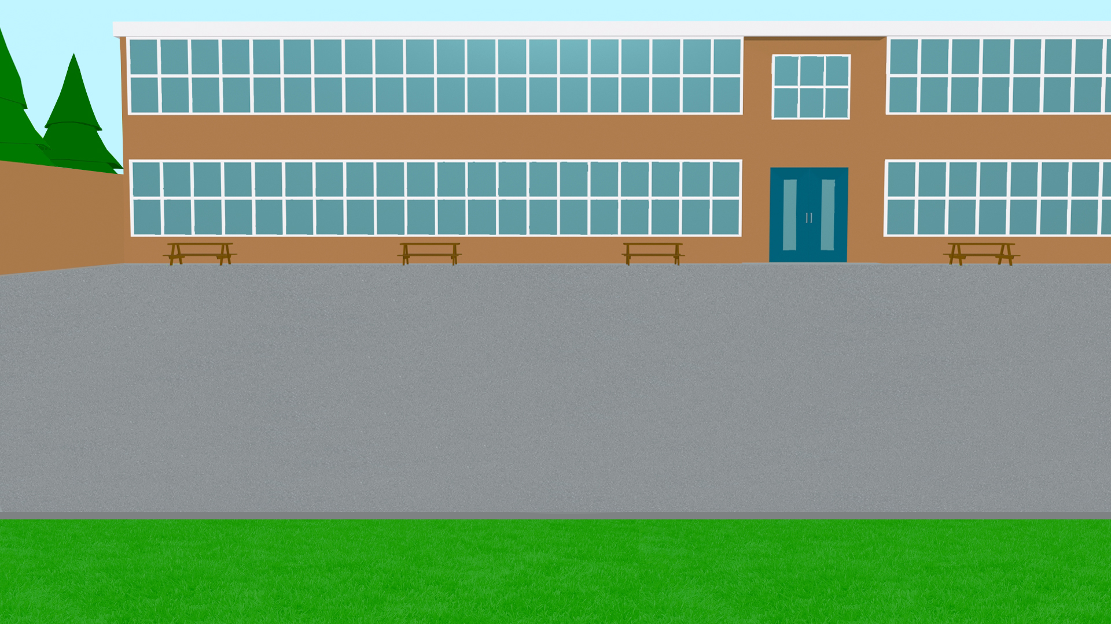
Talking about past and present events
–ar verbs: 1st person singular preterite (–é) 1st person singular present (-o) [revisited] Spanish syllables
Y8 Spanish Term 1.1 – Week 1 – Lesson 2 Nick Avery / Victoria Hobson / Rachel Hawkes Artwork: Mark Davies Date updated: 24.08.23
Notes:
Learning outcomes (lesson 2):
Consolidation of first person singular past tense for –ar verbs
Contrast with: 1st person singular present (-o)
Introduction and practice of Spanish syllables
Word frequency (1 is the most frequent word in French):
8.1.1.1 (introduce) vocab set: aprovechar [885]; quedar¹ [100]; pintar [1329]; ayudar [328]; pared [778]; verano [1139]; pasado (adj.) [932]; libre [473]; máximo [935]; antes [190]; sin embargo [embargo-203]; poco (as adverb only) [76]; negro [307]
Y7 3.2.4 (revisit) ir [33]; voy; vas; va; barrio [940]; al [a-8]; problema [145]; Italia [N/A]; playa [1475]; enero [1173]; febrero [1419]; sin [54]; día [65]
Y7 3.1.2 (revisit) hombre [97], cabeza [265], problema [145], pensar [105], usar [317], amar [700], cantar [717], besar [1591], sin [54], entender [229], leer [209], comer [347]
Source: Davies, M. & Davies, K. (2018). A frequency dictionary of Spanish: Core vocabulary for learners (2nd ed.). Routledge: London

Slide 18
Vocabulario
hablar
ir
barrio
leer
voy
usar
día
comer
entender
January
to go, going
man
February
to use,using
problem
beach
to the (m)
to read, reading
to eat, eating
to love, loving
to think, thinking
neighbourhood
I go, am going
you go, are going
without
to sing, singing
he/she goes, is going
to kiss, kissing
to understand, understanding
day
Italy
head
vas
playa
cantar
enero
sin
Italia
amar
febrero
pensar
al
besar
cabeza
problema
va
hombre
Notes:
Timing: 5 minutes
Aim: to practise written recognition and accurate read aloud of the words in Spanish from Y7 3.2.4 and Y7 3.1.2 to further embed these previously encountered words as per the cycle of vocabulary revisiting in the SoW.
Procedure:
Students supply the Spanish for the word which appears in English. The aim is to be able to give the Spanish before the image disappears (4 seconds).
Notes:
The activity can be repeated, clicking faster through the animations to increase speed of recall.
Teachers may wish to give students 30 seconds to look at the Spanish words before showing the English prompts

Slide 19
Fonética
In Spanish, syllables often come in single consonant-vowel pairs.
Each syllable in a word should be pronounced fully.
Escucha:
1
español
2
inglés
Four clear, separate syllables:
cho-co-la-te
Each part is always pronounced.
Three syllables when you speak slowly.
(‘choc-o-lat’).
Two syllables (‘choc–lat’) normally!
Notes:
Timing: 2 minutes
Aim: to introduce Spanish syllabification and compare it with English ahead of the practice activity that follows.
Procedure:
Clicking on the action arrow buttons will allow students to hear the difference between Spanish and English.
Encourage students to practise saying the two words aloud to compare them.
Picture from www.clipart-library.com (free for non-commercial use)

Slide 20
Fonética
leer / hablar
¿Cuántas sílabas tiene la palabra? Habla con tu compañero/a. Usa todas las palabras.
interesante
hombre
chocolate
famoso
ayudar
febrero
sin embargo
interesante
aprovechar
interesante
documento
pintar
generalmente
naturaleza
importante
completamente
entrevista
problema
[interview]
Notes:
EITHER THIS ACTIVITY OR THE LISTENING Timing: 5 minutes
Aim: to practise recognition and oral production using the syllabification rules just explained.
Procedure:
Students work in pairs. A says a word and B needs to say a different word with the same number of syllables.
Students keep talking until all words have been said.
Notes:
i) there are 4 x 5-syllable words, 6 x 4-syllable, 4 x 3-syllable and 2 x 2-syllable words on the slide.
ii) all words were introduced in Year 7 as vocabulary items or used for phonics practice, or are part of this week’s vocabulary sets. Generalmente and entrevista will be taught this term, too. iii) all words are either on all three GCSE wordlists OR are cognates. Chocolate is only on the Edexcel list, document is only on the AQA list, but both are also cognates. One exception is aprovechar, which is on Edexcel and Eduqas but not AQA.
Frequency of unknown words and cognates: chocolate [3408] documento [996] entrevista [1653] generalmente [1387] Source: Davies, M. & Davies, K. (2018). A frequency dictionary of Spanish: Core vocabulary for learners (2nd ed.). Routledge: London

Slide 21
Fonética
leer / hablar
¿Cuántas sílabas tiene la palabra? Habla con tu compañero/a. Usa todas las palabras.
2 sílabas
3 sílabas
4 sílabas
5 sílabas
chocolate
interesante
hombre
famoso
sin embargo
pintar
febrero
naturaleza
aprovechar
ayudar
documento
generalmente
importante
completamente
problema
entrevista
Notes:
This slide just shows the words in their syllable categories.

Slide 22
Fonética
escuchar
Escucha. ¿Cuántas sílabas tiene la palabra? Escribe también la palabra en español.
 | número de sílabas
palabra en español
1
5
interesante
2
4
importante
3
3
famoso
4
4
universo
5
5
naturaleza
6
4
elefante
Notes:
EITHER THIS ACTIVITY OR THE PREVIOUS SPEAKING Timing: 5 minutes
Aim: to gain practice in hearing the syllabification rules as just explained.
Procedure:
Click on each number - students listen to the single word items and write down the number of syllables in each words.
Students could be asked to write the word as well.
Notes:
1. All words were introduced in Year 7 as vocabulary items or used for phonics practice.
Transcript:
interesante
importante
famoso
completamente
naturaleza
elefante

Slide 23
Vocabulario
Lee las frases en inglés.
Escucha. ¿Cuál es la frase correcta?
escuchar
Escribe A, B o C.
A
B
C
Normally | It’s important to think before kissing. | It’s important to eat before singing. | It’s important to understand after reading.
In January | I really make the most of the holidays with my family. | I really make the most of my free time with my friends. | I really make the most of my free time with my family.
In February | I paint the house black before meeting up with friends. | I paint the wall black before meeting up with friends. | I paint the wall white after meeting up with friends.
Last summer | I helped in the neighbourhood. | I didn’t help in the neighbourhood. | I helped at home.
In Italy | Every day I go to the beach with Gabriela. | Every day he goes to the beach without Gabriela . | Every day you go to the beach without Gabriela.
1
Want to say ‘before doing’ something?
Use antes de + infinitive
E.g. Antes de estudiar, voy al parque.
Before studying, I go to the park.
2
3
4
5
Notes:
Timing: 5 minutes (plus 3 minutes additional preparation time, if required) Aim: To revisit three combined vocabulary sets (oral modality) Procedure: 1. Think about the Spanish for the key words on the slide. 2. Listen to the audio 1-5. For each, choose the correct answer A, B or C. 3. Click to see the answers. 4. Think what would have been heard for either of the other two possible answers.
Word frequencies:
Y8.1.1.1 (new vocabulary)
aprovechar [885]; quedar¹ [100]; pintar [1329]; ayudar [328]; pared [778]; verano [1139]; pasado (adj.) [932]; libre [473]; máximo [935]; antes [190]; [76]; negro [307]
Y7 3.2.4 (revisited)
ir [33]; voy; vas; va; barrio [940]; al [a-8]; problema [145]; Italia [N/A]; playa [1475]; enero [1173]; febrero [1419]; sin [54]; día [65]
Y7 3.1.2 (revisited)
pensar [105], cantar [717], besar [1591], sin [54], entender [229], leer [209], comer [347]
Transcript:
Normalmente, es importante comer antes de cantar.
En enero, aprovecho al máximo el tiempo libre con mi familia.
En febrero pinto de negro la pared antes de quedar con amigos.
El verano pasado, ayudé con los problemas en el barrio.
En Italia todos los días va a la playa sin Gabriela.

Slide 24
Saying what I do and did -ar verbs – 1st person singular past (preterite)
gramática
Remember, the verb ending changes depending on whether you are talking about routine things in the present or completed things in the past.
o
I help at home.
Ayud__ en casa.
This form of the verb is called ‘first person singular.’
é
I helped at home.
Ayud__ en casa.
This is first person singular in present tense.
This is first person singular in the past tense (preterite).
I paint the wall.
Pinto
la pared.
Use this form to say, ‘I…’
I painted the wall.
Pinté
la pared.
Notes:
Timing: 2 minutes
Aim: to recap the rules on 1st person singular present for –ar verbs (-o) and elicit this week’s new verb form (-é) for completed actions in the past.
Note:
Make sure to elicit the pronunciation of the Spanish verbs to highlight the final syllable stress for verbs ending in –é.

Slide 25
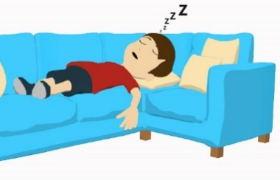
El primo de Daniel
İEl primo de Daniel dibuja en la carta!
leer
Lee el texto. Mira los verbos: ¿presente o pasado?
Lee las frases sobre el texto.
Escribe 1-8 y ‘verdadero’ o ‘falso.’
[Normalmente] viajo a Francia, pero [el verano pasado] viajé a Costa Rica.
Aunque [el verano pasado] no ayudé en casa, [normalmente] limpio el suelo.
[El verano pasado] visité Madrid y pasé tiempo en un museo famoso, El Prado. [Normalmente] no disfruto el arte y la cultura. Sin embargo, cuando visito los museos, son interesantes. El verano pasado también viajé en tren por la ciudad.
1) Daniel travels to France.
2) He didn’t help out at home.
3) He cleaned the floor.
4) He visited Madrid.
5) He spends time in El Prado.
6) He didn’t enjoy the art and culture.
7) He visits museums and they’re interesting.
8) He travels by train.
Notes:
Timing: 10 minutes
Aim: To identify past and present activities at sentence level within a longer text.
Procedure:
1. Read the text.
2. Read the statements 1-8.
3. Decide if the statements are true or false according to the text.
4. Answers are revealed on the next slide.
Note:
The task is designed so that temporal adverbs are obscured. The true/false questions are based only on whether the action is past or present. This means that the only way to complete the task is to pay attention to the verb form.

Slide 26
Respuestas
leer
Lee las frases sobre el texto.
Escribe 1-8 y ‘verdadero’ o ‘falso.’
[Normalmente] viajo a Francia, pero [el verano pasado] viajé a Costa Rica.
Aunque [el verano pasado] no ayudé en casa, [normalmente] limpio el suelo.
[El verano pasado] visité Madrid y pasé tiempo en un museo famoso, El Prado. [Normalmente] no disfruto el arte y la cultura. Sin embargo, cuando visito los museos, son interesantes. El verano pasado también viajé en tren por la ciudad.
1) Daniel travels to France.
2) He didn’t help out at home.
3) He cleaned the floor.
4) He visited Madrid.
5) He spends time in El Prado.
6) He didn’t enjoy the art and culture.
7) He visits museums and they’re interesting.
8) He travels by train.
Notes:
Answer slide.
Answers appear on a mouse click.

Slide 27
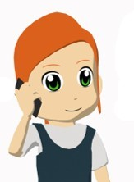
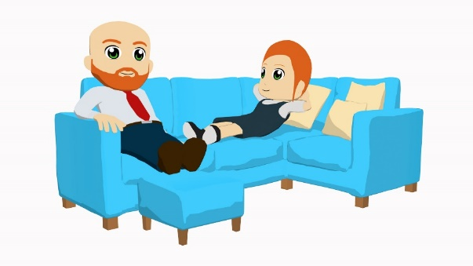
Lucía habla con unos amigos
escuchar
A
B
 | Normalmente… | El sábado pasado… | Actividad
1
C
C
2
B
3
D
4
A
D
E
5
E
Notes:
Timing: 8 minutes
Aim: to distinguish between present and past tense and understand the meaning of the sentence when listening.
Procedure:
1. Students listen to the audio.
2. They decide if the sentence is present or past tense.
3. They tick the correct box.
4. They match the picture to the meaning of the sentence.
5. They write the correct letter.
Transcript:
Usé el teléfono.
Pinto las paredes de rojo.
Aprovecho el tiempo libre con mi padre.
Ayudé con las tareas en casa.
5) Visité las tiendas.
Note: Teachers can adjust the level of challenge by switching the animation, removing the pictures initially to create a 2-stage listening process, whereby first listening = identify present/past. Teachers can correct the first page with students, then click to bring up the pictures and listen again to match the whole sentence meaning.

Slide 28
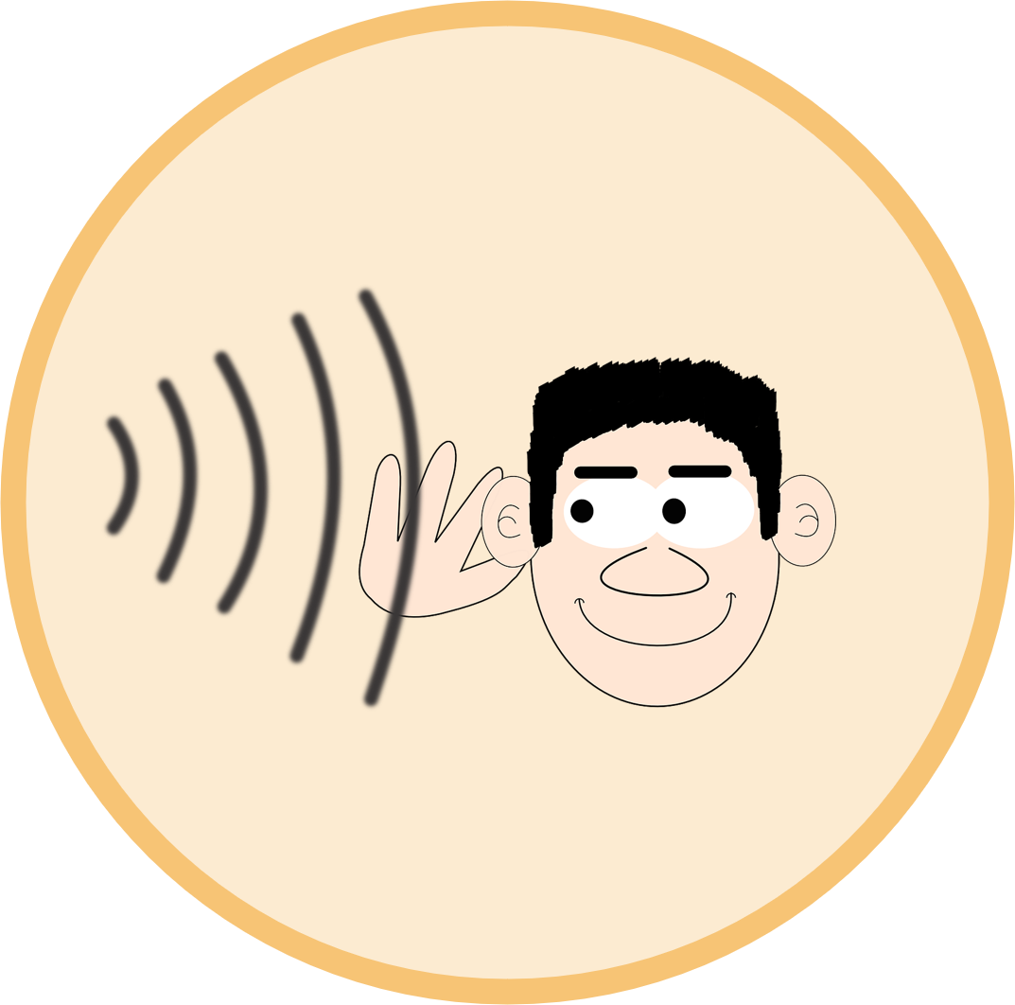
En clase (1/2)
Habla en español sobre tus clases de español en año 8 y en año 7.
hablar
A normalmente | B el lunes pasado
A normalmente | B el lunes pasado
A normalmente | B el lunes pasado
1
2
3
listen to music
study in silence
speak with a partner
4
A normalmente | B el lunes pasado
5
A normalmente | B el lunes pasado
6
A normalmente | B el lunes pasado
use a dictionary
dance salsa
sing in class
Notes:
Timing: 10 minutes (two slides) Aim: to practise speaking and understanding about present and past events in the first person singular. Procedure:
Students A and B write down 1-6 and their own choice of A or B for each, without showing the other.
Then Bs say their chosen sentences (without using the time adverbs) – e.g. 1B escuché música.
As note their partner’s choice and whether there is a match (yes/no).
After all 6 pictures have been spoken about, students swap roles and move to the next slide.
Note: it is only the first week of Y8 so observant Y8s might tell you it’s too soon to talk about ‘normalmente’ in Y8, but you can tell them they can use ‘wishful thinking’ to voice what they would like to be the norm in Y8 Spanish lessons. This may well get them asking ‘Señor(a), cómo se dice XXX?’ – no bad thing that they want to say new things! Personalising their repertoire continues to be an important part of the learning journey right through KS3.

Slide 29
En clase (2/2)
Habla en español sobre tus clases de español en año 8 y en año 7.
hablar
A normalmente | B el lunes pasado
A normalmente | B el lunes pasado
A normalmente | B el lunes pasado
1
2
[de memoria]
3
think a lot
speak from memory
help in class
4
A normalmente | B el lunes pasado
5
A normalmente | B el lunes pasado
6
A normalmente | B el lunes pasado
speak in Spanish
listen well
use (the) head
Notes:
2/2

Slide 30
¡A escribir!
Escribe las frases en español.
escribir
[use]
1 | 4
2 | 5
3 | 6
Normalmente uso el diccionario.
El lunes pasado, hablé con un compañero.
[normally]
[last Monday]
Normalmente escucho música.
El lunes pasado, canté en español.
[last Monday]
[normally]
[study]
Normalmente estudio en silencio.
El lunes pasado, bailé salsa.
[last Monday]
[normally]
Notes:
OPTIONAL WRITING TASK – ALTERNATIVE ON NEXT SLIDE
Timing: 8 minutes
Aim: to practise using present tense and past tense (preterite) –ar verbs successfully in first person singular (the ‘I’ form) in writing
Procedure:
Write sentences 1-6 in Spanish using either ‘normalmente’ + verb in first person singular present tense, or ‘el lunes pasado’ + verb in first person singular preterite.
Note:
Students should be familiar enough with the pictures by now not to need the English words with each one, though we do include an English prompt two items where the image could easily be misinterpreted. Teachers may need to remind students to write the full sentence depicted by the image. In-class teacher circulation will allow teachers to monitor this and give pointers to individual students as necessary.

Slide 31
¡A escribir!
Escribe en español.
escribir
¿Qué haces en tu clase de español en año 8?
¿Y en año 7?
Notes:
OPTIONAL WRITING ACTIVITY – ALTERNATIVE ON PREVIOUS SLIDE
Timing: 8 minutes
Aim: to practise using present tense and past tense (preterite) –ar verbs successfully in first person singular (the ‘I’ form) in writing
Procedure:
Write 6 sentences in Spanish using either ‘normalmente’ + verb in first person singular present tense, or ‘En año 7’ + verb in first person singular preterite.
Note: It is the design of the task that is different, here, not the required output. This slide design is more open-ended, and as such will give rise to students creating some variety. There’s also more likelihood that they will ask for additional vocabulary / a dictionary, something we want to continue to encourage right across KS3.

Slide 32
Deberes
Vocabulary Learning Homework (Y8 Term 1.1, Week 2)
Audio file
Student worksheet
In addition, revisit: Y7 Term 3.2 Week 5
Y7 Term 3.1 Week 4
Notes:
Note: HW for Y8 is made up of pre-learning of vocabulary 15-30 minutes (depending on school policy on HW time) plus 15 minutes vocabulary activities to deepen word knowledge, provided on a student homework sheet (which also contains a clickable link to the audio file). Answer sheets are also provided. The answer sheet for the Y8 vocabulary learning HW is here: https://rachelhawkes.com/LDPresources/Yr8Spanish/Spanish_Y8_Term1i_Wk2_audio_HW_sheet_answers.docx
Notes:
i) Teachers may, in addition, want to recommend use of a particular online app for the pre-learning of each week’s words. ii) Quizlet now requires parental involvement / registration / permissions for users below the age of 13, so it is perhaps most suitable for Y9 – 11 students. iii) Language Nut hosts LDP vocabulary lists and these are free for schools to use, though there is a registration process. One benefit is that all of the student tracking data that Language Nut offers are also available to schools that use the LDP lists for practice. Perhaps this makes it a good option for Y7/8.
iv) There are other free apps, and new ones are always appearing. Teachers have told us that they are currently using: Flippity, Wordwall (where using previously-created activities is free).
v) Gaming Grammar has been acquired by Language Nut. Its original content should still be available to teachers and much of it is appropriate for Y8 learners. From this lesson, for example, learners could practise:
Verbs: 1st person present & past tense in the ‘Verb agreement (past)’ menu

Slide 33
Las clases de Pedro y Patricia
hablar / escuchar
martes, 12 de julio.
İEl español es divertido!
Pedro y Patricia están en la misma escuela, pero en clases diferentes.
Persona A = eres Pedro.
Persona B = eres Patricia.
Usa las cartas. Describe las actividades en clase. Usa la forma correcta del verbo para el presente o pasado.
Notes:
ALTERNATIVE VERSION OF THE SPEAKING WITH HANDOUTS Timing: 10 minutes
Aim: to practise using present tense and past tense (preterite) –ar verbs successfully in first person singular (the ‘I’ form) in spoken form; to practise listening to understand whether an action is in the present or completed in the past.
Procedure:
1. Student A says the sentences to their partner, using the correct form of the verb. Student A should not say the Spanish for ‘last Monday’ or ‘normally’. The idea is that the past/present meaning is conveyed by the verb ending e.g. ‘usé el diccionario’, ‘escucho música’.
2. Student B notes whether the action is ‘normally’ or ‘last class.’
3. Partners then swap roles.
4. After both partners have had their turn at speaking, the teacher can conduct a whole class feedback (slide 23).
Transcript (for Persona A):
1) Usé el diccionario
2) Estudio en silencio
3) Canté en español
4) Hablo con un/a compañero/a
5) Escucho música
6) Bailé salsa
Word frequency (1 is the most frequent word in Spanish): usar [317]; estudiar [332]; cantar [717]; hablar [90]; escuchar [281]; bailar [1323]
Source: Davies, M. & Davies, K. (2018). A frequency dictionary of Spanish: Core vocabulary for learners (2nd ed.). Routledge: London

Slide 34
Las clases de Pedro
hablar
1. use the dictionary
(last Monday)
3. sing in Spanish
(last Monday)
5. listen to music
(normally)
2. study in silence
(normally)
4. speak with a partner
(normally)
6. dance salsa
(last Monday)
Notes:
Student A’s prompt cards - DO NOT DISPLAY DURING ACTIVITY

Slide 35
Las clases de Patricia
hablar
1. use the dictionary
(normally)
3. sing in Spanish
(normally)
5. listen to music
(last Monday)
2. study in silence
(last Monday)
4. speak with a partner
(normally)
6. dance salsa
(last Monday)
Notes:
Student B’s prompt cards - DO NOT DISPLAY DURING ACTIVITY

Slide 36
hablar
 | last Monday | normally
1. usar el diccionario
2. estudiar en silencio
3. cantar en espanol
4. hablar con una pareja
5. escuchar música
6. bailar salsa
Persona B
Las clases de Pedro
 | last Monday | normally
1. usar el diccionario
2. estudiar en silencio
3. cantar en espanol
4. hablar con una pareja
5. escuchar música
6. bailar salsa
Persona A
Las clases de Patricia
Notes:
These are the blank grids for student A and student B to record what they hear.

Slide 37
Respuestas
hablar
 | last Monday | normally
1. usar el diccionario
2. estudiar en silencio
3. cantar en espanol
4. hablar con una pareja
5. escuchar música
6. bailar salsa
Persona B
Las clases de Pedro
 | last Monday | normally
1. usar el diccionario
2. estudiar en silencio
3. cantar en espanol
4. hablar con una pareja
5. escuchar música
6. bailar salsa
Persona A
Las clases de Patricia
Notes:
ANSWERS
Here are the answers for the teacher to be able to conduct whole class feedback.

