Slide 1
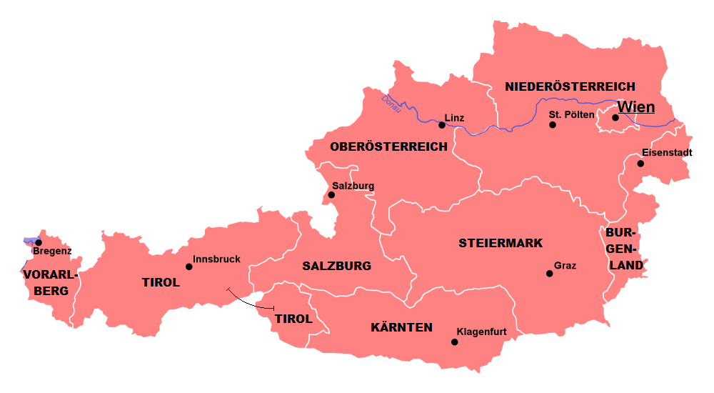
Jetzt oder früher Comparing places and people now and then
Imperfect tense: war, hatte, es gab
Range of SSC revisited
Y8 German
Term 2.1– Week 5 - Lesson 35 Stephen Owen / Rachel Hawkes Artwork: Steve Clarke
Date updated: 19/02/24
Gert Vincent / CC BY-SA
Notes:
Artwork by Steve Clarke. All additional pictures selected are available under a Creative Common license; no attribution required.
Note: All words listed below for this week’s learning (new and revisited sets) appear on all three Awarding Organisations’ word lists, with the following exceptions:
AQA and Eduqas lists do not have mitbringen, but it will be permitted as a transparent compound (in all papers).
Learning outcomes (lesson 1):
Introduction of imperfect tense: war, hatte, es gab Range of SSC revisited
Word frequency (1 is the most frequent word in German):
8.2.1.5 (introduce) es gab [49] hatte [6] war [4] heiß [1195] kalt [887] nah [480] tief [442] voll [388] wenig [102] damals [286] früher [411] links [893] rechts [829]
8.1.2.7 (revisit) anfangen [497] ankommen [653] anrufen [1146] einkaufen [2877] mitbringen [1828] setzen [228] stattfinden [652] stellen [135] vorbereiten [1421] Geburtstag [1766] weiterer, weitere, weiteres [182] während [173] 8.1.1.7 (revisit) lustig [1973] interessant [810] spannend [1810] wunderbar [1603] notwendig [742] unmöglich [1879] warum? [192] weil [88] denn [93] Source: Jones, R.L & Tschirner, E. (2019). A frequency dictionary of German: Core vocabulary for learners. London: Routledge.
The frequency rankings for words that occur in this PowerPoint which have been previously introduced in LDP resources are given in the LDP SOW and in the resources that first introduced and formally re-visited those words.
For any other words that occur incidentally in this PowerPoint, frequency rankings will be provided in the notes field wherever possible.

Slide 2
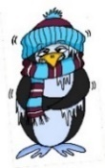
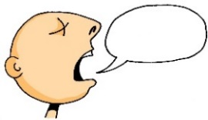
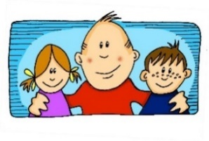
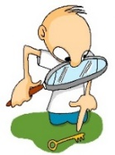
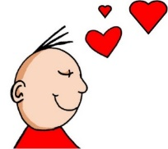
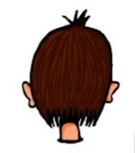
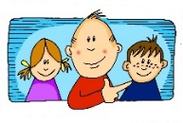
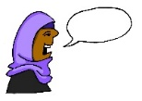
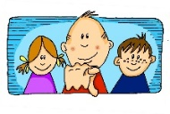
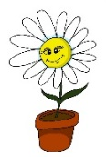
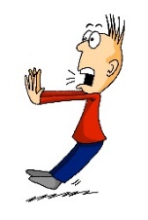
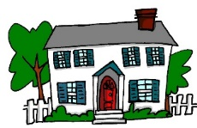
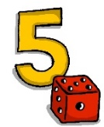
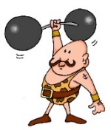
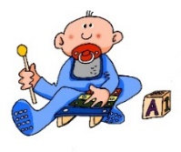
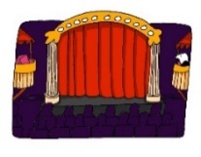
Overview of SSCs and source words
a
a
e
e
ei
w
z
sagen
kalt
geben
denken
frei
Welt
Zug
i
i
ie
ch
ch
sch
wir
finden
Liebe
ich
Buch
schreiben
o
o
u
u
er
er
r
r
v
s
ß
wo?
Kopf
du
Punkt
er
wieder
reden
Uhr
vor
sollen
groß
ü
ü
ö
ö
ä
ä
au
eu
äu
Tür
fünf
schön
plötzlich
spät
lächeln
Haus
Deutschland
Mäuse
-d
-ig
st-
sp-
j
th
und
richtig
stark
spielen
ja
Theater
Notes:
Timing: 5 minutes Aim: To revise all SSCs learned in Y7. Procedure: 1. Click on an SSC to hear it said aloud. Students repeat.
2. Point to the accompanying source word. Ask ‘Wie sagt man das?’ Students say it aloud. Click on the word or picture to check pronunciation. Students repeat.
3. Point at SSCs at random. Students say the SSC and source word aloud. Click to check pronunciation.

Slide 3
Österreich
hören / schreiben
Schreib die Ortsnamen!
1
1. ________
2
2. ________
3
7. ________
4
5
6. ________
5. ________
3. ________
6
Notes:
Timing: 5 minutes Aim: Transcription practice (place names). Procedure: 1. Click on the numbered audio buttons to play the play names.
2. Students transcribe what they hear.
3. Click to remove the numbered rectangles and reveal each place name, one by one.
Transcript: 1. Wien 2. Eisenstadt
3. Graz 4. Innsbruck 5. Bregenz 6. Salzburg

Slide 4
Vokabeln
why
sprechen
birthday
to take place
in former times
during
because, for
to put, set
to arrive
to start
to shop
additional
to prepare
to bring
to put, place (upright)
because
to call
a_ _ _ _ _ _ _
anfangen
G_ _ _ _ _ _ _ _ _
e_ _ _ _ _ _ _ _
Geburtstag
einkaufen
m_ _ _ _ _ _ _ _ _
mitbringen
während
ankommen
w_ _ _ _ _ _
a_ _ _ _ _ _ _
setzen
s_ _ _ _ _
vorbereiten
v_ _ _ _ _ _ _ _ _ _
anrufen
a_ _ _ _ _ _
stattfinden
weiterer
s_ _ _ _ _ _ _ _ _ _
w_ _ _ _ _ _ _
stellen
s_ _ _ _ _ _
weil
w_ _ _
denn
warum
d_ _ _
w_ _ _ _
f_ _ _ _ _
früher
Notes:
Timing: 4 minutes
Aim: to revise items of vocabulary from one of this week’s revisited vocabulary sets (plus three from another set and one from this week’s words). Only the first letter is provided so that students have to recall the word.
Procedure:
1. The teacher clicks for the English prompt to appear.
2. Students say the word in German in choral response to match the English.
3. Clicking again reveals the answer.
Word frequency (1 is the most frequent word in German):
anfangen [497] ankommen [653] anrufen [1146] einkaufen [2877] mitbringen [1828] setzen [228] stattfinden [652] stellen [135] vorbereiten [1421] Geburtstag [1766] weiterer, weitere, weiteres [182] während [173] warum? [192] weil [88] denn [93] früher [411] Source: Jones, R.L. & Tschirner, E. (2019). A frequency dictionary of German: core vocabulary for learners. Routledge

Slide 5
Vokabeln
hören / schreiben
Hör zu. Schreib das richtige Wort.
1
deep
tief
2
full
voll
3
on/to the right
rechts
4
few
wenig
5
was
war
6
in former times
früher
7
on/to the left
links
8
back then
damals
9
had
hatte
10
near(by), close
nah
Notes:
Timing: 5 minutes Aim: to practise written recall of items of vocabulary from this week’s new vocabulary set in the oral modality.
Procedure: 1. Click on the numbered buttons to play the audio.
2. Students hear three words each time.
3. The English appears in the first column upon clicking the mouse; students then write the correct German word.
4. Upon the next mouse click, the German word appears in the second column.
Adaptive teaching: to create an easier version (for the class or just for some students) the English prompts could be provided ahead of listening (either by clicking first each time OR by distributing a sheet to provide extra support for some students in the class).
Transcript: 1. tief, kalt, wenig (deep) 2. voll, nah, links (full) 3. kalt, rechts, damals (on/to the right) 4. hatte, voll, wenig (few) 5. nah, früher, war (was) 6. früher, heiß, tief (in former times) 7. kalt, links, rechts (on/to the left) 8. wenig, voll, damals (back then) 9. hatte, früher, heiß (had) 10. damals, rechts, nah (near(by), close) Word frequency (1 is the most frequent word in German): 8.2.1.3 (introduce) es gab [49] hatte [6] war [4] heiß [1195] kalt [887] nah [480] tief [442] voll [388] wenig [102] damals [286] früher [411] links [893] rechts [829]
Source: Jones, R.L. & Tschirner, E. (2019). A frequency dictionary of German: core vocabulary for learners. Routledge

Slide 6
es gab, er/sie/es hatte
Grammatik
Use es gibt to mean ‘there is, there are’, and es gab for ‘there was, there were’.
Er / sie / es hatte means ‘he(it) / she(it) / it had’.
Remember to use Row 2 (accusative) words for ‘a’ (or ‘the’) after most verbs. Only the masculine articles change.
It is handy to use this one-word past tense with these very common words, and it avoids repeating the two-verb perfect tense again and again.
PRESENT
Es gibt einen Strand.
There is a beach.
Berlin hat einen Zoo und eine Galerie.
Berlin has a zoo and a gallery.
PAST (IMPERFECT)
Es gab eine Kirche und ein Museum.
There was a church and a museum.
Berlin hatte einen Marktplatz.
Berlin had a market square.
These verb forms are in the imperfect tense and describe places, people and things in the past.
Notes:
Timing: 2 minutes Aim: To introduce ‘es gab’ and ‘hatte’. Procedure: 1. Click to animate the explanation.
2. Ensure students’ understanding at each stage.
Word frequency (1 is the most frequent word in German): Zoo [>5009] Galerie [4328] Source: Jones, R.L. & Tschirner, E. (2019). A frequency dictionary of German: core vocabulary for learners. Routledge

Slide 7
Using früher for ‘used to’
Grammatik
Use the adverb früher after es gab to say what there used to be, and with hatte to say what something used to have:.
PAST (IMPERFECT)
Es gab früher eine Kirche und ein Museum.
There used to be a church and a museum.
Früher hatte Berlin einen Marktplatz.
Berlin used to have a market square.
Remember! To negate nouns, use kein.
Es gab früher keine Kirche und kein Museum.
There didn’t use to be a church or a museum.
Früher hatte Berlin keinen Marktplatz.
Berlin didn’t use to have a market square.
Notes:
Timing: 2 minutes Aim: To explain the use of ‘früher’ with ‘es gab’ and ‘hatte’. Procedure: 1. Click to animate the explanation.
2. Ensure students’ understanding at each stage.

Slide 8
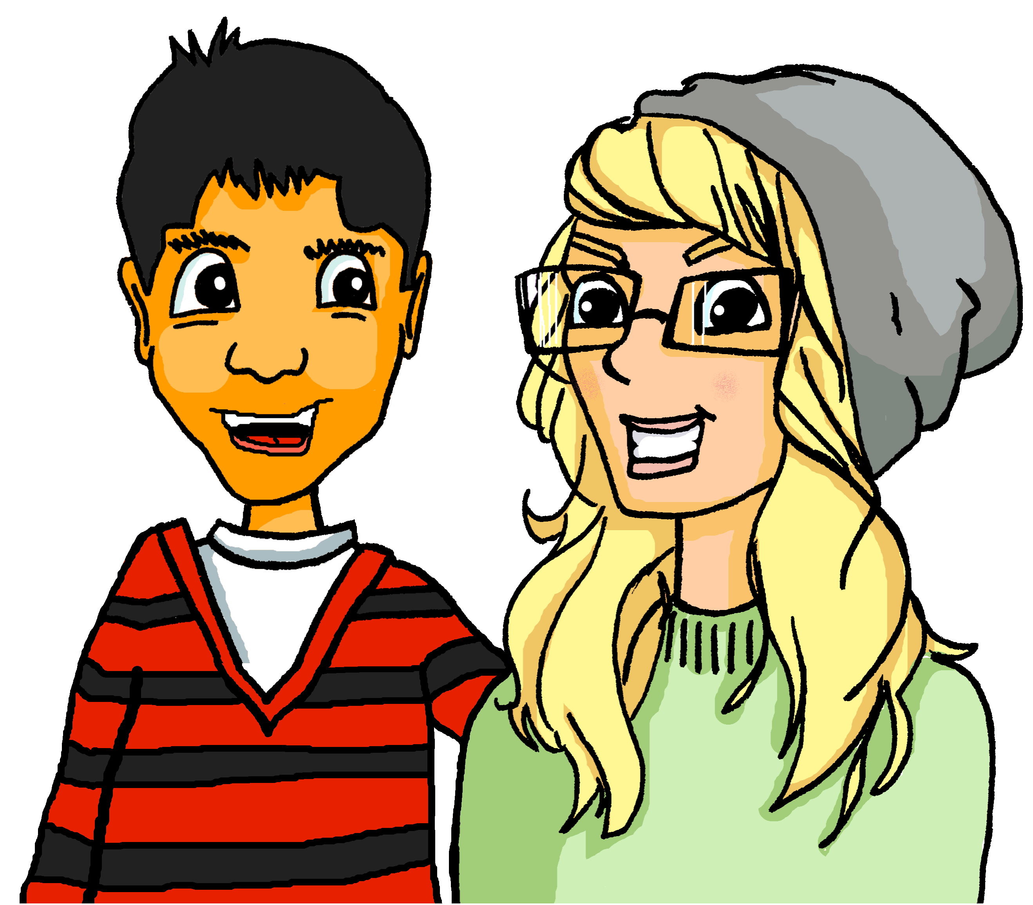
Innsbruck
hören
Heidi beschreibt ihre Geburtsstadt, Innsbruck. Hör zu. Jetzt oder früher?
Gert Vincent / CC BY-SA
Notes:
Timing: 1 minute
Aim: To give context for the listening activity that follows revisiting some known language in productive mode / oral modality. Procedure: 1. Teacher asks ‘Welches Land ist das?’ → Österreich.
2. Wo liegt Innsbruck? → im Westen
3. Innsbruck ist Heidis Geburtsstadt. Wie sagt man Geburtsstadt auf English? → birth town / town of birth

Slide 9
Innsbruck
hören
Heidi beschreibt ihre Geburtsstadt, Innsbruck. Hör zu. Jetzt oder früher?
 |  | jetzt | früher
 | Montags gibt es einen Markt.
 | Im Sommer gibt es einen Strand am Marktplatz.
 | Es gab ein Stadion.
 | Die Stadt hatte nicht viele Geschäfte.
 | Sie hatte auch keine Industrie.
 | Es gibt einen Skatepark.
1
2
3
4
5
6
Notes:
Timing: 5 minutes Aim: To practise distinguishing between present and past tense forms of ‘es gibt’ and ‘hat’ Procedure: 1. Click on the numbered buttons to play the audio.
2. Students listen to each sentence and tick the appropriate column.
3. Click to reveal first the German sentence heard, then the correct tick.
Transcript: 1. Montags gibt es einen Markt.
2. Im Sommer gibt es einen Strand am Marktplatz.
3. Es gab ein Stadion.
4. Die Stadt hatte nicht viele Geschäfte.
5. Sie hatte auch keine Industrie.
6. Es gibt einen Skatepark.
Word frequency of unknown words and cognates (1 is the most frequent word in German): Stadion [3140] Industrie [3483] Source: Jones, R.L. & Tschirner, E. (2019). A frequency dictionary of German: core vocabulary for learners. Routledge

Slide 10
Using früher with war
Grammatik
Use the adverb früher after war (was) to mean used to be:
PAST (IMPERFECT)
Innsbruck war früher klein und historisch.
Innsbruck used to be small and historical.
The imperfect of sein and haben can also describe people:
Ich war früher sehr klein.
Note: the ich and er/sie/es forms are the same. Add –st to mean ‘you’.
I used to be very small.
Du warst früher interessant.
You used to be interesting.
Ich hatte früher wenige Freunde.
I used to have few friends.
Du hattest früher viele Hausaufgaben.
You used to have lots of homework.
Notes:
Timing: 2 minutes Aim: To explain the use of ‘früher’ with ‘war’. Procedure: 1. Click to animate the explanation.
2. Ensure students’ understanding at each stage.
Word frequency (1 is the most frequent word in German): historisch [901] Source: Jones, R.L. & Tschirner, E. (2019). A frequency dictionary of German: core vocabulary for learners. Routledge

Slide 11
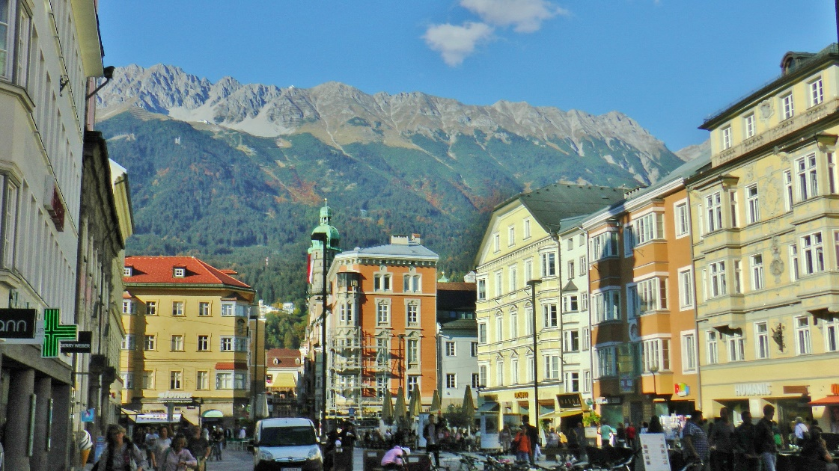
Innsbruck
lesen
ist | war
hat | hatte
es gibt | es gab
Heidi redet weiter… Schreib 1-8 und das richtige Verb.
 |  | heute | damals
1. | Mein Opa war ein toller Skifahrer.
2. | In Innsbruck gibt es im Winter immer viel Schnee.
3. | Ich glaube, dass Innsbruck die perfekte Stadt ist.
4. | Der Winter war ein bisschen zu kalt.
5. | Es gibt eine Skatehalle und eine Arena.
6. | Dort war ich einmal auf einem Konzert.
7. | Die Stadt hatte kein Einkaufszentrum.
8. | Die Stadt hat einen Strand!
___
______
__
___
______
___
_____
___
Friedrich-Karl Mohr / CC BY-SA 3.0 DE
Notes:
Timing: 5 minutes Aim: To practise distinguishing between sentences in the present and in the past tense. Procedure: 1. Students read each sentence and determine the correct present or past tense expression to fill the gap, from the six choices provided.
They do this according to the prompt of either ‘heute’ or ‘damals’ (deliberately not animated), together with the other words in the sentence.
2. Click to reveal the answers one by one.
Word frequency (1 is the most frequent word in German): Skifahrer [>5009] perfekt [1567] zu [21] Skatehalle [>5009] Arena [>5009] Einkaufszentrum [>5009] Source: Jones, R.L. & Tschirner, E. (2019). A frequency dictionary of German: core vocabulary for learners. Routledge

Slide 12
A – Wien (Runde 1)
B – Wien (Runde 1)
 | Was? | heute | früher
1
2
3
4
5
6
1. Wien ______ die Stadt von Mozart und Beethoven [was in former times].
2. _______ Rockkonzerte in der Wiener Stadthalle [there are today].
3. Wien ______ eine ‘Smart City’ [is today].
4. _______ keine Straßenbahn* in Wien [there was in former times].
5. Wien ______ das Sigmund-Freud-Museum [has today].
6. Wien ______ kein Internet [had in former times].
*die Straßenbahn - tramway
A – Salzburg (Runde 2)
B – Salzburg (Runde 2)
*berühmt - famous
 | Was? | heute | früher
1
2
3
4
5
6
1. Mozarts Geburtshaus ______ in Salzburg [is today].
2. _______ viele Museen in Salzburg [there are today].
3. Salzburg ______ in Bayern [was in former times].
4. Salzburg _______ kein Festival [had in former times].
5. Salzburg ______ ein berühmtes* Festival [has today].
6. ________ keine Autobahn [there was in former times].
Notes:
HANDOUT DO NOT DISPLAY

Slide 13
A – Wien (Runde 1)
sprechen
war
1. Wien ______ die Stadt von Mozart und Beethoven [in former times].
Es gibt
2. _______ Rockkonzerte in der Wiener Stadthalle [today].
ist
3. Wien ______ eine ‘Smart City’ [today].
Es gab
4. _______ keine Straßenbahn* in Wien [in former times].
hat
5. Wien ______ das Sigmund-Freud-Museum [today].
hatte
6. Wien ______ kein Internet [in former times].
*die Straßenbahn - tramway
Notes:
DO NOT DISPLAY DURING THE TASK
Timing: 5 minutes Aim: To practise production of ‘war’, ‘hatte’ and ‘es gab’ (oral modality) Procedure: 1. Distribute the handout.
2. Student A reads the sentences in German, inserting the correct verb form in each gap.
3. Student B listens and ticks either ‘heute’ or ‘früher’ as appropriate (see next slide), also noting in English the feature mentioned.
4. This slide is for going over the answers – click to make each verb form appear.
4. Students swap roles and do the Round 2 sentences about Salzburg.
Word frequency (1 is the most frequent word in German): Stadthalle [>5009] Straßenbahn [>5009] Internet [805] Source: Jones, R.L. & Tschirner, E. (2019). A frequency dictionary of German: core vocabulary for learners. Routledge

Slide 14
B – Wien (Runde 1)
sprechen
 | Was? | heute | früher
1
2
3
4
5
6
town of Mozart and Beethoven
rock concerts in town hall
Smart City
no tram
Sigmund Freud Museum
no internet
Notes:
This is Partner B’s card
Aim: To practise production of ‘war’, ‘hatte’ and ‘es gab’ (oral modality) Procedure: 1. Student B listens to the sentences read by Student A and ticks either ‘heute’ or ‘früher’ as appropriate, also noting in English the feature mentioned.
2. This slide is for going over the answers – click to make them appear.
3. Students swap roles and do the conversation about Salzburg.
Word frequency (1 is the most frequent word in German): Stadthalle [>5009] Straßenbahn [>5009] Internet [805] Source: Jones, R.L. & Tschirner, E. (2019). A frequency dictionary of German: core vocabulary for learners. Routledge

Slide 15
B – Salzburg (Runde 2)
sprechen
ist
1. Mozarts Geburtshaus ______ in Salzburg [today].
Es gibt
2. _______ viele Museen in Salzburg [today].
war
3. Salzburg ______ in Bayern [in former times].
hatte
4. Salzburg _______ kein Festival [in former times].
hat
5. Salzburg ______ ein berühmtes* Festival [today].
Es gab
6. ________ keine Autobahn [in former times].
*berühmt - famous
Notes:
DO NOT DISPLAY DURING THE TASK
Timing: 5 minutes Aim: To practise production of ‘war’, ‘hatte’ and ‘es gab’ (oral modality) Procedure: 1. The students have now swapped roles.
2. Student B reads the sentences in German, inserting the correct verb form in each gap.
3. Student A listens and ticks either ‘heute’ or ‘früher’ as appropriate (see next slide), also noting in English the feature mentioned.
4. This slide is for going over the answers – click to make each verb form appear.
Word frequency (1 is the most frequent word in German): Autobahn [2966] berühmt [1379] Source: Jones, R.L. & Tschirner, E. (2019). A frequency dictionary of German: core vocabulary for learners. Routledge

Slide 16
A – Salzburg (Runde 2)
sprechen
 | Was? | heute | früher
1
2
3
4
5
6
Mozart’s bithplace
lots of museums
in Bavaria
no festival
famous festival
no motorway
Notes:
This is Partner A’s card
Aim: To practise production of ‘war’, ‘hatte’ and ‘es gab’ (oral modality) Procedure: 1. Student A listens to the sentences read by Student B and ticks either ‘heute’ or ‘früher’ as appropriate, also noting in English the feature mentioned.
2. This slide is for going over the answers – click to make them appear.
Word frequency (1 is the most frequent word in German): Autobahn [2966] berühmt [1379] Source: Jones, R.L. & Tschirner, E. (2019). A frequency dictionary of German: core vocabulary for learners. Routledge

Slide 17
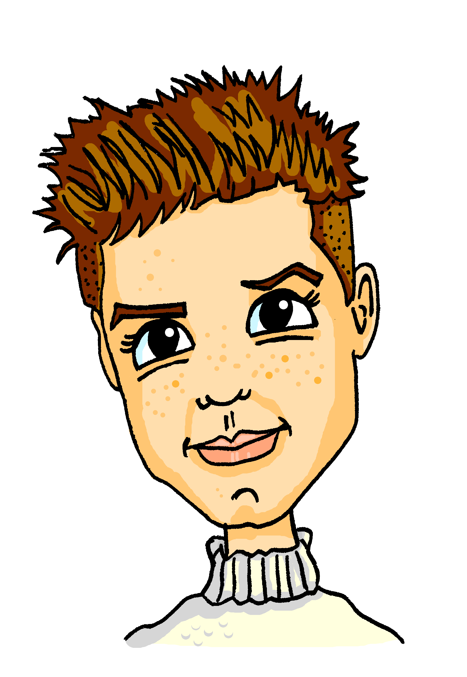
schreiben
You’re helping Alastair to write messages to Mia in German. Schreib auf Deutsch!
Summer is close and it is beautiful in Glagow.
In former times Glasgow had a tramway.
Today Glasgow has a lot of theatres.
Der Sommer ist nah und er ist schön in Glasgow.
Früher hatte Glasgow eine Straßen-bahn.
Heute hat Glasgow viele Theater.
Glasgow was very important for the ship building industry*.
In former times there were not many people in Glasgow.
There are four universities in Glasgow.
Glasgow war sehr wichtig
für die Schiffbau-industrie.
Früher gab es nicht viele Leute in Glasgow.
Es gibt vier Universitäten in Glasgow.
*die Schiffbauindustrie – the shipbuilding industry
Notes:
Note: if time is short, teachers could allocate 1 x sentence to each group of students. Timing: 10 minutes
Aim: This mini-Whatsapp exchange is a chance to bring together, in written practice, some of the different features practised this lesson:
-Introduction of imperfect tense: war, hatte, es gab -Range of SSC revisited
Procedure: 1. Translate the six messages into German without using reference resources. 2. The answers appear upon successive mouse clicks.
3. Check the answers carefully, noting any mistakes.

Slide 18
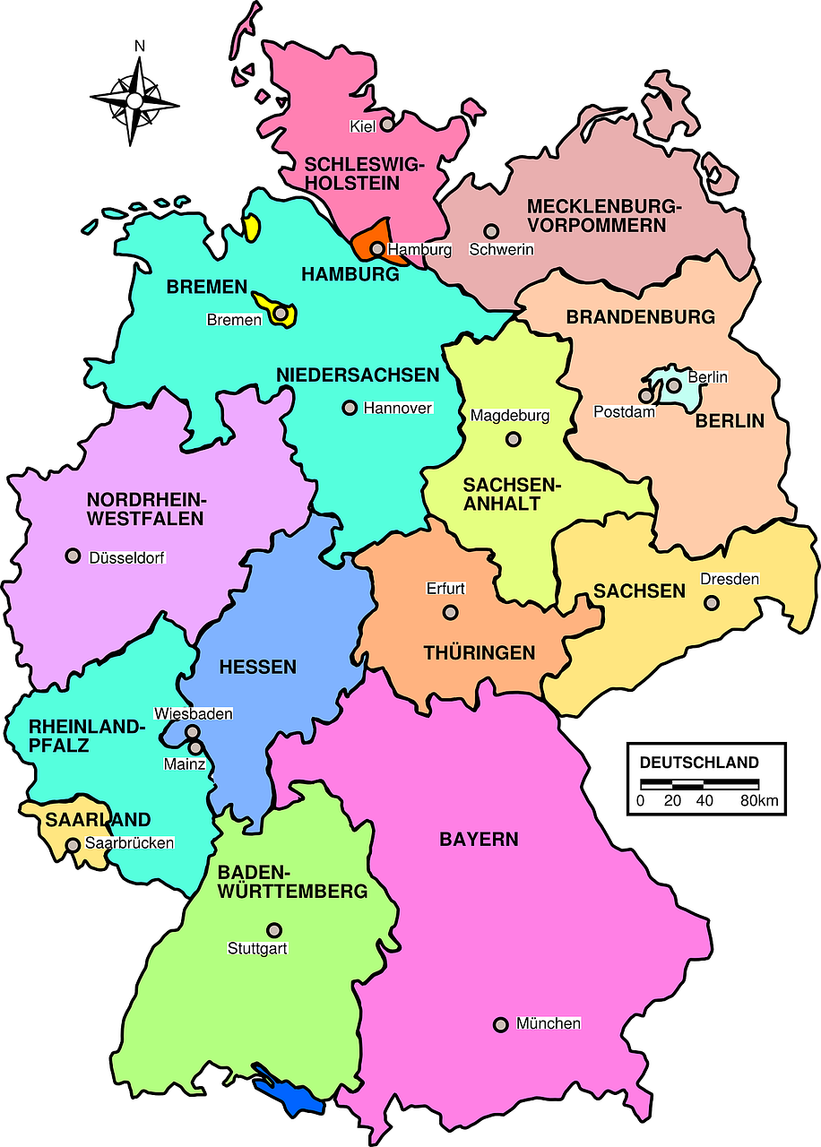
Jetzt oder früher Comparing places and people now and then
Imperfect tense: war, hatte, es gab
Range of SSC revisited
Y8 German
Term 2.1– Week 5 - Lesson 36 Stephen Owen / Rachel Hawkes Artwork: Steve Clarke
Date updated: 19/02/24
Notes:
Artwork by Steve Clarke. All additional pictures selected are available under a Creative Common license; no attribution required.
Note: All words listed below for this week’s learning (new and revisited sets) appear on all three Awarding Organisations’ word lists, with the following exceptions:
AQA and Eduqas lists do not have mitbringen, but it will be permitted as a transparent compound (in all papers).
Learning outcomes (lesson 2):
Introduction of imperfect tense: war, hatte, es gab Revisit adjective agreement R1 (nominative) and R2 (accusative) Range of SSC revisited
Word frequency (1 is the most frequent word in German):
8.2.1.5 (introduce) es gab [49] hatte [6] war [4] heiß [1195] kalt [887] nah [480] tief [442] voll [388] wenig [102] damals [286] früher [411] links [893] rechts [829]
8.1.2.7 (revisit) anfangen [497] ankommen [653] anrufen [1146] einkaufen [2877] mitbringen [1828] setzen [228] stattfinden [652] stellen [135] vorbereiten [1421] Geburtstag [1766] weiterer, weitere, weiteres [182] während [173] 8.1.1.7 (revisit) lustig [1973] interessant [810] spannend [1810] wunderbar [1603] notwendig [742] unmöglich [1879] warum? [192] weil [88] denn [93] Source: Jones, R.L & Tschirner, E. (2019). A frequency dictionary of German: Core vocabulary for learners. London: Routledge.
The frequency rankings for words that occur in this PowerPoint which have been previously introduced in LDP resources are given in the LDP SOW and in the resources that first introduced and formally re-visited those words.
For any other words that occur incidentally in this PowerPoint, frequency rankings will be provided in the notes field wherever possible.

Slide 19
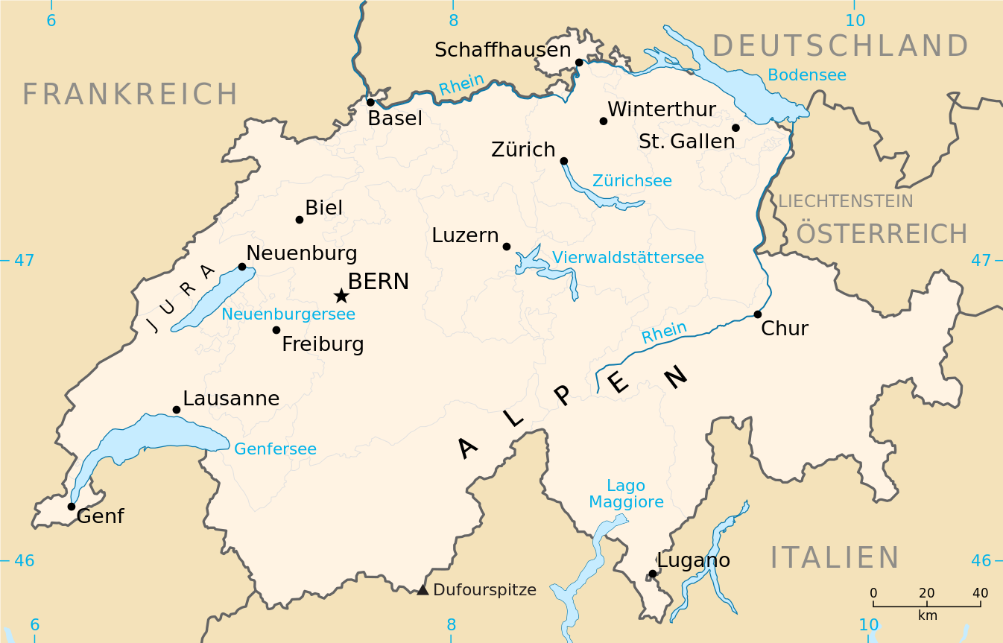
Die Schweiz
Sag die Städte. Dann hör zu.
sprechen
20
3
2
4
1
5
8
6
Sekunden
7
0
LOS!
Maximilian Dörrbecker (Chumwa) / CC BY-SA
Notes:
Timing: 5 minutes Aim: To practise spoken production of various SSC Procedure: 1. Students read the numbered place names aloud individually for one minute.
2. The teacher then plays the audio for each place name one by one, to enable students to check their pronunciation.
3. They then have a 20-second timer to say them all in tandem with their partner, taking turns.
Transcript: 1. Biel 2. Basel 3. Schaffhausen 4. Zürich 5. Luzern 6. Bern 7. Freiburg 8. Neuenburg

Slide 20
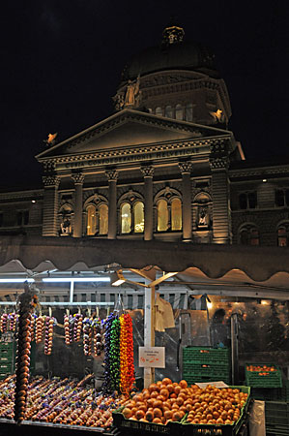
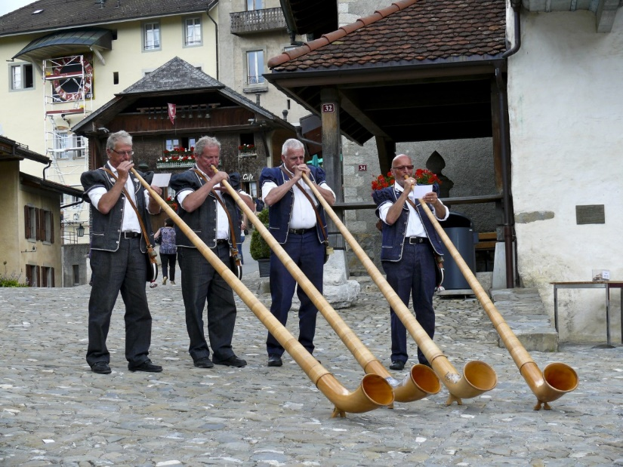
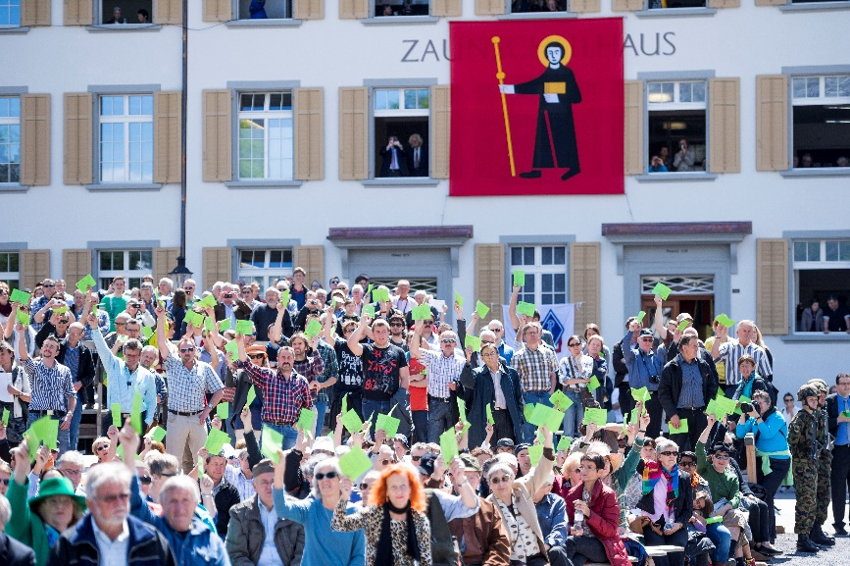
Phonetik (1/2)
hören / schreiben
1
1. Der Zwiebelmarkt findet im November in Bern statt.
1
1. The onion market takes place in November in Bern.
2. In Nendaz gibt es ein berühmtes Alphornfestival.
2
2
2. In Nendaz there is a famous alpine horn festival.
3. An der Landsgemeinde sagt man seine Meinung.
3
3
3. At the regional assembly you state your opinion.
Kanton Glarus, Samuel Trümpy Photography / CC BY 2.0
Arno Konings (Schweiz-bilder) / CC BY-SA
Notes:
OMIT THIS ACTIVITY IF TIME IS LIMITED
Timing: 5 minutes (two slides) Aim: Transcription practice involving various SSC Procedure: 1. Click to make each sentence appear, together with its English translation and illustrative photograph.
2. Students listen to the sentences and transcribe the missing words.
3. Click to make the missing words appear for checking.
Transcript: 1. Der Zwiebelmarkt findet im November in Bern statt.
2. In Nendaz gibt es ein berühmtes Alphornfestival.
3. An der Landsgemeinde sagt man seine Meinung.
Word frequency (1 is the most frequent word in German): Zwiebel [>5009] Alphorn [>5009] Meinung [787] Landsgemeinde [>5009] berühmt [1379] Source: Jones, R.L. & Tschirner, E. (2019). A frequency dictionary of German: core vocabulary for learners. Routledge

Slide 21
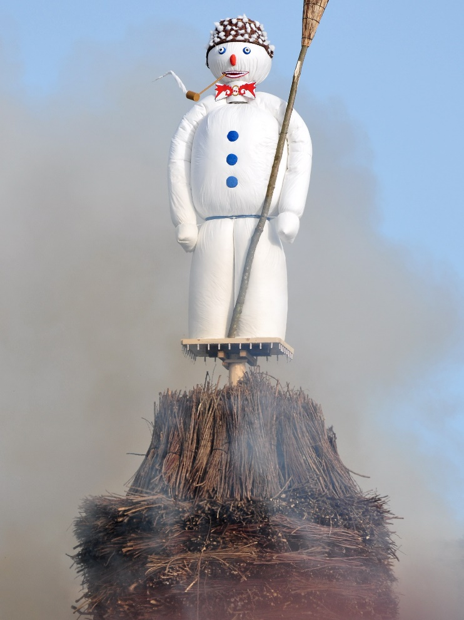
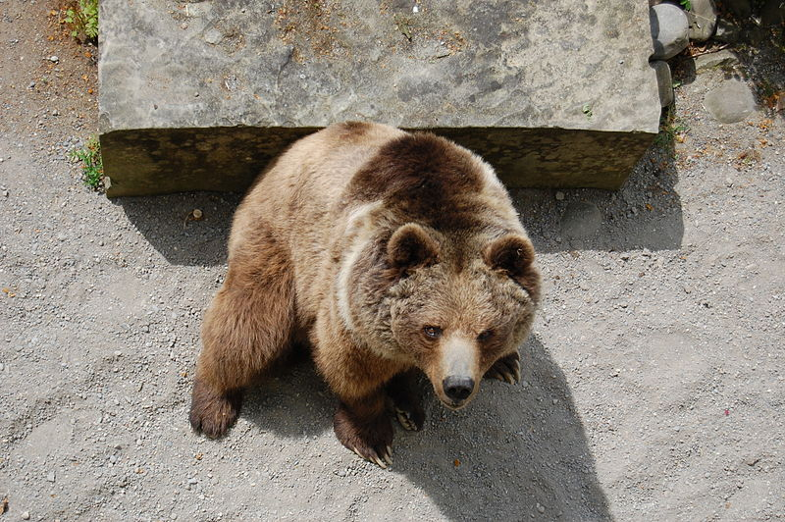
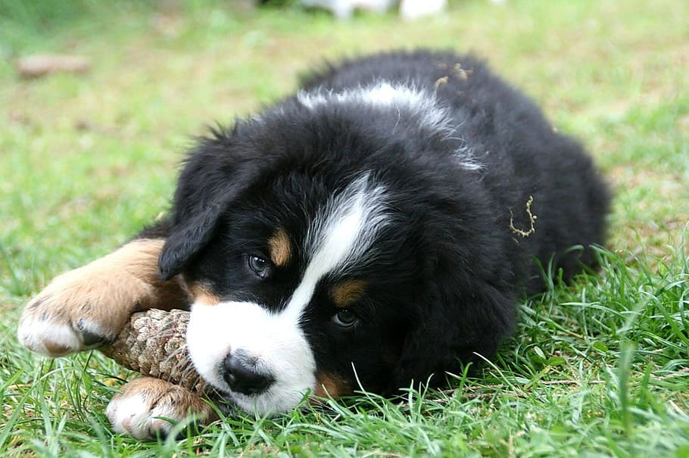
Phonetik (2/2)
hören / schreiben
4
4. Am Sechseläuten explodiert ein Schneemann!
4
4
4. At the Sechseläuten a snowman explodes!
5. In Bern gibt es einen Bärengraben.
5
5
5. In Bern there is a bear pit.
6. Hundehalter bezahlen eine Hundesteuer!
6
6
6. Dog owners pay a dog tax!
Roland zh / Wikimedia Commons
edwin .11/ Wikimedia Commons
5. In Bern there is a bear pit.
Notes:
This slide is the continuation of the activity on the previous slide.
Transcript: 4. Am Sechseläuten explodiert man einen Schneemann!
5. In Bern gibt es einen Bärengrabenl.
6. Hundhalter bezahlen eine Hundesteuer!
Word frequency (1 is the most frequent word in German): explodieren [>5009] Schneemann [>5009] Bärengraben [>5009] Hundehalter [>5009] Hundesteuer [>5009] Source: Jones, R.L. & Tschirner, E. (2019). A frequency dictionary of German: core vocabulary for learners. Routledge

Slide 22
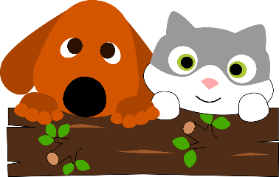
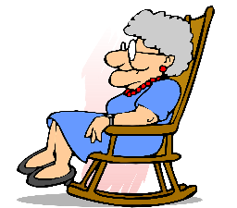
Adjektive (R1 / R2)
Remember! war (was) is the imperfect form of sein (to be).
Grammatik
Remember, articles (‘a’ and ‘the’) use R1 (nominative) with nouns after sein. Add R1 (nominative) endings to the adjectives that describe them:
Es war ein schöner Tag.
Es war eine kalte Jahreszeit.
Es war ein anderes Tier.
It was a beautiful day.
It was a cold season.
It was a different animal.
After most other verbs use R2 (accusative) articles and adjective endings:
Es gab einen schönen Park.
Es gab eine alte Frau.
Es gab ein wunderbares Café.
Er hatte einen tiefen See.
Sie hatte eine volle Tasche.
Es hatte ein kleines Fenster.
Notes:
Timing: 3 minutes Aim: To recap pronominal adjective agreement in R1 (nominative) and R2 (accusative) with indefinite articles. Procedure: 1. Click and present the knowledge in small steps as per animation.
2. For the R2 examples elicit the English meanings, which revisit new and existing vocabulary. 3. Point out that R1 and R2 endings are the same for feminine and neuter nouns, but different for masculine nouns.
Word frequency (1 is the most frequent word in German):
8.2.1.3 (introduce) es gab [49] hatte [6] war [4] kalt [887] tief [442] voll [388]
8.1.2.3 (revisit) wunderbar [1603] Source: Jones, R.L & Tschirner, E. (2019). A frequency dictionary of German: Core vocabulary for learners. London: Routledge.

Slide 23
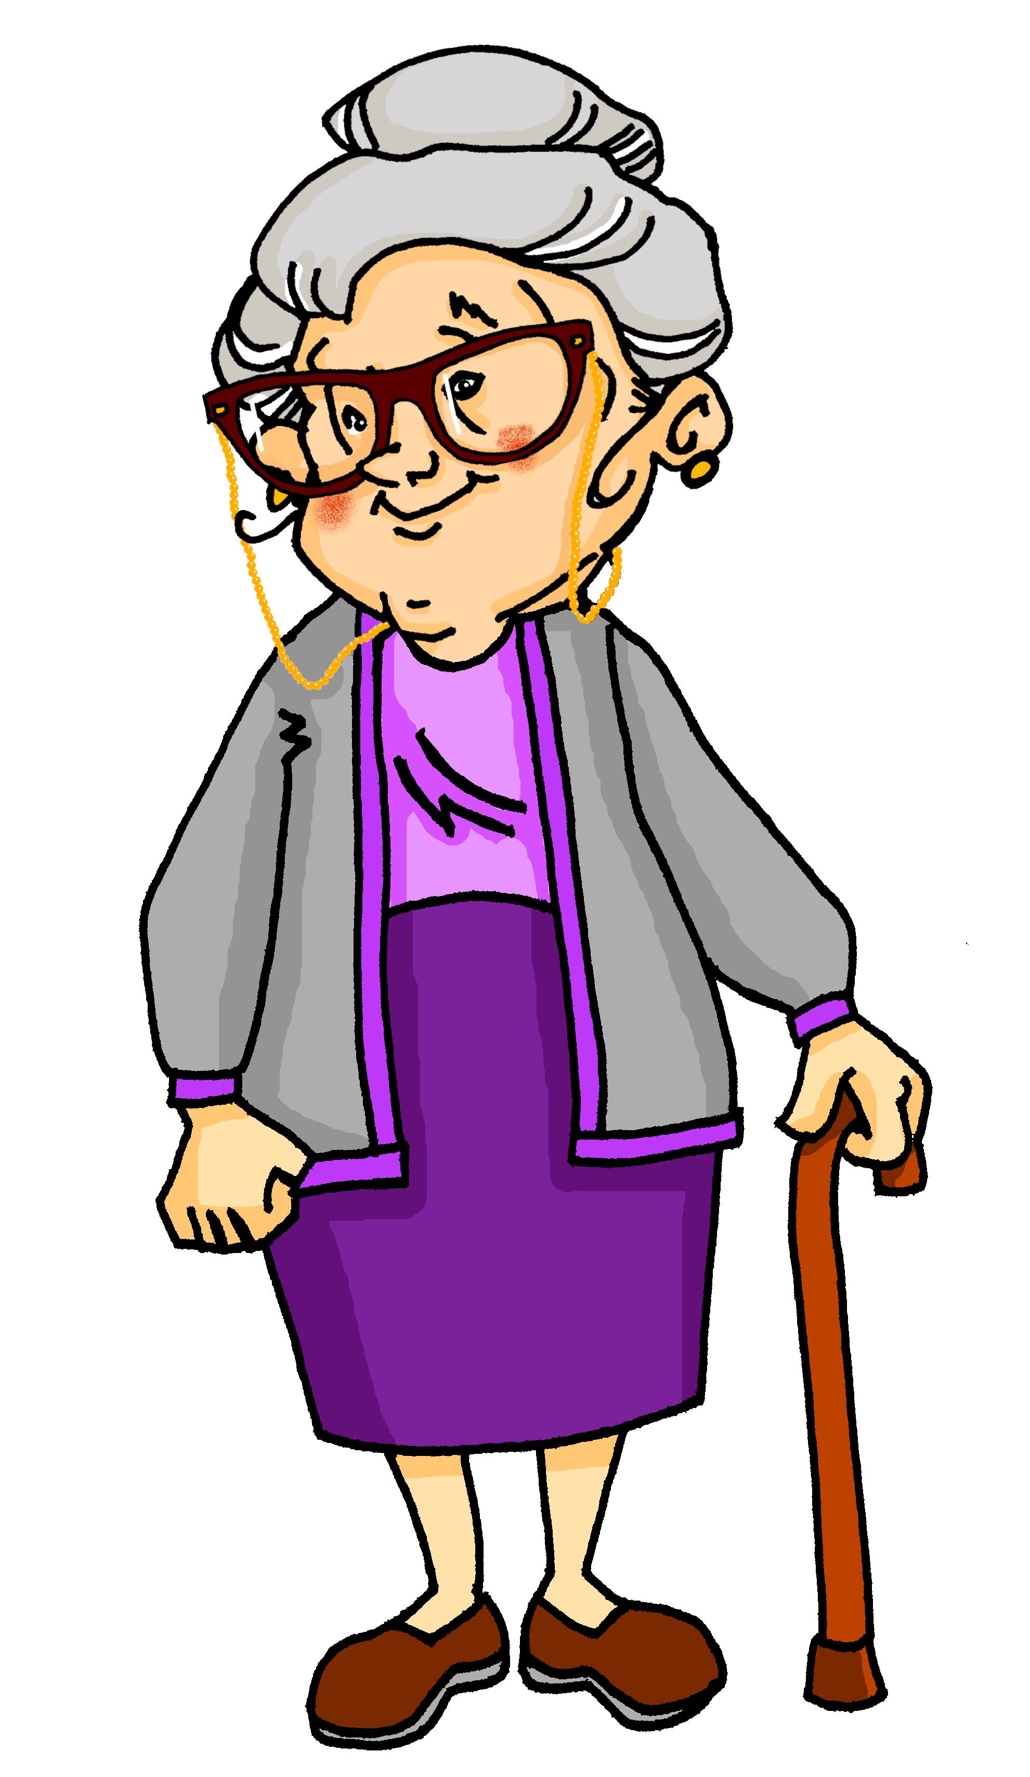
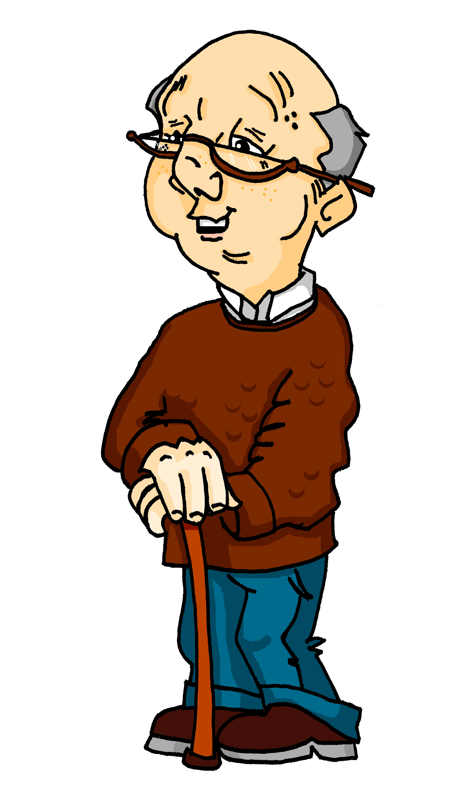
Meine Stadt
hören
Oma und Opa reden über Bad Hersfeld, Opas Geburtsstadt.
Wie war die Stadt? Was gab es damals dort?
Notes:
Aim: To give context for the listening activity that follows, revisiting some known language in productive mode / oral modality. Timing: 1 minute
Procedure: 1. Teacher asks ‘Welches Land ist das?’ → Deutschland
2. Wo liegt Bad Hersfeld? → in der Mitte
3. Bad Hersfeld is Omas Geburtsstadt. Wie war die Stadt? Hör zu…

Slide 24
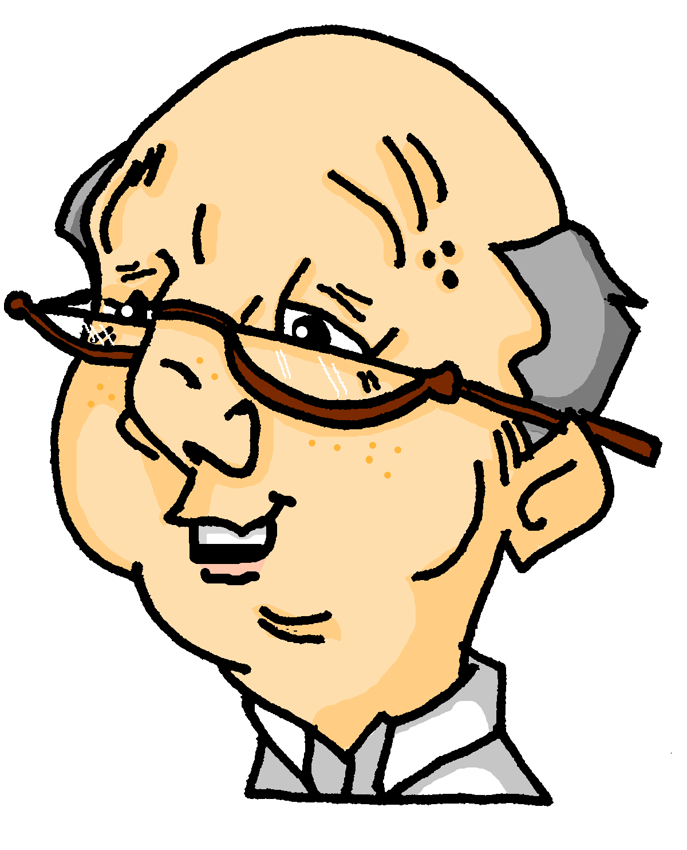
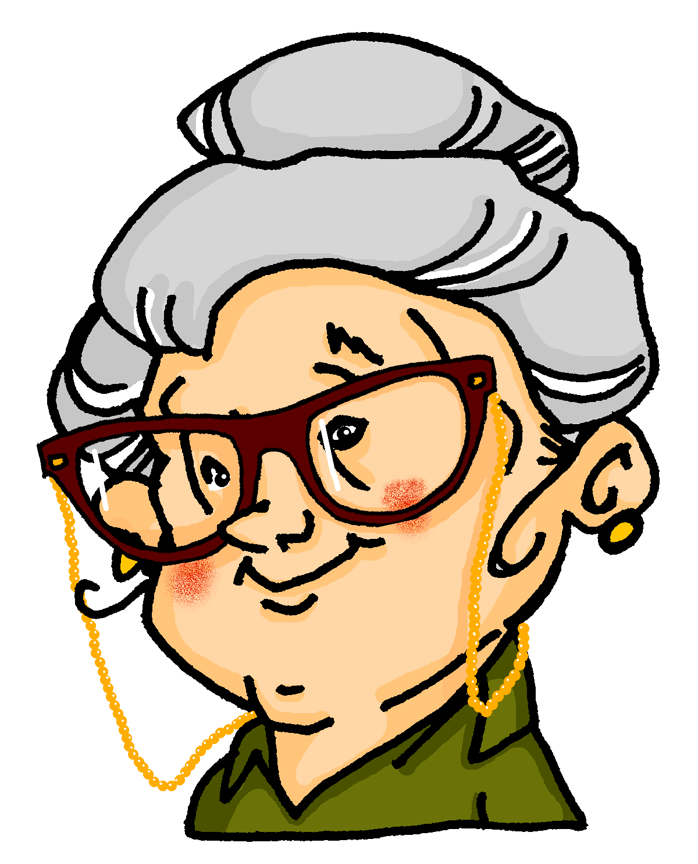
Bad Hersfeld
hören
Hör zu. Schreib 1-7. Welches Wort ist richtig?
Hör noch einmal zu. Was und wie war es? Schreib auf Englisch?
 |  | What? | Description
 | …………………………………………… Ort / Stadt.
 | ………………………………… Bahnhof / Geschäft.
 | ………………………………… Theater / Bibliothek.
 | ………………………………………… Tische / Buch.
 | ………………………………… Schwimmbad / Park.
 | …………………………………Woche / Tag ……….
 | ………………………………………… Sommer / Jahr.
1
1
town
beautiful
2
2
station
small
3
3
library
old
4
4
tables
few
5
5
park
big
6
6
day
wonderful
7
7
summer
hot
Notes:
Timing: 7 minutes Aim: To practise noticing R1 and R2 adjective endings Procedure: 1. Click on the numbered audio buttons to play the sentences.
2. Students listen and identify which of two nouns is obscured in the recording of each sentence, based on the article and adjective ending heard.
3. They then add the English for the noun, plus the adjective used to describe it, also in English.
4. Click to reveal the answers – first the ‘what?’ answers, then the descriptions. 5. Finally, click to bring up a second set of audio buttons with full versions of the sentences, for further consolidation, as required.
Transcript: 1. Sie war eine schöne [Stadt]. 2. Es gab einen kleinen [Bahnhof]. 3. Rechts war eine alte [Bibliothek]. 4. Sie hatte aber wenige [Tische]. 5. In der Stadtmitte gab es einen großen [Park]. 6. Wir haben dort einen wunderbaren [Tag] verbracht. 7. Es war ein heißer [Sommer].

Slide 25
Bad Hersfeld – heute und damals
schreiben / lesen
gab
früher
1
In Bad Hersfeld ______ es _______ nicht viel Industrie.
‘…hatte wenig…’ can also translate as ‘didn’t have much’. Note that ‘wenig’ doesn’t have an ending when used without an article.
In Bad Hersfeld there didn’t use to be much industry.
Heute
________ gibt es dort ____ großes Amazon-Zentrum.
2
ein
Today there is a big Amazon centre there.
Damals
_________ _________ Bad Hersfeld wenig Tourismus.
3
hatte
Back then Bad Hersfeld had little tourism.
wunderbaren
interessante
4
Es gab einen _____________ Marktplatz und eine ____________ Kirchenruine.
There was a wonderful market square and an interesting church ruin.
weitere
5
Eine _________ Attraktion sind die Sommerfestspiele.
A further attraction are the summer festivals.
Notes:
Note: A more challenging variation is also provided on the next slide.
Timing: 7 mins
Aim: to recall the revisited vocabulary for this week and spell it accurately. In addition, four of the gaps test adjective ending knowledge.
Procedure:
1. Students complete the German translations of the English sentences, filling in the missing words from the revisited vocabulary sets.
2. Reveal answers at the end of the exercise with each click.
3. Audio is provided for further reinforcement

Slide 26
Bad Hersfeld – heute und damals
schreiben / lesen
gab es
früher
viel
1
In Bad Hersfeld _______ _______ nicht ____ Industrie.
‘…hatte wenig…’ can also translate as ‘didn’t have much’. Note that ‘wenig’ doesn’t have an ending when used without an article.
Bad Hersfeld
industry
In ___ ________ there didn’t use to be much ________.
Heute
________ gibt es dort ____ großes Amazon-Zentrum.
2
ein
there is
big
Today ________ a ___ Amazon centre.
Damals
hatte
3
_________ _________ Bad Hersfeld wenig Tourismus.
had
little
Back then Bad Hersfeld _______ ________ tourism.
interessante
Es gab einen _____________ Marktplatz und eine ____________ Kirchenruine.
4
wunderbaren
There was
a
market place
an
and
_____ ______ ____ wonderful ______ _______ ___ ____ interesting ____ ______.
church ruin
weitere
5
Eine _________ Attraktion sind die Sommerfestspiele.
A
attraction
___ further __________ ____ ____ summer festivals.
the
are
Notes:
Variation Here, students translate parts of both the English and the German sentences. Note: it is not a 100% jigsaw translation, but close to it.

Slide 27
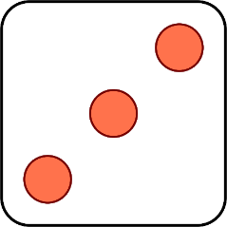
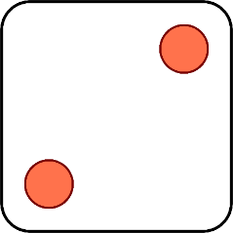
Ich hatte …
sprechen
Heidi hilft Mehmet mit den Deutschhausaufgaben. Sie spielen ein Wortspiel. Was muss Mehmet auf Deutsch sagen?
Ich hatte einen lustigen Sommer.
1 | funny, enjoyable
2 | wonderful
3 | exciting
4 | necessary
5 | interesting
6 | impossible
1 | tour
2 | view
3 | summer
4 | letter
5 | experience
6 | problem
Ich hatte eine notwendige Tour.
Ich hatte eine spannende Erfahrung.
Ich hatte ein unmögliches Problem.
Ich hatte einen wunderbaren Ausblick.
Ich hatte einen interessanten Brief.
Note: der Ausblick or die Aussicht is preferred to der Blick when you don’t say what the view is of.
Notes:
Timing: 5 minutes
Aim: to practise (oral modaility) adjective endings and revise vocabulary from this week’s revisited set in R2 (accusative) Procedure: 1. Click to ‘roll’ the dice.
2. Students pick the adjective and noun whose numbers correspond to the respective dice, then make a sentence using ‘ich hatte’ plus the two items in the accusative case. They chant the answer chorally.
3. Click to reveal the correct sentence.
4. Repeat until all combinations have been tried.
Word frequency (1 is the most frequent word in German): lustig [1973] interessant [810] spannend [1810] wunderbar [1603] notwendig [742] unmöglich [1879] Source: Jones, R.L. & Tschirner, E. (2019). A frequency dictionary of German: core vocabulary for learners. Routledge

Slide 28
Deine Stadt
schreiben
Schreib etwas für Mia über deine Stadt!
Beantworte diese Fragen:
Wie ist deine Stadt heute? Wie war sie früher? Was gab es früher nicht? Was gibt es jetzt? Was kann man in deiner Stadt machen?
Remember to use adjectives.
Don’t forget the R2 (accusative) endings!
Notes:
Timing: 15 minutes Aim: To practise productive use (written modality) of the R2 adjective endings, using vocabulary presented and revised this week. Procedure: 1. Students use the questions in German to guide them in writing a description of their town.

Slide 29
Hausaufgaben
Vocabulary Learning Homework (Y8, Term 2.1, Week 6)
Audio file
Student worksheet
In addition, revisit: Year 8 Term 1.2 Week 7
Year 8 Term 1.1 Week 7
Notes:
The answer sheet for the Y8 vocabulary learning HW is here: https://rachelhawkes.com/LDPresources/Yr8German/German_Y8_Term2i_Wk6_audio_HW_sheet_answers.docx
Notes:
i) Teachers may, in addition, want to recommend use of a particular online app for the pre-learning of each week’s words. ii) Quizlet now requires parental involvement / registration / permissions for users below the age of 13, so it is perhaps most suitable for Y9 – 11 students. iii) Language Nut hosts LDP vocabulary lists and these are free for schools to use, though there is a registration process. One benefit is that all of the student tracking data that Language Nut offers are also available to schools that use the LDP lists for practice. Perhaps this makes it a good option for Y7/8.
iv) There are other free apps, and new ones are always appearing. Teachers have told us that they are currently using: Flippity, Wordwall (where using previously-created activities is free).
v) Gaming Grammar has been acquired by Language Nut. Its original content should still be available to teachers and much of it is appropriate for Y8 learners. This week: Article agreement

