Slide 1
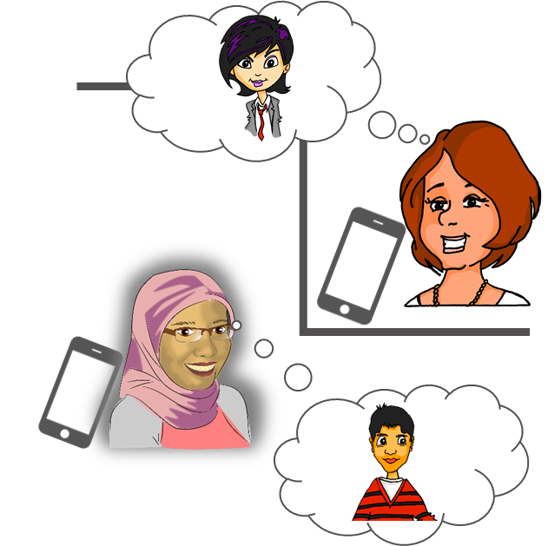
Familie und Freunde Saying what we think about things
Using verbs with indirect objects (2)
SSC [ei] and [ie] (revisited)
Y8 German
Term 2.1– Week 2 - Lesson 31 Inge Alferink / Rachel Hawkes Artwork: Steve Clarke
Date updated: 11/02/24
Notes:
Artwork by Steve Clarke. All additional pictures selected are available under a Creative Common license; no attribution required.
Note: All words listed below for this week’s learning (new and revisited sets) appear on all three Awarding Organisations’ word lists, with the following exceptions:
i) AQA list does not have fit, Hobby, weh.
ii) Edexcel list does not have anderer/andere, fit, Hobby, weh.
iii) Eduqas list does not have fit. Note that fit will be permitted in the reading paper as a cognate.
Learning outcomes (lesson 1):
Consolidation of SSC [ei] and contrast with [ie]
Introduction to second set of R3 (dative) verbs – those without word-for-word English translations
Word frequency (1 is the most frequent word in German):
8.2.1.2 (introduce) fehlen [420] gefallen [601] gehören [460] meinen [213] tun [123] Leid [1300] Meinung [787] fit [4080] weh [2798] dass [22] schwer [257]
8.1.2.5 (revisit) anderer, andere, anderes [59] Aktivität [1422] Hobby [3608] Jugendclub [2117/1360] Schloss [1907] Telefon [1595] langsam [526] normal [642] schnell [203] gern [278] 8.1.1.6 (revisit) verbringen [1391] Auge [222] Gesicht [346] Haar [748] Haare [748] Mund [856] Nase [1264] Schüler [557] Zeit [96] ähnlich [437] breit [847] dünn [1739] neu [84] rund [298] als [22]
Source: Jones, R.L & Tschirner, E. (2019). A frequency dictionary of German: Core vocabulary for learners. London: Routledge.
The frequency rankings for words that occur in this PowerPoint which have been previously introduced in NCELP resources are given in the NCELP SOW and in the resources that first introduced and formally re-visited those words.
For any other words that occur incidentally in this PowerPoint, frequency rankings will be provided in the notes field wherever possible.

Slide 2
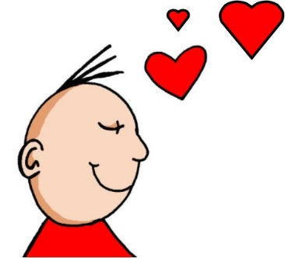
Phonetik
hören
ei
ie
frei
Liebe
Notes:
Timing: 8 minutes (three slides) Aim: To recap the two source words before the listening task on the next slide.

Slide 3
Welcher Buchstabe ist das? A, B, C…?
hören
Hör zu. Schreib 1-6 und A, B, C…
Biene
Beine
1
2
3
Wiese
Weise
Wein
Wien
4
5
Leib
lieb
hieß
heiß
Schein
schien
reif
rief
6
A
B
C
D
E
F
G
H
Antworten:
4
6
1
5
2
3
Notes:
Aim: To practise recognition of minimal pairs with SSC [ei] and [ie]
Procedure:
1. Click on a number to hear a recording. Students listen and follow the correct pathway, taking the left- or right-hand branch in each case according to which SSC they hear, [ei] or [ie].
2. The answers are animated and appear on clicks.
Transcript:
1. Biene, Weise, hieß 2. Beine, Wein, schien
3. Beine, Wien, reif
4. Biene, Wiese, Leib
5. Beine, Wein, Schein
6. Biene, Wiese, Lieb
Frequencies of unknown words and cognates: Bein [884] Biene [>5000] heißen [126] Leib [3274] lieb [897] reif [4480] rufen [530] scheinen [275] Schein [3383] Wein [1736] Wien [n/a]

Slide 4
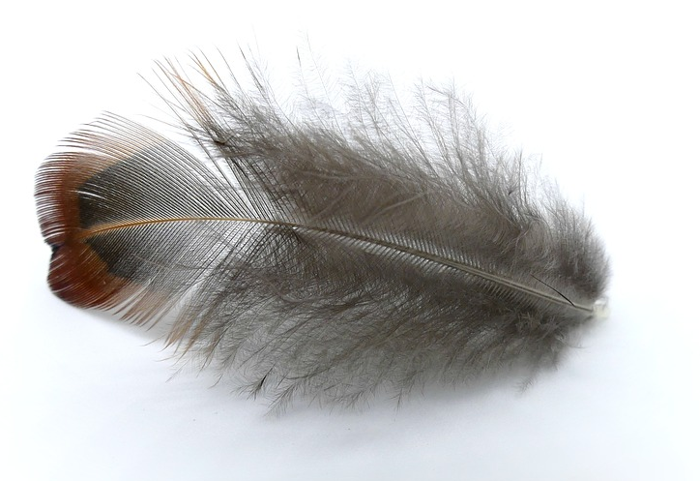
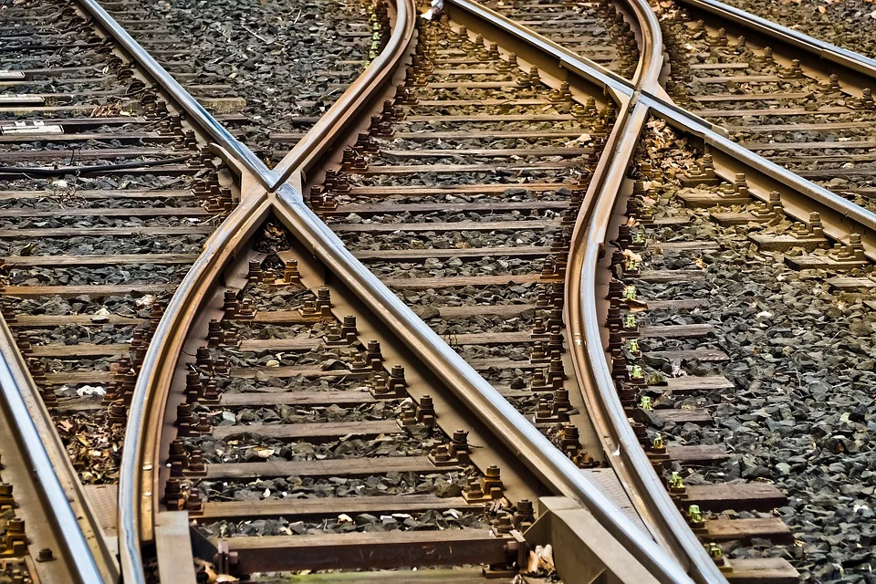
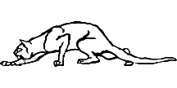
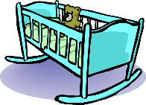
Phonetik
lesen / sprechen
60
Schiene [rail]
weich [soft]
Stein [stone]
biegen [bend]
Teich [pond]
fliehen [to flee]
Reis [rice]
schleichen [slink]
Sekunden
Leiter [ladder]
Frieden [peace]
beißen [to bite]
Wiege [crib]
Kiesel [pebble]
Sieg [victory]
Scheitel [parting]
Fliege [fly]
0
LOS!
Notes:
Aim: To practise SSCs in unfamiliar word context. The time limit helps automatization. Procedure: 1. Students take 60 seconds to practise saying the words out loud to themselves. Click LOS! to start the timer.
2. Then teacher clicks and each word flashes a couple of times before disappearing. Students have to pronounce the word (in chorus) – teacher checks pronunciation this week (as Covid prevents circulating round the class currently).
Word frequency (1 is the most frequent word in German): Schiene [>5000], weich [1836], Stein [1404], biegen [2986], Teich [>5000], fliehen [2824], Reis [>5000], schleichen [4008], Leiter [1321], Frieden[1478], beißen [>5000], Wiege [>5000], Kiesel [>5000], Sieg [1246], Scheitel [>5000], Fliege [>5000]
Source: Jones, R.L. & Tschirner, E. (2019). A frequency dictionary of German: core vocabulary for learners. Routledge

Slide 5
Vokabeln
lesen
gefallen
Schüler
tun
Auge
gehören
langsam
rund
Zeit
gern
schnell
dünn
verbringen
fehlen
breit
neu
als
normal
Notes:
Timing: 5 minutes (two slides)
Aim: To practise recall of meaning of some of the words in this week’s revisited sets in the written modality.
Procedure: 1. On click a word appears.
2. Write down the translation before the word disappears.

Slide 6
Vokabeln
lesen
to please, pleasing
pupil
gefallen
Schüler
to do, doing
eye
tun
to belong, belonging
Auge
gehören
round
time
slow
rund
gladly
Zeit
langsam
thin
gern
fast
to spend (time)
dünn
to lack, be missing
schnell
verbringen
fehlen
new
as
wide
normal
neu
als
breit
normal
Notes:
Procedure:
Give students a minute to check and correct their answers, as necessary.

Slide 7
Vokabeln
lesen
anderer
schnell
Zeit
Leid
gehören
breit
schwer
to belong, belonging
to lack, be missing
to please, pleasing
other, another
wide
slow
to do, doing
sore, hurt
sorrow, grief
difficult
fast
time
to spend (time)
gladly
verbringen
gern
gefallen
langsam
fehlen
weh
tun
Notes:
Timing: 5 minutes
Aim: To practise recognition and cued productive oral recall of this week’s new and some of the revisited vocabulary.
Procedure:
1. Students supply the German for the word which appears in English. The aim is to be able to give the German before the teacher counts drei – zwei – eins. Note: it may be helpful to give students a few moments to look through the list of German words before starting the exercise.
Notes:
The activity can be repeated, clicking faster through the animations to increase speed of recall.
Teachers may wish to give students 30 seconds to look at the German words before showing the English prompts

Slide 8
Verbs with indirect objects
Sometimes the ‘mir’ equates to English ‘me’ and sometimes to ‘to me’.
Grammatik
Remember that certain verbs use indirect object (R3-dative) pronouns:
Das Buch
hilft
mir.
The book helps me.
Das Buch
gehört
mir.
The book belongs to me.
Some verbs translate differently. Here, to make it sound right, the German indirect object translates as the English subject.
Compare:
SUBJECT
VERB
OBJECT
Das Buch
gefällt
mir.
The book is pleasing to me.
I like the book.
Ich
mag
das Buch.
I like the book.
Note – the subject (books) is plural so the verb must also be plural.
With gefallen, and other similar R3 (dative) verbs, this word order also works:
OBJECT
VERB
SUBJECT
Mir
gefällt
das Buch.
To me is pleasing the book. I like the book.
Mir
gefallen
die Bücher.
To me are pleasing the books. I like the books.
Notes:
Timing: 3 minutes Aim: To explain and illustrate the meaning of mir and to highlight the word order options in German sentences. Procedure: 1. Click on the mouse to animate the explanation.
2. Ensure student understanding at each stage. Word frequency (1 is the most frequent word in German):
8.2.1.2 (introduce) fehlen [420] gefallen [601] gehören [460] meinen [213] tun [123] Leid [1300] Meinung [787] fit [4080] weh [2798] dass [22] schwer [257]
8.1.2.5 (revisit) anderer, andere, anderes [59] Aktivität [1422] Hobby [3608] Jugendclub [2117/1360] Schloss [1907] Telefon [1595] langsam [526] normal [642] schnell [203] gern [278] 8.1.1.6 (revisit) verbringen [1391] Auge [222] Gesicht [346] Haar [748] Haare [748] Mund [856] Nase [1264] Schüler [557] Zeit [96] ähnlich [437] breit [847] dünn [1739] neu [84] rund [298] als [22]
Source: Jones, R.L & Tschirner, E. (2019). A frequency dictionary of German: Core vocabulary for learners. London: Routledge

Slide 9
Was fehlt?
lesen
Ich oder mir? Du oder dir? Er oder ihm? Sie oder ihr?
 |  | Who? | likes? | What?
1. | Mir gefällt die Aktivität. | ich / mir |  | the activity
2. | Er mag das Schloss nicht. | ihm / er |  | the castle
3. | Sie mag dein Gesicht. | sie / ihr |  | your face
4. | Dir gefällt ihre Nase. | du / dir |  | her nose
5. | Mir gefällt das Hobby nicht. | mir / ich |  | the hobby
6. | Ihr gefallen seine Augen. | ihr / sie |  | his eyes
7. | Mir gefallen meine Haare nicht. | ich / mir |  | my hair
8. | Er mag sein Telefon. | er / ihm |  | his phone
____
____
____
____
____
____
____
____
Notes:
Timing: 8 minutes Aim: To practise R1 (nominative) and R3 (dative) pronoun use by attending to the verbs. To practise listening out for negation. To practise listening for meaning. Procedure: 1. For each sentence say which pronoun fits.
2. Then in the second column say whether it a positive (like) or a negative (dislike) opinion
3. In the last column write the activity in English.
4. Click to reveal answers. Word frequency (1 is the most frequent word in German):
8.2.1.2 (introduce) fehlen [420] gefallen [601] gehören [460] meinen [213] tun [123] Leid [1300] Meinung [787] fit [4080] weh [2798] dass [22] schwer [257]
8.1.2.5 (revisit) anderer, andere, anderes [59] Aktivität [1422] Hobby [3608] Jugendclub [2117/1360] Schloss [1907] Telefon [1595] langsam [526] normal [642] schnell [203] gern [278] 8.1.1.6 (revisit) verbringen [1391] Auge [222] Gesicht [346] Haar [748] Haare [748] Mund [856] Nase [1264] Schüler [557] Zeit [96] ähnlich [437] breit [847] dünn [1739] neu [84] rund [298] als [22]
Source: Jones, R.L & Tschirner, E. (2019). A frequency dictionary of German: Core vocabulary for learners. London: Routledge

Slide 10
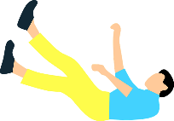
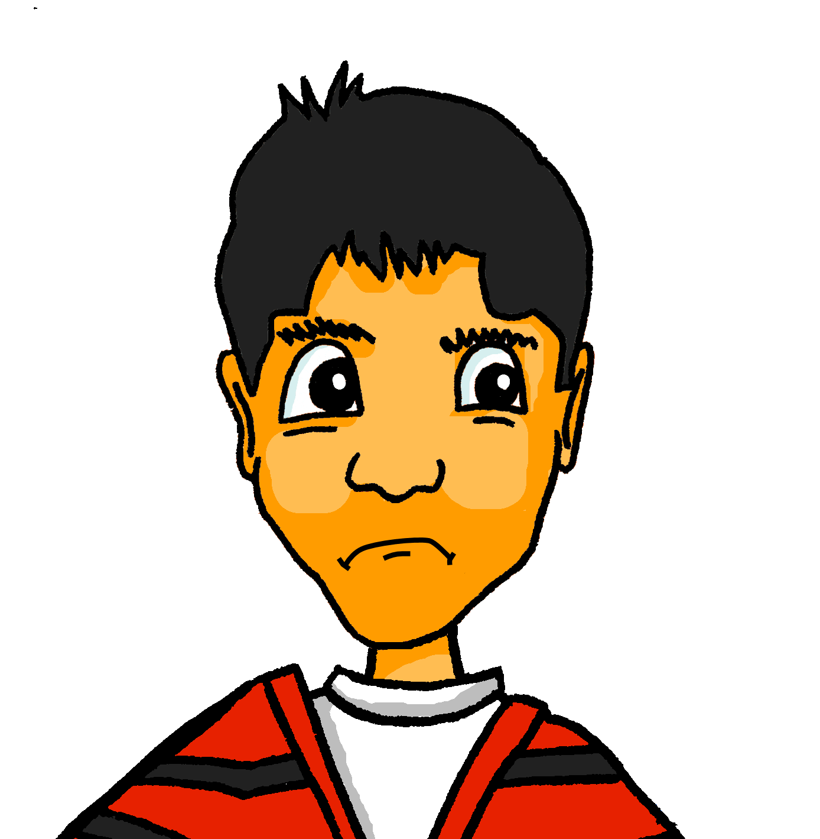
Verbs with indirect objects (2)
Grammatik
Remember, fallen means ‘to fall’:
Er
fällt
ins Wasser.
He falls / is falling into the water.
Fallen has a different meaning, when used with an indirect object.
?!?
Compare:
SUBJECT
VERB
OBJECT
Er
findet
Englisch schwer.
He finds English difficult.
Englisch
fällt
ihm schwer.
English falls to him with difficulty .
This word order also works:
He finds English difficult.
OBJECT
VERB
SUBJECT
Ihm
fällt
Englisch schwer.
To him falls English with difficulty.
Notes:
Timing: 2 minutes Aim: To explain and illustrate another meaning of fallen. Procedure: 1. Click on the mouse to animate the explanation.
2. Ensure student understanding at each stage.

Slide 11
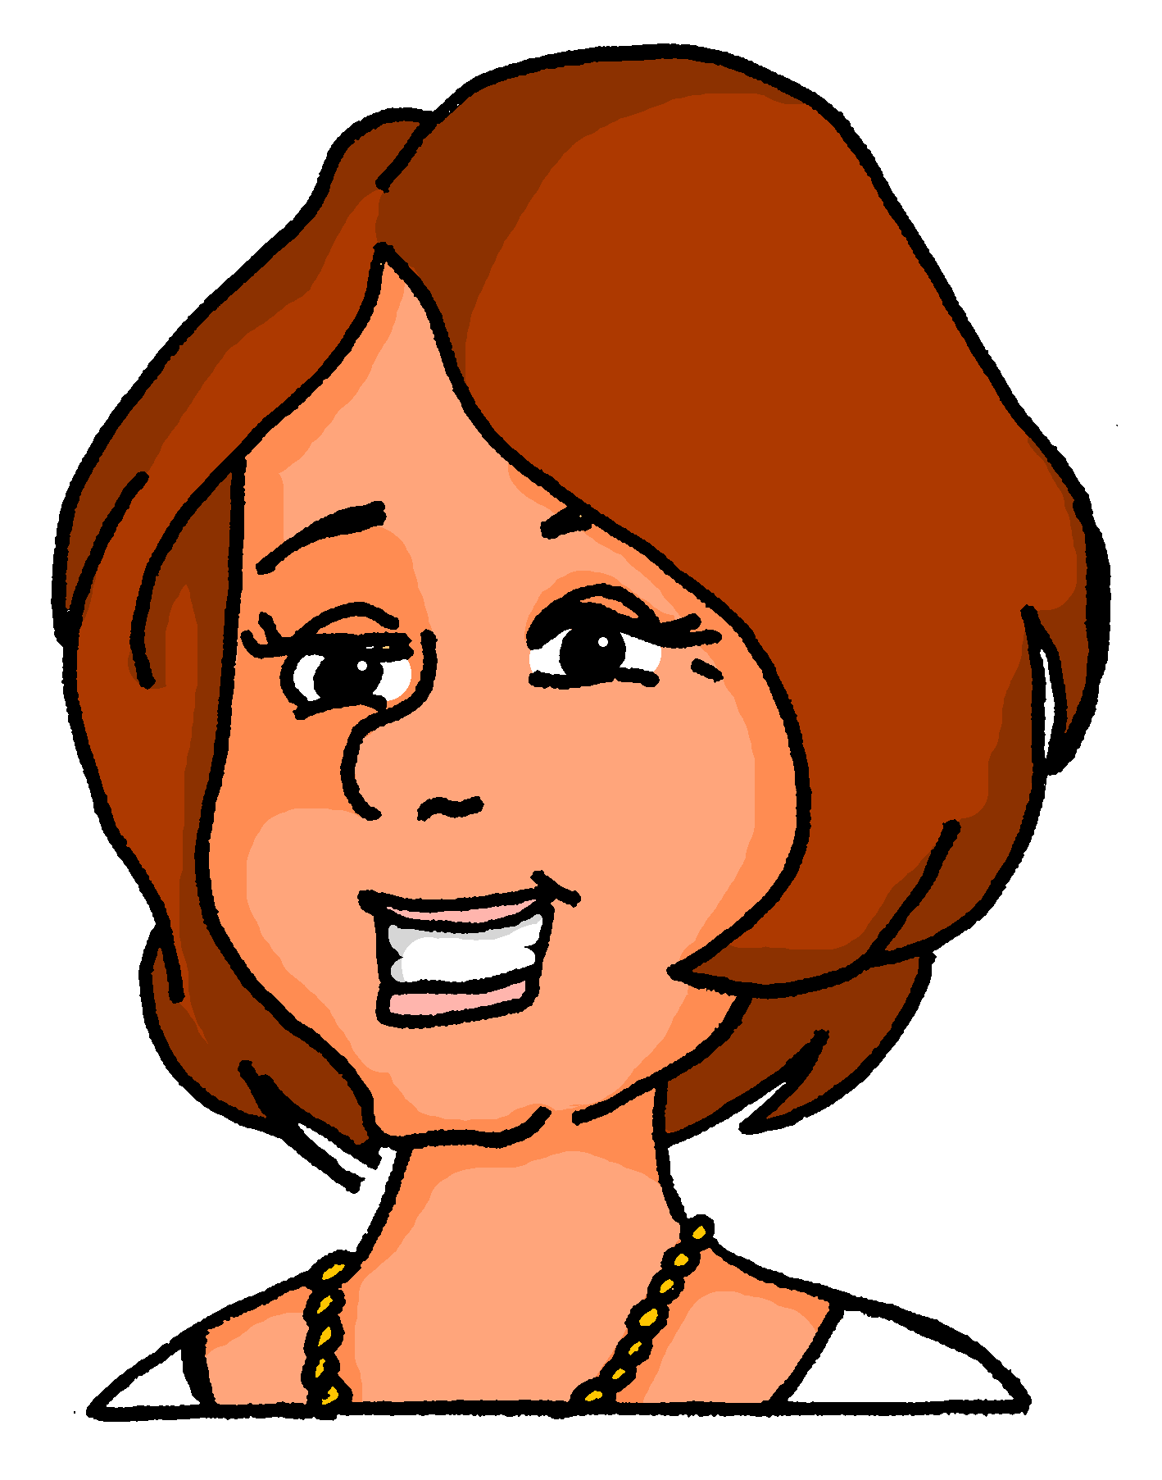
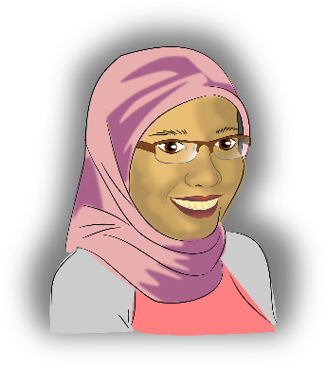
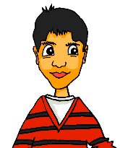
Meinungen
hören
Frau Nowak (Katjas Mutti) und Frau Bayrak (Mehmets Mutti) reden über die Schule.
Hör zu. Schreib das richtige Verb. Welches Fach? Meinung?
 |  | Fach? | Meinung?
 | findet / fällt | Mathe
 | fällt / findet | Mathe
 | gefällt / findet | Musik
 | fällt / gefällt | Englisch
 | findet / gefällt | Englisch
 | mag / gefällt | Naturwissenschaften
 | fällt / mag | Chemie
 | findet / fällt | Sport
1
1
2
2
3
3
4
4
5
5
6
6
7
7
8
8
Notes:
Timing: 8 minutes Aim: To practise using the correct verb, by listening out for the form of the personal pronoun. Also, to practise listening for meaning. Procedure: 1. Click on a number to play the recording.
2. For each item say which verb fits.
3. In the second column write in German what subject they are talking about.
4. In the final column say whether they express a positive or negative opinion.
Transcript: Nowak - 1. Sie [findet] Mathe schwer. Bayrak – 2. O! Ihm [fällt] Mathe dieses Jahr leicht. Der neue Lehrer ist gut. Nowak – 3. Und Musik [findet] er immer noch toll, nicht wahr? Bayrak – 4. Ja. Englisch [fällt] ihm aber noch ziemlich schwer. Nowak – 5. Englisch [gefällt] ihr sehr gut, denn sie mag Fremdsprachen. Bayrak – 6. Er [mag] Naturwissenschaften. Nowak – 7. Ihr [fällt] Chemie aber sehr schwer. Bayrak – 8. Sport [findet] er super wie immer.

Slide 12
Verbs with indirect objects (3)
Grammatik
Remember: sentences can also start with the object, without changing the meaning:
As we have seen, certain R3 (dative) verbs do not translate into English word for word:
OBJECT
VERB
SUBJECT
Polnisch fällt mir schwer.
I find Polish difficult.
Dir
tut
die Nase weh.
Der Jugendclub gefällt mir.
I like the youth club.
also means:
Your nose hurts / You have a sore nose.
Other verbs that work in the same way are:
SUBJECT
VERB
OBJECT
Du
fehlst
You are lacking/missing/absent to me.
mir.
→ I miss you.
Die Nase
tut
dir weh.
The nose is making to you sore.
→ Your nose hurts / You have a sore nose.
That is making to him sorrow.
Das
tut
ihm Leid.
→ He is sorry.
Das
tut
That is making to her sore/hurt.
ihr weh.
→ She is hurting / That hurts her.
Notes:
Timing: 3 minutes Aim: To introduce more verbs that take R3. To illustrate English translations.
Procedure: 1. Click on the mouse to animate the explanation.
2. Ensure student understanding at each stage. Word frequency (1 is the most frequent word in German):
8.2.1.2 (introduce) fehlen [420] gefallen [601] gehören [460] meinen [213] tun [123] Leid [1300] Meinung [787] fit [4080] weh [2798] dass [22] schwer [257]
8.1.2.5 (revisit) anderer, andere, anderes [59] Aktivität [1422] Hobby [3608] Jugendclub [2117/1360] Schloss [1907] Telefon [1595] langsam [526] normal [642] schnell [203] gern [278] 8.1.1.6 (revisit) verbringen [1391] Auge [222] Gesicht [346] Haar [748] Haare [748] Mund [856] Nase [1264] Schüler [557] Zeit [96] ähnlich [437] breit [847] dünn [1739] neu [84] rund [298] als [22]
Source: Jones, R.L & Tschirner, E. (2019). A frequency dictionary of German: Core vocabulary for learners. London: Routledge

Slide 13
Wie heißt das auf Englisch? (1/8)
lesen
Ich antworte dir.
Notes:
Timing: 8 minutes (for 9 slides) Aim: To practise translation from German into English, especially for verbs that take R3 in German. The time limit will help automatization. Procedure: 1. Read the German sentence on the screen.
2. Write down the English translation before the sentence disappears.

Slide 14
Wie heißt das auf Englisch? (2/8)
lesen
Er wünscht ihr ‘Frohe Weihnachten!’
Notes:
2/8

Slide 15
Wie heißt das auf Englisch? (3/8)
lesen
Du schenkst mir ein Buch.
Notes:
3/8

Slide 16
Wie heißt das auf Englisch? (4/8)
lesen
Das Buch gehört dir nicht.
Notes:
4/8

Slide 17
Wie heißt das auf Englisch? (5/8)
lesen
Ihr gefällt sein Gesicht.
Notes:
5/8

Slide 18
Wie heißt das auf Englisch? (6/8)
lesen
Dir gefallen meine Haare?
Notes:
6/8

Slide 19
Wie heißt das auf Englisch? (7/8)
lesen
Ihm tut der Mund weh.
Notes:
7/8

Slide 20
Wie heißt das auf Englisch? (8/8)
lesen
Oh! Das tut mir Leid!
Notes:
8/8

Slide 21
Antworten
1. | Ich antworte dir.
2. | Er wünscht ihr ‘Frohe Weihnachten!’
3. | Du schenkst mir ein Buch.
4. | Das Buch gehört dir nicht.
5. | Ihr gefällt sein Gesicht.
6. | Dir gefallen meine Haare?
7. | Ihm tut der Mund weh.
8. | Oh! Das tut mir Leid!
I answer you.
He wishes her ‘Happy Christmas.’
You give me a book.
The book doesn’t belong to you.
She likes his face.
Do you like my hair?
His mouth hurts.
Oh! I’m sorry!
Notes:
Procedure: Click to bring up the answers for students to check their work (or do peer marking).

Slide 22
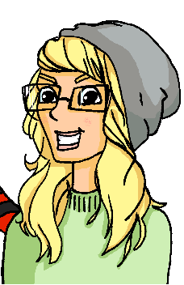
Familie und Freunde Saying what we think about things
Opinion verbs with / without dass (WO3)
SSC [ei] and [ie] (revisited)
Y8 German
Term 2.1– Week 2 - Lesson 32 Inge Alferink / Rachel Hawkes Artwork: Steve Clarke
Date updated: 11/02/24
Notes:
Artwork by Steve Clarke. All additional pictures selected are available under a Creative Common license; no attribution required.
Note: All words listed below for this week’s learning (new and revisited sets) appear on all three Awarding Organisations’ word lists, with the following exceptions:
i) AQA list does not have fit, Hobby, weh.
ii) Edexcel list does not have anderer/andere, fit, Hobby, weh.
iii) Eduqas list does not have fit. Note that fit will be permitted in the reading paper as a cognate.
Learning outcomes (lesson 2):
Consolidation of SSC [ei] and contrast with [ie]
Introduction to use of WO3 conjunction dass with verbs of opinion Consolidation of R3 (dative) verbs
Word frequency (1 is the most frequent word in German):
8.2.1.2 (introduce) fehlen [420] gefallen [601] gehören [460] meinen [213] tun [123] Leid [1300] Meinung [787] fit [4080] weh [2798] dass [22] schwer [257]
8.1.2.5 (revisit) anderer, andere, anderes [59] Aktivität [1422] Hobby [3608] Jugendclub [2117/1360] Schloss [1907] Telefon [1595] langsam [526] normal [642] schnell [203] gern [278] 8.1.1.6 (revisit) verbringen [1391] Auge [222] Gesicht [346] Haar [748] Haare [748] Mund [856] Nase [1264] Schüler [557] Zeit [96] ähnlich [437] breit [847] dünn [1739] neu [84] rund [298] als [22]
Source: Jones, R.L & Tschirner, E. (2019). A frequency dictionary of German: Core vocabulary for learners. London: Routledge.
The frequency rankings for words that occur in this PowerPoint which have been previously introduced in NCELP resources are given in the NCELP SOW and in the resources that first introduced and formally re-visited those words.
For any other words that occur incidentally in this PowerPoint, frequency rankings will be provided in the notes field wherever possible.

Slide 23
Phonetik
hören
ei
ie
frei
Liebe
Notes:
Timing: 10 minutes (five slides) Aim: To recap the two source words quickly as a reminder before the transcription task on the next slide.

Slide 24
Phonetik (1/2)
sprechen / hören / schreiben
Partner A sagt die Wörter. Partner B schreibt.
[ei]
[ie]
1. _______
1. _______
1. 2. peinlich [embarassing]
2. Geige [violin] 3. Ziege [goat] 4. nieder [down] 5. Riese [giant] 6. Eiche [oak]
2. _______
2. _______
3. _______
3. _______
Notes:
Aim: To practise SSC [ei] and [ie] with mostly unknown vocabulary, compelling students to apply their phonics knowledge.
Procedure: 1. Partner B draws two columns and numbers 1-3 in each column.
2. Partner A reads the words aloud. Partner B must turn away from the board and must transcribe the words in the correct column.
3. The next slide has the answers. Word frequency (1 is the most frequent word in German):
peinlich [2936], Geige [>5000], nieder [>5000], Riese [2794], Eiche [>5000] Ziege [>5000]
Source: Jones, R.L. & Tschirner, E. (2019). A frequency dictionary of German: core vocabulary for learners. Routledge

Slide 25
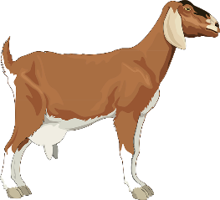
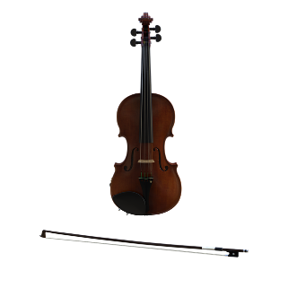
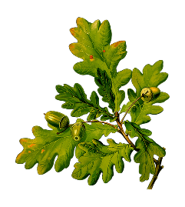
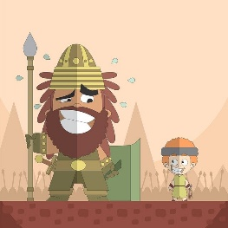
Antworten
sprechen / hören / schreiben
[ei]
[ie]
peinlich
Ziege
1. _______
1. _______
[embarrassing]
2. _______
nieder
Geige
2. _______
Eiche
Riese
3. _______
3. _______
Notes:
Aim: to check work of Partner B (who write) and Partner A (who spoke)
Answers appear in order of the transcript.
Transcript:
peinlich
Geige
Ziege
nieder
Riese
Eiche

Slide 26
Phonetik (2/2)
sprechen / hören / schreiben
Partner A schreibt. Partner B sagt die Wörter.
[ei]
[ie]
1. _______
1. _______
1. Krieg [war]
2. Kleid [dress]
3. Diener [servant] 4. Feind [enemy] 5. heiter [cheerful, bright] 6. niedlich [cute]
2. _______
2. _______
3. _______
3. _______
Notes:
Procedure: 1. Partner A draws two columns and numbers 1-3 in each column
2. Partner B reads the words aloud. Partner A must turn away from the board and must transcribe the words in the correct column.
3. The next slide has the answers. Word frequency (1 is the most frequent word in German):
Krieg [407], Kleid [1681], Sieb [>5000], Diener [>5000], Feind [24524], heiter [>5000], niedlich [>5000].
Source: Jones, R.L. & Tschirner, E. (2019). A frequency dictionary of German: core vocabulary for learners. Routledge

Slide 27
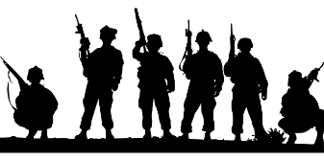
Antworten
sprechen / hören / schreiben
[ei]
[ie]
Kleid
Krieg
1. _______
1. _______
Feind
[enemy]
Diener
2. _______
2. _______
heiter
[cheerful, bright]
niedlich
3. _______
3. _______
Notes:
Answers
Timing: 30 seconds
Aim: to check work of Partner B (who write) and Partner A (who spoke)
Answers appear in order of the transcript.
Transcript:
1. Krieg
2. Kleid
3. Diener 4. Feind 5. heiter . niedlich

Slide 28
Vokabeln
schreiben
?
Schreib auf Deutsch:
A. that
B. sorrow, grief
C. sore, hurt
D. to think, have an opinion
E. difficult
F. fit
G. to please, pleasing
H. to do, doing
I. to lack, be missing, be absent
J. to belong, belonging
 |  |  |  |  |  |  |  |  |  |  | D | A | S | S
 |  |  |  |  | D | A | S |  | L | E | I | D
 |  |  |  |  |  |  |  |  |  | W | E | H
 |  |  |  |  |  |  |  |  |  |  | M | E | I | N | E | N
 |  |  |  |  |  |  | S | C | H | W | E | R
 |  |  |  |  |  |  |  |  |  | F | I | T
 |  |  |  | G | E | F | A | L | L | E | N
 |  |  |  |  |  |  |  |  |  | T | U | N
 |  |  |  |  |  | F | E | H | L | E | N
 |  |  |  |  |  |  |  |  |  |  | G | E | H | Ö | R | E | N
Notes:
Timing: 7 minutes
Aim: To practise productive written recall of 11 items of vocabulary (shown in bold below) drawn from this week’s vocabulary set. By working out the answers to the clues and spelling out the words correctly, students create the word ‘die Meinung’, which is part of the theme for this lesson. So the activity does the task of ‘sharing the context learning objective’ with students
Procedure: 1. Most students can do this by writing A-J and the answers in their books. If students would benefit from writing in the grid, it can be printed out and reduced to A5 on the copier.
Note: The clues relate to the words directly to their right. 2. Students complete answers.
3. This slide is then animated to provide the ANSWERS and give additional alphabet practice, as per the routine below, as desired:
i. Teacher elicits the answers, asking for A – J on slide. ii. Student(s) volunteer(s) the answer (e.g. dass).
iii. Teacher asks ‘wie schreibt man das?’ iv. Students in chorus (slowly and steadily) respond to spell out the answer: D - A – S - S. v. As students spell the word, teacher reveals each letter on a click. This will enable the teacher to pick up on any of the trickier letters, and do some remedial practice in the moment.

Slide 29
Word pattern
You can often make nouns from the infinitive of verbs.
He likes to swim / swimming. Swimming is easy.
Er mag schwimmen. Schwimmen ist leicht.
Translate these sentences.
1. Tanzen macht Spaß.
2. Travelling is my favourite activity.
What would the following words be in German?
reading
winning
giving
Choose one and write a sentence in German.
All nouns made from infinitive verbs are ‘das’. However, they are usually used without the indefinite article, as in English.
Notes:
Timing: 8 minutes (two slides) Aim: To develop knowledge of word patterns within German, using examples from the poem. Procedure: 1. Click to present the pattern and examples. 2. Give students time to complete the five short tasks. 3. Answers and further tasks on the next slide.

Slide 30
Antworten
Tanzen macht Spaß.
Travelling is my favourite activity.
reading
winning
giving
Dancing is fun.
Reisen ist meine Lieblingsaktivität.
(das) Lesen
(das) Gewinnen
(das) Schenken
…but some don’t. What do these mean? das Leben das Wissen das Essen
These words often end in –ing in English…
What is the gender of these new nouns?
to forget → forgetting
vergessen → Vergessen (ist normal!)
Don’t forget to pronounce the words.
Notes:
das Leben [life/living], das Wissen [knowledge/knowing], das Essen [food/eating] Note: in the 2019 edition of the frequency dictionary, verb nouns are not listed separately, whereas in 2019 edition they are. Source: Jones, R.L. & Tschirner, E. (2019). A frequency dictionary of German: core vocabulary for learners. Routledge

Slide 31
Meinungen mit dass
The essential meaning is the same, but after dass the verb must go to the end (WO3).
Grammatik
The verbs denken (think), glauben (believe) and meinen (have the opinion) can all be used to say what you think:
Use a comma and follow with Word Order 1:
Ich denke, Sport ist lustig.
I think sport is enjoyable.
Unlike the English example here, in German there is always a comma after an opinion verb.
Use the conjunction dass and follow with Word Order 3:
I think that sport is enjoyable.
Ich denke, dass Sport lustig ist.
Weil is another WO3 conjunction you know:
Ich denke, dass Sport lustig ist, weil es fit macht.
I think that sport is enjoyable because it makes (you) fit.
Notes:
Timing: 2 minutes Aim: To introduce the conjunction dass with WO3, and the syntax of sentences with opinion verbs with and without dass. Procedure: 1. Click to animate the explanation.
2. Ensure student understanding at each stage.

Slide 32
Meinungen
hören
Mia redet mit Wolfgang. Hör zu. Passt dass oder --?
 |  | dass | --
 | Meinst du, meine Nase ist zu dünn?
 | Ich glaube, dass Heidis Nase perfekt ist.
 | Ich denke, dein Haar ist schön heute.
 | Glaubst du, meine Augen sind grün oder blau?
 | Ich meine, dass meine Augen blau sind.
 | Ich glaube, Chemie fällt Katja sehr schwer.
 | Denkst du, dass Chemie schwer ist?
 | Meinst du, dass Musik Spaß macht?
1
1
2
2
3
3
4
4
5
5
6
6
7
7
8
8
Notes:
Timing: 8 minutes Aim: To practise using dass or [ – - ] by attending to word order Procedure: 1. Click on a number to play the recording.
2. For each item say whether dass or [--] fits.
3. Click to reveal answers. 4. Click to bring up the full audio buttons. 5. Click to reveal the full sentence/question text. Listen and read, as desired, for additional reinforcement.
Transcript: 1. Meinst du, […] meine Nase ist zu dünn? [dass / --]
2. Ich glaube, […] Heidis Nase perfekt ist. [dass / --]
3. Ich denke, […] dein Haar ist schön heute. [dass / --]
4. Glaubst du, […] meine Augen sind grün oder blau? [dass / --]
5. Ich meine, […] meine Augen blau sind. [dass / --]
6. Ich glaube, […] Chemie fällt Katja sehr schwer. [dass / --]
7. Denkst du, […] Chemie schwer ist? [dass / --]
8. Meinst du, […] [dass / --] Musik Spaß macht?

Slide 33
Virtueller Austausch*
Mias Klasse hilft Andreas Klasse online. Schreib 1-8 und ‘dass’ oder ‘--’
lesen
1) Ich denke, ______ Englisch unmöglich ist! (dass/--) DH
2) Glaubst du, ______ Berlin interessant ist? (dass/--) JS
dass
dass
4) Ich denke, ______ Katjas Haar ist wunderbar! (dass/--) MB
5) Mein Opa glaubt, ______ es regnet immer in England. (dass/--) WB
3) Ich meine, ______ Musik ist lustig. (dass/--) SW
--
--
--
dass
7) Meine Cousine glaubt, ______ ihre Vespa ganz schnell ist! (dass/--) KL
8) Meine Mutter meint, ______ Cambridge ist ganz schön. (dass/--) HZ
6) Denkst du, ______ ihre Klasse uns nochmal besucht? (dass/--) SG
dass
--
*der Austausch - exchange
Notes:
Timing: 5 minutes Aim: To practise recognising the word order used in each sentence and inferring the use of dass or -- as appropriate. Procedure: 1. Write 1-8.
2. Students read sentences and write dass or -- for each, as appropriate.
3. Click on the mouse to animate the correct answers. Context: This is a padlet wall. Mia’s class is helping Andrea’s class with their German grammar by posting dass / -- sentences for them to practise. Initials are initials of Mia’s classmates.
Word frequency (1 is the most frequent word in German):
8.2.1.2 (introduce) fehlen [420] gefallen [601] gehören [460] meinen [213] tun [123] Leid [1300] Meinung [787] fit [4080] weh [2798] dass [22] schwer [257]
8.1.2.5 (revisit) anderer, andere, anderes [59] Aktivität [1422] Hobby [3608] Jugendclub [2117/1360] Schloss [1907] Telefon [1595] langsam [526] normal [642] schnell [203] gern [278] 8.1.1.6 (revisit) verbringen [1391] Auge [222] Gesicht [346] Haar [748] Haare [748] Mund [856] Nase [1264] Schüler [557] Zeit [96] ähnlich [437] breit [847] dünn [1739] neu [84] rund [298] als [22]
Source: Jones, R.L & Tschirner, E. (2019). A frequency dictionary of German: Core vocabulary for learners. London: Routledge.

Slide 34
Was meinst du?
schreiben
Schreib die Antworten. Benutz die Wörter in Klammern*.
1. Wie findest du Mathe? [leicht/schwer fallen]
2. Meinst du, dass Musik ein lustiges Fach ist? [glauben, dass]
3. Glaubst du, du kriegst zu viele Hausaufgaben? [denken, kriegen]
4. Gefällt dir Englisch? Warum / warum nicht? [gefallen, weil]
5. Was fehlt dir am Wochenende? [fehlen]
6. Glaubst du, Sport ist wichtig? [glauben, denn]
7. Denkst du, dass du genug Freizeit hast? [meinen, dass]
8. Welche Aktivität gefällt dir? [gern, weil]
*Klammern = brackets
Notes:
NB: Adapt this activity to meet the needs / proficiency of your classes. E.g., some classes / students could focus on answering questions 1-4 only. Alternatively, students could answer odd or even numbered questions to reduce the overall load within the time. Timing: 10 minutes Aim: To practise using the grammar and vocabulary introduced in this sequence in a semi-scaffolded task. Procedure: Read the questions and write answers using the words in brackets.

Slide 35
Antworten (1/2)
schreiben
1. Wie findest du Mathe? [leicht/schwer fallen]
Mathe fällt mir …
2. Meinst du, dass Musik ein lustiges Fach ist? [glauben, dass]
Ja/Nein, ich glaube, dass Musik ……….. ist.
3. Glaubst du, du kriegst zu viele Hausaufgaben? [denken, kriegen]
Ja/Nein, ich denke, ich kriege…..
4. Gefällt dir Englisch? Warum / warum nicht? [gefallen, weil]
Ja/Nein, Englisch gefällt mir (nicht), weil/denn...
Notes:
ANSWER SLIDE [1/2] Timing: 2 minutes Procedure: 1. Display the answers. 2. Tell students that these suggestions are to model the overall sentence structure of possible answers and that there are different ways to finish the answers, of course.

Slide 36
Antworten (1/2)
schreiben
5. Was fehlt dir am Wochenende? [fehlen]
…fehlt/fehlen mir OR Mir fehlt/fehlen…
6. Glaubst du, Sport ist wichtig? [glauben, denn]
Ja/Nein, ich glaube, Sport ist (nicht) wichtig, denn…
7. Denkst du, dass du genug Freizeit hast? [meinen, dass]
Ja/Nein, ich meine, dass ich (nicht) genug Freizeit habe.
8. Welche Aktivität gefällt dir? [gern, weil]
Ich (schwimme) gern, weil...
*Klammern = brackets
Notes:
ANSWER SLIDE [2/2] Procedure: 1. Display the answers. 2. Tell students that these suggestions are to model the overall sentence structure of possible answers and that there are different ways to finish the answers, of course.

Slide 37
Hausaufgaben
Vocabulary Learning Homework (Y8, Term 2.1, Week 3)
This week’s homework is Y7 Revision Mashup 3.
Notes:
This week’s homework is a mash up of Y7 vocabulary (Y7 Revision Mashup 3). There are no new words. The link to the list on Quizlet is here: https://quizlet.com/gb/532967196/year-8-german-term-21-week-3-flash-cards/?new
Notes:
i) Teachers may, in addition, want to recommend use of a particular online app for the pre-learning of each week’s words. ii) Quizlet now requires parental involvement / registration / permissions for users below the age of 13, so it is perhaps most suitable for Y9 – 11 students. iii) Language Nut hosts LDP vocabulary lists and these are free for schools to use, though there is a registration process. One benefit is that all of the student tracking data that Language Nut offers are also available to schools that use the LDP lists for practice. Perhaps this makes it a good option for Y7/8.
iv) There are other free apps, and new ones are always appearing. Teachers have told us that they are currently using: Flippity, Wordwall (where using previously-created activities is free).
v) Gaming Grammar has been acquired by Language Nut. Its original content should still be available to teachers and much of it is appropriate for Y8 learners. This week: Question formation

