Slide 1
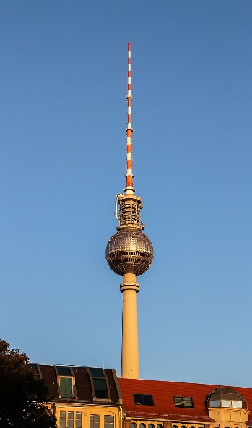
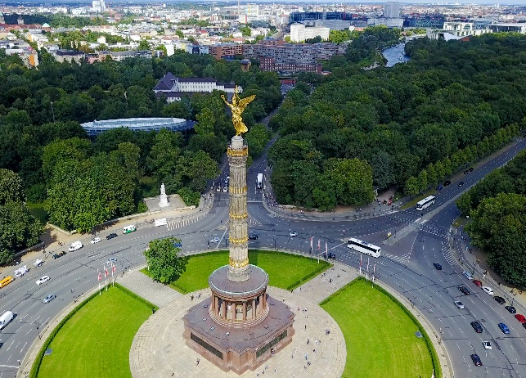
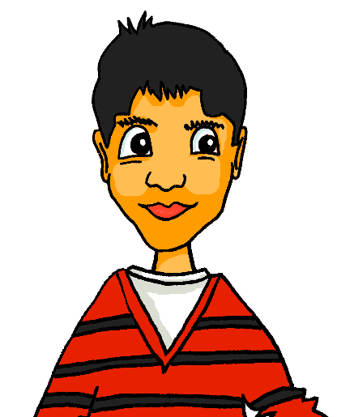
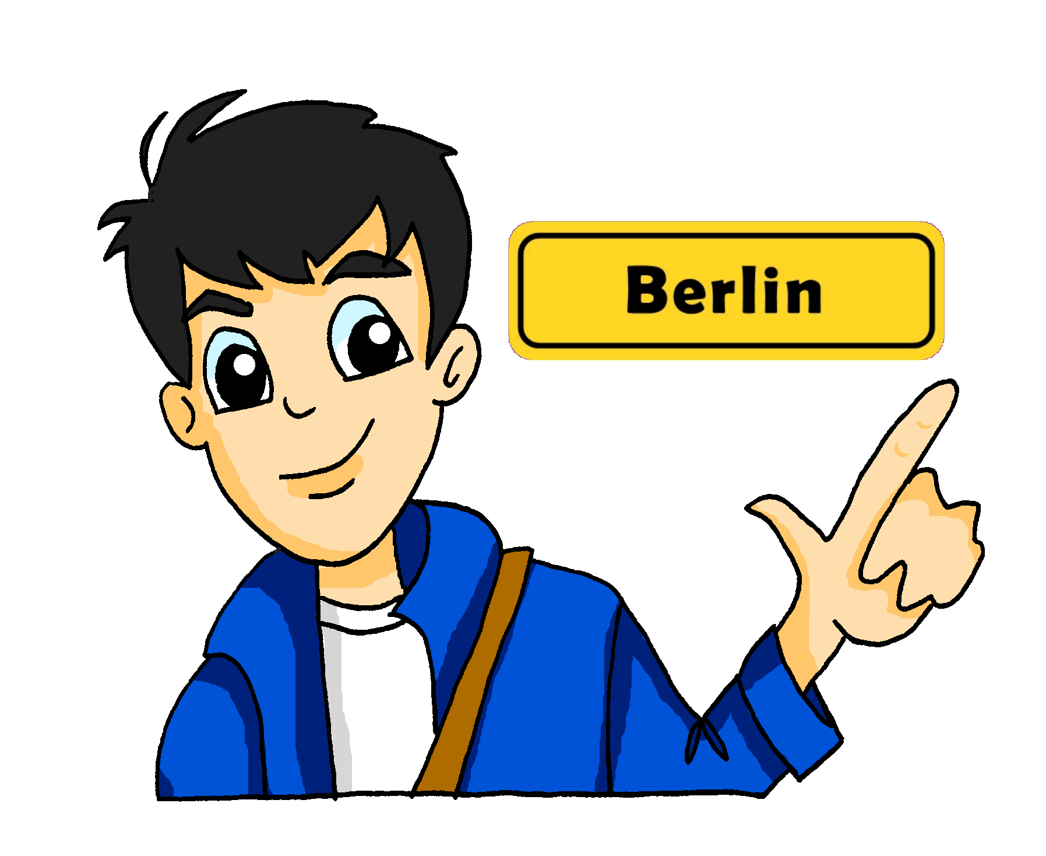


Berlin
Present tense: strong verbs [revisited]
Numbers 32 – 100, plurals
SSC [Z]
Wir wohnen in Berlin. Wo wohnst du?
Berliner Fernsehturm
Tiergarten
Y8 German
Term 1.2– Week 1 - Lesson 15
Rachel Hawkes / Inge Alferink
Artwork: Steve Clarke
Date updated: 04/02/24
Der Berliner Tiergarten hat über 20,000 Tiere!
Notes:
Artwork by Steve Clarke. All additional pictures selected are available under a Creative Common license; no attribution required.
Note: All words listed below for this week’s learning (new and revisited sets) appear on all three Awarding Organisations’ word lists, with the following exceptions:
i) AQA list does not have begreifen, duschen, mischen, Jahreszeit.
ii) Edexcel list does not have begreifen, duschen, mischen, sterben, Jahreszeit, Punkt.
iii) Eduqas list does not have begreifen, duschen, Jahreszeit.
Learning outcomes (lesson 1):
Consolidation of present tense: strong verbs
Introduction to numbers 32 – 100
Consolidation of plurals (Rules 1-5)
Word frequency (1 is the most frequent word in German):
8.1.2.1 enthalten [562] sterben [475] mich [65] dich [217] nichts [109] Bevölkerung [1018] Prozent [172] Unterstützung [1141] nur [39] vierzig [2907] fünfzig [2390] sechzig [2448] siebzig [2609] achtzig [3301] neunzig [3028] hundert [1107]
8.1.1.5 begreifen [1346] duschen [>5009] Blick [306] Dezember [1527] Jahreszeit [4818] Mal [82] März [987] Pflanze [1667] Schuh [1678] Wechsel [2525] bequem [3369] freundlich [1566] wieder [74]
7.3.2.4 beginnen [239] erhalten [283] gewinnen [408] legen [296] mischen [2105] werfen [672] ziehen [266] die Mitte [756] der Punkt [427] das Ziel [325] jeder, jede, jedes [88]
Source: Jones, R.L. & Tschirner, E. (2019). A frequency dictionary of German: core vocabulary for learners. Routledge
The frequency rankings for words that occur in this PowerPoint which have been previously introduced in LDP resources are given in the LDP SOW and in the resources that first introduced and formally re-visited those words.
For any other words that occur incidentally in this PowerPoint, frequency rankings will be provided in the notes field wherever possible.

Slide 2








Ein Dialog
Wiederholen!
sprechen
H_ _ _ _!
 | H_ _ _ _!
W_ w_ _ _ _ _ d_?
 | I_ _ w_ _ _ _ i_ [place you live]
M_ _ _ _ d_ [place name] ?
 | Ja/Nein, weil… [reason]
T_ _ _ _ _ _!
 | T_ _ _ _ _ _!
Notes:
Timing: 5 minutes
Aim: to recap wohnen and add asking and explaining like/dislike in a short, structured dialogue (with room for personalisation – place name, like and reason).
Procedure:
Students work in pairs to carry out this short dialogue.
They should be encouraged to repeat it, swapping roles A & B, a couple of times each.
Note: if additional support is needed, teachers may want to put in a few interim steps, using additional slides. For example:
model an example first, taking the role of A and engaging either one student or the whole class to respond as B.
Keep the activity to time so as not to leave insufficient time for the new learning.

Slide 3
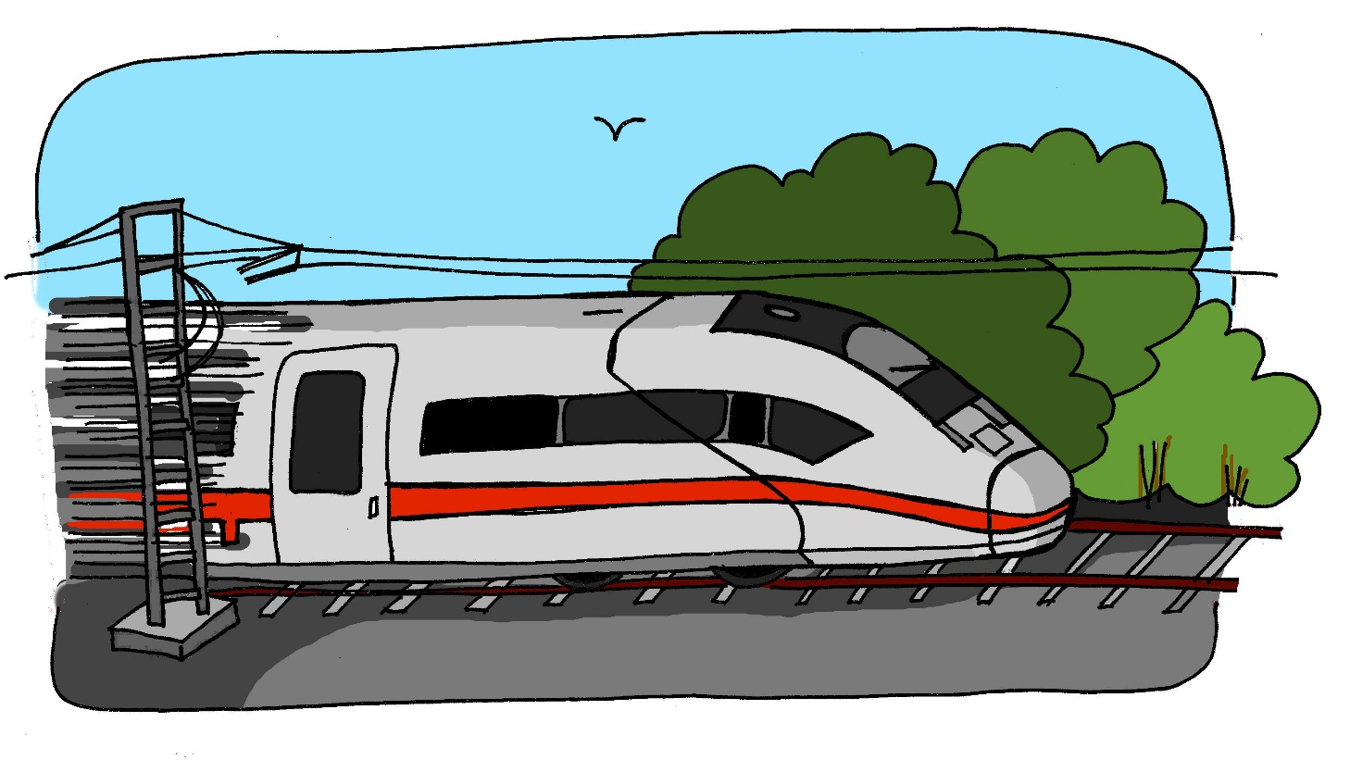
z
Zug
Notes:
Timing: 1 minute
Aim: To introduce/consolidate SSC [z]
Procedure:
1. Present the letter(s) and say the [z] sound first, on its own. Students repeat it with you.
2. Bring up the word “Zug” on its own, say it, students repeat it, so that they have the opportunity to focus all of their attention on the connection between the written word and its sound.
3. A possible gesture for this would be to mime wheels, holding your hands at your sides, elbows bent, forearms facing forwards in a right angle, and draw small circles with them, in the air (to denote the wheels of a train going round).
4. Roll back the animations and work through 1-3 again, but this time, dropping your voice completely to listen carefully to the students saying the [z] sound, pronouncing ”Zug” and, if using, doing the gesture.
Word frequency (1 is the most frequent word in German):
Zug [613]
Source: Jones, R.L. & Tschirner, E. (2019). A frequency dictionary of German: core vocabulary for learners. Routledge

Slide 4
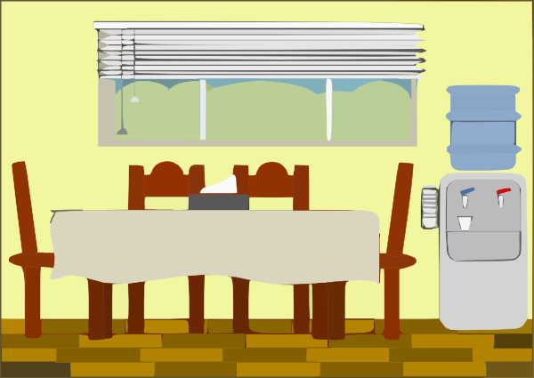









z
Zimmer
zehn
Zug
Arzt
sitzen
Platz
Notes:
Timing: 2 minutes
Aim: To introduce/consolidate SSC [z]
Procedure:
Introduce and elicit the pronunciation of the individual SSC [z] and then the source word again ‘Zug’ (with gesture, if using).
Then present and elicit the pronunciation of the five cluster words.
The cluster words have been chosen for their high-frequency, from a range of word classes, with the SSC (where possible) positioned within a variety of syllables within the words (e.g. initial, 2nd, final etc.). Additionally, we have tried to use words that build cumulatively on previously taught SSCs (see the Phonics Teaching Sequence document) and do not include new SSCs. Where new SSCs are used, they are often consonants which have a similar symbol-sound correspondence in English.
Word frequency (1 is the most frequent word in German):
Zug [613]; Zimmer [609] zehn [314]; Arzt [614]; Platz [344]; sitzen [261].
Source: Jones, R.L. & Tschirner, E. (2019). A frequency dictionary of German: core vocabulary for learners. Routledge

Slide 5

Vokabeln
lesen / sprechen
English ‘c’ can be German ‘z’ (as well as ‘k’).
When English ‘c’ is hard, German is‘k’. When English ‘c’ ist soft, German is often ‘z’.
The principle is special.
das Prinzip ist speziell.
What would the following words be in German?
social
central
concept (nt)
Choose one and write a sentence in German.
Translate these sentences.
1. Die Polizei ist hier wichtig.
2. My concentration is good.
Notes:
Timing: 6 minutes (two slides)
Aim: Explain and illustrate consistent patterns between German and English. Whilst there are not plentiful examples of this pattern in the most frequent 2000 words, this activity is envisaged as part of a sequence of three activities, revisiting the SSC ‘Z’.
The next two tasks include cognates with the spelling -tion that in German are pronounced with the same sound as German SSC ‘Z’.
Procedure:
Cycle through the explanation and examples using the animated sequence.
Word frequency: die Polizei [724] das Prinzip [796] sozial [372] speziell [893] zentral [706] das Konzept [893] Konzentration [1319]
Source: Jones, R.L. & Tschirner, E. (2019). A frequency dictionary of German: core vocabulary for learners. Routledge

Slide 6
Antworten
lesen / sprechen
Die Polizei ist hier wichtig.
My concentration is good.
social
central
concept
The police is important here.
Meine Konzentration ist gut.
sozial
zentral
das Konzept
Don’t forget to pronounce the new words!

Slide 7
Vokabeln
lesen
1. nur
2. hundert
3. Prozent
4. sterben
5. vierzig
6. nichts
7. Bevölkerung
8. Unterstützung
9. sechzig
10. achtzig
11. enthalten
12. fünfzig
13. neunzig
14. siebzig
Notes:
Timing: 5 minutes (two slides)
Aim: To practise recognition of the vocabulary for this week in written modality.
Procedure:
1. Click for first word. Students write down the English meaning before the word disappears.

Slide 8
Antworten
sprechen / lesen
only
100
percent
to die
40
1. nur
2. hundert
3. Prozent
4. sterben
5. vierzig
nothing
population
support
60
6. nichts
7. Bevölkerung
8. Unterstützung
9. sechzig
80
to contain
50
90
70
10. achtzig
11. enthalten
12. fünfzig
13. neunzig
14. siebzig
Notes:
Aim: To practise pronunciation and then spoken recall of this week’s vocabulary set.
Procedure:
1. Elicit the German then English answer from students – this can be done chorally. They can all practise reading the German aloud, even if they are missing one or two English answers.
2. Once all the English answers are revealed, elicit the German answers once more (in order) – words disappear to reveal the German on individual mouse clicks.

Slide 9
Vokabeln
lesen
das Mal
wieder
begreifen
duschen
bequem
der Wechsel
die Pflanze
look
December
again
season
change
March
comfortable
I understand
to understand
friendly
time (occasion)
shoe
to shower
plant
der Blick
März
Dezember
die Jahreszeit
freundlich
der Schuh
Ich begreife
Notes:
Timing: 3 minutes
Aim: To practise recognition and cued productive recall of one of the revisited vocabulary sets.
Procedure:
1. Students supply the German for the word which appears in English. The aim is to be able to give the German before the teacher counts drei – zwei – eins.
Notes:
The activity can be repeated, clicking faster through the animations to increase speed of recall.
Teachers may wish to give students 30 seconds to look at the German words before showing the English prompts

Slide 10

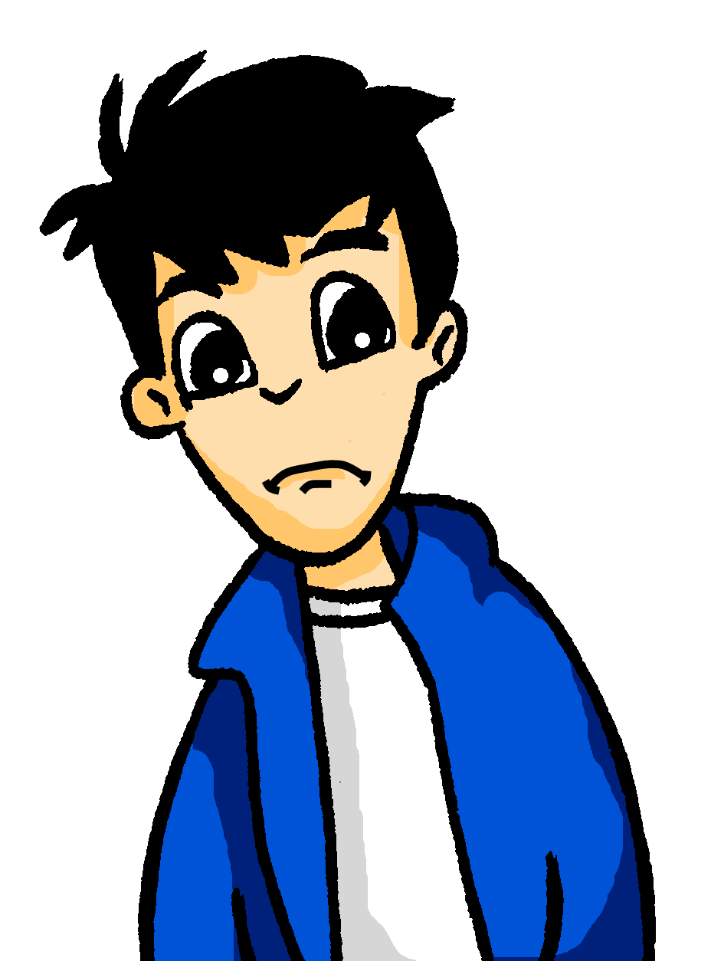
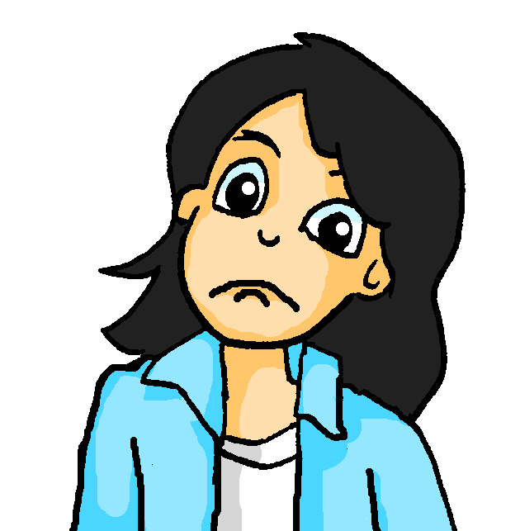


Strong verbs
We call these strong verbs.
Grammatik
Remember that some German verbs change the vowel in the du and er / sie / es form.
vergessen →
ich vergesse
du vergisst
er / sie / es vergisst
You have to learn which verbs are strong, but there are some rules!
Only verbs with an a or an e in their stem can be strong.
Stems with an e change to i or ie:
Stems with an a change to ä:
sterben →
Mia! Deine Pflanze stirbt!
enthalten →
Wolfgang! Dein Hamburger enthält 14 Gramm Fett!
Notes:
Timing: 2 minutes
Aim: To remind students of the pattern of strong verbs.
Procedure:
1. Take students through the animated explanation, step by step.
2. Elicit meanings of sterben, enthalten and the call outs.
3. Click to hear audio of all the verb examples, and the call outs.

Slide 11

die Nummern
Remember: 16 and 17 lose a letter or two!
Grammatik
Remember:
German numbers 13 - 19 are simple sums:
14
15
16
drei [3] (+) zehn [10] = dreizehn [13]
vierzehn
fünfzehn
sechzehn
17
18
19
siebzehn
achtzehn
neunzehn
And when you hear a number between 21 and 99, write it down from right to left as you will always hear the second number first:
vierundzwanzig
Numbers are always written as one word. Some words can be very long:
2
4
e.g. = fünftausendsechshundertzweiunddreißig!
5632
fünf|tausend|sechs|hundert|zweiunddreißig
Don’t worry! Just break them down to work them out.
Notes:
Time: 1 minute
Aim: To recap the key knowledge about German numbers from Term 3 Y7.
Note: Students have already learnt numbers 1-31. In this lesson we add numbers 32-100. Students have pre-learnt 40, 50, 60, 70, 80, 90, 100. 1000 (tausend) and 100, 000 (million) are brought in as cognates.
Procedure:
1. Teachers present the new information. It is animated to allow for a paced, interactive delivery.
2. Elicit the German for numbers 14 - 19. Audio has been added to these numbers to allow for listen and check. The written form of the number appears when the audio button is clicked.
3. Click on the ‘vierundzwanzig’ speech bubble to hear the number.
4. Click on 5632 to hear this number.

Slide 12
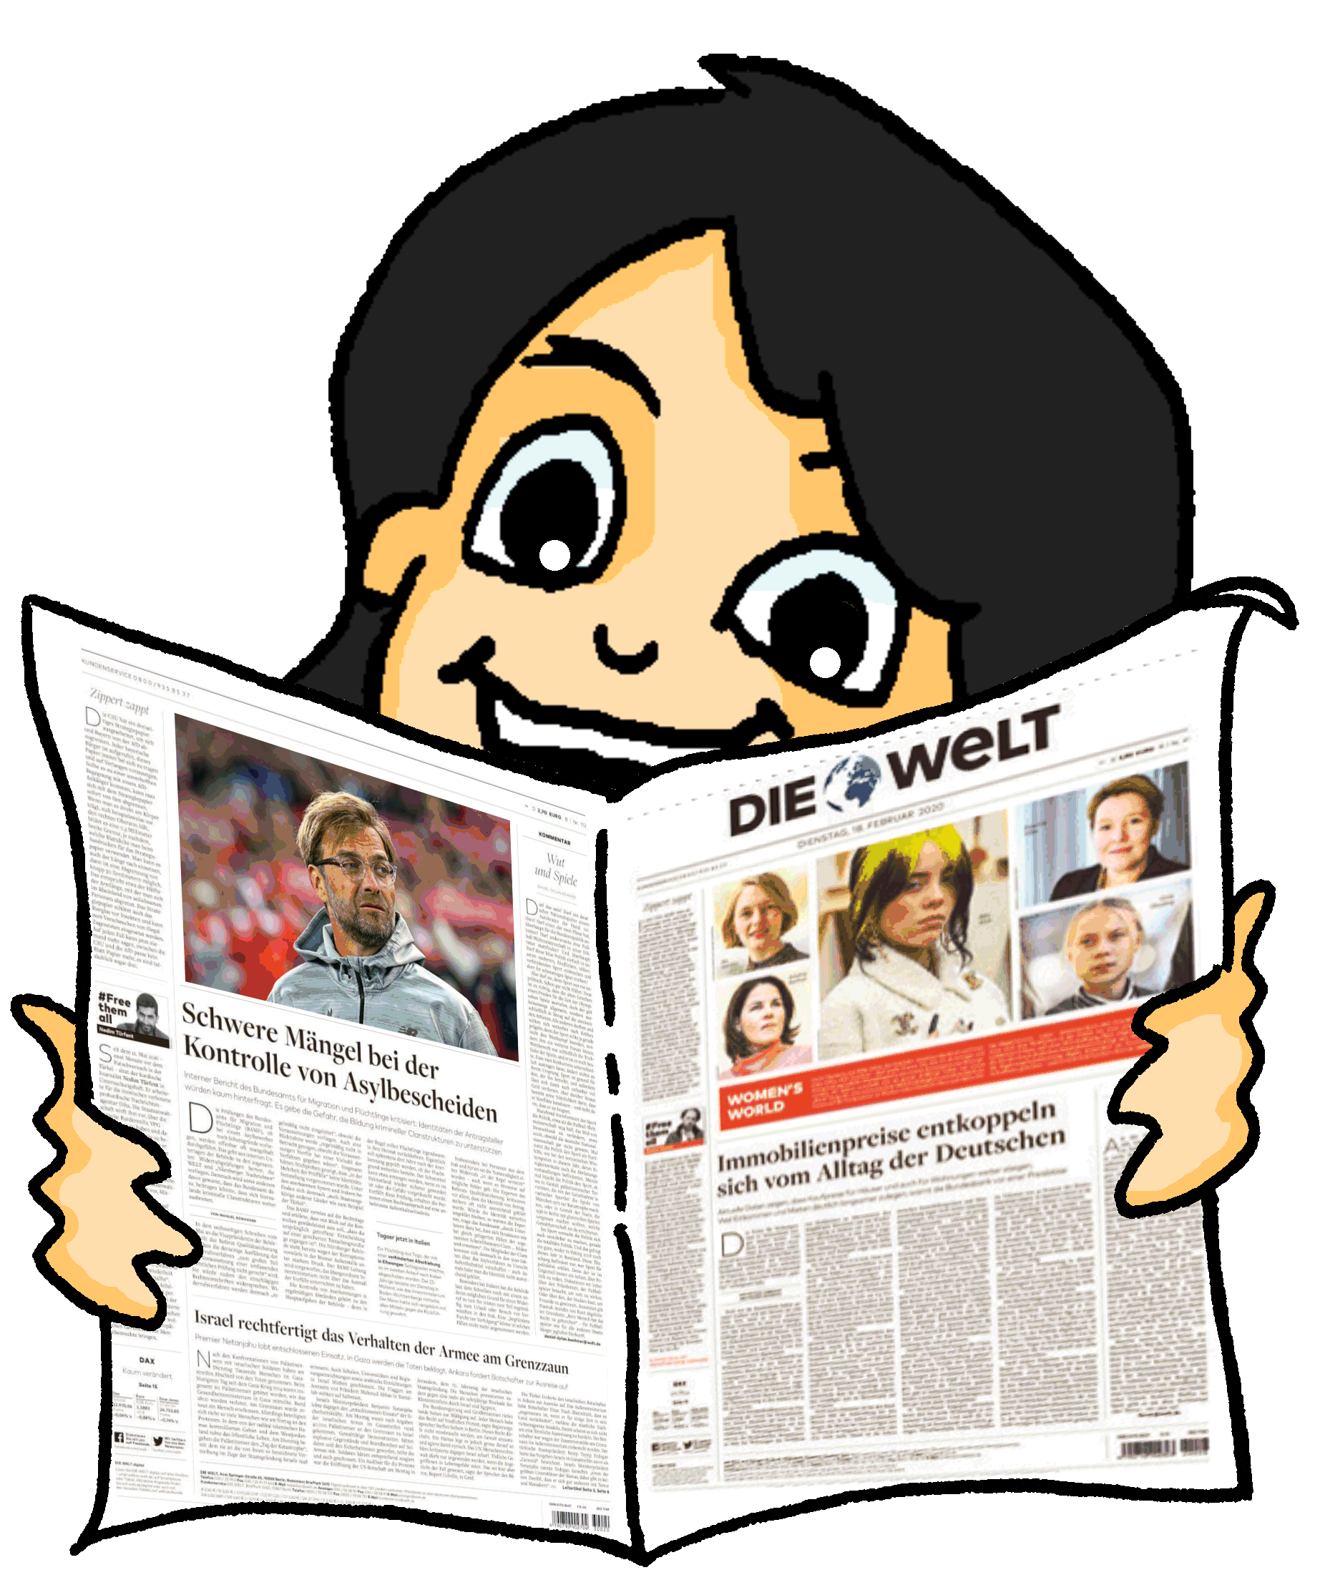
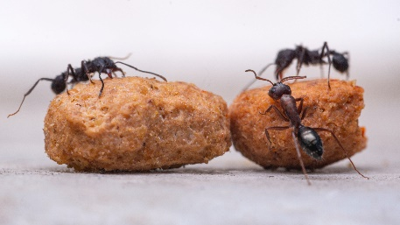

Die Tierwelt
Remember that subject pronouns match the gender of the noun they refer to.
die Ameise = sie (it).
lesen
Mia liest Wolfgang einen Artikel über Ameisen* vor. Lies die Sätze.
Ist das eine Ameise (sie) oder viele Ameisen (they)?
 |  | sie (it) | sie (they)
1. | Sie arbeiten für das Kollektiv.
2. | Die Arbeiterin trägt jeden Tag Materialien für das Ameisennest.
3. | Sie schläft vier Stunden 50 Minuten pro Tag.
4. | Sie machen 250 Schlafpausen von 60 Sekunden pro Tag.
5. | Sie läuft mehr als fünf Kilometer pro Tag.
6. | Sie frisst* andere Insekten.
7. | Schokoameisen sind in Mexico ein Lieblingssnack.
8. | Sie stirbt nach zwei Jahren.
*die Ameise - ant
*fressen – to eat (when animals do it)
Notes:
NB: if needed, omit either slide 12 (this slide) OR slide 13/14.
Timing: 5 minutes
Aim: To practise attending to the verb endings for 3 person singular and plural.
Procedure:
1. For each sentence say whether the sie is singular (it) or plural (they).
2. Click to reveal answers.

Slide 13
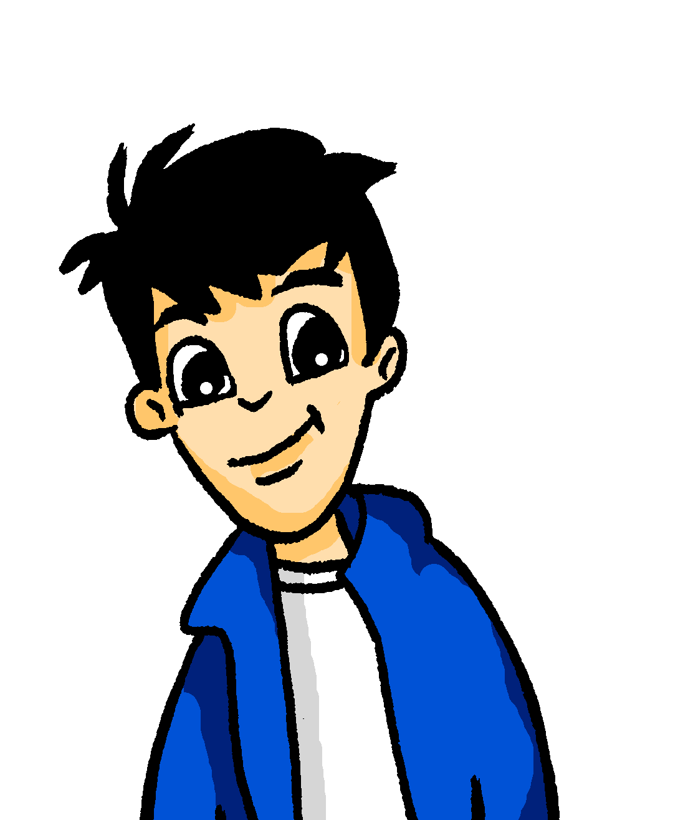

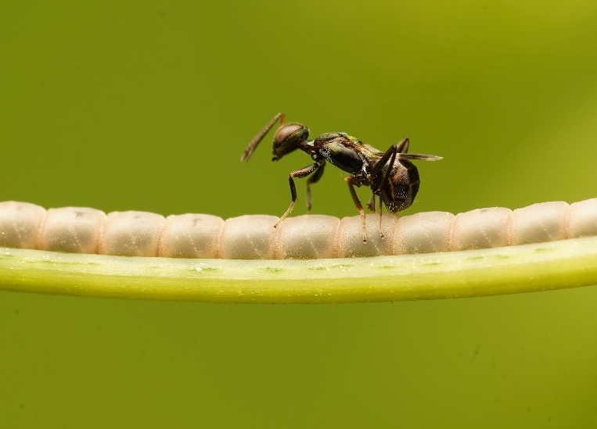
Die Arbeiterin(nen)
hören
 |  | sie (it) | sie (they)
 | Sie spricht nicht.
 | Sie legen eine Duftspur*.
 | Sie sieht nicht sehr gut.
 | Sie trägt drei hundert bis vier hundert Gramm.
 | Sie wiegt* selbst nur zehn Milligramm.
 | Sie laufen bis zu einen Meter pro Sekunde.
 | Sie wohnt mit hundert tausend Ameisen im Nest zusammen.
 | Sie arbeiten neunzehn Stunden pro Tag.
Wolfgang macht seine Hausaufgaben. Er sucht auch auf YouTube Infos über Ameisen .
Hör zu. Heißt das sie (it) oder sie (they)?
1
2
3
4
5
6
7
8
die Duftspur – scent trail | wiegen – to weigh
Notes:
Timing: 5 minutes
Aim: To practise attending to the verb endings for 3 person singular and plural.
Procedure:
Click on the number to hear the audio.
For item say whether the sie refers to singular (it) or plural (they)
Click to reveal answers.
Elicit English meanings orally.
Transcript:
1. Sie spricht nicht.
2. Sie legen eine Duftspur.
3. Sie sieht nicht sehr gut.
4. Sie trägt drei hundert bis vier hundert Gramm.
5. Sie wiegt selbst nur zehn Milligramm.
6. Sie laufen bis zu einen Meter pro Sekunde.
7. Sie wohnt mit hundert tausend Ameisen im Nest zusammen.
8. Sie arbeiten neunzehn Stunden pro Tag.

Slide 14
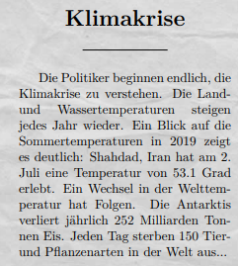
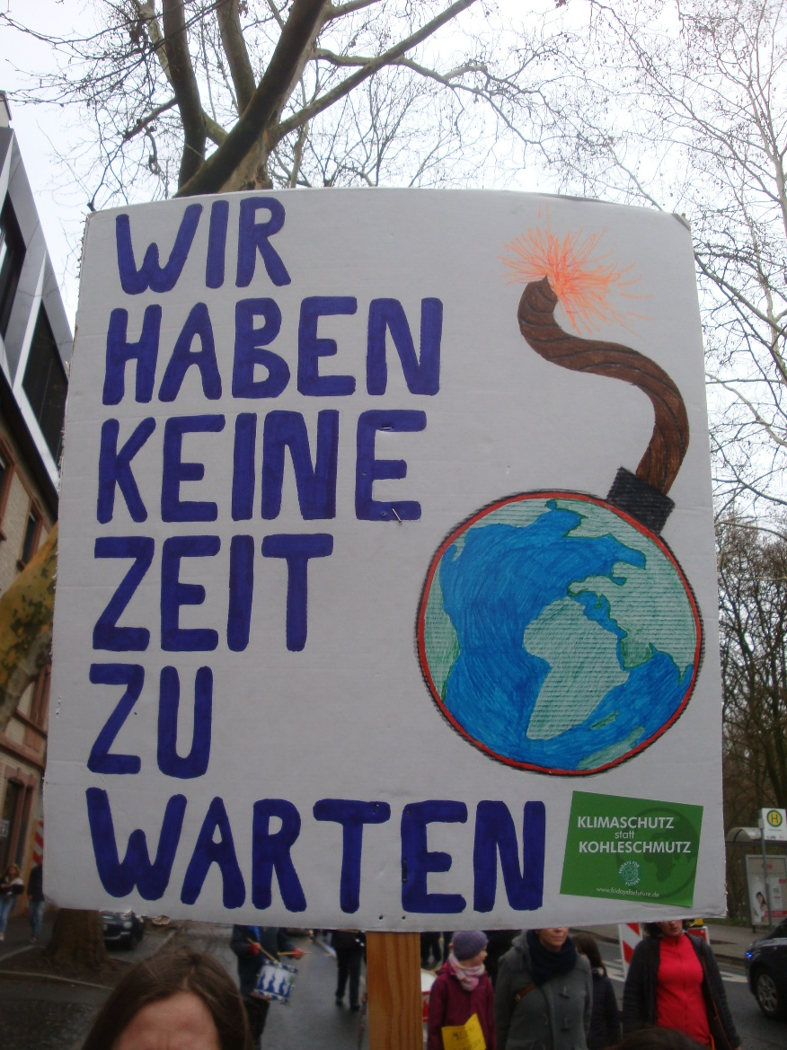
Klimakrise
Lies den Text. Finde Synonyme.
lesen / hören / sprechen
Lies jetzt den Text vor.
1
jedes Jahr
2
begreifen
3
klar
4
Konsequenzen
5
täglich
6
schließlich
2019
am 2. Juli
53,1 Grad
150
252 Milliarden Tonnen
Notes:
Timing: 7 minutes
Aim: to read vocabulary in context and finding synonyms.
Procedure:
Aural task 1
1. Listen to words 1-6 words and identify and word from the text with the same meaning.
2. Click to reveal answers.
Read aloud task 2.
Read the text aloud. Click the boxes to hear how the numbers are said.
jedes Jahr / begreifen / klar / Konsequenzen / täglich / schließlich / 2019 / am zweiten Juli / 53,1 Grad / 252 Milliarden Tonnen / 150 /
Site used to create newspaper article format: https://newspaper.jaguarpaw.co.uk

Slide 15
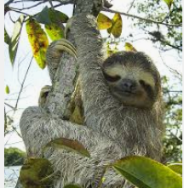
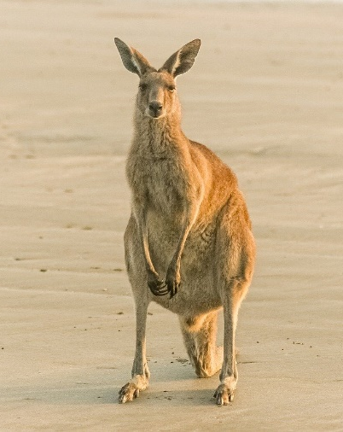
Tierprofile
Wolf macht seine Hausaufgaben. Kannst du helfen? Schreib einen Text zu einem Tier.
lesen / schreiben
fressen
schlafen
laufen
tragen
sehen
sterben
sprechen
leben
wohnen
fallen
nehmen
das Blatt – leaf
der Baum - tree
das Jungtier – young
die Bruttasche – pouch
grüßen – to greet
der Schatten - shade
Ein Faultier…
1. schläft 12 Stunden pro Tag.
2. läuft nicht; es hängt.
3. frisst normalerweise *Blätter.
4. stirbt nach 16 Jahren.
5. sieht Farben.
6. wohnt in *Bäumen.
Ein Känguru…
1. wohnt in Australien.
2. frisst nur Pflanzen.
3. trägt sein *Jungtier in einer *Bruttasche.
4. lebt 6 Jahren.
5. spricht nicht; sie *grüßen einander.
6. schläft normalerweise in dem *Schatten.
__________
__________
__________
__________
__________
__________
__________
__________
__________
__________
__________
__________
Notes:
Timing: 8 minutes
Aim: To practise strong verbs in writing.
Procedure:
1. Pick one of the profiles to complete.
2. Use the verbs in the centre. Not all verbs are needed.

Slide 16

Berlin
Present tense: strong verbs [revisited]
Direct object pronouns: mich, dich
SSC [Z]
Berlin ist die Hauptstadt von Deutschland.
Y8 German
Term 1.2– Week 1 - Lesson 16
Inge Alferink / Rachel Hawkes
Artwork: Steve Clarke
Date updated: 04/02/24
Notes:
Artwork by Steve Clarke. All additional pictures selected are available under a Creative Common license; no attribution required.
Note: All words listed below for this week’s learning (new and revisited sets) appear on all three Awarding Organisations’ word lists, with the following exceptions:
i) AQA list does not have begreifen, duschen, mischen, Jahreszeit.
ii) Edexcel list does not have begreifen, duschen, mischen, sterben, Jahreszeit, Punkt.
iii) Eduqas list does not have begreifen, duschen, Jahreszeit.
Learning outcomes (lesson 2):
Consolidation of present tense: strong verbs
Introduction to direct object pronouns (ihn, sie, es, mich, dich)
Use of nicht vs nichts
Word frequency (1 is the most frequent word in German):
8.1.2.1 enthalten [562] sterben [475] mich [65] dich [217] nichts [109] Bevölkerung [1018] Prozent [172] Unterstützung [1141] nur [39] vierzig [2907] fünfzig [2390] sechzig [2448] siebzig [2609] achtzig [3301] neunzig [3028] hundert [1107]
8.1.1.5 begreifen [1346] duschen [>5009] Blick [306] Dezember [1527] Jahreszeit [4818] Mal [82] März [987] Pflanze [1667] Schuh [1678] Wechsel [2525] bequem [3369] freundlich [1566] wieder [74]
7.3.2.4 beginnen [239] erhalten [283] gewinnen [408] legen [296] mischen [2105] werfen [672] ziehen [266] die Mitte [756] der Punkt [427] das Ziel [325] jeder, jede, jedes [88]
Source: Jones, R.L. & Tschirner, E. (2019). A frequency dictionary of German: core vocabulary for learners. Routledge
The frequency rankings for words that occur in this PowerPoint which have been previously introduced in LDP resources are given in the LDP SOW and in the resources that first introduced and formally re-visited those words.
For any other words that occur incidentally in this PowerPoint, frequency rankings will be provided in the notes field wherever possible.

Slide 17

Vokabeln
lesen / sprechen
Many German words are cognates ending in -tion.
She needs information.
Sie braucht Information.
What would the following words be in German?
situation
organisation
international
Choose one and write a sentence in German.
Translate these sentences.
1. Was ist die Definition von Integration?
2. The nation has lots of traditions.
The ‘t’ in ‘tion’ is pronounced ‘ts’, like German ‘z’.
Notes:
Timing: 8 minutes (both slides)
Aim: Word pattern tasks have been written particularly with the LDP Y8 SOW in mind. Current thinking is to include one short activity to introduce and practise a pattern once every two weeks.
We have not included every single pattern that exists, of course - just those where there were sufficient, high-frequency words in the top 2000 to suggest that it would be a useful pattern to highlight to students in Y8. NB: Within the Y8 German SOW document you will find a ‘word patterns’ tab, an inventory of all the patterns and their words that were considered.
The idea is that these patterns not only reinforce, revisit, extend vocabulary knowledge, but they also revisit key basic grammar knowledge (parts of speech, capital letters on nouns, definite articles/gender, plural rules) and can provide opportunities for students to apply their phonics knowledge when they sound out the new words they've created. In short, these are PVG-rich tasks.
Suggested procedure:
1. Click on the mouse to animate the explanation.
2. Students translate the sentences and words shown.
Word frequency of unknown words and cognates: Information [465] Organisation [1114] Situation [423] international [426] Nation [1734] Definition [1057] Integration [1282] Tradition [1650]
Source: Jones, R.L. & Tschirner, E. (2019). A frequency dictionary of German: core vocabulary for learners. Routledge
Image by IO-Images from Pixabay

Slide 18
Antworten
lesen / sprechen
Was ist die Definition von Integration?
The nation has lots of traditions.
situation
organisation
international
What is the definition of integration?
Die Nation hat viele Traditionen.
die Situation
die Organisation
international
Remember: most feminine nouns add (e)n to form the plural.
What do you notice about the gender of the nouns?
They are all feminine!
Pronounce the words. They look like English words, but note that the [a] sound is short!
Despite the spelling, there is a double consonant, because –tion is pronounced ‘-tsyon’
Notes:
Note: There is a double consonant pronunciation-wise, even if not in spelling, as the -tion sound is pronounced '-tsyon'. So in terms of what the mouth is doing, it still needs to take a 'pause' to form the double consonant sound that is there, even if the spelling of the word hides it (this is reflected in the IPA /naˈʦjoːn/)

Slide 19


Vokabeln
hören
Hör dir die Wörter an.
Hast du diese Wörter auf Deutsch gehört?
x
1
first
zuerst
2
to receive / receiving
erhalten
3
goal
das Ziel
x
4
to mix / mixing
mischen
x
5
in the end
schließlich
Notes:
Timing: 3 minutes
Aim: To practise vocabulary in the second revisited set for this week, in the spoken modality.
Procedure:
1. Click for the English word to appear.
2. Click on the number to play the sound.
3. Listen to the German words. Was any of the four words the German for the English word shown?
4. On a click an English word will appear. Was the word included in the German set?
5. Click for answers.
Note: Increase the challenge by listening first, revealing English word after listening to each set of four words.
Transcript:
1. Später – Danach – Schließlich – jetzt → First
2. Lassen – erhalten – halten – beginnen → To receive
3. das Ziel – die Mitte – der Punkt – der Spieler → the goal
4. Ziehen – nehmen – legen – werfen → to mix
5. deshalb – leider – aber – ziemlich → in the end

Slide 20
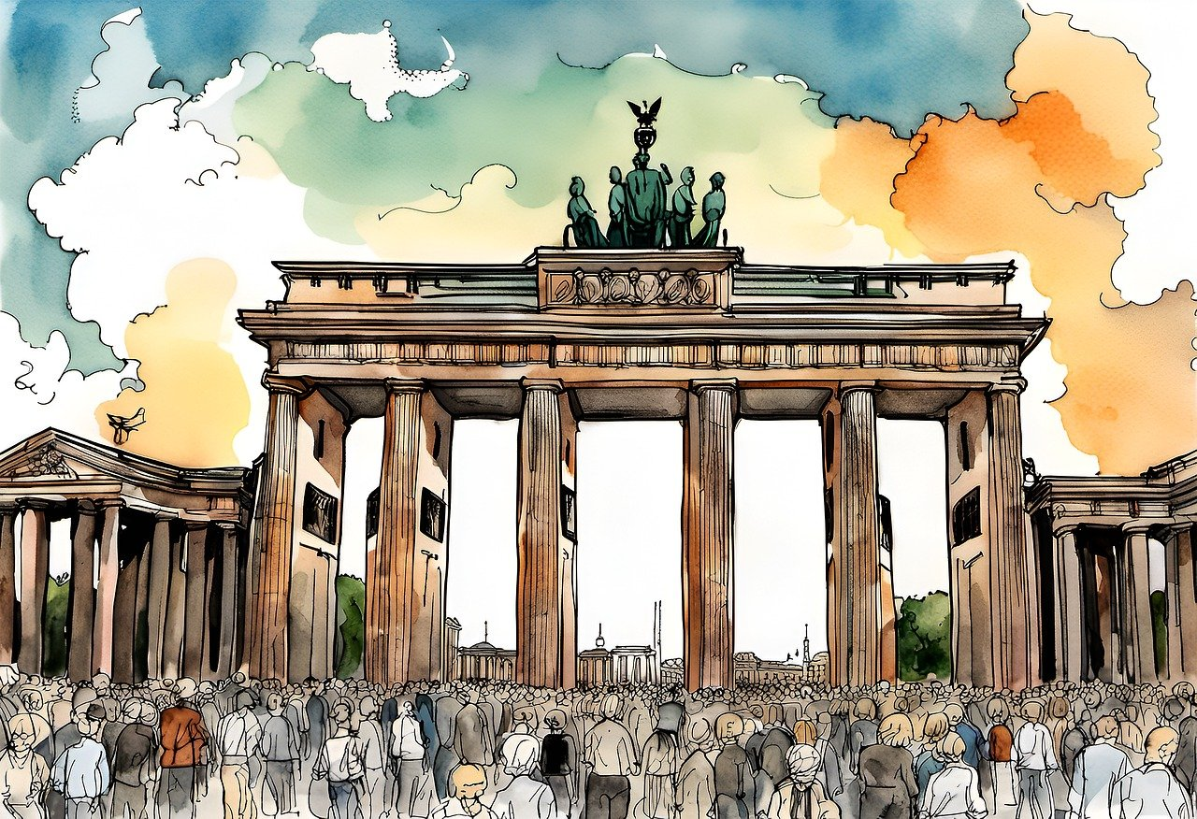
Hauptstadt Berlin
hören / lesen
1
Berlin has:
3.3 Million inhabitants
2
Hör dir den Text an and schreib die Nummern.
29% from abroad
3
Berlin hat 3,3 Millionen Einwohner.
29% der Einwohner kommen aus dem Ausland.
33% haben ein Auto.
72% haben ein Fahrrad.
500.000 Touristen besuchen täglich Berlin.
Es gibt 435.680 Bäume in der Stadt.
Der Berliner Fernsehturm ist 368 Meter hoch.
Die Nikolaikirche ist 640 Jahre alt.
Berlin hat 175 Museen, mehr als 50 Theater, rund 300 Kinos, und 4,650 Restaurants und Cafés.
_1_
33% with a car
4
_2_
72% with a bike
5
_3_
500,000 tourists daily
6
_4_
435,680 trees
7
_5_
TV tower (368m tall)
8
_6_
Nikolai church (640 years old)
9
_7_
_8_
275 museums, more than 50 theatres, around 300 cinemas, 4,650 restaurants and cafés
10
_9_
_10_
11
_11_
_12_
12
Notes:
Timing: 8 minutes
Aim: To practise hearing and writing numbers.
Procedure:
1. Click on the box to play the audio.
2. For each item write down the number you hear.
3. Click to check answers.
4. Ask students (in pairs or individually) to write down as many facts about Berlin as they can.
5. Click to reveal the English bullets
Transcript:
Berlin hat 3,3 Millionen Einwohner.
29% der Einwohner kommen aus dem Ausland.
33% haben ein Auto
72% haben ein Fahrrad
500.000 Touristen besuchen täglich Berlin.
Es gibt 435.680 Bäume in der Stadt.
Der Berliner Fernsehturm ist 368 Meter hoch.
die Nicolaikirche ist 640 Jahre alt.
Berlin hat 175 Museen, mehr als 50 Theater, rund 300 Kinos, und 4,650 Restaurants und Cafés.

Slide 21





Pronomen
Grammatik
We use pronouns to replace nouns in a sentence, to avoid repetition, when we already know who or what we are referring to:
Compare:
SUBJECT
VERB
OBJECT
ihn – means ‘him’ and ‘it’ for masculine nouns.
Wolfgang
isst
den Hamburger.
Er
isst
ihn.
sie – means ‘her’ and ‘it’ for feminine nouns.
Mia
vergisst
die Pflanze.
Sie
vergisst
sie.
das Mädchen
vergisst
das Buch.
es – means‘it’ for neuter nouns.
Es
vergisst
es.
Wolfgang und Mia
vergessen
die Ameisen.
sie – also means‘they’for all plural nouns.
Sie
vergessen
sie.
Notes:
Timing: 2 minutes
Aim: To recap the forms and uses of subject and object pronouns previously taught in Y7.
Procedure:
1. Click through and elicit the English meanings one by one from students.

Slide 22


mich (me) | dich (you)
Grammatik
These are the object pronouns ‘me’ and ‘you’:
Note: English uses ‘you’ for both subject and object pronouns.
Compare:
SUBJECT
VERB
OBJECT
Ich
sehe
dich.
I
see
you.
Du
siehst
mich.
You
see
me.
Nein, Wolfgang! Ich sehe dich nicht! Ich sehe nichts!
Note: Nicht and nichts have separate meanings:
Nicht (adv.) → not
Nichts (pron.)→ nothing
Notes:
Timing: 2 minutes
Aim: To introduce the new object pronouns mich and dich.
Procedure:
1. Click through and elicit the English meanings one by one from students.

Slide 23

Mia telefoniert mit ihrer Mutti
Schreib 1-6 und das Pronomen.
hören
Hallo, Mia. Hörst du mich?
_1_
Ja, Mutti. Ich höre dich. Was willst du denn?
_2_
Ich komme gleich nach Hause. Sag mal, hast du dein Zimmer geputzt?
[2]
[1]
[3]
Ja, Mutti. Ich habe es schon geputzt.
_3_
[4]
Und hat Wolfgang die Gartenarbeit gemacht?
[5]
Ja, Mutti. Er hat sie schon gemacht.
_4_
Und hat er auch den Boden in der Küche geputzt?
[6]
Ja, Mutti. Er hat ihn schon geputzt.
_5_
[7]
Und hast du deine roten Schuhe gefunden?
Ja, Mutti. Ich habe sie gefunden. Bis bald.
_6_
Notes:
Timing: 5 minutes
Aim: To listen out for pronoun forms.
Procedure:
1. Click on a bubble to hear the audio.
2. Fill in the gaps.
3. Click to check answers.
Transcript:
Hallo, Mia. Hörst du [mich]?
Ja, Mutti, Ich höre [dich]. Was willst du denn?
Ich komme gleich nach Hause. Sag mal, hast du dein Zimmer geputzt?
Ja, Mutti. Ich habe [es] schon geputzt.
Und hat Wolfgang die Gartenarbeit gemacht?
Ja, Mutti. Er hat [sie] schon gemacht.
Und hat er auch den Boden in der Küche geputzt?
Ja, Mutti, Er hat [ihn] geputzt.
Und hast du deine roten Schuhe gefunden?
Ja, Mutti. Ich habe [sie] gefunden. Bis bald.

Slide 24


Berlin
Andrea muss auch Hausaufgaben machen.
Sie schreibt über Berlin.
lesen
Findet Synonyme für:
die Mitte
enthält
Leute
der Ort
Ländern
jedes Jahr
Schreib die roten Wörter auf Englisch.
Schreib den ganzen Text auf Englisch.
me
Berlin interessiert mich sehr. Berlin liegt im Zentrum vom Land Brandenburg und hat mehr als 3 Millionen Einwohner. Berlin ist ein attraktives Ziel für viele Personen. Viele Menschen ziehen* nach Berlin und die Großstadt wird immer internationaler. Die Berliner Bevölkerung kommt aus 193 Nationen. Rund 100.000 Leute ziehen jährlich in die Hauptstadt; ungefähr 50% aus Europa. Die meisten kommen aus Polen, Rumänien, Bulgarien und Italien.
has
move
population
Around
Notes:
Timing: 10 minutes
Aim: To use vocabulary in context.
Procedure:
1. Find a synonym for: die Mitte, der Ort, enthält, Leute, Ländern, jedes Jahr.
2. Click to check answers. NB: for Einwohner, accept also Menschen or Personen as answers.
3. Translate the words in red.
4. Click to check answers.
5. Translate whole text.
6. Check translation on next slide.

Slide 25
Berlin - Antworten
lesen
Berlin interests me a lot. Berlin is situated in the centre of Brandenburg province and has more than 3 million inhabitants. Berlin is an attractive destination for many people. Many people move to Berlin and the big city is becoming ever more international. The population of Berlin comes from 193 countries. Around 100,000 people move to the capital every year; roughly 50% from Europe. Most come from Poland, Rumania, Bulgaria, and Italy.

Slide 26


Was macht David?
sprechen
Person A
Person B
cycles every week
cycles every day
David
David fährt jede Woche Rad.
Nein, er fährt jeden Tag Rad.
Notes:
Timing: 10 minutes (this slide models the activity)
Aim: To practise strong and weak verbs in speaking. This is a spot the difference task (information gap). Each person has 10 cards. Speakers exchange information to find the differences together.
Procedure:
1. Person A offers a description of one of the cards (e.g., David fährt jede Woche Rad).
2. Person B checks whether the information on their card is the same (Ja, David fährt jede Woche Rad / Nein, er fährt jeden Tag Rad).
3. Then person B offers a piece of information and so on until all cards have been discussed and the differences found.

Slide 27













Person A
Person B
Was macht David?
Was macht David?
showers often
runs every day
forgets names
only wears blue shoes
reads news online
sleeps badly
drives an old car
forgets numbers
wins games
reads news online
?
?
speaks English
wins games
sleeps badly
lives in a house
drives an old car
speaks English
only wears comfortable shoes
showers often
lives in a big house
runs every week
Notes:
HANDOUTS - NOT FOR DISPLAY DURING THE ACTIVITY

Slide 28

Hausaufgaben
Vocabulary Learning Homework (Y8, Term 1.2, Week 2)
Audio file
Student worksheet
In addition, revisit: Year 8 Term 1.1 Week 6
Year 7 Term 3.2 Week 3
Notes:
The answer sheet for the Y8 vocabulary learning HW is here: https://rachelhawkes.com/LDPresources/Yr8German/German_Y8_Term1ii_Wk2_audio_HW_sheet_answers.docx
Notes:
i) Teachers may, in addition, want to recommend use of a particular online app for the pre-learning of each week’s words.
ii) Quizlet now requires parental involvement / registration / permissions for users below the age of 13, so it is perhaps most suitable for Y9 – 11 students.
iii) Language Nut hosts LDP vocabulary lists and these are free for schools to use, though there is a registration process. One benefit is that all of the student tracking data that Language Nut offers are also available to schools that use the LDP lists for practice. Perhaps this makes it a good option for Y7/8.
iv) There are other free apps, and new ones are always appearing. Teachers have told us that they are currently using:
Flippity, Wordwall (where using previously-created activities is free).
v) Gaming Grammar has been acquired by Language Nut. Its original content should still be available to teachers and much of it is appropriate for Y8 learners.
This week: Verb agreement: Present

