Slide 1
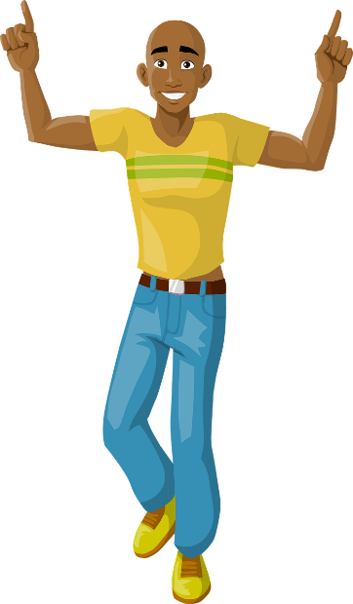
Wie sieht sie aus? Wie sieht er aus?
Describing others
Adjective agreement – R2 (accusative) SSC [r]
Y8 German
Term 1.1 – Week 6 - Lesson 11 Inge Alferink / Rachel Hawkes
Artwork: Steve Clarke
Date updated: 01/09/23
Notes:
Artwork by Steve Clarke. All additional pictures selected are available under a Creative Common license; no attribution required.
Note: All words listed below for this week’s learning (new and revisited sets) appear on all three Awarding Organisations’ word lists, with the following exceptions:
i) Edexcel list does not have Frankreich, Spanien.
Learning outcomes (lesson 1):
Introduction of SSC [r]
Introduction of adjective agreement with singular indefinite articles in R2 (accusative case).
Word frequency (1 is the most frequent word in German):
8.1.1.6 (introduce) verbringen [1391] Auge [222] Gesicht [346] Haar [748] Mund [856] Nase [1264] Schüler [557] Zeit [96] ähnlich [437] breit [847] dünn [1739] neu [84] rund [298] als [22]
8.1.1.2 (revisit) gegessen [323] gelegen [118] gesprochen [161] geschrieben [184] gesungen [1063] getroffen [259] getrunken [634] treffen [259] Frankreich [813] Sommer [771] Spanien [1745] bisher [441] welcher, welche, welches [122]
7.3.1.4 (revisit) Bruder [687] Eltern [351] Geschwister [3090] Kind [106] Schauspieler [2202] Schwester [776] mein1 [53] dein1 [225] ihr1[26] sein [36] über1 [48]

Slide 2
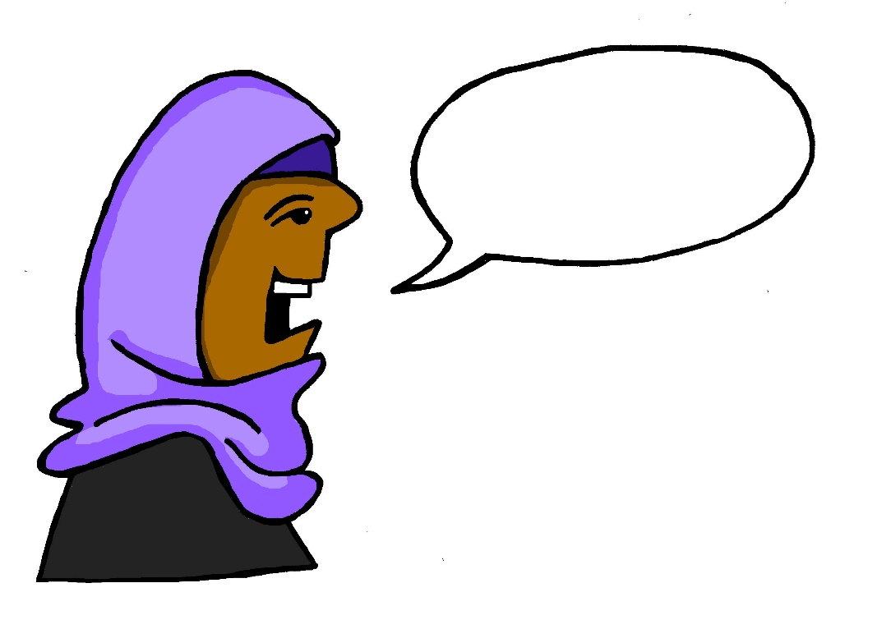
r
reden
Notes:
Timing: 1 minute
Aim: To introduce/consolidate SSC [r]
Procedure: 1. Present the letter(s) and say the [r] sound first, on its own. Students repeat it with you. 2. Bring up the word ”reden” on its own, say it, students repeat it, so that they have the opportunity to focus all of their attention on the connection between the written word and its sound.
3. A possible gesture for this would be to mime talking between your right hand and your left hand.
4. Roll back the animations and work through 1-3 again, but this time, dropping your voice completely to listen carefully to the students saying the [r] sound, pronouncing ”reden” and, if using, doing the gesture. Word frequency (1 is the most frequent word in German): reden [356]
Source: Jones, R.L. & Tschirner, E. (2006). A frequency dictionary of German: core vocabulary for learners. Routledge

Slide 3
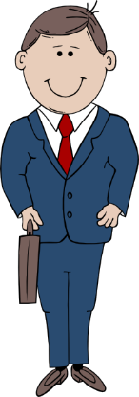
r
Regel
rot
reden
warum?
Beruf
Reise
Notes:
Timing: 2 minutes
Aim: To introduce/consolidate SSC [r]
Procedure:
Introduce and elicit the pronunciation of the individual SSC [r] and then the source word again ‘reden’ (with gesture, if using).
Then present and elicit the pronunciation of the five cluster words.
The cluster words have been chosen for their high-frequency, from a range of word classes, with the SSC (where possible) positioned within a variety of syllables within the words (e.g. initial, 2nd, final etc.). Additionally, we have tried to use words that build cumulatively on previously taught SSCs (see the Phonics Teaching Sequence document) and do not include new SSCs. Where new SSCs are used, they are often consonants which have a similar symbol-sound correspondence in English.
Word frequency (1 is the most frequent word in German): reden [356]; Regel [484] rot[381]; warum? [246]; Reise [786]; Beruf [477 Source: Jones, R.L. & Tschirner, E. (2006). A frequency dictionary of German: core vocabulary for learners. Routledge

Slide 4
r
Regel
rot
reden
warum?
Beruf
Reise
Notes:
With sound and no pictures to focus all attention on the sound-symbol correspondence.

Slide 5
r
Regel
rot
reden
warum?
Beruf
Reise
Notes:
Without sound to elicit pronunciation (without first hearing the teacher).
Teacher to elicit pronunciation by asking “Wie sagt man…”

Slide 6
r
Uhr
Notes:
Timing: 1 minute
Aim: To introduce/consolidate SSC [r]
Procedure: 1. Present the letter(s) and say the [r] sound first, on its own. Students repeat it with you. 2. Bring up the word ”Uhr” on its own, say it, students repeat it, so that they have the opportunity to focus all of their attention on the connection between the written word and its sound.
3. A possible gesture for this would be to look at your left wrist and tap your imaginary watch twice, to emphasise the two distinct sounds you hear – Uh-r.
4. Roll back the animations and work through 1-3 again, but this time, dropping your voice completely to listen carefully to the students saying the [r] sound, pronouncing ”Uhr” and, if using, doing the gesture. Word frequency (1 is the most frequent word in German): Uhr [349] Source: Jones, R.L. & Tschirner, E. (2006). A frequency dictionary of German: core vocabulary for learners. Routledge

Slide 7
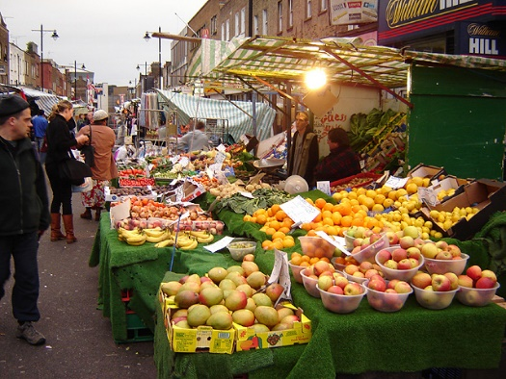
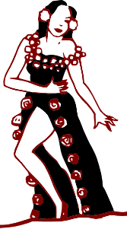
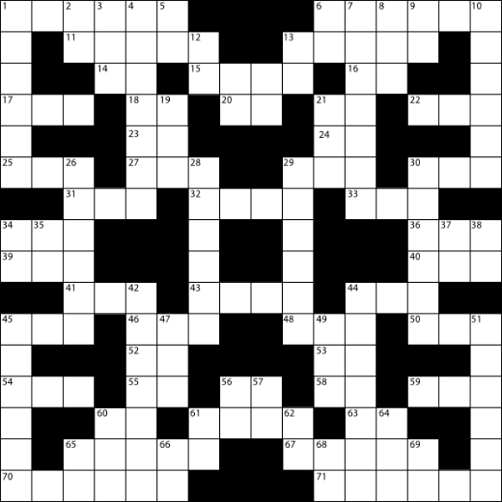
r
Markt
Morgen
Uhr
By Tarquin Binary - Own work, CC BY-SA 2.5
Kultur
Wort
dort
W O R T
Notes:
Timing: 2 minutes
Aim: To introduce/consolidate SSC [r]
Procedure:
Introduce and elicit the pronunciation of the individual SSC [r] and then the source word again ‘uhr’ (with gesture, if using).
Then present and elicit the pronunciation of the five cluster words.
The cluster words have been chosen for their high-frequency, from a range of word classes, with the SSC (where possible) positioned within a variety of syllables within the words (e.g. initial, 2nd, final etc.). Additionally, we have tried to use words that build cumulatively on previously taught SSCs (see the Phonics Teaching Sequence document) and do not include new SSCs. Where new SSCs are used, they are often consonants which have a similar symbol-sound correspondence in English.
Word frequency (1 is the most frequent word in German): Uhr [349]; Markt [508] Morgen [311]; Kultur [593]; dort [104]; Wort [243]. Source: Jones, R.L. & Tschirner, E. (2006). A frequency dictionary of German: core vocabulary for learners. Routledge

Slide 8
r
Markt
Morgen
Uhr
Kultur
Wort
dort
Notes:
With sound and no pictures to focus all attention on the sound-symbol correspondence.

Slide 9
r
Markt
Morgen
Uhr
Kultur
Wort
dort
Notes:
Without sound to elicit pronunciation (without first hearing the teacher).
Teacher to elicit pronunciation by asking “Wie sagt man…”

Slide 10
Phonetik
lesen / sprechen
reden
Tier
30
schreiben
lernen
oder
Wort
Eltern
Lehrerin
Schwester
reisen
Morgen
Farbe
Sekunden
Problem
fahren
Frage
Markt
Bruder
Frau
rund
leider
Kultur
Straße
rot
groß
0
aber
Herr
LOS!
Grund
Notes:
Timing: 2 minutes Aim: To automatize pronunciation of the SSC [r] by saying words containing the SSC at pace. All the words are known. Procedure: 1. Students say as many of these words out loud in 30 seconds as they can, taking it in turns, and without repeating a word.
2. Click on Los! to start the timer.
Adaptions:
1. Only one student talks - the listening student can listen out for English sounding ‘r’s and stop their partner for a 3-second penalty. Then they swap. 2. Add an additional comprehension element. The listening student has to translate the words into English. Note: the 2nd option here could be done with partners taking in turns over 30 seconds OR doing a round each for 30 seconds.

Slide 11
Wie heißt das auf Deutsch?
lesen / sprechen
das Auge
das Gesicht
das Haar
der Mund
die Nase
der Schüler
ähnlich
breit
dünn
neu
rund
als
as
new
(the) hair
round
similar, alike
(the) face
wide
(the) mouth
(the) pupil
(the) nose
thin
as
(the) eye
Notes:
Timing: 5 minutes (two slides)
Aim: to practise meaning recognition and read aloud of this week’s new vocabulary in the written modality; to practise meaning and then meaning and form recall.
Procedure: 1. Bring up an English prompt and elicit the German word from students, chorally.
2. Continue with the remaining 11 items.
3. Move to the next slide.

Slide 12
Wie heißt das auf Deutsch?
lesen / sprechen
d_ _ A_ _e
d_ _ G_ _ _ _ _ t
d_ _ H_ _r
d_ _ M_ _ d
d_ _ N_ _ e
d_ _ S_ _ _ _ _r
ä_ _ _ _ _h
b_ _ _t
d_ _n
n_u
r_ _d
a_s
as
new
(the) hair
round
similar, alike
(the) face
wide
(the) mouth
(the) pupil
(the) nose
thin
as
(the) eye
Notes:
Procedure: 1. Bring up an English prompt and elicit the German word from students, chorally.
2. Continue with the remaining 11 items.

Slide 13
verbringen
[to spend (time)| spending (time)]
verbringt
[spends (time)| is spending time]
Notes:
Timing: 3 minutes for sequence of six verbs
Aim:
Procedure
Bring up the word [verbringen] on its own, say it, students repeat it, and remind them of the phonics. Draw attention to [r] and [v]
Try to elicit the meaning from the students. Students have had explicit teaching that the present tense in German communicates two different present tense meanings in English. This reinforces that learning. Emphasise the two meanings for the short form, reminding students that German only has one form and does not have a direct equivalent of the grammar for ‘is + ing’, the continuous form (as covered in previous weeks).
Bring up the English translations. Emphasise the two meanings for the infinitive.
Bring up the short form [verbringt], say it, students repeat it. Draw attention to [r] and [v].
Try to elicit the meaning from the students. Emphasise the two meanings for the short form.

Slide 14
verbringen
[to spend (time) | spending (time)]
verbringt
[spends (time) | is spending (time)]
Notes:
Cycle through the long and short form again.

Slide 15
verbringt
[spends (time)| is spending (time)]
Sie verbringt ein Jahr in Berlin.
[She spends | is spending a year in Berlin.]
Notes:
Introduce the short form in a sentence.

Slide 16
verbringen
[to spend (time) | spending (time)]
Er will Zeit in Rom verbringen.
[He wants to spend time in Rome.]
Notes:
Introduce the long form in a sentence.

Slide 17
verbringt
[spends (time) | is spending (time)]
Sie _________ ein Jahr in Berlin.
verbringt
[She spends | is spending a year in Berlin.]
Notes:
Cycle through the short form in context again.

Slide 18
verbringen
[to spend (time) | spending (time)]
verbringen
Er will zeit in Rom ___________.
[He wants to spend time in Rome.]
Notes:
Cycle through the long form in context again.

Slide 19
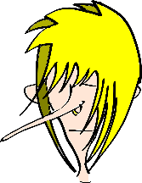
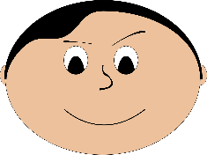
Adjektive – indefinite articles
R2 (acc.) singular endings for indefinite articles also have the same final letter as their matching definite articles.
Grammatik
Remember, R1 adjectives after the indefinite article ‘ein’ (and‘kein’) have these endings:
R1
Only the masculine ending is different in R2!
Das ist eine lange Nase.
Ein kleiner Mund ist schön.
Ein rundes Gesicht ist langweilig.
! We often use the plural without an article. Notice how the ending changes
Seine Schwester hat einen kleinen Mund.
Ihr Bruder hat eine lange Nase.
Meine Oma hat ein rundes Gesicht.
R2
Adjectives for R2 have these endings:
den Mund
die Nase
das Gesicht
R2 plural
Ich habe keine grünen Augen.
Ich habe grüne Augen.
Notes:
Timing: 5 minutes Aim: Explaning the use of indefinite articles and adjectives in R2 (accusative) Procedure: Use the animated sequence to work through the explanation and examples.

Slide 20
Andrea braucht Hilfe!
lesen
Andrea findet Adjektivendungen schwierig! Kannst du helfen? Ist es einen, eine oder ein?
 | Sie hat… | einen | eine | ein
1. | einen schönen Mund
2. | eine hässliche Tasche
3. | ein rundes Gesicht
4. | eine kleine Nase
5. | einen freundlichen Hund
6. | ein neues Handy
____
____
____
____
____
____
Notes:
Timing: 6 minutes Aim: To practice noticing the adjective endings and their relationship to the indefinite article and the noun. Procedure: 1. For each item say which article fits.
2. Click to check answers.

Slide 21
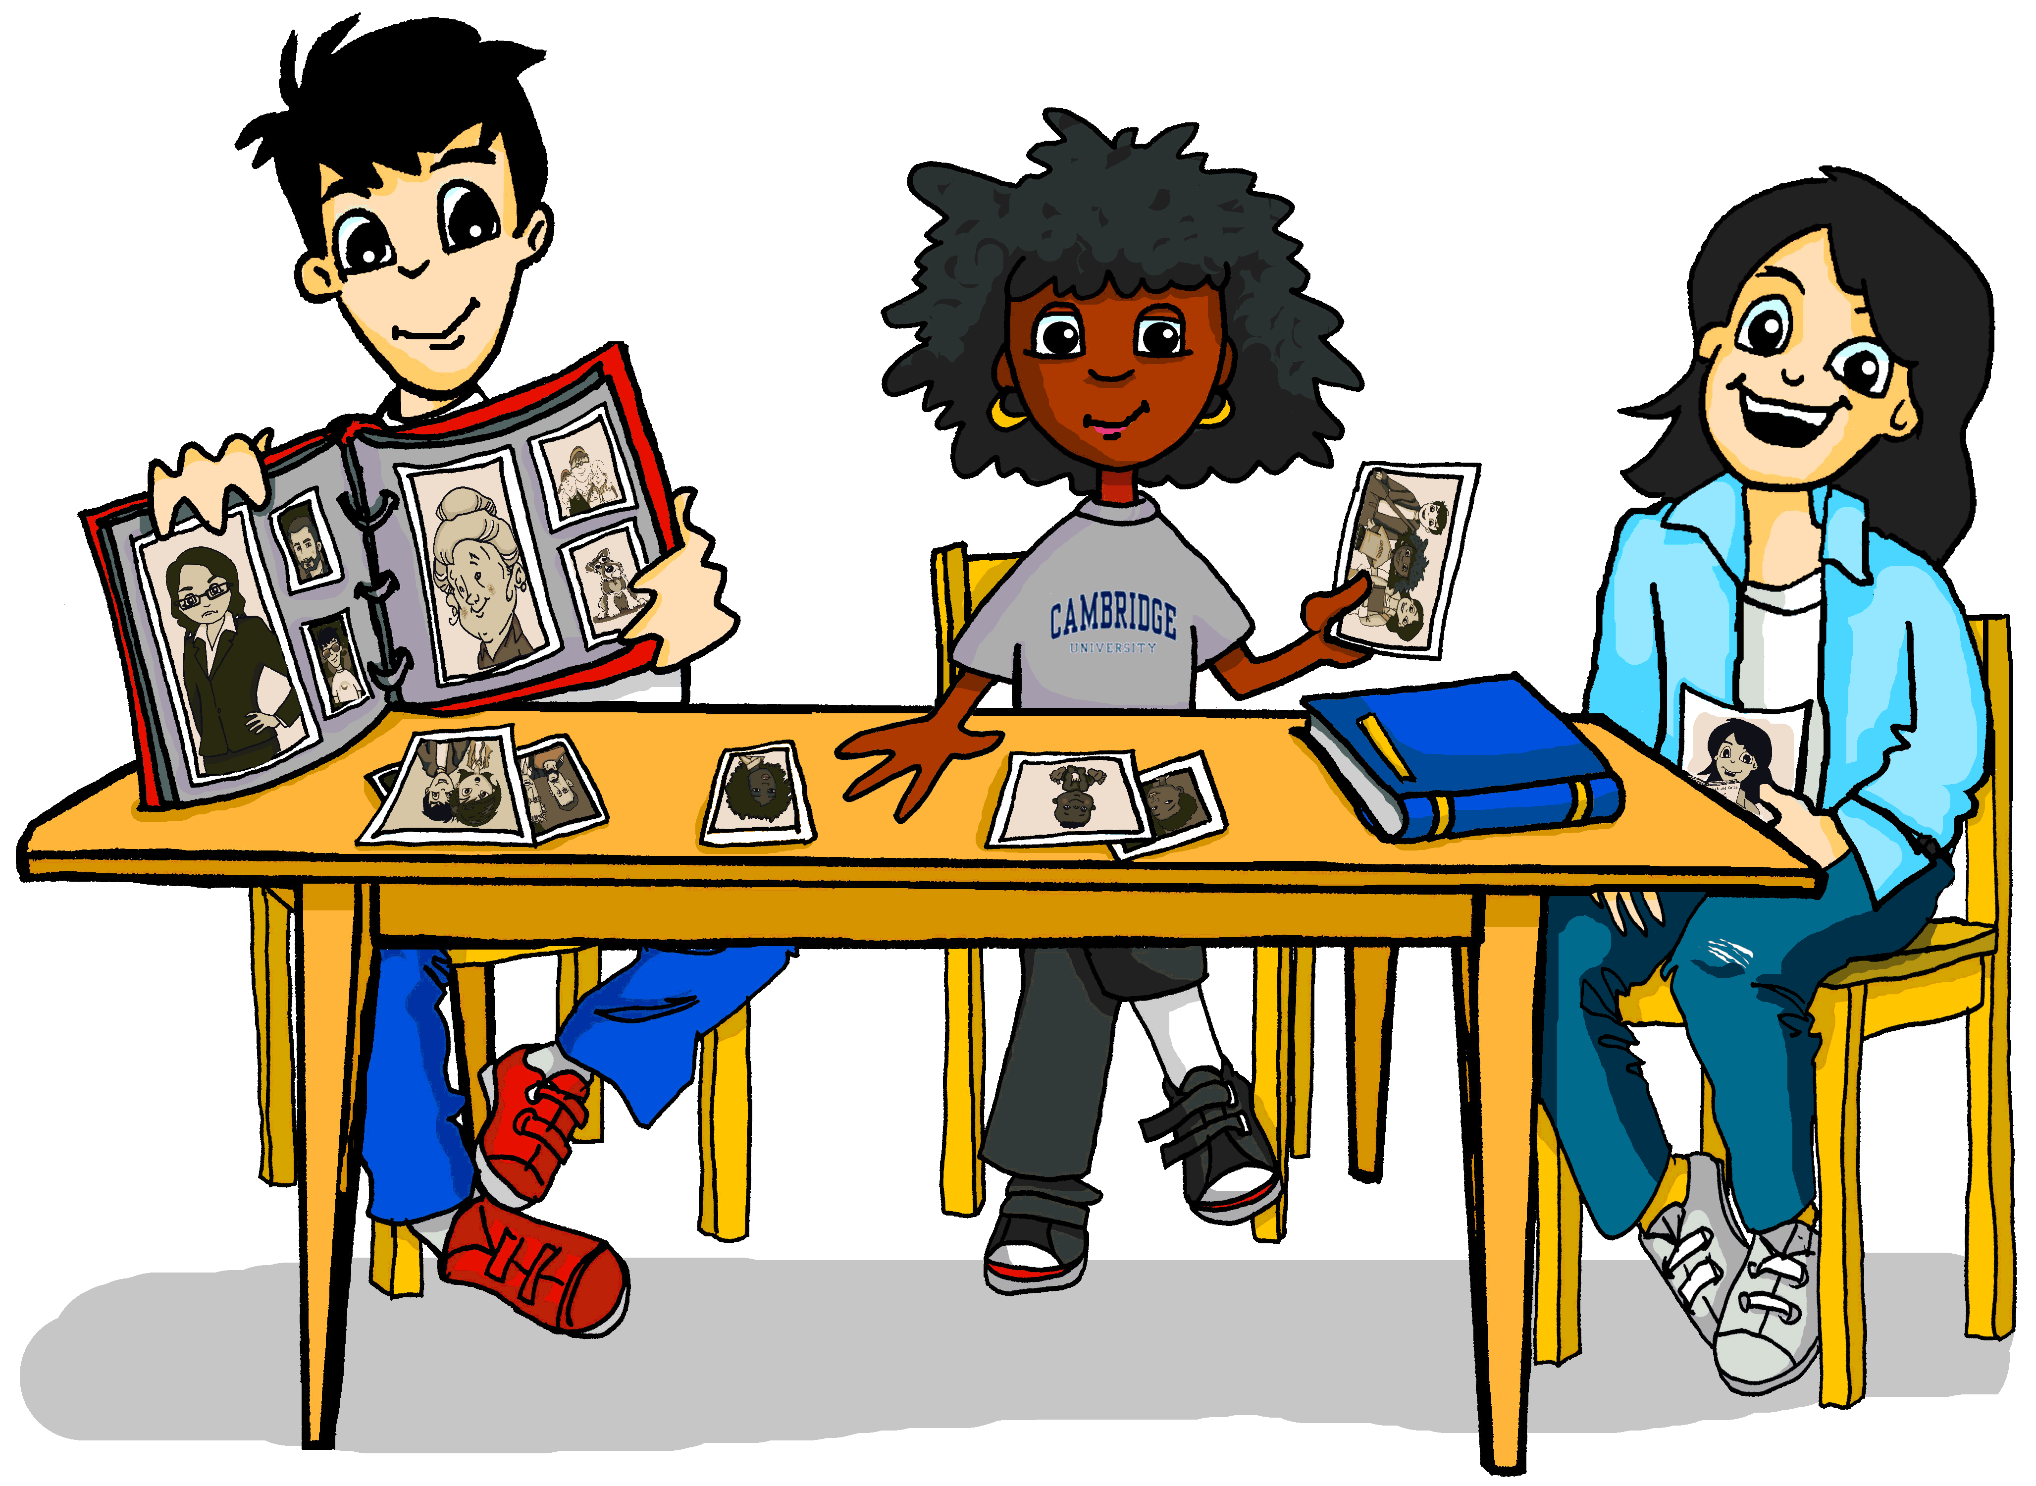
Mia redet über ihre Familie
hören
Spelling difference: -el → -ler – dunkel → dunkle(r,s)
 |  | A | B
 | Meine Mutter hat schwarze
 | Sie hat eine dunkle
 | Sie hat eine kleine
 | Sie hat ein freundliches
 | Wir haben einen ähnlichen
1
2
3
4
5
Notes:
Timing: 6 minutes Aim: Referential listening activity to practise noticing articles and word endings. Procedure: 1. Click to reveal the first pair of pictures. Bringing up the sets of pictures one at a time avoid sensory overload and helps focus on each pair of options in turn. 2. Click on a number to play the sentence.
3. For each item select the picture that could complete the picture.
4. Click to reveal and check answers.
Transcript: 1. Meine Mutter hat schwarze [Haare / Jacke]
2. Sie hat eine dunkle [Augen / Hose]
3. Sie hat eine kleine [Nase / Mund]
4. Sie hat ein freundliches [Gesicht / Hund]
5. Wir haben einen ähnlichen [Mund / Nase]

Slide 22
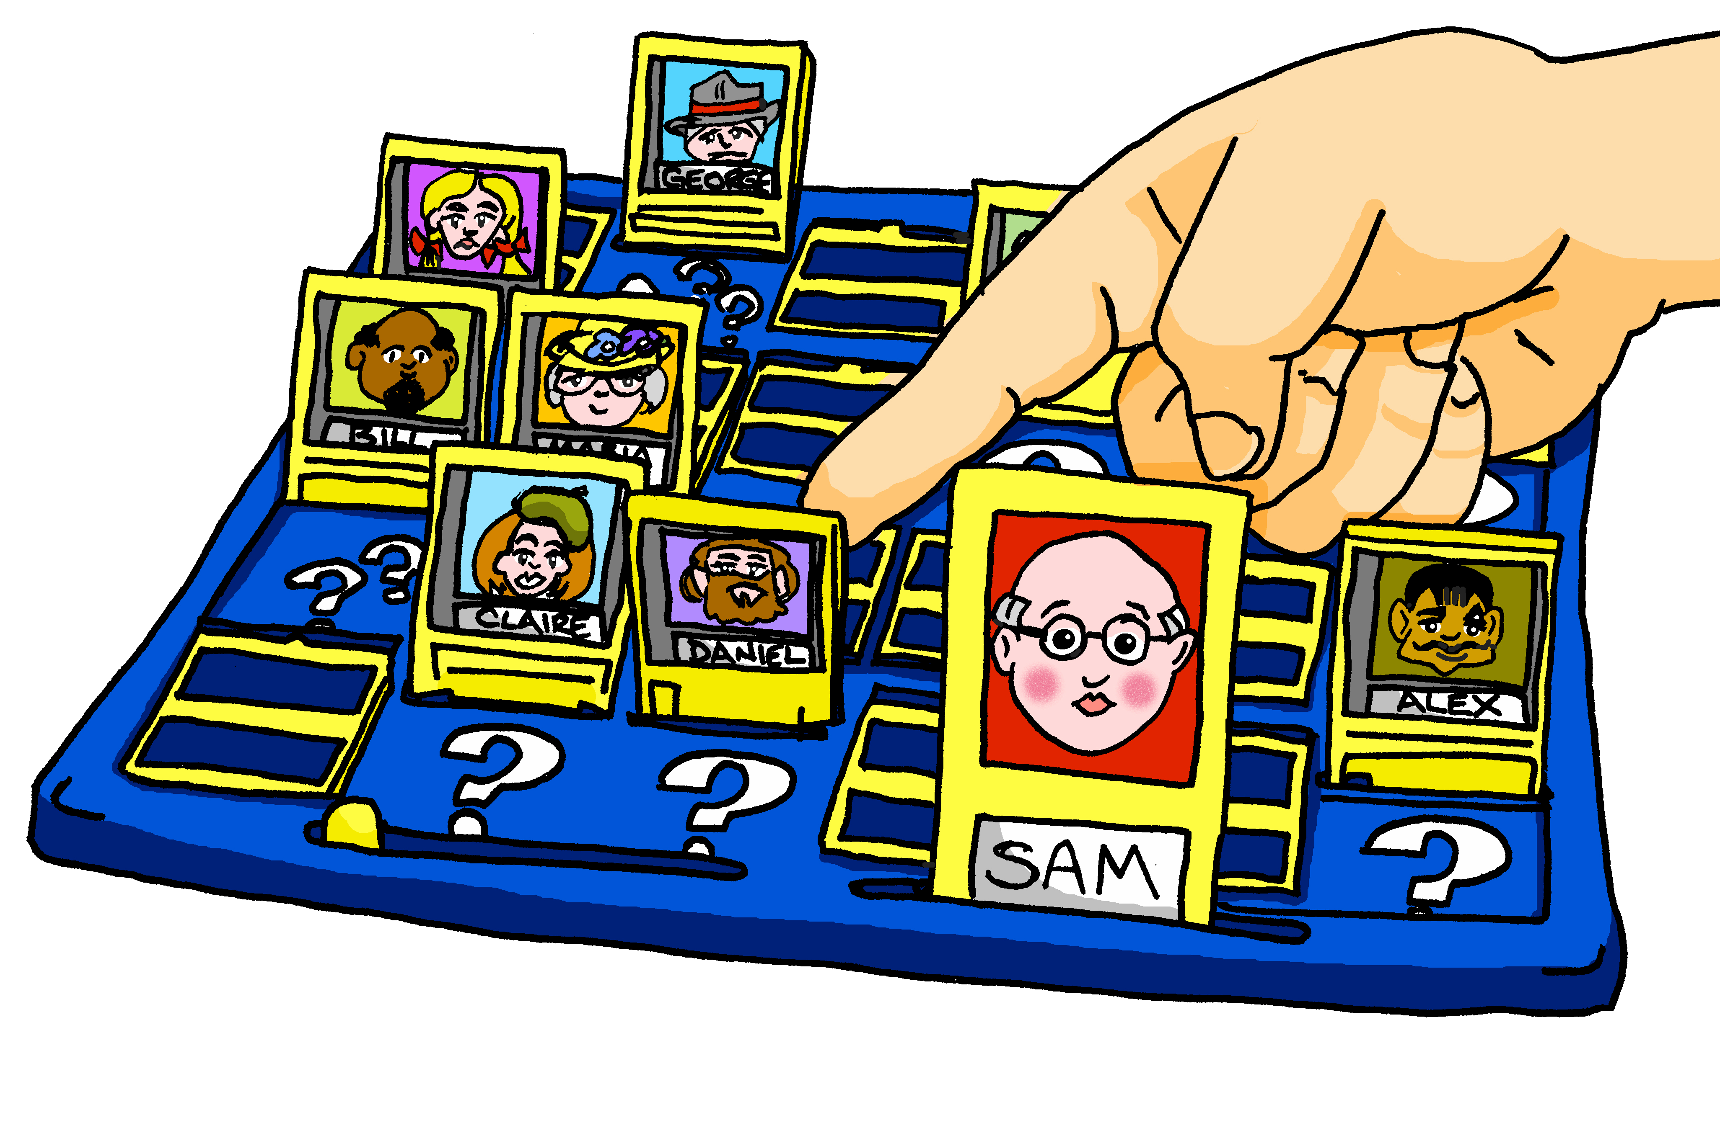
Wer bin ich?
sprechen
Person 1
Small mouth
Small face
Small nose
Small eyes
Small hat
Small child
Person 2
Small nose
Small eyes
Small face
Big hat
Small child
Small mouth
Person 3
Big face
Big hat
Big child
Big eyes
Big mouth
Big nose
Person 4
Small hat
Small face
Small eyes
Small nose
Big child
Small hat
Person 5
Big eyes
Small hat
Big face
Big mouth
Big nose
Big child
Person 6
Small child
Big mouth
Big nose
Big face
Big eyes
Big hat
Notes:
Timing: 8 minutes Aim: Practising using adjectives in Row 2 (accusative) in a Q&A game interaction. Procedure: 1. Person A picks a card for person B. Person B then asks questions to find out who they are (e.g. Habe ich einen kleinen Mund?)
2. When person B has enough information they guess which card it is.
3. The activity repeats with roles swapped.

Slide 23
Ein Profil
schreiben
Schreib Profil 1, 2, oder 3.
Benutze alle Verben.
sein
tragen
haben
Beschreib: - die Kleidung - das Gesicht - die Haare - den Körper - den Charakter - die Laune*
Profil 1
1.
2.
3.
4.
5.
Profil 2
1.
2.
3.
4.
5.
Profil 3
1.
2.
3.
4.
5.
* die Laune - mood
Notes:
Timing: 10 minutes Aim: To practise writing using the new grammar. Procedure: 1. Pick one of the pictures and write a 5 sentence profile.
2. Use the verbs on the left at least once.

Slide 24
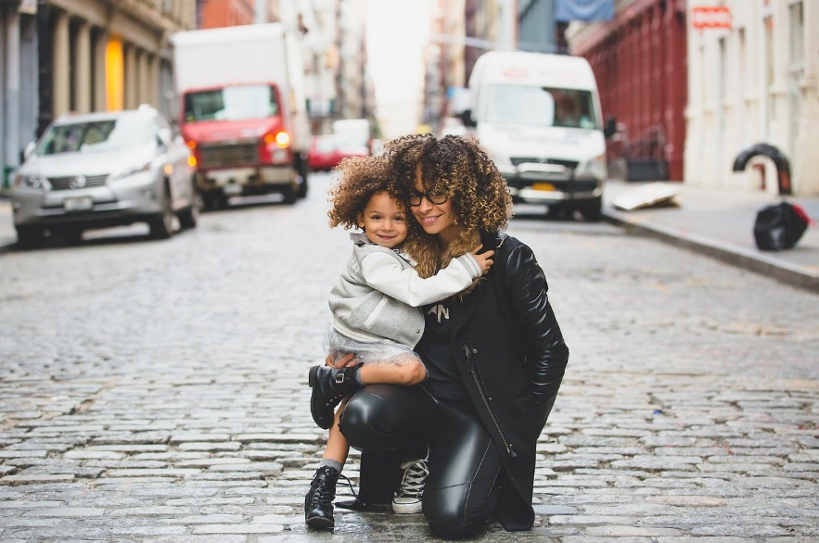
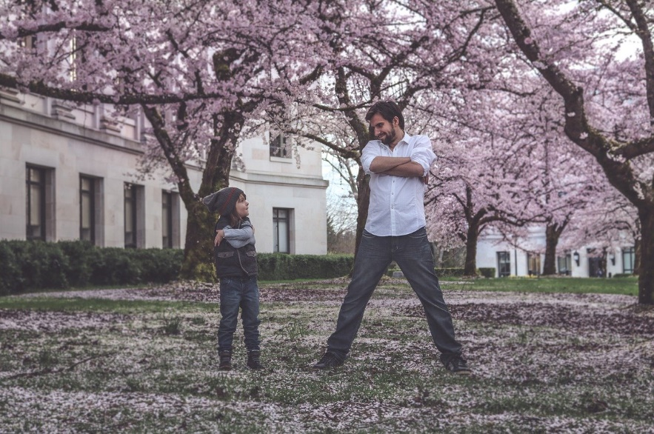
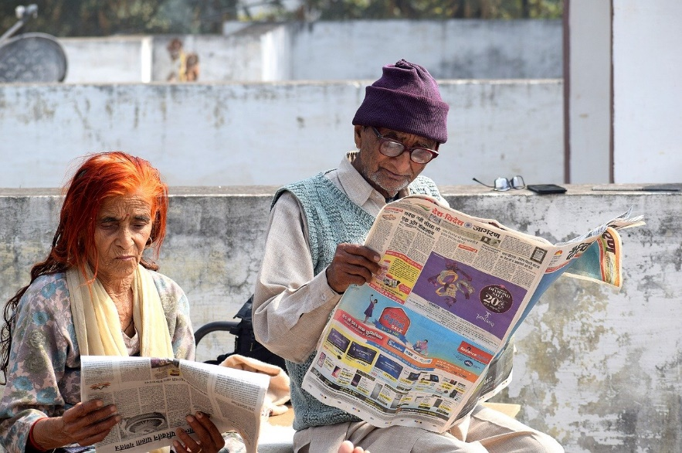
Ein Foto beschreiben
schreiben
Beschreib Foto 1, 2, oder 3.
1
2
3
Notes:
Timing: 5 minutes This could be an alternative, more challenging writing than the previous slide. Or it could be an extension task, or a homework task, or part of an assessment later this term. Aim: To practise writing using the new grammar. Procedure: 1. Pick one of the pictures and write a 5 sentence description.

Slide 25
Wie sieht sie aus? Wie sieht er aus?
Describing others
Adjective agreement SSC [r]
Y8 German
Term 1.1 – Week 6 - Lesson 12 Inge Alferink / Rachel Hawkes
Artwork: Steve Clarke
Date updated: 01/09/23
Notes:
Artwork by Steve Clarke. All additional pictures selected are available under a Creative Common license; no attribution required.
Note: All words listed below for this week’s learning (new and revisited sets) appear on all three Awarding Organisations’ word lists, with the following exceptions:
i) Edexcel list does not have Frankreich, Spanien.
Learning outcomes (lesson 1):
Introduction of SSC [r]
Introduction of adjective agreement with singular indefinite articles in R2 (accusative case).
Word frequency (1 is the most frequent word in German):
8.1.1.6 (introduce) verbringen [1391] Auge [222] Gesicht [346] Haar [748] Mund [856] Nase [1264] Schüler [557] Zeit [96] ähnlich [437] breit [847] dünn [1739] neu [84] rund [298] als [22]
8.1.1.2 (revisit) gegessen [323] gelegen [118] gesprochen [161] geschrieben [184] gesungen [1063] getroffen [259] getrunken [634] treffen [259] Frankreich [813] Sommer [771] Spanien [1745] bisher [441] welcher, welche, welches [122]
7.3.1.4 (revisit) Bruder [687] Eltern [351] Geschwister [3090] Kind [106] Schauspieler [2202] Schwester [776] mein1 [53] dein1 [225] ihr1[26] sein [36] über1 [48]

Slide 26
Feminine names for jobs
Note that you don’t say ‘a’ with jobs.
Vokabeln
Feminine words for jobs often add –in to the end.
She is a teacher.
Sie ist Lehrerin.
What would the following words be in German?
female friend / girlfriend
female pupil
female journalist female tourist Choose one and write a sentence in German.
Translate these sentences.
1. Die Ärztin ist nett.
2. Mia is my partner.
The letters ‘a’, ‘o’ and ‘u’ in the male form sometimes change to ‘ä’, ‘ö’ and ‘ü’
Notes:
Timing: 8 minutes Aim: To develop word knowledge, making links between the masculine and feminine forms of jobs / roles. Procedure: 1. Click through the animations to present the pattern.
2. Complete the short tasks.
3. Answers (with audio) are on the next slide.
Note: Students have already learnt Lehrer / Lehrerin, Freund/Freundin and Arzt/Schüler in Y7. They need to be told that Partner, Journalist and Tourist are cognates.
Word frequency of other words with this pattern (words in bold are included in the task): Freund [273] Kollege [440] Kunde [519] Präsident [546] Schüler [556] Lehrer [695] Patient [620] Arzt [622] Mitarbeiter [639] Autor [723] Künstler [789] Spieler [822] Chef [975] Sprecher [999] Trainer [1003] Student [1017] König [1087] Politiker [1140] Partner [1172] Forscher [1246] Nachbar [1283] Vertreter [1303] Tourist [1318] Experte [1437] Journalist [1480] Polizist [1433] Gegner [1532] Leser [1533] Bauer [1548] Bürgermeister [1600] Schauspieler [1704] Amerikaner [1741] Beamte [1806] Kanzler [1983] Manager [2174] Sportler [2565] Musiker [2577] Gastgeber [3008] Sänger [3029] Engländer [3903]
Source: Jones, R.L. & Tschirner, E. (2019). A frequency dictionary of German: core vocabulary for learners. Routledge
Note: This would combine well with the introduction of the plural rule for these feminine nouns, i.e. +-innen.

Slide 27
Antworten
1
Die Ärztin ist nett.
Mia is my partner.
female friend
female pupil
female journalist
female tourist
The doctor is nice.
Mia ist meine Partnerin.
die Freundin
die Schülerin
die Journalistin
die Touristin
2
3
4
5
6
What do you notice about the gender of these nouns?
der Schüler → die Schülerin
Don’t forget to pronounce the words.

Slide 28
Karaoke SSC
sprechen
Sag das deutsche Wort für jede Nummer.
6
Lehrerin
3
Schülerin
2
Partnerin
1
Sängerin
10
Kaiserin
4
Kanzlerin
5
Touristin
9
Sportlerin
8
Musikerin
7
Bankerin
Notes:
Timing: 5 minutes
Aim: Aural consolidation of SSC [r] with some known and some unfamiliar vocabulary. Several words pick up on the pronunciation difference between masculine role nouns and their feminine equivalents, which involves the SSC [r] within words. Pronunciation is very different from English, formed at the back of the throat without using the lips at all.
Procedure:
Click to highlight a word.
Say the word out loud, focusing on the SSC.
Click on the number button next to the word to check pronunciation.
Repeat as needed.
Transcript and word frequency (1 is the most frequent word in German):
1. Sängerin
2. Partnerin
3. Schülerin
4. Kanzlerin
5. Touristin
6. Lehrerin
7. Bankerin
8. Musikerin
9. Sportlerin
10. Kaiserin

Slide 29
Wolf redet mit Mia über die Ferien
hören und lesen
Mutti hat Recht*!
Letztes Jahr hast du viel im Sommerurlaub gemacht.
Du hast den tollen Wasserpark besucht! Du hast auch am Strand gespielt und im Café leckere Kekse gegessen. Und letzte Woche haben deine guten Freunde dich besucht. Wir haben zusammen einen neuen Film gesehen! Du hast auch im Theater ein schönes Lied gesungen! Und das große Schwimmbad macht immer Spaß.
Das ist bisher kein schlechter Urlaub!
Hör zu. Schreib 1 – 8. Schreib die Wörter.
1
5
Ist das R1 oder R2?
1.___________________
2
6
3
7
2.__________
4
8
3. __________
4._______
__
5._______
6._______
Ja, richtig! Vielleicht können wir nächstes Jahr Frankreich, Spanien, oder ein anderes Land besuchen!
__________
7. __________
8. ___________
__________
*Recht haben = to be right
Notes:
Timing: 12 minutes
Aim: To practise understanding of new language in the oral modality, segmentation and transcription. To then reflect on explicit knowledge of the new grammar in the written modality.
In terms of the storyline, Mia‘s mother‘s answer has reassured the twins, and they are now realising that they have not had such a bad time at home this summer!
Procedure
1. Click on the numbers to play the recording.
2. Write down the missing words. Note that there is always more than one missing word: (article) + adjective + noun. Students need to be able to segment stream of audio into these separate words in order to write them down accurately.
3. Click on the mouse to reveal and check answers.
4. Read the full text and decide for each gap whether the noun is R1 or R2 (Note that this stage can be omitted by removing the prompt.
5. Optional - Listen to the full recoding (click on the speech bubble). 6. Optional - Students can be asked to translate the text orally, if time.
Transcript
(Wolfgang)
Mutti hat Recht*!
Letztes Jahr hast du viel im Sommerurlaub gemacht.
Du hast den tollen Wasserpark besucht! Du hast auch am Strand gespielt und im Café leckere Kekse gegessen. Aber letzte Woche haben deine guten Freunden dich getroffen. Ihr habt zusammen einen neuen Film gesehen! Du hast auch im Theater ein schönes Lied gesungen! Und das große Schwimmbad macht immer Spaß.
Das ist bisher kein schlechter Urlaub!
(Mia)
Ja, richtig! Vielleicht können wir nächstes Jahr Frankreich, Spanien, oder ein anderes Land besuchen!

Slide 30
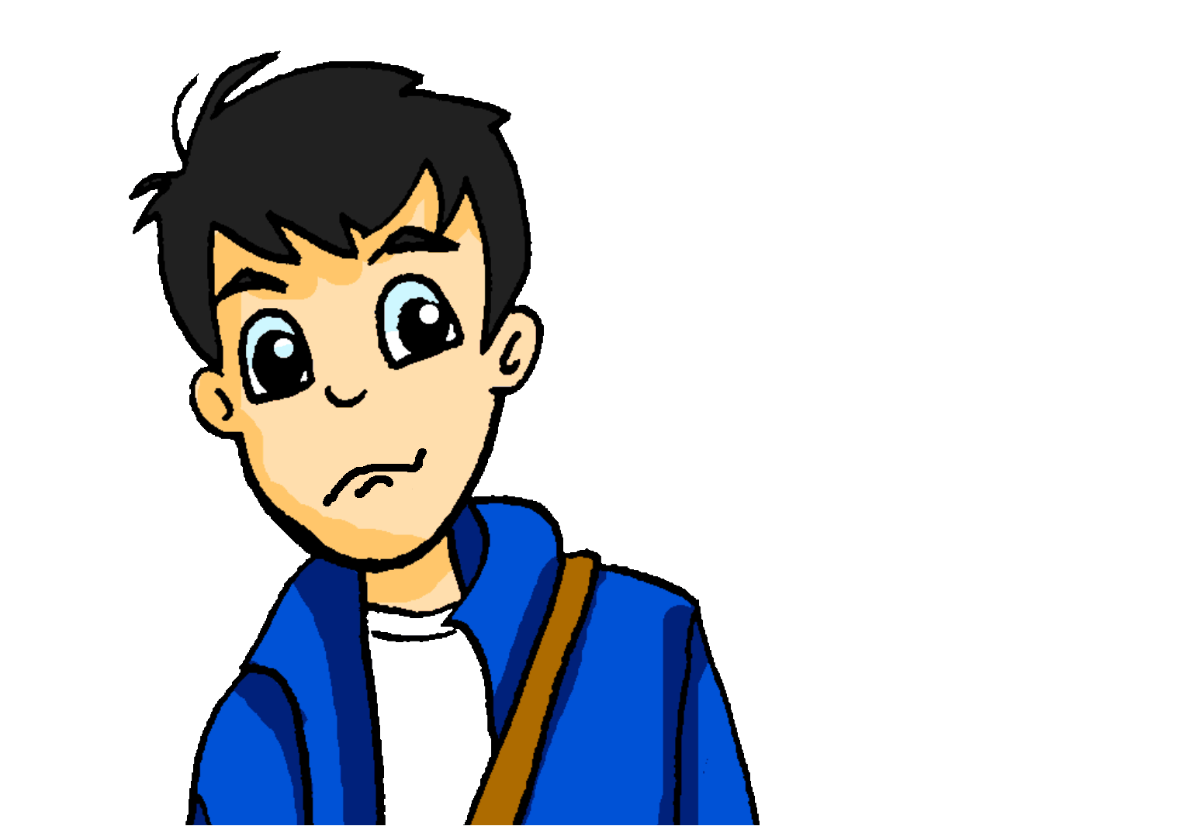
eine Postkarte aus Berlin
???
schreiben
Wolfgang versteht Andreas Postkarte nicht. Kannst du sie auf Deutsch schreiben?
Dear Mum and Dad,
How are you? I am having a lot of fun with Wolfgang and Mia. Mia’s friends are very nice. As a person Katja is great. She has violet hair and always wears interesting clothing!
I also like Heidi a lot. She is Wolfgang’s girlfriend and is always friendly. Mia and Wolfgang also showed me family photos.
The kids and their mum have very similar hair and eyes! See you soon, Andrea
Violett will need an ending to match plural Haare.
Note: Ich habe grüne Augen.
violet – violett me - mir
Notes:
Timing: 12-15 minutes Aim: To bring together previous and new vocabulary and grammar in writing. Procedure: 1. Translate the text.
2. Correct the text, using the next slide. Note: Students learnt ‘mir’ as a lexical item within one or two particular contexts in Y7. Later in Y7 they will be taught indirect object

Slide 31
eine Postkarte aus Berlin
???
schreiben
Wolfgang versteht Andreas Postkarte nicht. Kannst du sie auf Deutsch schreiben?
Liebe Vati und Mutti,
Wie geht’s? Ich habe viel Spaß mit Wolfgang und Mia. Mias Freunde sind sehr nett. Als Person ist Katja ganz toll. Sie hat violette Haare und trägt immer interessante Kleidung!
Ich mag Heidi auch sehr. Sie ist Wolfgangs Freundin und ist immer freundlich.
Mia und Wolfgang haben mir auch Familienfotos gezeigt. Die Kinder und ihre Mutter haben ganz ähnliche Haare und Augen! Bis bald, Andrea
violet – violett me - mir

Slide 32
Wer bin ich?
sprechen
1
2
3
4
Hat diese Person…?
Trägt diese Person…?
Ist er / sie Nummer [5]?
5
6
7
8
9
10
11
12
eine Brille – a pair of glasses
Notes:
Timing: 4-5 minutes per round Aim: To practise adjectives in the spoken modality. Procedure: 1. This is a version of Guess Who to be played in pairs.
2. Both players pick a person from the board.
3. Take turns asking each other questions until one of you arrives at the answer.
4. The game can be repeated.

Slide 33
Hausaufgaben
Vocabulary Learning Homework (Y8, Term 1.1, Week 7)
Audio file
Student worksheet
In addition, revisit: Year 8 Term 1.1 Week 3
Year 7 Term 3.1 Week
Notes:
The answer sheet for the Y8 vocabulary learning HW is here: https://rachelhawkes.com/LDPresources/Yr8German/German_Y8_Term1i_Wk7_audio_HW_sheet_answers.docx
Notes:
i) Teachers may, in addition, want to recommend use of a particular online app for the pre-learning of each week’s words. ii) Quizlet now requires parental involvement / registration / permissions for users below the age of 13, so it is perhaps most suitable for Y9 – 11 students. iii) Language Nut hosts LDP vocabulary lists and these are free for schools to use, though there is a registration process. One benefit is that all of the student tracking data that Language Nut offers are also available to schools that use the LDP lists for practice. Perhaps this makes it a good option for Y7/8.
iv) There are other free apps, and new ones are always appearing. Teachers have told us that they are currently using: Flippity, Wordwall (where using previously-created activities is free).
v) Gaming Grammar has been acquired by Language Nut. Its original content should still be available to teachers and much of it is appropriate for Y8 learners.

Slide 34
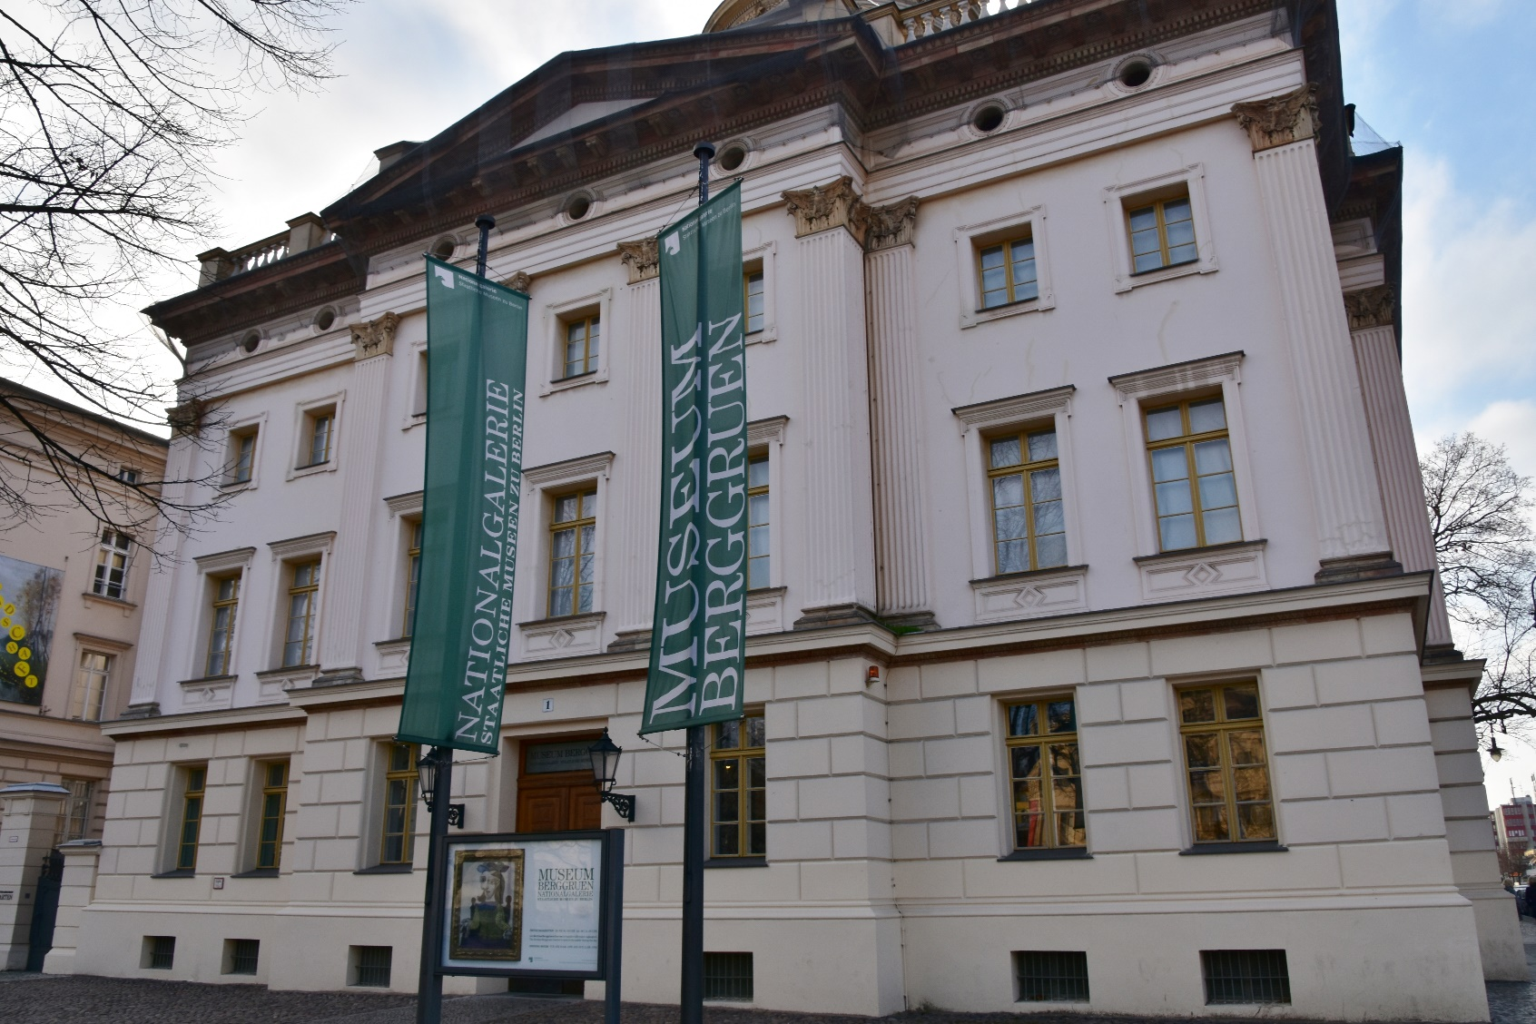
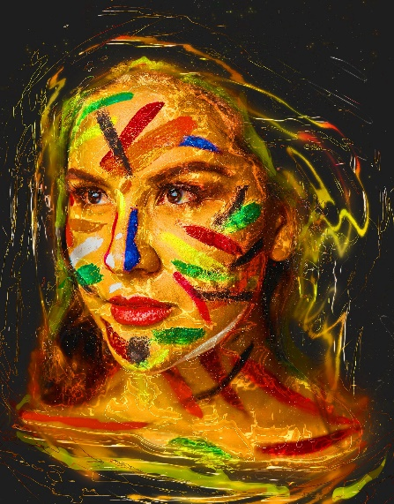
Ein Museumbesuch
lesen
Andrea hat in Berlin das Museum Berggruen besucht. Sie muss ein Kunstwerk* beschreiben.
*Kunstwerk = work of art
Notes:
OPTIONAL ADDITIONAL ACTIVITY Timing: 5 minutes (two slides) Aim: To apply new grammatical and vocabulary knowledge to the understanding of a short text. Procedure: 1. Use this slide to set the context. Ensure that the two sentences are understood, and draw attention to the compound noun title.
2. Number 1-8. Write the phrases that are missing.
3. Check answers.
Note: this could potentially be a springboard for a description of a person in a different piece of art, or photo.

Slide 35
ein Kunstwerk beschreiben
lesen
Leider hat Andrea ihre Notizen verloren*. Kannst du helfen? Schreib das richtig.
ein rotes
Es gibt eine Frau. Sie hat ein blaues Auge und ein rotes Auge. Sie hat auch einen grünen Mund und ihre Nase ist breit. Sie trägt einen vielfarbigen Hut. Ihr trauriges Gesicht ist grün und gelb und ihre langen Haare haben auch zwei Farben. Sie ist wirklich speziell!
breit
1._______
ein blaues
2.______
3._______
ihre langen
4._____
grün und gelb
5. ____________
6. ___________
ihr trauriges
7. ___________
8._______
einen vielfarbigen
einen grünen
verloren = lost
Notes:
Procedure cont’d:
2. Number 1-8. Write the phrases that are missing.
3. Check answers. Note: 1 and 2 are interchangeable.

