Slide 1
Diesen Sommer
Present vs past (perfect): weak verbs
SSC [ie] vs [ei]
Y8 German
Term 1.1 – Week 1 - Lesson 1 Inge Alferink/ Rachel Hawkes
Artwork: Steve Clarke
Date updated: 30/08/23
Notes:
Artwork by Steve Clarke. All additional pictures selected are available under a Creative Common license; no attribution required.
Note: All words listed below for this week’s learning (new and revisited sets) appear on all three Awarding Organisations’ word lists, with the following exceptions: Edexcel list does not have – Tour, erhalten, mischen or Punkt.
Learning outcomes (lesson 1)
Revisit of SSCs [ie] and [ei]
Introduction of present and past tense weak verbs: 1st person singular.
Frequency rankings of vocabulary introduced and revisited this week (1 is the most common word in German):
8.1.1.1 - besuchen [820] erleben [570] kaufen [506] August [1929] Ferien [3448] Juli [1544] Kleidung [2820] Kultur [594] Spaß [1045] Tour [2640] Türkei [922] dieser, diese, dieses [24] letzter, letzte, letztes [152] schon [61] selbst, selber [101] 7.3.2.4 - ziehen [266] gewinnen [408] erhalten [283] beginnen [239] legen [296] werfen [672] mischen [2105] das Ziel [325] die Mitte [756] der Punkt [427] jeder, jede, jedes [88]
7.2.2.5 - lassen [82] nehmen [141] halten [144] dann [33] zuerst [726] spät(er) [171] danach [437] schließlich [307] deshalb [264]
Jones, R.L & Tschirner, E. (2019). A frequency dictionary of German: Core vocabulary for learners. London: Routledge.

Slide 2
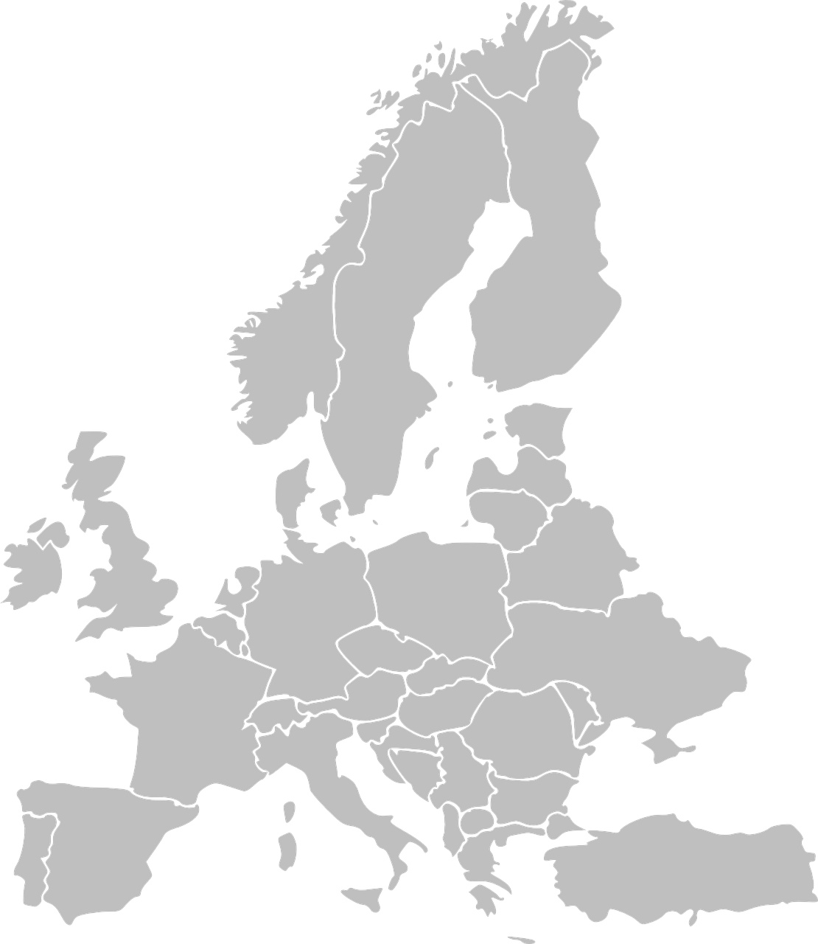
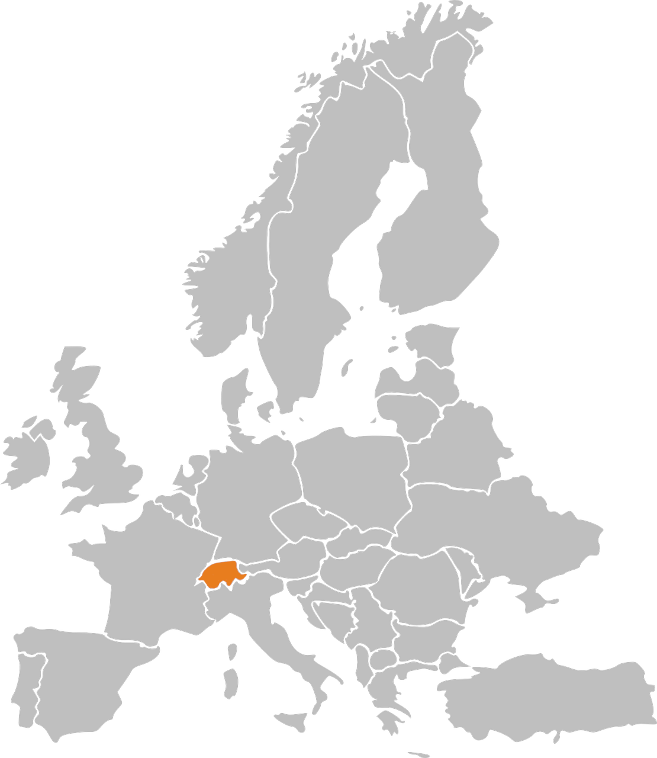
Phonetik: Stadt oder Land?
hören / schreiben
1
die Schweiz
Notes:
Timing: 8 minutes Aim: to revisit and practise the distinction between [ie] and [ei] Procedure: 1. Write 1-10.
2. Click on the number to play the sound. Note: each word is said TWICE. Transcribe either the whole word OR just the SSC [ei] / [ie].
3. Click again for spelling to appear.
4. Bist du in einer Stadt oder einem Land?
5. Click will reveal Stadt oder Land.
Transcript: die Schweiz
die Türkei
Wien
Kiel
Freiburg
Italien
Liechtenstein
Österreich
Spanien
Lienz

Slide 3
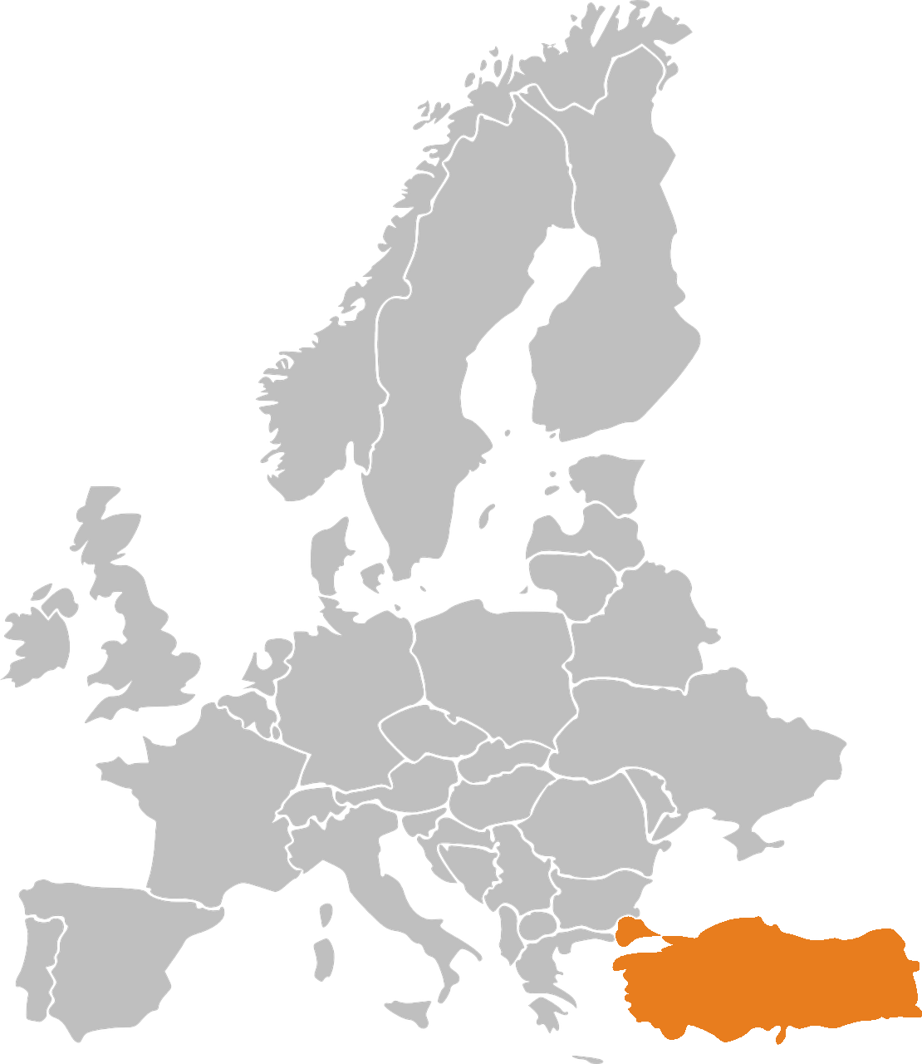
Phonetik: Stadt oder Land?
hören / schreiben
2
die Türkei
Notes:
[2/10]

Slide 4
Phonetik: Stadt oder Land?
hören / schreiben
3
Wien
Notes:
[3/10]

Slide 5
Phonetik: Stadt oder Land?
hören / schreiben
4
Kiel
Notes:
[4/10]

Slide 6
Phonetik: Stadt oder Land?
hören / schreiben
5
Freiburg
Notes:
[5/10]

Slide 7
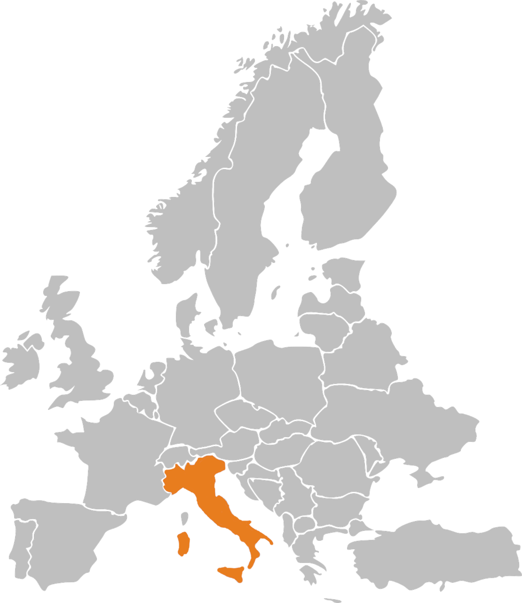
Phonetik: Stadt oder Land?
hören / schreiben
6
Italien
Notes:
[6/10]

Slide 8
Phonetik: Stadt oder Land?
hören / schreiben
7
Liechtenstein
Notes:
[7/10]

Slide 9
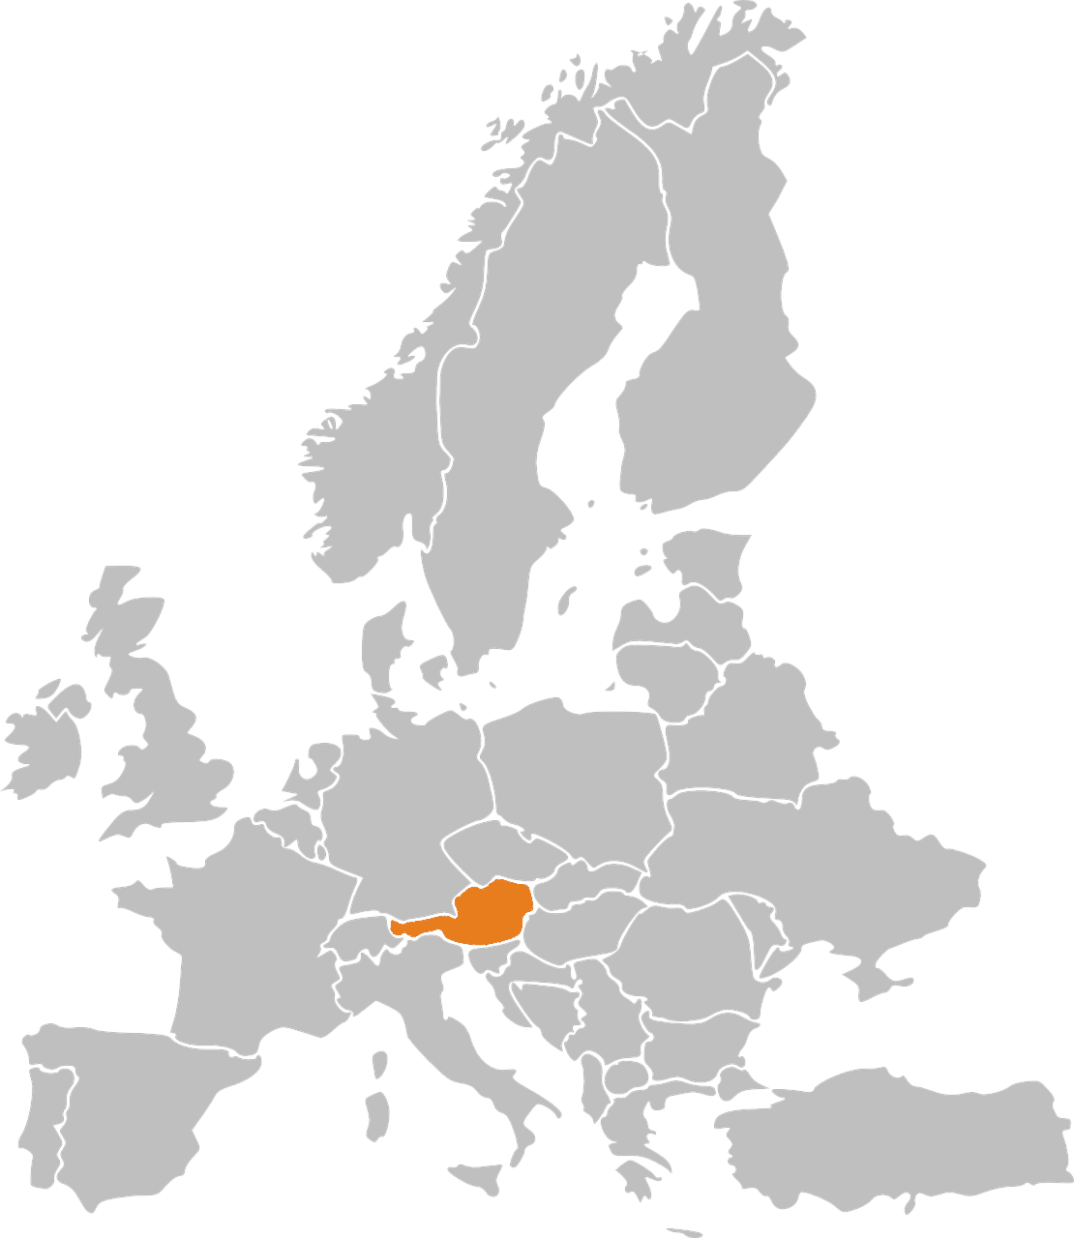
Phonetik: Stadt oder Land?
hören / schreiben
8
Österreich
Notes:
[8/10]

Slide 10
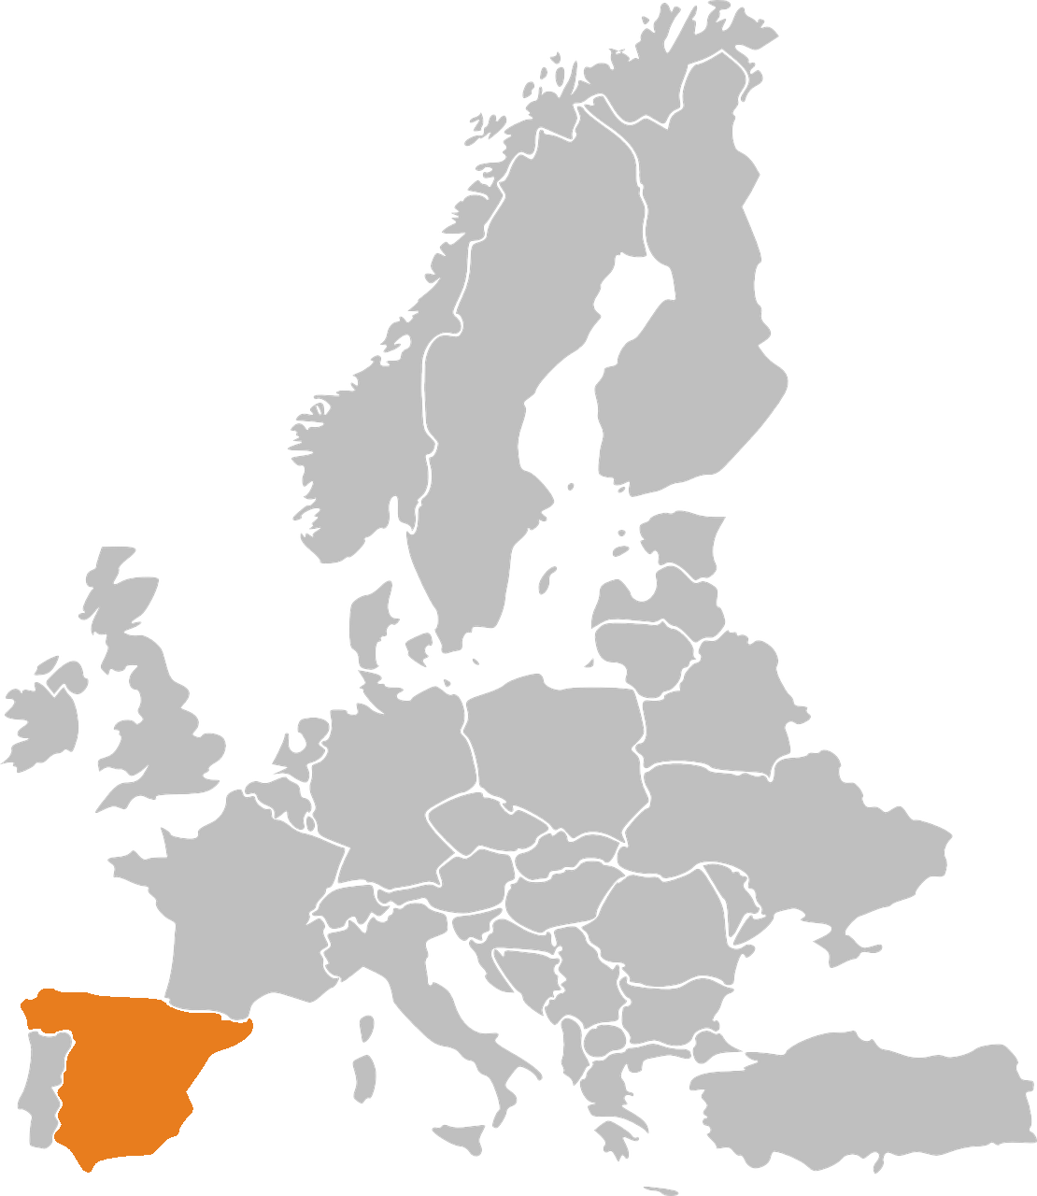
Phonetik: Stadt oder Land?
hören / schreiben
9
Spanien
Notes:
[9/10]

Slide 11
Phonetik: Stadt oder Land?
hören / schreiben
10
Lienz
Note that when followed by –n, [ie] sometimes sounds as two syllables. Wie sagt man…? Spanien Italien Lienz
Notes:
[10/10]

Slide 12
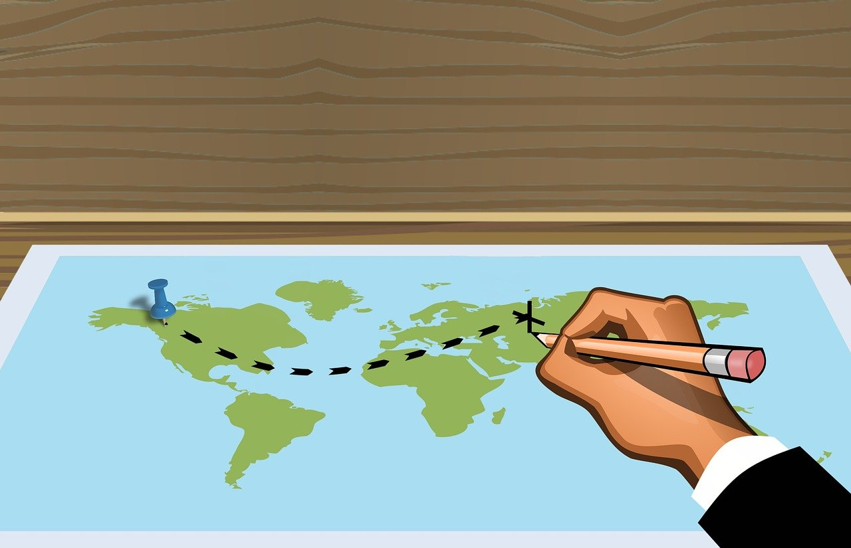
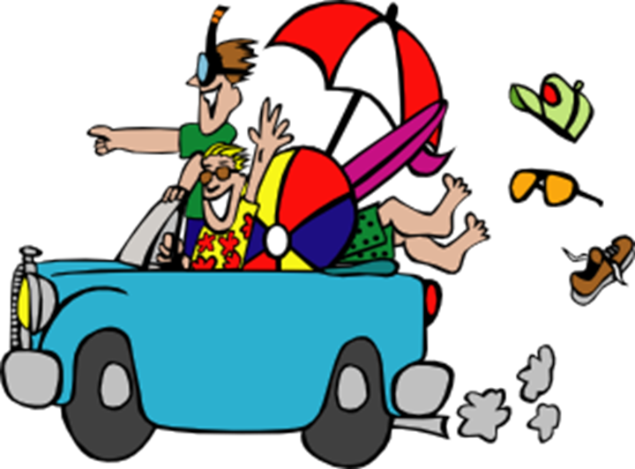
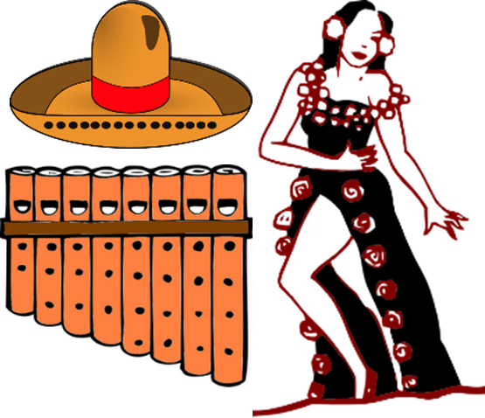
Vokabeln
Wie sagt man das auf Deutsch?
lesen / sprechen
(the) holidays
this, that
(the) tour
to experience
to buy
last
(the) culture
Ferien (holidays) is always plural. Holiday is der Urlaub.
(the) clothing
die Tour
die Kleidung
die Tour
letzt-(er, e, es)
die Kleidung
letzt-(er, e, es)
die Ferien
die Ferien
die Kultur
erleben
dies-(er, e, es)
erleben
dies-(er, e, es)
kaufen
die Kultur
kaufen
Notes:
Timing: 6 minutes (two slides)
Aim: to present and practise read aloud of this week’s vocabulary. Note: students will not have had the chance to pre-learn the vocabulary as this is the start of the new year. Therefore we present it here and practise it again later in the lesson to develop recognition then recall.
Procedure: 1. Click to bring up an English prompt.
2. Students say the German word. 3. Click to check answers. Move to slide 2.
Words:
1. die Kultur 2. erleben 3. die Kleidung 4. kaufen 5. letzter, letzte, letztes 6. dieser, diese, dieses 7. die Tour 8. die Ferien
9. der Spaß
10. schon
11.selbst, selber
12. Juli
13. August
14. die Türkei
15. besuchen

Slide 13
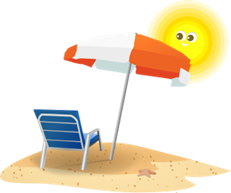
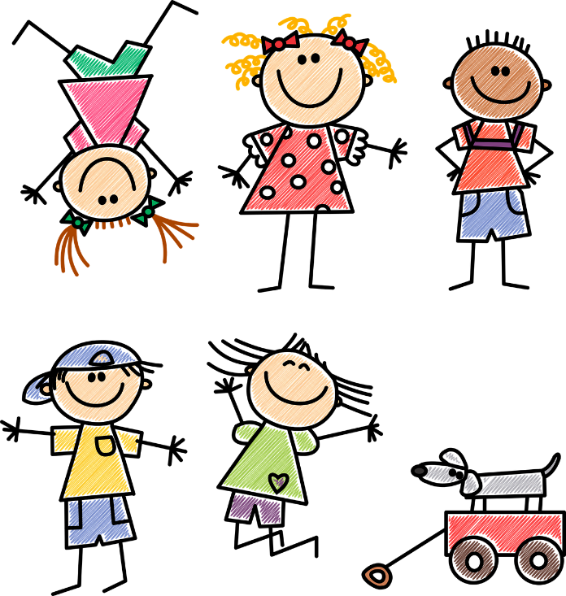
Vokabeln
Wie sagt man das auf Deutsch?
lesen / sprechen
July
to visit
Turkey
-self
already
August
(the) fun
besuchen
August
selbst, selber
besuchen
August
selbst, selber
der Spaß
die Türkei
schon
der Spaß
die Türkei
schon
Juli
Juli
Notes:
Words:
9. der Spaß
10. schon
11.selbst, selber
12. Juli
13. August
14. die Türkei
15. besuchen

Slide 14
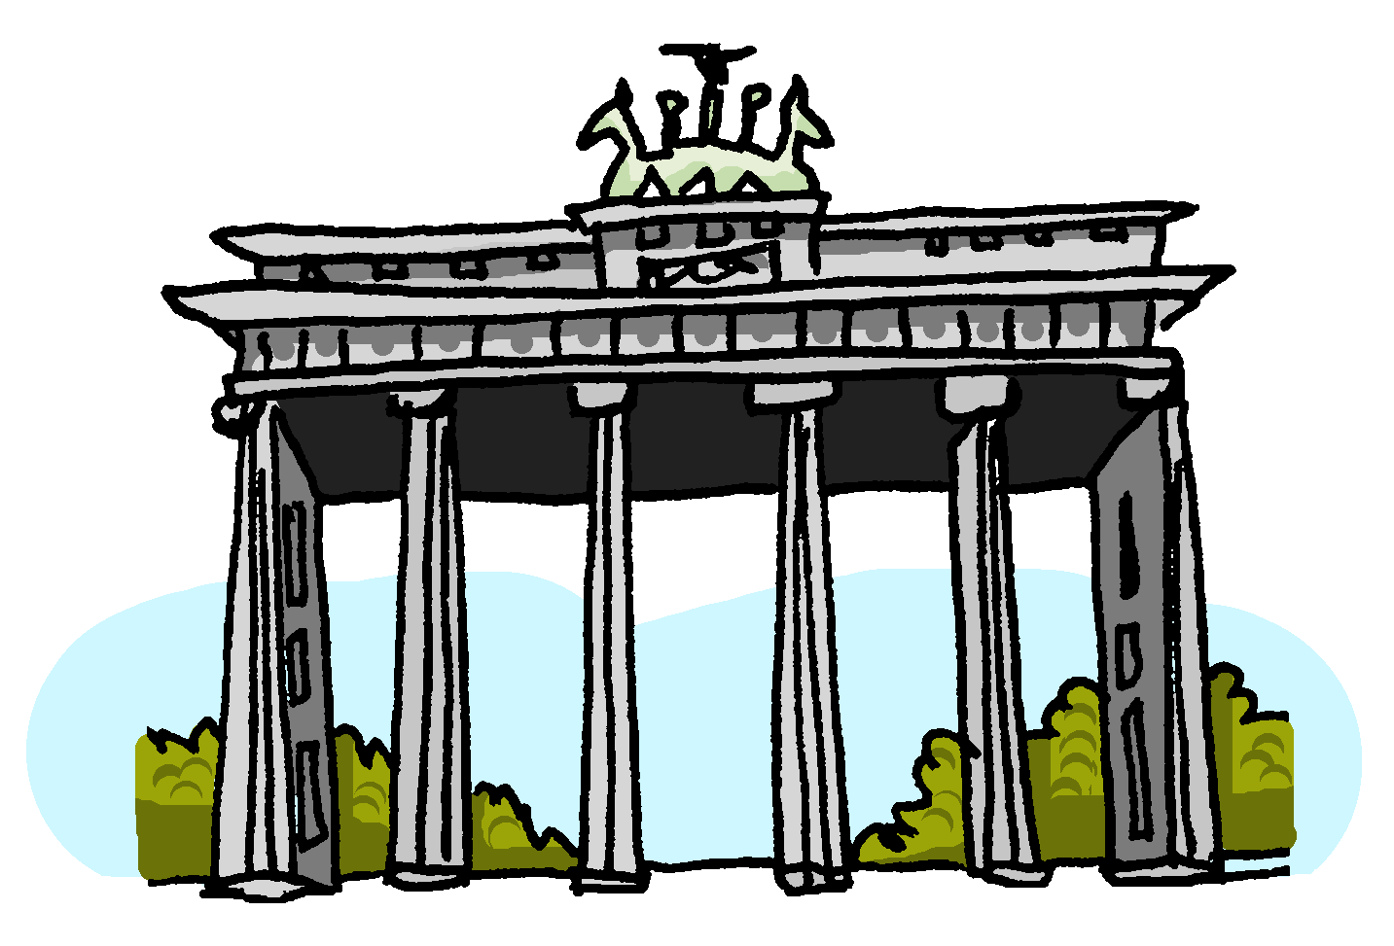
besuchen
[to visit | visiting]
besucht
[visits | is visiting]
Notes:
Timing: 3 minutes for sequence of six slides
Aim: to introduce the long and short forms of the verb ‘besuchen’, bearing in mind that students have had a substantial holiday period and will not have done pre-learning for the lesson. As the learning contrasts present and past (perfect) forms, it is important that students are thoroughly familiar with both the infinitive and short form in the present, before they are presented with the past (perfect) forms.
Procedure
Bring up the word [besuchen] on its own, say it, students repeat it, and remind them of the phonics. Draw attention to [SSC – s (like English ‘z’)]
Try to elicit the meaning from the students. Students have had explicit teaching that the present tense in German communicates two different present tense meanings in English. This reinforces that learning. Emphasise the two meanings for the short form, reminding students that German only has one form and does not have a direct equivalent of the grammar for ‘is + ing’, the continuous form (as covered in previous weeks).
Bring up the picture, and, if using gestures, a possible gesture would be [mime knocking on a door, as though you were going to visit someone’s house].
Then bring up the English translations. Emphasise the two meanings for the infinitive.
Bring up the short form [besucht], say it, students repeat it.
Try to elicit the meaning from the students. Emphasise the two meanings for the short form.

Slide 15
besuchen
[to visit |visiting]
besucht
[visits | is visiting]
Notes:
Cycle through the long and short form again.

Slide 16
besucht
[visits | is visiting]
Sie besucht die Türkei.
[She visits | is visiting Turkey.]
Notes:
Introduce the short form in a sentence.

Slide 17
besuchen
[to visit | visiting]
Sie will ihre Oma besuchen.
[She wants to visit her granny.]
Notes:
Introduce the long form in a sentence.

Slide 18
besucht
[visits | is visiting]
besucht
Sie ________ die Türkei.
[She visits | is visiting Turkey.]
Notes:
Cycle through the short form in context again.

Slide 19
besuchen
[to visit | visiting]
besuchen
Sie will ihre Oma ___________.
[She wants to visit her granny.]
Notes:
Cycle through the long form in context again.

Slide 20
Vokabeln
Wie sagt man das auf Deutsch?
sprechen
die Türkei
besuchen
die Tour
Juli
Turkey
to visit
(the) tour
July
August
die Ferien
schon
der Spaß
August
(the) holidays
already
(the) fun
dies-(er,e,es)
letzt- (er, e, es)
selbst, selber
zuerst
this, that
last
-self
first (of all)
dann
danach
spät(er)
schließlich
then
late(r)
afterwards
finally
die Kultur
erleben
die Kleidung
kaufen
(the) culture
to experience
(the) clothing
to buy
Notes:
Timing: 3 minutes
Aim: to practise oral recall of this week’s new vocabulary and 5 revisited words, in a low stakes but time-limited activity.
Note: at this stage recall of any non-cognate words is likely to be a challenge, but this short activity provides another opportunity to encounter and engage with the form and meaning of these words, progressively strengthening knowledge.
Procedure:
Work from left to right, top to bottom on the word wall. Ask ‘¿Wie sagt man das auf Deutsch?
Click to start the 5-second animation. Pupils say the English word before the animation finishes and reveals the word.
Continue with all words.

Slide 21
Past (perfect) tense
Grammatik
Note the word order! The past participle goes at the end of the sentence.
To talk about what you did, use the present tense of ‘haben’ and a past participle:
Present
Past (perfect)
Ich
mache
eine Tour.
Ich
habe
eine Tour
gemacht.
I’m
doing
a tour.
I
have
done
a tour.
I
do
a tour.
I
did
a tour.
Regular past participles sandwich the stem with ge- and –t.
machen
ge
t
→
mach
Some verbs don’t add –ge!
besuchen → besucht
erleben → erlebt
It would be harder to pronounce them if they did!
spielen
ge
t
→
spiel
kaufen
ge
t
→
kauf
Notes:
Timing: 3 minutes Aim: To explain how to form and use the 1st person singular (I-form) perfect tense in German. Procedure: 1. Present and carefully read each statement.
2. Wherever possible, elicit the English from students before presenting it.

Slide 22
Was schreibt Mia über die Ferien?
lesen
Present or past?
Ich oder ich habe?
 |  | Ich | Ich habe
1. | Ich habe im Juli Freunde besucht.
2. | Ich habe oft im Park Hockey gespielt.
3. | Ich habe keinen Spaß gehabt!
4. | Ich kaufe selbst viel Kleidung.
5. | Ich koche immer das Abendessen.
6. | Ich besuche das Museum.
7. | Ich habe schon eine Bootfahrt gemacht.
_______
_______
_______
_______
_______
_______
_______
Notes:
Timing: 7 minutes Aim: Reading activity to practise noticing the the present form or past participle. Procedure: 1. Remind that it is the presence of a past participle at the end of the sentence that is the cue for ‘ich habe’.
2. Read the sentences.
3. Which word(s) fit in the gap?

Slide 23
Mia telefoniert. Was sagt sie?
hören
Hör dir die Sätze an. Ich oder ich habe?
 | Ich… | Ich habe…
1
2
3
4
5
6
7
Notes:
Timing: 8 minutes Aim: Practising to notice the present form or past participle. Procedure: 1. Click on number to play sound.
2. Say whether they have been done (ich habe xxx) or are being done (ich xxx).
Transcript: 1. [Ich habe] die Stadt besucht.
2. [Ich habe] immer Spaß gehabt.
3. [Ich] mache eine Radtour.
4. [Ich habe] manchmal gekocht.
5. [Ich habe] in der Türkei Kleidung gekauft.
6. [Ich] lerne ein bisschen Türkisch.
7. [Ich] wohne in einem Ferienhaus.

Slide 24
Und auf Englisch?
Grammatik
The perfect tense in German can be translated in two ways in English:
Ich habe Berlin besucht.
→ I have visited Berlin.
→ I visited Berlin.
The English meaning we use often depends on information about when it happened.
Specified times that are finished use simple past.
Ich habe im August Berlin besucht → I visited Berlin in August.
Unspecified, general times in the past use present perfect.
Ich habe oft Berlin besucht → I have often visited Berlin.
Other words to look out for: im Juli, letzten Monat, letztes Jahr.
Other words to look out for: schon, nie
Notes:
Timing: 3 minutes Aim: To present the two different translations of the German perfect tense. Procedure: 1. Go through the information on the slide using the animation.

Slide 25
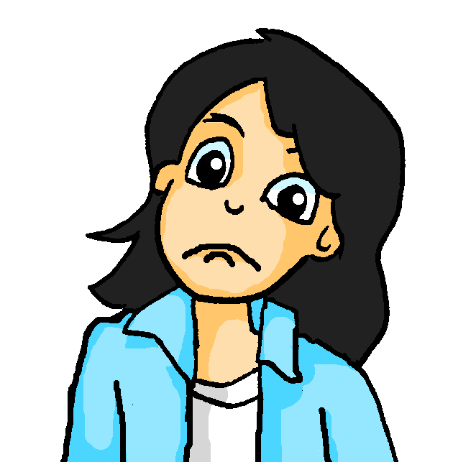
Mia findet Englisch schwierig
lesen
Kannst du helfen? Wie heißen die Säzte auf Englisch?
1 | Letzten Monat habe ich jeden Tag die Stadt besucht.
2 | Ich habe nie in einem Hotel gewohnt.
3 | Ich habe die Kultur in der Türkei schon erlebt.
4 | Ich habe heute morgen das Essen selber gekauft.
5 | Letzte Woche habe ich viel Spaß gehabt.
6 | Ich habe immer meine Kleidung selbst gemacht.
I visited | I have visited
I have never stayed | I never stayed
I already experienced | I have already experienced
I have bought| I bought
I had | I have had
I always made| I have always made
Notes:
Timing: 7 minutes Aim: To practise translating the German perfect tense into English. Procedure: 1. Model the task using number 1. 2. Remind students to look carefully at the temporal adverbs.
3. Complete each sentence and then feed back. This knowledge is very new and the process of establishing it needs to be very supported.

Slide 26
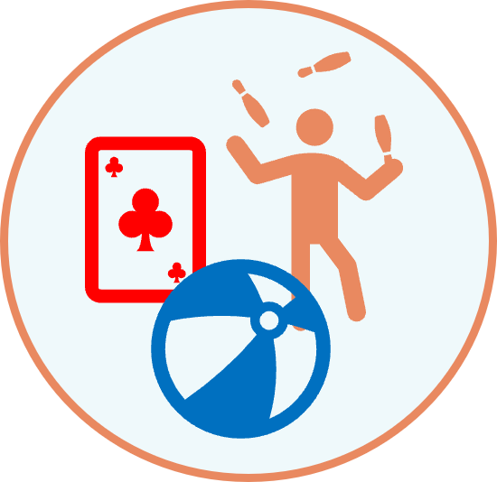
Was machst du? Was hast du gemacht?
schreiben / sprechen
Letzten Sommer | Normalerweise
Letzten Sommer | Normalerweise
1
2
Notes:
Timing: 2-3 minutes (and to be continued with another activity in the same format as starter next lesson) Aim: to practise written and oral production of 1st person present and past (perfect) tenses in German, in the context of holidays. Procedure: 1. Model the task using number 1. Voice the thought processes. E.g, ‘I’ve chosen playing football which is last summer so I’m going to write ‘Ich habe Fußball gespielt’ – I played football. Then – and my partner hasn’t seen me writing this – I’m going to prompt him/her with ‘ich habe’ and that will tell them whether it’s a past (letzten Sommer) activity or a present (normalerweise) activity. And then it’s over to them to try to say the sentence. I can then give them feedback as I’ve already written that one down.’
2. For the remaining prompt, tell students they need to choose either the past or present activity option and write the sentence for it. 3. Then they select past or present for number 2 and write the sentence. If there’s time, they prompt their partner with either ‘ich’ or ‘ich habe’… and give feedback on what the other says.
To be continued next lesson…

Slide 27
Hausaufgaben
Vocabulary Learning Homework (Y8, Term 1.1, Week 1)
Audio file
Student worksheet
Notes:
NB: Homework in Y8 continues to feature pre-learning of vocabulary. It also includes some vocabulary activities to deepen vocabulary knowledge. Therefore there is an answer sheet each week (which is a change from Y7). Clearly, as this is the first week of term, students will not have pre-learnt their words for this week but will need to pre-learn next week’s vocabulary. It is unlikely that they will be able to complete all of these two homeworks, but teachers can decide what to focus students on, and how to ensure that over time they do practise both of these two sets of vocabulary. We have placed the first week homework here, at the end of lesson 1, and the homework with next week’s vocabulary at the end of lesson 2.
The answer sheet for the Y8 vocabulary learning HW is here: https://rachelhawkes.com/LDPresources/Yr8German/German_Y8_Term1i_Wk1_audio_HW_sheet_answers.docx
Notes:
i) Teachers may, in addition, want to recommend use of a particular online app for the pre-learning of each week’s words. ii) Quizlet now requires parental involvement / registration / permissions for users below the age of 13, so it is perhaps most suitable for Y9 – 11 students. iii) Language Nut hosts LDP vocabulary lists and these are free for schools to use, though there is a registration process. One benefit is that all of the student tracking data that Language Nut offers are also available to schools that use the LDP lists for practice. Perhaps this makes it a good option for Y7/8.
iv) There are other free apps, and new ones are always appearing. Teachers have told us that they are currently using: Flippity, Wordwall (where using previously-created activities is free).
v) Gaming Grammar has been acquired by Language Nut. Its original content should still be available to teachers and much of it is appropriate for Y8 learners. From this lesson, for example, learners could practise:
Verb agreement Article agreement

Slide 28
Diesen Sommer
Present vs past (perfect) weak verbs
SSC [ie] vs [ei]
Y8 German
Term 1.1 – Week 1 - Lesson 2 Inge Alferink/ Rachel Hawkes
Artwork: Steve Clarke
Date updated: 30/08/23
Notes:
Artwork by Steve Clarke. All additional pictures selected are available under a Creative Common license; no attribution required.
Note: All words listed below for this week’s learning (new and revisited sets) appear on all three Awarding Organisations’ word lists, with the following exceptions: Edexcel list does not have – Tour, erhalten, mischen or Punkt.
Learning outcomes (lesson 2):
Consolidate the present and perfect 1st person singular
Introduce new determiners
In + indefinite article (Row 3)
Frequency rankings of vocabulary introduced this week (1 is the most common word in German):
8.1.1.1 - besuchen [820] kaufen [506] selbst, selber [101] welcher, welche, welches [122] August [1929] Ferien [3448] Juli [1544] Kleidung [2820] Kultur [594] Spaß [1045] Tour [2640] Türkei [922] letzten Monat [152/316]
Frequency rankings of vocabulary revisited this week (1 is the most common word in German):
7.3.2.4 - ziehen [266] gewinnen [408] erhalten [283] beginnen [239] legen [296] werfen [672] mischen [2105] das Ziel [325] die Mitte [756] der Punkt [427] jeder, jede, jedes [88]
7.2.2.5 - lassen [82] nehmen [141] halten [144] dann [33] zuerst [726] spät(er) [171] danach [437] schließlich [307] deshalb [264]
Source: Jones, R.L. & Tschirner, E. (2019). A frequency dictionary of German: core vocabulary for learners. Routledge

Slide 29
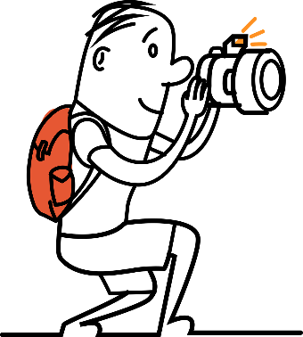
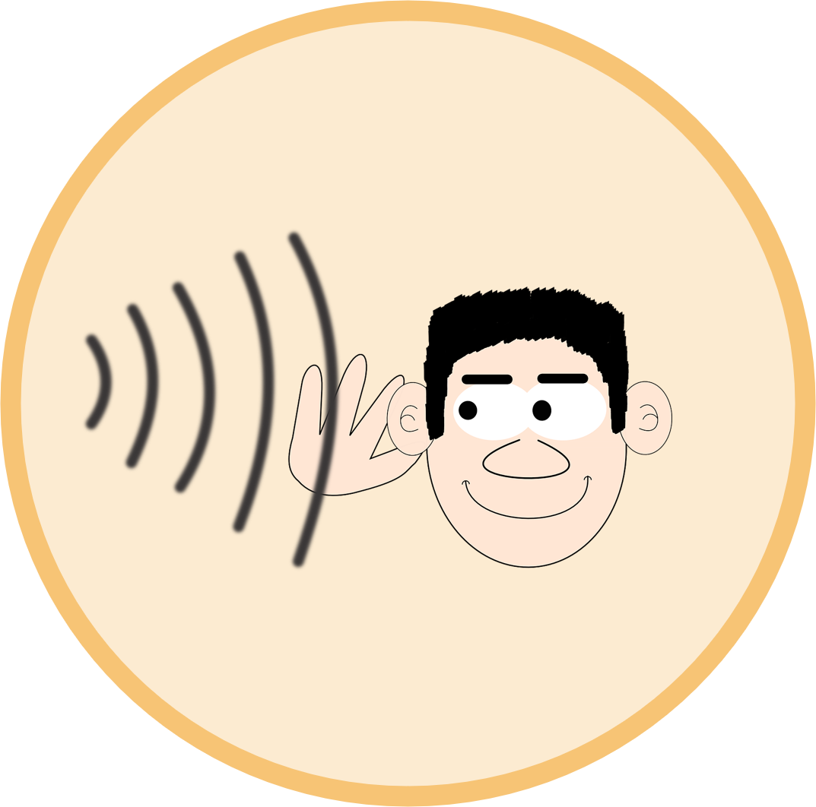
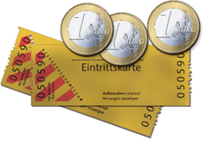
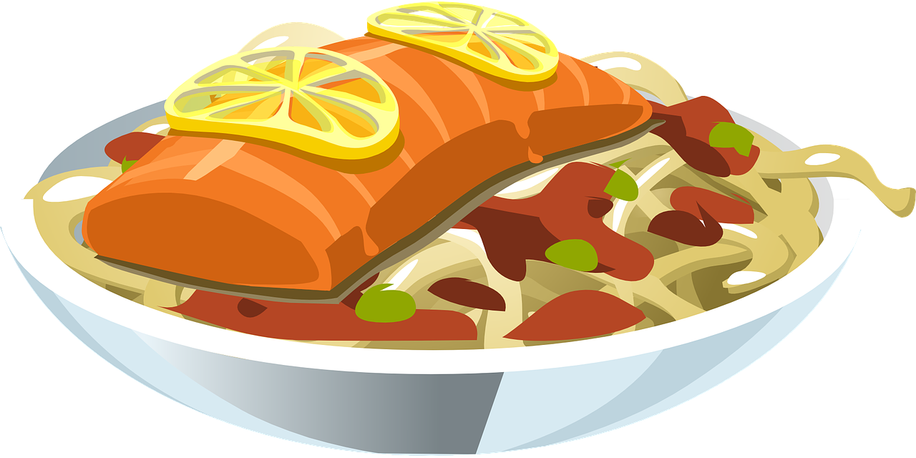
Was machst du? Was hast du gemacht?
schreiben / sprechen
Letzten Sommer | Normalerweise
Letzten Sommer | Normalerweise
Letzten Sommer | Normalerweise
1
2
3
4
Letzten Sommer | Normalerweise
5
Letzten Sommer | Normalerweise
6
Letzten Sommer | Normalerweise
*Use the verb ‘to live’ for ‘stayed’ in a hotel.
Notes:
Timing: 10 minutes Aim: to practise written and oral production of 1st person present and past (perfect) tenses in German, in the context of holidays. Procedure: 1. For all prompts, tell students they need to choose either the past or present activity option and write the sentence for it. Numbers 1 and 2 were worked through last lesson, so this gives a supported way in.
2. Students write their selection (present or past) sentence for all 6 prompts.
3. Then they prompt each other with with either ‘ich’ or ‘ich habe’… and give feedback on what the other says.
If time allows, students should repeat the activity using the prompts on the next slide.
Note: students should not use the time phrases as this will avoid the need to focus on the verb forms.

Slide 30
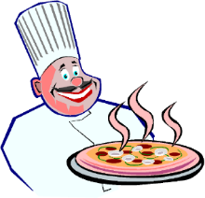
Was machst du? Was hast du gemacht?
schreiben / sprechen
Letzten Sommer | Normalerweise
Letzten Sommer | Normalerweise
Letzten Sommer | Normalerweise
1
2
3
[bike tour]
4
Letzten Sommer | Normalerweise
5
Letzten Sommer | Normalerweise
6
Letzten Sommer | Normalerweise
Notes:
Optional Round 2

Slide 31
Vokabeln
Hör dir die Wörter an. Hast du das deutsche Wort gehört?
hören
x
1
first
zuerst
2
to receive / receiving
erhalten
3
goal
das Ziel
x
4
to mix / mixing
mischen
x
5
in the end
schließlich
Notes:
Timing: 5 minutes Aim: To practise vocabulary in the spoken modality. Procedure: 1. Click on the number to play the sound.
2. Listen to the German words.
3. On a click and English word will appear. Was the word included in the German set?
Transcript: 1. Später – Danach – Schließlich – jetzt → First
2. Lassen – erhalten – halten – beginnen → To receive
3. das Ziel – die Mitte – der Punkt – der Spieler → the goal
4. Ziehen – nehmen – legen – werfen → to mix
5. deshalb – leider – aber – ziemlich → in the end

Slide 32
Letzter, letzte, letztes
Grammatik
In German, the adjective letzt- means ‘last’.
It works like nächst-, taking endings according to the gender of the thing it describes:
Remember - these are the Row 2 endings.
der Monat
letzten Monat (last month)
die Woche
letzte Woche (last week)
das Jahr
letztes Jahr (last year)
Another German adjective that works in the same way is dies- (this).
And you already know jeder, jede, jedes(every)
der Monat
diesen Monat (this month)
die Woche
diese Woche (this week)
letzt- always refers to the past, but dies- and jed-can refer to present or past
das Jahr
dieses Jahr (this year)
Notes:
Timing: 3 minutes
Aim
This slide explains how to form three useful past time adverbials (which are part of this week’s new vocabulary set) using the German adjective letzt, and comparing this to nächst, as met previously in 7.3.2.5 – one of the week’s whose vocabulary is being revisited this week. The Row 2 adjective agreement is again detailed, and the fact that Word Order 2 (as first met in 3.1.1 with adverbs of time) is required here is pointed out.
Suggested procedure
1. Click on the mouse to animate the explanation.
2. Check students’ understanding at all stages.

Slide 33
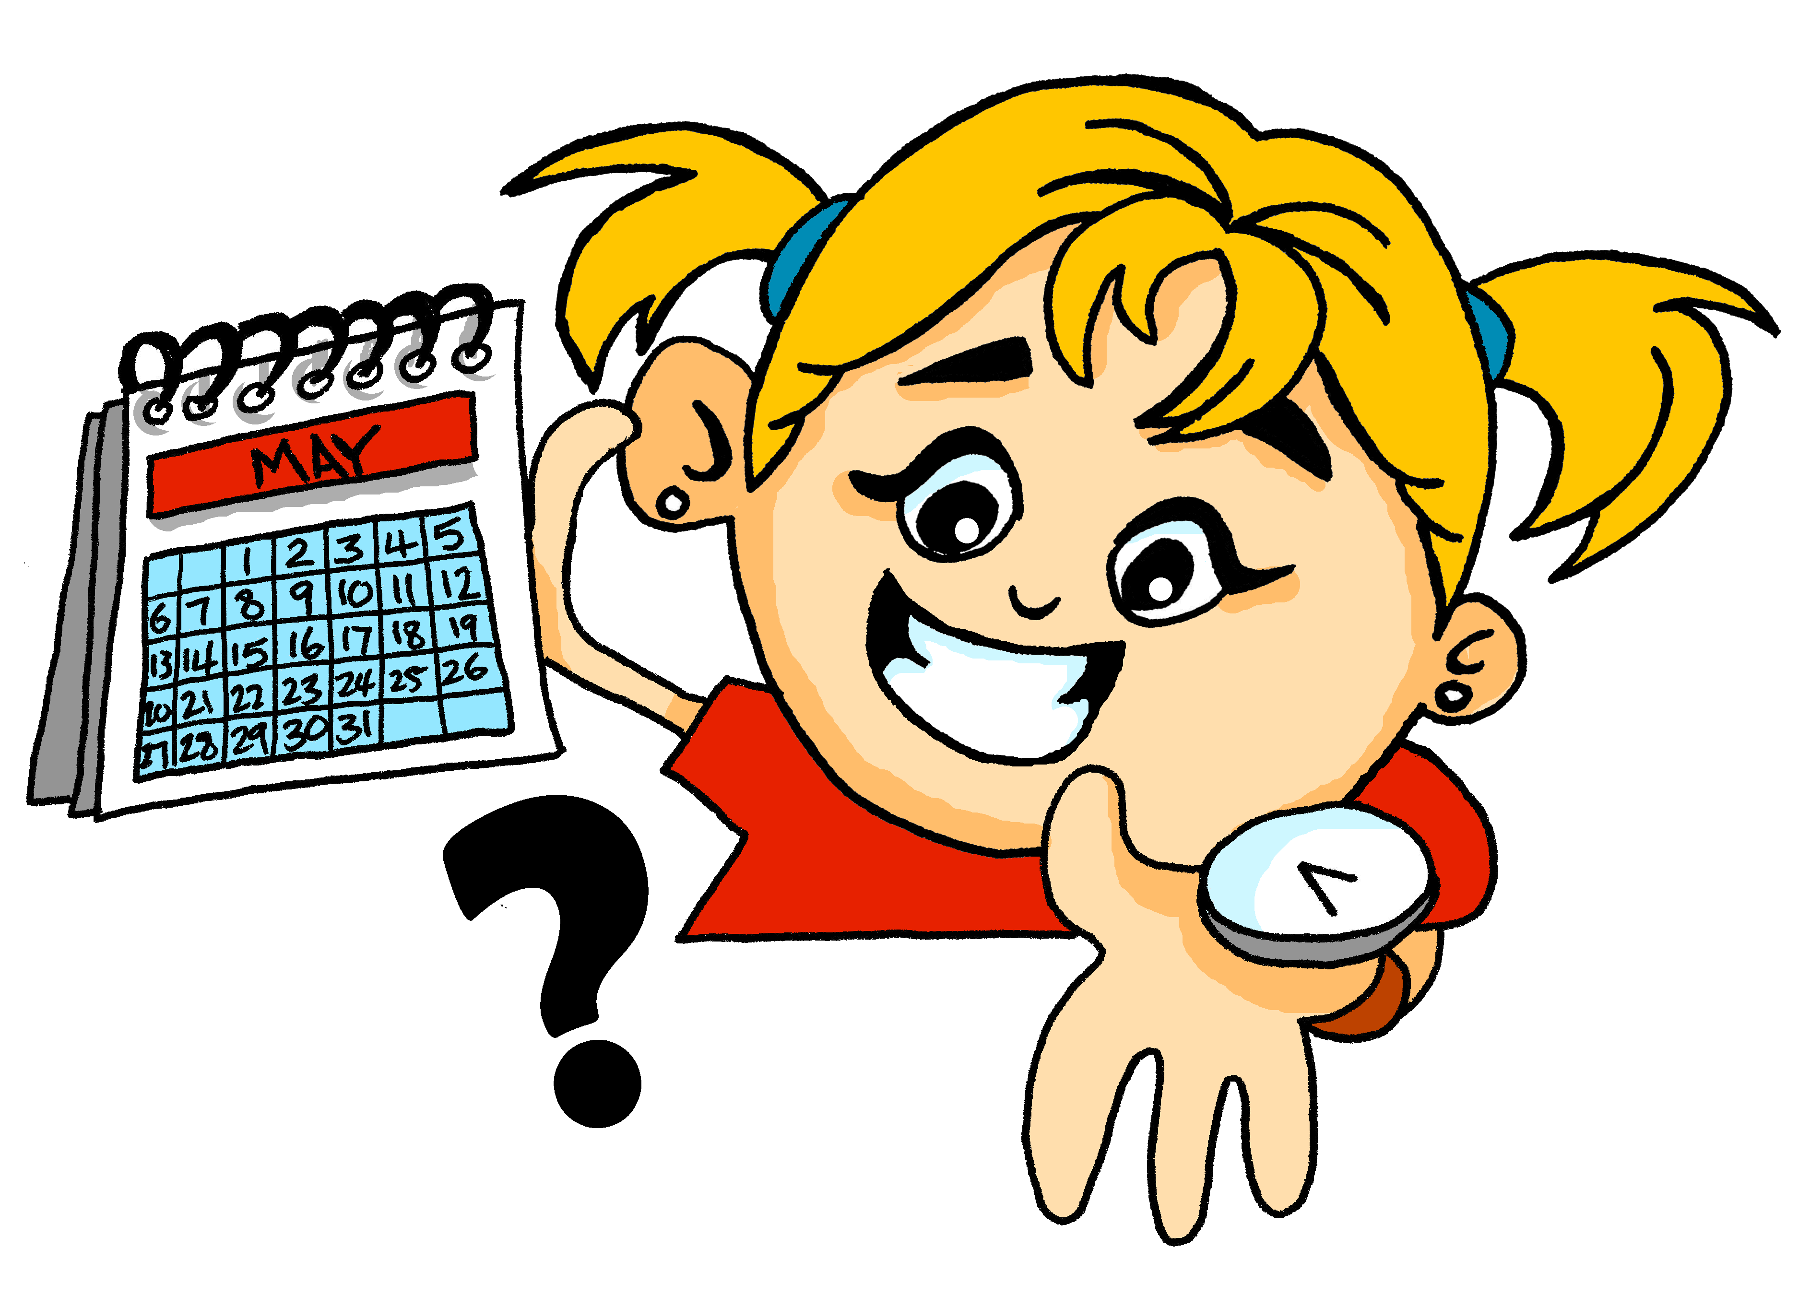
Wann ist das? Wann war* das?
lesen
Lies die Sätze. Welches Wort passt?
 |  | Monat | Woche | Jahr
1. | Jeden Monat reise ich nach Luxembourg.
2. | Letztes Jahr habe ich in einem Hotel gewohnt.
3. | Dieses Jahr habe ich eine Sprache gelernt.
4. | Letzte Woche habe ich das Haus geputzt.
5. | Diesen Monat erlebe ich die Kultur in Paris.
6. | Jede Woche habe ich Farben gemischt.
______
______
______
______
______
______
*war – was
Notes:
Timing: 5 minutes Aim: Referential reading activity to notice the endings of dies-, jed-. and letzt- as well as present vs past. Procedure: 1. Read the sentences.
2. Select (write) the word that could complete the sentence.
3. Click to see the answer.
4. Now say whether each sentence is happening now or happened in the past, by translating it orally into English.

Slide 34
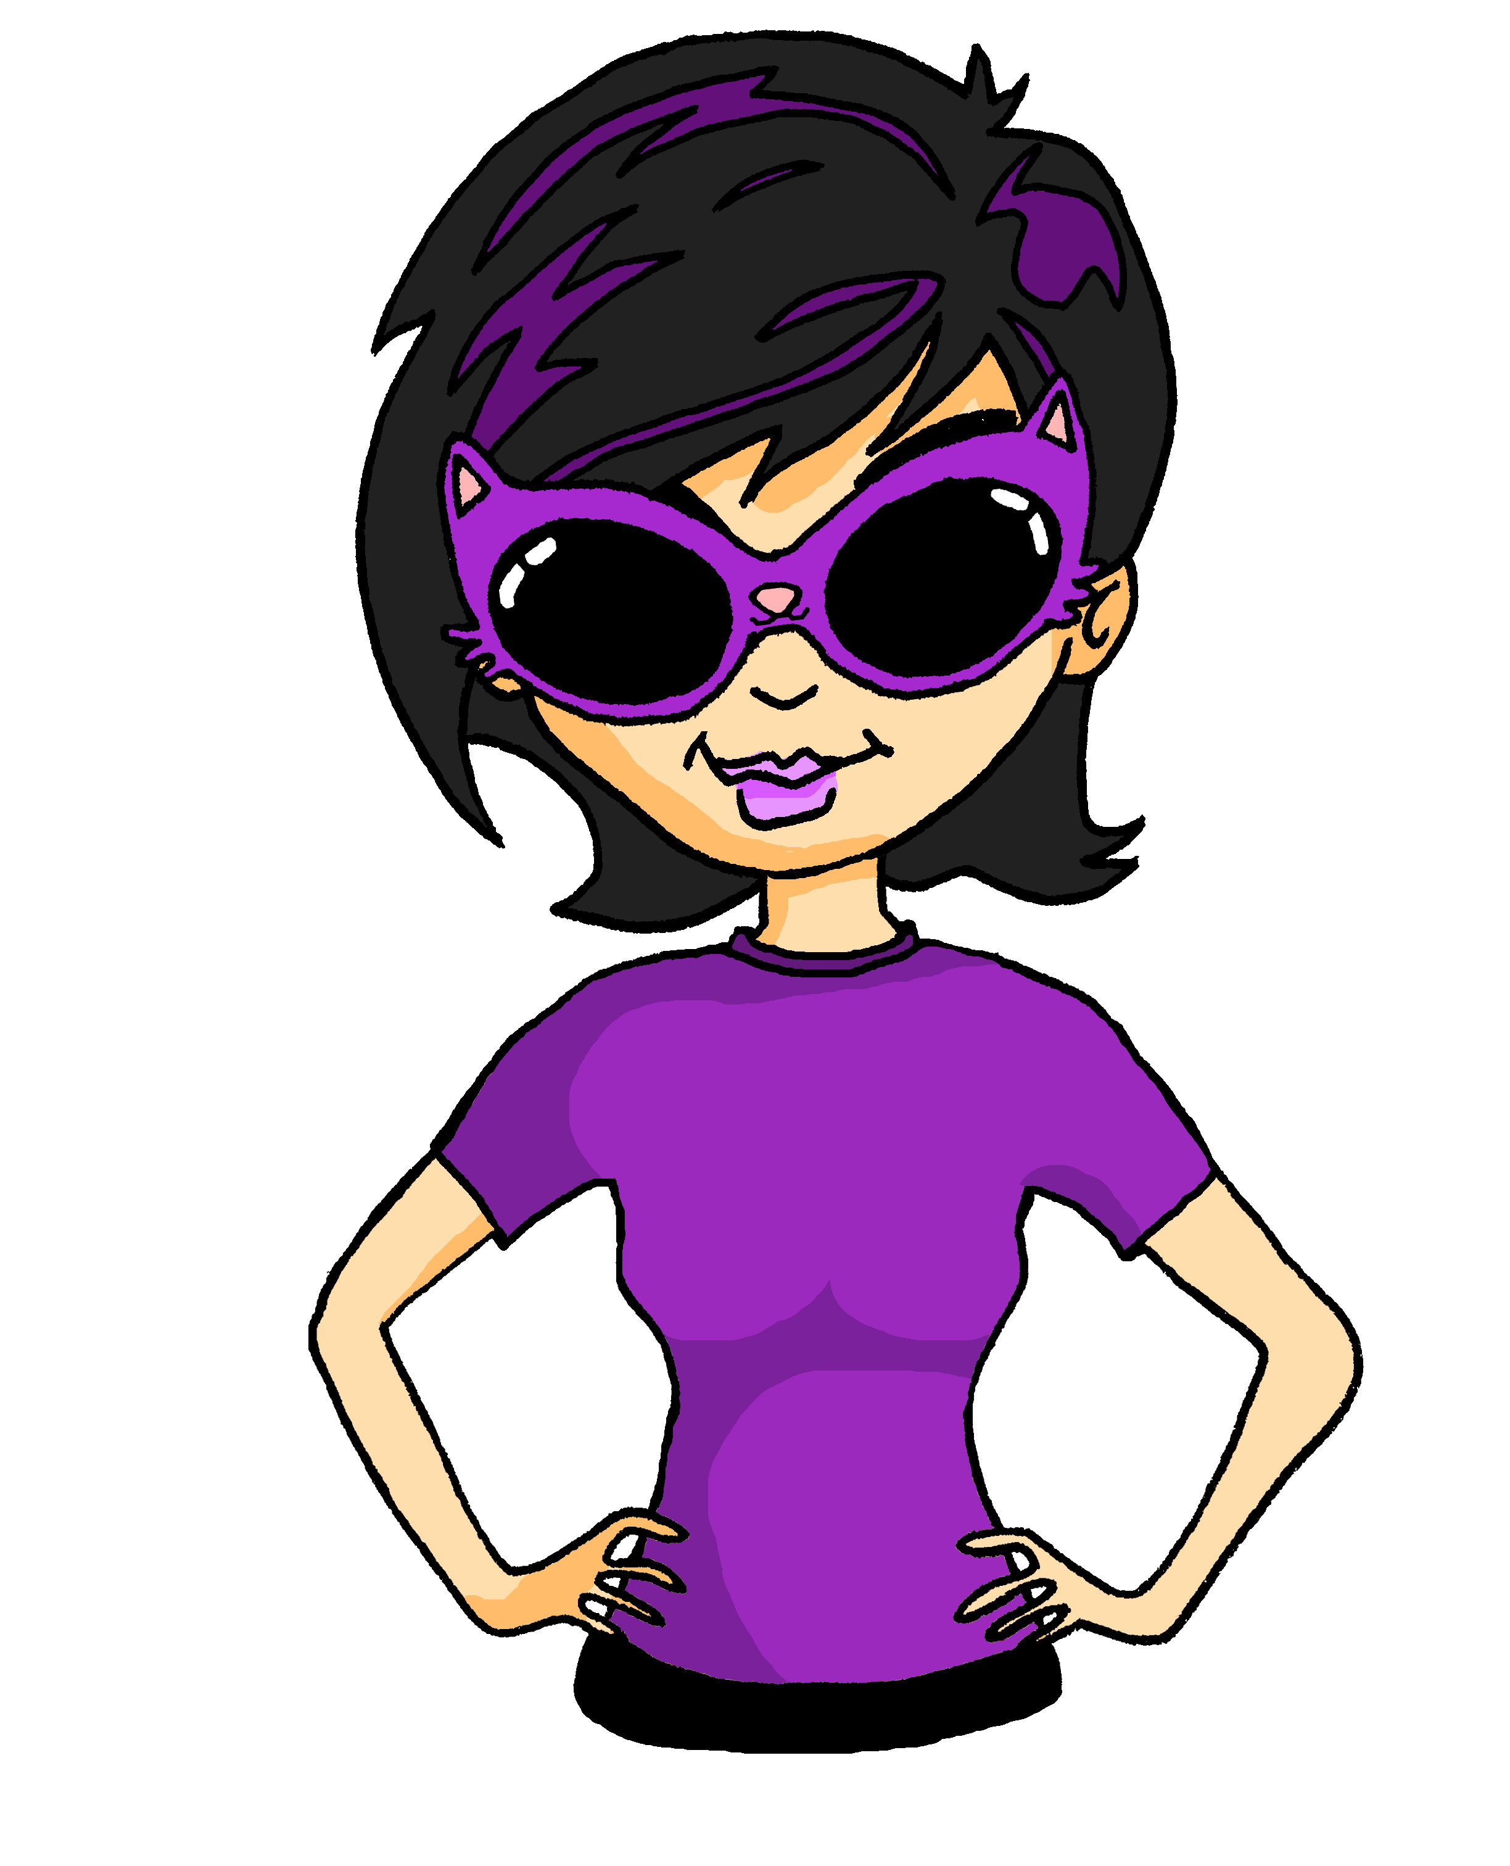
Katjas Ferien
Hör zu. Schreib die Sätze auf Englisch.
hören
1
This summer I had a lot of fun.
2
Last month I often played tennis in the park.
3
I listened to music every day.
4
Last week I visited the museum.
5
This week I am eating pizza and ice cream every day.
6
I visit my brother in Mainz every week.
Notes:
Timing: 8 minutes Aim: to practise aural comprehension of new structures and new vocabulary. Procedure: 1. Click on the numbers to play the audio.
2. Write the English translation.
3. Click to see the answer.
Transcript: 1. Diesen Sommer habe ich viel Spaß gehabt.
2. Letzten Monat habe ich oft im Park Tennis gespielt.
3. Jeden Tag habe ich Musik gehört.
4. Letzte Woche habe ich das Museum besucht.
5. Diese Woche esse ich jeden Tag Pizza und Eis.
6. Ich besuche jede Woche meinen Bruder in Mainz.

Slide 35
in + indefinite articles (R3-dative)
Grammatik
Remember: row 3 is used when describing location in or on something.
After in and auf the words for the sometimes changes:
Row 1:
der Park
die Stadt
das Kino
in dem Park
in dem Kino
Row 3:
Ich bin…
im Park
in der Stadt
im Kino
The same happens with the word for a:
Row 1:
ein Park
eine Stadt
ein Kino
Row 3:
Ich bin…
in einem Park
in einer Stadt
in einem Kino
Notes:
Timing: 3 minutes Aim: To briefly recap in + row 3 with definite articles and then extend the principle to include indefinite articles.
Procedure: 1. Click on the mouse to animate the explanation.
2. Check students’ understanding at all stages.

Slide 36
Wo ist das? Wo war* das?
Hör zu. Welches Wort passt?
hören
jetzt | letzten Monat
1
Hotel / Stadt
2
Party / Konzert
3
Wasserpark / Band
4
Stadt / Dorf
5
Theater / Stadt
6
Konzert / Straße
*war – was
Notes:
Timing: 8 minutes Aim: 1] Practise in + row 3. 2] Practise present and perfect tense. Procedure: 1. Click to bring up the first sentence with the two location options. 2. Click on corresponding number to play audio.
2. Listen to the sentence and pick the word that fits. Pay attention to the ending of the indefinite article.
3. Click to see the answer. Continue steps 1-4 with items 2-6.
4. Then listen to each sentence again, to confirm whether it is happening now or was happening last month. 5. Click to see ticks.
Transcript:
1. Ich mache Fotos in einem [Hotel / Stadt] 2. Ich tanze auf einem [Party / Konzert] 3. Ich habe in einem [Wasserpark / Band] viel Spaß gehabt. 4. Ich habe in einem [Stadt / Dorf] Sport gemacht. 5. Ich erlebe in einer [Theater / Stadt] die Kultur. 6. Ich habe auf einer [Konzert / Strasse] Rockmusik gehört.

Slide 37
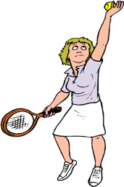
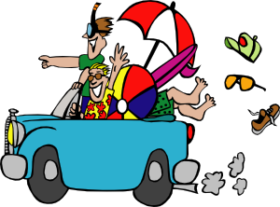
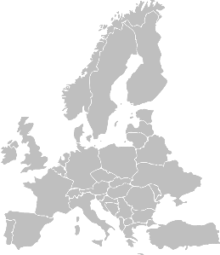
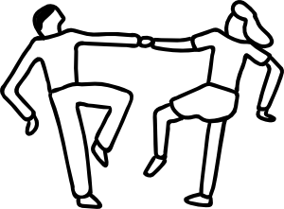
Meine Ferien
schreiben
Du bist im Urlaub!
You are doing a lot this year, but nothing is the same as you did last year on holiday. Write five sentences to describe your activities this year, and five to say what you did last year. Remember to use the right verb(s) for past and present. Use all the cards.
Notes:
WRITING OPTION 1
Timing: 8-10 minutes (potentially allow to finish at home) Aim: To practise 1st person present tense vs perfect tense in writing. Procedure: 1. Use all the cards.
2. Write 5 sentences to describe your activities this year and 5 sentences to describe your activities last year.

Slide 38
Meine Ferien
schreiben
dann
später
schließlich
zuerst
danach
letzt-
dies-
jed-
Juli
Monat
Woche
August
Tag
Sommer
Notes:
WRITING OPTION 2 (MORE CHALLENGING) Note: this could be saved for a mini assessment later in the term.
Timing: 8 minutes Aim: To practise present and perfect in writing. This activity also brings in the new determiners and sequencing adverbs. Procedure: 1. Pick one of the persons from the previous activity and write down their information.
2. Based on the information write a postcard message.
3. In your message also use at least 2 words from each of the three boxes above.

Slide 39
Hausaufgaben
Vocabulary Learning Homework (Y8, Term 1.1, Week 2)
Audio file
Student worksheet
Notes:
The answer sheet for the Y8 vocabulary learning HW is here: https://rachelhawkes.com/LDPresources/Yr8German/German_Y8_Term1i_Wk2_audio_HW_sheet_answers.docx
Notes:
i) Teachers may, in addition, want to recommend use of a particular online app for the pre-learning of each week’s words. ii) Quizlet now requires parental involvement / registration / permissions for users below the age of 13, so it is perhaps most suitable for Y9 – 11 students. iii) Language Nut hosts LDP vocabulary lists and these are free for schools to use, though there is a registration process. One benefit is that all of the student tracking data that Language Nut offers are also available to schools that use the LDP lists for practice. Perhaps this makes it a good option for Y7/8.
iv) There are other free apps, and new ones are always appearing. Teachers have told us that they are currently using: Flippity, Wordwall (where using previously-created activities is free).
v) Gaming Grammar has been acquired by Language Nut. Its original content should still be available to teachers and much of it is appropriate for Y8 learners. From this lesson, for example, learners could practise:
Verb agreement Article agreement

