Slide 1
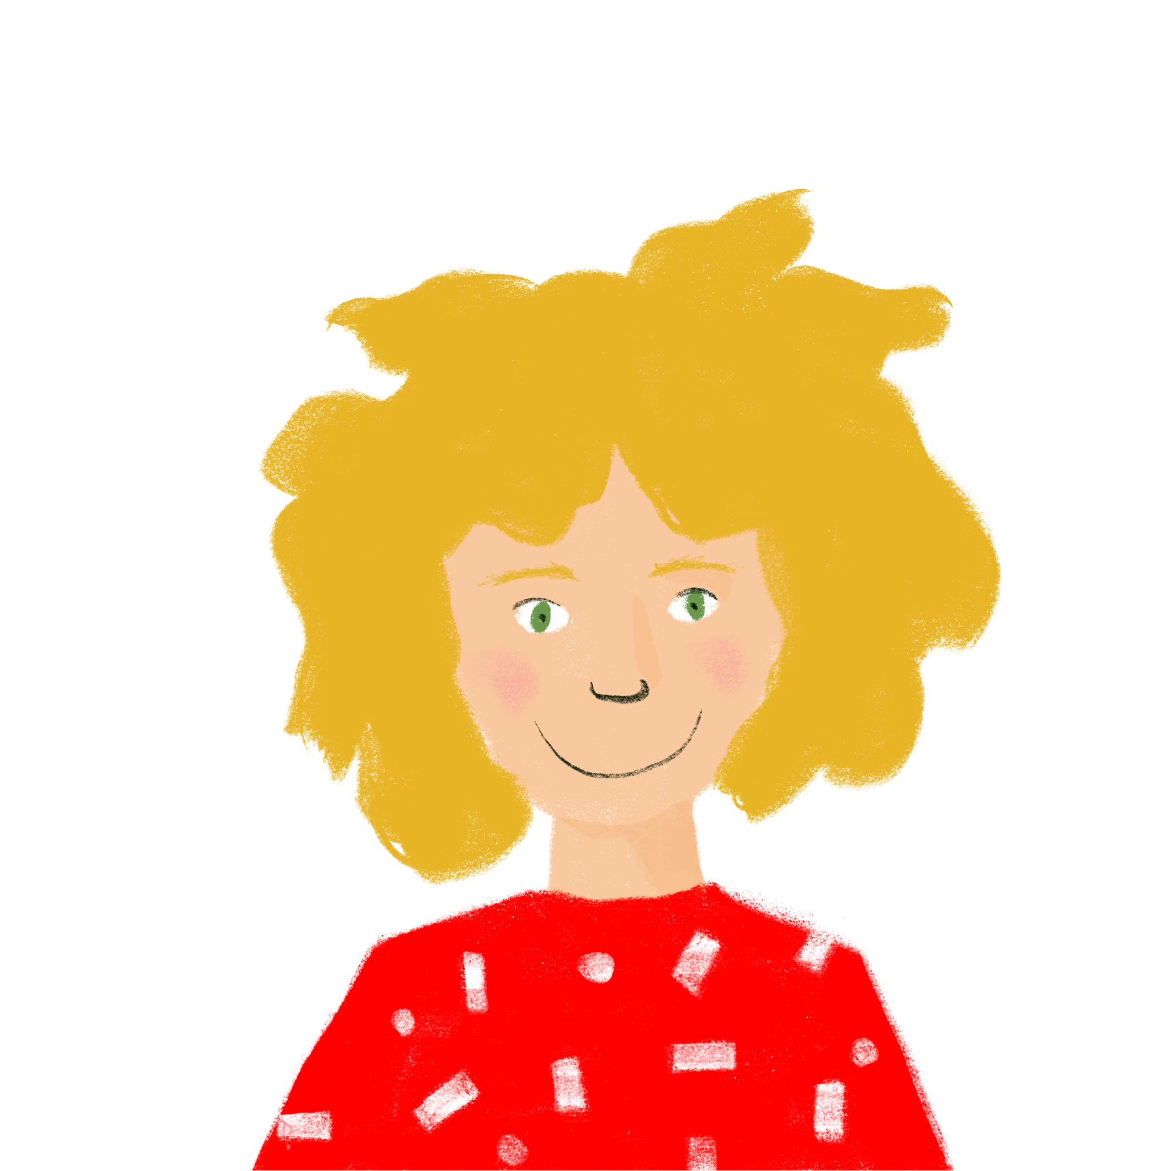
Life at school Talking about what you are doing this week and what you do every week
present tense (future meaning)
verbs like choisir (present) (nous, vous)
[h] revisited
Y8 French
Term 2.2 - Week 2 - Lesson 41 Stephen Owen / Natalie Finlayson
Artwork by: Chloé Motard
Date updated: 14.03.24
Notes:
Note: all words (new and revisited) in this week of the SOW appear on all three GCSE wordlists, with these exceptions: i) AQA
Artwork by Chloé Motard. All additional pictures selected are available under a Creative Commons license, no attribution required.
Learning outcomes (lesson 1):
Consolidation of SSC [h]
Introduction of verbs like choisir (present) (nous, vous)
Introduction of use of present tense with time adverbials to express future meaning
Word frequency (1 is the most frequent word in French):
8.2.2.2 (introduce) finir [583], nourrir [1261], chat [3138], dimanche [1235], heure [99], jeudi [1112], lundi [1091], mardi [1044], mercredi [1168], minute [375], vendredi [1086]
8.2.1.1 (revisit) boire [1879], bois [1879], boit [1879], gagner² [258], argent [472], chance [438], lait [2507], café² [1886], thé [3517], viande [2625], peu [91], verre [2174], beaucoup [150]
8.1.2.2 (revisit) automne [1503], été [623], hiver [1586], musée [2216], printemps [1288], place [129], saison [1667], belge [2795], dernier [87], dernière [87], pendant [89], Belgique [n/a], Bruxelles [n/a]
Source: Londsale, D., & Le Bras, Y. (2009). A Frequency Dictionary of French: Core vocabulary for learners London: Routledge.
The frequency rankings for words that occur in this PowerPoint which have been previously introduced in NCELP resources are given in the NCELP SOW and in the resources that first introduced and formally re-visited those words.
For any other words that occur incidentally in this PowerPoint, frequency rankings will be provided in the notes field wherever possible.

Slide 2
h
heure
Notes:
Timing: 1 minute [2 slides].
Aim: To consolidate SSC [h]
Procedure: 1. Present the letter(s) and the [h] first, on its own. As there is no sound, put a finger to your lips instead. 2. Bring up the word ”heure” on its own, say it, students repeat it, so that they have the opportunity to focus all of their attention on the connection between the written word and its sound.
3. A possible gesture for this would be to tap a watch/wrist. 4. Roll back the animations and work through 1-3 again, but this time, dropping your voice completely to listen carefully to the students saying the [h] sound, pronouncing ”heure” and, if using, doing the gesture.
Word frequency (1 is the most frequent word in French):
heure [99]
Source: Londsale, D., & Le Bras, Y. (2009). A Frequency Dictionary of French: Core vocabulary for learners London: Routledge.

Slide 3
h
hôtel
huit
8
hôpital
hiver
heure
[winter]
histoire
[history, story]
Notes:
Aim: To consolidate SSC [h]
Procedure:
Introduce and elicit the pronunciation of the individual SSC [h] and then the source word again ‘heure’ (with gesture, if using). Then present and elicit the pronunciation of the five cluster words. The cluster words have been chosen for their high-frequency, from a range of word classes, with the SSC (where possible) positioned within a variety of syllables within the words (e.g. initial, 2nd, final etc.). Additionally, we have tried to use words that build cumulatively on previously taught SSCs (see the Phonics Teaching Sequence document) and do not include new SSCs. Where new SSCs are used, they are often consonants which have a similar symbol-sound correspondence in English.
Word frequency (1 is the most frequent word in French): histoire [263]; huit [877]; hôpital [1308]; hôtel [1774]; hiver [1586]; heure [99]. Source: Londsale, D., & Le Bras, Y. (2009). A Frequency Dictionary of French: Core vocabulary for learners London: Routledge.

Slide 4
Phonétique
parler
60
Remember! Although some of these words look like English, the [h] is silent!
inhérent
cohérent
horrible
malheureusement
hostilité
[hostility]
secondes
[unfortunately]
envahir
habitation
hésitation
[to invade]
hôte
souhait
compréhension
0
[host]
[wish]
[understanding]
DÉBUT
Notes:
Timing: 2 minutes
Aim: Oral production of unknown words containing [h] in decreasing amounts of time (teacher to choose appropriately), helping automatisation of SSC production. Awareness raising of cross-linguistic pronunciation differences.
Procedure:
1. Students pair up.
2. Teacher starts timing.
3. Student A tries to say the words without pronouncing [h].
4. Student B listens for English pronunciation of [h] creeping in. Where this occurs, the listener asks the speaker to repeat the words three times.
5. Swap roles.
6. The student who says the most words correctly is the winner!
7. Click on the word to hear pronunciation by a native speaker. Students repeat.
8. Check understanding of words.
Transcript and word frequency (1 is the most frequent word in French): horrible [3190], hostilité [3436], envahir [2566], hôte [3780], malheureusement [1543], compréhension [2827], habitation [3616], cohérent [3274], hésitation [4323], inhérent [4672], souhait [3122]
Source: Londsale, D., & Le Bras, Y. (2009). A Frequency Dictionary of French: Core vocabulary for learners London: Routledge.

Slide 5
Vocabulaire
lire
Amir et Noura font un quiz en voiture. Lis les définitions. C’est quel mot ?
1. un animal 7. 60 minutes
2. un jour de week-end 8. entre jeudi et samedi
3. 60 secondes 9. compléter
4. entre lundi et mercredi 10. entre mercredi et vendredi
5. donner à manger 11. premier jour de la semaine
6. entre mardi et jeudi de travail.
un chat
une heure
dimanche
vendredi
une minute
finir
mardi
jeudi
nourrir
lundi
mercredi
finir – nourrir – un chat – dimanche – une heure – jeudi – lundi – mardi – mercredi – une minute – vendredi
Notes:
Timing: 5 minutes
Aim: Written recognition of the new vocabulary introduced this week at word level and in short contexts.
Procedure:
1. Students read the definitions and match each to a word from the box.
2. The answers appear one at a time upon clicking the mouse.
Word frequency of cognates used (1 is the most frequent word in French): quiz [>5000], définition [1587], week-end [2475], seconde [1542], completer [2043]
Source: Londsale, D., & Le Bras, Y. (2009). A Frequency Dictionary of French: Core vocabulary for learners London: Routledge.

Slide 6
Léa fait quoi cette semaine ?
1
2
3
4
5
6
7
écouter
* la machine à laver = washing machine
Monday
[2]
Thursday
[6]
finish my homework
fill the washing machine
Tuesday
Friday
[4]
[5]
spend an hour at the park
read a lot
A. C’est quel jour ?
→ Écris le numéro.
B. C’est quoi en anglais ?
→ Écris la phrase.
[1]
Saturday
Wednesday
[7]
feed the cat
drink a coffee in town
Sunday
[3]
buy some bread
Notes:
Timing: 5 minutes
Aim: Aural recognition of the new vocabulary introduced this week in longer contexts.
Procedure:
1. Click on the numbered buttons to play the audio.
2. On first hearing, students write the numbers next to the correct days.
3. On the second hearing, students write the English sentence.
4. The answers appear one by one in order of hearing upon clicking the mouse – first the numbering, then the sentences.
Transcript:
1. Samedi je nourris le chat.
2. Lundi je finis mes devoirs.
3. Dimanche j’achète du pain.
4. Mardi je passe une heure au parc.
5. Vendredi je lis beaucoup.
6. Jeudi je remplis la machine à laver.
7. Mercredi je bois un café en ville.
Word frequency (1 is the most frequent word in French): finir [583], nourrir [1261], chat [3138], dimanche [1235], heure [99], jeudi [1112], lundi [1091], mardi [1044], mercredi [1168], minute [375], vendredi [1086]
Source: Londsale, D., & Le Bras, Y. (2009). A Frequency Dictionary of French: Core vocabulary for learners London: Routledge.
Word frequency of cognates and unknown words used (1 is the most frequent word in French): machine [1294], laver [3503]
Source: Londsale, D., & Le Bras, Y. (2009). A Frequency Dictionary of French: Core vocabulary for learners London: Routledge.

Slide 7
Adverbs of time
grammaire
Adverbs of time tell you when something happens.
How many adverbs of time can you think of that express the future ?
What do the adverbs of time below mean?
dans cinq minutes
dans une heure
dans trois jours
dans un mois
demain
le week-end prochain
la semaine prochaine
l’année prochaine
in five minutes
in one hour
in three days
in one month
tomorrow
next weekend
next week
next year
Notes:
Timing: 3 minutes
Aim: To revise and extend knowledge of future time adverbials
Procedure:
1. Click to animate the first line of the explanation.
2. Ask students to recall as many suture time adverbials as they can in one minute (click again to display question).
3. Click again to display the list of future time adverbials. Ask students to write down what they mean in English.
4. Click to display the answers one by one.

Slide 8
Present tense with future meaning
grammaire
Note: ce mardi (this Tuesday) is also used.
Mardi je travaille en ville.
Mardi used without an article means ‘on Tuesday’ or ‘this (coming) Tuesday’. We use this to talk about what we are doing on a specific day in the future.
We do this in English too, using the present continuous:
Le mardi in French means ‘on Tuesdays’ or ‘every Tuesday’. We use this to talk about what we do every week (rather than on one specific day in the future).
In English, we express this using the present simple:
One word in French, two words in English
I am working in town on Tuesday.
Adverbs referring to specific days and times can go at the start OR at the end of the sentence. In English, these are normally at the end.
Le mardi je travaille en ville.
I work in town on Tuesdays.
Notes:
Timing: 3 minutes
Aim: To explain the use of the present tense to express future intention (with future time adverbial). To explain meaning usage of days of the week with and without the article.
Procedure:
1. Click to animate the explanation.
2. Ensure students’ understanding at each stage.

Slide 9
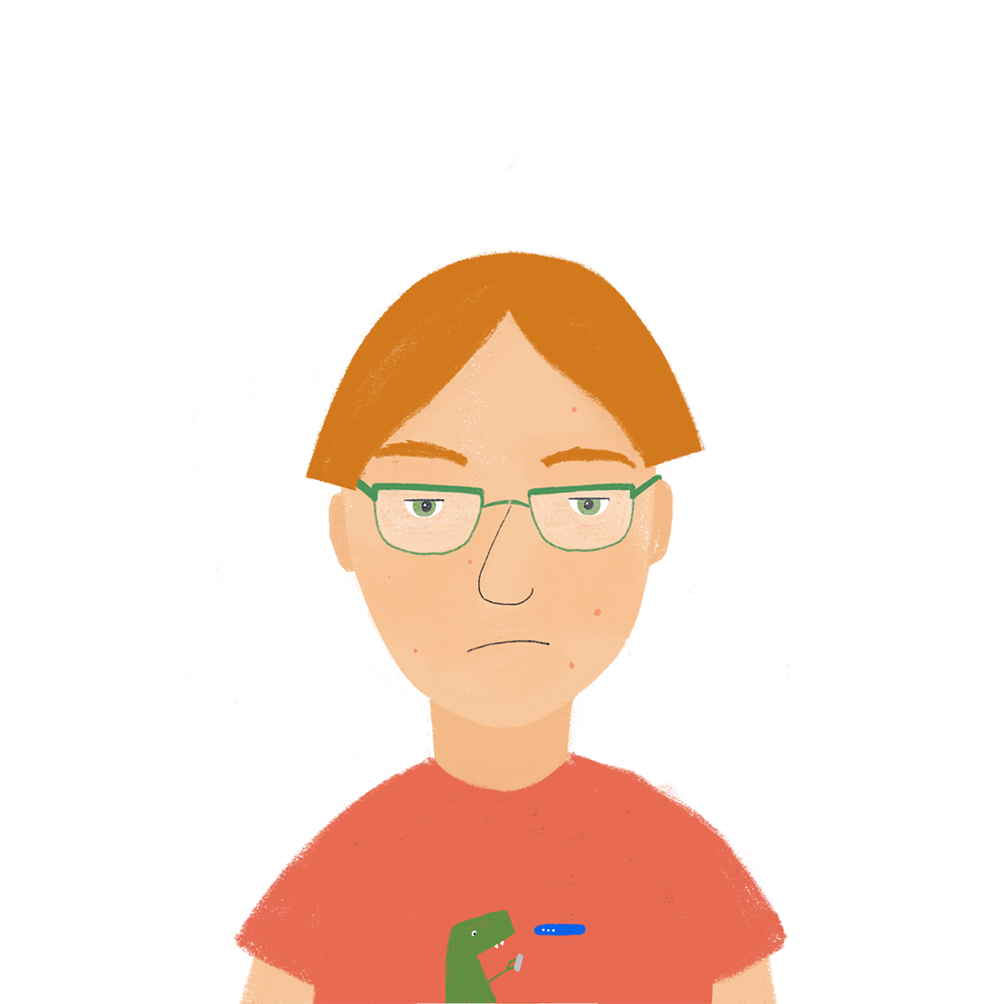
Cette semaine ou chaque semaine ?
écouter
Que fait Antoine cette semaine ? Que fait-il normalement ?
 | day and activity | is doing it this week only | does it every week
 | Sunday – buying ice cream
 | Saturday – doing exercise
 | Monday – using the computer
 | Friday – finishing homework
 | Tuesday – feeding the cat
 | Wednesday – drinking tea
 | Thursday – sending a letter
 | Monday – earning money
1
2
3
4
5
6
7
8
Notes:
Timing: 8 minutes
Aim: Aural recognition of days of the week with and without articles to express habitual actions and one-off future actions.
Procedure:
1. Click on the numbered buttons to hear Antoine talking about his week.
2. On the first listen, students tick the appropriate column for the time, using their knowledge of article usage with days of the week to inform them.
3. On the second listen, they write the day and activity spoken about in note form in English in the first column.
4. Click to reveal the answer – first the correct tick, then the English summary – for each item.
Transcript:
1. Le dimanche j’achète de la glace.
2. Samedi je fais de l’exercice.
3. Lundi j’utilise beaucoup l’ordinateur.
4. Le vendredi je finis mes devoirs.
5. Mardi je nourris le chat.
6. Le mercredi je bois du thé.
7. Jeudi j’envoie une lettre.
8. Le lundi je gagne de l’argent.
Word frequency (1 is the most frequent word in French): 8.1.2.2 (introduce) finir [583], nourrir [1261], chat [3138], dimanche [1235], jeudi [1112], lundi [1091], mardi [1044], mercredi [1168], vendredi [1086]
8.1.2.5 (revisit) bois [1879], gagner² [258], argent [472], thé [3517], beaucoup [150]
Source: Londsale, D., & Le Bras, Y. (2009). A Frequency Dictionary of French: Core vocabulary for learners London: Routledge.

Slide 10
Ma semaine
écrire
Que fais-tu cette semaine ? Et que fais-tu en général ? Écris sept phrases.
Le lundi je vais normalement en ville, mais ce lundi je reste à la maison.
On Mondays I normally go into town, but this Monday I’m staying at home.
1.
2.
3.
4.
5.
6.
7.
Notes:
Timing: 7 minutes
Aim: Written production of present tense with appropriate time adverbials to express future and habitual actions.
Procedure:
1. Click to animate the task explanation.
2. Make sure that students understand the intended format of each sentence, as per the example.
3. Ask students to make each sentence about a different day of the week.
4. Students write their sentences.
5. If time permits, students share their examples with one another.

Slide 11
Verbs like choisir (nous, vous)
grammaire
Do you remember the singular forms of verbs like choisir?
Remember, the last letter of all these verb forms is a
Silent Final Consonant!
je finis
I finish / I am finishing
tu finis
you finish / you are finishing
il finit
he finishes / he is finishing
elle finit
she finishes / she is finishing
Here are the WE and YOU (polite/plural) forms:
nous finissons
we finish / we are finishing
vous finissez
you finish / you are finishing
Author names: Stephen Owen / Emma Marsden
Author names: Stephen Owen / Emma Marsden
Notes:
Timing: 3 minutes
Aim: To introduce the first- and second-person plural forms of the present tense of verbs like choisir.
Procedure:
1. Click to animate the explanation. For the singular forms already met, the English appears first – elicit the French from students.
2. The new (plural) forms appear with the French first.
3. Ensure students’ understanding at each stage.

Slide 12
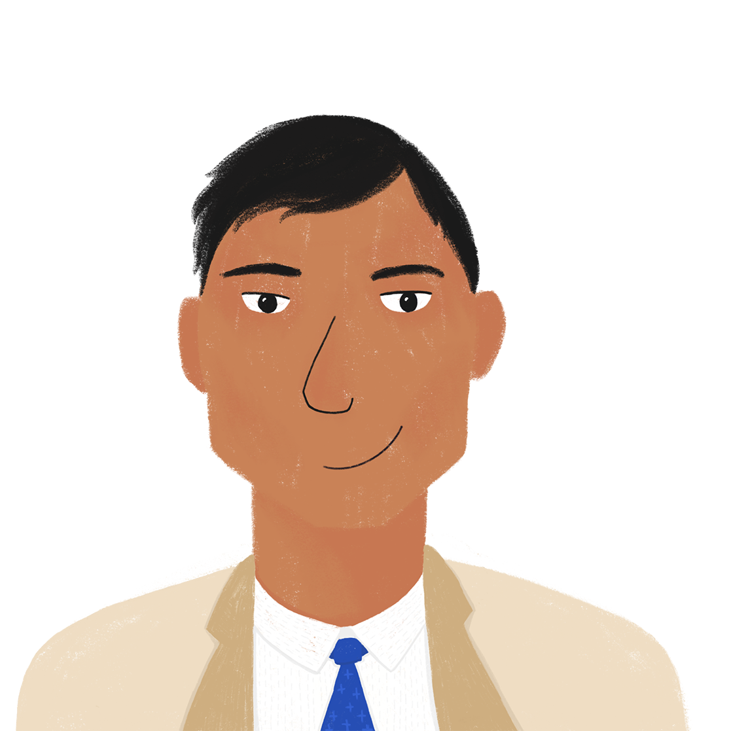
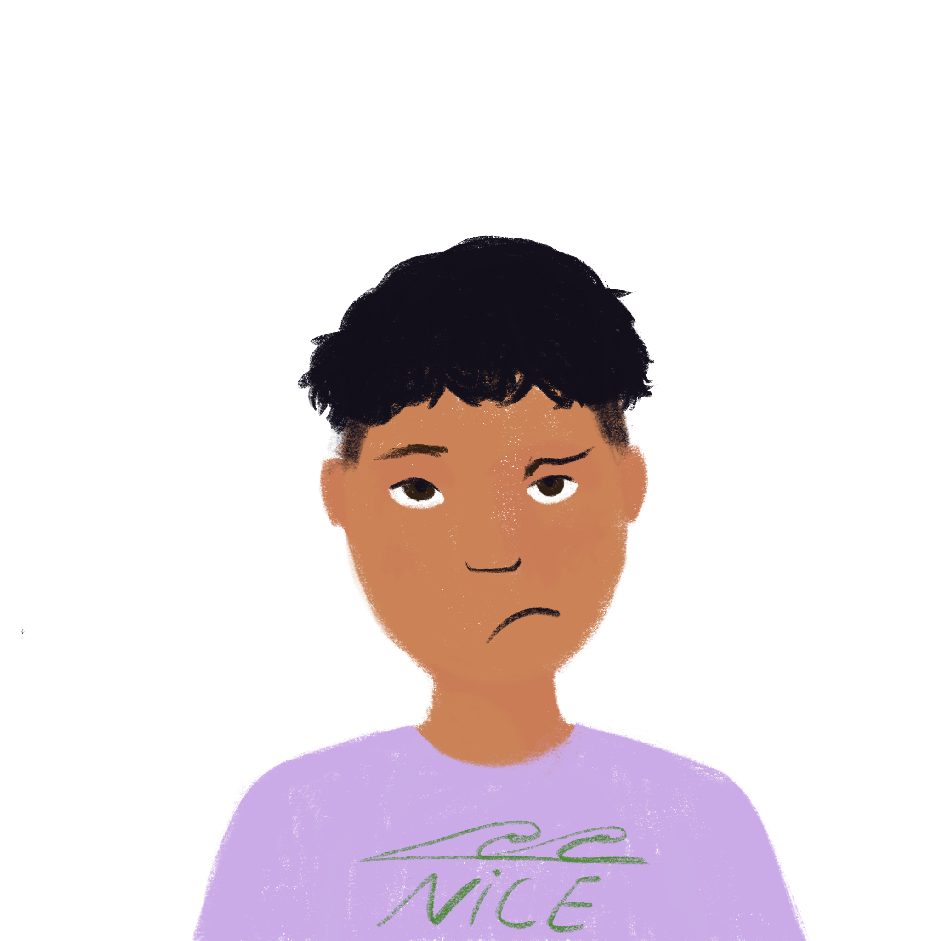
Qui fait quoi à la maison ?
* la tâche = chore
lire
Amir écrit à Papa. Qui fait les tâches* ? C’est Amir et Noura (nous) ou ses parents (vous) ?
1. Amir : Nous réussissons les examens.
4. Amir : Nous nourrissons le chien pendant la semaine.
7. Amir : Nous choisissons la glace dans 5 minutes.
2. Amir : Vous choisissez une pizza pour le repas ?
5. Amir : Nous remplissons la machine à laver.
8. Amir : Vous réussissez les cours ?
3. Amir : Vous nourrissez le chien le week-end.
6. Amir : Vous définissez les règles.
9. Amir : Vous remplissez les papiers administratifs
Notes:
Timing: 5 minutes
Aim: Written recognition of the ‘nous’ and ‘vous’ forms of present tense of verbs like choisir.
Procedure:
1. Students read each statement and decide if the verb is in the ‘nous’ or the ‘vous’ form, based upon the verb ending.
2. Click to reveal the pronoun for each sentence one by one, confirming the answers.
Word frequency of cognates and unknown words used (1 is the most frequent word in French): tâche [887], machine [1294], laver [3503], pizza [>5000], cours [169]
Source: Londsale, D., & Le Bras, Y. (2009). A Frequency Dictionary of French: Core vocabulary for learners London: Routledge.

Slide 13
En classe
Remember !
Vous can mean you (plural) or you (formal).
écouter
Léa et Sophie parlent avec la professeure en classe. Elles parlent de qui ?
 |  | us | you (polite)
 | Nous remplissons les blancs ?
 | Vous finissez tôt ?
 | Vous définissez les mots ?
 | Nous réussissons l’examen.
 | Nous finissons les devoirs.
 | Vous choisissez les activités pour la classe ?
 | Nous choisissons les cahiers.
 | Vous remplissez le verre ?
1
2
3
4
5
6
7
8
Notes:
Timing: 8 minutes
Aim: Aural recognition of the ‘nous’ and ‘vous’ forms of present tense of verbs like choisir.
Procedure:
1. Briefly recap the two meanings of vous.
2. Click on the numbered buttons to hear a sentence with the pronoun obscured.
3. Students listen to each sentence and use their knowledge of verbs like choisir endings to decide whether the children are talking about themselves or addressing the teacher.
4. Click to reveal the answer – first the correct tick, then the full sentence in French, with pronoun – for each item.
5. Full audio, with pronouns included, may be found on the next slide.
Transcript:
1. [nous] remplissons les blancs ?
2. [vous] finissez tôt ?
3. [vous] définissez les mots ?
4. [nous] réussissons l’examen !
5. [nous] finissons les devoirs.
6. [vous] choisissez les activités pour la classe ?
7. [nous] choisissons les cahiers verts.
8. [vous] remplissez le verre ?

Slide 14
En classe (réponses)
Remember !
Vous can mean you (plural) or you (formal).
écouter
Léa et Sophie parlent avec la professeure en classe. Elles parlent de qui ?
 |  | us | you (polite)
 | Nous remplissons les blancs ?
 | Vous finissez tôt ?
 | Vous définissez les mots ?
 | Nous réussissons l’examen.
 | Nous finissons les devoirs.
 | Vous choisissez les activités pour la classe ?
 | Nous choisissons les cahiers.
 | Vous remplissez le verre ?
1
2
3
4
5
6
7
8
Notes:
Full sentences, with pronouns included, play on number clicks. Transcriptions appear on clicks.

Slide 15
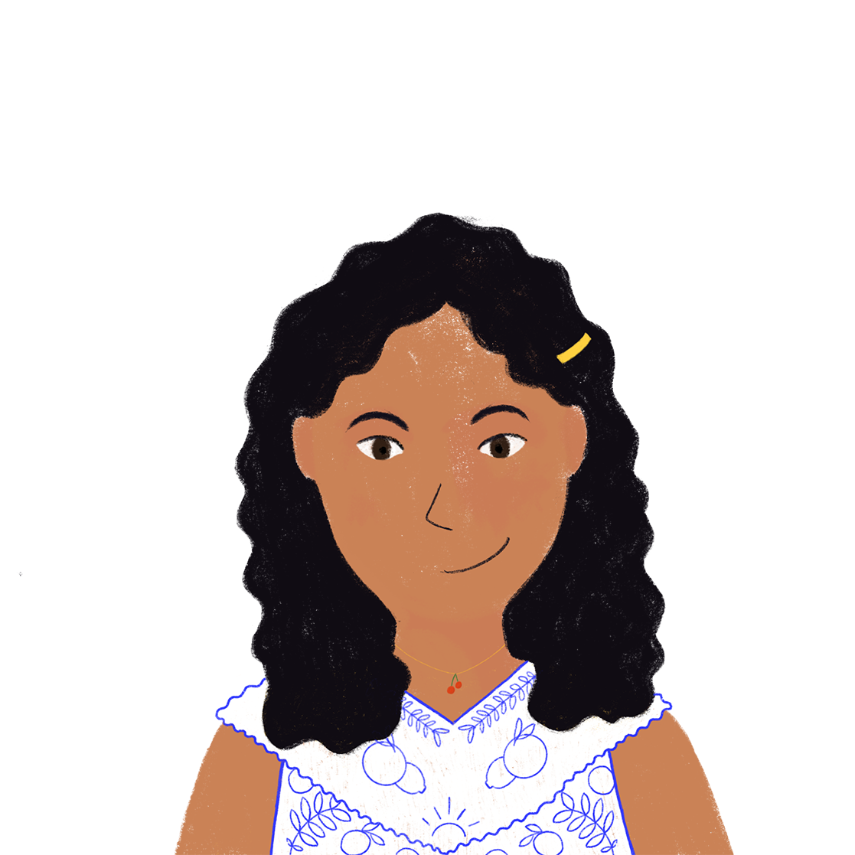
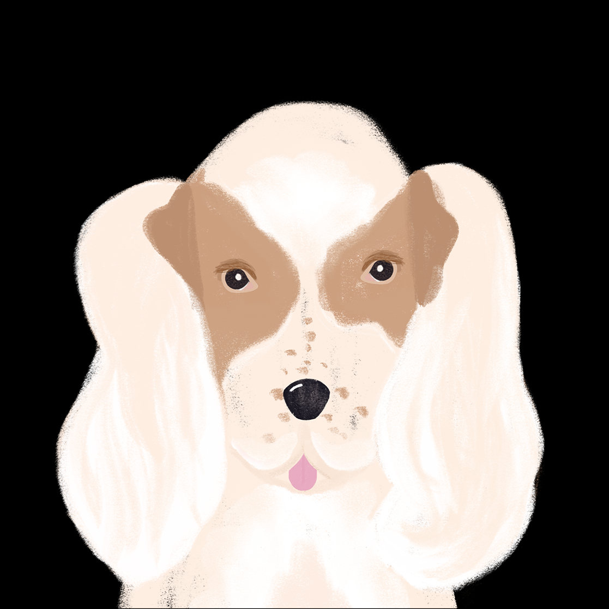
Life at school Talking about what you are doing this week and what you do every week
verbs like choisir (present) (ils, elles)
liaison/elision with [h]
Y8 French
Term 2.2 - Week 2 - Lesson 42 Stephen Owen / Natalie Finlayson
Artwork by: Chloé Motard
Date updated: 14.03.24
Notes:
Note: all words (new and revisited) in this week of the SOW appear on all three GCSE wordlists, with these exceptions: i) AQA
Artwork by Chloé Motard. All additional pictures selected are available under a Creative Commons license, no attribution required.
Learning outcomes (lesson 2):
Introduction of liaison/elision with [h]
Consolidation of verbs like choisir (present) (nous, vous)
Introduction of verbs like choisir (present) (ils, elles)
Consolidation of use of present tense with time adverbials to express future meaning
Word frequency (1 is the most frequent word in French):
8.2.2.2 (introduce) finir [583], nourrir [1261], chat [3138], dimanche [1235], heure [99], jeudi [1112], lundi [1091], mardi [1044], mercredi [1168], minute [375], vendredi [1086]
8.2.1.1 (revisit) boire [1879], bois [1879], boit [1879], gagner² [258], argent [472], chance [438], lait [2507], café² [1886], thé [3517], viande [2625], peu [91], verre [2174], beaucoup [150]
8.1.2.2 (revisit) automne [1503], été [623], hiver [1586], musée [2216], printemps [1288], place [129], saison [1667], belge [2795], dernier [87], dernière [87], pendant [89], Belgique [n/a], Bruxelles [n/a]
Source: Londsale, D., & Le Bras, Y. (2009). A Frequency Dictionary of French: Core vocabulary for learners London: Routledge.
The frequency rankings for words that occur in this PowerPoint which have been previously introduced in NCELP resources are given in the NCELP SOW and in the resources that first introduced and formally re-visited those words.
For any other words that occur incidentally in this PowerPoint, frequency rankings will be provided in the notes field wherever possible.

Slide 16
Liaison with [h]
lire / parler
If a word normally ends with a Silent Final Consonant, the final consonant is pronounced before a word beginning with [h]. This is called liaison.
Dis les phrases à un(e) partenaire. Il y a une liaison, ou pas ?
Partenaire A
 |  | Liaison ? ( ü / û )
1. | Elles chantent en harmonie.
2. | Vous restez chez Marie ?
3. | Il est très content.
4. | Ils sont horribles.
1
2
3
4
Notes:
Timing: 4 minutes for 2 slides
Aim: practising oral production of liaison with SSC [h] using cognates and known vocabulary
Procedure:
1. Teacher can recap liaison before beginning the task.
2. Partner A reads the four sentences aloud, making the liaison where necessary.
3. Partner B notes if there is a liaison or not.
4. Click to reveal the answers.
5. Partners swap roles (see next slide).
Transcript:
1. Elles chantent en harmonie.
2. Vous restez chez Marie ?
3. Il est très content.
4. Ils sont horribles.
Word frequency of cognates used (1 is the most frequent word in French): liaison [1968], harmonie [4584], horrible [3190]
Source: Londsale, D., & Le Bras, Y. (2009). A Frequency Dictionary of French: Core vocabulary for learners London: Routledge.

Slide 17
Liaison with [h]
lire / parler
If a word normally ends with a Silent Final Consonant, the final consonant is pronounced before a word beginning with [h]. This is called liaison.
Dis les phrases à un(e) partenaire. Il y a une liaison, ou pas ?
Partenaire B
 |  | Liaison ? ( ü / û )
1. | Les bâtiments sont grands.
2. | Elles parlent en français.
3. | Je vais chez Hugo.
4. | Le climat est très humide.
5
6
7
8
Notes:
This is the continuation of the activity on the previous slide
Transcript:
5. Les bâtiments sont grands.
6. Elles parlent en français.
7. Je vais chez Hugo
8. Le climat est très humide.
Word frequency of cognates used (1 is the most frequent word in French): humide [4841]
Source: Londsale, D., & Le Bras, Y. (2009). A Frequency Dictionary of French: Core vocabulary for learners London: Routledge.

Slide 18
Elision with [h]
lire / parler
Words like le, la, je, de, ne and que replace their final letter with an apostrophe before a word beginning with [h]. This is called elision.
Dis les phrases à un(e) partenaire. Quel mot complète la phrase ?
Partenaire A
1. | Tu trouves que Henri / Léo est sympa ?
2. | Tu n’ hésites / travailles pas !
3. | Je vais à la hôpital / caisse.
4. | Il n’y a pas d’ humains / vie dans l’espace.
Notes:
Timing: 4 minutes for 2 slides
Aim: practising oral production of elision with SSC [h] using cognates and known vocabulary
Procedure:
1. Teacher can recap elision with vowels before beginning the task.
2. Partner A chooses a word to complete each sentence based on the presence or absence of elision and reads the sentences aloud.
3. Partner B tries to correct any mistakes.
4. Click to reveal the answers.
5. Partners swap roles (see next slide).
Word frequency of cognates used (1 is the most frequent word in French): compléter [2034], hésiter [1606], humain [286], Mars [n/a]
Source: Londsale, D., & Le Bras, Y. (2009). A Frequency Dictionary of French: Core vocabulary for learners London: Routledge.

Slide 19
Elision with [h]
lire / parler
Words like le, la, de, ne and que replace their final letter with an apostrophe before a word beginning with [h]. This is called elision.
Dis les phrases à un(e) partenaire. Quel mot complète la phrase ?
Partenaire B
1. | Il ne habite / vient pas ici.
2. | Je pense qu’ Halloween / Jacques est amusant.
3. | C’est combien de hectares / mètres ?
4. | Elle regarde l’ horizon / télé.
Notes:
This is the continuation of the activity on the previous slide
Word frequency (1 is the most frequent word in French): Halloween [>5000], hectare [>5000], horizon [2502]
Source: Londsale, D., & Le Bras, Y. (2009). A Frequency Dictionary of French: Core vocabulary for learners London: Routledge.

Slide 20
C’est quoi en français ? [1/2]
parler / écrire
1. C’est quoi en français ?
Partenaire A parle; Partenaire B écrit.
to earn
Wednesday
meat
coffee
Friday
money
glass
to drink
tea
luck
a little
a lot
milk
hour
cat
to finish
Notes:
Timing: 8 minutes for two slides.
Aim: Spoken recall of vocabulary in this week’s new and revisited sets (the 8.1.2.5 set is recapped on this slide, and the 8.1.1.7 set on the next slide).
Procedure:
1. Click to make each English word flash on the screen.
2. Upon reading each word, Partner A says it in French.
3. Partner B, who is facing away from the board, writes down the French word heard.
4. When all words have been attempted, move to the next slide to bring up the answers.
Word frequency (1 is the most frequent word in French):
8.1.2.2 (introduce) finir [583], chat [3138], heure [99], mercredi [1168], vendredi [1086]
8.1.2.5 (revisit) boire [1879], gagner² [258], argent [472], chance [438], lait [2507], café² [1886], thé [3517], viande [2625], peu [91], verre [2174], beaucoup [150]

Slide 21
Réponses
parler / écrire
1 |  | 9
2 |  | 10
3 |  | 11
4 |  | 12
5 |  | 13
6 |  | 14
7 |  | 15
8 |  | 16
boire (to drink, drinking)
un peu (a little)
gagner (to win, winning)
le verre (a glass)
l’argent (m.) (money)
beaucoup (a lot)
la chance (luck)
chat (cat)
le lait (milk)
finir (to finish)
le café (coffee)
dimanche (Sunday)
le thé (tea)
jeudi (Thursday)
la viande (meat)
mardi (Tuesday)
Notes:
ANSWERS
Procedure:
1. Click to bring up the correct French words and English meanings, one by one, in order. Students check together.

Slide 22
C’est quoi en français ? [2/2]
parler / écrire
2. Changez de rôle ! C’est quoi en français ?
Partenaire B parle; Partenaire A écrit.
summer
autumn
museum
Brussels
winter
Belgium
season
to feed
Belgian
spring
last (f.)
(town) square
last (m.)
minute
Sunday
Tuesday
Thursday
Notes:
2nd round Students swap roles and repeat the steps.

Slide 23
Réponses
parler / écrire
1 |  | 9
2 |  | 10
3 |  | 11
4 |  | 12
5 |  | 13 | dimanche (Sunday)
6 |  | 14
7 |  | 15
8 |  | 16
l'automne (m.) (autumn)
Bruxelles (Brussels)
l’été (m.) (summer)
dernier (last m.)
l’hiver (m.) (winter)
la Belgique (Belgium)
le musée (museum)
nourrir (to feed)
le printemps (spring)
la place (town square)
l’heure (hour)
la saison (season)
mercredi (Wednesday)
belge (Belgian)
vendredi (Friday)
Notes:
ANSWERS
Procedure:
1. Click to bring up the correct French words and English meanings, one by one, in order. Students check together.

Slide 24
Verbs like choisir (il/elle)
lire
C’est dans le présent ou à l’avenir ?
Coche ‘present’ ou ‘future’ et écris ‘simple’ ou ‘continuous’.
 |  | present | future | present simple or continuous in English?
1. | En ce moment Amir nourrit le chien.
2. | Noura nourrit le poisson demain.
3. | Je nourris les enfants chaque jour.
4. | Le mardi j’achète du pain au marché.
5. | Samedi prochain je finis mes devoirs.
6. | Normalement tu choisis le fromage.
7. | Amir remplit la machine à laver bientôt.
8. | Noura sort en ville dans trois heures.
continuous (is feeding)
continuous (is feeding)
simple (feed)
simple (buy)
continuous (am finishing)
simple (choose)
continuous (is filling)
continuous (is going out)
Notes:
Timing: 8 minutes
Aim: Written recognition of time adverbials implying a future intention or a habitual action. To consider whether the present continuous or simple present form in English would best translate the idea.
Procedure:
1. Students read each sentence and tick either the ‘present’ or ‘future’ column as appropriate. They also indicate which form of the English present tense would best translate the idea in the French.
2. Click to bring up the correct ticks and English present tense forms, one by one.
Word frequency (1 is the most frequent word in French): présent [216]
Source: Londsale, D., & Le Bras, Y. (2009). A Frequency Dictionary of French: Core vocabulary for learners London: Routledge.

Slide 25
Verbs like choisir (ils/elles)
grammaire
Last lesson we met the WE and YOU (polite/plural) forms of verbs like choisir:
nous finissons
we finish / we are finishing
vous finissez
you finish / you are finishing
Here are the THEY forms (masculine and feminine plural) :
ils finissent
they (m.pl.) finish / are finishing
elles finissent
they (f.pl.) finish / are finishing
Notes:
Timing: 3 minutes
Aim: To introduce the third person plural forms of the present tense of verbs like choisir.
Procedure:
1. Click to animate the explanation. For the ‘nous’ and ‘vous’ forms already met, the English appears first – elicit the French from students.
2. The new (third person plural) forms appear with the French first. Pronounce these with the students.
3. Ensure students’ understanding at each stage.

Slide 26
Seul ou avec sa sœur ?
écouter
Écoute. C’est Amir (il) ou Amir et Noura (ils*) ?
 |  | il | ils
 | Ils finissent les devoirs.
 | Ils choisissent des glaces.
 | Il finit l’exercice.
 | Ils nourrissent le chat.
 | Il réussit l’examen.
 | Il remplit les blancs.
 | Ils définissent les mots.
 | Il choisit un fromage.
1
2
Remember! the masculine pronoun ils
means ‘they’ when the group is mixed-gender.
3
4
5
6
7
8
Notes:
Timing: 6 minutes
Aim: Aural recognition of the third person singular and third person plural forms of the present tense of verbs like choisir.
Procedure:
1. Click on the numbered buttons to play the audio. As there is no liaison between the pronoun and any of the verbs that follow, the masculine singular and plural subject pronouns sound the same in these sentences and need not be obscured in the audio.
2. Students listen to each sentence and tick the appropriate column - ‘he’ or ‘they’.
3. Click to reveal the answer – first the correct tick, then the transcription – for each item.
Transcript:
1. Ils finissent les devoirs.
2. Ils choisissent des glaces.
3. Il finit l’exercice.
4. Ils nourrissent le chien.
5. Il réussit l’examen.
6. Il remplit les blancs.
7. Ils définissent les mots.
8. Il choisit un fromage.

Slide 27
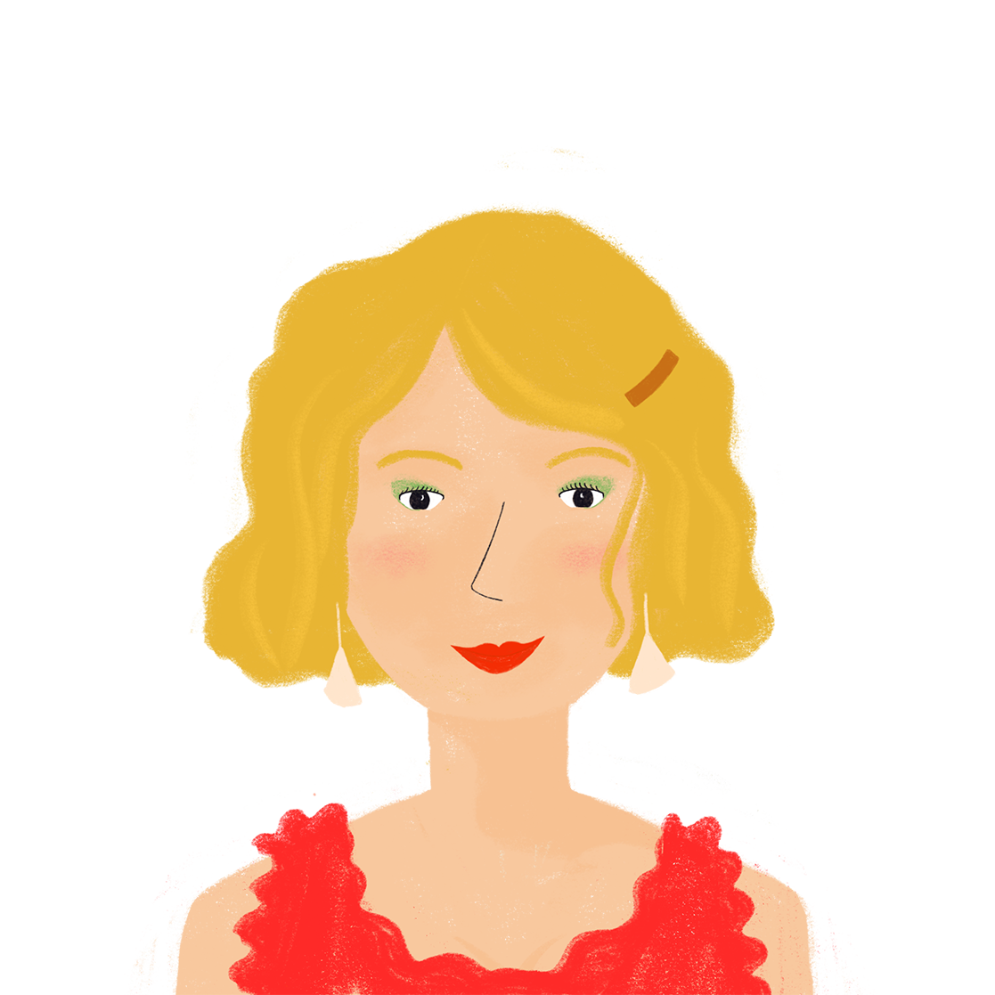
Maman écrit aux enfants
lire
C’est nous, vous ou ils ?
Salut les enfants !
(1) Vous finissez l’école tôt ce vendredi pour les vacances ? (2) Nous choisissons une nouvelle voiture et vous pouvez venir ! J’ai parlé à mes amis. (3) Ils nourrissent le chien pour nous. (4) Ils finissent le travail tôt. Dans 20 minutes (5) Nous remplissons une liste pour choisir la marque*, etc. ! (6) Vous choisissez la couleur ! Maman
* la marque
= brand
Notes:
Timing: 5 minutes
Aim: Written recognition of the ‘nous’, ‘vous’ and ‘ils’ forms of the present tense of verbs like choisir (reading)
Procedure:
1. Students read each statement and decide if the verb is in the ‘nous’, ‘vous’ or ‘ils’ form, based upon the verb ending.
2. They write 1-6 in their books and list the correct pronouns.
3. Click to reveal the pronoun for each sentence one by one, confirming the answers.
Word frequency of unknown words used (1 is the most frequent word in French): tortue [>5000]
Source: Londsale, D., & Le Bras, Y. (2009). A Frequency Dictionary of French: Core vocabulary for learners London: Routledge.

Slide 28
Noura répond à maman
Complète avec les formes verbales correctes !
écrire
Salut Maman !
Oui, nous (1) [finish] tôt ce vendredi. Je suis certaine que nous (2) [choose] une voiture noire. Vous (3) [fill out] la liste pour les voitures noires alors ! Tes amis, ils (4) [feed] le chien souvent ? Ils sont sympa, parce qu’ils (5) [finish] le travail très tard* normalement. Vous (6) [choose] bien les amis !
Noura
* tard = late
Notes:
Timing: 5 minutes
Aim: Written production of the ‘nous’, ‘vous’ and ‘ils’ forms of verbs like choisir.
Procedure:
1. Students read the text and put the verbs given in English into the correct French form. They may write 1-6 in their books and just list the verbs.
2. The answers are displayed on the next slide.
Word frequency of unknwon words and cognates used (1 is the most frequent word in French): compléter [2034], forme [369], verbale [>5000], correct [2617], certain [110], tard [348]
Source: Londsale, D., & Le Bras, Y. (2009). A Frequency Dictionary of French: Core vocabulary for learners London: Routledge.

Slide 29
Réponses
écrire
Salut Maman !
Oui, nous (1) finissons tôt ce vendredi.
Je suis certaine que nous (2) choisissons une voiture noire. Vous (3) remplissez la liste pour les voitures noires alors ! Tes amis, ils (4) nourrissent le chien souvent ? Ils sont sympa, parce qu’ils (5) finissent le travail très tard normalement. Vous (6) choisissez bien les amis ! Noura
Notes:
Answers to the activity on the previous slide

Slide 30
Vous faites quoi ?
écouter / écrire / parler
Vous nourrissez quoi ?
Nous nourrissons une tortue !
 | Ask your partners a question (vous) and write a sentence (ils/elles)
A. | nourrir ________________________
 | Tell your partners you are doing this (nous)
A. | nourrir, une tortue
Ils nourrissent une tortue.
Notes:
Timing: 8 minutes
Aim: Oral production of verbs like choisir in the nous, vous and ils/elles forms.
Procedure:
1. Students work in pairs with another pair to facilitate production of sentences in the nous and vous forms.
2. Print and distribute the rolecards, found on the following slides.
3. Use this slide to demonstrate the task. Explain that students are going to address the pair they are working with in the plural form to find out what is written on their card.
4. Ask students which question Léa and Sophie need to ask in order to get a response from Amir and Noura. Click to reveal.
5. Ask students how Amir and Noura respond. Click to reveal.
6. Ask students how Léa and Sophie will note their response. Click to reveal.
7. Students proceed with the task. Within the pairs, each student should ask two questions, answer two questions and write two setences.
8. Check answers on slides 39-40.

Slide 31
Printable rolecards – Group A
 | Tell your partners you are doing this (nous) |  | Ask your partners a question (vous) and write a sentence (ils/elles)
E. | finir, nos devoirs | A. | nourrir _________________________
F. | définir, les mots | B. | choisir _________________________
G. | remplir, les verres | C. | réussir _________________________
H. | choisir, des livres | D. | finir _________________________
 | Tell your partners you are doing this (nous) |  | Ask your partners a question (vous) and write a sentence (ils/elles)
E. | finir, nos devoirs | A. | nourrir _________________________
F. | définir, les mots | B. | choisir _________________________
G. | remplir, les verres | C. | réussir _________________________
H. | choisir, des livres | D. | finir _________________________
 | Tell your partners you are doing this (nous) |  | Ask your partners a question (vous) and write a sentence (ils/elles)
E. | finir, nos devoirs | A. | nourrir _________________________
F. | définir, les mots | B. | choisir _________________________
G. | remplir, les verres | C. | réussir _________________________
H. | choisir, des livres | D. | finir _________________________
 | Tell your partners you are doing this (nous) |  | Ask your partners a question (vous) and write a sentence (ils/elles)
E. | finir, nos devoirs | A. | nourrir _________________________
F. | définir, les mots | B. | choisir _________________________
G. | remplir, les verres | C. | réussir _________________________
H. | choisir, des livres | D. | finir _________________________
 | Tell your partners you are doing this (nous) |  | Ask your partners a question (vous) and write a sentence (ils/elles)
E. | finir, nos devoirs | A. | nourrir _________________________
F. | définir, les mots | B. | choisir _________________________
G. | remplir, les verres | C. | réussir _________________________
H. | choisir, des livres | D. | finir _________________________
Notes:
Answers for partner A

Slide 32
Printable rolecards – Group B
 | Tell your partners you are doing this (nous) |  | Ask your partners a question (vous) and write a sentence (ils/elles)
A. | nourrir, nos chats | E. | finir _________________________
B. | choisir, les cahiers | F. | définir ______________________
C. | réussir, nos examens | G. | remplir ______________________
D. | finir, le ménage | H. | choisir _________________________
 | Tell your partners you are doing this (nous) |  | Ask your partners a question (vous) and write a sentence (ils/elles)
A. | nourrir, nos chats | E. | finir _________________________
B. | choisir, les cahiers | F. | définir ______________________
C. | réussir, nos examens | G. | remplir ______________________
D. | finir, le ménage | H. | choisir _________________________
 | Tell your partners you are doing this (nous) |  | Ask your partners a question (vous) and write a sentence (ils/elles)
A. | nourrir, nos chats | E. | finir _________________________
B. | choisir, les cahiers | F. | définir ______________________
C. | réussir, nos examens | G. | remplir ______________________
D. | finir, le ménage | H. | choisir _________________________
 | Tell your partners you are doing this (nous) |  | Ask your partners a question (vous) and write a sentence (ils/elles)
A. | nourrir, nos chats | E. | finir _________________________
B. | choisir, les cahiers | F. | définir ______________________
C. | réussir, nos examens | G. | remplir ______________________
D. | finir, le ménage | H. | choisir _________________________
 | Tell your partners you are doing this (nous) |  | Ask your partners a question (vous) and write a sentence (ils/elles)
A. | nourrir, nos chats | E. | finir _________________________
B. | choisir, les cahiers | F. | définir ______________________
C. | réussir, nos examens | G. | remplir ______________________
D. | finir, le ménage | H. | choisir _________________________
Notes:
Answers for partner A

Slide 33
Vous faites quoi ? (A)
Réponses
parler
 | Ask the questions |  | Write your partners’ answers
A. | Vous nourrissez [nourrir] quoi ? | A. | Ils nourrissent un chat.
B. | Vous choisissez [choisir] quoi ? | B. | Ils choisissent un lycée.
C. | Vous réussissez [réussir] quoi ? | C. | Ils réussissent l’examen.
D. | Vous finissez [finir] quoi ? | D. | Ils finissent le ménage.
_______
_______
_______
_____
Notes:
Answers for partner A.
Procedure
Answers revealed on clicks (left-hand column answers appear first).
Elicit from students the verb form that is needed to create sentences with the unused items.

Slide 34
Vous faites quoi ? (B)
Réponses
parler
 | Ask the questions |  | Write your partners’ answers
E. | Vous finissez [finir] quoi ? | E. | Ils finissent les devoirs.
F. | Vous définissez [définir] quoi ? | F. | Nous définissent le mot.
G. | Vous remplissez [remplir] quoi ? | G. | Ils remplissent les blancs.
H. | Vous choississez [choisir] quoi ? | H. | Ils choississent des livres.
_____
_______
_______
_______
Notes:
Answers for partner A.
Procedure
Answers revealed on clicks (left-hand column answers appear first).
Elicit from students the verb form that is needed to create sentences with the unused items.

Slide 35
Devoirs
Vocabulary Learning Homework (Y8, Term 2.2, Week 3)
Audio file
Student worksheet
In addition, revisit: Y8 Term 2.1 Week 5 | Y8 Term 1.2 Week 3
Notes:
The answer sheet for the Y8, Term 2.2 Week 1 vocabulary learning HW is here: https://rachelhawkes.com/LDPresources/Yr8French/French_Y8_Term2ii_Wk3_audio_HW_sheet_answers.docx Don’t share this link with students ☺
Notes:
i) Teachers may, in addition, want to recommend use of a particular online app for the pre-learning of each week’s words. ii) Quizlet now requires parental involvement / registration / permissions for users below the age of 13, so it is perhaps most suitable for Y9 – 11 students. iii) Language Nut hosts LDP vocabulary lists and these are free for schools to use, though there is a registration process. One benefit is that all of the student tracking data that Language Nut offers are also available to schools that use the LDP lists for practice. Perhaps this makes it a good option for Y7/8.
iv) There are other free apps, and new ones are always appearing. Teachers have told us that they are currently using: Flippity, Wordwall (where using previously-created activities is free).
v) Gaming Grammar has been acquired by Language Nut. Its original content should still be available to teachers and much of it is appropriate for Y8 learners. Verbs (present): 1st person singular/plural (Verb agreement (present))
Verbs (present): 2nd person singular/plural (Verb agreement (present))
Verbs (present): 3rd person singular/plural (Verb agreement (present))
Questions: subject-verb inversion (Question formation)

