Slide 1
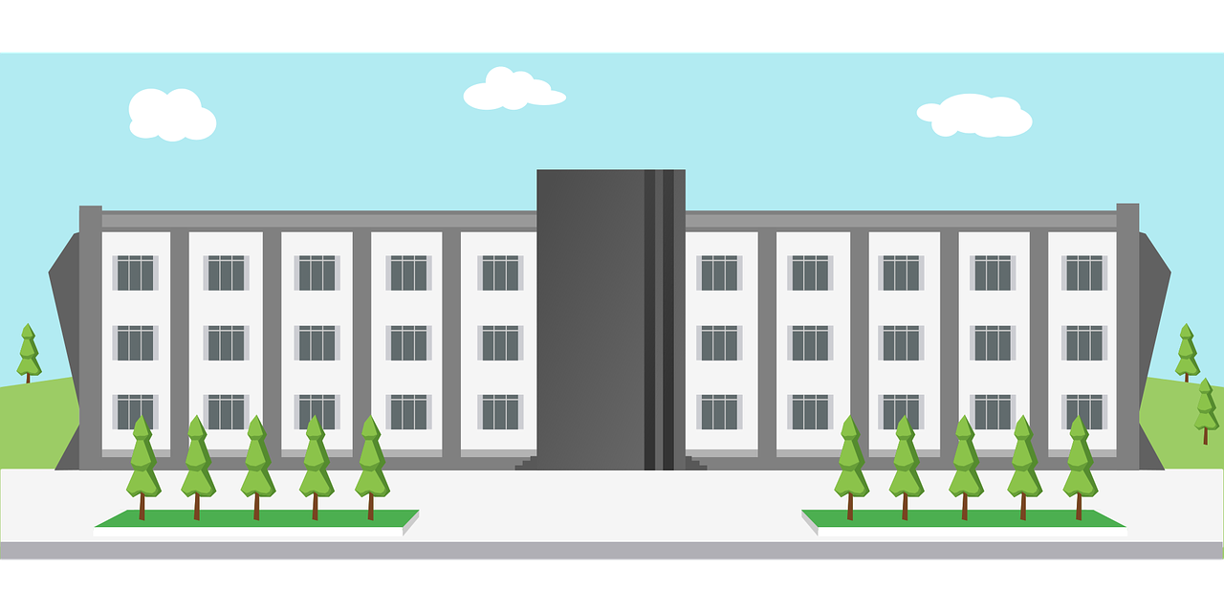
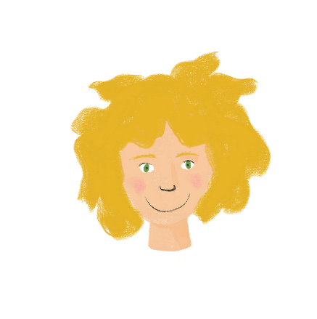
Life at school Talking about what you and others do at school
verbs like choisir (present) (je, il/elle)
SSC [y]
J’ai visité Bruxelles!
Y8 French
Term 2.2 - Week 1 - Lesson 39
Victoria Hobson / Natalie Finlayson / Stephen Owen
Artwork by: Chloé Motard
Date updated: 14.03.24
Notes:
Note: all words (new and revisited) in this week of the SOW appear on all three GCSE wordlists, with these exceptions: i) AQA
Artwork by Chloé Motard. All additional pictures selected are available under a Creative Commons license, no attribution required.
Learning outcomes (lesson 1):
Introduction of SSC [y]
Introduction of verbs like choisir (present) (je, il/elle)
Word frequency (1 is the most frequent word in French):
8.2.2.1 (introduce) choisir [226], réussir [279], remplir [751], définir [916], blanc² [701], examen [1448], lycée [2816], note [1161], cahier [4001], alors [81]
8.1.2.7 (revisit) acheter [636], coûter [984], peser [1584], eau [475], euro [1753], exercice² [1290], fromage [4475], glace [2580], pain [2802], natation [>5000], poisson [1616], sport [2011], travail [153]
8.1.2.1 (revisit) apporter [339], dit [dire 37], fait [faire 25], envoyer [526], utiliser [345], maintenant [192], hier [872], appartement [2323], banque [774], marché [280], passé [501]
Source: Londsale, D., & Le Bras, Y. (2009). A Frequency Dictionary of French: Core vocabulary for learners London: Routledge.
The frequency rankings for words that occur in this PowerPoint which have been previously introduced in NCELP resources are given in the NCELP SOW and in the resources that first introduced and formally re-visited those words.
For any other words that occur incidentally in this PowerPoint, frequency rankings will be provided in the notes field wherever possible.
The additional English meanings of the following words have been added to Quizlet since the creation of this resource:
remplir: to fill, filling; to fill (up), (in), filling (up) (in)
note: mark, grade
lycée: high school, (sixth form) college

Slide 2
y
y
Notes:
Timing: 1 minute
Aim: To introduce SSC [y]
Procedure: 1. Present the letter(s) and say the [y] sound first, on its own. Students repeat it with you. 2. Bring up the word ”y” on its own, say it, students repeat it, so that they have the opportunity to focus all of their attention on the connection between the written word and its sound.
3. A possible gesture for this would be [to point over ‘there’]. 4. Roll back the animations and work through 1-3 again, but this time, dropping your voice completely to listen carefully to the students saying the [y] sound, pronouncing ”y” and, if using, doing the gesture.
Word frequency (1 is the most frequent word in French):
y [36]
Source: Londsale, D., & Le Bras, Y. (2009). A Frequency Dictionary of French: Core vocabulary for learners London: Routledge.

Slide 3
y
y
Notes:
With sound and no pictures to focus all attention on the sound-symbol correspondence.

Slide 4
y
y
Notes:
Without sound to elicit pronunciation (without first hearing the teacher).
Teacher to elicit pronunciation by asking “Comment dit-on …”/

Slide 5
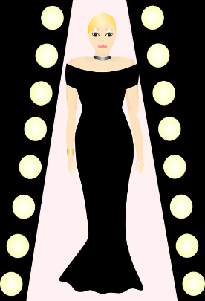
y
rythme
système
style
y
analyser
[to analyse]
physique
Notes:
Timing: 2 minutes
Aim: To introduce SSC [y]
Procedure:
1. Introduce and elicit the pronunciation of the individual SSC [y] and then the source word again ‘y’ (with gesture, if using). 2. Then present and elicit the pronunciation of the five cluster words.
The cluster words have been chosen for their high-frequency, from a range of word classes, with the SSC (where possible) positioned within a variety of syllables within the words (e.g. initial, 2nd, final etc.). Additionally, we have tried to use words that build cumulatively on previously taught SSCs (see the Phonics Teaching Sequence document) and do not include new SSCs. Where new SSCs are used, they are often consonants which have a similar symbol-sound correspondence in English.
Word frequency (1 is the most frequent word in French): système [289]; style [1999] physique [1146]; analyser [1209]; rythme [1662] Source: Londsale, D., & Le Bras, Y. (2009). A Frequency Dictionary of French: Core vocabulary for learners London: Routledge.

Slide 6
y
rythme
système
style
y
analyser
physique
Notes:
With sound and no pictures to focus all attention on the sound-symbol correspondence.

Slide 7
y
rythme
système
style
y
analyser
physique
Notes:
Without sound to elicit pronunciation (without first hearing the teacher).
Teacher to elicit pronunciation by asking “Comment dit-on …”

Slide 8
[y] en anglais vs français
écouter / parler
English | French
Syrian | syrien
anonymous | anonyme
system | système
Pythagoras | Pythagore
myth | mythe
cycling | cyclisme
English [y] in the middle of a word sounds like ‘ih’.
French [y] sounds like SSC [i].
A
B
C
D
E
F
Notes:
Timing: 3 minutes
Aim: Oral production of SSC [y]. Raising awareness of pronunciation differences between French and English [y].
Procedure:
1. Students say the English words and French words – focusing on the difference in pronunciation [French y is a more exaggerated sound than English y]
2. Click on letters to hear French pronunciation. Students repeat.
3. Click to bring up pronunciation tip.
Transcript:
a. syrien
b. anonyme
c. système
d. pythagore
e. mythe
f. cyclisme
Word frequency (1 is the most frequent word in French): anonyme[3129], syrien [4453], pythagore [>5000], système [289], cyclisme [>5000]
Source: Londsale, D., & Le Bras, Y. (2009). A Frequency Dictionary of French: Core vocabulary for learners London: Routledge.

Slide 9
Vocabulaire
écouter
well, so
J
1
Écoute et écris la lettre correcte.
B
2
A
B
C
G
3
F
4
Le lycée – this means ‘high school’ or ‘6th form college’.
D
5
E
D
E
F
6
H
7
A
8
I
to choose, choosing
to pass, passing
to fill, filling (up/in)
to define, defining
9
C
G
H
I
J
10
Notes:
Timing: 5 minutes
Aim: aural recognition of words from this week’s vocabulary set.
Procedure:
1. Click on the numbers to play each vocabulary item
2. Students match the audio to the correct picture by writing the letter.
3. Elicit the answers/alphabet practice by asking ‘numéro 1, c’est quelle lettre ?’ Students respond with the French letter name.
Transcript:
définir
la note
choisir
le cahier
un examen
le lycée
réussir
le blanc
remplir
alors

Slide 10
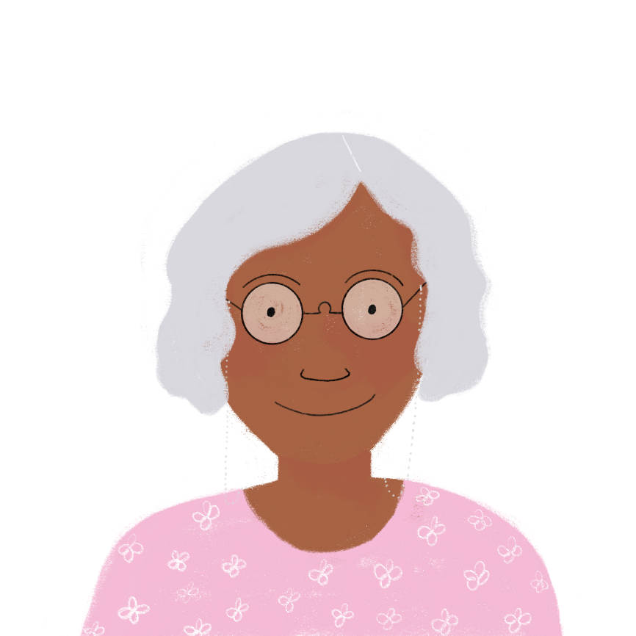
Vocabulaire
Lis et trouve six paires. Écris l’anglais aussi.
lire
Alors*, aujourd’hui nous allons …
les blancs
sortir
les mots
réussir
choisir
donner
nos cahiers
des notes
définir
remplir
un lycée
un examen
remplir les blancs
to define words
réussir un examen
to take out our exercise books
choisir un lycée
fill the gaps
sortir nos cahiers
choose a college
donner des notes
to give marks
definir les mots
to pass an exam
Notes:
Timing: 5 minutes
Aim: Written recognition of week’s new vocabulary. Strengthen semantic associations between words.
Procedure:
1. Students form six sentences by matching each verb with a suitable noun. NB: as students haven’t yet learned the conjugation pattern for verbs like choisir, the exercise is written in the future with aller so the infinitives may be used.
2. Elicit translations into English for each one.
3. Click to display the answers.
4. Draw attention to the filler word alors and explain usage.
Word frequency of unknown vocabulary (1 is the most frequent word in French): paire [3926], alors [81]
Source: Londsale, D., & Le Bras, Y. (2009). A Frequency Dictionary of French: Core vocabulary for learners London: Routledge.

Slide 11
choisir
[to choose | choosing]
choisit
[chooses | is choosing]
Notes:
Timing: 3 minutes for sequence of six verbs
Procedure
Bring up the word [choisir] on its own, say it, students repeat it, and remind them of the phonics. Draw attention to SSCs [ch] and [s].
Try to elicit the meaning from the students. Students have had explicit teaching that the present tense in French communicates two different present tense meanings in English. This reinforces that learning. Emphasise the two meanings for the short form, reminding students that French only has one form and does not have a direct equivalent of the grammar for ‘is + ing’, the continuous form (as covered in previous weeks).
Bring up the picture, and, if using gestures, a possible gesture would be to scratch you chin and use your finger to mime pointing.
Then bring up the English translations. Emphasise the two meanings for the infinitive.
Bring up the short form [choisit], say it, students repeat it. Draw attention to SSC [ch] and [s].
Try to elicit the meaning from the students. Emphasise the two meanings for the short form.

Slide 12
choisir
[to choose | choosing]
choisit
[choses | is choosing]
Notes:
Cycle through the long and short form again.

Slide 13
choisit
[chooses | is choosing]
Elle choisit le cahier bleu.
[She chooses | is choosing the blue exercise book.]
Notes:
Introduce the short form in a sentence.

Slide 14
choisir
[to choose | is choosing]
Elle va choisir le cahier bleu.
[She is going to choose the blue exercise book.]
Notes:
Introduce the long form in a sentence.

Slide 15
choisit
[chooses | is choosing]
Elle le cahier bleu.
choisit
[She chooses | is choosing the blue exercise book.]
Notes:
Cycle through the short form in context again.

Slide 16
choisir
[to choose | choosing]
choisir
Elle va le cahier bleu.
[She is going to choose the blue exercise book.]
Notes:
Cycle through the long form in context again.

Slide 17
Verbs like choisir
grammaire
These verb forms sound the same!
The –s and –t are silent final consonants (SFC)
You already know some verbs which end in -IR instead of –ER:
verbs like sortir (partir, dormir)
verbs like venir (revenir, devenir)
Verbs like choisir are another type of –IR verb.
To say ‘I’ with a verb like choisir, remove the –IR from the infinitive and add ‘-is’.
choisir
choisir
je choisis
I choose / am choosing
To say ‘s/he’ with a verb like choisir, remove the –IR and add ‘-it’.
choisir
choisir
il/elle choisit
s/he chooses / is choosing
Notes:
Timing: 3 minutes
Aim: to introduce first and third person singular of present tense verbs like choisir.
Procedure:
1. Click to bring up the explanation.
2. Emphasise that the je and il/elle forms sound the same.

Slide 18
À l’école
lire
Léa écrit un texte sur la vie à l’école. Elle parle de qui ? ‘Je’ (Léa ) ou ‘il’ (Amir)?
3.
1.
Je réussis l’examen avec une très bonne note.
Il remplit les blancs en allemand.
Il définit le vocabulaire important.
‘I’ | ‘He’
2.
pass the exam with a very good grade.
fills the blanks in German.
Il réussit l’examen de piano.
4.
Je choisis un cahier de maths.
am choosing a maths exercise book.
defines the important vocabulary.
5.
fill the glass for Mrs Chevrolet.
passes the piano exam.
Je remplis le verre pour Madame Chevrolet.
Il choisit un sandwich pour son déjeuner.
6.
7.
8.
Je définis des mots anglais difficiles.
am defining some difficult English words.
is choosing a sandwich for his lunch.
Notes:
Timing: 8 minutes
Aim: written recognition of present tense endings of verbs like choisir in first and third person singular and connecting these with meaning.
Procedure:
1. Students write 1-8 in their exercise books and write ‘I’ or ‘he’ for each speech bubble, using their knowledge of forms of verbs like choisir to inform their choices.
2. Click on the question mark to reveal the subject pronoun.
3. Students then complete the grid in English with the details of each sentence.
4. Answers are revealed on a mouse click. Note that the English translations in both the present simple and continuous are possible. Discuss how the choice of English tense affects meaning during the feedback.
Word frequency of cognates used (1 is the most frequent word in French): vocabulaire [4159], sandwich [>5000]
Source: Londsale, D., & Le Bras, Y. (2009). A Frequency Dictionary of French: Core vocabulary for learners London: Routledge.

Slide 19
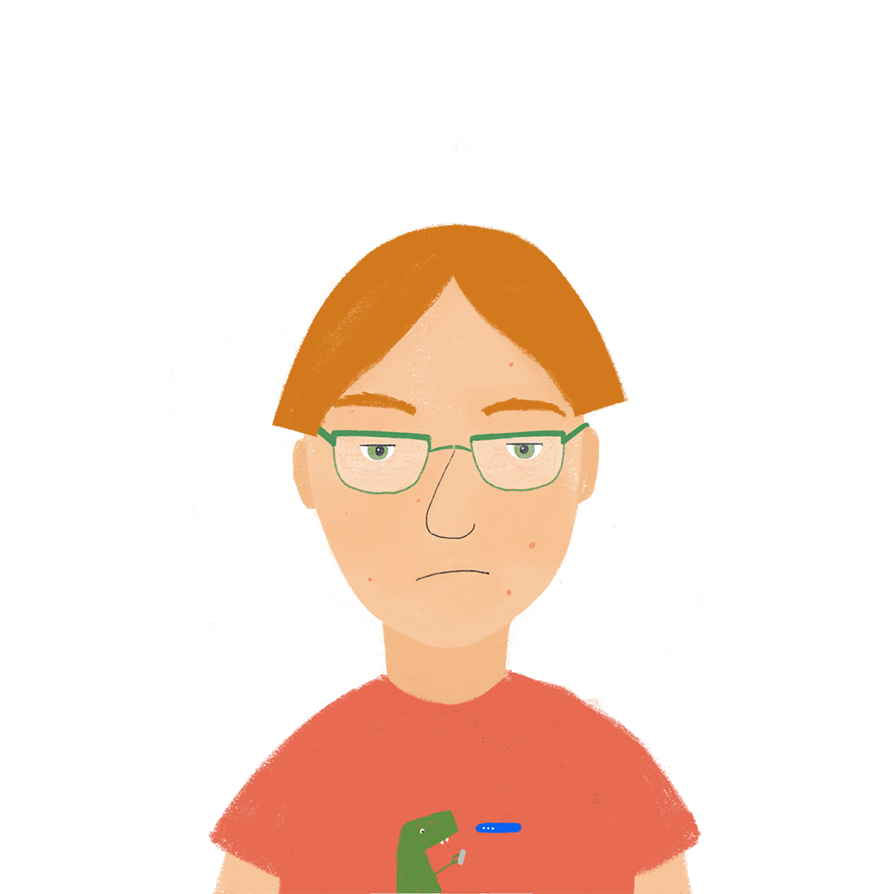
Je ou elle?
écouter / écrire
Maintenant, Antoine parle sur la vie à l’école. Écoute et regarde. Il parle de qui? ‘Je’ (Antoine) ou ‘elle’ (Léa) ? Écris le verbe en français.
Exemple:
Elle réussit
Notes:
Timing: 5 minutes (for the next 8 slides)
Aim: Written production of present tense verbs like choisir in first and third person singular. Reinforcing the fact that the je and il/elle forms of verbs like choisir sound identical.
Procedure:
Explain to students they will hear a verb without the subject pronoun. At the same time as hearing the verb, a circle will appear to indicate the pronoun required. Remind students that the audio won’t give them clues about the spelling as the je and il/elle forms sound identical!
Students write the pronoun and the verb with its correct ending.
Click to reveal the French.
Transcript:
réussit
Word frequency of cognates used (1 is the most frequent word in French):
verbe [>5000] Source: Londsale, D., & Le Bras, Y. (2009). A Frequency Dictionary of French: Core vocabulary for learners London: Routledge.

Slide 20
Je ou elle?
écouter / écrire
Je choisis
Notes:
Transcript:
choisis

Slide 21
Je ou elle?
écouter / écrire
Je définis
Notes:
Transcript:
définis

Slide 22
Je ou elle?
écouter / écrire
Elle remplit
Notes:
Transcript:
remplit

Slide 23
Je ou elle?
écouter / écrire
Je réussis
Notes:
Transcript:
réussis

Slide 24
Je ou elle?
écouter / écrire
Elle choisit
Notes:
Transcript:
choisit

Slide 25
Je ou elle?
écouter / écrire
Elle définit
Notes:
Transcript:
définit

Slide 26
Je ou elle?
écouter / écrire
Je remplis
Notes:
Transcript:
remplis

Slide 27
La vie à l’école
la la _ _ _ _
la ma _ _ _ _ _
la mu _ _ _ _ _
la ph _ _ _ _ la ré _ _ _ _ _
la sc _ _ _ _ _
la so _ _ _ _ _ _
l’ac _ _ _ _ _ _
l’al _ _ _ _ _ _
l’él _ _ _
l’er _ _ _ _
l’hi _ _ _ _ _ _
Noms
le bu _ _ _ _
le co _ _ _ _ _
le dé _ _ _ _ _ _
le di _ _ _ _ _ _ _
le li _ _ _
le mo _
le pr _ _ _ _ _ _ _ _
le pr _ _ _ _
le pr _ _ _ _ _ _
le pa _ _ _ _ _ _ _ _
le sp _ _ _
la langue
le bureau
la matière
Verbes
éc _ _ _ _
éc _ _ _ _ _
pa _ _ _ _
li _ _
tr _ _ _ _ _ _ _ _
ét _ _ _ _ _
co _ _ _ _ _ _ _ _ _
ap _ _ _ _ _ _ _
tr _ _ _ _ _
Adjectifs
im _ _ _ _ _ _ _
in _ _ _ _ _ _ _ _ _
in _ _ _ _ _ _ _ _ _ _
st _ _ _ _
tr _ _ _ _ _ _ _ _ _
fa _ _ _ _
di _ _ _ _ _ _ _
le collège
la musique
écouter
important
le déjeuner
la phrase
écrire
intelligent
le directeur
la réponse
parler
intéressant
le livre
la science
lire
strict
le mot
la solution
travailler
travailleur
le professeur
l’activité
étudier
facile
le projet
l’allemand
comprendre
difficile
le problème
l’élève
apprendre
le partenaire
l’erreur
trouver
le sport
l’histoire
Notes:
Timing: 5 minutes
Aim: written recall of school vocabulary to prime students for the texts about school to come in order to aid their comprehension.
Procedure:
1. Give students three minutes in groups of two four to complete as many of the words on the lists as they can.
2. Reveal the answers on a mouse click. Students award themselves one point for a partially-correct word, and a second point for a word that is spelled correctly an, for nouns, has the right gender.
3. Clarify/elicit meanings in English where necessary.

Slide 28
La vie au collège
*vocabulary = le vocabulaire
lire / parler / écouter
Personne B
Personne A
Who…?
is choosing English
is passing a guitar exam
is defining English words
is choosing German
is filling in the gaps
is defining German vocabulary*
Who…?
is choosing ‘pétanque’
is defining words for an exam
is filling their exercise book with important vocabulary*
is choosing football
passes difficult exams
is filling their maths exercise book with answers
Example: Qui choisit l’anglais ?
Notes:
Timing: 10 minutes
Aim: To practise oral production and aural recognition of 3rd person singular forms of verbs like choisir in the present tense. In addition, students practise written recognition of vocabulary / reading comprehension.
Procedure:
In pairs, one student takes the role of A, the other is B.
Give students a couple of minutes to consider how they will construct their set of questions in French. Work through the first example as a class (a suggested question with qui appears on a click). Give students time to make some notes if they wish (either in French or English). This could be done in exercise books. There is no need to print this sheet. Also encourage recourse to reference materials if students cannot readily recall the necessary vocab.
Display the next slide, asking student B to turn away from the board.
Student A uses the text (on the following slide) as the stimulus to give the appropriate answers to student B.
Student B faces away from the board and asks student A the questions in French from their prompt sheet.
Student A listens to the question in French and then gives the answer – either Amir or Léa.
Student B ticks the correct column on his/her sheet.
Partners then swap roles (see following slide).
Go through the answers on the final slide of the sequence to bring the activity to a close.
Word frequency of cognates used (1 is the most frequent word in French): vocabulaire [4159]
Source: Londsale, D., & Le Bras, Y. (2009). A Frequency Dictionary of French: Core vocabulary for learners London: Routledge.

Slide 29
La vie au collège
lire / parler / écouter
Partenaire A
La vie au collège est très bien. Dans ma famille, on aime des langues étrangères ! Je choisis l’anglais et Léa choisit l’anglais et l’allemand aussi. Aujourd’hui je définis les mots difficiles en anglais. J’ai des bonnes notes en anglais ! Léa définit le vocabulaire allemand. Souvent je remplis les blancs mais je préfère écrire des phrases complètes. Léa reussit l’examen de guitare. Elle adore la musique. Je veux jouer d’un instrument aussi !
Notes:
Student A stimulus text.
Word frequency of cognates used (1 is the most frequent word in French): vocabulaire [4159], complète [>5000]
Source: Londsale, D., & Le Bras, Y. (2009). A Frequency Dictionary of French: Core vocabulary for learners London: Routledge.

Slide 30
La vie au collège
lire / parler / écouter
Partenaire B
La vie au collège est assez bien. Dans ma famille, on n’aime pas beaucoup faire du sport, mais je choisis le foot et Amir choisit la pétanque. En ce moment je définis les mots pour réussir les examen d’anglais. En allemand, je remplis mon cahier avec le vocabulaire important. Amir est intelligent - il réussit les examens difficiles. Il remplit son cahier de maths avec les réponses aux problèmes difficiles. Il adore les maths – c’est bizarre !
Notes:
Student B stimulus text Word frequency of cognates used (1 is the most frequent word in French): vocabulaire [4159], bizarre [>5000]
Source: Londsale, D., & Le Bras, Y. (2009). A Frequency Dictionary of French: Core vocabulary for learners London: Routledge.

Slide 31
La vie au collège
Réponses
lire / parler / écouter
Partenaire B
Partenaire A
Who…?
is choosing English
is passing a guitar exam
is defining English words
is choosing German
is filling in the gaps
is defining German vocabulary
Who…?
is choosing ‘pétanque’
is defining words for an exam
is filling their exercise book with important vocabulary
is choosing football
passes difficult exams
is filling their maths exercise book with answers
Notes:
Answer slide.

Slide 32
Life at school Talking about what you and others do at school
verbs like choisir (present) (tu, il/elle)
SSC [y]
Les différentes écoles en France.
Présentation de Léa.
J’ai visité Bruxelles!
Y8 French
Term 2.2 - Week 1 - Lesson 40
Victoria Hobson / Natalie Finlayson / Stephen Owen
Artwork by: Chloé Motard
Date updated: 14.03.24
Notes:
Note: all words (new and revisited) in this week of the SOW appear on all three GCSE wordlists, with these exceptions: i) AQA
Learning outcomes (lesson 2):
Consolidation of SSC [y]
Introduction of verbs like choisir (present) (tu, il/elle)
Word frequency (1 is the most frequent word in French):
8.2.2.1 (introduce) choisir [226], réussir [279], remplir [751], définir [916], blanc² [701], examen [1448], lycée [2816], note [1161], cahier [4001], alors [81]
8.1.2.7 (revisit) acheter [636], coûter [984], peser [1584], eau [475], euro [1753], exercice² [1290], fromage [4475], glace [2580], pain [2802], natation [>5000], poisson [1616], sport [2011], travail [153]
8.1.2.1 (revisit) apporter [339], dit [dire 37], fait [faire 25], envoyer [526], utiliser [345], maintenant [192], hier [872], appartement [2323], banque [774], marché [280], passé [501]
Source: Londsale, D., & Le Bras, Y. (2009). A Frequency Dictionary of French: Core vocabulary for learners London: Routledge.
The frequency rankings for words that occur in this PowerPoint which have been previously introduced in NCELP resources are given in the NCELP SOW and in the resources that first introduced and formally re-visited those words.
For any other words that occur incidentally in this PowerPoint, frequency rankings will be provided in the notes field wherever possible.
The additional English meanings of the following words have been added to Quizlet since the creation of this resource:
remplir: to fill, filling; to fill (up), (in), filling (up) (in)
note: mark, grade
lycée: high school, (sixth form) college

Slide 33
y
rythme
système
style
y
analyser
[to analyse]
physique
Notes:
Timing: 1 minute
Aim: To consolidate SSC [y]
Procedure:
1. Introduce and elicit the pronunciation of the individual SSC [y] and then the source word again ‘y’ (with gesture, if using). 2. Then present and elicit the pronunciation of the five cluster words.
The cluster words have been chosen for their high-frequency, from a range of word classes, with the SSC (where possible) positioned within a variety of syllables within the words (e.g. initial, 2nd, final etc.). Additionally, we have tried to use words that build cumulatively on previously taught SSCs (see the Phonics Teaching Sequence document) and do not include new SSCs. Where new SSCs are used, they are often consonants which have a similar symbol-sound correspondence in English.
Word frequency (1 is the most frequent word in French): système [289]; style [1999] physique [1146]; analyser [1209]; rythme [1662] Source: Londsale, D., & Le Bras, Y. (2009). A Frequency Dictionary of French: Core vocabulary for learners London: Routledge.

Slide 34
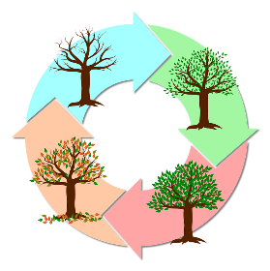
Phonétique
lire / parler
Dis les mots. Make sure to use your knowledge of French SSCs and not your knowledge of English!
60
typhon
analyser
[typhoon]
mystère
[to analyse]
cycle
[mystery]
psychologie
secondes
python
[psychology]
recycler
rythme
dynamique
hypothèse
[vibrant]
[hypothesis]
cynique
typique
0
[cynical]
[typical]
DÉBUT
Notes:
Timing: 5 minutes
Aim: Oral production of unknown words containing SSC [y].
Procedure:
1. Split students into pairs.
2. Click début to start the timer. NB: at higher levels, the timer can be set to a shorter time. To do this, click on ‘animations’ and then the orange timer bar. Adjust the number of seconds in ‘duration’.
3. Speaking student tries to pronounce all words accurately within a minute.
4. Listening student checks pronunciation. If they hear an English pronunciation of [y], they ask their partner to repeat the word correctly three times before proceeding.
5. When timer finishes, swap so other person speaks.
6. The winner is the student who pronounced the most words correctly within a given time.
7. Check pronunciation by clicking on words to hear them said by a native speaker. Students repeat.
Word frequency (1 is the most frequent word in French): cycle [2462], mystère [2777], analyser [1209], cynique [3547], hypothèse [1669], typique [4178], dynamique [2078], psychologie [4836], python [>5000], recycler [>5000], rythme [1662], typhon [>5000]
Source: Londsale, D., & Le Bras, Y. (2009). A Frequency Dictionary of French: Core vocabulary for learners London: Routledge.

Slide 35
Vocabulaire
*le sac = bag
parler
Personne A
Au marché je remplis mon sac* avec…
Personne B
le lycée
du poisson
les blancs
une note
le sport
du fromage
de la natation
du pain
la banque
de la glace
le travail
Notes:
Timing: 5 minutes (for next 4 slides)
Aim: to revisit vocabulary from 8.1.2.7 and 8.1.2.1 as per the cycle of revisiting in the SoW
Procedure:
1. Click to reveal the first text box.
2. Student A says this to their partner.
3. Click to reveal the options.
4. Student B then says all the possible answers that fit.
5. Click to reveal the answers.
6. Partners then swap roles. (Each student has two turns at asking and two turns at answering).
Word frequency of glossed words used (1 is the most frequent word in French): sac [2343]
Source: Londsale, D., & Le Bras, Y. (2009). A Frequency Dictionary of French: Core vocabulary for learners London: Routledge.

Slide 36
Vocabulaire
parler
Personne B
Au lycée je réussis un examen…
Personne A
de sport
un appartement
du poisson
de l’eau
avec une bonne note
difficile
et maintenant j’ai dix euros pour mon compte en banque

Slide 37
Vocabulaire
parler
Personne A
Au lycée je/j’ …
Personne B
fais de la natation
achète du poisson
fais du sport
pèse le fromage
fais un exercice
définis le vocabulaire
envoie des messages en classe
utlilise un ordinateur
fais le travail
apporte mes cahiers chaque jour
Notes:
Word frequency of cognates used (1 is the most frequent word in French): message [792]
Source: Londsale, D., & Le Bras, Y. (2009). A Frequency Dictionary of French: Core vocabulary for learners London: Routledge.

Slide 38
Vocabulaire
parler
Personne B
Hier au marché j’ai…
Personne A
fait du sport
joué au foot
fait de l’exercice
pesé le fromage
utilisé un ordinateur
acheté de l’eau
mangé une glace
envoyé vingt euros à ma mère
fait de la natation
dit, ‘Ça coûte combien ?’

Slide 39
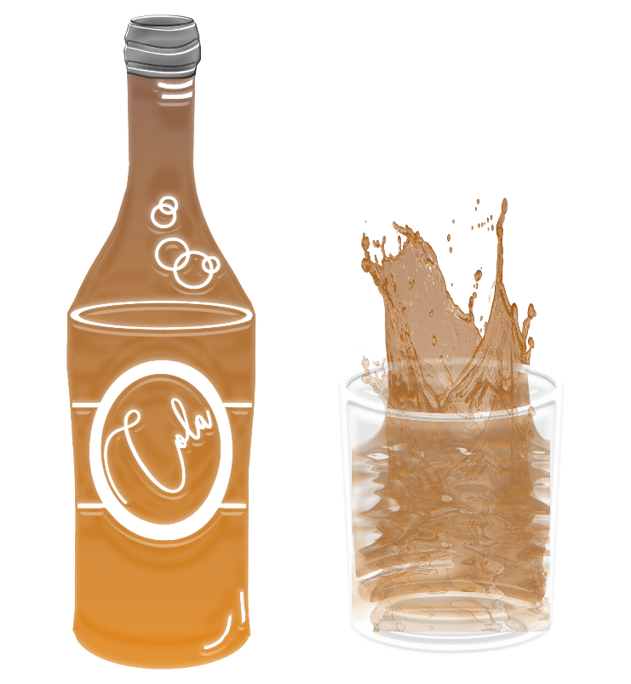
remplir
[to fill (up/in)|filling, to fill (up/in)]
remplit
[fills (up/in)|is filling (up/in)]
Notes:
Timing: 3 minutes for sequence of six verbs
Procedure
Bring up the word remplir on its own, say it, students repeat it, and remind them of the phonics. Draw attention to SSC [em/am].
Try to elicit the meaning from the students. Students have had explicit teaching that the present tense in French communicates two different present tense meanings in English. This reinforces that learning. Emphasise the two meanings for the short form, reminding students that French only has one form and does not have a direct equivalent of the grammar for ‘is + ing’, the continuous form (as covered in previous weeks).
Bring up the picture, and, if using gestures, a possible gesture would be to mime pouring liquid into a glass.
Then bring up the English translations. Emphasise the two meanings for the infinitive.
Bring up the short form remplit, say it, students repeat it. Draw attention to SSC [em/am] and SFC.
Try to elicit the meaning from the students. Emphasise the two meanings for the short form.

Slide 40
remplir
[to fill (up/in)|filling, to fill (up/in)]
remplit
[fills (up/in)|is filling (up/in)]
Notes:
Cycle through the long and short form again.

Slide 41
remplit
[fills (up/in)|is filling (up/in)]
Elle remplit les blancs.
[She fills in| is filling in the gaps.]
Notes:
Introduce the short form in a sentence.

Slide 42
remplir
[to fill (up/in)|filling, to fill (up/in)]
Elle sait remplir les blancs.
[She knows how to fill in the gaps.]
Notes:
Introduce the long form in a sentence.

Slide 43
remplit
[fills (up/in)|is filling (up/in)]
remplit
Elle les blancs.
[She fills in| is filling in the gaps.]
Notes:
Cycle through the short form in context again.

Slide 44
remplir
[to fill (up/in)|filling, to fill (up/in)]
remplir
Elle sait les blancs.
[She knows how to fill in the gaps.]
Notes:
Cycle through the long form in context again.

Slide 45
Verbs like choisir
grammaire
As you have learnt, some verbs end in -IR instead of -ER.
Verbs like choisir follow a pattern in the present tense.
These verb forms sound the same!
The –s and –t are silent final consonants (SFC)
To say ‘s/he’ with a verb like choisir, remove the -IR and add ‘-it’.
_____.
s/he chooses / is choosing =
il/elle choisit
s/he fills / is filling =
il/elle remplit
To say ‘you’ with a verb like choisir, remove the –IR and add ‘-is’.
tu choisis
you choose / are choosing
Verbs like choisir after ‘tu’ take the same ending as after ‘je’.
tu remplis
you fill / are filling
Notes:
Timing: 2 minutes
Aim: to introduce second person singular of present tense verbs like choisir.

Slide 46
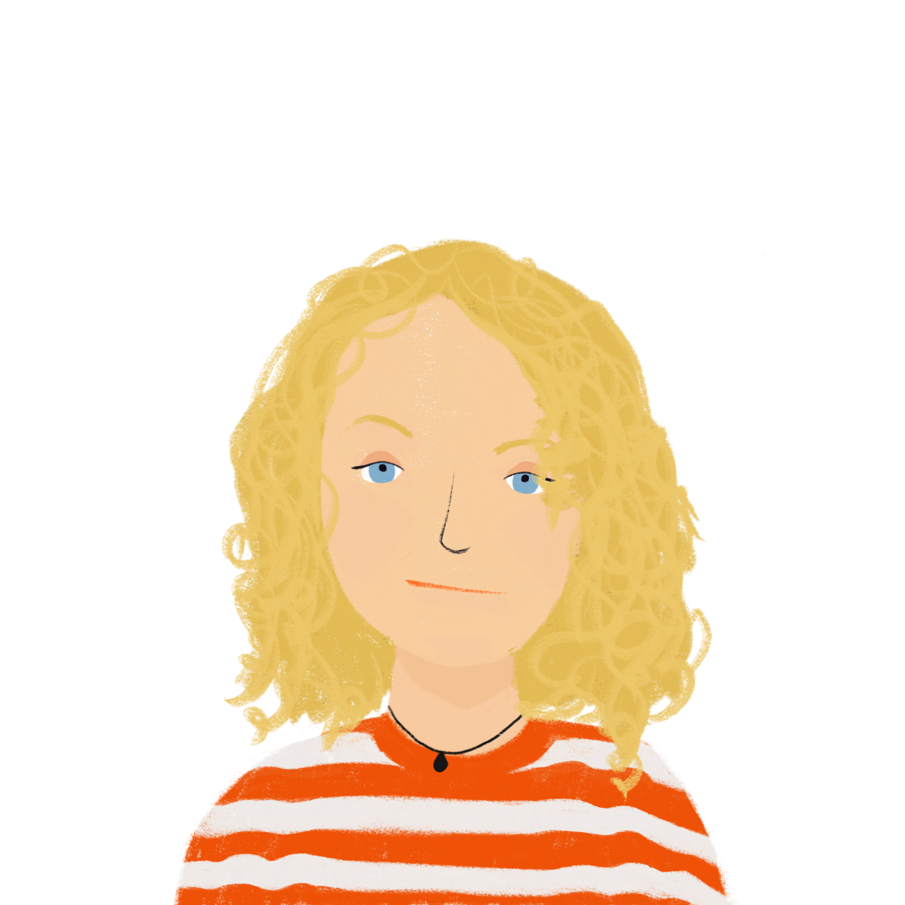
À l’école: Tu ou elle?
lire
Amir écrit un email à Kirsten à York. Il parle d’Océane.
Lis et écris ‘Kirsten’ (tu) ou ‘Océane’(elle) pour chaque numéro.
>> sujet: école
Salut Kirsten! Ça va ? La vie à l’école est super en ce moment. On n’a pas d’examens! Je suis très content. Océane n’est pas heureuse. Tu as dit que tu réussis des examens de science, de maths et de langues. Elle réussit seulement les examens d’histoire. Elle ne sait pas pourquoi ! En classe elle remplit ses cahiers avec beaucoup de travail et elle définit le vocabulaire, mais les examens sont difficiles. Tu remplis tes cahiers avec quoi ?. Tu choisis les matières intéressantes mais elle choisit des langues difficiles. C’est peut- être ça, la raison ? Elle est travailleuse, je ne trouve pas de solution! Peux-tu aider?
À bientôt, Amir.
1.
2.
3.
4.
5.
6.
7.
8.
Notes:
Timing: 5 minutes
Aim: written recognition of present tense endings of verbs like choisir in second and third person singular and connecting these with meaning.
Procedure:
1. Students read the text, focusing on the verbs and write ‘you’ or ‘she’ for each one.
2. Click to reveal the pronoun.
3. Move on to the comprehension task on the next slide.
Word frequency of cognates used (1 is the most frequent word in French): super [2993]
Source: Londsale, D., & Le Bras, Y. (2009). A Frequency Dictionary of French: Core vocabulary for learners London: Routledge.

Slide 47
À l’école: vrai ou faux?[
‘Faux’ has an irregular feminine form.
lire
Lis et décide si les phrases sont vraies ou fausses.
>> sujet: école
Salut Kirsten! Ça va ? La vie à l’école est super en ce moment. On n’a pas d’examens! Je suis très content. Océane n’est pas heureuse. Tu as dit que tu réussis des examens de science, de maths et de langues. Elle réussit seulement les examens d’histoire. Elle ne sait pas pourquoi ! En classe elle remplit ses cahiers avec beaucoup de travail et elle définit le vocabulaire, mais les examens sont difficiles. Tu remplis tes cahiers avec quoi ?. Tu choisis les matières intéressantes mais elle choisit des langues difficiles. C’est peut- être ça, la raison ? Elle est travailleuse, je ne trouve pas de solution! Peux-tu aider?
À bientôt, Amir.
Océane is very happy.
Kirsten is passing her science, maths and history exams.
Océane is only passing her history exams.
Kirsten chooses interesting subjects.
Océane chooses two difficult sciences.
Notes:
Timing: 5 minutes
Aim: reading comprehension to further embed understanding of vocabulary and endings of verbs like choisir at paragraph level.
Procedure:
Students read the text and decide if the sentences are true or false.
Click to reveal the answers.

Slide 48
Écris en français !
écrire
Kirsten écrit un email à Amir en anglais. Écris le texte en français.
>> RE: école
Hello Amir,
I am happy that you are passing your exams! Are you filling your bank account with euros now? My friend Natalie doesn’t have a problem with exams. She chooses difficult subjects like Océane but she passes exams. She has a good mark in French! In class, the teacher defines difficult words, then she fills her exercise book with important words. It’s Mr Campbell’s idea. He chooses intelligent activities. It’s a big project but it is a good solution. Does Océane define important words in English?
Bye, Kirsten.
Notes:
Timing: 10 minutes
Aim: L1-L2 translation. Written production of verbs like choisir, formulation of yes/no questions. adjective agreement, adjective placement and adverb placement.
Procedure:
1. Students translate the email into French.
2. A suggested translation is provided on the next slide. Accept accurate alternative translations.
Word frequency of cognates used (1 is the most frequent word in French): texte [631]
Source: Londsale, D., & Le Bras, Y. (2009). A Frequency Dictionary of French: Core vocabulary for learners London: Routledge.

Slide 49
Réponses
écrire
Kirsten écrit un email à Amir en anglais. Écris le texte en français.
>> RE: école
Bonjour Amir,
Je suis heureuse que tu réussis tes examens ! Remplis-tu ton compte en banque avec des euros maintenant? Mon amie Natalie n’a pas de problème avec les examens. Elle choisit les matières difficiles comme Océane, mais elle réussit les examens. Elle a une bonne note en français ! En classe, le professeur définit les mots difficiles, puis elle remplit son cahier avec les mots importants. C’est l’idée de Monsieur Campbell. Il choisit des activitiés intelligentes. C’est un grand projet mais c’est une bonne solution. Océane définit-elle les mots importants en anglais?
Au revoir,
Kirsten.
Notes:
Suggested solution to the text on the previous slide.

Slide 50
Léa parle des écoles en France
écouter / écrire / parler
Léa donne une présentation en classe sur le système scolaire en France.
Écoute et prends des notes.
Les différentes écoles en France.
Présentation de Léa.
Notes:
Timing: 10 minutes
Aim: Dictagloss – Reconstruct a text from notes
Procedure:
Students write 1-10 in their notebooks with plenty of space for each point.
Students listen to the presentation and take notes about each point.
Play the presentation again if necessary. How many times depends on the class and ability level and is up to the teacher’s judgment.
Based on the notes students reconstruct the monologue (could be done in pairs/groups of four).
Students summarise the text in English and discuss any differences between school in France and England.
Transcript: L’école primaire est pour les élèves de six à onze ans.
On ne va pas à l’école le mercredi après-midi.
Le collège est pour les élèves de onze à quinze ans.
On ne porte pas d’uniforme.
Le déjeuner est très important. Chaque jour, on mange les repas à table dans la cantine.
Les professeurs donnent des notes sur vingt aux élèves.
Pour réussir un examen, un élève doit avoir une note de dix sur vingt (au minimum).
Si on a une mauvaise note à la fin de l’année*, on doit redoubler.
Le lycée est pour les élèves de quinze à dix-huit ans.
Au lycée, on prépare le baccalauréat. Si on réussit, on peut aller à l’université.
Word frequency of cognates used (1 is the most frequent word in French): note [1161], système [289], présentation [1723]
Source: Londsale, D., & Le Bras, Y. (2009). A Frequency Dictionary of French: Core vocabulary for learners London: Routledge.

Slide 51
Léa parle des écoles en France
écouter
1
L’école primaire est pour les élèves de six à onze ans.
2
On ne va pas à l’école le mercredi après-midi.
3
Le collège est pour les élèves de onze à quinze ans.
4
On ne porte pas d’uniforme.
5
Le déjeuner est très important. Chaque jour, on mange les repas à table à la cantine.
Notes:
Transcript dictagloss for checking.
Word frequency of (near-)cognates used:
primaire [2527]; table [1019]; cantine [>5000]
Source: Londsale, D., & Le Bras, Y. (2009). A Frequency Dictionary of French: Core vocabulary for learners London: Routledge.

Slide 52
Léa parle des écoles en France
écouter
* at the end of the year.
6
Les professeurs donnent des notes sur vingt aux élèves.
7
Pour réussir un examen, un élève doit avoir une note de dix sur vingt (au minimum).
‘Redoubler’ means to repeat a year. This happens if you are not ready to move up to the next academic year.
8
Si on a une mauvaise note à la fin de l’année*, on doit redoubler.
9
Le lycée est pour les élèves de quinze à dix-huit ans.
10
Au lycée, on prépare le baccalauréat. Si on réussit, on peut aller à l’université.
The ‘baccalauréat’ is the high school leaving qualification you need to get if you want to study at university. You take it at around age 18.
Notes:
Transcript dictagloss for checking.
Word frequency of (near-)cognates used:
minimum [1410], redoubler [>5000]; baccalauréat [>5000], cantine [>5000]
Source: Londsale, D., & Le Bras, Y. (2009). A Frequency Dictionary of French: Core vocabulary for learners London: Routledge.

Slide 53
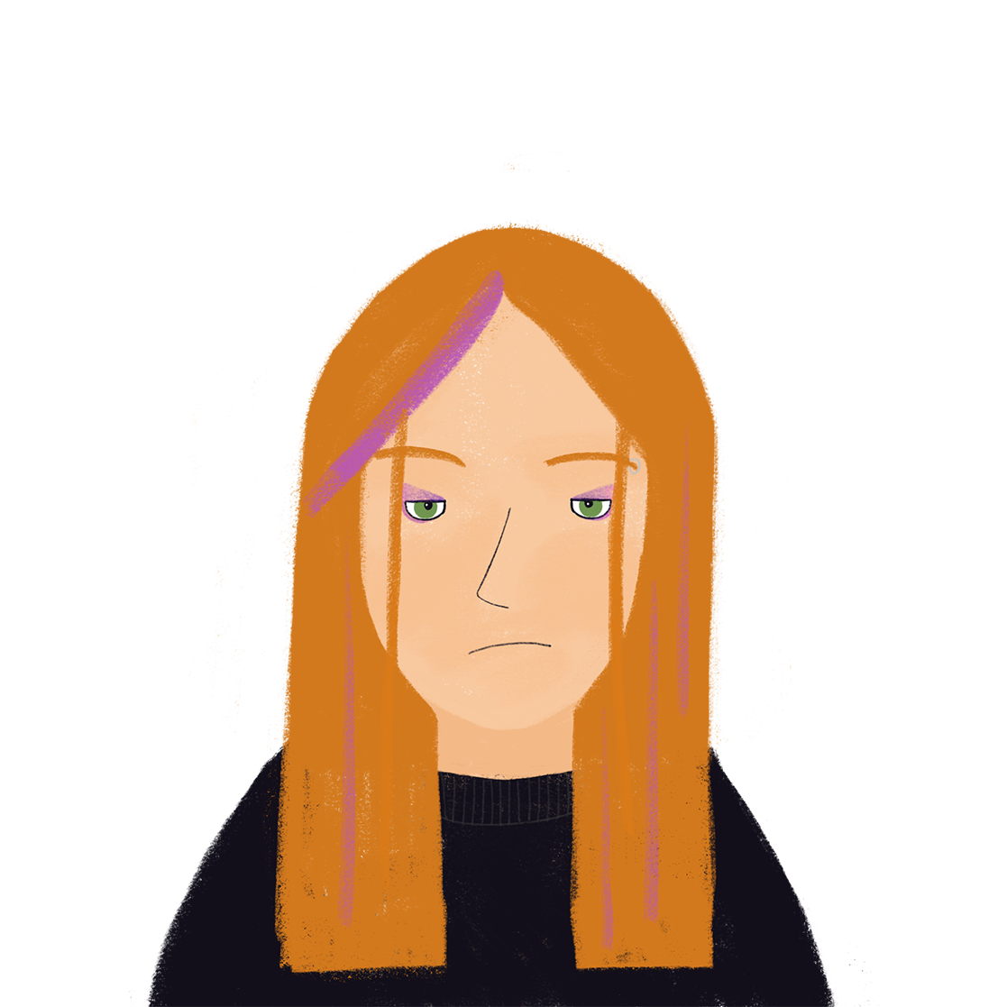
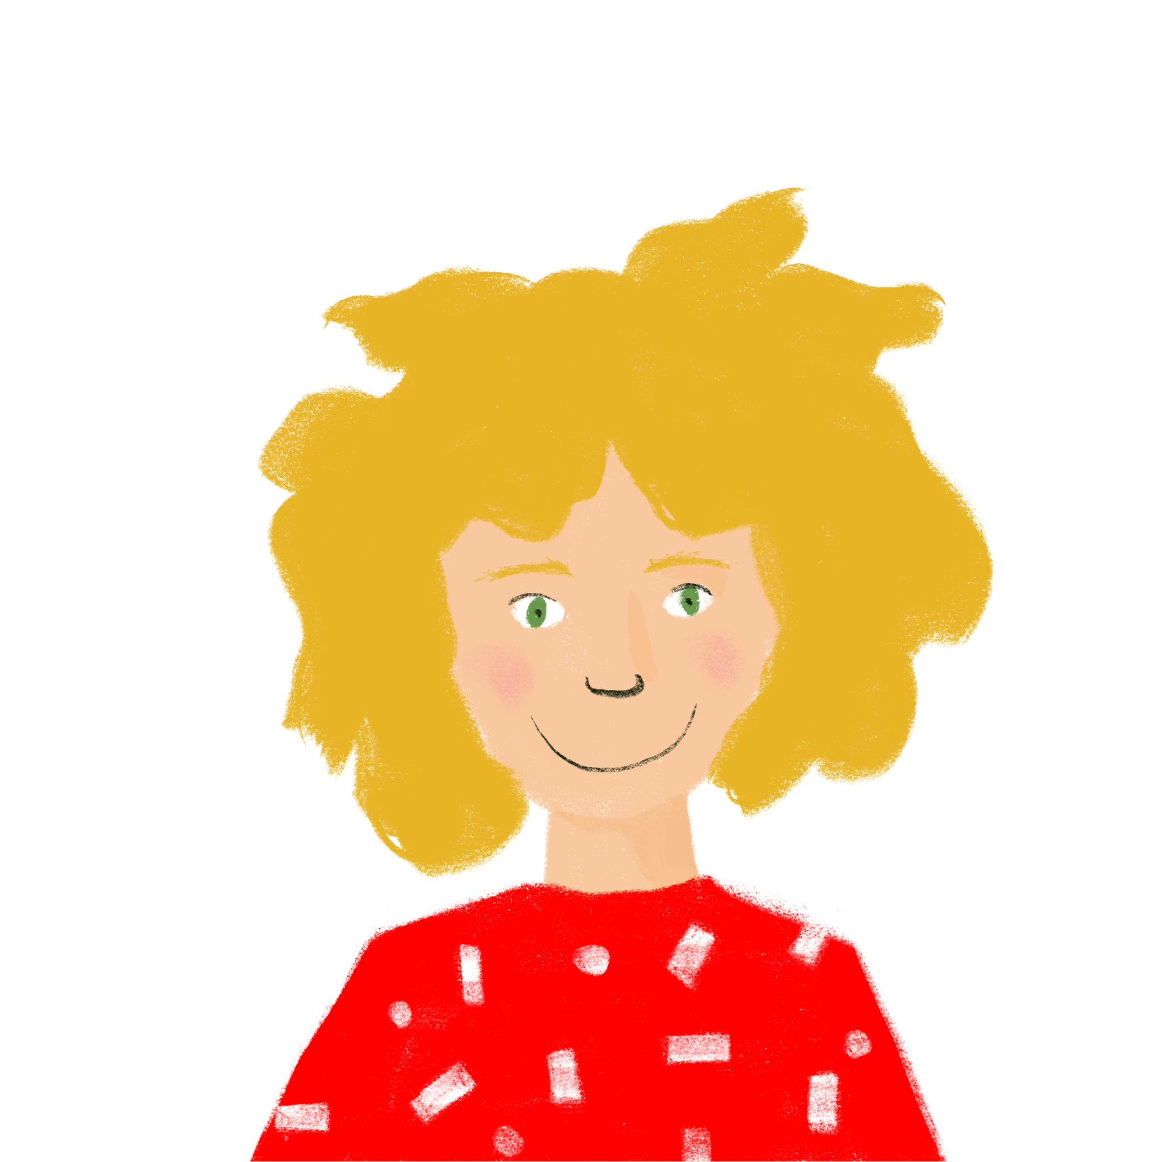
Qui va où ?
lire
L’école primaire
Le collège
Le lycée
L’université
Amir, 12
Élodie, 17
Abdel, 20
Noura, 9
Antoine, 15
Léa, 12
Notes:
Timing: 4 minutes
Aim: Applying cultural knowledge of the French school system
Procedure:
1. Students use the information about the school system that they learned through the dictagloss to determine which stage of the education system the young people are at.
2. Teachers elicit answers by asking e.g. ‘Amir, il va où ?’
3. On clicks, the faces fly to the appropriate type of school.

Slide 54
Devoirs
Vocabulary Learning Homework (Y8, Term 2.2, Week 2)
Audio file
Student worksheet
In addition, revisit: Y8 Term 2.1 Week 1 | Y8 Term 1.2 Week 2
Notes:
The answer sheet for the Y8, Term 2.2 Week 1 vocabulary learning HW is here: https://rachelhawkes.com/LDPresources/Yr8French/French_Y8_Term2ii_Wk2_audio_HW_sheet_answers.docx Don’t share this link with students ☺
Notes:
i) Teachers may, in addition, want to recommend use of a particular online app for the pre-learning of each week’s words. ii) Quizlet now requires parental involvement / registration / permissions for users below the age of 13, so it is perhaps most suitable for Y9 – 11 students. iii) Language Nut hosts LDP vocabulary lists and these are free for schools to use, though there is a registration process. One benefit is that all of the student tracking data that Language Nut offers are also available to schools that use the LDP lists for practice. Perhaps this makes it a good option for Y7/8.
iv) There are other free apps, and new ones are always appearing. Teachers have told us that they are currently using: Flippity, Wordwall (where using previously-created activities is free).
v) Gaming Grammar has been acquired by Language Nut. Its original content should still be available to teachers and much of it is appropriate for Y8 learners. Relevant games for this week:Verbs (present): 1st person singular/plural (Verb agreement (present))
Verbs (present): 2nd person singular/plural (Verb agreement (present))
Verbs (present): 3rd person singular/plural (Verb agreement (present))
Questions: subject-verb inversion (Question formation)

