Slide 1
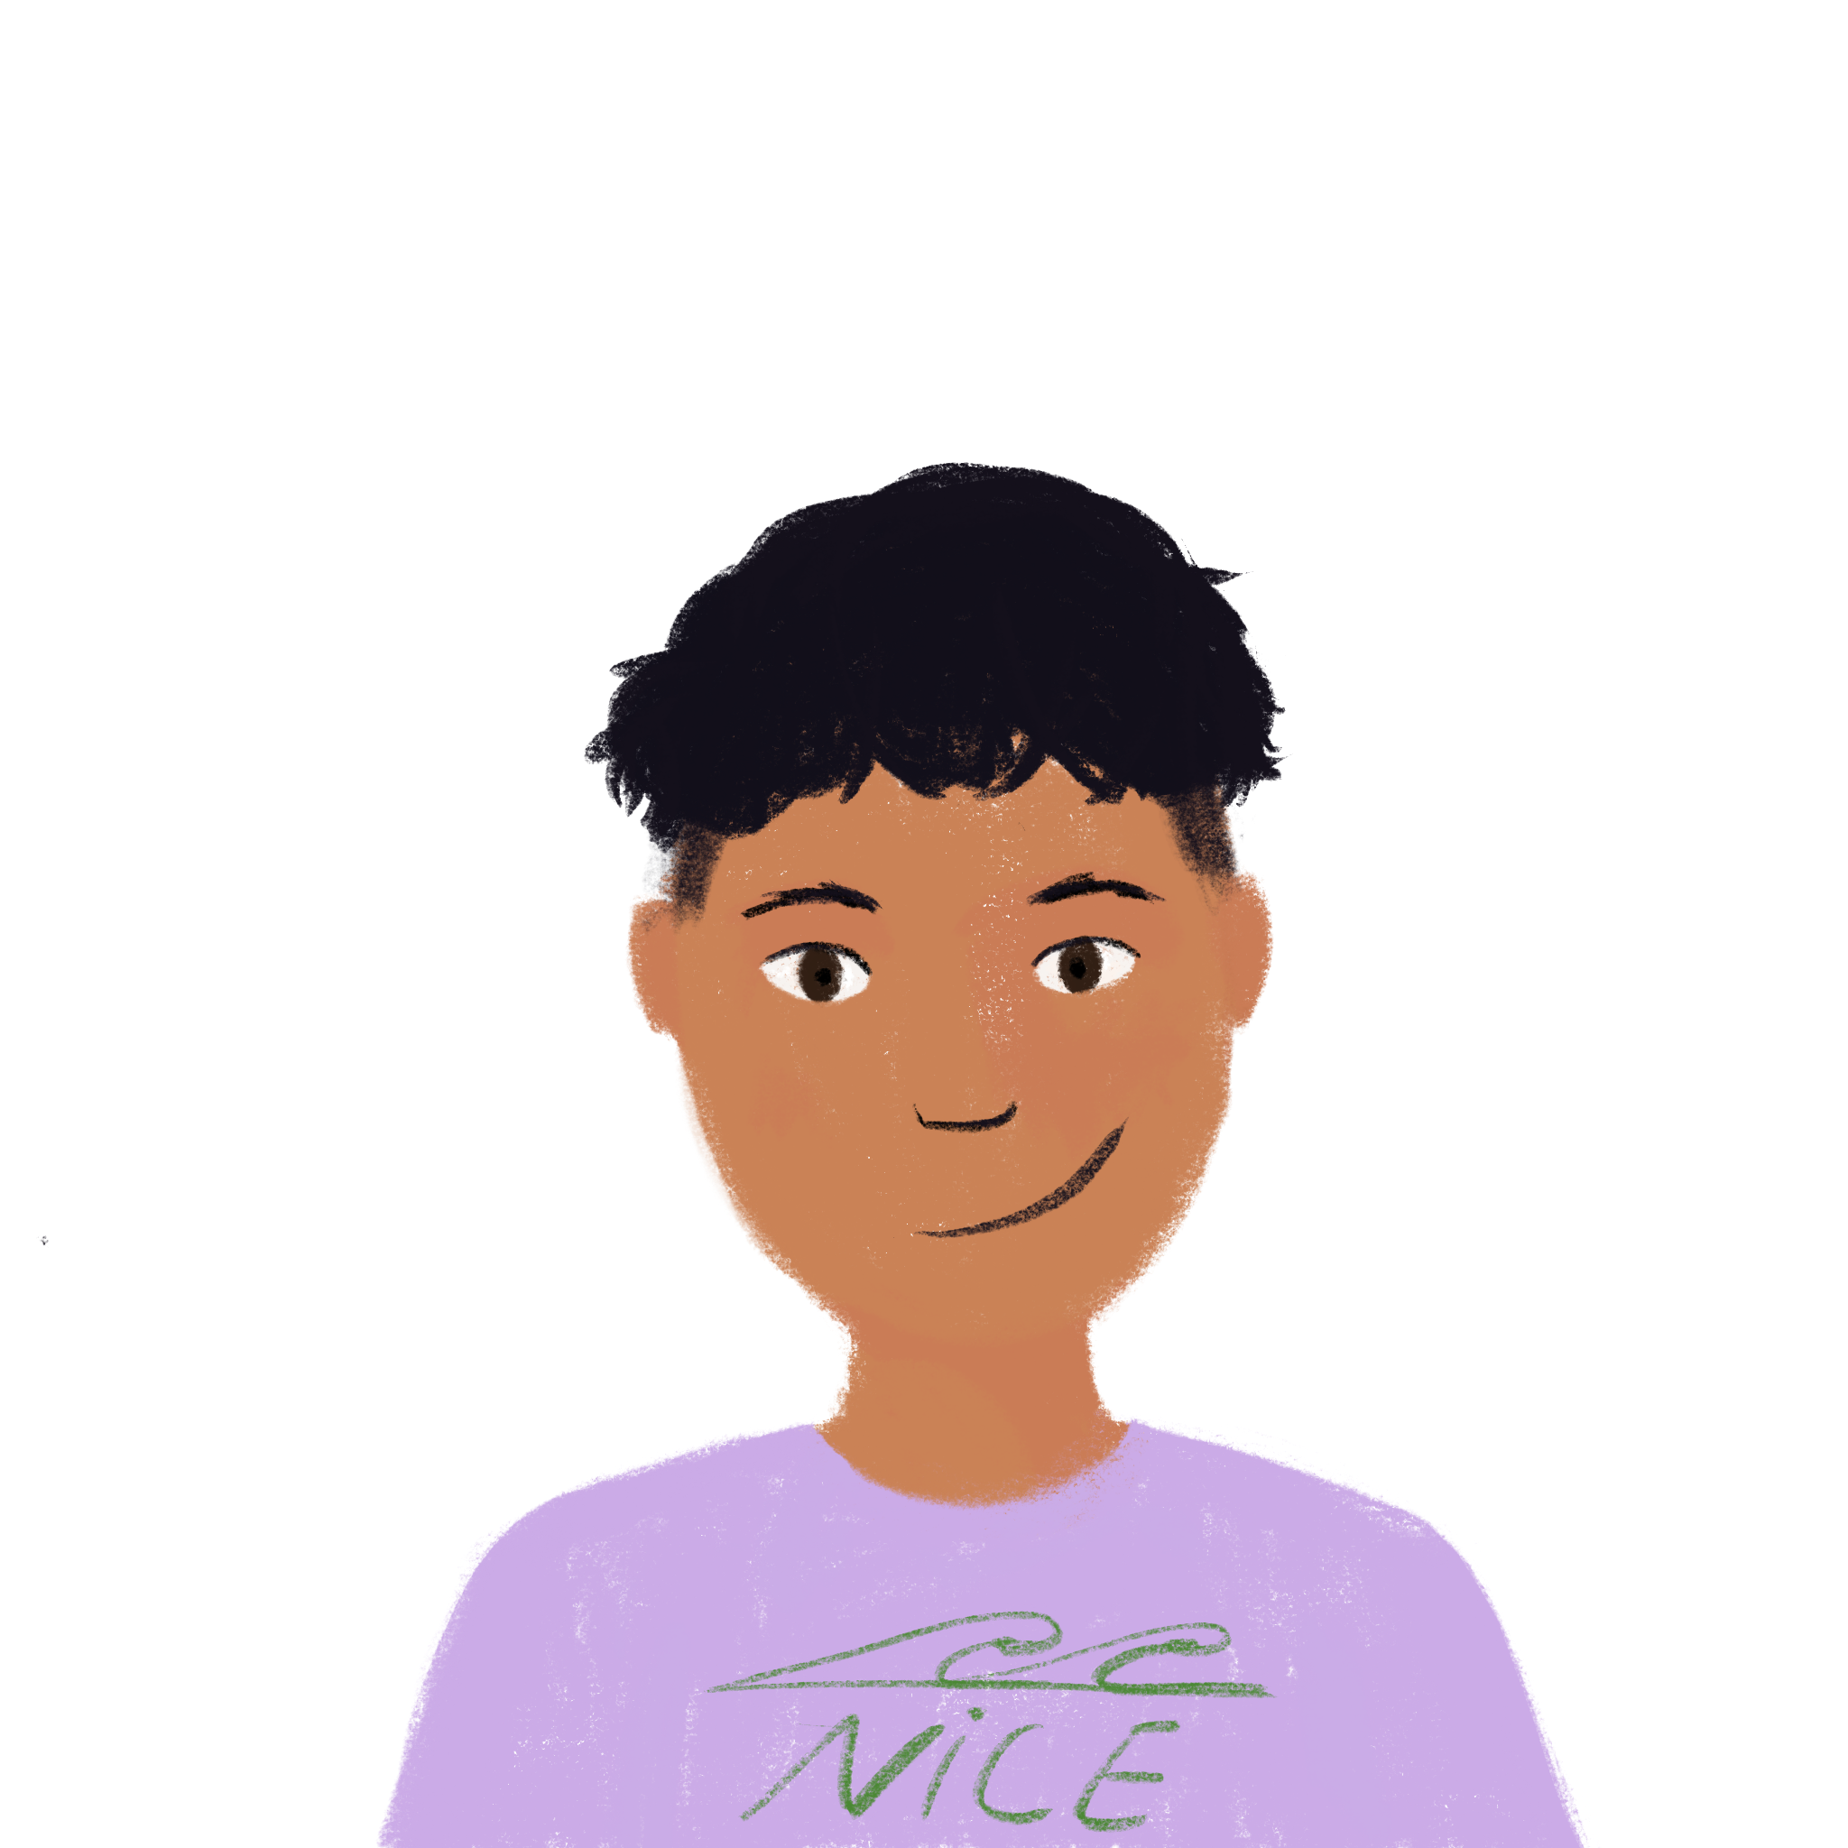
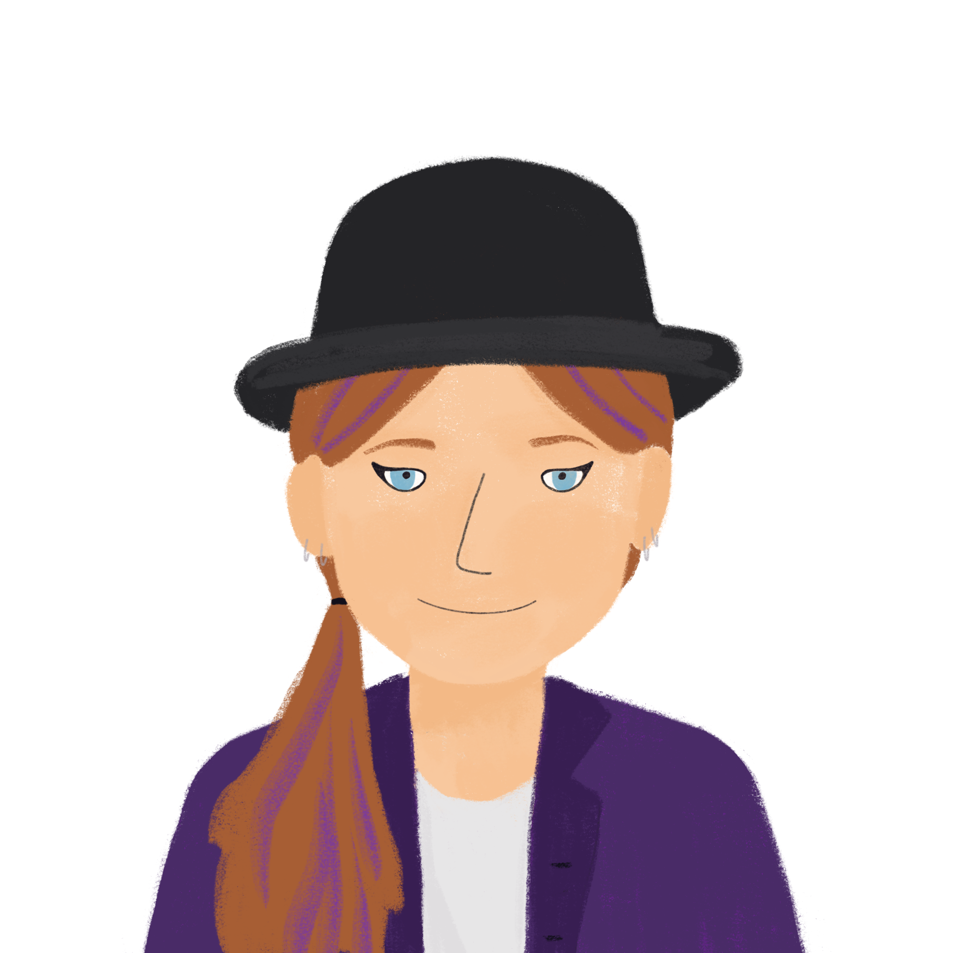
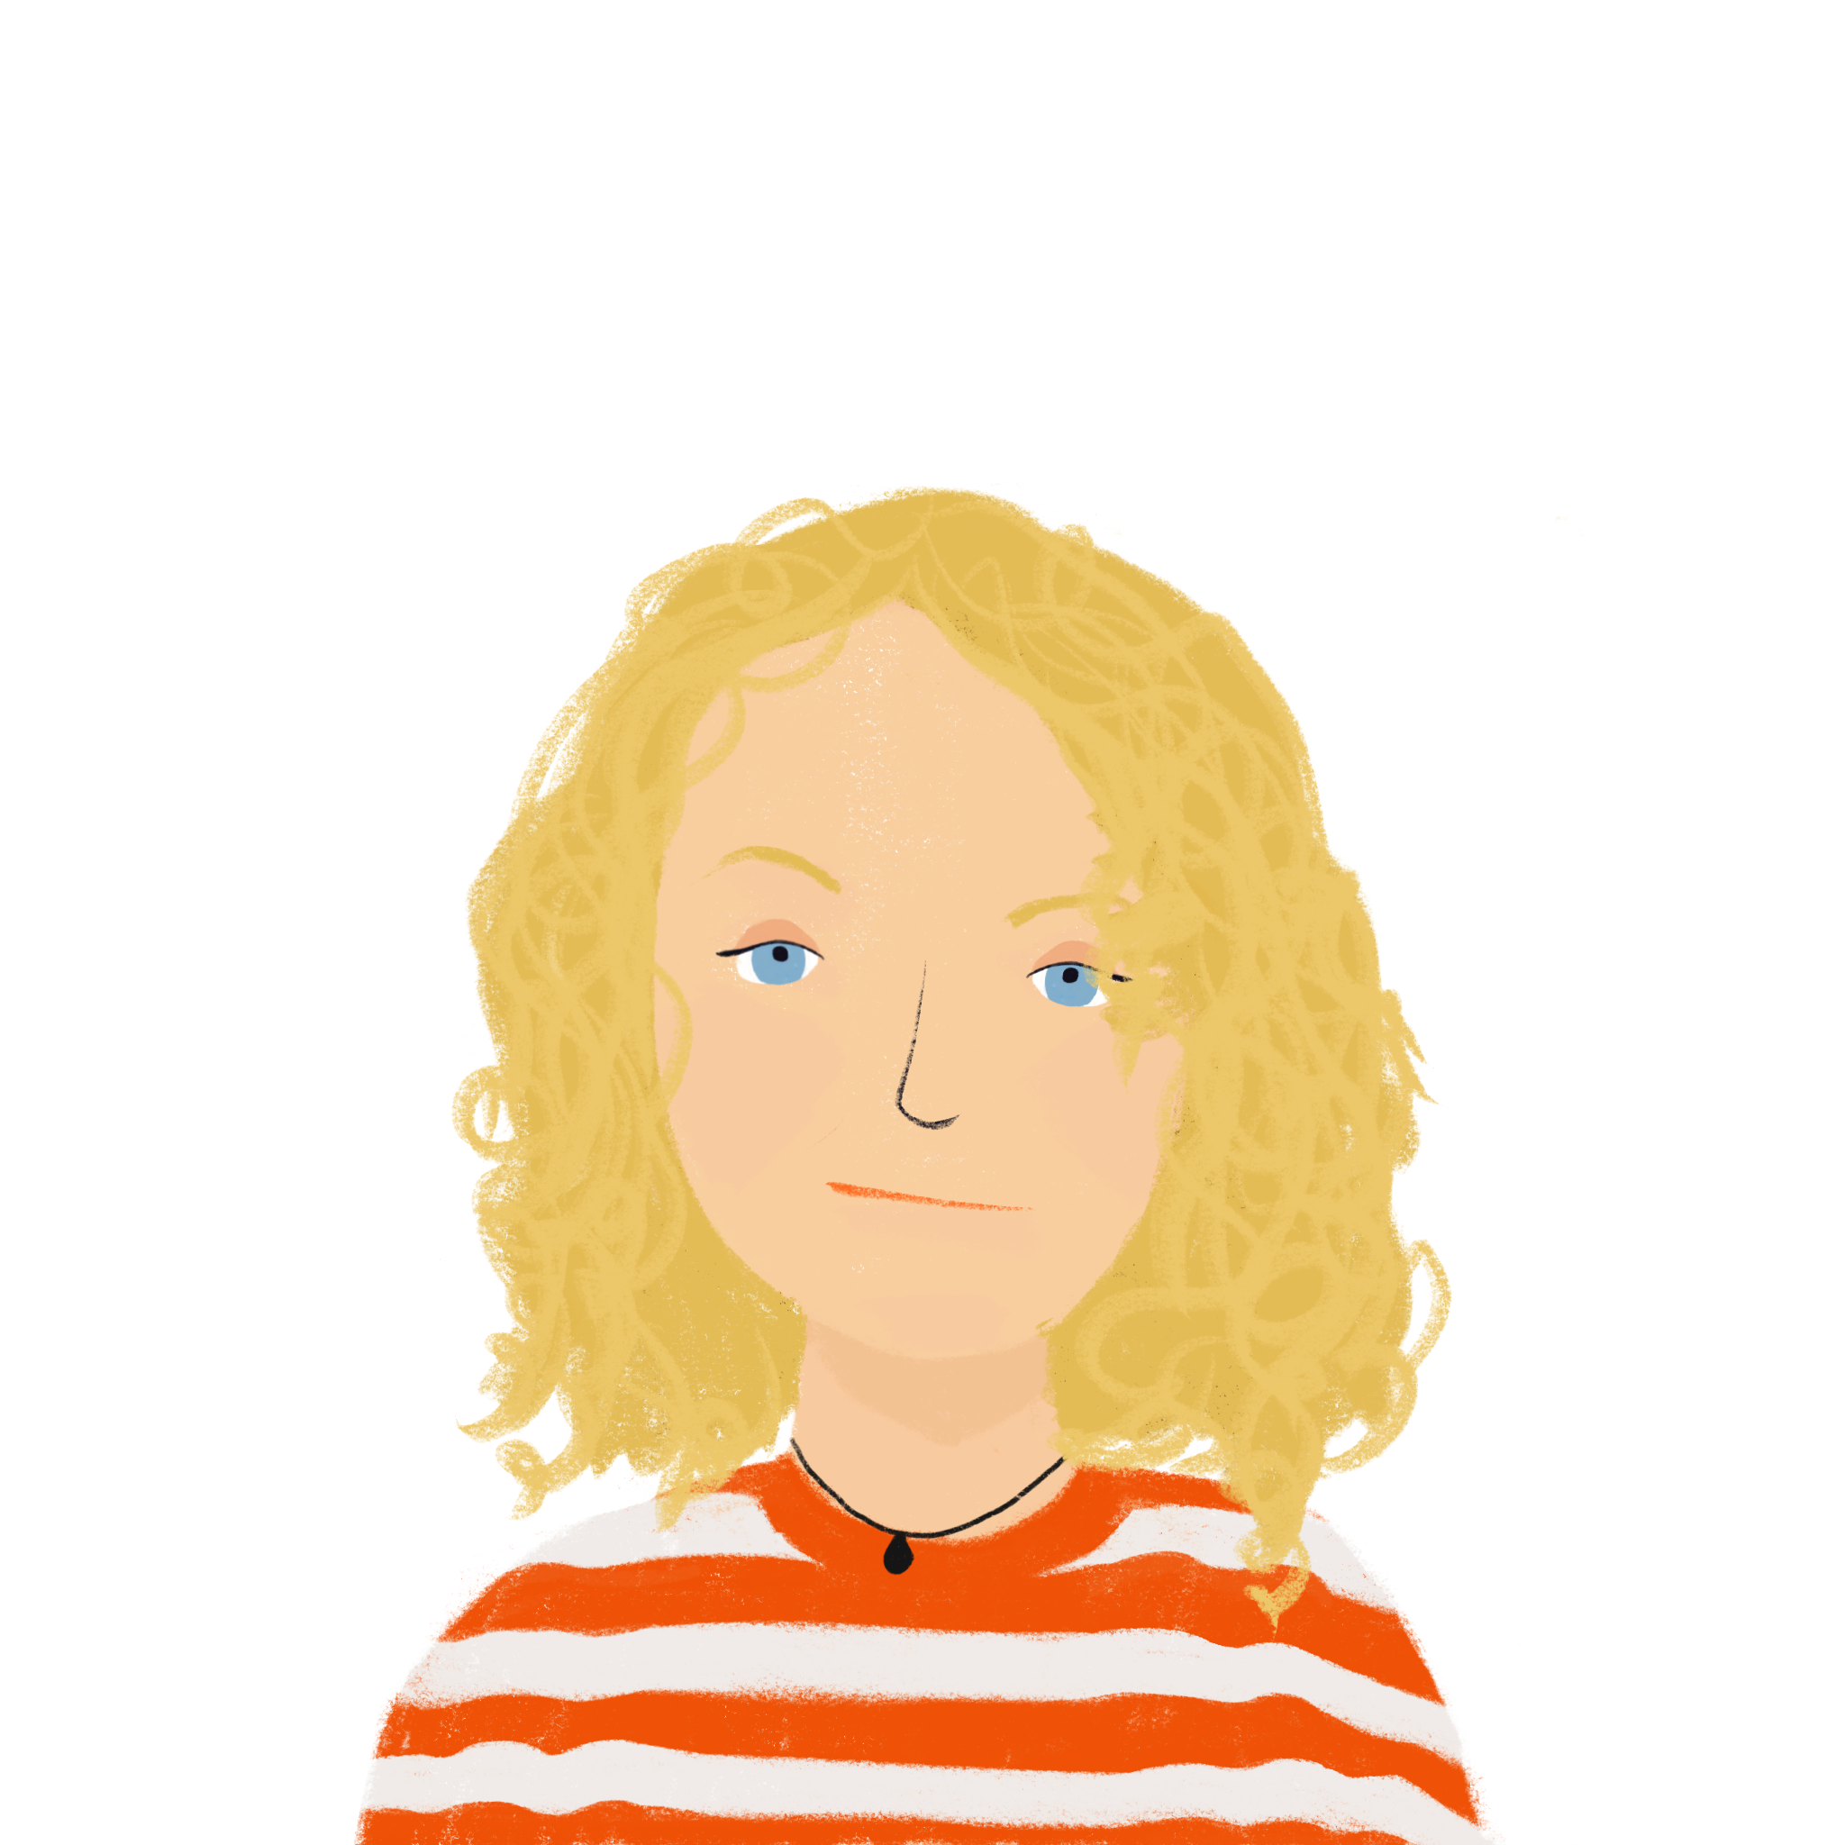
A school exchange Talking about what groups of people do
verbs like sortir and venir (nous, vous)
sans + infinitive
SSCs [-eill-, eil], [-euill-, -euil],
[-ouill-, -ouil]
J’ai visité Bruxelles!
J’ai visité la Suisse!
Y8 French
Term 2.1 - Week 5 - Lesson 35
Kirsten Somerville / Catherine Morris / Natalie Finlayson
Artwork by: Chloé Motard
Date updated: 19.02.24
Notes:
Note: all words (new and revisited) in this week of the SOW appear on all three GCSE wordlists, with these exceptions: i) AQA list does not have guitare, maman, pétanque, piano
ii) Edexcel list does not have chacun, guitare, maman, papa, pétanque, piano
iii) Eduqas list does not have have guitare, pétanque, piano
Artwork by Chloé Motard. All additional pictures selected are available under a Creative Commons license, no attribution required.
Learning outcomes (lesson 1):
Introduction of SSCs [-eill-, -eil], [-euill-, -euil], [-ouill-, -ouil], revision of [è/ê], [ou], and open [eu]/[œu]
Consolidation of first and second person singular forms of verbs like sortir and venir
Introduction of first and second person plural forms of verbs like sortir and venir
Introduction of sans + infinitive
Word frequency (1 is the most frequent word in French):
8.2.1.5 (introduce) sortir² [309], vous² [50], maman [2168], papa [2458], possible [175], seul [101], sans [71], salut [2205], s’il te plaît [34/13/112/804], s'il vous plaît [34/13/50/804]
8.1.2.6 (revisit) carte¹ [955], côté [123], foot(ball) [2602], guitare [>5000], instrument [1650], pétanque [>5000] piano [4967], droit [1293], gauche [607], loin [341], près [225]
8.1.1.6 (revisit) organiser [701], chacun [323], anniversaire [2043], août [1445], décembre [891], juillet [1326], septembre [944], octobre [826], novembre [982], général [147], national [227], partout [581]
Source: Londsale, D., & Le Bras, Y. (2009). A Frequency Dictionary of French: Core vocabulary for learners London: Routledge.

Slide 2
ê/è
[head]
tête
Notes:
Timing: 1 minute (3 slides)
Aim: To consolidate SSC [ê/è]
Procedure: 1. Present the letter(s) and say the [ê/è] sound first, on its own. Students repeat it with you. 2. Bring up the word ”tête” on its own, say it, students repeat it, so that they have the opportunity to focus all of their attention on the connection between the written word and its sound.
3. A possible gesture for this would be to point to one’s head.
4. Roll back the animations and work through 1-3 again, but this time, dropping your voice completely to listen carefully to the students saying the [ê/è] sound, pronouncing ” tête” and, if using, doing the gesture.
Word frequency (1 is the most frequent word in French):
tête [343]. Source: Londsale, D., & Le Bras, Y. (2009). A Frequency Dictionary of French: Core vocabulary for learners London: Routledge.

Slide 3
ou
nous
Notes:
Aim: To consolidate SSC [ou]
Procedure: 1. Present the letter(s) and say the [ou] sound first, on its own. Students repeat it with you. 2. Bring up the word ”nous” on its own, say it, students repeat it, so that they have the opportunity to focus all of their attention on the connection between the written word and its sound.
3. A possible gesture for this would be to have both hands draw semi-circles out away from the body. Hands start by the sides of the body, circle swiftly outwards and join up again in front, indicating the inclusion of the self in a larger group. 4. Roll back the animations and work through 1-3 again, but this time, dropping your voice completely to listen carefully to the students saying the [ou] sound, pronouncing ”nous” and, if using, doing the gesture.
Word frequency (1 is the most frequent word in French):
nous [31]
Source: Londsale, D., & Le Bras, Y. (2009). A Frequency Dictionary of French: Core vocabulary for learners London: Routledge.

Slide 4
open eu/œu
cœur
Notes:
Aim: To consolidate SSC open [eu]/[œu]
Procedure: 1. Present the letter(s) and say the open [eu]/[œu] sound first, on its own. Students repeat it with you. 2. Bring up the word ”cœur” on its own, say it, students repeat it, so that they have the opportunity to focus all of their attention on the connection between the written word and its sound.
3. A possible gesture for this would be to put your hand on your chest over your heart. 4. Roll back the animations and work through 1-3 again, but this time, dropping your voice completely to listen carefully to the students saying the open [eu]/[œu] sound, pronouncing ”cœur” and, if using, doing the gesture.
Word frequency (1 is the most frequent word in French):
cœur [568]
Source: Londsale, D., & Le Bras, Y. (2009). A Frequency Dictionary of French: Core vocabulary for learners London: Routledge.

Slide 5
Phonétique
phonétique
We know that [-ill/ille] and [-ail/aill] sound like a vowel + ‘yih’:
[-ill/ille]
= i + ‘yih’
[-ail/aill]
= a + ‘yih’
Using this pattern, we can work out how these new SSCs sound:
[-eil/eill]
= è + ‘yih’
e.g. oreille
[-ouil/ouill]
= ou + ‘yih’
e.g. brouillard
[-euil/euill]
= long eu/œ + ‘yih’
e.g. feuille
Notes:
Timing: 2 minutes
Aim: Introduction of SSCs [-eil/eill], [-euil/euill], and [-ouil/ouill]. Introducing the idea of vowel + [-il/ill] to help students break down these less frequent SSCs.
Procedure:
1. Click to remind students of SSCs [-ill/ille] and [-ail/aill], drawing attention to the fact that they can be broken down into SSCs [i]/[a] + yih.
2. Click to bring up the first new SSC. Students say SSC [-eil/eill] following the pronunciation tips given.
3. Click to reveal ‘decoded’ pronunciation and example word (click picture to hear pronunciation).
4. Repeat for [-ouil/ouill] and [-euil/euill].
Word frequency of unknown words (1 is the most frequent word in French):
oreille [1884], feuille [2440], brouillard [4452]
Source: Londsale, D., & Le Bras, Y. (2009). A Frequency Dictionary of French: Core vocabulary for learners London: Routledge.

Slide 6
-eill-/-eil
oreille
Notes:
Timing: 1 minute
Aim: To introduce SSC [-eill-/-eil]
Procedure: 1. Present the letter(s) and say the [-eill-/-eil] sound first, on its own. Students repeat it with you. 2. Bring up the word ”oreille” on its own, say it, students repeat it, so that they have the opportunity to focus all of their attention on the connection between the written word and its sound.
3. A possible gesture for this would be to point to your ear. 4. Roll back the animations and work through 1-3 again, but this time, dropping your voice completely to listen carefully to the students saying the [-eill-/-eil] sound, pronouncing ”oreille” and, if using, doing the gesture.
Word frequency (1 is the most frequent word in French):
oreille [1884]
Source: Londsale, D., & Le Bras, Y. (2009). A Frequency Dictionary of French: Core vocabulary for learners London: Routledge.

Slide 7
-eill-/-eil
oreille
Notes:
With sound and no pictures to focus all attention on the sound-symbol correspondence.

Slide 8
-eill-/-eil
oreille
Notes:
Without sound to elicit pronunciation (without first hearing the teacher).
Teacher to elicit pronunciation by asking “Comment dit-on …”

Slide 9
-euill-/-euil
[-ueill-/-ueill, -œill-/-œil]
feuille
Notes:
Timing: 1 minute
Aim: To introduce SSC [-euill-/-euil]
Procedure: 1. Present the letter(s) and say the [-euill-/-euil] sound first, on its own. Students repeat it with you. 2. Bring up the word ”feuille” on its own, say it, students repeat it, so that they have the opportunity to focus all of their attention on the connection between the written word and its sound.
3. A possible gesture for this would be [to stroke the back of one hand]. 4. Roll back the animations and work through 1-3 again, but this time, dropping your voice completely to listen carefully to the students saying the [-euill-/-euil] sound, pronouncing ”feuille” and, if using, doing the gesture.
Word frequency (1 is the most frequent word in French):
feuille [2440]
Source: Londsale, D., & Le Bras, Y. (2009). A Frequency Dictionary of French: Core vocabulary for learners London: Routledge.

Slide 10
-euill-/-euil
[-ueill-/-ueill, -œill-/-œil]
feuille
Notes:
With sound and no pictures to focus all attention on the sound-symbol correspondence.

Slide 11
-euill-/-euil
[-ueill-/-ueill, -œill-/-œil]
feuille
Notes:
Without sound to elicit pronunciation (without first hearing the teacher).
Teacher to elicit pronunciation by asking “Comment dit-on …”

Slide 12
-ouill-/-ouil
brouillard
Notes:
Timing: 1 minute
Aim: To introduce SSC [-ouill-/-ouil]
Procedure: 1. Present the letter(s) and say the [-ouill-/-ouil] sound first, on its own. Students repeat it with you. 2. Bring up the word ”brouillard” on its own, say it, students repeat it, so that they have the opportunity to focus all of their attention on the connection between the written word and its sound.
3. A possible gesture for this would be [to squint and wiggle fingers in front of face miming being unable to see through fog]. 4. Roll back the animations and work through 1-3 again, but this time, dropping your voice completely to listen carefully to the students saying the [-ouill-/-ouil] sound, pronouncing ”brouillard” and, if using, doing the gesture.
Word frequency (1 is the most frequent word in French):
brouillard [4452]
Source: Londsale, D., & Le Bras, Y. (2009). A Frequency Dictionary of French: Core vocabulary for learners London: Routledge.
Word frequency (1 is the most frequent word in French):
brouiller [4682]
Source: Londsale, D., & Le Bras, Y. (2009). A Frequency Dictionary of French: Core vocabulary for learners London: Routledge.

Slide 13
-ouill-/-ouil
brouillard
Notes:
With sound and no pictures to focus all attention on the sound-symbol correspondence.

Slide 14
-ouill-/-ouil
brouillard
Notes:
Without sound to elicit pronunciation (without first hearing the teacher).
Teacher to elicit pronunciation by asking “Comment dit-on …”

Slide 15
Phonétique
écouter / écrire
 |  | [-eil/eill] | [è]
 | sommeil
 | grès
 | bouteille
1
__
[sleep]
2
__
[sandstone]
3
__
 |  | [-ouil/ouill] | [ou]
 | fouiller
0 | rouille
 | bouton
4
__
[to search]
5
__
[rust]
6
__
[button]
 |  | [-euil/euill] | [long eu/œ]
 | bonheur
 | seuil
 | deuil
7
___
[joy]
8
___
[doorstep]
9
___
[grief]
Notes:
Timing: 7 minutes
Aim: aural recognition of SSCs [-eil/eill], [è], [ouil/ouill], [ou], [-euil/euill] and long [eu/oe]
Procedure:
1. Click the numbers to play the audio.
2. Students write 1-9 and choose which SSC they think is missing.
3. Click to reveal the answers.
Transcript:
1. sommeil
2. grès
3. bouteille
4. fouiller
5. rouille
6. bouton
7. bonheur
8. seuil
9. deuil
Word frequency (1 is the most frequent word in French): sommeil [3393], grès [>5000], bouteille [2979], fouiller [3431], rouille [>5000], bouton [4462], bonheur [1948], seuil [2068], deuil [3540]
Source: Londsale, D., & Le Bras, Y. (2009). A Frequency Dictionary of French: Core vocabulary for learners London: Routledge.

Slide 16
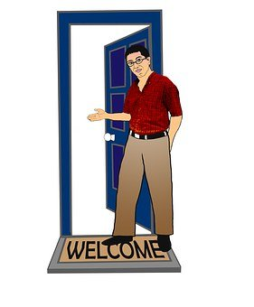
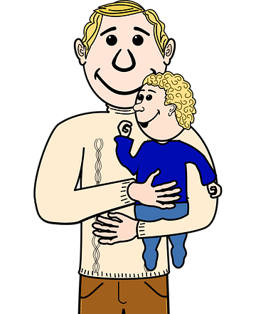
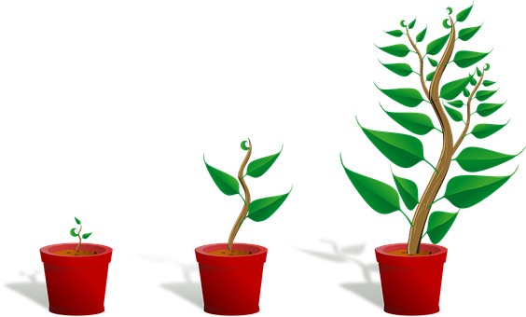
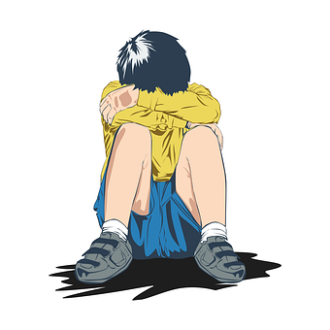
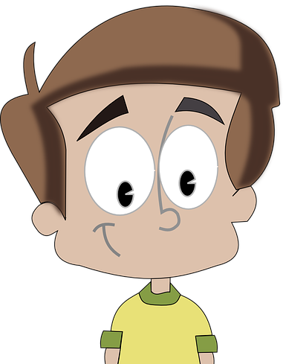
Vocabulaire
lire
1 | possible | i
2 | seul | l
3 | revenir | a
4 | sortir | j
5 | vous | o
6 | s’il te plaît | n
7 | partir | g
8 | dormir | m
9 | maman | k
10 | sans | h
11 | salut | c
12 | papa | f
13 | devenir | e
14 | s’il vous plaît | b
c
b
[please]
[hello]
h
[without]
a
g
e
f
[to leave]
[to come back]
[to become]
j
to go out, to take out
k
i
?
l
[possible]
n
o
[alone]
m
[please]
Notes:
Timing: 7 minutes
Aim: Written recognition or words in this week’s new vocabulary set, and of revisited verbs partir, dormir, venir, revenir and devenir which feature heavily in this double lesson.
Procedure:
Students match word to pictorial representation or translation.
2. Click to reveal answers 1-14. Say the word aloud while giving feedback. Students repeat.

Slide 17
Saying ‘without’: sans
vocabulaire
Sans means ‘without’.
To say ‘without something,’ use sans before a noun:
Je ne peux pas travailler sans mon ordinateur.
In French, sans is followed by the infinitive (long form).
In English, without is followed by the –ing form.
I cannot work without my computer.
To say ‘without doing something,’ use sans before a verb in infinitive (long form):
Elle part sans dire un mot.
She leaves without saying a word.
Notes:
Timing: 2 minutes
Aim: To introduce the use of sans before nouns and infinitives.
Procedure:
1. Click to animate the explanation.
2. Draw attention to the English –ing equivalent of the French infinitive after sans.

Slide 18
‘Sans’ ou ‘et’ ?
lire
Complète les phrases avec « sans » ou « et » !
 |  | sans | et
1. | Elle mange sans parler.
2. | Il travaille et écoute de la musique.
3. | Il va en Écosse et visite Edimbourg.
4. | Elle voyage sans acheter de billet.
5. | Tu gagnes beaucoup sans travailler.
6. | Il parle et chante bien.
Notes:
Timing: 4 minutes
Aim: Written recognition to contrast sans + verb (long form) with et + verb (short form).
Procedure:
1. Tell students that they are going to read sentences containing two verbs in which the connecting word/conjunction is missing. Remind students that the form of the verb (long after sans, short after et) will give them the answer.
2. Click to reveal answers.
3. Oral translation of each sentence. Draw attention to the verb forms in English (-ing after ‘without’, short form after ‘and’).

Slide 19
Vocabulaire - sortir
écouter
go out / take out | I will go out with my friends.
go out / take out | I will take the dog out of the house.
go out / take out | They take a lot of money out at the bank.
go out / take out | Please, go out to find the doctor!
1
2
3
4
Notes:
Timing: 4 minutes
Aim: aural identification of the meaning of sortir from context.
Procedure:
Click the numbers to listen to the audio
Does sortir mean ‘go out’ or ‘take out’ in each sentence?
What does each sentence mean? Students can work in pairs to translate the sentences.
Click to see the answers. (first meaning of sortir, then sentence translation)
Transcript:
Je vais sortir avec mes amis.
Je vais sortir le chien de la maison.
Ils sortent beaucoup d’argent à la banque.
S'il vous plaît, sortez pour trouver le médecin !

Slide 20
Verbs like ‘sortir’ and ‘venir’
grammaire
You already know the je and tu forms of verbs like sortir and venir:
je sors je viens
I go out / I am going out I come / I am coming
tu sors tu viens
you go out / you are going out (sing) you come / you are coming (sing)
The plural nous and vous forms are:
nous sortons nous venons
we go out / we are going out we come / we are coming
vous sortez vous venez
you go out / you take out (plural/formal) you come / you are coming
(plural/formal)
The pattern is the same for dormir and partir.
The pattern is the same for devenir and revenir.
Notes:
Timing: 2 minutes
Aim: introducing the first- and second-person plural forms of verbs like sortir (dormir, partir) and verbs like venir (devenir, revenir)

Slide 21
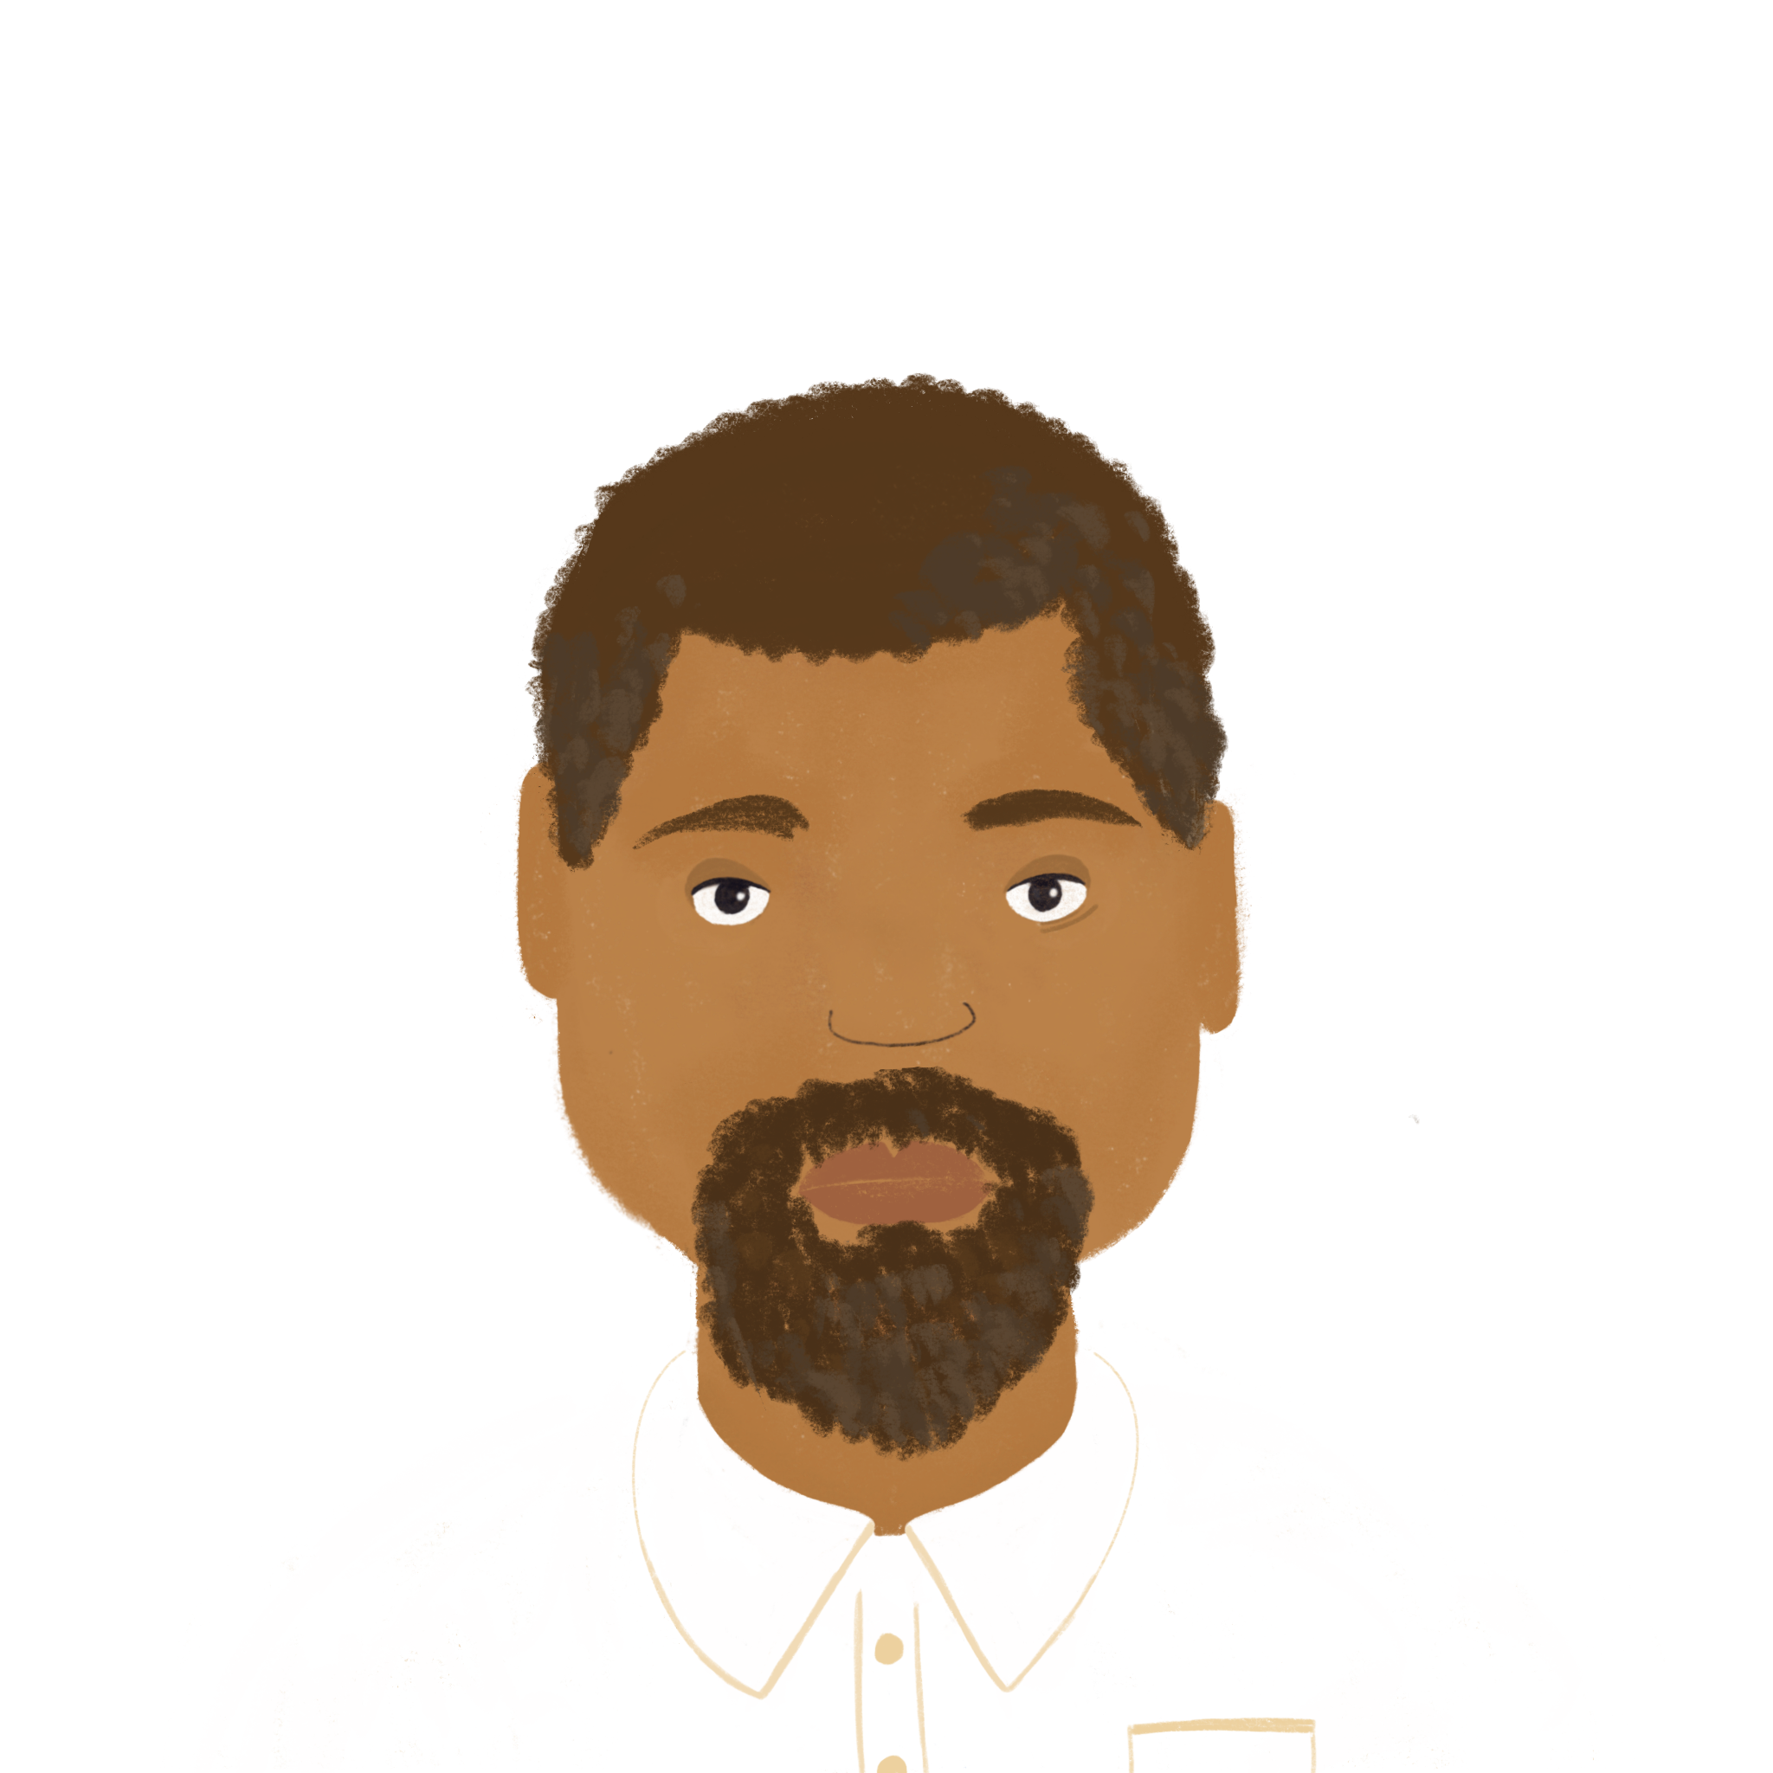
L’échange scolaire
*Un échange scolaire = a school exchange
lire
M. Campbell est un professeur de français en Angleterre. Il organise une visite à Nice avec sa classe. Il dit quoi sur le groupe entier (nous) et sur les élèves seulement (vous) ?
Subject: Informations importantes pour l’échange scolaire
Bonjour les élèves,
Nous partons samedi pour Nice ! Vous venez tôt au collège – ça c’est la première chose importante. Nous venons chacun avec un cadeau – ça aussi c’est très important !
Nous sortons avec des élèves français, et vous dormez chez des familles. Vous devenez peut-être amis ! Une dernière chose importante : vous ne sortez pas seuls. Nous revenons ensemble.
À samedi !
Monsieur Campbell
1)__
2)__
3)__
4)__
5)__
6)__
7)__
8)__
Notes:
Timing: 8 minutes
Aim: written recognition of the first- and second-person plural forms of verbs like sortir and venir.
Procedure:
1. Students write 1-8 and choose nous or vous for each.
2. Click to reveal the answers.
3. Students sketch a table in their books with the headings ‘whole group’ and ‘just the pupils’ and take notes in English underneath. At higher levels, teachers may want to skip stage 2, and give all feedback at the same time.
4. Solutions on following slide.
Word frequency of cognates used (1 is the most frequent word in French): échange [785], scolaire [1993], groupe [187], information [317]
Source: Londsale, D., & Le Bras, Y. (2009). A Frequency Dictionary of French: Core vocabulary for learners London: Routledge.

Slide 22
L’échange scolaire
Réponses
lire
whole group
leave for Nice on Saturday
each come with a present
go out with French students
come back together
just the pupils
come to school early
sleep in the families’ homes
might become friends
don’t go out alone
Notes:
Slide 2/2

Slide 23
À l’áeroport
écouter
La classe arrive à l’aéroport de Nice !
Monsieur Campbell donne des instructions pour le groupe (nous), ou pour les élèves (vous) ?
 | nous (le groupe) | vous (les élèves)
1
…
2
3
4
5
6
Notes:
Timing: 8 minutes. This is slide 1/2.
Aim: aural recognition of the first- and second-person plural forms of verbs like sortir and venir.
Procedure:
1. Click the numbers to play the audio. The subject pronouns are obscured by beeps.
2. Students write 1-6 and choose nous or vous for each.
3. Click to reveal the answers.
4. The full audio (without beeps) is provided on the next slide, along with a comprehension activity.
Transcript:
Voyager tôt, c’est facile si [nous] dormons bien !
[Vous] sortez les passeports.
[Nous] venons de l’étranger.
[Nous] revenons ici avec les billets.
[Nous] partons pour le bus maintenant.
[Vous] sortez les cadeaux pour les familles.
Word frequency of cognates used (1 is the most frequent word in French): instruction [1632], groupe [187], passeport [>5000], bus [4027], traduction [2826]
Source: Londsale, D., & Le Bras, Y. (2009). A Frequency Dictionary of French: Core vocabulary for learners London: Routledge.

Slide 24
À l’áeroport
…
écouter
Écoute encore. Les traductions sont-elles bonnes ?
Si non, quelle est la bonne traduction ?
 | It is easy to travel early if we sleep well. | oui / non
 | You’re going to put the passports away. | oui / non
 | We are going abroad. | oui / non
 | We’re going to leave with the tickets. | oui / non
 | We are leaving for the bus now. | oui / non
 | You are going to take out the presents. | oui / non
1
2
You’re going to take the passports out.
3
We are coming from abroad.
4
We’re going to come back with the tickets.
5
6
Notes:
This is slide 2/2.
Procedure:
1. Click the numbers to play the full audio, including pronouns.
2. Students write 1-8 and oui or non depending on whether they think the English translations are correct. If they write non, they should try to provide a correct translation.
3. Answers appear on clicks.
Transcript:
Voyager tôt, c’est facile si nous dormons bien !
Vous sortez les passeports.
Nous venons de l’étranger.
Nous revenons ici avec les billets.
Nous partons pour le bus maintenant.
Vous sortez les cadeaux pour les familles.
Vous venez dans le bus un par un.
On doit dire si vous devenez malade.

Slide 25
A school exchange Talking about what groups of people do
verbs like sortir and venir (ils, elles)
sans + infinitive
J’ai visité Bruxelles!
Y8 French
Term 2.1 - Week 5 - Lesson 36
Kirsten Somerville / Catherine Morris / Natalie Finlayson
Artwork by: Chloé Motard
Date updated: 19.02.24
Notes:
Note: all words (new and revisited) in this week of the SOW appear on all three GCSE wordlists, with these exceptions: i) AQA list does not have guitare, maman, pétanque, piano
ii) Edexcel list does not have chacun, guitare, maman, papa, pétanque, piano
iii) Eduqas list does not have have guitare, pétanque, piano
Artwork by Chloé Motard. All additional pictures selected are available under a Creative Commons license, no attribution required.
Learning outcomes (lesson 2):
Introduction of SSCs [-eill-, -eil], [-euill-, -euil], [-ouill-, -ouil], revision of [è/ê], [ou], and open [eu]/[œu]
Consolidation of third person singular forms of verbs like sortir and venir
Introduction of third person plural forms of verbs like sortir and venir
Consolidation of sans + infinitive
Word frequency (1 is the most frequent word in French):
8.2.1.5 (introduce) sortir² [309], vous² [50], maman [2168], papa [2458], possible [175], seul [101], sans [71], salut [2205], s’il te plaît [34/13/112/804], s'il vous plaît [34/13/50/804]
8.1.2.6 (revisit) carte¹ [955], côté [123], foot(ball) [2602], guitare [>5000], instrument [1650], pétanque [>5000] piano [4967], droit [1293], gauche [607], loin [341], près [225]
8.1.1.6 (revisit) organiser [701], chacun [323], anniversaire [2043], août [1445], décembre [891], juillet [1326], septembre [944], octobre [826], novembre [982], général [147], national [227], partout [581]
Source: Londsale, D., & Le Bras, Y. (2009). A Frequency Dictionary of French: Core vocabulary for learners London: Routledge.

Slide 26
Le journal de Natalie
*tenir = to keep
*le sac = bag
lire
Natalie doit tenir* un journal en français. Qu’écrit-elle ?
 | français | anglais
7.00 | Nous partons tôt pour l’aéroport. | We’re leaving for the airport early.
8.00 | Kirsten dort dans le train. | Kirsten is sleeping on the train.
11.00 | Amir vient maintenant. | Amir is coming now.
12.00 | Nous revenons ensemble chez Amir. | We go back to Amir’s place together.
13.00 | Je sors mes vêtements de mon sac. | I take my clothes out of my bag*.
15.00 | Nous sortons au parc. | We go out to the park.
16.00 | Nous devenons amis ! | We’re becoming friends!
Notes:
Timing: 7 minutes
Aim: Written comprehension of various forms of verbs like sortir and venir in short sentences.
Procedure:
1. Students read French sentences and translate into English. Remind them of: position of adverb in French (after the verb); translation of English present simple and continuous (present tense in French for both).
2. Click to reveal translations
Word frequency of unknown words (1 is the most frequent word in French): tenir [104], sac [2343]
Source: Londsale, D., & Le Bras, Y. (2009). A Frequency Dictionary of French: Core vocabulary for learners London: Routledge.
Word frequency of cognates (1 is the most frequent word in French): journal [520]
Source: Londsale, D., & Le Bras, Y. (2009). A Frequency Dictionary of French: Core vocabulary for learners London: Routledge.

Slide 27
Vocabulaire
emporter [1128], vue [191], [224]
parler / écrire
A
B
C
D
to go out, to take out
please (formal)
mum and dad are coming
you (plural
/ formal) are coming
E
F
G
H
are you
(plural / formal) alone?
they are going out without
dad
we are taking a book out
hi, bye
I
J
K
L
when are you (plural / formal) going out?
we are coming
is it possible?
please (informal)
Notes:
Timing: 5 minutes
Aim: written production of new vocabulary.
Procedure:
1. Students write A-L in books in the order shown here.
2. Click or press ‘enter’ to flash an English word/phrase. It will disappear after three seconds. (NOTE: words do not appear in alphabetical order)
3. Students write down the French word before the English word has faded away
4. Ensure that gender/definite articles are known for any words that are nouns.
5. Answers on the next slide.

Slide 28
Vocabulaire
emporter [1128], vue [191], [224]
parler / écrire
maman et papa viennent
sortir
s'il vous plaît
vous venez
vous-êtes seul(e)(s) ?
ils sortent sans papa
nous sortons un livre
salut
nous venons
c’est possible ?
vous sortez quand ?
s’il te plaît
Notes:
Answers to the activity on the previous slide.
NB: for the items that are questions, also accept inversion questions and est-ce que questions.

Slide 29
Les Anglaises sont inquiètes* !
inquiet = worried
le dictionnaire = dictionary
oublier = to forget
écrire
Kirsten et Natalie oublient* beaucoup de choses !
Kirsten écrit à Amir sur WhatsApp. Que dit-elle ?
1. I am travelling without my dictionary
Je voyage sans
mon dictionnaire
I am coming
without euros
Je viens
sans euros
___
_____________
____ _______
2. I am leaving without feeding the cat
Je pars sans
nourrir le chat
I am leaving without saying goodbye
Je pars sans
dire au revoir
___
___
_______
____
I am travelling without my mobile phone
Je voyage sans
mon portable
I am going out without eating a snack
Je sors sans
manger de snack
___
___
____________
______
Notes:
Timing: 8 minutes
Aim: written production of sans + noun and sans + infinitive.
Procedure:
1. Students read English sentences and translate the missing words into French. Remind students of the forms of verb form needed after sans (infinitive).
2. Click to bring up answers.
Word frequency of unknown words used (1 is the most frequent word in French): inquiet [1392], oublier [504]
Source: Londsale, D., & Le Bras, Y. (2009). A Frequency Dictionary of French: Core vocabulary for learners London: Routledge.
Word frequency of cognates used (1 is the most frequent word in French): dictionnaire [4094], snack [>5000]
Source: Londsale, D., & Le Bras, Y. (2009). A Frequency Dictionary of French: Core vocabulary for learners London: Routledge.

Slide 30
Verbs like ‘sortir’ and ‘venir’
grammaire
You already know the il and elle forms of verbs like sortir and venir:
il sort il vient
he goes out / he is going out he comes / he is coming
elle sort elle vient
she goes out / she is going out she comes / she is coming
The plural ils and elles forms are:
ils sortent ils viennent
they go out / they are going out (mpl) they come / they are coming (mpl)
elles sortent elles viennent
they go out / they are going out (fpl) they come / they are coming (fpl)
The pattern is the same for dormir and partir.
The pattern is the same for devenir and revenir.
Double the n before the ils / elles forms.
Notes:
Timing: 2 minutes
Aim: introducing the third person plural forms of verbs like sortir (dormir, partir) and venir (devenir, revenir)

Slide 31
La visite des Anglaises
lire
Amir écrit à Léa. Il parle de la visite de Natalie et Kirsten.
Il parle d’une des filles (Kirsten/elle), ou des deux filles (Natalie et Kirsten/elles) ?
Sujet : La visite des Anglaises
Salut Léa,
Nous avons des visiteuses anglaises, Natalie et Kirsten. Elles viennent de York en Angleterre. Elles sortent en ville aujourd’hui. Mais Kirsten ne dort pas bien, et elles partent en retard !
Kirsten sort son portable pour prendre des photos partout. Je trouve ça amusant. Elle vient regarder mon match de foot aussi. Il fait très beau, et la classe de Monsieur Campbell ne veut pas partir. Kirsten devient triste ! Elles reviennent peut-être en juillet pour mon anniversaire.
Salut,
Amir
1)___
2)___
3)___
4)___
5)___
6)___
7)___
8)___
Notes:
Timing: 10 minutes. This is slide 1/2.
Aim: written recognition of the third person plural form of verbs like sortir and venir.
Procedure:
1. Students write 1-8 and choose elle or elles for each.
2. Click to reveal the answers.
3. If time permits, students translate the full text. Encourage them to think about whether the present simple or continuous tense sounds best.
4. Full suggested translation may be found on the next slide.
Word frequency of cognates used (1 is the most frequent word in French): visiteur [2266], photo [1412]
Source: Londsale, D., & Le Bras, Y. (2009). A Frequency Dictionary of French: Core vocabulary for learners London: Routledge.

Slide 32
La visite des Anglaises
lire
Amir écrit à Léa. Il parle de la visite de Natalie et Kirsten.
Il parle d’une des filles (Kirsten/elle), ou les deux filles (Natalie et Kirsten/elles) ?
Sujet : La visite des Anglaises
Salut Léa,
Nous avons des visiteuses anglaises, Natalie et Kirsten. Elles viennent de York en Angleterre. Elles sortent en ville aujourd’hui. Mais Kirsten ne dort pas bien, et elles partent en retard !
Kirsten sort son portable pour prendre des photos partout. Je trouve ça amusant. Elle vient regarder mon match de foot aussi. Il fait très beau, et la classe de Monsieur Campbell ne veut pas partir. Kirsten devient triste ! Elles reviennent peut-être en juillet pour mon anniversaire.
Salut,
Amir
Subject: The English girls’ visit
Hi Léa
We have English visitors, Natalie and Kirsten.
They come from York in England.
They are going out in town today.
But Kirsten isn’t sleeping well, and they’re leaving late!
Kirsten takes her phone out to take photos everywhere.
I find that funny.
She is coming to
See my football match too.
The weather is very nice, and Mr Campbell’s class doesn’t want
to leave.
Kirsten is becoming sad!
Maybe they will come back in July for my birthday.
Bye,
Amir
Notes:
This is slide 2/2.
Procedure:
1. Click to reveal suggested translation one sentence at a time.

Slide 33
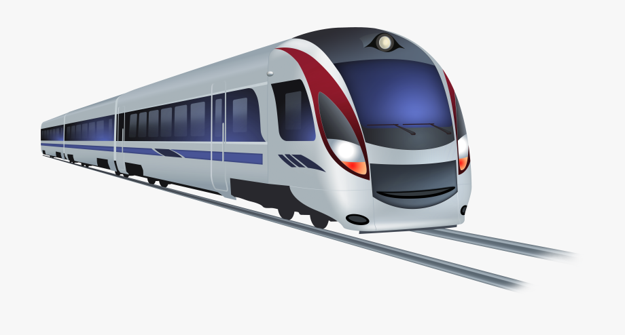
La visite des Anglaises
écouter / parler
Ils viennent en train.
They are coming by train.
Notes:
Timing: 4 minutes for 6 slides
Aim: pronunciation of the third person singular and plural forms of verbs like sortir and venir.
Procedure:
1. Listen and repeat.
2. Ask students to translate the sentence.
3. Reveal picture on a click, ask students to check their translations.
4. Reveal English translation on click.
Transcript:
Ils viennent en train.

Slide 34
La visite des Anglaises
écouter / parler
Elle dort très peu.
She is sleeping very little.
Zzz
Notes:
Transcript:
Elle dort très peu.

Slide 35
La visite des Anglaises
écouter / parler
Elles dorment sur la plage.
They are sleeping on the beach.
Zzz
Notes:
Transcript:
Elles dorment sur la plage.

Slide 36
La visite des Anglaises
écouter / parler
Elle revient avec du pain.
She is coming back with some bread.
Notes:
Transcript:
Elle revient avec du pain.

Slide 37
La visite des Anglaises
écouter / parler
Elles deviennent françaises !
They are becoming French !
Notes:
Transcript:
Elles deviennent françaises !

Slide 38
La visite des Anglaises
écouter / parler
Ils partent ensemble.
They are leaving together.
Notes:
Transcript:
Ils partent ensemble.

Slide 39
À la plage
écouter
Les élèves sont à la plage. Ils regardent des personnes intéressantes.
Amir parle d’une personne (il/elle), ou d’un groupe de personnes (ils/elles) ?
 | il / elle | ils / elles
1
2
3
4
5
6
Notes:
Timing: 6 minutes for 2 slides
Aim: aural recognition of the third person plural form of verbs like sortir and venir.
Procedure:
1. Click the numbers to play the audio. The subject pronouns are obscured by beeps.
2. Students write 1-8 and choose il/elle or ils/elles for each.
3. Click to reveal the answers.
4. The full audio (without beeps) is provided on the next slide.
Transcript:
[…] dort près de l’eau !
[…] vient d’Angleterre aussi.
[…] sort une guitare.
[…] sortent des verres.
[…] viennent parler avec la classe.
[…] devient amie avec Natalie.

Slide 40
À la plage
écouter
Réponses
Les élèves sont à la plage. Ils regardent des personnes intéressantes.
Amir parle d’une personne (il/elle), ou d’un groupe de personnes (ils/elles) ?
 | il / elle | ils / elles
1
2
3
4
5
6
Notes:
Procedure:
1. Click the numbers to play the full audio without beeps.
2. English translations can also be elicited.
Transcript:
Il dort près de l’eau !
Elle vient d’Angleterre aussi.
Il sort une guitare.
Elles sortent des verres.
Ils viennent parler avec la classe.
Elle devient amie avec Natalie.

Slide 41
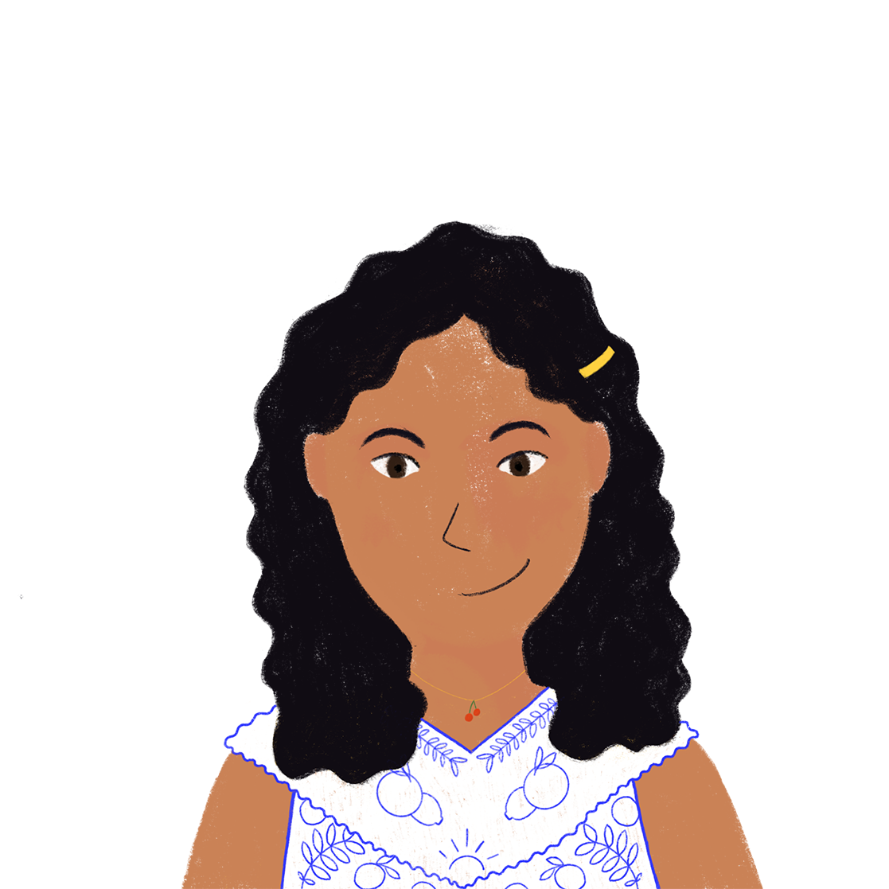
La semaine d’Amir
parler
Si tu …
[venir] chez ma famille, nous …
…viens
[sortir] ensemble.
…sortons
Notes:
Timing: 8 minutes
Aim: To recognise and produce verbs likes sortir and venir in all present tense forms; reading aloud an unfamiliar text; cooperative story-telling. Procedure: 1. Tell students that they are going to work in pairs to tell a story together. Use this slide to model the task. Click to bring up Noura’s sentence. Ask students what form of venir she must say to continue the sentence that Amir has begun. Click to reveal the answer and bring up Amir’s second sentence. Repeat.
2. Print and distribute the rolecards on slide 32.
3. Person A reads the first part of sentence 1, ending with a subject.
4. Person B completes the sentence with form of the verb in brackets on their rolecard that matches the subject they hear. They then begin the next sentence.
5. Repeat steps 1-2 until the story is complete.
6. Check answers and translation on slide 33.

Slide 42
La semaine d’Amir
parler
Partenaire A Partenaire B
Salut Océane ! Mes amies anglaises … (venir) de York. Nous …
(sortir) ensemble aujourd’hui. Mais Kirsten … (dormir) en ce moment. Je …
(devenir) strict parce que nous … (partir) en retard chaque jour et nous
(revenir) à la maison en retard aussi. Les filles … (dormir) beaucoup. Tu …
(dormir) peu, c’est bien. On … (sortir) tôt comme ça ! Je …
(sortir) avec Kirsten et Natalie chaque jour. Si tu … venir) ça va être amusant ! Elles…
(partir) la semaine prochaine. Tu … (sortir) avec les filles samedi ? Tu …
(venir) à la maison et vous … (devenir) amies. Vous …
(venir) en ville avec ma famille et puis vous … (partir) faire les magasins ensemble. Noura …
(dormir) chez une amie en ce moment. Elle … (revenir) demain. Elle …
(venir) en ville aussi.
Notes:
Note: for some classes it may be useful to display this slide during the activity for written support. Students still need to manipulate and produce the verbs. For more challenge, print the cards on the next slide and distribute.

Slide 43
La semaine d’Amir
La semaine d’Amir
Partenaire A Partenaire B
Salut Océane ! Mes amies anglaises … (venir) de York. Nous …
(sortir) ensemble aujourd’hui. Mais Kirsten … (dormir) en ce moment. Je …
(devenir) strict parce que nous … (partir) en retard chaque jour et nous
(revenir) à la maison en retard aussi. Les filles … (dormir) beaucoup. Tu …
(dormir) peu, c’est bien. On … (sortir) tôt comme ça ! Je …
(sortir) avec Kirsten et Natalie chaque jour. Si tu … venir) ça va être amusant ! Elles…
(partir) la semaine prochaine. Tu … (sortir) avec les filles samedi ? Tu …
(venir) à la maison et vous … (devenir) amies. Vous …
(venir) en ville avec ma famille et puis vous … (partir) faire les magasins ensemble. Noura …
(dormir) chez une amie en ce moment. Elle … (revenir) demain. Elle …
(venir) en ville aussi.
La semaine d’Amir
La semaine d’Amir
Partenaire A Partenaire B
Salut Océane ! Mes amies anglaises … (venir) de York. Nous …
(sortir) ensemble aujourd’hui. Mais Kirsten … (dormir) en ce moment. Je …
(devenir) strict parce que nous … (partir) en retard chaque jour et nous
(revenir) à la maison en retard aussi. Les filles … (dormir) beaucoup. Tu …
(dormir) peu, c’est bien. On … (sortir) tôt comme ça ! Je …
(sortir) avec Kirsten et Natalie chaque jour. Si tu … venir) ça va être amusant ! Elles…
(partir) la semaine prochaine. Tu … (sortir) avec les filles samedi ? Tu …
(venir) à la maison et vous … (devenir) amies. Vous …
(venir) en ville avec ma famille et puis vous … (partir) faire les magasins ensemble. Noura …
(dormir) chez une amie en ce moment. Elle … (revenir) demain. Elle …
(venir) en ville aussi.
Notes:
Handouts

Slide 44
La semaine d’Amir
parler
Salut Océane ! Mes amies anglaises viennent de York. Nous sortons ensemble aujourd’hui. Mais Kirsten dort en ce moment. Je deviens strict parce que nous partons en retard chaque jour et nous revenons à la maison en retard aussi. Les filles dorment beaucoup. Tu dors peu, c’est bien. On sort tôt comme ça ! Je sors avec Kirsten et Natalie chaque jour. Si tu viens ça va être amusant ! Elles partent la semaine prochaine. Tu sors avec les filles samedi ? Tu viens à la maison et vous devenez amies. Vous venez en ville avec ma famille et puis vous partez faire les magasins ensemble. Noura dort chez une amie en ce moment. Elle revient demain. Elle vient en ville aussi.
Hi Océane! My English friends come from York. We go out together every day. But Kirsten is sleeping at the moment. I’m becoming strict because we leave late every day, and we get back to the house late too. The girls sleep a lot. You sleep little, which is good. You/we can go out early that way! I go out with Kirsten and Natalie every day. If you come that will be fun! They are leaving next week. (Will you) go out with the girls on Saturday? You’ll come to the house and you (pl) will become friends. You (pl) will go into town with my family and then leave to go shopping together. Noura is sleeping at a friend’s place at the moment. She’s coming back tomorrow. She’ll come into town as well.
Notes:
Full story and translation

Slide 45
Devoirs
Vocabulary Learning Homework (Y8, Term 2.1, Week 5)
Audio file
Student worksheet
In addition, revisit: Y8 Term 1.2 Week 6 | Y8 Term 1.1 Week 6
Notes:
NOTE: This is the same HW as was set at the end of Week 4 after the assessment week. There is no new vocabulary for next week and no revision of previous vocabulary, so students have another week to practise this vocabulary. This is just to give a little slack in the schedule, knowing that this can be very helpful!
The answer sheet for the Y8, Term 2.1, Week 5 vocabulary learning HW is here: https://rachelhawkes.com/LDPresources/Yr8French/French_Y8_Term2i_Wk5_audio_HW_sheet_answers.docx Don’t share this link with students ☺
Notes:
i) Teachers may, in addition, want to recommend use of a particular online app for the pre-learning of each week’s words. ii) Quizlet now requires parental involvement / registration / permissions for users below the age of 13, so it is perhaps most suitable for Y9 – 11 students. iii) Language Nut hosts LDP vocabulary lists and these are free for schools to use, though there is a registration process. One benefit is that all of the student tracking data that Language Nut offers are also available to schools that use the LDP lists for practice. Perhaps this makes it a good option for Y7/8.
iv) There are other free apps, and new ones are always appearing. Teachers have told us that they are currently using: Flippity, Wordwall (where using previously-created activities is free).
v) Gaming Grammar has been acquired by Language Nut. Its original content should still be available to teachers and much of it is appropriate for Y8 learners.
This week:
Verbs (present): 1st person singular/plural (Verb agreement (present))
Verbs (present): 2nd person singular/plural (Verb agreement (present))
Verbs (present): 3rd person singular/plural (Verb agreement (present))

