Slide 1
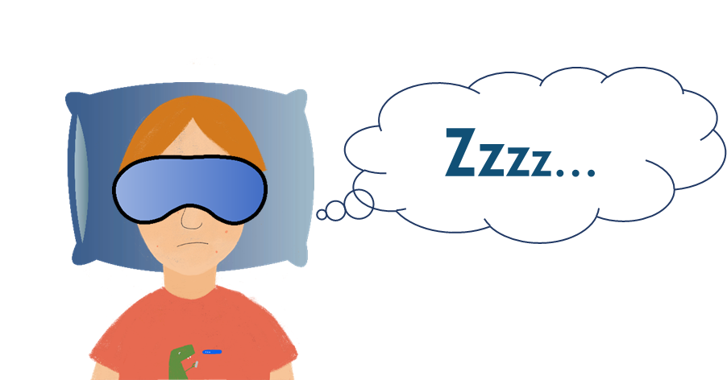
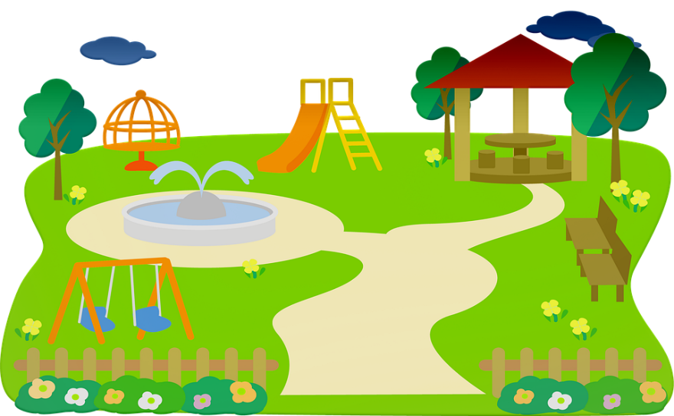
Everyday life Talking about when, where and how
verbs like sortir, venir, dire (present)
adverb placement
SSC [-aill-, -ail], [a] revisited
J’ai visité Bruxelles!
J’ai visité la Suisse!
Y8 French
Term 2.1 - Week 2 - Lesson 31
Kirsten Somerville / Natalie Finlayson / Catherine Morris
Artwork by: Chloé Motard
Date updated: 01.02.24
Notes:
Note: all words (new and revisited) in this week of the SOW appear on all three GCSE wordlists, with these exceptions: i) AQA list does not have jaune
ii) Edexcel list does not have intelligent
iii) Eduqas list does not have intelligent
Artwork by Chloé Motard. All additional pictures selected are available under a Creative Commons license, no attribution required.
Learning outcomes (lesson 1):
Introduction of SSC [-aill-, -ail], [a] revisited
Revision of verbs like prendre, sortir, venir, dire in the present simple and continuous
What is an adverb?
Revision of adverb placement
Word frequency (1 is the most frequent word in French):
apprendre [327], comprendre [95], devenir [162], dire [37], dis [37], dit [37], dormir [1836], dors [1836], dort [1836], partir [163], pars [163], part [163], prendre [43], prend [43], prends [43], revenir [184], sortir [309], sors [309], sort [309], venir [88], viens [88], vient [88], année [102], jour [78], mois [178], moment [148], semaine [245], anglais¹ [784], beau [393], belle [393], blanc [708], blanche [708], bleu [1216], bon [94], bonne [94], chaque [151], cher [803], chère [803], français¹ [784], grand¹ [59], grand² [59], heureux [764], heureuse [764], intelligent [2509], intéressant [1244], jaune [2585], jeune [152], naturel [760], naturelle [760], noir [572], nouveau [67], nouvelle [67], petit¹ [138], petit² [138], rouge [987], sympa(thique) [4146], vert [1060], vieille [671], vieux [671], absolument [1009], aujourd’hui [233], bien [47], dehors [1217], en retard [7/1278], encore [51], ensemble [124], ici [167], normalement [2018], parfois [410], peut-être [190], rarement [2535], souvent [287], tôt [513], très [66]
Source: Londsale, D., & Le Bras, Y. (2009). A Frequency Dictionary of French: Core vocabulary for learners London: Routledge.

Slide 2
a
animal
Notes:
Timing: 1 minute
Aim: To consolidate SSC [a]
Procedure: 1. Present the letter(s) and say the [a] sound first, on its own. Students repeat it with you. 2. Bring up the word ”animal” on its own, say it, students repeat it, so that they have the opportunity to focus all of their attention on the connection between the written word and its sound.
3. A possible gesture for this would be to mimic an animal’s motion, perhaps holding ones arms and hands close to the chest as ‘paws’. 4. Roll back the animations and work through 1-3 again, but this time, dropping your voice completely to listen carefully to the students saying the [a] sound, pronouncing ”animal” and, if using, doing the gesture.
Word frequency (1 is the most frequent word in French):
animal [1002]
Source: Londsale, D., & Le Bras, Y. (2009). A Frequency Dictionary of French: Core vocabulary for learners London: Routledge.

Slide 3
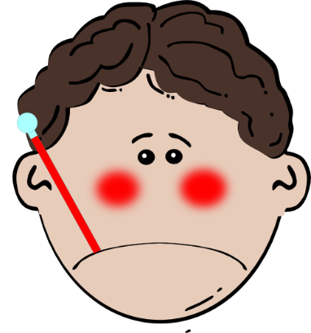
a
ça va ?
table
animal
malade
sac
mal
[badly]
Notes:
Timing: 1 minute
Aim: To consolidate SSC [a]
Procedure:
1. Introduce and elicit the pronunciation of the individual SSC [a] and then the source word again ‘animal’ (with gesture, if using). 2. Then present and elicit the pronunciation of the five cluster words.
The cluster words have been chosen for their high-frequency, from a range of word classes, with the SSC (where possible) positioned within a variety of syllables within the words (e.g. initial, 2nd, final etc.). Additionally, we have tried to use words that build cumulatively on previously taught SSCs (see the Phonics Teaching Sequence document) and do not include new SSCs. Where new SSCs are used, they are often consonants which have a similar symbol-sound correspondence in English.
Word frequency (1 is the most frequent word in French): animal [1002]; ça va? [54 (cela), 53 (aller)]; malade [1066] mal [277]; table [1019]; sac [2343] Source: Londsale, D., & Le Bras, Y. (2009). A Frequency Dictionary of French: Core vocabulary for learners London: Routledge.

Slide 4
-aill-/-ail
taille
Notes:
Timing: 1 minute
Aim: To introduce SSC [-aill-/-ail]
Procedure: 1. Present the letter(s) and say the [-aill-/-ail] sound first, on its own. Students repeat it with you. 2. Bring up the word ”taille” on its own, say it, students repeat it, so that they have the opportunity to focus all of their attention on the connection between the written word and its sound.
3. A possible gesture for this would be to start with hands together and move them apart, representing varying size. 4. Roll back the animations and work through 1-3 again, but this time, dropping your voice completely to listen carefully to the students saying the [-aill-/-ail] sound, pronouncing ”taille” and, if using, doing the gesture.
Word frequency (1 is the most frequent word in French):
taille [1500]
Source: Londsale, D., & Le Bras, Y. (2009). A Frequency Dictionary of French: Core vocabulary for learners London: Routledge.

Slide 5
-aill-/-ail
[garlic]
détail
ail
[detail]
taille
medaille
ailleurs
travailler
[elsewhere]
[to work]
Notes:
Timing: 2 minutes
Aim: To introduce SSC [-aill-/-ail]
Procedure:
Introduce and elicit the pronunciation of the individual SSC [-aill-/-ail] and then the source word again ‘taille’ (with gesture, if using). Then present and elicit the pronunciation of the five cluster words. The cluster words have been chosen for their high-frequency, from a range of word classes, with the SSC (where possible) positioned within a variety of syllables within the words (e.g. initial, 2nd, final etc.). Additionally, we have tried to use words that build cumulatively on previously taught SSCs (see the Phonics Teaching Sequence document) and do not include new SSCs. Where new SSCs are used, they are often consonants which have a similar symbol-sound correspondence in English.
Word frequency (1 is the most frequent word in French): taille [1500]; ail [>5000]; détail[318]; médaille [3361] travailler [290]; ailleurs [360]. Source: Londsale, D., & Le Bras, Y. (2009). A Frequency Dictionary of French: Core vocabulary for learners London: Routledge.

Slide 6
Phonétique
écouter / écrire
Say these words:
SSC [-ail-/aille]
sounds like a ‘yih’ sound after SSC [a].
This is similar to the [-ill-/ille] vs [i] pattern we practised last week.
à
[at, to, in]
ail
[garlic]
Notes:
Timing: 1 minute
Aim: aural recognition and production of SSCs [-ail-/aille] and [a] to prime for the activity on the next slide.
Procedure:
1. Students try to say the words in the minimal pair, à and ail.
2. Click to hear the words said by a native speaker. Students repeat.
3. Click to bring up the hint.
Transcript:
à
ail
Word frequency (1 is the most frequent word in French): ail [>5000]

Slide 7
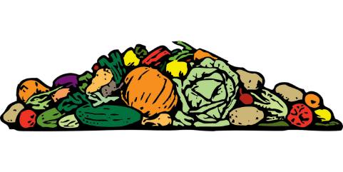
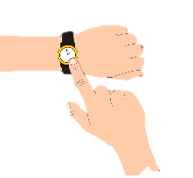
Phonétique
écouter
Écoute ! Quel mot a la SSC [-ail-/aille] ?
1
a) tas | b) taille
a) bail | b) bas
4
[pile]
[size]
[lease]
[bottom]
___
___
___
___
2
a) pas | b) paille
5
a) rat | b) rail
[step]
[straw]
[rail]
___
___
___
___
3
a) ailleurs | b) à l’heure
6
a) caille | b) cas
[elsewhere]
[scenario]
[on time]
[quail]
_
_
___
___
Notes:
Timing: 5 minutes
Aim: aural recognition of SSCs [-ail-/aille] and [a] in minimal pairs. Awareness-raising exercise in pronunciation of [-il(le)-] (sounds like the preceding vowel + ‘yih’.)
Procedure:
1. Click the numbers to play the audio.
2. Students write 1-6 and complete the word with [a] or
3. Click to reveal the answers. Draw attention to the SFC on many of the distractors.
4. Students sound out the pairs of words.
5. Move to the next slide and repeat steps 1-4.
Transcript:
1. a) tas b) taille
2. a) pas b) paille
3. a) ailleurs b) à l’heure
4. a) bail, b) bas
5. a) rat, b) rail
6. a) caille, cas
Word frequency (1 is the most frequent word in French): tas [2723], taille [1500], pas [18], paille [>5000], ailleurs [360], heure [99] bâille [>5000], bas [468], rat [4290], rail [4697], caille [>5000], cas [137]
Source: Londsale, D., & Le Bras, Y. (2009). A Frequency Dictionary of French: Core vocabulary for learners London: Routledge.

Slide 8
Verbs like sortir
grammaire
Remember, the verbs sortir, dormir and partir have the same pattern of endings:
je sors
I go out / I am going out
je dors
I sleep / I am sleeping
tu sors
you go out / you are going out
tu dors
you sleep/ you are sleeping
il sort
he goes out / he is going out
il dort
he sleeps / he is sleeping
elle sort
she goes out / she is going out
elle dort
she sleeps / she is sleeping
je pars
I leave / I am leaving
The je, tu, il and elle forms all sound the same: the –s and –t are Silent Final Consonants.
tu pars
you leave/ you are leaving
il part
he leaves / he is leaving
elle part
she leaves / she is leaving
Notes:
Timing: 3 minutes
Aim: revising the first, second- and third-person singular forms of verbs like sortir.
Procedure:
Click to bring up sortir.
Elicit the French forms of dormir and partir, prompted by the English forms.

Slide 9
Verbs like venir
grammaire
Venir, devenir and revenir also use these endings (with a stem change):
je viens
I come / I am coming
je deviens
I become / I am becoming
tu viens
you come / you are coming
tu deviens
you become / you are becoming
il vient
he comes/ he is coming
il devient
he becomes / he is becoming
elle vient
she comes / she is coming
elle devient
she becomes / she is becoming
je reviens
I come back / I am coming back
The only difference between these three verbs is the addition of a prefix (de- or re-).
tu reviens
you come back / you are coming back
il revient
he comes back / he is coming back
elle revient
she comes back / she is coming back
Notes:
Timing: 2 minutes
Aim: revising the first, second- and third-person singular forms of verbs like venir.
Procedure:
Click to bring up English prompts and elicit the French forms of devenir and revenir.

Slide 10
What is an adverb?
grammaire
An adverb or adverbial phrase gives more information about when, where how often, or how something happens. They are used to describe verbs.
when?
hier
aujourd’hui
demain
bientôt
where?
près
ici
dehors
loin
how often?
chaque semaine
rarement
normalement
chaque jour
how?
absolument
bien
ensemble
peut-être
What other adverbs and adverbial phrases do you know in French?
Notes:
Timing: 3 minutes
Aim: revising adverb functions and types
Procedure:
1. Elicit answers from students before bringing up the definition.
2. Give students time to write down as many French adverbs as they can think of, using the category boxes as guides if desired.
3. Elicit examples from the class.

Slide 11
Trouve le contraire !
lire
1. dans le passé | a) maintenant
 | b) à l’avenir
 | c) en retard
 | d) tôt
4. demain | a) souvent
 | b) ici
 | c) hier
 | d) partout
7. d’abord
2. parfois | a) peut-être
 | b) contre
 | c) bientôt
 | d) souvent
5. près | a) loin
 | b) puis
 | c) peu
 | d) rarement
a) contre
b) où
c) aujourd’hui
d) puis
3. beaucoup | a) assez
 | b) aujourd’hui
 | c) un peu
 | d) très
6. tôt | a) en retard
 | b) comment
 | c) d’abord
 | d) quand
Notes:
Timing: 3 minutes
Aim: written recognition of adverbs
Procedure:
Students tick the word they think represents the opposite of the word in bold
Answers revealed on clicks
Word frequency of cognates used (1 is the most frequent word in French): contraire [619]
Source: Londsale, D., & Le Bras, Y. (2009). A Frequency Dictionary of French: Core vocabulary for learners London: Routledge.

Slide 12
Where do adverbs go?
Exception!
Parfois (sometimes) always comes at the beginning of a sentence:
Parfois, il mange à la cantine.
grammaire
Adverbs that tell us how and how often normally come after the verb they describe.
This is sometimes different from English …
… and sometimes the same.
Il mange souvent à la cantine. Je dors bien à la maison.
He often eats at the canteen. I sleep well at home.
Adverbs that tell us when and where normally come at the beginning or the end.
In English, these normally come at the end.
Hier, j’ai visité le musée. I visited the museum yesterday.
J’ai visité le musée hier.
Exception!
Aussi (also) sometimes comes at the end. This is different from English.
J’ai visité la Tour Eiffel aussi.
Notes:
Timing: 3 minutes
Aim: revising word order with adverbs.
Word frequency of cognates used (1 is the most frequent word in French): cantine [>5000], tour [523]
Source: Londsale, D., & Le Bras, Y. (2009). A Frequency Dictionary of French: Core vocabulary for learners London: Routledge.

Slide 13
Le week-end de Noura
lire
1. Le samedi / souvent, je joue avec Amir dans le parc.
2. Nous jouons ensemble/le week-end quand il fait beau.
3. Rarement / Parfois, nous jouons au foot.
4. Nous faisons nos devoirs bien / aussi.
5. Je travaille bien / rarement dans ma chambre.
6. Aujourd’hui / Souvent, je fais une pause.
7. Je regarde des films et je dors aussi/ beaucoup !
Noura parle de son week-end.
Que dit-elle ?
Notes:
Timing: 7 minutes
Aim: to use knowledge of adverb placement rules to decipher meaning.
Procedure:
Students read the pairs of sentences and decide which adverb is needed using their knowledge of adverb placement rules in French.
Click to reveal a French answer.
Discuss the reasons for the answer with reference to French word order rules. Where there are alternatives, discuss how the sentence would be structured for the alternative answer to be correct.
Word frequency of cognates used (1 is the most frequent word in French): week-end [2475]
Source: Londsale, D., & Le Bras, Y. (2009). A Frequency Dictionary of French: Core vocabulary for learners London: Routledge.

Slide 14
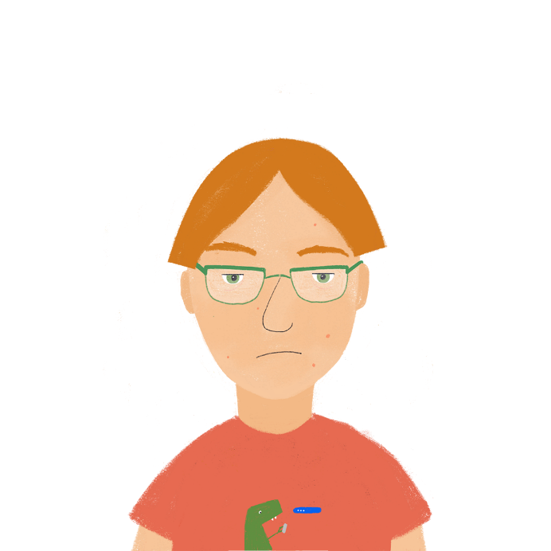
Le rêve d’Antoine
écouter
Antoine parle souvent quand il dort. Que dit-il ? Écris les phrases en anglais.
1
I’m on the island again!
_______________________________
Does it sound better to change the word order in English, or to keep it the same as the French?
2
The waves are very beautiful, too.
_______________________________
3
My favourite animal lives here.
_______________________________
4
A man is singing outside.
_______________________________
5
We often talk about France.
Zzzz…
_______________________________
6
I normally go into the mountains.
_______________________________
7
My boat is arriving early.
_______________________________
8
Maybe this is a dream …
_______________________________
9
I absolutely have to come back!
_______________________________
Notes:
Timing: 8 minutes
Aim: awareness-raising of adverb placement in French and English
Procedure:
1. Click the numbers to play the audio.
2. Students write 1-9 and try to write each sentence in English, paying attention to the adverb placement.
3. Click to reveal the answers.
4. Replay the audio and discuss which sentences sound natural with the adverb in the same position / a different position to the original French.
Transcript:
Je suis encore sur l’île !
Les vagues sont très belles aussi.
Mon animal préféré habite ici.
Un homme chante dehors.
Nous parlons souvent de la France.
Je vais normalement dans les montagnes.
Mon bateau arrive tôt.
C’est peut-être un rêve…
Je dois absolument revenir !

Slide 15
Qui fait quoi ?
Now translate the sentences into English. Where does the time phrase go?
Look at the time phrases. Do you need present simple or continuous in English?
Look at the time phrases. Do you need present simple or continuous in English?
lire
Léa compare sa vie avec Sophie.
C’est Léa (je) ou Sophie (elle) ?
 |  | simple (habitual action) | continuous (ongoing action)
1. | Je / Elle revient d’Allemagne aujourd’hui.
2. | Je / Elle dort bien normalement.
3. | Je / Elle dors rarement avec la fenêtre ouverte.
4. | Je / Elle pars de la station de métro chaque jour.
5. | Je / Elle deviens amie avec Sonja en ce moment.
6. | Je / Elle sort avec des amis maintenant.
7. | Je / Elle sors en ville cette semaine.
8. | Je / Elle vient souvent au collège à vélo.
Notes:
Timing: 10 minutes
Aim: written recognition of the first- and third-person singular forms of verbs like partir and venir; translating the French present tense with the English present simple/continuous
Procedure:
1. First, students write 1-8 and choose je or elle for each sentence.
2. Click to reveal the answers.
3. Then, click to reveal the hidden columns of the table.
4. Students use the time phrases to decide whether to translate each sentence using the present simple or the present continuous.
5. Click to reveal the answers.
6. If time permits, click to reveal the follow-up task instruction. Students translate sentences into English. Suggested answers can be found on the following slide.
Word frequency of cognates used (1 is the most frequent word in French): station [1399], métro [3227], week-end [2475]
Source: Londsale, D., & Le Bras, Y. (2009). A Frequency Dictionary of French: Core vocabulary for learners London: Routledge.

Slide 16
Qui fait quoi ?
Look at the time phrases. Do you need present simple or continuous in English?
Look at the time phrases. Do you need present simple or continuous in English?
lire
Léa compare sa vie avec Sophie.
C’est Léa (je) ou Sophie (elle) ?
 |  | simple (habitual action) | continuous (ongoing action)
1. | She is coming back from Germany today.
2. | She normally sleeps well.
3. | I rarely sleep with the window open.
4. | She leaves the metro station every day.
5. | I am becoming friends with Sophie at the moment.
6. | She is going out with friends now.
7. | I am going out into town this week.
8. | She often comes to school by bike.
Notes:
Suggested translations from the previous slide’s activity.

Slide 17
Everyday life Saying what things are like
verbs like sortir, venir, dire (present)
adverb placement
SSC [-aill-, -ail], [a] revisited
J’ai visité Bruxelles!
J’ai visité la Suisse!
Y8 French
Term 2.1 - Week 2 - Lesson 32
Kirsten Somerville / Natalie Finlayson / Catherine Morris
Artwork by: Chloé Motard
Date updated: 01.02.24
Notes:
Note: all words (new and revisited) in this week of the SOW appear on all three GCSE wordlists, with these exceptions: i) AQA list does not have jaune
ii) Edexcel list does not have intelligent
iii) Eduqas list does not have intelligent
Artwork by Chloé Motard. All additional pictures selected are available under a Creative Commons license, no attribution required.
Learning outcomes (lesson 2):
Consolidation of SSC [-aill-, -ail], [a] revisited
Revision of verbs like apprendre in the present simple and continuous
What is an adjective?
Revision of adjective agreement (-e and –euse in feminine, irregular feminine, -s in plural)
Revision of adjective placement (pre- and post-nominal)
Word frequency (1 is the most frequent word in French):
apprendre [327], comprendre [95], devenir [162], dire [37], dis [37], dit [37], dormir [1836], dors [1836], dort [1836], partir [163], pars [163], part [163], prendre [43], prend [43], prends [43], revenir [184], sortir [309], sors [309], sort [309], venir [88], viens [88], vient [88], année [102], jour [78], mois [178], moment [148], semaine [245], anglais¹ [784], beau [393], belle [393], blanc [708], blanche [708], bleu [1216], bon [94], bonne [94], chaque [151], cher [803], chère [803], français¹ [784], grand¹ [59], grand² [59], heureux [764], heureuse [764], intelligent [2509], intéressant [1244], jaune [2585], jeune [152], naturel [760], naturelle [760], noir [572], nouveau [67], nouvelle [67], petit¹ [138], petit² [138], rouge [987], sympa(thique) [4146], vert [1060], vieille [671], vieux [671], absolument [1009], aujourd’hui [233], bien [47], dehors [1217], en retard [7/1278], encore [51], ensemble [124], ici [167], normalement [2018], parfois [410], peut-être [190], rarement [2535], souvent [287], tôt [513], très [66]
Source: Londsale, D., & Le Bras, Y. (2009). A Frequency Dictionary of French: Core vocabulary for learners London: Routledge.

Slide 18
Phonétique
Hint
Is there a letter ‘i’ before the -ll- ?
parler
balle
60
allumer
[to turn on]
broussaille [bush / thicket]
bétail [cattle]
ballon
chaleur
[heat]
défaillance [failure]
cheval
secondes
détailler [to describe]
intervalle [interval]
également [also / as well]
parallèle [parallel]
éventail [range / variety]
taille-crayon
tailler
[to trim]
installer [to install]
0
DÉBUT
Notes:
Timing: 2 minutes
Aim: Oral production of words containing ‘l/ll’ after ‘a’ and ‘ai’
Procedure:
1. Start the timer.
2. Students have one minute to try to say all the words correctly to a partner.
3. Teacher circulates to listen in to pronunciation and correct if necessary.
4. Click on the words to hear them said by a native speaker.
5. Click to move on to a more challenging versions of this activity with an increase in speed to aid automisation of the sounds.
Word frequency (1 is the most frequent word in French): allumer [3169], balle [2311], ballon [3692], bétail [4842], broussaille [>5000], chaleur [2773], cheval [2220], défaillance [3951], détailler [2667], également [246], éventail [4621], intervalle [3226], parallèle [2196], taille-crayon [>5000], tailler [3802], installer [821]

Slide 19
The verb ‘dire’
grammaire
Can you remember the pattern of endings for the je, tu, il and elle forms of the verbs like sortir ?
The verb dire also uses these endings:
The je, tu, il and elle forms all sound the same: the –s and –t are Silent Final Consonants.
je
-s
je dis
I say / I am saying, I tell / I am telling
tu
-s
tu dis
you say / you are saying, you tell / you are telling
il
-t
il dit
he says / he is saying, he tells / he is telling
elle
-t
elle dit
she says / she is saying, she tells / she is telling
Notes:
Timing: 2 minutes
Aim: revising the first, second and third person singular forms of dire.
Procedure:
Click to bring up French pronouns and elicit the endings for singular persons of dire.
Click to bring up the French verb forms and elicit the English meanings.

Slide 20
Verbs like prendre
grammaire
The endings for prendre, apprendre and comprendre are slightly different:
je prends
I take / I am taking
j’apprends
I learn / I am learning
tu prends
you take / you are taking
tu apprends
you learn / you are learning
il prend
he takes / he is taking
il apprend
he learns / he is learning
elle prend
she takes / she is taking
elle apprend
she learns / she is learning
je comprends
I understand / I am understanding
The only difference between these three verbs is the addition of a prefix (ap- or com-).
tu comprends
you understand / you are understanding
il comprend
he understands / he is understanding
elle comprend
she understands / she is understanding
Notes:
Timing: 3 minutes
Aim: revising the first, second- and third-person singular forms of verbs like prendre.
Procedure:
Click to bring up the English forms and elicit the French forms of apprendre and comprendre.

Slide 21
C’est qui ?
lire
Noura parle avec Océane. Elle parle à Océane (tu), ou d’Amir (il) ?
tu | il
En hiver, tu comprends pourquoi habiter à Nice est sympa.
Maintenant il comprend la musique anglaise à la radio.
Il apprend un nouveau rap chaque mois ?
Tu apprends deux langues en ce moment ?
Il dit que vous êtes en couple maintenant ?
Tu dis des choses intéressantes ce week-end !
_
_
_
_
_
_
Translate the sentences into English using the present simple or continuous.
Notes:
Timing: 8 minutes for 2 slides
Aim: practising written recognition of the first- and third-person singular forms of verbs like prendre and dire. Translating the present tense with English present simple and continuous.
Procedure:
1. First, students write 1-6 and choose tu or il for each sentence.
2. Click to reveal the answers.
3. Then, students translate the sentences into English, using the time phrases to decide between the present simple or continuous.
4. Answers are provided on the next slide.
Word frequency of cognates used (1 is the most frequent word in French): cantine [>5000], rap [>5000], couple [1167]
Source: Londsale, D., & Le Bras, Y. (2009). A Frequency Dictionary of French: Core vocabulary for learners London: Routledge.

Slide 22
C’est qui ?
Réponses
lire
Noura parle à Océane (tu), ou d’Amir (il) ?
En hiver, tu comprends pourquoi habiter à Nice est sympa.
Tu apprends deux langues en ce moment ?
Maintenant il comprend la musique anglaise à la radio.
Il apprend un nouveau rap chaque mois ?
Il dit que vous êtes en couple maintenant ?
Tu dis des choses intéressantes ce week-end !
In winter, you understand why living in Nice is nice.
Are you learning two languages at the moment?
Now he understands English music on the radio.
‘Now’ can be used with the present simple or continuous.
Does he learn a new rap every month?
Does he say / Is he saying that you’re a couple now?
You are saying some interesting things this weekend!
Notes:
Procedure:
1. Click to reveal the suggested English translations. Accept accurate alternative translations, including justified tense choices. E.g., Does he learn / Is he learning – both do work here.
2. Highlight maintenant as a time phrase which could be translated with the present simple or continuous in English.

Slide 23
What is an adjective ?
grammaire
An adjective is a word that gives more information about a noun. In French, adjectives usually come after the noun – but there are a few exceptions!
Which adjectives do you know in French?
after the noun
sympa
intéressant(e)
blanc / blanche
heureux / heureuse
before the noun
beau / belle
jeune
bon / bonne
grand(e)
Remember!
BEAUTY
AGE
GOODNESS
SIZE
Notes:
Timing: 3 minutes
Aim: revising adjective function and placement
Procedure:
1. Elicit answers from students before bringing up the definition.
2. Give students time to write down as many French adjectives as they can think of, using the category boxes as guides if desired.
3. Elicit examples from the class. If students struggle for ideas, provide the English as prompts (eg. Comment dit-on ‘nice’ en français ?)
4. Go through the examples. Try to elicit the ‘BAGS’ rule for adjective placement. Highlight the different feminine forms.
5. The adjectives follow a range of agreement patterns – this will be explained further in a later slide.

Slide 24
Trouve le contraire !
lire
1. moderne | a) nouveau
 | b) jeune
 | c) cher
 | d) vieux
4. droit | a) gauche
 | b) faux
 | c) général
 | d) beau
7. petit
2. sympa | a) drôle
 | b) méchant
 | c) amusant
 | d) prudent
5. triste | a) naturel
 | b) préféré
 | c) heureux
 | d) intéressant
a) jeune
b) grand
c) vieux
d) cher
3. premier | a) bon
 | b) haut
 | c) dernier
 | d) prochain
6. difficile | a) différent
 | b) vieille
 | c) ouvert
 | d) facile
Notes:
Timing: 3 minutes
Aim: written recognition of adjectives
Procedure:
Students tick (write or volunteer orally) the word they think represents the opposite of the word in bold
Answers revealed on clicks
Word frequency (1 is the most frequent word in French): moderne [1239], nouveau [52], jeune [152], cher [803], vieux [671], sympa [4164], drôle [2166], méchant [3184], amusant [4695], prudent [1529], premier [56], bon [94], haut [264], dernier [87], prochain [380], droit [143], gauche [607], faux [555], général [147], beau [393], naturel [760], préféré [597], heureux [764], intéressant [1244], différent [350], ouvert [897], facile [822], petit [138], grand [59]
Source: Londsale, D., & Le Bras, Y. (2009). A Frequency Dictionary of French: Core vocabulary for learners London: Routledge.

Slide 25
Adjective agreement
grammaire
You can’t hear the difference between the singular and plural forms.
French adjectives agree with the gender and number of the noun they describe.
Regular adjectives add –e to make the feminine form, and –s to make the plural form:
Il est intéressant. Elle est intéressante.
Ils sont intéressants. Elles sont intéressantes.
If the adjective ends in –e, the masculine and feminine form is the same:
Il est malade. Elle est malade.
Notes:
Timing: 2 minutes
Aim: revising regular adjective agreement.
Procedure: 1. Click to present the information. 2. Elicit meanings where useful.

Slide 26
Adjective agreement
grammaire
Some adjectives follow different patterns in the feminine form:
Le garçon est heureux. La fille est heureuse.
Le film est bon. La musique est bonne.
Le goût est naturel. La couleur est naturelle.
Le portable est cher. La télé est chère.
There are also a few irregular adjectives which change form completely:
L’homme est beau. La femme est belle.
L’appartement est nouveau. La maison est nouvelle.
Le bâtiment est vieux. L’université est vieille.
Le vélo est blanc. La voiture est blanche.
________
________
________
________
________
________
________
________
Notes:
Timing: 2 minutes
Aim: revising irregular adjective agreement patterns
NB: Tell students that they will learn more about the ‘different patterns’ in the first set over the course of the Year 8 (they have already encountered -eux/-euse in 8.1.1.2).

Slide 27
Abdel parle de sa vie
écouter
Que dit-il ? Écris a ou b.
...
 | a | b
 | mon chien | ma vie
 | ma grand-mère | mon grand-père
 | ma famille | mon directeur
1
2
 | a | b
 | ma cuisine | mon déjeuner
 | mon ordinateur | ma radio
 | ma guitare | mon piano
3
4
5
6
Notes:
Timing: 5 minutes (two slides)
Aim: practising aural recognition of adjective gender agreement
Procedure:
1. Click the numbers to play the audio. The beginnings of the sentences are obscured by beeps.
2. Students write 1-6 and choose ‘a’ or ‘b’ to complete each sentence.
3. Click to reveal the answers.
4. The full audio (without beeps) is provided on the next slide.
Transcript:
[…] est heureuse.
[…] est vieille.
[…] est français.
[…] est bonne.
[…] est blanc.
[…] est nouveau.
Word frequency of cognates used (1 is the most frequent word in French): grand-père [3748], grand-mère [3883]
Source: Londsale, D., & Le Bras, Y. (2009). A Frequency Dictionary of French: Core vocabulary for learners London: Routledge.

Slide 28
Abdel parle de sa vie
Réponses
écouter
Que dit-il ? Écris a ou b.
...
 | a | b
 | mon chien | ma vie
 | ma grand-mère | mon grand-père
 | ma famille | mon directeur
1
2
 | a | b
 | ma cuisine | mon déjeuner
 | mon ordinateur | ma radio
 | ma guitare | mon piano
3
4
5
6
Notes:
Procedure:
1. Click the numbers to play the full audio without beeps.
2. English translations can also be elicited.
Transcript:
Ma vie est heureuse.
Ma grand-mère est vieille.
Mon directeur est français.
Ma cuisine est bonne.
Mon ordinateur est blanc.
Mon piano est nouveau.

Slide 29
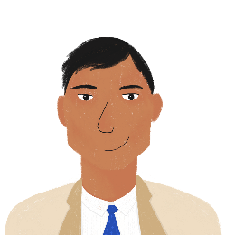
Un samedi en ville
lire
Bilal et Amandine font les magasins. Que font-ils ? Écris a ou b.
 |  | a | b
1. | Bilal et Amandine vont dans une boutique chère. | un magasin | une boutique
2. | Amandine a un style naturel. | un style | une élégance
3. | Bilal veut une chemise noire. | un tee-shirt | une chemise
4. | Amandine porte normalement des vêtements rouges. | un uniforme | des vêtements
5. | Bilal trouve un cadeau sympa pour Amandine. | un cadeau | des choses
6. | Amandine cherche un bikini jaune. | un bikini | des sandales
7. | Des jeunes femmes sont à la caisse. | un homme | des femmes
8. | Bilal achète un jean bleu. | un jean | une carte
__________
______
__________
__________
__________
______
__
______
______
Notes:
Timing: 5 minutes
Aim: written recognition of adjectival gender and number agreement
Procedure:
1. Students write 1-8 and choose ‘a’ or ‘b’ to complete each sentence.
2. Click to reveal the answers.
3. English translations can also be elicited.
Word frequency of cognates used (1 is the most frequent word in French): boutique [3791], style [1999], élégance [>5000], tee-shirt [>5000], bikini [>5000], sandale [>5000], jean [>5000]
Source: Londsale, D., & Le Bras, Y. (2009). A Frequency Dictionary of French: Core vocabulary for learners London: Routledge.

Slide 30
Écris en français !
écrire
Amir écrit un email à Abdel en anglais. Écris le texte en français.
>> Sujet: I like writing in English!!!
Hello Abdel,
I have a little question: how many languages do you speak? I have a very intelligent teacher at school – he understands six languages! My teacher says that I’m a good student. I understand that languages are important, and I take my time in class. Next week, two English girls are going to stay at my place. I will speak English because I don’t know if they speak French.
I sometimes say English sentences at home. My father is happy. He often takes the plane to England for work. Noura is learning a new language too. Are you learning interesting things at university?
Goodbye, Amir
Notes:
Timing: 15 minutes
Aim: practising written production of verbs like prendre and dire, adjective agreement, adjective placement and adverb placement.
NB: The context sets up the ‘school exchange’ topic of next week’s lesson.
Procedure:
1. Students translate the email into French.
2. A suggested translation is provided on the next slide. Accept accurate alternative translations.
Differentiation: To provide more support, teachers could customize the answers slide, giving first letter prompts for each word or for some of the words. Alternatively, the task could be set up as a jigsaw translation activity.
Word frequency of cognates used (1 is the most frequent word in French): email [>5000], texte [631]
Source: Londsale, D., & Le Bras, Y. (2009). A Frequency Dictionary of French: Core vocabulary for learners London: Routledge.

Slide 31
Écris en français !
Réponses
écrire
Amir écrit un email à Abdel en anglais. Écris le texte en français.
>> Sujet: J’aime écrire en anglais!!!
Bonjour Abdel,
J’ai une petite question : combien de langues parles-tu ? J’ai un professeur très intelligent au collège – il comprend six langues ! Mon professeur dit que je suis un bon élève. Je comprends que les langues sont importantes, et je prends mon temps en classe. La semaine prochaine, deux filles anglaises vont rester chez moi. Je vais parler anglais parce que je ne sais pas si elles parlent français.
Je dis parfois des phrases anglaises à la maison. Mon père est content. Il prend souvent l’avion pour Angleterre pour le travail. Noura apprend une nouvelle langue aussi. Apprends-tu des choses intéressantes à l’université ?
Au revoir, Amir
Notes:
Suggested solution to the text on the previous slide.

Slide 32
Devoirs
Vocabulary Learning Homework (Y8, Term 2.1, Week 3)
Revisit vocabulary: Y7 Mashup 4
Notes:
The link to this vocabulary set on Quizlet is here: https://quizlet.com/gb/528702792/year-8-french-term-21-week-3-revision-set-4-flash-cards/
Notes:
i) Teachers may want to recommend use of a particular online app for the revisiing of vocabulary.
ii) Quizlet now requires parental involvement / registration / permissions for users below the age of 13, so it is perhaps most suitable for Y9 – 11 students. iii) Language Nut hosts LDP vocabulary lists and these are free for schools to use, though there is a registration process. One benefit is that all of the student tracking data that Language Nut offers are also available to schools that use the LDP lists for practice. Perhaps this makes it a good option for Y7/8.
iv) There are other free apps, and new ones are always appearing. Teachers have told us that they are currently using: Flippity, Wordwall (where using previously-created activities is free).
v) Gaming Grammar has been acquired by Language Nut. Its original content should still be available to teachers and much of it is appropriate for Y8 learners.
Verbs (present): 1st person singular/plural (Verb agreement (present))
Verbs (present): 2nd person singular/plural (Verb agreement (present))
Verbs (present): 3rd person singular/plural (Verb agreement (present))
Adjectives: Number (Adjective agreement)

