Slide 1
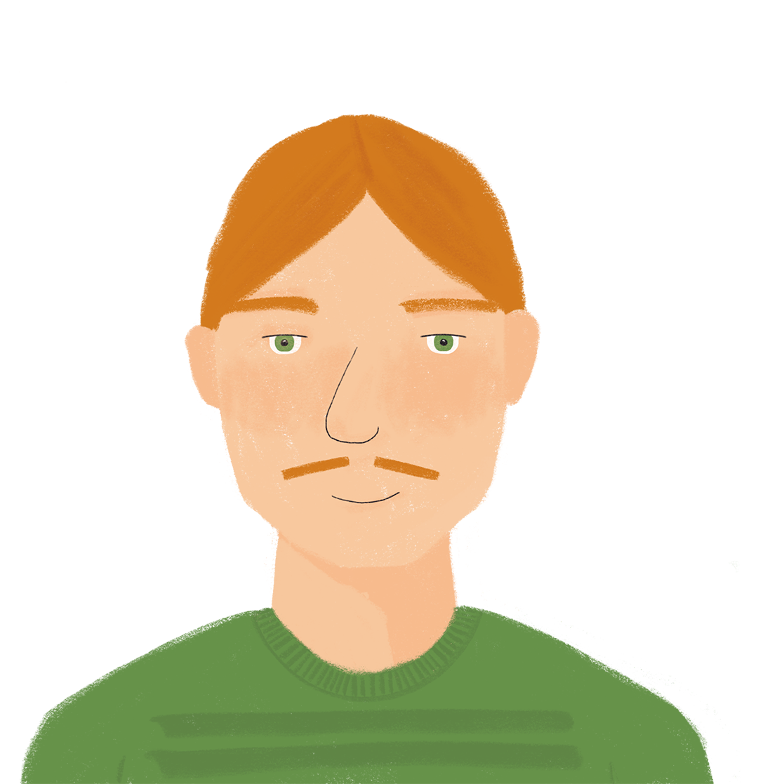
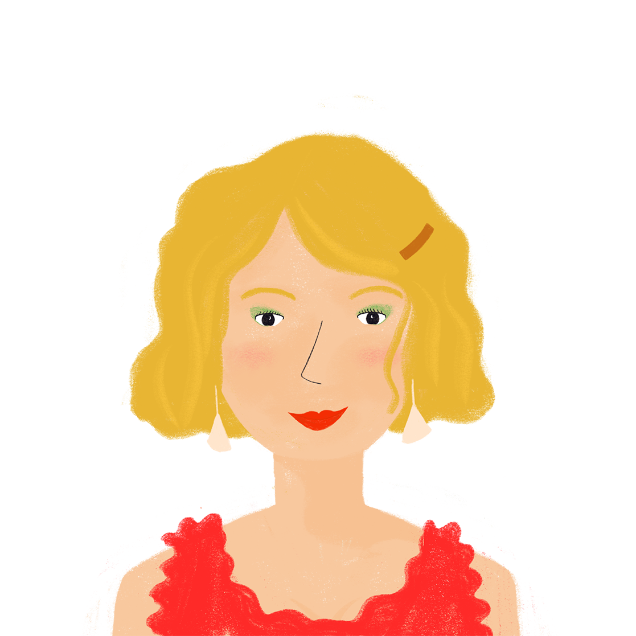
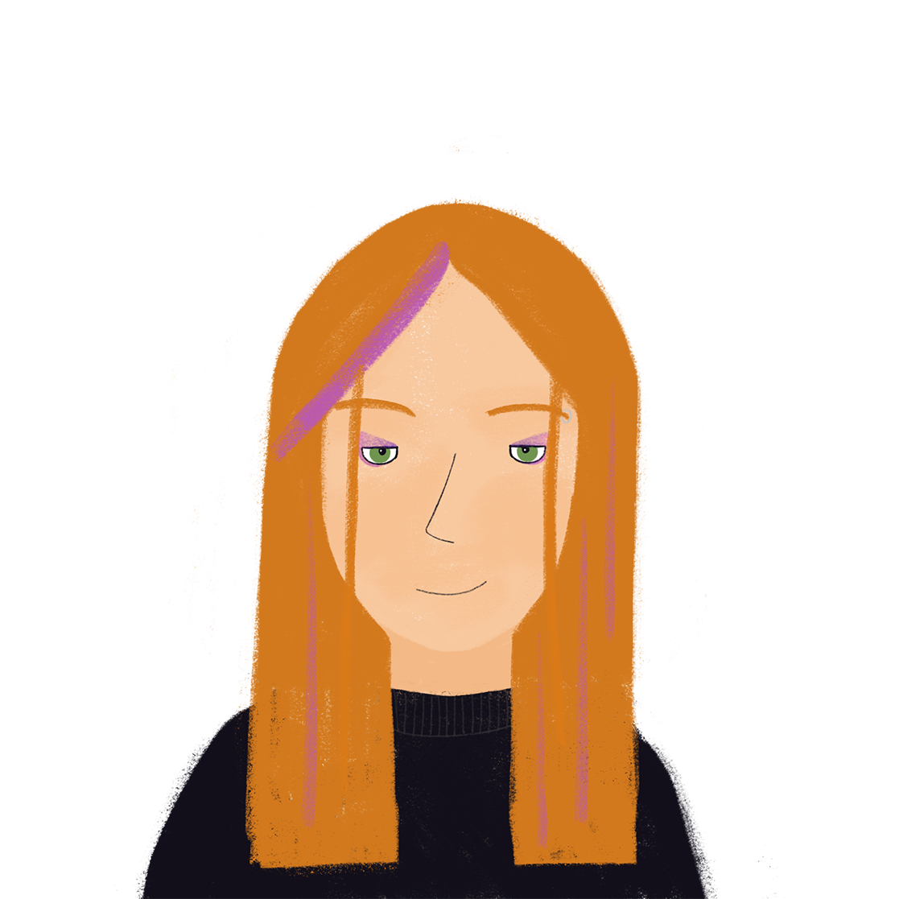
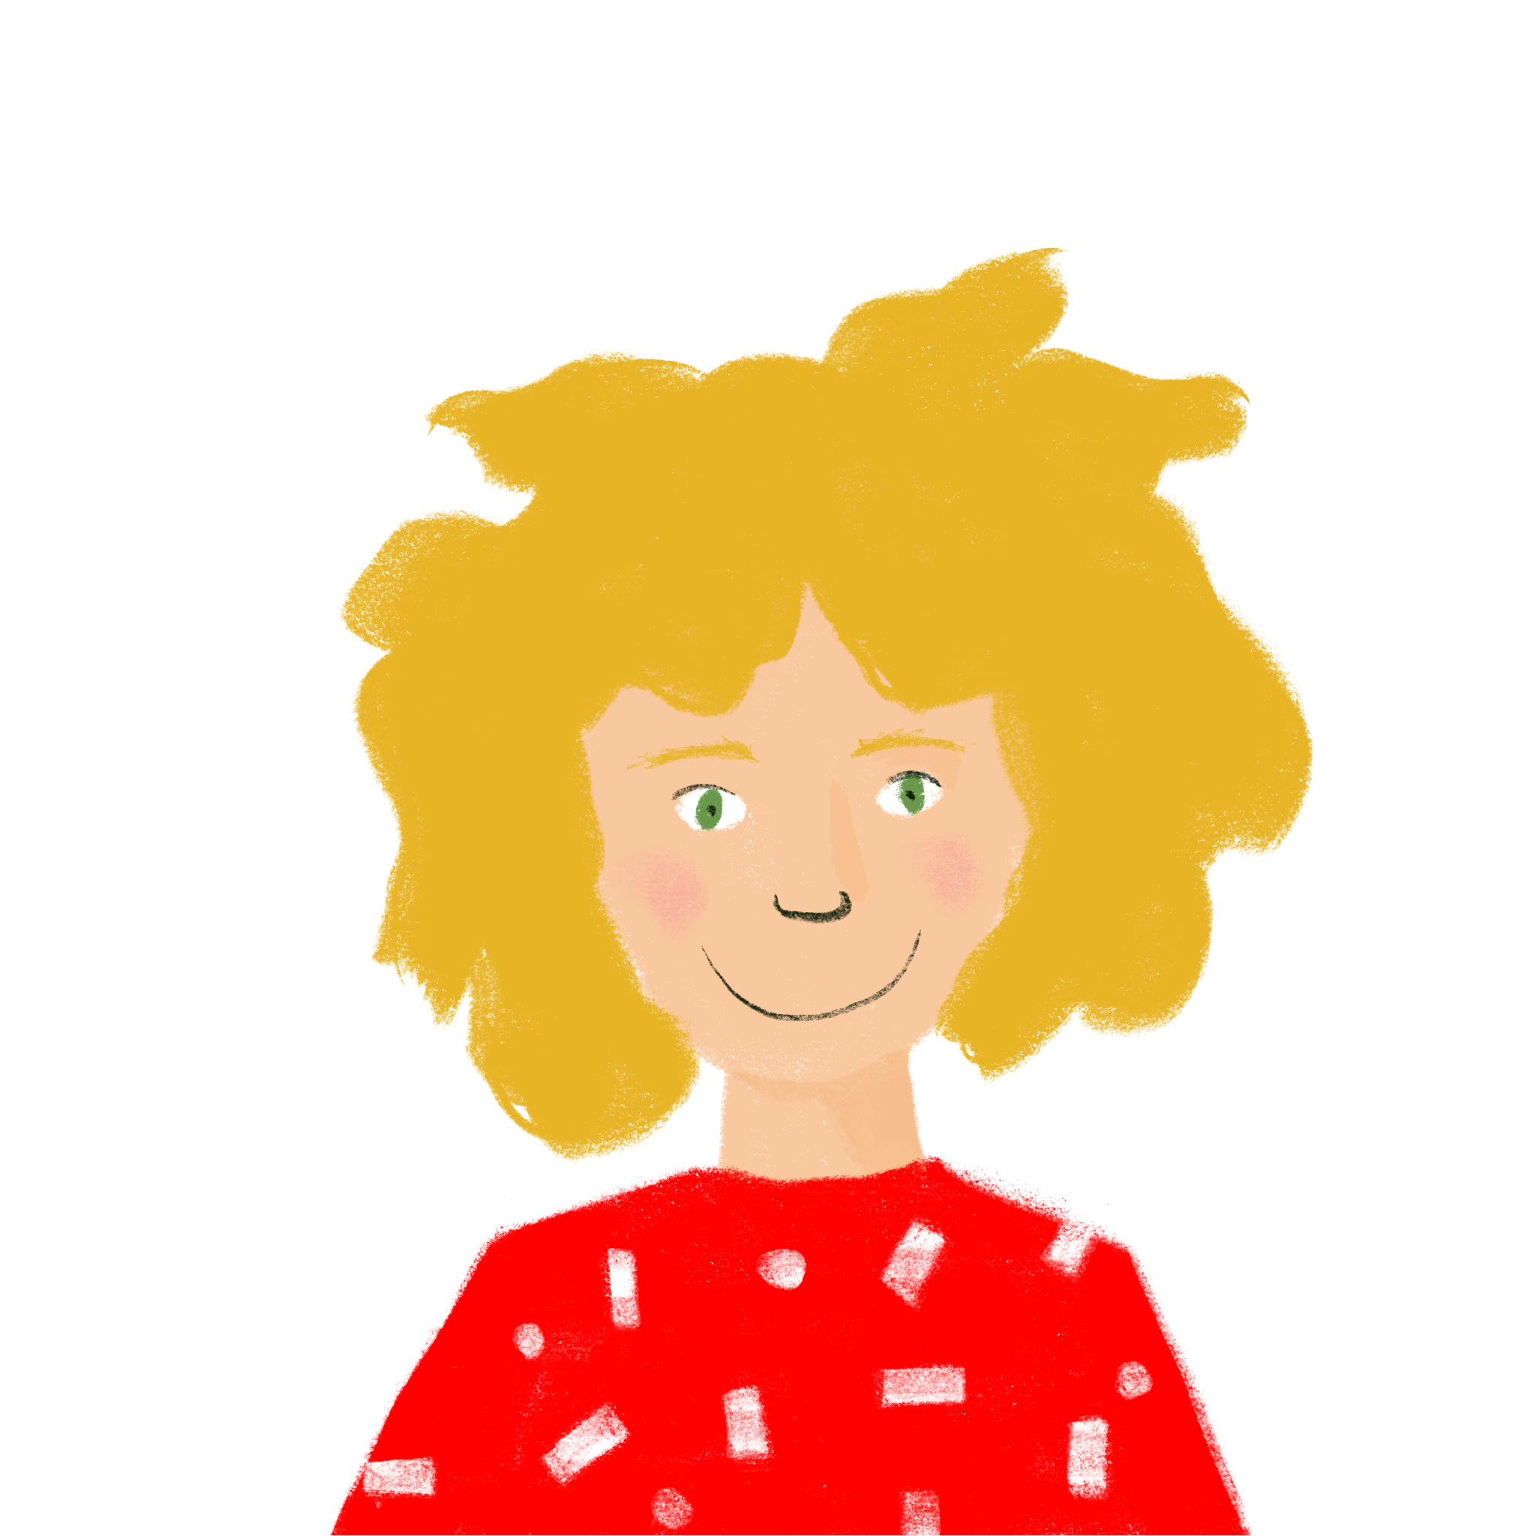
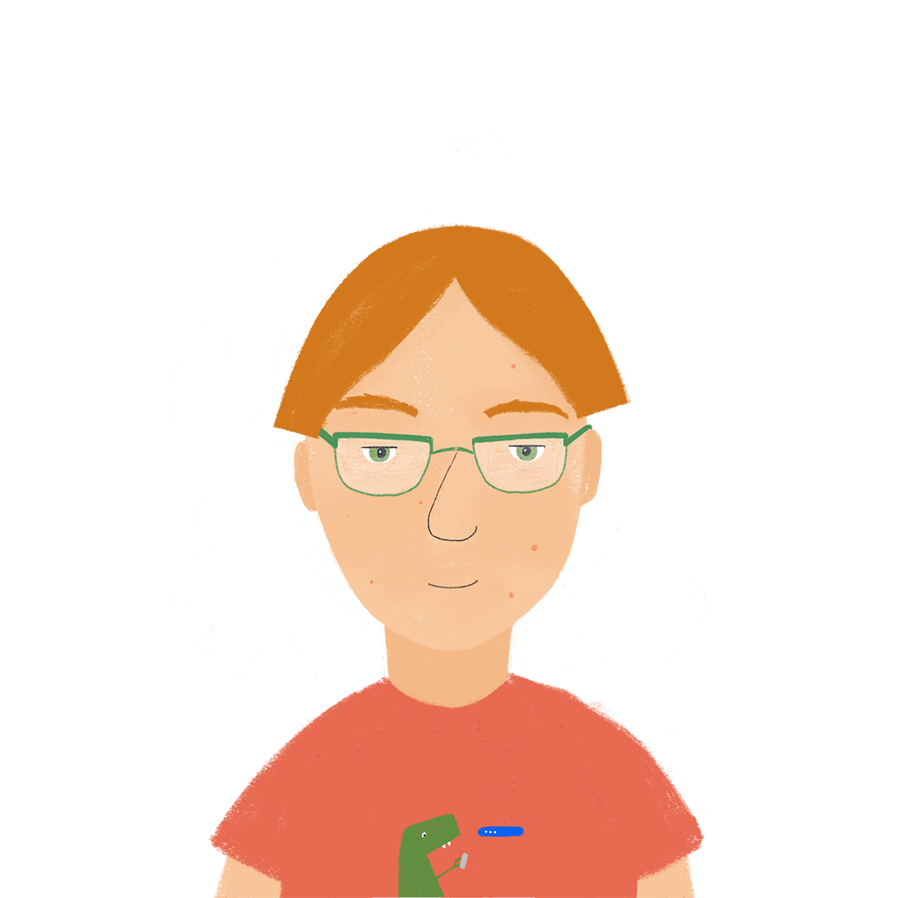
Everyday life Talking about eating and drinking
irregular verb boire (je, tu, il/elle)
partitive articles
SSC [-ill-, -ille], [i] revisited
Qui mange quoi ?
J’ai visité Bruxelles!
J’ai visité la Suisse!
Y8 French
Term 2.1 - Week 1 - Lesson 29
Kirsten Somerville / Catherine Morris / Natalie Finlayson
Artwork by: Chloé Motard
Date updated: 01.02.24
Notes:
Note: all words (new and revisited) in this week of the SOW appear on all three GCSE wordlists, with these exceptions: i) AQA list does not have réveillon
ii) Edexcel list does not have célébrer, gérer, Noël, réveillon
iii) Eduqas list does not have réveillon
Artwork by Chloé Motard. All additional pictures selected are available under a Creative Commons license, no attribution required.
Learning outcomes (lesson 1):
Introduction of SSC [-ill-, -ille], [i] revisited
Consolidation of partitive articles
Introduction of irregular –RE verb boire in the 1st, 2nd and 3rd person singular
Introduction of uncountable nouns used with partitive articles
Introduction of partitive articles in the negative
Word frequency (1 is the most frequent word in French):
8.2.1.1 (introduce) boire [1879], bois [1879], boit [1879], gagner² [258], argent [472], chance [438], lait [2507], café² [1886], thé [3517], viande [2625], peu [91], verre [2174], beaucoup [150]
8.1.2.5 (revisit) gérer [1354], espace [870], goût [1829], langue², [712], plat [2167], recette [1709], repas [2948] d'abord [326], puis [230], par [21], puisque [528], Noël [>5000], réveillon [>5000]
8.1.1.4 (revisit) célébrer [2170], préférer [597], on¹ [29], date [660], juin [931], mars [868], mai [943], tradition [1371], avril [1022], événement [573], février [1136], janvier [939], premier [56], première [56], quatorze [1472], quinze [3359], seize [3285], trente [1646], treize [3245], vingt [1273]
construction rule for numbers 13-31
Source: Londsale, D., & Le Bras, Y. (2009). A Frequency Dictionary of French: Core vocabulary for learners London: Routledge.

Slide 2
i
midi
Notes:
Timing: 1 minute
Aim: To consolidate SSC [i]
Procedure: 1. Present the letter(s) and say the [i] sound first, on its own. Students repeat it with you. 2. Bring up the word ”midi” on its own, say it, students repeat it, so that they have the opportunity to focus all of their attention on the connection between the written word and its sound.
3. A possible gesture for this would be to draw a circle representing a clock face with one hand, with the other arm and hand pointing straight up (representing the hands on 12) within the circle. 4. Roll back the animations and work through 1-3 again, but this time, dropping your voice completely to listen carefully to the students saying the [i] sound, pronouncing ”midi” and, if using, doing the gesture.
Word frequency (1 is the most frequent word in French):
midi [2483].
Source: Londsale, D., & Le Bras, Y. (2009). A Frequency Dictionary of French: Core vocabulary for learners London: Routledge.

Slide 3
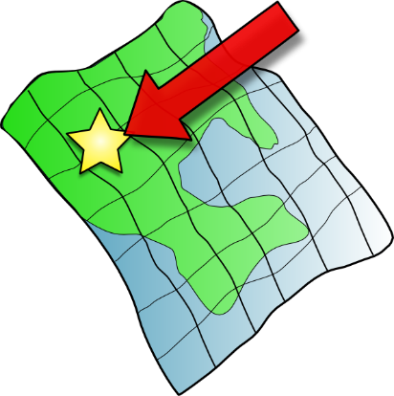
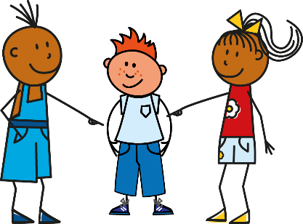
i
petit
lit
midi
ici
qui ?
il
?
Notes:
Timing: 1 minute
Aim: To consolidate SSC [i]
Procedure:
1. Introduce and elicit the pronunciation of the individual SSC [i] and then the source word again ‘midi’ (with gesture, if using). 2. Then present and elicit the pronunciation of the five cluster words.
The cluster words have been chosen for their high-frequency, from a range of word classes, with the SSC (where possible) positioned within a variety of syllables within the words (e.g. initial, 2nd, final etc.). Additionally, we have tried to use words that build cumulatively on previously taught SSCs (see the Phonics Teaching Sequence document) and do not include new SSCs. Where new SSCs are used, they are often consonants which have a similar symbol-sound correspondence in English.
Word frequency (1 is the most frequent word in French): midi [2483]; petit [138]; lit [1837] ici [167]; il[13]; qui [14]. Source: Londsale, D., & Le Bras, Y. (2009). A Frequency Dictionary of French: Core vocabulary for learners London: Routledge.

Slide 4
-ill-/-ille
fille
Notes:
Timing: 1 minute
Aim: To introduce SSC [-ill-/-ille]
Procedure: 1. Present the letter(s) and say the [-ill-/ille] sound first, on its own. Students repeat it with you. 2. Bring up the word ”fille” on its own, say it, students repeat it, so that they have the opportunity to focus all of their attention on the connection between the written word and its sound.
3. A possible gesture for this would be to gesture at some of the girls in the class. 4. Roll back the animations and work through 1-3 again, but this time, dropping your voice completely to listen carefully to the students saying the [-ill-/-ille] sound, pronouncing ”fille” and, if using, doing the gesture.
Word frequency (1 is the most frequent word in French):
fille [629]
Source: Londsale, D., & Le Bras, Y. (2009). A Frequency Dictionary of French: Core vocabulary for learners London: Routledge.

Slide 5
-ill-/-ille
fille
Notes:
With sound and no pictures to focus all attention on the sound-symbol correspondence.

Slide 6
-ill-/ille
fille
Notes:
Without sound to elicit pronunciation (without first hearing the teacher).
Teacher to elicit pronunciation by asking “Comment dit-on …”

Slide 7
-ill-/-ille
brillant
juillet
[shiny]
habiller
fille
pavillon
[to dress]
famille
[family]
Notes:
Timing: 2 minutes
Aim: To introduce SSC [-ill-/-ille]
Procedure:
Introduce and elicit the pronunciation of the individual SSC [-ill-/-ille] and then the source word again ‘fille’ (with gesture, if using). Then present and elicit the pronunciation of the five cluster words. The cluster words have been chosen for their high-frequency, from a range of word classes, with the SSC (where possible) positioned within a variety of syllables within the words (e.g. initial, 2nd, final etc.). Additionally, we have tried to use words that build cumulatively on previously taught SSCs (see the Phonics Teaching Sequence document) and do not include new SSCs. Where new SSCs are used, they are often consonants which have a similar symbol-sound correspondence in English.
Word frequency (1 is the most frequent word in French): brillant [2569]; juillet [1326]; habiller [3576]; famille [172]; pavillon [3412]. Source: Londsale, D., & Le Bras, Y. (2009). A Frequency Dictionary of French: Core vocabulary for learners London: Routledge.

Slide 8
-ill-/ille
brillant
juillet
habiller
fille
pavillon
famille
Notes:
With sound and no pictures to focus all attention on the sound-symbol correspondence.

Slide 9
-ill-/ille
brillant
juillet
habiller
fille
pavillon
famille
Notes:
Without sound to elicit pronunciation (without first hearing the teacher).
Teacher to elicit pronunciation by asking “Comment dit-on …”

Slide 10
Phonétique
écouter / écrire
Attention!
The last letter of gentil is an SFC, an exception to the CRFL rule.
Say these words:
 |  | SSC [-ill-/ille] | SSC [i]
 | gentil
 | briller
 | grille
 | fils
 | billet
 | fillette
fi !
[yuck]
fille
[girl]
1
[nice]
2
[to shine]
3
_
[railings]
4
[son]
Hint
SSC [-ill-/ille] sounds like SSC [i] followed by a ‘yih’ sound.
5
[ticket]
6
_
[little girl]
Notes:
Timing: 7 minutes (two slides)
Aim: aural recognition of SSCs [-ill-/ille] and [i]
Procedure:
1. Students try to say the words in the minimal pair, fi and fille. Click to hear the words said by a native speaker. Students repeat.
2. Click to bring up the hint.
3. Click the numbers to play the audio.
4. Students write 1- 6and choose [-ill-] or [i] for each.
5. Click to reveal the answers.
6. Click to highlight exceptions to the CRLF rule.
Transcript:
1. gentil
2. briller
3. grille
4. fils
5. billet
6. fillette
Word frequency (1 is the most frequent word in French): gentil [2832] fils [735] briller [2904], billard [>5000], fillette [4737] grille [3341]
Source: Londsale, D., & Le Bras, Y. (2009). A Frequency Dictionary of French: Core vocabulary for learners London: Routledge.

Slide 11
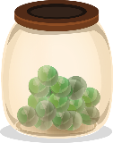
Phonétique
Quels mots sont différents ?
écouter / écrire
Il y a mille villes tranquilles comme Lille.
 |  | différent ?
 | famille [family]
 | ville [town]
 | mille [thousand]
 | billes [marbles]
 | tranquille [quiet]
 | Lille [a French city]
1
These four words are different – the letter ‘l’ in [ille] is pronounced as normal.
There are not many of these exceptions, but some are important, high-frequency words.
You just have to learn them by heart!
2
3
4
5
6
Notes:
Aim: To raise awareness of exceptions to the [-ill-/-ille] pronunciation rule
Procedure:
1. Explain to students that there are four important exceptions to the pronunciation rule they have practiced, and they are going to spot them in this exercise.
2. Click on the audio buttons to play the words.
3. Students tick in the column for the words in which they hear the difference.
4. Click to animate the answers (the words which are not exceptions disappear following the fifth click of the mouse).
5. Click once more to bring up the speech bubble explanation and the mnemonic. Students try to say the mnemonic. Teacher demonstrates, students repeat.
Transcript:
1. famille
2. ville
3. mille
4. bille
5. tranquille
6. Lille
Word frequency (1 is the most frequent word in French): famille [172], ville [260], mille [1008], bille [>5000], tranquille [2555], Lille [n/a]
Source: Londsale, D., & Le Bras, Y. (2009). A Frequency Dictionary of French: Core vocabulary for learners London: Routledge.

Slide 12
Vocabulaire
écouter
1
a lot
beaucoup
2
to win, to earn
gagner
3
money
l'argent (m)
4
luck
la chance
5
milk
le lait
6
coffee, café
le café
7
tea
le thé
8
meat
la viande
9
a little (bit)
un peu
10
glass
le verre
Notes:
Timing: 5 minutes
Aim: Aural recognition of new vocabulary.
Procedure:
1. Clicking the action buttons plays the audio for the vocabulary. Students write the English.
2. Clicking reveals the English word.
3. Optional extension for advanced levels: write the French word. Click to check.
[Note: the articles are missing from the nouns, but students can be encouraged to write them and teachers can elicit these from pupils)
Transcript:
beaucoup
gagner
l'argent
la chance
le lait
le café
le thé
la viande
un peu
le verre

Slide 13
boire
[to drink | drinking]
boit
[drinks | is drinking]
Notes:
Timing: 3 minutes for sequence of six verbs
Procedure
Bring up the word boire on its own, say it, students repeat it, and remind them of the phonics. Draw attention to SSC [oi].
Try to elicit the meaning from the students. Students have had explicit teaching that the present tense in French communicates two different present tense meanings in English. This reinforces that learning. Emphasise the two meanings for the short form, reminding students that French only has one form and does not have a direct equivalent of the grammar for ‘is + ing’, the continuous form (as covered in previous weeks).
Bring up the picture, and, if using gestures, a possible gesture would be to mime drinking tea.
Then bring up the English translations. Emphasise the two meanings for the infinitive.
Bring up the short form boit, say it, students repeat it. Draw attention to SSCs [oi] and SFC.
Try to elicit the meaning from the students. Emphasise the two meanings for the short form.

Slide 14
boire
[to drink | drinking]
boit
[drinks | is drinking]
Notes:
Cycle through the long and short form again.

Slide 15
boit
[drinks | is drinking]
Elle boit du thé.
[She drinks | is drinking tea.]
Notes:
Introduce the short form in a sentence.

Slide 16
boire
[to drink | drinking]
Elle aime boire du thé.
[She likes drinking tea.]
Notes:
Introduce the long form in a sentence.

Slide 17
boit
[drinks | is drinking]
Elle boit du thé.
[She drinks | is drinking tea.]
Notes:
Cycle through the short form in context again.

Slide 18
boire
[to drink | drinking]
Elle aime boire du thé.
[She likes drinking tea.]
Notes:
Cycle through the long form in context again.

Slide 19
Using the verb ‘boire’
You have seen this pattern of –s, -s, -t, -t endings before:
dire, sortir, partir, dormir and venir also follow this pattern.
grammaire
This is the pattern of endings for the first, second and third person singular forms of boire:
je bois
I drink / I am drinking
tu bois
you drink / you are drinking
These verb forms all sound the same!
The –s and the –t are silent final consonants (SFC).
il boit
he drinks / he is drinking
elle boit
she drinks / she is drinking
Notes:
Timing: 1 minute
The first three persons singular of the verb boire is now presented. Highlight that all forms sound the same due to the SFC.

Slide 20
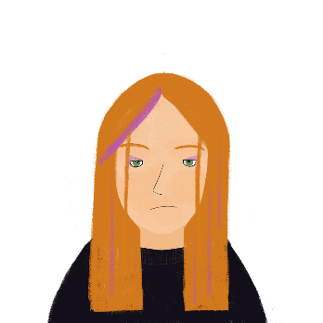
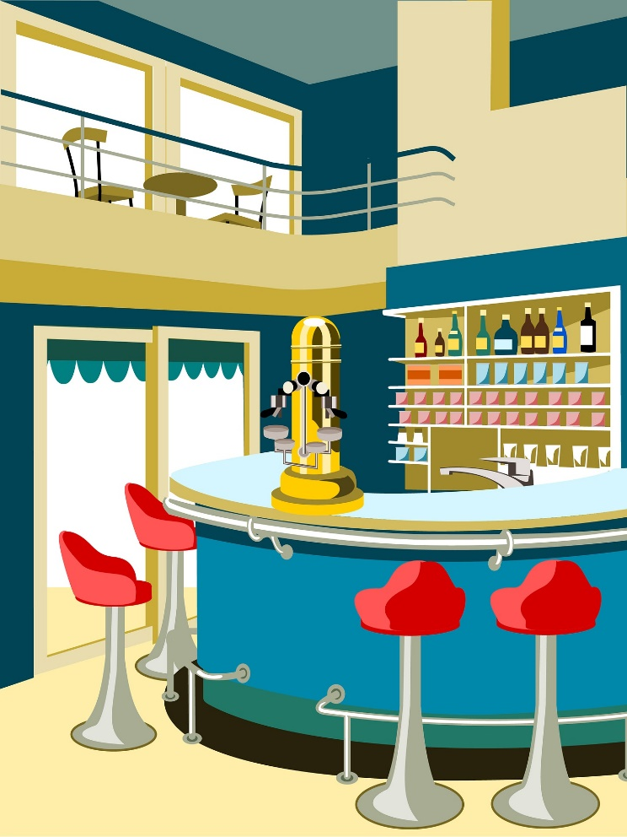
Qui boit quoi ?
* alors = right, so
* le vin = wine
lire
Élodie est serveuse dans un café. Elle trouve ça un peu difficile ! Elle prend la commande d’une femme. Qui boit quoi ?
1. Alors*… tu bois du thé et il boit du Coca-Cola.
[tu/il]
[tu/il]
2. Bah non, il boit du thé et je bois de l’eau.
[je/il]
[je/il]
3. D’accord, il boit du thé et tu bois du lait.
[tu/il]
[tu/il]
4. Je bois un verre de vin* et tu bois un grand café !
[je/il]
[tu/il]
Notes:
Timing: 5 minutes
Aim: Written recognition of forms of boire and connecting these with meaning.
Procedure:
1. Students write 1-4 and two pronouns for each, using their knowledge of forms of boire to make the choice.
2. Click to reveal answers.
3. Oral translation of the full text.
Word frequency of cognates used (1 is the most frequent word in French): commande [2123]
Source: Londsale, D., & Le Bras, Y. (2009). A Frequency Dictionary of French: Core vocabulary for learners London: Routledge.
Word frequency of unknown words used (1 is the most frequent word in French): alors [81], vin [2309]
Source: Londsale, D., & Le Bras, Y. (2009). A Frequency Dictionary of French: Core vocabulary for learners London: Routledge.

Slide 21
Uncountable nouns
grammaire
As you know, we use un/une (the indefinite article) to talk about ‘whole’ things, and du/de la/de l’ (the partitive article) to talk about ‘parts’ of things in French:
J’achète… un poisson du poisson
I’m buying… a fish some fish
These nouns are countable – you can put ‘a’ or a number in front of them (one fish, three ice creams, seven loaves of bread).
But what about nouns you can’t count? We can’t say ‘a flour’ or ‘two rice,’ we can only say ‘some’. These uncountable nouns take the partitive article only:
J’achète… du riz de la farine
I’m buying… some rice some flour
Notes:
Timing: 3 minutes
Aim: Introducing the concept of uncountable nouns, and the use of the partitive article with these.
Word frequency of unknown words used (1 is the most frequent word in French): riz [>5000], farine [>5000]
Source: Londsale, D., & Le Bras, Y. (2009). A Frequency Dictionary of French: Core vocabulary for learners London: Routledge.

Slide 22
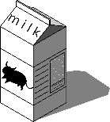
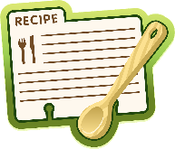
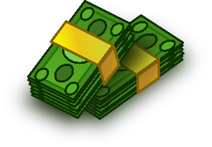
Amir a quoi ?
lire
Chance means ‘luck’ here, which is uncountable
(She has a lot of luck).
Chance can also mean ‘chance’, which is countable
(She has three chances).
Hint
To check whether a noun is countable or uncountable, try putting a number in front of the English word.
J’ai …
glace
du/de la (uncountable) | un/une (countable)
lait
chance
recette
langue
argent
viande
Notes:
Timing: 3 minutes
Aim: To connect article types (partitive and indefinite) with noun types (countable and uncountable)
Procedure:
1. Students sketch the table and assign the items to the appropriate columns, based on whether they think they are countable or uncountable nouns.
2. Click to see each noun move to the appropriate column.

Slide 23
Le week-end d’Élodie
* le prix = prize
* après tout = after all
* le riz = rice
* l’huile (f) = oil
lire
avoir de la chance
= to be lucky
Qu’est-ce qu’elle a fait ?
C’est samedi et Élodie a de la [1] surprise / chance. Elle a gagné un [2] prix* / argent au travail. C’est €50 ! Pour célébrer, elle décide de cuisiner un [3] bœuf / repas magnifique pour sa famille. Après tout*, elle a de l’ [4] argent / idée et elle a une [5] temps / recette aussi. Elle va au marché et elle achète un [6] poisson / riz*. Pour la sauce, elle prend de l’ [7] oignon / huile* d’olive. Elle revient chez elle pour préparer le dîner. Mais il y a un problème. Elle n’a pas acheté de boissons. On doit boire du [8] lait / verre d’eau. Quelle catastrophe !
Notes:
Timing: 7 minutes
Aim: Written recognition of indefinite and partitive articles and connecting these with countable and uncountable nouns.
Procedure:
Students write 1-8.
They read the text and use their knowledge of indefinite and partitive articles to decide which noun is needed.
Answers revealed on clicks.
On a final click, the info bubble explaining the avoir de la chance appears. Other adverbial expressions with avoir (faim/mal/peur) are taught in 8.1.2.2.
Oral translation of text, or short summary in English if time permits. Check students understand the meaning of boisson, which is not glossed as it is anticipated that students will infer the meaning using a combination of their knowledge of boire and the surrounding context.
Word frequency of (near) cognates used (1 is the most frequent word in French): week-end [2475], surprise [1815], bœuf [3914], magnifique [2136], sauce [>5000], oignon [>5000], olive [>5000], dîner [2365], catastrophe [1832]
Source: Londsale, D., & Le Bras, Y. (2009). A Frequency Dictionary of French: Core vocabulary for learners London: Routledge.
Word frequency of unknown words used (1 is the most frequent word in French): prix [310], decider [165], cuisiner [>5000], après [82], tout [24], riz [>5000], huile [2340], boisson [3614]
Source: Londsale, D., & Le Bras, Y. (2009). A Frequency Dictionary of French: Core vocabulary for learners London: Routledge.

Slide 24
Negating partitive articles
grammaire
Remember, un/une (the indefinite article) changes to de in negative sentences:
Il y a un café ici. Il n’y a pas de café ici.
There’s a café here. There isn’t a café here.
Du/de la/de l’ (the partitive article) also changes to de in negative sentences:
Il y a du lait dans le thé. Il n’y a pas de lait dans le thé.
There’s (some) milk in the tea. There isn’t any milk in the tea.
Il y a de la viande dans la recette. Il n’y a pas de viande dans la recette.
There’s (some) meat in the recipe. There isn’t any meat in the recipe.
Notes:
Timing: 2 minutes
Aim: Introducing negation with partitive articles

Slide 25
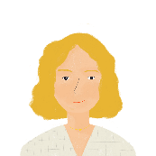
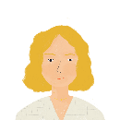
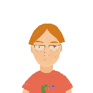
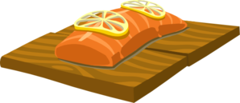
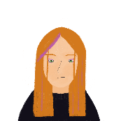
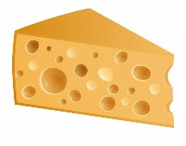
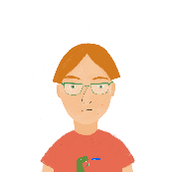
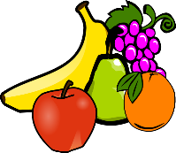
Qui aime quoi ?
écouter
La famille et les amis de Léa ont des goûts particuliers !
Écoute Léa. La personne mange / boit ça, ou pas ?
 |  |  | /
 |  |  | /
1
4
2
5
3
6
Notes:
Timing: 5 minutes for 2 slides
Aim: Practising aural recognition of negation of partitive articles with de.
Procedure:
1. Click the numbers to play the audio. The verb structures are obscured by beeps.
2. Students write 1-6 and a tick or cross for each item.
3. Move to the next slide to give answers. The full audio (without beeps) is provided on the next slide.
Transcript:
Mes parents […] de viande.
Mon père […] du poisson.
Ma mère […] du thé.
Nous […] du pain.
Élodie […] de fromage.
Antoine […] de fruit.
Word frequency of cognates used (1 is the most frequent word in French): particulier [381]
Source: Londsale, D., & Le Bras, Y. (2009). A Frequency Dictionary of French: Core vocabulary for learners London: Routledge.

Slide 26
Qui aime quoi ?
Réponses
écouter
 |  |  | /
 |  |  | /
1
4
2
5
3
6
Notes:
Procedure:
1. Click the numbers to play the full audio without beeps.
2. English translations can also be elicited.
Transcript:
Mes parents ne mangent pas de viande.
Mon père mange du poisson.
Ma mère boit du thé.
Nous mangeons du pain.
Élodie ne mange pas de fromage.
Antoine ne mange pas de fruit.

Slide 27
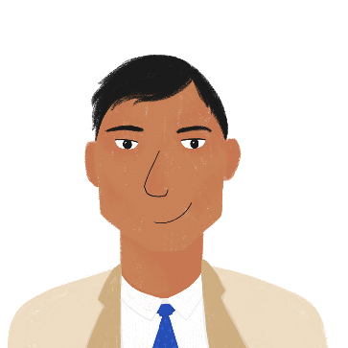
Un pique-nique
* pendant ce temps-là = in the meantime
lire
Bilal prépare un pique-nique. C’est un peu compliqué !
Qui fait/a fait quoi ? Qui ne fait pas / n’a pas fait quoi ?
 |  | oui | non
1. | Noura n’a pas préparé de sandwichs.
2. | Il n’y a pas de poisson.
3. | Il y a de la viande.
4. | Bilal cuisine un couscous.
5. | Amir fait du jus d'orange.
6. | Amandine n’a pas acheté de verres.
7. | Bilal va au magasin. Il ne trouve pas de choses.
8. | Pendant ce temps-là*, le chien a mangé du couscous.
9. | La famille prend une pizza à emporter.
Notes:
Timing: 8 minutes
Aim: Written recognition of use of de to negate both indefinite and partitive articles in present and perfect tense.
Procedure:
1. Students write 1-9, read the sentence and decide, based on the article, whether the action happened or not.
2. They indicate their answers by writing oui/non, and adding, where required, ‘ne’ and ‘pas’ in the correct places.
3. Click to reveal answers.
4. Elicit oral translations.
Word frequency of (near) cognates used (1 is the most frequent word in French): pique-nique [>5000], compliqué [3324], sandwich [>5000], couscous [>5000], jus [>5000], orange [3912], pizza [>5000]
Source: Londsale, D., & Le Bras, Y. (2009). A Frequency Dictionary of French: Core vocabulary for learners London: Routledge.

Slide 28
Tu fais quoi, normalement ?
You can choose what other vocabulary to use!
écrire
Write an answer to each question about what your every day activities.
 | Question | Réponse
1 | Qu’est-ce que tu manges au déjeuner au collège ?
2 | Tu apportes un sandwich ou tu achètes un repas à la cantine ?
3 | Tu aimes boire du thé?
4 | Que fais-tu normalement après* le déjeuner ?
*après - after
Notes:
Timing: 12 minutes
Aim: to practise written production of vocabulary and structures learnt in this and previous lessons.
Procedure:
Students write an answer to each question.
Students’ creativity can be encouraged here by advising them to review previously learnt vocabulary and to consult a dictionary to search for any new vocabulary items needed.
Frequency of unknown words and cognates: après [82] cantine [>5000 ] sandwich [>5000]
Source: Londsale, D., & Le Bras, Y. (2009). A Frequency Dictionary of French: Core vocabulary for learners London: Routledge.

Slide 29
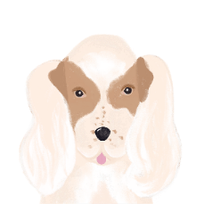
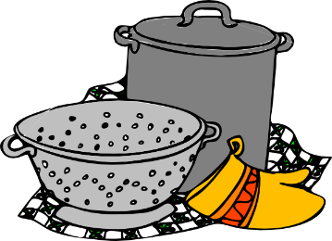
Everyday life Talking about eating and drinking
partitive articles
SSC [-ill-, -ille], [i] revisited
Y8 French
Term 2.1 - Week 1 - Lesson 30
Kirsten Somerville / Catherine Morris / Natalie Finlayson
Artwork by: Chloé Motard
Date updated: 01.02.24
Notes:
Note: all words (new and revisited) in this week of the SOW appear on all three GCSE wordlists, with these exceptions: i) AQA list does not have réveillon
ii) Edexcel list does not have célébrer, gérer, Noël, réveillon
iii) Eduqas list does not have réveillon
Artwork by Chloé Motard. All additional pictures selected are available under a Creative Commons license, no attribution required.
Learning outcomes (lesson 2):
Consolidation of SSC [-ill-, -ille], [i] revisited
Consolidation of partitive articles
Introduction of specified quantities with partitive articles
Introduction of unspecified quantities with partitive articles
Word frequency (1 is the most frequent word in French):
8.2.1.1 (introduce) boire [1879], bois [1879], boit [1879], gagner² [258], argent [472], chance [438], lait [2507], café² [1886], thé [3517], viande [2625], peu [91], verre [2174], beaucoup [150]
8.1.2.5 (revisit) gérer [1354], espace [870], goût [1829], langue², [712], plat [2167], recette [1709], repas [2948] d'abord [326], puis [230], par [21], puisque [528], Noël [>5000], réveillon [>5000]
8.1.1.4 (revisit) célébrer [2170], préférer [597], on¹ [29], date [660], juin [931], mars [868], mai [943], tradition [1371], avril [1022], événement [573], février [1136], janvier [939], premier [56], première [56], quatorze [1472], quinze [3359], seize [3285], trente [1646], treize [3245], vingt [1273]
construction rule for numbers 13-31
Source: Londsale, D., & Le Bras, Y. (2009). A Frequency Dictionary of French: Core vocabulary for learners London: Routledge.

Slide 30
Associations
lire
Write 1-4. Select the word (a-d) which best goes together with the word in bold.
1. le directeur | a) le goût
 | b) gérer
 | c) la recette
 | d) le repas
3. la tradition | a) d’abord
 | b) la première
 | c) l’espace
 | d) Noël
2. le premier | janvier
 | b) puis
 | c) préférer
 | d) l’événement
4. la recette | a) la langue
 | b) le plat
 | c) la date
 | d) célébrer
Notes:
Starter activity for students to do on arrival to the lesson Timing: 3 minutes
Aim: Written recognition of revisited vocabulary in an activity which strengthens semantic associations between words.
Procedure:
Students select the word they think best goes together with the word in bold and write 1b etc..
Answers revealed on clicks

Slide 31
LL
écouter / écrire
You have learned that ll is pronounced like the English ‘y’ when it follows the letter i (famille, juillet, travailler).
Remember the exceptions to this rule (ville, tranquille, mille, Lille). In these words, ll is pronounced like the English l.
After other vowels, ll is always pronounced like English L, (salle, belle, collège).
Challenge: on the next slide you will see a set of words in French containing ll.
Read them out to your partner before the timer runs out!
Notes:
Timing: 2 minutes
Aim: To introduce spelling rules governing the pronunciation of ‘ll’ and cross-linguistic comparison with English.

Slide 32
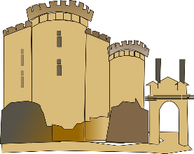
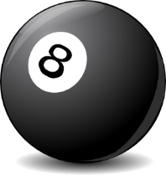
LL
parler
million
Lille
cédille
tellement
45
folle
[cedilla]
cheville
[so much]
[crazy]
vanille
collectif
actuellement
elle
[collective]
[at the moment]
[she]
secondes
syllabe
la Bastille
collègue
pull
[colleague]
[syllable]
installer
excellent
[to install]
dollar
vallée
0
salle
[valley]
DÉBUT
balle
Notes:
Timing: 5 minutes
Aim: Oral production (speaking) practice with the ‘ll’ sound after various vowels
Procedure:
1. Click to start the timer.
2. Students have 45 seconds to try to say all the words correctly to a partner.
3. If the LL sound is pronounced incorrectly, the listening students stops the speaker and has them pronounce the word correctly three times before moving on (any pronunciation errors noticed in other parts of the word should not be penalised, but noted by the listener and given as feedback once the timer stops.
4. The student who pronounces the most words correctly in 45 seconds is the winner.
5. After the timer runs down, re-set it to swap roles and repeat the task.
Word frequency (1 is the most frequent word in French): dollar [432], collègue [1099], collectif [1224], salle [812], installer [821], actuellement [728], vallée [2856], folle [fou 1357], syllabe [>5000], elle [38], cédille [>5000], tellement [869], excellent [1225], vanille [>5000], la Bastille [n/a], cheville [>5000], pull [>5000], balle [2311], Lille [n/a], million [307]
Source: Londsale, D., & Le Bras, Y. (2009). A Frequency Dictionary of French: Core vocabulary for learners London: Routledge.

Slide 33
Vocabulaire
parler 1/8
parler 1/2
4.5
[to earn, to win]
l’argent
gagner
le verre
Secondes
[a little (bit)]
le thé
un peu
0
DÉBUT
Notes:
Timing: 2 minutes for two slides Aim: Oral recall of three words within a given time. This is slide 1/2.
Procedure:
1. Say all three words before three seconds elapse.
2. Click to reveal answers.
3. Repeat if additional practice needed.

Slide 34
Vocabulaire
parler 1/8
parler 2/2
5
[a lot]
[to drink]
beaucoup
boire
Secondes
le lait
[luck]
la viande
la chance
le café
0
DÉBUT
Notes:
This is slide 2/2.

Slide 35
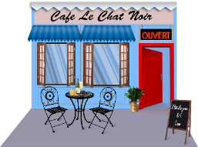
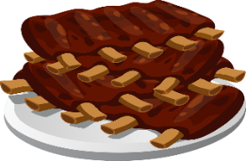
Vocabulaire
lire / écrire
Amir va au café. C’est quel mot?
Je vais au café. Je veux manger de la viande.
Je veux boire du thé ou du café, mais c’est un peu cher. Je n’ai pas beaucoup d’argent. Je dois travailler et gagner. Mais j’ai de la chance !
Le serveur est sympa. Je bois un verre de lait.
.
[a little bit]
[a lot]
[to earn]
.
Notes:
Timing: 5 minutes
Aim: Written recall of this week’s new vocabulary.
Procedure:
Students fill the gaps using the images or words provided. NB due to the use of partitives in the surrounding text, students are not asked to provide the noun articles here (they are, however, asked to recall these in the speaking exercise on the previous slide).
Answers revealed on clicks.

Slide 36
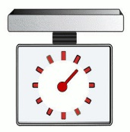
Specified quantities
grammaire
Uncountable nouns cannot be counted, but they can be measured.
We can do this using expressions of quantity, eg.:
beaucoup a lot un kilo a kilo un litre a litre
un peu a little un gramme a gram un verre a glass
The partitive article changes to de after an expression of quantity:
un peu de lait un kilo de viande un verre d’eau
a little milk a kilo of meat a glass of water
De → d’ before a vowel / h.
Notes:
Timing: 2 minutes
Aim: Introducing expressions of quantity with uncountable nouns

Slide 37
Que dit Amir ?
écouter
Amir dit des choses que sa famille mange et boit.
La phrase est complète, ou il y a une expression de quantité ? Écris a ou b.
 |  | a | b
 |  | [ - ] | un litre
 |  | [ - ] | un verre
 |  | [ - ] | un peu
 |  | a | b
 |  | [ - ] | beaucoup
 |  | [ - ] | un peu
 |  | [ - ] | des kilos
1
4
2
5
3
6
Notes:
Timing: 5 minutes for 2 slides
Aim: Practising aural recognition of expressions of quantity with de
Procedure:
1. Click the numbers to play the audio. There is a beep after each verb.
2. Students write 1-6 and choose ‘a’ if the sentence is already complete, or ‘b’ if the beep hides an expression of quantity.
3. Click to reveal the answers.
4. The full audio (without beeps) is provided on the next slide.
Transcript:
Chaque jour, mes parents partagent […] de café.
Noura préfère […] de lait.
Parfois, ma mère prépare […] du thé.
À Nice, on mange […] de poisson.
Ma famille achète […] de viande aussi.
En été, nous emportons […] de la glace à la plage.
Word frequency of cognates used (1 is the most frequent word in French): complet [965], expression [952], quantité [1680], litre [3972], gramme [>5000], kilo [3894]
Source: Londsale, D., & Le Bras, Y. (2009). A Frequency Dictionary of French: Core vocabulary for learners London: Routledge.

Slide 38
Que dit Amir ?
Réponses
écouter
 |  | a | b
 |  | [ - ] | un litre
 |  | [ - ] | un verre
 |  | [ - ] | un peu
 |  | a | b
 |  | [ - ] | beaucoup
 |  | [ - ] | un peu
 |  | [ - ] | des kilos
1
4
2
5
3
6
Notes:
Procedure:
1. Click the numbers to play the full audio without beeps.
2. English translations can also be elicited.
Transcript:
Chaque jour, mes parents partagent un litre de café.
Noura préfère un verre de lait.
Parfois, ma mère prépare du thé.
À Nice, on mange beaucoup de poisson.
Ma famille achète un peu de viande aussi.
En été, nous emportons de la glace à la plage.

Slide 39
Unspecified quantities
In French, we use the definite article to make general statements and give our opinions about things.
grammaire
To talk about things in general, we use the definite article.
Le/la/l’ is necessary in French, but, we don’t always say ‘the’ in English:
Tu aimes le fromage ? Do you like the cheese? (a specific cheese)
OR Do you like cheese? (cheese in general)
Similarly, du/de la/de l’ (the partitive article) is not always translated as ‘some’:
Tu as acheté du fromage ? Did you buy some cheese?
OR Did you buy cheese?
It is not possible to drop the article in French. The type of article tells us whether we are talking about something in general (le/la/l’), or referring to an unspecified amount of it.
Notes:
Timing: 2 minutes
Aim: introducing differences in article use between English and French

Slide 40
Unspecified quantities
Try the word ‘some’ in front of ketchup / mayonnaise to see if it implies an ‘amount’ .
lire
 |  | making a general statement | talking about an amount
1. | My favourite sauce is ketchup.
2. | I eat ketchup with every meal.
3. | You like mayonnaise.
4. | You often buy mayonnaise.
In English, we use context to work this out:
 |  | making a general statement | talking about an amount
1. | Tu aimes la mayonnaise.
2. | Ma sauce préférée est le ketchup.
3. | Tu achètes souvent de la mayonnaise.
4. | Je mange du ketchup à chaque repas.
In French, the article tells us this information:
Notes:
Timing: 5 minutes
Aim: Raising awareness of differences in article use and meaning between English and French
Procedure:
1. Students write 1-4 and choose if each sentence is talking about the noun in bold in general, or about an unspecified amount of it
2. Click to reveal the answers.
3. Repeat steps 1-2 for the French sentences. Emphasise that the article is essential in French, even if it isn’t used in English.
Word frequency of cognates used (1 is the most frequent word in French): sauce [>5000], ketchup [>5000], mayonnaise [>5000]
Source: Londsale, D., & Le Bras, Y. (2009). A Frequency Dictionary of French: Core vocabulary for learners London: Routledge.

Slide 41
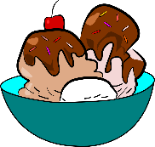
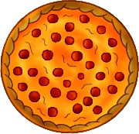
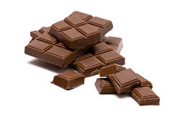
Le repas idéal
écouter
Amir veut préparer un repas pour Océane.
Il demande si elle aime ça, ou si elle mange ça ?
 |  | Tu aimes…? | Tu manges…?
 |  | Tu aimes… ? | Tu manges… ?
1
4
2
5
3
6
Notes:
Timing: 5 minutes for 2 slides
Aim: Practising aural recognition of the partitive article to indicate an unspecified amount
Procedure:
1. Click the numbers to play the audio. The verbs are obscured by beeps.
2. Students write 1-8 and choose ‘aimer’ (indicating something in general) or ‘manger’ (indicating an amount of something) for each.
3. Click to reveal the answers.
4. The full audio (without beeps) is provided on the next slide.
Transcript:
Tu […] du pain ?
Tu […] de la pizza ?
Tu […] le fromage ?
Tu […] la glace ?
Tu […] du gâteau ?
Tu […] le chocolat ?
Word frequency of cognates used (1 is the most frequent word in French): pizza [>5000], gâteau [4845], chocolat [4556]
Source: Londsale, D., & Le Bras, Y. (2009). A Frequency Dictionary of French: Core vocabulary for learners London: Routledge.

Slide 42
Le repas idéal
Réponses
écouter
 |  | Tu aimes…? | Tu manges…?
 |  | Tu aimes… ? | Tu manges… ?
1
4
2
5
3
6
Notes:
Procedure:
1. Click the numbers to play the full audio without beeps.
2. English translations can also be elicited.
Transcript:
Tu manges du pain ?
Tu manges de la pizza ?
Tu aimes le fromage ?
Tu aimes la glace ?
Tu manges du gâteau ?
Tu aimes le chocolat ?
Word frequency of cognates used (1 is the most frequent word in French): pizza [>5000], gâteau [4845], chocolat [4556]
Source: Londsale, D., & Le Bras, Y. (2009). A Frequency Dictionary of French: Core vocabulary for learners London: Routledge.

Slide 43
Noura et Apollon
* le chat
= cat
* maman
= mum
lire / écrire
Fill in the gaps. Do you need a definite article, an indefinite article or a partitive article?
A. Noura at Apollon font de l’exercice au parc. Apollon a de la chance. Il est heureux parce qu’il a trouvé un peu de viande dans la rue !
B. Noura trouve ça drôle. Normalement elle ne mange pas de viande. Elle préfère le poisson. Elle va au marché et elle achète un poisson entier.
C. Noura veut partager son déjeuner. Elle donne du poisson à Apollon. Mais Apollon est un chien. Les chiens préfèrent la viande.
D. Noura boit un verre de lait. Elle demande à Apollon s’il veut boire du lait aussi. Mais les chiens n’aiment pas le lait. Apollon boit seulement de l’eau.
E. Noura téléphone à sa mère qui fait du sport. Elle dit “Maman! Je veux un chat* !”
[1]
[2]
[3]
[4]
[5]
[6]
[7]
[8]
[9]
[10]
[11]
[12]
[13]
[14]
[15]
[16]
[17]
Notes:
This is the more challenging version of the activity. A less challenging version is on the next slide.
Timing: 10 minutes
Aim: Written production of articles, consolidating the various uses of definite, indefinite and partitive articles encountered so far.
Procedure:
NB: As the task is quite complex, it is broken down into sections A-E. We recommend working through these a section at a time, correcting and discussing each before moving onto another.
Begin by recapping the uses of definite, indefinite and partitive articles encountered so far.
Students write the numbers and decide, based on article knowledge and gender, which article is needed.
Answers revealed on clicks. For each answer revealed, give a detailed explanation for the use of the article.
As such a range of article uses are exemplified here, it is strongly recommended that students translate the story if time permits, thinking carefully about English translations of the various articles. A suggested translation is provided on the following slide.
Word frequency of cognates used (1 is the most frequent word in French): entier [455], téléphoner [2448]
Source: Londsale, D., & Le Bras, Y. (2009). A Frequency Dictionary of French: Core vocabulary for learners London: Routledge.
Word frequency of unknown words used (1 is the most frequent word in French): chat [3138], maman [2168]
Source: Londsale, D., & Le Bras, Y. (2009). A Frequency Dictionary of French: Core vocabulary for learners London: Routledge.

Slide 44
Noura et Apollon
* le chat
= cat
* maman
= mum
lire
Translate the text into English. Think carefully about the articles (in bold). They may not need translating.
A. Noura at Apollon font de l’exercice au parc. Apollon a de la chance. Il est heureux parce qu’il a trouvé un peu de viande dans la rue !
B. Noura trouve ça drôle. Normalement elle ne mange pas de viande. Elle préfère le poisson. Elle va au marché et elle achète un poisson entier.
C. Noura veut partager son déjeuner. Elle donne du poisson à Apollon. Mais Apollon est un chien. Les chiens préfèrent la viande.
D. Noura boit un verre de lait. Elle demande à Apollon s’il veut boire du lait aussi. Mais les chiens n’aiment pas le lait. Apollon boit seulement de l’eau.
E. Noura téléphone à sa mère qui fait du sport. Elle dit “Maman! Je veux un chat* !”
Notes:
This is the less challenging version of the activity. A more challenging version is on the previous slide. Timing: 10 minutes
Aim: To translate the text into English, consolidating understanding of the various uses of definite, indefinite and partitive articles encountered so far.
Procedure:
Begin by recapping the uses of definite, indefinite and partitive articles encountered so far. Remind students that sometimes we drop the article in English but we can’t do that in French.
Students translate the text into English (they could do this orally or in writing), paying attention to the articles in bold, which they may/may not need words for in English.
Word frequency of unknown words and cognates (1 is the most frequent word in French): chat [3138], entier [455], maman [2168], téléphoner [2448]
Source: Londsale, D., & Le Bras, Y. (2009). A Frequency Dictionary of French: Core vocabulary for learners London: Routledge.

Slide 45
Noura et Apollon
Look how often the article can be dropped in English! This cannot happen in French.
* le chat
= cat
* maman
= mum
écrire
Fill in the gaps. Do you need a definite article, an indefinite article or a partitive article?
A. Noura and Apollon are taking (some) exercise at the park. Apollon is lucky! He is happy because he has found a bit of meat on the street.
B. Noura finds this funny. She doesn’t normally eat (any) meat. She prefers fish. She goes to the market and (she) buys a whole fish.
C. Noura wants to share her lunch. She gives some fish to Apollon. But Apollon is a dog. Dogs prefer meat.
D. Noura is drinking a glass of milk. She asks Apollon if he wants to drink (some) milk as well. But dogs don’t like milk. Apollon only drinks water.
E. Noura calls her mother who is doing (some/a bit of) sport. She says: ‘Mum! I want a cat!”
Notes:
Suggested translation for the exercise.
The noun phrases in orange highlight the wide range of cross-linguistic differences in article usage. Note especially how often the article can be dropped in English, whereas it cannot in French.

Slide 46
Les nombres de 1 à 31
parler
Numbers 1 - 31
1
2
3
4
5
6
7
8
9
10
11
12
13
14
15
16
17
18
19
20
21
22
23
24
25
26
27
28
29
30
31
Say up to three consecutive numbers
One number -> next person
Two numbers -> change direction
Three numbers -> skip the next person
Notes:
Optional extra
Timing: 5 minutes
Aim: to revise numbers 1-31 (groups of three or four works best for this activity)
Procedure:
1. Like the number game 21 – but 31!
2. One by one students start counting out loud. They can say up to three consecutive numbers each.
3. If the student says one number, continue to the next student. If the student says two numbers, the game changes directions and goes back to the previous student. If the student says three numbers, the next student is skipped.
4. The goal is not to be the person who has to say 31

Slide 47
Devoirs
Vocabulary Learning Homework (Y8, Term 2.1, Week 2)
Revisit vocabulary: Y7 Mashup 3
Notes:
The link to this vocabulary set on Quizlet is here: https://quizlet.com/gb/517896602/year-8-french-term-12-week-6-revision-set-3-flash-cards/?new
Notes:
i) Teachers may want to recommend use of a particular online app for the revisiing of vocabulary.
ii) Quizlet now requires parental involvement / registration / permissions for users below the age of 13, so it is perhaps most suitable for Y9 – 11 students. iii) Language Nut hosts LDP vocabulary lists and these are free for schools to use, though there is a registration process. One benefit is that all of the student tracking data that Language Nut offers are also available to schools that use the LDP lists for practice. Perhaps this makes it a good option for Y7/8.
iv) There are other free apps, and new ones are always appearing. Teachers have told us that they are currently using: Flippity, Wordwall (where using previously-created activities is free).
v) Gaming Grammar has been acquired by Language Nut. Its original content should still be available to teachers and much of it is appropriate for Y8 learners.
Verbs (present): 1st person singular/plural (Verb agreement (present))
Verbs (present): 2nd person singular/plural (Verb agreement (present))
Verbs (present): 3rd person singular/plural (Verb agreement (present))

