Slide 1
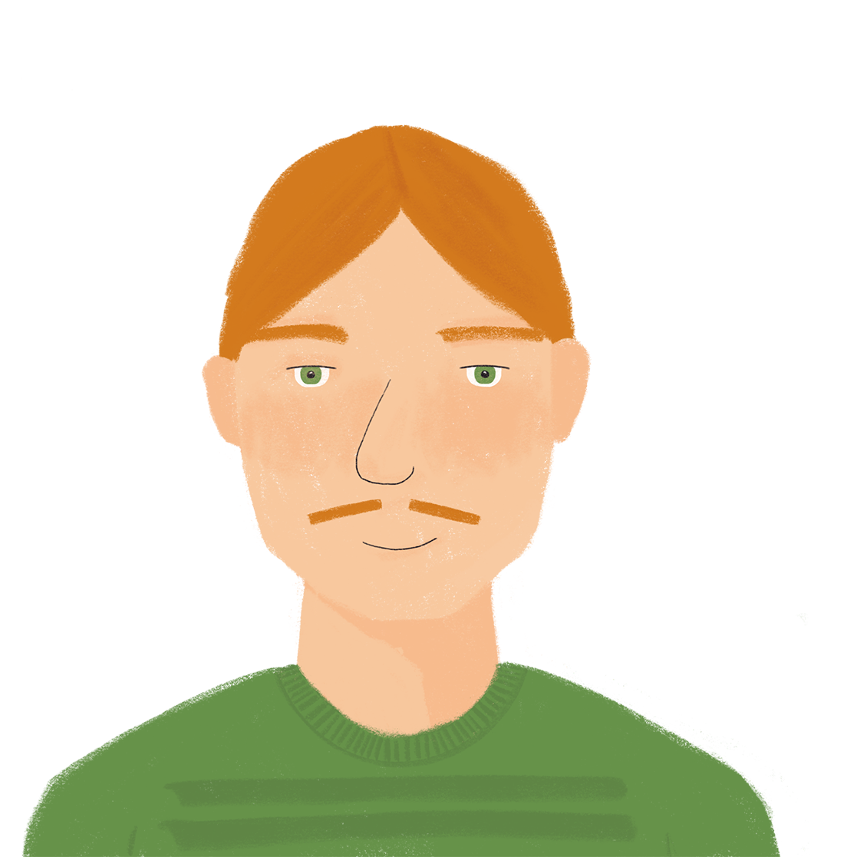
Free time activities Talking about shopping for food and other activities
partitive article (du, de la, de l’)
SSC [th]
J’ai visité Bruxelles!
J’ai visité la Suisse!
Y8 French
Term 1.2 - Week 7 - Lesson 27
Kirsten Somerville / Catherine Morris / Natalie Finlayson
Artwork by: Chloé Motard
Date updated: 31.01.24
Notes:
Note: all words (new and revisited) in this week of the SOW appear on all three GCSE wordlists, with these exceptions: i) AQA list does not have ambitieux, Genève, prudent
ii) Edexcel list does not have ambitieux, avocat, facteur, Genève, peser, secretaire, Suisse, suisse iii) Eduqas list does not have ambitieux, natation
Artwork by Chloé Motard. All additional pictures selected are available under a Creative Commons license, no attribution required.
Learning outcomes (lesson 1):
Introduction of SSC [th]
Introduction of partitive articles (du, de la, de l’)
Word frequency (1 is the most frequent word in French):
8.1.2.7 (introduce) acheter [636], coûter [984], peser [1584], eau [475], euro [1753], exercice² [1290], fromage [4475], glace [580], natation [>5000], pain [2802], poisson [1616], sport [2011], travail [153]
8.1.2.3 (revisit) emporter [1128], proposer [338], traverser [1040], voyager [2194], frontière [1182], forêt [1724], montagne [1732], vue [191], suisse [2241], Suisse [n/a], Genève [n/a], il y avait [13/36/8]
8.1.1.2 (revisit) avocat [1188], bureau² [273], directeur [640], emploi [517], facteur [1264], secrétaire [920], ambitieux [2905], prudent [1529], travailleur¹ [1341], travailleuse¹ [1341], assez [321]
Source: Londsale, D., & Le Bras, Y. (2009). A Frequency Dictionary of French: Core vocabulary for learners London: Routledge.

Slide 2
Une conversation
parler
S_ _ _ _!
 | S_ _ _ _!
Où h _ _ _ _ _ _-_ _ ?
 | J’ h_ _ _ _ _ à ………………..
C’_ _ _ p_ _ _ d_ college ?
 | Oui, ………… / Non, …………..
E_ _-_ _ q_ _ t_ j_ _ _ _ d’_ _ i_ _ _ _ _ _ _ _ _ ?
 | Oui, ………… / Non, …………..
A_ r_ _ _ _ _ !
 | A_ r_ _ _ _ _ !
Notes:
Timing: 5 minutes
Aim: to recap last week’s language in a short, structured dialogue (with room for some variation – names and nouns).
Procedure: Students work in pairs to carry out this short dialogue.
They should be encouraged to repeat it several times, varying the names and nouns each times, and swapping roles A & B.
Note: if additional support is needed, teachers may want to put in a few interim steps, using additional slides. For example: model an example first, taking the role of A and engaging either one student or the whole class to respond as B.
Keep both these activities to time so as not to leave insufficient time for the new learning.

Slide 3
th
thé
Notes:
Timing: 1 minute
Aim: To introduce SSC [th]
Procedure: 1. Present the letter(s) and say the [th] sound first, on its own. Students repeat it with you. 2. Bring up the word ”thé” on its own, say it, students repeat it, so that they have the opportunity to focus all of their attention on the connection between the written word and its sound.
3. A possible gesture for this would be to mime drinking tea. 4. Roll back the animations and work through 1-3 again, but this time, dropping your voice completely to listen carefully to the students saying the [th] sound, pronouncing ”thé” and, if using, doing the gesture.
Word frequency (1 is the most frequent word in French):
thé [3517]
Source: Londsale, D., & Le Bras, Y. (2009). A Frequency Dictionary of French: Core vocabulary for learners London: Routledge.

Slide 4
th
thé
Notes:
With sound and no pictures to focus all attention on the sound-symbol correspondence.

Slide 5
th
thé
Notes:
Without sound to elicit pronunciation (without first hearing the teacher).
Teacher to elicit pronunciation by asking “Comment dit-on …”

Slide 6
th
théâtre
bibliothèque
sympathique
thé
maths
[nice]
méthode
[method]
Notes:
Timing: 2 minutes
Aim: To introduce SSC [th]
Procedure:
Introduce and elicit the pronunciation of the individual SSC [th] and then the source word again ‘thé’ (with gesture, if using). Then present and elicit the pronunciation of the five cluster words. The cluster words have been chosen for their high-frequency, from a range of word classes, with the SSC (where possible) positioned within a variety of syllables within the words (e.g. initial, 2nd, final etc.). Additionally, we have tried to use words that build cumulatively on previously taught SSCs (see the Phonics Teaching Sequence document) and do not include new SSCs. Where new SSCs are used, they are often consonants which have a similar symbol-sound correspondence in English.
Word frequency (1 is the most frequent word in French): thé [3517]; méthode [1149]; théâtre [1701]; bibliothèque [2511]; maths [3438]; sympathique [4164]. Source: Londsale, D., & Le Bras, Y. (2009). A Frequency Dictionary of French: Core vocabulary for learners London: Routledge.

Slide 7
th
théâtre
bibliothèque
sympathique
thé
maths
méthode
Notes:
With sound and no pictures to focus all attention on the sound-symbol correspondence.

Slide 8
th
théâtre
bibliothèque
sympathique
thé
maths
méthode
Notes:
Without sound to elicit pronunciation (without first hearing the teacher).
Teacher to elicit pronunciation by asking “Comment dit-on …”

Slide 9
Comment dit-on… ?
parler
[th] is not a typical French SSC. All French words containing [th] come from other languages.
You will recognise a lot of the words from English. Be careful to pronounce them correctly!
45
 | athlète
 | mammouth
 | éthique [ethic]
 | menthe
 | thon
 | marathon [marathon]
 | authentique [authentic]
 | théorie
 | télépathie [telepathy]
 | catholique
 | enthousiaste [enthusiastic]
 | Mathieu
secondes
0
Début
Notes:
Timing: 3 minutes
Aim: oral production of unknown cognate words containing SSC [th]
Procedure:
1. Click début to start the timer
2. Student A reads the list of words out loud to student B. Student B listens carefully to their partner’s pronunciation and stops Student A if the [th] sound is pronounced the English way. They only stop their partner if the [th] is pronounced incorrectly. If an incorrect stress of other mispronunciation is noticed, the listening student should note this and correct it at the end of the round.
3. Students count how many words Student A managed to say correctly.
4. Students swap roles. The student with the most points at the end is the winner.
5. After two rounds, the teacher plays the correct pronunciation by clicking on the audio. Students repeat.
6. Optional extension: Teacher reminds students about stress patterns in French. Even though the words look like English, the stresses are in different places. Students repeat the exercise, being careful to stress all parts of the words equally (with a slight emphasis on the final syllable).
Word frequency (1 is the most frequent word in French): athlète [4722], mammouth [>5000], éthique [2747], menthe [>5000], thon [>5000], marathon [>5000], télépathie [>5000], authentique [3961], théorie [1773], mythe [2910], catholique [1578], enthousiaste [4287], Mathieu [n/a], rythme [1662]
Source: Londsale, D., & Le Bras, Y. (2009). A Frequency Dictionary of French: Core vocabulary for learners London: Routledge.

Slide 10
Vocabulaire
lire
l’exercice (m)
le poisson
exercise
acheter
fish
le travail
to buy, buying
work
l’euro (m)
la glace
euro
ice cream
peser
le fromage
to weigh, weighing
cheese
coûter
l’eau (f)
cost
le sport
le pain
water
la natation
sport
bread
swimming
Notes:
Timing: 3 minutes
Aim: written recognition of this week’s new vocabulary (pre-learned on Quizlet) in isolation.
Procedure:
Click to ‘zoom’ to a word in French.
Teacher pronounces the word. Students repeat.
Students say the English.
Repeat steps 1-3 until all words have English translations.

Slide 11
Vocabulaire
écouter
 | I’m buying cheese, water and fish | I’m buying ice cream, bread and fish | I’m buying buy cheese, bread and fish
 | My favourite sport is football | My favourite sport is swimming | My favourite sport is tennis
 | The cheese costs 4€ | The fish costs 4€ | The cheese weighs 4 pounds
 | I work at the weekend | I travel at the weekend | I do exercise at the weekend
 | He’s buying the fish | He’s weighing the fish | He’s weighing the bread
1
2
3
4
5
Notes:
Timing: 8 minutes (including three minutes additional preparation time, if required) Aim: aural recognition of this week’s vocabulary items in context. Procedure: 1. Think about the French for the key words on the slide. 2. Listen to the audio 1-5. For each, choose the correct answer A, B or C. 3. Click to see the answers. 4. Think what would have been heard for either of the other two possible answers.
Transcript:
J'achète du fromage, du pain et du poisson
Mon sport préféré est la natation.
Le fromage coûte 4€.
Je fais du travail le week-end
Il pèse le poisson.

Slide 12
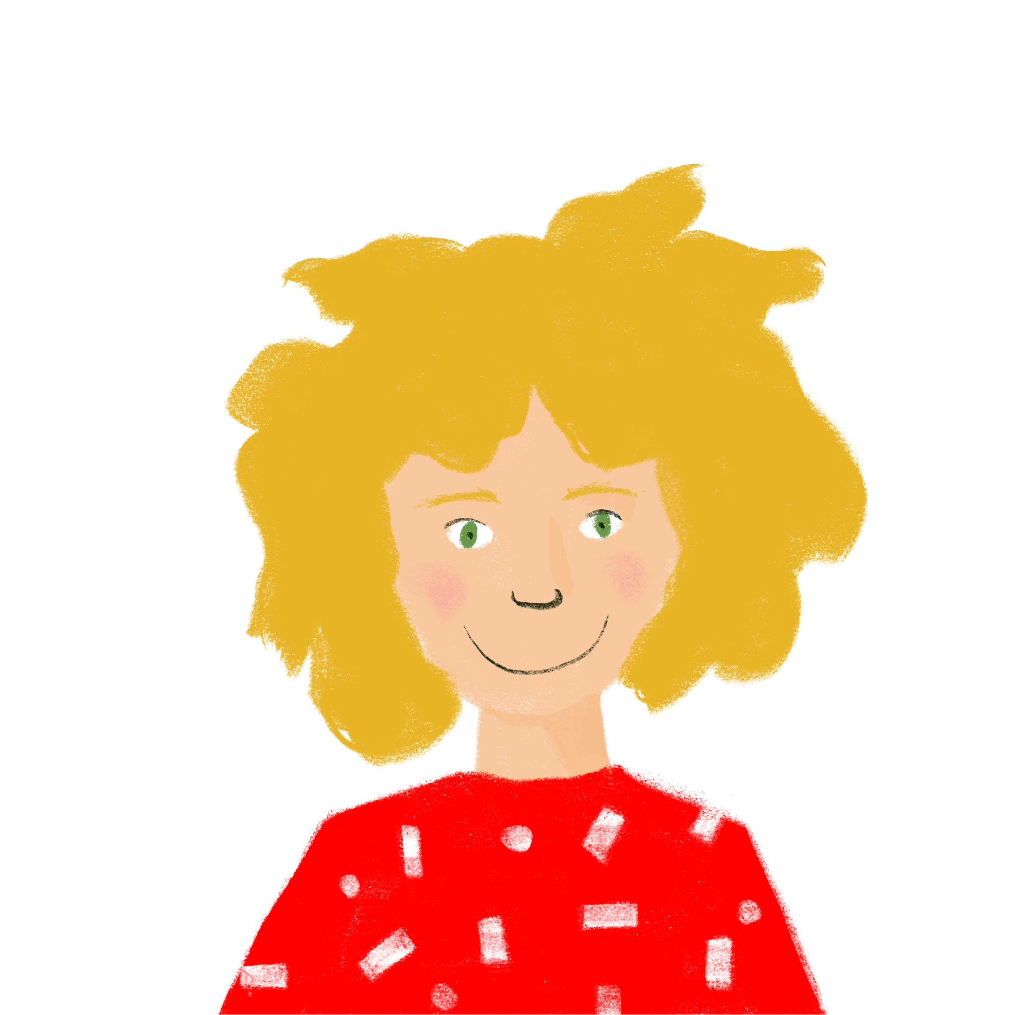
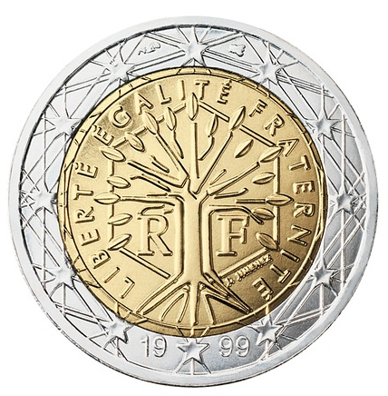
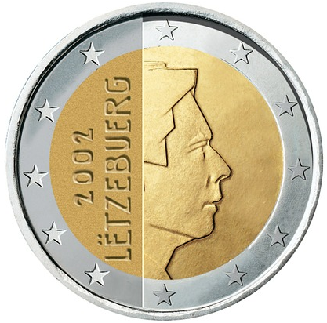
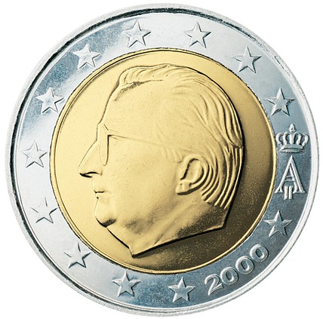
L’euro
*la pièce = coin
lire
L'euro est la monnaie officielle de 19 pays de l'Union européenne, par exemple la France, la Belgique et le Luxembourg.
Le symbole de l'euro est €. Il y a 100 centimes dans un euro.
Les différentes pièces* euro sont illustrées par un motif qui est un symbole de l'identité nationale du pays.
la France (€2)
le Luxembourg (€2)
la Belgique (€2)
Notes:
Timing: 2 minutes
Aim: Cultural information about the use of euros in French-speaking countries.
Teachers should take the opportunity to practice the pronunciation difference in the eu sound between the two languages.
Word frequency of cognates used (1 is the most frequent word in French): monnaie [1932], official [996], union [729], européen [445], Luxembourg [n/a], symbole [1427], illustrer [1939], motif [1369], identité [1437], national [227]
Source: Londsale, D., & Le Bras, Y. (2009). A Frequency Dictionary of French: Core vocabulary for learners London: Routledge.
Word frequency of unknown words used (1 is the most frequent word in French): centime [>5000], pièce [813]
Source: Londsale, D., & Le Bras, Y. (2009). A Frequency Dictionary of French: Core vocabulary for learners London: Routledge.

Slide 13
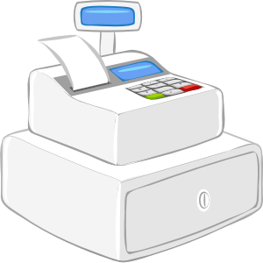
acheter
[to buy | buying]
The e in the stem changes to è in all forms except nous and vous.
achète
[buys | is buying]
achetons
[buy | are buying]
Notes:
Timing: 4 minutes for sequence of eight slides
Aim: to introduce the verb peser more explicitly. Both long form (infinitive) and short form (3rd person singular) are introduced in order to familiarise students with various forms of the same verb.
Procedure
Bring up the word peser on its own, say it, students repeat it, and remind them of the phonics.
Try to elicit the meaning from the students. Students have had explicit teaching that the present tense in French communicates two different present tense meanings in English. This reinforces that learning. Emphasise the two meanings for the short form, reminding students that French only has one form and does not have a direct equivalent of the grammar for ‘is + ing’, the continuous form (as covered in previous weeks).
Bring up the picture, and, if using gestures, a possible gesture would be to turn palms face up, and move alternate hands up and down as if weighing up options.
Then bring up the English translations. Emphasise the two meanings for the infinitive.
Bring up the first short form pèse, say it, students repeat it. Draw attention to different pronunciation of [è] vs [e].
Bring up the second short form pesons, say it, students repeat it. Draw attention to different pronunciation of [è] vs [e].
Try to elicit the meaning from the students. Emphasise the two meanings for the short forms.
Bring up the info bubble to introduce the stem-change. NB: This is not a grammar point that students are expected to produce at this stage and will not feature in any NCELP tests. It is showcased here for awareness and passive understanding only.

Slide 14
acheter
[to buy | buying]
achète
[buys | is buying]
achetons
[buy | are buying]
Notes:
Cycle through the long and short forms again.

Slide 15
achète
[buys | is buying]
Elle achète du fromage.
[She buys | is buying some cheese.]
Notes:
Introduce the first short form in a sentence.

Slide 16
achetons
[buy | are buying]
Nous achetons du fromage.
[We buy | are buying some cheese.]
Notes:
Introduce the second short form in a sentence.

Slide 17
acheter
[to buy | buying]
Elle veut acheter du fromage.
[She wants to buy some cheese.]
Notes:
Introduce the long form in a sentence.

Slide 18
achète
[buys | is buying]
achète
Elle du fromage.
[She buys | is buying some cheese.]
Notes:
Cycle through the first short form in context again.

Slide 19
achetons
[buy | are buying]
achetons
Nous du fromage.
[We buy | are buying some cheese.]
Notes:
Cycle through the second short form in context again.

Slide 20
acheter
[to buy | buying]
acheter
Elle veut du fromage.
[She wants to buy some cheese.]
Notes:
Cycle through the long form in context again.

Slide 21
The partitive article
grammaire
We already know the words for ‘the’ and ‘a’ in French. These are called articles:
(m) noun (f) noun (m/f) before a vowel/h
definite article: le poisson la glace l’eau
the fish the ice cream the water
indefinite article: un poisson une glace (-)
a fish an ice cream
To say ‘some’ (an unspecified amount or ‘part’), we use the partitive article:
partitive article: du poisson de la glace de l’eau
some fish some ice cream some water
The forms are the same as de + definite article, but the meaning is different!
This type of article doesn’t exist in English!
Notes:
Timing: 3 minutes
Aim: introducing the partitive article

Slide 22
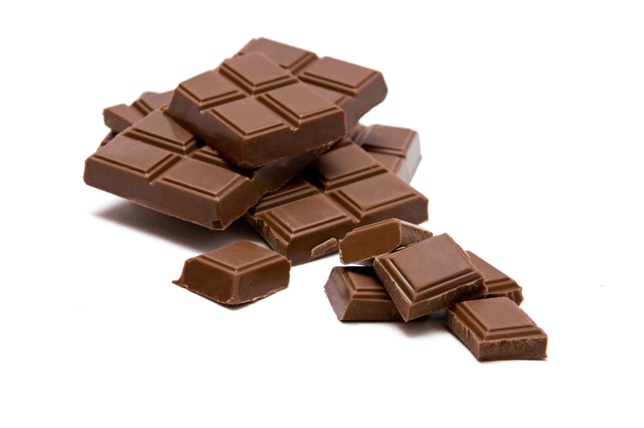
Il achète combien ?
* le produit entier
= whole product
écouter
Romain fait les courses dans des magasins spécialistes.
Il achète des produits entiers*, ou des portions ?
Écris a ou b.
 | a | b
 | a | b
1
5
2
6
3
7
4
8
Notes:
Timing: 5 minutes
Aim: practising aural recognition of the partitive article to indicate a ‘part’ or portion
Procedure:
1. Click the numbers to play the audio.
2. Students write 1-8 and use the presence or absence of the indefinite article to choose a or b.
3. Click to reveal the answers.
4. English translations can also be elicited. Attention can be drawn to the suffix –erie to indicate a store selling a particular item.
Transcript:
À la fromagerie, il achète du fromage.
À la poissonnerie, il achète du poisson.
À la boulangerie, il achète un pain.
À la pizzeria, il achète une pizza.
Au marché, il achète un fruit.
Au café-glacier, il achète de la glace.
À la pâtisserie, il achète un gâteau.
À la chocolaterie, il achète du chocolat.
Word frequency of cognates used (1 is the most frequent word in French): spécialiste [1588], produit [373], entier [455], portion [3806], fromagerie [>5000], poissonnerie [>5000], boulangerie [>5000], pizzeria [>5000], pizza [>5000], café-glacier [>5000], pâtisserie [>5000], gâteau [4845], chocolaterie [>5000], chocolat [4556]
Source: Londsale, D., & Le Bras, Y. (2009). A Frequency Dictionary of French: Core vocabulary for learners London: Routledge.

Slide 23
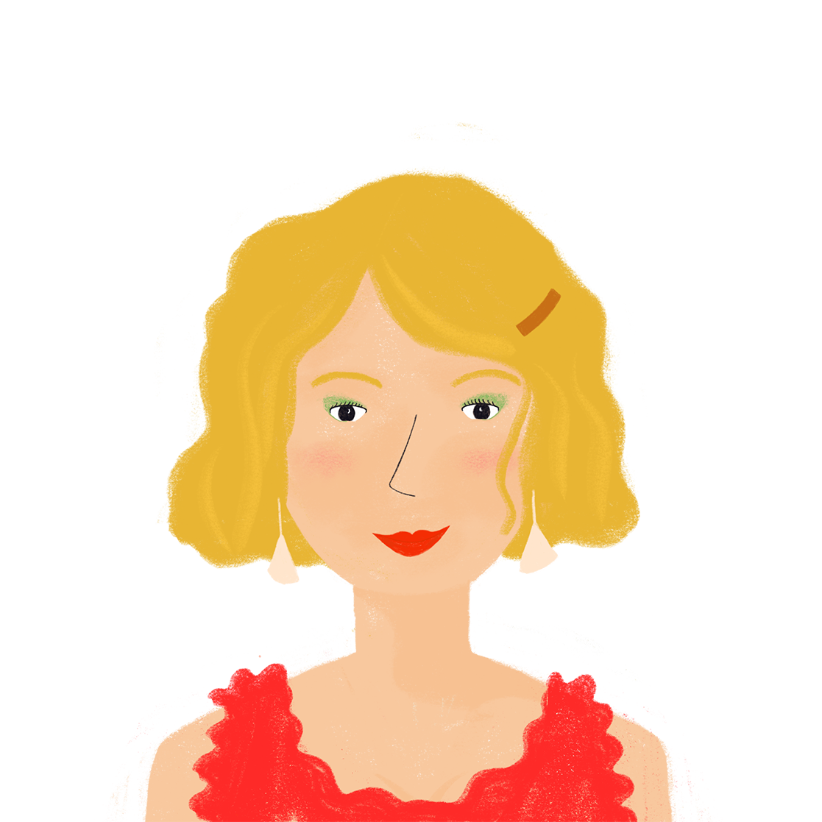
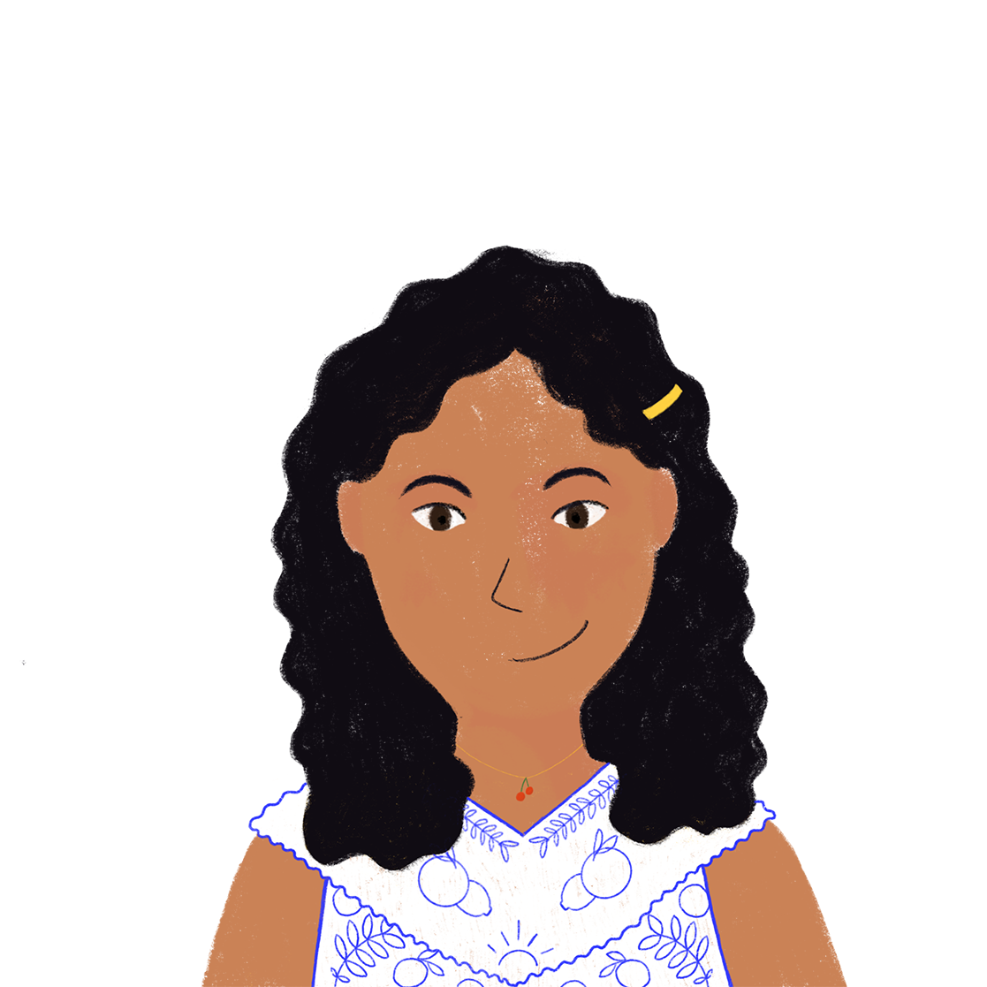
Qui a mangé quoi ?
lire
Hier, la famille d’Amir a bien mangé. Qui a mangé quoi ? Complète les phrases.
Noura a cherché du [1] gâteau (m) / glace au marché.
Elle a trouvé du [2] emmental / fromage suisse. Elle a emporté du [3] pain / Orangina (f) au parc pour faire un pique-nique. Elle a acheté de l’ [4] poisson / eau aussi. Au dîner, Amandine a mangé du [5] poisson / aubergine dans un restaurant. Pour le dessert, elle a partagé de la [6] fruit / glace avec Bilal. À la maison, Amir a préparé un plat avec de l’ [7] aubergine (f) / fromage. Il a utilisé de l’ [8] pain / emmental (m) dans la recette.
Notes:
Timing: 5 minutes
Aim: practising written recognition of agreement with the partitive article
Procedure:
1. Students write 1-8 and use their knowledge of noun genders and partitive article forms to choose a noun to complete each sentence.
2. Click to reveal the answers.
3. English translations can also be elicited.
Word frequency of cognates used (1 is the most frequent word in French): compléter [2034], emmental [>5000], Orangina [N/A], pique-nique [>5000], dîner [2365], aubergine [>5000], dessert [>5000]
Source: Londsale, D., & Le Bras, Y. (2009). A Frequency Dictionary of French: Core vocabulary for learners London: Routledge.

Slide 24
Qui fait quoi ?
Travaille avec ton/ta partenaire.
lire / parler
Écris 5 phrases en anglais.
Parle en français.
Est-ce que/qu’ | je/j’ tu il elle | achète achètes fais fait mange manges pèse pèses veux veut | un une du de la de l’ des | poisson café pain glace tomate(s) eau gâteau(x) sandwich(s)
I buy/am buying some bread.
Notes:
Timing: 8 minutes (two slides)
Aim: to practise comprehension and read aloud of new and revisited language and grammar from this and previous weeks.
Procedure:
Model the activity with this slide. Student A has written a sentence in English.
Student B says it in French.
Move to the next slide to give the full task instructions.

Slide 25
Qui fait quoi ?
Travaille avec ton/ta partenaire.
lire / parler
Écris 5 phrases en anglais.
Parle en français.
Est-ce que/qu’ | je/j’ tu il elle | achète achètes fais fait mange manges pèse pèses veux veut | un une du de la de l’ des | poisson café pain glace tomate(s) eau gâteau(x) sandwich(s)
Notes:
Procedure:
Both pupils write 5 sentences or questions (in English) made up of words from the table.
They swap sentences.
Partner A tries to say all B’s sentences in French as quickly as possible.
Then Partner B tries to say all A’s sentences in French.
Note:
i) Students can be challenged to say the sentences from memory by turning away from the board.
ii) tomate, gâteau and sandwich are included as cognates in this activity.
Frequency of unknown words and cognates:
gâteau [4845] tomate [>5000] sandwich [>5000]

Slide 26
Free time activities Talking about shopping for food and other activities
partitive article (du, de la, de l’)
SSC [th]
J’ai visité la Suisse!
Quels sports fais-tu ?
Y8 French
Term 1.2 - Week 7 - Lesson 28
Kirsten Somerville / Catherine Morris / Natalie Finlayson
Artwork by: Chloé Motard
Date updated: 31.01.24
Notes:
Note: all words (new and revisited) in this week of the SOW appear on all three GCSE wordlists, with these exceptions: i) AQA list does not have ambitieux, Genève, prudent
ii) Edexcel list does not have ambitieux, avocat, facteur, Genève, peser, secretaire, Suisse, suisse iii) Eduqas list does not have ambitieux, natation
Artwork by Chloé Motard. All additional pictures selected are available under a Creative Commons license, no attribution required.
Learning outcomes (lesson 2):
Consolidation of SSC [th]
Consolidation of partitive articles (du, de la, de l’)
Introduction of question words quels and quelles
Word frequency (1 is the most frequent word in French):
8.1.2.7 (introduce) acheter [636], coûter [984], peser [1584], eau [475], euro [1753], exercice² [1290], fromage [4475], glace [580], natation [>5000], pain [2802], poisson [1616], sport [2011], travail [153]
8.1.2.3 (revisit) emporter [1128], proposer [338], traverser [1040], voyager [2194], frontière [1182], forêt [1724], montagne [1732], vue [191], suisse [2241], Suisse [n/a], Genève [n/a], il y avait [13/36/8]
8.1.1.2 (revisit) avocat [1188], bureau² [273], directeur [640], emploi [517], facteur [1264], secrétaire [920], ambitieux [2905], prudent [1529], travailleur¹ [1341], travailleuse¹ [1341], assez [321]
Source: Londsale, D., & Le Bras, Y. (2009). A Frequency Dictionary of French: Core vocabulary for learners London: Routledge.

Slide 27
Ils demandent quoi ?
écrire
Léa aide des touristes anglais qui font les courses. Écris les phrases en français.
We’re looking for some cheese. How much does a (whole) cheese weigh?
Nous cherchons du fromage. Combien pèse un fromage ?
[1] _______.
[2] _______ ?
I want some ice cream. How much does an ice cream cost?
Je veux de la glace. Combien coûte une glace ?
[3] _______.
[4] _______ ?
She wants to buy some bread. Is a loaf of bread expensive?
Elle veut acheter du pain.
Un pain coûte cher ?
[5] _______.
[6] _______
His mother is asking for some fish. Can he take a fish on the plane?
Sa mère demande du poisson. Il peut emporter un poisson dans l’avion ?
[7] _______.
[8] _______
Notes:
Timing: 5 minutes
Aim: written recall of 4 items of this week’s new vocabulary, practising written production of agreement with the partitive article
Procedure:
1. Students write 1-8 and translate the words in bold to complete the sentences.
2. Click to reveal the answers.
Word frequency of cognates used (1 is the most frequent word in French): touriste [2653]
Source: Londsale, D., & Le Bras, Y. (2009). A Frequency Dictionary of French: Core vocabulary for learners London: Routledge.

Slide 28
Vocabulaire (1/2)
parler 1/8
parler 1/2
10
[physical exercise]
[to buy, buying]
Secondes
l’eau
la natation
l’exercice
acheter
[to cost]
0
coûter
le fromage
la glace
DÉBUT
Notes:
Timing: 1 minute for 2 slides Aim: productive (oral) recall of this weeks’ new vocabulary words within a given time.
Procedure:
1. Say all words before the time elapses.
2. Click to reveal answers.
3. Repeat if additional practice needed.

Slide 29
Vocabulaire (2)
parler 1/8
parler 2/2
10
le poisson
le pain
peser
Secondes
[work]
l’euro (m)
le sport
le travail
0
DÉBUT
Notes:
This is slide 2/2.

Slide 30
peser
[to weigh | weighing]
The e in the stem changes to è in all forms except nous and vous.
pèse
[weighs | is weighing]
pesons
[weigh | are weighing]
Notes:
Timing: 4 minutes for sequence of eight slides
Aim: to introduce the verb peser more explicitly. Both long form (infinitive) and short form (3rd person singular) are introduced in order to familiarise students with various forms of the same verb.
Procedure
Bring up the word peser on its own, say it, students repeat it, and remind them of the phonics.
Try to elicit the meaning from the students. Students have had explicit teaching that the present tense in French communicates two different present tense meanings in English. This reinforces that learning. Emphasise the two meanings for the short form, reminding students that French only has one form and does not have a direct equivalent of the grammar for ‘is + ing’, the continuous form (as covered in previous weeks).
Bring up the picture, and, if using gestures, a possible gesture would be to turn palms face up, and move alternate hands up and down as if weighing up options.
Then bring up the English translations. Emphasise the two meanings for the infinitive.
Bring up the first short form pèse, say it, students repeat it. Draw attention to different pronunciation of [è] vs [e].
Bring up the second short form pesons, say it, students repeat it. Draw attention to different pronunciation of [è] vs [e].
Try to elicit the meaning from the students. Emphasise the two meanings for the short forms.
Bring up the info bubble to introduce the stem-change. NB: This is not a grammar point that students are expected to produce at this stage and will not feature in any NCELP tests. It is showcased here for awareness and passive understanding only.

Slide 31
peser
[to weigh | weighing]
pèse
[weighs | is weighing]
pesons
[weigh | are weighing]
Notes:
Cycle through the long and short forms again.

Slide 32
pèse
[weighs | is weighing]
Il pèse des fruits.
[He weighs | is weighing fruit.]
Notes:
Introduce the first short form in a sentence.

Slide 33
pesons
[weigh | are weighing]
Nous pesons des fruits.
[We weigh | are weighing fruit.]
Notes:
Introduce the second short form in a sentence.

Slide 34
peser
[to weigh | weighing]
Il doit peser des fruits.
[He has to weigh fruit.]
Notes:
Introduce the long form in a sentence.

Slide 35
pèse
[weighs | is weighing]
pèse
Il des fruits.
[He weighs | is weighing fruit.]
Notes:
Cycle through the first short form in context again.

Slide 36
pesons
[weigh | are weighing]
pesons
Nous des fruits.
[We weigh | are weighing fruit.]
Notes:
Cycle through the second short form in context again.

Slide 37
peser
[to weigh | weighing]
peser
Il doit des fruits.
[He has to weigh fruit.]
Notes:
Cycle through the long form in context again.

Slide 38
The partitive article
grammaire
We often use the partitive article to talk about food and drink:
(m) noun (f) noun (m/f) before a vowel/h
J’achète… du poisson de la glace de l’eau
I buy… (some) fish (some) ice cream (some) water
We can also use it with faire to talk about doing different activities:
Je fais… du sport de la natation de l’exercice
I… do (some) sport do (some) swimming do (some) exercise
go swimming
Notes:
Timing: 2 minutes
Aim: recapping the partitive article with concrete nouns, introducing the use of partitive article with abstract nouns

Slide 39
Que fait Abdel ?
lire
Abdel a une vie active.
Que fait-il ?
Écris a ou b.
 |  | a | b
1. | Abdel aime faire de l’… | exercice. | activité.
2. | Chaque jour, il fait du… | sport. | lit.
3. | Souvent, il fait de la… | liste. | natation.
4. | Rarement, il fait du… | vélo. | voyage.
5. | Parfois, il fait la… | natation. | cuisine.
6. | À l’université, il fait… | attention. | sport.
7. | Chez un ami, il fait du… | modèle. | travail.
8. | À la maison, il fait un… | yoga. | exercice.
9. | Dehors, il fait une… | promenade. | natation.
10. | Aujourd’hui, il fait… | travail. | beau.
Notes:
Timing: 8 minutes NB: Students need not complete all questions. Stick to 6 minutes to do the items and 2 minutes to correct.
Aim: practising written recognition of activities with faire + partitive article
Procedure:
1. Students write 1-8 and choose ‘a’ or ‘b’ to complete the sentence.
2. Click to reveal the answers.
3. English translations can also be elicited.
4. Note that exercice (qs 1 and 8) can be used with the partitive and the indefinite article, with different meanings. The impersonal il (q 10) can also be highlighted.
Word frequency of cognates used (1 is the most frequent word in French): actif [1219], yoga [>5000]
Source: Londsale, D., & Le Bras, Y. (2009). A Frequency Dictionary of French: Core vocabulary for learners London: Routledge.

Slide 40
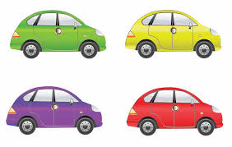
Saying ‘which’ in French
grammaire
As you know, the word for ‘which’ in French changes depending on the gender of the noun:
(m) noun: (f) noun:
Quel livre aimes-tu ? Quelle voiture aimes-tu ?
Which book do you like? Which car do you like?
The word for ‘which’ also changes depending on the number of the noun:
(m pl) noun: (f pl) noun:
Quels livres aimes-tu ? Quelles voitures aimes-tu ?
Which books do you like? Which cars do you like?
Quels is also used if the noun refers to a mixed group of males and females.
Notes:
Timing: 2 minutes
Aim: recapping quel / quelle, introducing quels / quelles

Slide 41
C’est quoi la question ?
lire / écrire
Quel mot complète la question ? Écris a ou b.
Écris des réponses personelles à chaque question.
Quels sports / activités fais-tu ?
Quelles fruits / glaces aimes-tu ?
Quels sandwich / plats manges-tu au déjeuner ?
Quelles recettes / repas sais-tu préparer ?
Quelle pays / ville veux-tu visiter ?
Quel emploi / voiture vas-tu avoir à l’avenir ?
Quel chanteur / albums écoutes-tu en ce moment ?
Quelle numéro / couleur préfères-tu ?
Exemples (Question 1):
Amir : Je joue au foot.
Léa : Je fais du vélo.
Pay attention to the articles!
You can use a dictionary.
Notes:
Timing: 15 minutes
Aim: practising written recognition of agreement with quel / quelle / quels / quelles, applying article knowledge to answer questions about yourself
Procedure:
1. First, students write 1-10 and choose a noun to complete each question.
2. Click to reveal the answers.
3. Elicit English translations to check understanding of the questions.
4. Then, students write personal responses to each question, using a dictionary to look up any unknown vocabulary.
Word frequency of cognates used (1 is the most frequent word in French): compléter [2034], personnel [398], sandwich [>5000], album [2874]
Source: Londsale, D., & Le Bras, Y. (2009). A Frequency Dictionary of French: Core vocabulary for learners London: Routledge.

Slide 42
La catégorisation
écouter
Which French word is a good example of…?
 | A | B | C | D
a country |  |  |  |  | la Suisse
a job title |  |  |  |  | l’avocate
something you do on a bridge |  |  |  |  | traverser
a word describing a house |  |  |  |  | cher
a place |  |  |  |  | la montagne
a nationality |  |  |  |  | suisse
an amount |  |  |  |  | assez
something on a map |  |  |  |  | la serveuse
1
2
3
4
5
6
7
8
Notes:
Timing: 5 minutes
Aim: aural recognition and semantic categorisation of revisited vocabulary
Procedure:
1. Click numbers to hear lists of four words.
2. Students tick which word they think matches the category.
3. Answers revealed on clicks.
Transcript:
a) la Suisse, b) Bruxelles, c) anglais, d) le français
a) le bureau, b) l’emploi, c) la forêt, d) l’avocate
a) traverser, b) proposer, c) dormir, d) travailler
a) travailleur, b) ambitieux, c) cher, d) prudent
a) la montagne, b) la vue, c) la directrice, d) la porte
a) l’anglais, b) la France, c) Genève, d) suisse
a) ambitieuse, b) assez, c) il y avait, d) prudente
a) la frontière, b) la pétanque, c) la serveuse, d) le marché

Slide 43
Vocabulaire
lire
Choose the word (a,b,c,d) which best goes together with the word in bold.
1. le secrétaire | a) la vue
 | b) prudent
 | c) l’emploi
 | d) traverser
3. traverser | a) la factrice
 | b) le directeur
 | c) emporter
 | d) la frontière
2. ambitieux | a) assez
 | b) travailleur
 | c) suisse
 | d) le montagne
4. l’avocate | a) le forêt
 | b) le bureau
 | c) la Suisse
 | d) il y avait
Notes:
Timing: 2 minutes
Aim: written recognition of revisited vocabulary
Procedure:
Students tick the word they think best goes together with the word in bold.
Answers revealed on clicks.

Slide 44
Vocabulaire
écrire / lire
Complete the French sentences. Then translate to English.
Les papiers sont dans le bureau. (the office)
The papers are in the office.
Traverser la frontière est difficile. (crossing the border)
Crossing the border is difficult
Le facteur est ambitieux et travailleur. (ambitious and hard working)
The waiter is ambitious and hard working.
Il y avait une belle vue dans le passé. (there was)
There was a beautiful view in the past.
Je vais proposer une idée. (to suggest something)
I will / I am going to suggest an idea.
___ ________
___________ ___ __________
___________ ___ __________
___ __ _________
__________
Notes:
Timing: 5 minutes
Aim: written production of this week’s revisited vocabulary.
Procedure:
1. Students first use the words in brackets to help them complete the French sentences.
2. Students then translate the whole sentences into English.
3. Answers revealed on clicks.

Slide 45
Devoirs
Vocabulary Learning Homework (Y8, Term 2.1, Week 1)
Audio file
Student worksheet
In addition, revisit: Y8 Term 1.2 Week 3 | Y8 Term 1.1 Week 2
Notes:
The answer sheet for the Y8, Term 2.1, Week 1 vocabulary learning HW is here: https://rachelhawkes.com/LDPresources/Yr8French/French_Y8_Term2i_Wk1_audio_HW_sheet_answers.docx Don’t share this link with students ☺
Notes:
i) Teachers may, in addition, want to recommend use of a particular online app for the pre-learning of each week’s words. ii) Quizlet now requires parental involvement / registration / permissions for users below the age of 13, so it is perhaps most suitable for Y9 – 11 students. iii) Language Nut hosts LDP vocabulary lists and these are free for schools to use, though there is a registration process. One benefit is that all of the student tracking data that Language Nut offers are also available to schools that use the LDP lists for practice. Perhaps this makes it a good option for Y7/8.
iv) There are other free apps, and new ones are always appearing. Teachers have told us that they are currently using: Flippity, Wordwall (where using previously-created activities is free).
v) Gaming Grammar has been acquired by Language Nut. Its original content should still be available to teachers and much of it is appropriate for Y8 learners.
Questions: Subject-verb inversion (Question formation)

