Slide 1
Au réveillon de Noël sur l’ISS, la gastronomie française au menu
Extended reading
SSC open [o]
J’ai visité Bruxelles!
J’ai visité la Suisse!
Y8 French
Term 1.2 - Week 5 - Lesson 23
Kirsten Somerville / Catherine Morris / Natalie Finlayson
Artwork by: Chloé Motard
Date updated: 01.02.24
Notes:
Note: all words (new and revisited) in this week of the SOW appear on all three GCSE wordlists, with these exceptions: i) AQA list does not have réveillon
ii) Edexcel list does not have gérer, Noël, réveillon iii) Eduqas list does not have réveillon
Artwork by Chloé Motard. All additional pictures selected are available under a Creative Commons license, no attribution required.
Learning outcomes (lesson 1):
Introduction of SSC open [o]
Identifying the type of text
Understanding the key ideas of the text
Word frequency (1 is the most frequent word in French):
8.1.2.5 (introduce) gérer [1354], espace [870], goût [1829], langue², [712], plat [2167], recette [1709], repas [2948] d'abord [326], puis [230], par [21], puisque [528], Noël [>5000], réveillon [>5000]
8.1.2.1 (revisit) apporter [339], dit [dire 37], fait [faire 25], envoyer [526], utiliser [345], maintenant [192], hier [872], appartement [2323], banque [774], marché [280], passé [501]
7.3.2.6 (revisit) aider [413], chercher [336], partager [527], peut [20], peux [20], pouvoir [20], sais [67], sait [67], savoir1 [67], projet [228], désolé [désoler - 2081], peut-être [190]
Source: Londsale, D., & Le Bras, Y. (2009). A Frequency Dictionary of French: Core vocabulary for learners London: Routledge.

Slide 2
open o
porte
Notes:
Timing: 1 minute
Aim: To introduce SSC open [o]
Procedure: 1. Present the letter(s) and say the open [o] sound first, on its own. Students repeat it with you. 2. Bring up the word ”porte” on its own, say it, students repeat it, so that they have the opportunity to focus all of their attention on the connection between the written word and its sound.
3. A possible gesture for this would be to mime opening and closing a door. 4. Roll back the animations and work through 1-3 again, but this time, dropping your voice completely to listen carefully to the students saying the [o] sound, pronouncing ”porte” and, if using, doing the gesture.
Word frequency (1 is the most frequent word in French):
porte [696]. Source: Londsale, D., & Le Bras, Y. (2009). A Frequency Dictionary of French: Core vocabulary for learners London: Routledge.

Slide 3
open o
porte
Notes:
With sound and no pictures to focus all attention on the sound-symbol correspondence.

Slide 4
open o
porte
Notes:
Without sound to elicit pronunciation (without first hearing the teacher).
Teacher to elicit pronunciation by asking “Comment dit-on …"

Slide 5
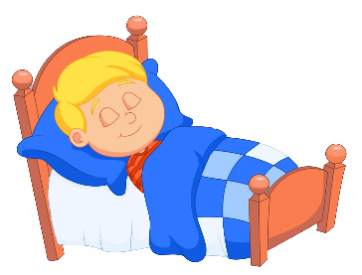
open o
école
poste
porte
d’accord
dormir
[okay]
personne
[person]
Notes:
Timing: 2 minutes
Aim: To introduce SSC open [o]
Procedure:
1. Introduce and elicit the pronunciation of the individual SSC open [o] and then the source word again ‘porte’ (with gesture, if using). 2. Then present and elicit the pronunciation of the five cluster words.
The cluster words have been chosen for their high-frequency, from a range of word classes, with the SSC (where possible) positioned within a variety of syllables within the words (e.g. initial, 2nd, final etc.). Additionally, we have tried to use words that build cumulatively on previously taught SSCs (see the Phonics Teaching Sequence document) and do not include new SSCs. Where new SSCs are used, they are often consonants which have a similar symbol-sound correspondence in English.
Word frequency (1 is the most frequent word in French): porte [696]; d’accord [736]; personne [84]; dormir [39]; école [477]; poste [489]. Source: Londsale, D., & Le Bras, Y. (2009). A Frequency Dictionary of French: Core vocabulary for learners London: Routledge.

Slide 6
open o
école
poste
porte
d’accord
dormir
personne
Notes:
With sound and no pictures to focus all attention on the sound-symbol correspondence.

Slide 7
open o
école
poste
porte
d’accord
dormir
personne
Notes:
Without sound to elicit pronunciation (without first hearing the teacher).
Teacher to elicit pronunciation by asking “Comment dit-on …"

Slide 8
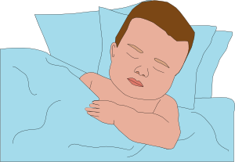
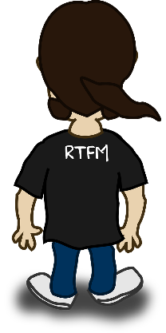
Closed and open [o]
écouter
What do you notice about these words?
Even though the vowel in these words appears the same, they sound different!
SSC closed [o] (as in dos) is different from SSC open [o] (as in dors).
[back]
[(I/you)sleep]
dos
dors
Notes:
Timing: 1 minute
Aim: Raising awareness of the difference in sound between closed and open [o]

Slide 9
Closed or open [o]?
The ‘hat’ on the letter ô is called a circumflex. You have seen it before with ê.
écouter
 |  | open (porte) | closed (photo)
 | corps [body]
 | repos [rest]
 | pôle
 | soldat
 | chose
 | atmosphère
1
2
What do you notice about the spelling of the words containing open [o] compared to those containing closed [o]?
3
4
5
6
If the [o] is the final sound, or followed by a ‘z’ sound, or has a circumflex [ô], it is closed.
Notes:
Timing: 5 minutes
Aim: Aural recognition of open and closed [o]. Awareness of spelling rules governing the pronunciation of these SSCs.
NB: The difference between these two sounds is subtle! Students might say that the only ones that really sound different to them are open [o] followed by ‘r’, and that the [o] in some other words (soldat, atmosphère) sounds like closed [o]. If students are unsure, try getting them to repeat the words and focus on the position of the mouth and tongue when they do. For open [o], the tongue is far from the roof of the mouth. For closed [o], the tongue touches the roof of the mouth. They will notice the difference in shape if they alternate saying ‘chose’ and ‘atmosphère’.
Procedure:
1. Click on numbers to hear words. Student decide if [o] is open or closed.
2. Click to reveal answers.
3. Click again to reveal the question about spelling. Students consider in pairs. They might say things like ‘the sound occurs near the end’ or ‘some of the words have a ‘hat’ symbol. You could guide the students by explaining that there are three rules in total to spot.
4. Click to reveal the answers and again to reveal the rule.
5. Click to reveal the info bubble about the the circumflex.
6. Students try to say the words.
Word frequency (1 is the most frequent word in French): corps [561], repos [2731], pôle [3165], soldat [1098], atmosphere [2493], chose [125],
Source: Londsale, D., & Le Bras, Y. (2009). A Frequency Dictionary of French: Core vocabulary for learners London: Routledge.

Slide 10
Vocabulaire
lire
taste
Christmas eve /
New Year’s
eve
by
dish
Christmas
le plat
puisque
la recette
le réveillon
l’espace
gérer
Noël
le goût
le repas
par
la langue
d’abord
puis
as, because
then
meal
to manage someone
/ something
tongue
space
recipe
first of all, firstly, to start with
Notes:
Timing: 5 minutes
Aim: checking written comprehension of this week’s new vocabulary
Procedure:
1. Click to reveal the French words.
2. Elicit the English for each.
3. Click to reveal the answers.

Slide 11
Écris l’ordre correct !
écouter / parler
 | meal | tongue | taste
 | recipe | space | plate
 | as/because | then | by
 | first of all, firstly, to start with | to manage someone /something | Christmas
 | Christmas/New Year’s Eve
1
a)
b)
c)
3
2
1
2
a)
b)
c)
2
1
3
3
a)
b)
c)
1
3
2
4
a)
b)
c)
3
4
2
d)
1
Notes:
Timing: 5 minutes Aim: checking aural comprehension of this week’s new vocabulary
Procedure:
1. Give students a few seconds to read the words and try to recall the French before beginning each item. 2. Click the numbers to play the audio.
3. Students write 1-4 and write a, b and c in the order of the French words they hear.
4. Click to reveal the answers.
Transcript:
le goût… la langue… le repas
l’espace… la recette… le plat
puisque… par … puis
le réveillon… Noël… d’abord … gérer
Word frequency of cognates used (1 is the most frequent word in French): ordre [197]
Source: Londsale, D., & Le Bras, Y. (2009). A Frequency Dictionary of French: Core vocabulary for learners London: Routledge.

Slide 12
Vocabulaire
lire / parler
Aujourd’hui nous allons lire un texte.
Regarde le vocabulaire et parle avec un(e) partenaire :
Le sujet de ce texte est…
la cuisine
les fêtes
les emplois
les astronautes
l’espace
le repas
la recette
la langue
le plat
le goût
Noël
gérer
le réveillon
Notes:
Timing: 2 minutes
Aim: applying 9 items of this week’s new vocabulary to predict the themes of the text
Procedure:
1. Students review the selected words with a partner and try to predict how they are connected by choosing an overall theme from the options provided.
2. Teacher elicits answers from the class (there are no right or wrong answers). Students may suggest more than one theme – ask them to predict how they are connected.
3. Suggested themes appear on clicks.
Word frequency of cognates used (1 is the most frequent word in French): texte [631], astronaute [>5000]
Source: Londsale, D., & Le Bras, Y. (2009). A Frequency Dictionary of French: Core vocabulary for learners London: Routledge.

Slide 13
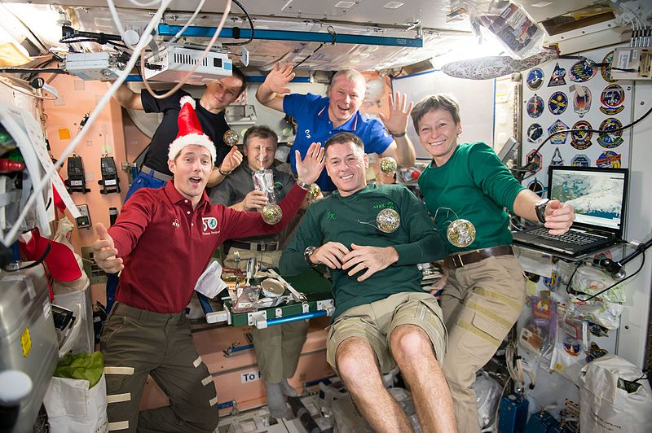
Une photo bizarre
lire / parler
Regarde la photo et parle avec un(e) partenaire :
1) C’est quel mois ?
2) Que font-ils ?
3) Qui sont-ils ?
4) Où sont-ils ?
5) Comment sont-ils ?
Notes:
Timing: 5 minutes
Aim: anticipating the key ideas of the text, re-activating prior knowledge and language relevant to the text
Procedure:
1. Students work in pairs to discuss possible answers to the questions.
2. Teacher elicits answers from the class – not for the purpose of correction, but to build interest and anticipation.
Word frequency of cognates used (1 is the most frequent word in French): bizarre [2756], photo [1412]
Source: Londsale, D., & Le Bras, Y. (2009). A Frequency Dictionary of French: Core vocabulary for learners London: Routledge.
Image attribution:
By NASA - https://www.flickr.com/photos/nasa2explore/32421914515/, Public Domain, https://commons.wikimedia.org/w/index.php?curid=55256303

Slide 14
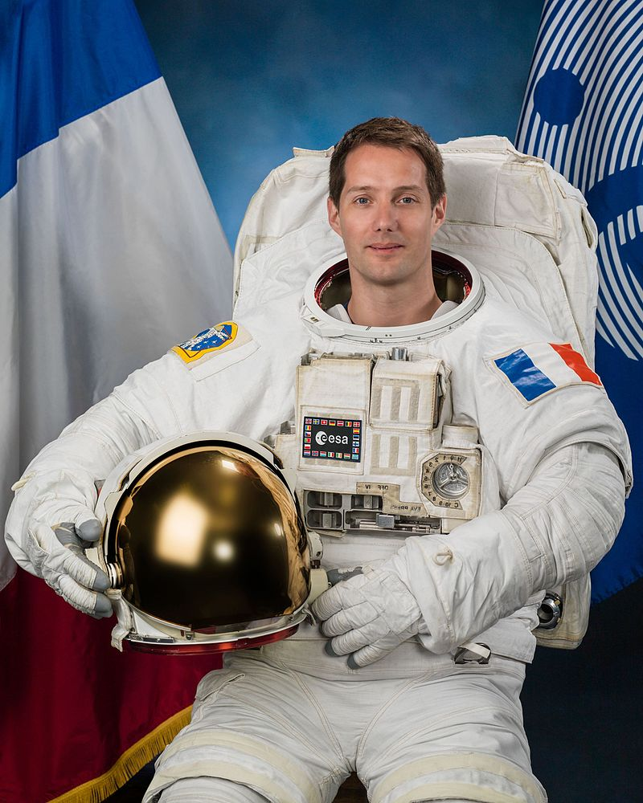
Thomas Pesquet
parler / lire / écouter
Thomas Pesquet est un astronaute français. Il vient de Normandie.
Il est comment ?
Voici des moments importants dans sa vie. Écoute et écris les dates.
2016 : Il part pour son premier voyage dans l’espace. le dix-sept novembre
2017 : Il sort de le véhicule dans l’espace. le treize janvier
Il célèbre son 39e anniversaire dans l’espace. le vingt-sept février
Il revient de la mission spatiale. le deux juin
2019 : Il est sélectionné pour une seconde mission. le vingt-deux janvier
1
________________
2
________________
3
________________
4
________________
5
________________
Notes:
Timing: 5 minutes
Aim: providing background to the text, practising aural recognition of dates
Procedure:
1. First, orally elicit some descriptions of Thomas Pesquet based on the photo. (Descriptions could be physical, or speculation about his mood or personality.)
2. Next, bring up the box with the key events. Students read the events. Elicit any further descriptions based on this information.
3. Finally, click the numbers to play the audio. Students write the dates they hear.
4. Click to reveal the answers and check understanding.
Note: Students have not yet encountered ordinal numbers in the format ‘39e‘. Try to elicit the English equivalent for ‘e’.
Transcript:
le dix-sept novembre
le treize janvier
le vingt-sept février
le deux juin
le vingt-deux janvier
Word frequency of cognates used (1 is the most frequent word in French): photo [1412], véhicule [1959], mission [627], spatial [2765], sélectionner [3671], second [379]
Source: Londsale, D., & Le Bras, Y. (2009). A Frequency Dictionary of French: Core vocabulary for learners London: Routledge.
Image attribution:
By NASA / BILL STAFFORD - https://www.flickr.com/photos/nasa2explore/27057214603/in/photostream/, Public Domain, https://commons.wikimedia.org/w/index.php?curid=49456677

Slide 15
Le texte
lire / parler
Regarde l’extrait et parle avec un(e) partenaire :
1) Ce texte est…
un article
une histoire
un poème
2) Pourquoi ? Il y a…
une date
un titre
des rimes
Au réveillon de Noël sur l’ISS, la gastronomie française au menu
24 décembre 2016
On ______ être astronaute et bien manger. Le Français Thomas Pesquet emporte des plats des grands chefs français sur la station spatiale internationale, pour des occasions spéciales.
Notes:
Timing: 4 minutes
Aim: identifying the type of text
Procedure:
1. Students look at the format of the extract, containing the headline, date and sub-heading.
2. Check understanding of the near-cognates used in the answer options.
2. Students discuss the questions in pairs.
3. Teacher elicits answers from the class.
Word frequency of cognates used (1 is the most frequent word in French): texte [631], extrait [4283], article [604], titre [399], rime [>5000]
Source: Londsale, D., & Le Bras, Y. (2009). A Frequency Dictionary of French: Core vocabulary for learners London: Routledge.

Slide 16
Aide la journaliste !
Each verb can be used more than once – or not at all!
lire / écrire
L’article est incomplet ! Lis les citations. Quel verbe peut compléter les phrases ? Écris des phrases complètes avec une forme verbale correcte.
« On peut être astronaute et bien manger. »
« Qui dit qu’on ne peut pas célébrer Noël dans l’espace ? »
« Dans l’espace, on doit modifier la cuisine. »
« On doit changer les textures et concentrer les goûts. »
« Il sait gérer ces contraintes puisqu’il est expert en cuisine spatiale. »
____
____
____
____
____
vouloir | devoir | pouvoir | savoir
Notes:
Timing: 3 minutes
Aim: applying knowledge of modal verbs to complete sentences from the text
Procedure:
1. Students read the quotations and choose which verb would make the most sense for each.
2. They write 1-5 and complete the sentence with the conjugated form of the verb they chose.
3. Click to reveal the answers as they are in the text. Alternative, accurate suggestions should also be accepted – elicit how they would change the meaning.
4. Draw attention to the use of pouvoir vs savoir in particular – elicit an explanation from students.
Word frequency of revisited vocabulary (1 is the most frequent word in French): peut [20], pouvoir [20], sait [67], savoir¹ [67]
Source: Londsale, D., & Le Bras, Y. (2009). A Frequency Dictionary of French: Core vocabulary for learners London: Routledge.
Word frequency of cognates used (1 is the most frequent word in French): journaliste [1337], certain [110], verbe [>5000], article [604], incomplet [>5000], citation [3110], compléter [2034], complet [965], correct [2617], forme [369]
Source: Londsale, D., & Le Bras, Y. (2009). A Frequency Dictionary of French: Core vocabulary for learners London: Routledge.

Slide 17
Quand font-ils quoi ?
lire
Écris les activités dans le passé et à l’avenir dans l’ordre correct.
Lis l’article complet.
Ils font ces activités dans le passé, à l’avenir ou en général ? Écris trois listes.
Les astronautes mangent bien dans l’espace.
Alain Ducasse développe des recettes pour l’espace.
Les astronautes mangent une langue de bœuf.
Les chefs modifient les textures et les goûts des plats.
Thierry Marx crée un menu pour le repas de Noël.
Les astronautes mangent un poulet.
Notes:
Timing: 8 minutes for 4 slides
Aim: applying vocabulary and grammar knowledge to understand the order of events in the text
Procedure:
Teachers distribute the full text (see next slide) to students.
Student read the text and use their knowledge of tenses to divide the events into past, future and general activities.
Answers are provided on the réponses slide (20).
Word frequency of cognates used (1 is the most frequent word in French): ordre [197], correct [2617], article [604]
Source: Londsale, D., & Le Bras, Y. (2009). A Frequency Dictionary of French: Core vocabulary for learners London: Routledge.

Slide 18
Partie 1
* spatial
= space (adj)
Partie 1
* spatial
= space (adj)
Au réveillon de Noël sur l’ISS, la gastronomie française au menu
24 décembre 2016
On peut être astronaute et bien manger. Le Français Thomas Pesquet emporte des plats des grands chefs français sur la station spatiale* internationale, pour des occasions spéciales.
Qui dit qu’on ne peut pas célébrer Noël dans l’espace ? L’équipe de la station spatiale internationale va partager un repas de fête cuisiné par des chefs français. Alain Ducasse et Thierry Marx ont préparé un vrai repas de Noël pour le Français Thomas Pesquet et ses collègues russes et américains.
Au réveillon de Noël sur l’ISS, la gastronomie française au menu
24 décembre 2016
On peut être astronaute et bien manger. Le Français Thomas Pesquet emporte des plats des grands chefs français sur la station spatiale* internationale, pour des occasions spéciales.
Qui dit qu’on ne peut pas célébrer Noël dans l’espace ? L’équipe de la station spatiale internationale va partager un repas de fête cuisiné par des chefs français. Alain Ducasse et Thierry Marx ont préparé un vrai repas de Noël pour le Français Thomas Pesquet et ses collègues russes et américains.
Partie 2
* essayer
= to try out
Partie 2
* essayer
= to try out
Les six astronautes vont essayer* une sélection de ses plats préférés. Au menu, des plats français traditionnels : d’abord, une langue de bœuf au foie gras, puis, un poulet au vin jaune*. Pour le dessert, c’est pain d’épice aux pommes.
Dans l’espace, on doit modifier la cuisine : on doit changer les textures et concentrer les goûts. Alain Ducasse sait gérer ces contraintes puisqu’il est expert en cuisine spatiale. Pendant les dix dernières années, il a développé des recettes pour l’espace avec l’agence spatiale française. Pour Thierry Marx, qui a créé le menu de Noël, l’aventure spatiale est nouvelle. Il a travaillé en collaboration avec l’agence spatiale européenne.
Les six astronautes vont essayer* une sélection de ses plats préférés. Au menu, des plats français traditionnels : d’abord, une langue de bœuf au foie gras, puis, un poulet au vin jaune*. Pour le dessert, c’est pain d’épice aux pommes.
Dans l’espace, on doit modifier la cuisine : on doit changer les textures et concentrer les goûts. Alain Ducasse sait gérer ces contraintes puisqu’il est expert en cuisine spatiale. Pendant les dix dernières années, il a développé des recettes pour l’espace avec l’agence spatiale française. Pour Thierry Marx, qui a créé le menu de Noël, l’aventure spatiale est nouvelle. Il a travaillé en collaboration avec l’agence spatiale européenne.
Notes:
Full text handout (this is two copies to be cut down the middle) Article adapted from: https://www.franceinter.fr/sciences/le-repas-de-noel-de-thomas-pesquet-dans-l-espace Image attribution:
By NASA - https://www.flickr.com/photos/nasa2explore/32421914515/, Public Domain, https://commons.wikimedia.org/w/index.php?curid=55256303
NB: The frequency values noted below relate to unknown vocabulary which features in the full text (i.e. the text which appears on this slide and the next). Glosses are provided for unknown vocabulary items which are a) not cognates or near-cognates, and b) do not feature in the follow-up vocabulary exercises in lesson 2. Any known vocabulary which is not glossed (such as the food items in the first paragraph on the next slide) should not be translated as this stage, as students will be asked to research it in dictionary work as part of the activities that follow.
One exceptions to this is cuisiner, as students should be able to work out the meaning of this from their knowledge of the phrase faire la cuisine.
Word frequency of cognates and near-cognates used (1 is the most frequent word in French): astronaute [>5000], chef [386], station [1399], international [282], occasion [423], spécial [726], collègue [1099], russe [1325], américain [374], sélection [2403], traditionnel [1574], menu [3470], dessert [>5000], modifier [1035], texture [>5000], concentrer [856], expert [1557], développer [892], agence [1481], collaboration [2037], aventure [2090], européen [445]
Source: Londsale, D., & Le Bras, Y. (2009). A Frequency Dictionary of French: Core vocabulary for learners London: Routledge.
Word frequency of unknown vocabulary used (1 is the most frequent word in French): cuisiner [>5000], spatial [2765], essayer [303], bœuf [3914], foie [4817], gras [4018], poulet [4222], vin [2309], pain [2802], épice [>5000], pomme [2847], contrainte [2250]
Source: Londsale, D., & Le Bras, Y. (2009). A Frequency Dictionary of French: Core vocabulary for learners London: Routledge.

Slide 19
Partie 1
* spatial
= space (adj)
lire
Au réveillon de Noël sur l’ISS, la gastronomie française au menu
24 décembre 2016
On peut être astronaute et bien manger. Le Français Thomas Pesquet emporte des plats des grands chefs français sur la station spatiale* internationale, pour des occasions spéciales.
Qui dit qu’on ne peut pas célébrer Noël dans l’espace ? L’équipe de la station spatiale internationale va partager un repas de fête cuisiné par des chefs français. Alain Ducasse et Thierry Marx ont préparé un vrai repas de Noël pour le Français Thomas Pesquet et ses collègues russes et américains.
Notes:
Article adapted from: https://www.franceinter.fr/sciences/le-repas-de-noel-de-thomas-pesquet-dans-l-espace
NB: The frequency values noted below relate to unknown vocabulary which features in the full text (i.e. the text which appears on this slide and the next). Glosses are provided for unknown vocabulary items which are a) not cognates or near-cognates, and b) do not feature in the follow-up vocabulary exercises in lesson 2. Any known vocabulary which is not glossed (such as the food items in the first paragraph on the next slide) should not be translated as this stage, as students will be asked to research it in dictionary work as part of the activities that follow.
One exceptions to this is cuisiner, as students should be able to work out the meaning of this from their knowledge of the phrase faire la cuisine.
Word frequency of cognates and near-cognates used (1 is the most frequent word in French): astronaute [>5000], chef [386], station [1399], international [282], occasion [423], spécial [726], collègue [1099], russe [1325], américain [374], sélection [2403], traditionnel [1574], menu [3470], dessert [>5000], modifier [1035], texture [>5000], concentrer [856], expert [1557], développer [892], agence [1481], collaboration [2037], aventure [2090], européen [445]
Source: Londsale, D., & Le Bras, Y. (2009). A Frequency Dictionary of French: Core vocabulary for learners London: Routledge.
Word frequency of unknown vocabulary used (1 is the most frequent word in French): cuisiner [>5000], spatial [2765], essayer [303], bœuf [3914], foie [4817], gras [4018], poulet [4222], vin [2309], pain [2802], épice [>5000], pomme [2847], contrainte [2250]
Source: Londsale, D., & Le Bras, Y. (2009). A Frequency Dictionary of French: Core vocabulary for learners London: Routledge.

Slide 20
Partie 2
* essayer
= to try out
lire
Les six astronautes vont essayer* une sélection de ses plats préférés. Au menu, des plats français traditionnels : d’abord, une langue de bœuf au foie gras, puis, un poulet au vin jaune*. Pour le dessert, c’est pain d’épice aux pommes.
Dans l’espace, on doit modifier la cuisine : on doit changer les textures et concentrer les goûts. Alain Ducasse sait gérer ces contraintes puisqu’il est expert en cuisine spatiale. Pendant les dix dernières années, il a développé des recettes pour l’espace avec l’agence spatiale française. Pour Thierry Marx, qui a créé le menu de Noël, l’aventure spatiale est nouvelle. Il a travaillé en collaboration avec l’agence spatiale européenne.

Slide 21
Quand font-ils quoi ?
Réponses
lire
Ils font ces activités dans le passé, à l’avenir ou en général ? Écris trois listes.
 | dans le passé
B. | Alain Ducasse développe des recettes pour l’espace.
E. | Thierry Marx crée un menu pour le repas de Noël.
 | à l’avenir
C. | Les astronautes mangent une langue de bœuf.
F. | Les astronautes mangent un poulet.
 | en général
A. | Les astronautes mangent bien dans l’espace.
D. | Les chefs modifient les textures et les goûts des plats.

Slide 22
Au réveillon de Noël sur l’ISS, la gastronomie française au menu
Extended reading
SSC open [o]
J’ai visité Bruxelles!
J’ai visité la Suisse!
Y8 French
Term 1.2 - Week 5 - Lesson 24
Kirsten Somerville / Catherine Morris / Natalie Finlayson
Artwork by: Chloé Motard
Date updated: 01.02.24
Notes:
Note: all words (new and revisited) in this week of the SOW appear on all three GCSE wordlists, with these exceptions: i) AQA list does not have réveillon
ii) Edexcel list does not have gérer, Noël, réveillon iii) Eduqas list does not have réveillon
Artwork by Chloé Motard. All additional pictures selected are available under a Creative Commons license, no attribution required.
Learning outcomes (lesson 2):
Consolidation of SSC open [o]
Understanding the details of the text
Being creative with the text
Word frequency (1 is the most frequent word in French):
8.1.2.5 (introduce) gérer [1354], espace [870], goût [1829], langue², [712], plat [2167], recette [1709], repas [2948] d'abord [326], puis [230], par [21], puisque [528], Noël [>5000], réveillon [>5000]
8.1.2.1 (revisit) apporter [339], dit [dire 37], fait [faire 25], envoyer [526], utiliser [345], maintenant [192], hier [872], appartement [2323], banque [774], marché [280], passé [501]
7.3.2.6 (revisit) aider [413], chercher [336], partager [527], peut [20], peux [20], pouvoir [20], sais [67], sait [67], savoir1 [67], projet [228], désolé [désoler - 2081], peut-être [190]
Source: Londsale, D., & Le Bras, Y. (2009). A Frequency Dictionary of French: Core vocabulary for learners London: Routledge.

Slide 23
Closed or open [o] ?
phonétique
Open [o] is a short version of English “or”
Closed [o] sounds similar to English’s long o sound as in “go”
The French [o] can be open or closed.
It is closed when it:
is the final sound in a word (trop)
is followed by a z sound (rose)
has a circumflex (hôtel)
SSC [au] and [eau] are also pronounced as a closed [o].
It is open when followed by any consonant sound other than ‘z’:
sonner (to ring), un ordinateur, un voleur (thief)
SFC!
Notes:
Timing: 3 minutes Aim: to recap the rules for closed and open [o] SSC.
Procedure: 1. Click through the information.
2. Elicit further examples of words for each of the rules from students.

Slide 24
Phonétique
Open [o] - the tongue is far from the roof of the mouth.
Closed [o] - the tongue touches the roof of the mouth.
lire / parler
fantôme
exploser
support
60
optimiste
imposer
[to enforce]
métro
médiocre
format
alors
[then, so]
pétrole
lorsque [when]
secondes
zéro
solde [sale]
or
[gold]
confortable
révolte
tantôt
[sometimes]
forte [strong (f)]
0
violent
Écosse
DÉBUT
Notes:
Timing: 5 minutes
Aim: To decide based on spelling whether [o] is open or closed, and to say the word accordingly.
Procedure:
1. Students pronounce as many words against the clock as possible.
2. Click ‘début’ to start the timer.
3. Click to check pronunciation.
Word frequency (1 is the most frequent word in French): exploser [2678], support [3708], fantôme [4075], médiocre [4125], imposer [469], métro [3227], optimiste [2751], pétrole [2157], or [300], lorsque [256], zéro [2274], alors [81], confortable [3964], révolte [2720], solde [4622], violent [1119], Écosse [n/a], tantôt [3031], forte [107]
Source: Londsale, D., & Le Bras, Y. (2009). A Frequency Dictionary of French: Core vocabulary for learners London: Routledge.

Slide 25
Vocabulaire (1/2)
écrire / parler
anglais : | français :
to manage, managing
recipe
meal
by
(Christmas) eve
first of all
Écris les mots en français.
Prononce les mots.
Fais attention à la SSC [r].
gérer
la recette
le repas
par
le réveillon
d’abord
Notes:
Timing: 5 minutes for 2 slides
Aim: written and/or spoken recall of 14 items of this week’s new vocabulary, oral production of SSC [r]
Procedure:
1. Students translate the words to French, making a note in their exercise books.
2. Answers are revealed on clicks, students should pronounce the words, focusing on [r].
3. The activity continues on the next slide with the words which do not containing SSC [r].
Word frequency of cognates used (1 is the most frequent word in French): prononcer [706]
Source: Londsale, D., & Le Bras, Y. (2009). A Frequency Dictionary of French: Core vocabulary for learners London: Routledge.

Slide 26
Vocabulaire (2/2)
écrire / parler
anglais : | français :
space
taste
tongue
plate
then
as, because
Christmas
Écris les mots en français.
Prononce les mots.
l’espace
le goût
la langue
le plat
puis
puisque
Noël

Slide 27
Trouve l’intrus ! [1]
lire
[Odd one out!]
1. | dit | fait | apporter
2. | hier | désolé | maintenant
3. | peut-être | marché | passé
4. | sais | projet | partager
5. | appartement | banque | utiliser
6. | peux | aider | chercher
not a past participle
not an adverb
not a noun
not a verb
not a noun
not an infinitive
Notes:
Timing: 3 minutes
Aim: grammatical categorisation of items from this week’s revisited vocabulary sets
Procedure:
Students use grammar knowledge to identify the odd one out.
Click to reveal the answers.

Slide 28
Quelle est la catégorie ?
lire
What connects the following lists of words?
1. | écrire | la lettre | envoyer
2. | la banque | le marché | l’église
3. | emporter | apporter | prendre
4. | le passé | hier | l'année dernière
5. | maintenant | en ce moment | aujourd’hui
6. | l’appartement | habiter | la maison
sending post
buildings in a town
bringing/taking
time (past)
time (present)
living somewhere
Notes:
Timing: 3 minutes
Aim: semantic categorisation of items from this week’s revisited vocabulary sets
Procedure:
Students use knowledge of meaning to identify a connecting theme.
Click to reveal the answers.

Slide 29
Cherche les mots
lire / parler
Cherche les mots français dans l’article.
Prononce les mots.
 | anglais | français
1. | to develop | développer
2. | an agency | une agence
3. | colleague (m) | le collègue
4. | the menu | le menu
5. | the selection | la sélection
6. | American (m) | américain
7. | international (m) | international
8. | Russian (m) | russe
Make sure to use the French pronunciation – what SSCs are in the words ?
Notes:
Omit this activity to give more time for the writing activity, if time is short. Timing: 5 minutes
Aim: applying grammar knowledge to produce the ‘dictionary’ forms of cognates in the text, applying phonics knowledge to accurately pronounce cognates
Procedure:
1. First, students re-read the article on slides 18-19 to find the French words for 1-8.
2. They use grammar clues in the text to identify the ‘dictionary’ form of the word (ie. verb infinitive, noun gender, masculine singular adjective form).
3. Click to reveal the answers.
4. Then, they use SSC knowledge to read the words aloud using the French pronunciation.
5. Click to reveal the play buttons. Click to check pronunciation.
Transcript:
développer, une agence, le collègue, le menu, la sélection, américain, international, russe
Word frequency of cognates used (1 is the most frequent word in French): article [604], prononcer [706], développer [892], agence [1481], collègue [1099], menu [3470], selection [2403], américain [374], international [282], russe [1325]
Source: Londsale, D., & Le Bras, Y. (2009). A Frequency Dictionary of French: Core vocabulary for learners London: Routledge.

Slide 30
Aide la journaliste !
lire / écrire
La journaliste pense à utiliser des mots différents, mais elle n’a pas d’idées !
Donne des suggestions à la journaliste pour les mots orange.
« Au réveillon de Noël sur l’ISS, la gastronomie française au menu. »
« Le Français Thomas Pesquet emporte des plats des grands chefs français. »
« … pour des occasions spéciales. »
« Dans l’espace, on doit modifier la cuisine. »
« Il sait gérer ces contraintes puisqu’il est expert en cuisine spatiale. »
« Pour Thierry Marx, l’aventure spatiale est nouvelle. »
You can change the order of the words in the sentence.
Notes:
Omit this activity to give more time for the writing activity, if time is short. Timing: 5 minutes
Aim: working out meaning from context, applying vocabulary knowledge to provide synonyms for words and phrases in the text
Procedure:
1. Students write 1-6 and suggest alternative expressions for the words and phrases in orange. It may be helpful to return to the full text for context.
2. Elicit answers from the class. Accept any accurate alternative which is close in meaning to the original.
Suggested answers:
la cuisine française, des plats français
des chefs français importants, excellents [highlight the figurative use of grand to mean ‘great’, ie important, successful]
des fêtes, des événements importants
changer
parce que
la cuisine spatiale, faire la cuisine pour l’espace [highlight that Thierry Marx isn’t going into space himself!]
Word frequency of cognates used (1 is the most frequent word in French): journaliste [1337], suggestion [3254], orange [3912], gastronomie [>5000], occasion [423], spécial [726], modifier [1035], aventure [2090], spatial [2765]
Source: Londsale, D., & Le Bras, Y. (2009). A Frequency Dictionary of French: Core vocabulary for learners London: Routledge.

Slide 31
C’est quoi la réponse ?
lire
Lis l’article complet encore. Répond aux questions avec a, b, ou c.
1) Les astronautes mangent des plats français…
a) chaque jour b) souvent c) parfois
2) Pour le repas de Noël, ils mangent des plats préférés de…
a) Thomas Pesquet b) Alain Ducasse c) Thierry Marx
3) Alain Ducasse est…
a) un astronaute b) un chef c) un Américain
4) Comparé à la cuisine normale, la cuisine pour l’espace est…
a) chère b) rapide c) différente
5) Thierry Marx travaille avec…
a) une agence française b) une agence européenne c) une agence internationale
Notes:
Timing: 5 minutes
Aim: understanding the detail of the text
Procedure:
1. Students write 1-5 and answer each question with ‘a’, ‘b’ or ‘c’, based on the information in the full text of the article.
2. Click to reveal the answers. Elicit which sentence(s) in the text they found the answers in.
Word frequency of cognates used (1 is the most frequent word in French): article [604], complet [965], répondre [200], astronaute [>5000], américain [374], comparer [1560], normal [833], agence [1481], européen [445], international [282]
Source: Londsale, D., & Le Bras, Y. (2009). A Frequency Dictionary of French: Core vocabulary for learners London: Routledge.

Slide 32
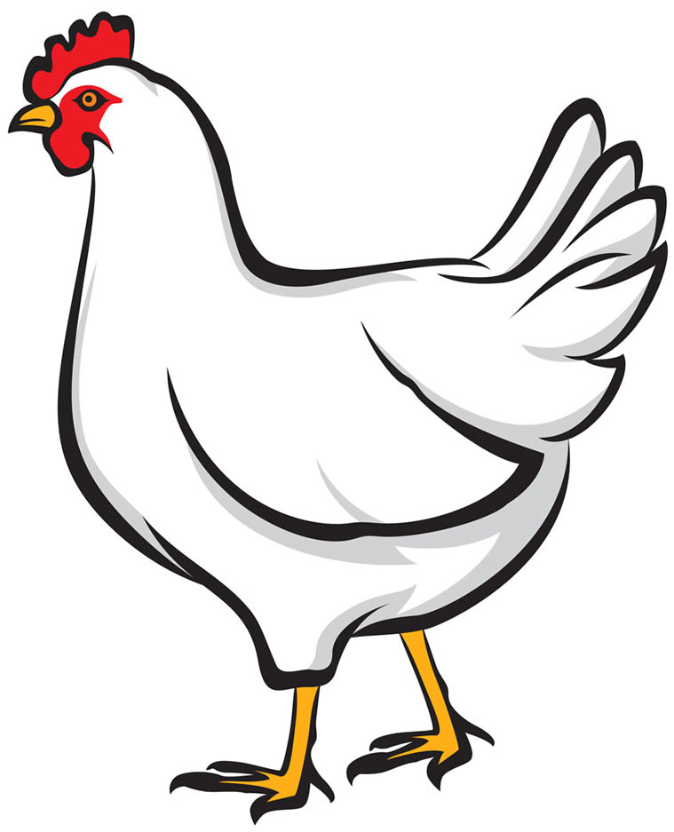
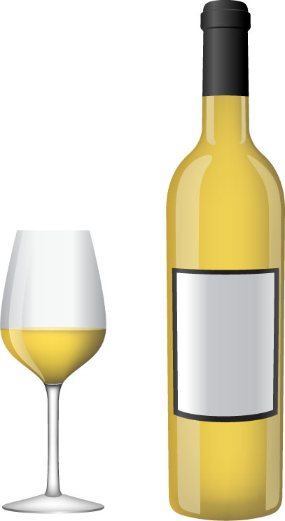
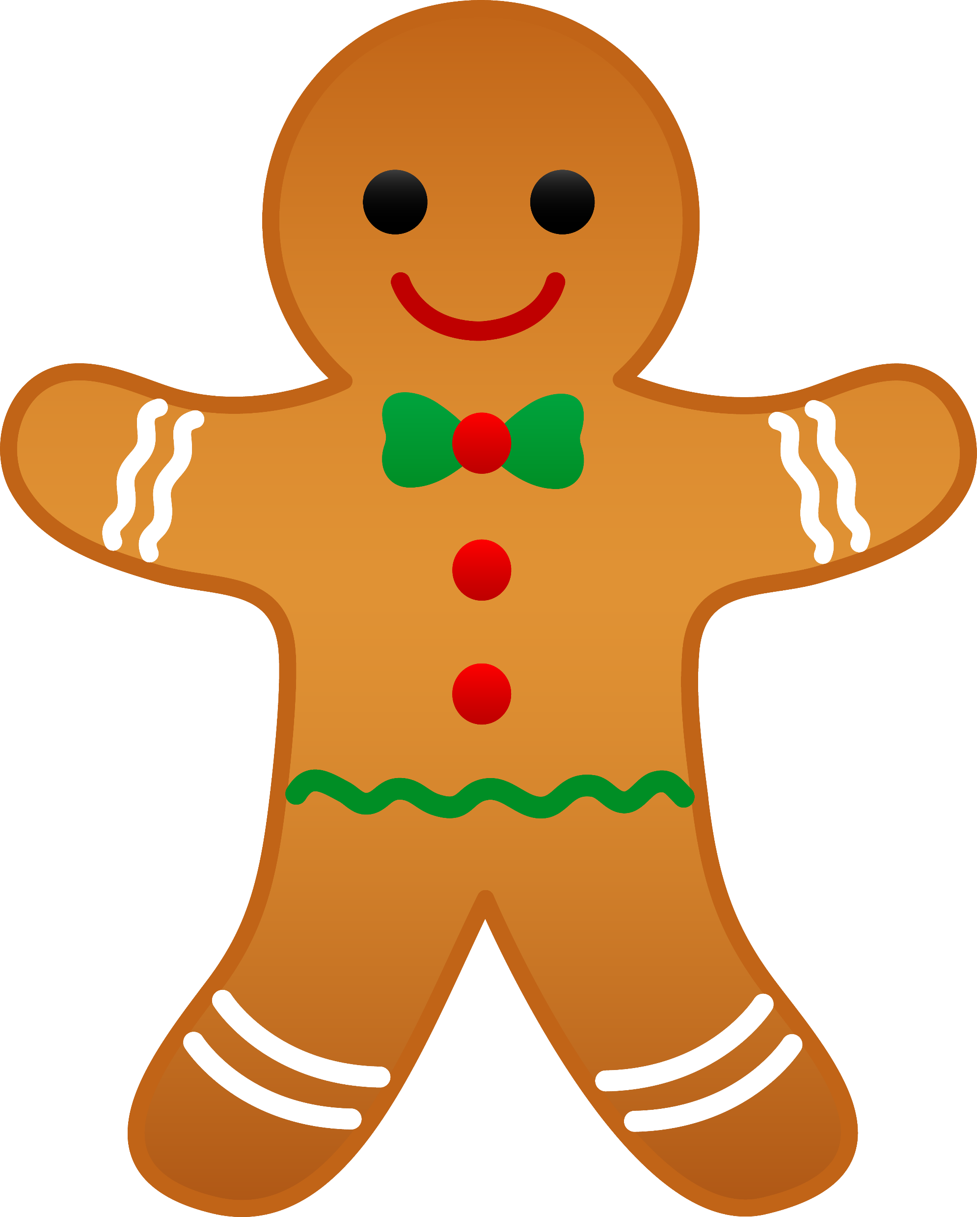
Le menu de Noël
lire
Use a dictionary and the internet!
As you know, French prepositions can often be translated in several ways.
For example, the preposition à can be translated as ‘at’, ‘to’, or ‘in’.
When talking about food, à can also be used to describe what a dish is made or served with.
Menu de Noël
langue de bœuf au foie gras
poulet au vin jaune
pain d’épice aux pommes
a)
b)
c)
Lis le menu de Noël.
On mange quoi avec quoi ?
Fais des paires pour chaque plat.
d)
e)
f)
Notes:
Omit this activity to give more time for the writing activity, if time is short. Timing: 5 minutes
Aim: introducing a specific use of preposition à, using a dictionary/research to understand the detail of the text
Procedure:
1. Introduce the specific use of à to indicate ingredients / accompaniments in a dish.
2. Bring up the Christmas menu. Students use dictionaries and/or websites to find out what food types are in each dish.
3. Students pair up pictures a-f, based on the pairings on the menu.
4. Click to reveal the answers (in the order of the menu).
5. Reactions to the menu can also be elicited – eg. ‘Qui aime le menu ?’, ‘Qui n’aime pas le menu ?’, ‘Quel plat aimes-tu ?’, ‘Pourquoi ?’
Word frequency of cognates used (1 is the most frequent word in French): menu [4370], paire [3926]
Source: Londsale, D., & Le Bras, Y. (2009). A Frequency Dictionary of French: Core vocabulary for learners London: Routledge.
Word frequency of unknown vocabulary (1 is the most frequent word in French):
bœuf [3914], foie [4817], gras [4018], poulet [4222], vin [2309], pain [2802], épice [>5000], pomme [2847]
Source: Londsale, D., & Le Bras, Y. (2009). A Frequency Dictionary of French: Core vocabulary for learners London: Routledge.

Slide 33
À ton tour !
écrire
Écris un article similaire : imagine que tu es astronaute !
C’est quoi ton menu idéal pour l’espace ?
C’est pour quelle occasion spéciale ?
Quel chef / restaurant / café / magasin prépare le repas ?
ou
Écris une interview avec Thomas Pesquet, avec un(e) partenaire :
Pourquoi aime-t-il ces plats français traditionnels ?
Pourquoi aime-t-il être astronaute ?
Notes:
Timing: 10 minutes (Note that if the three identified activities have been omitted, there will be an additional 15 minutes for the writing task).
Aim: responding creatively to the text
Procedure:
1. Students choose whether to write an article about themselves, or write an interview with Thomas Pesquet.
2. They can use dictionaries and do research online to inform their writing.
3. The activity can be extended by using their writing as scripts for a TV news report / chat show interview, to be recorded or performed in class.
Word frequency of cognates used (1 is the most frequent word in French): tour [523], article [604], similaire [2632], imaginer [840], astronaute [>5000], menu [3470], idéal [1429], occasion [423], spécial [726], restaurant [2336], interview [3186], traditionnel [1574]
Source: Londsale, D., & Le Bras, Y. (2009). A Frequency Dictionary of French: Core vocabulary for learners London: Routledge.

Slide 34
Devoirs
Vocabulary Learning Homework (Y8, Term 1.2, Week 6)
Audio file
Student worksheet
In addition, revisit: Y8 Term 1.2 Week 1 | Y7 Term 3.2 Week 7
Notes:
The answer sheet for the Y8, Term 1.2, Week 6 vocabulary learning HW is here: https://rachelhawkes.com/LDPresources/Yr8French/French_Y8_Term1ii_Wk6_audio_HW_sheet_answers.docx Don’t share this link with students ☺
Notes:
i) Teachers may, in addition, want to recommend use of a particular online app for the pre-learning of each week’s words. ii) Quizlet now requires parental involvement / registration / permissions for users below the age of 13, so it is perhaps most suitable for Y9 – 11 students. iii) Language Nut hosts LDP vocabulary lists and these are free for schools to use, though there is a registration process. One benefit is that all of the student tracking data that Language Nut offers are also available to schools that use the LDP lists for practice. Perhaps this makes it a good option for Y7/8.
iv) There are other free apps, and new ones are always appearing. Teachers have told us that they are currently using: Flippity, Wordwall (where using previously-created activities is free).
v) Gaming Grammar has been acquired by Language Nut. Its original content should still be available to teachers and much of it is appropriate for Y8 learners.
Verbs (present): 1st person singular/plural (Verb agreement (past))
Verbs (present): 3rd person singular/plural (Verb agreement (past))

