Slide 1
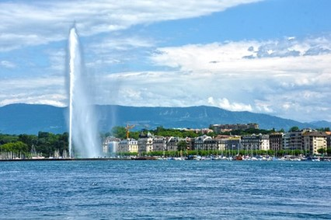
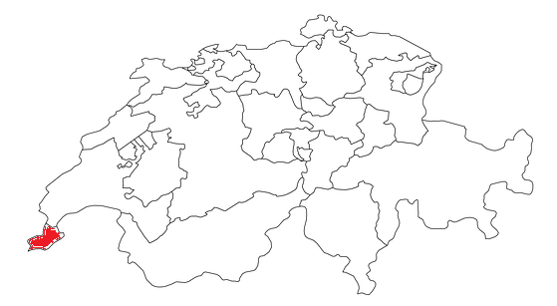
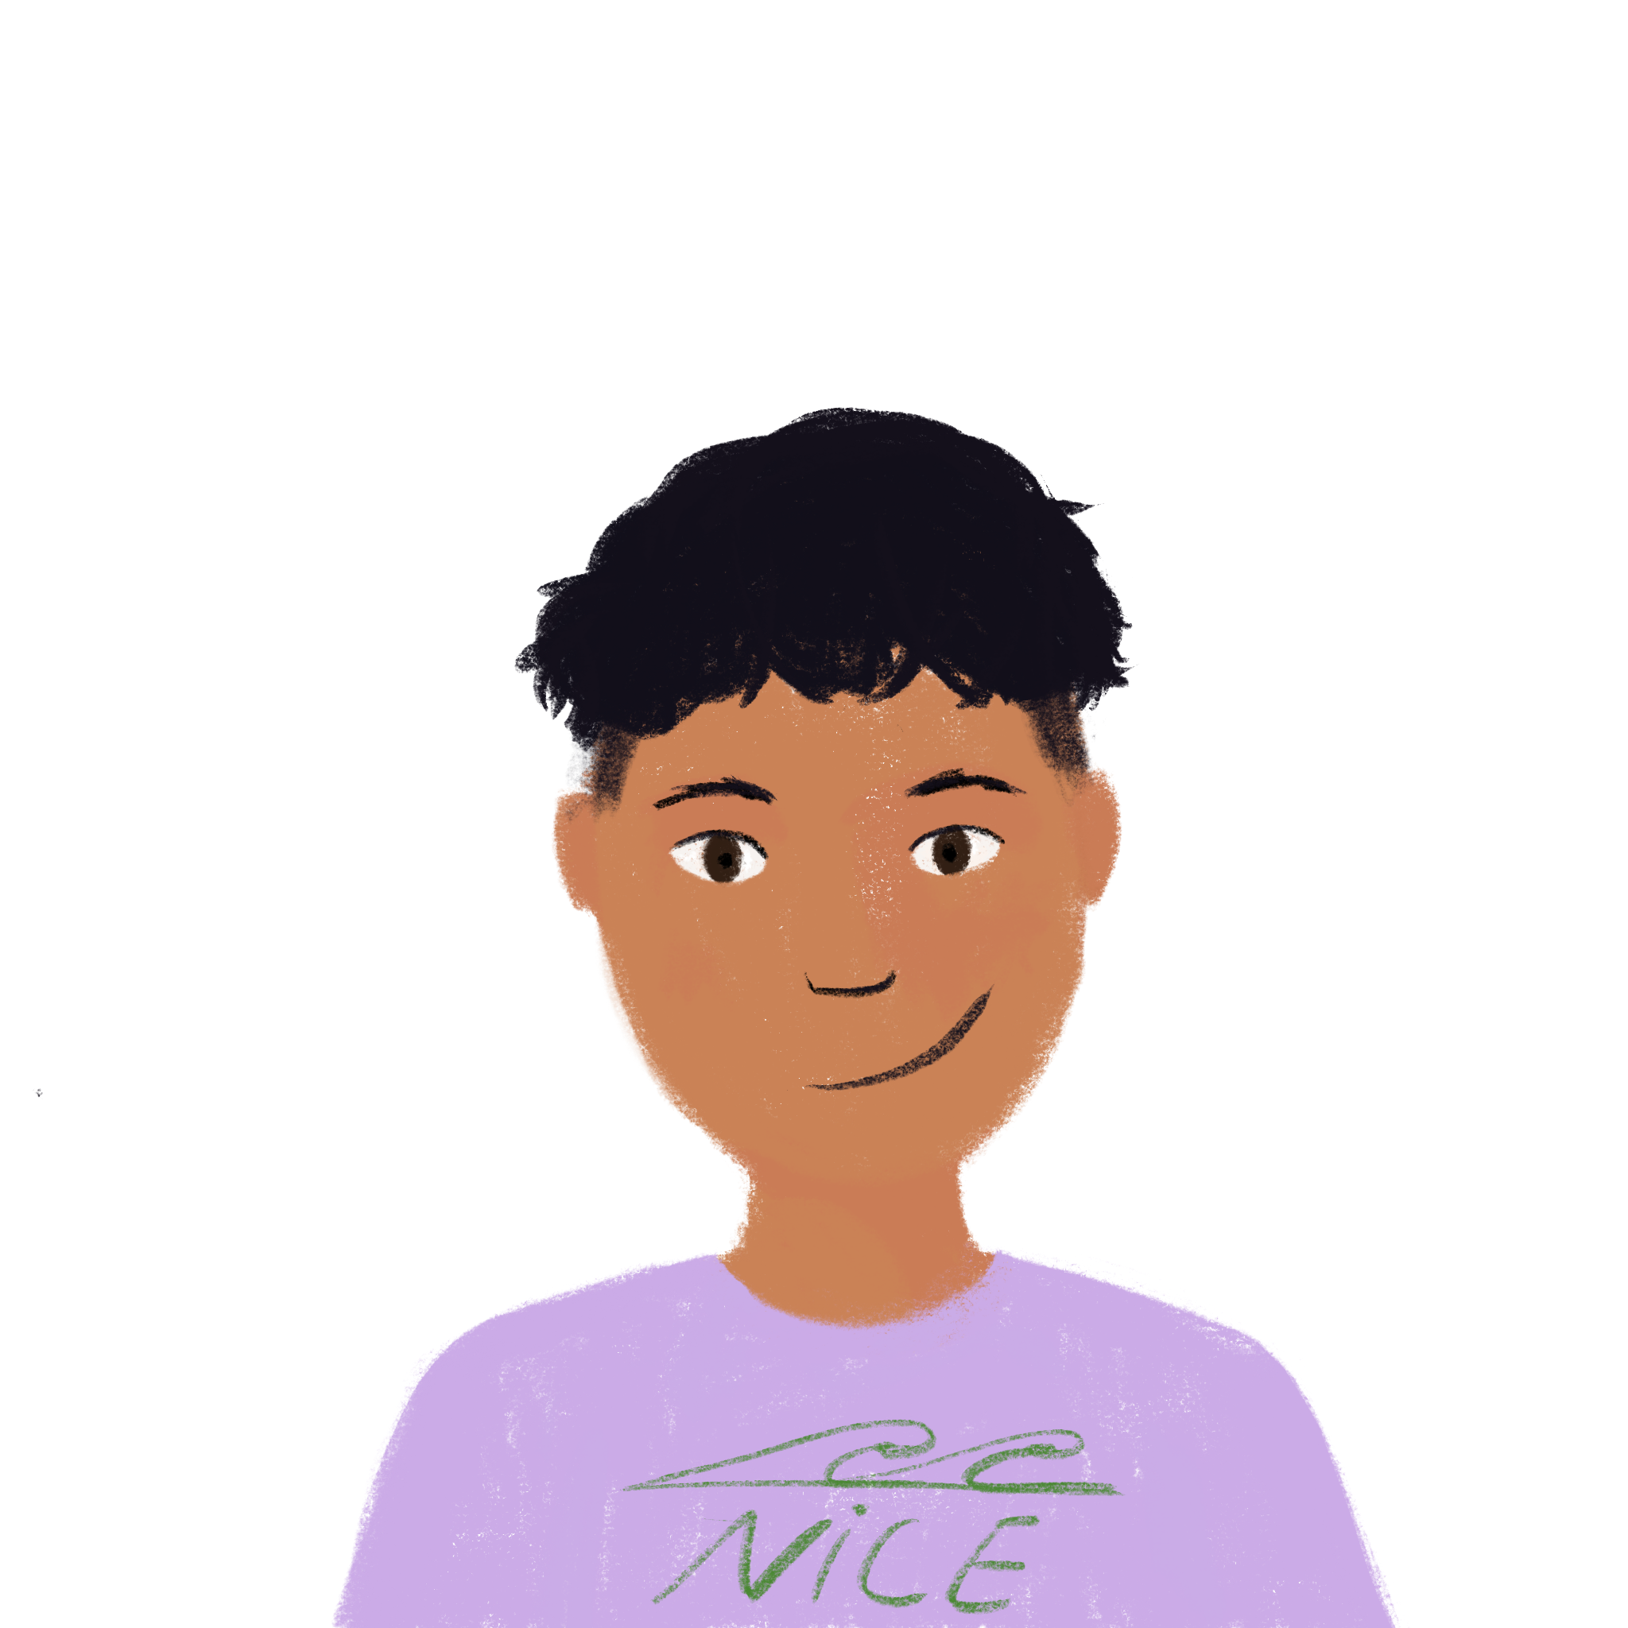
Asking and answering questions
about past holidays
intonation (SV) and ‘est-ce que’ questions in the present and perfect tense
SSC closed [o/ô]
J’ai visité Bruxelles!
J’ai visité la Suisse!
Y8 French
Term 1.2 - Week 4 - Lesson 21
Kirsten Somerville / Catherine Morris / Amber Dudley
Artwork by: Chloé Motard
Date updated: 09/07/21
J’ai visité Genève !
Notes:
Note: all words (new and revisited) in this week of the SOW appear on all three GCSE wordlists, with these exceptions: i) Edexcel list does not have emporter, chacun, Genève
ii) AQA list does not have Genève
Artwork by Chloé Motard. All additional pictures selected are available under a Creative Commons license, no attribution required.
Learning outcomes (lesson 1):
Introduction of SSC closed [o/ô]
Introduction of yes/no questions using intonation and est-ce que in the present tense
Introduction of yes/no questions using intonation and est-ce que in the perfect tense
Word frequency (1 is the most frequent word in French):
8.1.2.4 (introduce) emporter [1128], proposer [338], voyager [2194], traverser [1040], frontière [1182], forêt [1724], montagne [1732], vue [191], suisse [2241], Suisse [n/a], Genève [n/a], il y avait [13/36/8]
8.1.1.6 (revisit) organiser [701], chacun [323], anniversaire [2043], août [1445], décembre [891], juillet [1326], septembre [944], octobre [826], novembre [982], général [147], national [227], partout [581]
7.3.2.5 (revisit) devoir [39], dois [39], doit [39], veut [57], veux [57], vouloir [57], visiter [1378], billet [1916]
Source: Londsale, D., & Le Bras, Y. (2009). A Frequency Dictionary of French: Core vocabulary for learners London: Routledge.

Slide 2
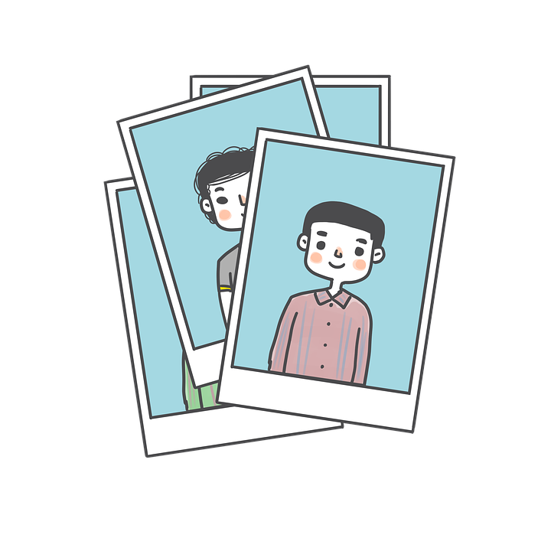
closed o/ô
photo
Notes:
Timing: 1 minute
Aim: To introduce SSC closed [o/ô]
Procedure: 1. Present the letter(s) and say the closed [o/ô] sound first, on its own. Students repeat it with you. 2. Bring up the word ”photo” on its own, say it, students repeat it, so that they have the opportunity to focus all of their attention on the connection between the written word and its sound.
3. A possible gesture for this would be to mime opening and closing a door. 4. Roll back the animations and work through 1-3 again, but this time, dropping your voice completely to listen carefully to the students saying the closed [o/ô] sound, pronouncing ”photo” and, if using, doing the gesture.
Word frequency (1 is the most frequent word in French):
photo [1412] Source: Londsale, D., & Le Bras, Y. (2009). A Frequency Dictionary of French: Core vocabulary for learners London: Routledge.

Slide 3
closed o/ô
photo
Notes:
Without sound to elicit pronunciation (without first hearing the teacher).
Teacher to elicit pronunciation by asking “Comment dit-on …"

Slide 4
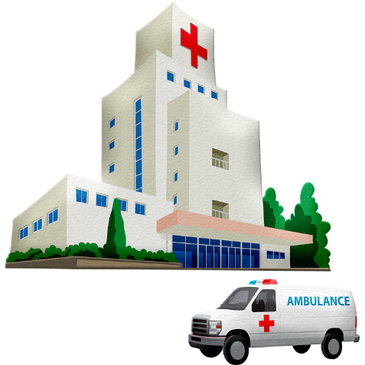
closed o/ô
contrôle
hôpital
[test]
photo
drôle
mot
[funny]
chose
[word]
[thing]
Notes:
Timing: 2 minutes
Aim: To introduce SSC closed [o/ô]
Procedure:
1. Introduce and elicit the pronunciation of the individual SSC closed [o/ô] and then the source word again ‘photo’ (with gesture, if using). 2. Then present and elicit the pronunciation of the five cluster words.
The cluster words have been chosen for their high-frequency, from a range of word classes, with the SSC (where possible) positioned within a variety of syllables within the words (e.g. initial, 2nd, final etc.). Additionally, we have tried to use words that build cumulatively on previously taught SSCs (see the Phonics Teaching Sequence document) and do not include new SSCs. Where new SSCs are used, they are often consonants which have a similar symbol-sound correspondence in English.
Word frequency (1 is the most frequent word in French): photo [1412], mot [220], hôpital [1310], chose [125], contrôle [662], drôle [2166] Source: Londsale, D., & Le Bras, Y. (2009). A Frequency Dictionary of French: Core vocabulary for learners London: Routledge.

Slide 5
closed o/ô
contrôle
hôpital
photo
drôle
mot
chose
Notes:
Without sound to elicit pronunciation (without first hearing the teacher).
Teacher to elicit pronunciation by asking “Comment dit-on …"

Slide 6
Phonétique
Combien de mots contiennent la SSC [o/ô] ?
10
écouter
poser
combien
trop
[to put]
poisson
position
[too]
boulot
moule
atmosphère
dos
[job]
[back]
report
importer
repos
[to import]
[rest]
héros
rose
bœuf
impôt
bientôt
[beef]
[tax]
[soon]
Notes:
Timing: 3 minutes
Aim: Aural recognition of SSC [o/ô] from a pool of words containing the letter ‘o’, to raise awareness of the different SSC patterns into which this letter can enter.
Procedure: 1. Click on the words to hear them said aloud.
2. Students tally how many words they hear that contain the SSC. Note that in the case of position and boulot, there are two examples of letter ‘o’, only one of which represents the SSC.
3. Answers and total revealed on click.
4. Click on report, atmosphère and importer again to demonstrate the difference between closed and open [o] (open [o] will be the focus of next week’s lesson). Word frequency (1 is the most frequent word in French): poser [218], position [383], repos [2731], bientôt [1208], dos [1672], poisson [1616], trop [195], boulot [2929], report [4406], combien [800], héros [1883], impôt [1241], atmosphère [2493], bœuf [3914], importer [354], rose [2671]
Source: Londsale, D., & Le Bras, Y. (2009). A Frequency Dictionary of French: Core vocabulary for learners London: Routledge.

Slide 7
Genève
*l’ouest (m) = west
*le drapeau = flag
*la croix* = cross
lire
Genève est une ville importante en Suisse. Comme chaque ville de l’ouest* de la Suisse, Genève est uniquement francophone. La principale branche européenne de l’Organisation des Nations Unies et le Comité international de la Croix*-Rouge sont basés ici. Un groupe de citoyens a créé la Croix-Rouge en 1863. C’est pour ça que le symbole de la Croix-Rouge ressemble au drapeau* suisse !
4. The Red Cross was created by a group of Swiss citizens.
3. UN European branch, International Committee of the Red Cross
1. Where is Geneva located?
1. In the west of Switzerland.
2. How many languages are spoken in Geneva?
2. One.
3. Which important international organisations are based in Geneva?
4. Why does the Red Cross symbol look like the Swiss flag?
Notes:
Timing: 5 minutes
Aim: Recognition of this week’s new vocabulary in longer contexts; offering some cultural and geographical insights into Geneva.
Procedure: 1. Point out the location of Geneva on the map. Draw attention to its proximity to the French border.
2. Students read the text.
3. Click to bring up a comprehension question in English. Students answer in English. These questions are also below.
4. Click to bring up the answer.
5. Click again to bring up another question.
6. Repeat steps 2-5 for 4 questions in total.
Questions:
Where is Geneva located?
How many languages are spoken in Switzerland?
Which important international organisations are based in Geneva?
Why does the Red Cross symbol look like the Swiss flag?
Word frequency of unknown words used (1 is the most frequent word in French):
ouest [1690], uniquement [1395], francophone [3118], drapeau [2582]
Source: Londsale, D., & Le Bras, Y. (2009). A Frequency Dictionary of French: Core vocabulary for learners London: Routledge.
Word frequency of cognates used (1 is the most frequent word in French):
principal [458], branche [2140], européen [445], organisation [570], nation [576], uni [2153], comité [651], international [282], croix [3901], basé [baser 1712], groupe [187], citoyen [1081], symbole [1427]
Source: Londsale, D., & Le Bras, Y. (2009). A Frequency Dictionary of French: Core vocabulary for learners London: Routledge.

Slide 8
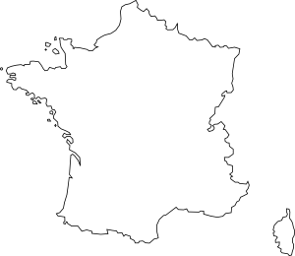
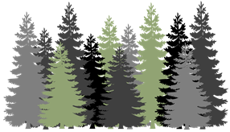
Vocabulaire
parler / écrire
A
B
C
D
[to travel, travelling]
[to cross, crossing]
[Switzerland]
[border]
E
F
G
H
[Geneva]
[there was, there were]
I
J
K
L
[to suggest doing]
[to take with, taking with]
[Swiss]
[view]
Notes:
Timing: 5 minutes
Aim: To revise in productive mode/written modality 12 items of vocabulary, within a limited time frame.
Procedure:
1. Write A-L in books.
2. Click / press enter to flash a picture. It will disappear after 3 seconds. Note that the pictures do not appear in alphabetical order to increase the challenge.
3. Write down the French word before the picture has faded away. 4. Ensure that gender/definite articles are known for any words that are nouns.
5. Repeat steps 1-5 in spoken modality. Students can compete in pairs to be the first to say the word.
Answers:
la frontière
voyager
la Suisse
traverser
Genève
la forêt
le montagne
il y avait
suisse
proposer
la vue
emporter

Slide 9
Vocabulaire
emporter [1128], vue [191], [224]
Réponses
parler / écrire
la frontière
voyager
la Suisse
traverser
le montage
Genève
la forêt
il y avait
suisse
proposer
la vue
emporter
Notes:
Answers to the vocabulary activity on the previous slide.

Slide 10
Les vacances
lire
Pendant les vacances, les choses sont différentes. Complète les phrases.
Normalement, chacun doit travailler ou étudier.
Pendant les vacances, chacun veut changer sa routine.
En général, les personnes n’aiment pas travailler chaque jour. On veut faire des choses différentes, c’est naturel !
Normalement, je dois passer la semaine au collège.
Pendant les vacances, je veux passer la semaine dehors.
______
______
___
______
______
devoir
dois
doit
veut
veux
vouloir
What are the infinitive forms of these verbs?
Notes:
Timing: 5 minutes
Aim: written comprehension of 8 items of this week’s revisited vocabulary items
Procedure:
1. Students write 1-6 and choose a different orange word to complete each sentence.
2. Click to reveal the answers.
3. English translations can also be elicited.
4. Click to reveal the final task instruction. Students say or write the infinitive forms.
5. Click to reveal.
Note: While there may be more than one grammatically correct answer, the focus in on distinguishing obligations and wishes with devoir and vouloir.
Word frequency of revisited vocabulary (1 is the most frequent word in French): chacun [323], général [147], devoir [39], dois [39], doit [39], veut [57], veux [57], vouloir [57]
Source: Londsale, D., & Le Bras, Y. (2009). A Frequency Dictionary of French: Core vocabulary for learners London: Routledge.
Word frequency of cognates used (1 is the most frequent word in French): routine [4120]
Source: Londsale, D., & Le Bras, Y. (2009). A Frequency Dictionary of French: Core vocabulary for learners London: Routledge.

Slide 11
The perfect tense: yes/no questions
grammaire
Remember: in French, you can ask a yes/no question by simply raising the pitch of your voice (intonation) at the end of a sentence:
Statement: Il a visité la ville. He visited the town.
Question: Il a visité la ville ? Did he visit the town?
Another way is to add est-ce que to the beginning of a sentence:
Statement: Elle a organisé un voyage. She organised a trip.
Question: Est-ce qu’elle a organisé un voyage ? Did she organise a trip?
There is no French equivalent for ‘did’ in a question.
Est-ce que → est-ce qu’ before a vowel / h.
Notes:
Timing: 2 minutes
Aim: introducing yes/no questions using intonation and est-ce que in the perfect tense

Slide 12
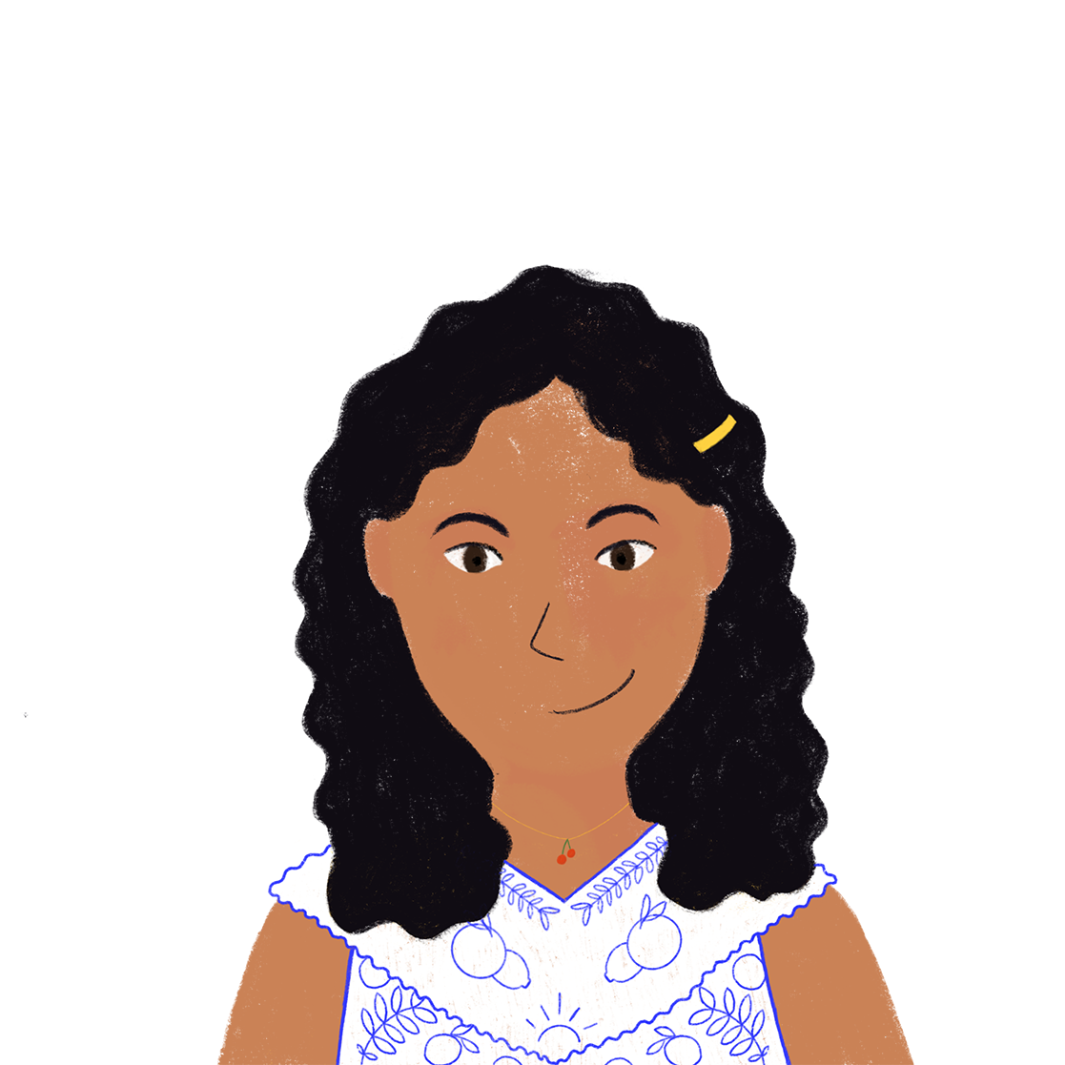
Un message vocal
écouter
Noura envoie un message à Abdel. Écoute chaque phrase et décide si elle donne une information ou pose une question.
1
Dad celebrated / Did dad celebrate his birthday last week.
2
You sent / Did you send a present?
3
Your family went / Did your family go on a trip to Switzerland last year.
4
You travelled / Did you travel to Zurich?
5
You visited / Did you visit Lausanne?
6
We visited / Did we visit Lausanne yesterday.
Notes:
Timing: 5 minutes
Aim: Aural recognition of yes/no questions and statements in the perfect tense; to connect use of est-ce que and raised intonation with past tense sentence with the English translation ‘did’.
Procedure:
1. Students write 1-8 in their books.
2. To play the audio, click the number button.
3. Students listen to the audio and choose the correct beginning of each sentence, based on the presence or absence of est-ce que or raised intonation. Remind students that the sentence could still be a question even if they don’t hear est-ce que at the beginning. If the sentence doesn’t start with est-ce que, they will have to listen to the intonation at the end of the sentence to decide whether or not it is a question.
4. Click to reveal answers, including correct pronunciation marks.
Transcript:
Mon père a célébré son anniversaire la semaine dernière.
Est-ce que tu as envoyé un cadeau ?
Ta famille a fait un voyage en Suisse l’année dernière.
Tu as voyagé à Zurich ?
Est-ce que tu as visité Lausanne ?
On a visité Lausanne hier.
Tu as fait une visite du musée ?
Ma mère a aimé des montagnes.
Word frequency of cognates used (1 is the most frequent word in French): message [792], vocal [4316], décider [165], information [317], poser [218]
Source: Londsale, D., & Le Bras, Y. (2009). A Frequency Dictionary of French: Core vocabulary for learners London: Routledge.

Slide 13
Un voyage en Suisse
lire/ écouter
Partenaire A: choisit une phrase. Lis la phrase en français.
Partenaire B: traduis en anglais. Ça commence avec ‘You…’ ou ‘Did you…’?
1. Est-ce que tu as visité le musée?
2. Tu as visité le musée.
3. Tu as voyagé à Genève.
4. Est-ce que tu as voyagé à Genève?
5. Tu as traversé la frontière.
6. Est-ce que tu as traversé la frontière.
Did you visit the museum?
You visited the museum.
You travelled to Geneva.
Did you travel to Geneva?
You crossed the border.
Did you cross the border?
Notes:
Timing: 7 minutes
Aim: to gain confidence in reading aloud and recognising questions with est-ce que.
Procedure:
1. Divide students into pairs.
2. One person looks at the board and chooses a sentence at random.
3. The other person looks away from the board and writes down the English meaning.
4. If support is needed, the answers could be presented as answer options in random order.

Slide 14
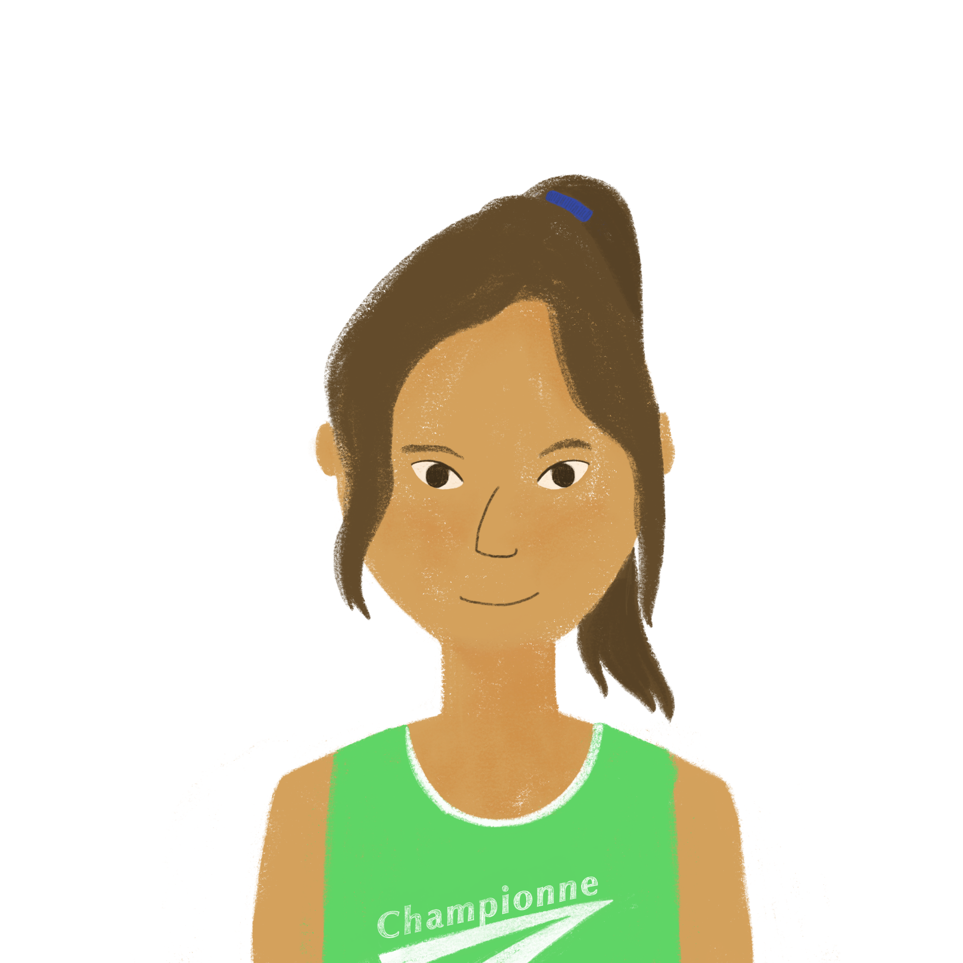
Des WhatsApps d’Océane
Lis les réponses d’Amir, et
écris les questions d’Océane.
écrire
Amir <3
Amir <3
(Est-ce que) tu as visité le musée ?
(Est-ce que) tu as cherché mon cadeau ?
Oui, j’ai visité le musée !
Non, je n’ai pas cherché ton cadeau.
(Est-ce que) tu as fait du shopping ?
(Est-ce que) tu as voyagé à Genève ?
Non, je n’ai pas fait de shopping.
Oui, j’ai voyagé à Genève.
Notes:
Timing: 8 minutes. This is slide 1/2.
Aim: Written production of yes/no questions in the perfect tense; comprehension of written statements in the perfect tense.
Procedure:
1. Students read Amir’s answers and decide what Océane’s questions must be. Remind students to play close attention to the subject of the answer (je or il/elle) in order to write questions in the correct form (tu or il/elle). Encourage students to use a mix of est-ce que and intonation questions.
2. Click to reveal suggested answers.

Slide 15
Des WhatsApps d’Océane
lire / écrire
Amir <3
Amir <3
(Est-ce que) ton père a fait une promenade ?
(Est-ce que) Noura a parlé allemand ?
Oui, mon père a fait une promenade.
Non, Noura n’a pas parlé allemand.
(Est-ce que) ta mère a trouvé le parc ?
(Est-ce que) tu as traversé la frontière ?
Non, ma mère n’a pas trouvé le parc.
Oui, j’ai traversé la frontière.
Notes:
This is slide 2/2.

Slide 16
Est-ce que c’est une question?
*la carte = card
*la partie = part
parler
Travaille à deux pour faire des phrases ensemble.
Partenaire A utilise sa carte* pour dire la première partie* de la phrase.
Partenaire B utilise sa carte pour compléter la phrase.
Elle a …
fait ses devoirs.
(statement)
fait ses devoirs ?
(question)
Notes:
Timing: 5 minutes
Aim: Oral production of perfect tenses statements and yes/no questions using appropriate intonation.
Procedure:
1. Teacher distributes role cards on the next slide to pairs of students.
2. Partner A uses their role card to begin a sentence. Some sentences start with est-ce que, others with a pronoun.
3. Partner B then uses the role play card to complete the second half of the sentence. Remind students that if the sentence starts with est-ce que, then it must be a question and Partner B must raise their intonation at the end of the sentence. If the sentence starts with a pronoun, it could be either a question or a statement and students should practise use both types of intonation to create statements and questions.
4. After four sentences, students to swap roles (Partner B starts the sentence and then Partner A completes it).
Word frequency of unknown words used (1 is the most frequent word in French): carte [955], partie [118]
Source: Londsale, D., & Le Bras, Y. (2009). A Frequency Dictionary of French: Core vocabulary for learners London: Routledge.
Word frequency of cognates used (1 is the most frequent word in French): compléter [2034]
Source: Londsale, D., & Le Bras, Y. (2009). A Frequency Dictionary of French: Core vocabulary for learners London: Routledge.

Slide 17
Question or Statement ?
Question or Statement ?
Partner A
Partner B
Est-ce que tu as …
Tu as…
 | fermé la porte?
 | regardé le film.
 | fait un voyage en Suisse?
 | visité la montagne
 | organisé la fête?
 | fait une promenade dans la forêt.
 | traversé la frontière?
 | emporté des sandwichs.
Est-ce que tu as …
Tu as…
…………………………… …………...…………………………………………  …………………………………………............. ……………...
Est-ce que tu as …
Tu as…
 | fermé la porte?
 | regardé le film.
 | fait un voyage en Suisse?
 | visité la montagne
 | organisé la fête?
 | fait une promenade dans la forêt.
 | traversé la frontière.
 | emporté des sandwichs?
Est-ce que tu as …
Tu as…
Notes:
Role play cards for the previous slide.
This is slide 2/2.

Slide 18
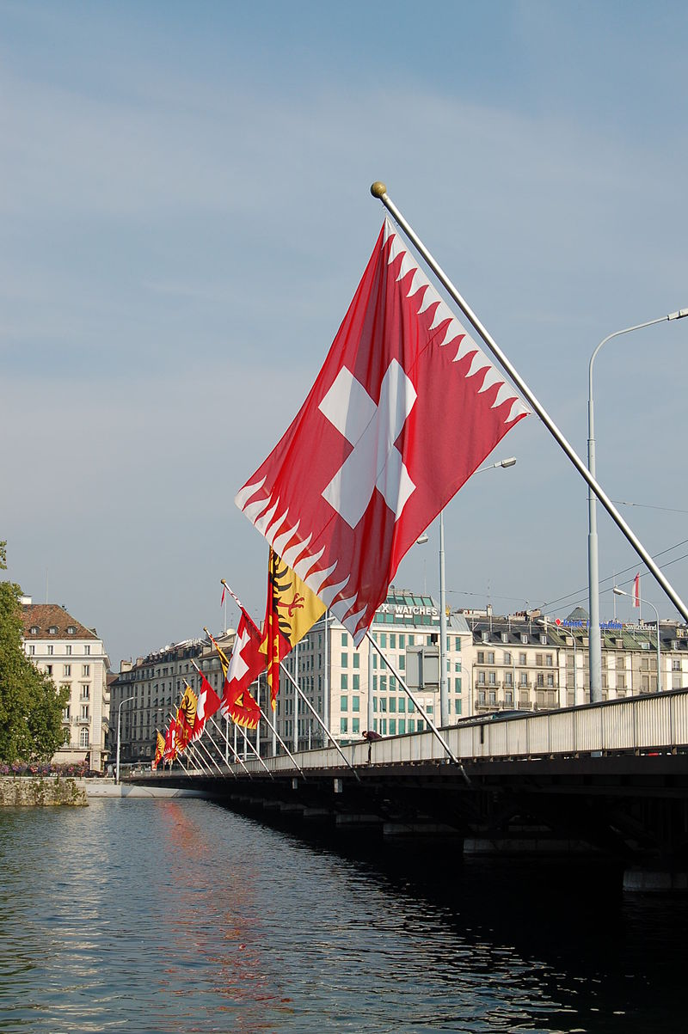
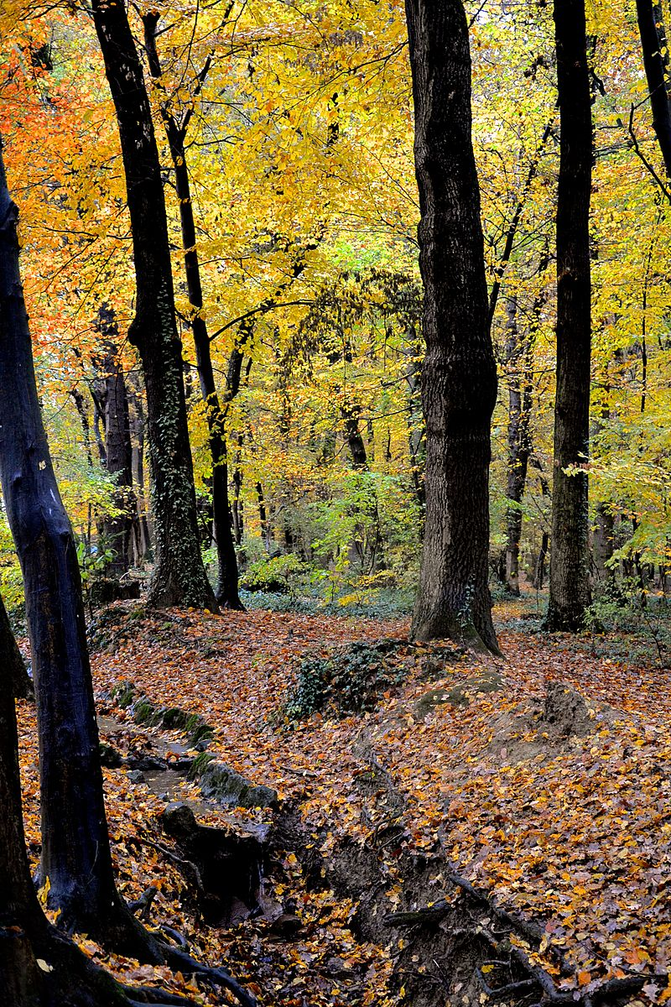
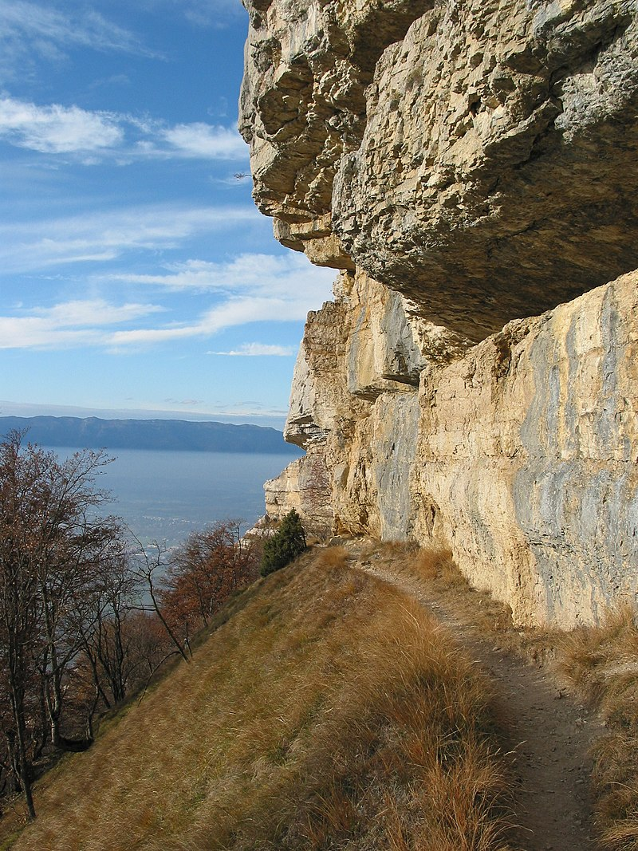
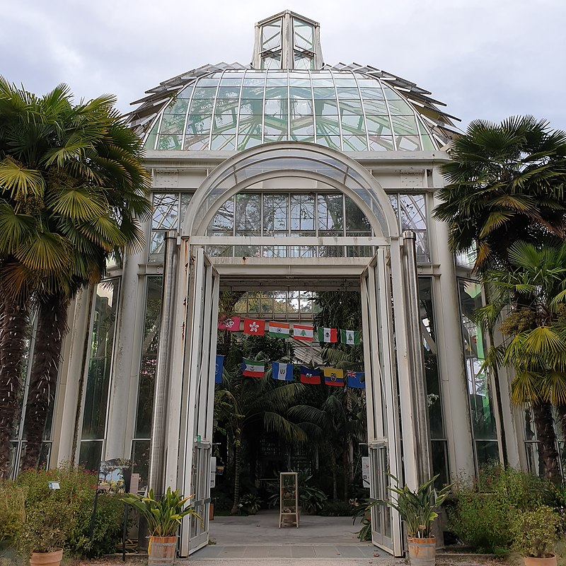
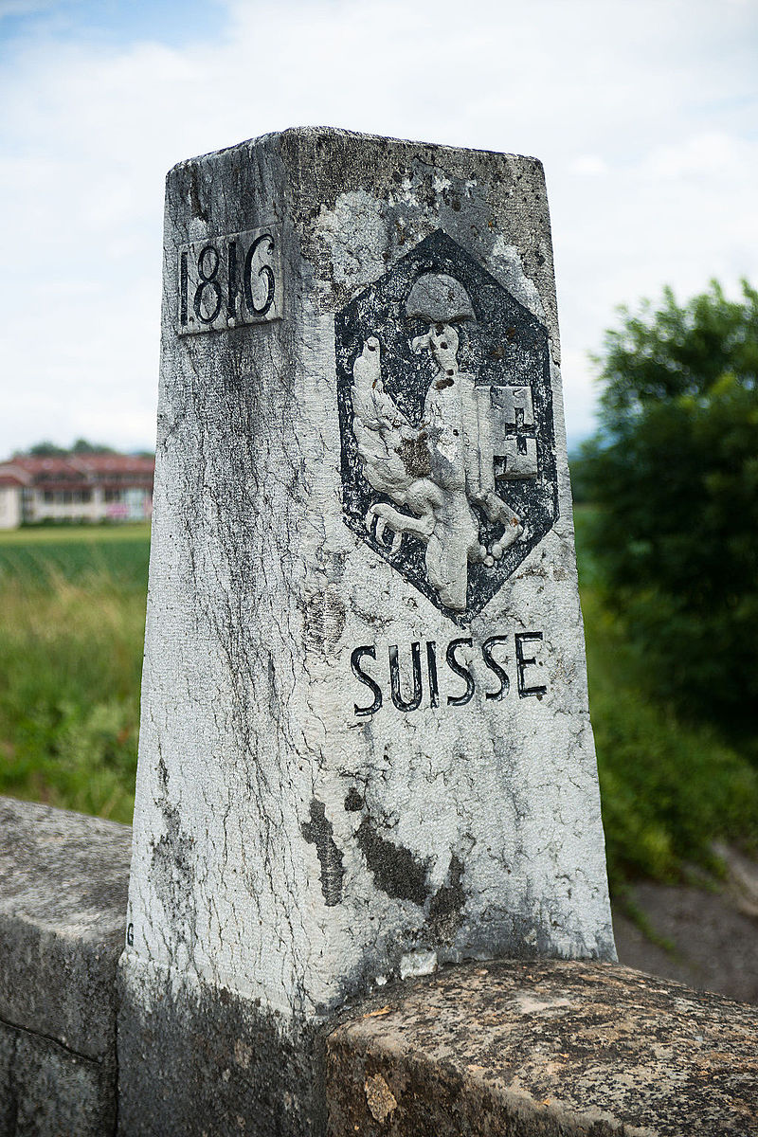
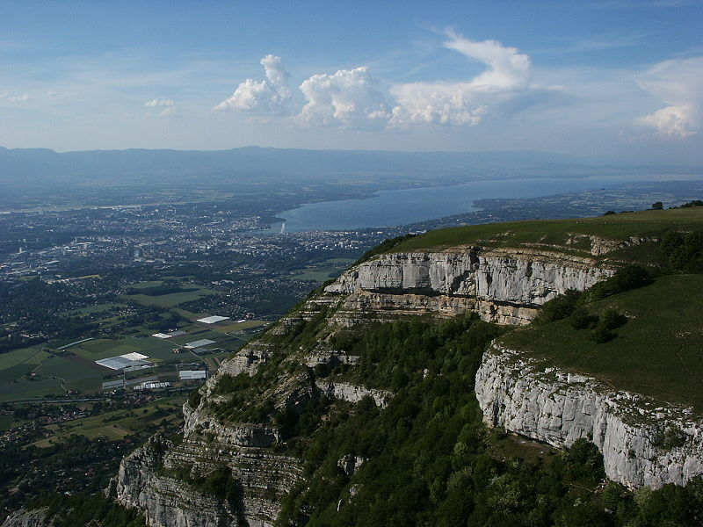
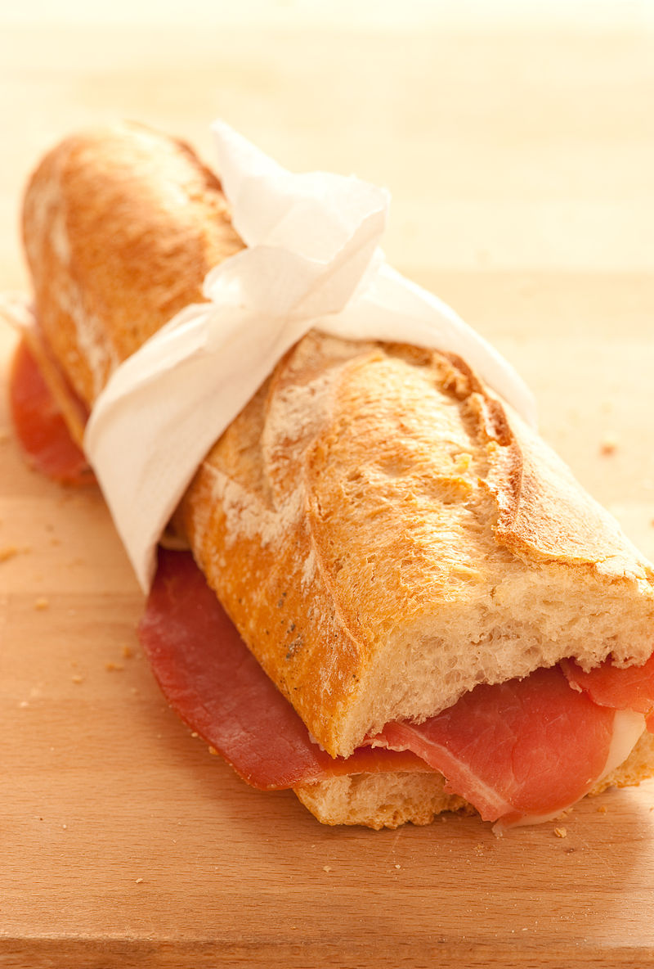
Talking about past holiday activities
ne…pas (de) in the perfect tense
SSCs closed [o/ô] and [au]
J’ai visité Bruxelles!
Y8 French
Term 1.2 - Week 4 - Lesson 22
Kirsten Somerville / Stephen Owen / Amber Dudley
Artwork by: Chloé Motard
Date updated: 09/07/21
Notes:
Note: all words (new and revisited) in this week of the SOW appear on all three GCSE wordlists, with these exceptions: i) Edexcel list does not have emporter, chacun, Genève
ii) AQA list does not have Genève
Learning outcomes (lesson 2):
Consolidation of SSCs open and closed [eu/œu]
Introduction of il y avait
Consolidation of il y a
Word frequency (1 is the most frequent word in French):
8.1.2.3 (introduce) emporter [1128], proposer [338], voyager [2194], traverser [1040], frontière [1182], forêt [1724], montagne [1732], vue [191], suisse [2241], Suisse [n/a], Genève [n/a], il y avait [13/36/8]
8.1.1.6 (revisit) organiser [701], chacun [323], anniversaire [2043], août [1445], décembre [891], juillet [1326], septembre [944], octobre [826], novembre [982], général [147], national [227], partout [581]
7.3.2.5 (revisit) devoir [39], dois [39], doit [39], veut [57], veux [57], vouloir [57], visiter [1378], billet [1916]
Source: Londsale, D., & Le Bras, Y. (2009). A Frequency Dictionary of French: Core vocabulary for learners London: Routledge.

Slide 19
Closed [o] et [au/eau]
écouter
What do you notice about these words?
Even though these words are spelled differently, they sound exactly the same!
SSC closed [o] is the same sound as SSC [au/eau], which you already know.
[skin]
peau
pot
Notes:
Timing: 2 minutes
Aim: Raising awareness of the identical sound in SSCs closed [o], and [au/eau]
For a reminder of Year 7 SSC [au/eau], see the two slides that follow.

Slide 20
[au/eau]
gauche
Notes:
Timing: 1 minute
Aim: To consolidate SSC [au]
Procedure: 1. Present the letter(s) and say the [au] sound first, on its own. Students repeat it with you. 2. Bring up the word ”gauche” on its own, say it, students repeat it, so that they have the opportunity to focus all of their attention on the connection between the written word and its sound.
3. A possible gesture for this would be to point to the students’ left (teacher’s right!) to indicate this direction. 4. Roll back the animations and work through 1-3 again, but this time, dropping your voice completely to listen carefully to the students saying the [au] sound, pronouncing ”gauche” and, if using, doing the gesture.
Word frequency (1 is the most frequent word in French):
gauche [607].
Source: Londsale, D., & Le Bras, Y. (2009). A Frequency Dictionary of French: Core vocabulary for learners London: Routledge.

Slide 21
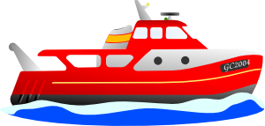
au
faux
bateau
[au/eau]
beau
eau
gauche
aussi
[also]
Notes:
Timing: 1 minute
Aim: To consolidate SSC [au]
Procedure:
1. Introduce and elicit the pronunciation of the individual SSC [au] and then the source word again ‘gauche’ (with gesture, if using). 2. Then present and elicit the pronunciation of the five cluster words.
The cluster words have been chosen for their high-frequency, from a range of word classes, with the SSC (where possible) positioned within a variety of syllables within the words (e.g. initial, 2nd, final etc.). Additionally, we have tried to use words that build cumulatively on previously taught SSCs (see the Phonics Teaching Sequence document) and do not include new SSCs. Where new SSCs are used, they are often consonants which have a similar symbol-sound correspondence in English.
Word frequency (1 is the most frequent word in French): gauche [607]; aussi [44]; faux [555] bateau [1278]; beau [393]; eau [475] Source: Londsale, D., & Le Bras, Y. (2009). A Frequency Dictionary of French: Core vocabulary for learners London: Routledge.

Slide 22
Phonétique
Say only the words which contain a closed [o] sound.
parler
 | coin | dispositif | chaud | bougie | ancien | chose
 | sauter | clôture | croissant | cerveau | idiot | tournant
 | onze | écran | oser | fantôme | bureau | sombre
 | chaos | pendant | troupe | aussitôt | moitié | chaussure
 | propos | erreur | texto | manteau | réponse | confiance
 | cerveau | plutôt | source | champion | toit | symptôme
a
[corner]
[device]
[candle]
b
[to jump]
[closing]
[brain]
[corner]
c
[screen]
[to dare]
[gloomy]
d
[group]
[instantly]
[half]
[shoe]
e
[statements]
[text message]
[coat]
[confidence]
f
[brain]
[rather]
[roof]
Notes:
Timing: 7 minutes
Aim: written recognition and pronunciation of letter combinations pronounced like SSC closed [o]. Students’ knowledge of patterns which are pronounced this is strengthened by recognising them from a pool of distractors, learning to disregard options which contain the letters ‘o’ and ‘a’ as part of other SSCs ([oi], [on], [ou], and [an]).
Procedure:
1. Students take turns read their line of words and take it in turns to say aloud ONLY the ones containing a closed ‘o’.
Optional – click to underline closed ‘o’ sound to help students. (otherwise, use this function to reveal answers).
2. Click on the letters to check pronunciation.
3. Challenge – encourage students to speed up as they get more confident
4. Swap roles and repeat/
Transcript and word frequency:
coin [1793], dispositif [2248], chaud [1852], bougie [>5000], ancien [392], chose [125]
sauter [2114], clôture [2839], croissant [2069], cerveau [1990], idiot [3556], tournant [2406]
onze [2447], écran [2421], oser [1634], fantôme [4075], bureau [273], sombre [2348]
chaos [3266], pendant [89], troupe [1282], aussitôt [2362], moitié [470], chaussure [3638]
propos [505], erreur [612], texto [>5000], manteau [3746], réponse [456], confiance [435]
cerveau [1990], plutôt [272], source [817], champion [2443], toit [2894], symptôme [4095]
Source: Londsale, D., & Le Bras, Y. (2009). A Frequency Dictionary of French: Core vocabulary for learners London: Routledge.

Slide 23
The perfect tense: negatives
grammaire
As you know, to make a sentence negative, we add ne… pas before and after the verb:
Present:
Je ne visite pas la ville. I’m not visiting the town.
Elle n’organise pas de voyages. She isn’t organising trips.
In two verb structures, ne… pas surrounds the first verb (which agrees with the subject). So, in the perfect tense, ne… pas surrounds the form of avoir:
Perfect (past):
Je n’ai pas visité la ville. I didn’t visit the town.
Elle n’a pas organisé de voyages. She didn’t organise any trips.
Ne → n’ before a vowel / h.
un/une/des → de in negative sentences.
There is no one-word equivalent for ‘didn’t’ in French.
Didn’t = ne … pas + past tense
Notes:
Timing: 3 minutes
Aim: introducing construction of negative sentences in the perfect tense

Slide 24
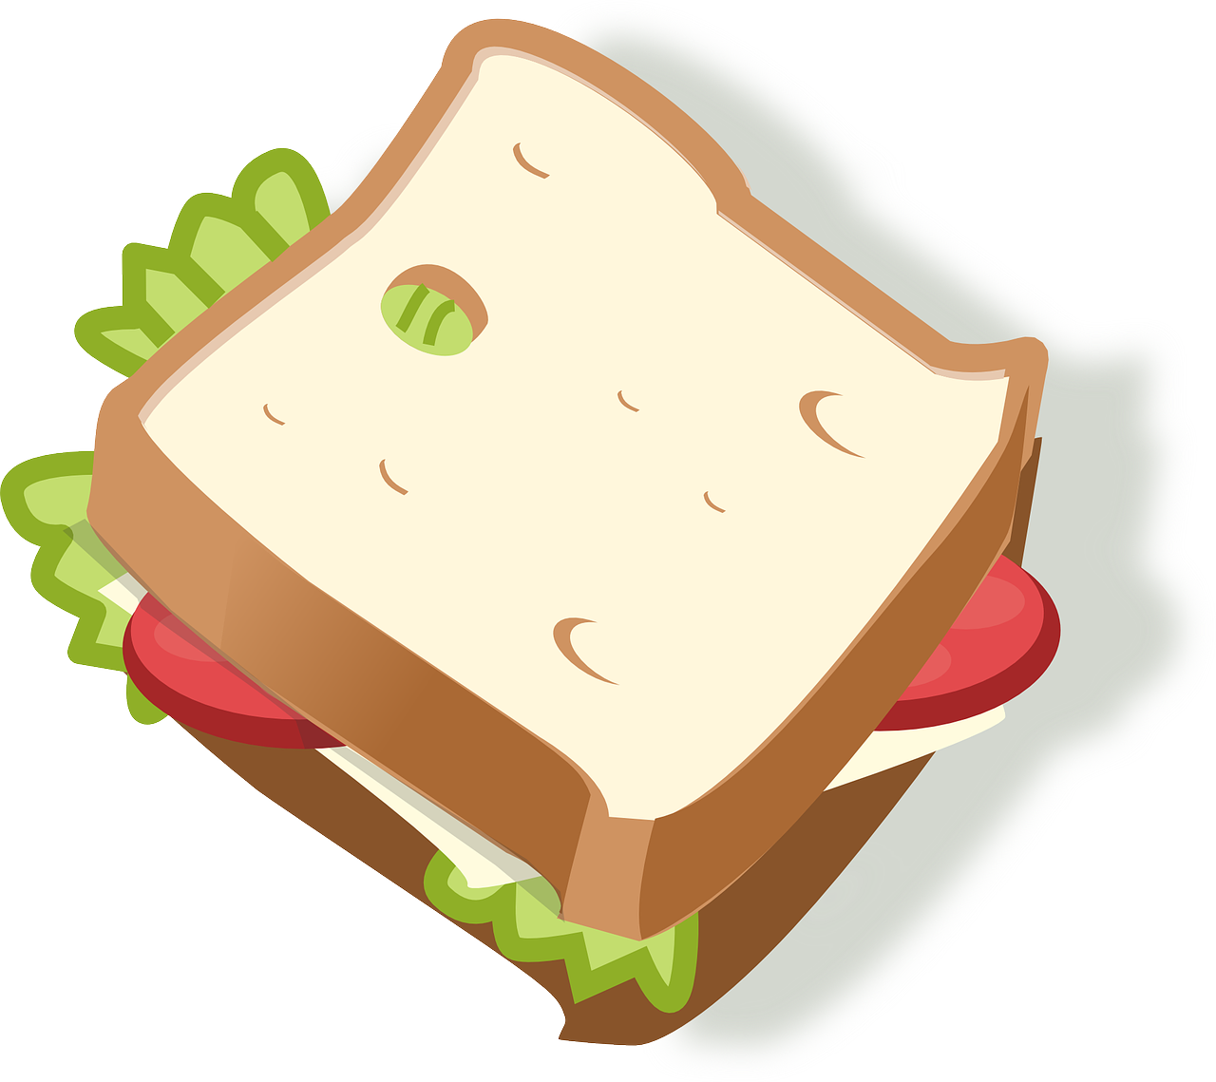
La famille a fait quoi ?
écouter
Noura parle de son dernier jour en Suisse. La famille a fait ces activités ?
Exemple
Exemple
Notes:
Timing: 8 minutes (2 slides)
Aim: Aural recognition of affirmative and negative statements in the perfect tense.
Procedure:
1. Depending on the level of the class, students can listen to individual sentences describing each picture (click on the number buttons) or listen to a monologue (click on the loudspeaker icon).
2. Students decide whether the family did the activity or not, based on the presence or absence of ne…pas.
3. Click to reveal answers.
Transcript:
1. On n’a pas fait les magasins.
2. Et on a mangé des sandwiches au parc.
Word frequency of cognates used (1 is the most frequent word in French): sandwich [>5000], activité [452]
Source: Londsale, D., & Le Bras, Y. (2009). A Frequency Dictionary of French: Core vocabulary for learners London: Routledge.

Slide 25
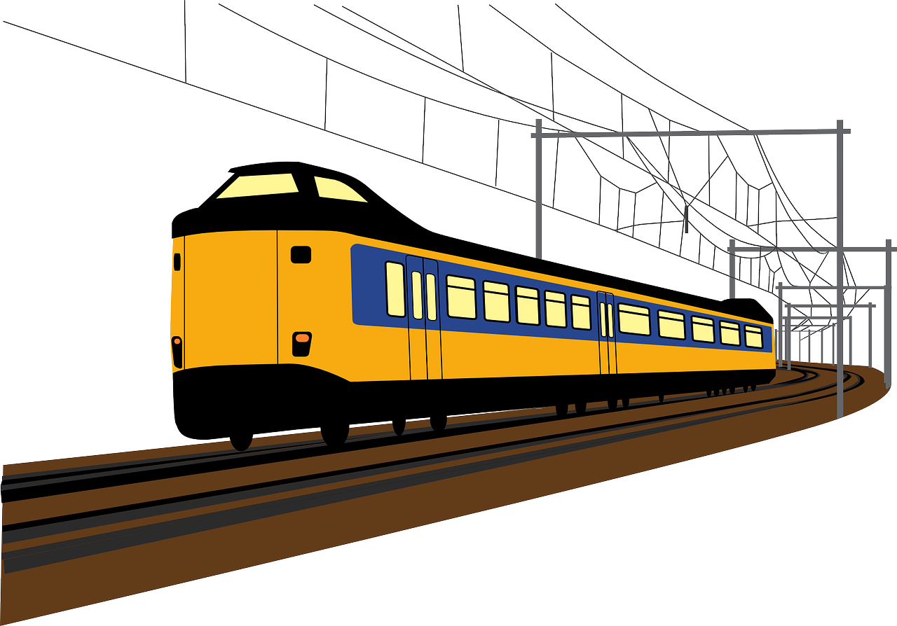
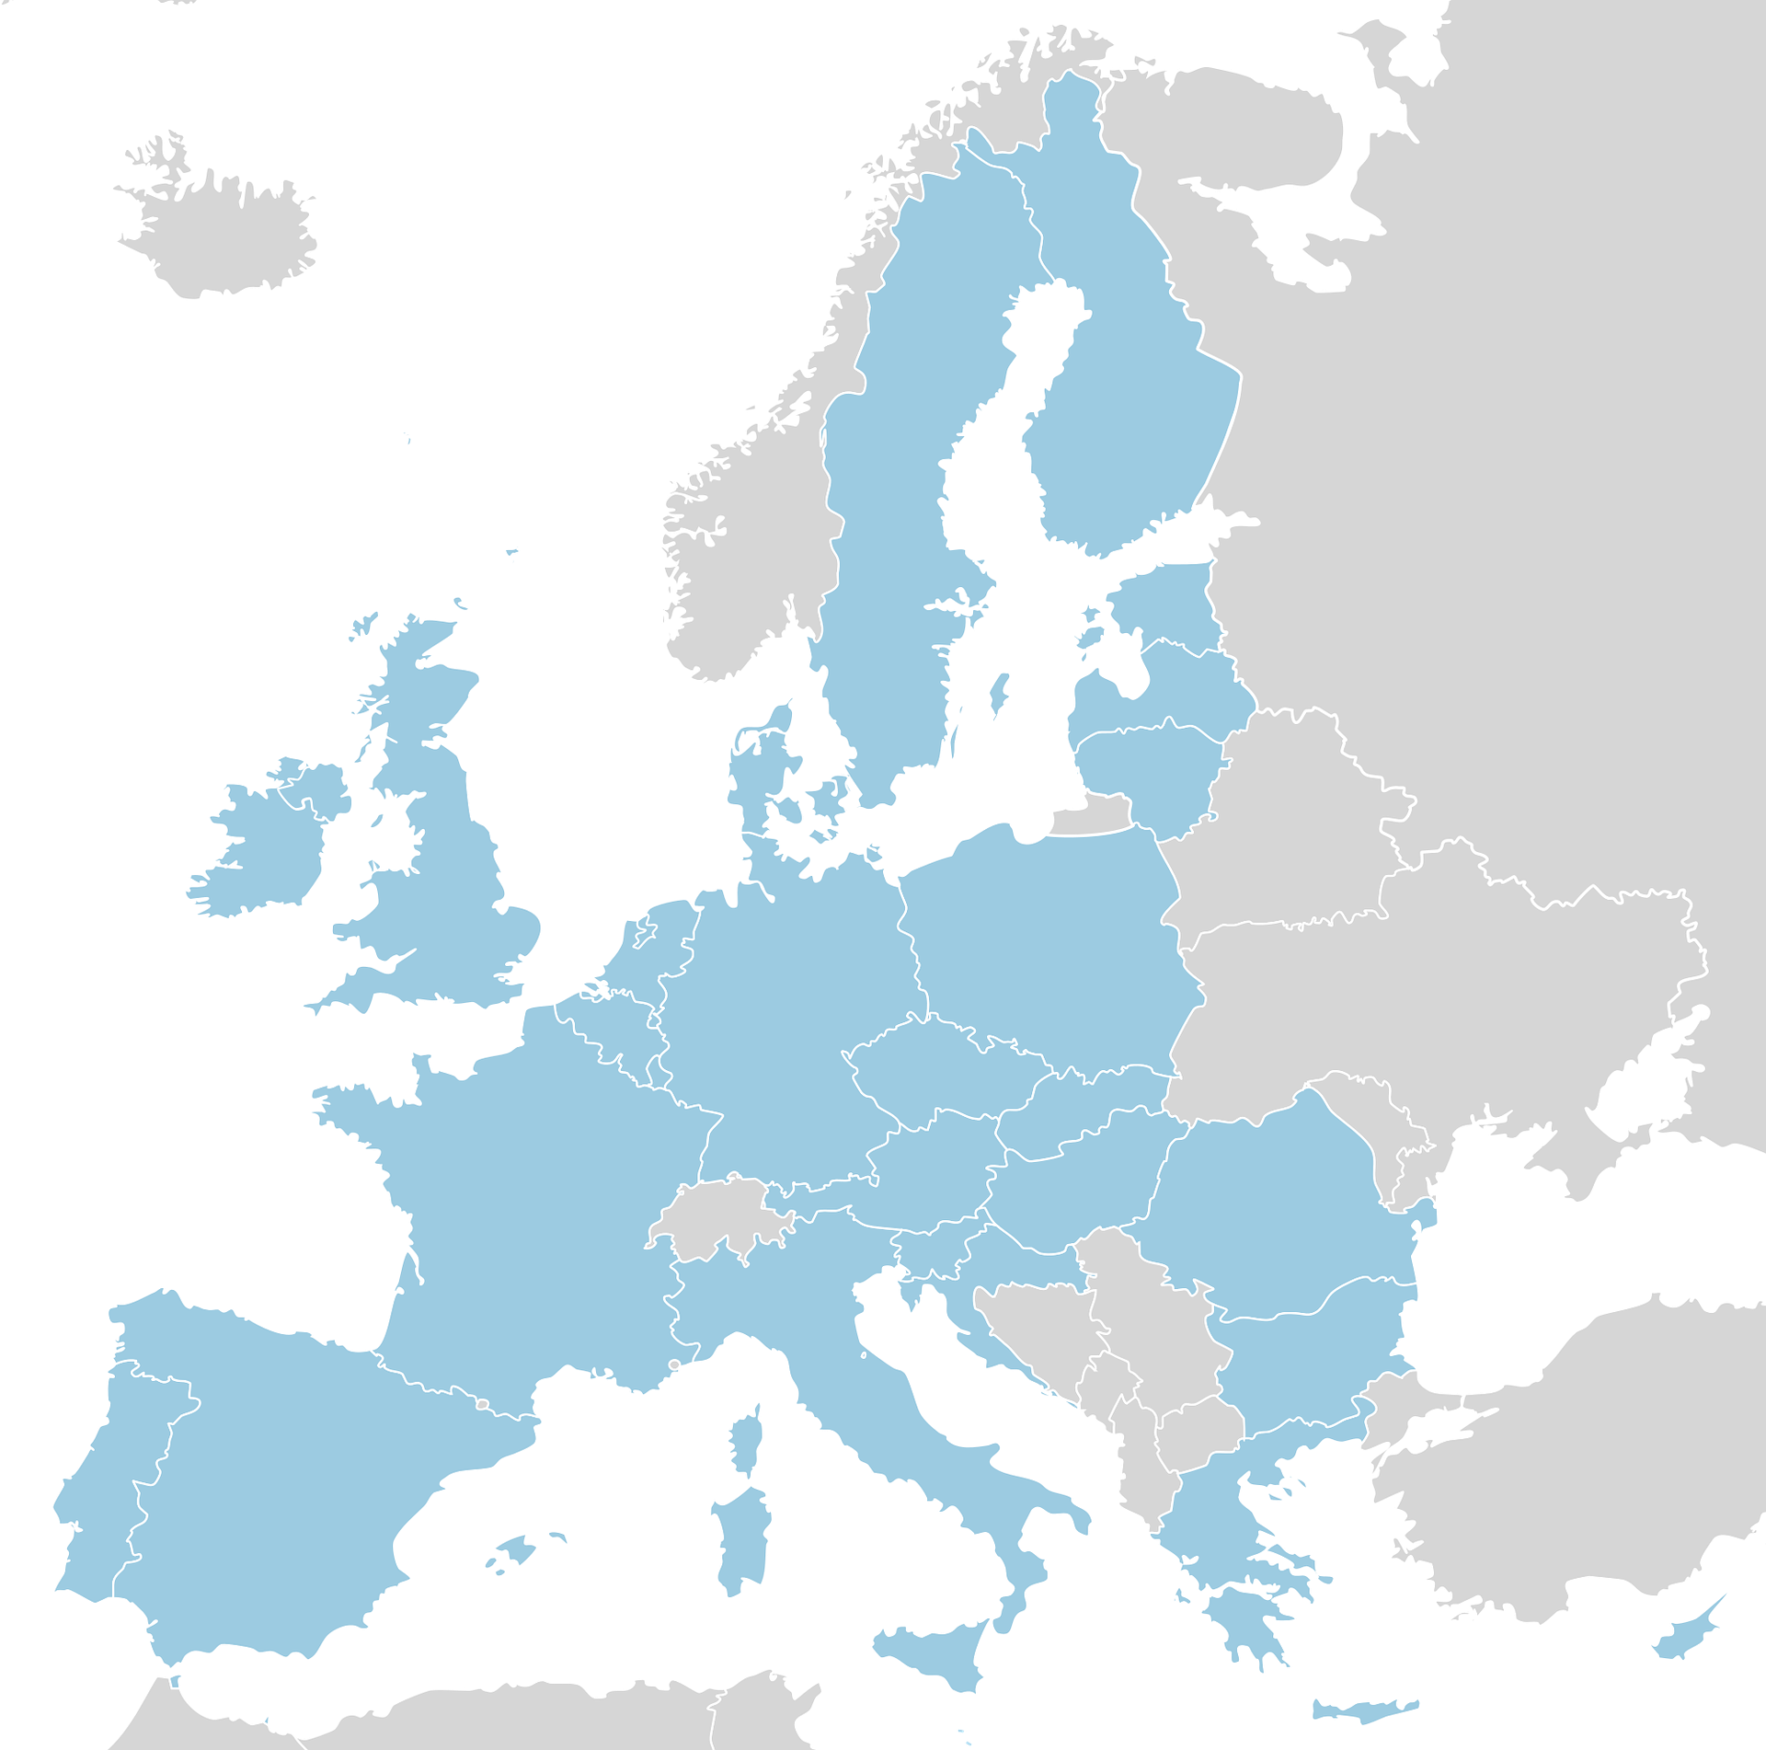
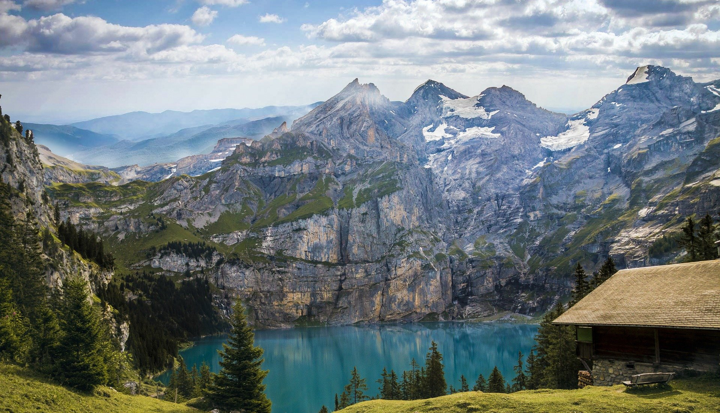
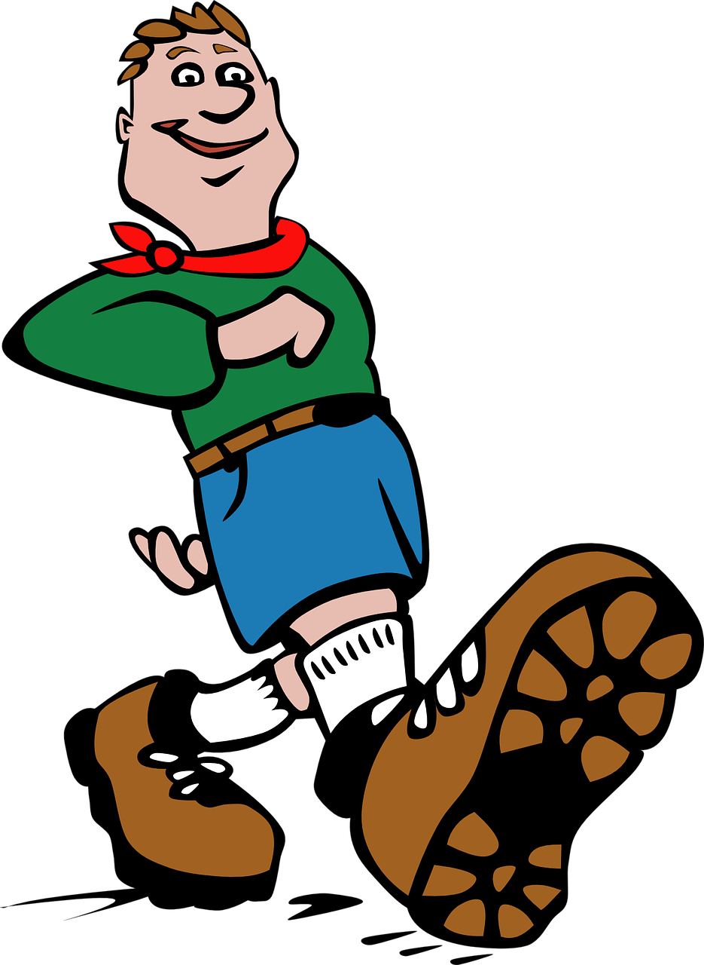
La famille a fait quoi ?
écouter
Noura parle de son dernier jour en Suisse. La famille a fait ces activités ?
1
2
3
4
5
6
Notes:
2/2 Procedure:
1. Depending on the level of the class, students can listen to individual sentences describing each picture (click on the number buttons) or listen to a monologue (click on the loudspeaker icon).
2. Students decide whether the family did the activity or not, based on the presence or absence of ne…pas.
3. Click to reveal answers.
Transcript:
1. On n’a pas traversé la frontière hier.
2. On a passé du temps à Lausanne.
3. On a voyagé en train.
4. Et on n’a pas trouvé un cadeau pour mon ami.
5. On n’a pas visité le musée.
6. On a fait une promenade.
Word frequency of cognates used (1 is the most frequent word in French): sandwich [>5000], activité [452]
Source: Londsale, D., & Le Bras, Y. (2009). A Frequency Dictionary of French: Core vocabulary for learners London: Routledge.

Slide 26
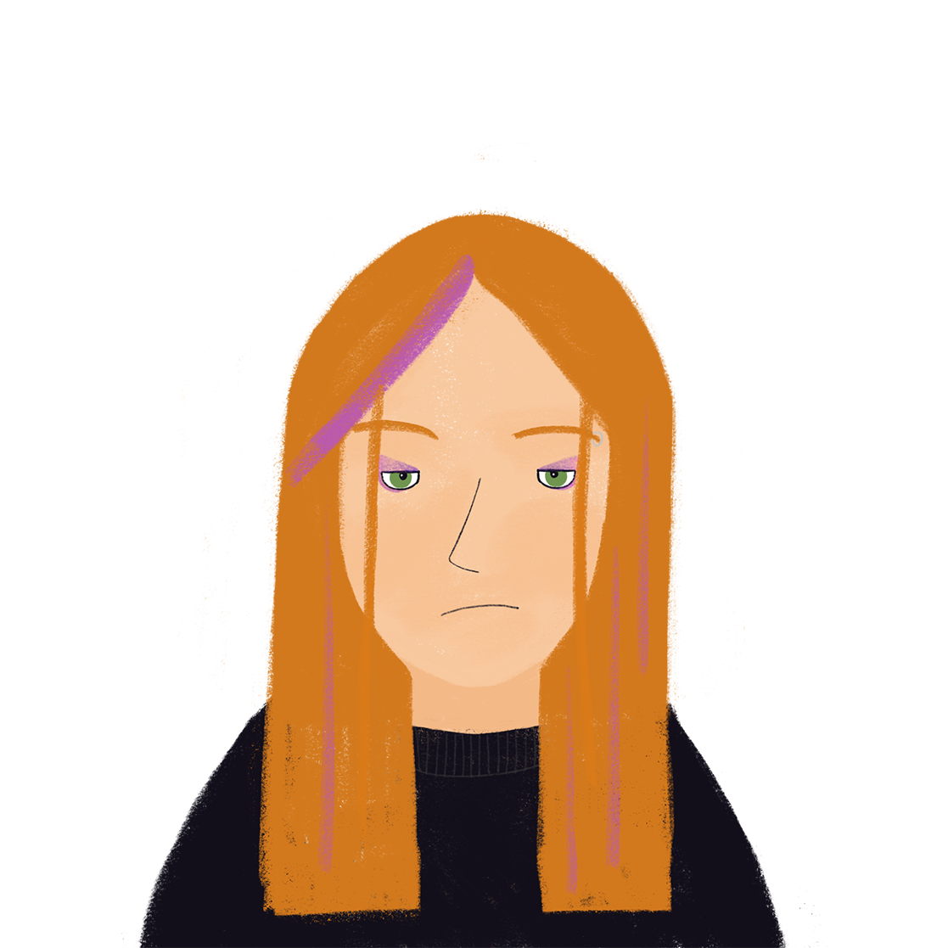
Les vacances (1/3)
écrire
Chacun dans la famille a aimé les vacances – chaque personne n’a pas fait une chose qu’elle fait normalement ! Écris des phrases avec ne…pas.
Exemple:
travailler au café
Je n’ai pas travaillé au café.
Élodie
Notes:
Timing: 10 minutes for 3 slides
Aim: written production of word order with negative sentences in the perfect tense
Procedure:
1. Students write 1-6 and write a sentence for each family member using the perfect tense and ne…pas.
2. Check answers on the réponses slide.
3. English translations can also be elicited.
Word frequency of cognates used (1 is the most frequent word in French): chocolat [4556]
Source: Londsale, D., & Le Bras, Y. (2009). A Frequency Dictionary of French: Core vocabulary for learners London: Routledge.

Slide 27
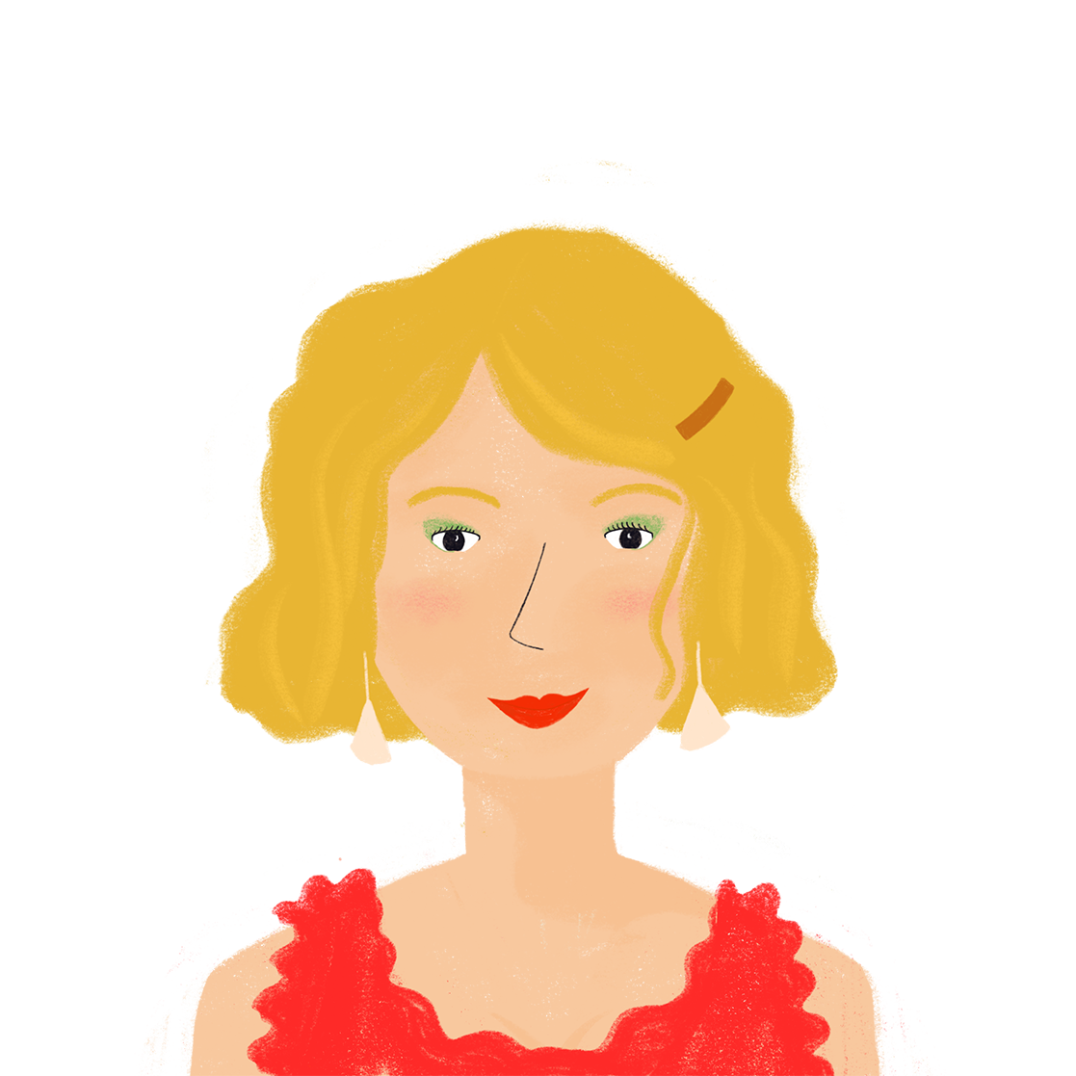
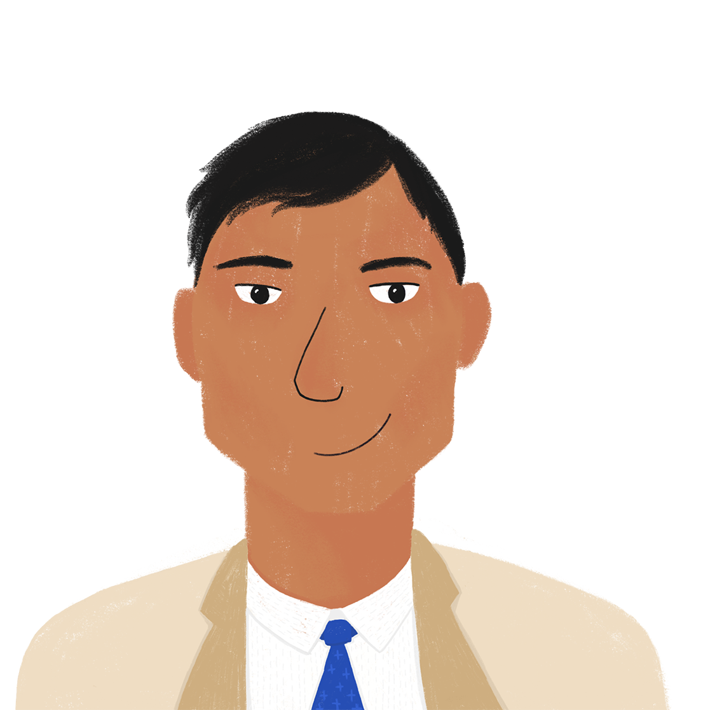
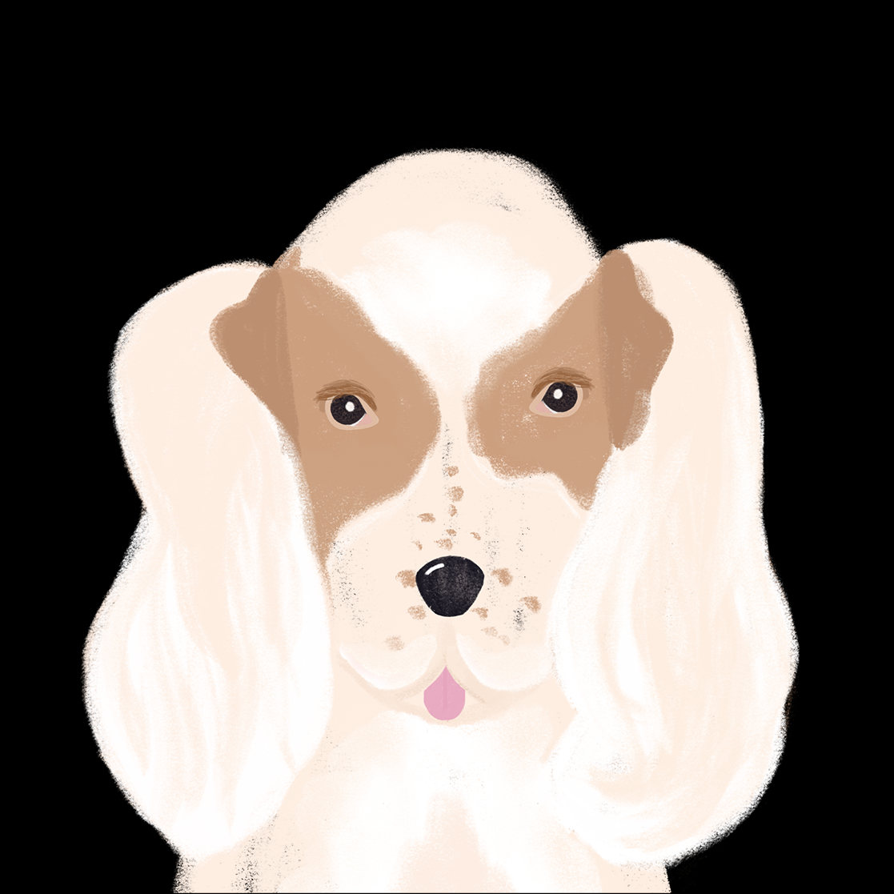
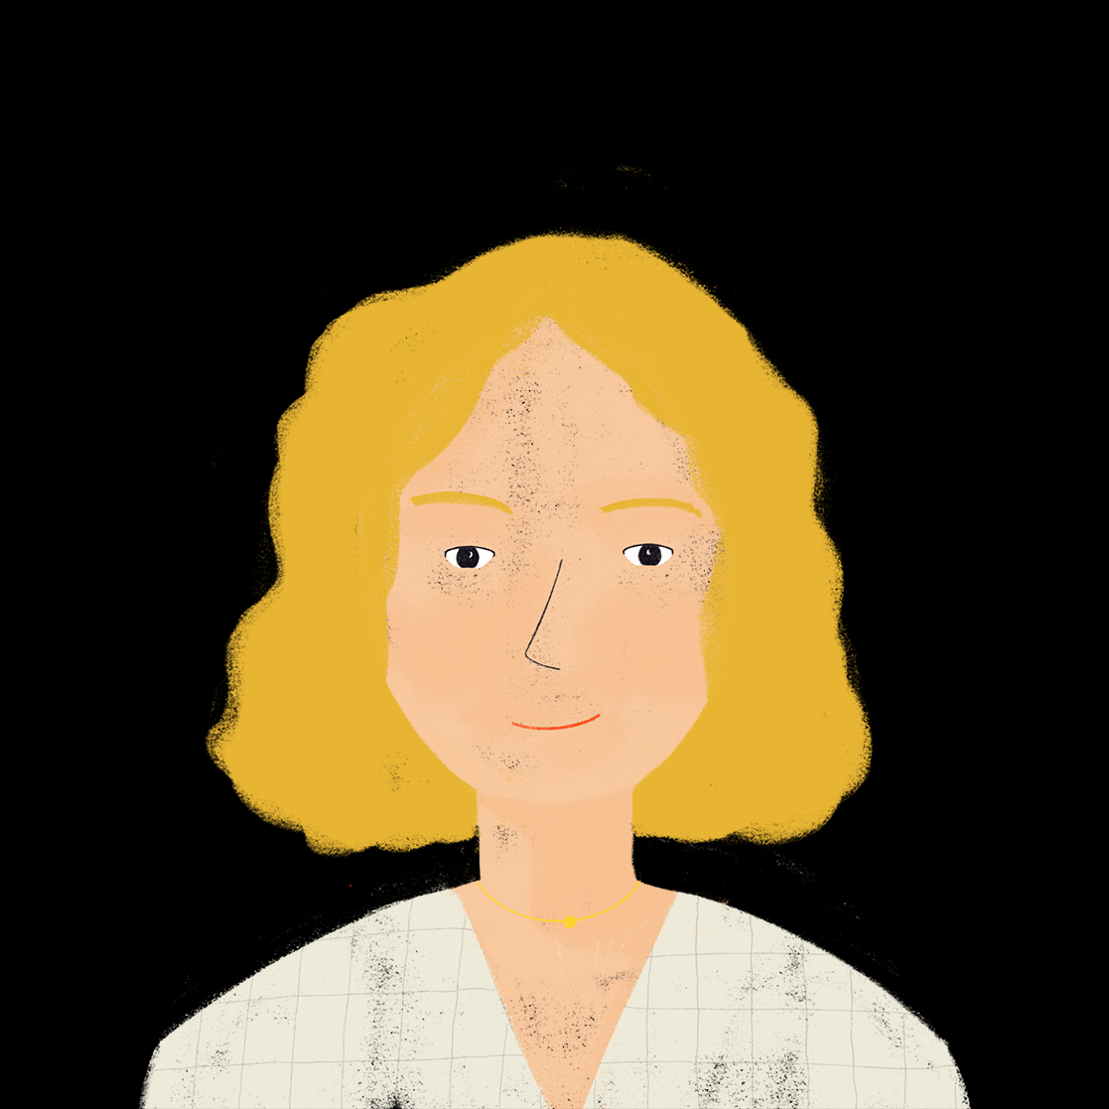
Les vacances (2/3)
écrire
Écris des phrases avec ne…pas.
1. Amandine
utiliser la voiture
2. Bilal
manger au bureau
3. Noura
penser aux devoirs
Remember! un/une/des → de
in negative sentences.
4. Amir
écouter les professeurs
5. Apollon
trouver des chocolats
6. Aurélie
parler au directeur
Notes:
Procedure:
1. Students write 1-6 and write a sentence for each family member using the perfect tense and ne…pas.
2. Check answers on the réponses slide.
3. English translations can also be elicited.
Word frequency of cognates used (1 is the most frequent word in French): chocolat [4556]
Source: Londsale, D., & Le Bras, Y. (2009). A Frequency Dictionary of French: Core vocabulary for learners London: Routledge.

Slide 28
Les vacances (3/3)
Réponses
écrire
Chacun dans la famille a aimé les vacances – chaque personne n’a pas fait une chose qu’elle fait normalement ! Écris des phrases avec ne…pas.
Amandine n’a pas utilisé la voiture.
Bilal n’a pas mangé au bureau.
Noura n’a pas pensé aux devoirs.
Amir n’a pas écouté les professeurs.
Apollon n’a pas trouvé de chocolats.
Aurélie n’a pas parlé au directeur.

Slide 29
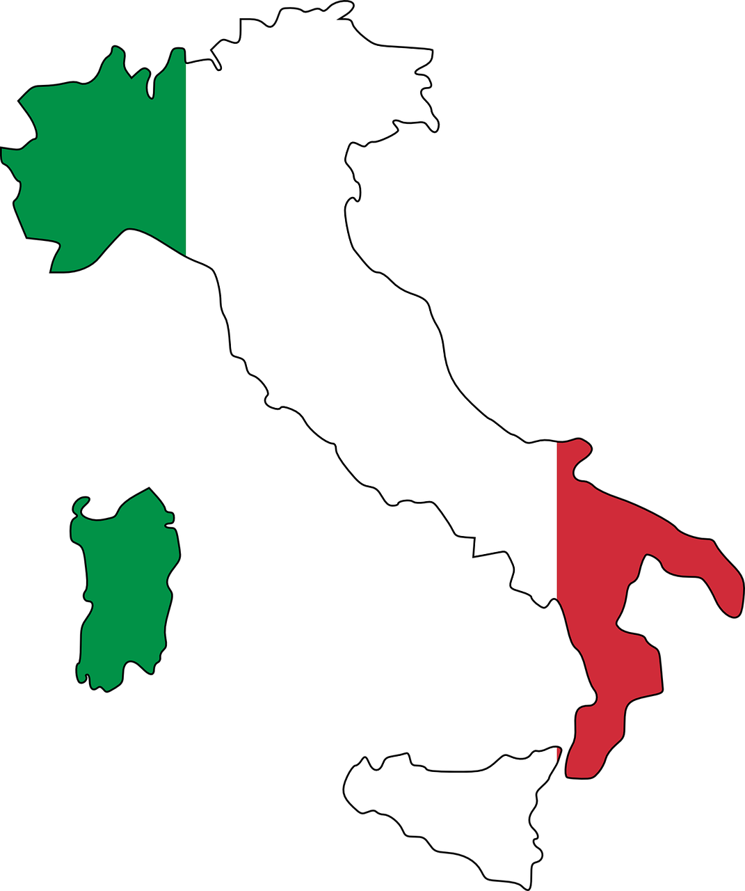
Deux voyages en Suisse !
Partenaire A
parler
?
jouer dans la forêt
chercher la frontière
voyager en Italie
regarder la vue
visiter le jardin botanique
traverser le pont
faire de la marche à la montagne
emporter un sandwich
Notes:
Timing: 10 minutes
Aim: practising oral production of questions and negative sentences in the perfect tense.
Procedure:
Students work together to determine which activities they have in common, and which are different.
Students take it in turn to form yes/no questions using the prompts provided (in any order) and respond with oui / non followed by an affirmative or negative sentence.
The student who asks the question also gives a full sentence stating whether they did or did not do the activity, and students note whether it is a match.
Continue until all activities have been asked about.
Word frequency of cognates used (1 is the most frequent word in French): botanique [>5000], sandwich [>5000]
Source: Londsale, D., & Le Bras, Y. (2009). A Frequency Dictionary of French: Core vocabulary for learners London: Routledge.
Image attribution:
Par Babsy — Travail personnel, CC BY-SA 4.0, https://commons.wikimedia.org/w/index.php?curid=37089073
Par Ludovic Péron — Travail personnel, CC BY-SA 3.0, https://commons.wikimedia.org/w/index.php?curid=20025169
Par Patrick Nouhailler's…, CC BY-SA 3.0, https://commons.wikimedia.org/w/index.php?curid=59465878
Par Benoit Kornmann — Travail personnel, CC BY-SA 3.0, https://commons.wikimedia.org/w/index.php?curid=1366663
Par Geneva photos — Travail personnel, CC BY-SA 4.0, https://commons.wikimedia.org/w/index.php?curid=82625475
By Norbert Aepli, Switzerland, CC BY 2.5, https://commons.wikimedia.org/w/index.php?curid=1254144
By Björn S., CC BY-SA 3.0, https://commons.wikimedia.org/w/index.php?curid=54431295
Par jules:stonesoup — https://www.flickr.com/photos/stone-soup/4143143813/, CC BY 2.0, https://commons.wikimedia.org/w/index.php?curid=12248164

Slide 30
Deux voyages en Suisse !
Partenaire B
parler
?
jouer dans la forêt
chercher la frontière
voyager en Italie
regarder la vue
visiter le jardin botanique
traverser le pont
faire de la marche à la montagne
emporter un sandwich

Slide 31
Devoirs
Vocabulary Learning Homework (Y8, Term 1.2, Week 5)
Audio file
Student worksheet
In addition, revisit: Y8 Term 1.1 Week 6 | Y7 Term 3.2 Week 5
Notes:
The answer sheet for the Y8, Term 1.2, Week 5 vocabulary learning HW is here: https://rachelhawkes.com/LDPresources/Yr8French/French_Y8_Term1ii_Wk5_audio_HW_sheet_answers.docx Don’t share this link with students ☺
Notes:
i) Teachers may, in addition, want to recommend use of a particular online app for the pre-learning of each week’s words. ii) Quizlet now requires parental involvement / registration / permissions for users below the age of 13, so it is perhaps most suitable for Y9 – 11 students. iii) Language Nut hosts LDP vocabulary lists and these are free for schools to use, though there is a registration process. One benefit is that all of the student tracking data that Language Nut offers are also available to schools that use the LDP lists for practice. Perhaps this makes it a good option for Y7/8.
iv) There are other free apps, and new ones are always appearing. Teachers have told us that they are currently using: Flippity, Wordwall (where using previously-created activities is free).
v) Gaming Grammar has been acquired by Language Nut. Its original content should still be available to teachers and much of it is appropriate for Y8 learners.
Verbs (present): 1st person singular/plural (Verb agreement (past))
Verbs (present): 3rd person singular/plural (Verb agreement (past))

