Slide 1
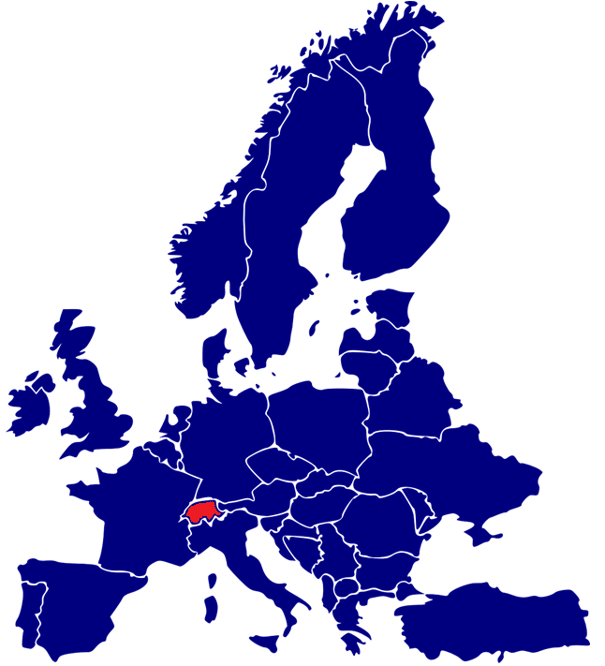
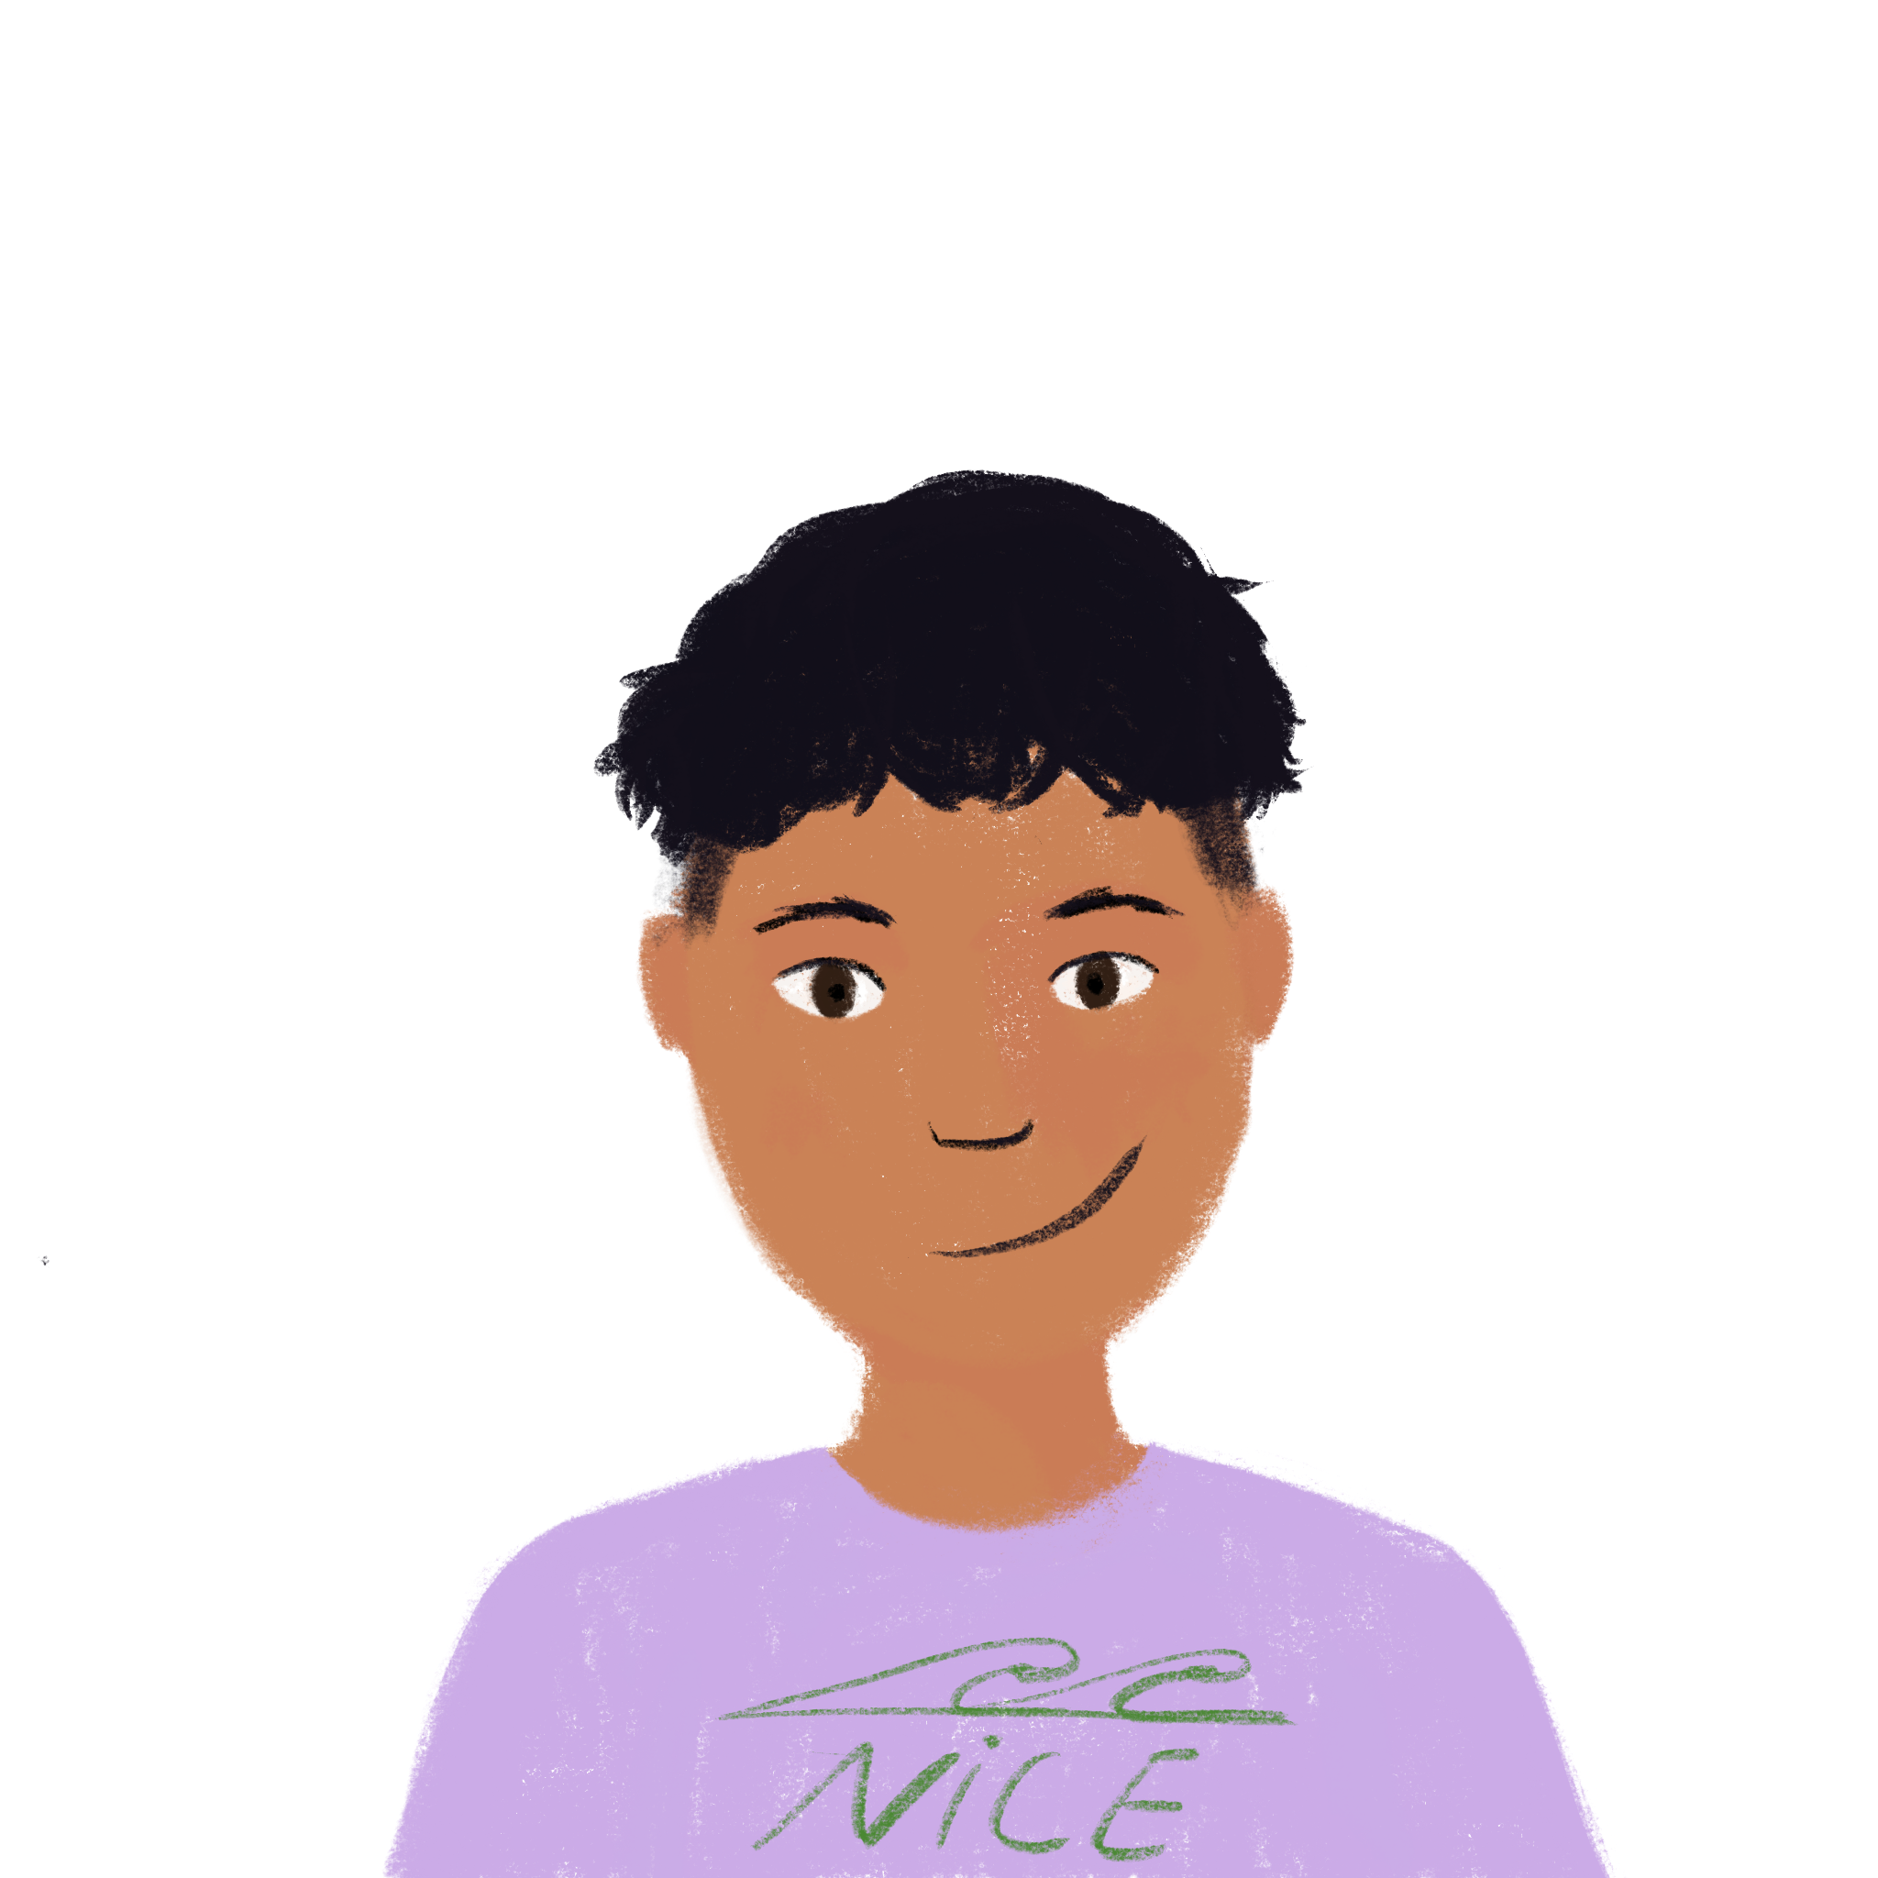
Talking about holidays: people and places in the past
present vs perfect tense (with past simple equivalent in English)
–ER verbs (taking avoir) (je, tu, il/elle)
J’ai visité la Suisse !
Y8 French
Term 1.2 - Week 3 - Lesson 19
Kirsten Somerville / Amber Dudley / Natalie Finlayson
Artwork by: Chloé Motard
Date updated: 31/12/2023
Notes:
Note: all words (new and revisited) in this week of the SOW appear on all three GCSE wordlists, with these exceptions: i) Edexcel list does not have Genève
ii) AQA list does not have emporter, Genève
Artwork by Chloé Motard. All additional pictures selected are available under a Creative Commons license, no attribution required.
Learning outcomes (lesson 1):
Introduction of SSC open [eu/œu]
Revision of SSC closed [eu/œu]
Revision of perfect tense constructions (with past simple equivalent) of –ER verbs with avoir as auxiliary (1st and 2nd person singular)
Introduction of perfect tense constructions (with past simple equivalent) of –ER verbs with avoir as auxiliary (3rd person singular)
Word frequency (1 is the most frequent word in French):
8.1.2.3 (introduce) emporter [1128], proposer [338], voyager [2194], traverser [1040], frontière [1182], forêt [1724], montagne [1732], vue [191], suisse [2241], Suisse [n/a], Genève [n/a], il y avait [13/36/8]
8.1.1.6 (revisit) organiser [701], chacun [323], anniversaire [2043], août [1445], décembre [891], juillet [1326], septembre [944], octobre [826], novembre [982], général [147], national [227], partout [581]
7.3.2.5 (revisit) devoir [39], dois [39], doit [39], veut [57], veux [57], vouloir [57], visiter [1378], billet [1916]
Source: Londsale, D., & Le Bras, Y. (2009). A Frequency Dictionary of French: Core vocabulary for learners London: Routledge.

Slide 2
open eu/œu
cœur
Notes:
Timing: 1 minute
Aim: To introduce SSC open [eu]/[œu]
Procedure: 1. Present the letter(s) and say the open [eu]/[œu] sound first, on its own. Students repeat it with you. 2. Bring up the word ”cœur” on its own, say it, students repeat it, so that they have the opportunity to focus all of their attention on the connection between the written word and its sound.
3. A possible gesture for this would be to put your hand on your chest over your heart. 4. Roll back the animations and work through 1-3 again, but this time, dropping your voice completely to listen carefully to the students saying the open [eu]/[œu] sound, pronouncing ”cœur” and, if using, doing the gesture.
Word frequency (1 is the most frequent word in French):
cœur [568]
Source: Londsale, D., & Le Bras, Y. (2009). A Frequency Dictionary of French: Core vocabulary for learners London: Routledge.

Slide 3
open eu/œu
cœur
Notes:
With sound and no pictures to focus all attention on the sound-symbol correspondence.

Slide 4
open eu/œu
cœur
Notes:
Without sound to elicit pronunciation (without first hearing the teacher).
Teacher to elicit pronunciation by asking “Comment dit-on …”

Slide 5
open eu/œu
acteur
neuf
9
jeune
cœur
sœur
[young]
[sister]
erreur
[mistake]
Notes:
Timing: 2 minutes
Aim: To introduce SSC open [eu]/[œu]
Procedure:
Introduce and elicit the pronunciation of the individual SSC open [eu]/[œu] and then the source word again ‘œil’ (with gesture, if using). Then present and elicit the pronunciation of the five cluster words. The cluster words have been chosen for their high-frequency, from a range of word classes, with the SSC (where possible) positioned within a variety of syllables within the words (e.g. initial, 2nd, final etc.). Additionally, we have tried to use words that build cumulatively on previously taught SSCs (see the Phonics Teaching Sequence document) and do not include new SSCs. Where new SSCs are used, they are often consonants which have a similar symbol-sound correspondence in English.
Word frequency (1 is the most frequent word in French): acteur [1552]; cœur [568]; jeune [152]; erreur [612]; neuf [787]; sœur [1558]. Source: Londsale, D., & Le Bras, Y. (2009). A Frequency Dictionary of French: Core vocabulary for learners London: Routledge.

Slide 6
open eu/œu
acteur
neuf
jeune
cœur
sœur
erreur
Notes:
With sound and no pictures to focus all attention on the sound-symbol correspondence.

Slide 7
open eu/œu
acteur
neuf
jeune
cœur
sœur
erreur
Notes:
Without sound to elicit pronunciation (without first hearing the teacher).
Teacher to elicit pronunciation by asking “Comment dit-on …”

Slide 8
Closed and open [eu/œu]
écouter
You have already met an [eu] sound in Year 7:
The long vowel sounds like the ‘ur’ in the English ‘hurt.’
[few]
[fear]
peu
peur
This is a closed vowel.
When you say this sound, your tongue is near the top of your mouth.
This is an open vowel.
When you say this sound, your tongue is near the bottom of your mouth.
Notes:
Timing: 2 minutes
Aim: To introduce the concept of open and closed vowel sounds.
Procedure:
1. Click to reveal ‘peu’. Students repeat it
2. Click to relevel the first info bubble. Students hear and say ‘peu’ again several time, noticing the position of the tongue in the mouth.
3. Click to reveal ‘peur’. Repeat steps one and two.
4. Click to play the words in quick succession.
5. Move to the following slides for a reminder of other words containing closed [eu].
Word frequency (1 is the most frequent word in French): peu [92], peur [755]

Slide 9
eu
deux
Notes:
Timing: 1 minute
Aim: To consolidate SSC [eu]
Procedure: 1. Present the letter(s) and say the [eu] sound first, on its own. Students repeat it with you. 2. Bring up the word ”deux” on its own, say it, students repeat it, so that they have the opportunity to focus all of their attention on the connection between the written word and its sound.
3. A possible gesture for this would be to hold up two fingers (N.B. palm of the hand facing the class!). 4. Roll back the animations and work through 1-3 again, but this time, dropping your voice completely to listen carefully to the students saying the [eu] sound, pronouncing ”deux” and, if using, doing the gesture.
Word frequency (1 is the most frequent word in French):
deux [41].
Source: Londsale, D., & Le Bras, Y. (2009). A Frequency Dictionary of French: Core vocabulary for learners London: Routledge.

Slide 10
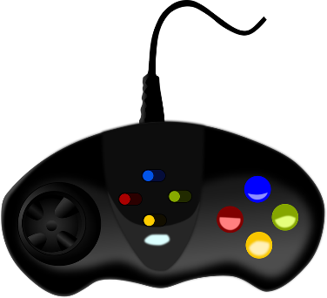
eu
jeudi
lieu
[place]
deux
feu
jeu
un peu
[a little]
Notes:
Timing: 1 minute
Aim: To consolidate SSC [eu]
Procedure:
1. Introduce and elicit the pronunciation of the individual SSC [eu] and then the source word again ‘deux’ (with gesture, if using). 2. Then present and elicit the pronunciation of the five cluster words.
The cluster words have been chosen for their high-frequency, from a range of word classes, with the SSC (where possible) positioned within a variety of syllables within the words (e.g. initial, 2nd, final etc.). Additionally, we have tried to use words that build cumulatively on previously taught SSCs (see the Phonics Teaching Sequence document) and do not include new SSCs. Where new SSCs are used, they are often consonants which have a similar symbol-sound correspondence in English.
Word frequency (1 is the most frequent word in French): deux {41]; jeudi[1112]; lieu [117] feu [786]; un peu [138/91]; jeu [291]. Source: Londsale, D., & Le Bras, Y. (2009). A Frequency Dictionary of French: Core vocabulary for learners London: Routledge.

Slide 11
Closed or open [eu/œu]?
écouter / écrire
 |  | open | closed
 | bleu [blue]
 | deux
 | bœuf
 |  | open | closed
 | ordinateur
 | vœux [wishes]
 | rumeur [rumour]
1
4
2
5
3
6
What do you notice about the spelling of the words containing open [eu/œu] compared to those containing closed [eu/œu]?
If the vowel is followed by a pronounced consonant (not an SFC), it is open.
Notes:
Timing: 5 minutes
Aim: aural recognition of open and closed [eu/œu]. Raising awareness of spelling rules governing the pronoun.
Procedure:
1. Click on numbers to hear words. Student decide if [eu/œu] is open or closed.
2. Click to reveal answers.
3. Click again to reveal the question about spelling. Students consider in pairs. They might say things like ‘the words are longer’ or ‘the sound is in the middle of the word’. Encourage students to look at the letters they see after the SSC.
4. Click to reveal the answers and again to reveal the rule.
5. Students try to say the words.
Word frequency (1 is the most frequent word in French): bleu [1216], deux [41], bœuf [3914], ordinateur [2201], déjeuner [2724], vœu [2103], rumeur [2164], peuple [378], adieu [3968], meuble [3876], feu [786],
Source: Londsale, D., & Le Bras, Y. (2009). A Frequency Dictionary of French: Core vocabulary for learners London: Routledge.

Slide 12
Vocabulaire
écouter / lire
1
mountain
la montagne
2
to suggest doing
proposer
3
Switzerland
la Suisse
7
to travel, travelling
voyager
4
forest
la forêt
8
swiss
suisse
to take with,
taking with
emporter
9
border
la frontière
5
to cross,
to go through
traverser
10
6
view
la vue
11
Geneva
Genève
12
there was, there were
il y avait
Notes:
Timing: 6 minutes
Aim: Recognition of this week’s new vocabulary in the oral and written modalities.
Note: Students in Y8 pre-learn vocabulary, additionally completing several tasks. This activity provides an additional step; listening and understanding the new vocabulary.
Procedure: 1. Click to hear the words in French. 2. Write down the meaning in English. 3. Click to reveal answers and transcriptions, one by one.
4. Click to cover the English.
5. Teacher now points at the French words in a random order.
6. Students say the English.

Slide 13
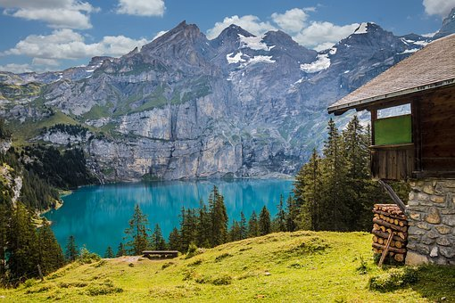
La Suisse
*l’Autriche = Austria
*du = of the
lire
La Suisse est un pays en Europe centrale. Elle a des frontières avec la France, l'Allemagne, l'Autriche*, le Liechtenstein et l'Italie. La suisse a quatre langues officielles : l’allemand, le français, l’italien et le romanche. Les Alpes représentent 58% du* territoire suisse. Si on voyage en Suisse, on peut admirer une belle vue sur les montagnes et les forêts.
1. Where is Switzerland located?
1. In central Europe.
2. How many borders does it have?
2. Five.
3. Which languages are spoken in Switzerland?
3. German, French, Italian, Romanche (spoken in the state of Grisons).
4. What is the Swiss scenery like?
4. Alpine, mountainous, forests, beautiful views
Notes:
Timing: 5 minutes
Aim: Recognition of this week’s new vocabulary in longer contexts; offering some cultural and geographical insights into Switzerland.
Procedure: 1. Point out the location of Switzerland on the map. Ask students to identify France.
2. Students read the text.
3. Click to bring up a comprehension question in English. Students answer in English.
4. Click to bring up the answer.
5. Click again to bring up another question.
6. Repeat steps 2-5 for 4 questions in total.
Word frequency of unknown words used (1 is the most frequent word in French):
Autriche [n/a]
Source: Londsale, D., & Le Bras, Y. (2009). A Frequency Dictionary of French: Core vocabulary for learners London: Routledge.
Word frequency of cognates used (1 is the most frequent word in French):
Europe [n/a], centrale [3164], Liechtenstein [n/a], officiel [996], italien [1477], romanche [>5000], représenter [293], territoire [698], admirer [2789]
Source: Londsale, D., & Le Bras, Y. (2009). A Frequency Dictionary of French: Core vocabulary for learners London: Routledge.

Slide 14
The perfect tense: il/elle
grammaire
Remember: -ER verbs make their perfect tense with tu as follows:
Present Perfect (past)
tu travailles → tu as travaillé
(you work) (you have worked)
What do you think the il/elle form looks like?
Present Perfect (past)
il travaille → il a travaillé
(he works) (he worked)
elle joue → elle a joué
(she plays) (she played)
Remember:
in the perfect tense
we use tu as (‘you have’),
rather than tu (‘you’).
The past participle does not change – only the part of avoir changes with the change of person.
Notes:
Timing: 2 minutes
Aim: recapping the formation of the perfect tense je form with –ER verbs taking avoir, introducing the il/elle form

Slide 15
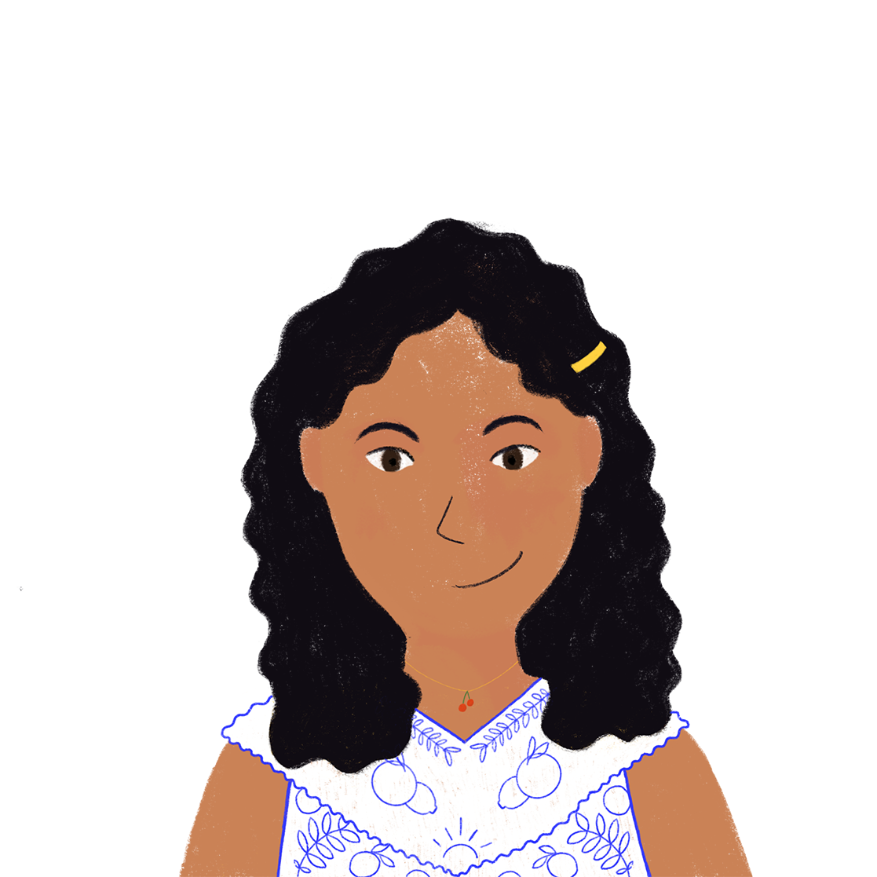
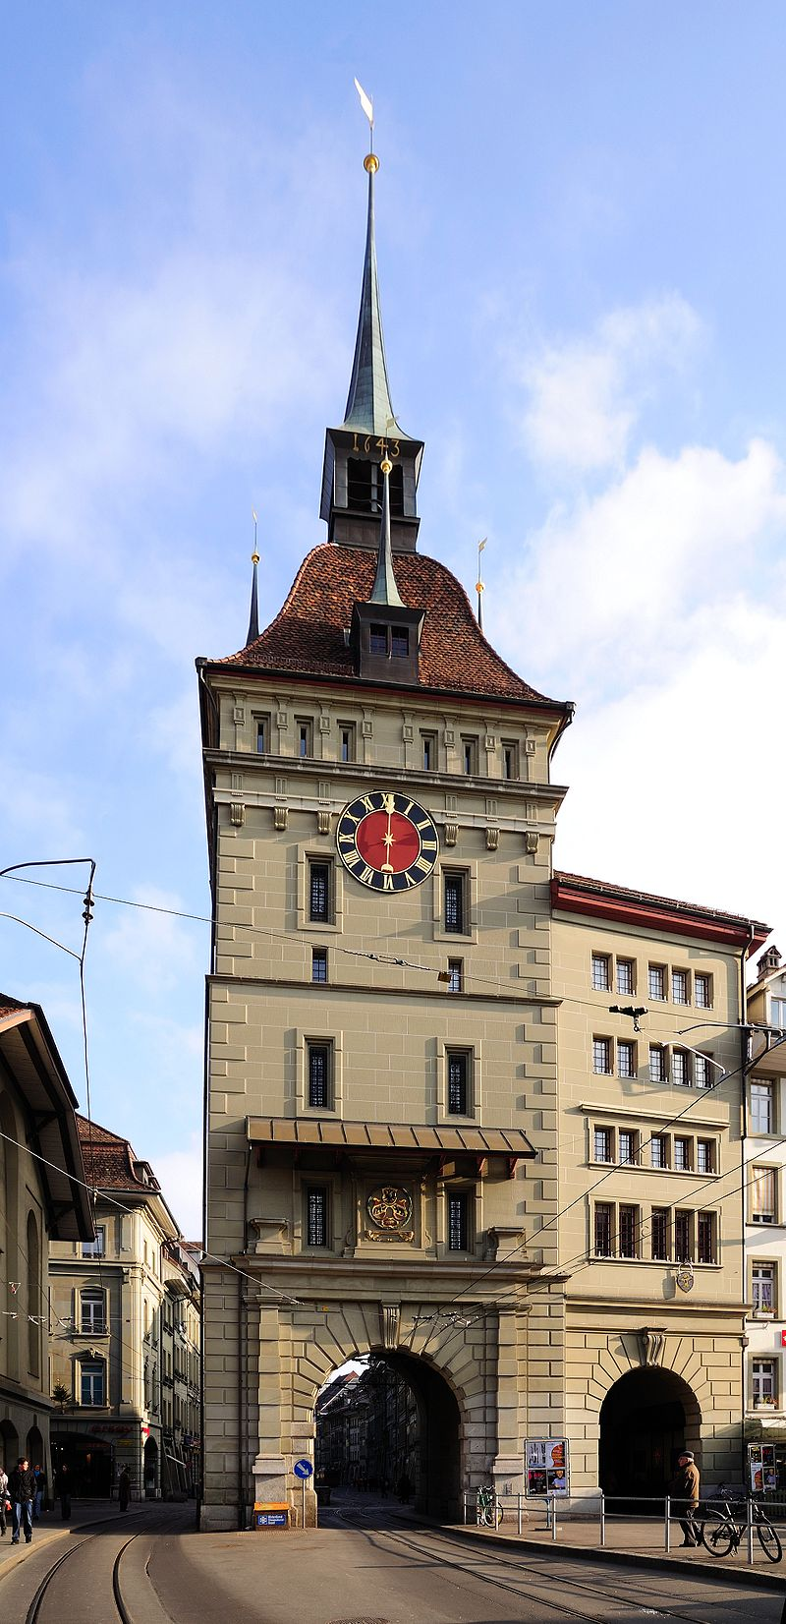
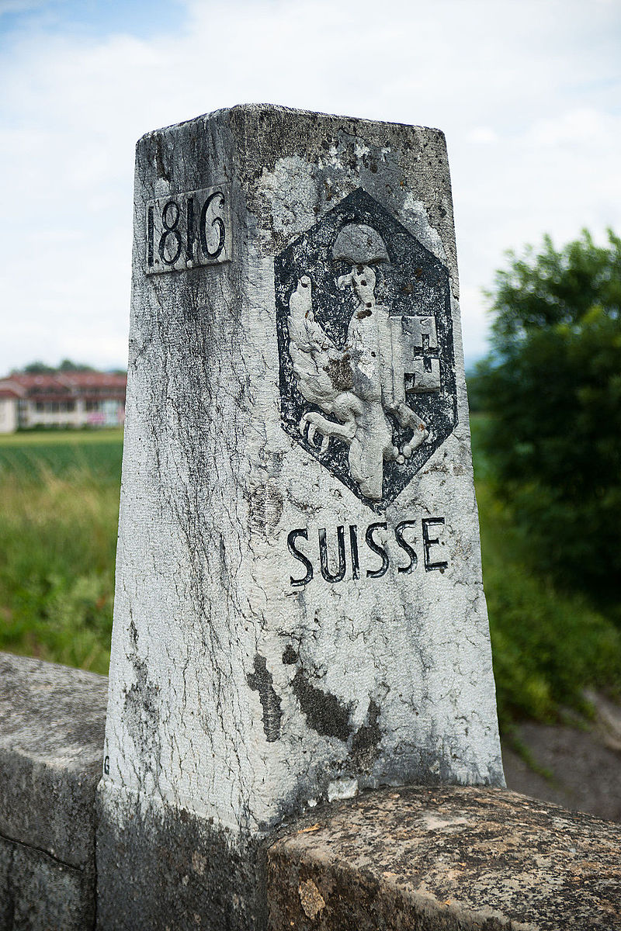
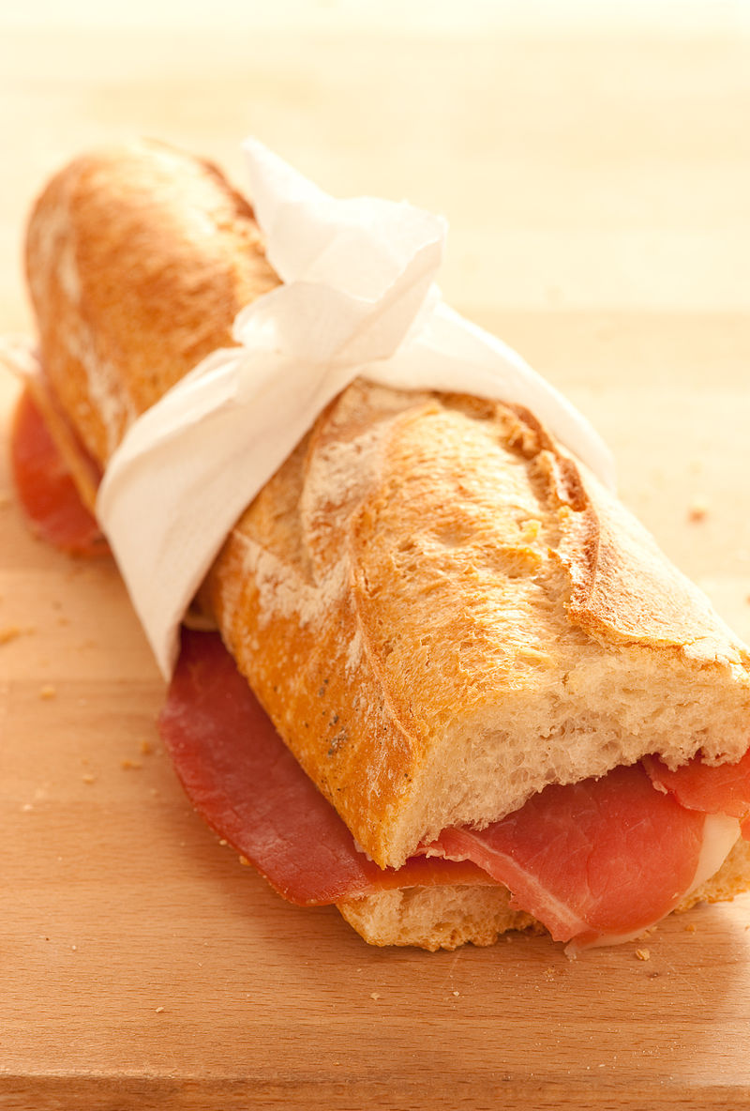
Un voyage en Suisse (1/3)
lire
La famille d’Amir a passé les vacances à Genève, en Suisse.
Amir montre des photos à Léa. Qui a fait quoi ? Écris j’(Amir) ou elle (Noura).
1. J’ ai voyagé à Berne, la capitale de la Suisse
2. Elle a demandé une photo à la frontière suisse.
3. J’ ai emporté un sandwich pour le voyage.
__
__
__
Notes:
Timing: 8 minutes for 3 slides
Aim: written recognition of the je and il/elle forms of avoir as the auxiliary in the perfect tense. This is slide 1/3.
Procedure:
1. Students write 1-6 (the activity continues on the next slide) and choose ‘Amir’ for the je form, or ‘Noura’ for the elle form.
2. Click to reveal the answers.
3. English translations can also be elicited.
4. See slide 3/3 for a follow-up comprehension activity in which students write sentences in English to describe the trip (suggested solutions are provided).
Word frequency of cognates used (1 is the most frequent word in French): photo [1412], sandwich [>5000]
Source: Londsale, D., & Le Bras, Y. (2009). A Frequency Dictionary of French: Core vocabulary for learners London: Routledge.
Image attribution:
Par jules:stonesoup — https://www.flickr.com/photos/stone-soup/4143143813/, CC BY 2.0, https://commons.wikimedia.org/w/index.php?curid=12248164
Par Ludovic Péron — Travail personnel, CC BY-SA 3.0, https://commons.wikimedia.org/w/index.php?curid=20025169
Taxiarchos228 - Own work, CC BY-SA 3.0, https://commons.wikimedia.org/wiki/File:Bern_Kaefigturm.jpg
By Norbert Aepli, Switzerland, CC BY 2.5, https://commons.wikimedia.org/w/index.php?curid=1254144

Slide 16
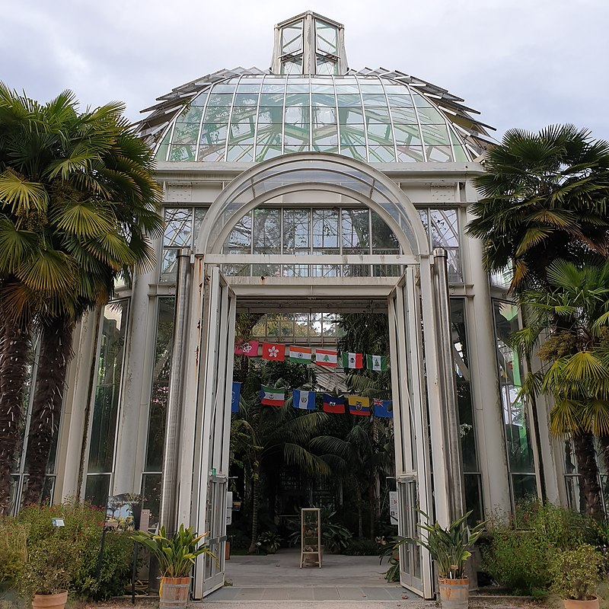
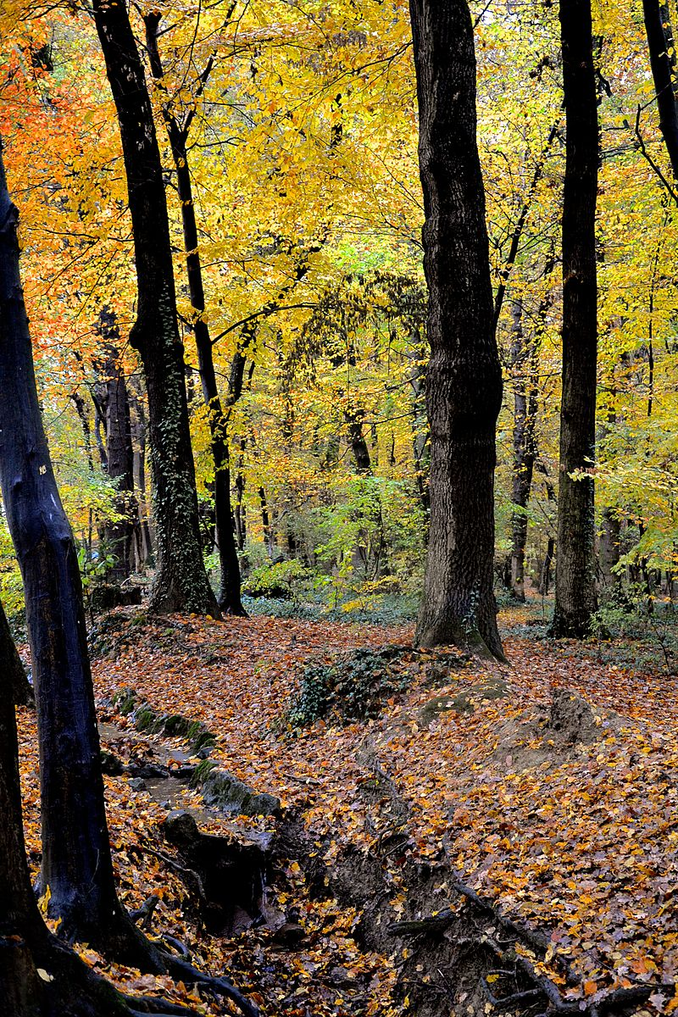
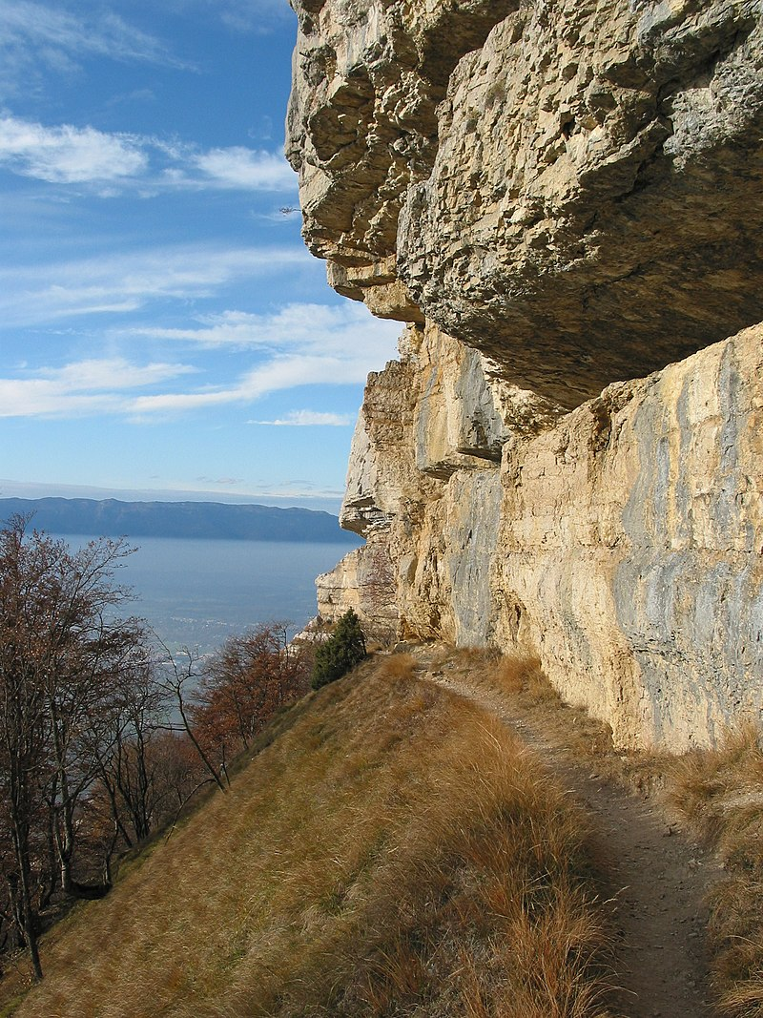
Un voyage en Suisse (2/3)
*faire de la marche
= to go walking
lire
La famille d’Amir a passé les vacances à Genève, en Suisse.
Amir montre des photos à Léa. Qui a fait quoi ? Écris j’(Amir) ou elle (Noura).
4. Elle a proposé une visite au jardin botanique.
5. Elle a joué dans la forêt.
6. J’ ai fait de la marche* à la montagne.
__
__
__
Notes:
This is slide 2/3.
Note: Teacher to highlight the difference in French/English preposition use in ‘à la montagne’, meaning ‘in the mountains’.
Word frequency (1 is the most frequent word in French): botanique [>5000]
Source: Londsale, D., & Le Bras, Y. (2009). A Frequency Dictionary of French: Core vocabulary for learners London: Routledge.
Image attribution:
Par Geneva photos — Travail personnel, CC BY-SA 4.0, https://commons.wikimedia.org/w/index.php?curid=82625475
Par Babsy — Travail personnel, CC BY-SA 4.0, https://commons.wikimedia.org/w/index.php?curid=37089073
By Björn S., CC BY-SA 3.0, https://commons.wikimedia.org/w/index.php?curid=54431295
Par Benoit Kornmann — Travail personnel, CC BY-SA 3.0, https://commons.wikimedia.org/w/index.php?curid=1366663

Slide 17
Un voyage en Suisse (3/3)
*décrire = to describe
lire
Écris des phrases en anglais pour décrire* le voyage. La famille a fait quoi ? Écris quatre choses pour Amir et quatre choses pour Noura.
Amir
Amir travelled to Bern, the capital of Switzerland. He brought a sandwich with him. He went walking in the mountains and found the view beautiful.
Noura
Noura asked for a photo at the Swiss border. She crossed the bridge and suggested a visit to the botanic gardens. She played in the forest.
Notes:
This is slide 3/3.
Word frequency of cognates used (1 is the most frequent word in French): décrire [1176]
Source: Londsale, D., & Le Bras, Y. (2009). A Frequency Dictionary of French: Core vocabulary for learners London: Routledge.

Slide 18
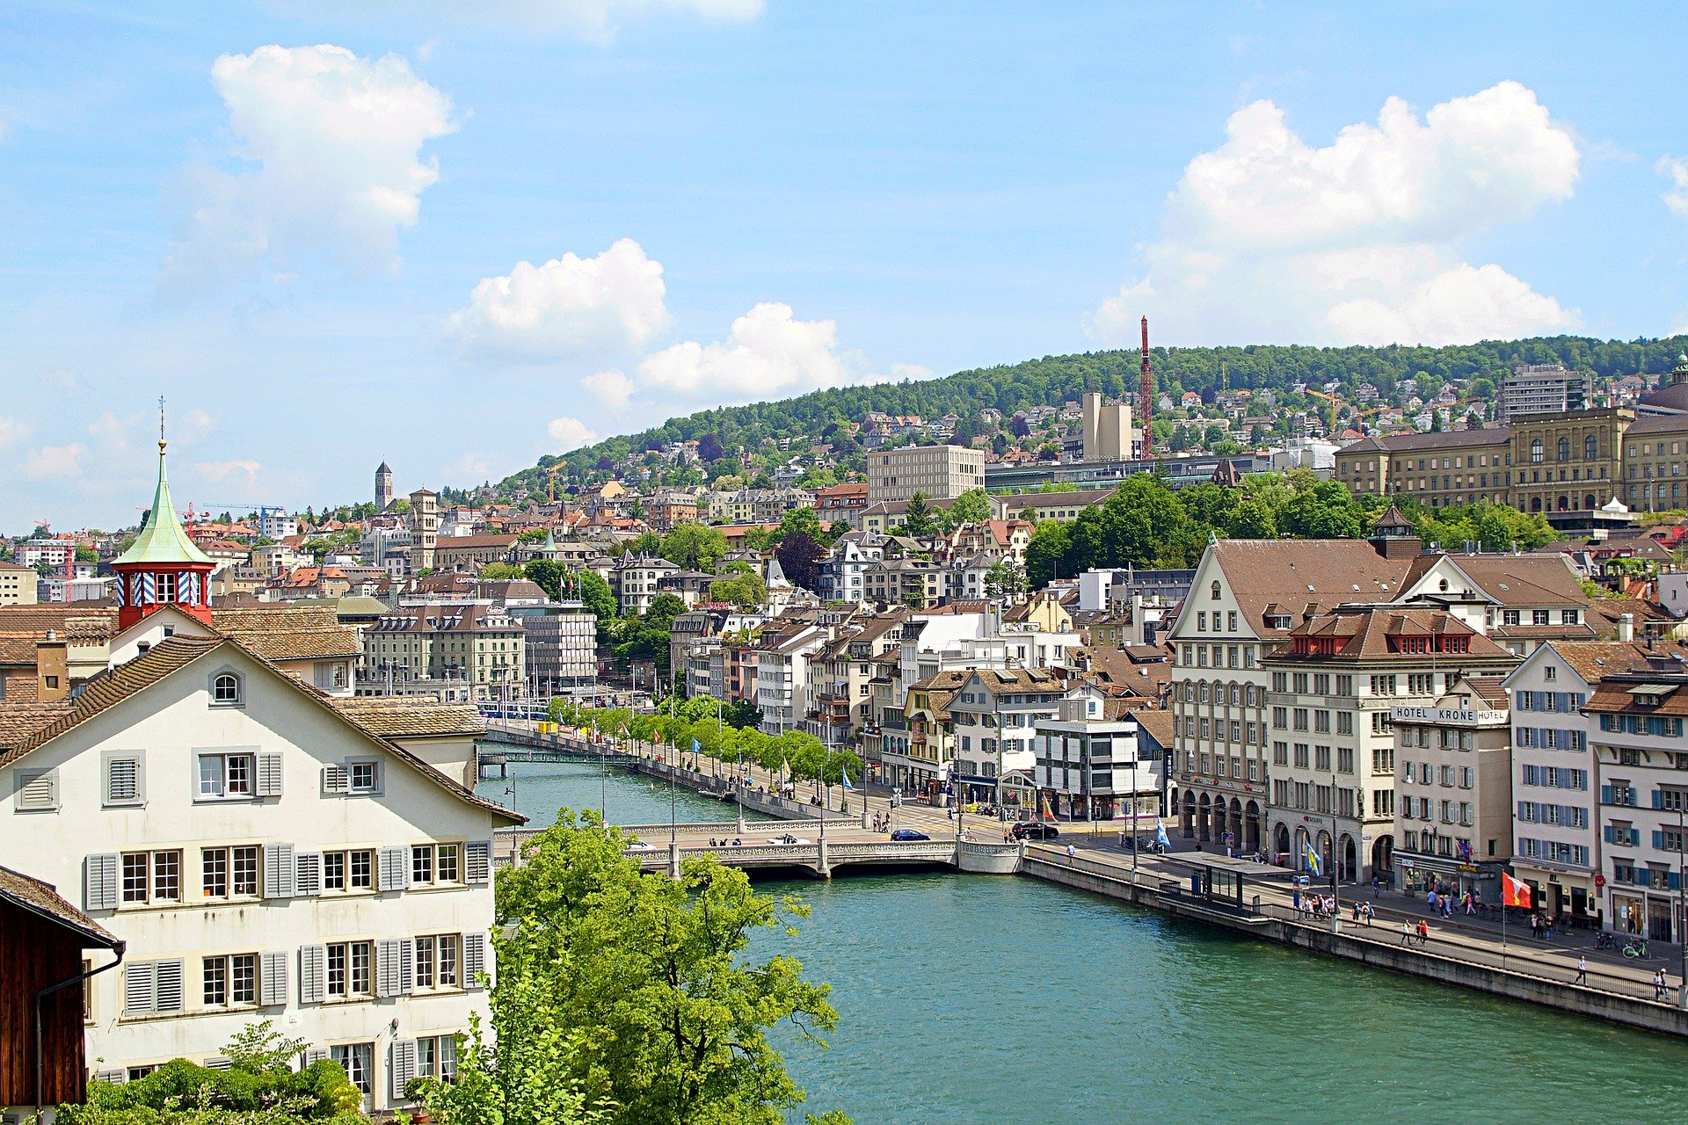
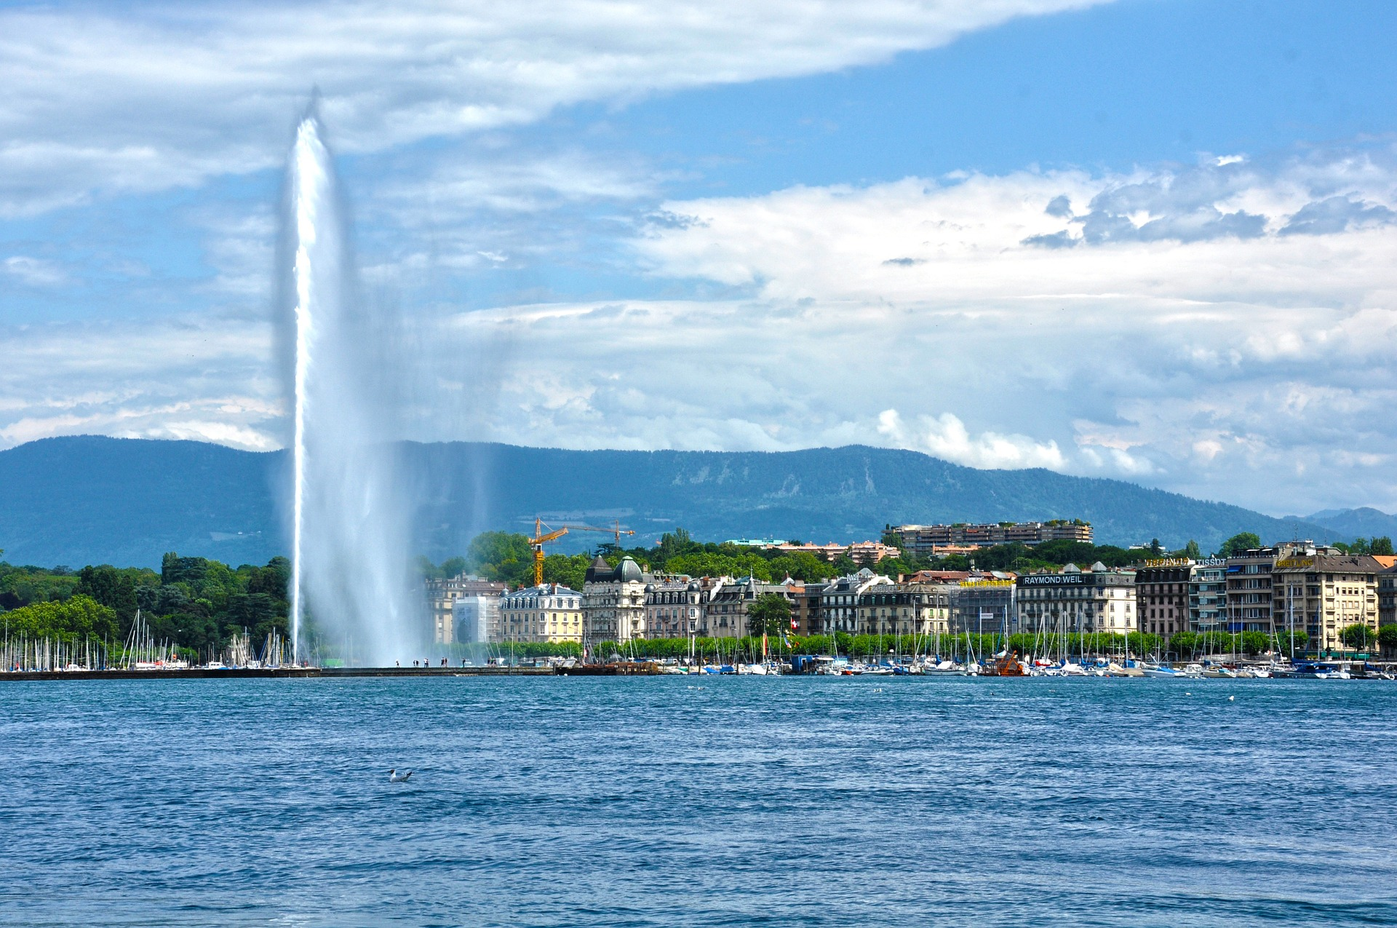
Que fait Bilal ?
écouter
Amandine parle avec une amie au téléphone. Elles parlent de Bilal. Écoute la conversation. Décide si Bilal fait l’activité au présent ou s’il a fait ça dans le passé.
1 | 2 | 3
hier/en ce moment | hier/en ce moment | hier/en ce moment
 | 6
hier/en ce moment | hier/en ce moment | hier/en ce moment
1
2
3
4
5
6
Notes:
Timing: 5 minutes
Aim: Aural recognition of sentences with verbs in the 3rd person singular in the present and perfect tenses. This is slide 1/2.
Procedure:
1. Click the number button to play the audio.
2. Students listen to the audio with the time adverb muted and decide whether the activity happened yesterday or is happening now, based on the verb form they hear.
3. See the next slide for answers and full audio.
Transcript:
1. [Hier], il a traversé la frontière suisse.
2. [Hier], il a envoyé une lettre à son ami.
3. [En ce moment], il célèbre son anniversaire.
4. [Hier], il a organisé un voyage à Zurich.
5. [En ce moment], il fait les magasins avec Noura.
6. [En ce moment], il visite Genève.
7. [Hier], il a parlé l’allemand.
8. [En ce moment], il cherche un cadeau pour son père.
Word frequency of cognates used (1 is the most frequent word in French): décider [165], présent [216]
Source: Londsale, D., & Le Bras, Y. (2009). A Frequency Dictionary of French: Core vocabulary for learners London: Routledge.

Slide 19
Que fait Bilal ?
écouter
Amandine parle avec une amie au téléphone. Elles parlent de Bilal. Écoute la conversation. Décide si Bilal fait l’activité au présent ou s’il a fait ça dans le passé.
1 | 2 | 3
hier/en ce moment | hier/en ce moment | hier/en ce moment
hier/en ce moment | hier/en ce moment | hier/en ce moment
1
2
3
4
5
6
Notes:
Answer slide with full audio.
This is slide 2/2.

Slide 20
Fais des phrases ! (1/6)
parler
Qui ?
Quoi ?
Quand ?
en ce moment
acheter
Elle achète des billets en ce moment.
Notes:
Timing: 5 minutes. This is slide 1/6.
Aim: Oral production of sentences with verbs in the 3rd person singular in the present and perfect tenses; oral production of new and revisited vocabulary.
Procedure:
1. Students use the prompts to create sentences in the present and past tenses. Before beginning, remind students of the position of the time adverb in a sentence (normally at the end).
2. Click to reveal a suggested solution.
3. Repeat for a total of 8 sentences.

Slide 21
Fais des phrases ! (2/6)
parler
Qui ?
Quoi ?
Quand ?
samedi dernier
faire la cuisine
Il a fait la cuisine samedi dernier.
Notes:
This is slide 2/6.

Slide 22
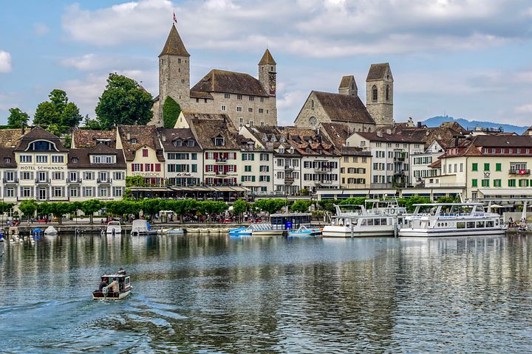
Fais des phrases ! (3/6)
parler
Qui ?
Quoi ?
Quand ?
la semaine dernière
Zurich
voyager
Elle a voyagé à Zurich la semaine dernière.
Notes:
This is slide 3/6.

Slide 23
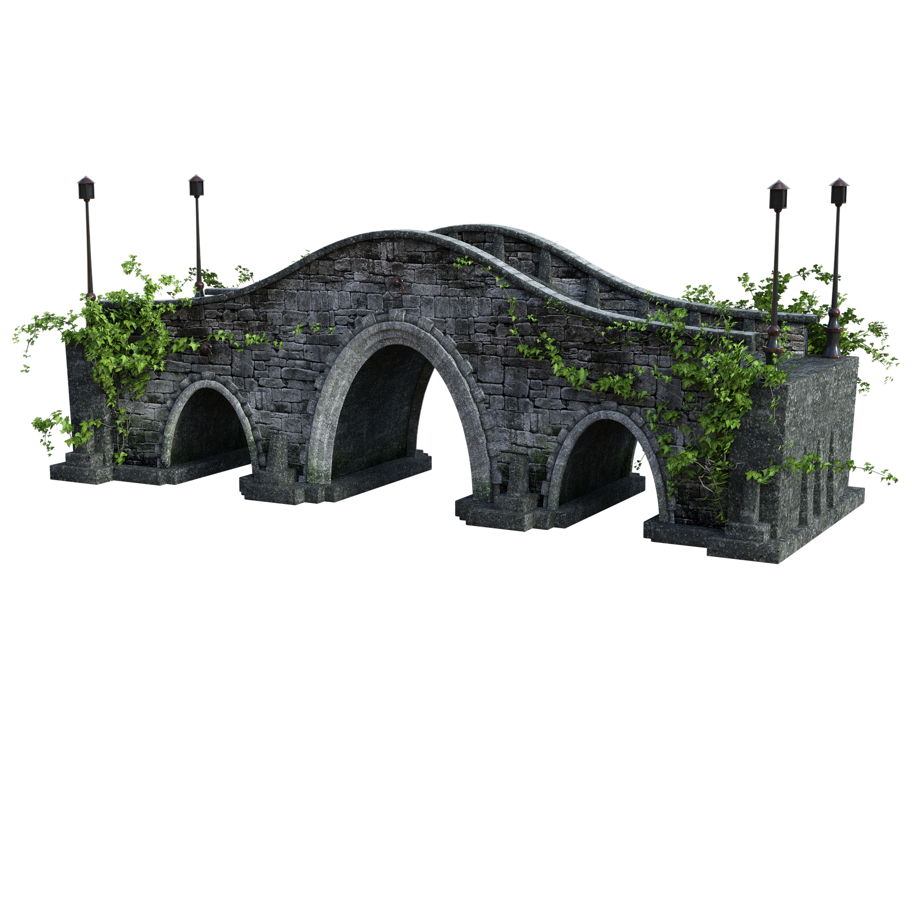
Fais des phrases ! (4/6)
parler
Qui ?
Quoi ?
Quand ?
maintenant
traverser
Il traverse le pont maintenant.
Notes:
This is slide 4/6.

Slide 24
Fais des phrases ! (5/6)
parler
Qui ?
Quoi ?
Quand ?
en ce moment
organiser
Elle organise une fête en ce moment.
Notes:
This is slide 5/6.

Slide 25
Fais des phrases ! (6/6)
parler
Qui ?
Quoi ?
Quand ?
le week-end dernier
parler
Il a parlé allemand le week-end dernier.
Notes:
This is slide 6/6.
Word frequency of cognates used (1 is the most frequent word in French): week-end [2475]
Source: Londsale, D., & Le Bras, Y. (2009). A Frequency Dictionary of French: Core vocabulary for learners London: Routledge.

Slide 26
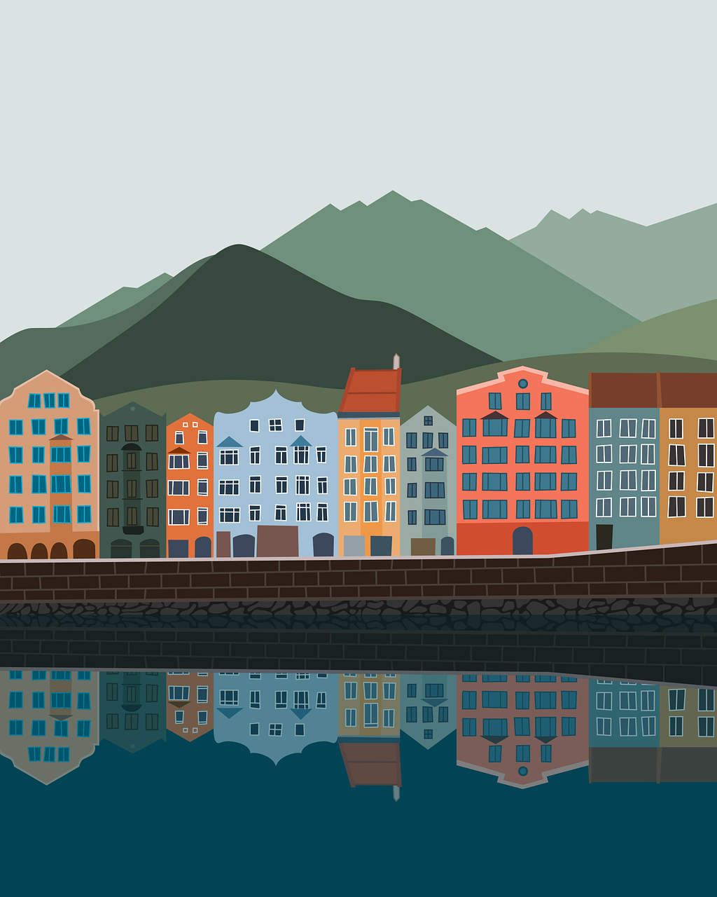
Vacances de rêve
écrire
1. Imagine que tu as passé des vacances de rêve la semaine dernière ! Tu as fait quoi ? Écris quatre phrases sur ces vacances.
Par exemple : « La semaine dernière, j’ai voyagé aux États-Unis ! »
2. Donne tes phrases à un(e) partenaire. Il/elle doit écrire ces phrases à la forme il/elle.
Par exemple : « La semaine dernière, Natalie a voyagé aux États-Unis ! »
Notes:
Timing: 8 minutes
Aim: Written production of perfect tense sentences in the 1st and 3rd person singular forms.
Procedure:
1. Each student writes four perfect tense sentences in the first person singular about what they did on their dream holiday, using known vocabulary and a dictionary to look up new words if desired.
2. Click to reveal the second part of the task.
3. Students give their sentences to a partner. The partner rewrites the sentences in the third person.
4. Optional extension: select some students to present their partner’s holiday to the rest of the class by reading out the third person sentences they have written.
Word frequency of cognates used (1 is the most frequent word in French): imaginer [840], forme [369]
Source: Londsale, D., & Le Bras, Y. (2009). A Frequency Dictionary of French: Core vocabulary for learners London: Routledge.

Slide 27
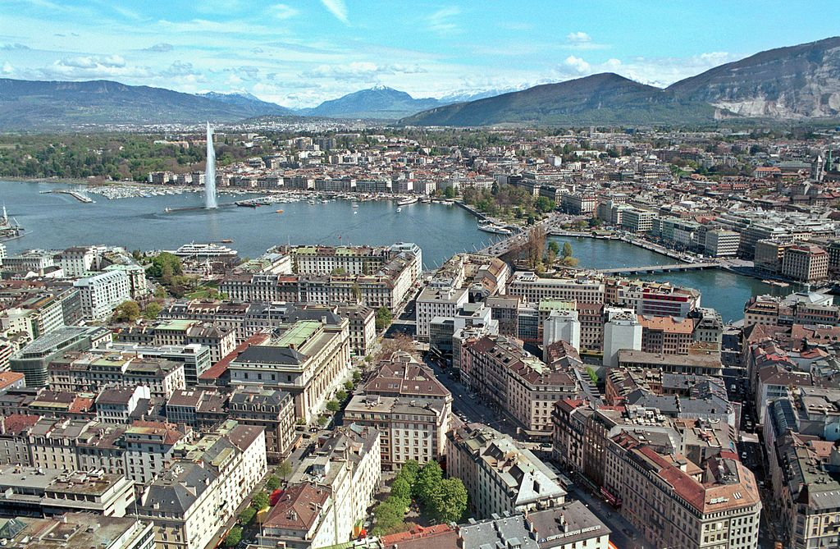
Talking about holidays: people and places in the past
il y a vs il y avait
SSCs open and closed [eu/œu]
Qu’est-ce qu’il y a à Genève ?
Y8 French
Term 1.2 - Week 3 - Lesson 20
Kirsten Somerville / Amber Dudley / Natalie Finlayson
Artwork by: Chloé Motard
Date updated: 31/12/2023
Notes:
Note: all words (new and revisited) in this week of the SOW appear on all three GCSE wordlists, with these exceptions: i) Edexcel list does not have Genève
ii) AQA list does not have emporter, Genève
Learning outcomes (lesson 2):
Consolidation of SSCs open and closed [eu/œu]
Introduction of il y avait
Consolidation of il y a
Word frequency (1 is the most frequent word in French):
8.1.2.3 (introduce) emporter [1128], proposer [338], voyager [2194], traverser [1040], frontière [1182], forêt [1724], montagne [1732], vue [191], suisse [2241], Suisse [n/a], Genève [n/a], il y avait [13/36/8]
8.1.1.6 (revisit) organiser [701], chacun [323], anniversaire [2043], août [1445], décembre [891], juillet [1326], septembre [944], octobre [826], novembre [982], général [147], national [227], partout [581]
7.3.2.5 (revisit) devoir [39], dois [39], doit [39], veut [57], veux [57], vouloir [57], visiter [1378], billet [1916]
Source: Londsale, D., & Le Bras, Y. (2009). A Frequency Dictionary of French: Core vocabulary for learners London: Routledge.

Slide 28
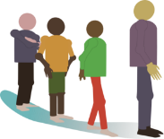
Open or closed [eu/œ]?
lire / parler
Remember!
What kind of sound follows an open vowel?
 |  |  | open | closed
 | fleur
 | queue
 | cheveu | [hair]
j | courageux | [brave]
 | beurre
 | nœud | [knot]
1
2
3
4
5
6
Notes:
Timing: 5 minutes
Aim: Applying awareness of the spelling rules governing SSCs open and closed [eu/œu].
Procedure
Student read the words and decide based on the presence of absence of a pronounced consonant after [eu/œu] whether the vowel is open or closed.
Click on the numbers to check. Click to reveal answers.
Students say the words aloud.
Word frequency (1 is the most frequent word in French): fleur [2305], queue [3255], cheveu [2296], courageux [2198], beurre [4112], nœud [3551], œuvre [331], milieu [479]
Source: Londsale, D., & Le Bras, Y. (2009). A Frequency Dictionary of French: Core vocabulary for learners London: Routledge.

Slide 29
Les vacances
lire / écrire
*scolaire (adj) = school
*la fin (n) = end
Voici les périodes de vacances scolaires* en France. C’est quel mois ?
les vacances d’automne
deux semaines d’octobre à novembre
_______
__________
les vacances de fin* d’année
deux semaines de décembre à janvier
__________
_______
les vacances d’hiver
deux semaines de février à mars
______
_______
les vacances de printemps
deux semaines d’avril à mai
__
__
les vacances d’été
____
huit semaines de juillet, août à septembre
__
_____________
… Quel mois n’a pas de vacances ? juin
____
Notes:
Timing: 6 minutes
Aim: written recall of previously taught vocabulary, including 6 items of this week’s revisited vocabulary
Procedure:
1. Students write the names of each holiday, and work out which months each one takes place, using the names as clues.
2. Click to reveal the answers.
3. Students then work out which month doesn’t have any school holidays, by a process of elimination.
4. Click to reveal the answer.
Word frequency of revisited vocabulary (1 is the most frequent word in French): août [1445], décembre [891], juillet [1326], septembre [944], octobre [826], novembre [982]
Source: Londsale, D., & Le Bras, Y. (2009). A Frequency Dictionary of French: Core vocabulary for learners London: Routledge.
Word frequency of cognates used (1 is the most frequent word in French): période [407], scolaire [1993], fin [111]
Source: Londsale, D., & Le Bras, Y. (2009). A Frequency Dictionary of French: Core vocabulary for learners London: Routledge.

Slide 30
There was / there were
grammaire
As you know, to say ‘there is’ / ‘there are’ in French, we use the expression il y a:
Present:
Il y a une erreur dans la phrase. There is a mistake in the sentence.
Il y a des voitures dehors. There are (some) cars outside.
To say ‘there was’ / ‘there were’, we use il y avait:
Past:
Il y avait une erreur dans la phrase. There was a mistake in the sentence.
Il y avait des voitures dehors. There were (some) cars outside.
Remember! Il y avait means both ‘there was’ (sing) and ‘there were’ (pl).
Notes:
Timing: 3 minutes
Aim: introducing the expression il y avait to mean ‘there was’ / ‘there were’
Note: The imperfect tense will not be introduced explicitly until Year 9 – il y avait is introduced here as a set phrase to facilitate past descriptions.

Slide 31
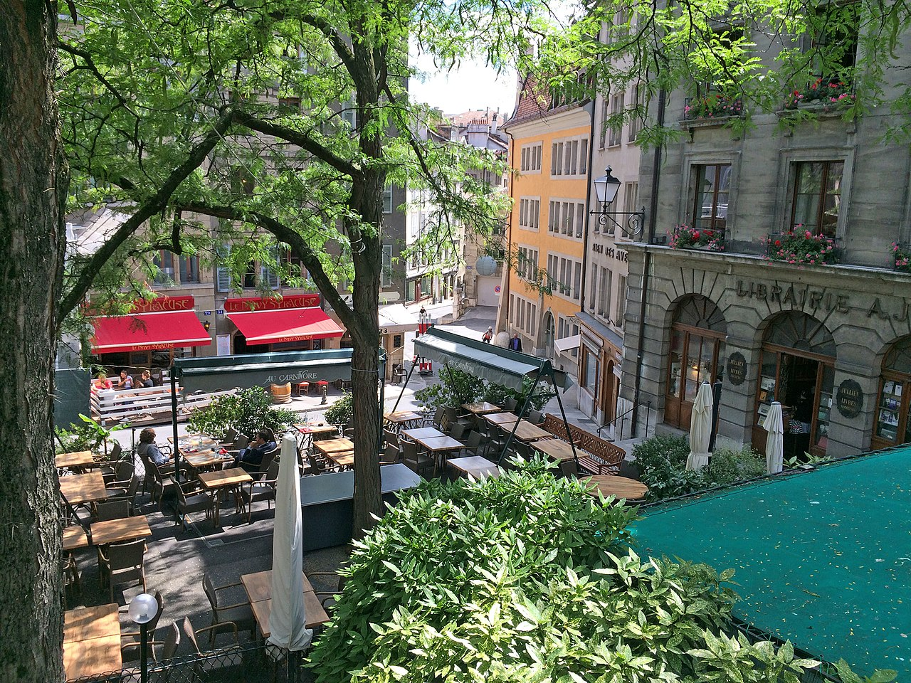
La Place du Bourg-de-Four
*l’époque (f.) = era, times
*le Moyen Âge = the Middle Ages
*le château = castle *jusque = until
lire
Lis ce texte au sujet d’une vielle place à Genève. Décide si chaque attraction existe maintenant ou si elle a existé dans le passé.
Remember!
Un/une/des → de after il n’y a pas.
La Place du Bourg-de-Four est au cœur de la vieille ville de Genève. À l’époque* romaine il y avait un château. Et puis, au Moyen Âge* il y avait un marché. Il n'y a pas de marché maintenant, mais il y a des magasins. Jusqu*’en 1857, il y avait un hôpital. En 1904, il y avait un tramway. Aujourd'hui, il y a des galeries d’arts et des cafés. Au cœur de la place, il y a une magnifique fontaine.
 | Then | Now
cafés
a castle
a tram
a fountain
shops
a hospital
a market
art galleries
Notes:
Timing: 8 minutes
Aim: Written recognition of il y a and il y avait and connecting these with meaning (what there is now vs what there was in the past).
Procedure:
To start with, ask students to look at the picture and think about what the text could be about.
Click to reveal the text and the activity.
Students read the text and then write two columns with headings ‘then’ and ‘now’. Alert students to the fact that the texts contains quite a lot of unknown vocabulary, and they must look for French words that look similar to the English in some cases.
Under each column, students write what is in the square now, and what was in the square in the past.
Click to reveal the answers.
Click to bring up the reminder about article de after il n’y a pas. If students ask, explain that the rule also applies to the negative form il n’y avait pas, which will be practised in a future lesson.
Word frequency of unknown words used (1 is the most frequent word in French): château [3510], époque [465], jusque [134], Moyen Âge [n/a]
Source: Londsale, D., & Le Bras, Y. (2009). A Frequency Dictionary of French: Core vocabulary for learners London: Routledge.
Word frequency of cognates used (1 is the most frequent word in French): sujet [353], décider [165], attraction [>5000], exister [269], présent [216], romain [3144], hôpital [1308], tramway [>5000], galerie [3850], art [1181], magnifique [2136], fontaine [>5000]
Source: Londsale, D., & Le Bras, Y. (2009). A Frequency Dictionary of French: Core vocabulary for learners London: Routledge.

Slide 32
À Genève
écouter
Pendant les vacances, Amir a parlé à Abdel au téléphone chaque jour.
Écoute les messages.C’est une description d’où il est en ce moment, ou d’un site qu’il a visité hier ?
 | en ce moment | hier
1
2
3
4
5
6
Notes:
Timing: 8 minutes. This is slide 1/2.
Aim: practising aural recognition of il y avait
Procedure:
1. Click the numbers to play the audio.
2. Students write 1-6 and choose ‘en ce moment’ or ‘hier’ for each.
3. Click to reveal the second task instruction.
4. Move to the second part of the activity on the next slide.
Transcript:
Il y a une radio dans la voiture.
Il y avait un bâtiment à la frontière.
Il y a une plage devant la ville.
Il y avait une petite île avec un parc.
Il y a un grand bateau.
Il y avait des cafés sympas partout.
Word frequency of revisited vocabulary (1 is the most frequent word in French): partout [581]
Source: Londsale, D., & Le Bras, Y. (2009). A Frequency Dictionary of French: Core vocabulary for learners London: Routledge.
Word frequency of cognates used (1 is the most frequent word in French): téléphone [1366], message [792], description [2779], site [1462], restaurant [2336]
Source: Londsale, D., & Le Bras, Y. (2009). A Frequency Dictionary of French: Core vocabulary for learners London: Routledge.
Image attribution:
By fr:Utilisateur:Ork.ch - http://www.ork.ch, fr:Image:Geneve_2005_001_Ork.ch.jpg, CC BY-SA 2.0 fr, https://commons.wikimedia.org/w/index.php?curid=1814711

Slide 33
À Genève (réponses)
écouter
Il y a / il y avait quoi?
 | a radio in car ( there is)
 | a building at the border (there was)
 | a beach in front of the town (there is)
 | a little island with a park (there was)
 | a big boat (there is)
 | nice cafes everywhere (there were)
1
2
3
4
5
6
Notes:
This is slide 2/2.
Aim: comprehension of vocabulary
Procedure:
1. Click the numbers to play the audio for a second time.
2. Students write 1-6 and what there is/isn’t.
3. Click to reveal the answers. NB: The English forms of ‘to be’ (past and present) are included in brackets to demonstrated the different possible translations of il y a / il y avait.
Transcript:
Il y a une radio dans la voiture.
Il y avait un bâtiment à la frontière.
Il y a une plage devant la ville.
Il y avait une petite île avec un parc.
Il y a un grand bateau.
Il y avait des cafés sympas partout.
Word frequency of revisited vocabulary (1 is the most frequent word in French): partout [581]
Source: Londsale, D., & Le Bras, Y. (2009). A Frequency Dictionary of French: Core vocabulary for learners London: Routledge.
Word frequency of cognates used (1 is the most frequent word in French): téléphone [1366], message [792], description [2779], site [1462], restaurant [2336]
Source: Londsale, D., & Le Bras, Y. (2009). A Frequency Dictionary of French: Core vocabulary for learners London: Routledge.
Image attribution:
By fr:Utilisateur:Ork.ch - http://www.ork.ch, fr:Image:Geneve_2005_001_Ork.ch.jpg, CC BY-SA 2.0 fr, https://commons.wikimedia.org/w/index.php?curid=1814711

Slide 34
Il y a / il y avait quoi?
écrire / parler
In the past, there was a market.
il y avait un marché
Dans le passé, __________________.
Notes:
Slide 1/8
Timing: 5 minutes
Aim: to practise written production of il y a and il y avait
Procedure:
Hand out mini whiteboards (or alternatively, use this activity to elicit spoken responses and use the following activity for written practice).
Give students a few seconds to read the English sentence and think about how they would translate it into French.
Click again to reveal the sentence scaffolding.
Students write the missing words on their mini whiteboards.

Slide 35
Il y a / il y avait quoi?
écrire / parler
Today, there is a square.
il y a une place
Aujourd’hui, _________________.
Notes:
Slide 2/8

Slide 36
Il y a / il y avait quoi?
écrire / parler
In the past, there was a café.
il y a avait un café
Dans le passé, _________________.
Notes:
Slide 3/8

Slide 37
Il y a / il y avait quoi?
écrire / parler
Today, there are cafés everywhere.
Aujourd’hui, _____________________.
il y a des cafés partout
Notes:
Slide 4/8

Slide 38
Il y a / il y avait quoi?
écrire / parler
In the past, there was a restaurant.
Dans le passé, _____________________.
il y avait un restaurant
Notes:
Slide 5/8

Slide 39
Il y a / il y avait quoi?
écrire / parler
Today, there is a church.
Aujourd’hui, ________________.
il y a une église
Notes:
Slide 6/8

Slide 40
Il y a / il y avait quoi?
écrire / parler
Today, there are some shops.
Aujourd’hui, ________________.
il y a des magasins
Notes:
Slide 7/8

Slide 41
Il y a / il y avait quoi?
écrire / parler
In the past, there was a hospital.
Dans le passé, _____________________.
il y avait un hôpital
Notes:
Slide 8/8

Slide 42
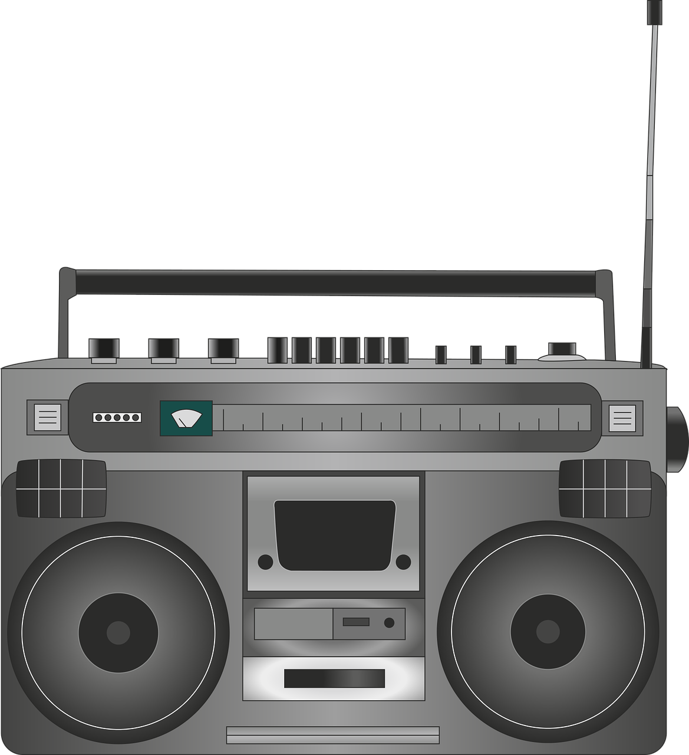
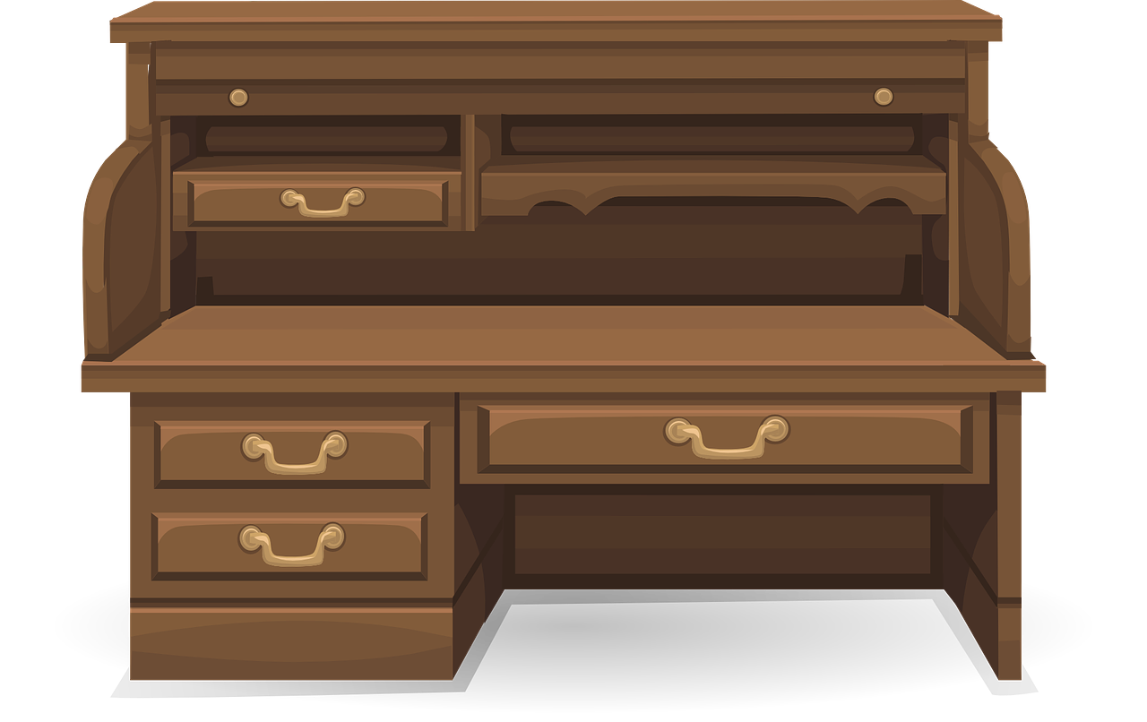
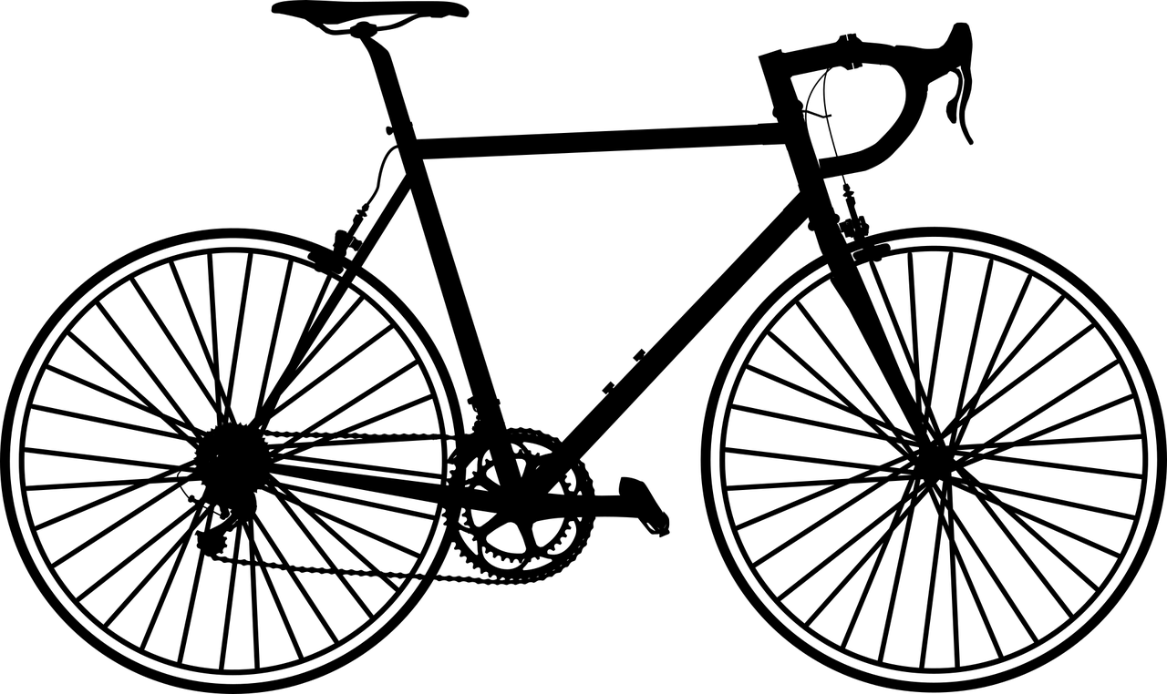
Jeu des différences (1/3)
parler / écrire
Regarde les deux photos. Utilise les expressions « il y a » et « il y avait » pour faire des comparaisons.
dans le passé
aujourd’hui
« Il y avait une fenêtre dans le passé, mais il y a deux fenêtres maintenant »
« Il y avait une radio dans le passé, et il y a une radio aujourd’hui »
Notes:
Timing: 10 minutes
Aim: Oral production of sentences with il y a and il y avait. This is slide 1/3.
Procedure:
1. Explain that jeu des différences is the French title for the game ‘spot the difference’.
2. Teacher displays the before and after photos on the screen (see the next slide for larger versions).
3. Students either write OR say several sentences comparing the photos. Use this slide to provide examples.
Word frequency of cognates used (1 is the most frequent word in French): photo [1412], expression [952], comparaison [2244]
Source: Londsale, D., & Le Bras, Y. (2009). A Frequency Dictionary of French: Core vocabulary for learners London: Routledge.

Slide 43
Jeu des différences (2/3)
parler / écrire
dans le passé
aujourd’hui
Notes:
Larger version of the pictures from the previous slide.
This is slide 2/3.

Slide 44
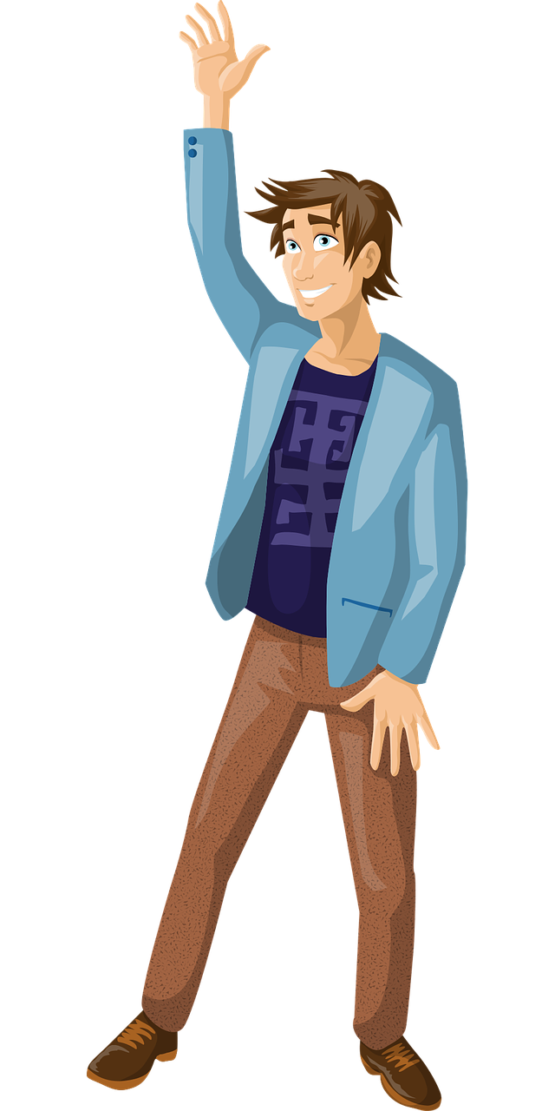
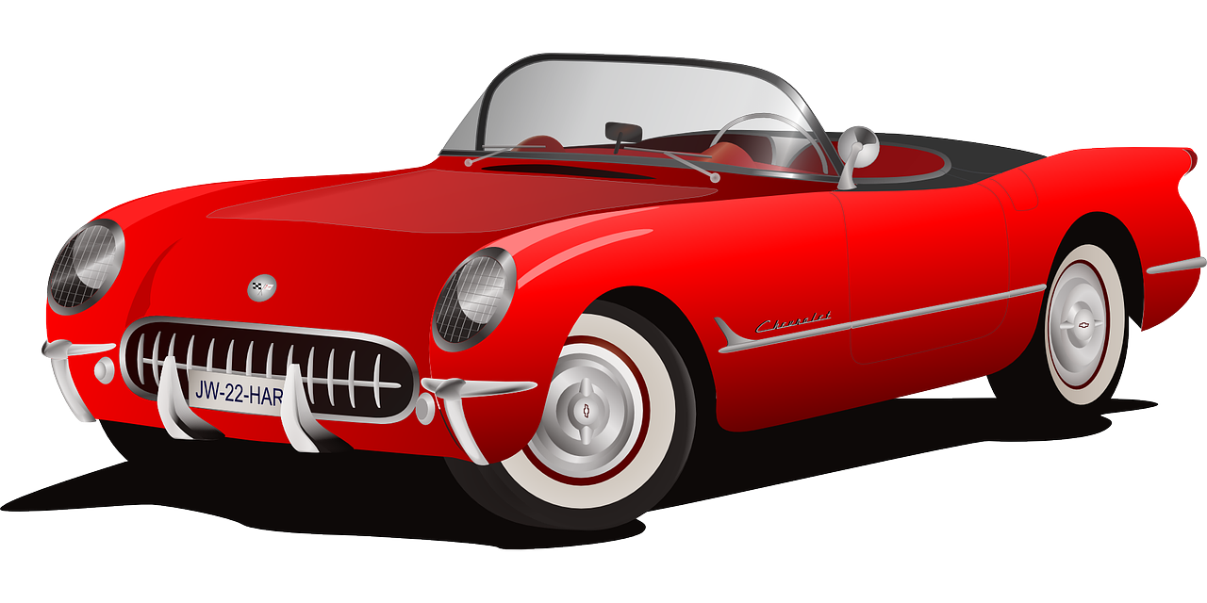
Jeu des différences (3/3)
parler / écrire
dans le passé
aujourd’hui
Notes:
This is slide 3/3.

Slide 45
Devoirs
Vocabulary Learning Homework (Y8, Term 1.2, Week 4)
Revisit: Y8 Term 1.2 Week 3 Y8 Term 1.1 Week 6 Y7 Term 3.2 Week 5
Notes:
There is no new vocabulary for 8.1.2.4. Students need to continue learning and revisiting the allocated weeks from last week (8.1.2.3).
Notes:
i) Teachers may, in addition, want to recommend use of a particular online app for the pre-learning of each week’s words. ii) Quizlet now requires parental involvement / registration / permissions for users below the age of 13, so it is perhaps most suitable for Y9 – 11 students. iii) Language Nut hosts LDP vocabulary lists and these are free for schools to use, though there is a registration process. One benefit is that all of the student tracking data that Language Nut offers are also available to schools that use the LDP lists for practice. Perhaps this makes it a good option for Y7/8.
iv) There are other free apps, and new ones are always appearing. Teachers have told us that they are currently using: Flippity, Wordwall (where using previously-created activities is free).
v) Gaming Grammar has been acquired by Language Nut. Its original content should still be available to teachers and much of it is appropriate for Y8 learners.
Verbs (present): 1st person singular/plural (Verb agreement (past))
Verbs (present): 3rd person singular/plural (Verb agreement (past))

Slide 46
Additional material
Notes:
The following slides have additional material may be used flexibly by any schools that have more than two 50-60 minute lessons per week.

Slide 47
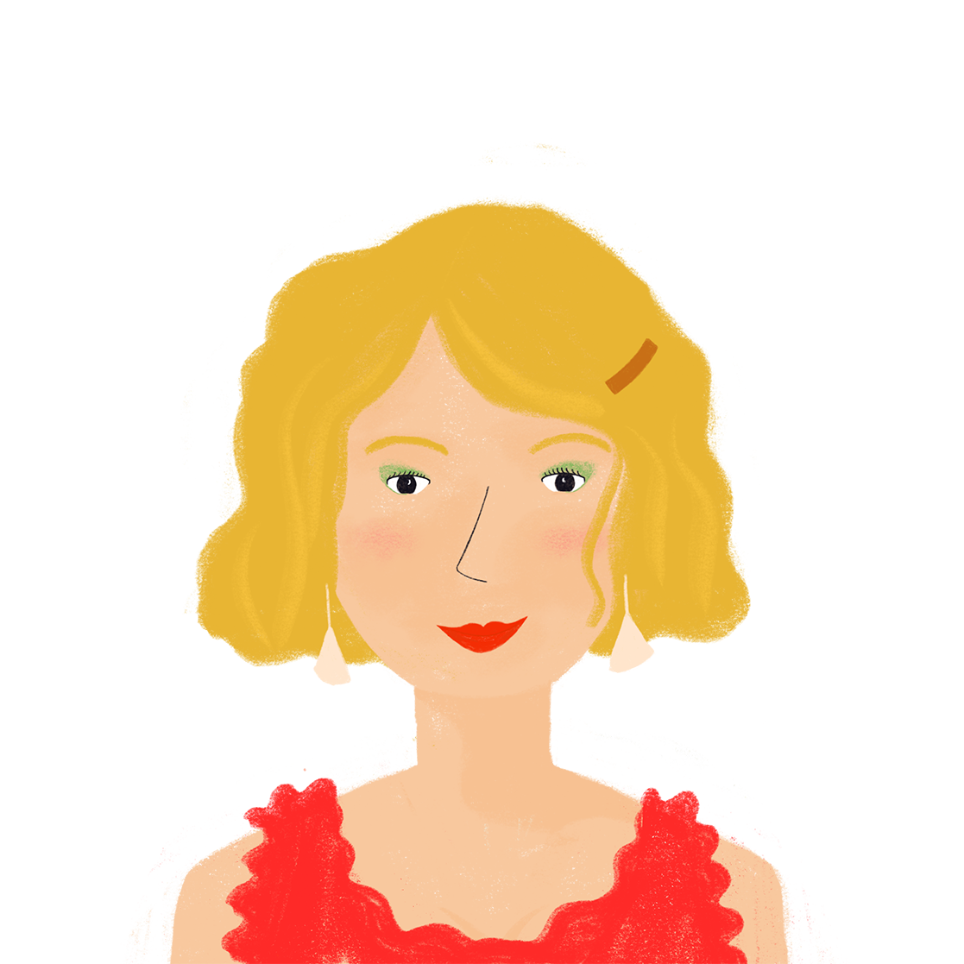
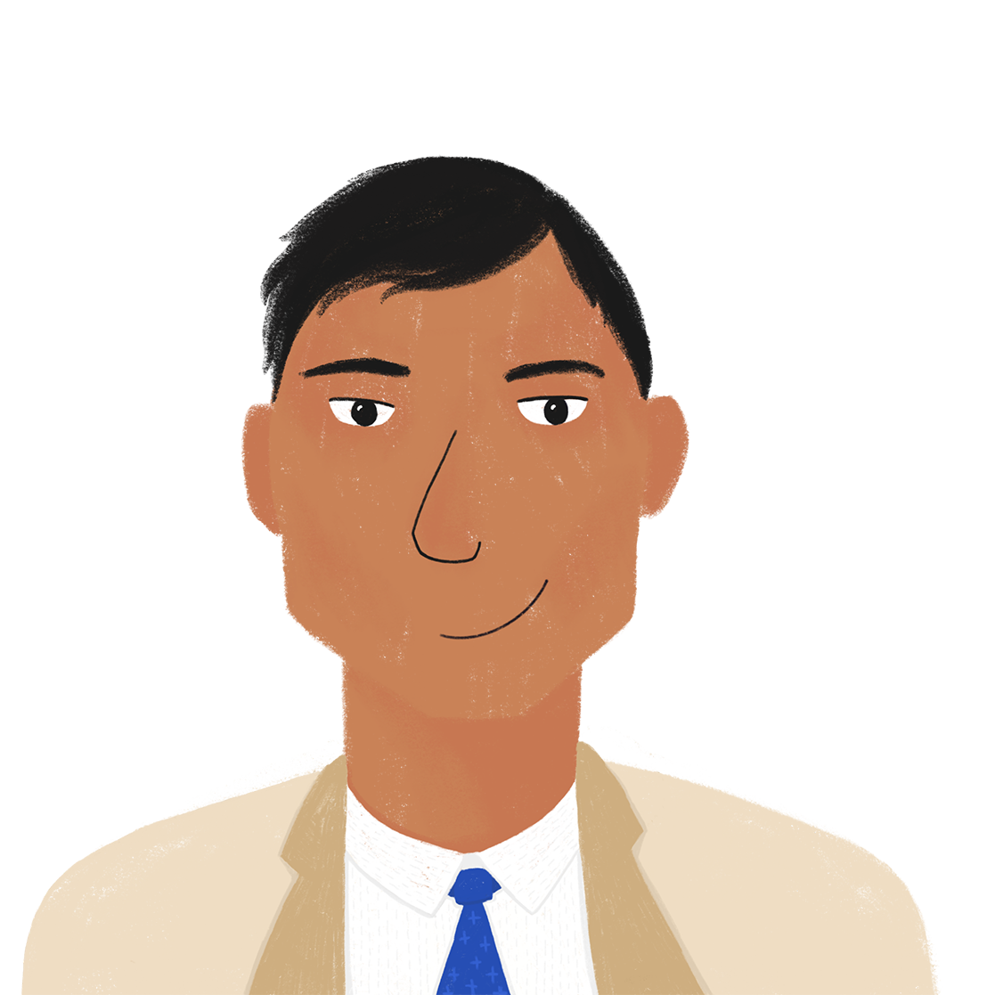
Que font les parents ?
écrire / parler
Partenaire A
Que fait Amandine pendant les vacances ?
Écris des phrases en français avec elle.
 | quoi ? | quand ?
1. | _________ un hôtel à Genève. (trouver) | hier
2. | _________ une amie suisse. (visiter) | hier
3. | _________ un livre au parc. (emporter) | en ce moment
4. | _________ une promenade. (proposer) | en ce moment
Écoute les activités de Bilal. C’est en ce moment, ou hier ?
Complète les phrases avec il y a ou il y avait.
 | quand ? | quoi ?
1. |  | … des projets pour chaque jour.
2. |  | … des vues excellentes de la fenêtre.
3. |  | … un match de la ligue nationale.
4. |  | … il y avait un grand lac. (le lac = lake)
Notes:
Timing: 10 minutes for 3 slides
Aim: practising written production of the il/elle form of avoir as the auxiliary in the perfect tense, practising oral production of il y avait, connecting past actions with past descriptions
Procedure:
1. Each partner completes the sentences in the top table of their rolecards using pronouns il/elle and a form of the verb to match the tense indicated by the time phrase on their rolecard (see next slide for Partner B’s rolecard).
2. Partner A reads out their first sentence (without the time phrase) to Partner B.
3. Partner B notes in their bottom table whether Partner A’s sentence refers to the present or the past, and responds with the description in their bottom table on their rolecard, using il y a or il y avait as appropriate.
4. Partners swap roles.
5. Continue until both partners have said their four sentences and given four descriptions in response.
6. Check answers on the réponses slide.
7. English translations can also be elicited.
Word frequency of revisited vocabulary (1 is the most frequent word in French): visiter [1378], national [227]
Source: Londsale, D., & Le Bras, Y. (2009). A Frequency Dictionary of French: Core vocabulary for learners London: Routledge.
Word frequency of cognates used (1 is the most frequent word in French): compléter [2034], lac [3121], ligue [>5000]
Source: Londsale, D., & Le Bras, Y. (2009). A Frequency Dictionary of French: Core vocabulary for learners London: Routledge.

Slide 48
Que font les parents ?
écrire / parler
Partenaire B
Que fait Bilal pendant les vacances ?
Écris des phrases en français avec il.
 | quoi ? | quand ?
1. | _________ des activités pour la famille. (organiser) | en ce moment
2. | _________ la Suisse en voiture. (traverser) | hier
3. | _________ l’équipe de football locale. (regarder) | en ce moment
4. | _________ à Lausanne. (voyager) | hier
Écoute les activités d’Amandine. C’est en ce moment, ou hier ?
Complète les phrases avec il y a ou il y avait.
 | quand ? | quoi ?
1. |  | … une chambre sympa avec trois lits.
2. |  | … une fête pour son anniversaire.
3. |  | … douze parcs différents dans la ville.
4. |  | … une belle forêt à la frontière.
Notes:
Word frequency of revisited vocabulary (1 is the most frequent word in French): organiser [701], billet [1916], anniversaire [2043]
Source: Londsale, D., & Le Bras, Y. (2009). A Frequency Dictionary of French: Core vocabulary for learners London: Routledge.
Word frequency of cognates used (1 is the most frequent word in French): compléter [2034], football [2602], local [622], Internet [N/A]
Source: Londsale, D., & Le Bras, Y. (2009). A Frequency Dictionary of French: Core vocabulary for learners London: Routledge.

Slide 49
Que font les parents ?
Réponses
écrire / parler
 | A | B
1. | Elle a trouvé un hôtel à Genève. | Il y avait une chambre sympa avec trois lits.
2. | Elle a visité une amie suisse. | Il y avait une fête pour son anniversaire.
3. | Elle emporte un livre au parc. | Il y a douze parcs différents dans la ville.
4. | Elle propose une promenade. | Il y a une belle forêt à la frontière.
 | B | A
1. | Il organise des activités pour la famille | Il y a des projets pour chaque jour.
2. | Il a traversé la Suisse en voiture. | Il y avait des vues excellents de la fenêtre.
3. | Il regarde l’équipe de football locale. | Il y a un match de la ligue nationale.
4. | Il a voyagé à Lausanne. | Il y avait un grand lac. (le lac = lake)

