Slide 1
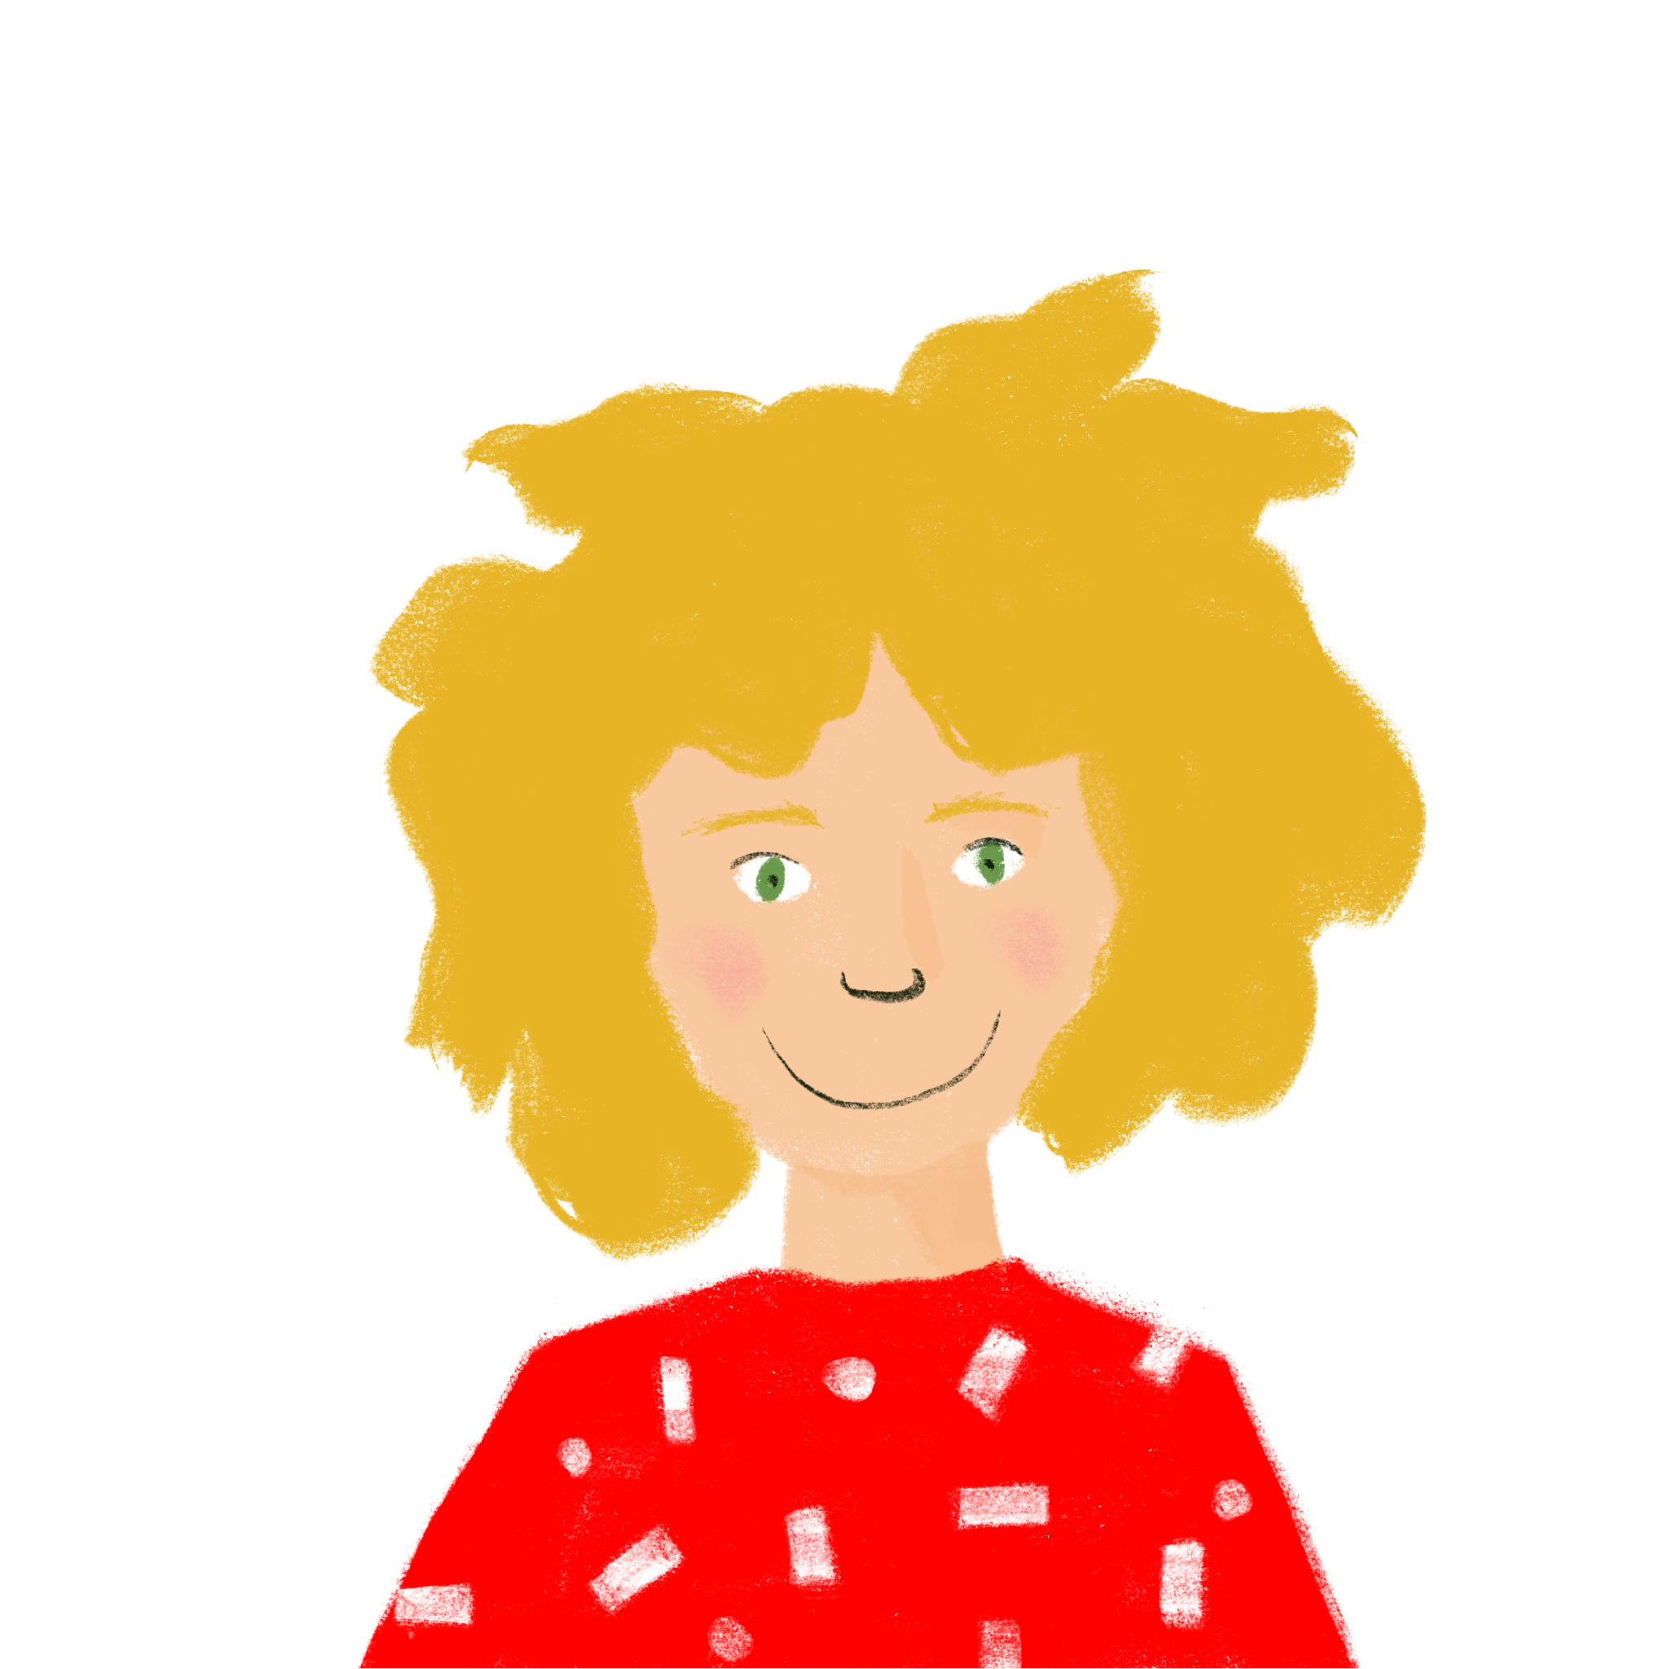
Sharing past experiences
present vs perfect tense
regular –ER verbs (taking avoir) (je, tu)
information questions (intonation)
SSC [r]
J’ai visité Bruxelles!
Y8 French
Term 1.2 - Week 2 - Lesson 17
Stephen Owen / Natalie Finlayson / Catherine Morris
Artwork by: Chloé Motard
Date updated: 07.12.23
Notes:
Note: all words (new and revisited) in this week of the SOW appear on all three GCSE wordlists, with these exceptions: i) Edexcel list does not have belge or Bruxelles
ii) AQA list does not have Bruxelles
Artwork by Chloé Motard. All additional pictures selected are available under a Creative Commons license, no attribution required.
Learning outcomes (lesson 1):
Introduction of SSC [r]
Consolidation of perfect tense constructions (with past simple equivalent) of –ER erbs with avoir as auxiliary in the 1st person
Introduction of perfect tense constructions (with past simple equivalent) of –ER erbs with avoir as auxiliary in the 2nd person
Introduction of information questions (intonation with question word) in the perfect tense
Word frequency (1 is the most frequent word in French):
8.1.2.2 (introduce) automne [1503], été [623], hiver [1586], musée [2216], printemps [1288], place [129], saison [1667], belge [2795], dernier [87], dernière [87], là [109], pendant [89], Belgique [n/a], Bruxelles [n/a]
8.1.1.4 (revisit) célébrer [2170], préférer [597], avril [1022], date [660], événement [573], février [1136], janvier [939], juin [931], mars [868], mai [943], tradition [1371], premier [56], première [56], quatorze [1472], quinze [3359], seize [3285], trente [1646], treize [3245], vingt [1273], on [29]
7.3.2.4 (revisit) avion [1409], lettre [480], allemand [844], différent [350], prochain [380], bientôt [1208], demain [871], Allemagne [n/a],
Source: Londsale, D., & Le Bras, Y. (2009). A Frequency Dictionary of French: Core vocabulary for learners London: Routledge.

Slide 2
Vocabulaire
lire
Which word which best goes together with the word in bold?
1) l’avion | a) aller | ☐
 | b) seize | ☐
 | c) mars | ☐
 | d) parfois | ☐
4) janvier | a) l’hiver | ☐
 | b) demain | ☐
 | c) quinze | ☐
 | d) l’été | ☐
2) la fête | a) bientôt | ☐
 | b) l’Allemagne | ☐
 | c) l’événement | ☐
 | d) différent | ☐
5) prochain | a) chaque | ☐
 | b) dernier | ☐
 | c) quatorze | ☐
 | d) juin | ☐
3) treize | a) la lettre | ☐
 | b) trente | ☐
 | c) avril | ☐
 | d) jaune | ☐
6) février | a) vingt | ☐
 | b) célébrer | ☐
 | c) préférer | ☐
 | d) la date | ☐
Notes:
Timing: 5 minutes
Aim: To revisit vocabulary from weeks 8.1.1.3 and 7.3.2.4. Students will be familiar with this style of question from the second half of the Year 7 test.
Procedure:
1. Students read the four words and write down which they associate most with the word in bold.
2. Answers revealed on clicks.
3. Clarify the meanings of question items, target items and distractors.

Slide 3
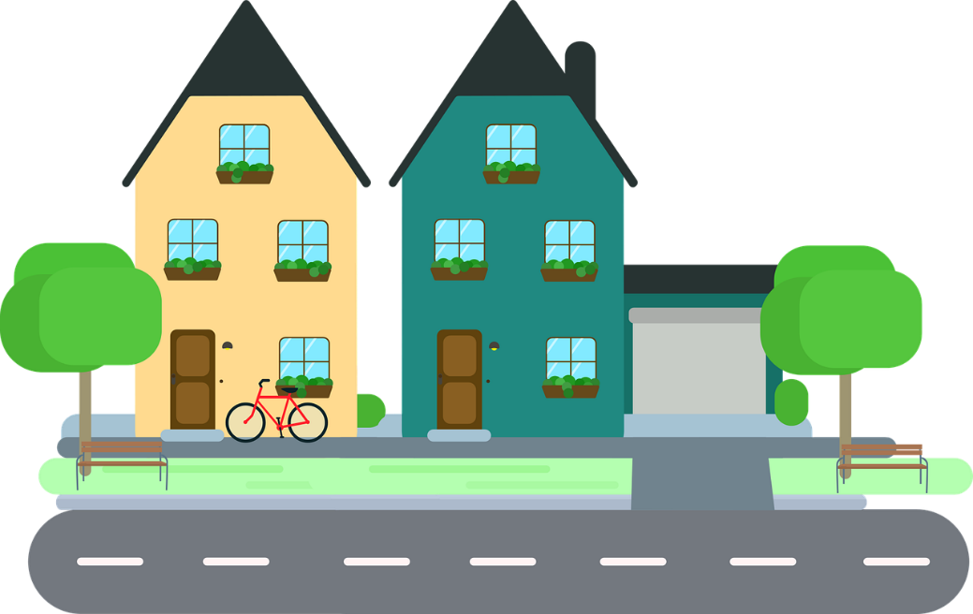
r
rue
Notes:
Timing: 1 minute
Aim: To introduce SSC [r]
Procedure: 1. Present the letter(s) and say the [r] sound first, on its own. Students repeat it with you. 2. Bring up the word ”rue” on its own, say it, students repeat it, so that they have the opportunity to focus all of their attention on the connection between the written word and its sound.
3. A possible gesture for this would be to look left and right and mime crossing a road. 4. Roll back the animations and work through 1-3 again, but this time, dropping your voice completely to listen carefully to the students saying the [r] sound, pronouncing ”rue” and, if using, doing the gesture.
Word frequency (1 is the most frequent word in French):
rue [598]
Source: Londsale, D., & Le Bras, Y. (2009). A Frequency Dictionary of French: Core vocabulary for learners London: Routledge.

Slide 4
r
rue
Notes:
With sound and no pictures to focus all attention on the sound-symbol correspondence.

Slide 5
r
rue
Notes:
Without sound to elicit pronunciation (without first hearing the teacher).
Teacher to elicit pronunciation by asking “Comment dit-on …”

Slide 6
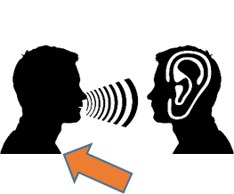
r
triste
frère
[brother]
moderne
rue
parler
[modern]
être
[to be]
Notes:
Timing: 2 minutes
Aim: To introduce SSC [r]
Procedure:
Introduce and elicit the pronunciation of the individual SSC [r] and then the source word again ‘rue’ (with gesture, if using). Then present and elicit the pronunciation of the five cluster words. The cluster words have been chosen for their high-frequency, from a range of word classes, with the SSC (where possible) positioned within a variety of syllables within the words (e.g. initial, 2nd, final etc.). Additionally, we have tried to use words that build cumulatively on previously taught SSCs (see the Phonics Teaching Sequence document) and do not include new SSCs. Where new SSCs are used, they are often consonants which have a similar symbol-sound correspondence in English.
Word frequency (1 is the most frequent word in French): rue [598]; frère [1043], triste [1843], moderne [1239], être [5], parler [106] Source: Londsale, D., & Le Bras, Y. (2009). A Frequency Dictionary of French: Core vocabulary for learners London: Routledge.

Slide 7
r
triste
frère
moderne
rue
parler
être
Notes:
With sound and no pictures to focus all attention on the sound-symbol correspondence.

Slide 8
r
triste
frère
moderne
rue
parler
être
Notes:
Without sound to elicit pronunciation (without first hearing the teacher).
Teacher to elicit pronunciation by asking “Comment dit-on …”

Slide 9
[r] en anglais vs français
écouter / parler
horrible | horrible
university | université
party | partie (part)
orientate | orienter
paragraph | paragraphe
interview | interview
[r] is a raspy sound pronounced in the back of the throat.
A
B
C
To pronounce [r], press your tongue towards the place you would pronounce English ‘g’, but don’t close your throat completely.
D
E
F
Notes:
Timing: 5 minutes
Aim: practising aural recognition and oral production of SSC [r]
Procedure:
Students say the English words, with their hands on their throats, paying particular attention to the pronunciation of [r]. They shouldn’t feel any vibration when pronouncing the [r].
Click on the letters to hear the French word. Pay attention to the pronunciation of the [r]. Before attempting to say the words, students should ‘warm up’ by saying the English letter ‘g’ a few times, feeling the vibration in their throats.
Students repeat the French word as many times as is necessary with their hands on their throats. They should feel a vibration when saying the [r].
Transcript:
horrible
université
partie
orienter
paragraphe
interview
Word frequency (1 is the most frequent word in French): horrible [3190], université [1192], partie [118], orienter [2124], paragraphe [2126], interview [3186]
Source: Londsale, D., & Le Bras, Y. (2009). A Frequency Dictionary of French: Core vocabulary for learners London: Routledge.

Slide 10
Vocabulaire
lire
[season]
[spring]
[winter]
[autumn]
[summer]
la saison
le printemps
l’hiver (m)
l’automne (m)
l’été (m)
l’hiver (m)
l’ automne (m)
l’été (m)
le printemps
la saison
Notes:
Timing: 3 minutes
Aim: To introduce this week’s new vocabulary
Procedure:
1. Ask students to match words to pictures, working from left to right.
2. click to animate answers in that order.

Slide 11
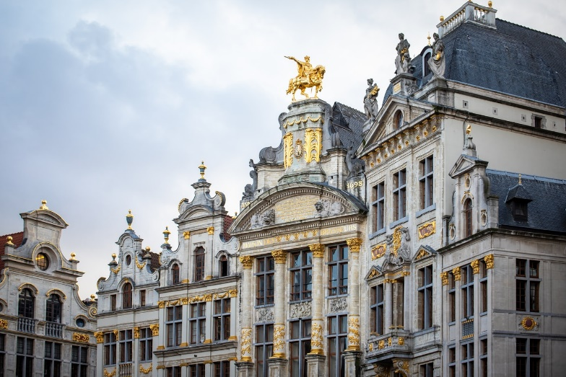
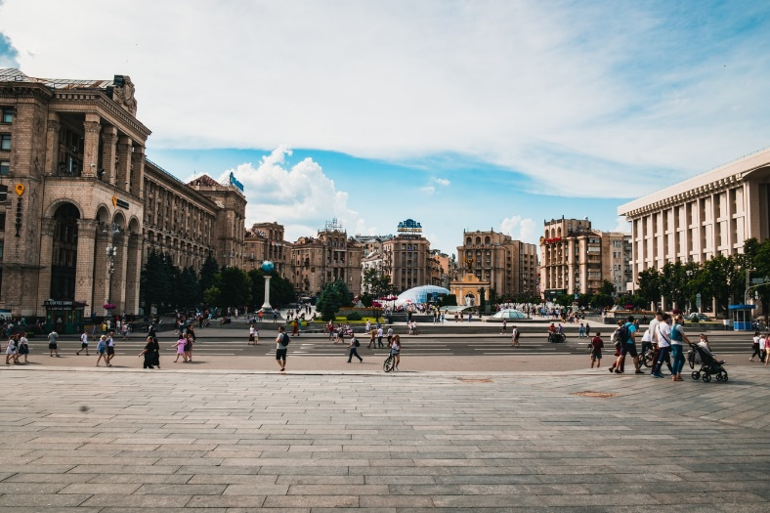
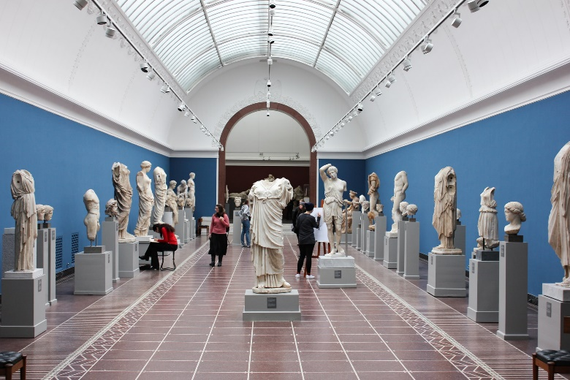
Vocabulaire
lire
Bruxelles
la place
le musée
la place
le musée
Bruxelles
Notes:
Timing: 1 minute
Aim: To introduce this week’s new vocabulary
Procedure:
1. Ask students to match words to pictures, working from left to right.
2. Click to animate answers in that order.

Slide 12
Vocabulaire
lire
The end of ‘dernier’ changes to ‘-ère’ to make the feminine form – a number of French words make their feminine like this.
belge
Belgique
pendant
dernier
dernière
Belgian
Belgium
during
last (m)
last (f)
Note that the adjective does not have a capital letter in French.
during
last (m)
last (f)
Belgium
Belgian
Notes:
Timing: 2 minutes
Aim: To introduce this week’s new vocabulary
Procedure:
1. Ask students to match English words to their French translation, working from left to right.
2. click to animate answers in that order.

Slide 13
Le passé composé
grammaire
Remember: -ER verbs make their perfect tense with je as follows:
Present Perfect (past)
je travaille → j’ai travaillé
(I work) (I worked)
What do you think the tu form looks like?
Present Perfect (past)
tu travailles → tu as travaillé
(you work) (you worked)
tu joues → tu as joué
(you play) (you played)
Remember:
in the perfect tense
we use j’ai (‘I have’),
rather than je (‘I’).
The past participle does not change. Only the form of avoir changes to match the subject.
Notes:
Timing: 2 minutes
Aim: To recap formation of perfect tense je form with –ER verbs and introduce tu form
Procedure:
1. Click to animate the explanation.
2. Ask students what they think the tu form of the perfect tense looks like, before revealing the answer.

Slide 14
L'été dernier
* un escargot = snail
lire
Léa parle des vacances l’année dernière. C’est Léa (je) ou Amir (tu)?
à:
Amir.Amara@bonjour.fr
objet:
vacances
(je)
(tu)
/
Tu as mangé des escargots*.
J’ ai mangé dans un café sur la place de la ville.
J’ ai joué au tennis.
Tu as joué au foot avec des amis.
Tu as gagné le match !
J’ ai préparé un bon déjeuner !
__
/
__
/
__
__
/
__
/
__
/
Notes:
Timing: 5 minutes
Aim: To provide practice in distinguishing between the first and second person singular form of avoir used as the auxiliary in the perfect tense.
Procedure:
1. Students read the sentences and determine the missing pronoun, considering the auxiliary verb form.
2. They then indicate whether the sentence refers to Léa or Amir.
3. Click to reveal the correct answer.
Word frequency of unknown words used (1 is the most frequent word in French): escargot [>5000]
Source: Londsale, D., & Le Bras, Y. (2009). A Frequency Dictionary of French: Core vocabulary for learners London: Routledge.

Slide 15
Les questions au passé composé
grammaire
Remember – you can questions in French by raising the pitch of your voice.
Remember:
in French, we leave a space before the question mark!
Statement
Tu chantes.
You sing.
Question
Tu chantes ?
Do you sing?
You can do the same thing in the perfect tense:
Tu as chanté.
Tu as chanté ?
Tu as chanté quand ?
Add a question word to the end for more information.
Notes:
Timing: 2 minutes
Aim: To recap the formation of questions using intonation alone, then introduce some examples of this with question words using the perfect tense.
Procedure:
1. Animate the explanation.
2. Ensure students’ understanding at each stage.
Word frequency (1 is the most frequent word in French): voyager [2194] malade [1066] comment [234] où [48]
Source: 1Londsale, D., & Le Bras, Y. (2009). A Frequency Dictionary of French: Core vocabulary for learners London: Routledge.

Slide 16
Les questions au passé composé
grammaire
Here are some more examples:
Statement
Tu as mangé.
You ate.
Question
Tu as mangé quoi ?
What did you eat?
Statement
Tu as travaillé.
You worked.
Question
Tu as travaillé quand ?
When did you work?
Notes:
Timing: 2 minutes
Aim: To provide some more (audio supported) examples of questions using intonation with question words using the perfect tense.
Procedure:
1. Animate the explanation. The audio plays automatically as each French item appears.
2. Ensure students’ understanding at each stage.
Transcript:
Tu as mangé.
Tu as mangé quoi ?
Tu as travaillé.
Tu as travaillé quand ?
Word frequency (1 is the most frequent word in French): manger [1338] travailler [290] quoi [297] quand [119]
Source: Londsale, D., & Le Bras, Y. (2009). A Frequency Dictionary of French: Core vocabulary for learners London: Routledge.

Slide 17
Aujourd’hui ou l’hiver dernier ?
écouter
Amir a des questions pour Abdel !
Les questions sont-ils au présent ou au passé ?
 |  | aujourd’hui | l’hiver dernier
 | Tu as travaillé où ?
 | Tu manges quand ?
 | Tu fais des voyages avec qui ?
 | Tu as joué comment ?
 | Tu as regardé quoi ?
 | Tu écoutes quoi ?
1
2
3
4
5
6
Notes:
Timing: 5 minutes
Aim: To provide practice in distinguishing between the tu form present and perfect tenses when listening.
Procedure:
1. Click on the audio buttons to play the sentences (all information questions in either the present or perfect tense).
2. Students listen and tick the appropriate column, according to the tense heard, and note down the activity.
3. Click to reveal the correct ticks, plus the actual questions heard.
Transcript:
1. Tu as travaillé où ?
2. Tu manges quand ?
3. Tu fais des voyages avec qui ?
4. Tu as joué comment ?
5. Tu as regardé quoi ?
6. Tu écoutes quoi ?
7. Tu prépares le déjeuner quand ?
8. Tu as visité le musée où ?

Slide 18
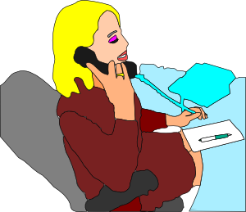
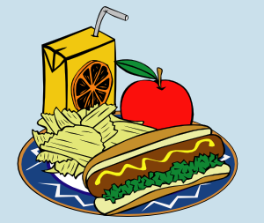
Écrire
écrire
étudier
écouter
jouer
parler
travailler
préparer
regarder
manger
Notes:
Timing: 8 minutes
Aim: To practise written production of the first and second person singular forms of the perfect tense with regular –ER verbs.
Procedure:
1. Each click produces a new combination of a pronoun (I or you) plus a verb and a picture suggesting a complement.
2. Using mini-whiteboards/paper as the teacher sees fit, students write each sentence that is suggested, using the perfect tense.
3. Feedback could be given after the first two or three, to check that all learners are producing the tense correctly.
Suggested sentences:
1. J’ai écouté la radio.
2. Tu as regardé la télé.
3. Tu as mangé un fruit.
4. J’ai préparé le déjeuner.
5. Tu as parlé avec des amis.
6. J’ai travaillé dans un bureau.
7. J’ai joué au foot.
8. Tu as étudié le français.
Word frequency (1 is the most frequent word in French):
manger [1338] travailler [290] étudier [960] jouer [219] regarder [425] écouter [429] préparer [368] parler [106] radio [1526] télé [2746] fruit [896] déjeuner [2724] bureau [273] ami [467] foot [>5000] français [251]
Source: Londsale, D., & Le Bras, Y. (2009). A Frequency Dictionary of French: Core vocabulary for learners London: Routledge.

Slide 19
Comment dit-on en français?
+5
+15
+10
+5
+10
I prepared lunch.
I listened to the radio.
You prepared lunch.
You watched TV.
I ate a banana.
You played football.
+10
You ate a banana.
+15
You listened to the radio.
+5
I played football.
I watched TV.
+15
+5
Notes:
Timing: 8 minutes
Aim: to practise oral production of the first and second person singular forms of the perfect tense with regular –ER verbs.
Procedure:
1. Divide the class into two teams.
2. Each team takes a turn to say one of the sentences in French. Ensure that a different team member says the sentence each time. Allow students to confer with each other quietly in teams to increase participation.
3. When a correct sentence is given, click on the English prompt to reveal the number of points that the team has gained. Points are intended to motivate students, rather than reflect the difficulty of the question.
4. The team with the most points at the end wins.
Optionally, if a team fails to provide the answer, the other team may have the chance to take the turn.

Slide 20
Comment dit-on en français?
I prepared lunch. | I listened to the radio. | You prepared lunch. | You watched TV. | I ate a banana.
You played football. | You ate a banana. | I watched TV. | You listened to the radio. | I played football.
Mots útiles:
écouter
regarder
préparer
jouer
parlé
travaillé
jouer
étudier
Notes:
This is an alternative version of the activity on the previous slide, designed for pairwork.
Procedure:
Students work in pairs and take turns to translate the sentences into French. Verbs are provided for support.
Students tally how many sentences they correctly say in French. Half marks could be given for partially correct answers. The winner in each pair says the most sentences correctly.

Slide 21
Sharing past experiences
present vs perfect tense
regular –ER verbs (taking avoir) (je, tu)
demonstrative adjective
SSC [r]
J’ai visité Bruxelles!
Y8 French
Term 1.2 - Week 2 - Lesson 18
Stephen Owen / Natalie Finlayson / Catherine Morris
Artwork by: Chloé Motard
Date updated: 07.12.23
Notes:
Note: all words (new and revisited) in this week of the SOW appear on all three GCSE wordlists, with these exceptions: i) Edexcel list does not have belge or Bruxelles
ii) AQA list does not have Bruxelles
Artwork by Chloé Motard. All additional pictures selected are available under a Creative Commons license, no attribution required.
Learning outcomes (lesson 1):
Introduction of SSC [r]
Consolidation of perfect tense constructions (with past simple equivalent) of –ER erbs with avoir as auxiliary in the 1st person
Introduction of perfect tense constructions (with past simple equivalent) of –ER erbs with avoir as auxiliary in the 2nd person
Introduction of information questions (intonation with question word) in the perfect tense
Word frequency (1 is the most frequent word in French):
8.1.2.2 (introduce) automne [1503], été [623], hiver [1586], musée [2216], printemps [1288], place [129], saison [1667], belge [2795], dernier [87], dernière [87], là [109], pendant [89], Belgique [n/a], Bruxelles [n/a]
8.1.1.4 (revisit) célébrer [2170], préférer [597], avril [1022], date [660], événement [573], février [1136], janvier [939], juin [931], mars [868], mai [943], tradition [1371], premier [56], première [56], quatorze [1472], quinze [3359], seize [3285], trente [1646], treize [3245], vingt [1273], on [29]
7.3.2.4 (revisit) avion [1409], lettre [480], allemand [844], différent [350], prochain [380], bientôt [1208], demain [871], Allemagne [n/a],
Source: Londsale, D., & Le Bras, Y. (2009). A Frequency Dictionary of French: Core vocabulary for learners London: Routledge.

Slide 22
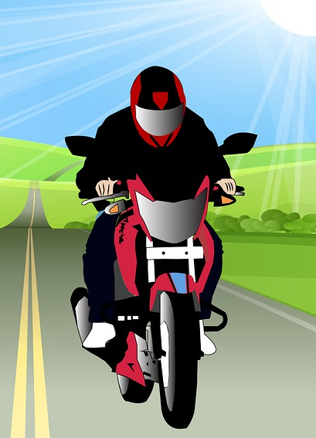
Des virelangues !
écouter / parler
Cinq gros rats grillent dans la grosse graisse grasse
[Five fat rats are roasting in the fatty, greasy fat]
1
2
3
La roue sur la rue roule; la rue sous la roue reste.
[The wheel on the road is rolling; the road under the wheel remains.]
1
2
3
Notes:
Timing: 5 minutes
Aim: practising oral production of SSC [r]
Procedure:
1. Using their knowledge of the meanings of langue, ask students what they think the word virelangue might mean.
2. Click on ‘1’ to hear a tongue twister pronounced at a slow speed. Students repeat as many times a necessary.
3. If students feel confident, click on ‘2’ to hear a tongue twister pronounced at a medium speed, and repeat step 2.
4. At very advanced levels, students can try speed 3!
Transcript:
Cinq gros rats grillent dans la grosse graisse grasse.
La roue sur la rue roule; la rue sous la roue reste.

Slide 23
Les vacances de Léa
* la fois = time * posséder = to possess
* le néerlandais = Dutch
* les moules = mussels
lire
bientôt
allemand
première(e)
on
préférer
tradition
mai
quatorze
Fill in the gaps with the correct form of the words in the table.
En mai, j’ai visité la Belgique pour la première fois*. J’ai passé quatorze jours à Bruxelles. Le cœur de Bruxelles est magnifique et le printemps est une belle saison.
La Belgique possède* trois langues officielles ! On
parle néerlandais*, français et allemand. C’est un pays très intéressant !
Les traditions belges sont intéressantes aussi. On peut manger les moules* mais je préfère le chocolat belge ! Je veux revenir bientôt, en automne peut-être.
[1]
[2]
[3]
[4]
[5]
[6]
[7]
[8]
Notes:
Timing: 10 minutes
Aim: To revise some of this week’s revisited vocabulary in context.
Procedure
1. Students write 1-8 and try to fill the gaps. Remind them that, in some cases, they will need to agree the word with the surrounding vocabulary in the text. The forms in the table will not help them! They will have to understand the context.
2. Answers revealed on clicks.
3. If time permits, students translate or summarise the text in English.
4. A suggested translation is given on the next slide.
Word frequency of unknown words used (1 is the most frequent word in French): fois [49], magnifique [2136], posséder [709], officiel [996], néerlandais [4640], moule [>5000]
Source: Londsale, D., & Le Bras, Y. (2009). A Frequency Dictionary of French: Core vocabulary for learners London: Routledge.

Slide 24
Les vacances de Léa
lire
Une solution possible :
In May, I visited Belgium for the first time. I spent fourteen days in Brussels. The heart of Brussels is magnificent and spring is a beautiful season.
Belgium has three official languages! People speak Dutch, French and German. It’s a very interesting country!
Belgian traditions are interesting too. You can eat mussels, but I prefer Belgian chocolate! I want to go back soon, perhaps in autumn.
Notes:
Suggested translation for the previous activity.

Slide 25
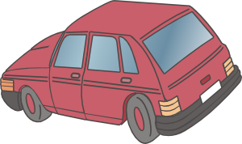
Ce, cet, cette and ces
grammaire
You have met the word ce, meaning ‘this’:
c’est (this is); en ce moment (at this moment)
Ce is a demonstrative adjective. These are used to identify which noun you are talking about. Ce has different forms matching the noun to which it refers.
ce livre (this book) cette voiture (this car)
[masculine singular] [feminine singular]
cet homme (this man) ces personnes (these people)
[masculine singular [plural=these]
before vowel/h-]
Notes:
Timing: 3 minutes
Aim: To introduce the other forms of the demonstrative adjective ‘ce’
Procedure:
1. Click to animate the explanation.
2. Ensure students’ understanding at each stage.

Slide 26
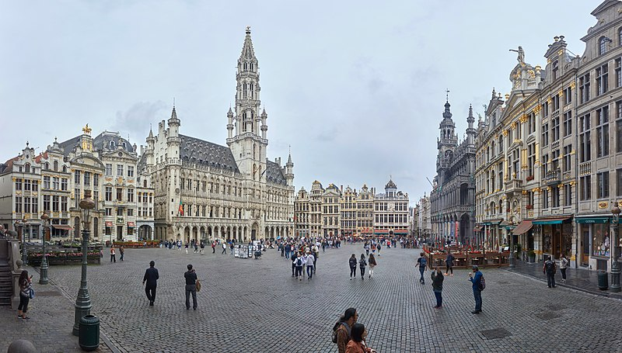
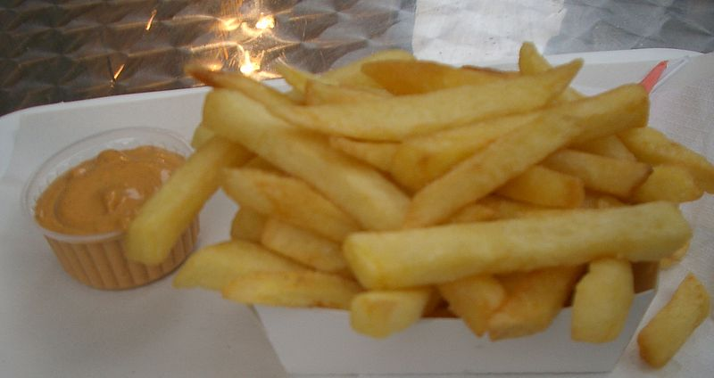
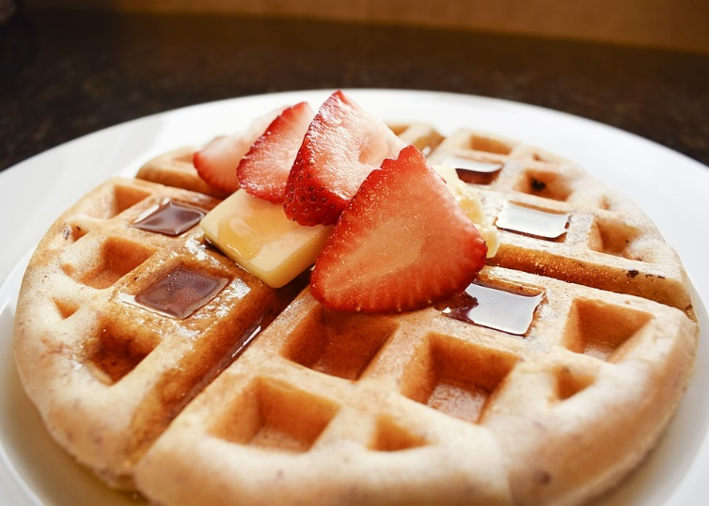
Bruxelles, capitale de la Belgique !
* célèbre = famous
* la gaufre = waffle
* les frites (fpl) = chips
lire
2. J’ai mangé ces gaufre* / frites*.
C’est une spécialité belge !
1. J’ai visité cette place / magasins.
C’est très célèbre.
Notes:
Timing: 6 minutes for four slides
Aim: To provide practice in recognising the different forms of the demonstrative adjective and linking these to appropriate nouns
Procedure:
1. Students read the sentences and select the correct noun from the two options in each, according to the form of the demonstrative adjective shown.
2. Click to show the answers and pictures.
3. This is the first of three slides.
Word frequency of unknown words used (1 is the most frequent word in French): célèbre [1689], gaufre [>5000] frite [>5000], spécialité [3356]
Source: Londsale, D., & Le Bras, Y. (2009). A Frequency Dictionary of French: Core vocabulary for learners London: Routledge.

Slide 27
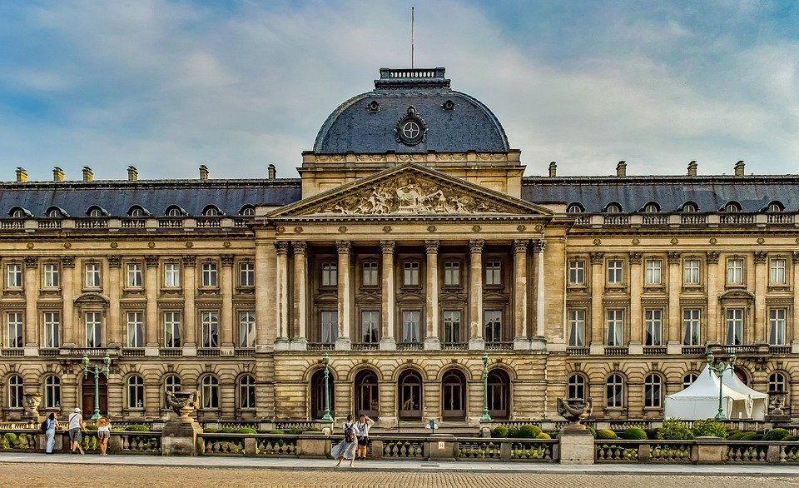
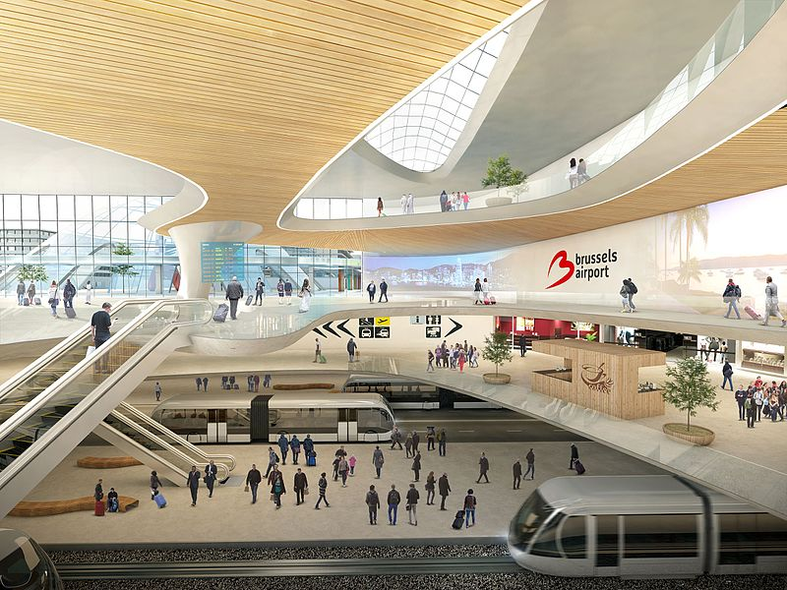
Bruxelles, capitale de la Belgique !
lire
3. J’ai préféré ce bâtiment / maison. C’est le Palais Royal.
4. J’ai aimé cet train/ aéroport très moderne.
Notes:
This is the second of four slides.
Word frequency of unknown words used (1 is the most frequent word in French):
moderne [1239]
Source: Londsale, D., & Le Bras, Y. (2009). A Frequency Dictionary of French: Core vocabulary for learners London: Routledge.

Slide 28
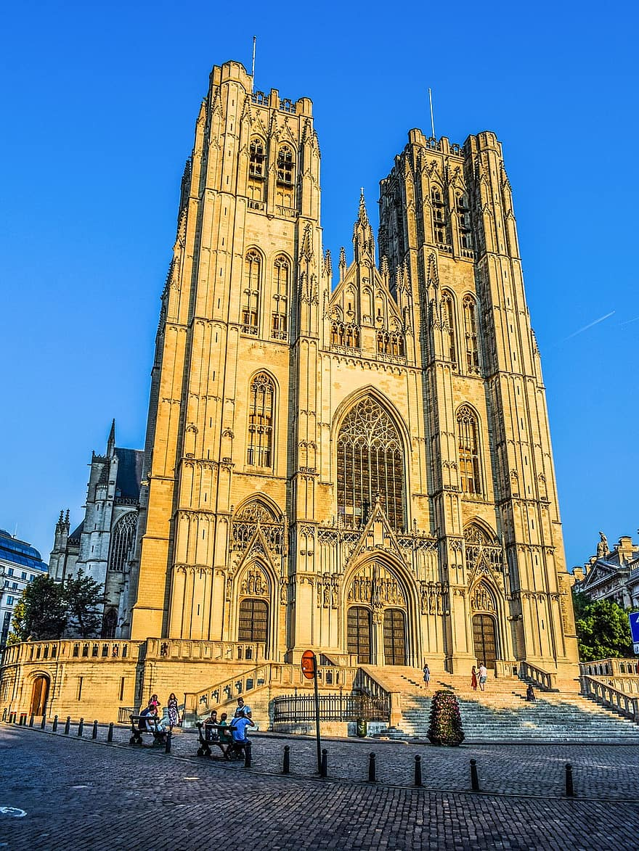
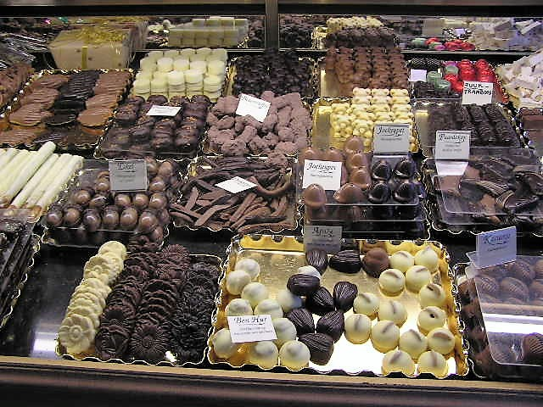
Bruxelles, capitale de la Belgique !
* le chocolat
= chocolate
lire
5. J’ai visité cette monument / église. C’est la cathédrale Saints-Michel-et-Gudule.
6. J’ai mangé ce chocolat / chose. C’est une tradition belge !
Notes:
This is the third of four slides.
Word frequency of unknown words used (1 is the most frequent word in French): cathédrale [>5000] chocolat [4556]
Source: Londsale, D., & Le Bras, Y. (2009). A Frequency Dictionary of French: Core vocabulary for learners London: Routledge.

Slide 29
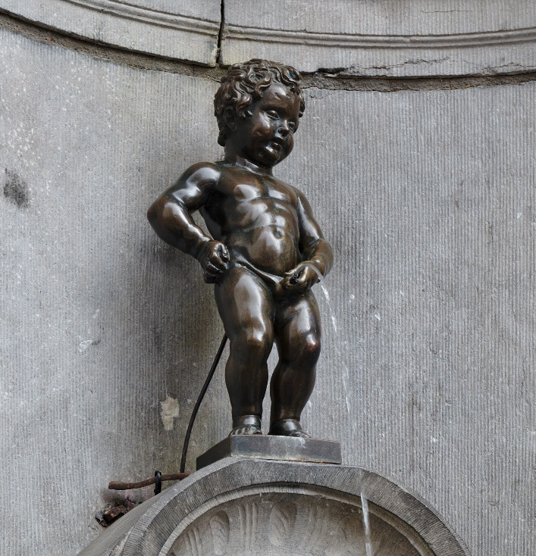
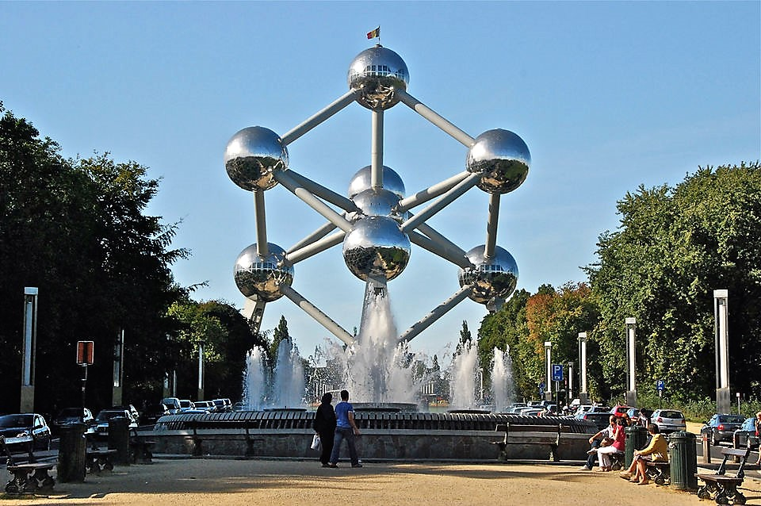
Bruxelles, capitale de la Belgique !
* le monument
= monument
* la structure = structure
lire
7. Ce monument / personne en bronze est le Manneken Pis ! C'est drôle, ça !
8. Voici l’Atomium ! Je trouve cette musée / structure très intéressant. J’aime la science !
Notes:
This is the fourth of four slides.
Word frequency of unknown words used (1 is the most frequent word in French): monument [4113], structure [964]
Source: Londsale, D., & Le Bras, Y. (2009). A Frequency Dictionary of French: Core vocabulary for learners London: Routledge.
Image attributions:
Mannekin Pis: By Trougnouf - Own work, CC BY-SA 4.0, https://commons.wikimedia.org/w/index.php?curid=69684858
Atomium: By Horst J. Meuter - Own work, CC BY-SA 4.0, https://commons.wikimedia.org/w/index.php?curid=87967315

Slide 30
Les voyages dans le passé
lire
utilisé
visité
aimé
organisé
préféré
trouvé
mangé
musée
aéroport
église
appartement
fête
place
monument
voyage
J’ai
ce
cet
cette
Notes:
Timing: 7 minutes
Aim: written comprehension of demonstrative adjectives (ce, cet, cette), including gender agreement with nouns
Procedure:
Students read the prompts and use them to put together a sentence in French. They need to consider the gender of nouns and adjectives in order to write a sentence correctly.
Ask students to read these out and then check comprehension by asking the rest of the class.

Slide 31
Les questions au passé composé
grammaire
Remember – you can questions in French by raising the pitch of your voice.
Remember:
in French, we leave a space before the question mark!
Statement
Tu chantes.
You sing.
Question
Tu chantes ?
Do you sing?
You can do the same thing in the perfect tense:
Tu as chanté.
Tu as chanté ?
Did you sing?
Notes:
Timing: 2 minutes
Aim: To recap the formation of questions using intonation alone, then introduce some examples of this with question words using the perfect tense.
Procedure:
1. Animate the explanation.
2. Ensure students’ understanding at each stage.
Word frequency (1 is the most frequent word in French): voyager [2194] malade [1066] comment [234] où [48]
Source: 1Londsale, D., & Le Bras, Y. (2009). A Frequency Dictionary of French: Core vocabulary for learners London: Routledge.

Slide 32
Les questions au passé composé
lire / écrire
Complète les phrases.
Did you visit this museum?
ce
Tu as visité _______ musée?
Hint?
musée = masculine
Notes:
Timing: 7 minutes (slide 1/7)
Aim: written production of demonstrative adjectives ‘ce’, ‘cet’ and ‘cette’
Procedure:
1. Students read the English question.
2. Give them a couple of seconds to think how they write the translation. Depending on the group, some students may be able to translate the whole sentence.
3. Click to bring up the sentence scaffolding for support.
4. Students write the missing word.
4. Click again to reveal the answer.

Slide 33
Les questions au passé composé
lire / écrire
Complète les phrases.
Did you organise this party?
cette
Tu as organisé _______ fête?
Hint?
fête = feminine
Notes:
Slide 2/7

Slide 34
Les questions au passé composé
lire / écrire
Complète les phrases.
Did you use this appartment?
cet
Tu as utilisé _______ appartement?
Hint?
appartement = masculine
Notes:
Slide 3/7

Slide 35
Les questions au passé composé
lire / écrire
Complète les phrases.
Did you prefer this church?
cette
Tu as préféré _______ église?
église = feminine
Hint?
Notes:
Slide 4/7

Slide 36
Les questions au passé composé
lire / écrire
Complète les phrases.
Did you like this building?
ce
Tu as aimé _______ bâtiment?
bâtiment = building
Hint?
Notes:
Slide 5/7

Slide 37
Les questions au passé composé
lire / écrire
Complète les phrases.
Did you eat in this restaurant?
ce
Tu as mangé dans _______ restaurant?
restaurant = masculine
Hint?
Notes:
Slide 6/7

Slide 38
Les questions au passé composé
lire / écrire
Complète les phrases.
Did you use this airport?
Tu as utilisé _______ aéroport?
cet
aéroport = masculine
Hint?
Notes:
Slide 7/7

Slide 39
Les questions au passé composé
lire / parler
Imagine que ton ami était en vacances.
Pose des questions avec ‘ce’, ‘cet’ et ‘cette’.
musée
aéroport
église
appartement
fête
place
monument
voyage
(des idées)
Tu as visité…?
Tu as mangé…?
Tu as utilisé…?
Tu as aimé…?
Tu as préféré…?
ce
cette
cet
Example: Tu as visité ce musée?
(Did you visit this museum?)
Notes:
Timing: 7 minutes
Aim:
to practise reading sentences aloud in the perfect tense
to correctly produce demonstrative adjectives ‘ce’, ‘cet’ and ‘cette’ + noun
Procedure:
Working in pairs, students create sentences together orally with the support of the sentence starters.
Student A chooses a starter from the first box.
Student B finishes the sentence with ‘ce’, ‘cet’ or ‘cette’ and a noun of their choice. A help box is given for support if needed.
Alternatively, students can create questions individually and their partner can be asked to translate them into English.

Slide 40
Devoirs
Vocabulary Learning Homework (Y8, Term 1.2, Week 3)
Audio file
Student worksheet
In addition, revisit: Y8 Term 1.1 Week 6 | Y7 Term 3.2 Week 5
Notes:
The answer sheet for the Y8, Term 1.2, Week 3 vocabulary learning HW is here: https://rachelhawkes.com/LDPresources/Yr8French/French_Y8_Term1ii_Wk3_audio_HW_sheet_answers.docx Don’t share this link with students ☺
Notes:
i) Teachers may, in addition, want to recommend use of a particular online app for the pre-learning of each week’s words. ii) Quizlet now requires parental involvement / registration / permissions for users below the age of 13, so it is perhaps most suitable for Y9 – 11 students. iii) Language Nut hosts LDP vocabulary lists and these are free for schools to use, though there is a registration process. One benefit is that all of the student tracking data that Language Nut offers are also available to schools that use the LDP lists for practice. Perhaps this makes it a good option for Y7/8.
iv) There are other free apps, and new ones are always appearing. Teachers have told us that they are currently using: Flippity, Wordwall (where using previously-created activities is free).
v) Gaming Grammar has been acquired by Language Nut. Its original content should still be available to teachers and much of it is appropriate for Y8 learners.

Slide 41
EXTRA SLIDES – Lesson 1

Slide 42
Maintenant et dans le passé
lire / écrire
Écris une réponse à la question. Tu peux utiliser un dictionnaire !
Tu as fait quoi l’hiver dernier ?
Notes:
Timing: 16 minutes (2 minutes per question)
Aim: Written comprehension and production in response to information questions in the present and perfect tenses.
Procedure:
1. Students read the question and write their own response in the appropriate tense.
2. Students may consult a dictionary if needed.
3. There are eight questions in all. Each question is on a different slide.

Slide 43
Maintenant et dans le passé
lire / écrire
Écris une réponse à la question. Tu peux utiliser un dictionnaire !
Tu fais quoi aujourd’hui ?

Slide 44
Maintenant et dans le passé
lire / écrire
Écris une réponse à la question. Tu peux utiliser un dictionnaire !
Tu manges où au déjeuner ?

Slide 45
Maintenant et dans le passé
lire / écrire
Écris une réponse à la question. Tu peux utiliser un dictionnaire !
Tu as mangé avec qui hier ?

Slide 46
Maintenant et dans le passé
lire / écrire
Écris une réponse à la question. Tu peux utiliser un dictionnaire !
Tu as passé tes vacances comment l’été dernier ?

Slide 47
Maintenant et dans le passé
lire / écrire
Écris une réponse à la question. Tu peux utiliser un dictionnaire !
Tu passes tes vacances comment normalement ?

Slide 48
Maintenant et dans le passé
lire / écrire
Écris une réponse à la question. Tu peux utiliser un dictionnaire !
Tu travailles quand à la maison ?

Slide 49
Maintenant et dans le passé
lire / écrire
Écris une réponse à la question. Tu peux utiliser un dictionnaire !
Tu as travaillé quand hier ?

Slide 50
EXTRA SLIDES – lesson 2

Slide 51
Maintenant et dans le passé
écouter / parler
Numérote tes réponses au hasard*. Lis les phrases à ton/ta partenaire.
Ton/ta partenaire va répéter tes réponses !
Exemple:
Partner A
1. J’ai regardé un film l’hiver dernier.
(and so on for sentences 2-8)
Partner B (after all sentences complete)
1. Tu as regardé un film l’hiver dernier.
*numéroter au hasard – to number at random
Notes:
Timing: 10 minutes
Aim: To provide practice in listening and speaking with statements in the present and perfect tenses (with time expressions)
Procedure:
1. Students randomly number their statements from the previous writing exercise 1-8.
2. They read their statements in this new order to their partner, who notes down what they did/do and when.
3. Partners then state back what they have understood, using the tu form.
4. Partners swap roles and repeat.
Example:
Partner A: 1. J’ai regardé un film l’hiver dernier.
Partner B (after all sentences complete): 1. Tu as regardé un film l’hiver dernier.

Slide 52
Tu fais quoi ? Tu as fait quoi ? (A)
parler
A | aujourd’hui | l’année dernière
B | aujourd’hui | l’année dernière
1.
2.
3.
4.
5.
Notes:
Timing: 5 minutes
Aim: To provide production (speaking) practice in contrasting present and perfect tense forms with –ER verbs (first and second person singular)
Procedure:
Student A faces the board. Student B turns away from the board and sketches a 6x2 grid.
Student A says s/he does/did each thing pictured in turn, using the first person present or perfect tense according to whether the tick appears in the ‘today’ or ‘last year’ column.
Student B writes down what the activity is/was in English, ticking the appropriate column on his/her blank copy of the grid.
Student B then tells Student A what s/he has recorded: ‘Tu as...’
Students compare cards to check answers.
Students swap roles and use the second set of cards on the next slide.

Slide 53
Tu fais quoi ? Tu as fait quoi ? (B)
parler
B | aujourd’hui | l’année derniere
A | aujourd’hui | l’année derniere
1.
2.
3.
4.
5.
Notes:
This is the second set of cards, for when partners swap roles.

