Slide 1
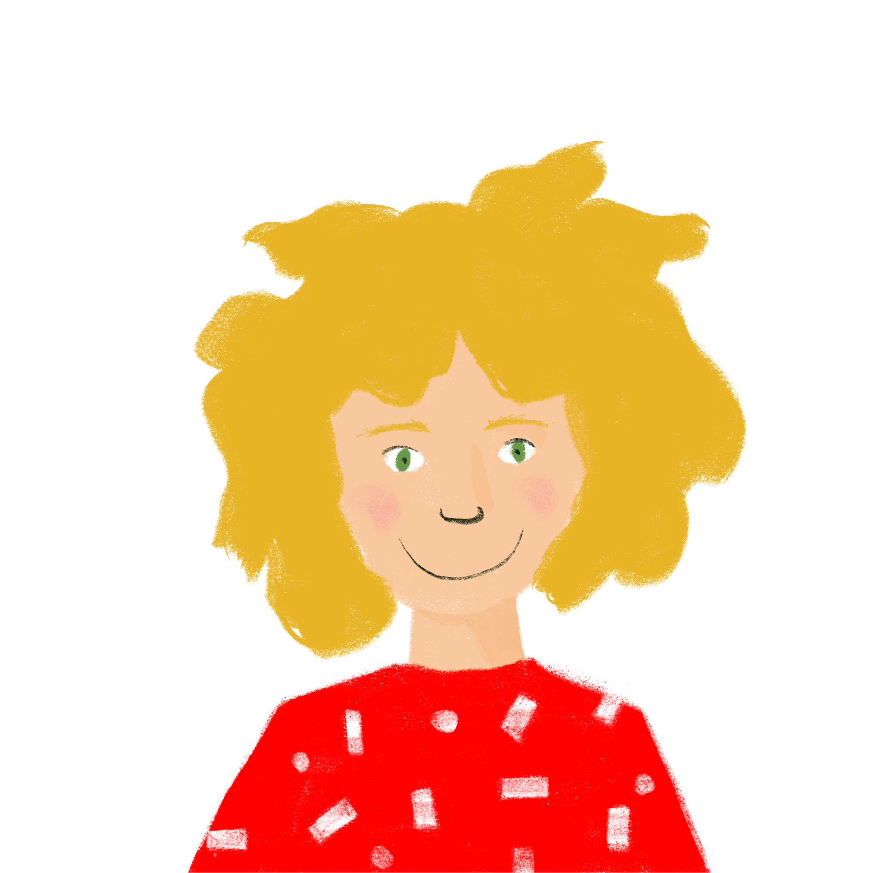
Talking about what you are doing today vs what you did yesterday
present vs perfect tense irregular verbs (taking avoir): faire and dire (je) SSC [-gn-]
Je parle de ma routine !
Je fais quoi maintenant ?
J’ai fait quoi hier ?
Y8 French
Term 1.2 - Week 1 - Lesson 15
Stephen Owen / Natalie Finlayson
Artwork by: Chloé Motard
Date updated: 23/11/23
Notes:
Note: all words (new and revisited) in this week of the SOW appear on all three GCSE wordlists, with these exceptions: i) Edexcel list does not have appartement
Artwork by Chloé Motard. All additional pictures selected are available under a Creative Commons license, no attribution required.
Learning outcomes (lesson 1):
Introduction of SSC [-gn-]
Introduction of perfect tense constructions (with past simple equivalent) with avoir as auxiliary in the 1st person
Introduction of past participles of faire and dire
Word frequency (1 is the most frequent word in French):
8.1.2.1 (introduce) apporter [329], dit [dire 37], envoyer [526], fait [faire 25], utiliser [345], maintenant [192 ], hier [872], appartement [2323], banque [774], marché [280], passé [501]
8.1.1.2 (revisit) avocat [1188], bureau² [273], directeur¹ [640], emploi¹ [517], facteur [1264], secrétaire [920], ambitieux [2905], prudent [1529], travailleur, travailleuse [1341], assez [321]
7.3.2.3 (revisit) devenir [162], partir [163], pars [163], part [163], revenir [184], avenir [471], match [1906], madame [294], monsieur [79], encore¹ [51], en retard [7/1278], tôt [513]
Source: Londsale, D., & Le Bras, Y. (2009). A Frequency Dictionary of French: Core vocabulary for learners London: Routledge.

Slide 2
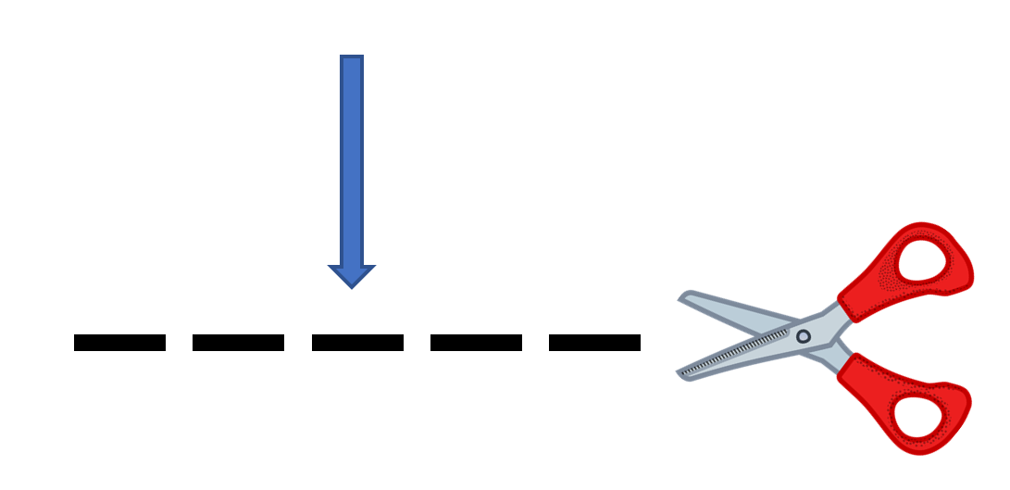
-gn-
ligne
Notes:
Timing: 1 minute
Aim: To introduce SSC [-gn-]
Procedure: 1. Present the letter(s) and say the [-gn-] sound first, on its own. Students repeat it with you. 2. Bring up the word ”ligne” on its own, say it, students repeat it, so that they have the opportunity to focus all of their attention on the connection between the written word and its sound.
3. A possible gesture for this would be to draw a line in the air with your finger, 4. Roll back the animations and work through 1-3 again, but this time, dropping your voice completely to listen carefully to the students saying the [-gn-] sound, pronouncing ”ligne” and, if using, doing the gesture.
Word frequency (1 is the most frequent word in French):
ligne [342]
Source: Londsale, D., & Le Bras, Y. (2009). A Frequency Dictionary of French: Core vocabulary for learners London: Routledge.

Slide 3
-gn-
ligne
Notes:
With sound and no pictures to focus all attention on the sound-symbol correspondence.

Slide 4
-gn-
ligne
Notes:
Without sound to elicit pronunciation (without first hearing the teacher).
Teacher to elicit pronunciation by asking “Comment dit-on …”

Slide 5
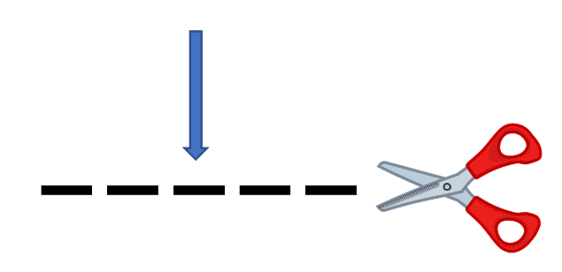
-gn-
gagner
montagne
[to win]
espagnol
ligne
Allemagne
ignorer
[to not know]
Notes:
Timing: 2 minutes
Aim: To introduce SSC [-gn-]
Procedure:
Introduce and elicit the pronunciation of the individual SSC [-gn-] and then the source word again ‘ligne’ (with gesture, if using). Then present and elicit the pronunciation of the five cluster words. The cluster words have been chosen for their high-frequency, from a range of word classes, with the SSC (where possible) positioned within a variety of syllables within the words (e.g. initial, 2nd, final etc.). Additionally, we have tried to use words that build cumulatively on previously taught SSCs (see the Phonics Teaching Sequence document) and do not include new SSCs. Where new SSCs are used, they are often consonants which have a similar symbol-sound correspondence in English.
Word frequency (1 is the most frequent word in French): ligne [342]; gagner [258]; ignorer [639]; espagnol [1666]; montagne [1734]; Allemagne [N/A]. Source: Londsale, D., & Le Bras, Y. (2009). A Frequency Dictionary of French: Core vocabulary for learners London: Routledge.

Slide 6
-gn-
gagner
montagne
espagnol
ligne
Allemagne
ignorer
Notes:
With sound and no pictures to focus all attention on the sound-symbol correspondence.

Slide 7
-gn-
gagner
montagne
espagnol
ligne
Allemagne
ignorer
Notes:
Without sound to elicit pronunciation (without first hearing the teacher).
Teacher to elicit pronunciation by asking “Comment dit-on …”

Slide 8
Phonétique
écouter / écrire
 | What do you hear? | [gn] | [n]/[nn]
 | me n er
 | dessi n er
 | souligner
 | campagne
 | gouver n er
 | poignée
1
_
[to lead]
2
_
3
_
[to underline]
4
_
[countryside]
5
_
[to rule]
6
_
Notes:
Timing: 5 minutes
Aim: Aural differentiation between [gn] and [n].
Procedure:
1. Click numbers to hear words.
2. Students tick whether they think the word needs [gn] or [n]/[n] to fill the gap.
3. On clicks the answers are revealed.
Transcript:
mener
dessiner
souligner
campagne
gouverner
poignée
Word frequency (1 is the most frequent word in French): mener [4040], dessiner [2086], souligner [816], campagne [666], gouverner [2063], poignée [3208], accompagne [727], innocent [2059], éloigner [1541], anniversaire [2043], baigner [4608],
Source: Londsale, D., & Le Bras, Y. (2009). A Frequency Dictionary of French: Core vocabulary for learners London: Routledge.

Slide 9
Vocabulaire
lire / parler
 | Word | English meaning
1 | apporter | to bring
2 | dit | said (pp)
3 | envoyer | to send
4 | fait | made (pp)
5 | utiliser | to use
6 | maintenant | now
7 | hier | yesterday
8 | un appartement | appartment, flat
9 | la banque | bank
10 | le marché | market
11 | le passé | past
60
With envoyer, the y changes to an i in the present tense forms (apart from nous and vous):
j’envoie
tu envoies
0
DÉBUT
Notes:
Timing: 5 minutes Aim: To reactivate and strengthen vocabulary knowledge. Note: Students in Y8 pre-learn their vocabulary on Quizlet, additionally completing several tasks to build their knowledge. This task assists recall of the new vocabulary. Procedure: Round 1: Look at the French, recall the English meanings, saying them aloud. [1 minute] Round 2: Look at the English, recall the French meanings, saying them aloud. [1 minute] Repeat for two further minutes, to speed up recall.

Slide 10
Le passé composé
grammaire
To say what we did in the past, we use the perfect tense (passé composé):
j’ai fait – I did/made j’ai dit – I said
Look at the differences between the present and perfect (past) tense forms of these verbs:
Present Perfect (past)
je dis → j’ai dit
(I say) (I said)
je fais → j’ai fait
(I do/make) (I did/made)
In the perfect tense
we use j’ai (‘I have’),
rather than je (‘I’).
The –s and –t at the end of the verbs are silent final consonants (SFCs).
The only difference we hear between present and past tense forms is the j’ai.
The forms of the main verb look different!
(i.e. dit – said; fait – made)
These forms are called past participles.
Notes:
Timing: 4 minutes
Aim: To introduce the formation of the perfect tense with two verbs for which there is no audible difference between the present tense for je and the past participle.
Procedure:
1. Click to animate the explanation.
2. Point out the use of the auxiliary, the past participle and the fact that the latter sounds the same as the present tense je form for these verbs, as per the speech bubbles.
3. Check students’ understanding at each stage.
Word frequency (1 is the most frequent word in French):
8.1.1.5 (introduce) dit [dire 37], fait [faire 25]
Source: Londsale, D., & Le Bras, Y. (2009). A Frequency Dictionary of French: Core vocabulary for learners London: Routledge.

Slide 11
Au présent
écouter
je dis
I say, I am saying
Notes:
Timing: 1 minute for 4 slides
Aim: to introduce the concept of an auxiliary verb to show past tense.
Procedure:
Listen and repeat.

Slide 12
Au passé
écouter
j’ai dit
I said

Slide 13
Au présent
écouter
je fais
I do, I make

Slide 14
Au passé
écouter
j’ai fait
I made, I did

Slide 15
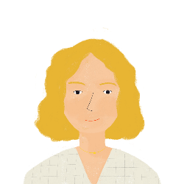
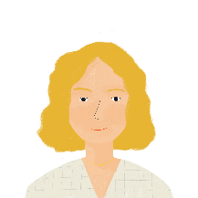
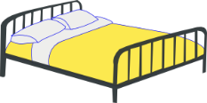
Ma routine - Aurélie
* la nuit
= night
parler / écouter
Amandine, c’est la mère de la famille. Elle parle de sa routine. Elle dit:
Maintenant ... Hier...
Bonjour !
Je dis bonjour à ma famille.
J’ai dit bonjour à ma famille.
Je fais mon lit.
J’ai fait mon lit.
Je fais le ménage dans mon appartement.
J’ai fait le ménage dans mon appartement.
Je fais les courses au marché.
J’ai fait les courses au marché.
Je fais mon travail.
J’ai fait mon travail.
Je dis bonne nuit !
J’ai dit bonne nuit !
Notes:
Timing: 5 minutes
Aim: To provide further listening and reading input of the perfect tense with two verbs for which there is no audible difference between the present tense for je and the past participle.
Note: The listening input is provided to help students to realise that the audible difference in the tenses for these verbs lies solely with the presence of the auxiliary verb, and thus to focus upon that.
Procedure:
Students predict how each sentence will sound in the perfect tense and try to say it.
Click to reveal each solution. The audio plays upon the appearance of each item.
Students repeat.
Check students’ understanding at each stage.
Word frequency of unknown words (1 is the most frequent word in French): nuit [580], routine [4120]
Source: Londsale, D., & Le Bras, Y. (2009). A Frequency Dictionary of French: Core vocabulary for learners London: Routledge.

Slide 16
Ma routine - Léa
* le café
= coffee
écouter
Je parle de ma routine !
Je fais quoi maintenant ?
J’ai fait quoi hier ?
 | hier (yesterday) | maintenant (now)
1
2
3
4
5
6
Notes:
Timing: 6 minutes
Aim: To provide listening input practice in recognising the presence of the auxiliary in the perfect tense, thereby distinguishing this from the present.
Procedure:
1. Click on audio buttons to play sentences.
2. Students listen and tick whether the sentence refers to yesterday, or now (i.e. the present).
3. Click to reveal the animated answers.
Transcript:
1. J’ai fait mon lit.
2. J’ai fait mes devoirs.
3. Je fais une activité.
4. Je dis bonjour à ma famille.
5. J’ai fait une pizza.
6. Je fais un café.
7. J’ai dit bonjour à Antoine.
8. Je fais une promenade.
Word frequency (1 is the most frequent word in French): dit [dire 37], fait [faire 25], maintenant [192 ], hier [872], activité [452], devoirs [39], lit [1837], ménage [2326], café [1886], pizza [>5000], promenade [>5000]
Source: Londsale, D., & Le Bras, Y. (2009). A Frequency Dictionary of French: Core vocabulary for learners London: Routledge.

Slide 17
Hier ou maintenant?
lire
Léa écrit à Amir. C’est hier ou maintenant?
1. Léa: Je fais la cuisine.
 | Hier (yesterday) | Maintenant (now)
1
2
3
4
5
6
2. Amir: J’ai fait les courses.
3. Léa: Je dis bonjour à Antoine.
4. Léa: J’ai fais un café.
5. Amir: Je fais une pizza.
6. Léa: J’ai dit bonjour à Élodie.
Notes:
Timing: 6 minutes
Aim: To provide reading input practice in recognising the difference between the past participle and the present tense form for je.
Procedure:
1. Students read the sentences with the pronoun je or pronoun plus auxiliary j’ai obscured..
2. Students write 1-6 and whether the sentence refers to yesterday, or now.
3. Click to reveal the animated answers.

Slide 18
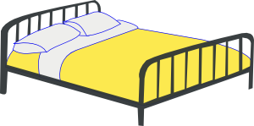
Hier ou maintenant?
parler
Person A: Say the action in French.
It is happening now (‘maintenant’), use ‘je fais’.
If it happened yesterday (‘hier’), use ‘j’ai fait’.
Person B: turn away from the board.
You will listen and write ‘yesterday’ or ‘now’ for each sentence.
Then swap roles when told by your teacher.
1. Hier
J’ai fait mon lit.
Example:
faire mon lit
1. Yesterday
Notes:
Timing: 10 minutes
Aim: To provide production practice (speaking) with the perfect versus the present tense with je.
Procedure:
1. Partner B turns to face away from the board where this side is being displayed.
2. Click on the mouse to bring up the first selection of five items (shown in orange). These are for Partner A. ‘Hier’ or ‘maintenant’ is indicated for each item.
3. Partner A produces the appropriate sentence in French for each item, using the perfect or present tense as required (in the first person form).
4. Partner B writes whether Partner A is speaking about ‘yesterday’ or ‘now’.
5. Swap roles so that Partner A now faces away and Partner B says the next set of five items, which appear on the next click of the mouse (shown in blue).
6. Partner A writes whether Partner B is speaking about ‘yesterday’ or ‘now’.
7. Both partners check their answers.
Word frequency (1 is the most frequent word in French): dit [dire 37], fait [faire 25], maintenant [192 ], hier [872], appartement [2323], marché [280], devoirs [39], lit [1837], ménage [2326], café [1886], pizza [>5000], courses [1289], cuisine [2618], petit déjeuner [138/368]
Source: Londsale, D., & Le Bras, Y. (2009). A Frequency Dictionary of French: Core vocabulary for learners London: Routledge.

Slide 19
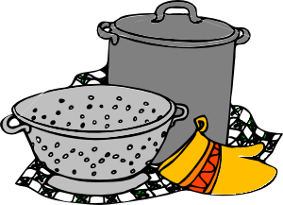
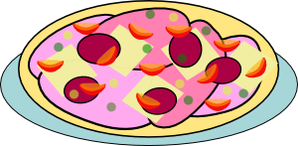
Partner A
parler
1. hier
2. maintenant
3. hier
Bonjour !
faire un café
dire bonjour
faire mon lit
4. maintenant
5. hier
faire une pizza
faire la cuisine
Notes:
Person A prompts
(Person B now looking away from the board)

Slide 20
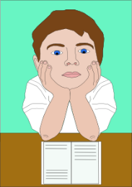
Partner B
écrire
1. maintenant
2. hier
3. maintenant
faire le ménage
dans l’appartement
faire mon petit déjeuner
faire mes devoirs
4. hier
5. maintenant
Au revoir !
faire les courses
au marché
dire au revoir
Notes:
Person B prompts
(Person A now looking away from the board)

Slide 21
Les phrases
écrire
B
1. Hier j’ai fait mon lit.
2. Maintenant je fais un café.
3. Hier j’ai dit bonjour.
4. Maintenant je fais la cuisine.
5. Hier j’ai fait une pizza.
A
1. Maintenant je fais mon petit déjeuner.
2. Hier j’ai fait mes devoirs.
3. Maintenant je fais le ménage dans l’appartement.
4. Hier j’ai fait les courses au marché.
5. Maintenant je dis au revoir.
Notes:
This slide can be used to support feedback.

Slide 22
Trouve le trésor !
écrire
0
+5
+10
+15
+ 25
 | 1 | 2 | 3 | 4
A
B
C
D
the desk
a job
the secretary
quite
le bureau
un emploi
le/la secrétaire
assez
to become
to leave
(you, sing.) leave
(il/elle) part
devenir
partir
(tu) pars
(he/she) leaves
to come back
the match
madame
revenir
a future
le match
Miss
un avenir
Sir
again
late
tôt
monsieur
encore
en retard
early
Notes:
Timing: 10 minutes Aim: This ‘treasure hunt’ activity revisits key vocabulary to consolidate knowledge (in the written modality). As well as meaning, the focus is on form and spelling. Procedure:
1. Work individually, in pairs or in small groups. Each row (A-D) represents one round. 2. Write 1-4 in exercise books or mini whiteboards, and write the French for each number. 3. Click the blue box to reveal and check answers. 4. Click the yellow box to reveal the points for each correct answer (these are randomly allocated for an element of chance) – tally the total.
Word frequencies:
8.1.1.1 (revisit) bureau² [273], emploi [517], secrétaire [920], assez [321]
7.3.2.3 (revisit) devenir [162], partir [163], pars [163], part [163], revenir [184], avenir [471], match [1906], madame [294], monsieur [79], encore¹ [51], en retard [7/1278], tôt [513]

Slide 23
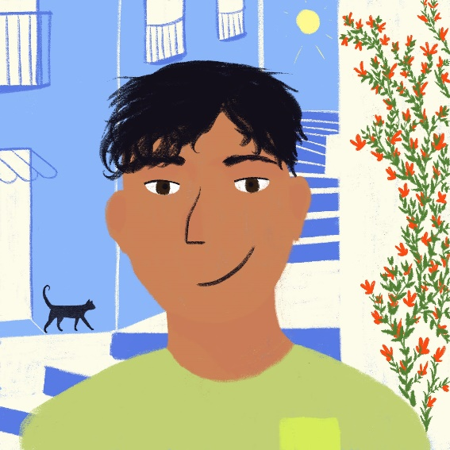
Talking about what you are doing today vs what you did yesterday
present vs perfect tense regular -ER verbs (taking avoir) (je)
SSC [-gn]
J’ai fait quoi ?
Qu’aime-je faire ?
Y8 French
Term 1.2 - Week 1 - Lesson 16
Stephen Owen / Natalie Finlayson
Artwork by: Chloé Motard
Date updated:P 23/11/23
Notes:
Note: all words (new and revisited) in this week of the SOW appear on all three GCSE wordlists, with these exceptions: i) Edexcel list does not have appartement
Artwork by Chloé Motard. All additional pictures selected are available under a Creative Commons license, no attribution required.
Learning outcomes (lesson 1):
Introduction of SSC [-gn-]
Introduction of perfect tense constructions (with past simple equivalent) with avoir as auxiliary in the 1st person
Introduction of past participles of faire and dire
Word frequency (1 is the most frequent word in French):
8.1.2.1 (introduce) apporter [329], dit [dire 37], envoyer [526], fait [faire 25], utiliser [345], maintenant [192 ], hier [872], appartement [2323], banque [774], marché [280], passé [501]
8.1.1.2 (revisit) avocat [1188], bureau² [273], directeur¹ [640], emploi¹ [517], facteur [1264], secrétaire [920], ambitieux [2905], prudent [1529], travailleur, travailleuse [1341], assez [321]
7.3.2.3 (revisit) devenir [162], partir [163], pars [163], part [163], revenir [184], avenir [471], match [1906], madame [294], monsieur [79], encore¹ [51], en retard [7/1278], tôt [513]
Source: Londsale, D., & Le Bras, Y. (2009). A Frequency Dictionary of French: Core vocabulary for learners London: Routledge.

Slide 24
Phonétique
lire / parler
chinois
signe
60
ministre
règne
significatif
[reign]
[significant]
compagnie
signal
[company]
témoignage
[testimony]
secondes
minime
généreux
[minimal]
raisonnable
signature
détenir
0
dignité
ignorance
Canada
DÉBUT
Notes:
Timing: 4 minutes for three slides
Aim: Written recognition and oral production of SSC [gn] in cognate or near-cognate words.
Procedure:
1. Click début to start timer
2. Students pronounce all words (mixture of [gn] and [n]/[nn]). Students work in pairs and listen to each other’s attempts. If a student mispronounces [gn] (they may pronounce it the English way and say a ‘g’ or ‘n’ sound) or [n] (they may overapply the rule and say [gn]) they must repeat the word three times before moving on.
3. Following slides have shorter timer to increase challenge
Word frequency (1 is the most frequent word in French): généreux [2015], raisonnable [2021], dignité [2171], signe [707], compagnie [775], signal [978], témoignage [1548], règne [3649], significatif [2292], minime [2030], détenir [2056], Canada [n/a], ministre [204], chinois [1914], signature [2187], ignorance [4055]
Source: Londsale, D., & Le Bras, Y. (2009). A Frequency Dictionary of French: Core vocabulary for learners London: Routledge.

Slide 25
Phonétique
lire / parler
chinois
signe
45
ministre
règne
significatif
[reign]
[significant]
compagnie
signal
[company]
témoignage
[testimony]
secondes
minime
généreux
[minimal]
raisonnable
signature
détenir
0
dignité
ignorance
Canada
DÉBUT
Notes:
45 seconds

Slide 26
Phonétique
lire / parler
chinois
signe
30
ministre
règne
significatif
[reign]
[significant]
compagnie
signal
[company]
témoignage
[testimony]
secondes
minime
généreux
[minimal]
raisonnable
signature
détenir
0
dignité
ignorance
Canada
DÉBUT
Notes:
30 seconds

Slide 27
Vocabulaire
lire
Écrivez les mots dans le tableau.
 |  | masculin | féminin
nom
adjectif
avocat directrice travailleur factrice
ambitieuse avocate directeur travailleuse
prudente facteur ambitieux prudent
Notes:
Timing: 5 minutes
Aim: To revisit and categorise the vocabulary from 8.1.1.1 and its associated grammar point (masculine/feminine agreement of nouns and adjectives).
Procedure:
1. Students categorise these known words in accordance with their part of speech (noun or adjective) and their gender, completing the table (there are three words to go in each box).
2. The answers are shown on the following slide.

Slide 28
Vocabulaire - réponses
parler
 |  | masculin | féminin
nom |  | avocat directeur facteur | directrice factrice avocate
adjectif |  | travailleur ambitieux prudent | ambitieuse travailleuse prudente
avocat directrice travailleur factrice
ambitieuse avocate directeur travailleuse
prudente facteur ambitieux prudent
Notes:
These are the answers to the task on the previous slide.

Slide 29
envoyer
[to send | sending]
e is added to the stem in the il/elle/on form
envoie
[sends | is sending]
envoyons
[send | are sending]
Notes:
Timing: 3 minutes for sequence of eight slides
Aim: to introduce the verb envoyer more explicitly. Both long form (infinitive) and short form (3rd person singular) are introduced in order to familiarise students with various forms of the same verb.
Procedure
Bring up the word envoyer on its own, say it, students repeat it, and remind them of the phonics.
Try to elicit the meaning from the students. Students have had explicit teaching that the present tense in French communicates two different present tense meanings in English. This reinforces that learning. Emphasise the two meanings for the short form, reminding students that French only has one form and does not have a direct equivalent of the grammar for ‘is + ing’, the continuous form (as covered in previous weeks).
Bring up the picture, and, if using gestures, a possible gesture would be to mime stamping and posting a letter
Then bring up the English translations. Emphasise the two meanings for the infinitive.
Bring up the first short form envoie, say it, students repeat it. Draw attention to spelling change
Bring up the second short form pesons, say it, students repeat it.
Try to elicit the meaning from the students. Emphasise the two meanings for the short forms.
Bring up the info bubble to introduce the stem-change. NB: This is not a grammar point that students are expected to produce at this stage and will not feature in any NCELP tests. It is showcased here for awareness and passive understanding only.

Slide 30
envoyer
[to send | sending]
envoie
[sends | is sending]
envoyons
[send | are sending]
Notes:
Cycle through the long and short forms again.

Slide 31
envoie
[sends | is sending]
Il envoie une lettre.
[He sends | is sending a letter.]
Notes:
Introduce the first short form in a sentence.

Slide 32
envoyons
[send | are sending]
Nous envoyons une lettre.
[We send | are sending a letter.]
Notes:
Introduce the second short form in a sentence.

Slide 33
envoyer
sending
Il doit envoyer une lettre.
[He has to send a letter.]
Notes:
Introduce the long form in a sentence.

Slide 34
envoie
[sends | is sending]
envoie
Il une lettre.
[He sends | is sending a letter.]
Notes:
Cycle through the first short form in context again.

Slide 35
envoyons
[send | are sending]
envoyons
Nous une lettre.
[We send | are sending a letter.]
Notes:
Cycle through the second short form in context again.

Slide 36
envoyer
[to send | sending]
envoyer
Il doit une lettre.
[He has to send a letter.]
Notes:
Cycle through the long form in context again.

Slide 37
Regular –ER verbs in the perfect tense
grammaire
As you know, verbs change to show that we are talking about the past. To make the perfect tense, we do two things:
1. add the present tense of avoir after the pronoun (j’ai)
2. add the past participle of the main verb:
You already know the past participles of two irregular verbs:
j’ai fait – I did/made j’ai dit – I said
Regular -ER verbs all make their past participles by changing the -er ending to -é:
Present Perfect (past)
j’apporte → j’ai apporté
(I’m bringing) (I brought)
___
___
We use the past participle with j’ai
(‘I have’),
rather than je (‘I’).
The –er on the infinitive is replaced by –é
(this sounds the same
as the infinitive!)
Notes:
Timing: 2 minutes
Aim: To introduce the formation of the past participle of regular –ER verbs (je form).
Procedure:
1. Click to animate the explanation.
2. Point out that the auxiliary is still used, and the formation of the past participle, as per the speech bubbles.
3. Check students’ understanding at each stage.
Word frequency (1 is the most frequent word in French):
dit [dire 37], fait [faire 25] travaillé [travailler 290] joué [jouer 219]
Source: Londsale, D., & Le Bras, Y. (2009). A Frequency Dictionary of French: Core vocabulary for learners London: Routledge.

Slide 38
La semaine d’Amir
lire
Lis les phrases. C’est dans le passé ou maintenant?
J’ai passé une excellente semaine !
J’ai regardé un bon film au cinéma.
J’ aime les films drôles !
J’ apporte mes livres à l'école.
J’ai envoyé un message à Abdel.
J’ai joué au football avec des amis.
dans le passé
dans le passé
maintenant
maintenant
dans le passé
dans le passé
Notes:
Timing: 5 minutes
Aim: To provide reading input practice in distinguishing between past participle and present tense (je form) for known –ER verbs.
Procedure:
1. Students read the sentences and state whether each is ‘dans le passé’ or ‘maintenant’, by considering whether there is a present tense verb ending or a past participle. The pronoun, or pronoun plus auxiliary, is obscured.
2. Click to reveal the pronoun, or pronoun plus auxiliary, together with the correct answers, one by one.
Word frequency of cognates used (1 is the most frequent word in French): message [792]
Source: Londsale, D., & Le Bras, Y. (2009). A Frequency Dictionary of French: Core vocabulary for learners London: Routledge.

Slide 39
J’aime ou j’ai fait ?
écouter
 |  | something he likes to do | something he did in the past
 | j’aime poser
 | j’ai travaillé
 | j’ai écouté
 | j’aime regarder
 | j’aime porter
 | j’ai préparé
1
2
3
4
J’ai fait quoi ?
Qu’aime-je faire ?
5
6
Notes:
Timing: 5 minutes
Aim: to provide practice in distinguishing aurally between j’ai with past participle and j’aime with infinitive
Procedure:
1. Click on the audio buttons to play the sentences.
2. Students listen and tick the appropriate column, also noting the activity in English.
3. Click on the mouse to show the correct ticks, along with the verb phrases from the sentences.
Transcript:
1. J’aime poser des questions.
2. J’ai travaillé à l’école.
3. J’ai écouté la radio.
4. J’aime regarder un film.
5. J’aime porter mon uniforme.
6. J’ai préparé le déjeuner.
7. J’ai trouvé la solution.
8. J’aime passer une semaine en vacances.

Slide 40
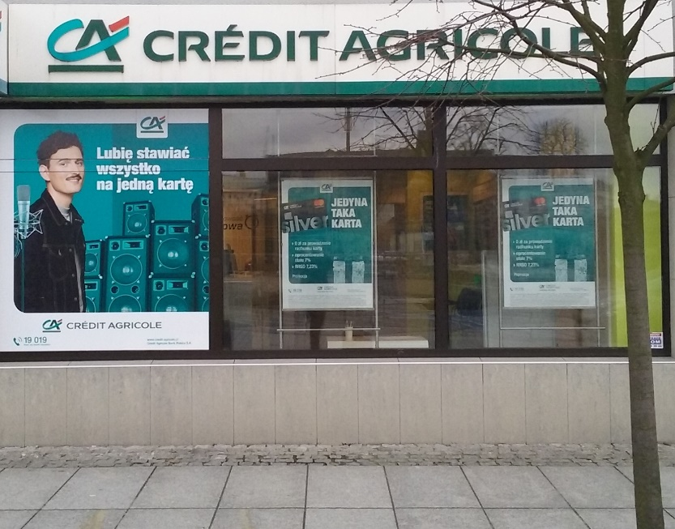
Maintenant ou dans le passé ?
Le Crédit Agricole est une banque Française.
écrire
Je 1: travaille [to work] en ville à la banque.
Aujourd’hui j’ai 2: utilisé [to use] l’ordinateur au bureau.
J’ 3: aime [to like] travailler à l’ordinateur.
Hier j’ai 4: préparé [to prepare] une présentation.
J’ai 5: mangé [to eat] mon déjeuner – une pizza.
J’ai 6: aimé [to like] la pizza !
Je 7: parle [to speak] au telephone aussi.
Aujourd’hui j’ai 8: apporté [to bring] un café au directeur.
J’ 9: envoie [to send] souvent des emails.
______
_____
____
______
_____
____
____
______
______
Notes:
Timing: 6 minutes
Aim: to provide production (writing) practice in the use of the present tense verb form (with je) or the past participle as appropriate, with known –ER verbs.
Procedure:
1. Students read the sentences and put the appropriate form (present tense or past participle) of the verb indicated in brackets into the gap in each, considering whether or not the auxiliary verb is present.
2. Click to reveal the answers, one by one.
Word frequency (1 is the most frequent word in French): presentation [1723], pizza [>5000], telephone [1366]
Source: Londsale, D., & Le Bras, Y. (2009). A Frequency Dictionary of French: Core vocabulary for learners London: Routledge.

Slide 41
La semaine d’Amir
lire/parler
J’ai passé une semaine en France!
J’ai regardé un bon film au cinéma.
J’aime les films drôles !
J’apporte mes livres à l'école.
J’ai envoyé un message à Abdel.
J’ai joué au football avec des amis.
Je gagne parfois.
Je travaille bien à l’école.
J’ai écouté le professeur en classe.
1.
2.
3.
4.
5.
6.
7.
8.
9.
Dis la phrase!
Notes:
Timing: 4 minutes
Aim: to practise aural recognition of vocabulary and improve students’ confidence in reading aloud
Procedure:
Read a sentence aloud in English (see transcript below):
Students look at the board and compete with a partner to see who can say the sentence first.
Students keep record of the number of each points each person has to see who wins.
I spent a week in France.
I watched a good film at the cinema.
I like funny films.
I bring my books to school.
I sent a message to Abdel.
I played football with my friends.
I win sometimes.
I work well at school.
I listened to the teacher in class.

Slide 42
C’est à vous!
écrire / parler
What are you doing today? What did you do yesterday?
Écris six phrases et parle avec un(e) partenaire.
Aujourd’hui je / j’….
Hier j’ai …
Notes:
Timing: 8 minutes
Aim: To provide production practice (speaking and writing) in distinguishing between j’ai with past participle and je / j’ + present tense verb.
Procedure:
1. Partner A chooses 3 things to say s/he did yesterday, and 3 things to say s/he likes doing (s/he may need to note these down for reference).
2. Partner A says the 6 sentences implied by the above to Partner B, in random order.
3. Partner B lists, in English, the things Partner A did and the things Partner A likes doing.
4. Partners check answers collaboratively, then swap roles and repeat.

Slide 43
Devoirs
Vocabulary Learning Homework (Y8, Term 1.2, Week 2)
Audio file
Student worksheet
In addition, revisit: Y8 Term 1.1 Week 4 | Y7 Term 3.2 Week 4
Notes:
The answer sheet for the Y8, Term 1.2, Week 2 vocabulary learning HW is here: https://rachelhawkes.com/LDPresources/Yr8French/French_Y8_Term1ii_Wk2_audio_HW_sheet_answers.docx Don’t share this link with students ☺
Notes:
i) Teachers may, in addition, want to recommend use of a particular online app for the pre-learning of each week’s words. ii) Quizlet now requires parental involvement / registration / permissions for users below the age of 13, so it is perhaps most suitable for Y9 – 11 students. iii) Language Nut hosts LDP vocabulary lists and these are free for schools to use, though there is a registration process. One benefit is that all of the student tracking data that Language Nut offers are also available to schools that use the LDP lists for practice. Perhaps this makes it a good option for Y7/8.
iv) There are other free apps, and new ones are always appearing. Teachers have told us that they are currently using: Flippity, Wordwall (where using previously-created activities is free).
v) Gaming Grammar has been acquired by Language Nut. Its original content should still be available to teachers and much of it is appropriate for Y8 learners. From this lesson, for example, learners could practise:
Verbs (present): 1st person singular/plural

Slide 44
Les activités d’Amir
écrire
I played football with my friends.
J’ai joué
__________ au foot avec mes amis.
Notes:
Additional slides that may be of use to teachers who have more than 2 x lessons per week. Slide 1/10
Timing: 5 minutes
Aim: to practise written production of j’ai + past participle and je + present tense verb
Procedure:
Hand out mini whiteboards.
Give students a few seconds to read the English sentence and think about how they would translate it into French.
Click again to reveal the sentence scaffolding.
Students write the full sentence on their mini whiteboards.

Slide 45
Les activités d’Amir
écrire
I play football with my friends.
Je joue
__________ au foot avec mes amis.
Notes:
Slide 2/10

Slide 46
Les activités d’Amir
écrire
I watch films at the cinema.
Je regarde
______________ des films au cinema.
Notes:
Slide 3/10

Slide 47
Les activités d’Amir
écrire
I watched films at the cinema.
J’ai regardé
______________ des films au cinema.
Notes:
Slide 4/10

Slide 48
Les activités d’Amir
écrire
I listened to the teacher in class.
J’ai écouté
_____________ le professeur en classe.
Notes:
Slide 5/10

Slide 49
Les activités d’Amir
écrire
I listen to the teacher in class.
J’écoute
___________ le professeur en classe.
Notes:
Slide 6/10

Slide 50
Les activités d’Amir
écrire
I won a match.
J’ai gagné
___________ un match.
Notes:
Slide 7/10

Slide 51
Les activités d’Amir
écrire
I win sometimes.
Je gagne
____________ parfois.
Notes:
Slide 8/10

Slide 52
Les activités d’Amir
écrire
I brought my book to school.
J’ai apporté
____________ mon livre à l’école.
Notes:
Slide 9/10

Slide 53
Les activités d’Amir
écrire
I bring my book to school.
J’apporte
____________ mon livre à l’école.
Notes:
Slide 10/10

