Slide 1
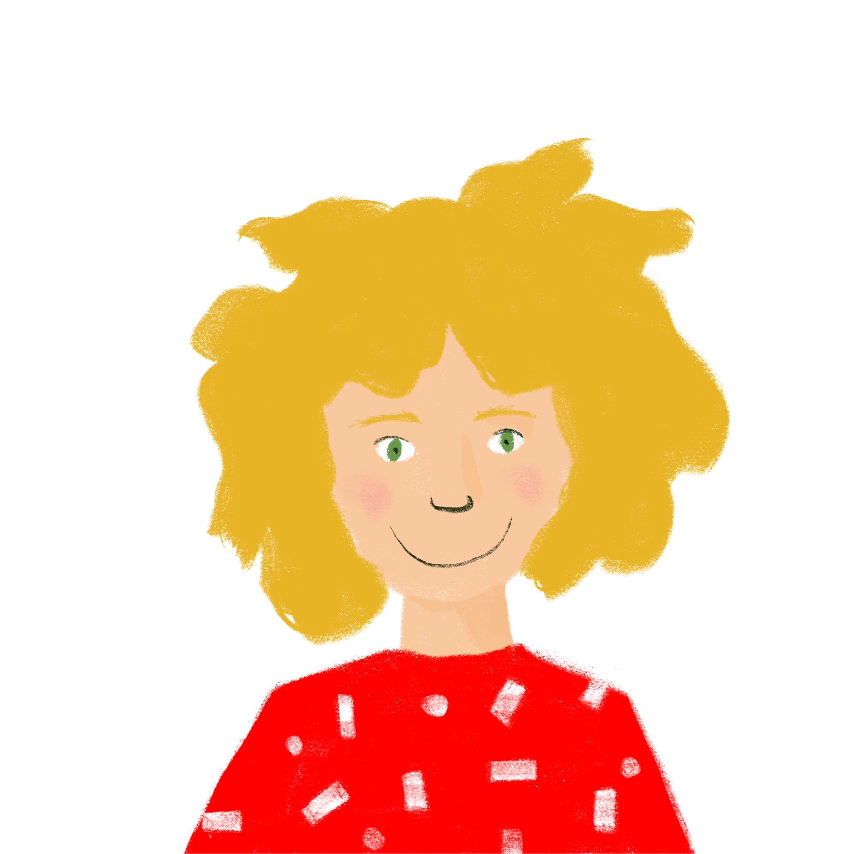
Talking about everyday activities
Regular -ER verbs (present) (all persons)
à with certain verbs
SSC [um/un]
Les jours d’école, j’arrive normalement chez moi assez tard, à 17:30 !
Y8 French
Term 1.1 - Week 7 - Lesson 13 Stephen Owen / Natalie Finlayson
Artwork by: Chloé Motard
Date updated: 22.08.23
Notes:
Note: all words (new and revisited) in this week of the SOW appear on all three GCSE wordlists, with these exceptions: i) Edexcel list does not have frapper, radio. ii) Eduqas list does not have radio (though it could appear as a cognate in reading).
Learning outcomes (lesson 1):
Introducing SSC [um/un]
Revision of present tense of regular -ER verbs (all persons)
Revision of use of ‘à’ with certain verbs
Verbs with English prepositional use implied
Word frequency (1 is the most frequent word in French):
8.1.1.7 (revisit): arriver [174], chanter [1820], changer [283], chercher [336], demander [80], donner [46], écouter [429], étudier [960], frapper [745], gagner [258], habiter [1186], jouer [219], marcher [1532], manger [1338], montrer [108], parler [106], penser [116], préparer [368], regarder² [425], rester [100], travailler [290], ressembler à [1398/4], elle¹ [14], elles [13], je [22], il¹ [13], ils [13], nous¹ [31], que² [9], qui [14], tu [112], vous¹ [50], déjeuner [2724], école [477], enfant [126], maison [325], radio [1526], solution [608], université [1192], quel [146], comment [234], quand [119], où [48], pourquoi [193], à² [4]
Source: Londsale, D., & Le Bras, Y. (2009). A Frequency Dictionary of French: Core vocabulary for learners London: Routledge.

Slide 2
um/un
1
un
Notes:
Timing: 1 minute
Aim: To introduce SSC [um/un]
Procedure: 1. Present the letter(s) and say the [um/un] sound first, on its own. Students repeat it with you. 2. Bring up the word ”un” on its own, say it, students repeat it, so that they have the opportunity to focus all of their attention on the connection between the written word and its sound.
3. A possible gesture for this would be to hold up one finger. 4. Roll back the animations and work through 1-3 again, but this time, dropping your voice completely to listen carefully to the students saying the [um/ un] sound, pronouncing ”un” and, if using, doing the gesture.
Word frequency (1 is the most frequent word in French):
un [3]
Source: Londsale, D., & Le Bras, Y. (2009). A Frequency Dictionary of French: Core vocabulary for learners London: Routledge.

Slide 3
um/un
un
Notes:
With sound and no pictures to focus all attention on the sound-symbol correspondence.

Slide 4
um/un
1
un
Notes:
Without sound to elicit pronunciation (without first hearing the teacher).
Teacher to elicit pronunciation by asking “Comment dit-on …”

Slide 5
um/un
lundi
parfum
1
aucun
un
commun
[none]
chacun
[common]
[each]
Notes:
Timing: 2 minutes
Aim: To introduce SSC [um/un]
Procedure:
Introduce and elicit the pronunciation of the individual SSC [um/un] and then the source word again ‘un’ (with gesture, if using). Then present and elicit the pronunciation of the five cluster words. The cluster words have been chosen for their high-frequency, from a range of word classes, with the SSC (where possible) positioned within a variety of syllables within the words (e.g. initial, 2nd, final etc.). Additionally, we have tried to use words that build cumulatively on previously taught SSCs (see the Phonics Teaching Sequence document) and do not include new SSCs. Where new SSCs are used, they are often consonants which have a similar symbol-sound correspondence in English.
Word frequency (1 is the most frequent word in French): un [3]; aucun [63] chacun [323]; commun [780]; lundi [1091]; parfum [4477]. Source: Londsale, D., & Le Bras, Y. (2009). A Frequency Dictionary of French: Core vocabulary for learners London: Routledge.

Slide 6
um/un
parfum
lundi
1
aucun
un
commun
chacun
Notes:
With sound and no pictures to focus all attention on the sound-symbol correspondence.

Slide 7
um/un
parfum
lundi
1
aucun
un
commun
chacun
Notes:
Without sound to elicit pronunciation (without first hearing the teacher).
Teacher to elicit pronunciation by asking “Comment dit-on …”

Slide 8
Phonétique
lire / parler
emprunter
aucun
40
lundi
[to borrow]
[Monday]
[none]
commun
opportun
[common]
[appropriate]
jungle
secondes
brun
[um] is very rare but you should still be aware of it!
[brown]
quelqu’un
[somebody]
chacun
0
[each]
parfum
DÉBUT
Notes:
Timing: 2 minutes
Aim: spoken production of SSC [un/um]
Procedure:
1. Students pair up and have 40 seconds (once you press début) to play pronunciation tennis
2. Students can say the words in any order but must not repeat the last word that was said
Word frequency (1 is the most frequent word in French): aucun[63], commun [780], jungle [4891], lundi [1091], quelqu’un [772], brun [>5000], emprunter [1123], opportun [4485], chacun [323], parfum [4479]
Source: Londsale, D., & Le Bras, Y. (2009). A Frequency Dictionary of French: Core vocabulary for learners London: Routledge.

Slide 9
Phonétique
A-Z
lire / parler
emprunter
aucun
60
lundi
[to borrow]
[Monday]
[none]
commun
opportun
[common]
[appropriate]
jungle
secondes
brun
[brown]
quelqu’un
[somebody]
chacun
0
[each]
parfum
DÉBUT
Notes:
Timing: 2 minutes
Aim: To practise pronunciation of SSC [un/um]
Procedure:
1. Students pair up and have 60 seconds (once you press début) to play pronunciation tennis
2. Students must say the words in alphabetical order for an added challenge
3. Click on the words to hear them said by a native speaker

Slide 10
Reminder: -ER verbs
grammaire
je mange
I eat / am eating
tu manges
Note that verbs whose stem ends in –g add an –e before the nous form ending!
you eat / are eating
il mange
he eats / is eating
elle mange
she eats / is eating
nous mangeons
we eat / are eating
vous mangez
you eat / are eating
ils mangent
they (m) eat / are eating
elles mangent
they (f) eat / are eating
Notes:
Timing: 2 minutes
Aim: To revise present tense forms of regular –ER verbs (all persons)
Procedure:
1. Click to bring up the English line by line (the English appears first in each line).
2. Elicit the French from the students, then click again to bring up the French.
3. Point out the spelling change in the ‘nous’ form in this verb and others like it, as per the speech bubble.

Slide 11
Bataille navalle (A)
parler
 | je | tu | il / Amir | elle | nous | vous | ils/Léa et Amir | elles
jouer
rester
montrer
donner
changer
gagner
demander
préparer
 | je | tu | il / Amir | elle | nous | vous | ils/Léa et Amir | elles
jouer
rester
montrer
donner
changer
gagner
demander
préparer
Notes:
Timing: 10 minutes (two rounds of the game)
Aim: To use the ‘battleships’ game to revise known –ER verbs in all their present tense forms
Procedure:
This is Partner A’s grid and we use it here just to model the task.
Tell the students they have to find the locations of four five-block shapes. Click to bring up one example but each student should get a handout to draw their own four ‘five-block battleships’.
Partners A & B sketch their battleships quickly on their own handouts. Note – they have different handouts to practise different verbs.
Round 1 - Looking for As battleships, Partner B calls out ‘coordinates’ using pronoun + correct present tense form of a particular verb.
Student As acknowledge a hit with ‘oui’ and a miss with ‘non’.
Students continue to play until all the ships are sunk, or the time (5 minutes) is up.
Students swap roles.

Slide 12
Partenaire A
parler
 | je | tu | il / Amir | elle | nous | vous | ils/Léa et Amir | elles
jouer
rester
montrer
donner
changer
gagner
demander
préparer
Notes:
Blank grid for printing ½ As sketch on this sheet. Bs use their blank version of this sheet to ask questions and log the hits.

Slide 13
Partenaire B
grammaire
 | je | tu | il / Amir | elle | nous | vous | ils/Léa et Amir | elles
parler
frapper
arriver
écouter
étudier
habiter
travailler
regarder
Notes:
Blank grid for printing 2/2
Bs sketch on this sheet. As use their blank version of this sheet to ask questions and log the hits.

Slide 14
Le verbe et ses prépositions
grammaire
Some verbs need to be followed by a prepostion in English, but not in French:
I listen to the radio. J’écoute la radio. (no à)
Remember!
au (à + le)
à la (à + la)
à l’ (à + l’ + vowel)
aux (à + les)
I am looking at the train. Je regarde le train. (not au)
I am looking/asking for a book. Je cherche/demande un livres. (no pour)
Other verbs need a preposition in French too. This is often a form of à:
I am talking to the teacher. Je parle au professeur. (au = à + le)
I am giving a present to the girl. Je donne un cadeau à la fille.
Notes:
Timing: 2 minutes
Aim: To raise awareness of cross-linguistic differences by revising some common verbs which do not take a preposition in French, but do in English.
Procedure:
1. Animate the explanation.
2. Ensure students’ understanding at each stage.
Word frequency of unknown words (1 is the most frequent word in French): préposition [>5000]
Source: Londsale, D., & Le Bras, Y. (2009). A Frequency Dictionary of French: Core vocabulary for learners London: Routledge.

Slide 15
Le père de Léa
lire
Le père de Léa parle de sa routine. Quel est le bon mot ? Au, à la, à l’ ou aux ?
Le lundi*, mes enfants vont à l’ école / maison.
Moi, je vais au université / bureau. Je suis avocat.
Je prends le déjeuner au café / maison en ville.
* lundi
= Monday
* tard
= late
Je ne joue pas à l’ ordinateur / bureau !
J’arrive tard* à la maison / parc.
Je donne à manger aux enfants/ chat.
Je vais au chambre / lit !
Notes:
Timing: 7 minutes
Aim: To revise the use of ‘à’ (in combination with the definite article) with ‘to’ and ‘at’ meanings, or idiomatic alternatives
Procedure:
1. Students read the sentences and decide which word of the two options presented follow, based upon the preposition.
2. Click to animate the correct answers.

Slide 16
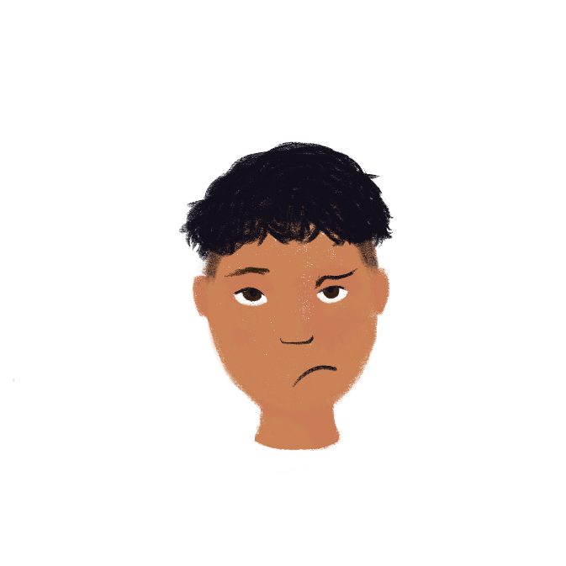
C’est quel verbe ?
lire
?
Amir is trying to read a story, but all the verbs are smudged!
Peux-tu aider? Attention aux prepositions !
1. Il écoute / il parle ses amis.
2. Tu regardes / tu ressembles à ta sœur.
3. Vous frappez / vous fermez à la porte.
4. Je cherche / je travaille pour mon père.
5. Il donne l'eau / il demande un chien.
6. Je montre un photo / je cherche à Fred.
Notes:
Timing: 6 minutes
Aim: To practise recognising verbs which take a preposition in English but not in French (listening modality). Raising awareness of cross-linguistic differences.
Procedure:
Students read sentences and decide which verb is needed based on the presence or absence of a preposition.
Click to reveal answers.
Ask students what needs to be added/removed to form a correct sentence with the alternative verb.

Slide 17
Les verbes
grammaire
Which word is the verb in the following sentence? How do you know?
Amir oublie souvent le football.
‘Football’ cannot be a verb because it does not appear next to the subject.
It has a definite article (le) in front of it, meaning it is a noun.
‘Souvent’ cannot be a verb because it does not appear next to the subject.
It is an adverb. It comes after the verb in French.
The verb is ‘oublie’. It appears next to the subject (Amir), and ends in –e to match it.
To find out the meaning of ‘oublie’, look up the infinitive form in the dictionary.
To work out the infinitive, remove –e and add –er in this case (-e is an –ER verb ending):
Amir oublie→
oubli- →
oublier →
to forget / forgetting
Notes:
Timing: 3 minutes
Aim: To explain how to identify the verb in a given sentence, and how to look up the meaning of a verb from its infinitive
Procedure:
1. Animate the explanation.
2. Ensure students’ understanding at each stage.

Slide 18
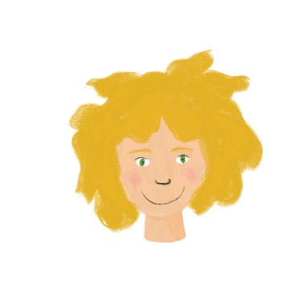
Les jours d’école
* beaucoup
= a lot
* en désordre
= untidy
* tous les = every
lire
Léa parle de sa vie. Trouve les 19 verbes !
Les jours d’école, j’arrive normalement chez moi assez tard, à 17:30 ! J’étudie à la maison chaque jour. Je travaille beaucoup* ! Je suis ambitieuse. Je pense aller à l’université. Mais ma chambre est en désordre* ! Je dois chercher mes livres partout !
Est-ce que tu pratiques un instrument ?
Voici mon piano. Quand je peux, je pratique tous* les jours.
Ça aide à éviter le stress !
Je compte passer mon examen* bientôt.
Je souhaite donner un concert un jour !
Notes:
Timing: 8 minutes
Aim: To practise identifying the verb(s) in a text.
Procedure:
1. In the first of a series of scaffolded activities based on a longer text, students are asked to identify all examples of verbs. They can do this by circling/underlining on a printed copy, or by writing a list in their workbooks. The first page contains known regular –ER verbs, though ‘je suis’, ‘c’est’, ‘je dois’ and ‘je peux’ are also included, having been met in Year 7. Remind students that these are also verbs! The second page contains unknown regular –ER verbs which students should be able to identify using the knowledge recapped on the previous slide.
2. Click on the audio button to play the recorded text.
3. Click to proceed to the answers on the following slide (all verbs are highlighted)
Transcript:
Les jours d’école, j’arrive normalement chez moi assez tard, à 17:30 ! J’étudie à la maison chaque jour. Je travaille beaucoup* ! Je suis ambitieuse. Je pense aller à l’université. Mais ma chambre est en désordre* ! Je dois chercher mes livres partout ! Est-ce que tu pratiques un instrument ? Voici mon piano. Quand je peux, je pratique tous* les jours. Ça aide à éviter le stress ! Je compte passer mon examen* bientôt. Je souhaite donner un concert un jour !
Word frequency (1 is the most frequent word in French): désordre [3376]
Source: Londsale, D., & Le Bras, Y. (2009). A Frequency Dictionary of French: Core vocabulary for learners London: Routledge.

Slide 19
Les jours d’école
* chez moi
= at my place
* beaucoup = a lot
* en désordre
= untidy
* tous les = every
lire
Léa parle de sa vie. Trouve les 19 verbes !
Les jours d’école, j’arrive normalement chez moi assez tard, à 17:30 ! J’étudie à la maison chaque jour. Je travaille beaucoup ! Je suis ambitieuse. Je pense aller à l’université. Mais ma chambre est en désordre* ! Je dois chercher mes livres partout !
Est-ce que tu pratiques un instrument ?
Voici mon piano. Quand je peux, je pratique tous les jours.
Ça aide à éviter le stress !
Je compte passer mon examen* bientôt.
Je souhaite donner un concert un jour !
Notes:
Aim: To present the answers to the activity on the previous slide.
Procedure:
Students check their answers.
Word frequency (1 is the most frequent word in French): désordre [3376]
Source: Londsale, D., & Le Bras, Y. (2009). A Frequency Dictionary of French: Core vocabulary for learners London: Routledge.

Slide 20
Les jours d’école
Don’t forget to add any words you think are useful to your personal repertoir.
lire
Recherche les nouveaux verbes dans le dictionnaire !
Est-ce que tu pratiques un instrument ?
Voici mon piano. Quand je peux, je pratique tous les jours.
Ça aide à éviter le stress !
Je compte passer mon examen* bientôt.
Je souhaite donner un concert un jour !
pratique → pratiquer → practise
éviter → to avoid
compte → compter → intend
passer → to sit (exams)
souhaite → souhaiter → want
*un examen = exam
Notes:
Timing: 5 minutes
Aim: Dictionary skills
Procedure:
1. Here, students are invited to use dictionaries to find the meanings of unfamiliar verbs – in this case, those highlighted in orange. Remind them of the process to follow.
N.B. Students have met ‘passer’ before, but not with the meaning as used here – remind them also not to seize upon the first meaning listed in the dictionary, without first checking whether it fits the context!
2. Clicking on the mouse bring up the meanings of the verbs one by one on the right-hand side of the screen.
Word frequency of unknown words (1 is the most frequent word in French): pratiquer [1268] aider [413] éviter [396] compter [140] passer [90] souhaiter [403]
Source: Londsale, D., & Le Bras, Y. (2009). A Frequency Dictionary of French: Core vocabulary for learners London: Routledge.

Slide 21
Talking about everyday activities
What happens and doesn’t happen
Asking and answering questions (-ER verbs)
à with certain verbs
Et toi, que fais-tu les jours d’école ?
Y8 French
Term 1.1 - Week 7 - Lesson 14 Stephen Owen / Natalie Finlayson
Artwork by: Chloé Motard
Date updated: 22.08.23
Notes:
Learning outcomes (lesson 2):
Revision of question formation (intonation vs inversion, with and without question words)
Revision of ne…pas negation in single verb structures
Word frequency (1 is the most frequent word in French):
8.1.1.7 (revisit): arriver [174], chanter [1820], changer [283], chercher [336], demander [80], donner [46], écouter [429], étudier [960], frapper [745], gagner [258], habiter [1186], jouer [219], marcher [1532], manger [1338], montrer [108], parler [106], penser [116], préparer [368], regarder² [425], rester [100], travailler [290], ressembler à [1398/4], elle¹ [14], elles [13], je [22], il¹ [13], ils [13], nous¹ [31], que² [9], qui [14], tu [112], vous¹ [50], déjeuner [2724], école [477], enfant [126], maison [325], radio [1526], solution [608], université [1192], quel [146], comment [234], quand [119], où [48], pourquoi [193], à² [4]
Source: Londsale, D., & Le Bras, Y. (2009). A Frequency Dictionary of French: Core vocabulary for learners London: Routledge.

Slide 22
Vocabulaire
Mets les mots anglais dans le bon ordre !
lire
quel(le)
why
qui
when
comment
where
que
who
pourquoi
what
quand
what
où
which
quoi
how
Notes:
Timing: 3 minutes (two slides)
Aim: to revise the question words learnt in Year 7
Procedure:
1. Students match up the English for the question words with the French (they may do this in their exercise books).
2. Click to advance to the answers on the next slide.

Slide 23
Vocabulaire
lire
Réponses:
quel(le)
which
qui
who
comment
how
que
what
pourquoi
why
quand
when
où
where
quoi
what
Notes:
Aim: To display the answers to the activity on the previous slide
Procedure:
1. Students check their answers against the correct version displayed here.

Slide 24
Comment poser une question ?
grammaire
Remember - in French, you raise your voice at the end of a question (this is called raising the intonation):
Statement
Elle est malade.
She is ill.
Remember:
in French, we leave a space before the question mark too!
Note that,
with this type of question,
the question word goes at the end of the sentence in French.
Question
Elle est malade ?
Is she ill?
The same happens with questions using question words:
Tu chantes quand ?
When do you sing?
Tu joues où ?
Where are you playing?
Notes:
Timing: 1 minute
Aim: To recap the formation of questions using intonation alone, then introduce some examples of this with question words.
Procedure:
1. Animate the explanation.
2. Ensure students’ understanding at each stage.
Word frequency (1 is the most frequent word in French): voyager [2194]
Source: 1Londsale, D., & Le Bras, Y. (2009). A Frequency Dictionary of French: Core vocabulary for learners London: Routledge.

Slide 25
Comment poser une question ?
grammaire
Here are some more examples:
Statement
Tu manges.
You are eating.
Question
Tu manges quoi ?
What are you eating?
Statement
Tu travailles.
You are working.
Question
Tu travailles quand ?
When are you working?
Notes:
Timing: 1 minute
Aim: To provide some more examples of questions using intonation with question words.
Procedure:
Animate the explanation and bring up the English.
Students try to say the French.
Click to see the French and hear it pronounced. Students repeat.
Transcript:
Tu manges.
Tu manges quoi ?
Tu travailles.
Tu travailles quand ?

Slide 26
Un message sur la boîte vocale
* la boîte vocale
= voicemail
écouter
C’est une question ou une déclaration ?
 |  | déclaration | question
 | Tu habites à Nice ?
 | Tu étudies l’anglais.
 | Tu travailles bien en classe.
 | Tu demandes une solution?
 | Tu restes à l’école ?
 | Tu gagnes le match.
Make three of these WH-questions to get more information.
1
2
3
4
5
6
Choose from these question words:
pourquoi, où, comment, quel(le), quoi, quand, qui
Notes:
Timing: 8 minutes
Aim: To practise recognising questions using intonation alone.
Procedure:
1. Students listen to each utterance and tick the appropriate column, according to whether it is a question or a statement.
2. Click to reveal the questions/statements one by one, plus the correct ticks. 3. Click to bring up the prompt to make three of them WH- questions. Give 2 minutes – students can think-pair-share. (Students who work quickly can do all of them, of course, or create multiple questions from each). 4. Elicit some suggestions from students and clarify any misunderstandings. For example, students may find it tricky if they try to use quel(le) – model possibilities – e.g. Tu gagnes quel match ? Tu demandes quelle solution ?
Transcript:
1. Tu habites à Nice ?
2. Tu étudies l’anglais.
3. Tu travailles bien en classe.
4. Tu demandes une solution?
5. Tu restes à l’école ?
6. Tu gagnes le match.

Slide 27
Comment poser une question ?
grammaire
Remember! There is another (more formal) way of making a question -
inverting (turning round) the verb and subject:
Statement
Elle est malade.
She is ill.
Remember:
in French, we leave a space before the question mark!
Question
Est-elle malade ?
Is she ill?
When using question words, these now start the sentence:
The intonation still rises at the end of the sentence.
Quand chantes-tu ?
When do you sing?
Où joues-tu ?
Where are you playing?
Notes:
Timing: 1 minute
Aim: To recap the formation of questions using subject-verb inversion, then introduce some examples of this with question words.
Procedure:
1. Animate the explanation.
2. Ensure students’ understanding at each stage.
Word frequency (1 is the most frequent word in French): voyager [2194]
Source: 1Londsale, D., & Le Bras, Y. (2009). A Frequency Dictionary of French: Core vocabulary for learners London: Routledge.

Slide 28
Comment poser une question ?
grammaire
Here are some more examples:
Que is used instead of Quoi for ‘what’
at start of the sentence.
Statement
Tu manges.
You are eating.
Question
Que manges-tu ?
What are you eating?
Statement
Tu travailles.
You are working.
Question
Quand travailles-tu ?
When are you working?
Notes:
Timing: 1 minute
Aim: To provide some more examples of questions using intonation with question words.
Procedure:
Animate the explanation and bring up the English.
Students try to say the French.
Click to see the French and hear it pronounced. Students repeat.
Transcript:
Tu manges.
Que manges-tu ?
Tu travailles.
Quand travailles-tu ?

Slide 29
Des SMS à Abdel
Abdel types all his answers all in one SMS and not all in order!
lire
Quelles sont les réponses d’Abdel ? Écris 1-8 et la réponse.
Samedi.
Un fruit.
En voiture.
Non/Oui.
Dans la cuisine.
Oui/Non.
Mon frère. C’est intéressant.
5
1. Tu manges quoi ?
4. Qui frappe à la porte ?
7. Pourquoi regardes-tu la télé ?
1
3
2. Tu regardes la télé ?
5. Tu travailles quand ?
2
8. Où prépares-tu le déjeuner ?
8
3. Comment vas-tu à l’école ?
6. Tu étudies l’histoire ?
6
4
7
Notes:
Timing: 7 minutes
Aim: To practise recognising the information sought by different question words in yes/no and information questions of different types.
Procedure:
1. Students match the answers to the questions.
2.Click to advance to the answers on the next slide.
Word frequency of unknown words and cognates used (1 is the most frequent word in French): SMS [>5000]
Source: Londsale, D., & Le Bras, Y. (2009). A Frequency Dictionary of French: Core vocabulary for learners London: Routledge.

Slide 30
Négation
grammaire
Remember!
To say that we do not do something, we add ne…pas before and after the verb.
before
after
In front of a vowel ne → n’
For example: Je n’aime pas
Je ne parle pas.
n
n
If the sentence is longer and contains more words after the verb, keep the same structure:
Spot the verb.
Place ne…pas before and after the verb.
Continue the sentence.
What happens if pas comes before a vowel?
Je ne vais pas au collège.
Similar to:
je → j’ j’aime
le → l’ l’ami
ce → c’ c’est
Je ne vais pas au collège le samedi.
ne
pas
n
n
Notes:
Timing: 3 minutes
Aim: To revise the use of ne (n’) ... pas to make the negative
Procedure:
1. Animate the explanation.
2. Ensure students’ understanding at each stage.

Slide 31
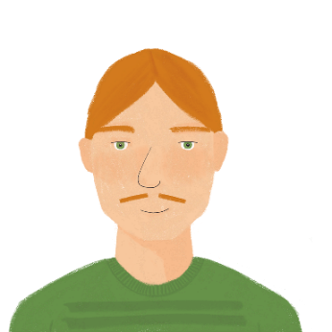
Le père de Léa
*le patron
= boss
écouter
Le père de Léa parle encore de son travail.
 |  | il fait ça | il ne fait pas ça
 | Je ne vais pas au bureau le samedi.
 | Je travaille en ville pendant la semaine.
 | Je mange mon petit déjeuner.
 | Je ne reste pas à la maison.
 | Je n’arrive pas en retard au travail.
 | J’utilise mon ordinateur au bureau.
1
2
3
4
5
6
Notes:
Timing: 7 minutes
Aim: To practise recognising negative sentences with ne (n’) ... pas when listening; scenario: Léa’s father talks about his work.
Procedure:
Students listen to each sentence and tick the appropriate column, according to whether it is an affirmative or negative sentence.
Students note down (in English) what he does or doesn’t do.
Click to reveal the French sentences one by one, plus the correct ticks.
Transcript:
1. Je ne vais pas au bureau le samedi.
2. Normalement je travaille en ville.
3. Je mange à la cantine.
4. Je ne reste pas à la maison.
5. Je n’arrive pas en retard au travail.
6. J’utilise mon ordinateur au bureau.
Word frequency of unknown words (1 is the most frequent word in French): patron [1706], cantine [>5000]
Source: Londsale, D., & Le Bras, Y. (2009). A Frequency Dictionary of French: Core vocabulary for learners London: Routledge.

Slide 32
Les jours d’école
écrire
Écris un texte sur les jours d’école. Réponds aux questions de Léa.
Add words you want to your repertoire!
Où habites du ?
Comment vas-tu à l’école ?
Quand tu arrives, que fais-tu ?
Où manges –tu normalement ?
Tu étudies l’histoire ?
Quel sport préfères-tu jouer ?
Qu’est-ce que tu aimes à l’école ?
Éric
Write 7 sentences Use 1 negative (ne…pas) sentence Include 1 ‘we’ (nous) sentence Use 1 conjunction Use 1 adverb of frequency (e.g., normalement) | Write 9-10 sentences Use at least 2 negative sentences Include 2 sentences about others Use 2 different conjunctions Use at least 3 adverbs (frequency – always, often, sometimes, or intensity – very, quite, a bit)
Exemples de verbes -ER:
parler, rester, demander, donner, montrer, penser, arriver, marcher, étudier, travailler, habiter, ressembler, écouter, chercher, regarder, jouer, manger, gagner
et – and | mais – but | aussi – also
très – very | assez – quite | un peu – a litte (bit)
toujours – always | souvent – often | parfois - sometimes
Notes:
Note: if teachers do not want to do an extended writing task here, there are alternative speaking and reading (translation) activities Timing: 18 minutes Aim: to revisit previously taught vocabulary and grammar in the context of a short piece of writing, bringing together language from Y8 Term 1.1 so far.
Procedure: 1. Clarify the activity with students.
2. Suggest they build their text by writing one sentence for each bullet first, and if they have time they could add another one.
3. Suggest that students read through the text (Léa’s text) from last lesson and note any vocabulary they want to use, but then put them out of sight to write the full sentences. 4. Teachers may want to give students 10 minutes to plan the task out, and then ask them to put their notes away and write the text without referring. Clearly teachers may want to differentiate the level of challenge for different students within their classes. All levels of adaption are possible, here, including for example just asking pupils to make a list of words that they would need to do this task, but not asking them to do it.
5. Tell students that: “we are all individuals and our language repertoire (the words we learn, store and use) will be individual, too. Whilst there are lots of essential words that everyone will need (and those are the ones I’m teaching you), you will also want to add in words that are important to you to express your meanings, so remember to keep your repertoire from Y7 growing. Look back to your own vocabulary repertoire and/or look up any words you need specifically to describe something about your everyday school activities and record them and record them in the space we’ve left for that in your exercise book.” (e.g., back pages).

Slide 33
Devoirs
Vocabulary Learning Homework (Y8, Term 1.2, Week 1)
Audio file
Student worksheet
In addition, revisit: Y8 Term 1.1 Week 2 | Y7 Term 3.2 Week 3
Notes:
The answer sheet for the Y8, Term 1.2, Week 1 vocabulary learning HW is here: https://rachelhawkes.com/LDPresources/Yr8French/French_Y8_Term1ii_Wk1_audio_HW_sheet_answers.docx Don’t share this link with students ☺
Notes:
i) Teachers may, in addition, want to recommend use of a particular online app for the pre-learning of each week’s words. ii) Quizlet now requires parental involvement / registration / permissions for users below the age of 13, so it is perhaps most suitable for Y9 – 11 students. iii) Language Nut hosts LDP vocabulary lists and these are free for schools to use, though there is a registration process. One benefit is that all of the student tracking data that Language Nut offers are also available to schools that use the LDP lists for practice. Perhaps this makes it a good option for Y7/8.
iv) There are other free apps, and new ones are always appearing. Teachers have told us that they are currently using: Flippity, Wordwall (where using previously-created activities is free).
v) Gaming Grammar has been acquired by Language Nut. Its original content should still be available to teachers and much of it is appropriate for Y8 learners. From this lesson, for example, learners could practise:
Verbs (present): 1st person singular/plural (Verb agreement (present))
Verbs (present): 2nd person singular/plural (Verb agreement (present))
Verbs (present): 3rd person singular/plural (Verb agreement (present))
Questions: subject-verb inversion (Question formation)

Slide 34
Puissance 4! (Connect 4)
parler
porter une
chemise
manger à
l’école
bien travailler en classe
jouer à l'ordinateur
A: Tu portes une chemise normalement ?
B: Oui, je porte une chemise normalement.
OU:
A: Portes-tu une chemise en ce moment ?
B: Non, je ne porte pas une chemise en ce moment.
parler avec mes amis
étudier l’allemand
arriver en retard
aimer les chiens
préparer mon déjeuner
chanter dans une chorale
habiter à [name of town]
écouter la radio
regarder la télé
ressembler à ton ami(e)
gagner des matchs
rester à la maison le week-end
Notes:
SPEAKING - ALTERNATIVE TO WRITING TASK Timing: 8 minutes
Aim: To practise spoken question production (intonation alone or subject-verb inversion) and answering in either the affirmative or negative, as appropriate
Procedure:
1. The aim of the game is to cross off four adjacent squares in a row. Each student picks his/her own colour to do this.
2. Student A picks a square, and asks a question as suggested by the verb phrase in the square – see animated example on slide, which should be played through for students before starting.
3. The question should contain either normalement or en ce moment, at the choice of Student A, who is trying to elicit both affirmative and negative responses.
4. Upon production of a valid question in correct French, Student A crosses off the relevant square in his/her own colour.
5. Student B responds to the question honestly, in either the affirmative or the negative as required, as per the examples on the slide.
6. Upon production of a valid answer in correct French, Student B crosses off the relevant square in his/her own colour
7. The winner is the first student to cross off four boxes in a row, either vertically, horizontally or diagonally.
8. If all questions and answers are produced correctly in a given round, then obviously Student A will win, having started first. When partners swap roles, this advantage will be reversed. Clearly, any mistake gives the advantage to the opposing side.
9. Partners swap roles after four questions have been asked. If the previous round resulted in a win, they start again; if not, they play on until there is a winner.

Slide 35
Traduction possible [1]
lire
Léa is talking about her life.
Les jours d’école, j’arrive normalement chez moi assez tard, à 17:30 !
J’étudie à la maison chaque jour. Je travaille beaucoup ! Je suis ambitieuse. Je pense aller à l’université.
Mais ma chambre est en désordre* !
Je dois chercher mes livres partout !
On school days I normally arrive home quite late, at 5:30 pm.
I study at home every day. I work a lot! I am ambitious.
I am thinking of going to university.
But my bedroom is untidy!
I have to look everywhere for my books!
Notes:
READING (TRANSLATION) ALTERNATIVE TO WRITING TASK Timing: 10 minutes
Aim: To practise translating a text into English, revisiting some of the verbs and other vocabulary encountered in Year 7
Procedure:
1. Students may now be asked to translate the text into English, if time permits.
Note: This is the first half of the text only: the second half appears on the next slide.
2. Click to bring up a possible answer on the right-hand side of the screen.

Slide 36
Traduction possible [2]
lire
Est-ce que tu pratiques un instrument ?
Voici mon piano.
Quand je peux, je pratique tous les jours. Ça aide à éviter le stress !
Je compte passer mon examen*bientôt.
Je souhaite donner un concert un jour !
Do you play an instrument?
Here is my piano.
When I can, I practise every day. It helps avoid stress !
I intend to pass my exam soon.
I want to perform at/do a concert one day!
Notes:
Aim: To practise translating a text into English, revisiting some of the verbs and other vocabulary encountered in Year 7
Procedure:
1. Students may now be asked to translate the text into English, if time permits.
Note: This is the second half of the text only: the first half appears on the previous slide.
2. Click to bring up a possible answer on the right hand side of the screen.
3. Cick to bring up the speech bubble explaining the word order of verb-adverb in French, as different from the English sometimes.

