Slide 1
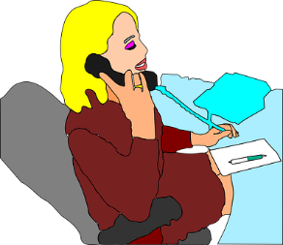
Talking about jobs [1]
having or being? être vs avoir (je, tu, il/elle) yes/no questions with ‘est-ce que’
syllable stress [1]
Y8 French
Term 1.1 - Week 2 - Lesson 3 Stephen Owen / Catherine Morris / Robert Woore
Artwork by: Chloé Motard
Date updated: 21.08.23
Notes:
Artwork by Chloé Motard. All additional pictures selected are available under a Creative Commons license, no attribution required.
Note: all words (new and revisited) in this week of the SOW appear on all three GCSE wordlists, with these exceptions: i) AQA list does not have ambitieux, prudent.
ii) Edexcel list does not have ambitieux, avocat, directeur, emploi, facteur, secretaire (though directeur (meaning director) and secretaire could be cognates in reading).
iii) Eduqas list does not have ambitieux.
Learning outcomes (lesson 1):
Introducing stress syllabification
Revisiting singular forms of être and avoir
Revisiting intonation and inversion questions
Introducing est-ce que questions
Word frequency (1 is the most frequent word in French):
8.1.1.2 (introduce) avocat [1188], bureau² [273], directeur¹ [640], emploi¹ [517], facteur [1264], secrétaire [920], ambitieux [2905], prudent [1529], travailleur, travailleuse [1341], assez [321]
7.3.2.5 (revisit) devoir [39], dois [39], doit [39], veut [57], veux [57], vouloir [57], visiter [1378], billet [1916]
7.3.1.4 (revisit) dormir [1836], dors [1836], dort [1836], bureau¹ [273], équipe [814], parfois [410], sous [112], sur [16]
Source: Londsale, D., & Le Bras, Y. (2009). A Frequency Dictionary of French: Core vocabulary for learners London: Routledge.

Slide 2
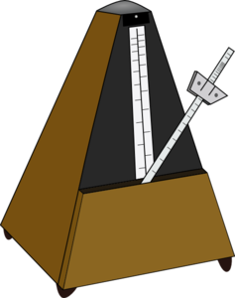
Syllables and stress
parler
English is a ‘stress timed’ language. We use the stressed syllables to keep a rhythm when we speak – like the beats that keep time in music.
Look at these two examples again:
organisation identification
What do you notice about the other syllables in these words? How are they pronounced?
organisation identification
' ' ' ' ' ' ‘
The syllables with dots under them are ‘unstressed’. The vowel sounds in them are not as strong or clear as in the stressed syllables. We say that these vowels are ‘reduced’.
Notes:
Timing: 3 minutes
Aim: To introduce the concepts of unstressed syllables and vowel reduction in preparation for contrasting with French.
Procedure:
1. Work through the first two paragraphs of suggested explanatory wording.
2. Give students one minute to discuss the example words organisation and identification. It may be helpful to guide students by asking them to consider vowel sounds specifically.
3. Click to reveal answer and suggested explanation.
Possible extension: Watch this video to help students better understand the concept. (You can skip the first 2 minutes and start at 02m00s, where it says on the screen ‘English is a stress-timed language’). https://www.youtube.com/watch?v=sUMM5eCvi8w

Slide 3
Syllables and stress
écouter / parler
French is not a stress-timed language. All syllables are sounded fairly equally, with a slightly stronger stress on the last syllable). Vowels are not ‘reduced’ – they are sounded in full.
This is good news! When you read French words aloud, you don’t have to worry about which syllables to stress, or which vowels get ‘reduced’. Just sound all the syllables equally (with a bit of extra emphasis on the last one) and pronounce the SSCs as you have learned them.
1. amusing | amusant
2. animal | animal
3. excellent | excellent
4. computer | ordinateur
5. modern | moderne
6. interesting | intéressant
Notes:
Timing: 5 minutes
Aim: To compare stress syllabification and vowel reduction patterns of known French words and their English translations.
Procedure:
1. Work through the first two paragraphs of suggested explanatory wording. Students may find it interesting/useful to consider things from the perspective of French-speaking learners of English, who DO have to worry about which syllables are stressed, and which vowels might get ‘reduced’.
2. Click to reveal the table.
3. Students sound out the English word in each pair. They try to tap out the syllables and underline the syllable that they think is the ‘strongest’ – the one with primary stress. They note any syllables that are ‘reduced’.
4. Students listen to the French word in each pair. They try to tap out the syllables. Again, tap out the syllables. Draw attention to how all the syllables are sounded roughly equally (perhaps with a bit more emphasis on the last one) and none of the vowels is reduced.
5. Now, students try saying the pairs of words aloud. Remind them about the focus points (primary stress and reduced vowels in English; equal stress, full vowels and slight emphasis on the last syllable in French.
Possible extension: Watch the following video to help students understand this. Explain that the presenter uses some written symbols on her whiteboard called the ‘phonetic alphabet’, but that they don’t need to worry about this! https://www.youtube.com/watch?v=2EKBAMnZnSI
Transcript
1. amusant
2. animal
3. excellent
4. ordinateur
5. moderne
6. intéressant
7. préparer
8. partenaire
9. université
10. important
11. absolument
12. arriver

Slide 4
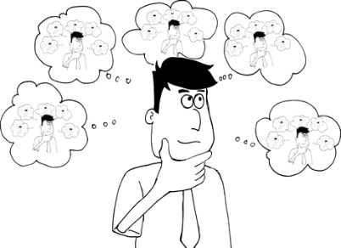
Vocabulaire
écouter
1
2
3
4
5
6
7
8
9
10
11
[quite]
[lawyer]
[headteacher]
l’emploi
l’avocat
le directeur
assez
ambitieux
[hard working (m)]
[careful]
[hard working (f)]
le secrétaire
travailleur
prudent
le bureau
le facteur
travailleuse
Notes:
Timing: 7 minutes
Aim: Oral recognition of new vocabulary.
Procedure:
1. Click on an audio button to hear a French word said aloud.
2. Students match the word heard to the picture or English word on the screen.
3. Click to reveal answer.
4. Repeat for buttons 2-11.
Transcript:
1. le bureau
2. le secrétaire
3. assez
4. travailleuse
5. l’emploi
6. l’avocat
7. prudent
8. le facteur
9. travailleur
10. le directeur
11. ambitieux

Slide 5
Vocabulaire
*gérer = to manage
*livrer = to deliver
lire
Le directeur gère* l’école. C’est un emploi difficile.
Le facteur doit livrer* les lettres à la bonne adresse. Il doit être très prudent.
L’avocat travaille dans un bureau. Il est ambitieux et travailleur.
La secrétaire est travailleuse mais assez stricte.
__________
_______
________
_________
________
________
___________
___________
___________
_____________
_____
secrétaire
emploi
bureau
facteur
avocat
ambitieux
prudent
directeur
travailleur
assez
travailleuse
Notes:
Timing: 5 minutes
Aim: Written recognition of new vocabulary in longer contexts.
Procedure:
1. Students read the text and fill the gaps with the words from the bottom of the slide. At lower levels, it may be helpful to give feedback on one sentence at a time, so that some words can be eliminated to help students. Remind students that they will need to pay close attention to the articles given to choose the appropriate noun. Remind them of the position of adjectives (after nouns and être) and the position of quantifiers (before an adjective).
2. Answers revealed one by one on clicks. Though prudent is the best semantic fit for the fourth gap, ambitieux and travailleur are also appropriate.
Word frequency of unknown words used (1 is the most frequent word in French): livrer [613], gérer [1354]
Source: Londsale, D., & Le Bras, Y. (2009). A Frequency Dictionary of French: Core vocabulary for learners London: Routledge.
Word frequency of cognates used (1 is the most frequent word in French): adresse [1925]
Source: Londsale, D., & Le Bras, Y. (2009). A Frequency Dictionary of French: Core vocabulary for learners London: Routledge.

Slide 6
Être et avoir
grammaire
C’est être ou avoir ? C’est qui ? Complète et organise les mots !
être
je suis | I am
tu es | you are
il/elle est | he/she is
avoir
j’ai | I have
tu as | you have
il/elle a | he/she has
__________
__________
__________
__________
__________
__________
__ as
__ suis
__ a
__ est
__ ai
__ es
Notes:
Timing: 3 minutes
Aim: Recognition of the forms and meanings of the 1st, 2nd and 3rd person singular forms of être and avoir.
Procedure:
1. Students look at the verb forms in the box and decide which are forms of être and which are forms of avoir.
2. Students add the missing pronoun to create translations of the English verb forms.
3. Answers appear on clicks.
Word frequency of unknown words used in task instructions (1 is the most frequent word in French):
compléter [2034],
Source: Londsale, D., & Le Bras, Y. (2009). A Frequency Dictionary of French: Core vocabulary for learners London: Routledge.

Slide 7
Être ou avoir?
What do you notice about the articles in the French sentences with être compared to English?
écrire
_
Pierre est avocat.
Pierre is a lawyer.
_
Pierre a un avocat prudent.
Pierre has a careful lawyer.
J’ai une directrice travailleuse.
_
I have a hard-working headteacher.
_
Je suis directrice.
I am a headteacher.
_
Tu es secrétaire.
You are a secretary.
Tu as un secrétaire ambitieux.
You have an ambitious secretary.
_
Notes:
Timing: 5 minutes
Aim: Production of the forms and meanings of the 1st, 2nd and 3rd person singular forms of être and avoir in context, highlight the differences in usage between the two.
Procedure:
Challenge students to supply the correct form for each gap, according to the translation provided.
Click to reveal answers.
Check students’ understanding at each stage.
Click to reveal the info bubble which introduced the grammar point (null article with être + profession) introduced on the next slide.

Slide 8
Comment poser une question ?
grammaire
As you know, you can change a statement into a question by raising the pitch of your voice at the end of the sentence (rising intonation):
Statement
Elle est malade.
She is ill.
Remember to leave a space before the question mark in French!
Question
Elle est malade ?
Is she ill?
To emphasise that a question is being asked, we often add the phrase Est-ce que (‘Is it that...?’) at the beginning of the sentence:
Est-ce que changes to est-ce qu’ before a vowel.
Est-ce qu’elle est malade ?
Is she ill?
This works like a spoken question mark! The intonation still rises at the end.
Notes:
Timing: 5 minutes. This is slide 1/2.
Aim: To first revise formation of questions using intonation alone, before introducing the use of est-ce que. This is followed on the next slide by a recap of question formation by subject-verb inversion, and a note about formal versus informal usage.
Procedure:
1. Animate the explanation.
2. Ensure students’ understanding at each stage.
Word frequency of unknown cognates used in task instructions (1 is the most frequent word in French): poser [218]
Source: 1Londsale, D., & Le Bras, Y. (2009). A Frequency Dictionary of French: Core vocabulary for learners London: Routledge.

Slide 9
Comment poser une question ?
grammaire
You can also form a question by swapping round (inverting) the subject and verb:
The intonation still rises at the end of the question!
Statement
Elle est malade.
She is ill.
Question
Est-elle malade ?
Is she ill?
Remember to add a hyphen between verb and subject when you do this.
Inversion questions are used in more formal situations, especially in writing.
Est-ce que questions are used in more casual situations, especially in speaking.
Notes:
This is slide 2/2.

Slide 10
Une détective travailleuse !
lire
A detective is gathering evidence for a case!
Pose-t-elle des questions au téléphone ou par email ?
Lis et coche !
 |  | au téléphone (est-ce que) | par email (inversion)
1. | Est-ce qu’il est au bureau ?
2. | Dort-il dans un hôtel ?
3. | Est-il prudent ?
4. | Est-ce qu’elle est ambitieuse ?
5. | Est-ce qu’il veut être avocat ?
6. | Veut-il être professeur ?
7. | Doit-elle avoir un billet ?
8. | Est-ce qu’elle doit travailler en équipe ?
Notes:
Timing: 10 minutes
Aim: To practise differentiating between written and spoken question style based on word order.
Procedure:
Remind students that inverted word order is more commonly found in writing (email) and linear word order with est-ce que in speaking (phone).
Students write 1-8 and decide based on the presence of absence of a verb after the block whether inversion, and therefore written communication, is being used. Click on the mouse to uncover the start of each sentence.
Click to reveal answers.
Oral translation of full sentences.
Word frequency of unknown cognates used in task instructions (1 is the most frequent word in French): détective [>5000], email [>5000]. téléphone [1366], par [21],
Source: 1Londsale, D., & Le Bras, Y. (2009). A Frequency Dictionary of French: Core vocabulary for learners London: Routledge.

Slide 11
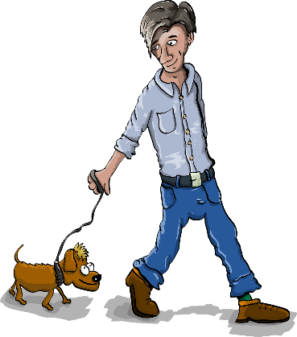
C’est qui ?
parler
Exemple:
A: Est-ce que c’est un garçon ?
B: Oui, c’est un garçon.
B: Oui, il est grand.
A: Est-ce qu’il est grand ?
B: Non, il a un chien !
A: Est-ce qu’il a un fruit ?
Jacques
B: Oui, c’est Jacques !
A: Est-ce que c’est Jacques ?
Notes:
Timing: 7 minutes (two slides)
Aim: To practise production (spoken modality) of questions using est-ce que and 3rd person singular forms of avoir and être, in the context of a ‘guess who’ game. The slide following this one should be displayed during the activity.
Procedure:
1. Student B selects a character, without revealing their identity.
2. Student A asks a question such as that shown in the example on this slide. By asking questions about whether the character is a girl/boy, is big/small and has a dog/fruit or not, student a can try to home in on the identity of the chosen character.
3 Student B responds to the question.
4. Continue until the character is guessed correctly (N.B. students must ask at least 3 questions before making a guess, and cannot guess twice in a row).
5. Swap roles and play again.

Slide 12
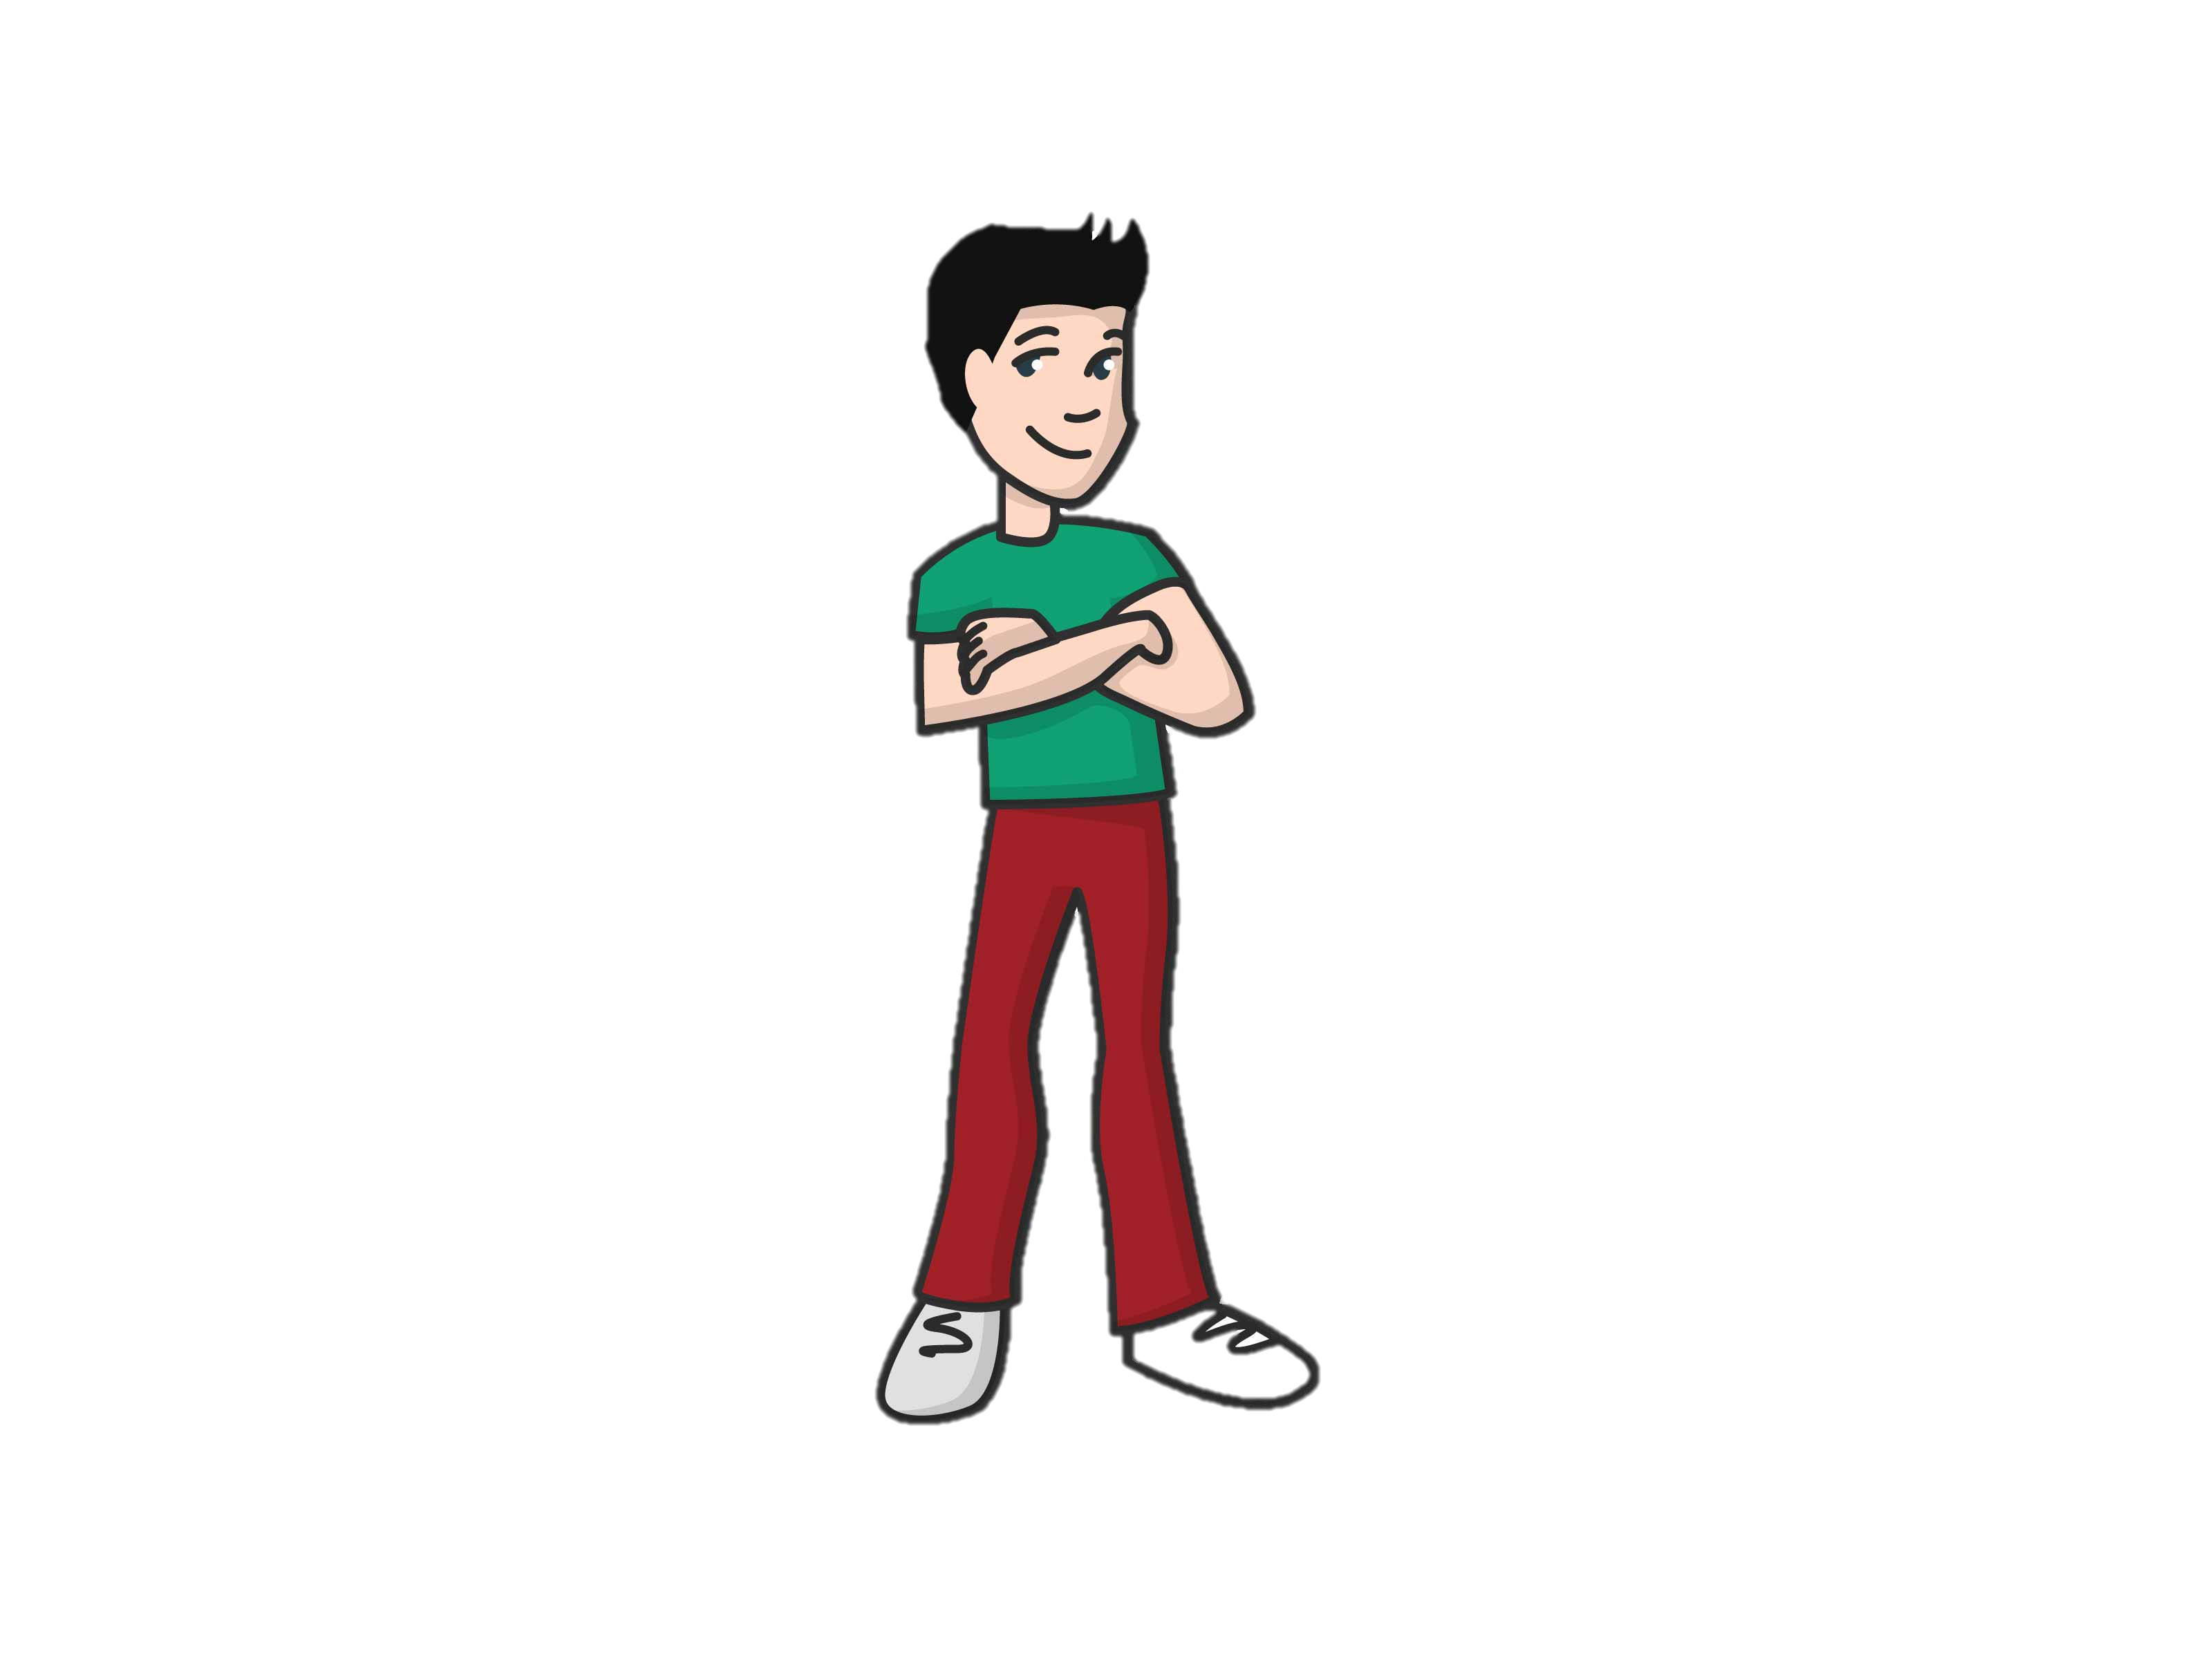
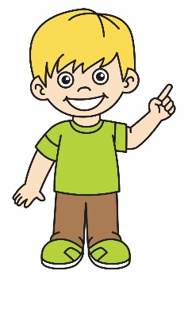
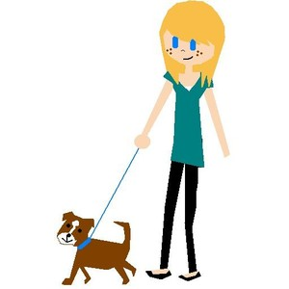
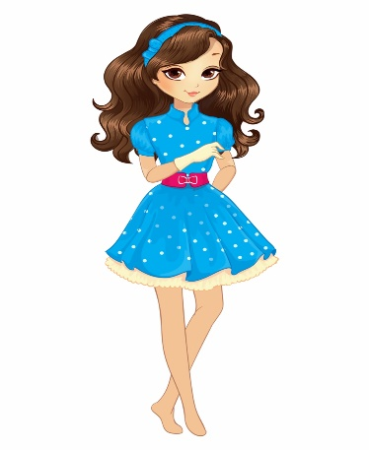
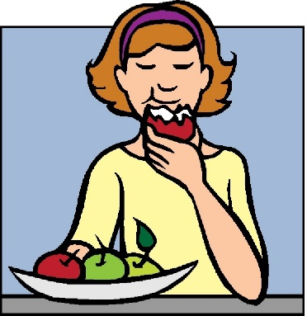
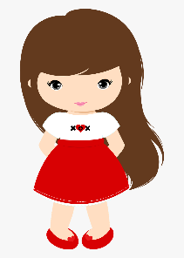
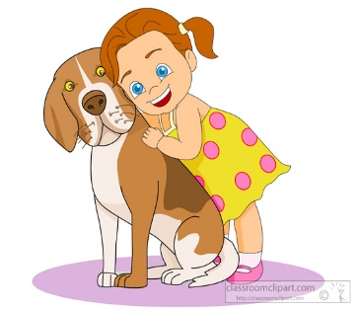
Speaking prompt slide
parler
Jacques
Max
Pierre
Raoul
Hakim
Jean
Hélène
Chantale
Laetitia
Sophie
Maria
Chloë
Notes:
Display this slide during the activity.

Slide 13
Talking about jobs [1]
article use with ‘être’ + profession être vs avoir (nous, vous ils/elles)
syllable stress[1]
Y8 French
Term 1.1 - Week 2 - Lesson 4 Stephen Owen / Catherine Morris / Robert Woore
Artwork by: Chloé Motard
Date updated: 21.08.23
Notes:
Artwork by Chloé Motard. All additional pictures selected are available under a Creative Commons license, no attribution required.
Learning outcomes (lesson 2):
Introducing stress syllabification
Revisiting plural forms of être and avoir
Introducing use of être + no article to talk about professions
Word frequency (1 is the most frequent word in French):
8.1.1.2 (introduce) avocat [1188], bureau² [273], directeur¹ [640], emploi¹ [517], facteur [1264], secrétaire [920], ambitieux [2905], prudent [1529], travailleur, travailleuse [1341], assez [321]
7.3.2.5 (revisit) devoir [39], dois [39], doit [39], veut [57], veux [57], vouloir [57], visiter [1378], billet [1916]
7.3.1.4 (revisit) dormir [1836], dors [1836], dort [1836], bureau¹ [273], équipe [814], parfois [410], sous [112], sur [16]
Source: Londsale, D., & Le Bras, Y. (2009). A Frequency Dictionary of French: Core vocabulary for learners London: Routledge.

Slide 14
Syllable and stress
Remember!
Sound all the syllables fairly equally (emphasise the last one a bit more). Pronounce the vowels fully – don’t ‘reduce’ them!
lire / parler
Comment prononcer les mots ?
la promotion
rectangulaire
l’animatrice [TV presenter]
impossibilité
! Exception
The –s is not a SFC here. Pronounce it like English.
interrompre [to interrupt]
le diplodocus
Notes:
Timing: 5 minutes
Aim: to consolidate the French stress-pattern rules introduced in lesson 1 in spoken modality.
Procedure:
1. Remind students of the differences between English and French pronunciation patterns. Click to reveal a bubble containing the key points.
2. Working in pairs, students try to say the words aloud. Students should take their time, as they will also need to apply SSC knowledge.
3. Click to hear the words pronounced by a native speaker. Students repeat.
4. For the cognate words, have students say the English followed by the French several times, slowly at first to focus on the difference, then increasing in speed.
5. Students will have fun with le prestidigitateur (!) This and the other unknown item, animatrice fit this week’s vocabualry theme nicely! Have students produce the feminine and masculine forms respectively.
Word frequency of unknwon vocabulary (1 is the most frequent word in French):
promotion [2139], diplodocus [>5000], prestidigitateur [>5000], interrompre [1479], rectangulaire [>5000], impossibilité [4522], caractérisation [>5000]
Source: Londsale, D., & Le Bras, Y. (2009). A Frequency Dictionary of French: Core vocabulary for learners London: Routledge.

Slide 15
C’est quel mot ?
parler
Décris les mots sur ta carte. Tu dois parler seulement en français!
Exemple:
Une médecin est …
Je travaille bien et je suis …
… travailleuse !
Notes:
Timing: 5 minutes (two slides)
Aim: to describe the words in this week’s vocabulary set using known French words and phrases.
Procedure:
1. Use this slide to model the task. Explain that students are going to play ‘Articulate’ in French.
2. Display the next slide.

Slide 16
C’est quel mot ?
parler
60
60
Partenaire A
le facteur
le secrétaire
ambitieux
l’avocat
assez
?
?
?
?
?
Partenaire B
?
?
?
?
?
l’emploi
le bureau
le directeur
prudent
travailleur
secondes
secondes
0
0
DÉBUT
DÉBUT
Notes:
Procedure: 1. Students work in pairs. Student A faces the board, Student B turns away. Click once to remind Bs to turn away.
2. Click again to reveal A’s words.
3. Start the first timer. Student A has 60 seconds to give French prompts to describe the five words on their list for their partner to guess (the amount of time allotted can be increased or decreased according to the needs of the class). The words are ordered by difficulty (more abstract concepts are further down the list). Student A can use words they have learnt this week or any other vocabulary they know but must not use English.
4. Student B has three attempts to guess the word. If they do not guess correctly, Student A moves on to the next word. Students score how many words they have correctly managed to guess between them in 60 seconds.
5. Bs turn back to see all the words.
6. Click to remind As to turn around. Click again to bring up B’s words.
7. Repeat steps 3-4.
8. Optional: students add up the two scores. The pair with the highest total score in the class is the winner.

Slide 17
Talking about professions
grammaire
We use the verb être to give information about our job titles:
Je suis avocate. I am a lawyer.
Il veut être secrétaire. He wants to be a secretary.
There is no indefinite article with être + profession. This is like être + nationality:
Je suis Écossais. I am a Scot.
We do need articles with less personal statements, like when we use adjectives or talk about the job in general:
Je suis une avocate ambitieuse. I am an ambitious lawyer.
C’est un secrétaire de l'école. He’s a secretary at the school.
‘C’est’ means ‘he is’ or ‘she is’ when used with an article + job title.
Notes:
Timing: 3 minutes
Aim: To introduce grammar and usage rules pertaining to job titles, and to provide some culture insight into reasons for cross-linguistic differences.

Slide 18
Job titles and articles
*le serveur = waiter
lire
Lis les phrases. C’est quel verbe ?
1. Je suis / je cherche un médecin.
4. Tu demandes / tu es un avocat.
2. Il est / il aime secrétaire.
5. C’est / elle veut être actrice.
3. C’est / elle est une professeure stricte.
8. Il est / c’est un serveur* de restaurant.
Notes:
Timing: 5 minutes
Aim: Written recognition of article use/lack thereof and connecting this with meaning (être vs other verbs).
Procedure:
1. Students read the sentences and decide, based on the presence of absence of an article, which verb must be used.
2. Answers revealed on clicks.
3. Ask students what needs to change about the sentence to make a correct sentence with the other verb.
Word frequency of unknown words used (1 is the most frequent word in French): serveur [4377]
Source: Londsale, D., & Le Bras, Y. (2009). A Frequency Dictionary of French: Core vocabulary for learners London: Routledge.
AQA list includes médecin, secrétaire, acteur, professeur, serveur Edexcel: médecin, acteur, professeur Eduqas: médecin, secretaire, acteur, professeur, avocat, serveur

Slide 19
Être et avoir
grammaire
C’est être ou avoir ? C’est qui ? Complète et organise les mots !
être
nous sommes | we are
vous êtes | you (pl) are
ils/elles sont | they (m/f) are
avoir
nous avons | we have
vous avez | you (pl) have
ils/elles ont | they (m/f) have
____________
____________
____________
____________
____________
____________
__ sommes
__ ont
__ avez
__ sont
__ êtes
__ avons
Notes:
Timing: 3 minutes
Aim: To revise the form and meaning of the 1st, 2nd and 3rd person plural forms of être and avoir.
Procedure:
1. Students look at the verb forms in the box and decide which are forms of être and which are forms of avoir.
2. Students add the missing pronoun to create translations of the English verb forms.
3. Answers appear on clicks.
Word frequency of unknown words used in task instructions (1 is the most frequent word in French):
compléter [2034],
Source: Londsale, D., & Le Bras, Y. (2009). A Frequency Dictionary of French: Core vocabulary for learners London: Routledge.

Slide 20
Amir écrit à Léa
C’est quel verbe?
lire
Réponses:
Salut Léa ! Tu veux savoir mon rêve bizarre ?
Je ____ un chien ! J’____ deux amis. Ils ____ élèves. Ils ____ des uniformes pour l’école. Nous ______ une voiture. Nous ________ drôles ! Mon père ____ un problème: il doit aller en ville. Il peut venir avec nous en voiture ! Il ____ content. Nous arrivons en ville. Il y a une femme. Elle ____ grande. Elle ____ un petit chien. Elle veut faire une promenade avec moi et le petit chien dans le parc ! xx Amir
suis
ai
sont
ont
avons
sommes
a
avons
ai
sont
est (x2)
sommes
ont
a (x2)
suis
est
est
a
Notes:
Timing: 8 minutes
Aim: To practise using different forms of avoir and être in context, according to correct person and meaning.
Procedure:
1. Students read the text and decide which verb form, from the options in the orange box, goes in each gap.
2. Click on the mouse to animate the answers.
3. Clicking on the orange box removes it, making the task more challenging.
4. Oral translation or short summary in English.

Slide 21
Amir écrit à Léa
lire
Réponse en anglais:
Salut Léa! Tu veux savoir mon rêve bizarre ?
Je ____ un chien ! J’____ deux amis. Ils ____ élèves.
Ils ____ des uniformes pour l’école. Nous ______ une voiture. Nous ________ drôles ! Mon père ____ un problème: il doit aller en ville. Il peut venir avec nous en voiture ! Il ____ content. Nous arrivons en ville. Il y a une femme. Elle ____ grande. Elle ____ un petit chien. Elle veut faire une promenade avec moi et le petit chien dans le parc ! xx Amir
Hi Léa!
Do you want to know about my weird dream?
I am a dog!
They are pupils.
suis
I have two friends.
ai
sont
They have uniforms for school.
ont
We have a
avons
car.
We are funny!
avons
ai
sont
est (x2)
sommes
ont
a (x2)
suis
sommes
My dad has a problem:
a
he must go to town.
He can come with us
in the car!
est
He is happy.
We arrive in town.
There is
She is tall.
She has a small dog.
a woman.
est
a
She wants to go for a walk with me and the small
dog in the park!
Notes:
Procedure:
1. Elicit translation one sentence at a time
2. Click to reveal suggested translation sentence by sentence

Slide 22
Saying what people have
écouter / parler
ils ont
they (m or m/f) have
Notes:
Timing: 4 minutes. This is slide 1/6.
Aim: To exemplify use of third person plural forms of être and avoir, focusing on pronunciation of the liaison in the former case.
Procedure:
1. Students listen to audio and repeat (several times as necessary).
2. Ensure student understanding at each stage.
Transcript:
ils ont
Word frequency (1 is the most frequent word in French): avoir [8] être [5]
Source: Londsale, D., & Le Bras, Y. (2009). A Frequency Dictionary of French: Core vocabulary for learners London: Routledge.

Slide 23
Saying what people have
écouter / parler
elles ont
they (f) have
Notes:
This is slide 2/6.

Slide 24
Saying what people have
écouter / parler
Ils ont deux sœurs.
They (m/f) have two sisters.
Notes:
This is slide 3/6.

Slide 25
Saying who people are
écouter / parler
ils sont
they (m or m/f) are
Notes:
This is slide 4/6.

Slide 26
Saying who people are
écouter / parler
elles sont
they (f) are
Notes:
This is slide 5/6.

Slide 27
Saying who people are
écouter / parler
Ils sont deux enfants.
They (m/f) are two children.
Notes:
This is slide 6/6.

Slide 28
C’est ‘sont’ ou ‘ont’ ?
écouter
Attention ! Les deux mots sont très similaires. Écoute bien !
 |  | they are (sont) | they have (ont)
 |  | they are (sont) | they have (ont)
1
5
2
6
3
7
4
8
Notes:
Timing: 5 minutes
Aim: Aural differentiation between ‘ils/elles sont’ and ‘ils/elles ont’.
Procedure:
1. Students listen to the recordings and tick the correct option in each case. Numbers are added to avoid the need for an indefinite or null article.
2. Answers revealed on clicks.
Transcript:
1. Ils sont deux médecins. 2. Ils ont deux médecins. 3. Elles ont trois amis. 4. Elles sont trois amies. 5. Elles sont quatre avocates. 6. Elles ont quatre avocates. 7. Ils ont deux directeurs. 8. Ils sont deux directeurs.

Slide 29
Avoir ou être ?
parler
Person A asks the questions suggested by his/her card. Person B answers.
Partner A
 |  | having | being
 | lawyer |  | x
Partner B
 |  | having | being
 | lawyer | x
Person A: ‘Est-ce qu’il est avocat ?
Person B: ‘Non, il a un avocat’.
Partner A
 |  | having | being
 | teacher | x
Partner B
 |  | having | being
 | teacher |  | x
Person A: ‘Est-ce qu’ils ont des professeurs ?
Person B: ‘Non, ils sont professeurs.’
Notes:
Timing: 10 minutes
Aim: To practise asking (and answering) questions about jobs using est-ce que and the correct forms of avoir and être. This slide explains the activity, and the prompt cards themselves are on the following one.
Procedure:
1. Display the slide following this one during the task.
2. Using the set of cards (A and B) shown on the left of the screen, Student A asks a question according to what is suggested on Card A – see examples on this slide.
3. Student B answers the question appropriately.
4. Continue until everything on the card has been dealt with.
5. Swap roles and repeat, using the set of cards on the right of the screen.

Slide 30
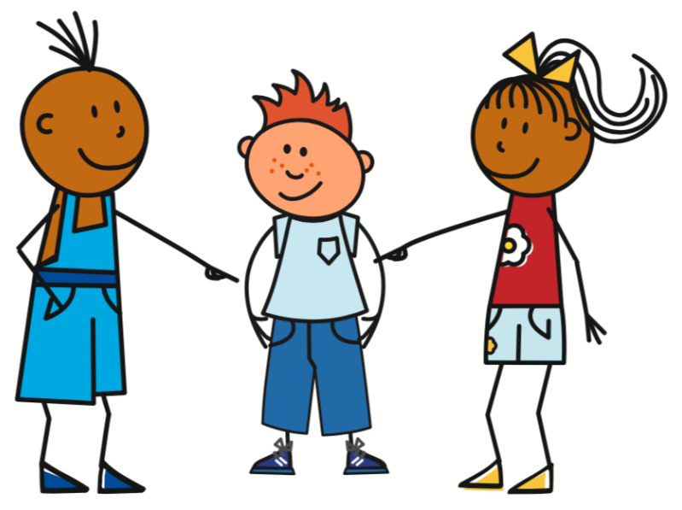
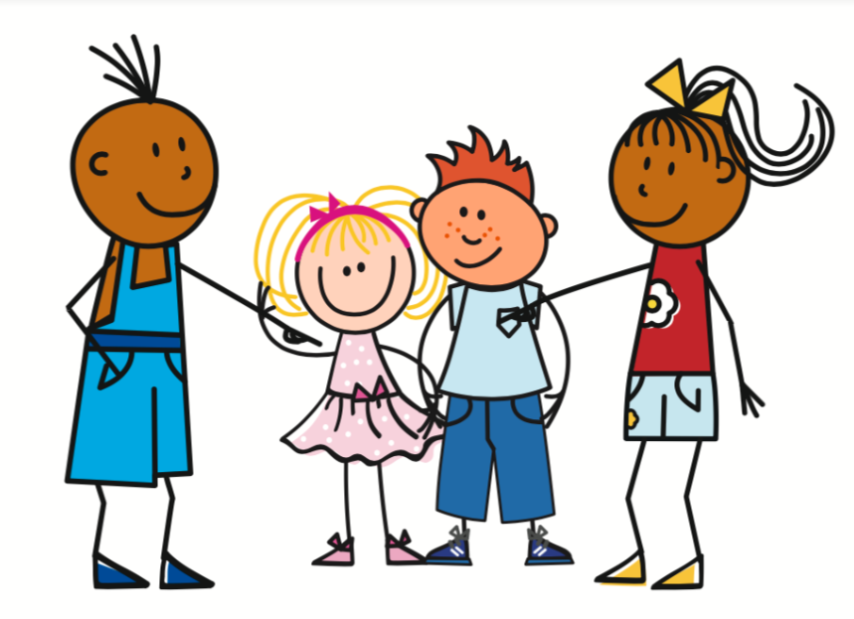
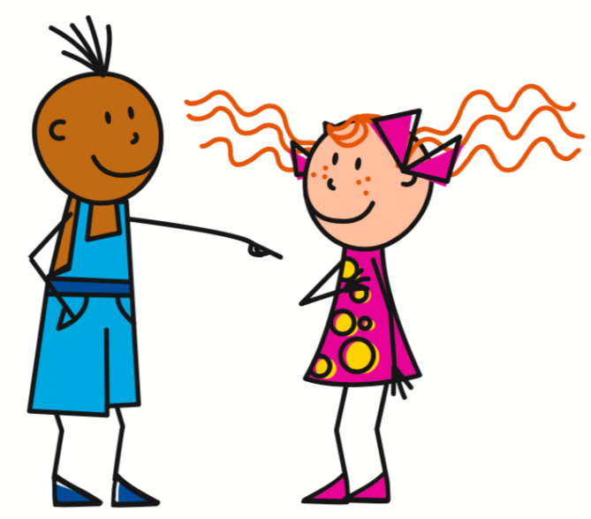
Partner A
 |  | having | being
 | lawyer |  | x
 | headmaster | x
 | secretary |  | x
 | waiter/waitress |  | x
 | teacher | x
 | doctor |  | x
Partner A
 |  | having | being
 | lawyer |  | x
 | headmaster | x
 | secretary | x
 | waiter/waitress |  | x
 | teacher | x
 | doctor |  | x
Partner B
 |  | having | being
 | lawyer | x
 | headmaster |  | x
 | secretary | x
 | waiter/waitress | x
 | teacher | x
 | doctor |  | x
Partner B
 |  | having | being
 | lawyer | x
 | headmaster | x
 | secretary |  | x
 | waiter/waitress | x
 | teacher |  | x
 | doctor | x

Slide 31
Devoirs
Vocabulary Learning Homework Continue to practise vocabulary from last week (Y8 Term 1.1, Week 2)
In addition, revisit: Y7 Term 3.2 Week 5 Y7 Term 3.1 Week 4
Notes:
Notes:
i) Teachers may, in addition, want to recommend use of a particular online app for the pre-learning of each week’s words. ii) Quizlet now requires parental involvement / registration / permissions for users below the age of 13, so it is perhaps most suitable for Y9 – 11 students. iii) Language Nut hosts LDP vocabulary lists and these are free for schools to use, though there is a registration process. One benefit is that all of the student tracking data that Language Nut offers are also available to schools that use the LDP lists for practice. Perhaps this makes it a good option for Y7/8.
iv) There are other free apps, and new ones are always appearing. Teachers have told us that they are currently using: Flippity, Wordwall (where using previously-created activities is free).
v) Gaming Grammar has been acquired by Language Nut. Its original content should still be available to teachers and much of it is appropriate for Y8 learners. From this lesson, for example, learners could practise:
Questions: subject-verb inversion (Question formation)
To have and to be: 1st person and 3rd person singular

