Slide 1
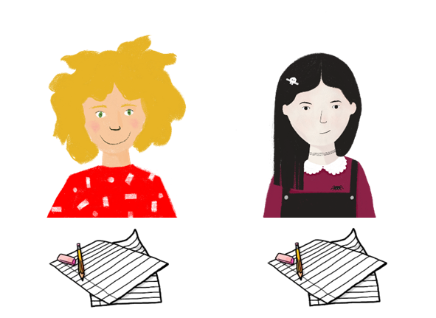
Talking about how to say and write new words in French
Comment dit-on ça…
gender and number definite and indefinite articles il y a / il n’y a pas
Y7 SSCs revisited
… en français ?
… en anglais ?
Y8 French
Term 1.1 - Week 1 - Lesson 1 Kirsten Somerville / Natalie Finlayson Artwork by: Chloé Motard
Date updated: 20.08.23
Notes:
Artwork by Chloé Motard. All additional pictures selected are available under a Creative Commons license, no attribution required.
Note: all words (new and revisited) in this week of the SOW appear on all three GCSE wordlists, with these exceptions: i) AQA list does not have chemise, phrase (though phrase may be used as a cognate in reading).
ii) Edexcel list does not have phrase (though phrase may be used as a cognate in reading).
iii) Eduqas list does not have chemise.
Learning outcomes (lesson 1):
Revisiting Y7 SSCs
Revision of gender and number
Revision of definite and indefinite articles
Revision of structures with il y a / il n’y a pas
Word frequency (1 is the most frequent word in French):
8.1.1.1 (revisit) écouter [429], écrire [382], lire [278], parler [106], affaires [170], cadeau [2298], chemise [3892], chien [1744], courses [1289], devoirs [39], femme [154], fruit [896], homme [136], livre [358], mot [220], ordinateur [2201], parents [546], phrase [2074], portable [4002], porte [696], règle [488], télé [2746], vacances [1726], vélo [4594], vêtements [2383], voiture [881], anglais [784], français [251], et [6], ou [33], un2 [3], une [3], des [3], le [1], la [1], les [1], ce [12], ça [54 (cela)], il² [13], elle² [38], il(s)² [13], elle(s)² [38], en [7], voici [1103], cinq [288], deux [41], dix [372], douze (1664), huit [877], neuf [787], onze (2447), quatre [253], sept [905], six [450], trois [115], au revoir [4/1/1274], bonjour [1972], quoi [297], comment dit-on [234/37/29], comment ça s’écrit [234/54/17/382], il y a [13/36/8]
Source: Londsale, D., & Le Bras, Y. (2009). A Frequency Dictionary of French: Core vocabulary for learners London: Routledge.

Slide 2
Vocabulaire
écouter
On means ‘you’ in the sense of ‘people in general’.
Comment dit-on ça…
[How do you say that…]
… en français ?
… en anglais ?
Notes:
Timing: 1 minute Aim: to revise the phrase comment dit-on… and the structures en français and en anglais
Note: Students have not yet met pronoun on. Teaching it to students here as part of a set phrase primes for its explicit introduction in 8.1.1.3.

Slide 3
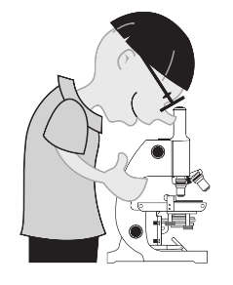
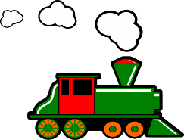
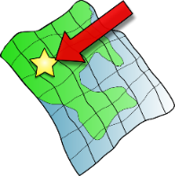
SFC
a
i
eu
e
au
X
midi
je
gauche
dans
animal
deux
u
ou
SFE
é
en/an
on
tu
nous
timide
écrire
X
enfant
Non!
ain/in
ê/è
ai
oi
ch
ç/soft c
train
tête
vrai
voir
chercher
ici
qu
-tion
ien
?
j/soft g
X
question
jour
Attention!
bien
Notes:
Timing: 5 minutes Aim: To revise all SSCs learned in Y7. Procedure: 1. Click to hear SSCs and source words to said aloud. Students repeat.
2. Point at SSCs at random. Ask ‘Comment dit-on la SSC?’ Students say it aloud.
3. Ask ‘Comment dit-on le mot?’ Students say the source word aloud. Click to check pronunciation.

Slide 4
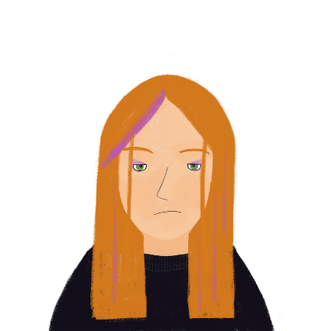
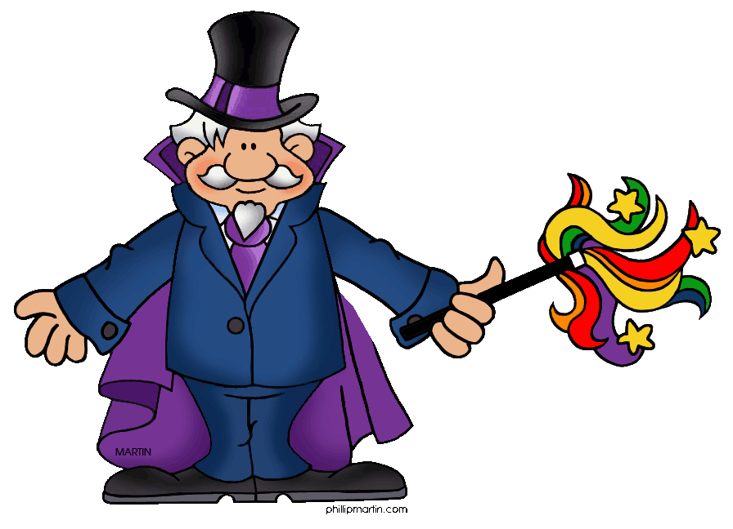
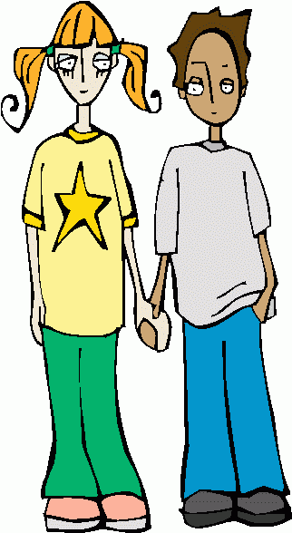
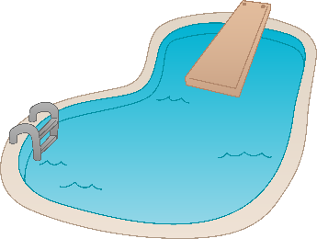
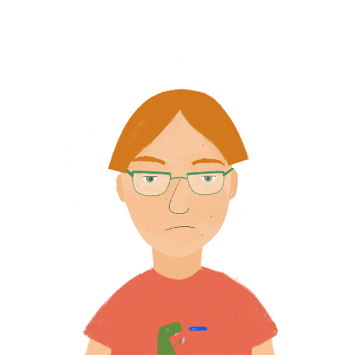
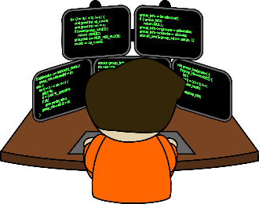
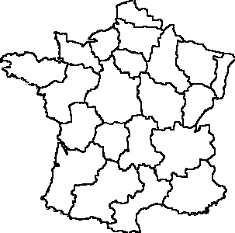
Les vacances
écouter / écrire
Ils font quoi ? Écoute les phrases et complète le mot final.
m a g i c i e n
c o p a i n
1
4
_ _ _
_ _ _
Léa
Élodie
p i s c i n e
g l a c e s
2
5
_
_
_
Sophie
Amir
p r o g r a m m a t i o n
r é g i o n
3
6
_
_ _ _ _
Antoine
Océane
Notes:
Timing: 4 minutes
Aim: aural recognition and transcription of a range of Y7 SSCs to complete unknown words
Procedure:
1. Click the numbers to play the audio. Each sentence ends with the word to complete.
2. Students write 1-8 and the SSCs they hear (5-8 are on the next slide). Each dash represents one missing letter.
3. Click to reveal the answers.
Transcript:
Je regarde un magicien.
Je vais à la piscine.
J’apprends la programmation.
Je sors avec mon copain.
Je mange des glaces.
Je visite la region.
Word frequency of cognates used (1 is the most frequent word in French): compléter [2034], final [1461]
Source: Londsale, D., & Le Bras, Y. (2009). A Frequency Dictionary of French: Core vocabulary for learners London: Routledge.
Word frequency of unknown vocabulary (1 is the most frequent word in French): magician [>5000], piscine [>5000], programmation [3844], copain [3020] glace [2580], région [241],
Source: Londsale, D., & Le Bras, Y. (2009). A Frequency Dictionary of French: Core vocabulary for learners London: Routledge.

Slide 5
Comment dit-on… ?
écouter
Léa et Sophie font les devoirs d’anglais.
Léa a des questions pour Sophie.
Écris les réponses.
 | en français ? | en anglais ?
 | écrire | to write, writing
 | quoi? | what?
 | la phrase | sentence
 | lire | to read, reading
 | au revoir | goodbye
 | parler | to speak, speaking
1
2
3
4
5
6
Notes:
Timing: 5 minutes
Aim: aural recall of eight of this week’s revisited words, presented in the comment dit-on… phrase
Procedure:
Click on the numbers to hear questions in French.
Students write or say the English translations.
On a click, a transcription of the French word appears. Students check their answers.
On a second click, the answer is revealed.
Transcript:
Comment dit-on « écrire » en anglais ?
Comment dit-on « quoi » en anglais ?
Comment dit-on « la phrase » en anglais ?
Comment dit-on « lire » en anglais ?
Comment dit-on « au revoir » en anglais ?
Comment dit-on « parler » en anglais ?
Note: all words are on all GCSE lists.

Slide 6
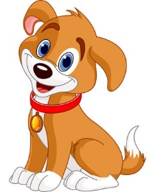
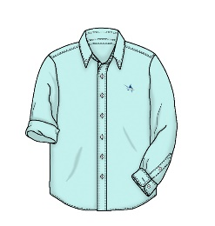
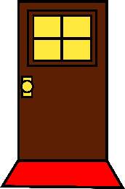
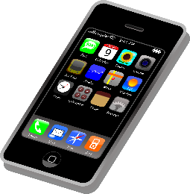
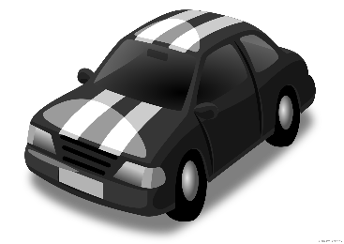
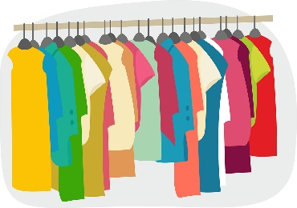
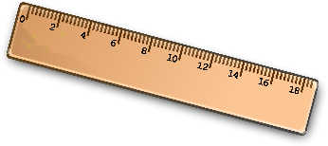
Comment dit-on… ?
parler
Tu viens de France et tu apprends l’anglais. Comment dit-on les choses ?
Demande à un(e) partenaire en français. Dis l’article (le, la ou les).
le chien
la télé
le vélo
le cadeau
la chemise
la porte
la règle
la femme
le portable
le livre
la voiture
les vêtements
Notes:
Timing: 5 minutes Aim: oral and aural recall of twelve of this week’s revisited words; oral production of the comment dit-on phrase to ask what unknown words mean Procedure: 1. Tell students they are now going to take on the roles of Léa and Sophie (see previous slide) They will take it in turns to ask questions about the words on the screen in French, and answer in English.
2. Student A chooses a picture that they know the French word for. Pretending to be Léa, they ask e.g. ‘Comment dit-on « le chien » en anglais ?’.
3. Student B replies ‘dog’.
4. Student B chooses a picture and asks the French question.
5. Student A responds.
6. Continue until all pictures have been used.
7. Click to reveal the French words.
Note: all words are on all 3 AO GCSE lists, with the exception of ‘chemise’ which is only on the Edexcel list.

Slide 7
Saying ‘a’ and ‘the’
grammaire
As you know, French nouns are either masculine or feminine.
Each gender has a different word for ‘the’ … and ‘a’.
Like in English, French nouns can be singular or plural.
The number also determines the word for ‘the’ … and ‘a / some’.
le → l’ before a vowel / h
la → l’ before a vowel / h
masculine
le vélo l’ordinateur
(the bike) (the computer)
un vélo un ordinateur
(a bike) (a computer)
feminine
la voiture l’amie
(the car) (the friend)
une voiture une amie
(a car) (a friend)
plural
les voitures
(the cars)
des voitures
(some cars)
___
___
___
___
____
___
___
___
___
____
Notes:
Timing: 3 minutes
Aim: to recap gender / number agreement with definite and indefinite articles

Slide 8
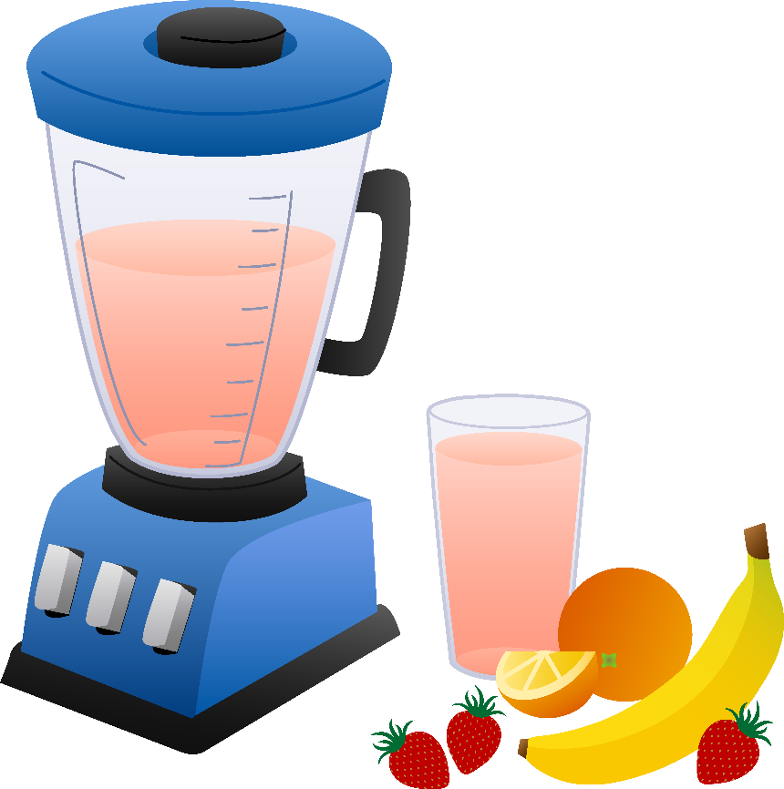
Il y a quoi ?
parler
Il y a quoi dans le smoothie ? Dis des phrases avec un / une / des.
Exemples:
Il y a un kiwi.
Il y a des kiwis.
le kiwi
A
________
les kiwis
B
________
Silent Final Consonant!
Notes:
Timing: 5 minutes Aim: to use SSC knowledge to pronounce unknown words and to connect definite articles with indefinite articles Procedure: 1. Use this example slide to explain the activity on the following slide.
2. Click to reveal the examples. Students read the words aloud using their SSC knowledge.
3. Students take it in turns to use the gender and number of the word to say a sentence with un / une / des, depending on the prompt.
4. Click to reveal the answer.
5. Click the letters to check pronunciation.
Transcript
Il y a un kiwi.
Il y a des kiwis.
Word frequency of unknown words used (1 is the most frequent word in French): smoothie [>5000], kiwi [>5000] Source: Londsale, D., & Le Bras, Y. (2009). A Frequency Dictionary of French: Core vocabulary for learners London: Routledge.

Slide 9
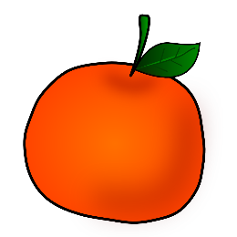
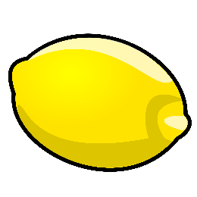
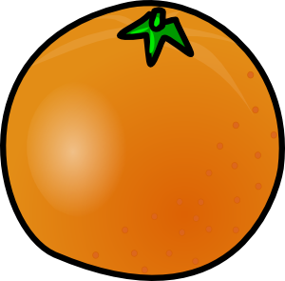
Il y a quoi ?
parler
la banane
les mandarines
le citron
________
Il y a un citron.
Il y a une banane.
________
1
________
2
Il y a des mandarines.
3
les pêches
la pastèque
l’orange (f)
Il y a des pêches.
6
4
________
5
________
Il y a une orange.
Il y a une pastèque.
________
Notes:
This is the activity outlined on the previous slide.
Transcript
1. Il y a une banane.
2. Il y a des mandarines.
3. Il y a un citron.
4. Il y a des pêches.
5. Il y a une pastèque.
6. Il y a une orange.
Word frequency of cognates used in task instructions (1 is the most frequent word in French): banane [>5000], mandarine [>5000], citron [>5000], pêche [1790], pastèque [>5000], orange [3912] Source: Londsale, D., & Le Bras, Y. (2009). A Frequency Dictionary of French: Core vocabulary for learners London: Routledge.

Slide 10
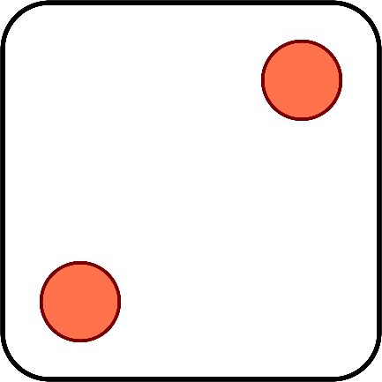
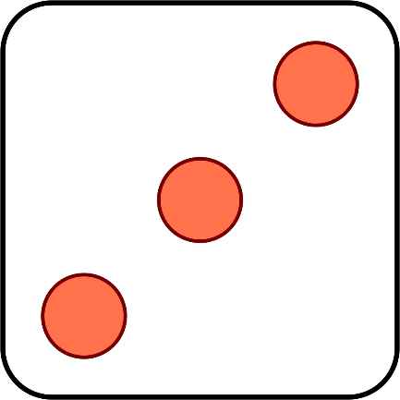
C’est combien ?
parler
Léa et Sophie jouent ensemble. Elles ont combien de points ? Dis les numéros.
Notes:
Timing: 2 minutes
Aim: oral recall of numbers
Procedure:
1. Click to ‘roll’ the dice for Léa and Sophie.
2. Students say the total shown on the two dice in French.
3. Click again to move on to the next number.
Word frequency of cognates used (1 is the most frequent word in French): point [97]
Source: Londsale, D., & Le Bras, Y. (2009). A Frequency Dictionary of French: Core vocabulary for learners London: Routledge.

Slide 11
La liaison
grammaire
The plural articles ‘les’ and ‘des’ end with a Silent Final Consonant:
les vacances des parents
However, when we use them before a noun beginning with a vowel or ‘h’, the final ‘-s’ is pronounced like an English ‘z’. This is called liaison:
les affaires des hommes
The same thing happens with the numbers ‘deux’ and ‘trois’:
deux ordinateurs trois idées
Notes:
Timing: 2 minutes
Aim: to recap liaison with plural articles and numbers

Slide 12
La liaison
écouter / parler
Elles font des fêtes.
They have parties.
Notes:
Timing: 3 minutes for 6 slides
Aim: practising pronunciation plural articles and numbers + liaison
Procedure:
1. Listen and repeat.
2. Ask students to translate the sentence.
3. Reveal picture on a click, ask students to check their translations.
4. Reveal English translation on click.

Slide 13
La liaison
écouter / parler
Ils font des affaires.
They are doing business.

Slide 14
La liaison
écouter / parler
Elle parle à deux femmes.
She is speaking to two women.

Slide 15
La liaison
écouter / parler
Il parle à deux hommes.
He is speaking to two men.

Slide 16
La liaison
écouter / parler
Il y a trois questions.
There are three questions.

Slide 17
La liaison
écouter / parler
Il y a trois exercices.
There are three exercises.

Slide 18
Il y a quoi ?
écouter / parler / écrire
Il y a quoi dans la maison d’Amir ? Il y a quoi dans la maison d’Océane ?
A
6
1. _________________________
2. _________________________
3. _________________________
4. _________________________
5. _________________________
6. _________________________
7
3
1
12
8
Notes:
Timing: 10 minutes
Aim: aural comprehension / oral and written production of numbers, aural comprehension / oral and written production of this week’s revisited vocabulary
Procedure:
Partner Bs need to turn away from the board. Click to show B disappearing.
Then click to reveal Partner A’s house contents.
Partner A says how many of each item there is in Amir’s house (using the prompts on this slide).
4. Partner B writes them down in English.
5. Move to the next slide to swap around.

Slide 19
Il y a quoi ?
écouter / parler / écrire
Il y a quoi dans la maison d’Amir ? Il y a quoi dans la maison d’Océane ?
B
4
1. _________________________
2. _________________________
3. _________________________
4. _________________________
5. _________________________
6. _________________________
11
5
2
10
9
Notes:
Round 2: Partner B rolecard
Procedure:
Partner A turns away from the board.
Click to reveal Partner B’s house.
3. Partner B says how many of each item there is in Océane’s house (using the prompts on the next slide).
4. Partner A writes them down in English.
5. Both partners write 6 sentences in French describing the contents of their partner’s house.
6. Check answers on the réponses slide, next.

Slide 20
Il y a quoi ?
Réponses
écouter / parler / écrire
1. Il y a six vélos.
2. Il y a sept télés.
3. Il y a trois ordinateurs.
4. Il y a un chien.
5. Il y a douze portes.
6. Il y a huit fruits.
1. Il y a quatre voitures.
2. Il y a onze livres.
3. Il y a cinq portables.
4. Il y a deux hommes.
5. Il y a dix chemises.
6. Il y a neuf règles.
Notes:
Answers

Slide 21
Il n’y a pas de …
grammaire
As you know, we use il y a with an article + noun to say ‘there is’ or ‘there are’.
The article agrees with the gender and number of the noun:
Il y a une porte. There is a door.
Il y a un ordinateur. There is a computer.
Il y a des vêtements. There are some clothes.
To say ‘there isn’t’ or ‘there aren’t’, we use il n’y a pas.
After il n’y a pas, all articles change to de, or d’ before a vowel/h.
This happens no matter what the gender or number of the noun is.
Il n’y a pas de porte. There is no door.
Il n’y a pas d’ordinateur. There is no computer.
Il n’y a pas de vêtements. There are no clothes.
_______________
_______________
_______________
_______________
_______________
_______________
Notes:
Timing: 2 minutes
Aim: to revise usage of il y a with an indefinite article vs il n’y a pas with a definite article.

Slide 22
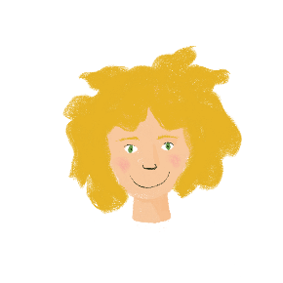
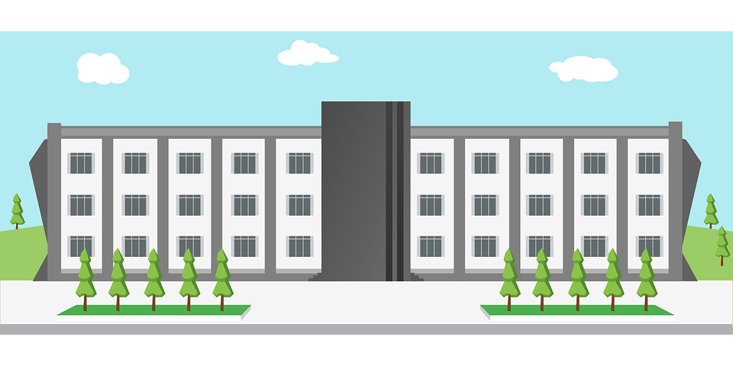
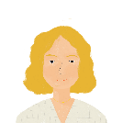
L’école de Léa
écouter
Léa montre l’école à une nouvelle élève.
Il y a quoi ? Il n’y a pas quoi ?
 |  | il y a | il n’y a pas
1
1
2
2
3
3
4
4
5
5
6
6
Notes:
Timing: 8 minutes
Aim: to apply knowledge of article forms after il y a and il n’y a pas to determine whether an object is present or absent.
Procedure:
1. Click on a number to hear a sentence with il (n)’y a (pas) bleeped out. Remind students the articles they hear after the beep will tell them whether the item is there or not.
2. Click to reveal answers.
3. Click to bring up a 2nd set of buttons with full audio.
4. Elicit, then play and reveal each answer.
Transcript:
1. Il [beep] des ordinateurs.
2. Il [beep] de télé.
3. Il [beep] un chien.
4. Il [beep] des vélos.
5. Il [beep] de parents.
6. Il [beep] de portables !
Transcript 2:
1. Il y a des ordinateurs.
2. Il n’y a pas de télé.
3. Il y a un chien.
4. Il y a des vélos.
5. Il n’y a pas de parents.
6. Il n’y a pas de portables !

Slide 23
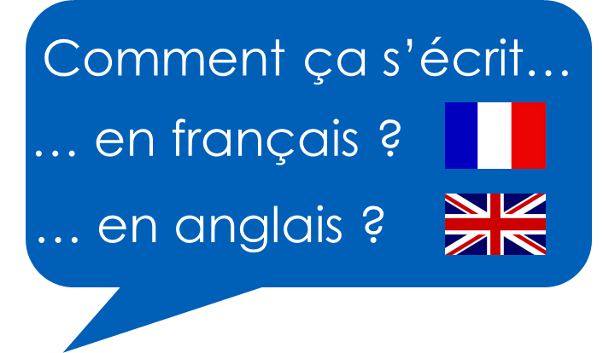
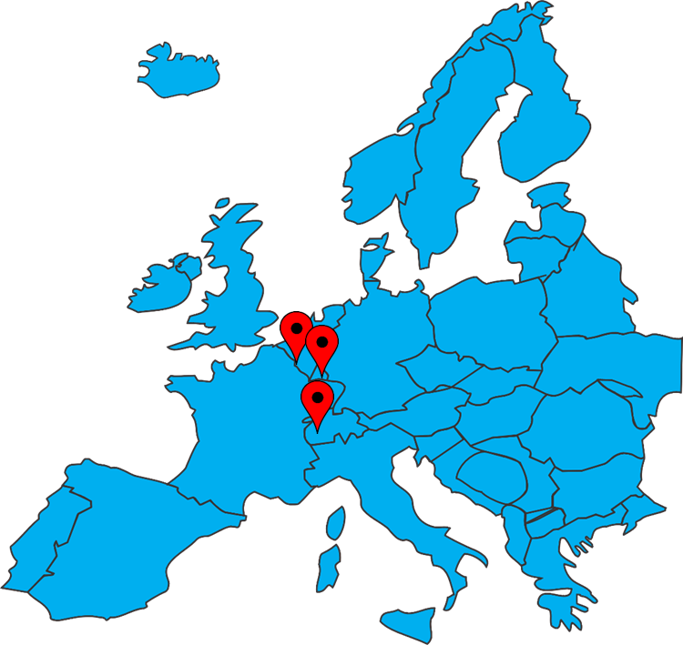
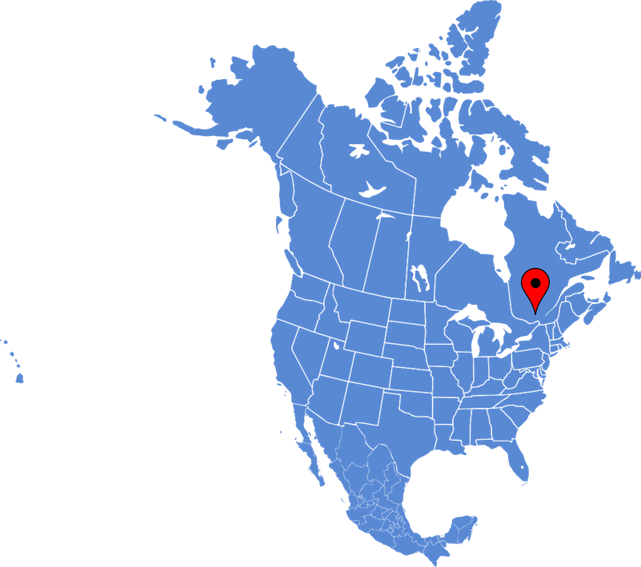
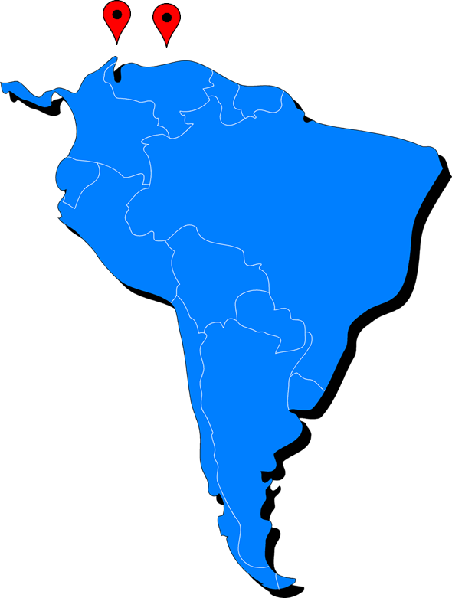
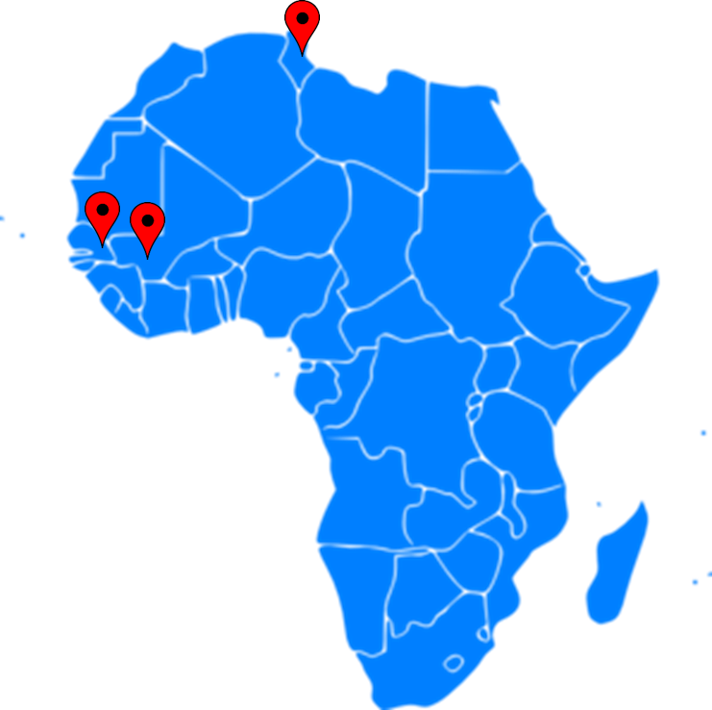
Talking about how to say and write new words in French
alphabet il(s)/elle(s) meaning 'it'/'they'
possessive adjectives (1st, 2nd singular)
Y7 SSCs revisited
Y8 French
Term 1.1 - Week 1 - Lesson 2 Kirsten Somerville / Natalie Finlayson Artwork by: Chloé Motard
Date updated: 20.08.23
Notes:
Learning outcomes (lesson 2):
Revisiting Y7 SSCs
Revision of 3rd person pronouns meaning it/they
Revision of possessive adjectives (mon, ma, mes, ton, ta, tes)
Word frequency (1 is the most frequent word in French):
8.1.1.1 (revisit) écouter [429], écrire [382], lire [278], parler [106], affaires [170], cadeau [2298], chemise [3892], chien [1744], courses [1289], devoirs [39], femme [154], fruit [896], homme [136], livre [358], mot [220], ordinateur [2201], parents [546], phrase [2074], portable [4002], porte [696], règle [488], télé [2746], vacances [1726], vélo [4594], vêtements [2383], voiture [881], anglais [784], français [251], et [6], ou [33], un2 [3], une [3], des [3], le [1], la [1], les [1], ce [12], ça [54 (cela)], il² [13], elle² [38], il(s)² [13], elle(s)² [38], en [7], voici [1103], cinq [288], deux [41], dix [372], douze (1664), huit [877], neuf [787], onze (2447), quatre [253], sept [905], six [450], trois [115], au revoir [4/1/1274], bonjour [1972], quoi [297], comment dit-on [234/37/29], comment ça s’écrit [234/54/17/382], il y a [13/36/8]
Source: Londsale, D., & Le Bras, Y. (2009). A Frequency Dictionary of French: Core vocabulary for learners London: Routledge.

Slide 24
Vocabulaire
écouter
Comment ça s’écrit ?
[How do you write/spell that?]
Notes:
Timing: 1 minute Aim: to revise the phrase comment ça s’écrit ?
Note: [explain se = how that itself writes]

Slide 25
L’alphabet
écouter / parler
A
B
C
D
E
F
G
H
I
J
K
L
M
N
O
P
Q
R
S
T
U
V
W
X
Y
Z
Notes:
Timing: 5 minutes Aim: to revise letter names and pronunciation Procedure: 1. Click on each letter to hear it said aloud. Students repeat.
2. Click on the speaker to hear the full alphabet said aloud. Students say the alphabet along with the recording.
3. Point at letters at random. Students say them out loud. Click to check pronunciation.

Slide 26
C’est quelle lettre ?
lire
Les mots ont une lettre en commun. C’est quelle lettre ?
?
?
?
?
A
R
T
O
?
_
_
?
_
_
_
_
_
_
_
_
_
?
_
_
_
?
_
_
_
_
?
?
B | O | N | J | O | U | R
É | C | O | U | T | E | R
O | N | Z | E
A | F | F | A | I | R | E | S
V | A | C | A | N | C | E | S
P | H | R | A | S | E
D | E | V | O | I | R | S
P | A | R | E | N | T | S
É | C | R | I | R | E
P | O | R | T | A | B | L | E
T | R | O | I | S
E | T
_
_
_
_
_
_
_
?
_
?
_
_
_
_
_
_
?
_
_
_
_
?
_
_
_
_
_
_
?
_
_
_
_
_
_
_
?
_
_
_
_
?
_
?
_
_
?
?
_
_
_
Notes:
Timing: 4 minutes Aim: to revise the written form of twelve of this week’s revisited words, and to practise saying letter names Procedure: 1. Tell students that the orange question marks in the slide hide a letter. This letter is shared by all three words. Students will see the other letters revealed one by one and the first person to guess the words, and the mystery letter they share, is the winner.
2. On clicks, the letters within a box disappear one by one (the least revealing letters disappear first).
3. If a student thinks they know the letter, they say ‘J’ai la réponse !’
4. Ask ‘C’est quel mot ?’
5. The student says the names of the words they recognise.
6. Ask ‘Comment ça s’écrit ?’
7. The student spells the names of the words they recognise.
8. Click to reveal any remaining letters and ask ‘C’est quelle lettre ?’
9. The solution is revealed on a final click.
Word frequency of cognates used (1 is the most frequent word in French): commun [780]
Source: Londsale, D., & Le Bras, Y. (2009). A Frequency Dictionary of French: Core vocabulary for learners London: Routledge.

Slide 27
Trouve les paires !
parler
 | H | L | D | Q | C | P | F | V
1
2
3
4
5
6
7
8
douze
vêtements
homme
courses
parler
quatre
fruit
lire
Notes:
Timing: 4 minutes Aim: to revise the form and meaning of eight of this week’s revisited words, and practise eight letters of the alphabet. Procedure: 1. Starting with number 1, students volunteer the letter that they think starts the word cued in the first row – i.e., number 12. The pair = the number of the row and the correct letter of the column, which starts the word of the picture in the row.
2. Teachers elicits the French word – ‘Le mot, c’est quoi ?’
3. Click to reveal the correct word in the correctly lettered column.
4. Repeat with the other 7 items (2-8).
Answers:
1 – D (douze) 2 – V (vêtements)
3 - H (homme)
4 – C (courses) 5 – P (parler)
6 – Q (quatre)
7 – F (fruit)
8 - L (lire)
Word frequency of cognates used (1 is the most frequent word in French): paire [3926]
Source: Londsale, D., & Le Bras, Y. (2009). A Frequency Dictionary of French: Core vocabulary for learners London: Routledge.

Slide 28
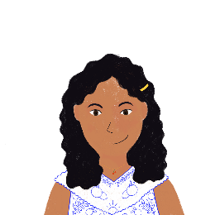
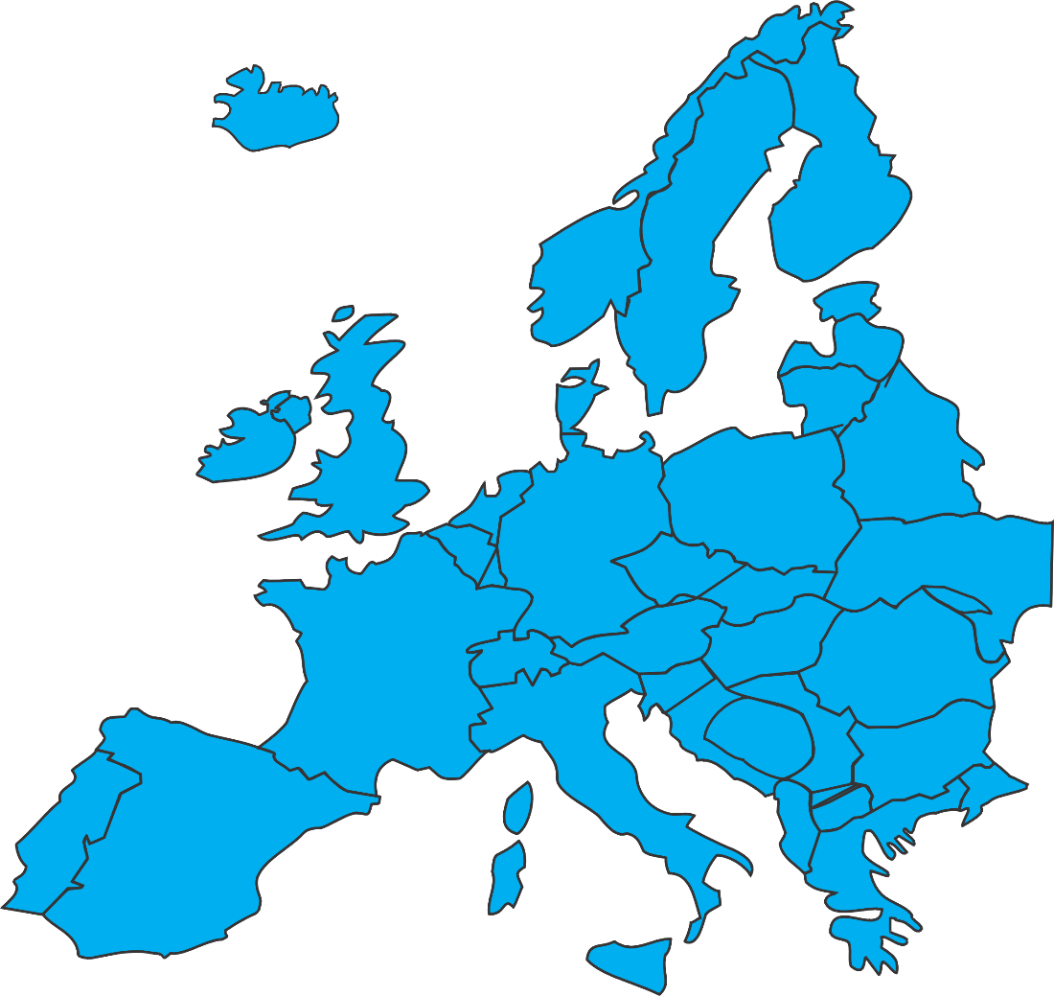
C’est où ?
écouter / écrire / parler
Noura étudie les pays où on parle français. Elle demande le nom des villes à Léa.
1
Tournai
(Belgium)
2
Rumelange
(Luxembourg)
1
3
2
Montreux
(Switzerland)
3
Notes:
Timing: 5 minutes Aim: aural comprehension and transcription of letters of the alphabet Procedure:
1. Check students understand task instructions. Ask students where they have they met pronoun on before (in the phrase comment dit-on in Lesson 1) and what it means here.
2. Click on a number to hear a dialogue between Noura and Léa. 3. Students write down the place names based on the spelling they hear.
4. Click to check.
Transcript: 1. C’est où ça ?
Ça c’est Tournai.
Comment ça s’écrit ?
T-O-U-R-N-A-I.
2. C’est où ça ?
Ça c’est Rumelange.
Comment ça s’écrit ?
R-U-M-E-L-A-N-G-E.
3. C’est où ça ?
Ça c’est Montreux.
Comment ça s’écrit ?
M-O-N-T-R-E-U-X.

Slide 29
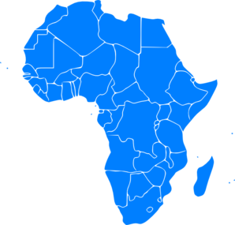
C’est où ? (A)
écouter / écrire / parler
Noura étudie les pays où on parle français. Elle demande le nom des villes à Léa.
1
1
Sousse
(Tunisia)
2
3
2
Ballou
(Senegal)
3
Bamako
(Mali)
Notes:
Timing: 8 minutes for two slides. Aim: to practise hearing, writing and saying new words and their spellings Procedure: 1. Starting with number 1, Partner B asks ‘C’est où ça ?’
2. Partner B turns away from the board.
3. Click to reveal the place name.
4. Using their SSC knowledge, Partner A reads the word out loud.
5. Partner B asks ‘Comment ça s’écrit ?’
5. Partner A spells the words while Partner B writes it down.
6. Partner B turns back to the board to check the spelling.
7. Click on the number to check pronunciation.
8. Repeat for the remaining items, then move on to the next slide to swap roles.
Transcript
1. Sousse
2. Ballou
3. Bamako

Slide 30
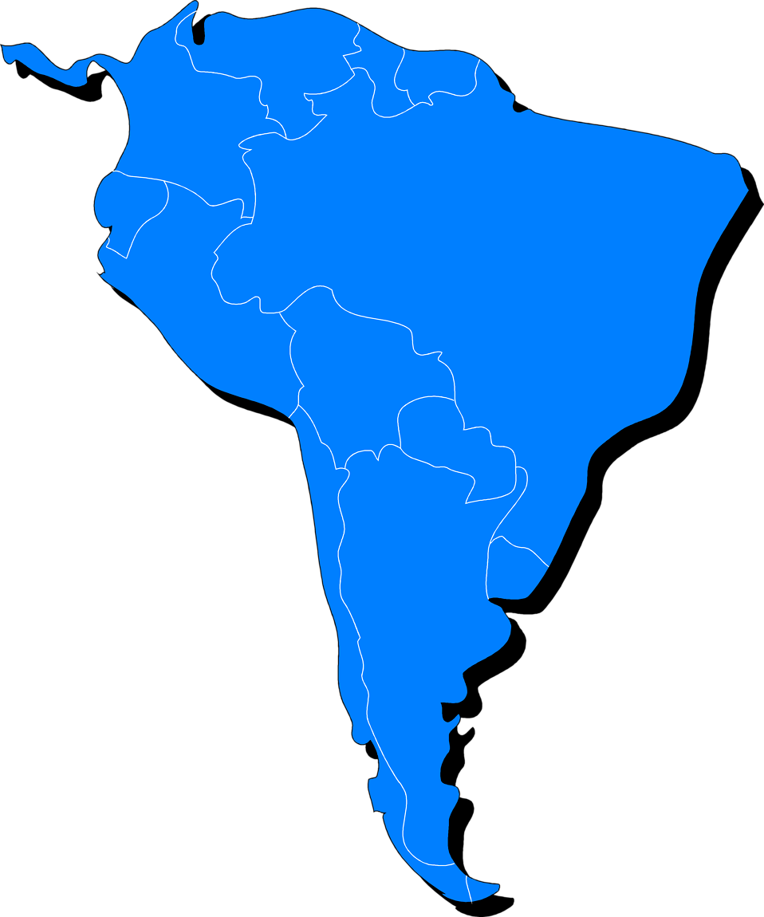
C’est où ? (B)
écouter / écrire / parler
Noura étudie les pays qui parlent français. Elle demande le nom des villes à Léa.
1
2
3
Gatineau
(Canada)
2
Carrefour
(Haiti)
3
1
Dubedou
(Guadeloupe)
Notes:
This is the second part of the activity described on the previous slide. Students swap roles.
Transcript
1. Gatineau
2. Carrefour
3. Dubedou

Slide 31
Saying ‘my’ and ‘your’
grammaire
We have seen that the words for ‘the’ and ‘a’ are different in French depending on the gender and number of the noun.
This is also true for the words for ‘my’ … and ‘your’.
masculine
mon vélo
(my bike)
ton vélo
(your bike)
feminine
ma voiture mon amie
(my car) (my friend)
ta voiture ton amie
(your car) (your friend)
plural
mes voitures
(my cars)
tes voitures
(your cars)
ma → mon before a vowel / h
____
____
____
____
____
____
____
ta → ton before a vowel / h
____
Notes:
Timing: 3 minutes
Aim: to recap gender / number agreement with possessive adjectives (1st and 2nd person singular)

Slide 32
Un message
lire / écouter
1
2
3
4
5
6
7
8
9
Abdel a un message d’Amir. Il dit quoi ? Complète les phrases.
Bonjour Abdel. Tu passes tes semaine / vacances comment ? Tu prends ta voiture / vélo pour faire des voyages ?
Je reviens au collège aujourd’hui. Je dois donner mon portable / réponse au professeur en classe. C’est difficile ! Mais je peux travailler sur mon projets / ordinateur. J’aime apprendre l’anglais en ce moment. C’est quoi ton phrase préférée / mot préféré en anglais ?
Je dois dire au revoir – je cherche ma règle / livre pour demain ! Je ne veux pas faire mes exercice / devoirs… Tu dis à tes parents / famille : « Amir dit bonjour » !
00
Notes:
Timing: 10 minutes
Aim: Text segmentation exercise to revise genders of common nouns and practise gender / number agreement with possessive adjectives (1st and 2nd person singular)
Procedure:
1. Click on the number buttons to hear the story read aloud. Students read along. Note: the text has been divided into nine segments to facilitate teacher pausing. Each segment pauses before the bold nouns as below. Each numbered segment picks up where the last left off – i.e., with the correct bold noun.
2. Students work out which noun comes next (based on gender/number).
3. Click to reveal the correct noun.
4. Continue the audio and repeat for each set of nouns.
5. Once all nouns are revealed, students write a short summary of the text in English (2-3 sentences).
Transcript:
Bonjour Abdel. Tu passes tes [vacances] comment ? Tu prends ta [voiture] pour faire des voyages ?
Je reviens au college aujourd’hui. Je dois donner mon [portable] au professeur en classe. C’est difficile ! Mais je peux travailler sur mon [ordinateur]. J’aime apprendre l’anglais en ce moment. C’est quoi ton [mot] préféré en anglais ?
Je dois dire au revoir – je cherche ma [règle] pour demain ! Je ne veux pas faire mes [devoirs]. Tu dis à tes [parents] : « Amir dit bonjour » !
Word frequency of cognates used (1 is the most frequent word in French): message [792], compléter [2034]
Source: Londsale, D., & Le Bras, Y. (2009). A Frequency Dictionary of French: Core vocabulary for learners London: Routledge.

Slide 33
Saying ‘it’ and ‘they’
grammaire
Il and elle mean ‘he’ and ‘she’ when we are talking about people.
Amir a un portable. → Il a un portable. Léa a une règle. → Elle a une règle.
Il and elle can also mean ‘it’ when we are talking about things.
We use il for masculine nouns and elle for feminine nouns:
Le portable est cher. → Il est cher. La règle est petite. → Elle est petite.
We use ils / elles to mean ‘they’ (referring to people or things):
Amir et Léa sont contents. → Ils sont contents.
Les règles sont blanches. → Elles sont blanches.
__
__
___
___
Notes:
Timing: 3 minutes
Aim: to recap the use of il(s) / elle(s) to mean ‘it’ / ‘they’

Slide 34
C’est quoi ?
lire
Amir donne des descriptions des choses. Il parle de quoi ? Écris a ou b.
 |  | a | b
1. | Il est calme.
2. | Elle est moderne.
3. | Il est rapide.
4. | Elle est rouge.
 |  | a | b
5. | Ils sont sympas.
6. | Elles sont jaunes.
7. | Ils sont drôles.
8. | Elles sont difficiles.
[questions]
Notes:
Timing: 5 minutes
Aim: written recognition of gender agreement with il(s) / elle(s) meaning ‘it’ / ‘they’
Procedure:
1. Teacher to check students know the gender of nouns before students do the task.
2. Write 1-8 and choose if the pronoun refers to the noun in picture ‘a’ or ‘b’.
3. Click to reveal the answers.
Word frequency of cognates used (1 is the most frequent word in French): description [2779]
Source: Londsale, D., & Le Bras, Y. (2009). A Frequency Dictionary of French: Core vocabulary for learners London: Routledge.

Slide 35
Devoirs
Vocabulary Learning Homework (Y8 Term 1.1, Week 2)
Audio file
Student worksheet
In addition, revisit: Y7 Term 3.2 Week 5 Y7 Term 3.1 Week 4
Notes:
The answer sheet for this week’s vocabulary learning homework is here:
https://rachelhawkes.com/LDPresources/Yr8French/French_Y8_Term1i_Wk2_audio_HW_sheet_answers.docx Don’t share this link with students ☺
Notes:
i) Teachers may, in addition, want to recommend use of a particular online app for the pre-learning of each week’s words. ii) Quizlet now requires parental involvement / registration / permissions for users below the age of 13, so it is perhaps most suitable for Y9 – 11 students. iii) Language Nut hosts LDP vocabulary lists and these are free for schools to use, though there is a registration process. One benefit is that all of the student tracking data that Language Nut offers are also available to schools that use the LDP lists for practice. Perhaps this makes it a good option for Y7/8.
iv) There are other free apps, and new ones are always appearing. Teachers have told us that they are currently using: Flippity, Wordwall (where using previously-created activities is free).
v) Gaming Grammar has been acquired by Language Nut. Its original content should still be available to teachers and much of it is appropriate for Y8 learners. From this lesson, for example, learners could practise:
Indefinite articles: Gender (Article agreement)
Definite articles: Gender (Article agreement)
Possessive adjectives: 1st person gender (Possessive adjective agreement)
Possessive adjectives: Number (Possessive adjective agreement)

