Slide 1
Actividades con amigos en clase
Talking about what people can do Using modal verb ‘poder’
SSC [u]
Y7 Spanish Term 2.2 - Week 2 - Lesson 41 Amanda Izquierdo / Nick Avery Artwork: Mark Davies Date updated: 16.04.24
Notes:
All pictures selected are available under a Creative Commons license, no attribution required.
Note: all words (new and revisited) in this week of the SOW appear on all three GCSE wordlists, with the following exception:
i) AQA list does not have material Artwork by Mark Davies. All additional pictures selected are available under a Creative Commons license, no attribution required.
Learning outcomes (lesson 1):
Consolidation of SSC [u]
Introduction of PODER in singular persons (puedo, puedes, puede) and its use in negative statements
Word frequency (1 is the most frequent word in Spanish):
7.2.2.2 (introduce) poder [32]; puedo; puedes; puede; jugar [356]; participar [593]; preguntar [220]; pedir [218], material [690]; cambiar [256]; favor [517]; compañero/a [551]; ¿puedo ir a los servicios?
7.2.1.4 (revisit) ¿cuándo? [57]; ¿cuánto? [580]; ¿cuál? [445]; hacer [26]; hago; haces; hace; deporte [1489]; deberes [2187]; actividad [344]; dibujo [1726]; noche [164]; tarde [392]; mañana [402]; para [16]
7.1.2.6 (revisit) pueblo [244]; equipo [373]; trabajo [152]; edificio [857]; plato [1808]; familia [233]; película [543]; vista [408]; isla [810]; grande [66]; interesante [616]; de [2]
Source: Davies, M. & Davies, K. (2018). A frequency dictionary of Spanish: Core vocabulary for learners (2nd ed.). Routledge: London
The frequency rankings for words that occur in this PowerPoint which have been previously introduced in NCELP resources are given in the NCELP SOW and in the resources that first introduced and formally re-visited those words.
For any other words that occur incidentally in this PowerPoint, frequency rankings will be provided in the notes field wherever possible.

Slide 2
Inicio
Pronuncia las palabras en orden alfabético.
leer / hablar
¿Qué significan en inglés?
jugar | para | (los) deberes | (el) dibujo
participar | (la) actividad | (el) deporte | (el) material
(la) familia | poder | (el) favor | (el/la) compañero/a
actividad, compañero/a, deberes, deporte, dibujo, familia, favor, jugar, material, para, participar, poder
Notes:
Starter activity to settle students on arrival. Timing: 5 minutes
Aim: to practise recognition of new and revisited vocabulary for this week.
Procedure:
Students say the words in alphabetical order.
They work out the meaning of each word in English. (If students have not done any pre-learning some words will be new, but several are cognates. For any words students don’t know, the teacher provides the English meanings during feedback. Students will practise these words during this lesson.)
Note: teachers set the conditions for the activity – e.g., pairs/solo, say or write etc..

Slide 3
u
universo
Notes:
Introduce and elicit the pronunciation of the individual SSC ‘U’ and then present and practise the pronunciation of the source word ‘universo’.
A possible gesture for this source word would be to extend your arms over your head and then out to the sides in a single motion

Slide 4
u
mundo
mucho
un
lugar
universo
[a; an]
[place]
nunca
[never]
Notes:
Introduce and elicit the pronunciation of the individual SSC ‘u’ and then the source word again (with gesture, if using). Then present and elicit the pronunciation of the five cluster words.
The cluster words have been chosen for their high-frequency, from a range of word classes, with the SSC (where possible) positioned within a variety of syllables within the words(e.g. initial, 2nd, final etc..) and additionally, we have tried to use words that build cumulatively on previously taught SSCs (see the Phonics Teaching Sequence document) and do not include new SSCs. Where new SSCs are used, they are often consonants which have a similar symbol-sound correspondence in English.

Slide 5
[u]
Escucha. ¿Cuántas veces escuchas el sonido [u]?
escuchar / escribir
 | 1 | 2 | 3
Escucha otra vez. Escribe las frases en español.
1
Hay un mercado.
2
Escuchar música es fantástico.
3
Estudia mucho en la escuela.
4
El lugar está cerca.
5
Hay un museo en la ciudad.
6
El pueblo antiguo está lejos.
Notes:
Timing: 7 minutes
Aim: to raise awareness of the SSC [u] in different words
Procedure:
Students listen out for how many times they can listen to the sound ‘u’, 1, 2 or 3 times.
Students listen again and write the whole sentence.
Notes:
All words in this activity have been previously taught (except for fantástico, which is introduced later). Students can therefore be prompted to give English meanings to deepen vocabulary knowledge.
Omit the 2nd time of listening, if preferred, according to the level of the class. Higher-achieving groups may be able to write the whole sentence the first time they listen. Writing the sentence will help students to check their initial decision about how many times ‘u’ appears.
There is some phonological variation in the SSC ‘u’ in several of these words. It can be useful to make students aware that ‘u’ can vary in sound, depending on the letters that come before or after it. (For example, it is followed by a vowel in respuesta, pueblo and antiguo and so sounds different.) Students may recognise other previously taught SSCs, e.g. ‘cu’ in escuchar.
Students have already met cuánto/cuantos in lesson 2.1.4, but have not seen its feminine form or ‘vez’, yet. Ensure that the meaning of this word is clear to them when giving task instructions.
Transcript:
Hay un mercado.
Escuchar música es fantástico.
Estudia mucho en la escuela.
El lugar está cerca.
El pueblo antiguo está lejos.
Hay un museo en la ciudad.

Slide 6
¿Cuál es la palabra española? (1/2)
leer / hablar
¿Cómo se dice en español?
I do, I make
you do, you make
s/he (or it) does, makes
activity
night
interesting
to do, to make
job, work
big
team
morning
la mañana
interesante
el equipo
la actividad
hacer
la noche
grande
el trabajo
la actividad
la noche
interesante
hacer
el trabajo
grande
el equipo
la mañana
Notes:
Timing: 5 minutes (two slides)
Aim: to recap this week’s revisited vocabulary.
Procedure:
The teacher clicks to bring up the English word.
Students say the word in Spanish out loud.
The teacher clicks again to make the correct Spanish word move next to it.

Slide 7
¿Cuál es la palabra española? (2/2)
leer / hablar
when?
de
la vista
la tarde
la vista
el plato
la isla
el edificio
evening
dish, plate
from, of
view
building
island
view
when?
la tarde
el plato
de
la vista
el edificio
la isla
la vista
¿cuándo?
Notes:
[2/2]

Slide 8
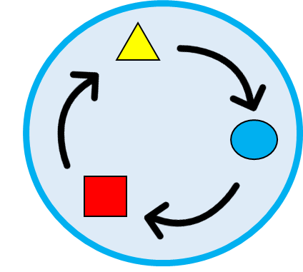
Vocabulario (1/2)
leer / hablar
participar
preguntar
pedir
Asking a question? Use ‘preguntar’.
Asking for something? Use ‘pedir’.
to participate
to ask
to ask for
cambiar
jugar
poder
to change
to play
to be able to, can
Notes:
Note: teachers may wish to omit these slides if students a) have done the pre-learning thoroughly. Timing: 3 minutes
Aim: to practise vocabulary introduced this week.
Procedure: 1. Click to present the new words for this week. 2. Students repeat.

Slide 9
Vocabulario (2/2)
leer / hablar
poder
puedo
puedes
to be able to, can
I can
you can
puede
el material
el favor
she/he can
Notes:
2/2
Note that the infinitive ‘poder’ is repeated (deliberately), here.

Slide 10
poder
[can | to be able to]
puede
[s/he can | is able to]
Notes:
Note: teachers may wish to omit these slides if students a) have done the pre-learning and b) responded confidently to the previous slide.
[1/6]
Timing: 3 minutes.
Procedure:
Teacher brings up the word ‘poder’ on its own, say it, students repeat it, and remind them of the phonics.
Teacher elicits the meaning from the students.
Teacher brings up the English translations.
Teacher brings up the 3rd person form ‘puede’, say it, students repeat it.
Teacher elicits the meanings from the students.
Note: Deber is one of the NCELP 25 most frequent verbs in Spanish. Both the 1st and 3rd person singular are introduced in order to familiarise students over the next few slides.

Slide 11
poder
[can | to be able to]
puede
[s/he can | is able to]
Notes:
[2/6]
Timing: 3 minutes
Aim: to introduce the 3rd person singular of the verb ‘poder’.
Procedure:
1. Teacher and students cycle through the long and short form again.

Slide 12
puede
[s/he can | is able to]
La profesora puede cambiar los deberes.
[The teacher can change the homework.]
Notes:
[3/6]
Timing: 3 minutes
Aim: to introduce the short form in a sentence.
Procedure:
Teacher introduces the short form in a sentence.
Teacher elicits the meaning of the sentence from the students.
Teacher shows the translation in English.

Slide 13
poder
[can | to be able to]
Poder preguntar en clase es normal.
[To be able to ask in class is normal.]
Notes:
[4/6]
Timing: 3 minutes
Aim: to introduce the long form in a sentence.
Procedure:
Teacher introduces the long form in a sentence.
Teacher elicits the meaning of the sentence from the students.
Teacher shows the translation in English.

Slide 14
puede
[s/he can | is able to]
La profesora puede cambiar los deberes.
[The teacher can change the homework.]
Notes:
[5/6]
Timing: 3 minutes
Aim: to introduce the short form in a sentence.
Procedure:
Teacher shows the sentence without the verb.
Teacher elicits the short form from the students.
Teacher shows the translation in English.

Slide 15
poder
[can | to be able to]
Poder preguntar en clase es normal.
[To be able to ask in class is normal.]
Notes:
[6/6]
Timing: 3 minutes
Aim: to introduce the long form in a sentence.
Procedure:
Teacher shows the sentence without the verb.
Teacher elicits the long form from the students.
Teacher shows the translation in English.

Slide 16
leer
Oh no! Someone put your Spanish homework through the shredder.
leer
¿Qué significa?
Marca la opción correcta. Luego, escribe la acción en inglés.
‘can’, ‘to be able to’ (the action in general) | someone can / is able to
ask
participate
change
help
give
study
¿Qué acción? (en inglés)
1
poder preguntar
2
poder participar
3
puede cambiar
4
poder ayudar
5
puede dar
6
puede estudiar
Notes:
Timing: 7 minutes
Aim: to help learners understand the difference in meaning between ‘puede’ and ‘poder’, to provide students with the opportunity to re-visit many high-frequency verb infinitives.
Procedure:
Students read the sentences and tick the correct column depending on the meaning of the verb.
Students write the action in English.
Note: students have seen ‘ayuda’ but not ‘ayudar’ in the scheme of work. We included ‘ayudar’ given its similarity in form and meaning to ‘ayuda’.

Slide 17
leer / escribir
You find six more pieces in the shredder!
leer / escribir
Escribe seis frases completas en español.
Usa una frase de ‘A’ y una frase de ‘B’.
B
poder pedir ayuda
A
es importante
el profesor
poder preguntar en clase
es bueno
es normal
puede pedir silencio
Hugo
la chica
puede comprar material
poder hablar español
Escribe las frases en inglés.
Un ejemplo:
puede cambiar la respuesta
“It’s important to participate in class.”
Notes:
OPTIONAL (could be given as extension to some students on a handout)
Timing: 5 minutes
Aim: to improve students’ awareness of the compatibility of ‘poder’ and ‘puede’ with other elements in a sentence.
Procedure:
Students read the 12 sentence fragments and try to write grammatical combinations by matching fragments from A and B.
Teacher asks students about the meaning of the sentences and asks them which sentence combinations seem most and least likely.

Slide 18
puedo
[I can / I am able to]
Notes:
[1/2]
Timing: 1 minute
Aim: to revisit the 1st person singular of ‘poder’.
Procedure:
1. Teacher and students cycle through the 1st of ‘poder’.

Slide 19
I can
[I can / I am able to]
Puedo pedir material.
[I can ask for material.]
Notes:
[2/2]
Timing: 1 minute
Aim: to introduce the 1st person singular of ‘poder’ in a sentence.
Procedure:
Teacher introduces the 1st person singular in a sentence.
Teacher elicits the meaning of the sentence from the students.
Teacher shows the translation in English.

Slide 20
Tienes un amigo en una escuela diferente.
escuchar
You tell the teacher what you can do in your school and what he can do in his school.
Completa la tabla en inglés.
 | I can | He can
Yo (“I can”)
Mi amigo (“he can”)
1
ask in class
take magazines
3
4
share materials
ask for help
5
ask for favours
arrive late
6
7
Notes:
Timing: 8 minutes
Aim: to understand the difference in meaning between ‘puedo’ and ‘puede’.
Procedure:
Students listen to each sentence and tick the first column, ‘I can’, if they hear ‘puedo’ and the second column, ‘he can’, if they hear ‘puede’.
Students listen again and complete the table in English, highlighting the difference between the first and the third person.
Transcript
1) Puedo preguntar en clase.
2) Puede hablar con amigos en clase.
3) Puedo compartir los materiales
4) Puede llevar revistas.
5) Puede pedir ayuda
6) Puede llegar tarde.
7) Puedo pedir favores.

Slide 21
Un amigo en una escuela diferente
escuchar
You tell the teacher what you can do in your school and what he can do in his school.
Completa la tabla en inglés.
 | I can | He can
Yo (“I can”)
Mi amigo (“he can”)
1
ask in class
take magazines
3
4
share materials
ask for help
5
ask for favours
arrive late
6
7
Notes:
Timing: 8 minutes
Aim: to understand the difference in meaning between ‘puedo’ and ‘puede’.
Procedure:
Students listen to each sentence and tick the first column, ‘I can’, if they hear ‘puedo’ and the second column, ‘he can’, if they hear ‘puede’.
Students listen again and complete the table in English, highlighting the difference between the first and the third person.
Transcript
1) Puedo preguntar en clase.
2) Puedo compartir los materiales
3) Puede llevar revistas.
4) Puede pedir ayuda
5) Puede llegar tarde.
6) Puedo pedir favores.

Slide 22
Tu amigo/tu amiga
hablar / escuchar
Ask your compañero / compañera about what their friend can do. Answer their questions about your friend.
Ejemplo:
¿Puede caminar a la escuela
Persona A (pregunta):
Sí puede.
Persona B (contesta):
Ask in Spanish: Can your friend..? → Puede
[walk to school]
Persona B
Answer in Spanish: Yes, she/he can. She/he can’t.
Tick for yes, cross for no.
[Sí puede]
[No puede]
Notes:
Timing: 12 minutes
Aim: to practise the use of puede + verb infinitives and negative ‘no’; to revisit vocabulary drawn from previous weeks.
Procedure:
Student A asks questions with the information in English on the slide (or their card, if they are doing the handout version – see slides at the end of this presentation)
Student B answers ‘sí puede’ if their friend (preferably a friend in a different school) can do what is asked, and no puede if they can’t. Or (for the role card version) student answers ‘sí puede’ if the question is represented in their card and ‘no puede’ if on their card there is no reference to what’s being asked.
Student A writes a tick if the answer is positive or a cross if it’s negative.

Slide 23
Round 1
Persona A
Persona B
Answer your partner’s questions about your friend. The questions may not be asked in order.
[walk to school]
[have animals at home]
[study Chinese]
[work with animals]
[use the phone in school]
[participate in the theatre]
Notes:
Student A can ask in any order. B chooses how to answer. A writes ‘yes/no’ next to each activity – i.e., makes notes. walks? no. has animals a home? yes
etc…
DO NOT DISPLAY
Answers:
caminar a la escuela
tener animales en casa
estudiar chino
trabajar con animales
usar el teléfono en la escuela
participar en el teatro

Slide 24
Round 2
Persona B
Persona A
Answer your partner’s questions about your friend. The questions may not be asked in order.
[study drawing]
[do sport]
[ask for materials in class]
[play with classmates]
[work in a team]
[watch films in school]
Notes:
Student B can ask in any order. A chooses how to answer. B writes ‘yes/no’ next to each activity – i.e., makes notes. walks? no. has animals a home? yes
etc…
DO NOT DISPLAY
Answers:
estudiar dibujo
hacer deporte
pedir materiales en clase
jugar con compañeros
trabajar en (un) equipo
ver películas en clase

Slide 25
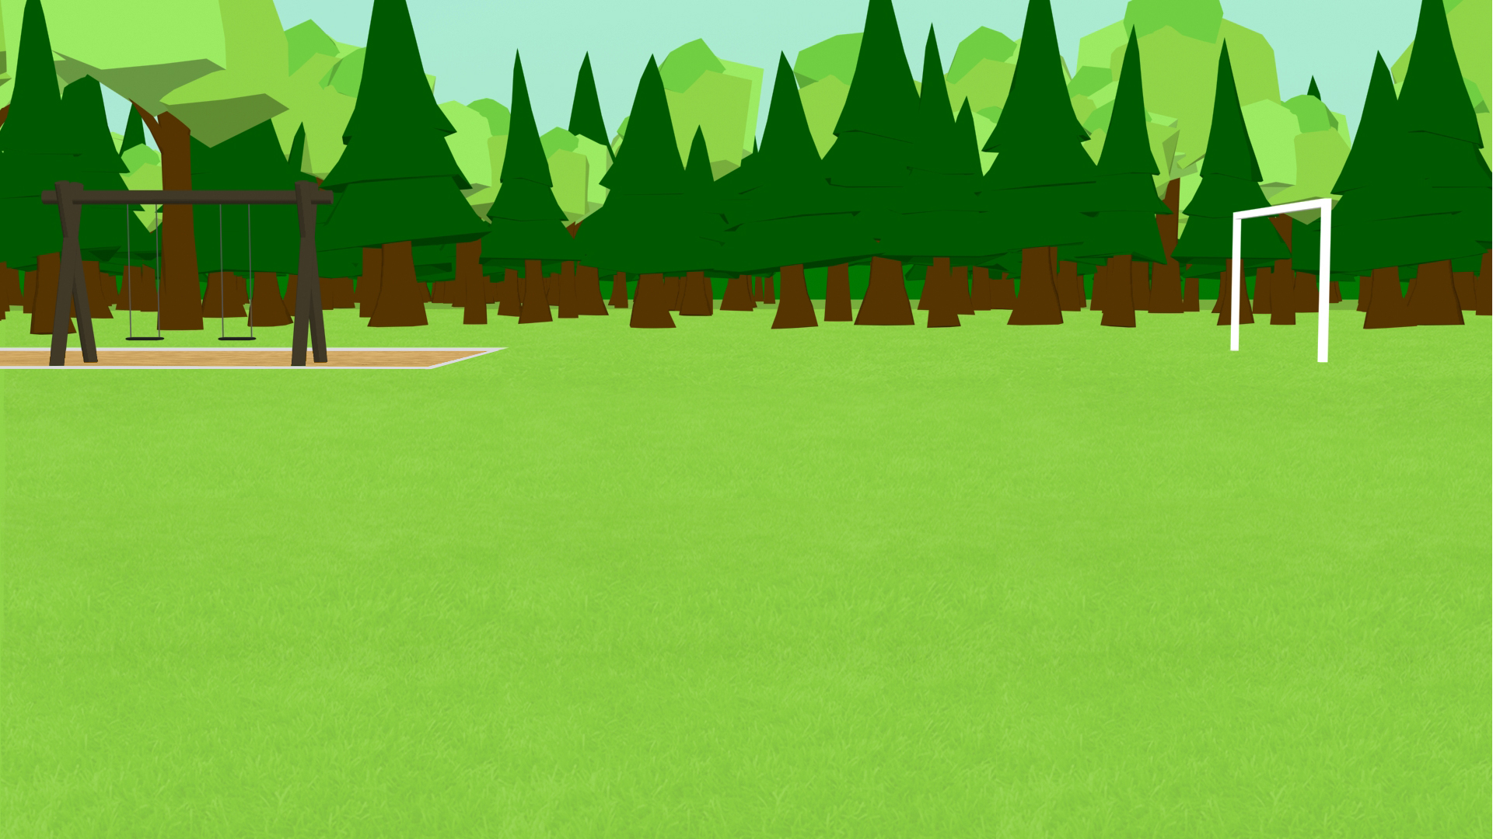
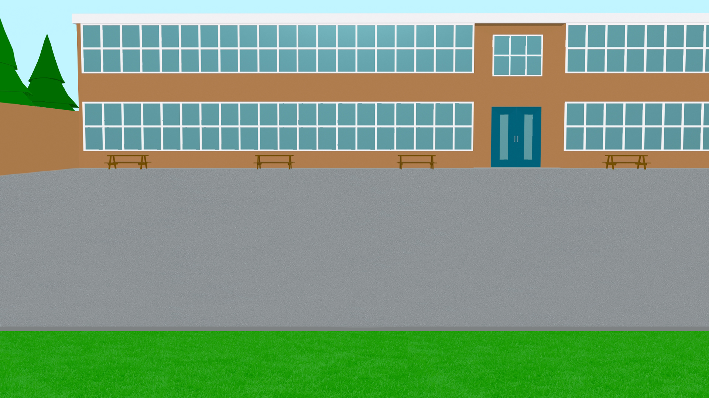
Actividades con compañeros de clase
Talking about what people can do Using modal verb ‘poder’
SSC [u]
Y7 Spanish Term 2.2 - Week 2 - Lesson 42 Amanda Izquierdo / Nick Avery Artwork: Mark Davies Date updated: 16.04.24
Notes:
All pictures selected are available under a Creative Commons license, no attribution required.
Note: all words (new and revisited) in this week of the SOW appear on all three GCSE wordlists, with the following exception:
i) AQA list does not have material Artwork by Mark Davies. All additional pictures selected are available under a Creative Commons license, no attribution required.
Learning outcomes (lesson 1):
Consolidation of SSC [u]
Introduction of PODER in singular persons (puedo, puedes, puede) and its use in negative statements
Word frequency (1 is the most frequent word in Spanish):
7.2.2.2 (introduce) poder [32]; puedo; puedes; puede; jugar [356]; participar [593]; preguntar [220]; pedir [218], material [690]; cambiar [256]; favor [517]; compañero/a [551]; ¿puedo ir a los servicios?
7.2.1.4 (revisit) ¿cuándo? [57]; ¿cuánto? [580]; ¿cuál? [445]; hacer [26]; hago; haces; hace; deporte [1489]; deberes [2187]; actividad [344]; dibujo [1726]; noche [164]; tarde [392]; mañana [402]; para [16]
7.1.2.6 (revisit) pueblo [244]; equipo [373]; trabajo [152]; edificio [857]; plato [1808]; familia [233]; película [543]; vista [408]; isla [810]; grande [66]; interesante [616]; de [2]
Source: Davies, M. & Davies, K. (2018). A frequency dictionary of Spanish: Core vocabulary for learners (2nd ed.). Routledge: London
The frequency rankings for words that occur in this PowerPoint which have been previously introduced in NCELP resources are given in the NCELP SOW and in the resources that first introduced and formally re-visited those words.
For any other words that occur incidentally in this PowerPoint, frequency rankings will be provided in the notes field wherever possible.

Slide 26
Inicio
hablar / escuchar
 | Español | Inglés
1 | poder | can, to be able to
2 | puedo | I can, I am able to
3 | puedes | you can, you are able to
4 | puede | s/he can, s/he is able to
5 | participar | to participate, participating
6 | preguntar | to ask, asking
7 | pedir | to ask for, asking for
8 | jugar | to play (e.g. a game), playing
9 | el material | material
10 | cambiar | to change, changing
11 | el favor | favour
60
Asking a question? Use “preguntar”
Segundos
Asking for something? Use “pedir”
0
INICIO
Notes:
Starter activity to settle students on arrival. Timing: 3 minutes
Aim: to practise vocabulary introduced this week.
Procedure:
Students either work by themselves or in pairs, reading out the words and recapping their English meaning (1 minute).
Then the English meanings are removed and they try to recall them, looking at the Spanish (1 minute).
Then the Spanish meanings are removed and they to recall them, looking at the English (1 minute)
Further rounds of learning can be facilitated by one student turning away from the board, and his/her partner asking him/her the meanings. This activity can work from L2 → L1 or L1 → L2.
Note: This lesson will also present; compañero [551]; ¿puedo ir a los servicios?

Slide 27
Persona A
✄
Persona B
Mi ciudad es interesante y bonita. Hay tiendas, un mercado, un museo, una iglesia y dos bancos. También tiene naturaleza: hay un río entre árboles muy verdes. Mi _sc_ _la es m_y b_en_, p_ed_ p_rtic_par en d_p_rt_s en gr_p_ y t_mbién p_ _d_ _st_diar c_ _nc_a y _rt_. P_ _d_ camin_r a l_ _sc_el_ o ir _n b_c_clet_ p_rqu_ _stá c_rca.
M_ c_ _dad es int_resant_ y b_nit_. H_y t_ _ndas, un m_rc_d_, un m_s_ _, una igl_s_ _ y dos b_nc_s. T_mb_én t_ _n_ n_t_ral_za: hay un rí_ _ntr_ árb_l_s m_y v_rd_s. Mi escuela es muy buena, puedo participar en deportes en grupo y también puedo estudiar ciencia y arte. Puedo caminar a la escuela o ir en bicicleta porque está cerca.
- - - - - - - - - - - - - - - - - - - - - - - - - - - - - - - - - - - - - - - - - - - - - - - - - - - - - - - - - - - - - - - - - - - - - - - - - - - - - - - - - -
- - - - - - - - - - - - - - - - - - - - - - - - - - - - - - -
Persona A
Persona B
Mi ciudad es interesante y bonita. Hay tiendas, un mercado, un museo, una iglesia y dos bancos. También tiene naturaleza: hay un río entre árboles muy verdes. Mi _sc_ _la es m_y b_en_, p_ed_ p_rtic_par en d_p_rt_s en gr_p_ y t_mbién p_ _d_ _st_diar c_ _nc_a y _rt_. P_ _d_ camin_r a l_ _sc_el_ o ir _n b_c_clet_ p_rqu_ _stá c_rca.
M_ c_ _dad es int_resant_ y b_nit_. H_y t_ _ndas, un m_rc_d_, un m_s_ _, una igl_s_ _ y dos b_nc_s. T_mb_én t_ _n_ n_t_ral_za: hay un rí_ _ntr_ árb_l_s m_y v_rd_s. Mi escuela es muy buena, puedo participar en deportes en grupo y también puedo estudiar ciencia y arte. Puedo caminar a la escuela o ir en bicicleta porque está cerca.
Notes:
HANDOUT

Slide 28
¿A, e, i, o, u?
hablar / escuchar / escribir
Persona A
✄
Persona B
Mi ciudad es interesante y bonita. Hay tiendas, un mercado, un museo, una iglesia y dos bancos. También tiene naturaleza: hay un río entre árboles muy verdes. Mi _sc_ _la es m_y b_en_, p_ed_ p_rtic_par en d_p_rt_s en gr_p_ y t_mbién p_ _d_ _st_diar c_ _nc_a y _rt_. P_ _d_ camin_r a l_ _sc_el_ o ir _n b_c_clet_ p_rqu_ _stá c_rca.
M_ c_ _dad es int_resant_ y b_nit_. H_y t_ _ndas, un m_rc_d_, un m_s_ _, una igl_s_ _ y dos b_nc_s. T_mb_én t_ _n_ n_t_ral_za: hay un rí_ _ntr_ árb_l_s m_y v_rd_s. Mi escuela es muy buena, puedo participar en deportes en grupo y también puedo estudiar ciencia y arte. Puedo caminar a la escuela o ir en bicicleta porque está cerca.
- - - - - - - - - - - - - - - - - - - - - - - - - - - - - - -
Notes:
Do not display during the activity. Timing: 5 minutes
Aim: To revisit SSCs [a], [e], [i], [o], [u].
Procedure:
Student A reads out the text to their partner .
Students B listens out for the missing vowels and fills in the gaps.
Notes:
Some students might be able to complete some of the words on their own (i.e. from memory of how the word is spelled, and using the context), but most will need the input from their partner reading the full text aloud to be able to complete all the words.
More vowels can be deleted to make it more challenging, depending on the level of the group.
All the vocabulary used here has been seen in previously taught vocabulary sets or phonics practice, and words have also been included from the sets of words to be revisited during this week. Also, the form “puedo” has been purposely used to allow an opportunity for teachers to focus students on this verb, which was taught in lesson 1.

Slide 29
Vocabulario
¿cuál?
el deporte
el dibujo
para
¿cuándo?
¿cuánto?
los deberes
la tarde
J
N
homework
L
How much? How many?
sport
Q
Which?
M
for
A
drawing
P
When?
K
afternoon/evening
Notes:
OPTIONAL – OMIT THIS ACTIVITY IF NECESSARY TO ENSURE YOU HAVE TIME FOR THE SPEAKING. Timing: 5 minutes
Aim: to revise vocabulary from one of this week’s revisited sets (2.1.4)
Procedure:
Teacher elicits the vocabulary from students by asking questions. Suggested routine:
Teacher: ¿Qué es ‘K’? Students: el dibujo Teacher: ¿Qué es ‘M’? Students: ¿cuándo?
2. Teacher clicks on the letter to trigger the lines to connect the word to the English translation.
Notes:
This means that students are practising their understanding of another set of alphabet letters at the same time.
The teacher chooses which order to ask the letters in – clearly, it would be easy to ask in alphabetical order, but this would be what students would naturally expect, so it reduces the need for them to listen attentively to them.

Slide 30
Vocabulario
jugar
preguntar
participar
cambiar
pedir
puede
favour
el favor
el compañero
el material
en clase
Notes:
[1/10]
Timing: 5 minutes.
Aim: to recap of vocabulary seen last lesson; to introduce a new word this week.
Procedure:
1. Students read the word in English in the centre of the slide and say the equivalent word in Spanish.
Notes:
The new word compañero [551] will be the last one to appear.
Each word is crossed out every time it has been said in order to facilitate introduction of the new word at the end of the activity.

Slide 31
Vocabulario
jugar
preguntar
participar
cambiar
pedir
to change
puede
el favor
el compañero
el material
en clase
Notes:
[2/10]

Slide 32
Vocabulario
jugar
preguntar
participar
cambiar
pedir
puede
to play
el favor
el compañero
el material
en clase
Notes:
[3/10]

Slide 33
Vocabulario
jugar
preguntar
participar
cambiar
pedir
in class
puede
el favor
el compañero
el material
en clase
Notes:
[4/10]

Slide 34
Vocabulario
jugar
preguntar
participar
cambiar
pedir
to ask
puede
el favor
el compañero
el material
en clase
Notes:
[5/10]

Slide 35
Vocabulario
jugar
preguntar
participar
cambiar
pedir
puede
to ask for
el favor
el compañero
el material
en clase
Notes:
[6/10]

Slide 36
Vocabulario
jugar
preguntar
participar
cambiar
pedir
puede
material
el favor
el compañero
el material
en clase
Notes:
[7/10]

Slide 37
Vocabulario
jugar
preguntar
participar
cambiar
pedir
to participate
puede
el favor
el compañero
el material
en clase
Notes:
[8/10]

Slide 38
Vocabulario
jugar
preguntar
participar
cambiar
pedir
puede
s/he can
el favor
el compañero
el material
en clase
Notes:
[9/10]

Slide 39
Vocabulario
jugar
preguntar
el compañero = classmate (boy)
la compañera = classmate (girl)
participar
cambiar
pedir
puede
classmate
el favor
el compañero
el material
en clase
Notes:
[10/10]

Slide 40
Vocabulario (1/2)
escribir
participar
preguntar
pedir
to participate
to ask
to ask for
cambiar
jugar
poder
to change
to play
to be able to, can
Notes:
NB: it’s important for students to try to produce the words in writing as well as speaking, and also for them to try to produce them from memory, even if this is a challenge. High challenge, low risk – teachers need to tell students that trying to write words from memory is a learning (not a testing) activity - it’s like training the memory like a muscle, through repeated practice - and that it’s fine not to be able to produce them all at this stage in their learning. Timing: 5 minutes (two slides)
Aim: to practise vocabulary introduced this week.
Procedure: 1. Students write the 6 words. 2. Teachers elicit answers and click to reveal.

Slide 41
Vocabulario (2/2)
leer / hablar
poder
puedo
puedes
to be able to, can
I can
you can
puede
el material
el favor
she/he can
Notes:
2/2 Note that the infinitive ‘poder’ is repeated (deliberately), here.

Slide 42
‘Poder’ used for requests
gramática
Use poder for making requests and asking permission:
¿Puedes llevar el regalo a la chica?
Can you take the gift to the girl?
¿Puedes comprar el periódico?
Can you buy the newspaper?
¿Puedo usar el teléfono?
Can I use the phone?
¿Puedo ir a los servicios?
Can I go to the toilet?
Notes:
Timing: 2 minutes
Aim: to recap of the verb ‘poder’; to contrast the forms ‘puedes’ and ‘puedo’, pointing out the use of these forms for requests and for asking permission.
Procedure:
Go through the grammar explanation with students, revealing each new sentence on a mouse click.

Slide 43
La profesora pregunta en clase. Lee y marca la opción correcta. ¿Las frases son verdaderas o falsas?
leer
 | The teacher asks... | V | F
1 | Can you change the activity?
2 | Can you ask where the material is?
3 | Can s/he ask for a drawing?
4 | Can s/he do the homework in the morning?
5 | Can you participate with the classmates?
6 | Can you work in a team?
¿Puedes cambiar la actividad?
¿Puede preguntar dónde está el material?
1
2
¿Puedes pedir un dibujo?
¿Puede hacer los deberes por la mañana?
3
4
¿Puede participar con los compañeros?
¿Puedes trabajar en un equipo?
5
6
Notes:
Timing: 7 minutes
Aim: to differentiate between ‘puedes’ and ‘puede’ in requests ('Can you...?’ and 'Can s/he...?’)
Procedure:
Students read the speech bubbles.
Students read the sentences in English and decide whether they are true or false.
During feedback, the teacher can elicit the form of the verb needed if the English statement is false. This will reinforce the connection between the verb ending and the person referred to.
Note:
Students need to focus on the verb ending, which is the only element that could make the question true or false.
The teacher can remove all the item numbers and change the order of the questions in the chart to make it more challenging. This way, students first have to search for the speech bubble with the vocabulary mentioned in the question.

Slide 44
escuchar
La profesora está en clase
Escucha las preguntas.
escuchar
Who is talking, the teacher (¿puedes…?) or the student (¿puedo…?).
Completa la tabla en inglés.
 | The teacher “Can you…?” | The student “Can I…?”
The teacher
(“Can you… ?”)
The student
(“Can I…?”)
1
speak to the headteacher
use the dictionary
2
change the word
do the homework with a classmate
3
4
take the book
to the classroom
go to the toilet
5
6
Notes:
Timing: 8 minutes
Aim: to understand the difference in meaning between ‘puedo’ and ‘puedes’, as used in an oral request
Procedure:
Students listen to the requests and tick the first column ‘Can you’, if they hear ‘puedes’ and the second column, ‘Can I’, if they hear ‘puedo’.
Students listen again and complete the table in English. They will need to write the rest of the sentence in English in the correct column.
Transcript
1) ¿Puedes hablar con el director?
2) ¿Puedes cambiar la palabra?
3) ¿Puedo usar un diccionario?
4) ¿Puedes llevar el libro a la clase?
5) ¿Puedo hacer los deberes con un compañero?
6) ¿Puedo ir a los servicios?

Slide 45
Una excursion al campo
hablar / escuchar
Escucha a tu compañero/compañera.
¿ Es “puedes” (you can) or “puede” (s/he can)?
Escribe la actividad en inglés.
Un ejemplo:
Puedes llevar la cámara.
Persona A (habla):
Lee la tarea.
1 - Puedes llevar la cámara.
Persona B (escucha, escribe):
 | You can | S/he can | Escribe la frase en inglés.
1 |  |  | You can carry/take the camera.

Slide 46
Persona A
hablar / escuchar
Lee las tareas.
1 - Puedes preparar la comida.
2 - Puede comprar cosas.
3 – Puedes jugar con el caballo.
Persona B
 | You can | S/he can | Escribe la frase en inglés.
1
2
3
Notes:
DO NOT DISPLAY DURING ACTIVITY TO AVOID PRINTING, PARTNER B TURNS AWAY FROM THE BOARD.
Person A speaking cards/listening grid
Student A:
Puedes preparar la comida.
Puede comprar cosas.
Puedes jugar con el caballo.

Slide 47
Persona B
hablar / escuchar
Lee las tareas
1 – Puede hacer un plan.
2 – Puede pedir ayuda.
3 - Puedes preguntar dónde está el norte.
Persona A
 | You can | S/he can | Escribe la frase en inglés.
1
2
3
Notes:
DO NOT DISPLAY DURING ACTIVITY
TO AVOID PRINTING, PARTNER A TURNS AWAY FROM THE BOARD.
Person B speaking cards/listening grid
Student B:
Puede hacer un plan.
Puede pedir ayuda.
Puedes llevar preguntar dónde está el norte.

Slide 48
Respuestas
hablar / escuchar
Lee las tareas.
1 - Puedes preparar la comida.
2 - Puede comprar cosas.
3 – Puedes jugar con el caballo.
Persona B
 | You can | S/he can | Escribe la frase en inglés.
1 |  |  | prepare the food
2 |  |  | buy things
3 |  |  | play with the horse
Notes:
ANSWERS – Not animated
Person B’s answers
Student A:
Puedes preparar la comida.
Puede comprar cosas.
Puedes jugar con el caballo.

Slide 49
Persona B
hablar / escuchar
Lee las tareas
1 – Puede hacer un plan.
2 – Puede pedir ayuda.
3 - Puedes preguntar dónde está el norte.
Persona A
 | You can | S/he can | Escribe la frase en inglés.
1 |  |  | make a plan
2 |  |  | ask for help
3 |  |  | ask where the north is
Notes:
ANSWERS – Not animated
Person A’s answers
Student B:
Puede hacer un plan.
Puede pedir ayuda.
Puedes llevar preguntar dónde está el norte.

Slide 50
Deberes
New vocabulary for 7.2.2.3:
Audio file
Student worksheet
In addition, revisit: Term 1.2.7
Notes:
Use this slide to set the homework.
For Y7, the typical homework will be to pre-learn vocabulary for the next lesson. There is an audio file to accompany the student worksheet.
Notes:
i) Teachers may, in addition, want to recommend use of a particular online app for the pre-learning of each week’s words. ii) Quizlet now requires parental involvement / registration / permissions for users below the age of 13, so it is perhaps most suitable for Y9 – 11 students. iii) Language Nut hosts LDP vocabulary lists and these are free for schools to use, though there is a registration process. One benefit is that all of the student tracking data that Language Nut offers are also available to schools that use the LDP lists for practice. Perhaps this makes it a good option for Y7/8.
iv) There are other free apps, and new ones are always appearing. Teachers have told us that they are currently using: Flippity, Wordwall (where using previously-created activities is free).
v) Gaming Grammar has been acquired by Language Nut. Its original content should still be available to teachers and much of it is appropriate for Y7 learners. Verbs (present): 1st person singular/plural in the ‘Verb agreement (present)’ menu practices aspects of this week’s lessons.

Slide 51
Persona A
Persona A
Persona A
When asked, say your friend can ( ) or can’t ( )do the following:
Ask your partner if his/her friend can…
(Tick the things s/he can do and cross out what s/he can’t do):
[arrive home late]
[buy expensive products]
[walk to the city]
[walk to school]
[have animals at home]
[study English]
[work with animals]
[use the phone in school]
[participate in the theatre]
[speak in English with friends]
[study science]
[play in the square]
Notes:
SPEAKING ACTIVITY FROM LESSON1 – WITH PRESCRIBED ANSWERS (REQUIRES PRINTING)
DO NOT DISPLAY
Answers:
caminar a la escuela
tener animales en casa
estudiar inglés
trabajar con animales
usar el teléfono en la escuela
participar en el teatro
estudiar ciencias
caminar a la ciudad
hablar en inglés con amigos
jugar en la plaza
comprar productos caros
llegar tarde a casa / llegar tarde a casa

Slide 52
Persona B
Persona B
Persona B
When asked, say your friend can ( ) or can’t ( )do the following:
Ask your partner if his/her friend can…
(Tick the things s/he can do and cross out what s/he can’t do):
[study science]
[walk to the city]
[speak in English with friends]
[participate in the theatre]
[use a phone in school]
[study English]
[play in the square]
[buy expensive products]
[arrive home late]
[walk to school]
[work with animals]
[have animals at home]
Notes:
DO NOT DISPLAY
Answers:
estudiar ciencias
caminar a la ciudad
hablar en inglés con amigos
jugar en la plaza
Comprar productos caros
llegar tarde a casa / llegar tarde a casa
participar en el teatro
usar el telefóno en la escuela
estudiar inglés
caminar a la escuela
trabajar con animales
Tener animales en casa

Slide 53
Persona A
Persona A
Persona A
When asked, say your friend can ( ) or can’t ( )do the following:
Ask your partner if his/her friend can…
(Tick the things s/he can do and cross out what s/he can’t do):
[arrive home late]
[buy expensive products]
[walk to the city]
[walk to school]
[have animals at home]
[study English]
[work with animals]
[use the phone in school]
[participate in the theatre]
[speak in English with friends]
[study science]
[play in the square]
Notes:
ANSWER KEY - DO NOT DISPLAY DURING ACTIVITY

Slide 54
Persona B
Persona B
Persona B
When asked, say your friend can ( ) or can’t ( )do the following:
Ask your partner if his/her friend can…
(Tick the things s/he can do and cross out what s/he can’t do):
[study science]
[walk to the city]
[speak in English with friends]
[participate in the theatre]
[use a phone in school]
[study English]
[play in the square]
[buy expensive products]
[arrive home late]
[work with animals]
[walk to school]
[have animals at home]
Notes:
ANSWER KEY - DO NOT DISPLAY DURING ACTIVITY

