Slide 1
Actividades con familia y amigos
Talking about what we do Present tense -ar verbs: 1st person plural (-amos)
SSCs [e],[i]
Y7 Spanish Term 2.2 - Week 1- Lesson 39 Ivan Luciano Avaca / Nick Avery Artwork: Mark Davies Date updated: 22.03.24
Notes:
All pictures selected are available under a Creative Commons license, no attribution required.
Note: all words (new and revisited) in this week of the SOW appear on all three GCSE wordlists, with the following exception:
i) Edexcel list does not have respuesta, iglesia. Artwork by Mark Davies. All additional pictures selected are available under a Creative Commons license, no attribution required.
Learning outcomes (lesson 1):
Consolidation of SSCs [e], [i]
Introduction and practice of present tense –ar verbs in 1st person plural (-amos ending).
Word frequency (1 is the most frequent word in Spanish):
7.2.2.1 (introduce) trabajar [174]; buscar [179]; descansar [1749]; preparar [570]; comida [906]; animal [322]; pasar [68]; tiempo [80]; campo [342]; junto[s] [149]; solo [181]
7.2.1.3 (revisit) naturaleza [712]; árbol [748]; pájaro [1607]; río [496]; rojo [534]; amarillo [1381]; verde [812]; azul [811]; lugar [144]; sólo [95]
7.1.2.5 (revisit) museo [1114]; banco [728]; teatro [605]; centro [316]; mercado [487]; tienda [1515]; plaza [806]; iglesia [437]; escuela [424]; ciudad [178]; entre [63]; el, la [1]; lejos [833]; cerca [1042]; respuesta [488]
Source: Davies, M. & Davies, K. (2018). A frequency dictionary of Spanish: Core vocabulary for learners (2nd ed.). Routledge: London
The frequency rankings for words that occur in this PowerPoint which have been previously introduced in LDP resources are given in the LDP SOW and in the resources that first introduced and formally re-visited those words.
For any other words that occur incidentally in this PowerPoint, frequency rankings will be provided in the notes field wherever possible.

Slide 2
Inicio
Work out the missing letter in each words 1-11 and then the secret word.
1 | 2 | 3 | 4 | 5 | 6 | 7 | 8 | 9 | 10 | 11
 |  |  |  |  |  | m
a |  |  |  |  |  | e |  | c
n |  |  |  |  |  | r |  | o | m
i | e | e |  |  |  | c |  | m | u | p
m | s | n | t |  | r | a | c | i | s | a
a | c | t | i | v | i | d | a | d | e | s
l | u | r | e | e | o | o | m | a | o | a
 | e | e | m | r |  |  | p |  |  | r
 | l |  | p | d |  |  | o
 | a |  | o | e
1. animal
2. school
3. between
4. time
5. green
6. river
7. market
8. countryside
9. food
10. museum
11. to spend (time)
Notes:
Starter activity to settle students on arrival. Timing: 5 minutes
Aim: to practise recognition of new and revisited vocabulary for this week.
Procedure:
1. Students write 1-11 and the missing letter from each word (no need to write all words in full) 2. The 11 missing letters spell ‘Actividades’. Students should write this word and the English meaning and then put their hand up in silence. 3. When all students have had time to start the activity (they may not finish, if their arrival is staggered), s/he elicits feedback and reveals the missing letters one by one. The word ‘actividades’ is key to the theme of this week’s lessons. Note: for higher proficiency learners, either remove the English completely or in a mixed proficiency class, challenge some students not to look at the English.

Slide 3
e
papel
en
espalda
tener
elefante
[to have]
estar
[to be]
Notes:
Timing: 2 minutes (two slides)
Aim: to revisit two SSC.
Procedure:
1. Elicit the pronunciation of the individual SSC ‘e’ and then the source word again (with gesture, if using). 2. Then elicit the pronunciation of the five cluster words. 3. Move to the next slide.
The cluster words have been chosen for their high-frequency, from a range of word classes, with the SSC (where possible) positioned within a variety of syllables within the words(e.g. initial, 2nd, final etc..) and additionally, we have tried to use words that build cumulatively on previously taught SSCs (see the Phonics Teaching Sequence document) and do not include new SSCs. Where new SSCs are used, they are often consonants which have a similar symbol-sound correspondence in English.
Word frequency rankings: elefante [>5000]; papel [393]; espalda [942]; estar [21]; en [5]; tener [19] Source: Davies, M. & Davies, K. (2018). A Frequency Dictionary of Spanish: Core vocabulary for learners (2nd ed.) London: Routledge.

Slide 4
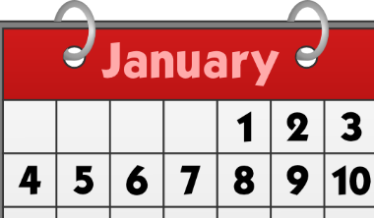
i
lista
ir
idea
interesante
sin
primero
Sin ketchup
Nick Avery
Notes:
Procedure:
1. Elicit the pronunciation of the individual SSC ‘i’ and then the source word again (with gesture, if using). 2. Then elicit the pronunciation of the five cluster words. The cluster words have been chosen for their high-frequency, from a range of word classes, with the SSC (where possible) positioned within a variety of syllables within the words(e.g. initial, 2nd, final etc..) and additionally, we have tried to use words that build cumulatively on previously taught SSCs (see the Phonics Teaching Sequence document) and do not include new SSCs. Where new SSCs are used, they are often consonants which have a similar symbol-sound correspondence in English.

Slide 5
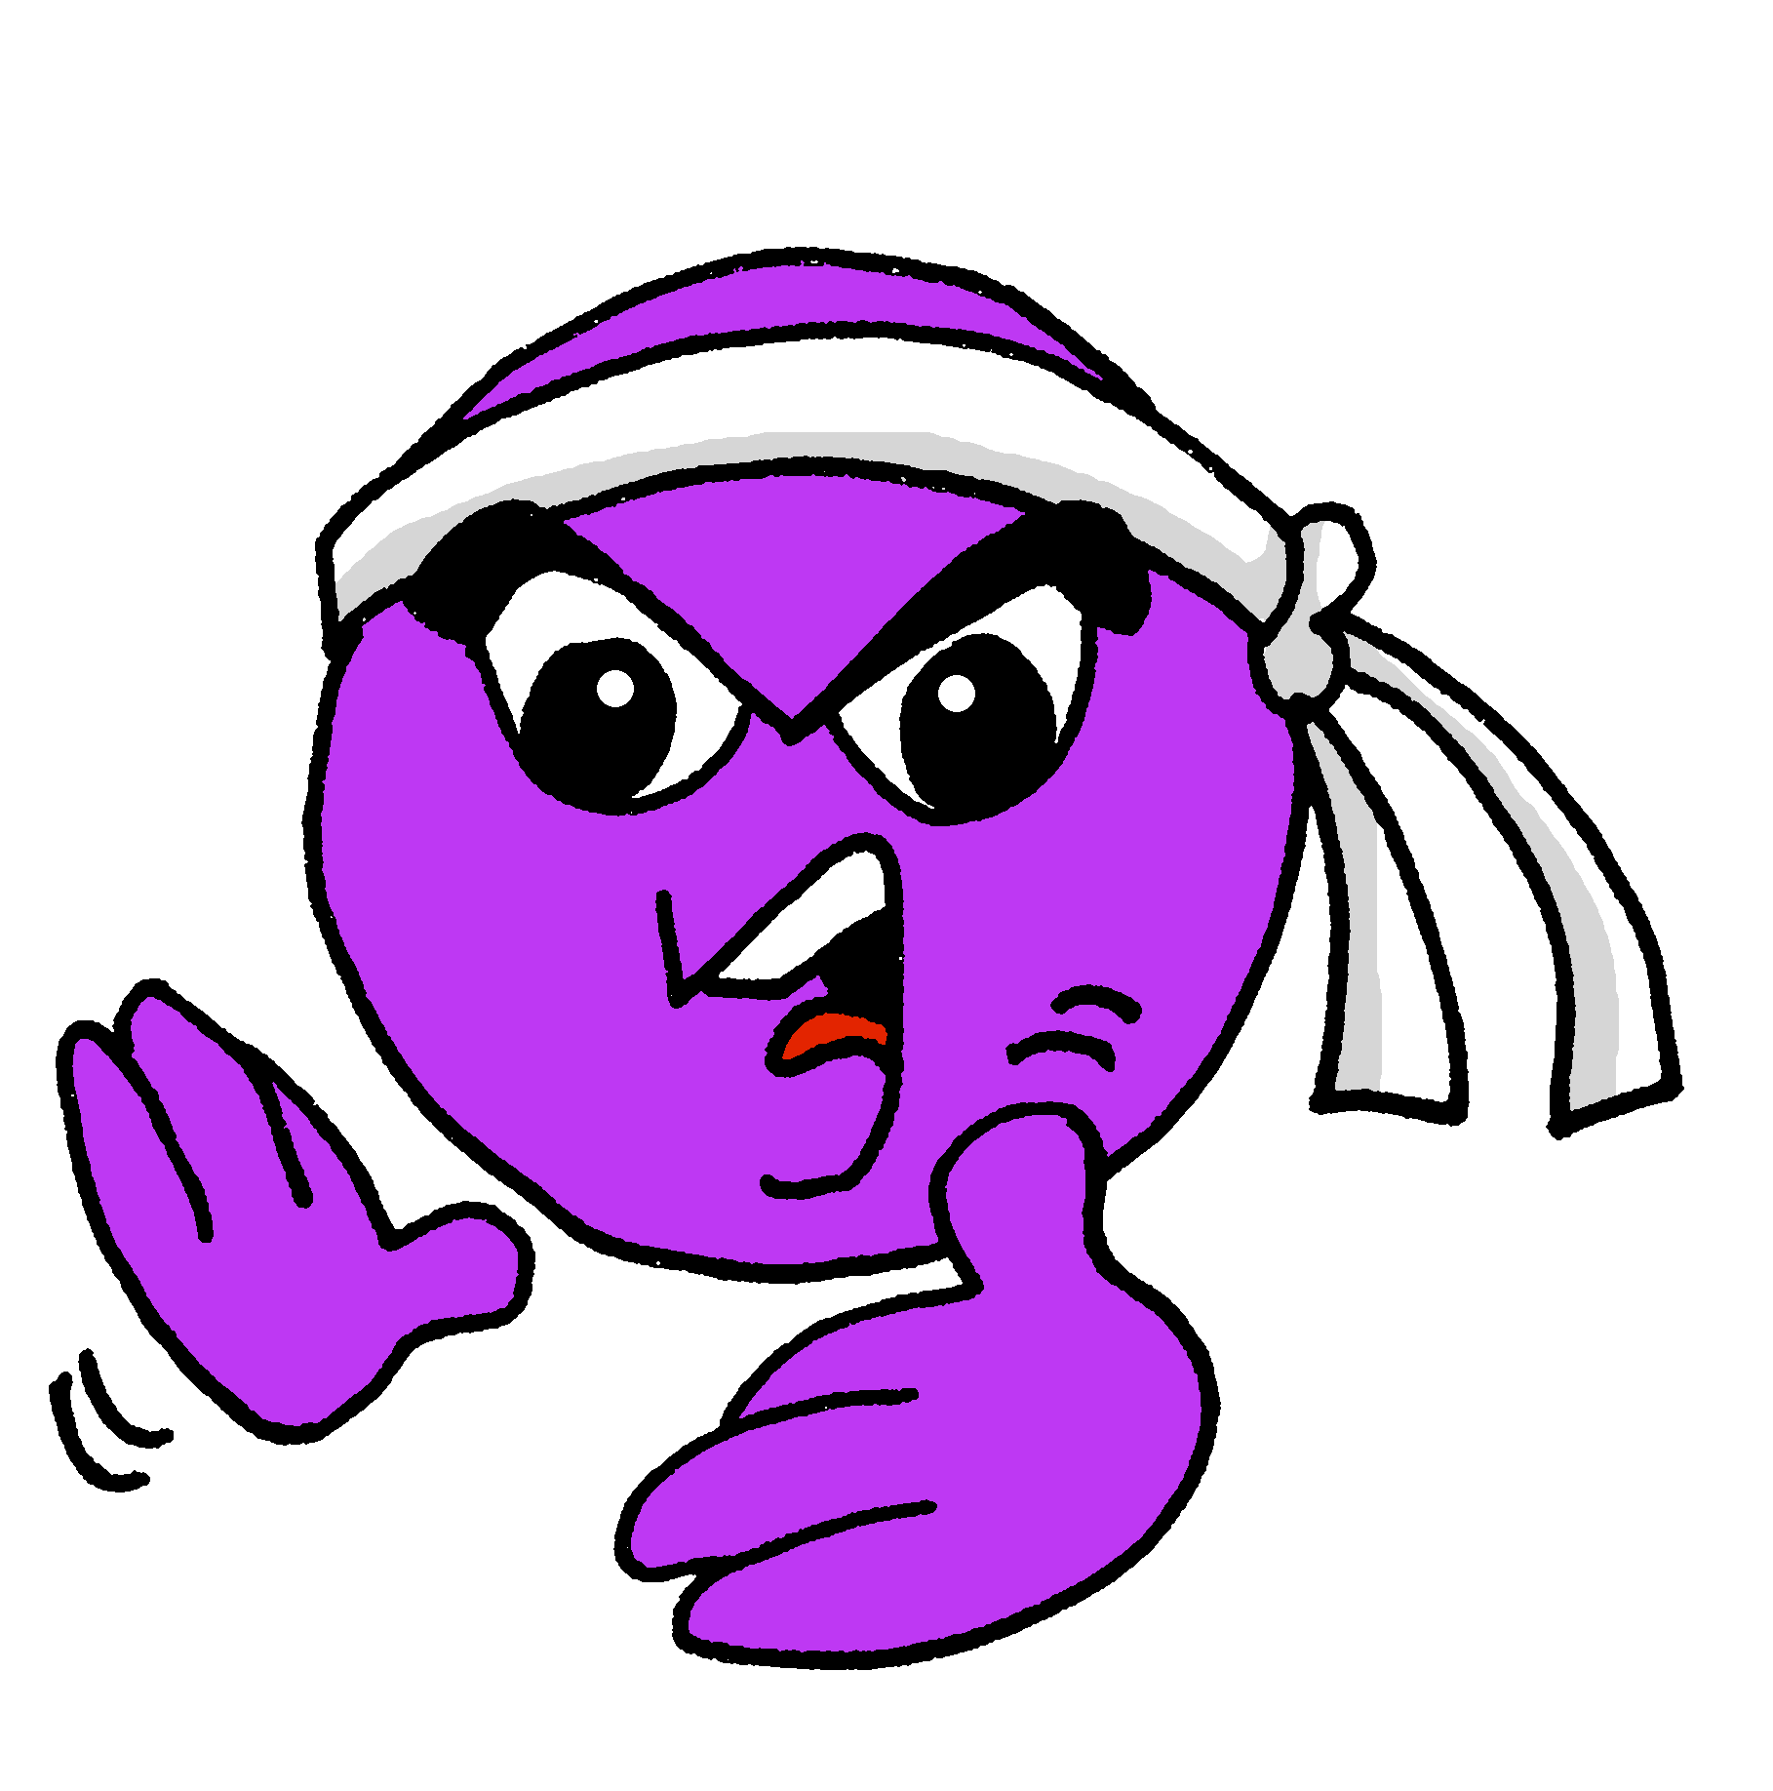
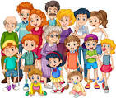
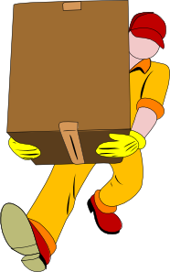
Vocabulario
Escucha. Escribe la letra correcta.
escuchar
Escucha otra vez. Escribe la palabra. ¿E o I?
A
B
C
D
E
F
G
H
Letra
[active]
[family]
1
F
camisa
2
D
naturaleza
[to wear, to carry]
[shirt]
3
E
activo
4
B
llevar
5
G
entre
[cousin]
[between]
6
A
familia
7
H
mirar
[nature]
[to look, looking]
8
C
primo
Notes:
Timing: 10 minutes
Aim: Listening exercise practising vocabulary recognition, but also phonemic distinction between ‘e’ and ‘i’ and some transcription.
Procedure:
Students write 1-8 in their books. Teachers click the number buttons to play the recording, and students write down the letter corresponding to the Spanish word that they heard.
Teachers then click to show the answers one by one.
Listen again and write the word. Click to correct.
Transcript:
1. camisa
2. naturaleza
3. activo
4. llevar
5. entre
6. familia
7. mirar
8. primo

Slide 6
Vocabulario
hablar
I
J
K
L
M | M | O | P
preparar | (el) árbol | trabajar | (el) tiempo
(el) mercado | (la) iglesia | junto(s) | (la) comida
pasar | (el) campo | (el) animal | (el) río
solo | buscar | (la) tienda | descansar
Notes:
Timing: 5 minutes Aim: to reactivate and strengthen vocabulary knowledge of this week’s new vocab and a few previously taught words; to revisit letters of the alphabet Procedure: 1. Teacher gives co-ordinates using Spanish alphabet letters. E.g., I M – ¿qué palabra es (en español / inglés)?
2. Students respond by either reading aloud the Spanish word and/or by giving the English meaning. E.g., preparar - to prepare, preparing
NB: The teacher can extend questioning here, depending on the proficiency of the class – e.g. prompting for phrases ¿Cómo se dice…(work in the market)? or asking students to suggest infinitive + noun combinations for other students to translate.

Slide 7
Vocabulario
leer / hablar
60
 | Word | English meaning
1 | trabajar | to work, working
2 | buscar | to look for, looking for
3 | el tiempo | time
4 | la comida | food
5 | pasar | to pass, to spend (time)
6 | el campo | countryside
7 | junto[s], junta[s] | together
8 | preparar | to prepare, preparing
9 | el animal | animal
10 | descansar | to rest, resting
11 | solo, sola | alone
12 | llevar | to wear, to carry/take
‘Junto’ normally refers to more than one thing or person, so usually appears with an –s at the end (e.g., juntos, juntas).
Segundos
0
INICIO
Notes:
Timing: 6 minutes
Aim: to give students more time to practise the new vocabulary for this week
Procedure:
1. Pupils either work by themselves or in pairs, reading out the words and studying their English meaning (1 minute). 2.Then the English meanings are removed by clicking, and they try to recall them, looking at the Spanish. Teachers click on the ‘inicio’ button to start the timer, or use their own timing device (1 minute). 3. Then the Spanish meaning are removed by clicking and they to recall them, looking at the English (1 minute).
4. Further rounds of learning can be facilitated by one pupil turning away from the board, and his/her partner asking him/her the meanings. This activity can work from L2 → L1 or L1 → L2.
5. Clicking once more activates a short additional explanation to remind about the adjective ‘junto’ (and its agreement in number & gender with subject).

Slide 8
Saying what you do with other people -ar verbs in 1st person plural (present)
gramática
Present tense -ar verbs: 1st person plural (-amos)
Remember that present tense –ar verbs change depending on who the verb refers to.
Llego tarde.
I arrive late.
Llegamos tarde.
We arrive late.
To mean ‘we’ with an –ar verb, remove –ar and add –amos to the stem.
compr-
compramos
we buy
habl-
hablamos
we speak
Notes:
Timing: 2 minutes
Aim: to introduce the first person plural form of -ar verbs
Procedure:
1. Teachers click to show each new explanation sentence and example followed by translation
Notes:
The 1st person singular form is used for comparison with the new verb form (1st person plural). The 1st person singular form (-o ending) was introduced in term 1.1 week 7.

Slide 9
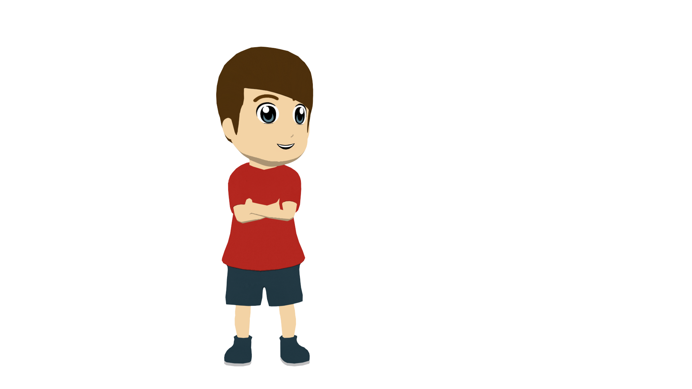
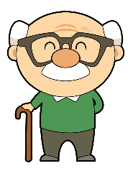
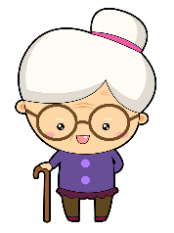
I or we?
Lee la frase y marca la imagen correcta.
¿Quién habla, solo Daniel (‘I’) o Daniel y otra persona (‘we’)?
leer
1. | A | B | busco una revista.
y
2. | A | B Mi primo y | no llevamos comida a la tienda.
3. | A | B | paso tiempo en casa.
y
4. | A | B | preparamos la comida.
y
Notes:
Timing: 3 minutes
Aim: To practise connecting with the first person singular and plural forms of -ar verbs with their meaning. NB: Use this short activity as a check for understanding. If students are secure with this, go straight on to the listening. If they need further reading practice, use the reading activity on slides at the end of this lesson.
Procedure:
Pupils need to identify the correct person (1st person singular or plural) by choosing the correct picture/word, writing either ‘A’ or ‘B’ in their exercise books or mini whiteboards.
Teachers click to show the answers.
Teachers can also elicit translations of the sentences from students.
Note: the use of subject pronouns like ‘yo’ will be taught as grammar features in the first term of year 8. The meaning of ‘yo’ might be learnt incidentally here (e.g. in item 2, ‘mi primo y yo’).

Slide 10
I or we?
escuchar
Escucha.
Marca ‘I’ o ‘WE’.
Talks about ‘I’
Talks about ‘we’
Escribe la frase en inglés.
1
No trabajamos.
We don’t work.
2
Preparo la comida.
I prepare the food.
3
Pasamos tiempo con animales.
We spend time with animals.
4
Hoy descansamos.
Today we rest.
5
Estudio en casa.
I study at home.
6
Hablamos inglés.
We speak English.
Notes:
Timing: 8 minutes
Aim: Listening exercise pairing the first person singular and plural of ‘ar’ verbs
Procedure:
Students write 1-7 in their exercise books. They will need to decide if the verb in the recording refers to ‘I’ or ‘we’ and tick the correct column. They should then write out the sentence in Spanish
Teachers click the number button to play the recording.
Teachers click to show the answers for each question individually.
After the last one has been corrected, teachers can ask students to translate the sentences. Clicking will show the answers.
Transcript:
No trabajamos.
Preparo la comida.
Pasamos tiempo con animales.
Hoy descansamos.
Estudio en casa.
Hablamos inglés.
Buscamos un profesor de arte.

Slide 11
¿Cómo se dice…?
leer/hablar
compro compramos prepare preparamos descanso descansamos paso pasamos llevo llevamos busco buscamos | una camisa comida una bolsa tiempo un animal | en casa en un museo en el centro en el campo en la ciudad con un amigo con una amiga con familia
Notes:
Timing: 5 minutes
Aim: to practise comprehension and read aloud of new and revisited language and grammar from this and previous weeks.
Procedure:
The teacher cues students in English: ¿Cómo se dice ‘We rest at home’.
Students volunteer answers, either individually or chorally. (Alternatively, they can write them on mini whiteboards).

Slide 12
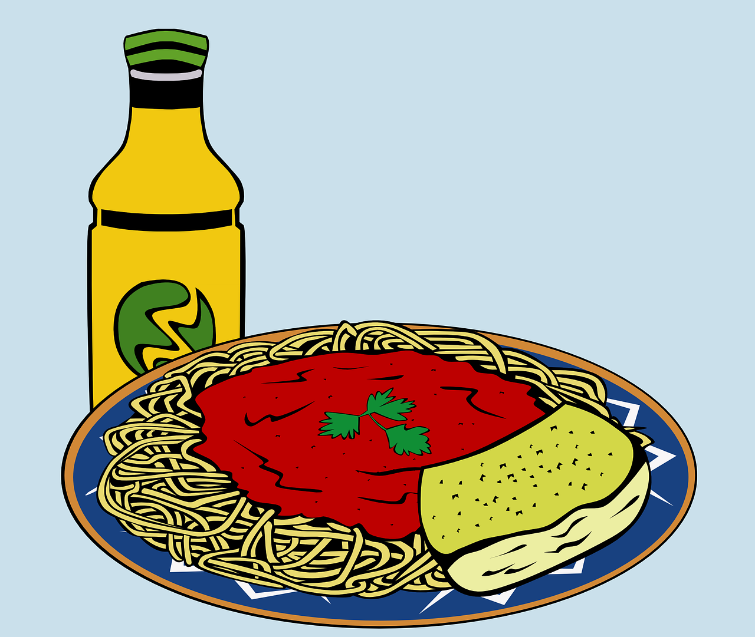
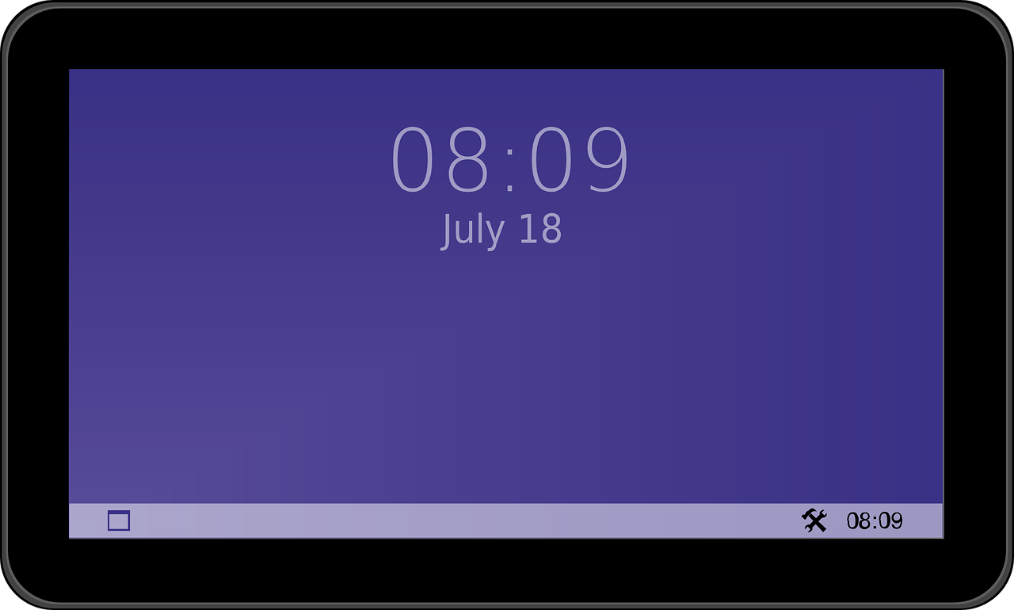
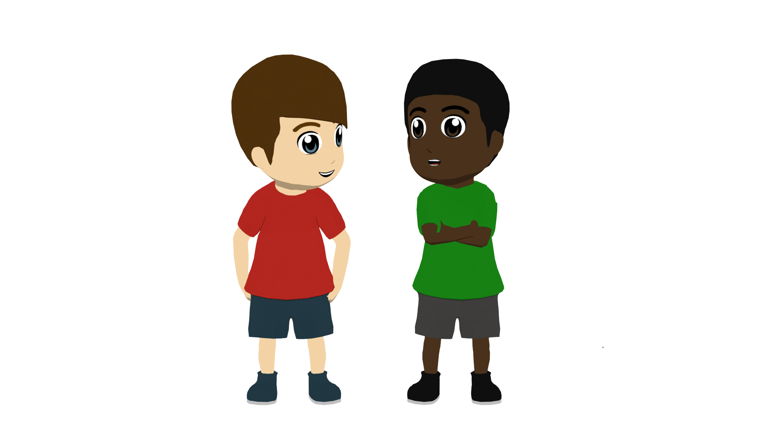
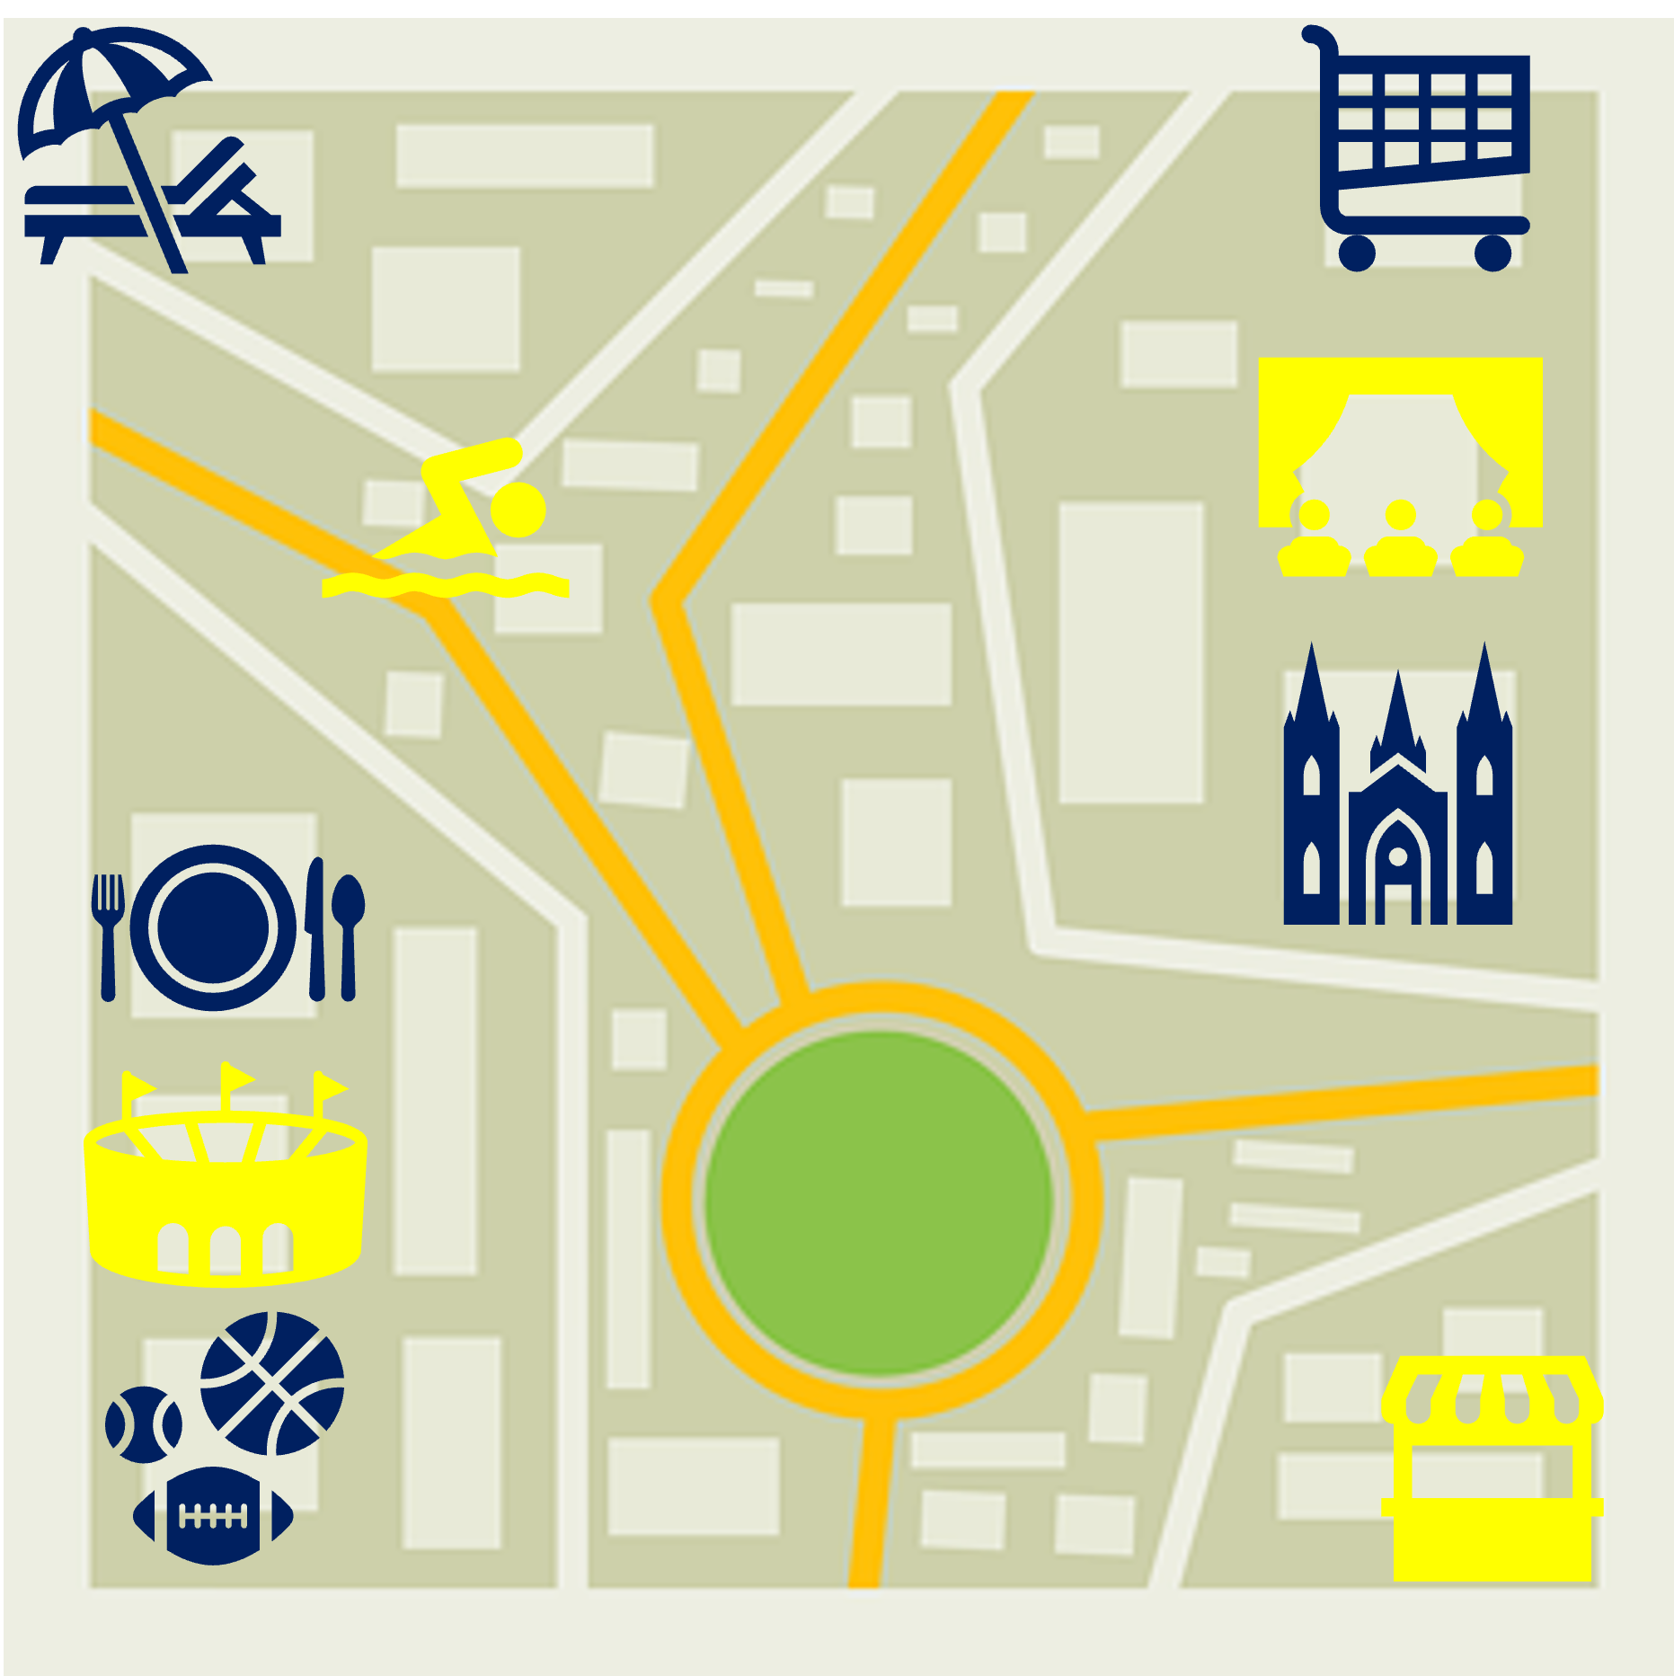
¿Solo o juntos ?(1/2)
hablar
A solo (I) | B juntos (we)
A solo (I) | B juntos (we)
A solo (I) | B juntos (we)
1
2
3
prepare food
wear a shirt
watch the tv
4
A solo (I) | B juntos (we)
5
A solo (I) | B juntos (we)
6
A solo (I) | B juntos (we)
work in a theatre
spend time in town
rest/relax at home
Notes:
Note: this version of the activity is more challenging, with prompts in English. On the following slides there is a less challenging version with the infinitive-noun phrases given in Spanish.
Timing: 10 minutes (two slides) Aim: to practise speaking and understanding about present events in the first person singular and plural. Procedure:
Students A and B write down 1-6 and their own choice of A or B for each, without showing the other.
Then Bs say their chosen sentences (without using the time adverbs) – e.g. 1B escuché música.
As note their partner’s choice and whether there is a match (yes/no).
After all 6 pictures have been spoken about, students swap roles and move to the next slide.

Slide 13
¿Solo o juntos ?(2/2)
hablar
school bag – la mochila
A solo (I) | B juntos (we)
A solo (I) | B juntos (we)
A solo (I) | B juntos (we)
1
2
3
prepare school bag
carry a bag
watch a film
4
A solo (I) | B juntos (we)
5
A solo (I) | B juntos (we)
6
A solo (I) | B juntos (we)
work in a bank
spend time in the countryside
rest/relax in bed
Notes:
2/2 Swap roles

Slide 14
¿Solo o juntos ?(1/2)
hablar
A solo (I) | B juntos (we)
A solo (I) | B juntos (we)
A solo (I) | B juntos (we)
1
2
3
preparar comida
llevar una camisa
mirar la tele
4
A solo (I) | B juntos (we)
5
A solo (I) | B juntos (we)
6
A solo (I) | B juntos (we)
trabajar en un teatro
pasar tiempo en la ciudad
descansar en casa
Notes:
Note: this version of the activity is more challenging, with prompts in English. On the following slides there is a less challenging version with the infinitive-noun phrases given in Spanish.
Timing: 10 minutes (two slides) Aim: to practise speaking and understanding about present events in the first person singular and plural. Procedure:
Students A and B write down 1-6 and their own choice of A or B for each, without showing the other.
Then Bs say their chosen sentences (without using the time adverbs) – e.g. 1B escuché música.
As note their partner’s choice and whether there is a match (yes/no).
After all 6 pictures have been spoken about, students swap roles and move to the next slide.

Slide 15
¿Solo o juntos ?(2/2)
hablar
school bag – la mochila
A solo (I) | B juntos (we)
A solo (I) | B juntos (we)
A solo (I) | B juntos (we)
1
2
3
preparar la mochila
llevar una bolsa
mirar una película
4
A solo (I) | B juntos (we)
5
A solo (I) | B juntos (we)
6
A solo (I) | B juntos (we)
trabajar en un banco
pasar tiempo en el campo
descansar en la cama
Notes:
2/2 Swap roles

Slide 16
Actividades con familia y amigos
Talking about what we do Present tense -ar verbs: 1st person plural (-amos)
SSCs [e],[i]
Y7 Spanish Term 2.2 - Week 1- Lesson 40 Ivan Luciano Avaca / Nick Avery Artwork: Mark Davies Date updated: 22.03.24
Notes:
All pictures selected are available under a Creative Commons license, no attribution required.
Note: all words (new and revisited) in this week of the SOW appear on all three GCSE wordlists, with the following exception:
i) Edexcel list does not have respuesta, iglesia. Artwork by Mark Davies. All additional pictures selected are available under a Creative Commons license, no attribution required.
Learning outcomes (lesson 1):
Consolidation of SSCs [e], [i]
Consolidation of present tense –ar verbs in 1st person plural (-amos ending).
Word frequency (1 is the most frequent word in Spanish):
7.2.2.1 (introduce) trabajar [174]; buscar [179]; descansar [1749]; preparar [570]; comida [906]; animal [322]; pasar [68]; tiempo [80]; campo [342]; junto[s] [149]; solo [181]
7.2.1.3 (revisit) naturaleza [712]; árbol [748]; pájaro [1607]; río [496]; rojo [534]; amarillo [1381]; verde [812]; azul [811]; lugar [144]; sólo [95]
7.1.2.5 (revisit) museo [1114]; banco [728]; teatro [605]; centro [316]; mercado [487]; tienda [1515]; plaza [806]; iglesia [437]; escuela [424]; ciudad [178]; entre [63]; el, la [1]; lejos [833]; cerca [1042]; respuesta [488]
Source: Davies, M. & Davies, K. (2018). A frequency dictionary of Spanish: Core vocabulary for learners (2nd ed.). Routledge: London
The frequency rankings for words that occur in this PowerPoint which have been previously introduced in LDP resources are given in the LDP SOW and in the resources that first introduced and formally re-visited those words.
For any other words that occur incidentally in this PowerPoint, frequency rankings will be provided in the notes field wherever possible.

Slide 17
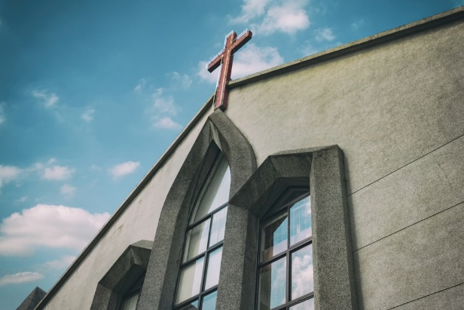
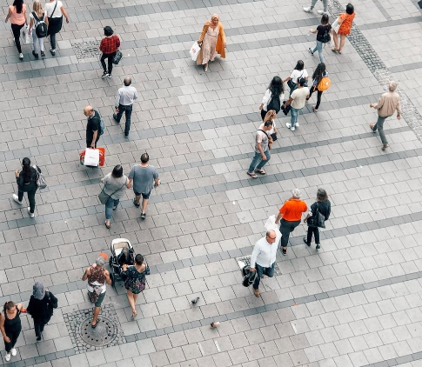
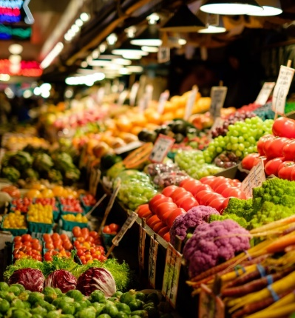
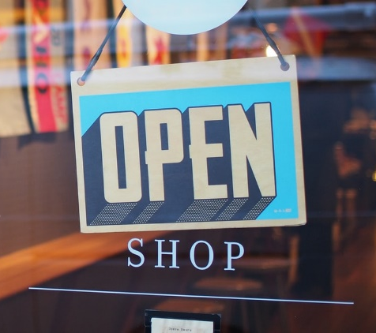
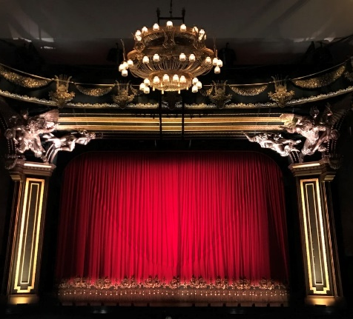
Vocabulario
hablar
centre
el mercado
la iglesia
el centro
el m_ _ _ _ _ _
la i_ _ _ _ _ _
el c_ _ _ _ _
la tienda
el t_ _ _ _ _
la t_ _ _ _ _
el teatro
[square]
[school]
[between]
[city]
[far]
entre
la escuela
e_ _ _ _
la plaza
la e_ _ _ _ _ _
la c_ _ _ _ _
la p_ _ _ _
la ciudad
l_ _ _ _
lejos
[near]
[answer]
[bank]
la respuesta
la r_ _ _ _ _ _ _ _
el b_ _ _ _
cerca
el banco
c_ _ _ _
Notes:
NB: Students can make a start on this activity as they arrive.
Timing: 7 minutes
Aim: revision of vocabulary from 7.1.2.5
Procedure:
1. This could either be done as a whole class, pair or individual activity. The first letter of the Spanish word corresponding to the picture / English translation is provided.
2. Students have to say what the missing word is based on the picture and word clue.
3. Teachers click anywhere on the screen to reveal the answer. Answers appear horizontally.

Slide 18
Fonética
¿Qué escuchas? [e], [i] o [i] y [e]?
escuchar
1
[e]
La señora compra una bolsa barata.
The lady buys a cheap bag.
Notes:
Timing: 5 minutes (5 slides)
Aim: phonics practice, a listening activity practising recognition of the [e] and [i] SSCs
Procedure:
Teachers click the number button to play the recording. Students listen and note down in their books or on a mini whiteboard if they hear [e], [i] or both in the sentence.
Teachers will then click to show the answer and again to show the whole sentence. They can then ask the students to translate the sentence.
Follow the same procedure for the next 4 slides.
Notes:
All vocabulary used in the activity has been previously taught in the scheme of work.

Slide 19
Fonética
¿Qué escuchas? [e], [i] o [i] y [e]?
escuchar
2
[i] y [e]
Hay un regalo para la prima.
There is a gift for the (female) cousin.
Notes:
Timing: 5 minutes (5 slides)
Aim: phonics practice, a listening activity practising recognition of the [e] and [i] SSCs
Procedure:
Teachers click the number button to play the recording. Students listen and note down in their books or on a mini whiteboard if they hear [e], [i] or both in the sentence.
Teachers will then click to show the answer and again to show the whole sentence. They can then ask the students to translate the sentence.
Follow the same procedure for the next 4 slides.
Notes:
All vocabulary used in the activity has been previously taught in the scheme of work.

Slide 20
Fonética
¿Qué escuchas? [e], [i] o [i] y [e]?
escuchar
[i] y [e]
3
¿Cuándo escuchas música?
When do you listen to music?
Notes:
Timing: 5 minutes (5 slides)
Aim: phonics practice, a listening activity practising recognition of the [e] and [i] SSCs
Procedure:
Teachers click the number button to play the recording. Students listen and note down in their books or on a mini whiteboard if they hear [e], [i] or both in the sentence.
Teachers will then click to show the answer and again to show the whole sentence. They can then ask the students to translate the sentence.
Follow the same procedure for the next 4 slides.
Notes:
All vocabulary used in the activity has been previously taught in the scheme of work.

Slide 21
Fonética
¿Qué escuchas? [e], [i] o [i] y [e]?
escuchar
4
[i] y [e]
La autora lleva una camisa.
The (female) author wears a shirt.
Notes:
Timing: 5 minutes (5 slides)
Aim: phonics practice, a listening activity practising recognition of the [e] and [i] SSCs
Procedure:
Teachers click the number button to play the recording. Students listen and note down in their books or on a mini whiteboard if they hear [e], [i] or both in the sentence.
Teachers will then click to show the answer and again to show the whole sentence. They can then ask the students to translate the sentence.
Follow the same procedure for the next 4 slides.
Notes:
All vocabulary used in the activity has been previously taught in the scheme of work.

Slide 22
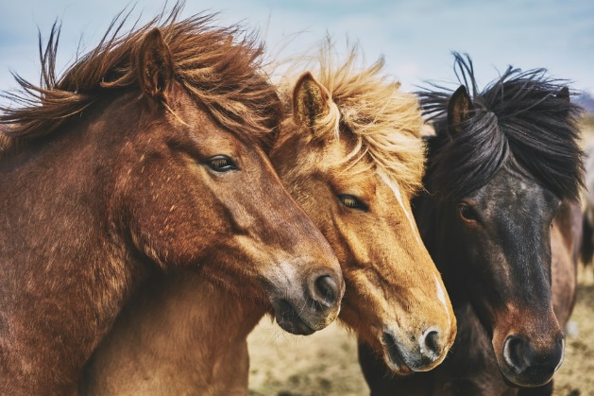
Fonética
¿Qué escuchas? [e], [i] o [i] y [e]?
escuchar
5
[i]
Doy comida a los caballos.
I give food to the horses.
¿Cómo se dice ‘the horses are beautiful’ en español?
Los caballos son hermosos.
Notes:
Timing: 5 minutes (5 slides)
Aim: phonics practice, a listening activity practising recognition of the [e] and [i] SSCs
Procedure:
Teachers click the number button to play the recording. Students listen and note down in their books or on a mini whiteboard if they hear [e], [i] or both in the sentence.
Teachers will then click to show the answer and again to show the whole sentence. They can then ask the students to translate the sentence.
Follow the same procedure for the next 4 slides.
Notes:
All vocabulary used in the activity has been previously taught in the scheme of work.

Slide 23
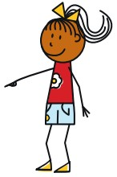
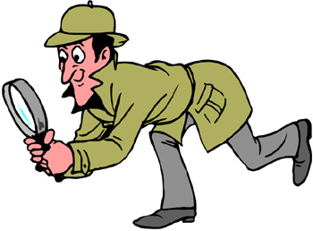
Using verbs
gramática
Remember that verb endings change depending on who the verb refers to.
S/he looks for the school.
I look for the school.
We look for the school.
Busco la escuela.
Busca la escuela.
Buscamos la escuela.
Notes:
OPTIONAL
Timing: 1 minute
Aim: a quick recap of the meanings of the 3 –ar verb endings that will appear in the next activity (first person singular and plural, and 3rd person singular). All have been previously taught.
Procedure:
1. Teachers click to show the Spanish phrase and then again to show the translation. The verb ‘buscar’ is used for these examples

Slide 24
¿Un perro normal?
leer
leer
Hugo habla con Daniel por telefono…
¡Es pequeño, fuerte y muy feo!
¿Cómo es el perro de Vanessa?
Notes:
Timing: 2 minutes (two slides)
Aim: This slide presents the context for the full text presented on slide 49. The full text on slide 45 is Fiona’s reply to the question.

Slide 25
¿Es el perro de Vanessa?
leer
leer
Notes:
Procedure:
1. Teachers could use this slide to ask the students to say if they think this is the dog or not. Ask yes-no questions such as ¿Es grande o pequeño?’, ‘¿Es guapo o feo?’, ‘¿Es fuerte?’. (It’s a small dog, but not strong and not very ugly, so probably not!)

Slide 26
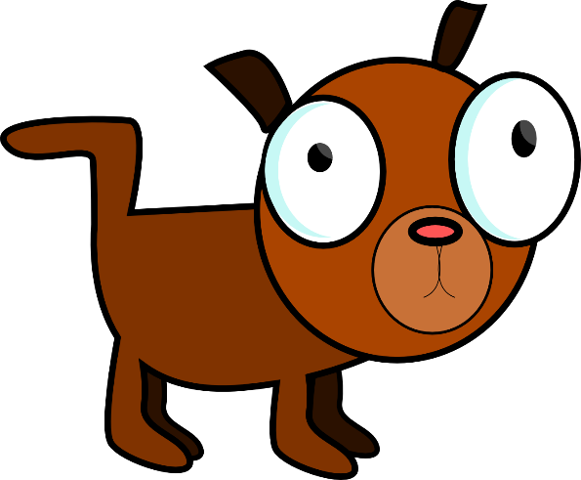
El perro de Vanessa
Lee el texto y escribe los verbos ‘we’ y ‘she/he’ en español.
leer
leer
we | she/he
Notes:
Timing: 10 minutes (3 slides)
Aim: to raise awareness and understanding of ‘she/he’ and ‘we’ verb forms in Spanish.
Procedure:
First, students draw two columns and title them ‘we’ and ‘she/he’
Move to next slide.

Slide 27
leer
leer
El perro de Vanessa es fuerte y bastante feo, pero no es malo. Pasa mucho tiempo con el abuelo y la abuela de Vanessa cerca de una plaza artística. Escucha música en la iglesia antigua de un pueblo rico y famoso. Luego, el perro busca un lugar tranquilo con los abuelos. Vanessa y yo estudiamos juntas en la escuela. Pasamos tiempo en la tarde en el pueblo famoso. Usamos un teléfono caro y hablamos con los abuelos de Vanessa. En la noche, bailamos y caminamos mucho. Compramos unos zapatos baratos y una camisa con muchos colores para el perro. ¡El perro de Vanessa es muy guapo!
Notes:
Timing: 10 minutes
Aim: Reading task for grammar awareness raising
Procedure:
3. Students read the text and identify how many examples of the verbs refer to ‘we’ and how many to ‘s/he’. Students write these out in Spanish in the two columns.
4. Move to next slide for the answers.
Notes:
Alternatively, students can first listen to the gapped text on the next slide and complete the gaps (which include examples of these grammar features, and other vocabulary items revisited this week), before going on to complete the activities that follow.

Slide 28
El perro de Vanessa
Respuestas
leer
leer
we | she/he
estudiamos
es
pasamos
es
usamos
pasa
hablamos
escucha
bailamos
busca
caminamos
es
compramos
Notes:
ANSWERS
Procedure:
4. Students check their answers.
5. Teacher elicits the English for each verb.

Slide 29
escuchar
El perro de Vanessa _______________, pero no es malo. _________________con el abuelo y la abuela de Vanessa cerca de una plaza artística. _____________________________________ en la iglesia antigua de un pueblo rico y famoso. Luego, el perro _____________ tranquilo con los abuelos. Vanessa y yo __________________ en la escuela. Pasamos tiempo en la tarde en el pueblo famoso. _______________ caro y hablamos con los abuelos de Vanessa. En la noche, _______________ y ________________. Compramos unos zapatos baratos y una camisa con muchos colores para el perro. ¡El perro de Vanessa es muy guapo!
escuchar
Notes:
Timing: 7 minutes
Aim: Listening exercise for transcribing practice.
Procedure:
Some words are missing from the original text. Ask the students to listen and write the missing words. Missing words include: examples of 1st person plural –amos and 3rd person singular –a
Teachers click the speaker button to play the recording when ready.
The whole passage could be translated when the answers have been gone through
Notes:
This activity could be done before the reading activity on the previous slide.
It could be useful to quickly remind the students of the adjective agreement in Spanish.
This activity could be done individually or in pairs.

Slide 30
El perro de Vanessa
leer
Translate each sentence in English next to ‘S/he’ or ‘We’.
pasa mucho tiempo
usamos un teléfono
estudiamos juntas
busca un lugar
escucha buena música
es fuerte y bastante feo
bailamos
caminamos mucho
S/he |  | We
S/he |  | We
S/he |  | We
S/he |  | We
spends a lot of time
use a phone
looks for a place
study together
listens to good music
dance
is strong and quite ugly
walk a lot
Notes:
Timing: 5 minutes
Aim: reading practice focusing on verb ending meanings
Procedure:
The 8 text fragments contain 4 x examples of the 1st person plural and 3rd person singular, respectively.
Students need to identify which ones correspond to the ‘s/he’ and ‘we’ sentence starters and then translate the sentences.
Teachers click to show the answers.

Slide 31
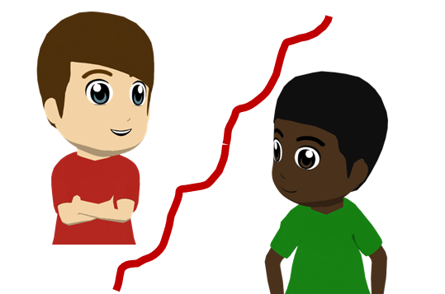
Daniel no escucha bien
Daniel has some trouble hearing Hugo.
Can you help him know the missing words ?
hablar
strong
quite
bad
El perro de Vanessa es y feo, pero no es .
grandfather
grandmother
Pasa mucho tiempo con el y la v de Vanessa
cerca de una plaza .
artistic
old, ancient
good
Escucha música __________ en la iglesia de un pueblo
y .
rich
famous
Notes:
Timing: 4 minutes
Aim: speaking practice of revisited vocabulary
Procedure:
It can be done as paired read-aloud, where students have to recall and say the Spanish translations of the English words as they read.
Teachers click to show the missing words in English to help recall.
Eliciting the Spanish answers chorally, to check, the teacher can click to reveal the Spanish words.
Notes:
It may be useful to remind students of the need for gender agreement on most of the adjectives before the exercise. This is something to check when going through the answers.

Slide 32
Daniel no escucha bien
Daniel has some trouble hearing Hugo.
Can you help him know the missing words ?
hablar
fuerte
bastante
quite
malo
strong
bad
El perro de Vanessa es y feo, pero no es .
grandfather
abuelo
abuelo
grandmother
Pasa mucho tiempo con el y la v de Vanessa
cerca de una plaza .
artistic
artística
antigua
old, ancient
buena
good
Escucha música __________ en la iglesia de un pueblo
y .
rico
rich
famous
famoso
Notes:
ANSWERS

Slide 33
Deberes
New vocabulary for 7.2.2.2:
Audio file
Student worksheet
In addition, revisit: Term 2.1.4 Term 1.2.6
Notes:
Use this slide to set the homework.
For Y7, the typical homework will be to pre-learn vocabulary for the next lesson. There is an audio file to accompany the student worksheet.
Notes:
i) Teachers may, in addition, want to recommend use of a particular online app for the pre-learning of each week’s words. ii) Quizlet now requires parental involvement / registration / permissions for users below the age of 13, so it is perhaps most suitable for Y9 – 11 students. iii) Language Nut hosts LDP vocabulary lists and these are free for schools to use, though there is a registration process. One benefit is that all of the student tracking data that Language Nut offers are also available to schools that use the LDP lists for practice. Perhaps this makes it a good option for Y7/8.
iv) There are other free apps, and new ones are always appearing. Teachers have told us that they are currently using: Flippity, Wordwall (where using previously-created activities is free).
v) Gaming Grammar has been acquired by Language Nut. Its original content should still be available to teachers and much of it is appropriate for Y7 learners. Verbs (present): 1st person singular/plural in the ‘Verb agreement (present)’ menu practices aspects of this week’s lessons.

Slide 34
Daniel y los abuelos
Daniel y los abuelos son diferentes.
¿Quién habla, Daniel (‘I’) o los abuelos (‘we’)?
Lee la frase, mira la imagen y marca el verbo correcto.
leer
I
We
Trabajo
con un primo en el campo.
Trabajamos
¿Cómo se dice en inglés?
I work with a (male) cousin in the countryside.
Notes:
ADDITIONAL READING PRACTICE FOR LESSON 1, AS NEEDED.
Timing: 5 minutes (for slides 20-27)
Aim: reading exercise pairing the ‘I’ form and ‘we’ form of ‘ar’ verbs in the present tense
Procedure:
Students write the correct verb in their books (e.g. trabajo), looking at the image in the left hand box
Teachers click to reveal the correct answer.
When clicking again, students can be asked to translate the sentence into English. This can either be done orally or students can write the answer down.
Teachers follow the same procedure for the next 7 slides.
Notes:
The English pronoun is presented and circled for additional reinforcement of the agreement between the Spanish verb form and the 1st person singular or plural. Without the explicit English pronouns here, the pictures could otherwise be misinterpreted (e.g., as ‘he’ and ‘they’).

Slide 35
Daniel y los abuelos
leer
I
We
Compramos
comida barata en el mercado.
Compro
¿Cómo se dice en inglés?
We buy cheap food at the market.

Slide 36
Daniel y los abuelos
leer
I
We
Buscamos
animales pequeños.
Busco
¿Cómo se dice en inglés?
I look for small animals.

Slide 37
Daniel y los abuelos
leer
I
We
Miro
dibujos en una revista.
Miramos
¿Cómo se dice en inglés?
We look at drawings in a magazine.

Slide 38
Daniel y los abuelos
leer
I
We
No paso
mucho tiempo en la ciudad antigua.
No pasamos
¿Cómo se dice en inglés?
I don’t spend much time in the old city.
Notes:
Mucho² is one of the words from vocabulary set 2.1.3 to be revisited this week.

Slide 39
Daniel y los abuelos
leer
I
We
Llevamos
libros a la escuela.
Llevo
¿Cómo se dice en inglés?
I take books to school.

Slide 40
Daniel y los abuelos
leer
I
We
Preparo
una actividad para la familia.
Preparamos
¿Cómo se dice en inglés?
We prepare an activity for the family.

Slide 41
Daniel y los abuelos
leer
I
We
Descanso
en una plaza bonita y famosa.
Descansamos
¿Cómo se dice en inglés?
I rest in a pretty and famous square.

